Slide 1


Cavitation in nanopores
Institut de Sciences des Matériaux de Mulhouse – B. Lebeau, H. Nouali, P. Ott
ICMN Orléans – Joël Puibasset
Institut Néel – P. Coutin, P. Spathis
Laboratoire de Physique de l’ENS – K. Davitt, E. Rolley
ANR project NanoCav

Slide 2
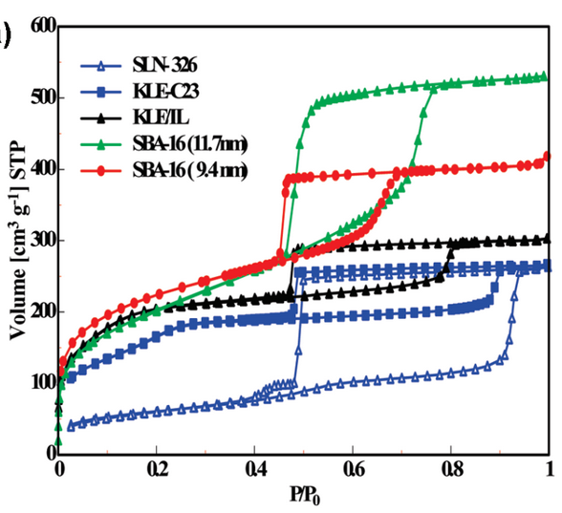
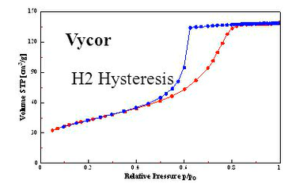
Evaporation in ordered mesoporous silica
Sharp drop of V_{ads}
+
Evaporation pressure P* ∼ 0.45 Psat
(N2 @ 77 K)
signature of cavitation
[Rasmussen 2010]
[Thommes 2004]
[Thommes 2004]
0 0.2 0.4 0.6 0.8 1
P/P₀
Interpore 2026 - Nantes

Slide 3
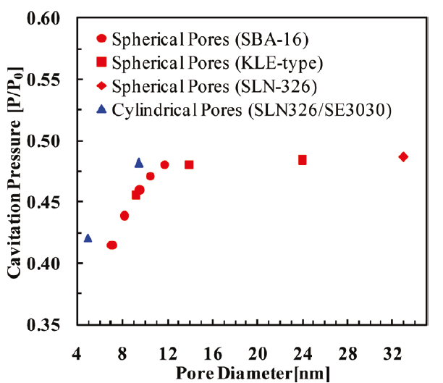
Evaporation in ordered mesoporous silica
Evaporation pressure P*/P₀ lies in the range 0.42 – 0.46
depends on pore size (cavitation more difficult in confined liquid)
→ How to identify cavitation unambiguously ?
→ Impact of confinement ?
P* dependance on pore radius, temperature…
[Rasmussen 2010]
Interpore 2026 - Nantes

Slide 4
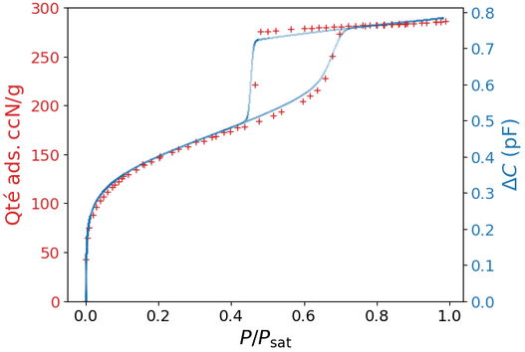
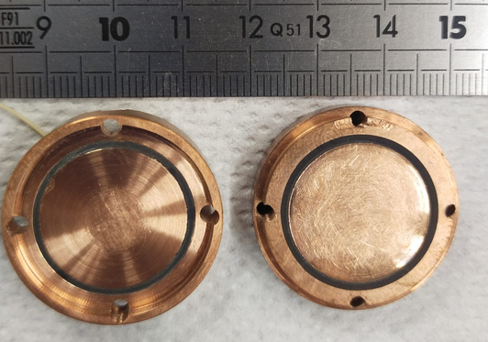
Capacitive measurements
SBA-16 ∅ = 8 nm
Sample mass = 10 mg
N2 @ 77.45 K
= 20 mm
Espacement = 0.1 mm
High accuracy capacitance bridge – resolution 10⁻⁵ pF
Relation capacitance – adsorbed mass:
see you at poster session Thursday 10:05
Interpore 2026 - Nantes

Slide 5
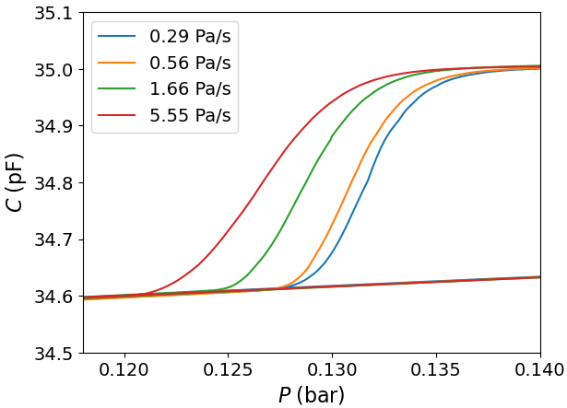
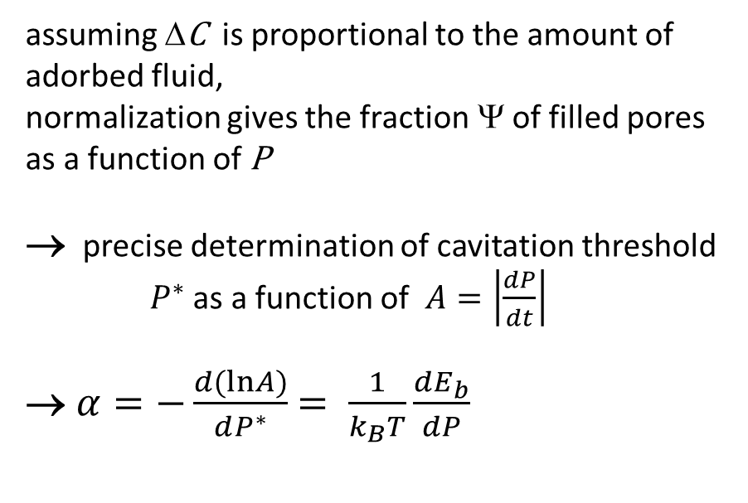
Continuous measurements at controlled pressure rate
assuming ΔC is proportional to the amount of adorbed fluid,
normalization gives the fraction Ψ of filled pores as a function of P
→ precise determination of cavitation threshold
$P^{∗}$as a function of $A=\left|\frac{dP}{dt}\right|$
→ $α=−\frac{d(lnA)}{dP^{∗}}$ $= \frac{1}{k_{B}T}\frac{dE_{b}}{dP}$
Filled pores
half
filled
P*
Empty pores
SBA-16 ∅ = 7.6 nm
N2 @ 70.07 K
Interpore 2026 - Nantes

Slide 6
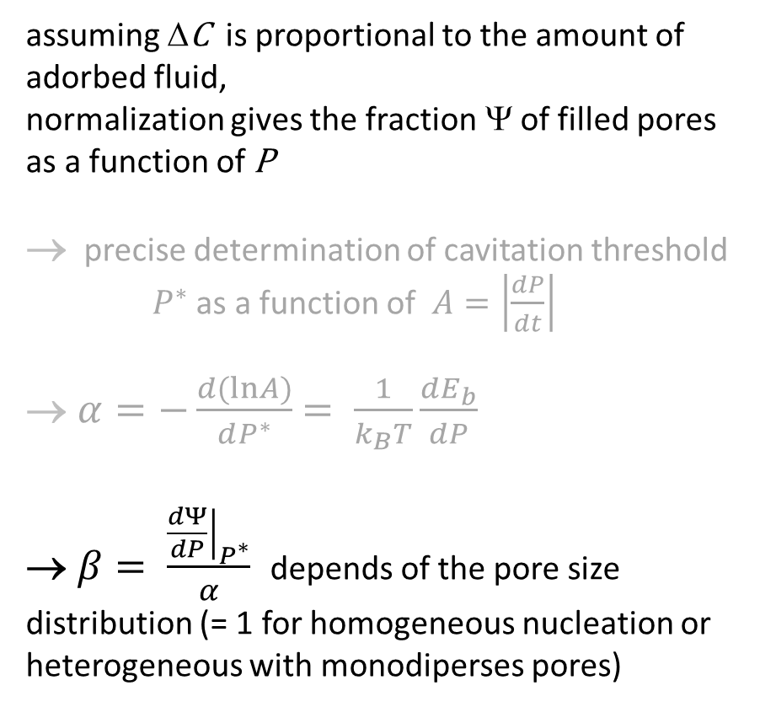
Continuous measurement at controlled pressure rate
assuming ΔC is proportional to the amount of adorbed fluid,
normalization gives the fraction Ψ of filled pores as a function of P
→ precise determination of cavitation threshold
$P^{∗}$as a function of $A=\left|\frac{dP}{dt}\right|$
→ $α=−\frac{d(lnA)}{dP^{∗}}$ $= \frac{1}{k_{B}T}\frac{dE_{b}}{dP}$
→ $β= \frac{{\left.\frac{dΨ}{dP}\right|}_{P^{∗}}}{α}$ depends of the pore size distribution (= 1 for homogeneous nucleation or heterogeneous with monodiperses pores)
Filled pores
half
filled
Empty pores
SBA-16 ∅ = 7.6 nm
N2 @ 70.07 K
Interpore 2026 - Nantes

Slide 7
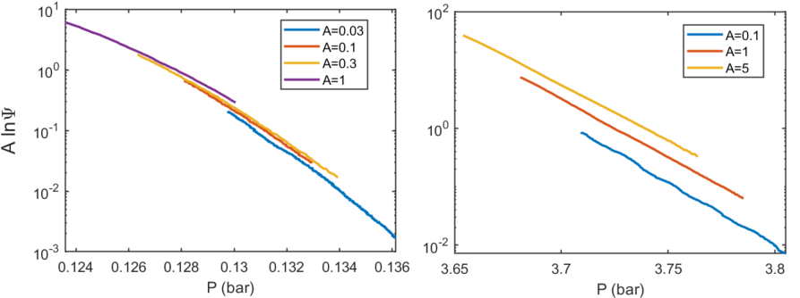
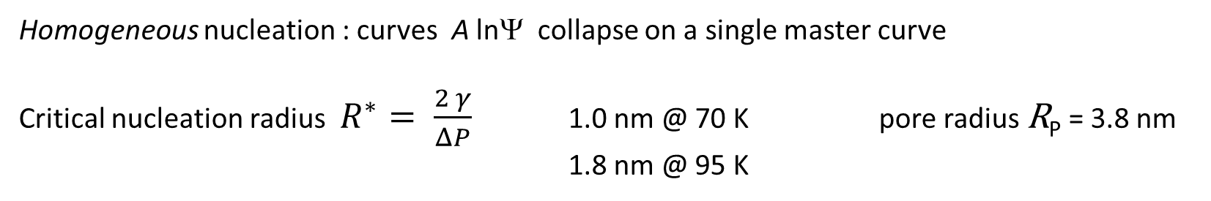
Results – shape of ψ_{A}(P)
SBA-16 ∅ = 7.6 nm
@ 70.06 K
@ 94.81 K
Homogeneous nucleation : curves A lnΨ collapse on a single master curve
Critical nucleation radius $R^{∗}= \frac{2 γ}{ΔP}$ 1.0 nm @ 70 K pore radius R_{P} = 3.8 nm
1.8 nm @ 95 K
Interpore 2026 - Nantes

Slide 8
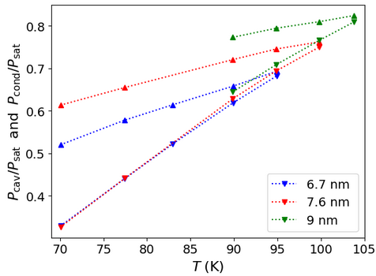
Experimental results – phase diagram
3 SBA-16 samples
with dif. pore diameter
condensation
P_{cav}
P_{cond}
the larger the pores
the easier the cavitation
cavitation
Interpore 2026 - Nantes

Slide 9
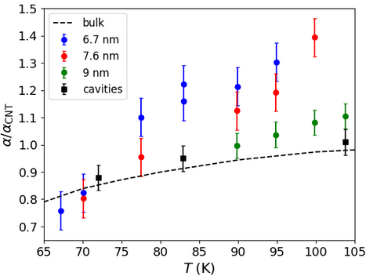
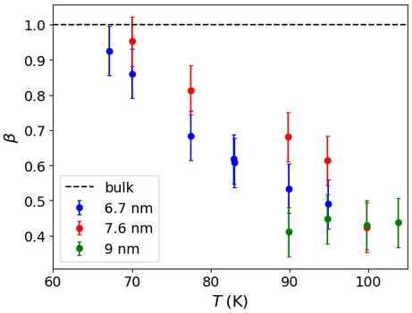

Experimental results – coefficients α and β
$$α=\frac{1}{k_{B}T}\frac{dE_{b}}{dP}$$
R*= 1.8 nm
homogeneous cav.
homogeneous cav.
R*= 1 nm
The smaller the pore radius R_{P}
the larger T (hence critical radius R*)
the larger the departure from homogeneous cavitation
Interpore 2026 - Nantes

Slide 10
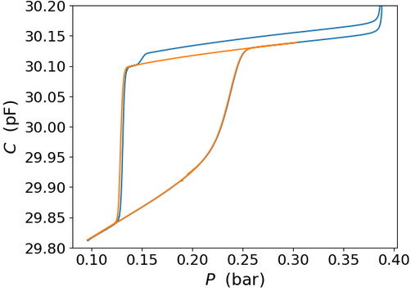
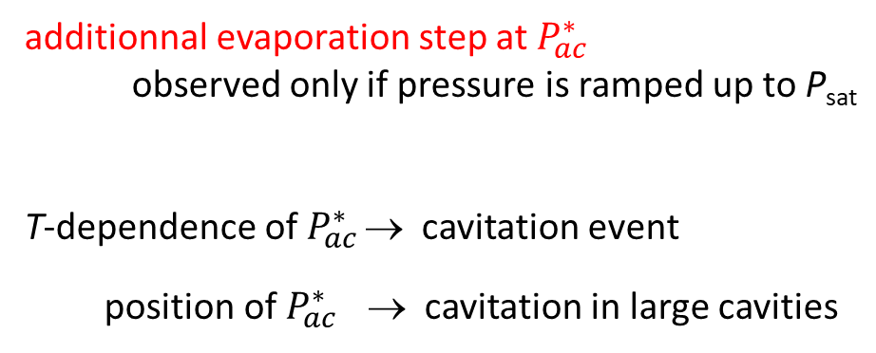
Large cavities (inter-grains ?) cavitation
additionnal evaporation step at $P_{ac}^{∗}$
observed only if pressure is ramped up to P_{sat}
T-dependence of $P_{ac}^{∗}$ → cavitation event
position of $P_{ac}^{∗}$ → cavitation in large cavities
N2 @ 70 K
possibly voids between SBA grains ?
Cavities (≡ bulk liquid) provide a reference for cavitation features
Interpore 2026 - Nantes

Slide 11
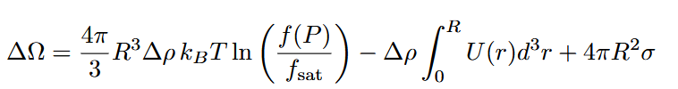
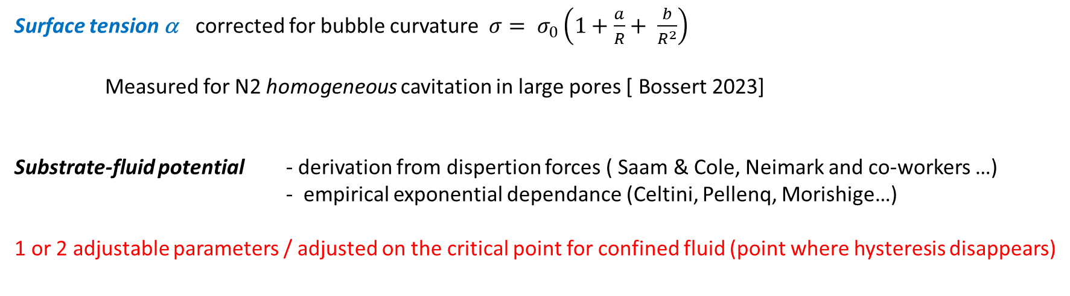
Thermodynamic approach – the energy barrier E_{B}
Grand potential for bubble formation in the metastable liquid [ Sharp interface - Bonnet & Wolf 2019 ]
gain in chemical
potential: known
correction due to
substrate-fluid
interaction potential
cost of the interface
Surface tension α corrected for bubble curvature $σ= σ_{0}\left(1+\frac{a}{R}+ \frac{b}{R^{2}}\right)$
Measured for N2 homogeneous cavitation in large pores $\text{[ }\text{Bossert}\text{ 2023]}$
Substrate-fluid potential - derivation from dispertion forces ( Saam & Cole, Neimark and co-workers …)
- empirical exponential dependance (Celtini, Pellenq, Morishige…)
1 or 2 adjustable parameters / adjusted on the critical point for confined fluid (point where hysteresis disappears)
Interpore 2026 - Nantes

Slide 12
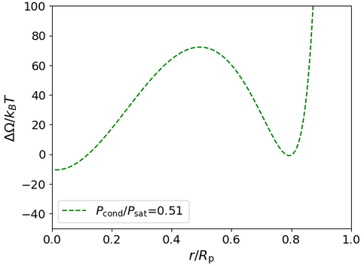
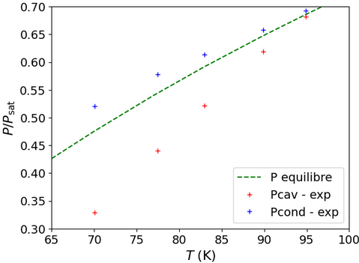
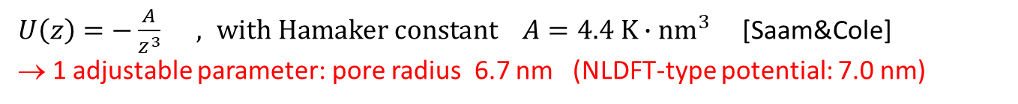
Thermodynamic approach – substrate-fluid potential
Substrate-fluid potential - derivation from dispertion forces ( Saam & Cole, Neimark and co-workers …)
$U\left(z\right)=−\frac{A}{z^{3}} , with Hamaker constant A=4.4 K∙{nm}^{3}$ [Saam&Cole]
→ 1 adjustable parameter: pore radius 6.7 nm (NLDFT-type potential: 7.0 nm)
Bubble
empty
filled
Interpore 2026 - Nantes

Slide 13
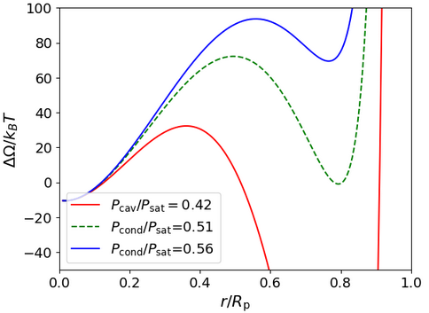
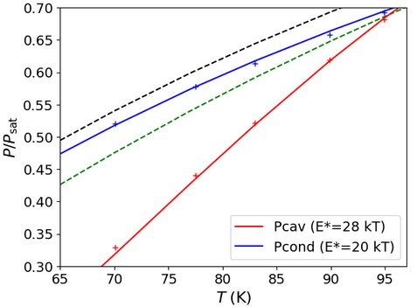
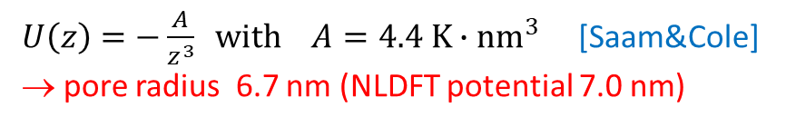
Thermodynamic approach – substrate-fluid potential
Substrate-fluid potential - derivation from dispertion forces ( Saam & Cole, Neimark and co-workers …)
- empirical exponential dependance (Celtini, Pellenq, Morishige…)
1 or 2 adjustable parameters / adjusted on the critical point for confined fluid
$U\left(z\right)=−\frac{A}{z^{3}} with A=4.4 K∙{nm}^{3}$ [Saam&Cole]
→ pore radius 6.7 nm (NLDFT potential 7.0 nm)
Phase diagram (similar with NLDFT potentials)
pore filling
E*
bubble
nucl.
Bubble
E*
empty
filled
Interpore 2026 - Nantes

Slide 14
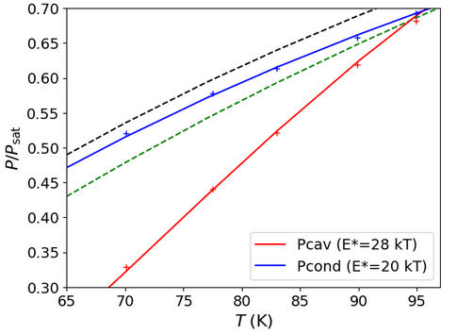
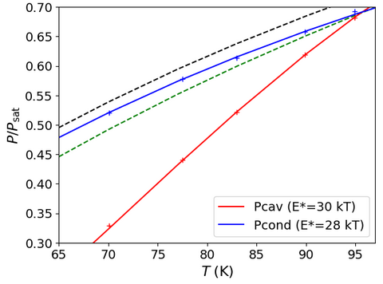
Thermodynamic approach – substrate-fluid potential
Substrate-fluid potential - derivation from dispertion forces ( Saam & Cole, Neimark and co-workers …)
- empirical exponential dependance (Celtini, Pellenq, Morishige…)
$$U\left(z\right)=−ε e^{−\frac{z}{λ}}$$
Assuming R_{p} = 6.7 nm
$$ε=52k_{B} and λ=0.375 nm ε=18k_{B} and λ=0.6 nm$$
Interpore 2026 - Nantes

Slide 15
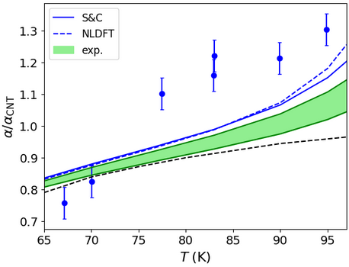
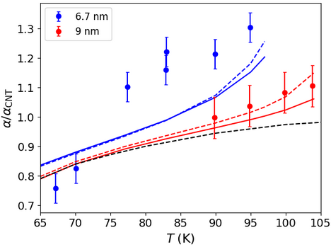
Thermodynamic approach - results
The NLDFT potential does the best job, but predicted α still smaller than measured for small pores
→ underestimates confinement
Interpore 2026 - Nantes

Slide 16
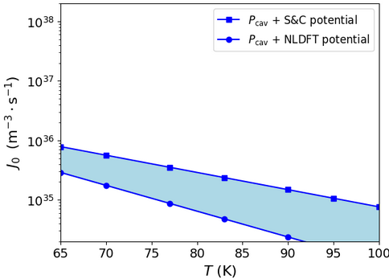
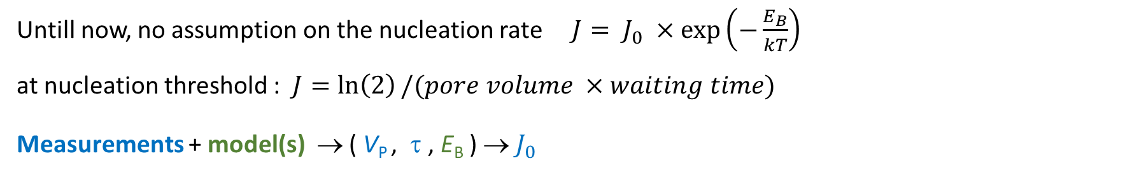
Thermodynamic approach – nucleation rate
Untill now, no assumption on the nucleation rate $J= J_{0} ×\exp\left(−\frac{E_{B}}{kT}\right)$
at nucleation threshold : $J=\ln\left(2\right)/(pore volume ×waiting time)$
Measurements + model(s) → ( V_{P} , τ , E_{B} ) → $J_{0}$
Interpore 2026 - Nantes

Slide 17

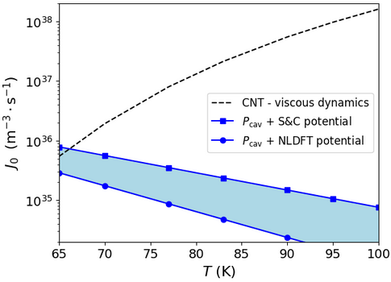

Thermodynamic approach – nucleation rate
Untill now, no assumption on the nucleation rate $J= J_{0} ×\exp\left(−\frac{E_{B}}{kT}\right)$
at nucleation threshold : $J=\ln\left(2\right)/(pore volume ×waiting time)$
Measurements + model(s) → ( V_{P} , τ , E_{B} ) → $J_{0}$
CNT [Bl. & Katz 1975]
Hyp. • nucleation site density = liquid number density
• escape rate controlled by viscous dynamics of the
critical bubble.
CNT overestimates 10³ x $J_{0}$ at high T
significant ? (equiv. to ΔE_{B} ∼ 7-8 kT)
if yes - Effect of confinement on bubble dynamics
- Number of nucleation sites ?
=
Interpore 2026 - Nantes

Slide 18
Conclusion • New capacitive continuous method for measuring isotherms
• Allows to evidence confinement impact on cavitation
• Reasonnable agreement with simple thermodynamic approach
→ indication that the kinetic prefactor J₀ is impacted by confinement
What’s next ? • Go for molecular dynamics?
• Effect of the distributions of pore diameter (parameter β)
THANKS FOR YOUR ATTENTION !

