Slide 1


Periodic Mesoporous Organosilicas as Host Materials for Studying Surface Chemistry and Pore Size Effects on the Properties of Nanoconfined Water
P. Lenz, U. Sazama, S. König, S.-M. Meinert, M. Steiger and M. Fröba
Institute of Inorganic and Applied Chemistry
University of Hamburg, Germany
Anorganisch-Chemisches Kolloquium, Universität Bayreuth, 17. Mai 2022

Slide 2
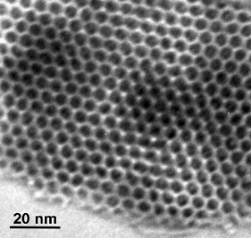

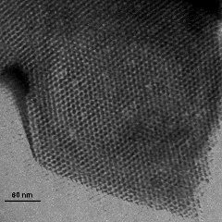
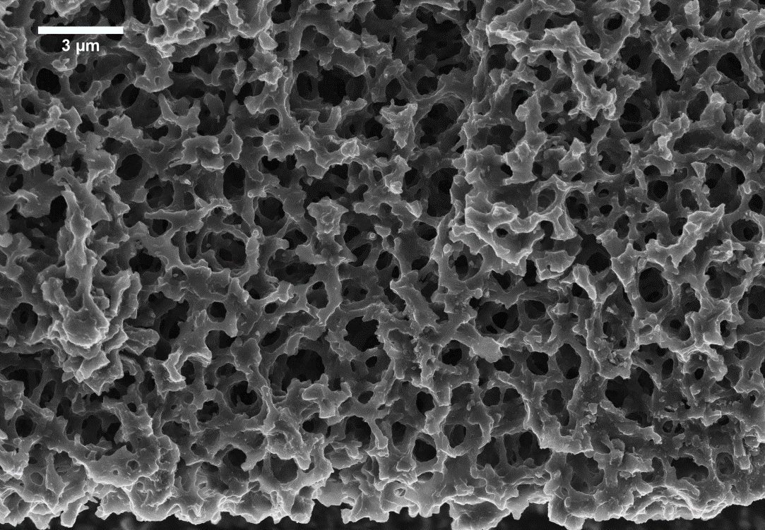

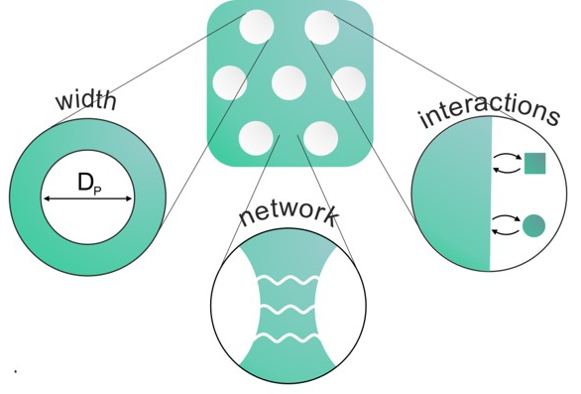
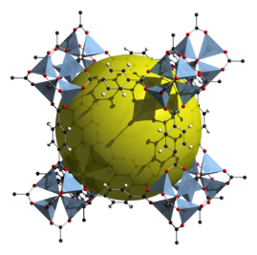
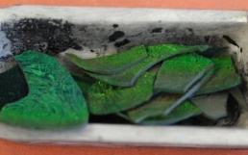
Research
Carbons and polymers
Mesoporous silicas
(M41S/SBAs)
Periodic mesoporous
organosilicas (PMOs)
1 µm
Metal-Organic
Frameworks (MOFs)
Confinement
2
Notes:
Synthesis: phase separated alkali borosilicate glasses
Applications:
reference materials for texture analytic methods MPI, PALS, N2 Sorption,
inert support for enzyme immobilization
transparent support for photochemical applications

Slide 3
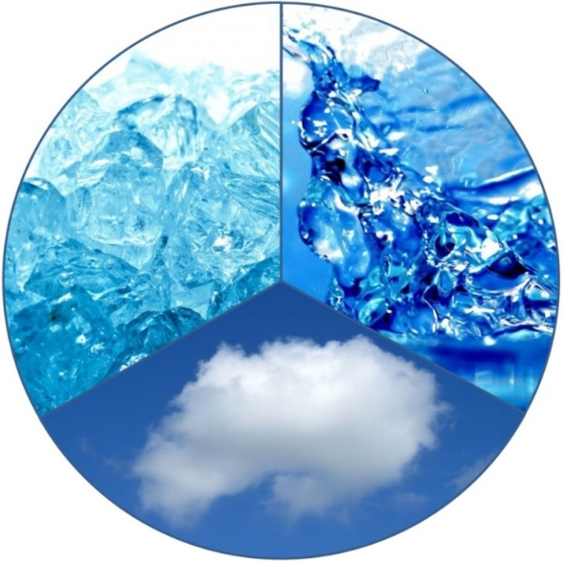
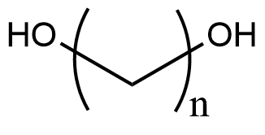
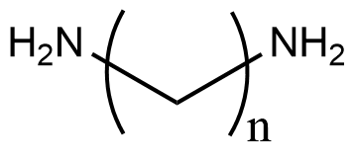
Research ̶ Systems in nanoconfinement
Binary mixtures
Aqueous solutions of
or
Water/ice/vapor
n= 3…9
n= 2…7
alkanedioles & glycerol
alkanediamines
aqueous solutions
salts/salt hydrates
Poster # 43 Anna Westhues
Thu. 21.05.26, 10.05-11.35 a.m.
Poster # 46 Sonja Kemmerer
Wed. 20.05.26, 3.35-5.05 p.m.
3
Notes:
Synthesis: phase separated alkali borosilicate glasses
Applications:
reference materials for texture analytic methods MPI, PALS, N2 Sorption,
inert support for enzyme immobilization
transparent support for photochemical applications

Slide 4
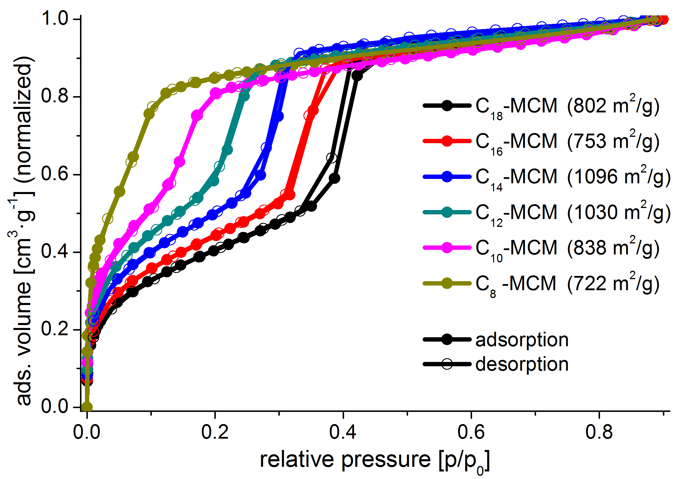
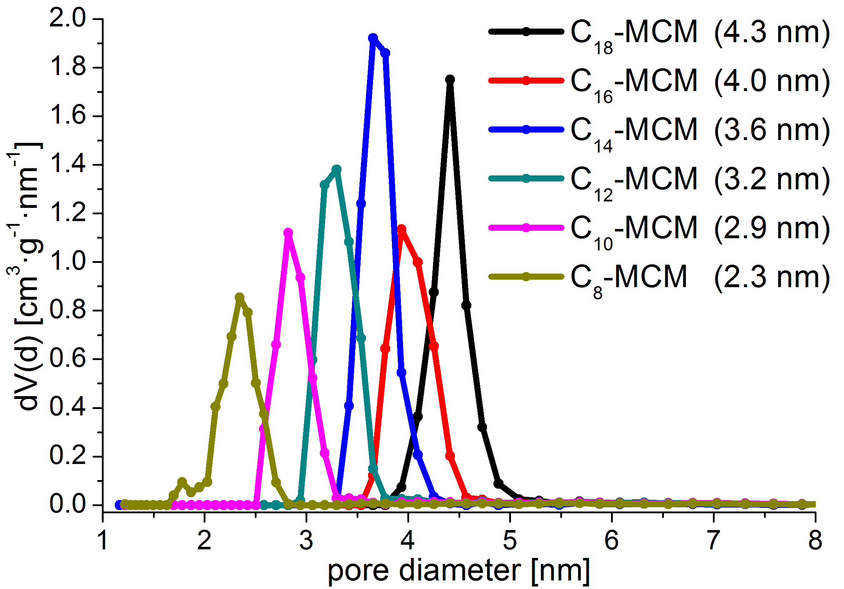

Mesoporous silica (MCM-41 type)
Nitrogen physisorption (77 K)

Slide 5
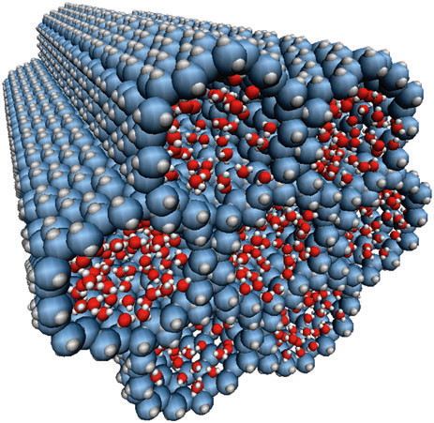
Water/ice in mesoporous silica
Melting point of confined water in MCM-41 silica
  smaller pore diameter → lower melting point
  no freezing in pores < 2.8 nm?
liquid
solid
?

Slide 6

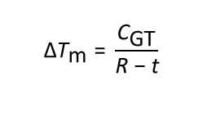
Water/ice in mesoporous silica
Melting point of confined water in MCM-41 silica
  smaller pore diameter → lower melting point
$${\text{∆}\text{T}}_{\text{m}} \text{= }\frac{{\text{C}}_{\text{GT}}}{\text{R} \text{−} \text{t}}$$
ΔT_{m}(R) change of the melting temperature
C_{GT} Gibbs-Thomson-constant
R pore radius
t non-freezable layer
Different types of water:
free water in the middle of pores which can freeze to form I_{h} or I_{c}
non-freezable water (interfacial water)
  in general: 2-3 water layers (t-layer)
  low order
  width can be influenced by surface chemistry
  structure is different from that of both the bulk crystal and liquid
  “liquid-like” or “quasi-liquid”
t
R

Slide 7
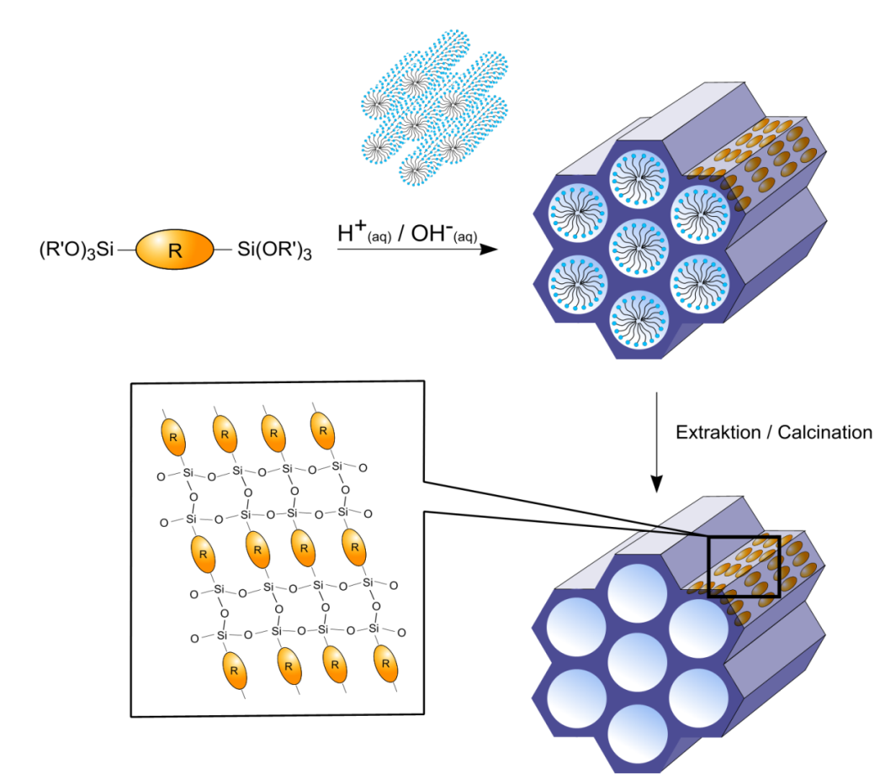
Periodic mesoporous organosilicas – Wall structure
Periodic Mesoporous Organosilicas (PMOs)
with crystal-like pore walls
  high thermal stability
  only observed for rigid organic
  bridges (all C sp² hybridized)
  pore diameters in the range of 2 to 10 nm
  metal-free compounds
for terminal Si-groups:
Si = Si(OR)₃
R = CH₃, C₂H₅
F. Hoffmann, M. Cornelius, J. Morell, M. Fröba, Angew. Chem. Int. Ed. 2006, 45, 3216-3251.

Slide 8
Organosilica precursors: examples
BTEVB-NH₂
BTEVB-F
BTEBP-bPy
BTEVB
BTEVB-Cl
hydrophilic
hydrophobic
BTEVB-Py
BTEVB-p2F
BTEVB-N⁺I–
BTEBP
BTEVB-o2F

Slide 9
Water in PMOs
2025
2025
Water vapor sorption
Differential scanning calorimetry (DSC)

Slide 10
Water in PMOs
2026
2025
DSC-TGA coupled

Slide 11
Fluorinated PMOs
XRD and nitrogen physisorption (77 K)
  hexagonal pore arrangement
  crystal-like pore walls
  narrow pore size distribution
  high surface area
4.0 nm
0.81 cm³g⁻¹
866 m²g⁻¹

Slide 12
Fluorinated PMOs
Water vapor sorption (298 K)
  all PMOs with the same surface chemistry, but different pore diameters (2.6 -̶ 4.7 nm)
  isotherms are shifted to higher relative pressure
  effect of pore size (Kelvin equation)
P. Lenz, S.-M. Meinert, S. König, M. Steiger, and M. Fröba, J. Phys. Chem. C 2025, 129, 12536−12550.

Slide 13
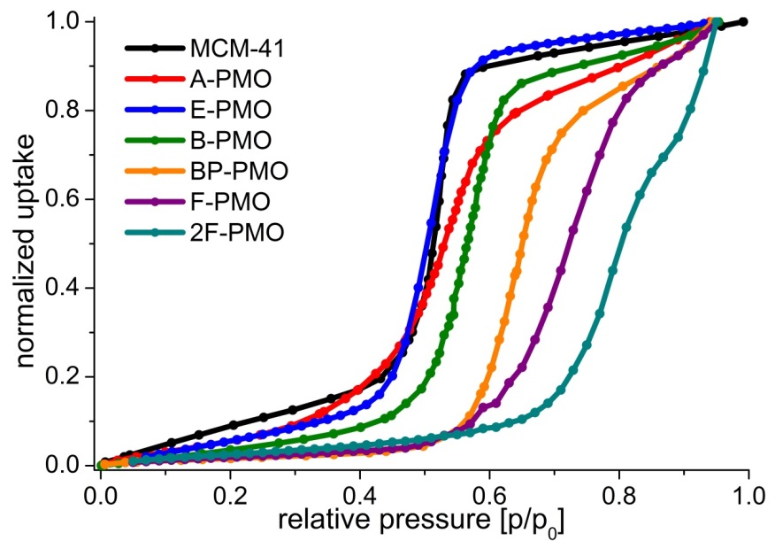
Repertoire of PMO precursors
Water vapor sorption (298 K)
  all PMOs with the same pore diameter (3.2 nm)
  isotherms are shifted to higher relative pressure (humidity)
  effect of surface polarity!

Slide 14
Different PMOs
Water vapor sorption (298 K)
  PMOs with the same pore diameter of about 3.8 nm
  isotherms are normalized with respect to the BET surface area of each material to show the number of water molecules per surface unit
P. Lenz, S.-M. Meinert, S. König, M. Steiger, and M. Fröba, J. Phys. Chem. C 2025, 129, 12536−12550.

Slide 15
Different PMOs
Hydrophilicity indices (HI)
  PMOs with the same pore diameter (3.8 nm)
  all hydrophilicity indices (HI) show the same trend for the different materials
P. Lenz, S.-M. Meinert, S. König, M. Steiger, and M. Fröba, J. Phys. Chem. C 2025, 129, 12536−12550.

Slide 16
Different PMOs
t-layer thicknesses
  PMOs with different pore diameters (2.5 -̶ 5.5 nm)
  BTEB-PMO shorter organic bridging unit (7.6 vs. 11.8 Å)
  for more hydrophilic pore walls thinner t-layers
calculated from adsorption (t_{a}) and desorption (t_{d}) isotherms
P. Lenz, S.-M. Meinert, S. König, M. Steiger, and M. Fröba, J. Phys. Chem. C 2025, 129, 12536−12550.

Slide 17
Different PMOs
Melting point depression
for larger pores (r_{P} > 1.9 nm), no significant influence of the surface chemistry on the melting point
for smaller pores (r_{P} < 1.9 nm) stronger melting point depression in more hydrophobic materials
P. Lenz, U. Sazama, M. Steiger, and M. Fröba, J. Phys. Chem. C 2025, 129, 20373−20386.

Slide 18
Different PMOs
Melting (•) and freezing points (Δ)
below the temperature of the intersection of the freezing and melting curve no more first-order phase transition
despite ist hydrophilic nature N-MBTEVP⁺I⁻-PMO exhibits the largest values for all critical pore radii
P. Lenz, U. Sazama, M. Steiger, and M. Fröba, J. Phys. Chem. C 2025, 129, 20373−20386.

Slide 19
Summary
hydrophilicity
T_{melting}
t-layer
t
surface effect has a greater impact on pores smaller than 3.8 nm
larger t-layer → melting occurs at lower temperature
R

Slide 20
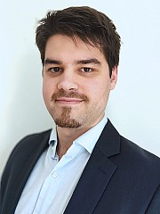
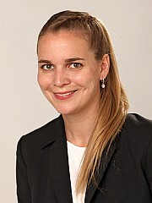


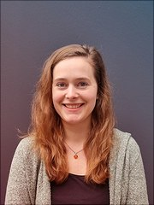
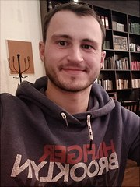


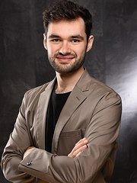
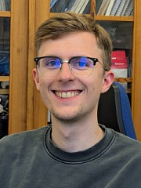
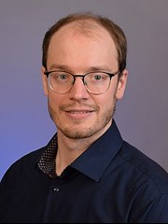

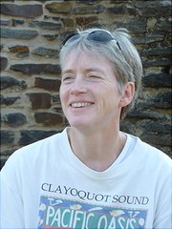
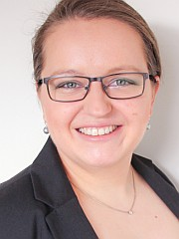


Philip Lenz
Sophia Schwake
Tabea Haug
Sarah Claas
Anna Westhues
Christian Köhn
Patrick Funnemann
Jingxuan Zeng
Tim Wagner
Maurice Sifrin
Timm Kraus
Sonja Kemmerer
Uta Sazama
Sandra König
Dr. Tamas Simon
Dr. Frank Hoffmann
Notes:
Synthesis: phase separated alkali borosilicate glasses
Applications:
reference materials for texture analytic methods MPI, PALS, N2 Sorption,
inert support for enzyme immobilization
transparent support for photochemical applications

Slide 21





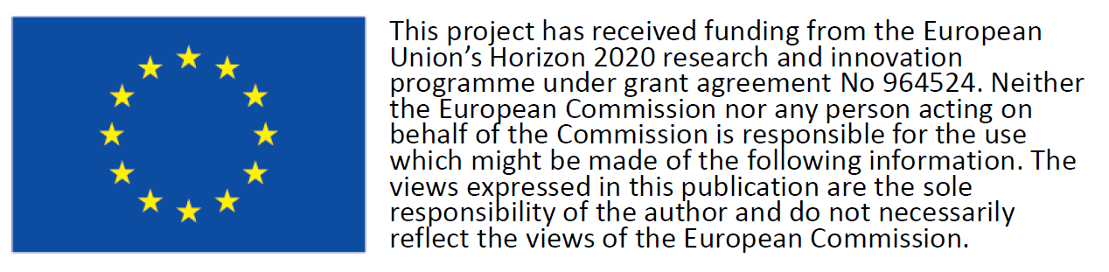

Acknowledgements
  financial support
collaborations
  Prof. P. Huber (TU Hamburg)
  Prof. M. Steiger (U Hamburg)
  Prof. D. Morineau (U Rennes)
  Dr. F. Lehmkühler (DESY, Hamburg)
  Prof. M. Thommes (FAU Erlangen-Nuremberg)
  Prof. D. Enke (U Leipzig)
Cluster of excellence
Hamburg Centre for
Ultrafast Imaging (CUI)

