Slide 1
Interpore 2026
A New In-situ Gas Content Measurement Method for Deep Coalbed by Pressure Build-Up
Prensenter: Wei Xiong
Authors: Wei Xiong, Weifeng Lv, Xianggang Duan, Yingying Xu, Yishen Duan, Runshi Huo
PetroChina Research Institute of Petroleum Exploration & Development
20 May, 2026

Slide 2
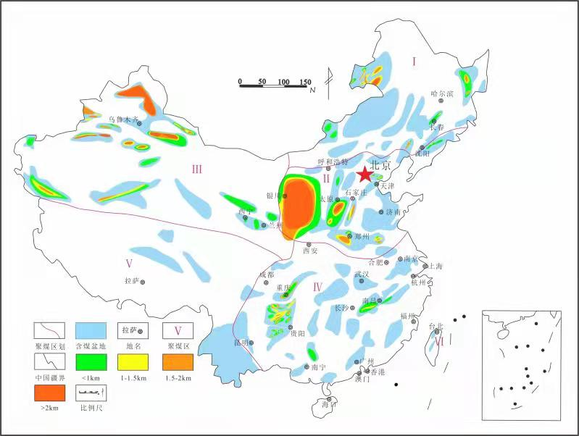
Part1. Back Ground and Motivation
Traditional coalbed methan gas content standard(USBM): time requirement within 30 minitus
Deep coalbed is buried at depth of 2000~3500m, core lifting time in wellbore 6~8 hours, result in much lost gas and less accuracy
Importance of total, free and adsorbed gas content accuracy : Reserves and EUR
Junggar Basin
Tuha Basin
Ordos Basin
Sichuan Basin

Slide 3
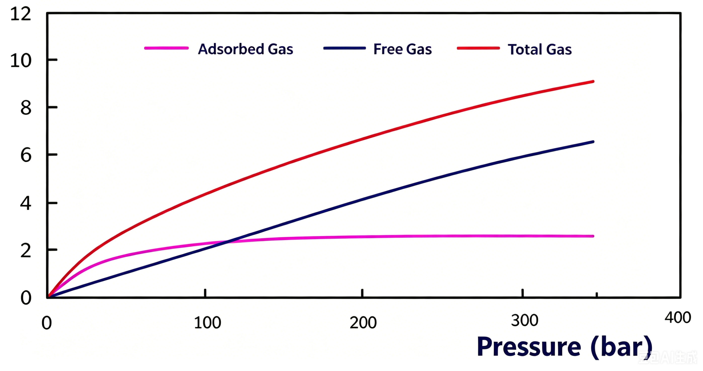
Part2. Theory
Toal gas content consists of free gas(V_{f}) and adsorbed gas (V_{a}) , Equation 1
V_{a} is a constant when pressure exceeds 150bar, purple line
V_{f} is a function of pore volume(V_{p}) underground occupied by free gas and reservoir pressure, V_{p} is a constant, Equation 2
A linear equation with two variables（ V_{p} & V_{a} ） is derived, Equation 3
Test at 250bar and 300bar seperately provide two definite condition to solve the equation
Total gas ：
Equation 1
Free gas：
Equation 2
Equation of total gas ：
Equation 3
Equation 4
Gas content VS Pressure

Slide 4

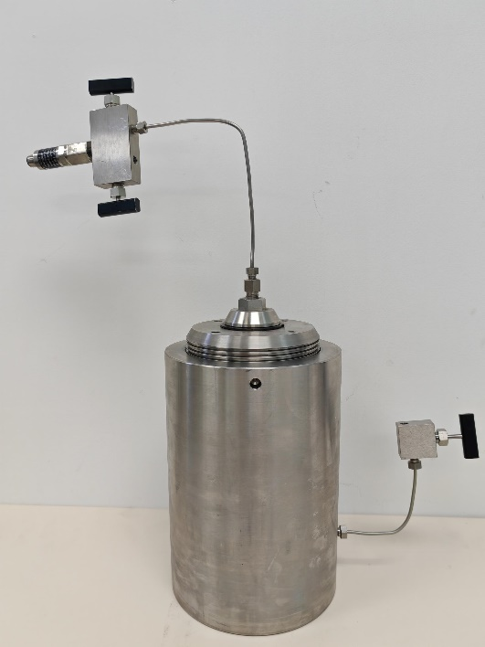
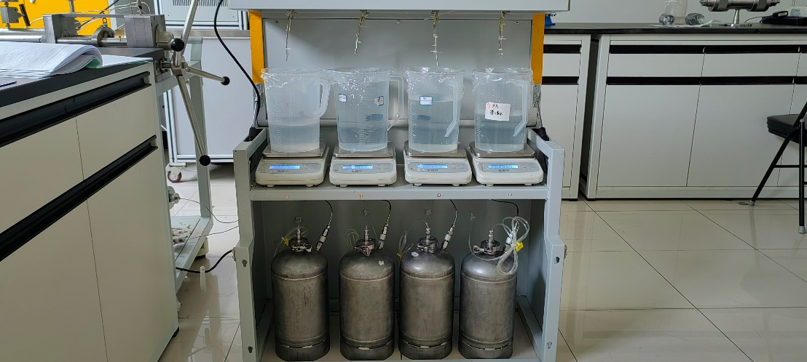
Part3. Testing Apparatus, 500bar,100℃
unit 1. Gas boosting unit：build up pressure to reservoir pressure after core is placed into canister
unit 2. A thermostatic control unit: heat the core to reservoir temperature
unit 3. A gas‑water displacement unit：to ensure every millimeter of gas comes from the core
unit 4, A metering unit: measure the weight of water instead of the volume of gas
Part 3
Part 4
Part 2
Part 1

Slide 5
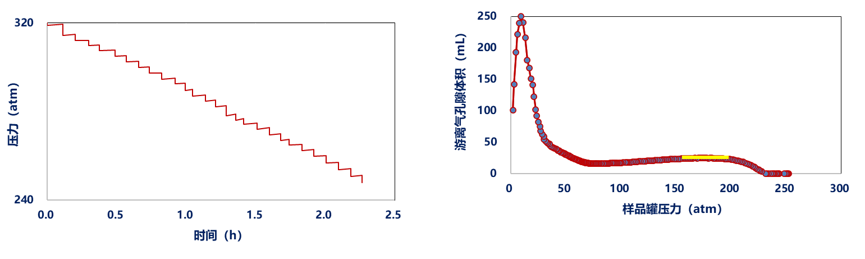

Part4. Testing Procedure
Initial plan: do 2 test at 250bar and 300bar separately, time comsuming and non-repeatable
New procedure: build up pressure to reservoir pressure and temperature; Quick-small-pressure-drop; More than a dozen quick-small-pressure-drop tests above 150bar; Depressure continuously when pressure below 150atm until no gas from core
All the gas from the core under reservoir pressure and temperature be called in-situ gas content
Quick-small-pressure-drop test

Slide 6
Part5. Testing Results:Vp
Vp can be calculated by Equation 3 using test data
Figure 1, hundreds of quick-small-pressure-drop until pressure decrease to very low pressure in core1, indicats that Vp is not affected by desorbed gas when pressure is above 150 bar
Figure 2, more than a dozen of quick-small-pressure-drop were done in a deep coalbed core2, the error of Vp above 150 bar is less than 2%
Test Result of core 1
Test Result of core 2

Slide 7
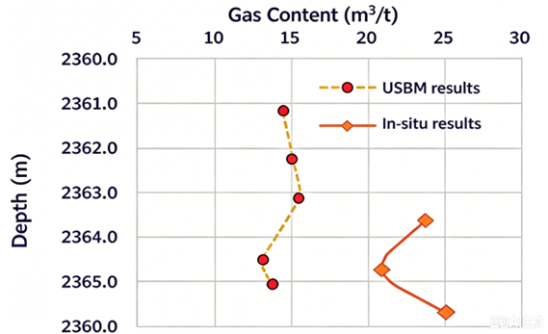
Part5. Testing Results:total gas and components
Results from new method are 50%–60% higher than USBM values which match field production performance much better. Free gas is about 30% of total gas, adsorbrd gas is about 70%

Slide 8
Conclusions
1. A theoretical formula for gas content testing was derived
2. A high‑temperature, high‑pressure testing apparatus was developed
3. A quick-small‑pressure-drop test procedure was established
4. The in-situ gas content is more than that of USBM method

Slide 9

Thank you for your attention!
Notes:
9

