Slide 1
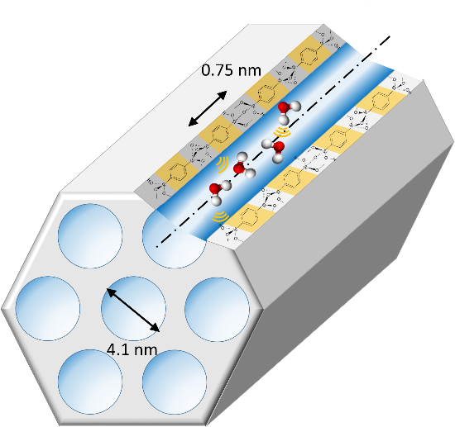

Water Dynamics in Porous Materials: What can we learn from Quasielastic Neutron Scattering?
Denis MORINEAU
CNRS – Institute of Physics of Rennes

Slide 2
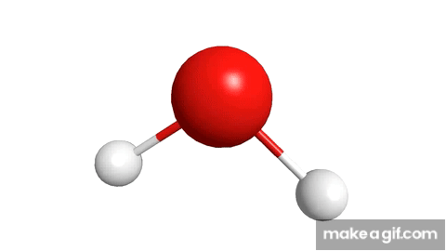
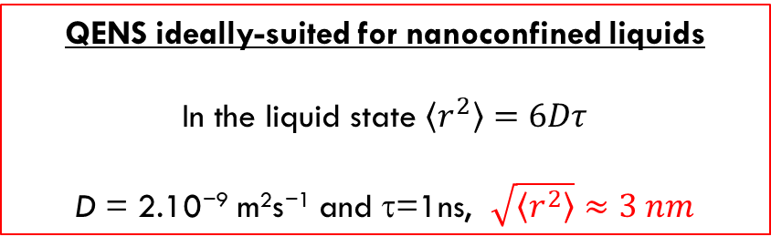
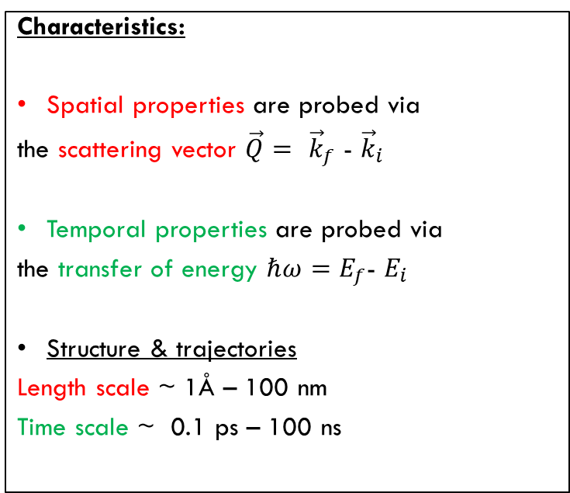



Neutron scattering / Space & time
Principle:
Characteristics:
Spatial properties are probed via
the scattering vector $\vec{Q}= {\vec{k}}_{f}\text{ − }{\vec{k}}_{i}$
Temporal properties are probed via
the transfer of energy $ℏω=E_{f}$- $E_{i}$
Structure & trajectories
Length scale ~ 1Å – 100 nm
Time scale ~ 0.1 ps – 100 ns
Scattered neutrons
$${\vec{k}}_{f}, E_{f}$$
Incoming neutrons
$$ψ_{i}=e^{i(k_{i}.x−ω_{i}t)}$$
$${\vec{k}}_{i},E_{f}$$
Sample
QENS ideally-suited for nanoconfined liquids
In the liquid state $\left\langle r^{2}\right\rangle =6Dτ$
D = 2.10⁻⁹ m²s⁻¹ and τ=1ns, $\sqrt{\left\langle r^{2}\right\rangle }≈3 nm$

Slide 3
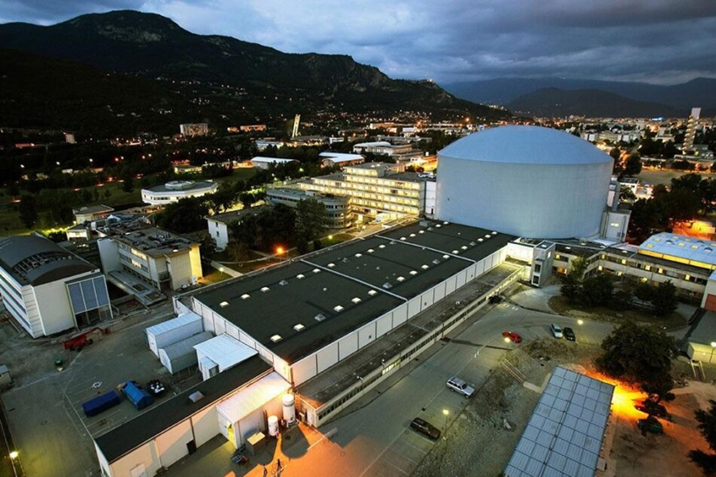
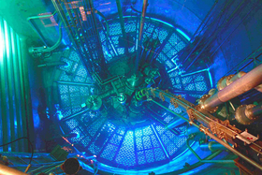

Neutron Scattering Facilities
Around 50 research reactors in the world and 8 spallation sources
European
ILL Institut Laue Langevin (Grenoble, F) Reactor
ESS European Spallation Source (Lund, S) Under construction, start 2028
National
MLZ FRMII (Garching, G) Reactor expected to restart in 2027
ISIS (Oxford, UK) Spallation Source
SINQ (CH) Spallation Source
ILL in Grenoble is currently the most performant facility worldwide
Power 58 MW
40 instruments
Per year : ~1400 researchers from over 40 countries conduct ~ 1000 experiments

Slide 4
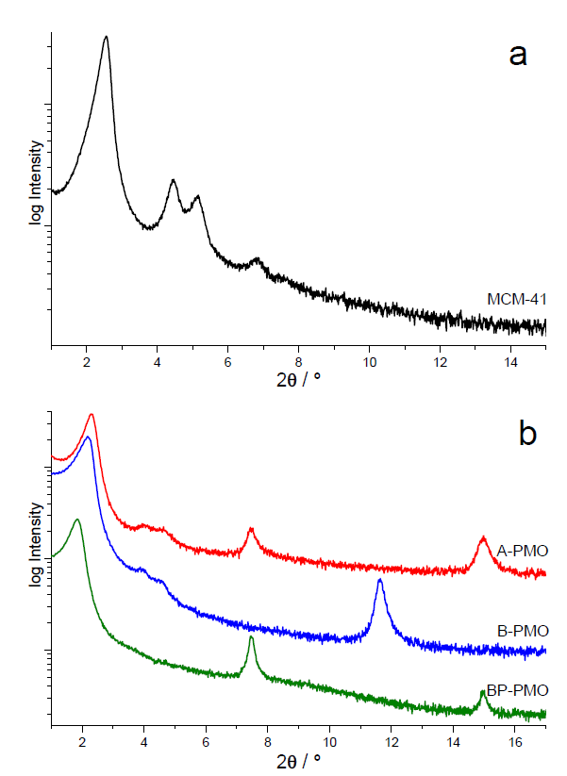
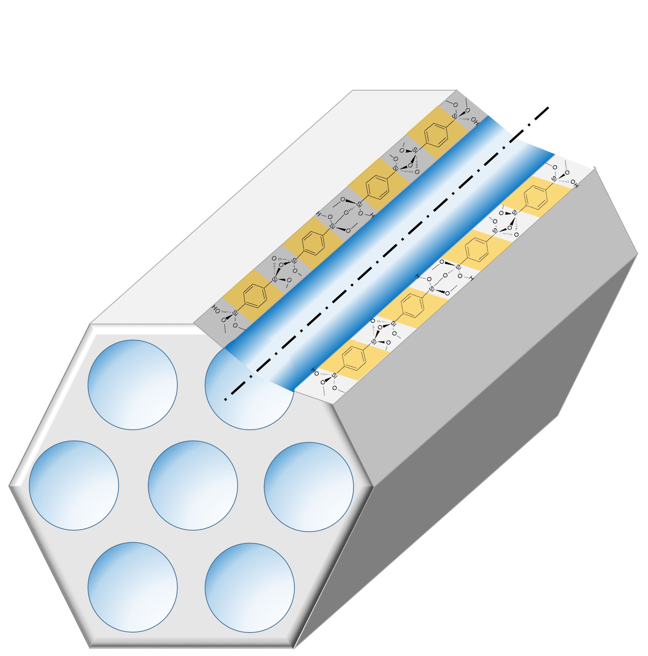
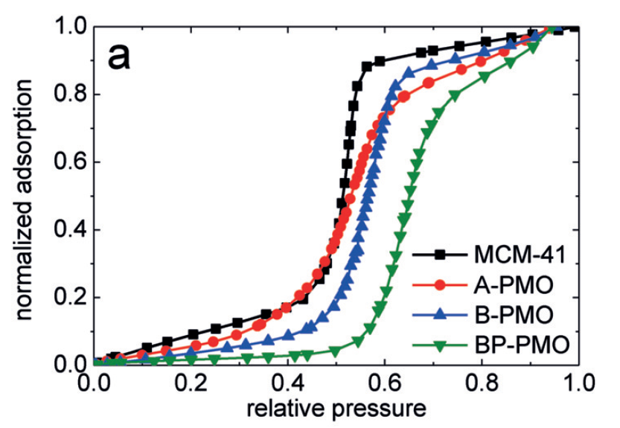

Model Nanoporous hosts - Tuning surface interaction
Silicas (MCM-41) & Periodic Mesoporous Organosilicas (PMOs)
Different bridging units
X-ray diffraction
100
Pure Silica
c = 0.7-1.2 nm
110
200
210
Water sorption isotherm
PMOs
001
002
001
Hydrophoby
S ≈ 500-1,000 m²/g
V ≈ 0.5-1 cm³/g
D = 3-4 nm
Crystalline arrangement of aligned nanochannels
M. Fröba et al. J. Phys. Chem. C 2018, 122, 12673−12680

Slide 5



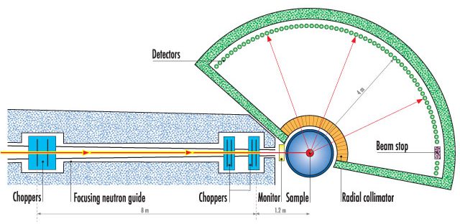
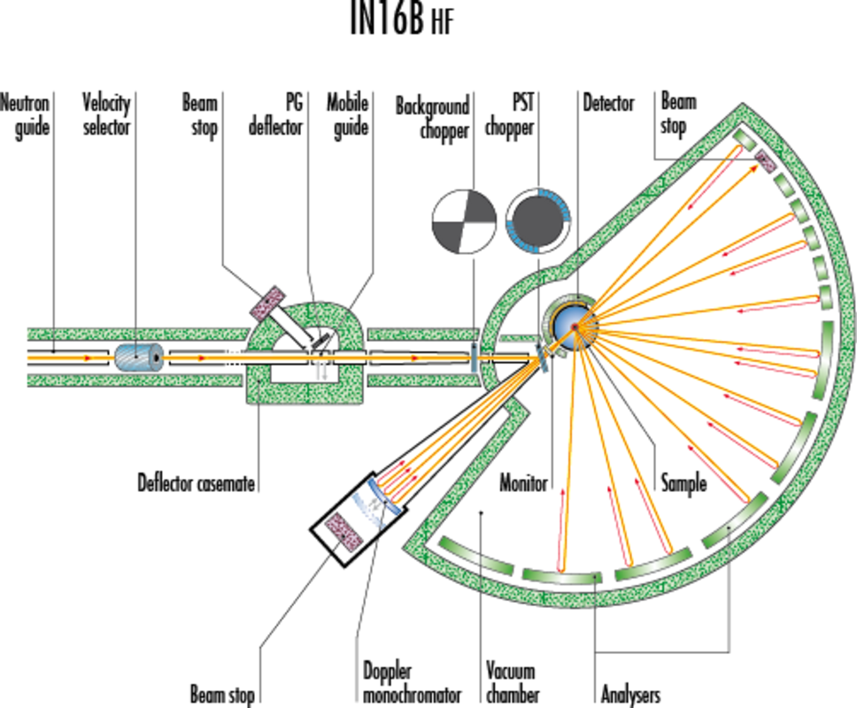
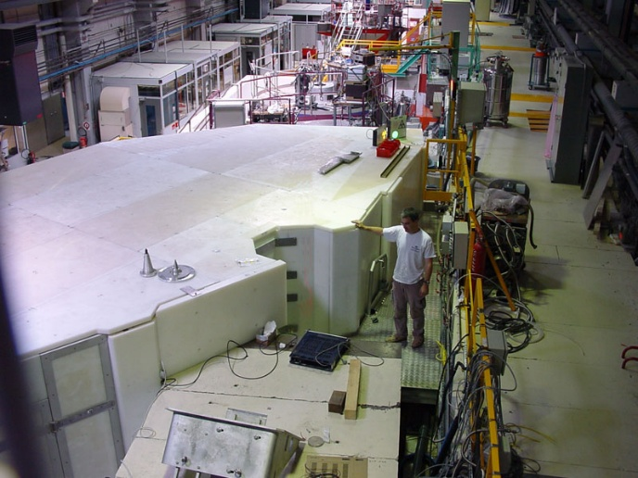
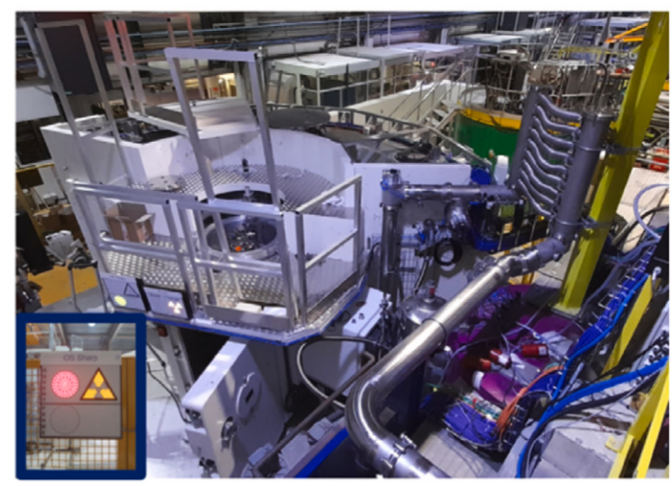
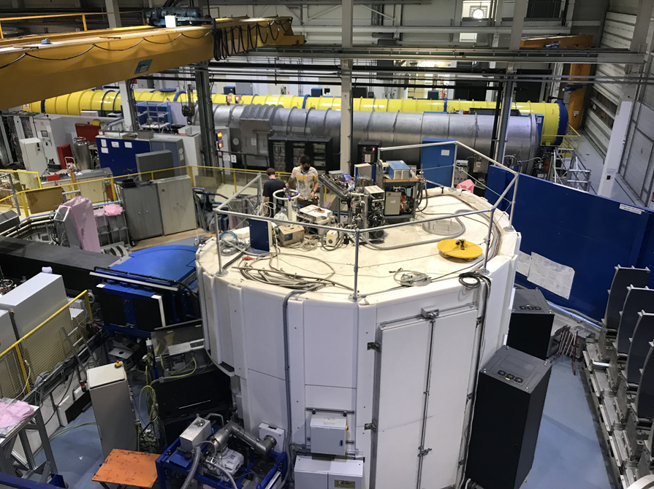







Different instruments
Quasielastic intensity
S($\vec{Q}$, ℏω)
Time of flight spectrometer
Backscattering spectrometer
ΔE$≠0$
$$\vec{k_{f}}$$
$$\vec{Q}$$
$$\vec{k_{i}}$$
Fast dynamics (vibration, rotation)
t ~ 0.1 à 100 ps
Slow dynamics
(translational diffusion)
t ~ 0.1 à 1 ns
IN5B
SHARP
IN16B

Slide 6
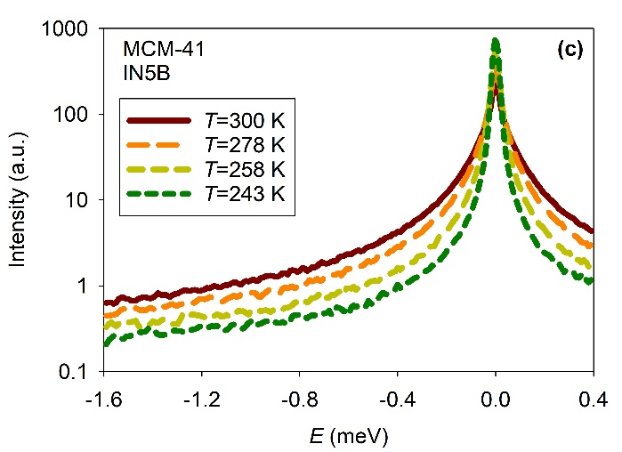
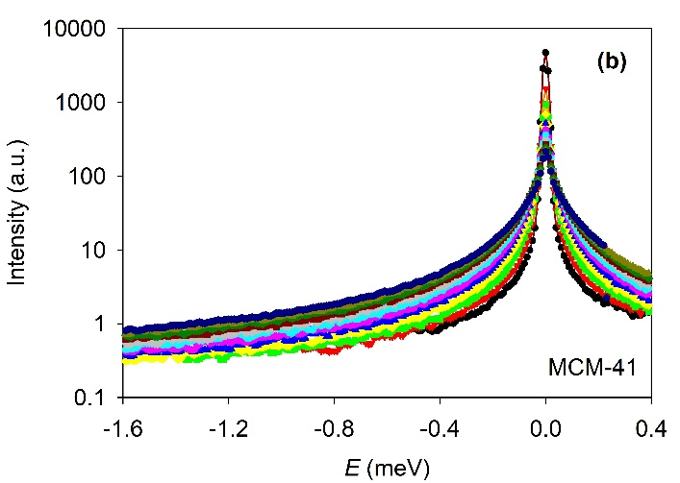
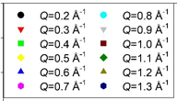

Water dynamics in MCM-41 silica
Temperature dependence:
S($\vec{Q}$, ℏω)
Modelling
Water motions
Q dependence:
2 motions:
Local fast motion (τ =1-3ps)
“intrabassin motion” (rotation, tumbling)
+
Translational diffusion
Spatially restricted Jump diffusion (non-Fickian)
A. Jani et al. J. Chem. Phys. 154, 094505 (2021)

Slide 7
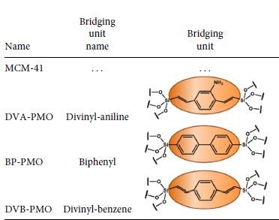
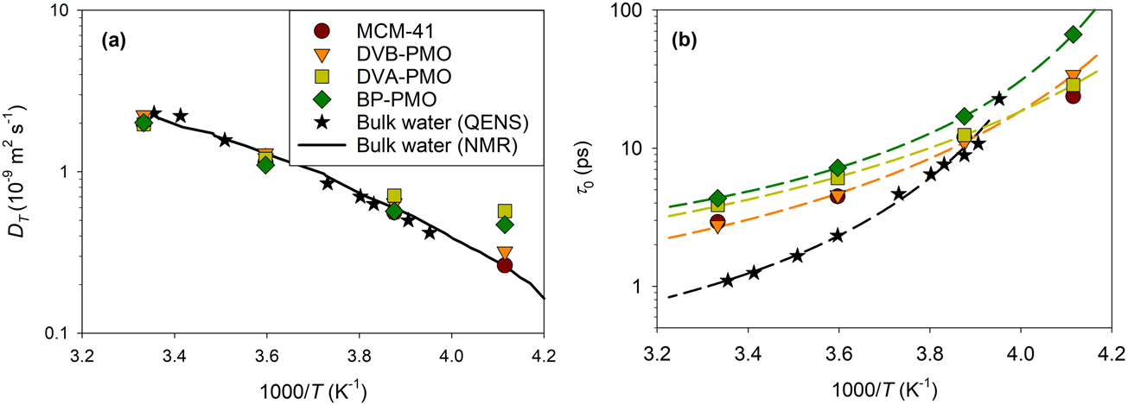
Impact of hydrophilicity of water dynamics
Compared to bulk water :
10 % reduction of diffusivity,
x2-x4 increase of residence time,
Modest effect of surface chemistry
Diffusivity
Residence time
A. Jani et al. J. Chem. Phys. 154, 094505 (2021)

Slide 8
Ionically Charged Pore Surface
Divinyl-pyridine PMO
Divinyl-methylpyridinium PMO
A. Mozhdehei et al. J. Phys. Chem. C 129, 18311-18324 (2025)

Slide 9
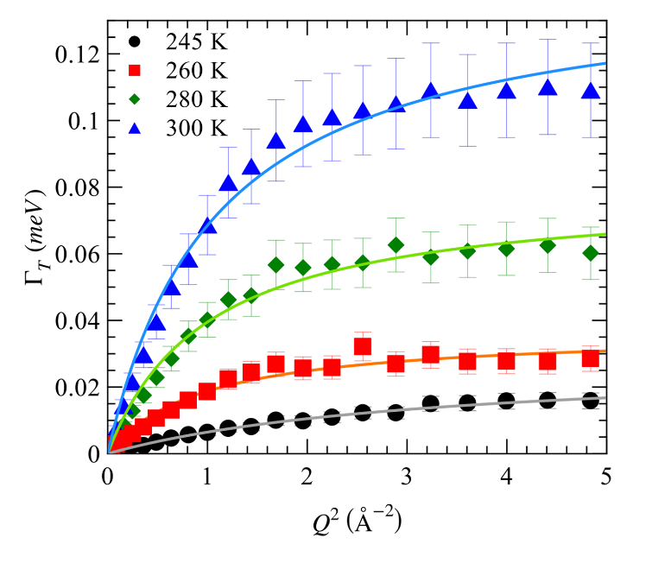
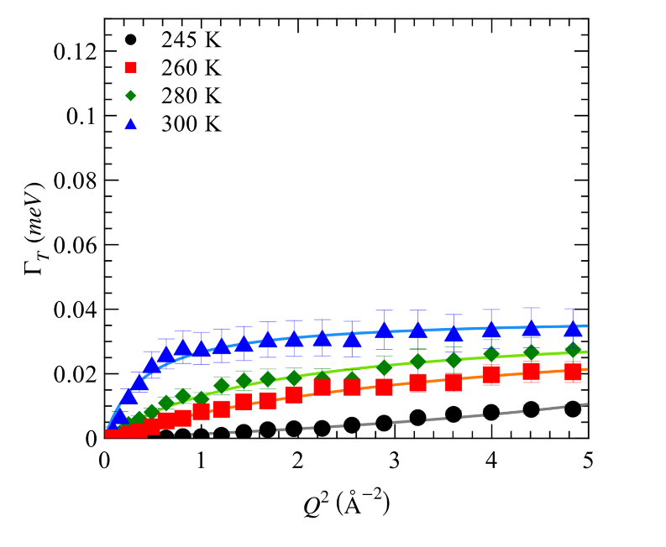


Ionically Charged Pore Surface
Neutral pore
Charged pore
Jump diffusion
model
Jump diffusion
model
QENS broadening (HWHM)
~D_{T}Q² (Fick’s law)
Mean jump length
τ₀
Compared to bulk water :
x4 reduction of diffusivity
x10 increase of residence time
No charge effect on jump length (l=2-3 Å)
A. Mozhdehei et al. J. Phys. Chem. C 129, 18311-18324 (2025)

Slide 10
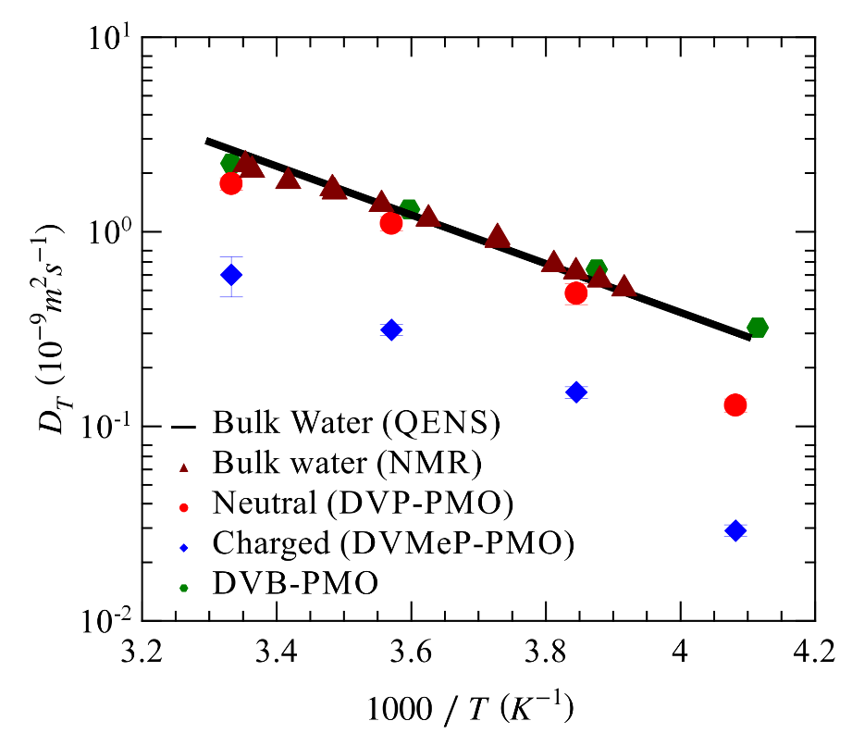
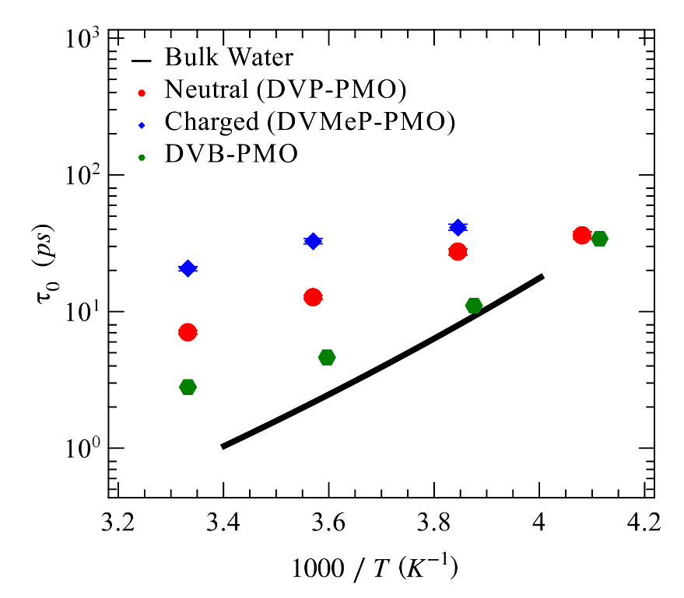
Charged vs neutral hydrophilic vs hydrophobic surfaces
Diffusivity
Residence time
Bulk
Hydrophobic
Hydrophilic neutral
Charged

Slide 11
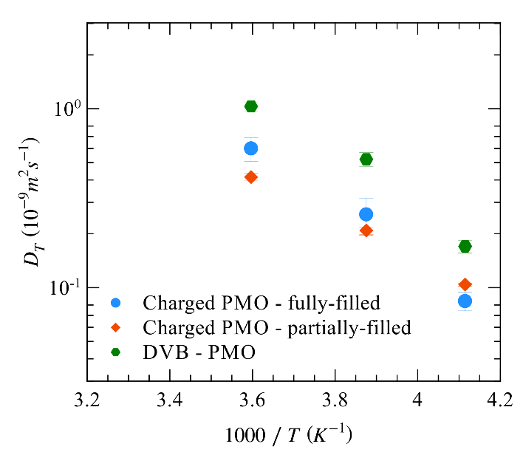
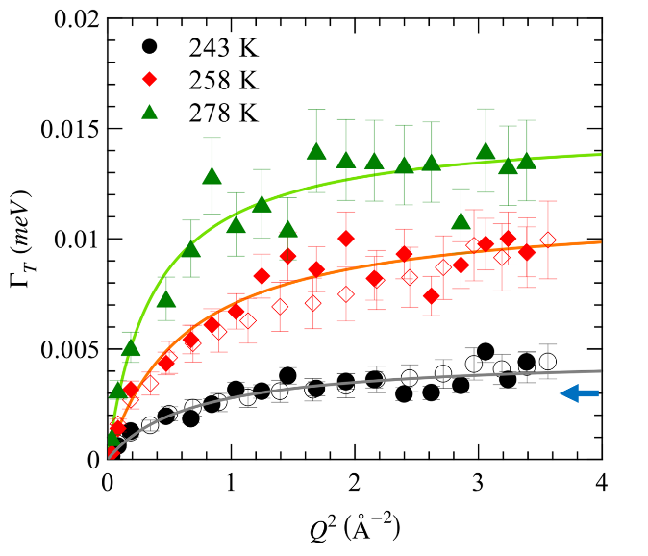
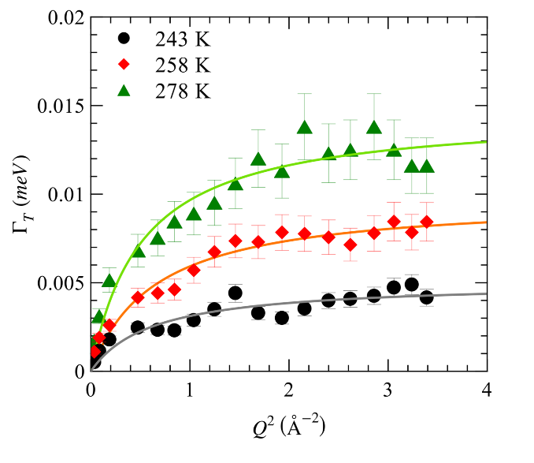
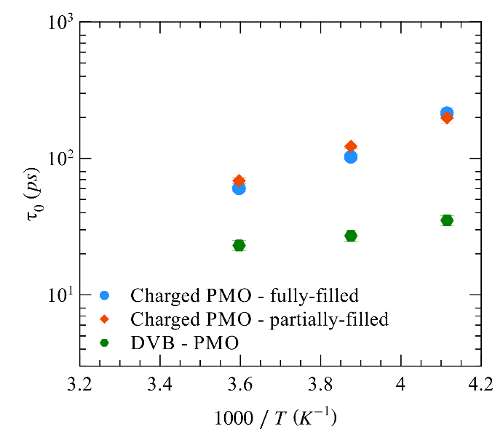
Variable pore filling : Range of Ionic Charge Interaction?
HWHM diffusive motion
Diffusivities
Neutral
Charged
75% RH
33% RH
Spectra (Filled symbols)
IFWS (Open symbols)
HWHM diffusive motion
Residence time
%RH has small impact on dynamics
compared
to surface charge
Charged
33% RH
75% RH
Neutral

Slide 12

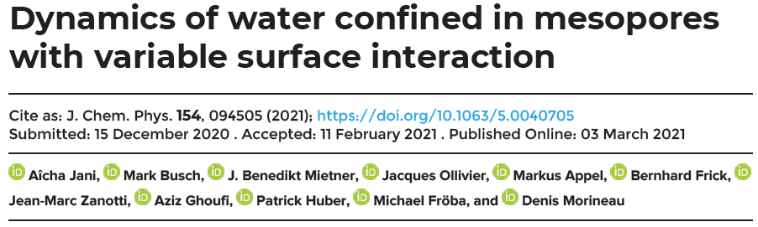

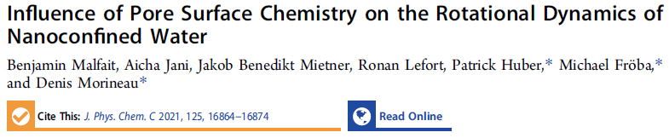
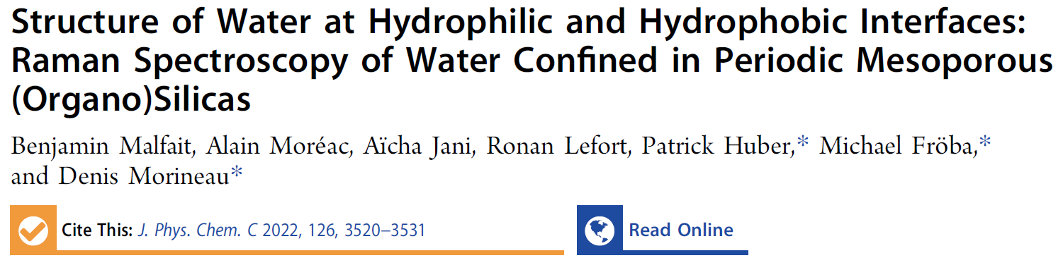

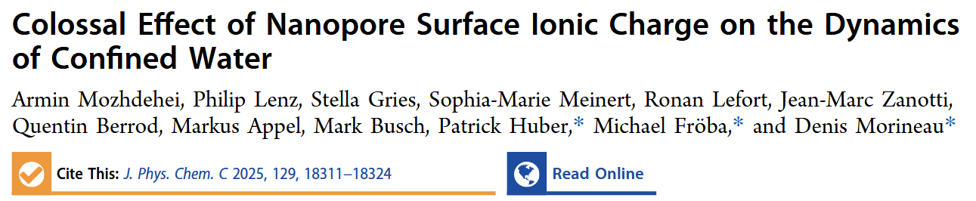


Acknowledgements - Thank you for your attention !
Institute of Physics of Rennes
Benjamin Malfait, Aïcha Jani, Ronan Lefort, Armin Mozdehei, Nadim Kamar, Alain Moréac
Patrick Huber
Michael Fröba
Markus Appel, Bernhard Frick, Jean-Marc Zanotti, Quentin Berrod, Jacques Ollivier
NanoLiquids
N° 18-CE92-0011
SolutinPore
N° 23-CE29-0028

Slide 13
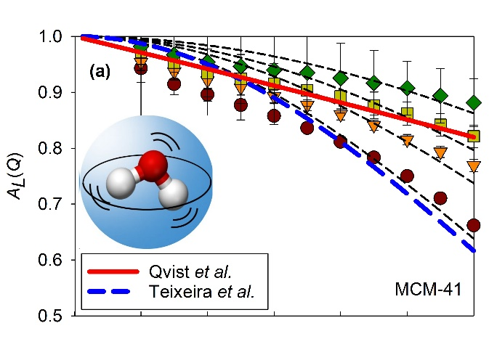
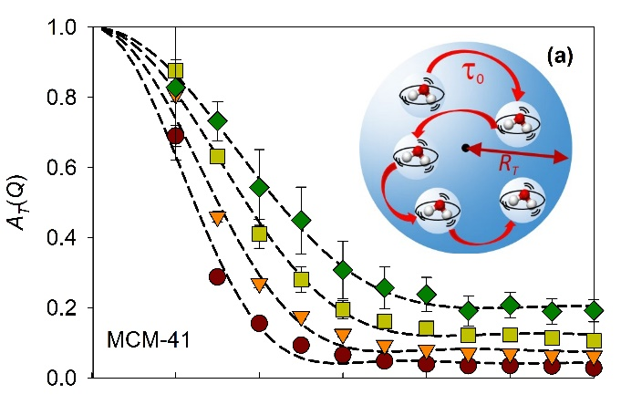
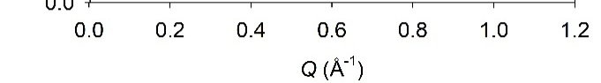
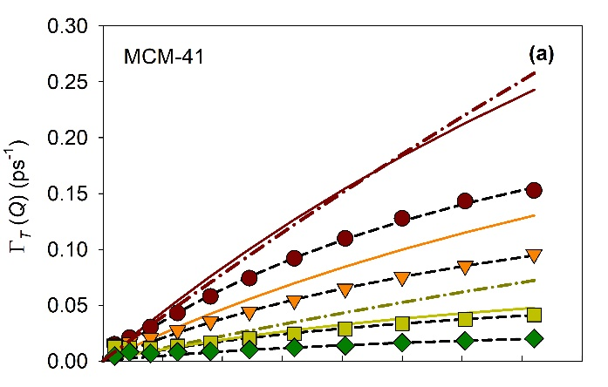
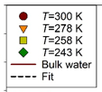

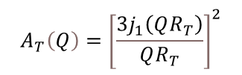


QENS modelling
EISF Local fast motion
EISF slow motion
EISFs:
$$A_{R}\left(Q\right)={\left[j_{0}\left(QR_{R}\right)\right]}^{2}$$
$$A_{T}\left(Q\right)={\left[\frac{{3j}_{1}\left(QR_{T}\right)}{QR_{T}}\right]}^{2}$$
HWHM slow motion
HWHM slow motion (low-Q)
2 motions:
Local fast motion (τ =1-3ps)
“intrabassin motion” (rotation, tumbling)
+
Slow dispersive motion
spatially restricted jump translational diffusion
$$_{T}= \frac{4.33{ D}_{T}}{{R_{T}}^{2}}$$
Confined water: A. Jani et al., J. Chem. Phys. 154, 094505 (2021) Bulk water: J. Teixeira et al., Phys. Rev. A 31(3), 1913 (1985)
J. Qvist et al., J. Chem. Phys. 134(14), 144508 (2011)

Slide 14
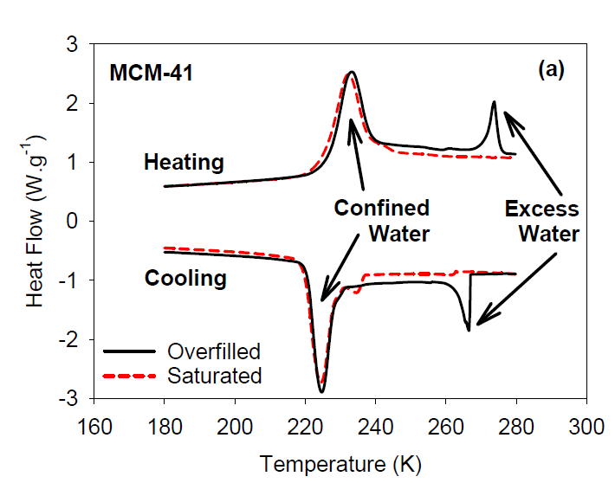
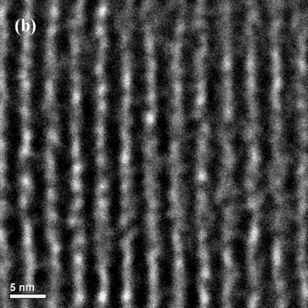
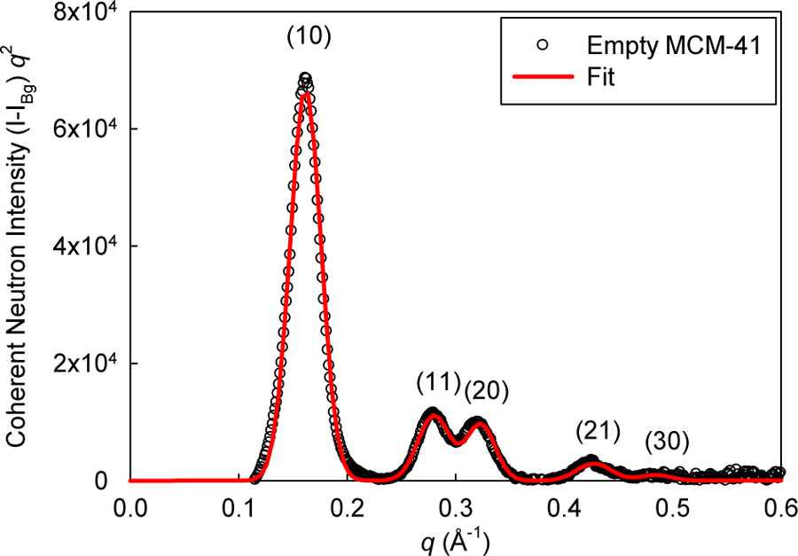
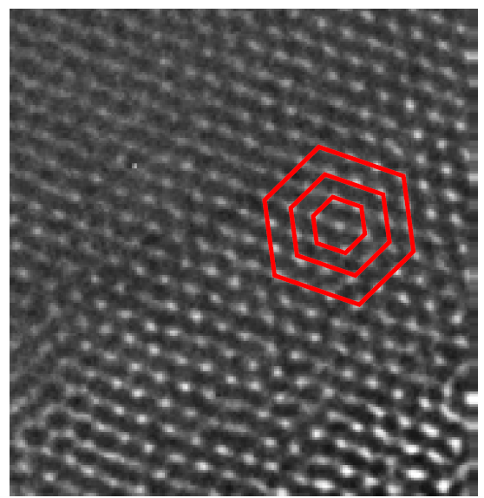
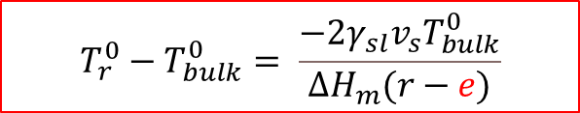
MCM-41 silicas
DSC
MCM-41 (D = 3.6 nm, ~10σ)
SANS
ΔTm
Melting point
-50K
$$T_{r}^{0}−T_{bulk}^{0}= \frac{−2γ_{sl}v_{s}T_{bulk}^{0}}{∆H_{m}(r−e)}$$
G. H. Findenegg, et al. ChemPhysChem 9, 2651 (2008)

Slide 15
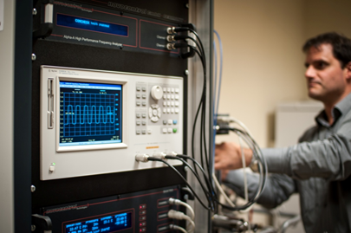
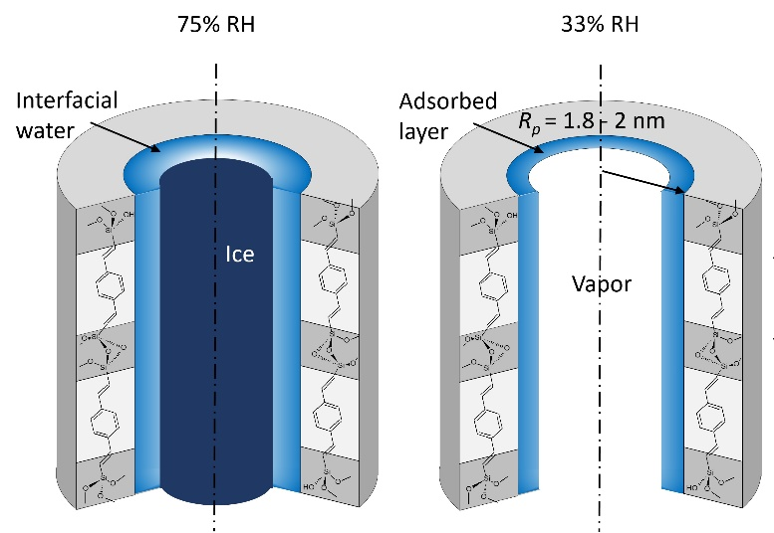
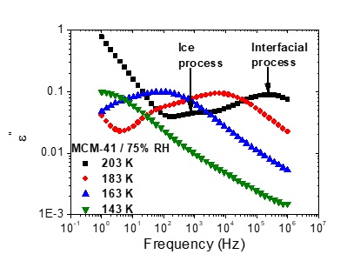
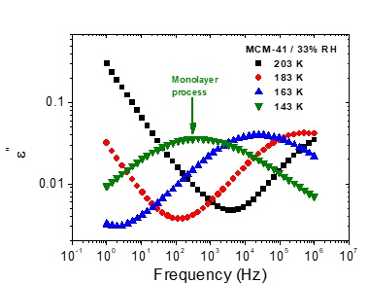
Interfacial layer
Dielectric Spectroscopy
Unfreezable surface layer e≈0.6nm
B. Malfait et al. J. Phys. Chem. C 125, 16864 (2021)
Along with geometrical confinement
Surface plays a central role

Slide 16
Impact of surface chemistry on H-bonds structure
Totally filled pores (75%RH)
Disrupted ‘bulk-like’ H-bonded structure
Interfacial contribution is overwhelmed by bulk-like order
B. Malfait et al. J. Phys. Chem. C 126, 3520 (2022)

Slide 17
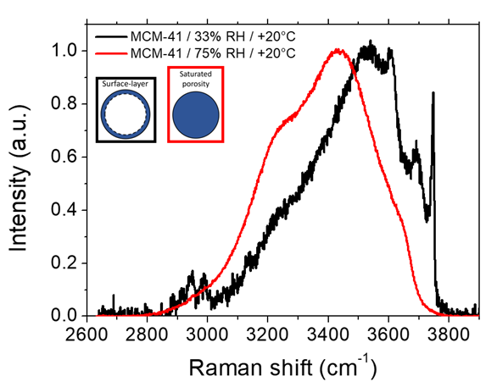
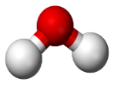
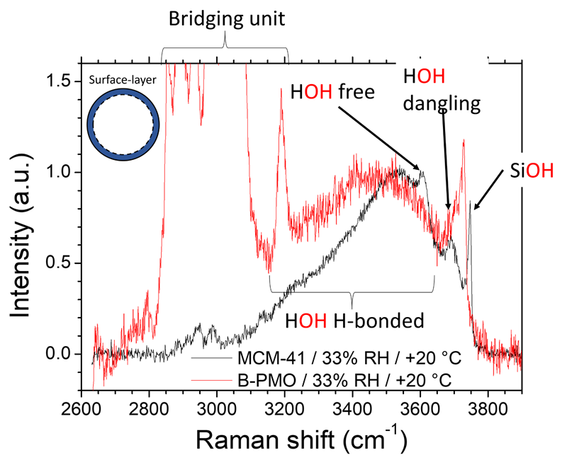
Impact of surface chemistry on H-bonds structure
Raman intensity
2 types of interfacial
dangling OH
Adsorbed
layer
33% RH
Organic
bridge
Vapor
H-bonded
Partially filled pores (33%RH)
H-bond structure evidences Water-Surface and Water-Vapor interfaces
B. Malfait et al. J. Phys. Chem. C 126, 3520 (2022)

Slide 18





Impact of hydrophilicity of water dynamics
HWHM diffusive motion
~D_{T}Q²
τ₀
Jump diffusion
model

