Slide 1



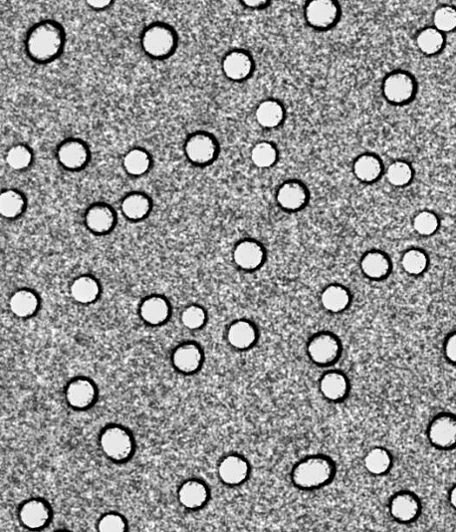
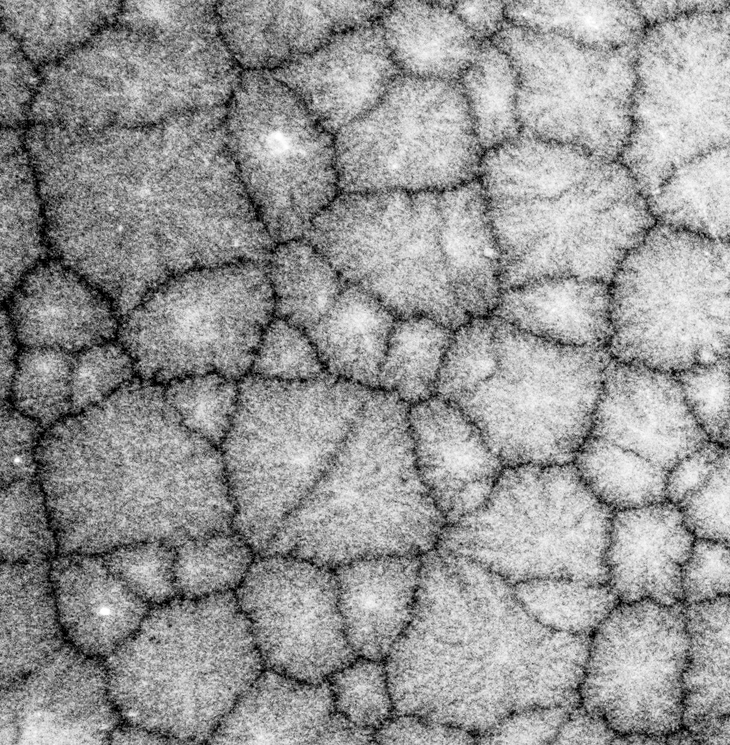

Humidity-driven crystallization and deliquescence of salt in nanopores
Olivier Vincent, Hugo Bellezza, Marine Poizat
CNRS & Univ. Lyon 1, Institute for Light & Matter (Lyon, France)

Slide 2
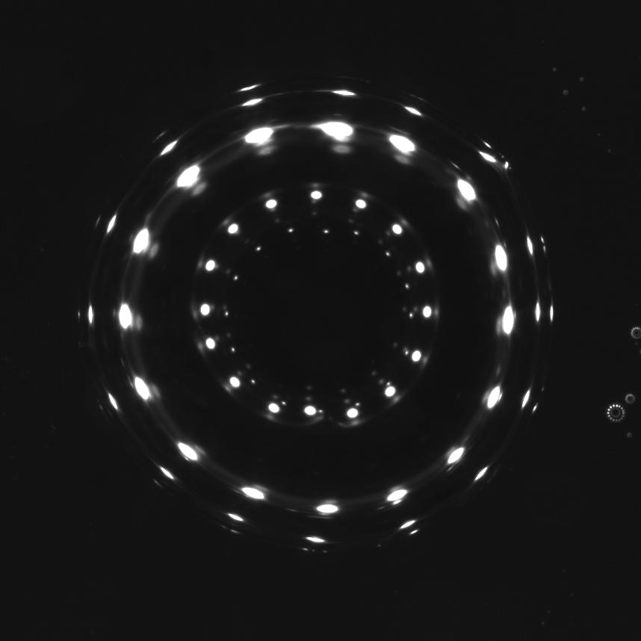
Crystallization and Deliquescence
1
NaCl(aq) droplet
50%RH
Notes:
Let’s start with a droplet …
We have two phases with a transition line situated at 75%RH for NaCl
Phase diagram

Slide 3
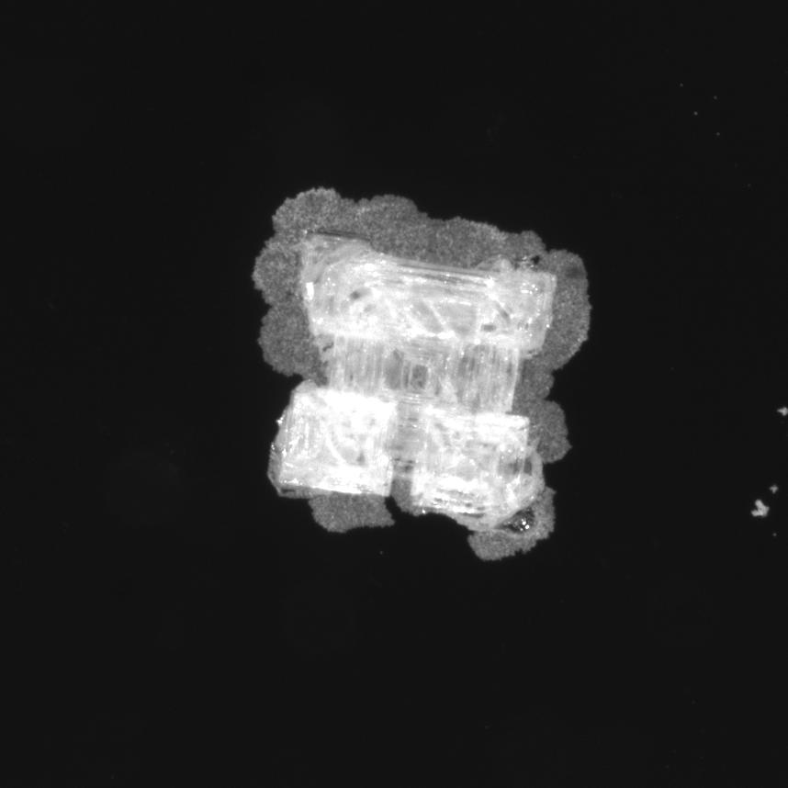
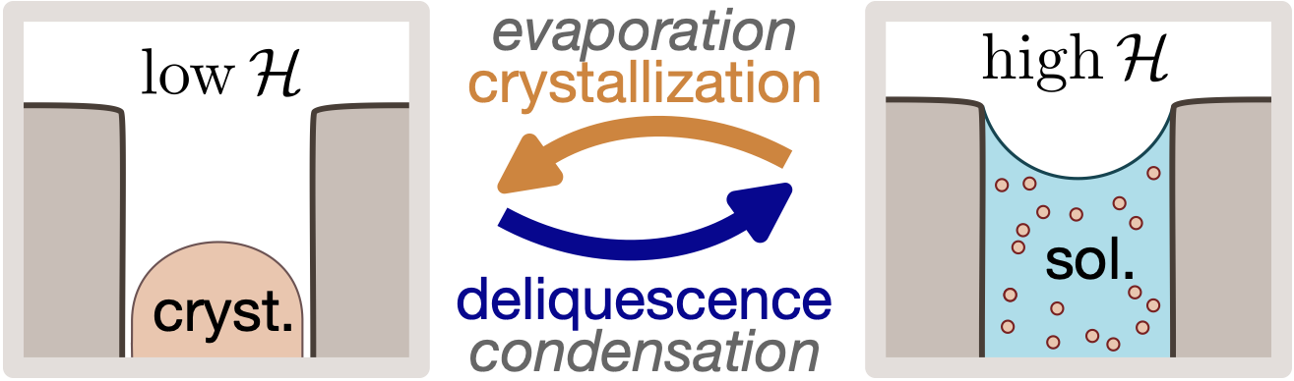


Crystallization and Deliquescence
1
NaCl(aq) droplet
80%RH
low
75%RH
high
Relative Humidity
Notes:
Let’s start with a droplet …
We have two phases with a transition line situated at 75%RH for NaCl
Phase diagram

Slide 4
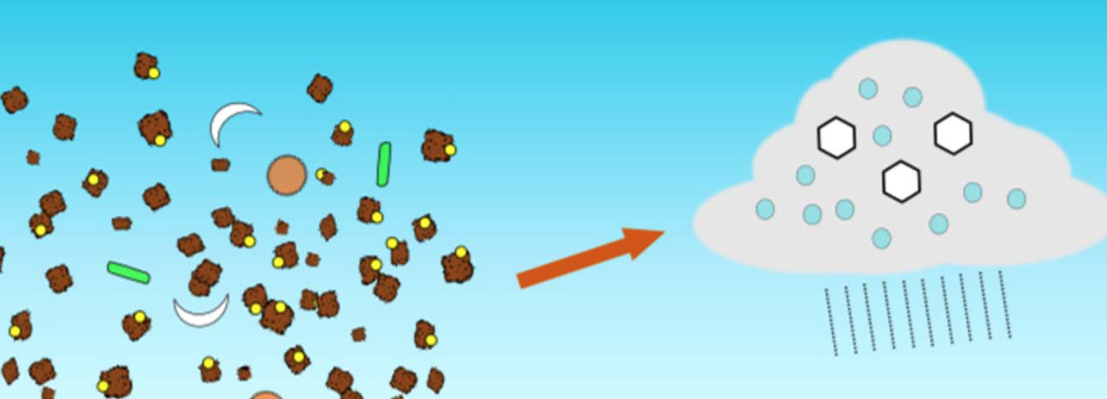
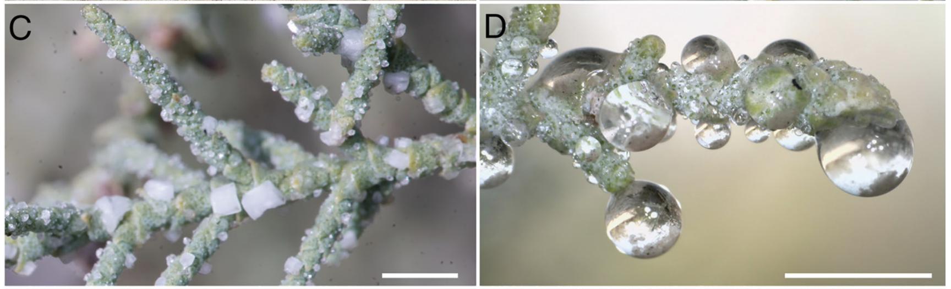
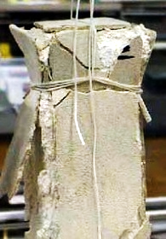
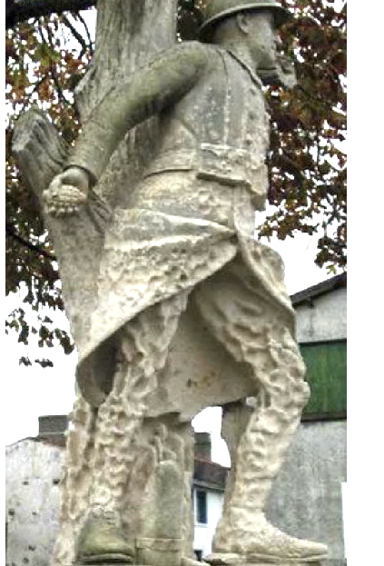

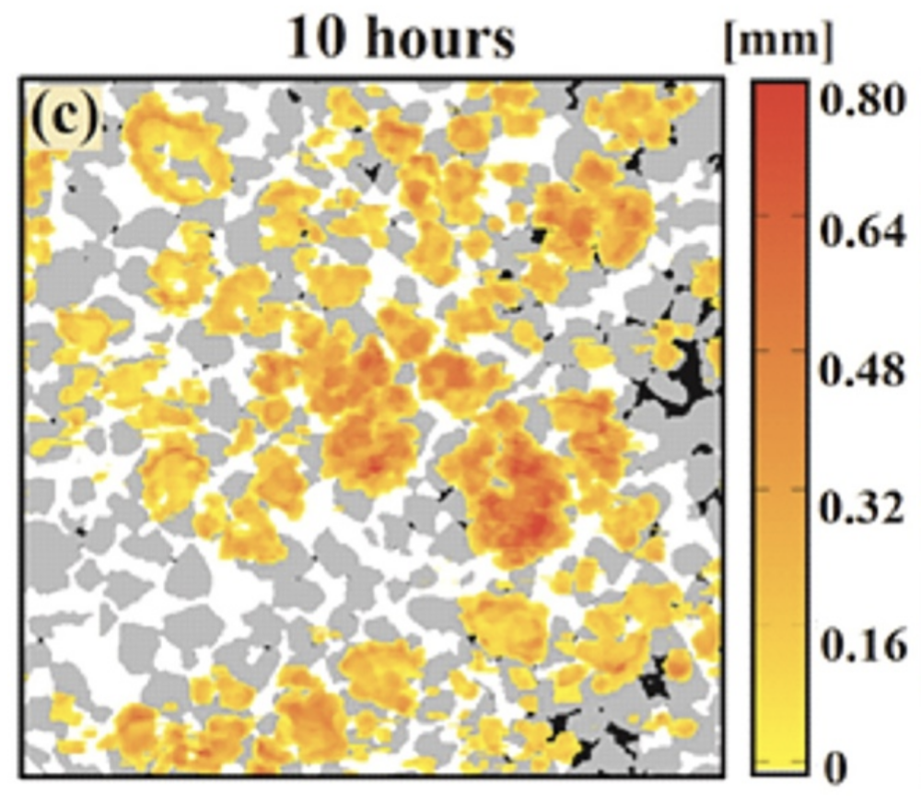
Motivations / Applications
2
Atmosphere aerosols
Water harvesting
O’Sullivan et al. 2015
Al-Handawi et al. 2023
Civil engineering, heritage conservation , geophysics
Soil salination
Espinosa-Marsal & Scherer, 2010
Putnis, 2015
Flatt et al., 2014
Shokri et al., 2024
(+ CO2/H2 sequestration, heat/energy storage & conversion etc.)

Slide 5
Scientific question
3
low
Relative Humidity (RH)
high
Critical RH triggering phase change in pores?
Impact of
Salt concentration
Pore size (nm range)

Slide 6
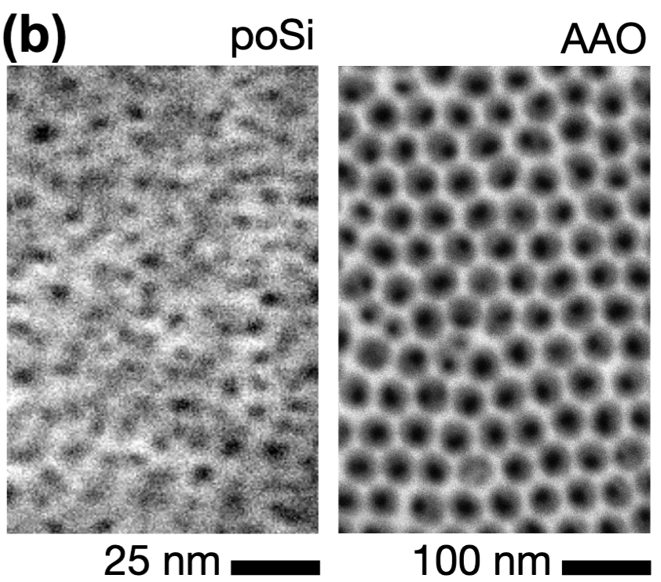
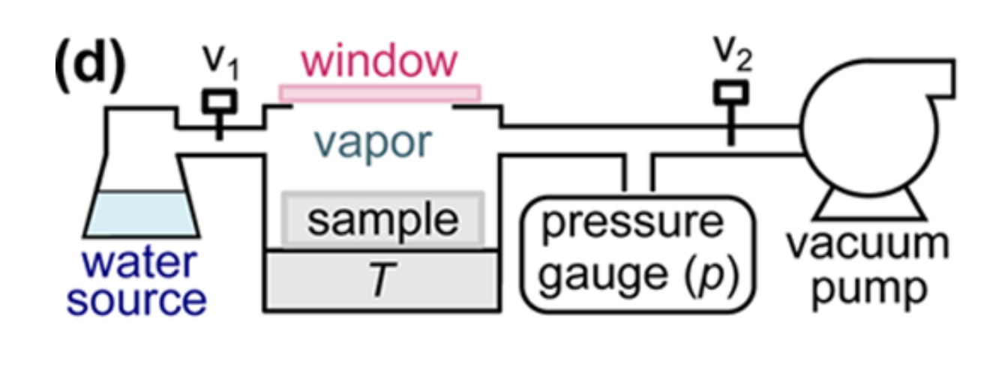

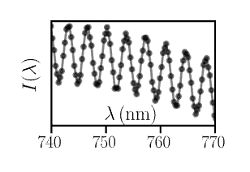

Methods
4
Samples
Water sorption isotherms
Vacuum system controlled in RH
White light interferometry (WLI)
Porous silica and alumina
Mean pore diameters 3 to 20 nm
( water content)
Imbibed with NaCl solution
Notes:
Soak into salt solution and then put in RH controlled chamber.

Slide 7
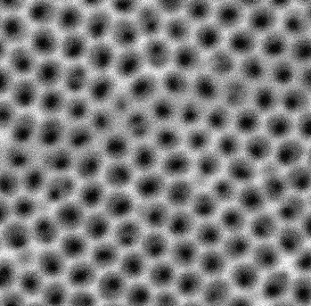
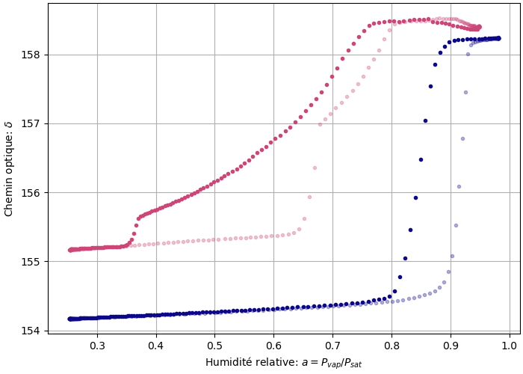
Water sorption isotherms
5
AAO
Pore diameter 12 nm
Water content (OPL)
no salt
with salt
Crystallization and deliquescence define the shape of water sorption isotherms
deliquescence
crystallization
Relative Humidity
Notes:
Salt phase transitions define hysteresis, not water capillarity

Slide 8
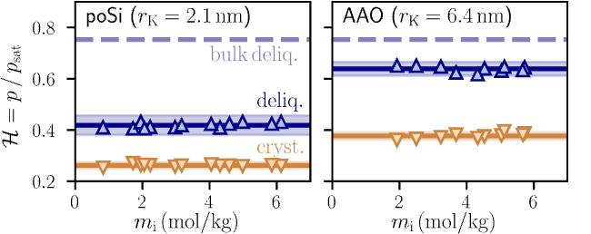
Impact of salt concentration
6
No effect of salt amount on the RH of crystallization & deliquescence
Pore size-dependent shift of phase transitions compared to bulk
Notes:
Define Kelvin radius here

Slide 9
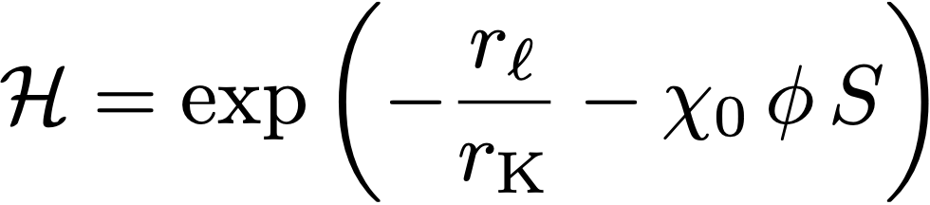




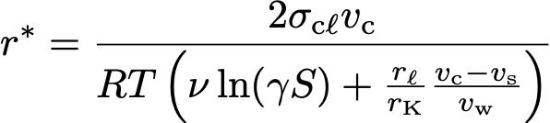
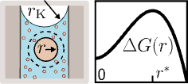
Theory
7
Liquid / vapor equilibrium
solubility (mole ratio)
osmotic coefficient
(super)saturation
vapor
capillary
osmotic
(Kelvin)
Confined nucleation theory
Confined nucleation possible only if
r* < r_{p} ≃ r_{K} (steric criterion)

Slide 10
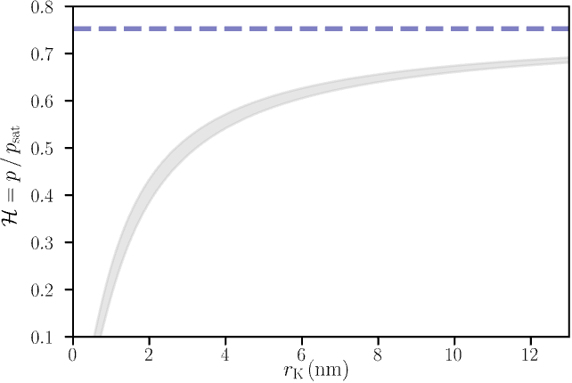

Theory vs. Experiments
8
bulk equilibrium
steric nucleation

Slide 11
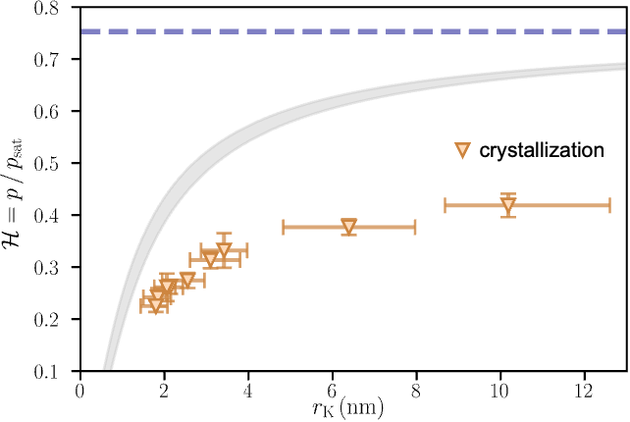
Theory vs. Experiments
8
bulk equilibrium
steric nucleation
Notes:
I know this is what some people would call reasonable agreement, but in reality it shows …

Slide 12
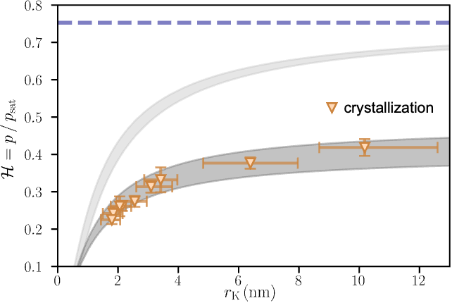

Theory vs. Experiments
8
bulk equilibrium
steric nucleation
kinetic nucleation

Slide 13
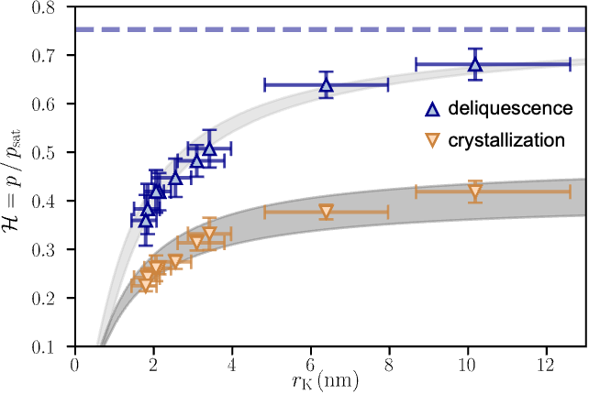
Theory vs. Experiments
8
bulk equilibrium
steric nucleation
kinetic nucleation

Slide 14
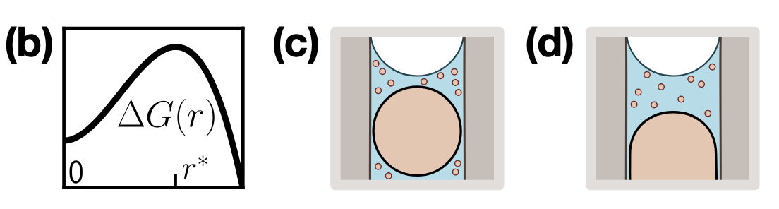
Steric nucleation vs. Deliquescence
9
Sterically limited nucleation (r* = r_{p})
3-phase equilibrium
(this work)
(Talreja-Muthreja et al. Langmuir 2022)
Mathematically equivalent!
Notes:
Describe the same situation (unstable equilibrium)

Slide 15
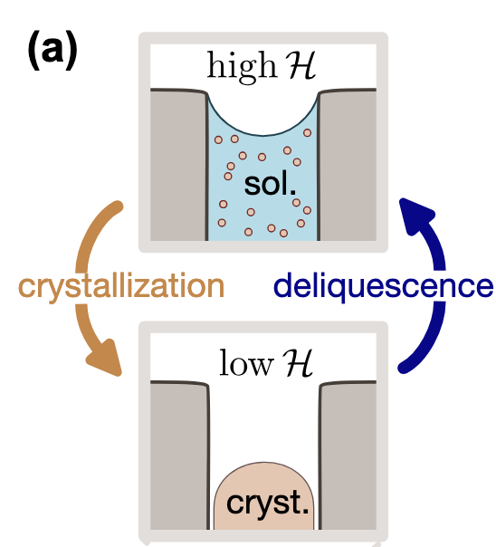




Conclusion & Acknowledgements
10
Salts qualitatively change water uptake/release in nanopores
Capillary condensation
Deliquescence (equilibrium)
Meniscus evaporation
Crystallization (metastable)
(!)
More info:
Bellezza, H., Poizat, M. & Vincent, O. Salt crystallization and deliquescence triggered by humidity cycles in nanopores. arXiv:2510.27309 (in revision)
ANR JCJC (SINCS)
ANR–DFG (SolutInPore)
Hugo Bellezza
Marine Poizat
Notes:
Shape and hysteresis of sorption isotherms is not defined anymore by … but by …
Equilibrium, even if metastable
Interesting to finely tune absorption and release of water in materials for various applications

Slide 16
Supporting Slides

Slide 17
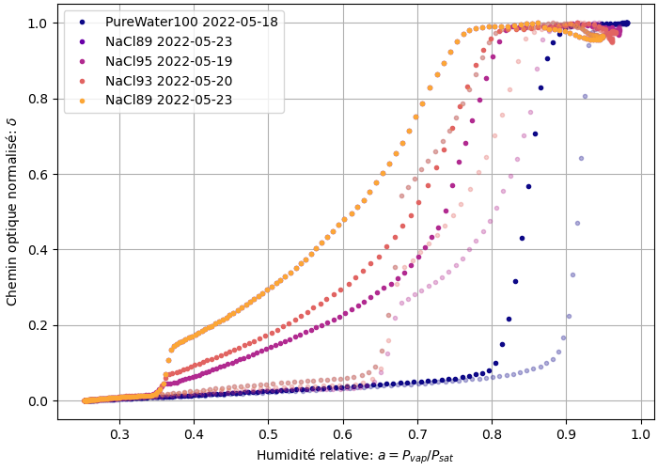
Water sorption isotherms
s1
No salt
NaCl 1.6 M
NaCl 2.5 M
NaCl 3.7 M
Water content (relative)
cryst.
deliq.
Relative Humidity

