Slide 1
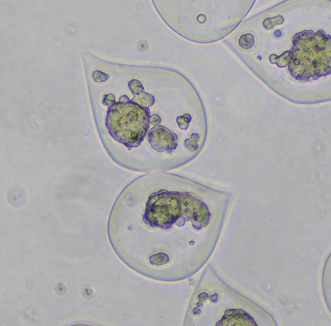
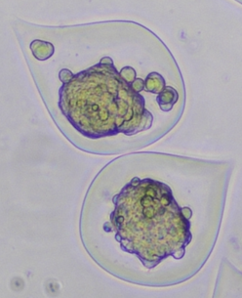


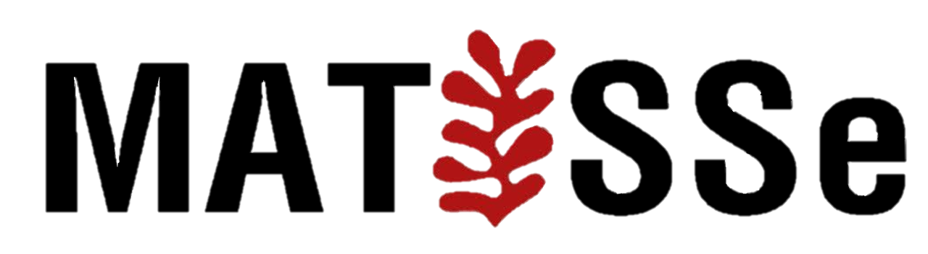

A hybrid Phase-Field-Poromechanical Model for Tumor Growth in Encapsulated conditions
M. LACOUR^{1,2}, A. BEN-ABDELWAHED^{1,2}, M. AZAIEZ^{1,2}, G. SCIUMÈ^{1,2,3}
Univ. Bordeaux, CNRS, Bordeaux INP, I2M, UMR 5295, F-33400, Talence, France Arts et Metiers Institute of Technology, CNRS, Bordeaux INP, I2M, UMR 5295, F-33400 Talence,France Institut universitaire de France
0h
24h
INTERPORE 2026
21/05/2026
$$100µm$$
$$100µm$$
matthieu.lacour.1@u-bordeaux.fr

Slide 2
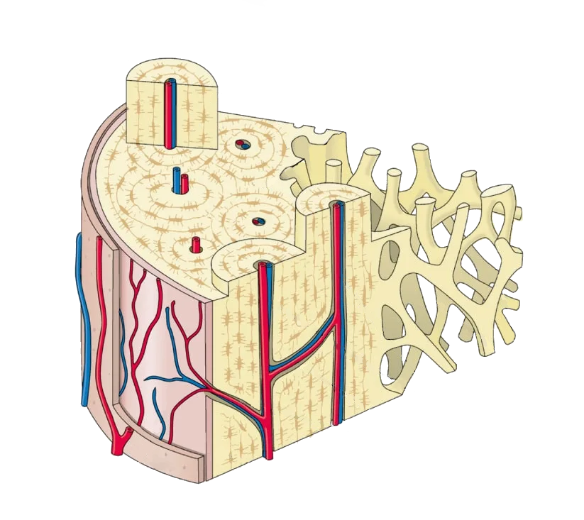
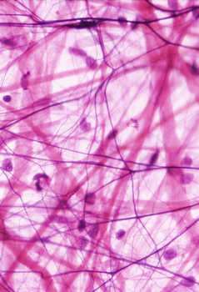
Poromechanics and biological tissues
Unconsolidated porous medium
Anatomy and Physiology in the LES CAHIERS INFIRMIERS 2022 series
Human Structure Virtual Histology, Indiana University (2016).

Slide 3
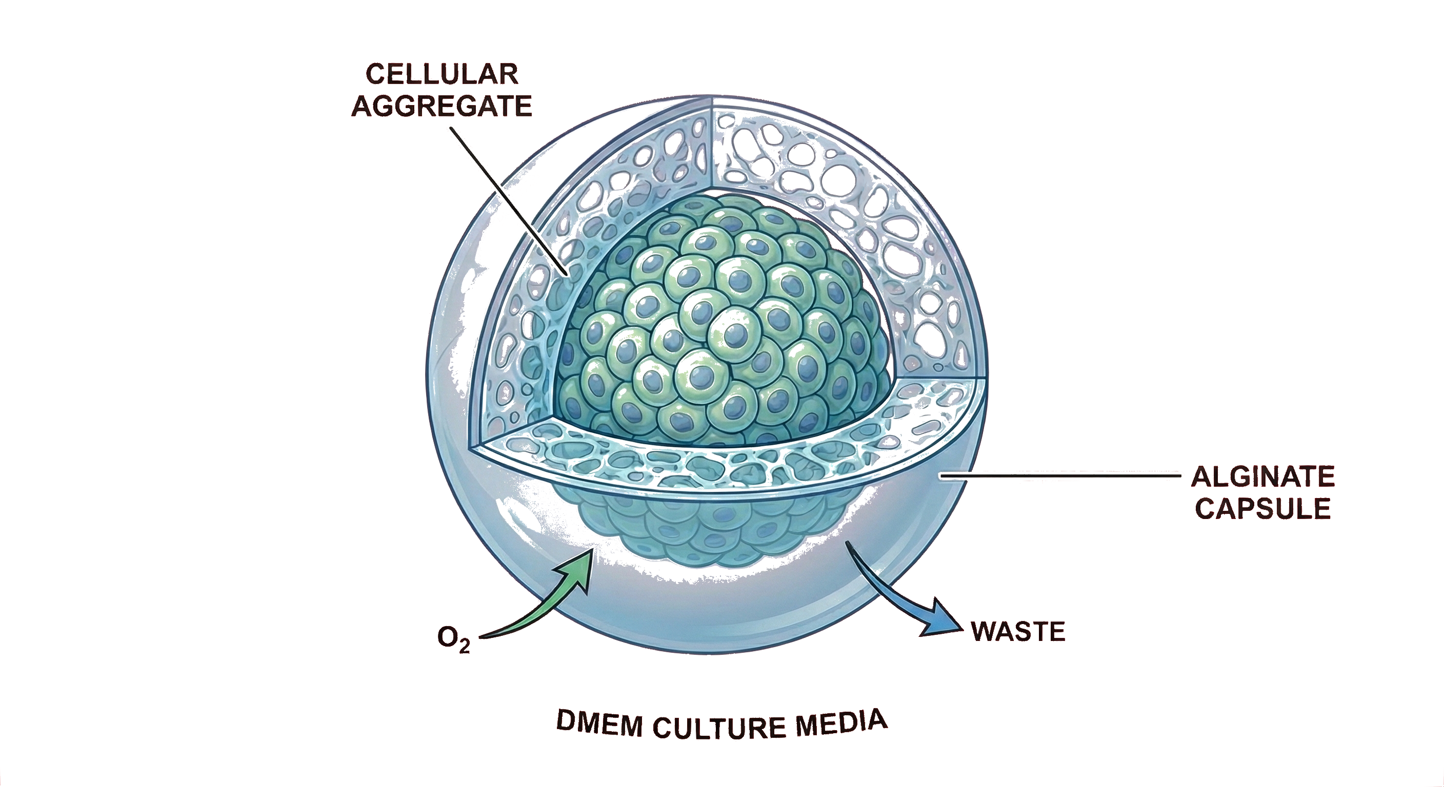
Poromechanics and biological tissues
Unconsolidated porous medium
Spheroid
Anatomy and Physiology in the LES CAHIERS INFIRMIERS 2022 series
Human Structure Virtual Histology, Indiana University (2016).
Spheroid, by Matthieu Lacour, modified using Biorender and Google Gemini

Slide 4
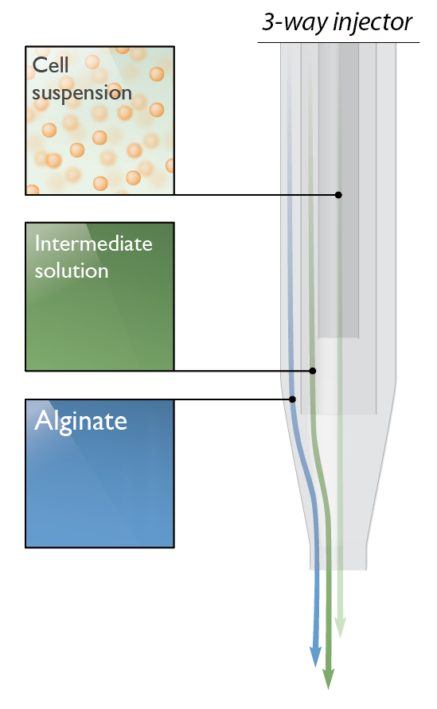
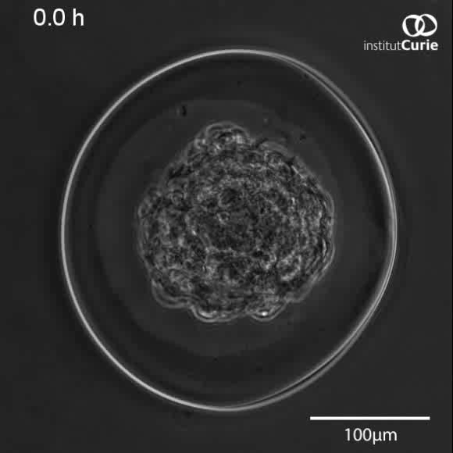
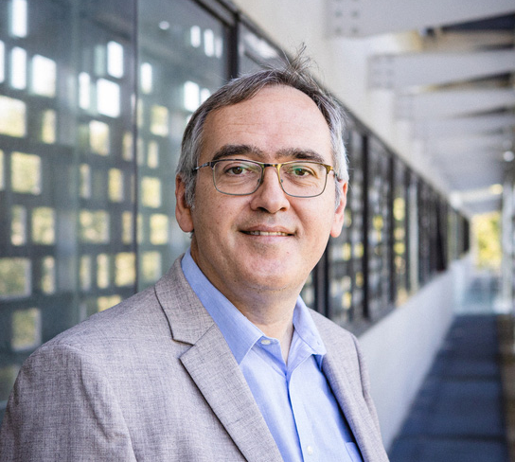
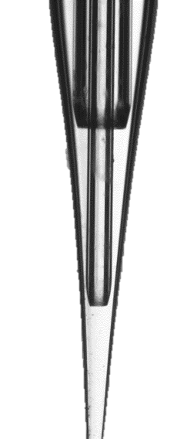
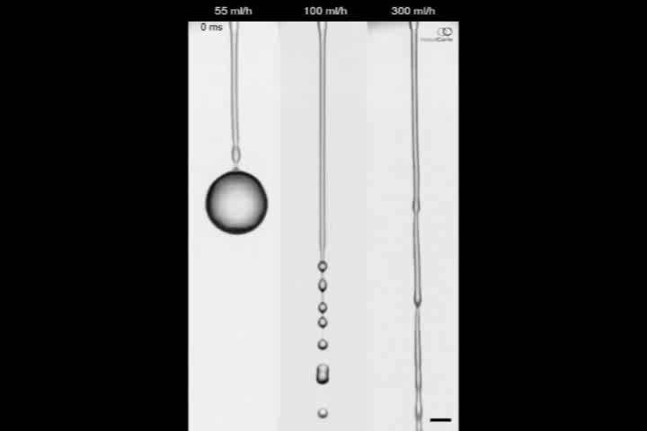
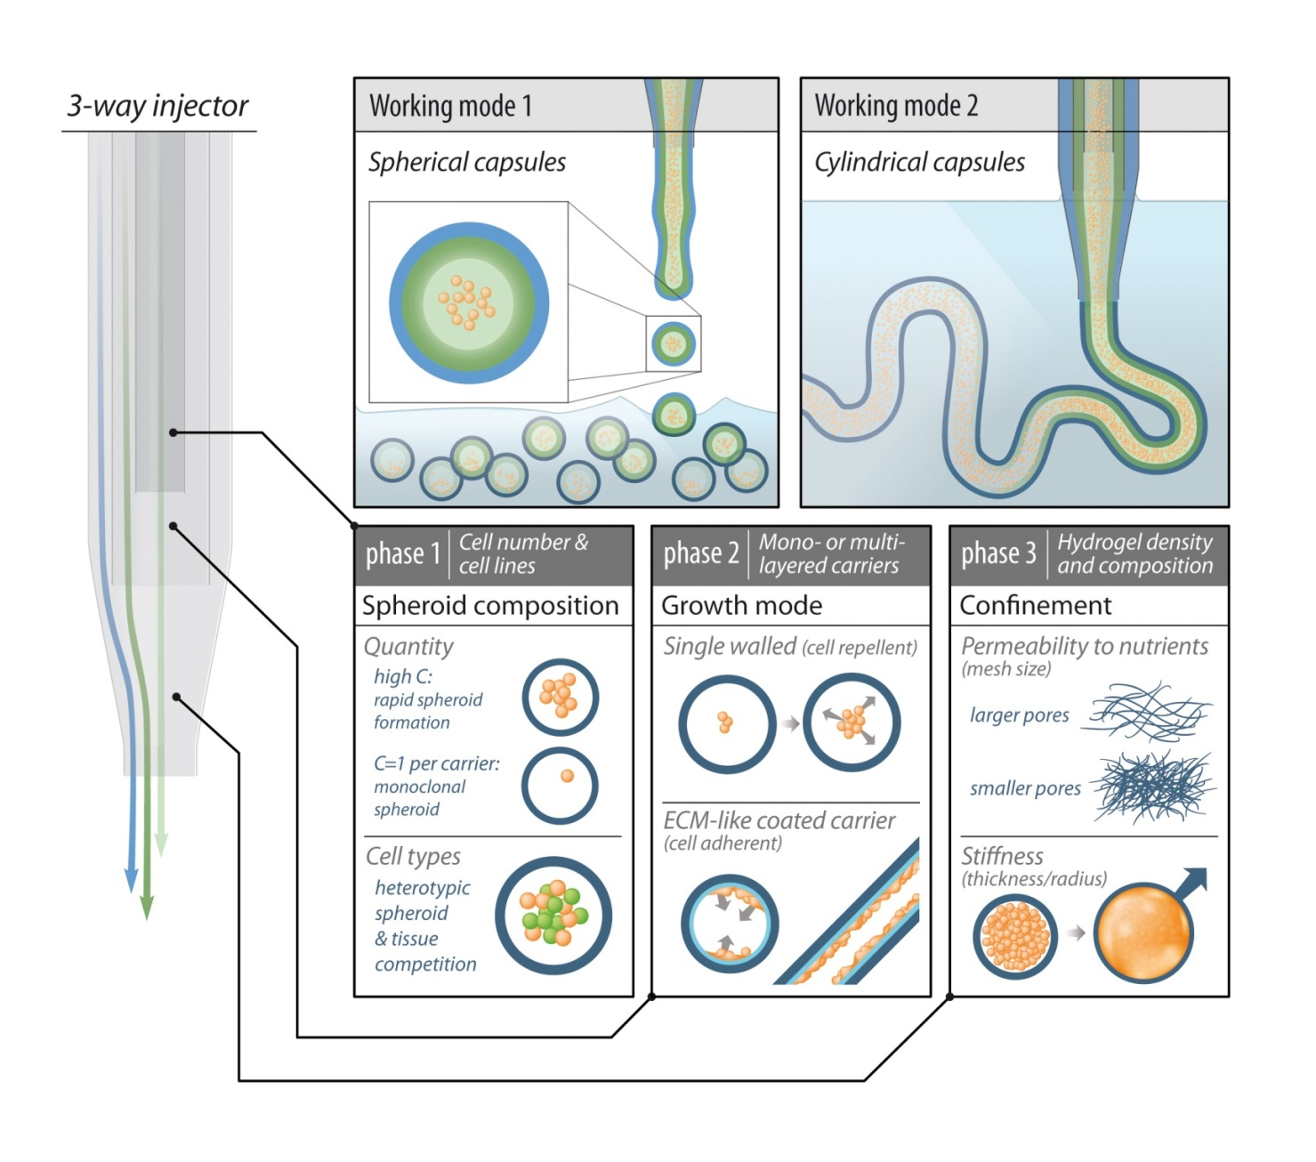
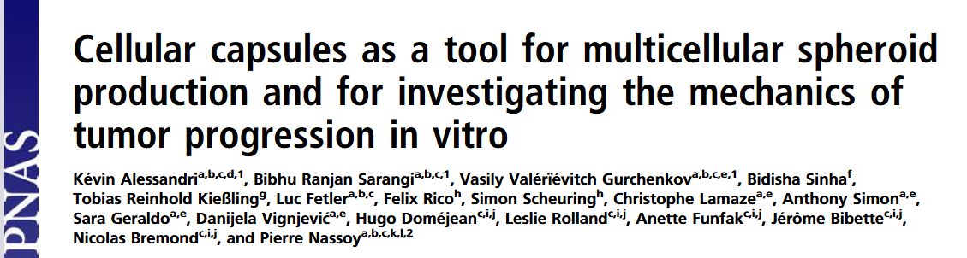
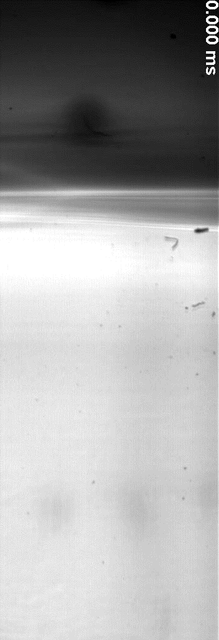
Digital-twinning of the CCT: the role of stress
Co-injection
Fall

Slide 5
The importance of mathematical modeling of CCT
Custom made Organoids/Spheroids

Slide 6

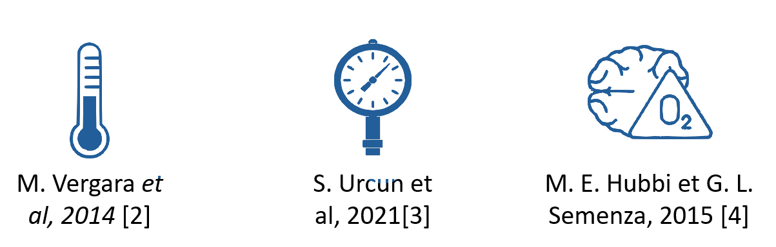
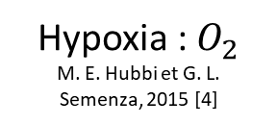
The importance of mathematical modeling of CCT
Custom made Organoids/Spheroids
Quantify physical cues effects
Pressure
S. Urcun et al, 2021[2]
Hypoxia : $O_{2}$
M. E. Hubbi et G. L. Semenza, 2015 [4]

Slide 7
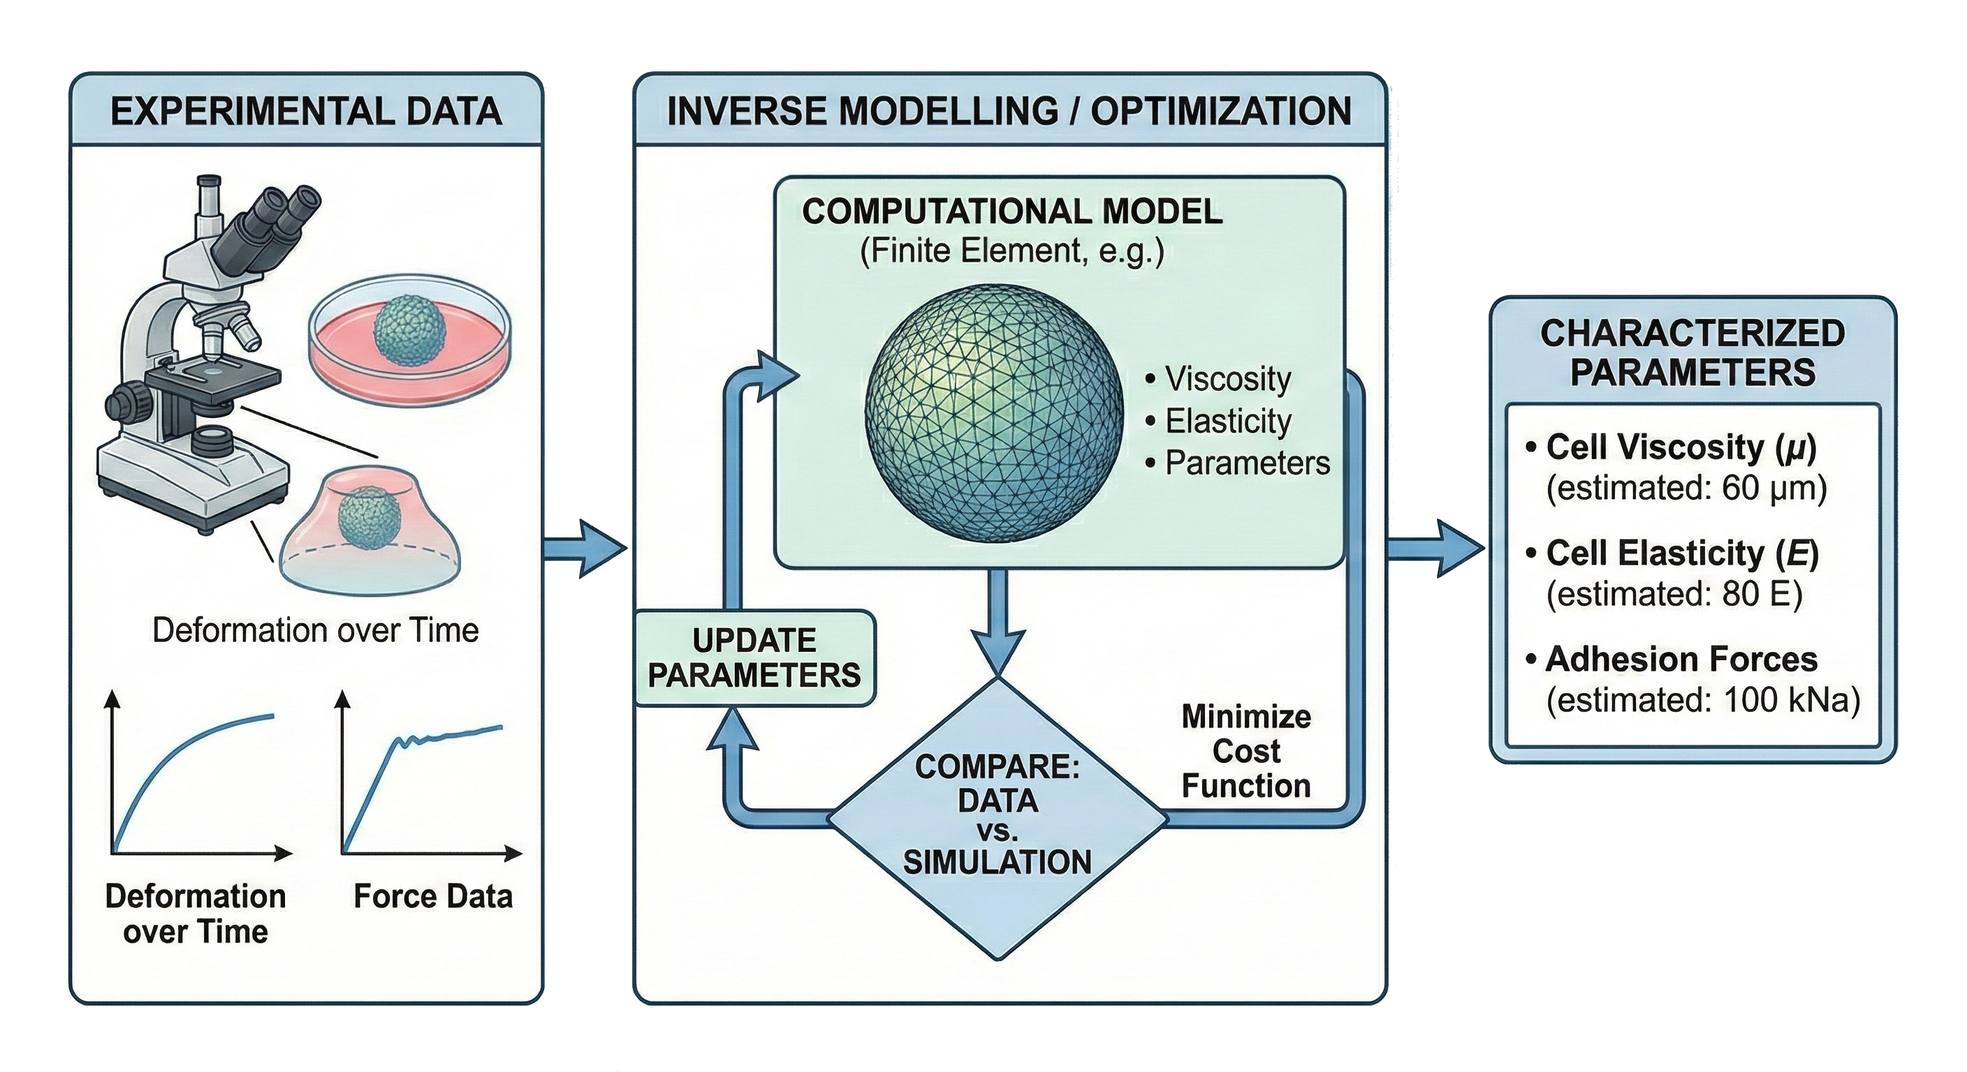
The importance of mathematical modeling of CCT
Custom made Organoids/Spheroids
Inverse modeling
Quantify physical cues effects
Pressure
S. Urcun et al, 2021[2]
Hypoxia : $O_{2}$
M. E. Hubbi et G. L. Semenza, 2015 [4]
Inverse modelling, by Matthieu Lacour, modified using Biorender and Google Gemini

Slide 8
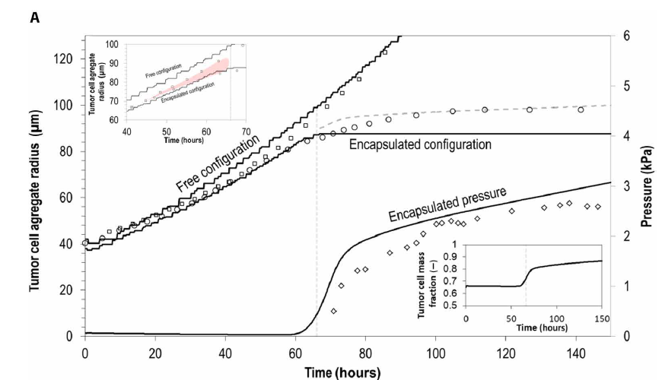
Existing modeling approaches (developped by our team)
Phase field (V. Le Maout et al. 2020 [1])
No cell diffusion during free growth
Accuracy for free growth prediction
Divergence during confined growth
Does not take in account the deformability of the capsule
☑
☑
☒
☒
Notes:
Malgré les désavantages de l’approche poromécanique, à notre avis, cette approche est la plus pertinente car elle nous permet explicitement de modéliser la déformation de la capsule toutefois il faudrait améliorer ses prédictinos dans la phase initiale. L’idée est donc de développer une version hybride poromechanical phase field.

Slide 9
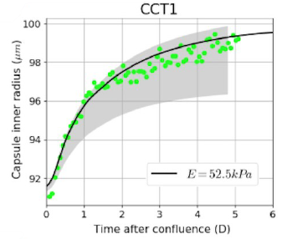
Existing modeling approaches (developped by our team)
Phase field (V. Le Maout et al. 2020 [1])
Poromechanical (S. Urcun et al. 2021 [2])
No cell diffusion during free growth
Accuracy for free growth prediction
Divergence during confined growth
Does not take in account the deformability of the capsule
Super accuracy during confined growth
Pressure resulting in deformation
Poor accuracy during free growth
Cell diffusion during free growth
☑
☑
☒
☒
☑
☑
☒
☒
Notes:
Malgré les désavantages de l’approche poromécanique, à notre avis, cette approche est la plus pertinente car elle nous permet explicitement de modéliser la déformation de la capsule toutefois il faudrait améliorer ses prédictinos dans la phase initiale. L’idée est donc de développer une version hybride poromechanical phase field.

Slide 10
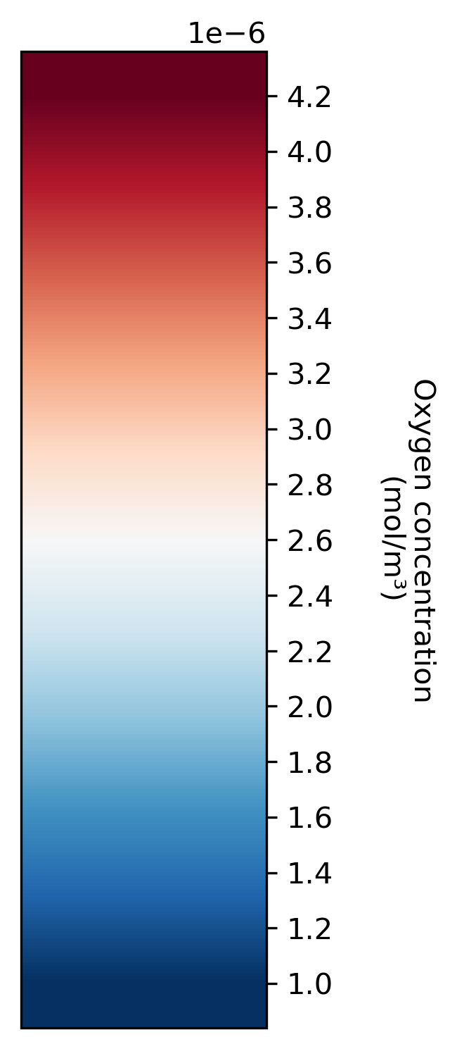
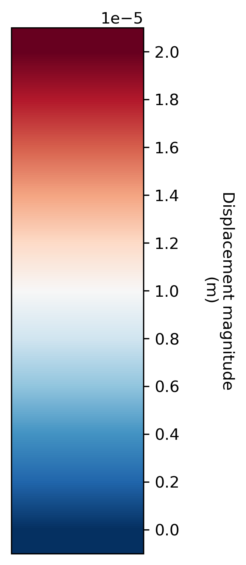
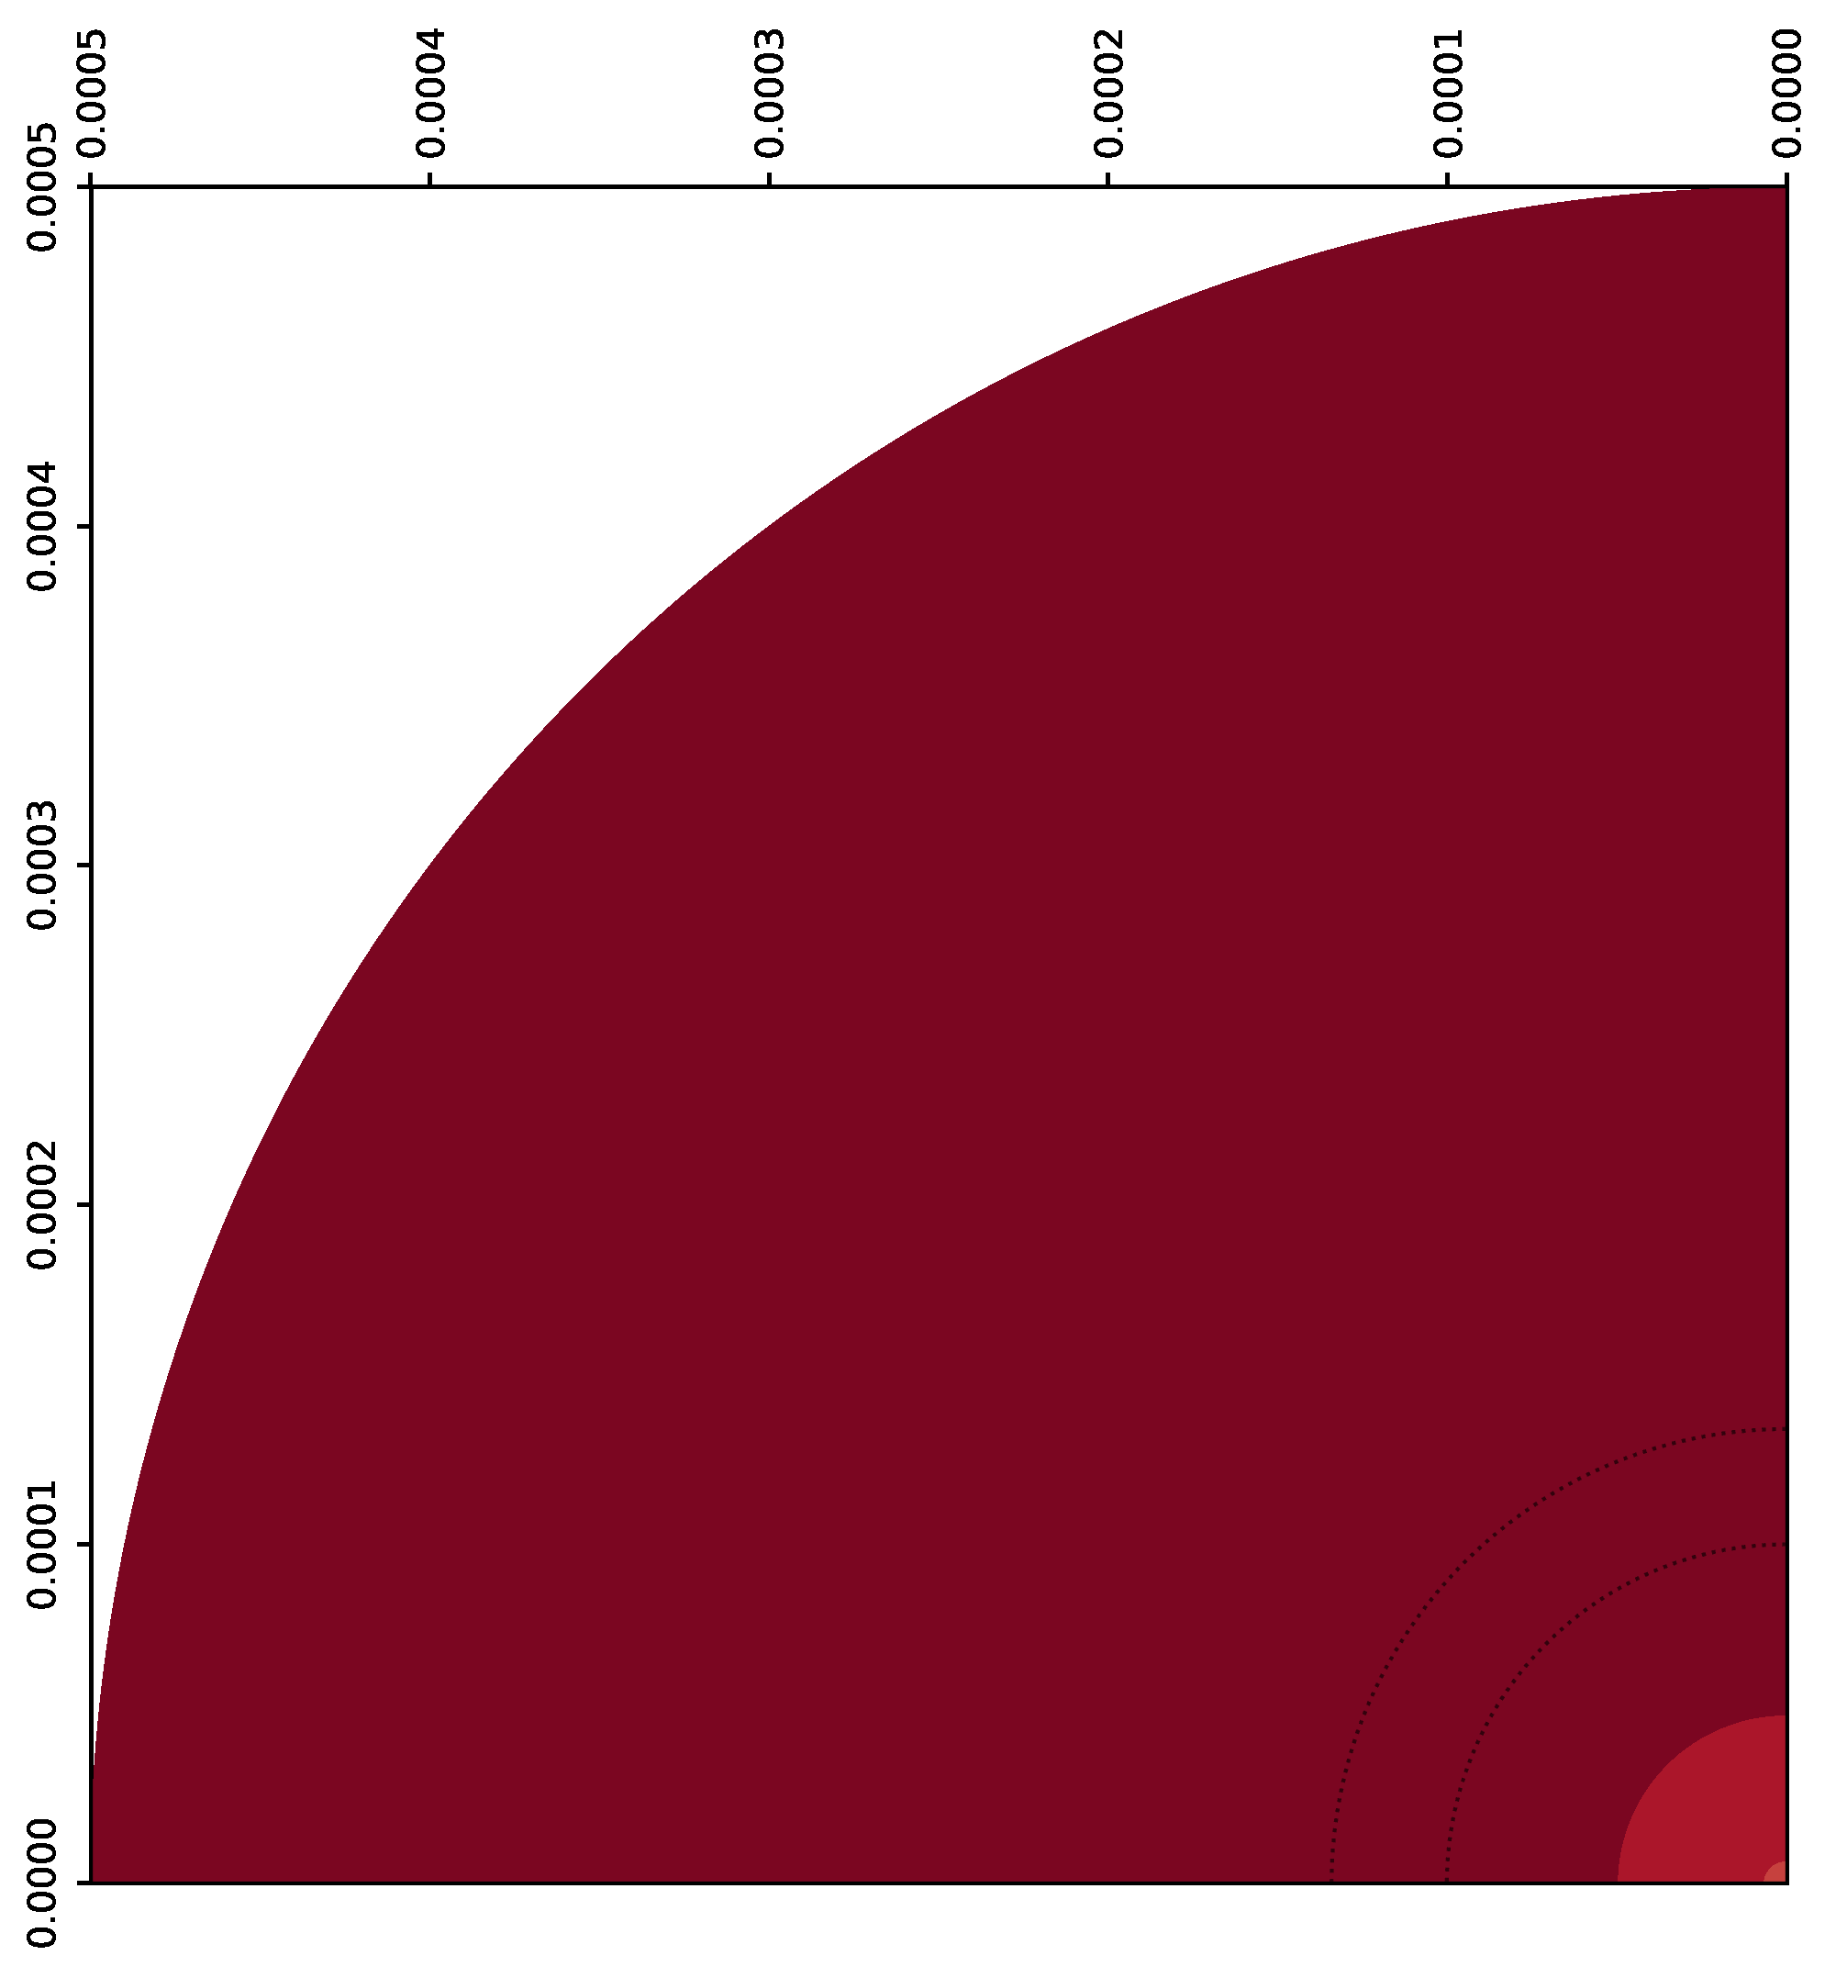
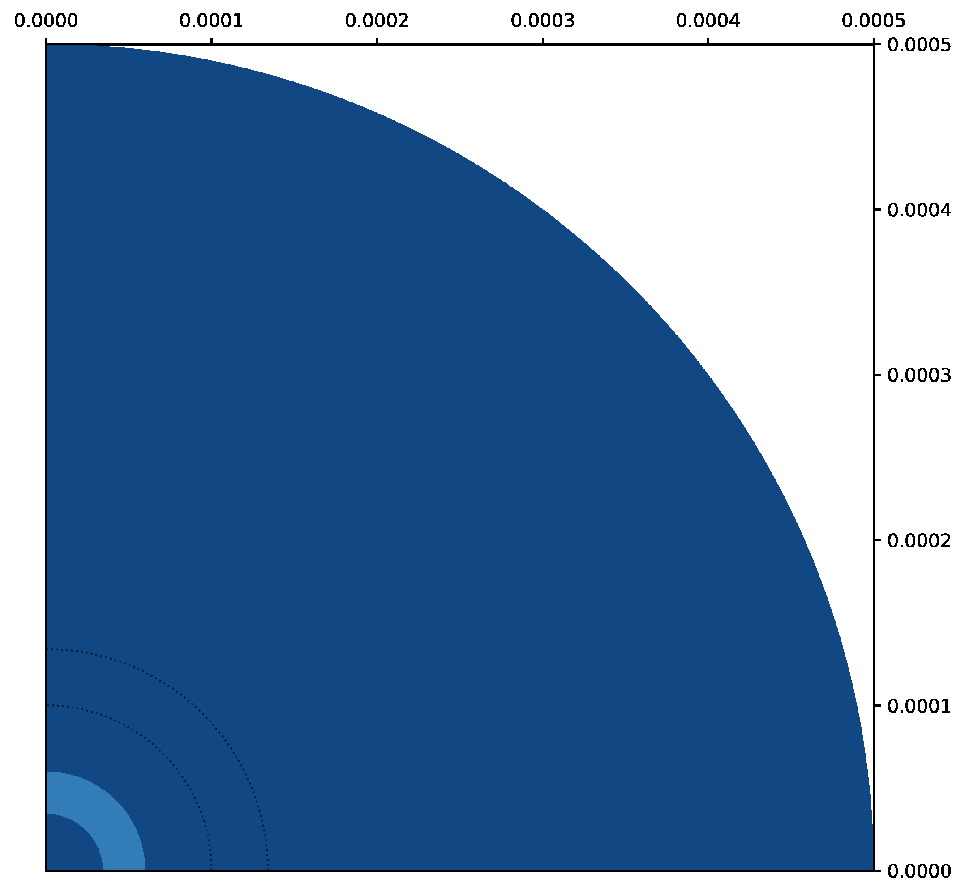
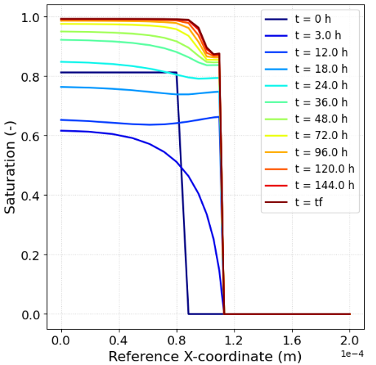
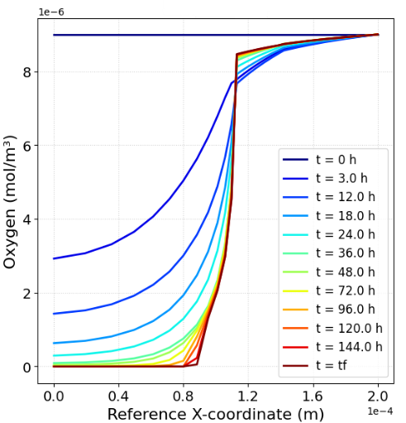
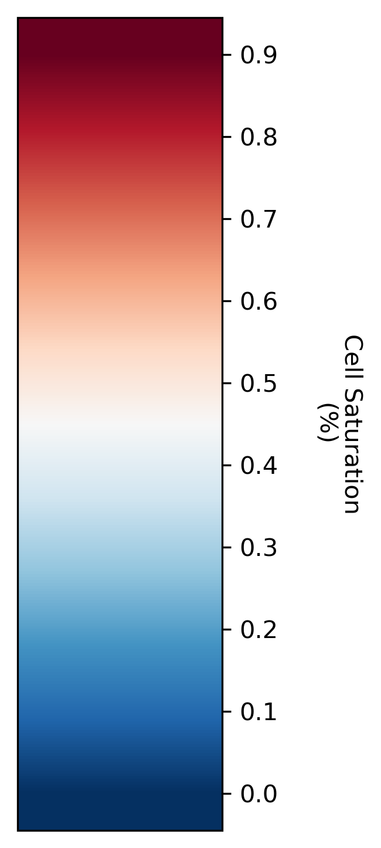
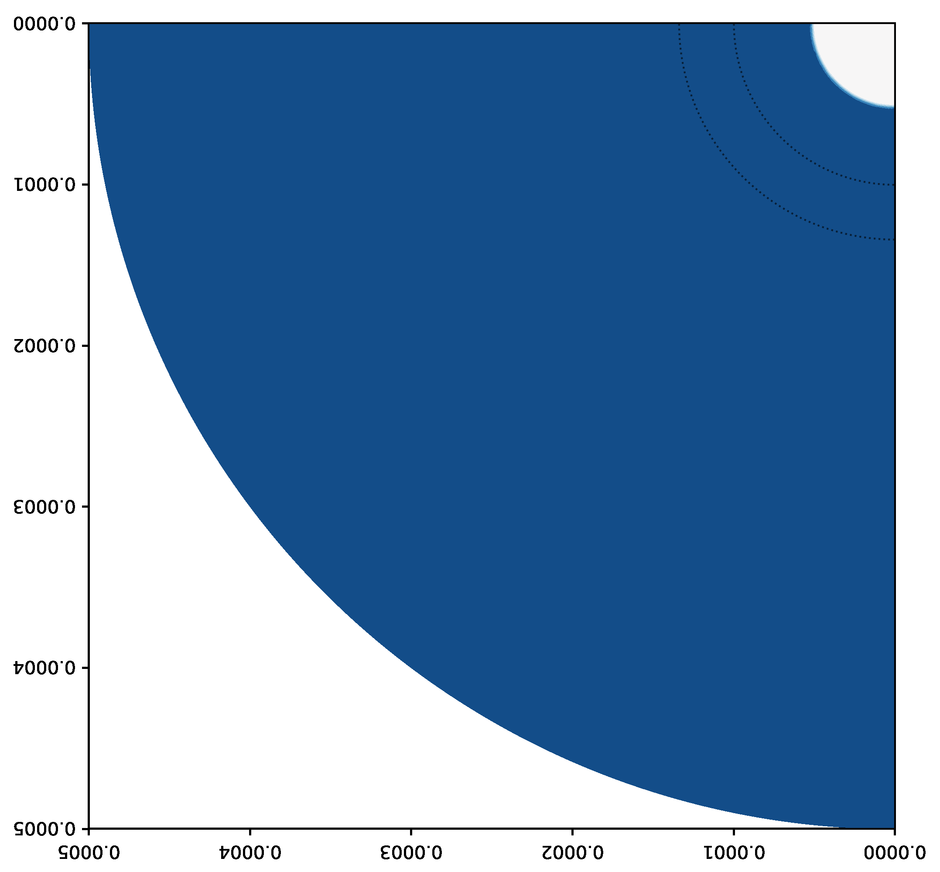
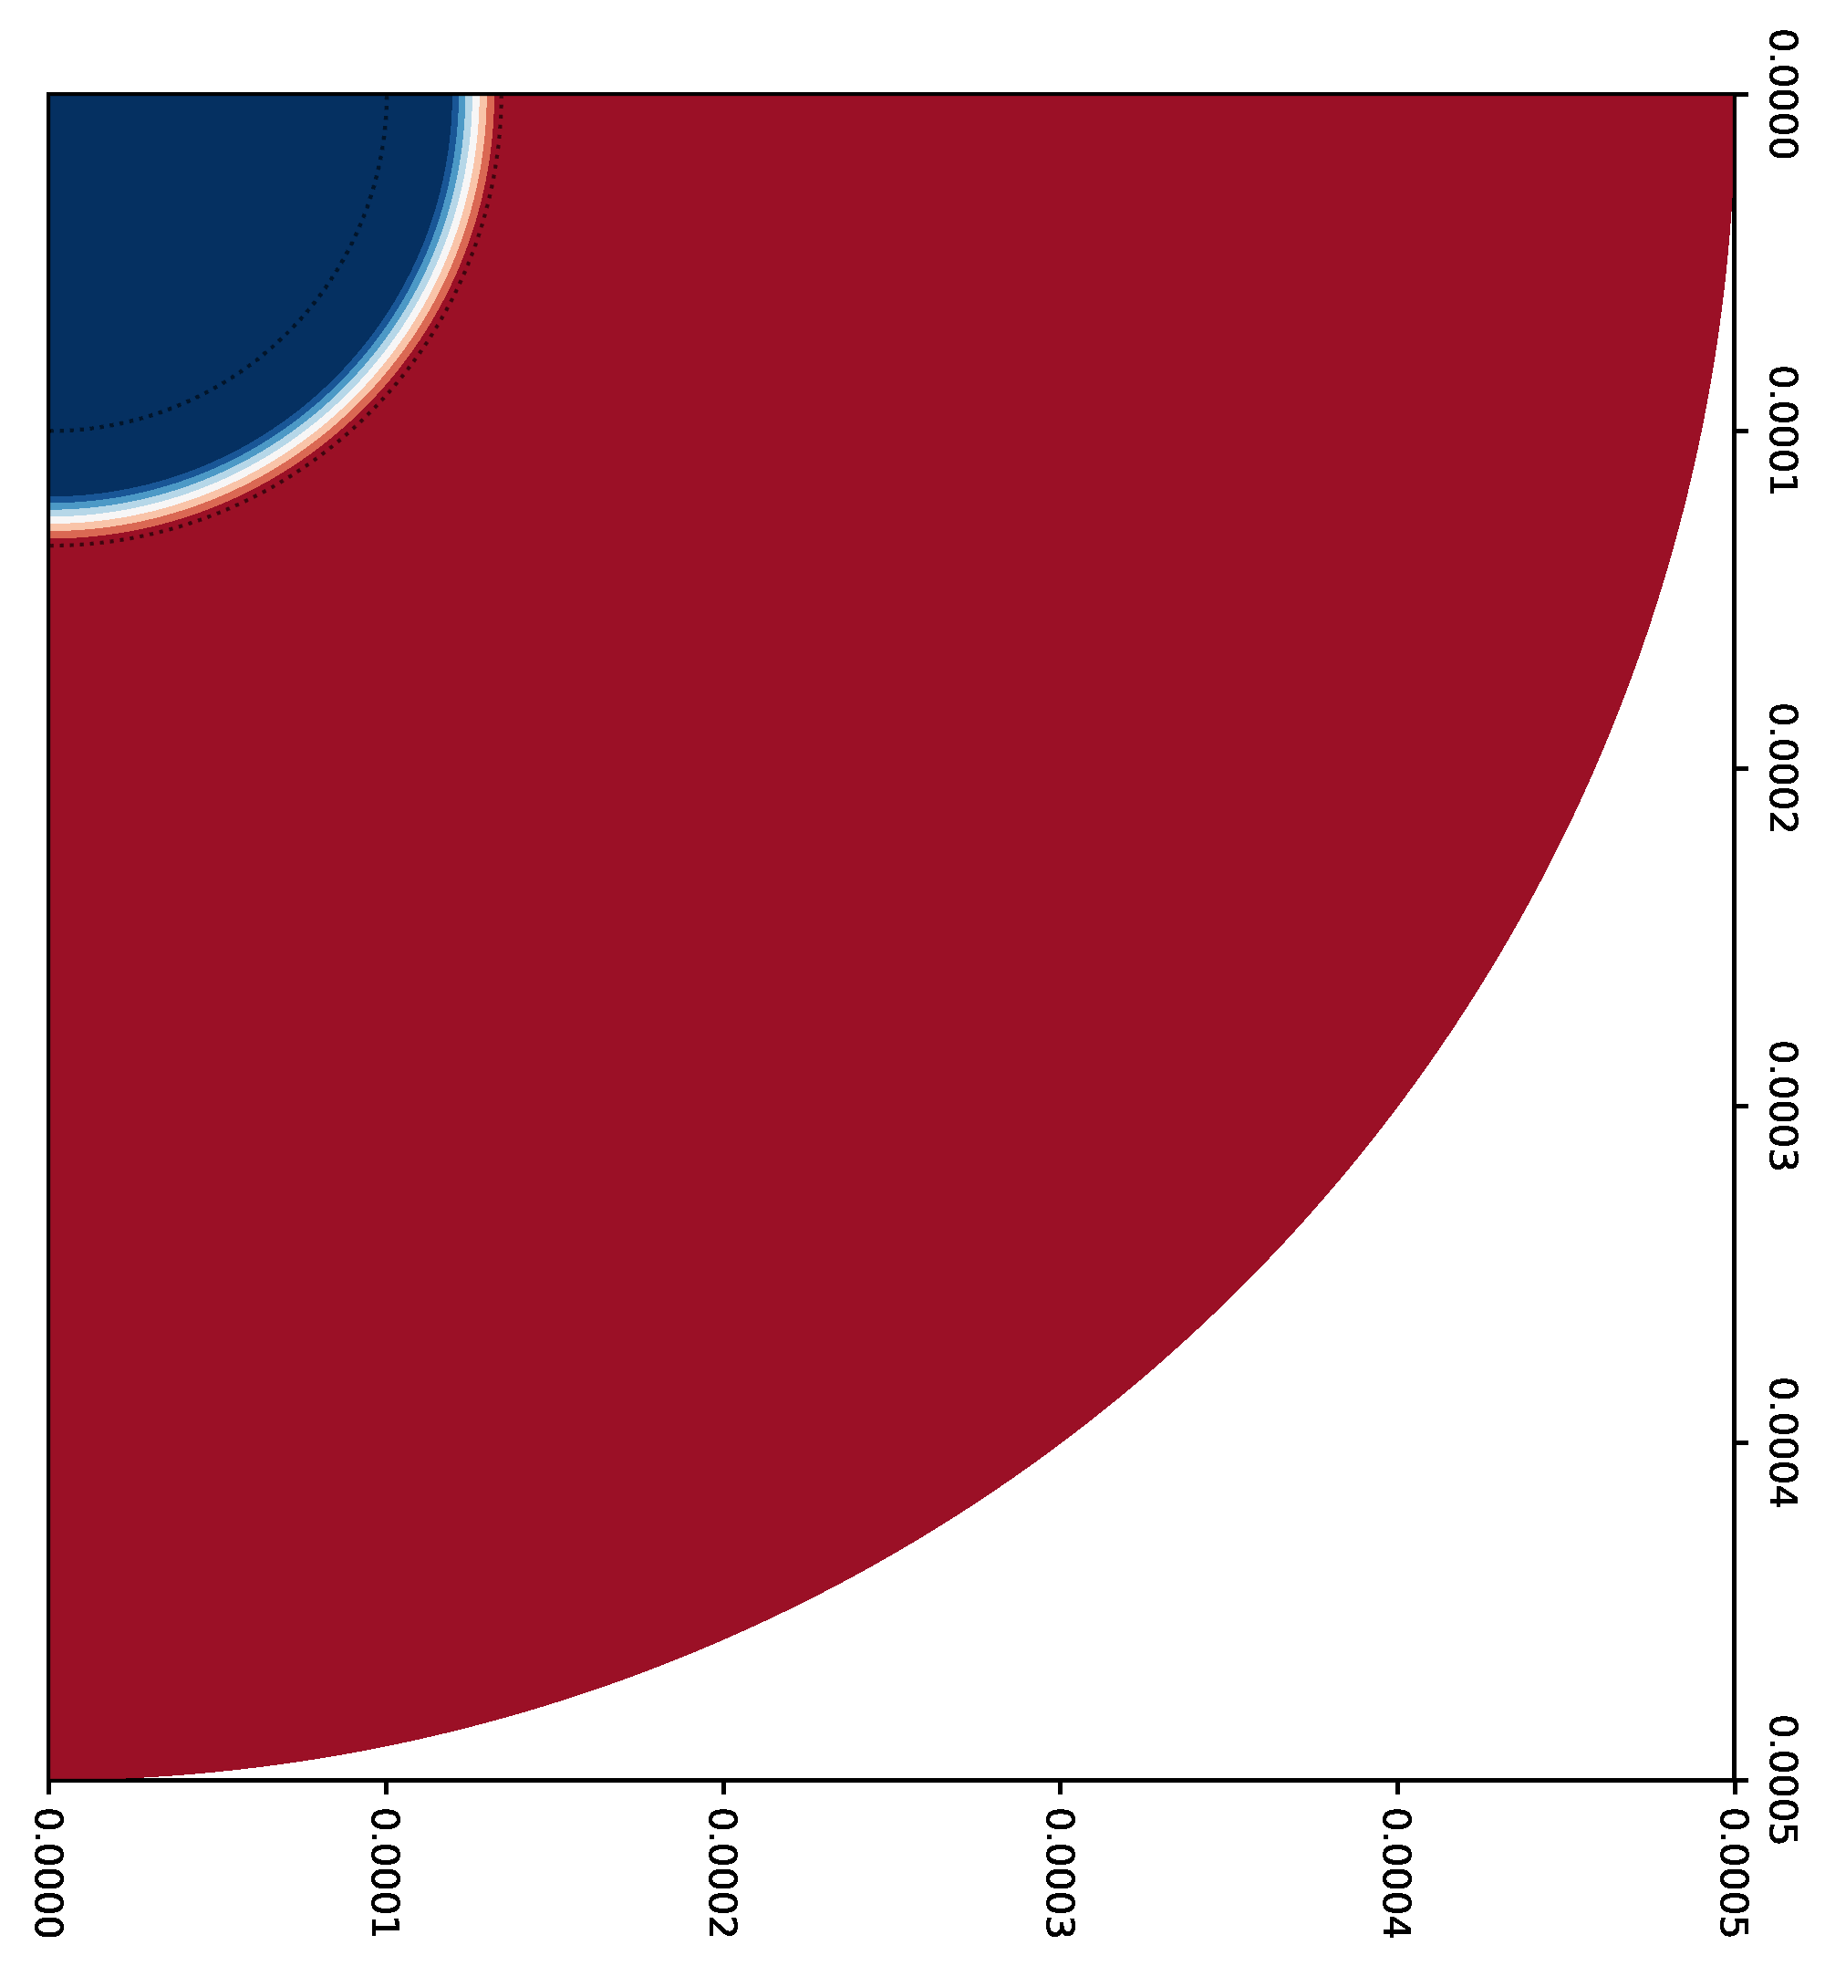
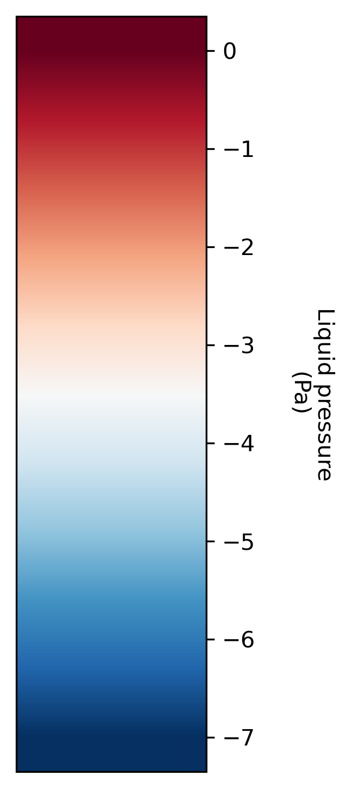
Poromechanical model results
OXYGEN
DISPLACEMENT
CELL SATURATION
OXYGEN
CELL SATURATION
LIQUID PRESSURE

Slide 11
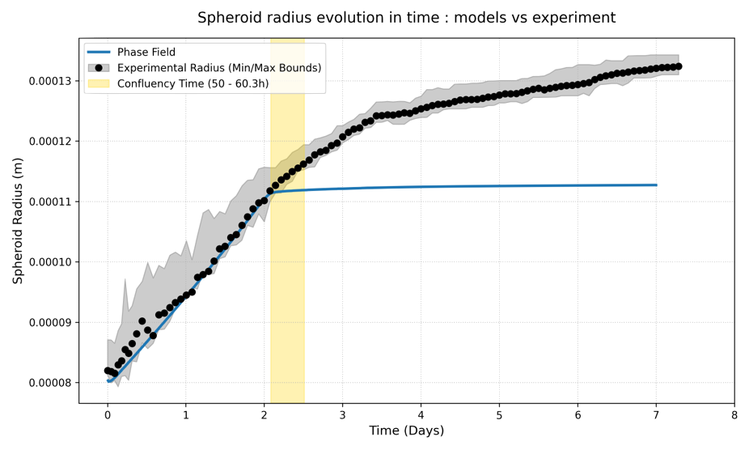
Existing modeling approaches (developped by our team)
Notes:
Malgré les désavantages de l’approche poromécanique, à notre avis, cette approche est la plus pertinente car elle nous permet explicitement de modéliser la déformation de la capsule toutefois il faudrait améliorer ses prédictinos dans la phase initiale. L’idée est donc de développer une version hybride poromechanical phase field.

Slide 12
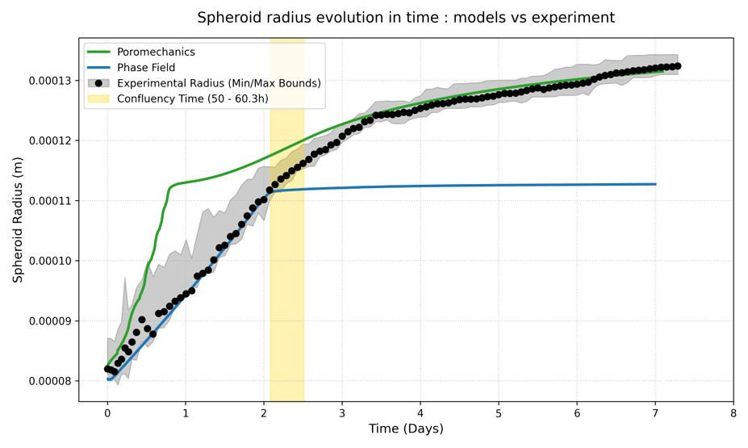
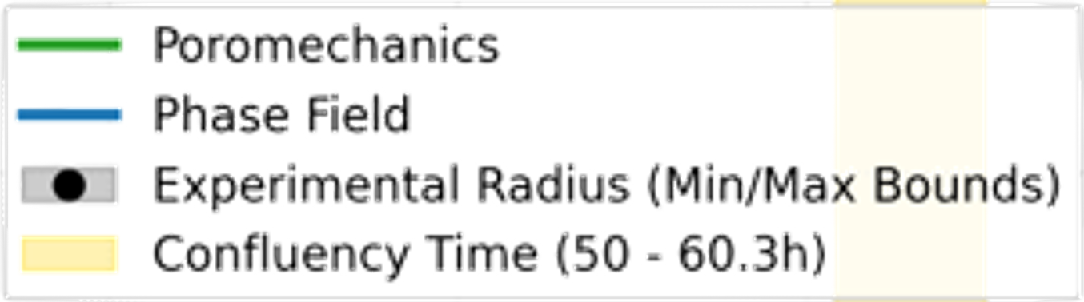
Existing modeling approaches (developped by our team)
Notes:
Malgré les désavantages de l’approche poromécanique, à notre avis, cette approche est la plus pertinente car elle nous permet explicitement de modéliser la déformation de la capsule toutefois il faudrait améliorer ses prédictinos dans la phase initiale. L’idée est donc de développer une version hybride poromechanical phase field.

Slide 13
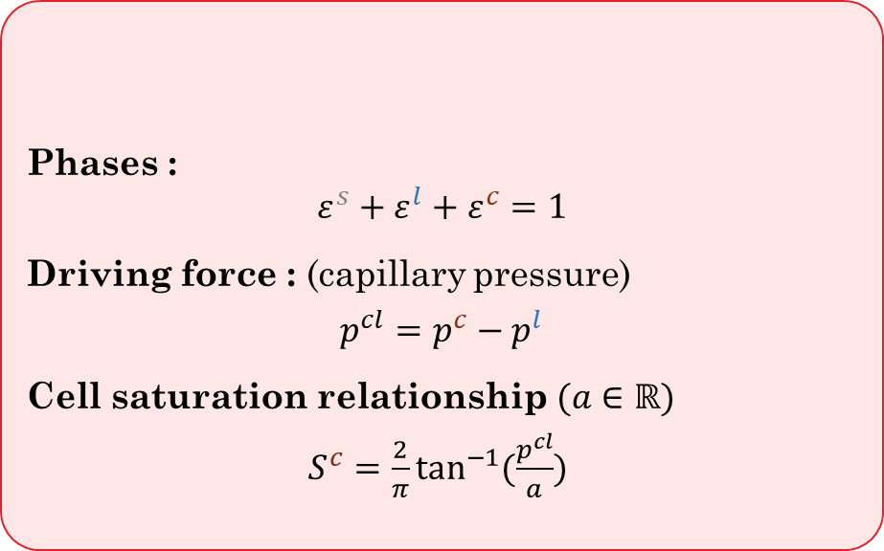
Hybrid model
Poromechanical (S. Urcun et al.)
Phases :
$ε^{s}+ε^{l}+ε^{c}=1$
Driving force : (capillary pressure)
$p^{cl}=p^{c}−p^{l}$
Cell saturation relationship $(a∈ℝ)$
$S^{c}=\frac{2}{π}\tan^{−1}{(\frac{p^{cl}}{a})}$
REV

Slide 14
Hybrid model
Poromechanical (S. Urcun et al.)
Phases :
$ε^{s}+ε^{l}+ε^{c}=1$
Driving force : (capillary pressure)
$p^{cl}=p^{c}−p^{l}$
Cell saturation relationship $(a∈ℝ)$
$S^{c}=\frac{2}{π}\tan^{−1}{(\frac{p^{cl}}{a})}$
Microscale
REV
IF
ECM
ECM
IF
IF
C IF SOLID

Slide 15
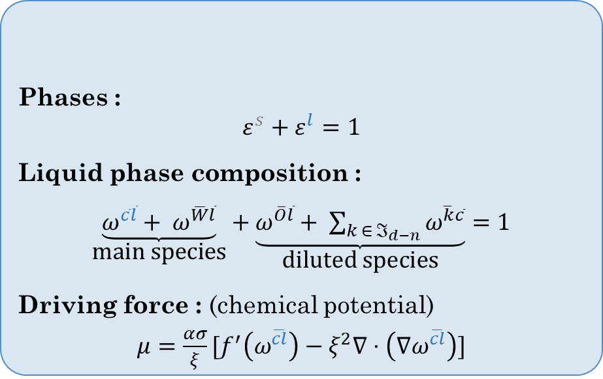
Hybrid model
Poromechanical (S. Urcun et al.)
Hybrid model
Phases :
$ε^{s}+ε^{l}+ε^{c}=1$
Driving force : (capillary pressure)
$p^{cl}=p^{c}−p^{l}$
Cell saturation relationship $(a∈ℝ)$
$S^{c}=\frac{2}{π}\tan^{−1}{(\frac{p^{cl}}{a})}$
Phases :
$ε^{s}+ε^{l}=1$
Liquid phase composition :
$\underset{\text{main} \text{species}}{\underbrace{ω^{\overline{c}\overline{l}}+ ω^{\overline{W}\overline{l}}}}+\underset{\text{diluted} \text{species}}{\underbrace{ω^{\overline{O}\overline{l}}+ \sum_{k ∈ ℑ_{d−n}}{ω^{\overline{k}\overline{c}}}}}=1$
Driving force : (chemical potential)
$μ=\frac{ασ}{ξ}[f^{′}\left(ω^{\overline{cl}}\right)−ξ^{2}∇⋅\left(∇ω^{\overline{cl}}\right)]$
Microscale
REV
REV
IF
ECM
ECM
IF
IF
C IF SOLID

Slide 16
Hybrid model
Poromechanical (S. Urcun et al.)
Hybrid model
Phases :
$ε^{s}+ε^{l}+ε^{c}=1$
Driving force : (capillary pressure)
$p^{cl}=p^{c}−p^{l}$
Cell saturation relationship $(a∈ℝ)$
$S^{c}=\frac{2}{π}\tan^{−1}{(\frac{p^{cl}}{a})}$
Phases :
$ε^{s}+ε^{l}=1$
Liquid phase composition :
$\underset{\text{main} \text{species}}{\underbrace{ω^{\overline{c}\overline{l}}+ ω^{\overline{W}\overline{l}}}}+\underset{\text{diluted} \text{species}}{\underbrace{ω^{\overline{O}\overline{l}}+ \sum_{k ∈ ℑ_{d−n}}{ω^{\overline{k}\overline{c}}}}}=1$
Driving force : (chemical potential)
$μ=\frac{ασ}{ξ}[f^{′}\left(ω^{\overline{cl}}\right)−ξ^{2}∇⋅\left(∇ω^{\overline{cl}}\right)]$
Microscale
REV
REV
Microscale
IF
ECM
IF
ECM
ECM
ECM
IF
IF
IF
IF
C IF SOLID
Cl IF SOLID

Slide 17
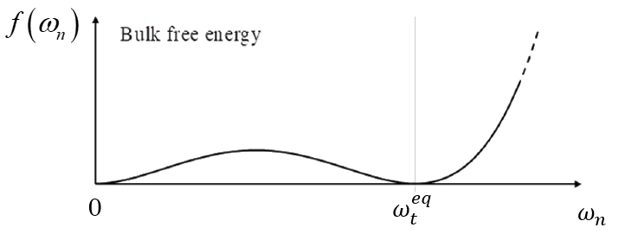
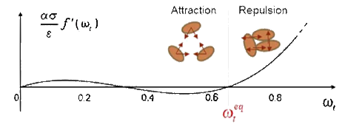

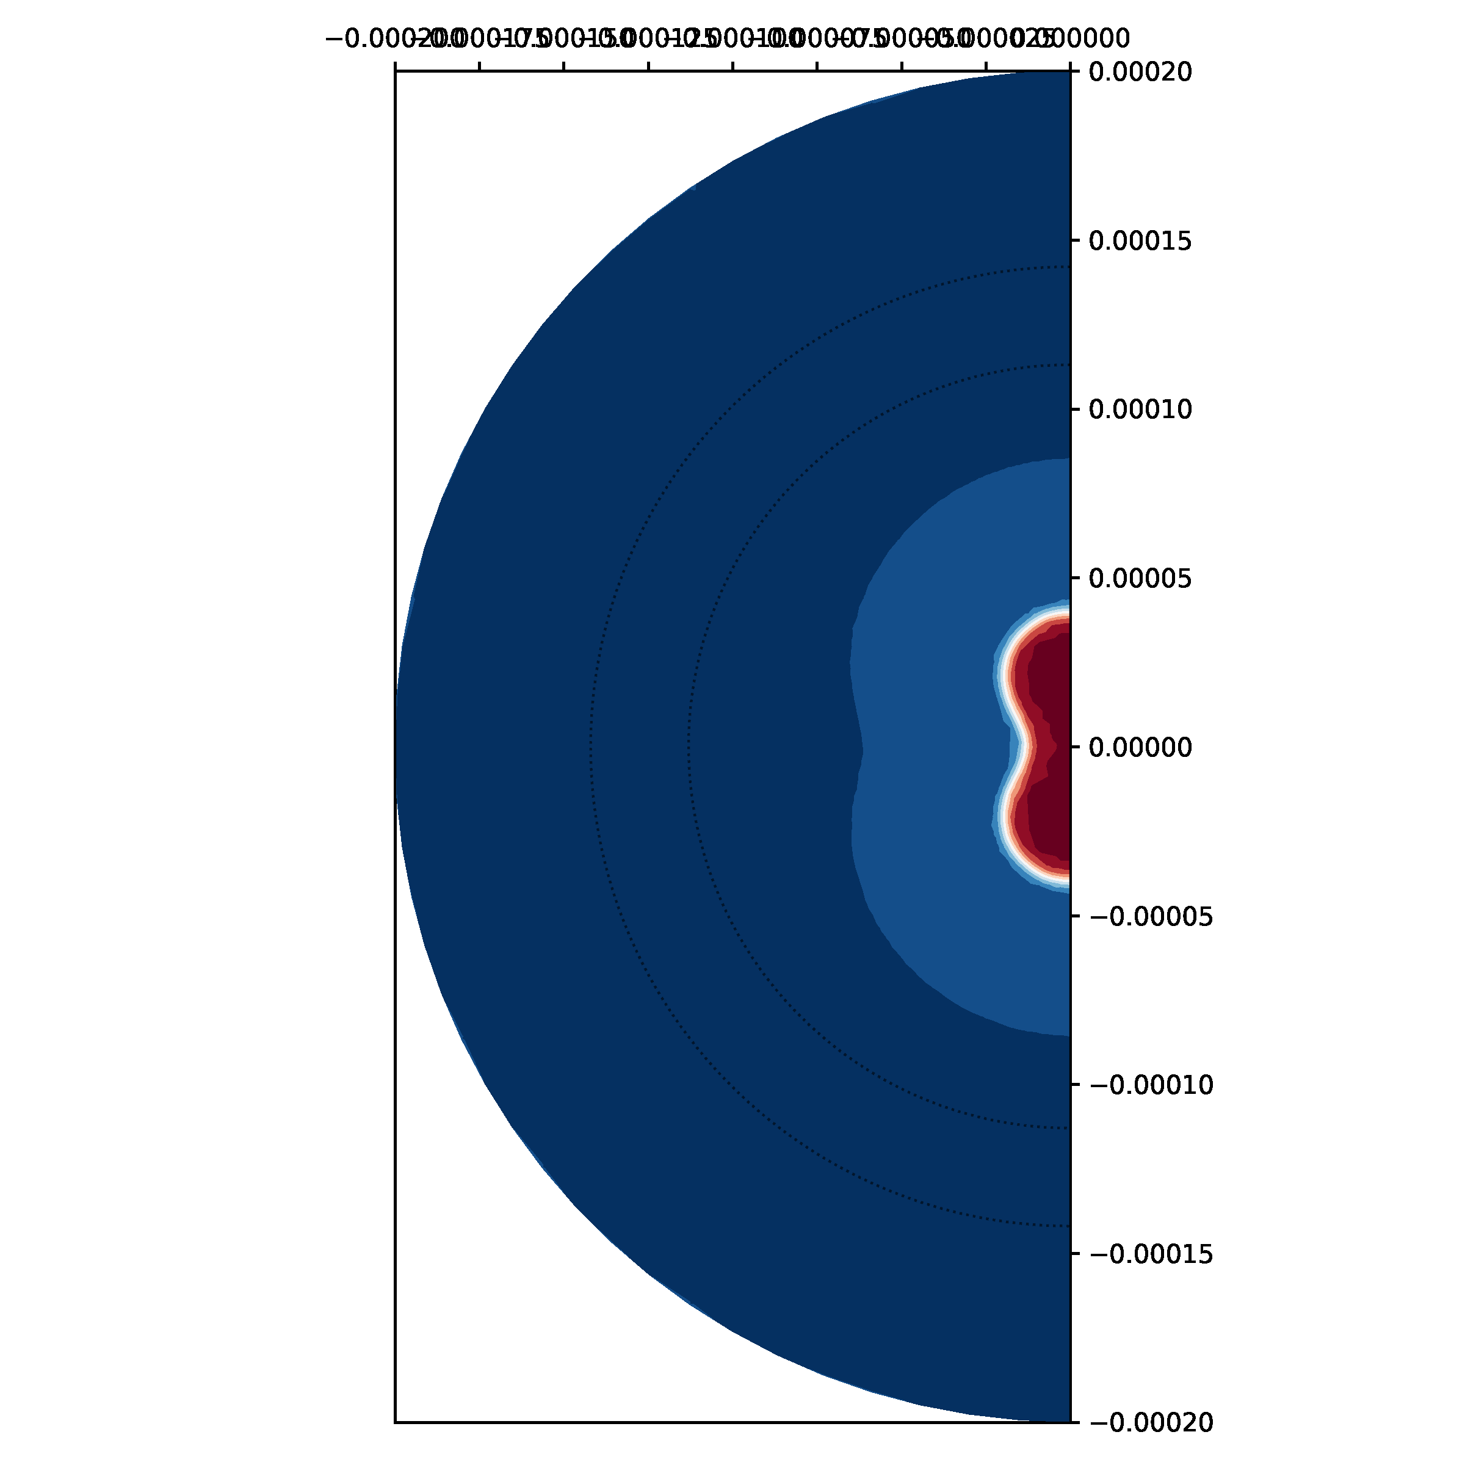
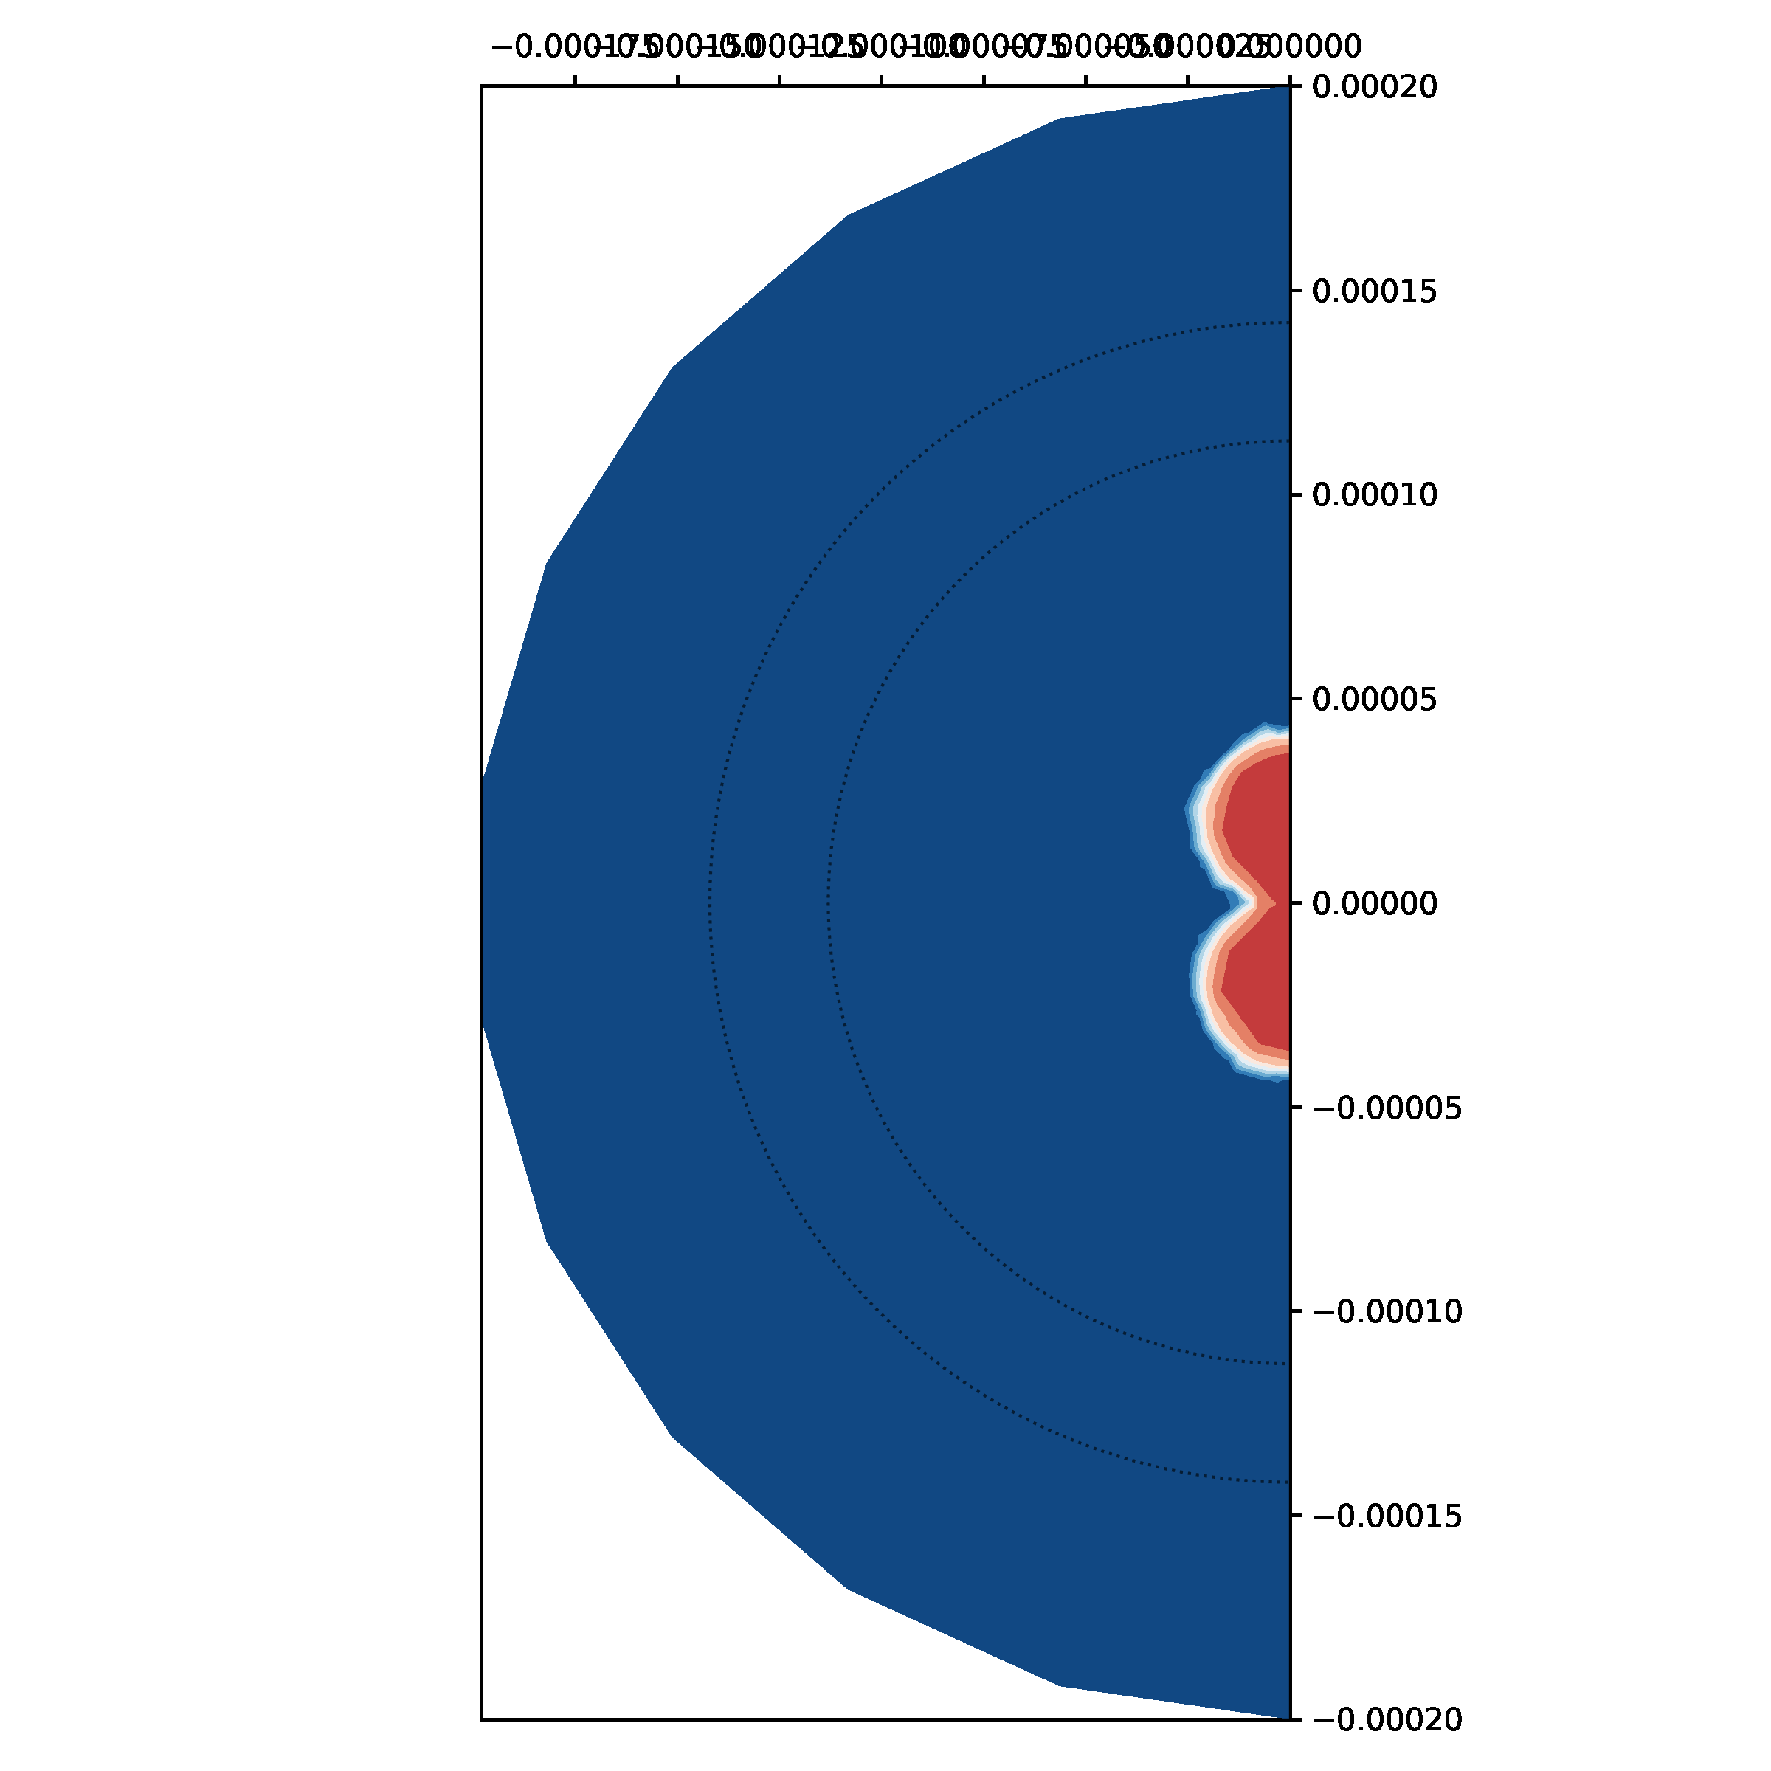


Hybrid model
Driving force
Mass conservations : phases
24h
0h
Poromechanical Hybrid
Cell mass fraction (%)
$$100µm$$
$$100µm$$

Slide 18


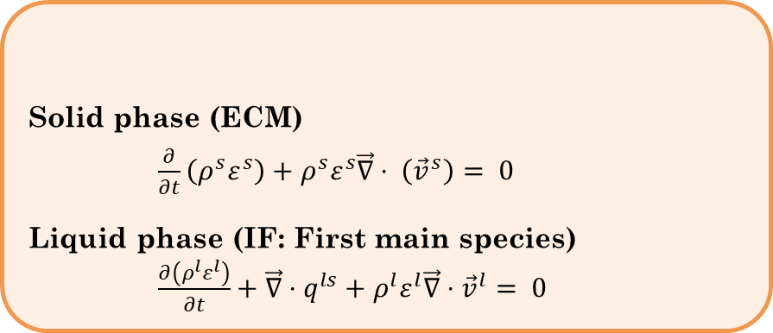



Hybrid model
Mass conservations : phases
Solid phase (ECM)
$\frac{∂}{∂t}\left(ρ^{s}ε^{s}\right)+ρ^{s}ε^{s}\vec{∇}⋅ \left({\vec{v}}^{s}\right)= 0$
Liquid phase (IF: First main species) $\frac{∂\left(ρ^{l}ε^{l}\right)}{∂t}+\vec{∇}⋅q^{ls}+ρ^{l}ε^{l}\vec{∇}⋅{\vec{v}}^{l}= 0$
FEniCSx
REV

Slide 19

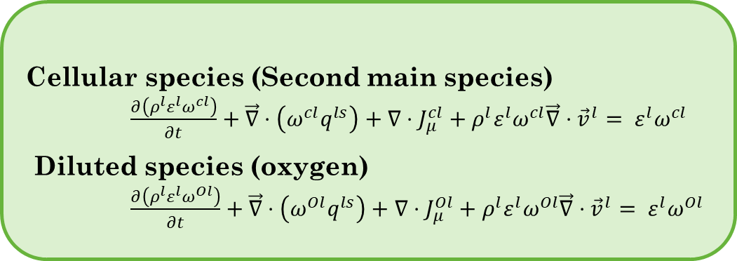
Hybrid model
Mass conservations : phases
Solid phase (ECM)
$\frac{∂}{∂t}\left(ρ^{s}ε^{s}\right)+ρ^{s}ε^{s}\vec{∇}⋅ \left({\vec{v}}^{s}\right)= 0$
Liquid phase (IF: First main species) $\frac{∂\left(ρ^{l}ε^{l}\right)}{∂t}+\vec{∇}⋅q^{ls}+ρ^{l}ε^{l}\vec{∇}⋅{\vec{v}}^{l}= 0$
FEniCSx
Mass conservation : species
REV
Cellular species (Second main species)
$\frac{∂\left(ρ^{l}ε^{l}ω^{cl}\right)}{∂t}+\vec{∇}⋅\left({ω^{cl}q}^{ls}\right)+∇⋅J_{μ}^{cl}+ρ^{l}ε^{l}ω^{cl}\vec{∇}⋅{\vec{v}}^{l}= ε^{l}ω^{cl}$
Diluted species (oxygen)
$\frac{∂\left(ρ^{l}ε^{l}ω^{Ol}\right)}{∂t}+\vec{∇}⋅\left({ω^{Ol}q}^{ls}\right)+∇⋅J_{μ}^{Ol}+ρ^{l}ε^{l}ω^{Ol}\vec{∇}⋅{\vec{v}}^{l}= ε^{l}ω^{Ol}$
$$O_{2}$$

Slide 20
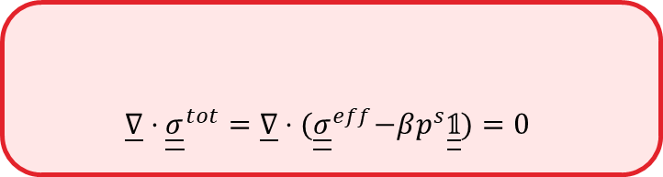
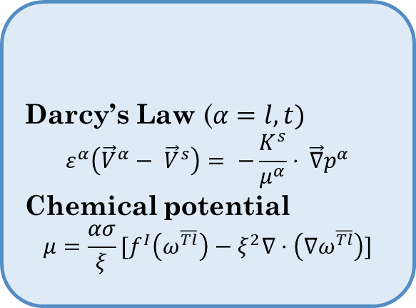
Hybrid model
Mass conservations : phases
Momentum conservation
Solid phase (ECM)
$\frac{∂}{∂t}\left(ρ^{s}ε^{s}\right)+ρ^{s}ε^{s}\vec{∇}⋅ \left({\vec{v}}^{s}\right)= 0$
Liquid phase (IF: First main species) $\frac{∂\left(ρ^{l}ε^{l}\right)}{∂t}+\vec{∇}⋅q^{ls}+ρ^{l}ε^{l}\vec{∇}⋅{\vec{v}}^{l}= 0$
$$\underline{∇}⋅{\underline{\underline{σ}}}^{tot}=\underline{∇}⋅{(\underline{\underline{σ}}}^{eff}−βp^{s}\underline{\underline{𝟙}})=0$$
FEniCSx
Constitutive equations
Mass conservation : species
Darcy’s Law ($α=l, t)$
$$ε^{α}\left({\vec{V}}^{α}− {\vec{V}}^{s}\right)= −\frac{K^{s}}{μ^{α}}⋅ \vec{∇}p^{α}$$
Chemical potential
$$μ=\frac{ασ}{ξ}[f^{I}\left(ω^{\overline{Tl}}\right)−ξ^{2}∇⋅\left(∇ω^{\overline{Tl}}\right)]$$
REV
Cellular species (Second main species)
$\frac{∂\left(ρ^{l}ε^{l}ω^{cl}\right)}{∂t}+\vec{∇}⋅\left({ω^{cl}q}^{ls}\right)+∇⋅J_{μ}^{cl}+ρ^{l}ε^{l}ω^{cl}\vec{∇}⋅{\vec{v}}^{l}= ε^{l}ω^{cl}$
Diluted species (oxygen)
$\frac{∂\left(ρ^{l}ε^{l}ω^{Ol}\right)}{∂t}+\vec{∇}⋅\left({ω^{Ol}q}^{ls}\right)+∇⋅J_{μ}^{Ol}+ρ^{l}ε^{l}ω^{Ol}\vec{∇}⋅{\vec{v}}^{l}= ε^{l}ω^{Ol}$
$$O_{2}$$

Slide 21
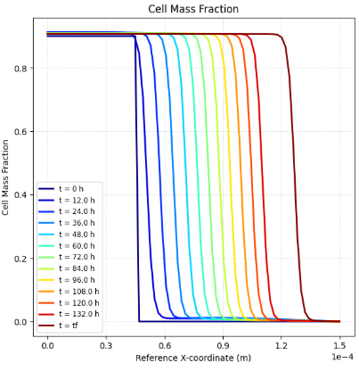
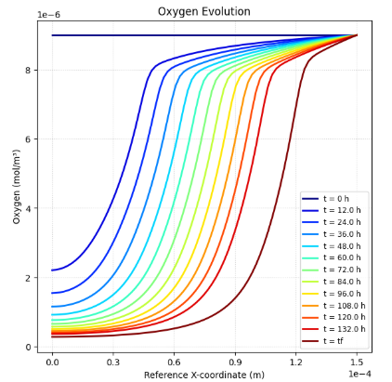
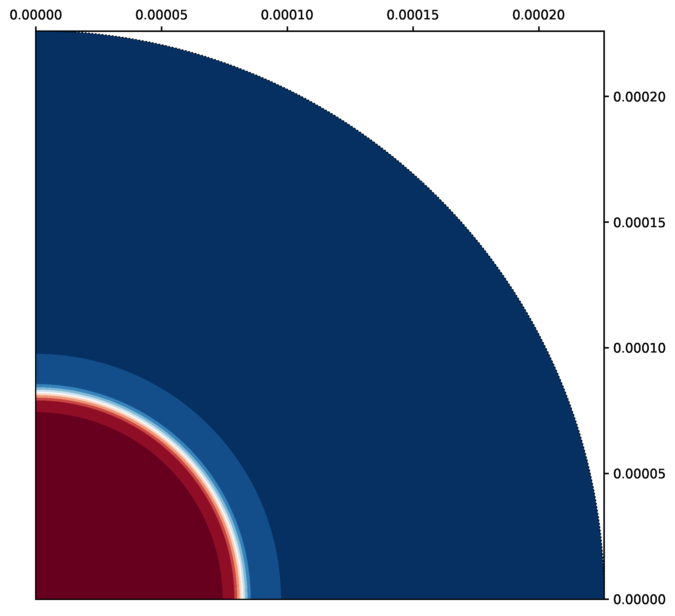
Hybrid model (preconfluence stage)
Cell mass fraction %
Cell mass fraction %
Oxygen evolution
Cell mass fraction (%)
FEniCSx
Notes:
Mettre la croissance d’un spheroid préconfluence avec notre modèle hybride (faire durer un peu moins longtemps pour éviter l’écart de la dernière courbe

Slide 22
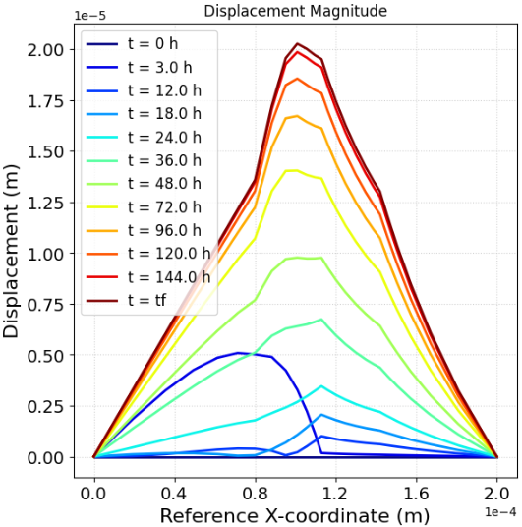
Perspectives
Include the solid deformation in the hybrid code

Slide 23
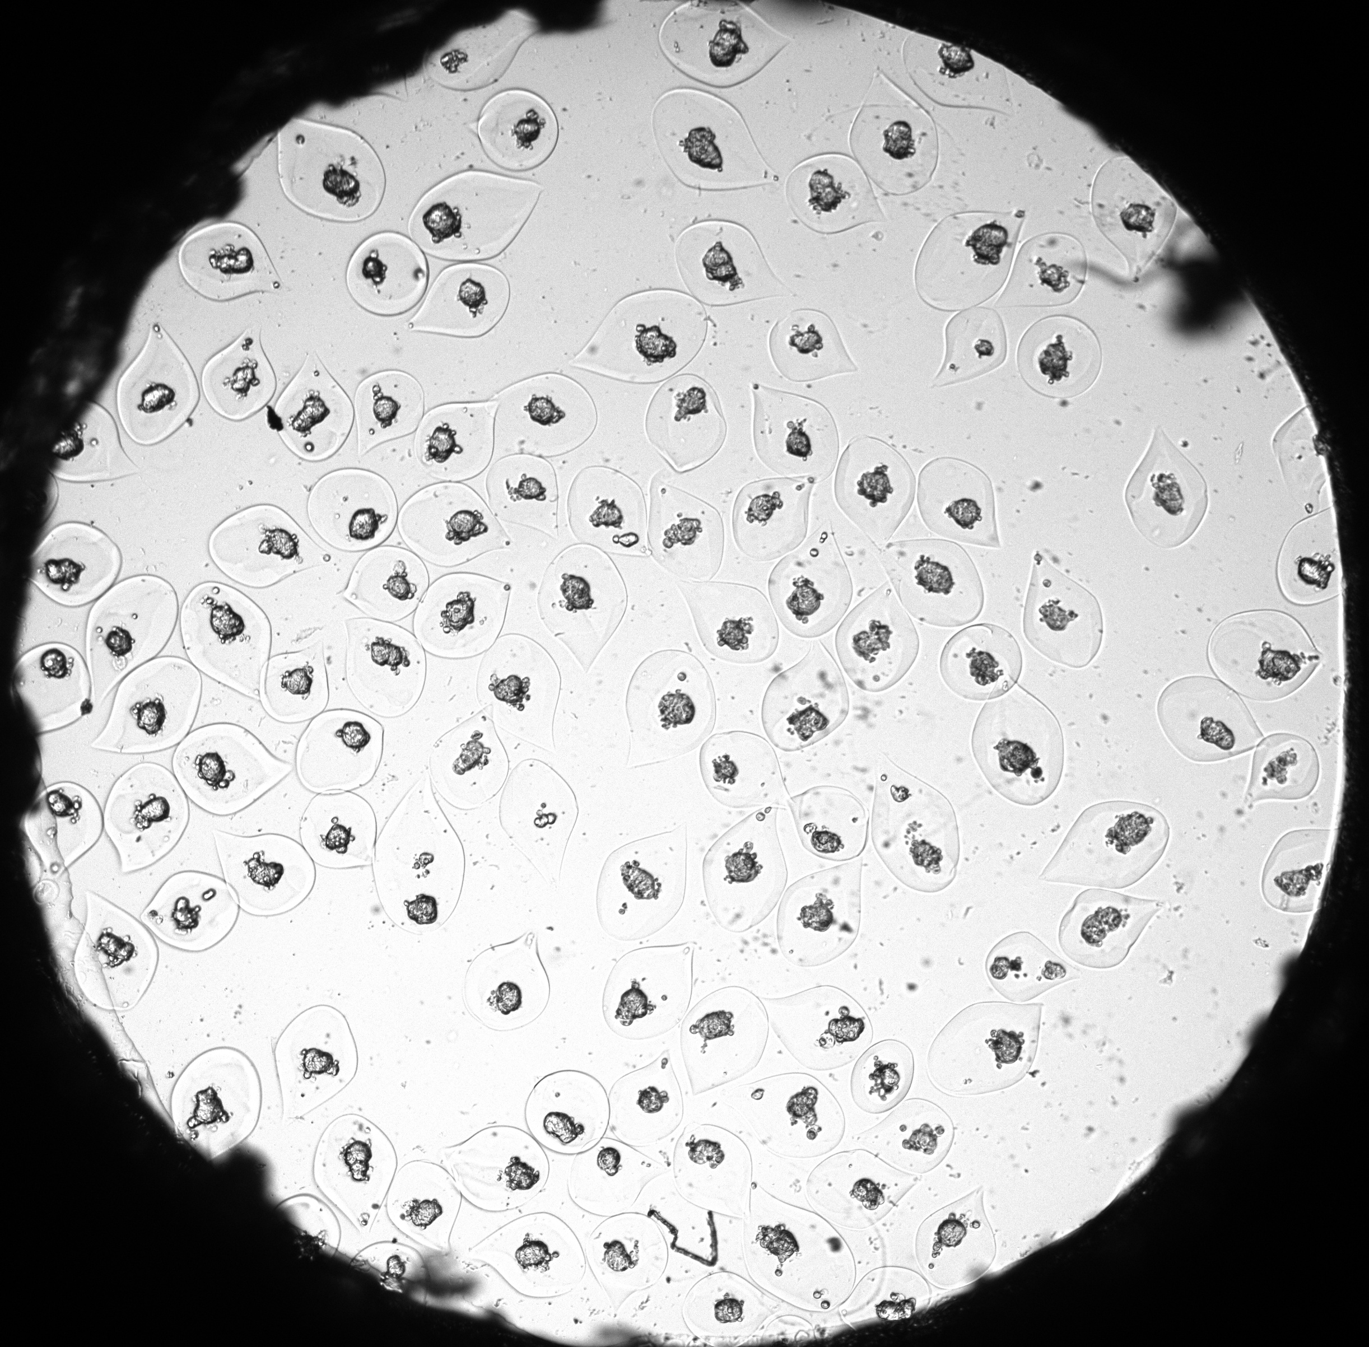
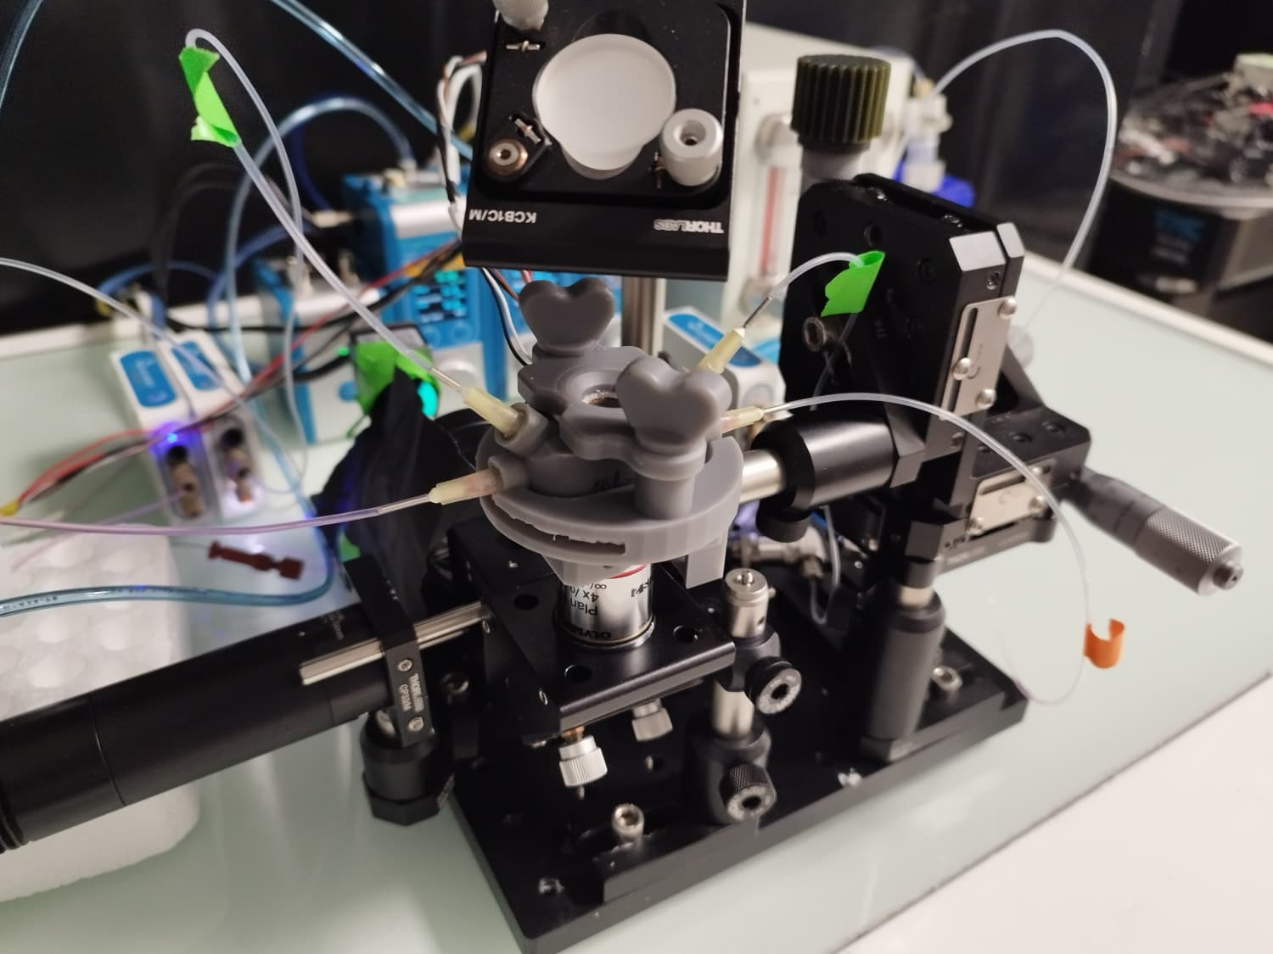
Perspectives
Include the solid deformation in the hybrid code
Finalize experimental setup

Slide 24


Perspectives
Include the solid deformation in the hybrid code
Finalize experimental setup
Couple the mathematical model to the experimental setup
FEniCSx

Slide 25


A hybrid Phase-Field-Poromechanical Model for Tumor Growth in Encapsulated conditions
M. LACOUR^{1,2}, A. BEN-ABDELWAHED^{1,2}, M. AZAIEZ^{1,2}, G. SCIUMÈ^{1,2,3}
Univ. Bordeaux, CNRS, Bordeaux INP, I2M, UMR 5295, F-33400, Talence, France Arts et Metiers Institute of Technology, CNRS, Bordeaux INP, I2M, UMR 5295, F-33400 Talence,France Institut universitaire de France
0h
24h
INTERPORE 2026
21/05/2026
$$100µm$$
$$100µm$$
matthieu.lacour.1@u-bordeaux.fr

Slide 26
Literature Review / Scientific Writing
[1] S. Urcun, P.-Y. Rohan, W. Skalli, P. Nassoy, S. P. A. Bordas, et G. Sciumè, « Digital twinning of Cellular Capsule Technology: Emerging outcomes from the perspective of porous media mechanics », PLOS ONE, vol. 16, no 7, p. e0254512, juill. 2021, doi: 10.1371/journal.pone.0254512
[2] Le Maout, V., Alessandri, K., Gurchenkov, B., Bertin, H., Nassoy, P., & Sciumè, G. (2020). Role of mechanical cues and hypoxia on the growth of tumor cells in strong and weak confinement: A dual in vitro–in silico approach. Science Advances, 6(13), eaaz7130. https://doi.org/10.1126/sciadv.aaz7130
[3] G. Sciumè et al., « A multiphase model for three-dimensional tumor growth », New J. Phys., vol. 15, nº 1, p. 015005, janv. 2013, doi: 10.1088/1367-2630/15/1/015005.
[4] M. E. Hubbi et G. L. Semenza, « Regulation of cell proliferation by hypoxia-inducible factors », American Journal of Physiology-Cell Physiology, vol. 309, no 12, p. C775‑C782, déc. 2015, doi: 10.1152/ajpcell.00279.2015
[5] G. Sciumè, R. Santagiuliana, M. Ferrari, P. Decuzzi, et B. A. Schrefler, « A tumor growth model with deformable ECM », Phys Biol, vol. 11, nº 6, p. 065004, nov. 2014, doi: 10.1088/1478-3975/11/6/065004.
[6] S. Urcun, P.-Y. Rohan, G. Sciumè, et S. P. A. Bordas, « Cortex tissue relaxation and slow to medium load rates dependency can be captured by a two-phase flow poroelastic model », Journal of the Mechanical Behavior of Biomedical Materials, vol. 126, p. 104952, févr. 2022, doi: 10.1016/j.jmbbm.2021.104952.
[7] G. Sciumè, W. G. Gray, F. Hussain, M. Ferrari, P. Decuzzi, et B. A. Schrefler, « Three phase flow dynamics in tumor growth », Comput Mech, vol. 53, nº 3, p. 465‑484, mars 2014, doi: 10.1007/s00466-013-0956-2.
[8] M. Vergara et al., « Differential Effect of Culture Temperature and Specific Growth Rate on CHO Cell Behavior in Chemostat Culture », PLOS ONE, vol. 9, no 4, p. e93865, avr. 2014, doi: 10.1371/journal.pone.0093865.

