Slide 1



Stress-Controlled Gas Transport in Boom Clay: From Oedometer to Isotropic Conditions
Salar Lakimahalleh, Laura Gonzalez-Blanco, Enrique Romero
21 May 2026, Nantes, France

Slide 2
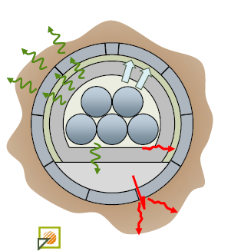
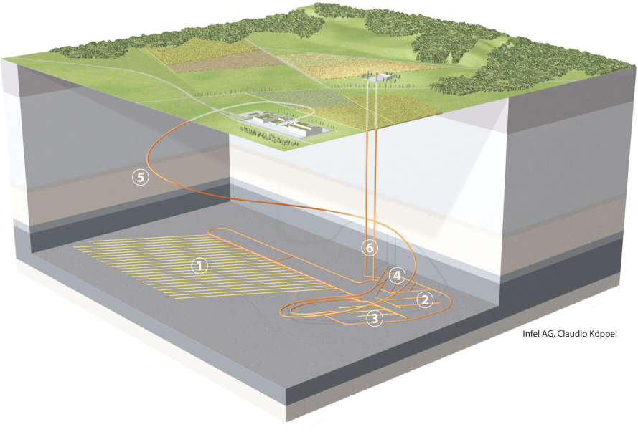
Research Context
Deep Geological Repositories (DGRs)
Multi-barrier system
The long-term management of high-level and long-lived radioactive waste requires effective isolation from the biosphere.
Deep geological repositories are recognised as one of the most suitable long-term solutions.
ONDRAF/NIRAS 2016
Waste canister
Sealing and buffer material
The geological host formation acts as the natural barrier
Argillaceous rock:
Low permeability
Low diffusion coefficient
Low porosity
High gas entry pressure
Nagra (www.mont-terri.ch)

Slide 3
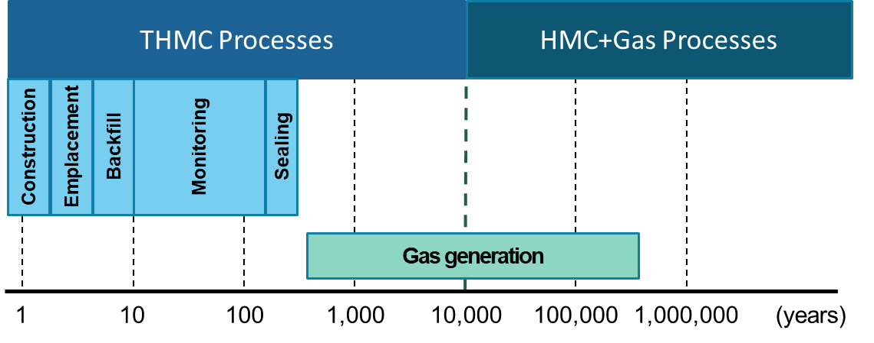
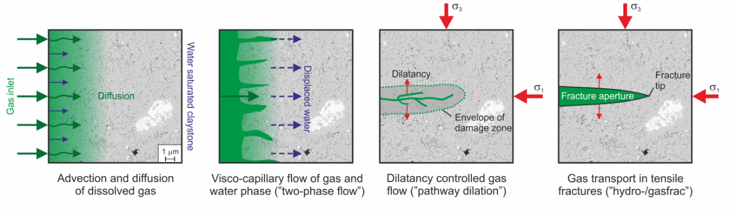
Gas production and transport mechanisms
Dissolved gas in pore water migrates through diffusion
Gas migrates by displacing water (two-phase flow)
Gas migrates through preferential pathways
Gas migrates through tensile fractures
Modified from Nagra (www.mont-terri.ch)
Gas generation may occur through several processes:
Organic material degradation (Methane or Carbon Dioxide)
Anaerobic corrosion of metals (Hydrogen)
Radiolysis (Hydrogen, Oxygen, Carbon Dioxide)
Low diffusion coefficient leads to accumulated gas volume and gas pressure buildup
Low intrinsic permeability might induce gas pressure buildup
If gas pressure exceeds the main principal stress
Modified after Marschall (2005)

Slide 4
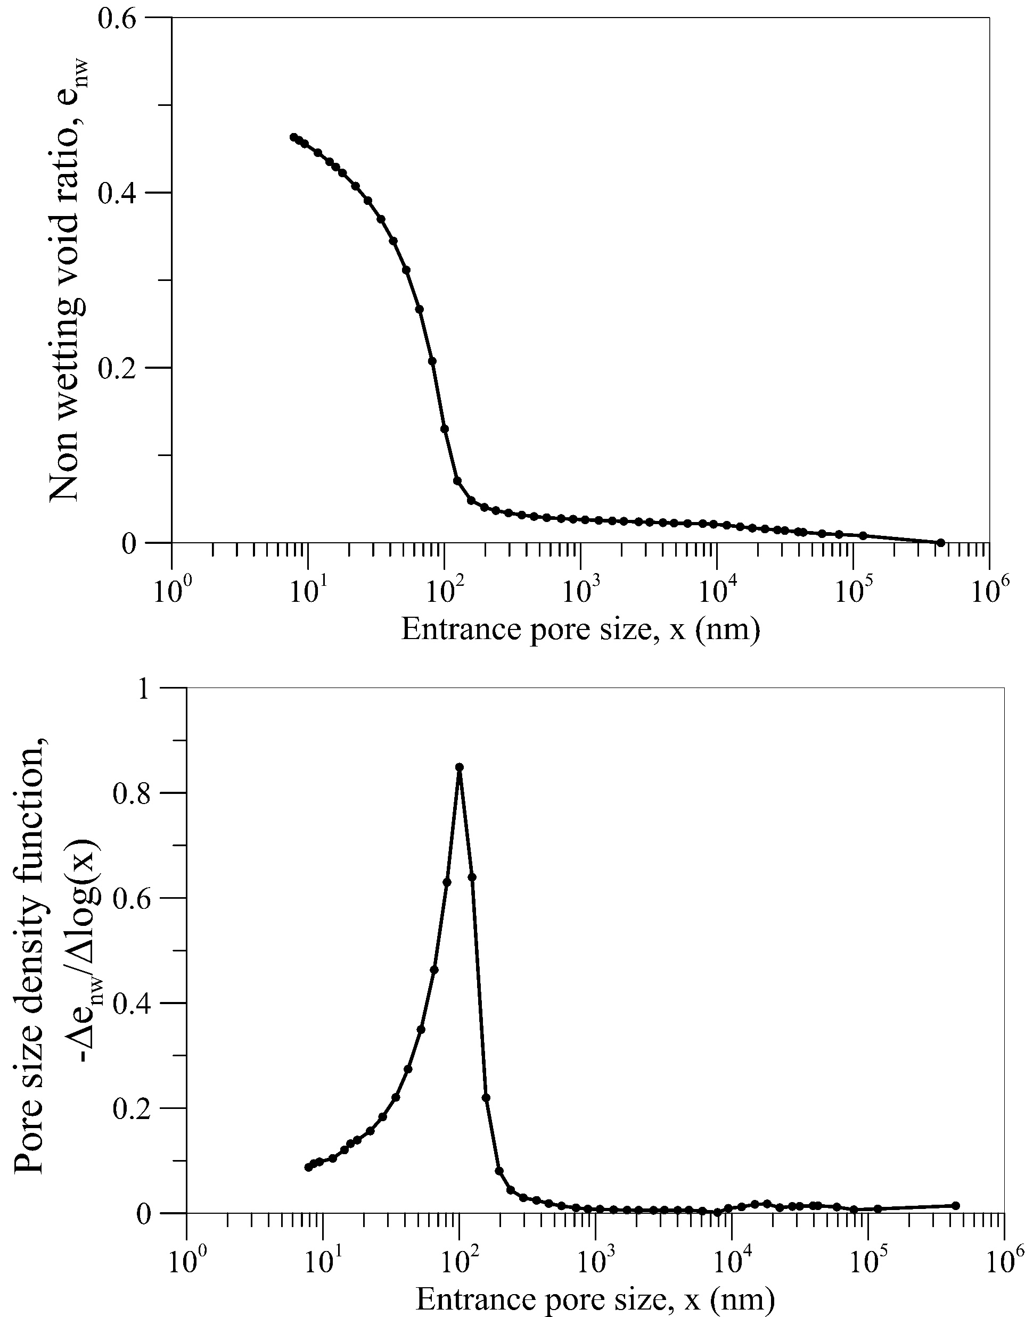
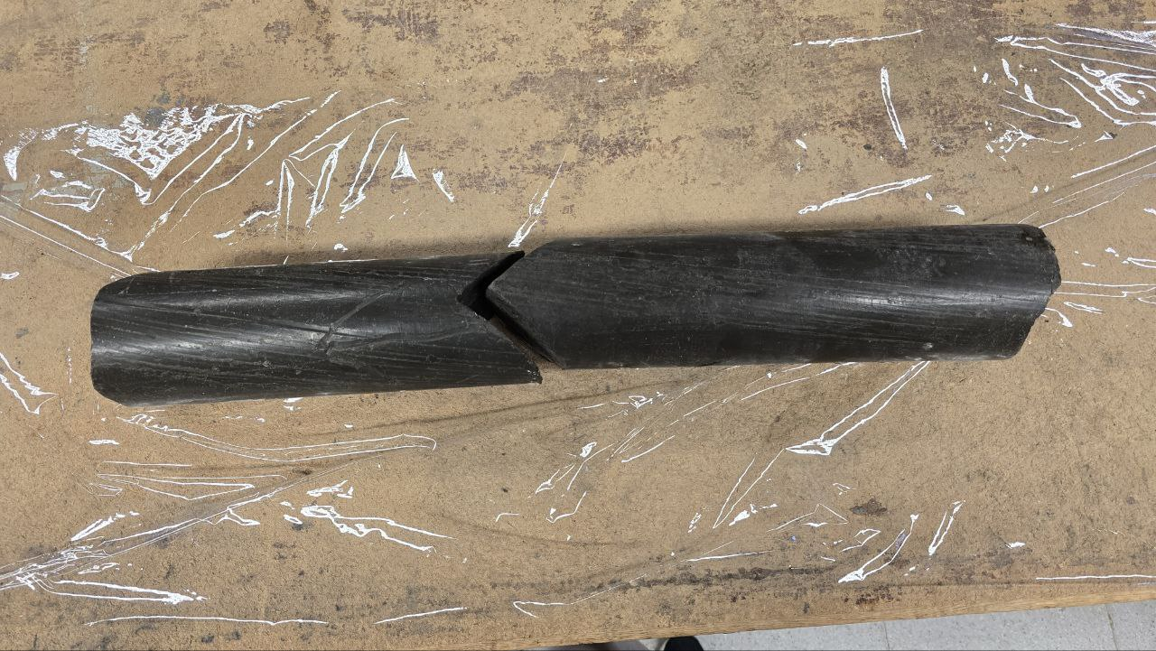
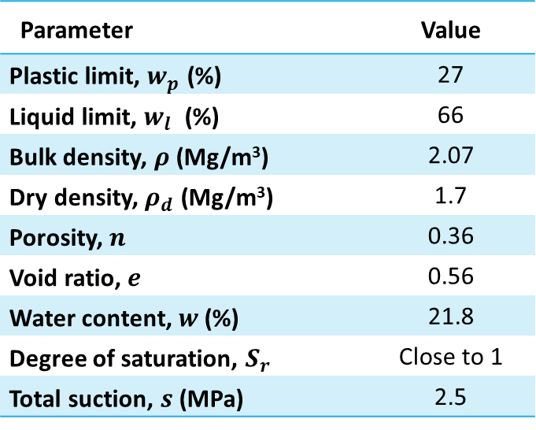
Candidate host rock in Belguim
Boom clay
Boom Clay is a Cenozoic marine sedimentary clay formation.
At the Mol–Dessel nuclear site, the Boom Clay formation is located approximately 190–290 m below ground level.
MIP (Mercury intrusion porosimetery)
At depth of 223 m
CG 76-77 W Core 8.2 7.5-8.15 m
Parameter | Value
Plastic limit, $w_{p}$ (%) | 27
Liquid limit, $w_{l}$ (%) | 66
Bulk density, $ρ$(Mg/m³) | 2.07
Dry density, $ρ_{d}$ (Mg/m³) | 1.7
Porosity, $n$ | 0.36
Void ratio, $e$ | 0.56
Water content, $w$ (%) | 21.8
Degree of saturation, $S_{r}$ | Close to 1
Total suction, $s$ (MPa) | 2.5
Dominant pore size 81.30 nm
Air entry value 3.9 MPa

Slide 5
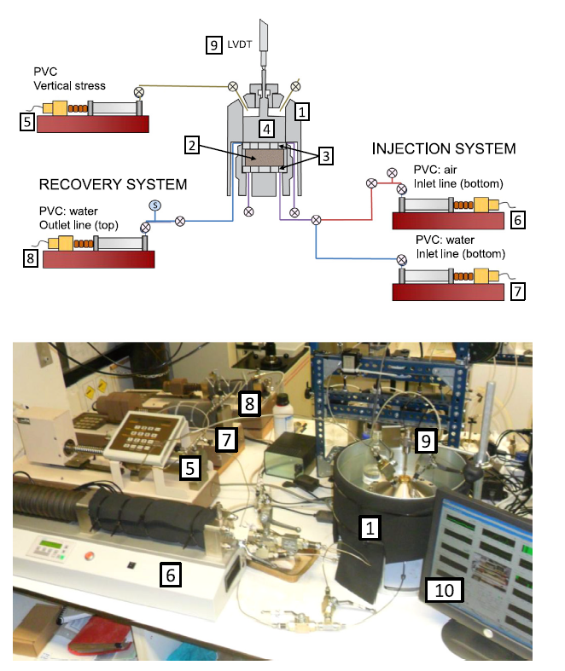
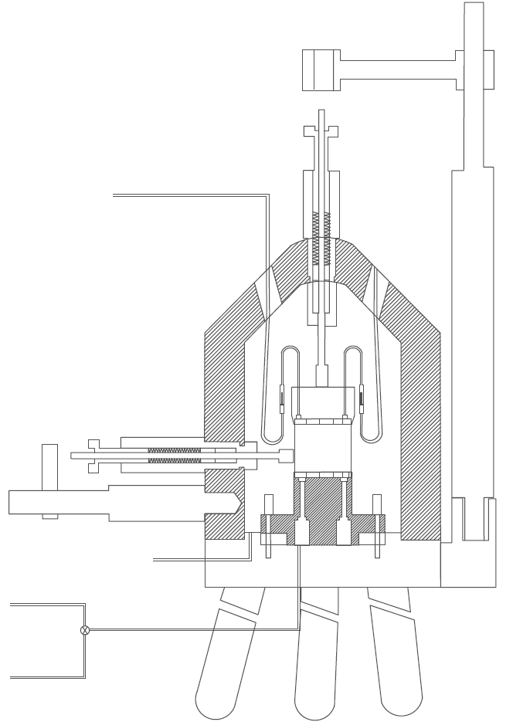
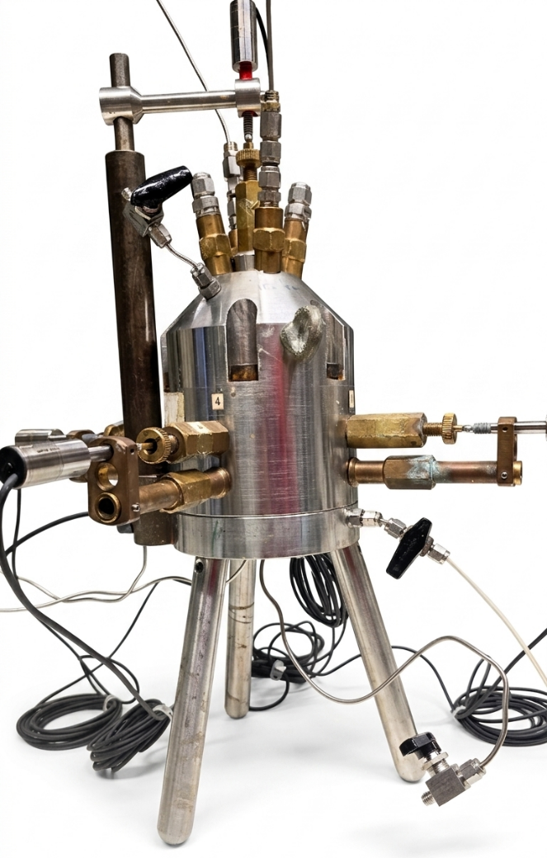
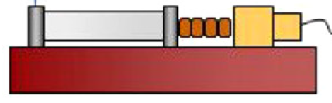


Experimental equipment
Oedometer setup
Sample size
Isotropic setup
h = 20 mm
$φ$ = 50 mm
8
Sample size
8
h = 25 mm
$φ$ = 38 mm
8
4
1
2
9
3
9
Cell
Sample
Porous stones
Axial / Isotropic pressure volume controller (PVC)
Gas injection PVC
Water inflow PVC
Water outflow PVC
Axial LVDT
Axial rod-spring system
Radial rod-spring system
Radial LVDT holder
7
5
7
6
Gonzalez-Blanco & Romero (2024)
10
10
11
2
3
11
7
1
6
8
4
4
1
1
5
5
6
Mora Ortiz (2016)
Mora Ortiz (2016)

Slide 6

















Test Protocol
Oedometer conditions
$$p = 3 MPa$$
$$p = 3 to 6 MPa \\ r=0.5 kPa/min$$
$$σ_{a}$$
$$u_{w} =0.5 MPa$$
Water
$$u_{w} =0.5 MPa$$
Water
Porous stones to distribute fluids
$$u_{w} =0.5 MPa$$
Water
Test protocol
$$u_{w} =0.5 MPa$$
Water
Oedometer ring
$$p = 3 \& 6 MPa$$
Isotropic conditions
1st Pre-conditioning
$$p =6 MPa$$
2rd Drained loading
$$u_{w} =0.5 MPa$$
Water
$$u_{f} =0.5 MPa$$
Fluid
$$p$$
3th Water permeability
4th Gas injection and dissipation
$$u_{w} =0.6 MPa$$
Water
$$u_{g} =0.5 to 4 MPa \\ r=2ml/min$$
Gas
5th Undrained unloading
$$p =6 to 0 MPa \\ Instantly$$
Sampling for MIP
Neoprene membrane
6th Post mortem
$$u_{f} =0 MPa$$
Fluid
Bedding orientation
Sampling for µ-CT imaging
Gas flow
$$u_{g} =0 MPa$$
Gas

Slide 7
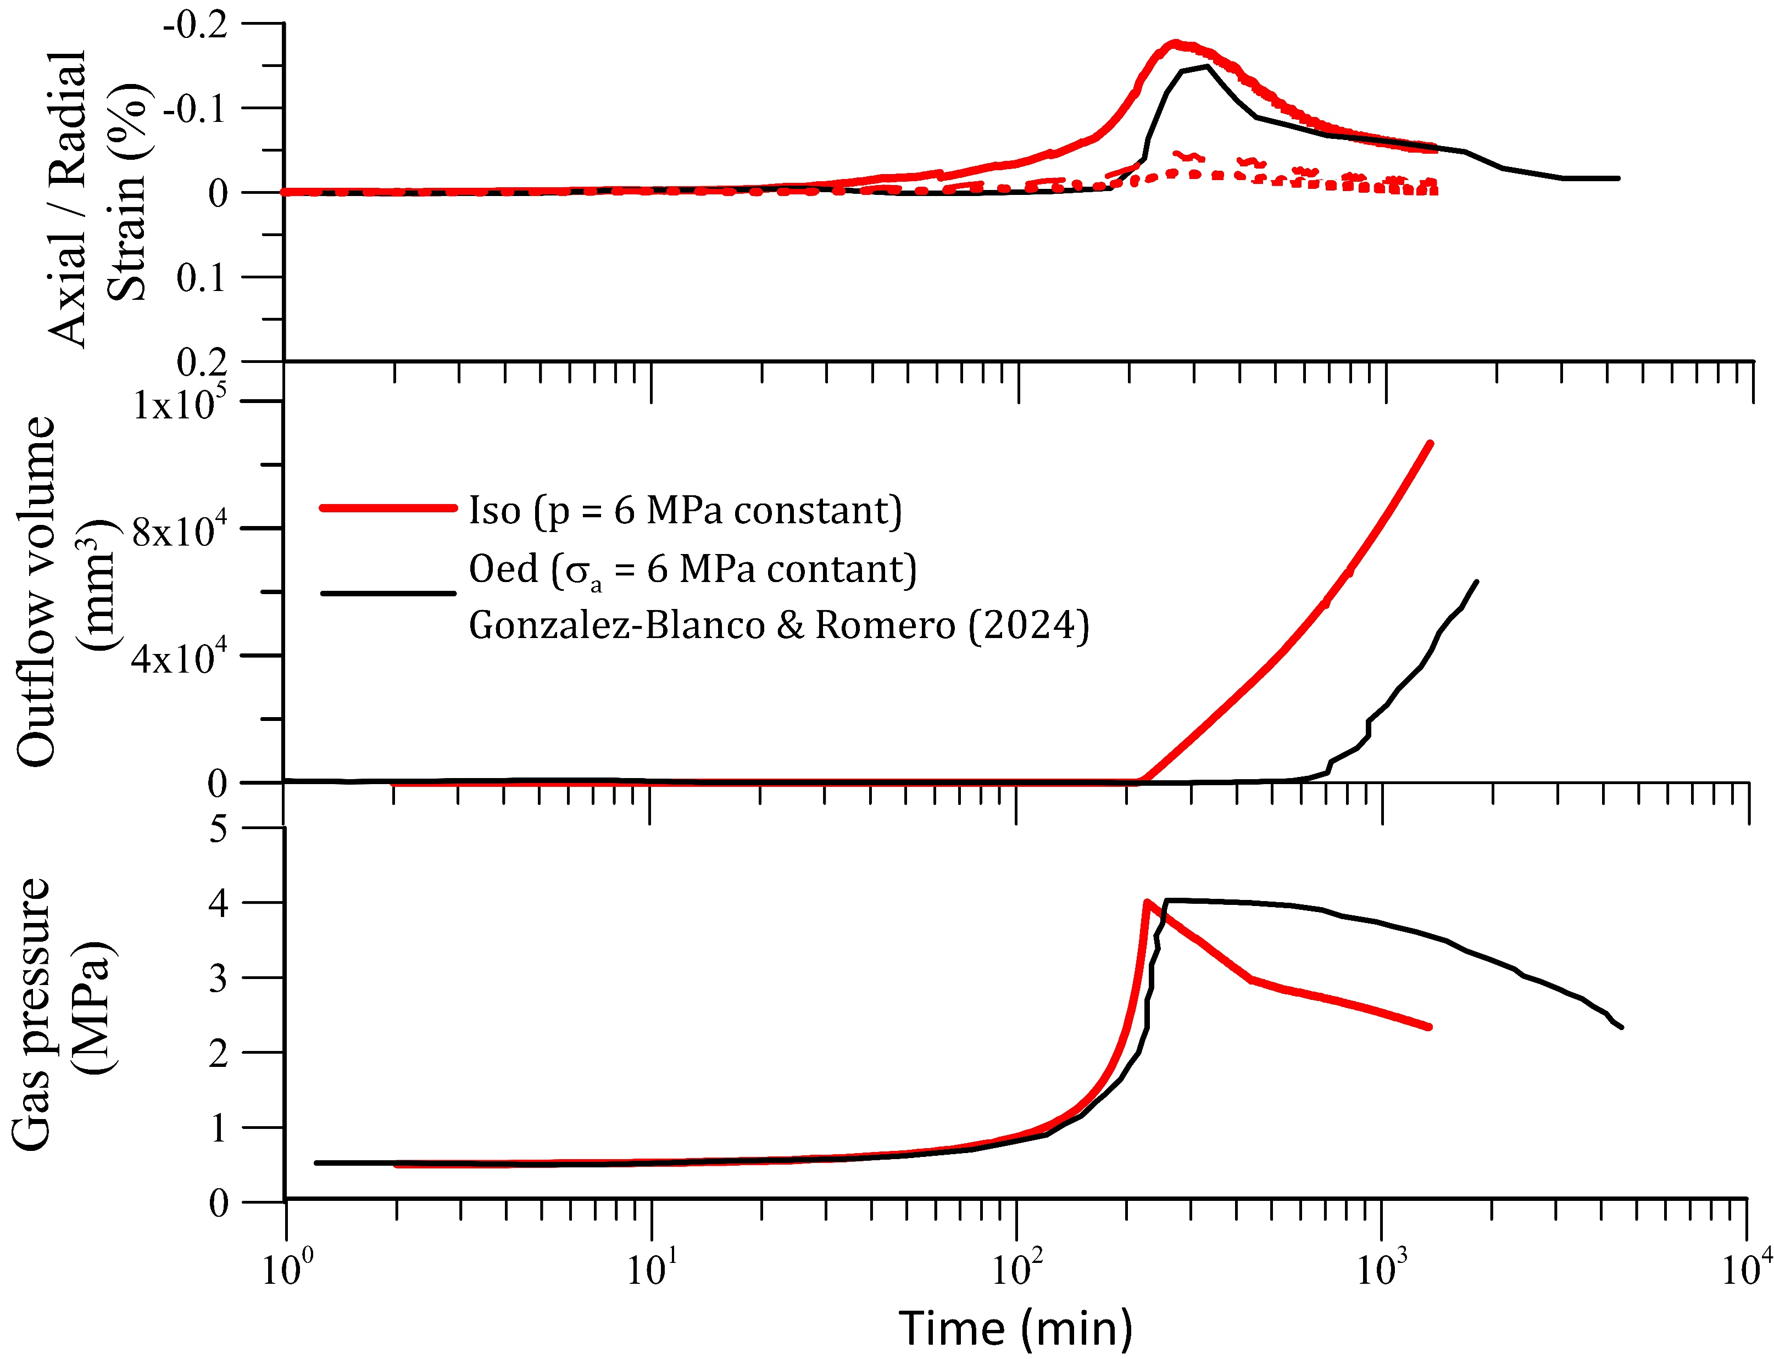

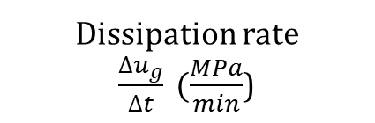






Gas injection and dissipation results
$$ε_{a}$$
$$ε_{a}$$
Oed. conditions: Gas breakthrough occurred with a delay after injection shut-off. Iso. conditions: Gas breakthrough occurred simultaneously with injection shut-off.
$$ε_{r1}$$
$$ε_{r2}$$
Isotropic conditions seem to facilitate the formation of preferential gas pathways.
Dissipation rate $\frac{∆u_{g}}{∆t} (\frac{MPa}{min}$)
B
B’
A-B: Gas injection stage
B: Shut off gas injection B-C: Gas dissipation stage
B-B’ slope
$$−5∙{10}^{−3}$$
B’
C
B’-C slope
$$−6∙{10}^{−4}$$
C
A
B’-C slope
$$−4∙{10}^{−4}$$

Slide 8
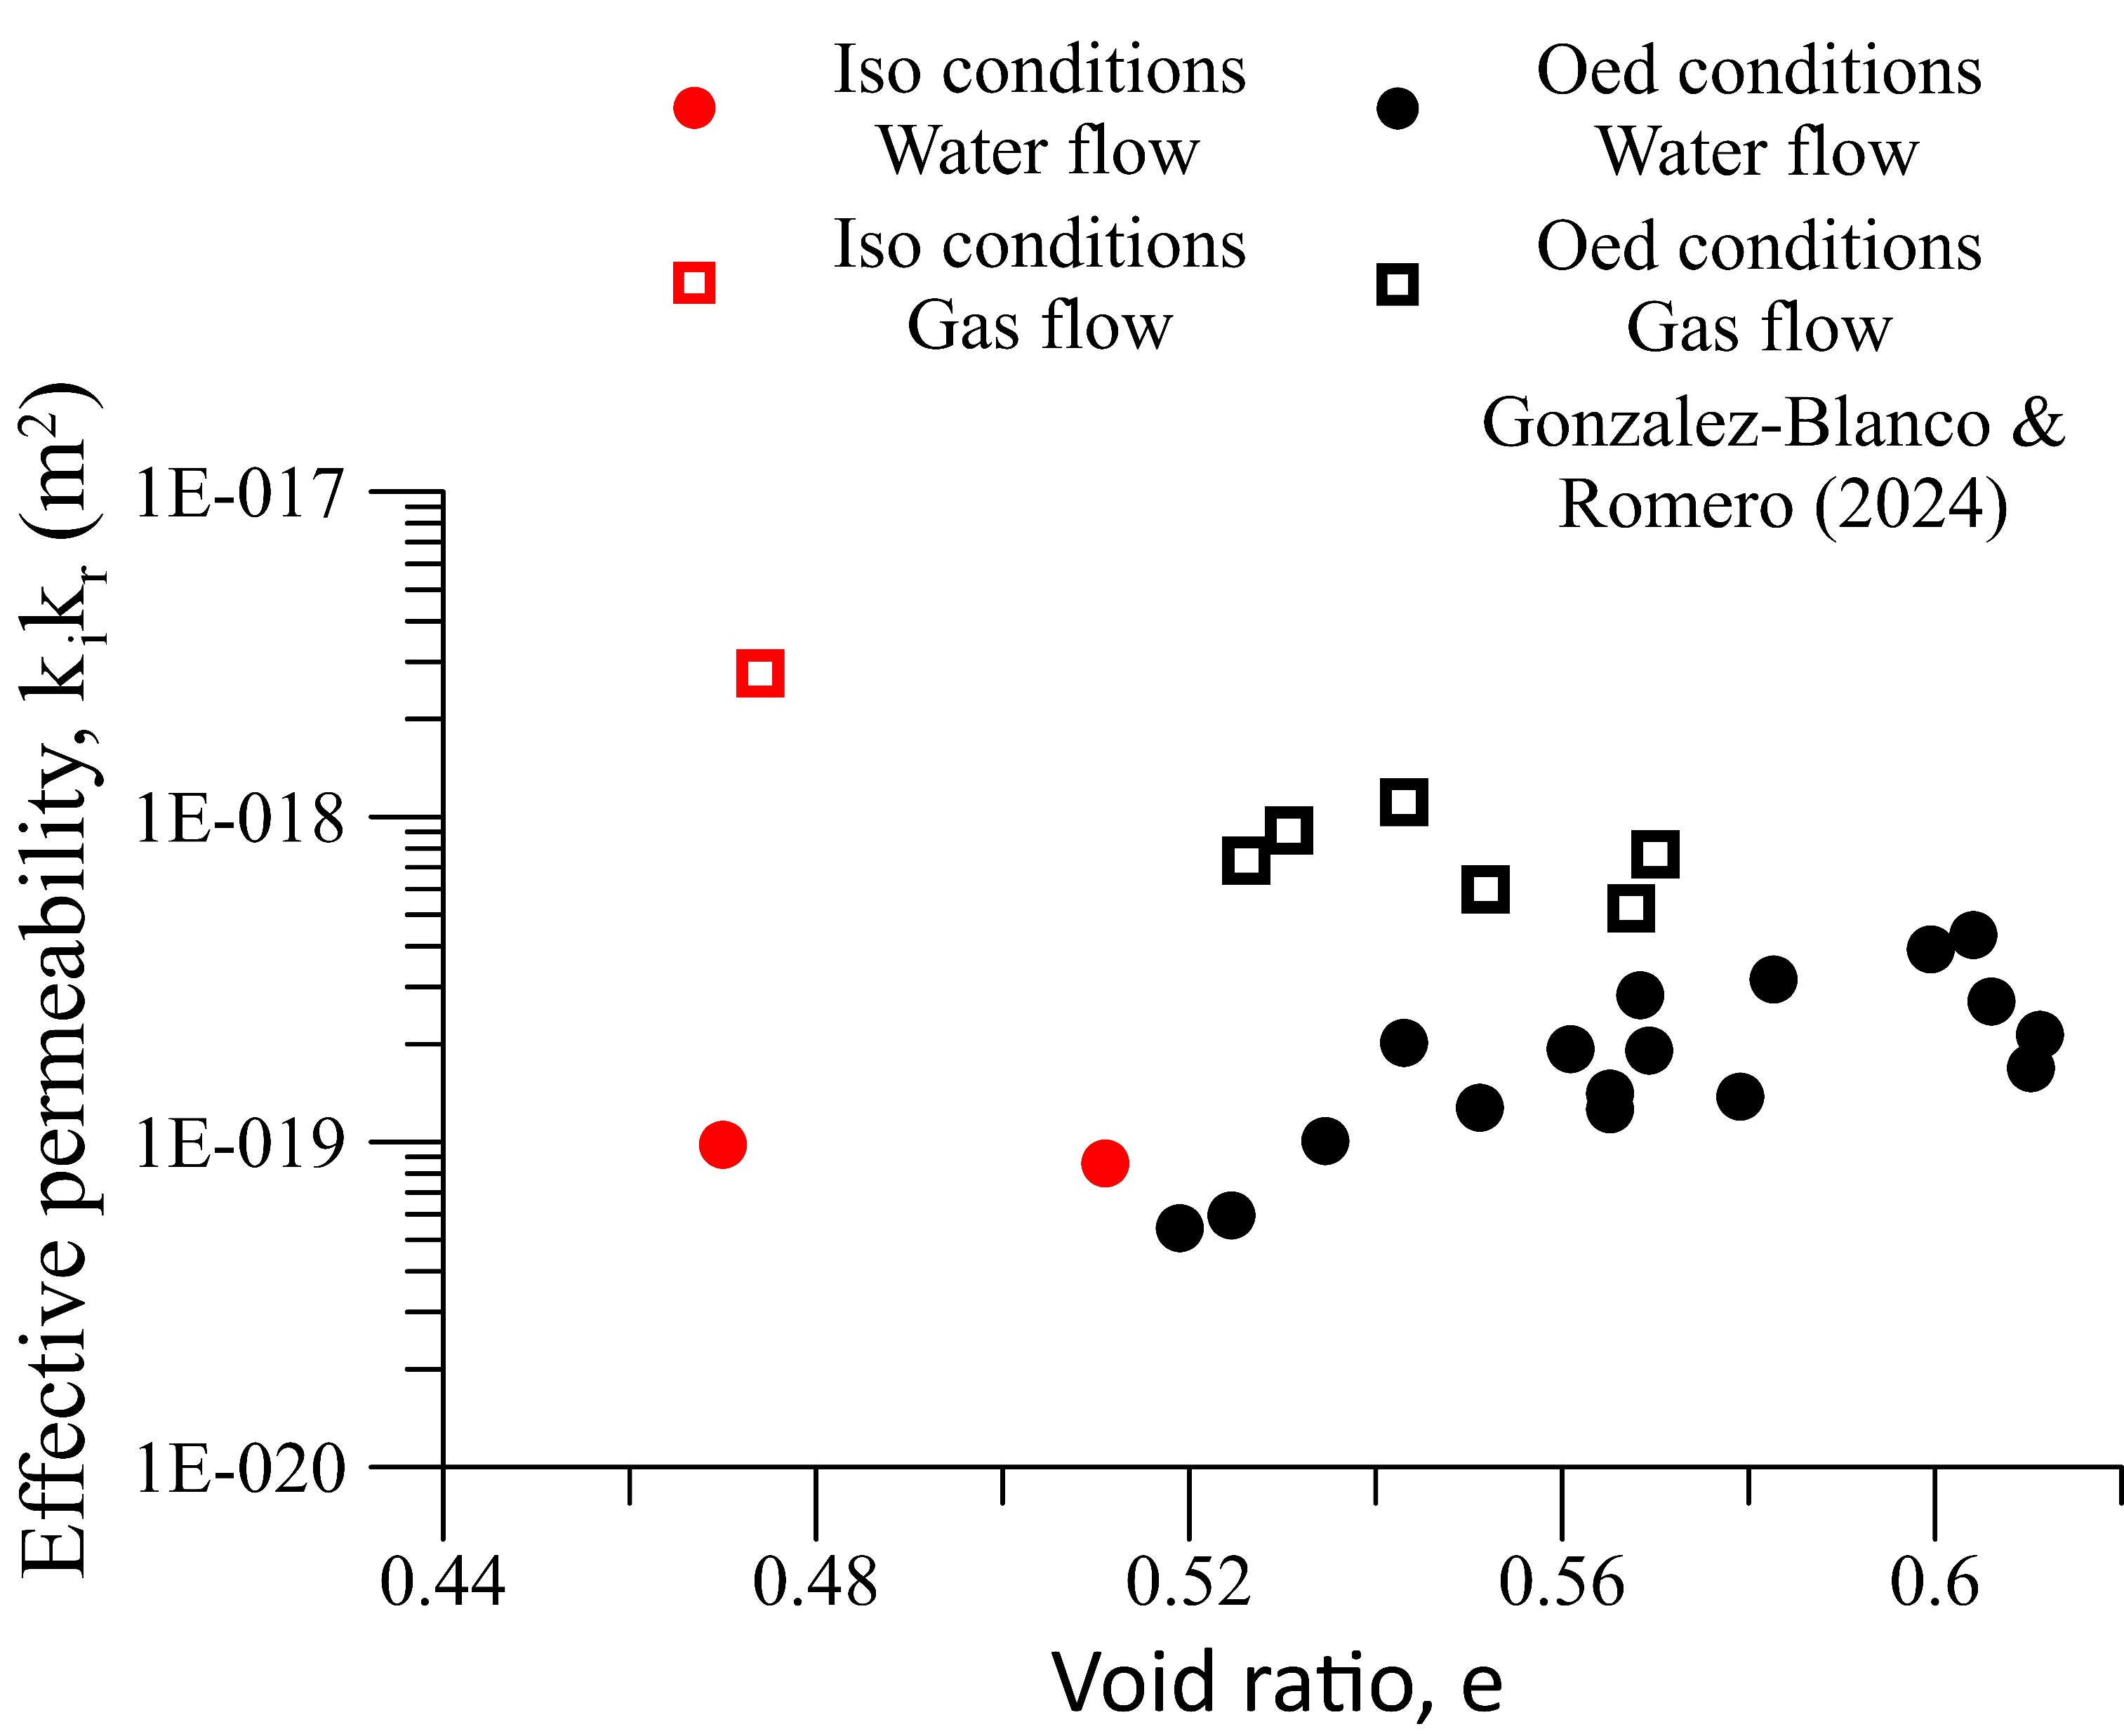
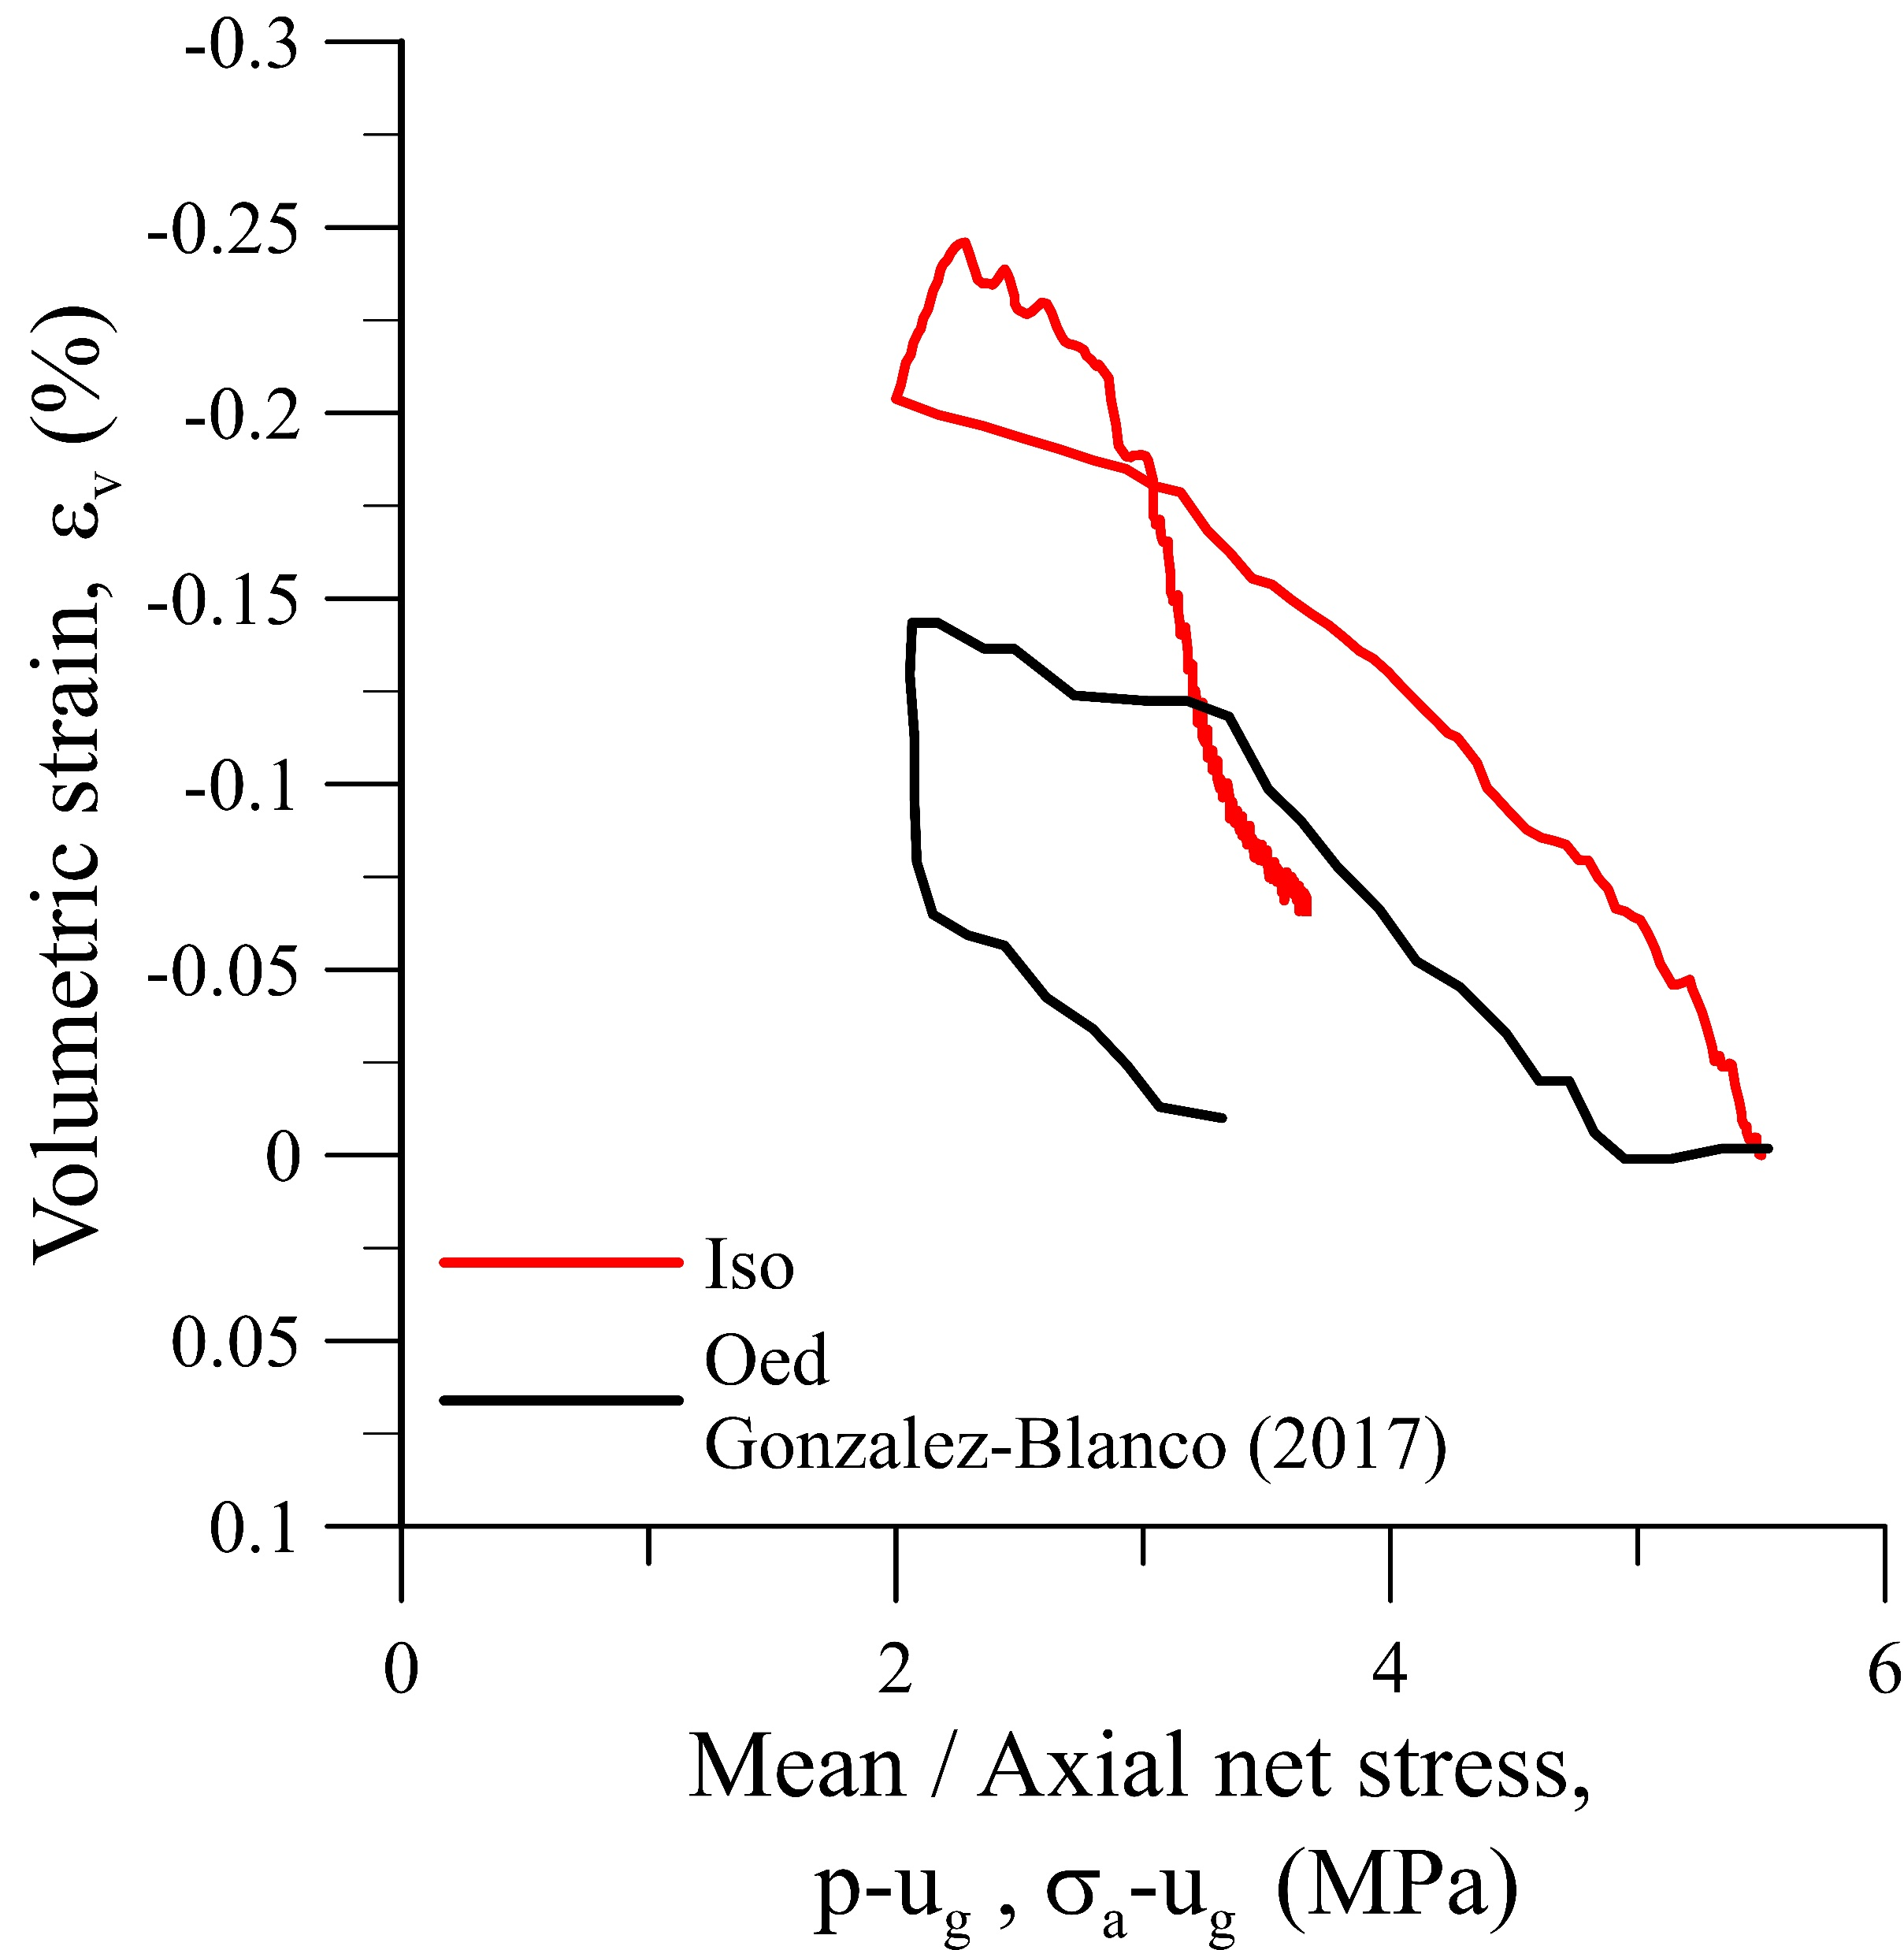



Coupled flow-deformation
$$\frac{∆\left(p−u_{g}\right)}{∆ε_{v}}=1700 MPa$$
B
$$\frac{∆\left(p−u_{g}\right)}{∆ε_{v}}=800 MPa$$
B
C
A
$$\frac{∆(σ_{a}−u_{g})}{∆ε_{v}}=1780 MPa$$
Gas permeability is always higher than water permeability.
Gas permeability is controlled by localised pathways. However, water permeability is controlled by the pore network.
A-B: Gas injection stage
B: Shut off gas injection B-C: Gas dissipation stage

Slide 9
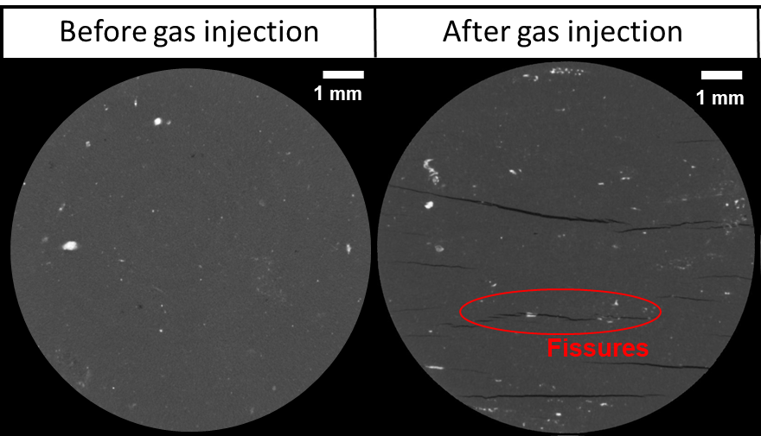
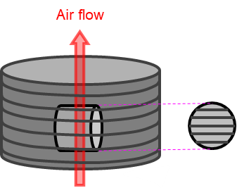
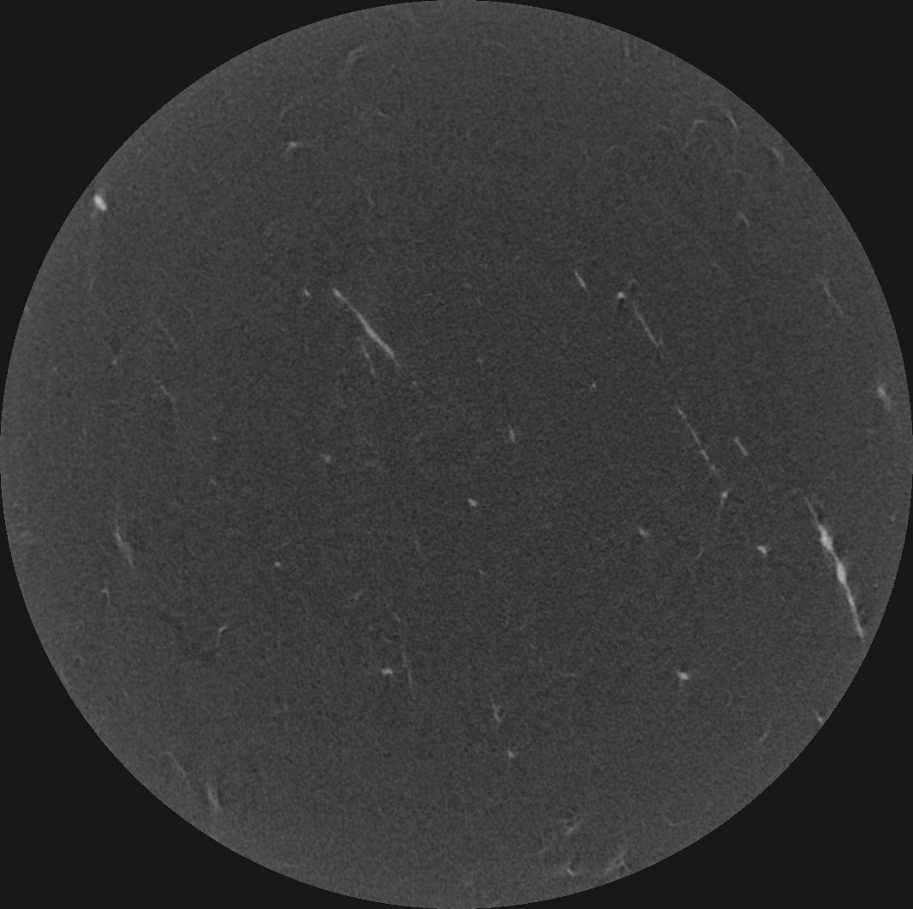
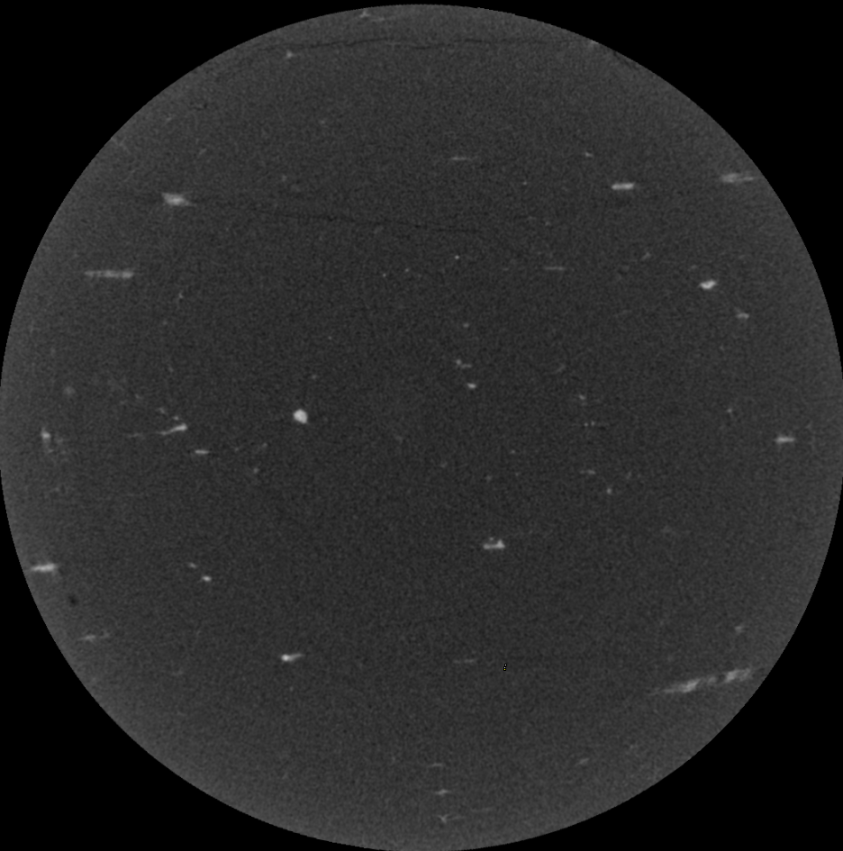



Microstructure analysis
µ-CT imaging resolution is 8 µm
Large fissures (>40 μm) in the direction of the bedding planes
Oedometer conditions
Small fissures (<10 μm) in the direction of the bedding planes
Gas flow
Under isotropic conditions fissures are narrower than oedometer conditions
1 mm
1 mm
Isotropic conditions
Fissures
$$ε_{a}$$
$$ε_{a}$$
$$ε_{r}$$
Oedometric conditions
Isotropic conditions

Slide 10
Summary and future works
Preferential gas pathways were generated under both isotropic and oedometer conditions.
Under oedometer conditions, the breakthrough was delayed with respect to the shut-off; however, under isotropic conditions, they occurred simultaneously, suggesting easier pathway formation and propagation.
Gas permeability is higher than water permeability. Also, gas permeability under isotropic conditions is higher than under odeometer conditions.
Gas pathways generated under isotropic conditions were narrower than under oedometer conditions.
Investigate the effect of bedding orientation on gas transport properties under isotropic stress.
Preferential pathway self-sealing after re-saturation under isotropic stress conditions.

Slide 11


Thanks for your attention
Acknowledgments
The authors acknowledge the financial support of the INTERMO2 project (PID2022-141429OB-I00) funded by the Spanish Ministry of Science/Research Agency CIN/AEI/10.13039/501100011033/FEDER EU (2023-2027) and from ONDRAF/NIRAS under contract No. CCHO 2024-0374/00/00 (2024-2026).

