Slide 1




A stress-strain constitutive model for bentonite-based engineered barriers considering adsorption, capillarity and pore structure evolution
Session: 4.1 - MS12
22th May 2026 – 09:20 am
Nantes, France
PRESENTED BY
Alessandro PARZIALE
Angelica TUTTOLOMONDO
Lyesse LALOUI

Slide 2
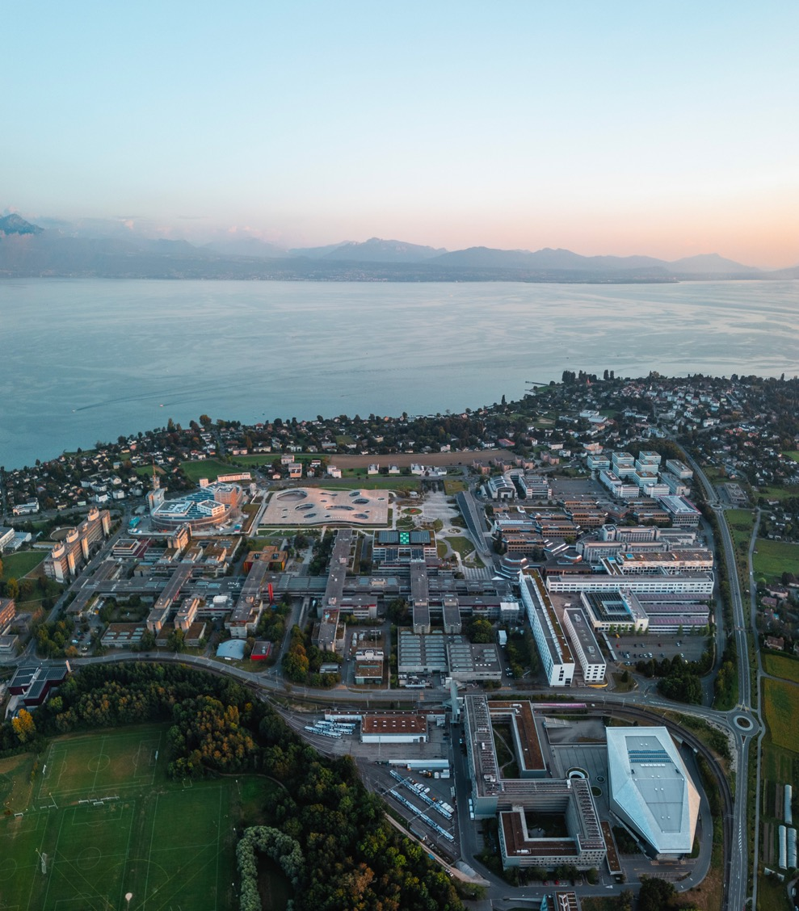
OUTLINE
Introduction
Water retention framework
Mechanical framework
Model calibration
Model performance
Conclusions

Slide 3


Multi-barrier concept for geological disposal
Safety functions (system-level)
Isolation | Mechanical support | Radionuclides retention | Long-term stability
Host rock
Liner
Bentonite buffer
Safety functions (barrier-level)
Low hydraulic conductivity | Swelling pressure | Sorption capacity
Metallic canister
(HLW)
Bentonite
blocks
Controlling factors (barrier-level)
Dry density | Degree of saturation | Temperature | Pore structure

Slide 4
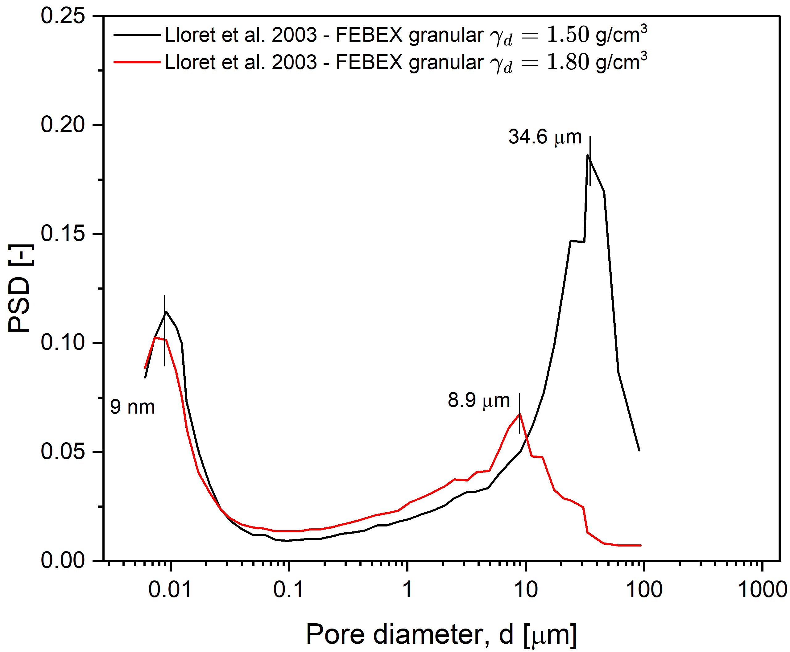
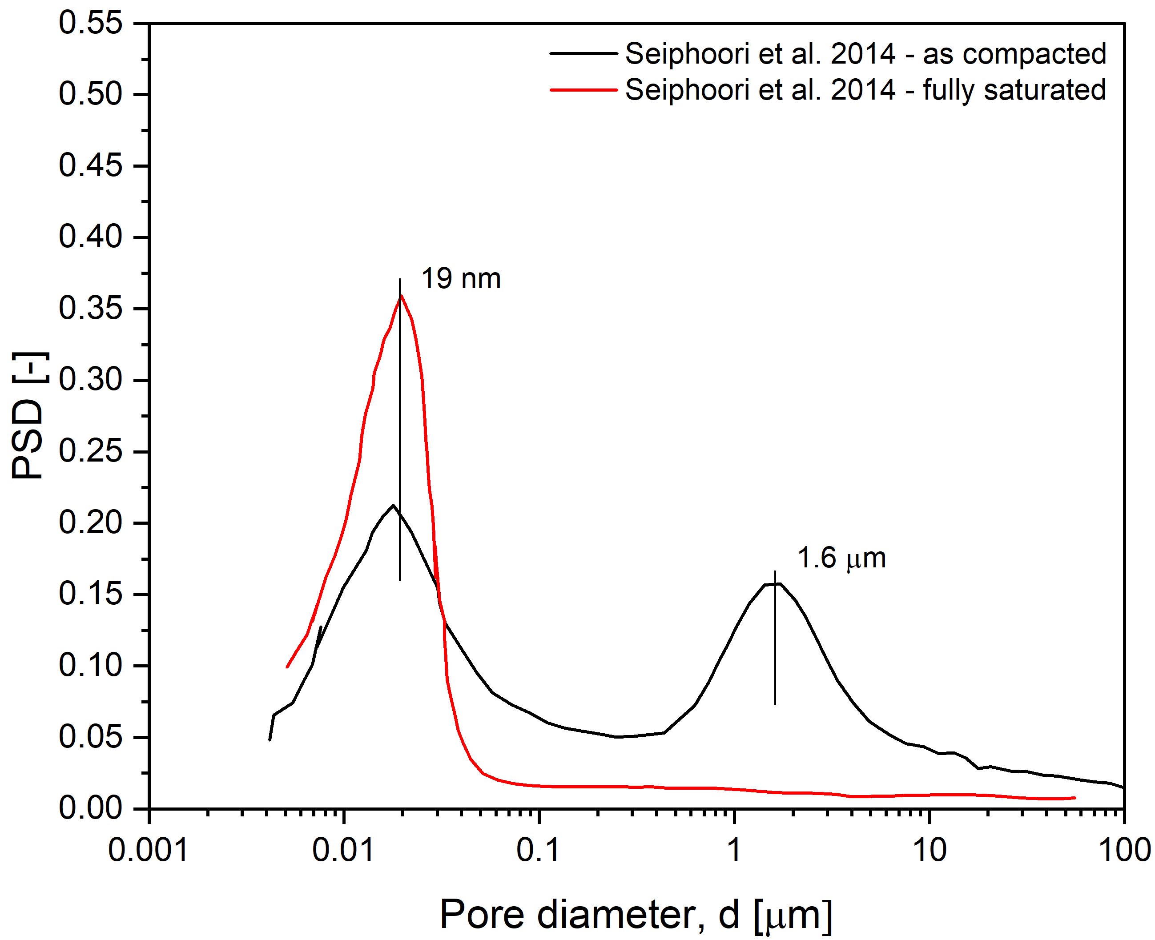
Pore structure evolution
Mechanical effect
Host rock
Mechanical load
Before compaction
After compaction
Bentonite
microstructure
macrostructure
How to include this stress-path dependency of the pore structure into a stress-strain constitutive model?
Waste
PSD
1
2
Pore size diameter
after Lloret et al., 2003
Hydration effect
Host rock
Wetting front
Dry state
After wetting (constant volume)
Bentonite
microstructure
macrostructure
Waste
PSD
1
2
Pore size diameter
after Seiphoori et al., 2014
Lloret et al. (2003). Mechanical behaviour of heavily compacted bentonite under high suction changes. Geotechnique. 53. 27-40. 10.1680/geot.2003.53.1.27.
Parziale, A., Tuttolomondo, A., & Laloui, L. (2026). Advances in understanding and modelling compacted expansive clays: a constitutive approach. Canadian Geotechnical Journal. 63. 1-19. 10.1139/cgj-2025-0669.
Seiphoori, A., Ferrari, A., & Laloui, L. (2014). Water retention behaviour and microstructural evolution of MX-80 bentonite during wetting and drying cycles. Geotechnique. 64. 721-734. 10.1680/geot.14.P.017.

Slide 5
OUTLINE
Introduction
Water retention framework
Mechanical framework
Model calibration
Model performance
Conclusions

Slide 6
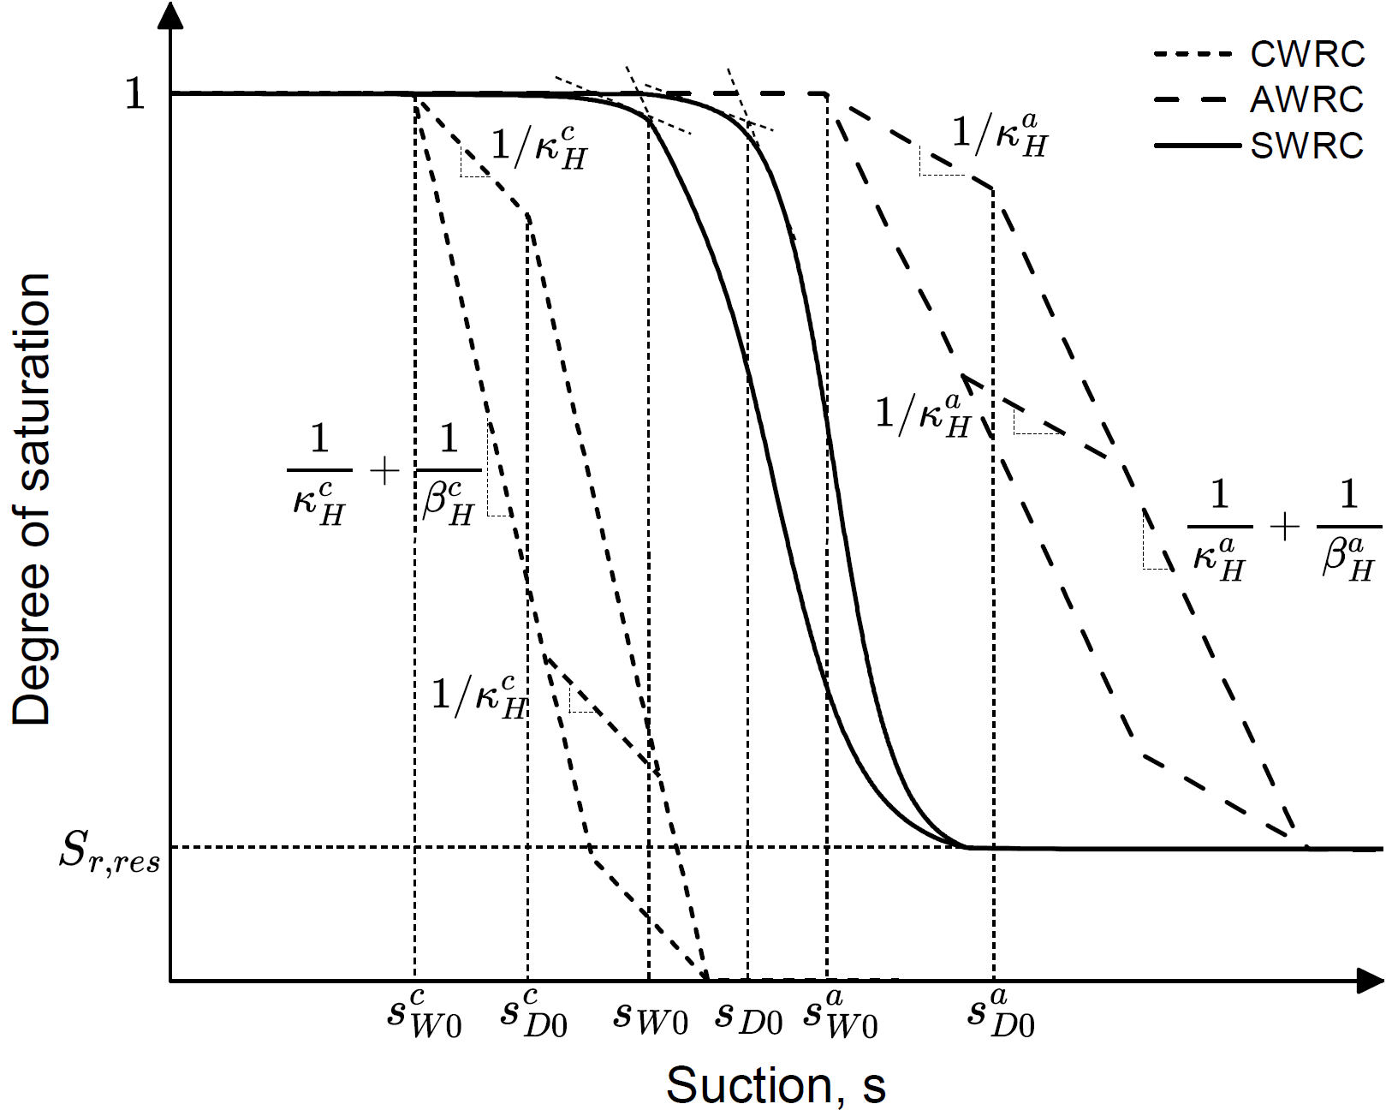



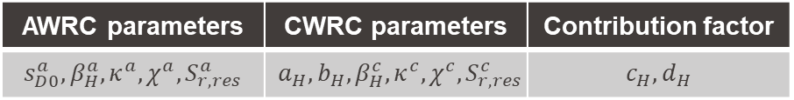






A double structure water retention model
Definition of degree of saturation (Qiao et al., 2021):
$$dS_{r}^{c}=dS_{r}^{ce}+dS_{r}^{cp}$$
$$S_{r}=ξS_{r}^{a}+\left(1−ξ\right)S_{r}^{c}$$
$$dS_{r}^{a}=dS_{r}^{ae}+dS_{r}^{ap}$$
Yield functions:
$$f^{c}=\left|\log\left(s\right)−\log\left(s_{D}^{c}\right)+\frac{1}{2}log⁡(χ_{c})\right|−\frac{1}{2}log⁡(χ_{c})$$
$$f^{a}=\left|\log\left(s\right)−\log\left(s_{D}^{a}\right)+\frac{1}{2}log⁡(χ_{a})\right|−\frac{1}{2}log⁡(χ_{a})$$
Hardening rules:
$$s_{D}^{c}=s_{D0}^{c}exp⁡(β_{H}^{c}S_{r}^{cp})$$
$$s_{D}^{a}=s_{D0}^{a}exp⁡(β_{H}^{a}S_{r}^{ap})$$
Flow rules:
$$dS_{r}^{cp}=λ_{H}^{cp}\frac{∂f^{c}}{∂s}$$
$$dS_{r}^{ap}=λ_{H}^{ap}\frac{∂f^{a}}{∂s}$$
AWRC parameters | CWRC parameters | Contribution factor
$$s_{D0}^{a}, β_{H}^{a}, κ^{a}, χ^{a},S_{r,res}^{a}$$ | $$a_{H},b_{H}, β_{H}^{c}, κ^{c}, χ^{c},S_{r,res}^{c}$$ | $$c_{H},d_{H}$$
Parziale, A., Tuttolomondo, A., & Laloui, L. (2026). Advances in understanding and modelling compacted expansive clays: a constitutive approach. Canadian Geotechnical Journal. 63. 1-19. 10.1139/cgj-2025-0669.
Qiao et al. (2021). A generalized water retention model with soil fabric evolution. Geomechanics for Energy and the Environment. 25. 100205. 10.1016/j.gete.2020.100205.

Slide 7










Pore structure evolution under different stress-paths
Mechanical effect
1
Before compaction
CWRC
After compaction
SWRC
$$e_{c}$$
2
$$ξ=\frac{e_{a}}{e}$$
AWRC
microstructure
macrostructure
PSD
compaction
1
2
1
2
$$e_{a}$$
1
Contribution factor
Degree of saturation
$$ξ↑$$
2
$$ξ=\frac{e_{a}}{e_{a}+e_{c}}$$
Pore size diameter
Void ratio, e
$$s_{D0}^{c}$$
$$(1)$$
$$s_{D0}^{c}$$
$$(2)$$
Suction, s
after Lloret et al., 2003
Hydration effect
Dry state
1
2
After wetting (constant volume)
CWRC
SWRC
$$e_{c}$$
microstructure
macrostructure
$$ξ=\frac{e_{a}}{e}$$
AWRC
$$e_{a}$$
PSD
1
Contribution factor
wetting
Degree of saturation
1
2
$$ξ↑$$
2
$$ξ=\frac{e_{a}}{e_{a}+e_{c}}$$
Pore size diameter
Suction, s
Suction, s
after Seiphoori et al., 2014
Lloret et al. (2003). Mechanical behaviour of heavily compacted bentonite under high suction changes. Geotechnique. 53. 27-40. 10.1680/geot.2003.53.1.27.
Parziale, A., Tuttolomondo, A., & Laloui, L. (2026). Advances in understanding and modelling compacted expansive clays: a constitutive approach. Canadian Geotechnical Journal. 63. 1-19. 10.1139/cgj-2025-0669.
Seiphoori, A., Ferrari, A., & Laloui, L. (2014). Water retention behaviour and microstructural evolution of MX-80 bentonite during wetting and drying cycles. Geotechnique. 64. 721-734. 10.1680/geot.14.P.017.

Slide 8
OUTLINE
Introduction
Water retention framework
Mechanical framework
Model calibration
Model performance
Conclusions

Slide 9
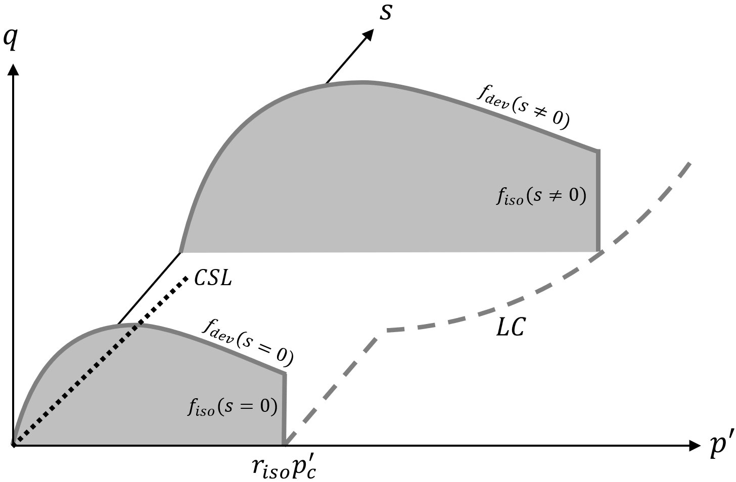



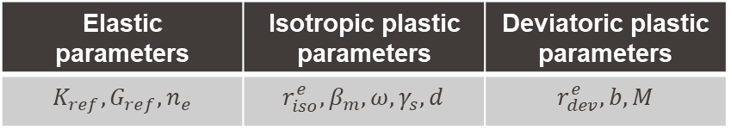






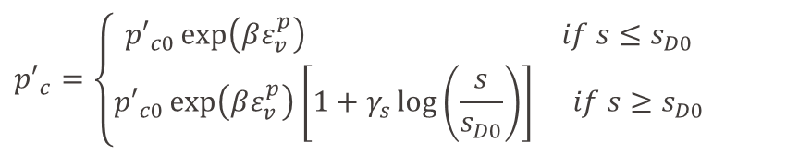
Mechanical framework
Strain variable:
Effective stress framework:
$$\begin{aligned}ε_{kl}=ε_{kl}^{e}+ε_{kl}^{p} \end{aligned}$$
$$\left\{\begin{aligned}σ^{′}=σ_{net}+S_{r}^{c}s \\ s=f(S_{r}^{c})\end{aligned}\right.$$
Non-linear elasticity:
$$K=K_{ref}{\left(\frac{p′}{p_{ref}^{′}}\right)}^{n_{e}}$$
$${dε}_{kl}^{e}=E_{ijkl}^{−1}dσ_{ij}^{′}$$
$$G=G_{ref}{\left(\frac{p′}{p_{ref}^{′}}\right)}^{n_{e}}$$
Yield functions:
Flow rules:
$$f_{dev}=q−Mp′\left(1−bln\frac{dp^{′}}{p_{c}^{′}}\right)r_{dev}$$
$$ε_{d}^{p}=λ_{dev}\frac{∂f_{dev}}{∂q}$$
$$ε_{v}^{p}=λ_{iso}\frac{∂f_{iso}}{∂p′}+λ_{dev}\frac{∂f_{dev}}{∂p′}$$
$$f_{iso}=p^{′}−p_{c}^{′}r_{iso}$$
Hardening rule:
$${p′}_{c}=\left\{\begin{aligned}{p′}_{c0}\exp\left(βε_{v}^{p}\right) if s≤s_{D0} \\ {p′}_{c0}\exp\left(βε_{v}^{p}\right)\left[1+γ_{s}\log\left(\frac{s}{s_{D0}}\right)\right] if s≥s_{D0}\end{aligned}\right.$$
Elastic parameters | Isotropic plastic parameters | Deviatoric plastic parameters
$$K_{ref},G_{ref}, n_{e}$$ | $$r_{iso}^{e},β_{m}, ω, γ_{s},d$$ | $$r_{dev}^{e}, b, M$$
Parziale, A., Tuttolomondo, A., & Laloui, L. (2026). Advances in understanding and modelling compacted expansive clays: a constitutive approach. Canadian Geotechnical Journal. 63. 1-19. 10.1139/cgj-2025-0669.

Slide 10
OUTLINE
Introduction
Water retention framework
Mechanical framework
Model calibration
Model performance
Conclusions

Slide 11
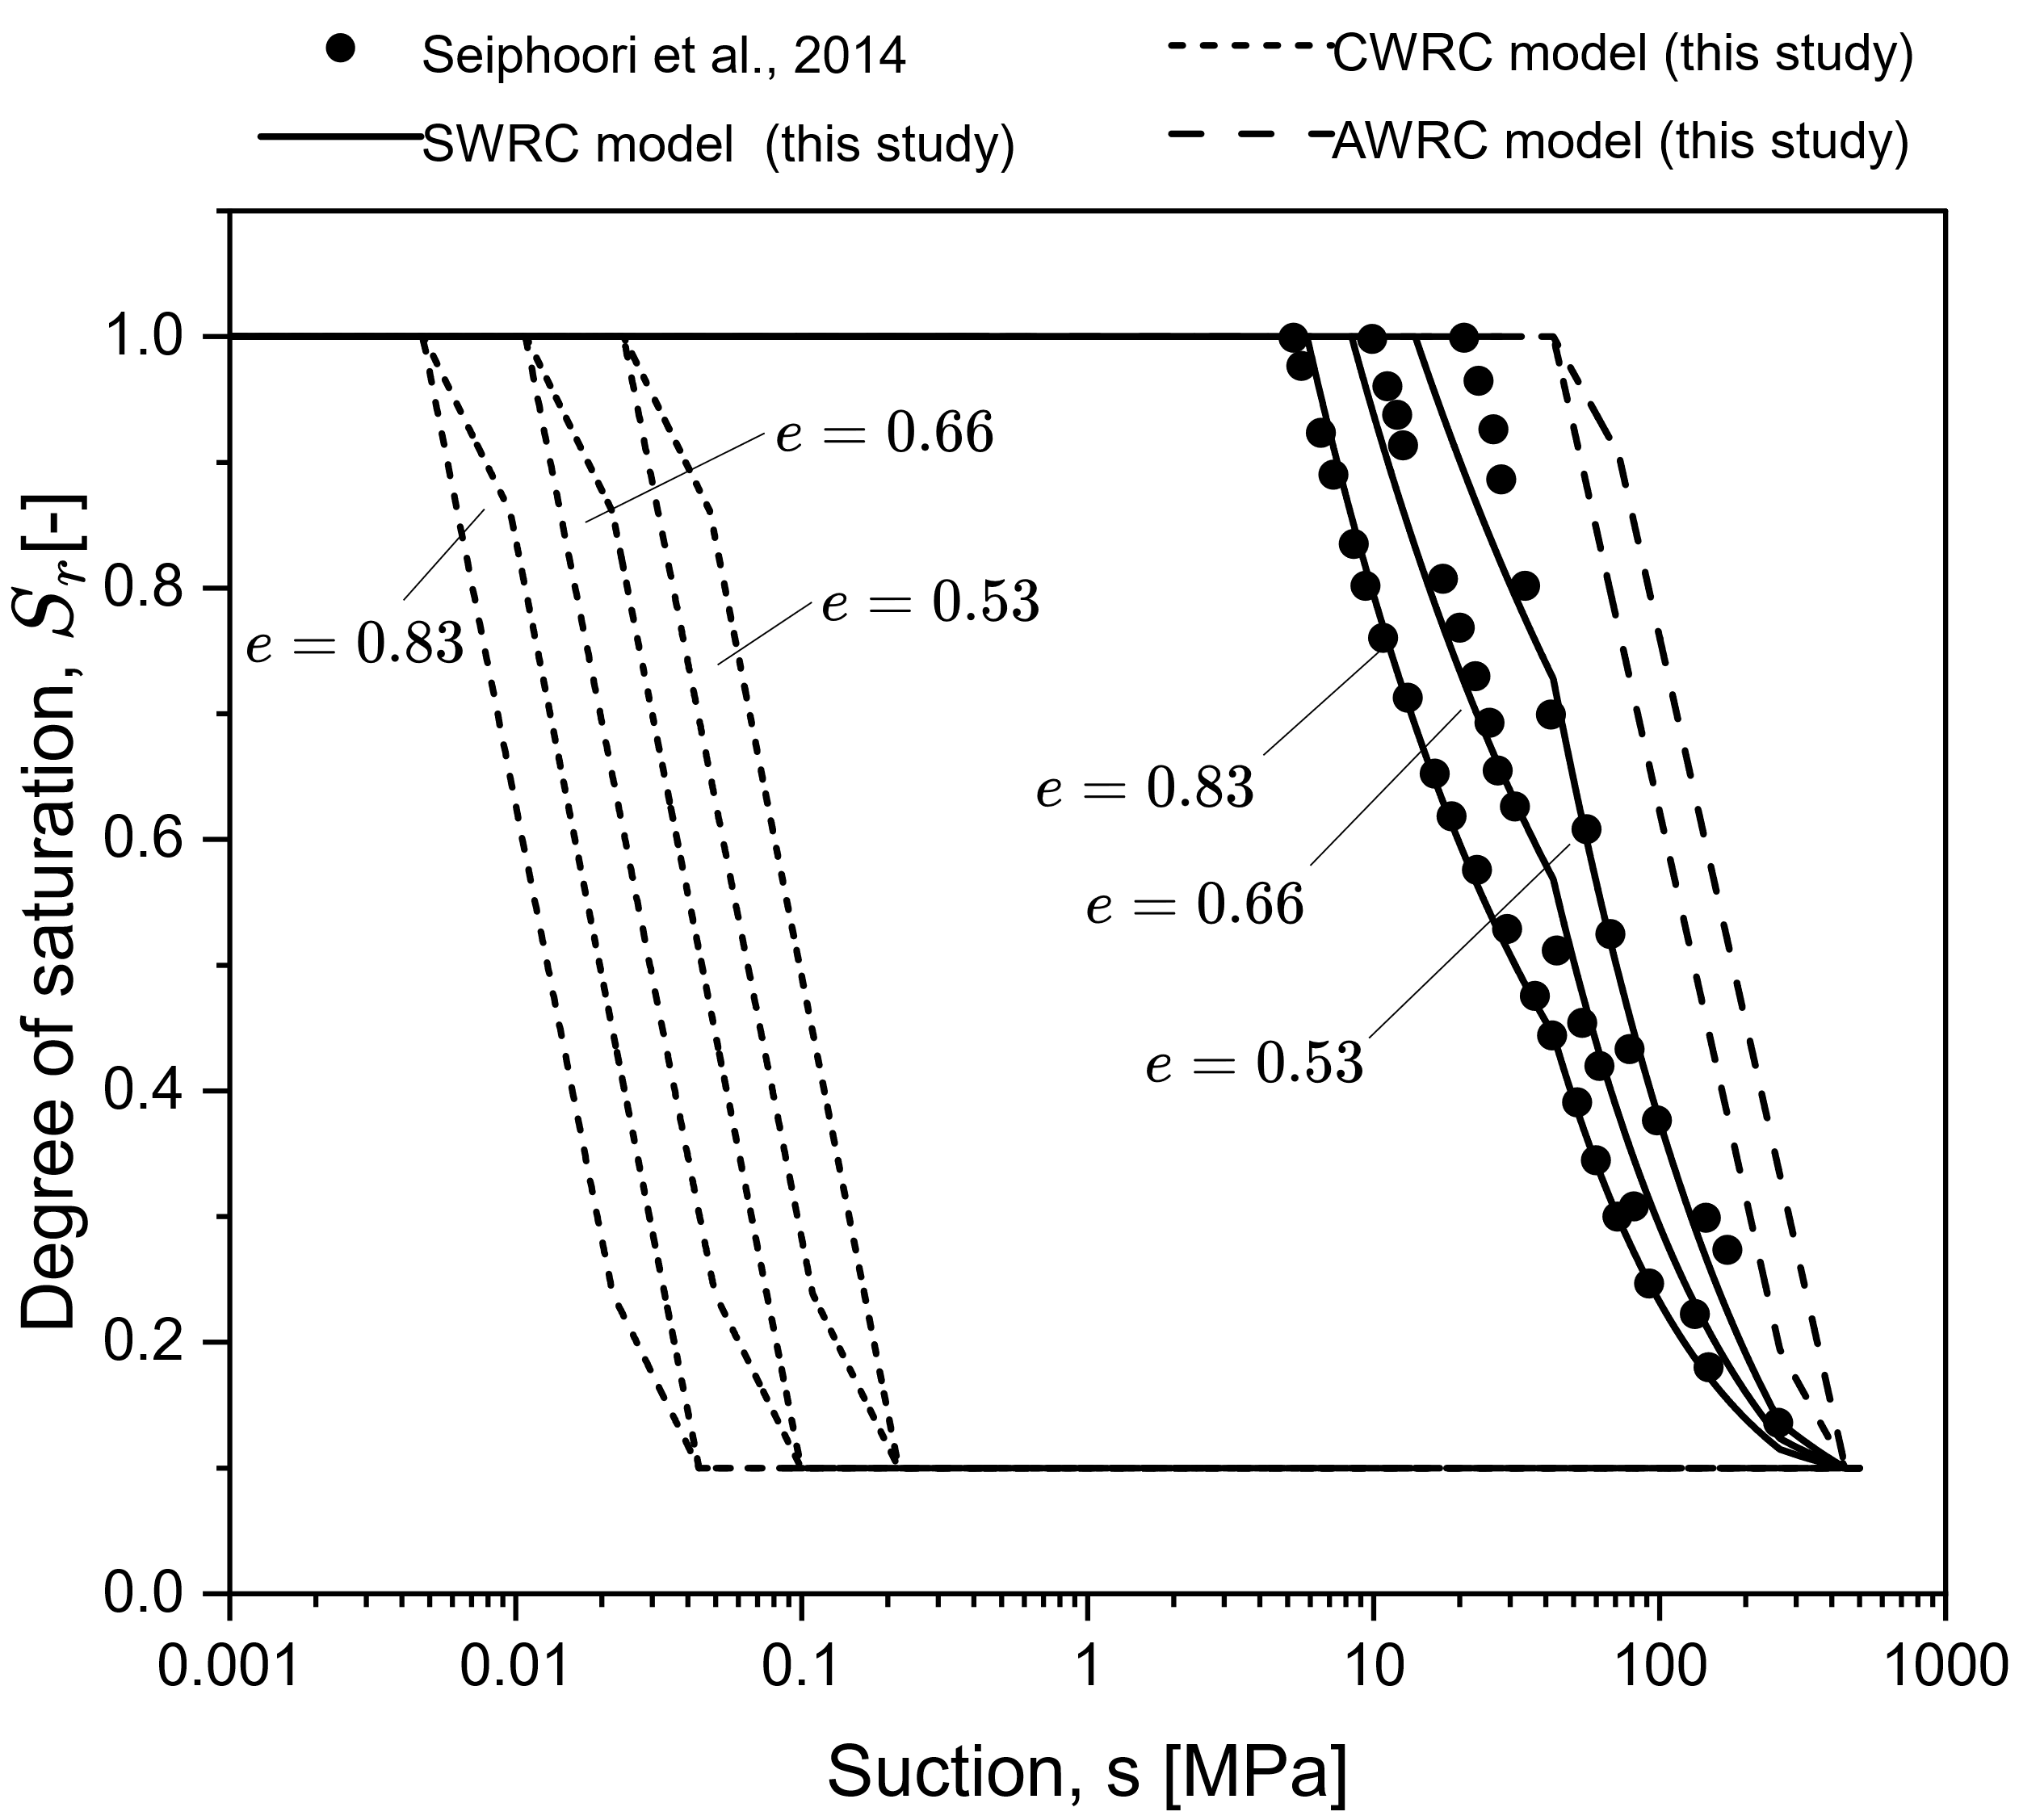
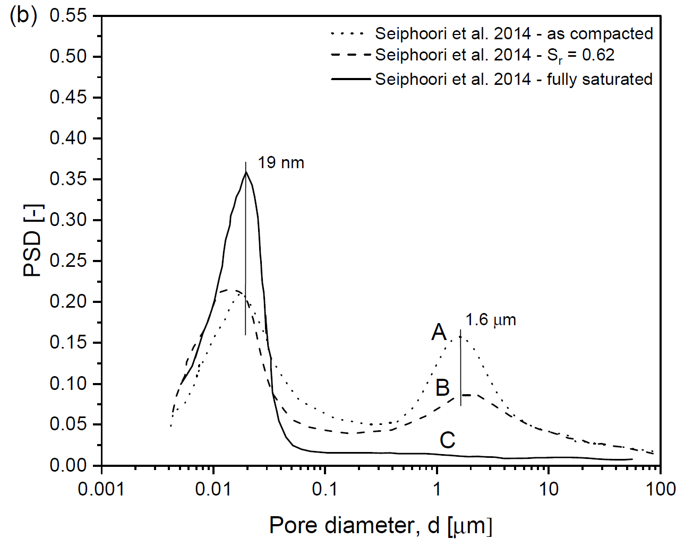
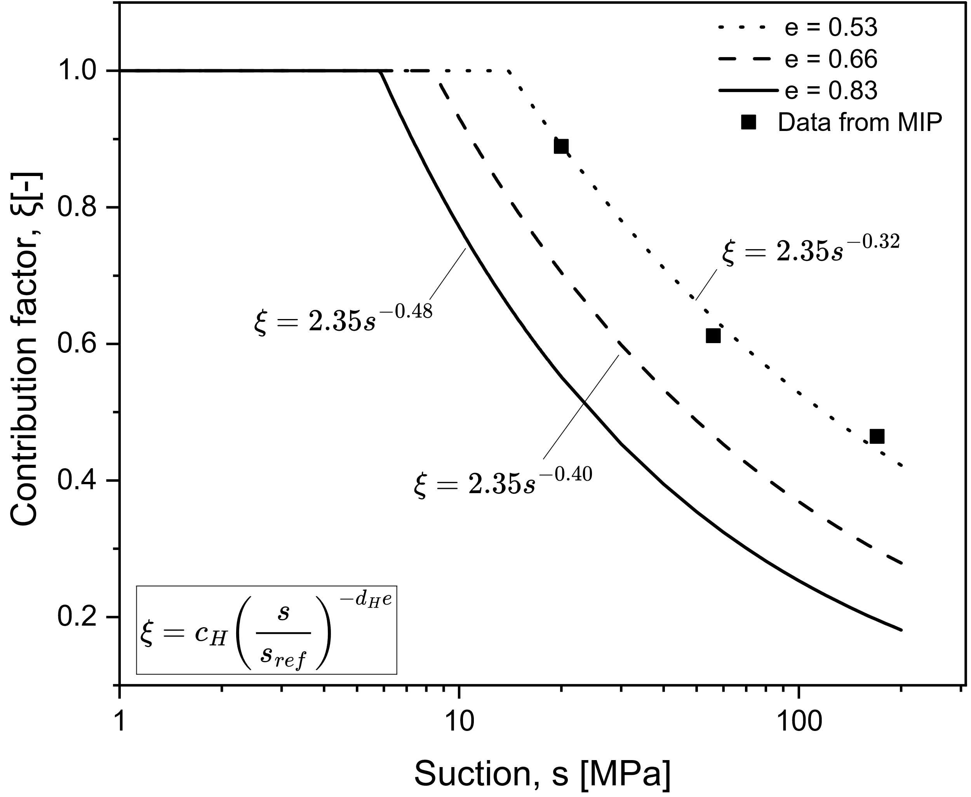



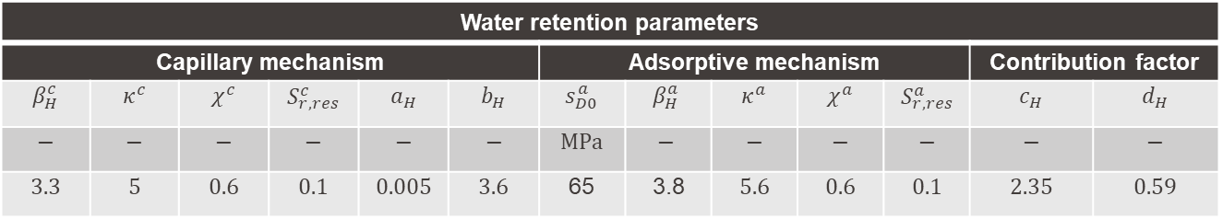

ACMEG-Ex-S: Calibration
$$s≈20 MPa$$
$$s≈20 MPa$$
$$s≈52 MPa$$
$$s≈52 MPa$$
$$s≈180 MPa$$
$$s≈180 MPa$$
Water retention parameters
Capillary mechanism |  |  |  |  |  | Adsorptive mechanism |  |  |  |  | Contribution factor
$$β_{H}^{c}$$ | $$κ^{c}$$ | $$χ^{c}$$ | $$S_{r,res}^{c}$$ | $$a_{H}$$ | $$b_{H}$$ | $$s_{D0}^{a}$$ | $$β_{H}^{a}$$ | $$κ^{a}$$ | $$χ^{a}$$ | $$S_{r,res}^{a}$$ | $$c_{H}$$ | $$d_{H}$$
$$−$$ | $$−$$ | $$−$$ | $$−$$ | $$−$$ | $$−$$ | $$MPa$$ | $$−$$ | $$−$$ | $$−$$ | $$−$$ | $$−$$ | $$−$$
$$3.3$$ | $$5$$ | $$0.6$$ | $$0.1$$ | $$0.005$$ | $$3.6$$ | 65 | 3.8 | $$5.6$$ | $$0.6$$ | $$0.1$$ | $$2.35$$ | $$0.59$$
Parziale, A., Tuttolomondo, A., & Laloui, L. (2026). Advances in understanding and modelling compacted expansive clays: a constitutive approach. Canadian Geotechnical Journal. 63. 1-19. 10.1139/cgj-2025-0669.
Seiphoori, A., Ferrari, A., & Laloui, L. (2014). Water retention behaviour and microstructural evolution of MX-80 bentonite during wetting and drying cycles. Geotechnique. 64. 721-734. 10.1680/geot.14.P.017.

Slide 12
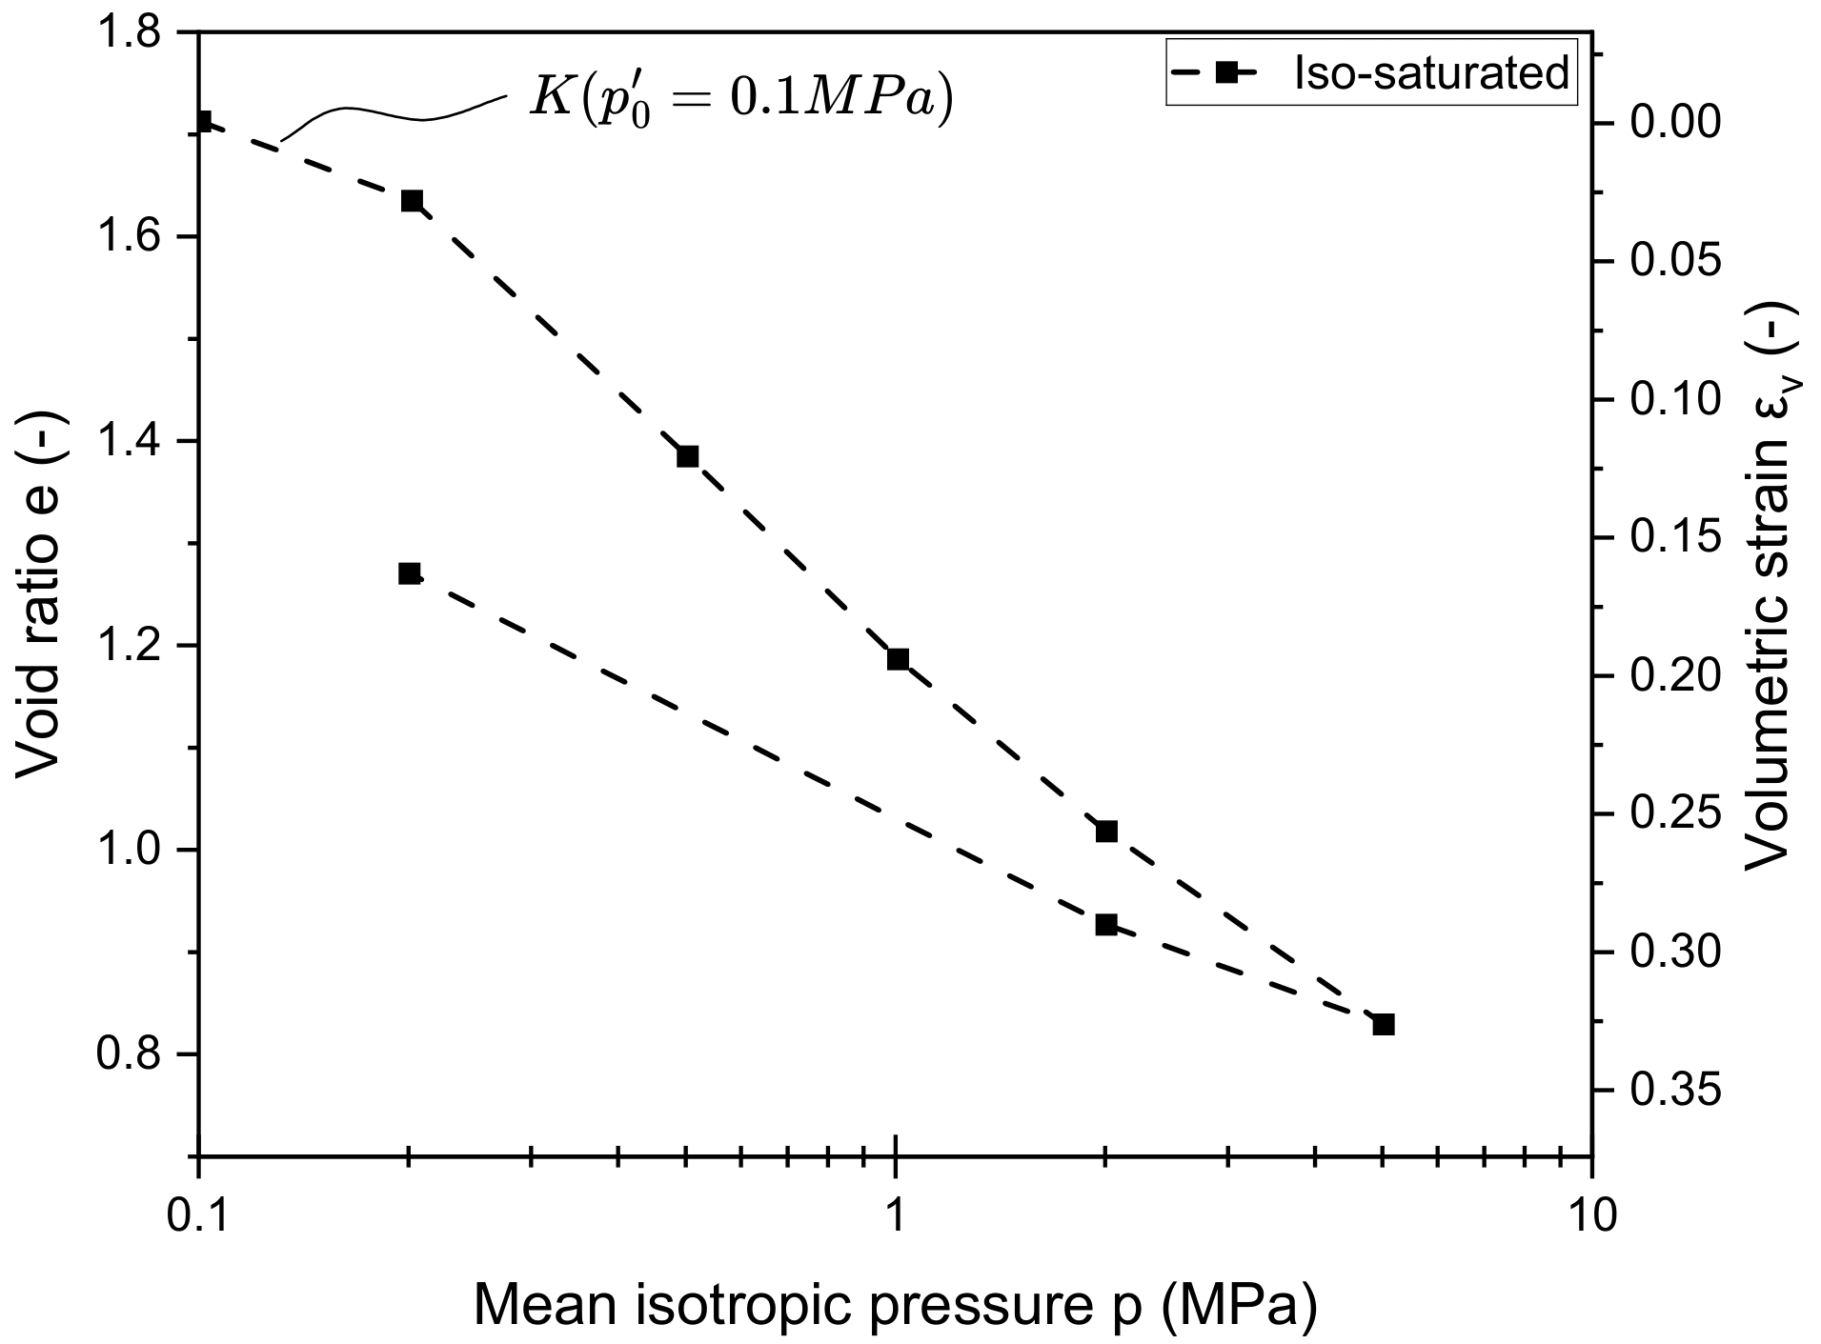
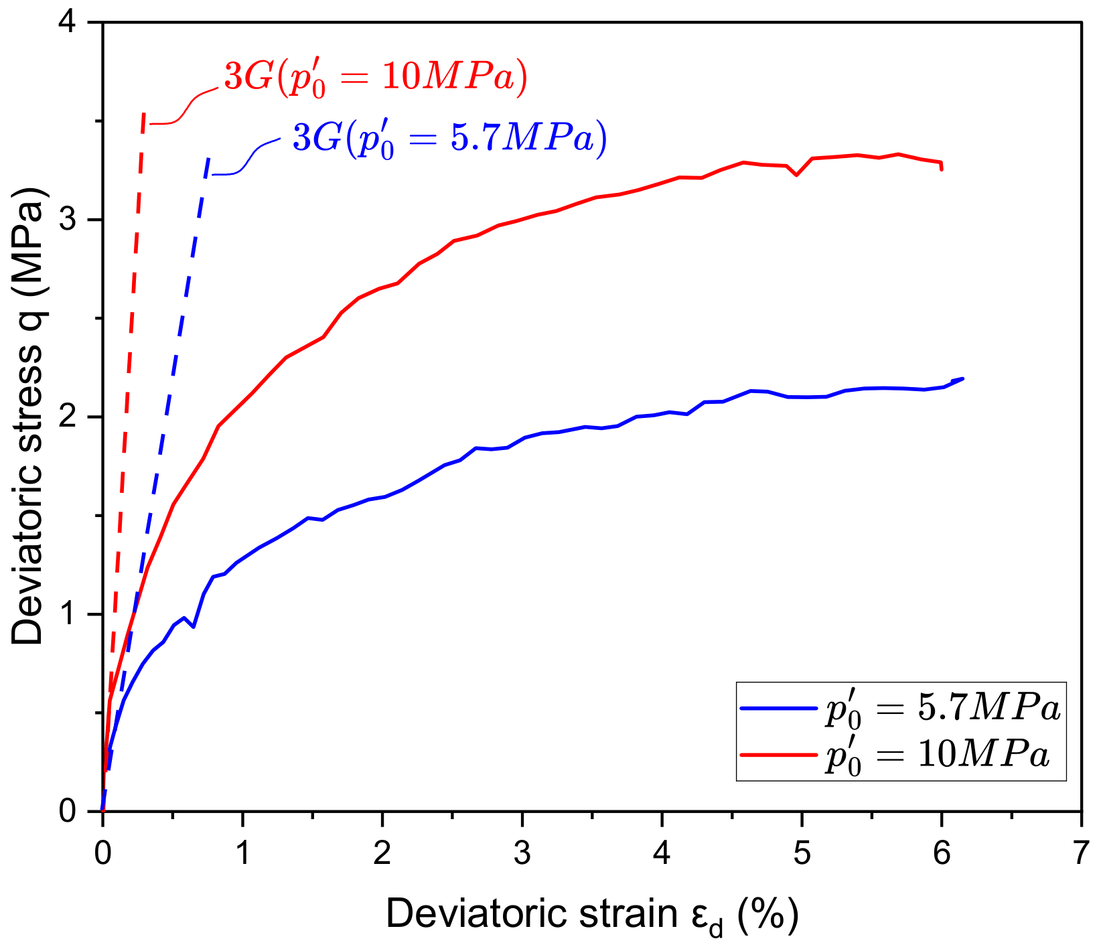
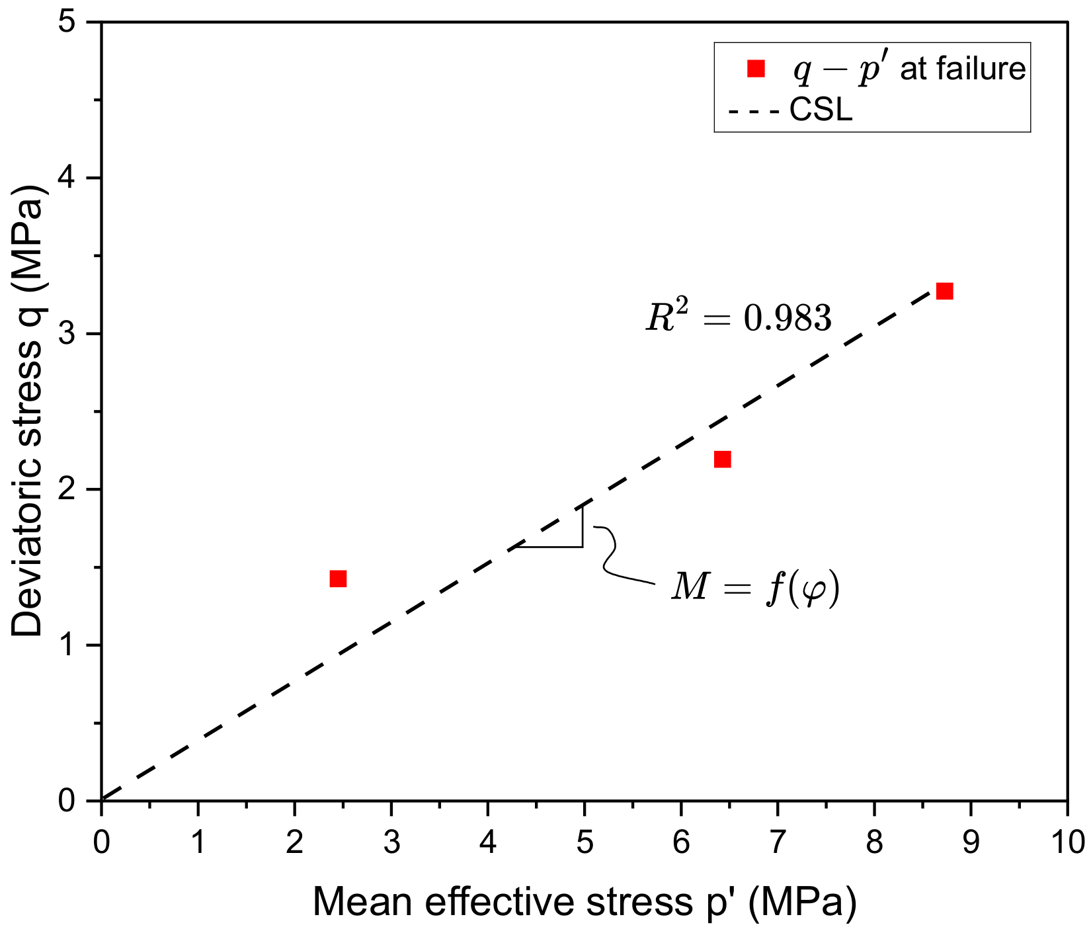
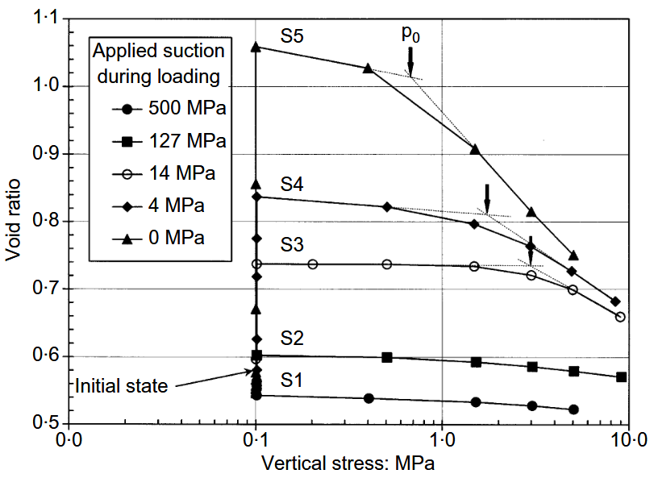




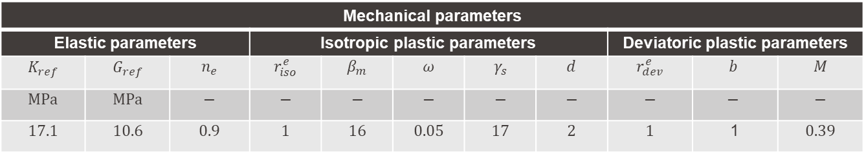



ACMEG-Ex-S: Calibration
Isotropic compression test
saturated conditions (Tang, 2005)
Triaxial compression test
saturated conditions (Kim et al., 2024)
Oedometric compression tests at different suction level (Lloret et al., 2003)
$$κ$$
$$λ$$
$$K=\frac{vp^{′}}{κ}→K_{ref}=K{\left(\frac{p_{ref}^{′}}{p^{′}}\right)}^{n_{e}}$$
$$G=\frac{q}{3ε_{d}}→G_{ref}=G{\left(\frac{p_{ref}^{′}}{p^{′}}\right)}^{n_{e}}$$
$$M=\frac{6sinφ}{3−sinφ}$$
$$p_{c}^{′}={p′}_{c0}\exp\left(βε_{v}^{p}\right)\left[1+γ_{s}\log\left(\frac{s}{s_{D0}}\right)\right]$$
$$β_{m}=\frac{λ−κ}{1+e_{0}}$$
Mechanical parameters
Elastic parameters |  |  | Isotropic plastic parameters |  |  |  |  | Deviatoric plastic parameters
$$K_{ref}$$ | $$G_{ref}$$ | $$n_{e}$$ | $$r_{iso}^{e}$$ | $$β_{m}$$ | $$ω$$ | $$γ_{s}$$ | $$d$$ | $$r_{dev}^{e}$$ | $$b$$ | $$M$$
$$MPa$$ | $$MPa$$ | $$−$$ | $$−$$ | $$−$$ | $$−$$ | $$−$$ | $$−$$ | $$−$$ | $$−$$ | $$−$$
$$17.1$$ | $$10.6$$ | $$0.9$$ | $$1$$ | $$16$$ | $$0.05$$ | $$17$$ | $$2$$ | $$1$$ | 1 | $$0.39$$
Kim et al. (2024). Salinity-dependent ultimate shear strength of compacted Wyoming-type bentonite investigated by triaxial tests. Applied Clay Science. 261. 107576. 10.1016/j.clay.2024.107576.
Lloret et al. (2003). Mechanical behaviour of heavily compacted bentonite under high suction changes. Geotechnique. 53. 27-40. 10.1680/geot.2003.53.1.27.
Parziale, A., Tuttolomondo, A., & Laloui, L. (2026). Advances in understanding and modelling compacted expansive clays: a constitutive approach. Canadian Geotechnical Journal. 63. 1-19. 10.1139/cgj-2025-0669.
Tang, A.M. (2005). Temperature effect on the behaviour of engineered clay barriers. PhD thesis. Ecole des Ponts ParisTech. pastel-00001594.

Slide 13
OUTLINE
Introduction
Water retention framework
Mechanical framework
Model calibration
Model performance
Conclusions

Slide 14
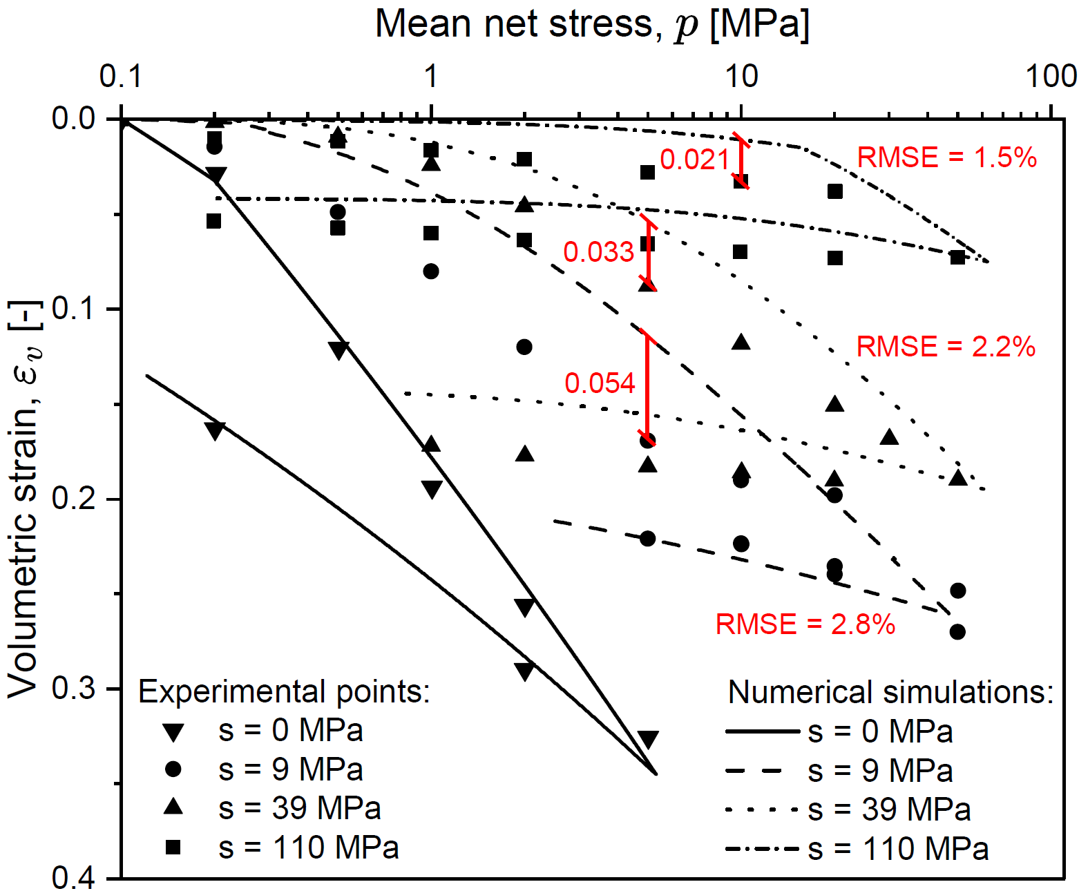
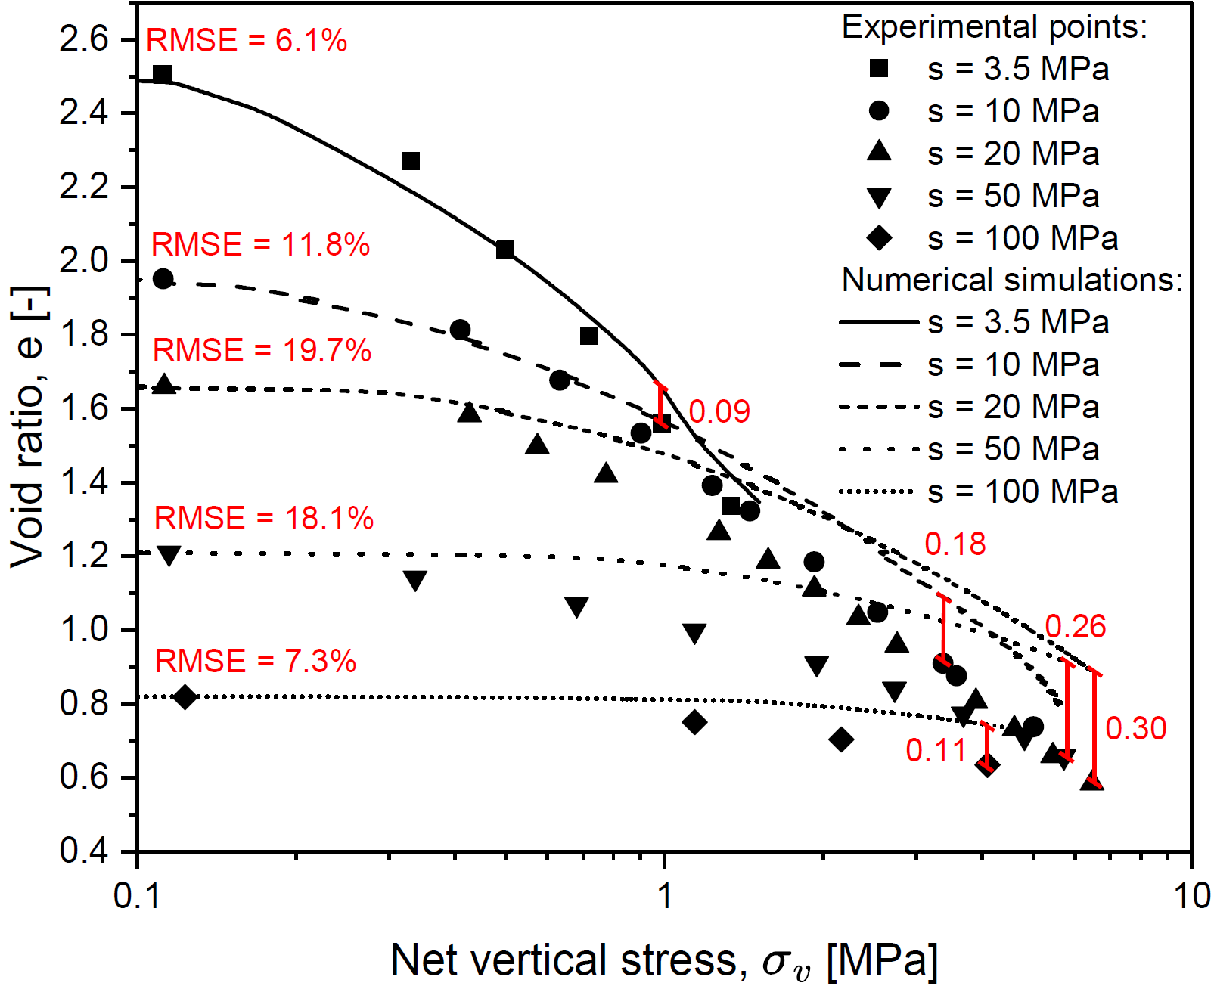
ACMEG-Ex-S: Mechanical compression tests
Isotropic compression tests
Oedometric compression tests
Parziale, A., Tuttolomondo, A., & Laloui, L. (2026). Advances in understanding and modelling compacted expansive clays: a constitutive approach. Canadian Geotechnical Journal. 63. 1-19. 10.1139/cgj-2025-0669.
Seiphoori, A. (2014). Thermo-hydro-mechanical characterisation and modelling of MX-80 granular bentonite. PhD thesis. EPFL, Lausanne.
Tang, A.M. (2005). Temperature effect on the behaviour of engineered clay barriers. PhD thesis. Ecole des Ponts ParisTech, Paris.

Slide 15
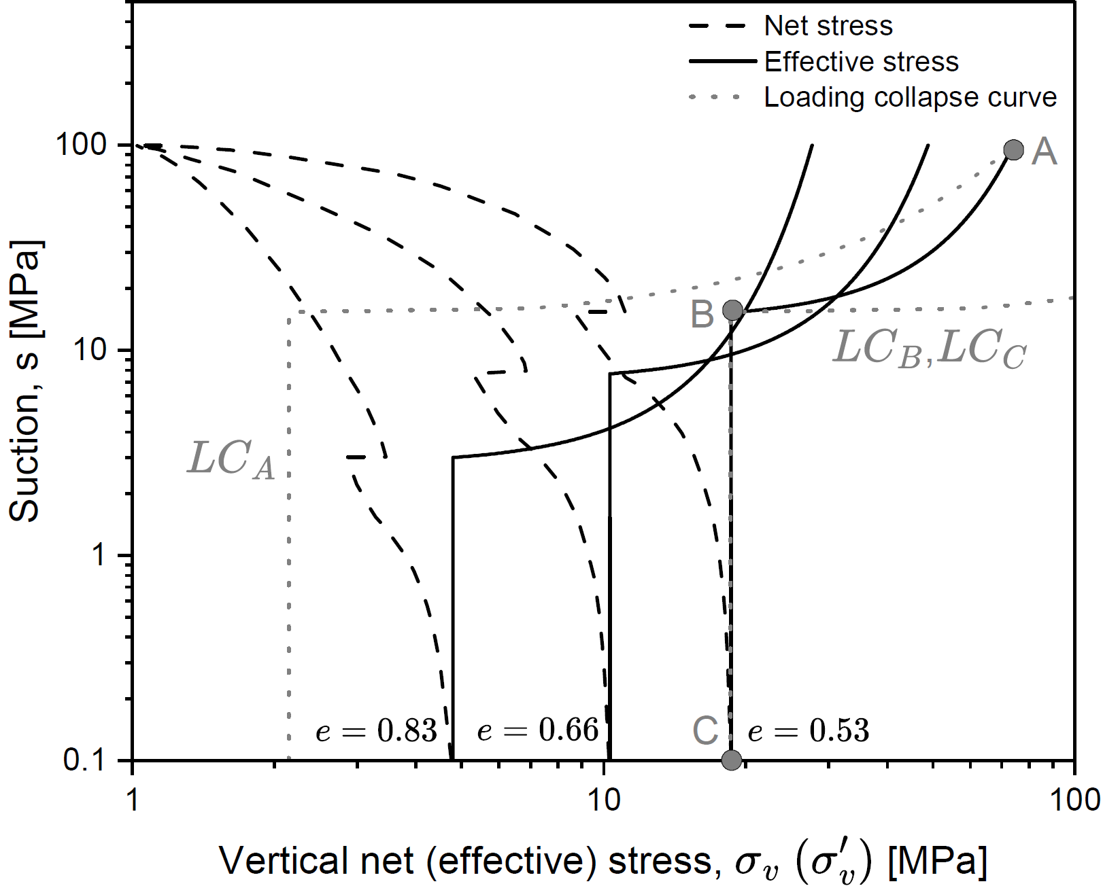
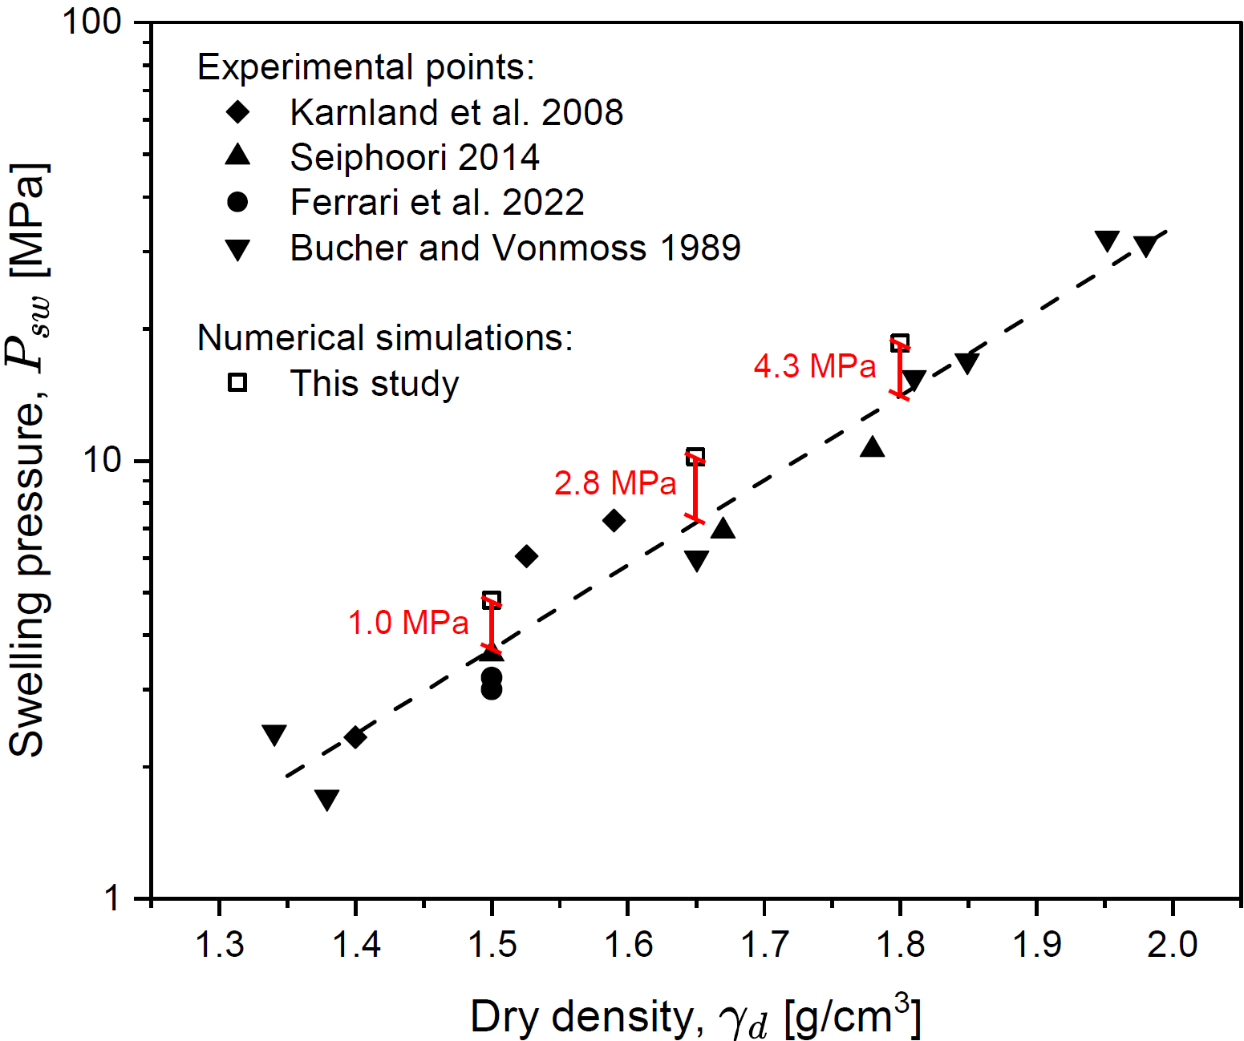
ACMEG-Ex-S: Swelling pressure tests
Stress-paths
Literature data
Bucher, F., & Müller-Vonmoos, M. (1989). Bentonite as a containment barrier for the disposal of highly radioactive wastes. Applied Clay Science. 4. 157-177. 10.1016/0169-1317(89)90006-9.
Ferrari et al. (2022). Volume change response and fabric evolution of granular MX80 bentonite along different hydro-mechanical stress paths. Acta Geotech. 17. 3719-3730. 10.1007/s11440-022-01481-0.
Karnland et al. (2008). Sealing ability of Wyoming bentonite pellets foreseen as buffer material – Laboratory results. Physics and Chemistry of the Earth, Parts A/B/C. 33. S472-S475. 10.1016/j.pce.2008.10.024.
Parziale, A., Tuttolomondo, A., & Laloui, L. (2026). Advances in understanding and modelling compacted expansive clays: a constitutive approach. Canadian Geotechnical Journal. 63. 1-19. 10.1139/cgj-2025-0669.

Slide 16
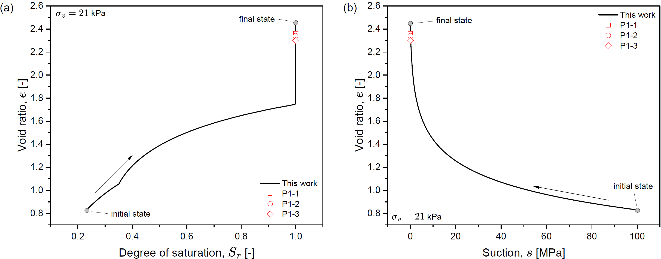


ACMEG-Ex-S: Free swelling tests
$$s<AEV$$
$$s>AEV$$
Ferrari et al. (2022). Volume change response and fabric evolution of granular MX80 bentonite along different hydro-mechanical stress paths. Acta Geotech. 17. 3719-3730. 10.1007/s11440-022-01481-0.
Parziale, A., Tuttolomondo, A., & Laloui, L. (2026). Advances in understanding and modelling compacted expansive clays: a constitutive approach. Canadian Geotechnical Journal. 63. 1-19. 10.1139/cgj-2025-0669.

Slide 17
OUTLINE
Introduction
Water retention framework
Mechanical framework
Model calibration
Model performance
Conclusions

Slide 18



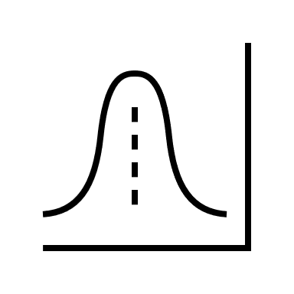
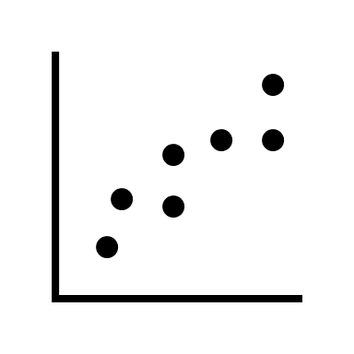
Conclusions
References:
Bucher, F., & Müller-Vonmoos, M. (1989). Applied Clay Science. 4. 157-177.
Ferrari et al. (2022). Acta Geotech. 17. 3719-3730.
Karnland et al. (2008). Physics and Chemistry of the Earth, Parts A/B/C. 33. S472-S475.
Kim et al. (2024). Applied Clay Science. 261.
Lloret et al. (2003). Geotechnique. 53. 27-40.
Parziale et al. (2026). Canadian Geotechnical Journal. 63. 1-19.
Qiao et al. (2021). Geomechanics for Energy and the Environment. 25. 100205.
Seiphoori, A. (2014). PhD thesis. EPFL, Lausanne.
Tang, A.M. (2005). PhD thesis. Ecole des Ponts ParisTech, Paris.
Microstructural informations embedded in the water retention model
Stress-path dependency of the pore structure
Water retention mechanisms are independently modelled
Validated against hydro-mechanical stress-paths for bentonite
Mechanics
Hydraulics
Structure
Validation
Advanced mechanical formulation
Water retention mechanisms
(adsorption + capillarity)
Pore structure evolution
HM stress-paths for bentonite
Contact: alessandro.parziale@epfl.ch

Slide 19
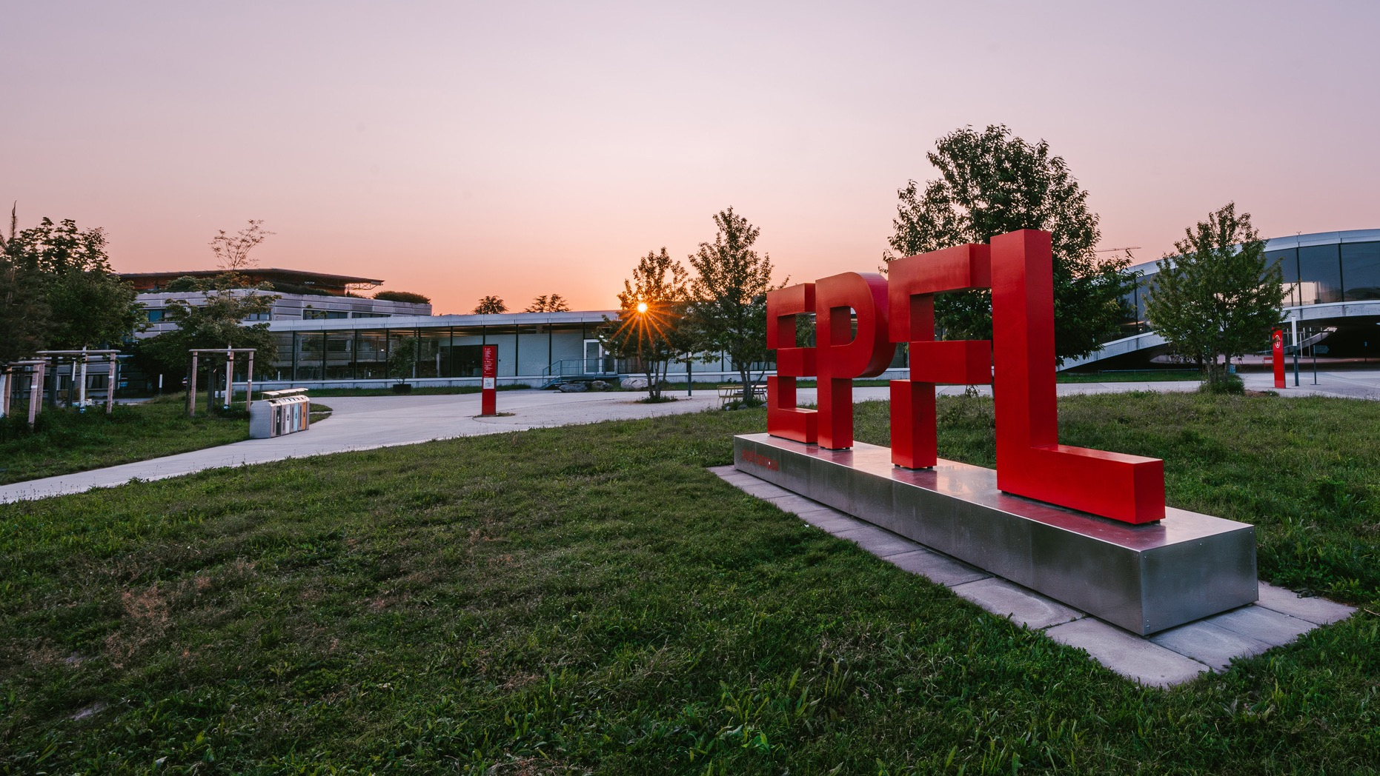
Thank you for your attention !
PRESENTED BY
Alessandro PARZIALE
Angelica TUTTOLOMONDO
Lyesse LALOUI

