Slide 1




Enabling Boundary-Value Interpretation of Element-Level Tests through Distributed Fibre Optic Sensing
Coupled flow-deformation in shales under multiphase flow
InterPore2026 Friday, 22 May 2026
Nantes, France
Qazim Llabjani Alessio Ferrari
Paul Marschall
Lyesse Laloui
Notes:
So the idea of this research is to enable element-level tests to be interpretated as boundary-value experiments. In other words, to be able to observe the response of tested specimens in both time and space.

Slide 2
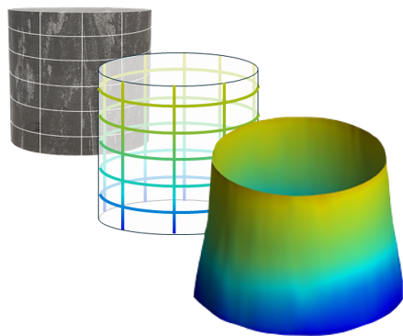
Enabling Boundary-Value Interpretation of Element-Level Tests through Distributed Fibre Optic Sensing
Coupled flow-deformation in shales under multiphase flow

Slide 3
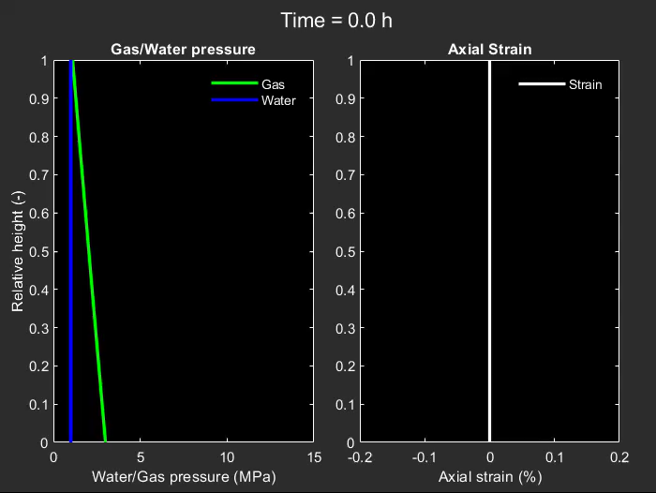
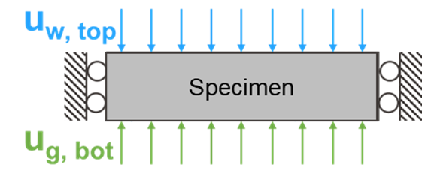
Model-supported analysis of gas injection experiments
3
Expansion (-)
Compression (+)
σ_{a} = 15 MPa
Water
1 MPa
ε_{r} = 0
Gas
3-10 MPa
More details:
Llabjani, Ferrari, Marschall & Laloui (2025). IJRMMS
Finsterle, Llabjani, Ferrari & Marschall (2025). Comput. Geosci.
Notes:
Let me start with a model output. This is a numerical simulation of a gas injection experiment on a low-permeability shale. Gas is injected from the bottom at increasing pressure; water is held at the top; the lateral deformation is blocked.
What you see in the two panels are the predicted internal fields — porewater and gas pressure on the left, axial strain on the right — evolving in time.
The point is: there's a lot going on inside the specimen as a model output, which is not captured by the experiment. Pressure gradients, strain heterogeneity, pore pressure redistribution. None of this is directly observable in a conventional experiment. We measure pressures and flows at the boundary. We measure overall deformation with an LVDT, or strain at a point with a gauge. The internal fields you're looking at here — they're predicted, not measured.

Slide 4
The need for distributed observation
4
Physical interpretation and modelling relies on a small set of boundary observables
Boundary fluid pressure/flow; Global (LVDT) or local (strain gauge) deformation
Different models fit the same data, but predict different internal responses
Various interpretation and lack of predictability
Need for additional observable variables to discriminate modelling approaches
→ Spatially-distributed data at sub-mm spatial resolution, where gradients of interest develop
Notes:
Modelling of gas transport in shales relies on boundary pressures, fluxes, and limited strain data. Different modelling approaches predict different internal behaviours but fit the same boundary data. To distinguish them, we need spatially-distributed observables inside the specimen.

Slide 5
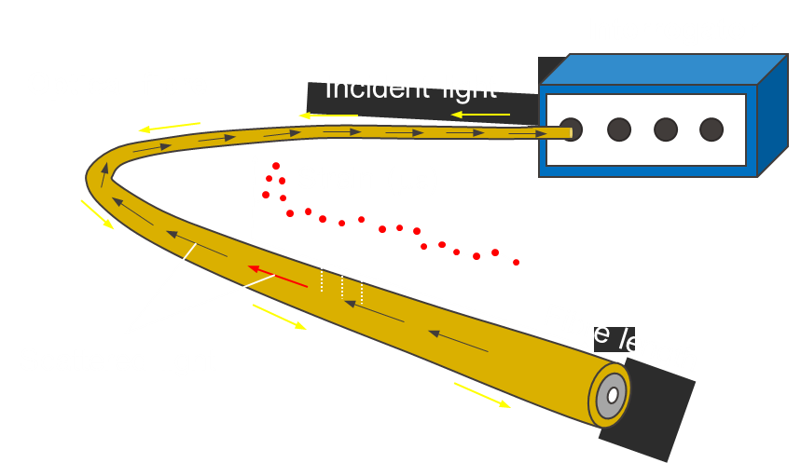
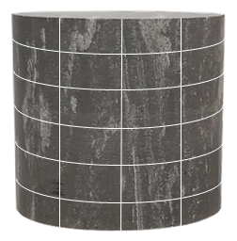
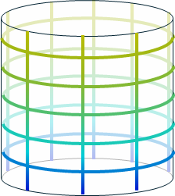
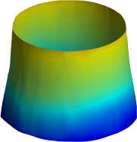
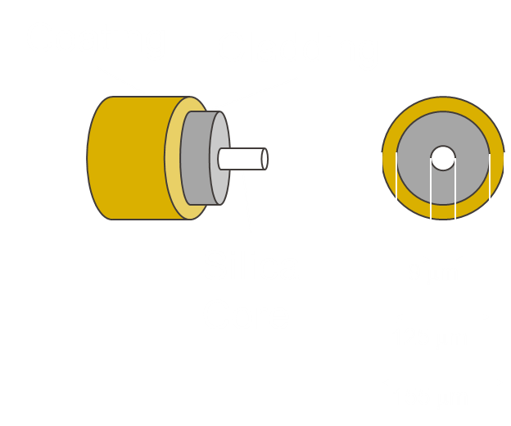
Element-level testing with distributed sensing
5
Distributed fibre optic sensing
From point data to strain field
Llabjani, Ferrari, Marschall & Laloui (2026). In preparation
Notes:
Distributed fibre optic sensing is one way to deliver spatial observables. A single optical fibre is bonded to the specimen surface. Light propagates and the backscattered signal is interpreted as strain along the fibre's length.

Slide 6
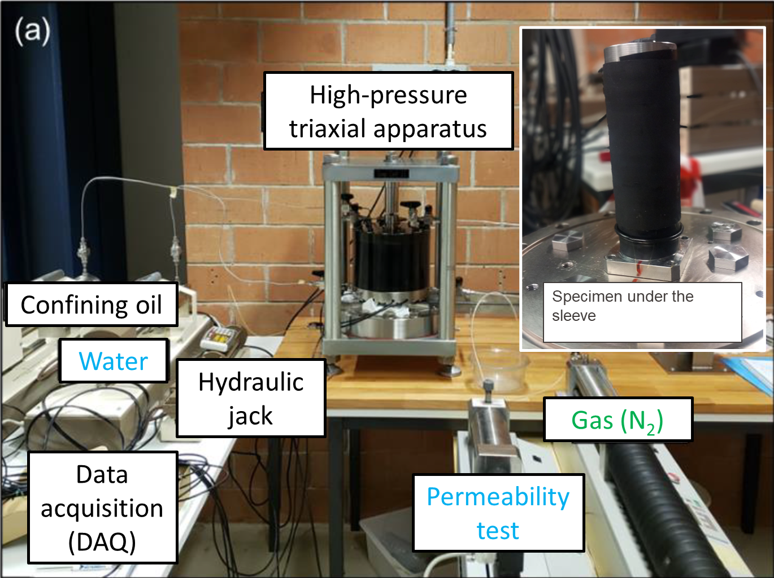
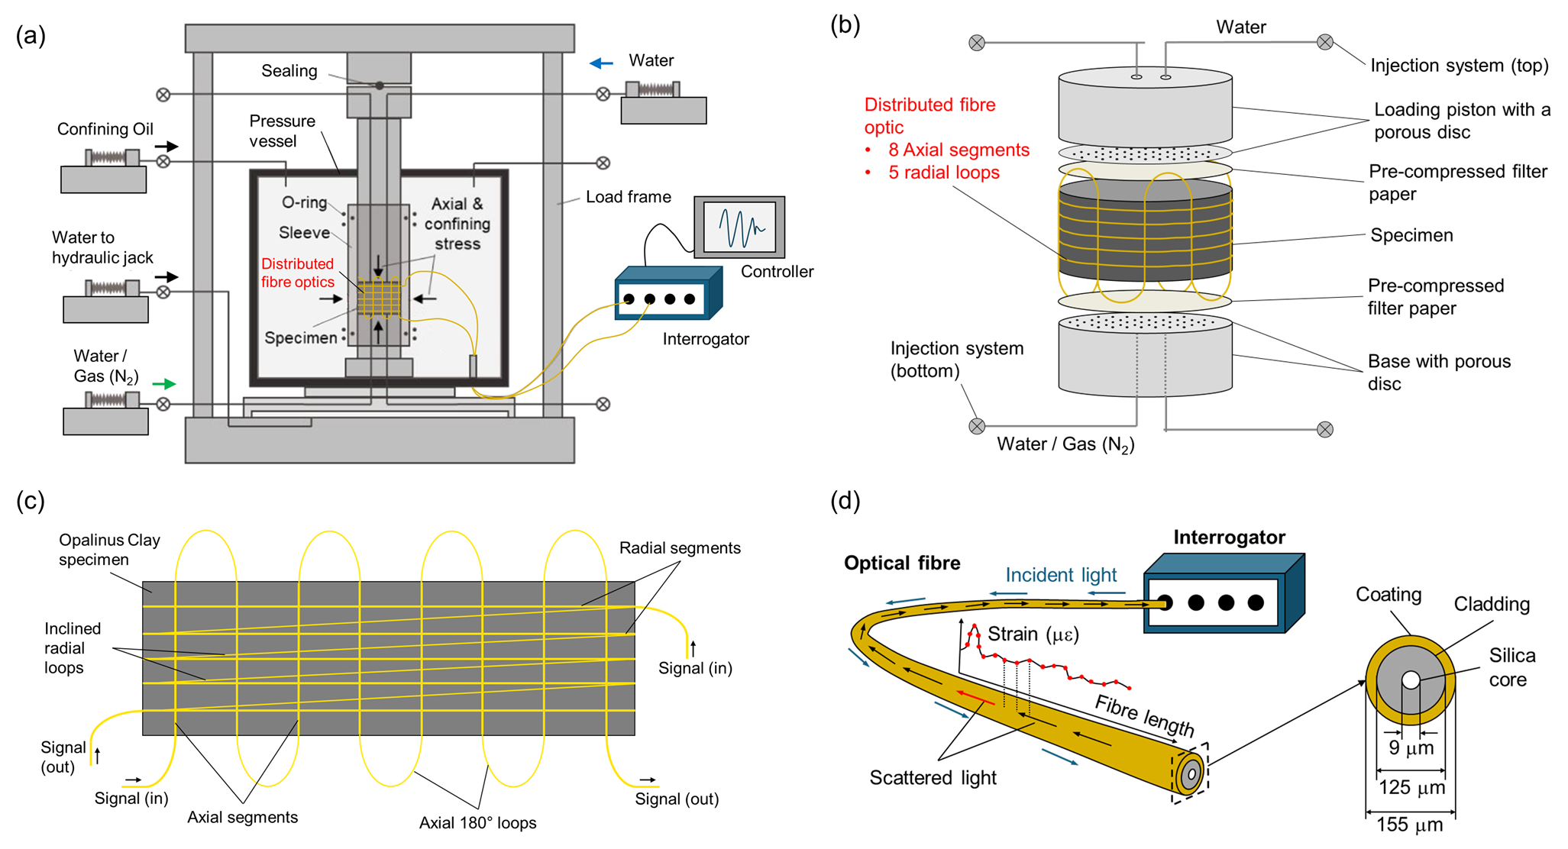
Distributed fibre optics in a high-pressure triaxial cell
6
High-pressure triaxial cell
Specimen with DFO sensors
DFO performance
>1500
strain points per acquisition
0.65 mm
spatial gauge spacing
25 με
Multiphase flow capability
σ_{a} 80 MPa, σ_{r} 64 MPa
Specimen: D = 43 mm; H = 40 mm
system accuracy
Notes:
Now, how do we deploy this in a high-stress, multiphase-flow apparatus?
We instrument a cylindrical shale specimen with the optical fibre, then place it in a high-pressure triaxial cell capable of multiphase flow. Axial stress up to 80 megapascals, radial up to 64. Gas and water pressures controlled at top and bottom.
The fibre runs along the lateral surface in a combination of axial segments and circumferential loops. Over 1500 strain measurements per acquisition, with 0.65 millimetre spacing and accuracy of about 25 microstrain.

Slide 7
S-sample: a hydro-mechanical testing programme
7
Test programme
Resaturation
Water permeability
Gas injection
1
2
3
synthetic water, both ends; σ → 20-30 MPa
u_{w,bot} = 2, 5, 10 MPa;
σ = 20 MPa (isotropic)
u_{g,bot} 3 → 19.5 MPa; u_{w,top} = 2 MPa
σ = 20 MPa (isotropic)
σ_{a}
σ_{a}
u_{w,top}
u_{w,top}
σ_{r}
σ_{r}
bedding (⊥ flow)
u_{w,bot}
u_{g,bot}
DFO records the surface strain field through every phase
Notes:
Testing programme is composed of three phases
The goal is to restaure in-situ conditions, without damaging the material, and to assess its relevant properties (permeability), before moving to the main testing phase with gas injection.
Resaturation is started at low stress, and is increased as swelling develops, to maintain quasi-constant volume conditions, and avoid excessive swelling (and damage).
Then gas is injected by increasing gas pressure at the bottom to investigate the material response.
Throughout all three phases, the DFO records the surface strain field continuously. Bedding is perpendicular to flow in this specimen.

Slide 8
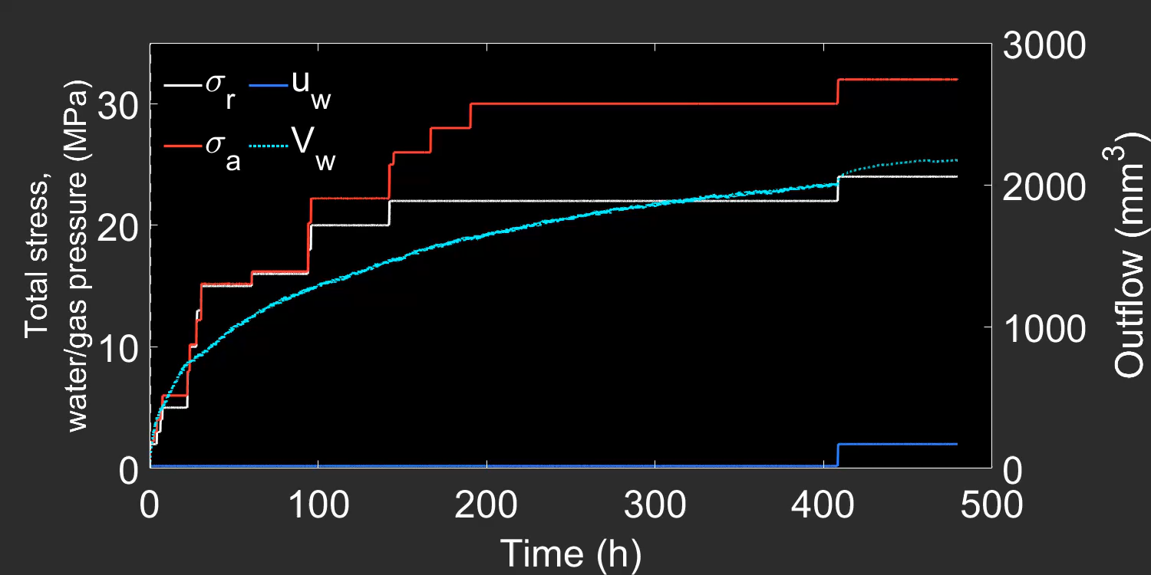
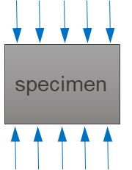
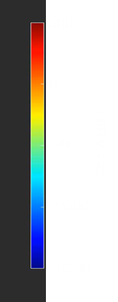
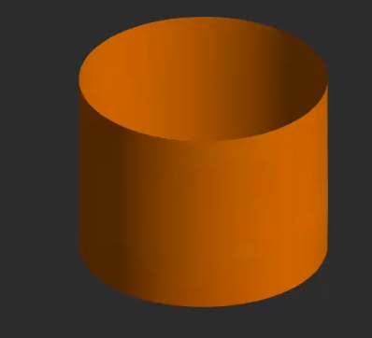
Resaturation Wetting fronts and non-uniform strain response
8
Radial strain
Spatial response
Swelling concentrated at the wetted faces; propagate towards the centre with the wetting front
Temporal response
Homogenisation of the strain field as the wetting front reaches the centre.
Contraction
Multiple coupled stress–hydraulic paths inside the specimen
Expansion

Slide 9
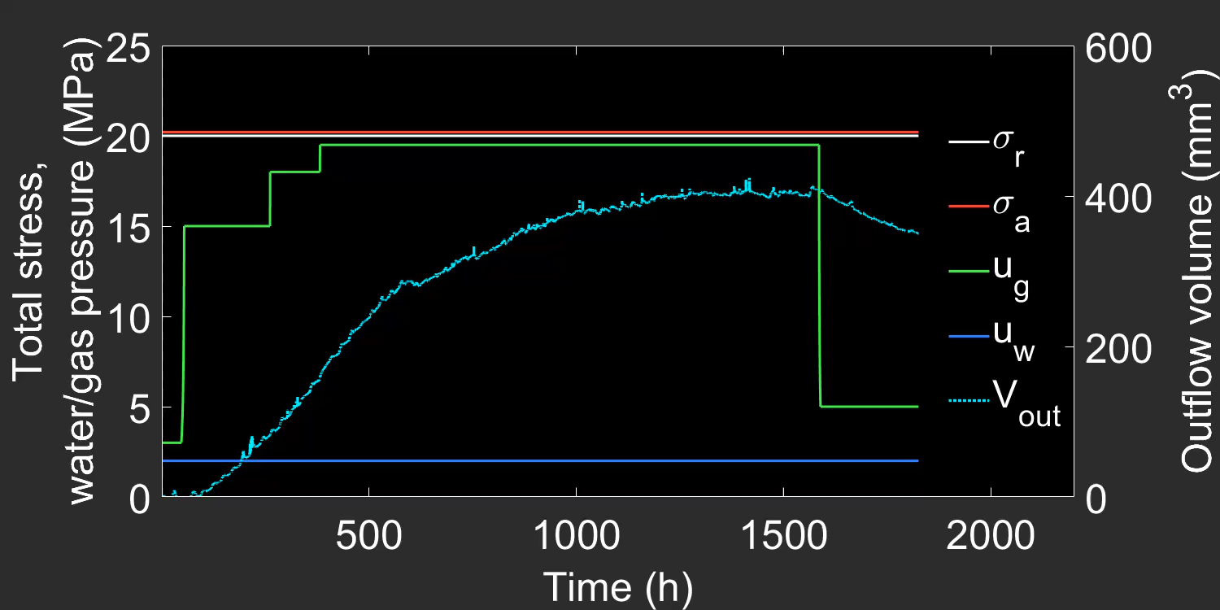
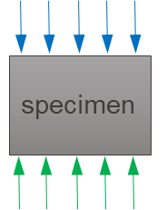
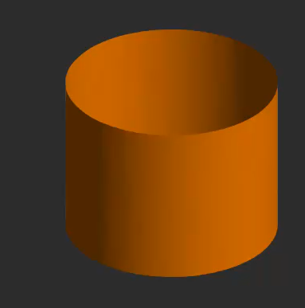
Gas injection Localisation in space, transient in time
9
Radial strain
Spatial response
Expansion localises near the gas inlet
Dominant height gradient, circumferential uniformity
Temporal response
Under constant boundary pressures, expansion peaks and partially recovers while outflow decays toward zero.
Contraction
Gas pressurisation drives a transient porewater redistribution across the specimen
Expansion
Notes:
Now gas injection
Same kind of visualisation, now during gas injection. Gas pressure ramps up from the bottom; water and confining pressures are held constant.
gas pressurisation drives a transient porewater redistribution across the specimen. Gas enters near the inlet, displaces porewater, and the porewater redistributes through the connected water phase, leading to this peak and relaxation deformation. The gas itself doesn't break through.

Slide 10
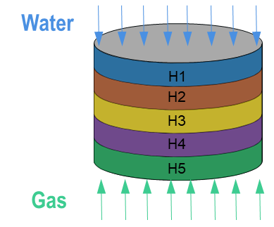
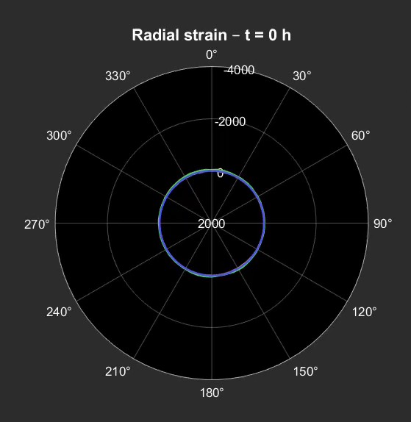
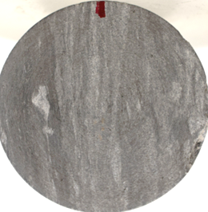
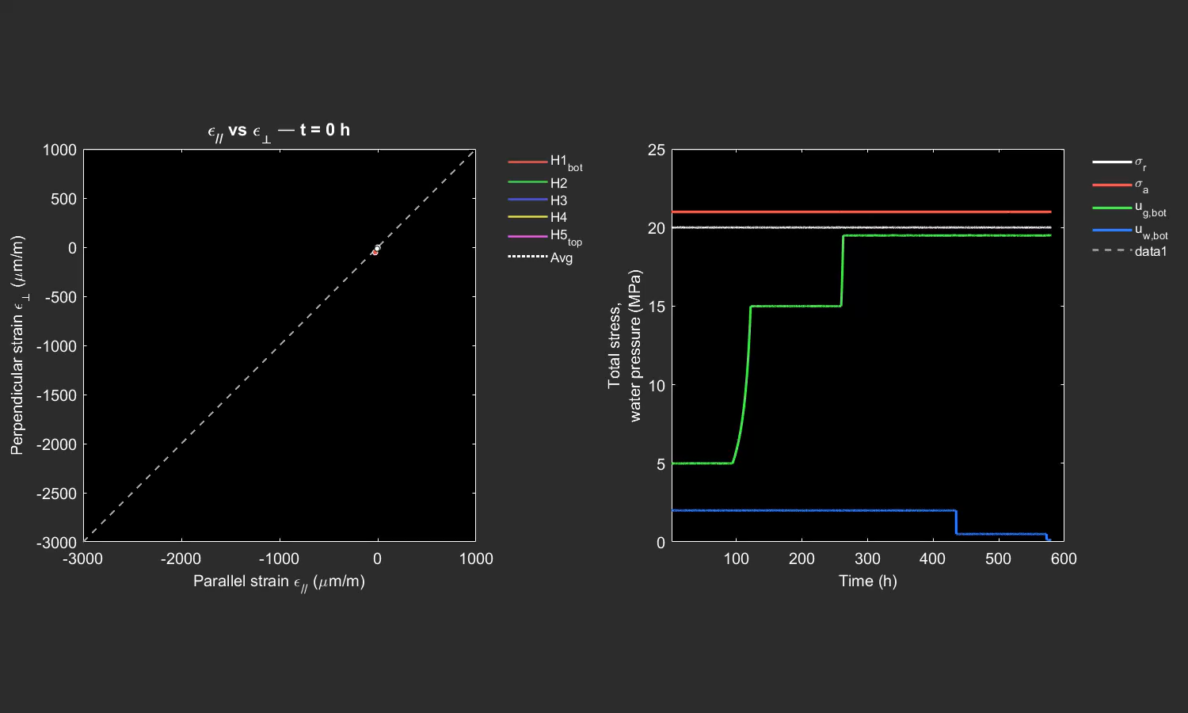
Bedding-parallel injection Anisotropic deformation
10
Anisotropic deformation (bedding planes) under fluid injection
Same method, bedding rotated 90°
Flow now parallel to bedding plane
Circ.
bedding (|| flow)
ε//
σ_{a}
σ_{r}
U_{g,bot}
ε⊥
u_{w,top}
U_{w,top}
u_{g,bot}

Slide 11
A boundary-value interpretation of element tests
11
Element tests, read as boundary-value experiments
Spatial and temporal information now part of the interpretation. Multiple HM stress-path inside one specimen.
A new level of observability
Spatiotemporal observation supports physical understanding and provides previously unobservable variables needed to constrain coupled HM models
DFO reveals coupled flow-deformation of OPA in time and space
Under sustained gas pressure, deformation localises at the injection locus, with a peak and relaxation pattern due to transient porewater redistribution

Slide 12
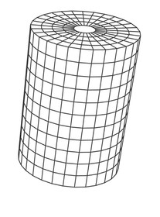
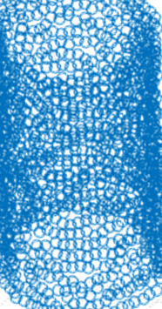
What this brings to coupled flow-deformation research
12
Experimental Geomechanics
Numerical modelling
Data-driven
approaches
DFO works under multiphase flow in geomaterials
Sub-mm spatial resolution opens element-scale testing to spatial observation
Model-supported physical understanding
Coupled HM models confronted against the spatiotemporal field, particularly under transient, boundary-driven regimes
1500 data points per time step offer dense spatiotemporal observables
Supports inverse and data-driven approaches; constrains parametrisation beyond what boundary point sensors allow.

Slide 13

Thank you for your attention !
InterPore2026
PRESENTED BY
Qazim Llabjani qazim.llabjani@epfl.ch

