Slide 1



Geomechanics of Cyclic Underground Hydrogen Storage: From Site Conditions to Lab Experiments
Philipp BRAUN, Assistant Professor
Zhaochen XU, PhD candidate
Jean SULEM, Professor

Slide 2

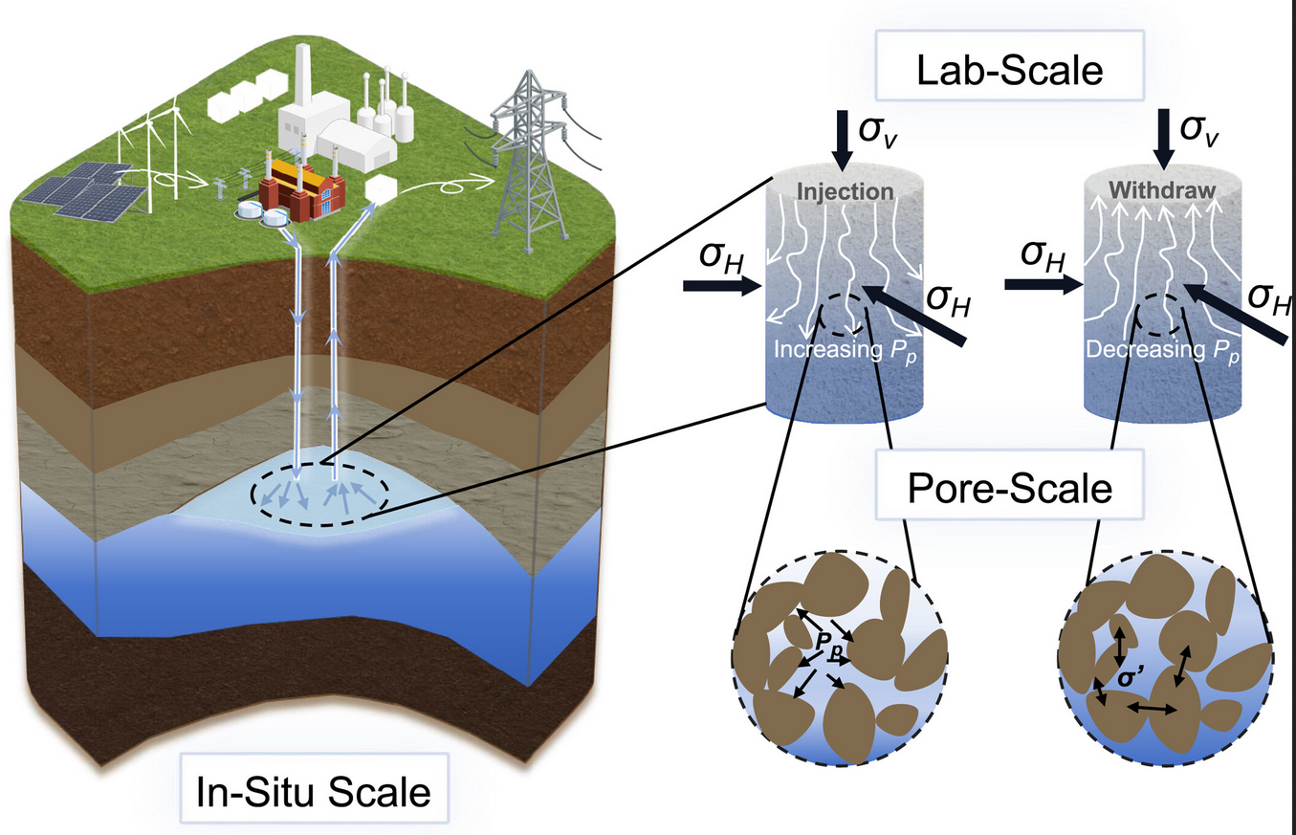
Underground hydrogen storage in porous rock

Slide 3
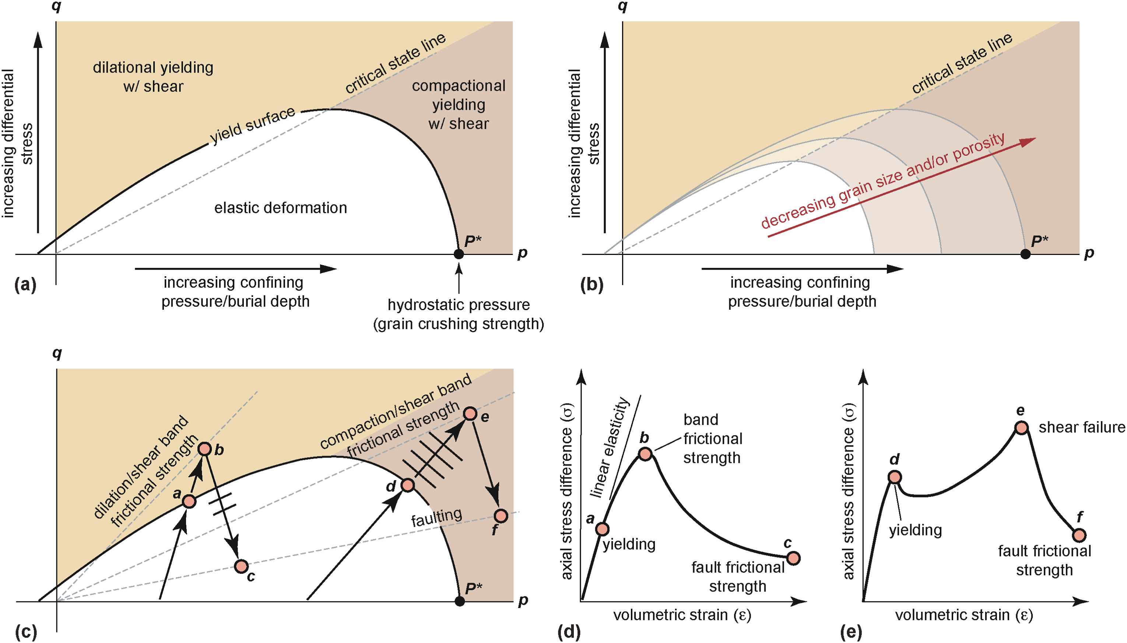
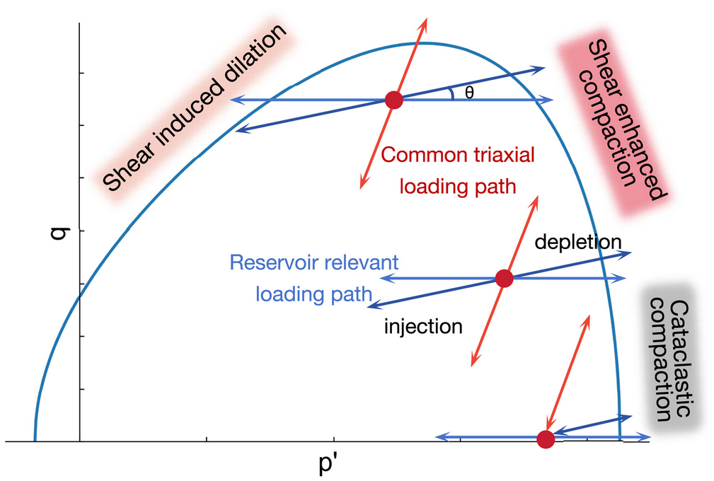
Long term and cyclic response
Goldsby et al. (2024), Schultz and Siddharthan (2005) and Swanger et al. (2023)
Exceeding yield envelope should be avoided !
Can we risk additional deformation or failure before yield?
Time dependent (creep) deformation?
Cyclic deformation (accelerating/stabilizing)?
Fatigue failure?

Slide 4
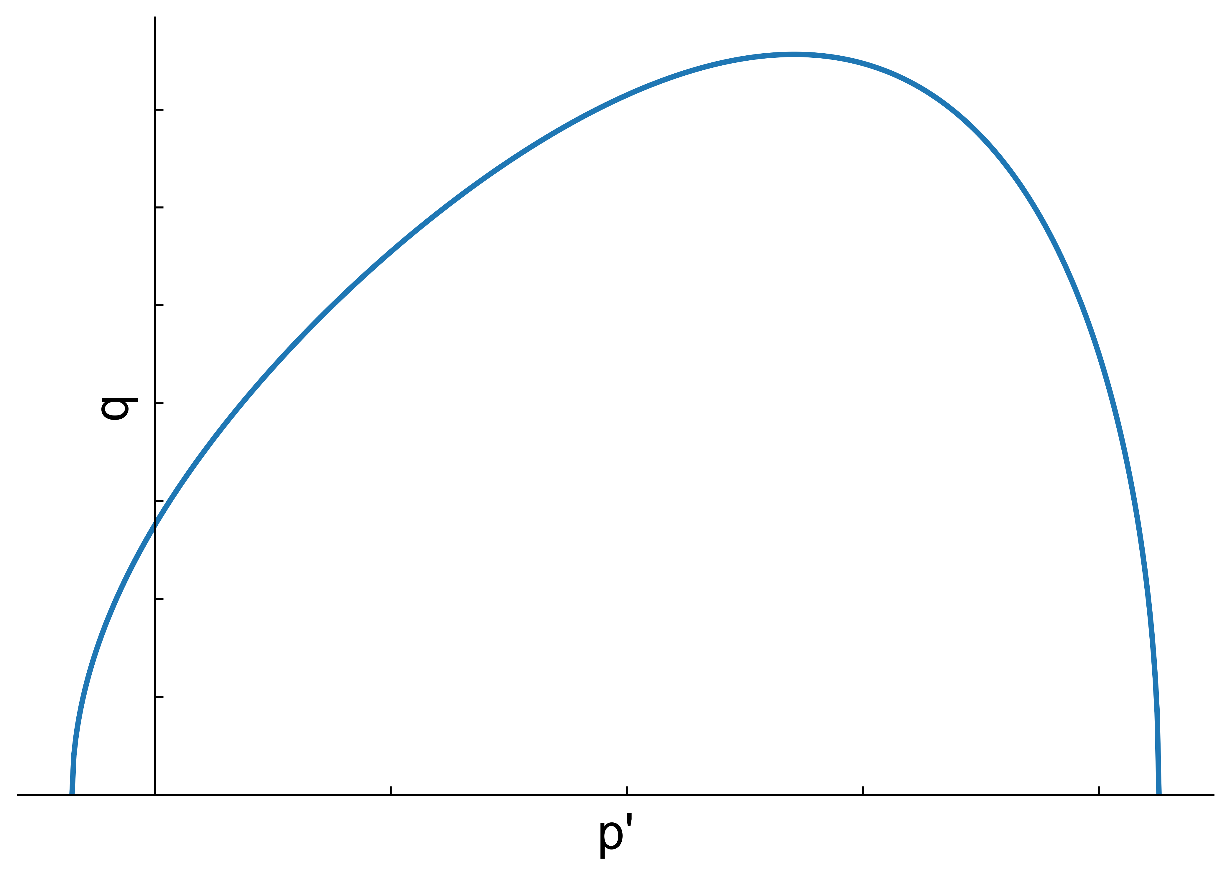
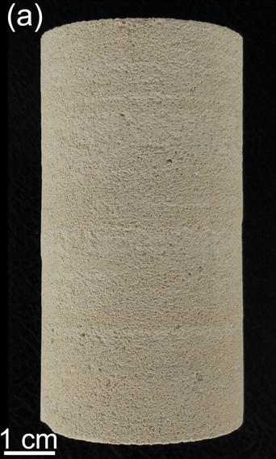
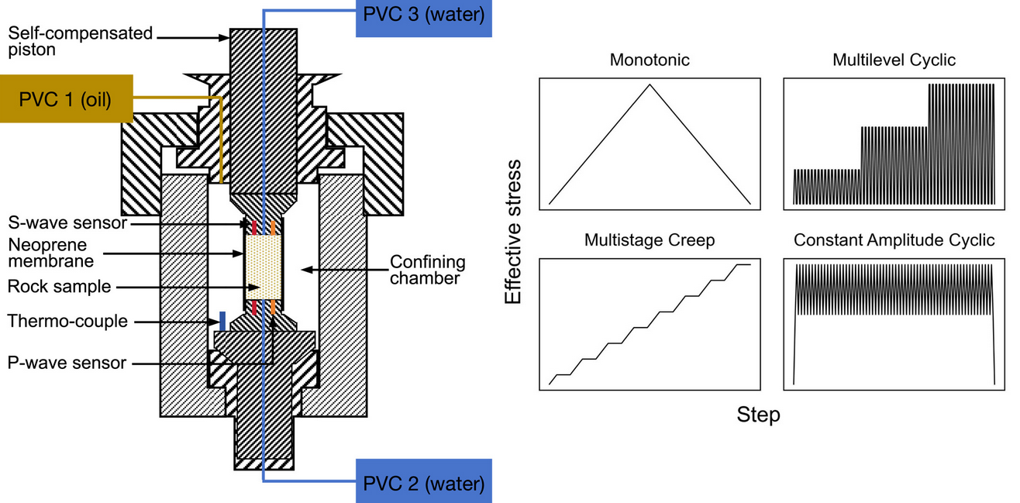
Cyclic behaviour of carbonate rock
Shear induced dilation
Shear enhanced compaction
Cataclastic compaction
St Maximin limestone
80% calcite & 20% quartz
High macroscopic porosity (~ 35%)
High permeability (~ 50 mD)
Heterogeneous and complex microstructure
Pore volume changes
Live Permeability test
Live wave velocity
Post-test porosyimetry

Slide 5

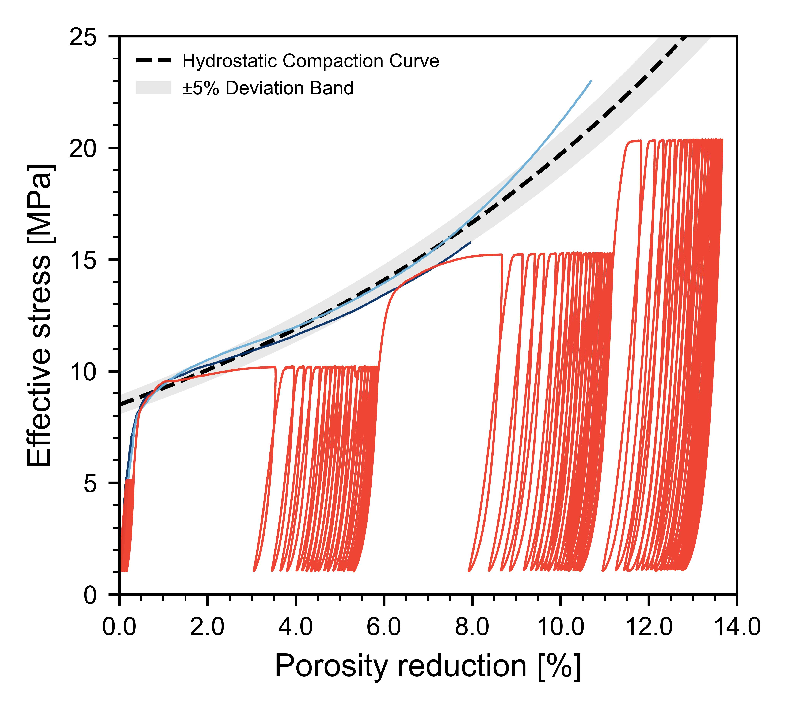
Monotonic and cyclic loading
Pore collapse P* observed as in previous works
Cyclic loading below compaction stress produces additional compaction and hardening
Porosity change as a proxy for hardening in both monotonic and cyclic loading
Significant permeability decrease (10-90%), captured well by permeability-porosity relationship
Yielding was accompanied through a slight decrease of wave velocity
Monotonic loading
Multilevel cyclic loading
Does additional compaction result from time-dependent or cycle-dependent mechanisms?

Slide 6
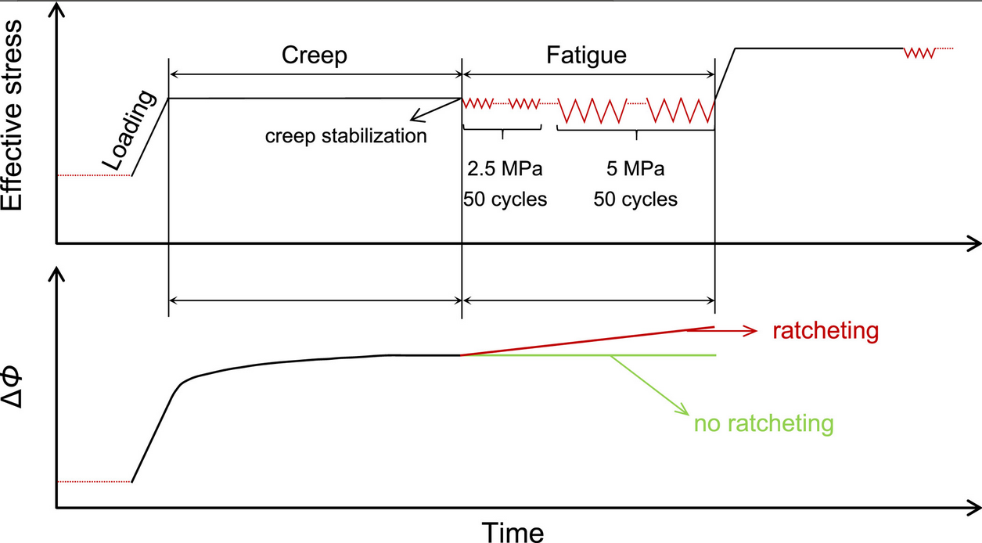
Creep or Ratcheting?
Creep depends on time and rate
Ratcheting depends on accumulated cycles (number, amplitude, …)

Slide 7

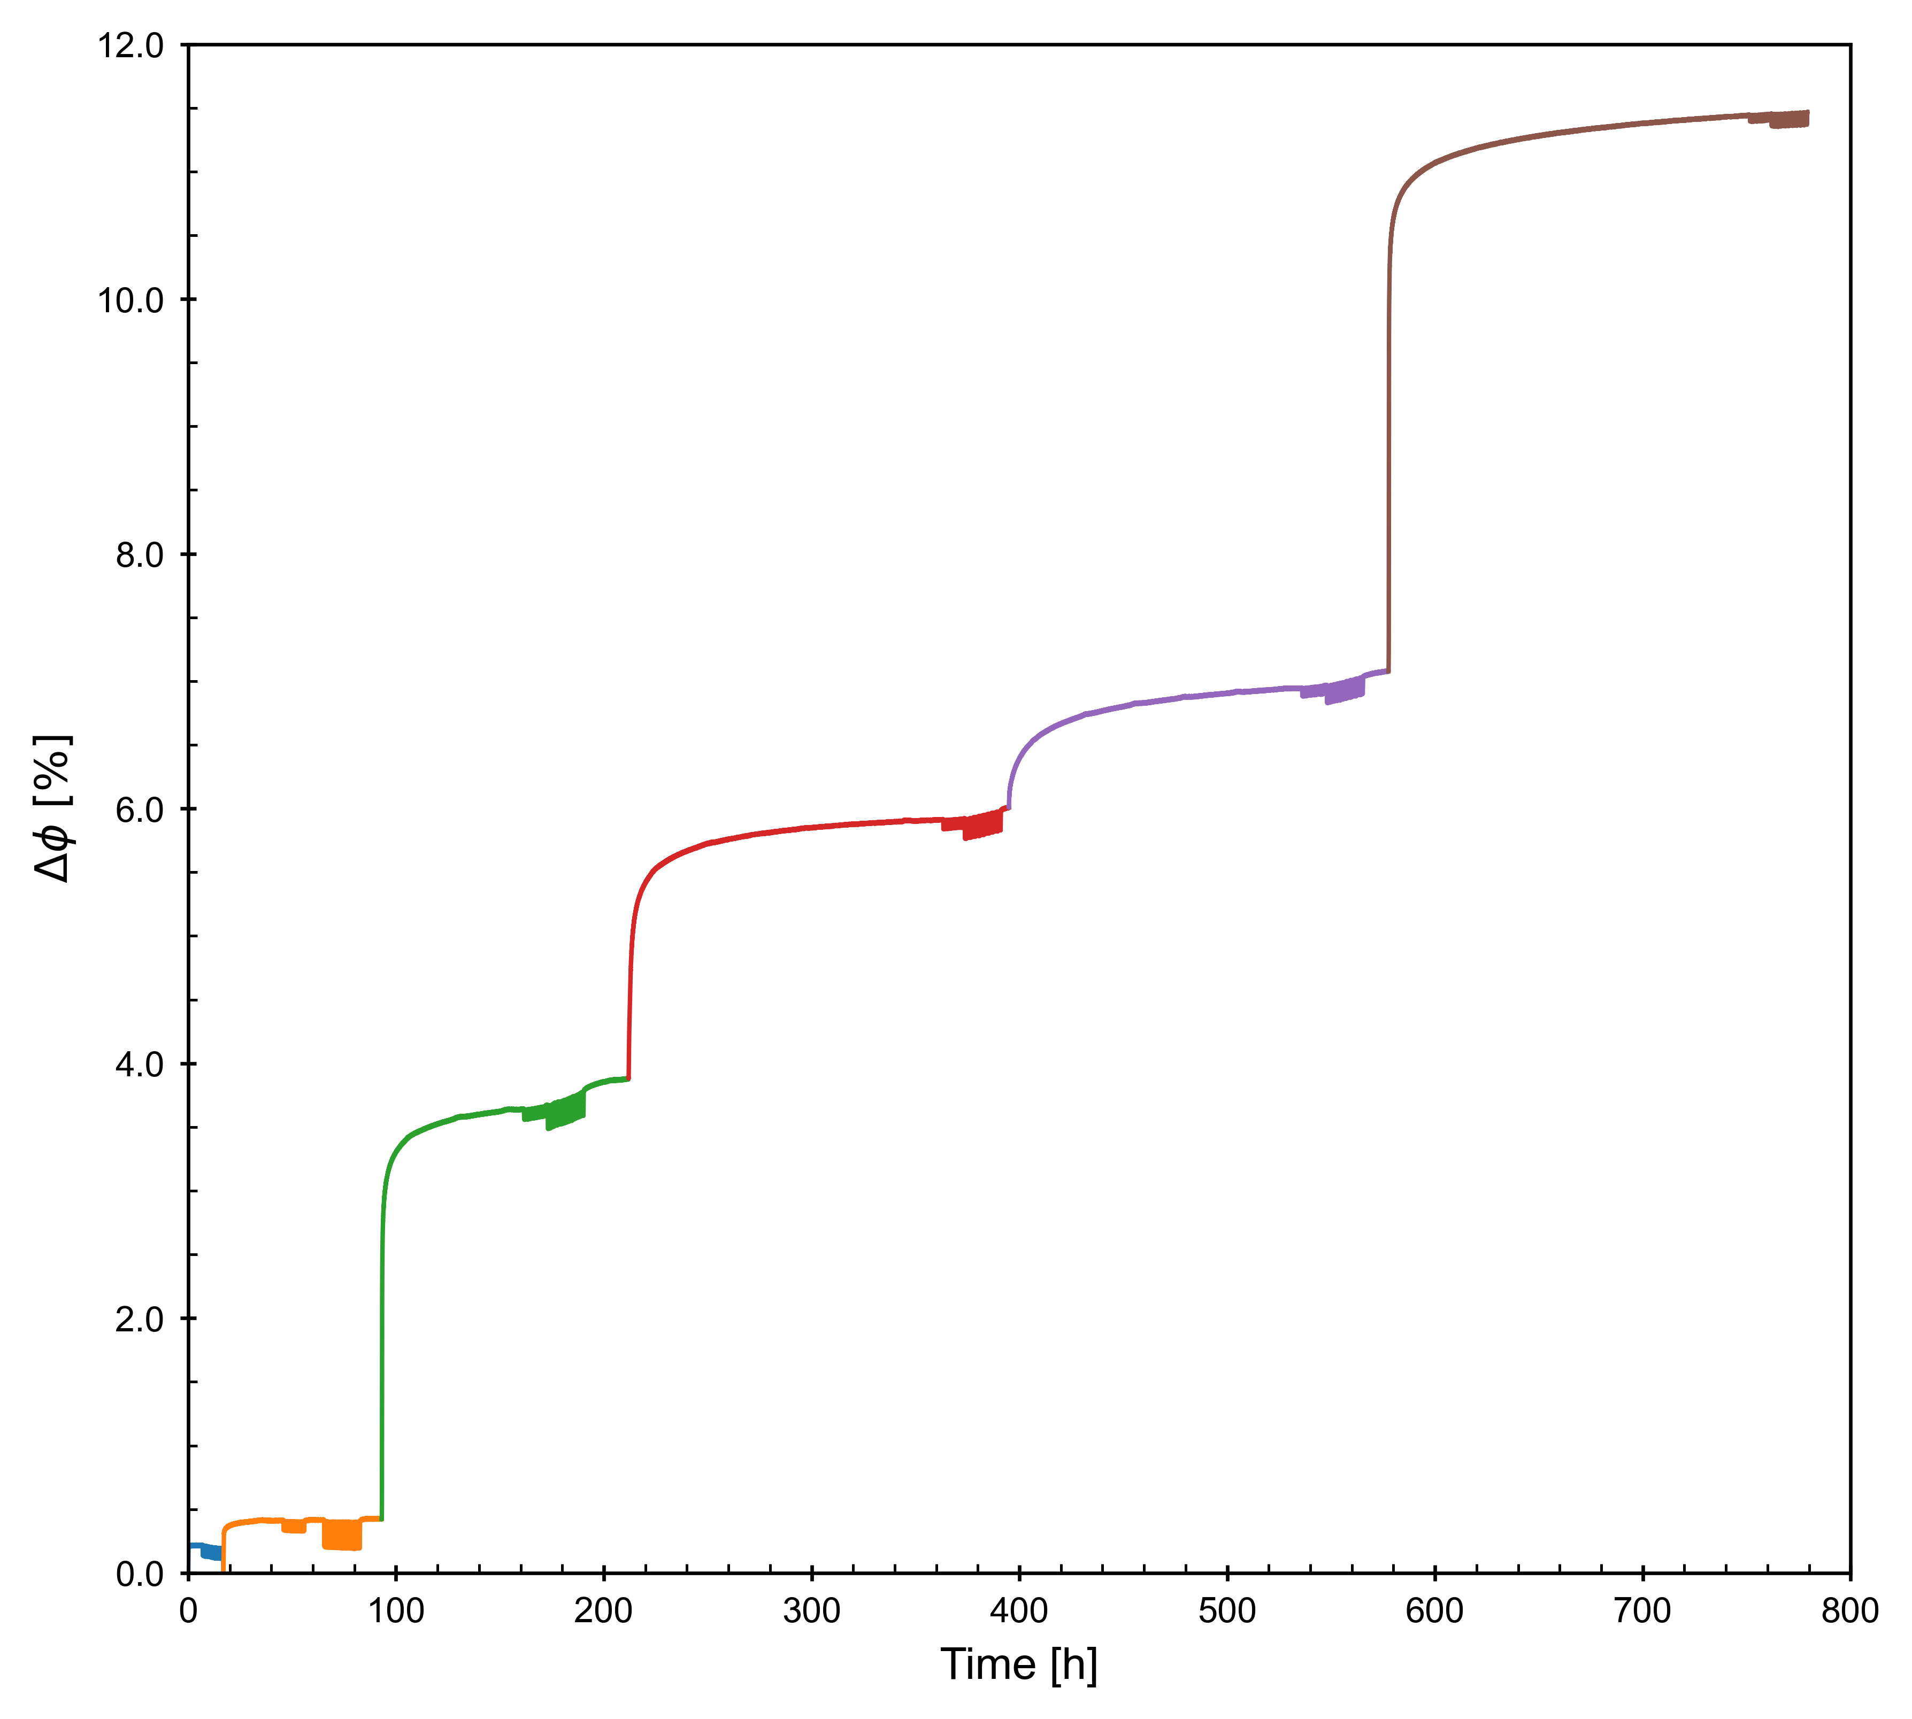
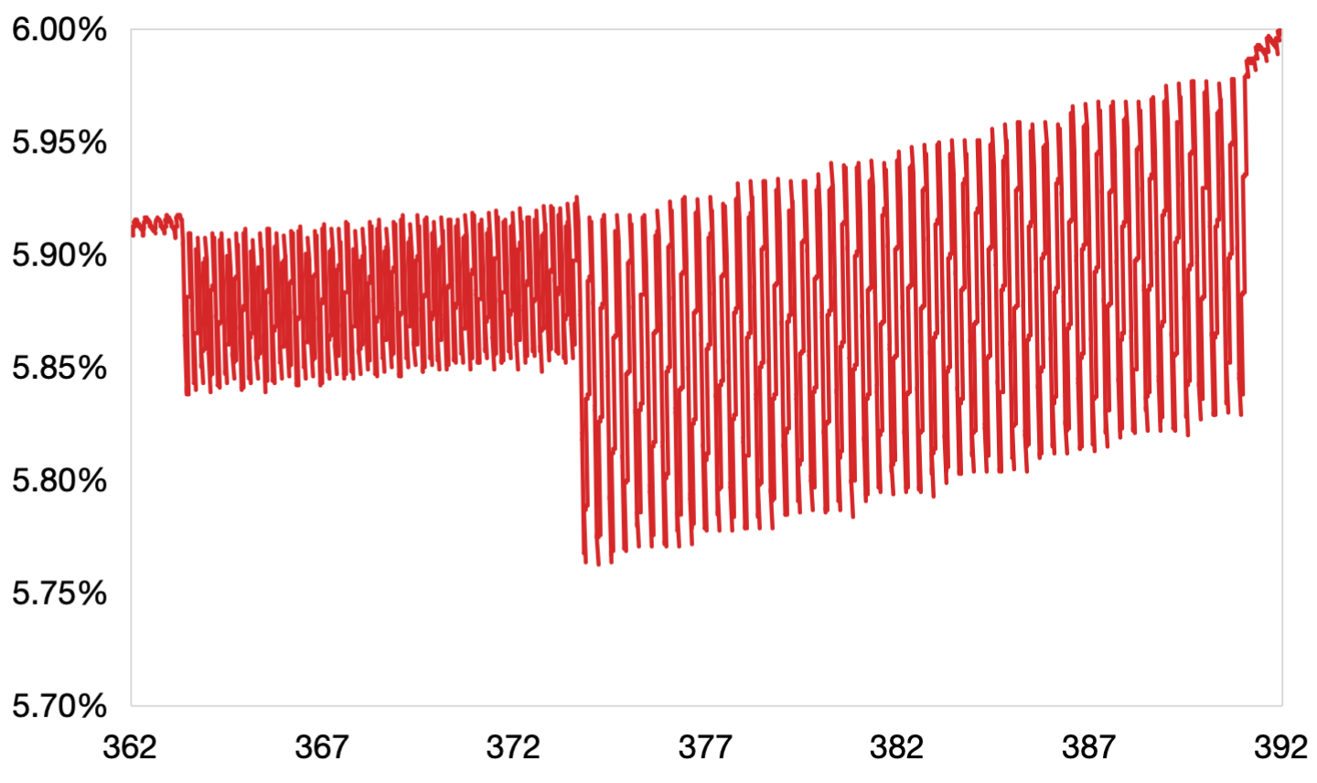
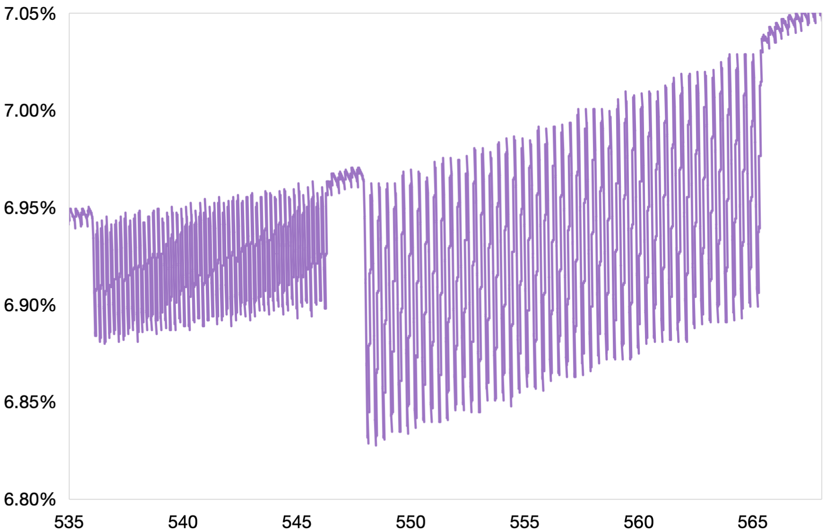
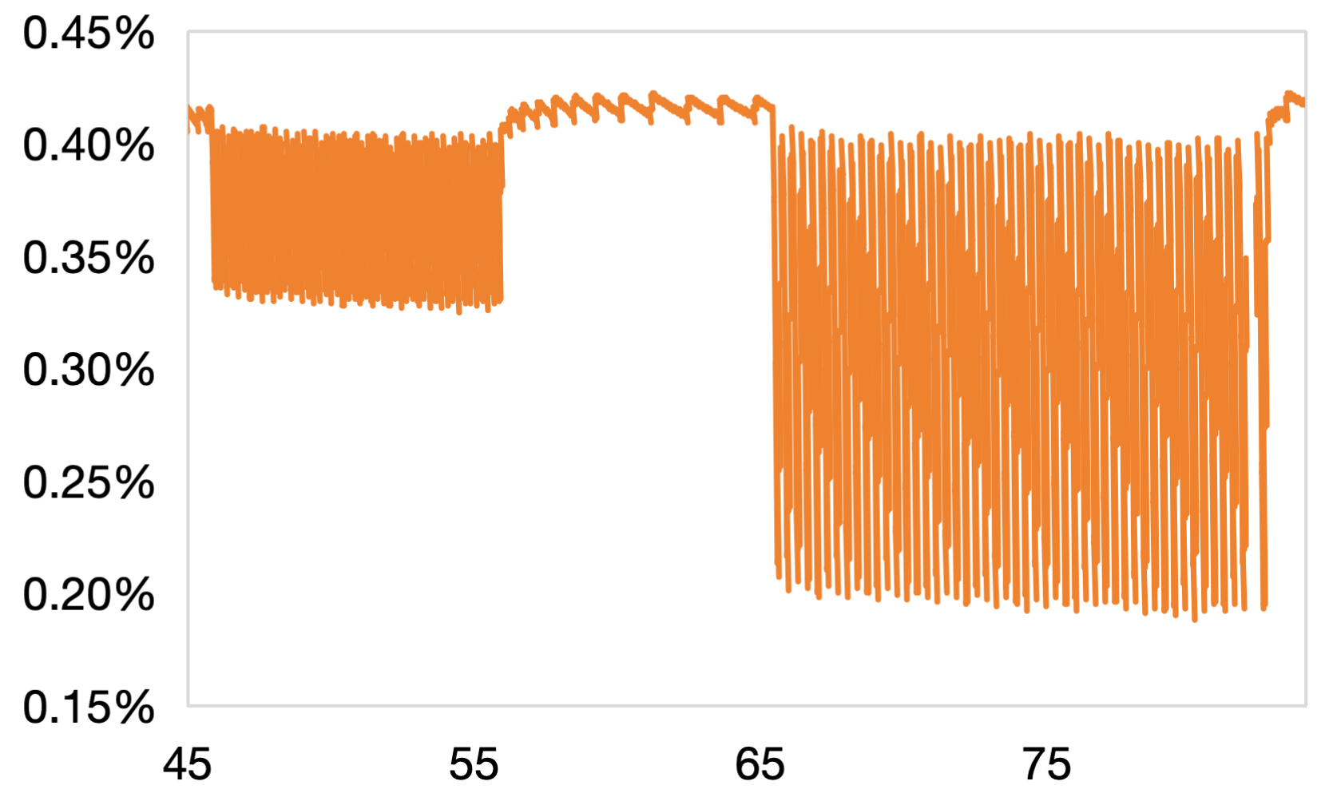
Creep or Ratcheting?
20 MPa
Below yield
No ratcheting deformation observed
Creep only source of additional deformation
15 MPa
12.5 MPa
After yield
Ratcheting deformation occurs
Ratcheting rate increases with amplitude and is mainly governed by the valley stress
Creep is still dominant source of deformation, while ratcheting accounts for less than 10% of total deformation
10 MPa
7.5 MPa

Slide 8
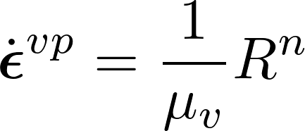
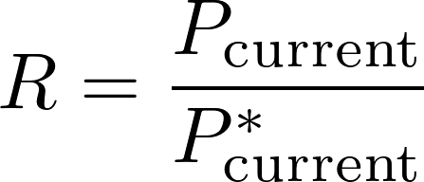
Constitutive modelling
Capturing various deformation mechanisms observed from experiments
Subloading-Overstress Model (elasto-viscoplastic, Hashiguchi and Okayasu, 2000)
Unified elasto-visco-plastic framework
Simplified expression: without consideration of kinematic hardening and existence of pure elastic zone
depends on the distance between the current stress and the compaction curve

Slide 9
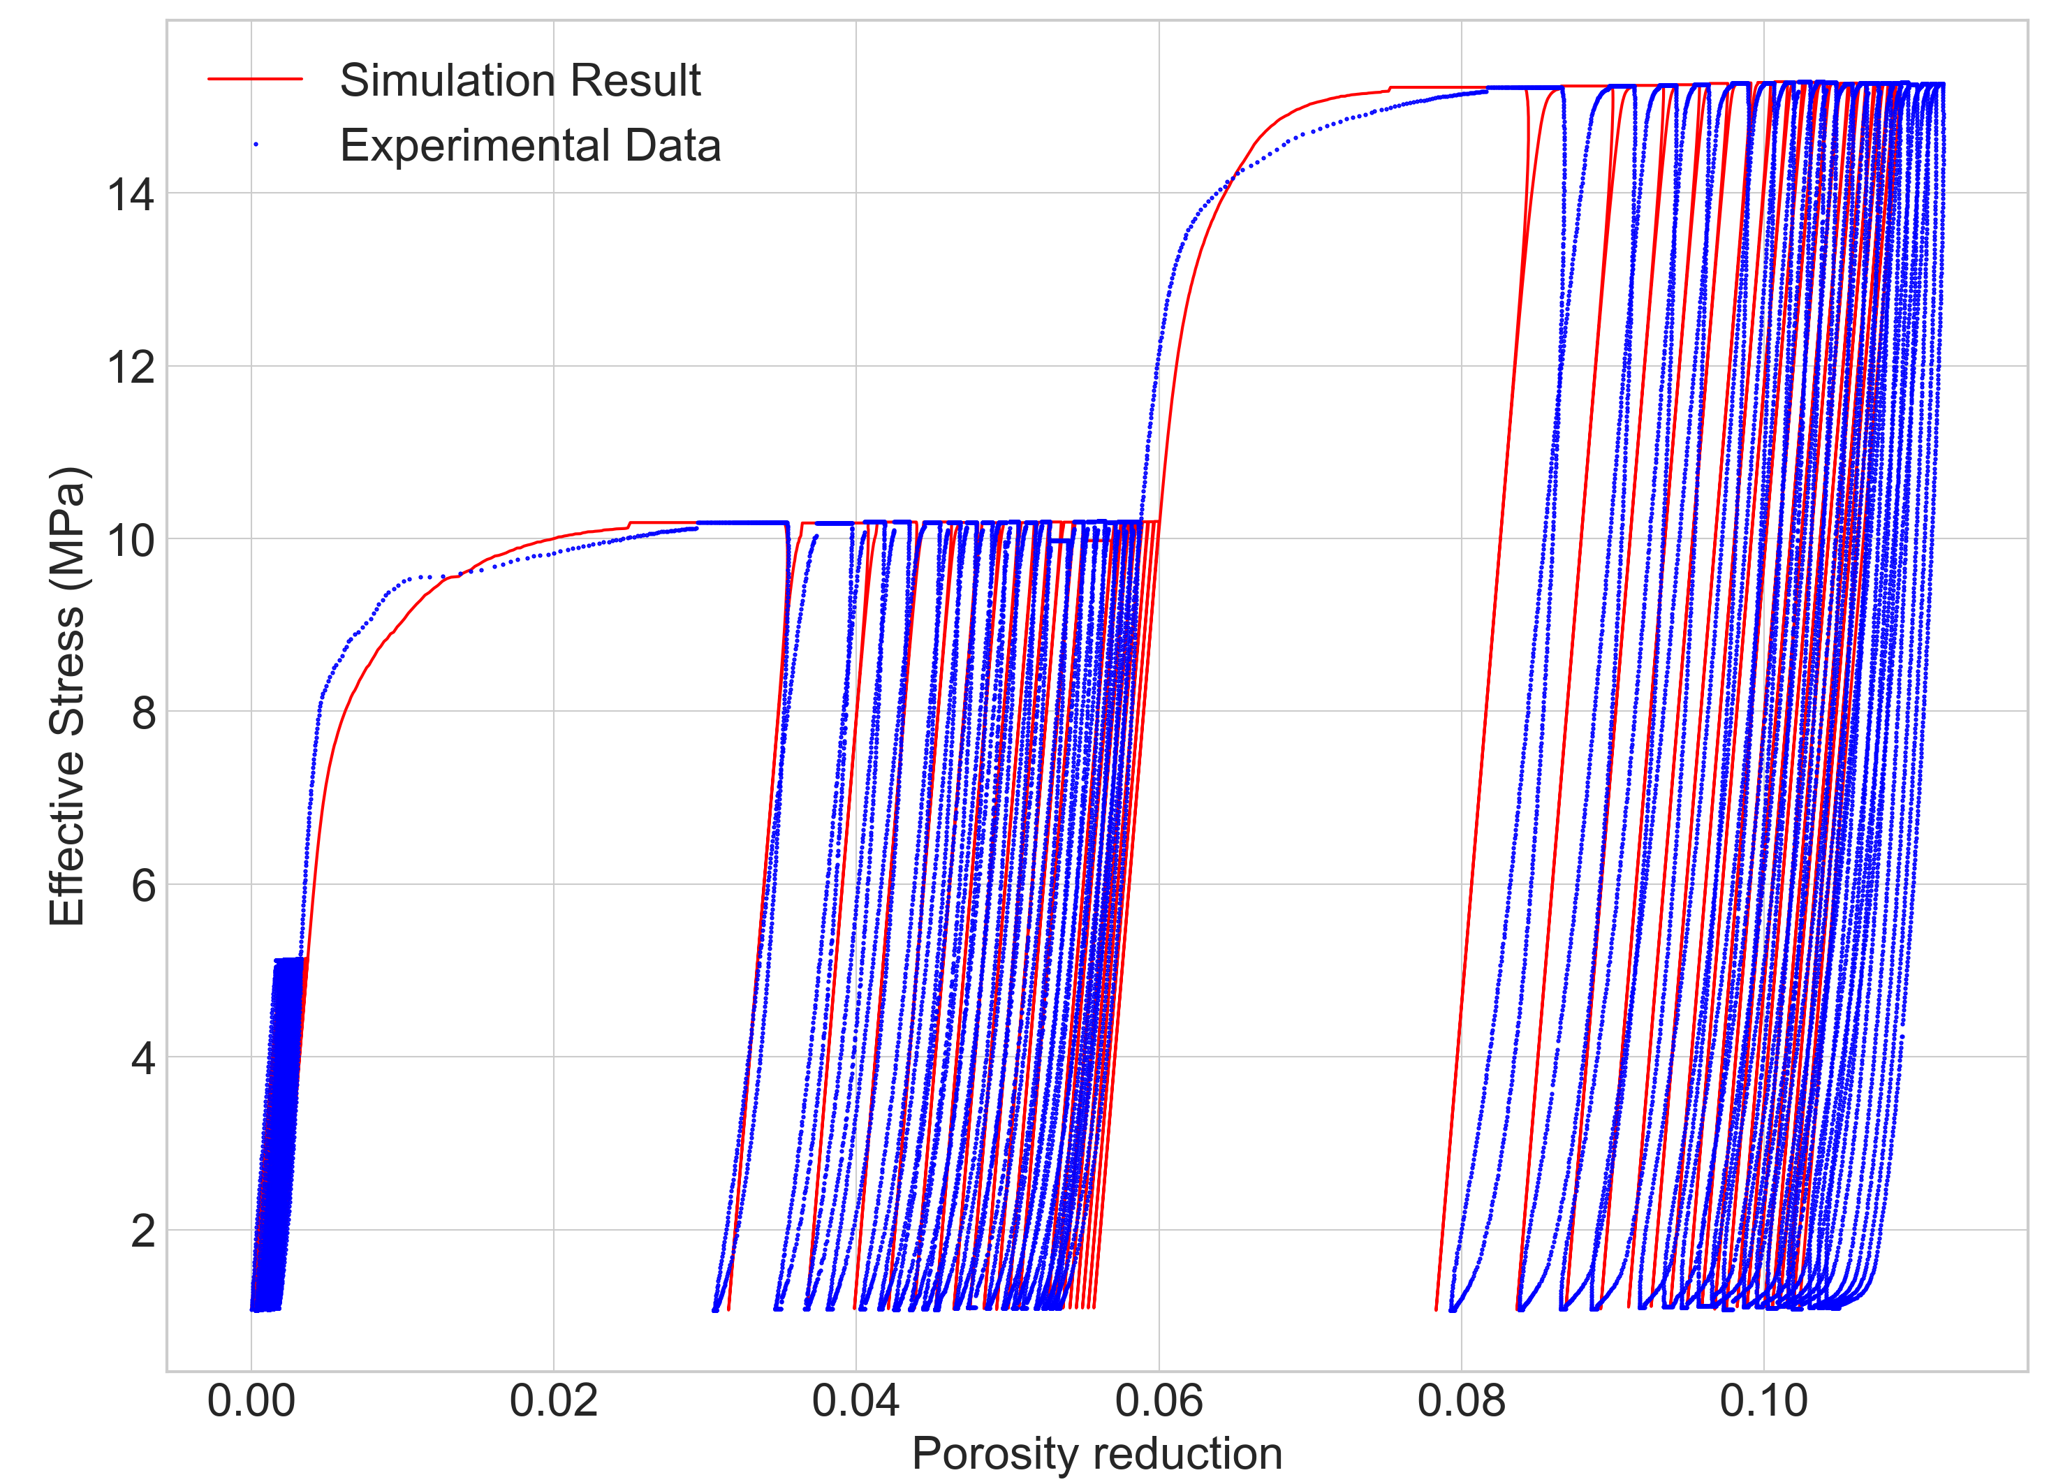
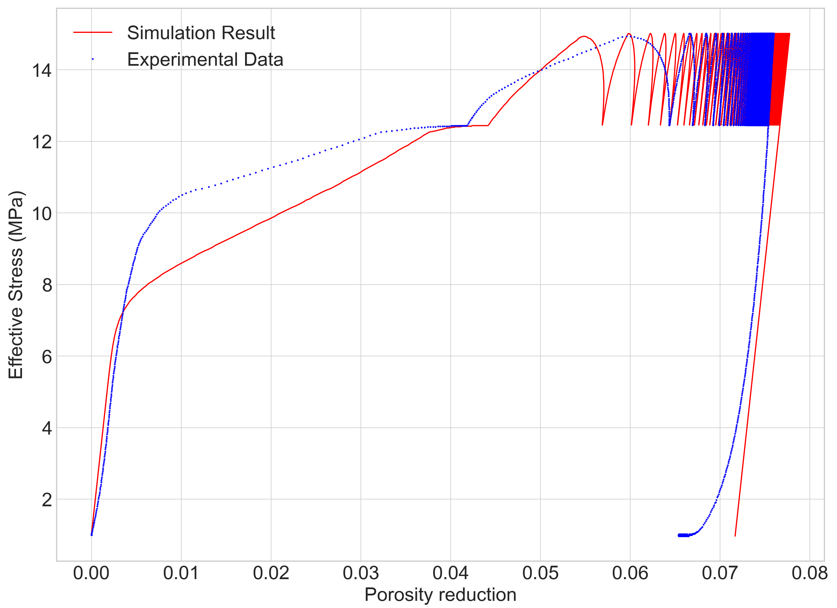
Preliminary modelling results
_{Multilevel cyclic loading}
Constant-amplitude cyclic loading
Global behaviour well captured only with viscoplasticity
Refinement and validation under different loading paths ongoing

Slide 10
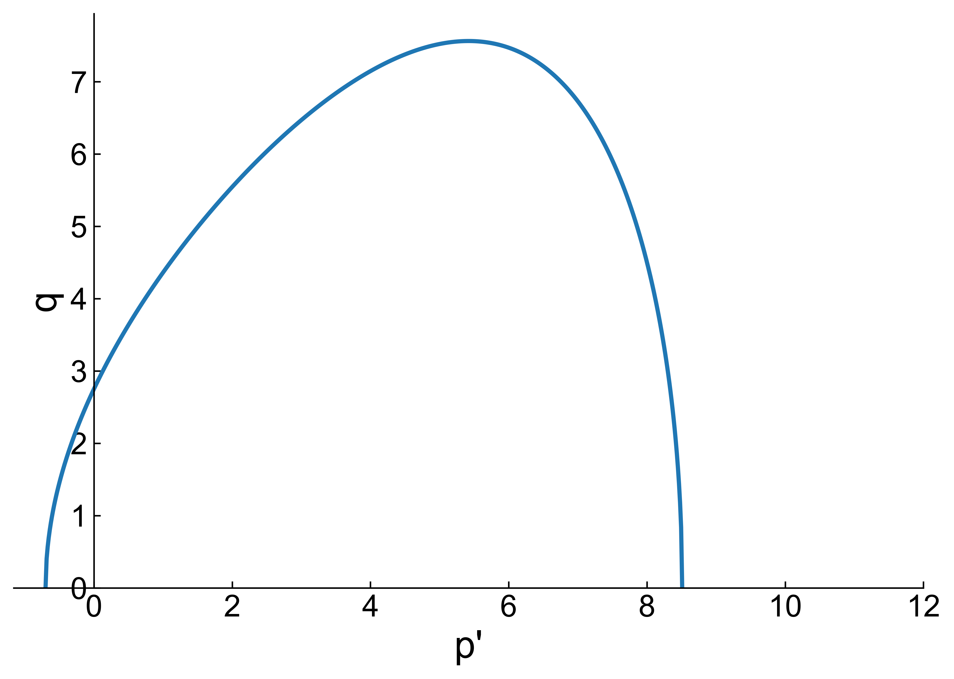
Conclusions and perspectives
01
Deformation characteristics of SML depend on the stress state relative to the plastic onset P*
❗️Vertical reservoir strains below 1% can induce surface subsidence of tens of centimeters. (Pijnenburg et al., 2019)
02
Creep is the dominant deformation mechanism of SML, while ratcheting contributes only a small fraction
Elastic
Limited Creep
No Ratcheting
Large Creep
& Ratcheting
P*
Overall depletion in a H₂ reservoir would primarily mobilize creep, while ratcheting can occur at same mean stress level
03
Porosity change is a robust indicator linking mechanical behaviour and permeability evolution under various loading paths, which can be simulated through constitutive models
04
Stress paths provoking shear enhanced dilation and shear enhanced compaction:
Additional experiments and numerical modelling ongoing

