Slide 1


High Pressure/High Temperature CO₂-brine Relative Permeability for Ultra-deep Carbon Storage: Core-flooding Measurements in Nugget Sandstone
Yun Yang, Ph.D.
Research Scientist
Center for Economic Geology Research
School of Energy Resources, University of Wyoming
Date: May 21st, 2026

Slide 2

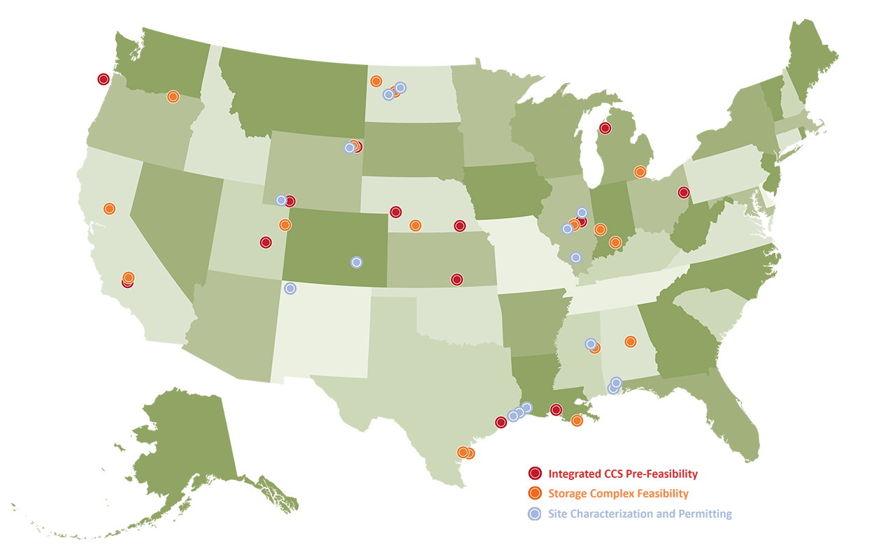
CarbonSAFE Initiative
Project phases
Wyoming CarbonSAFE
01
Integrated Pre-Feasibility: Economic feasibility analysis, regional data modeling, and business plan development for targeted sites.
02
Storage Complex Feasibility: Feasibility studies for regional CO₂ storage complexes, including site selection, risk assessment, and permitting.
03
Site Characterization & Permitting: Detailed geologic characterization, baseline monitoring, and regulatory compliance.
04
Construction: Building infrastructure for CO₂ injection and monitoring.
Goal: The CarbonSAFE Initiative reduces cost and uncertainty associated with the implementation of commercial-scale subsurface geologic storage to expedite deployment timelines while maintaining quality standards.
Phased project-development pathway
Phase I
Phase II
Phase III
Phase IV
Pre-feasibility
Storage feasibility
Characterization, permits
12–18 mo
18–24 mo
Construction
<3 yr
<2.5 yr
Notes:
The CarbonSAFE Initiative is a U.S. Department of Energy (DOE) program led by the National Energy Technology Laboratory (NETL) to accelerate the development of commercial-scale carbon capture and storage (CCS) projects and related energy infrastructure. Launched in 2016, CarbonSAFE builds on the work of the Regional Carbon Sequestration Partnerships. needed to nationally deploy commercial scale (50+ million metric ton) CO2 storage. Funded 29 projects.

Slide 3
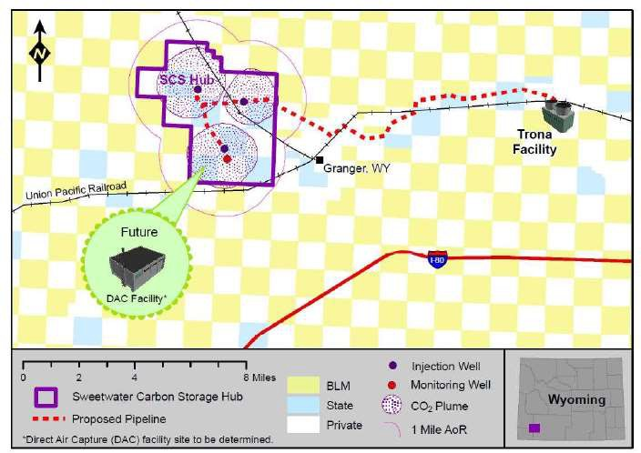
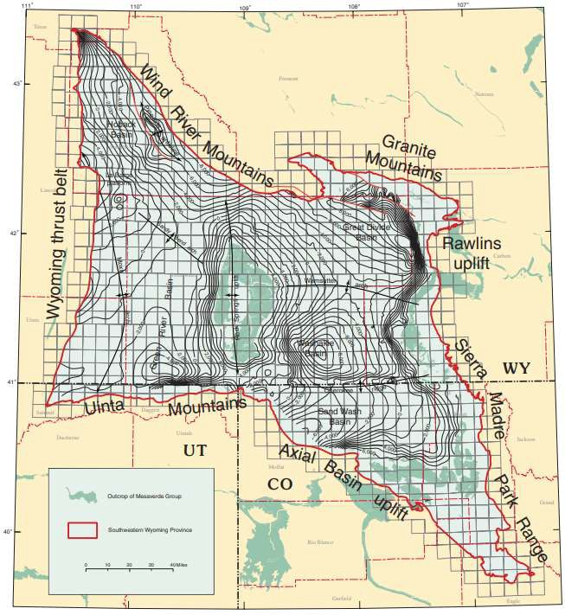
Sweetwater Carbon Storage Hub
The SCS Hub will sequester CO₂ from two sources:
Trona (soda ash) mining and processing facilities
Direct Air Capture (DAC)
Soda ash is the second largest mining industry in Wyoming behind coal. The entire U.S. trona industry is located within 10 miles of the SCS Hub, a critical national industry that supplies 90% of the world’s soda ash.
The U.S. (Wyoming) trona industry emits between 5 to 7 metric tons (MT) of CO₂ per year. The SCS Hub aims to provide enough CO₂ storage capacity to decarbonize this industry.
The SCS Hub will also support the scale-up of DAC by serving as a site host and sink for Project Basin, one of the largest DAC facilities planned for development within the U.S.
The Greater Green River Basin occupies ~20,000 mi² of the Central Rocky Mountains and has proven CO₂ storage reservoirs with multiple formations potentially suitable for secure sequestration.
Notes:
Academic training is very interdisciplinary.
Strongly shaped my research to address interdisciplinary problems by combining physics, data, and system analysis.
Quickly introduce an overview of my research contributions.

Slide 4
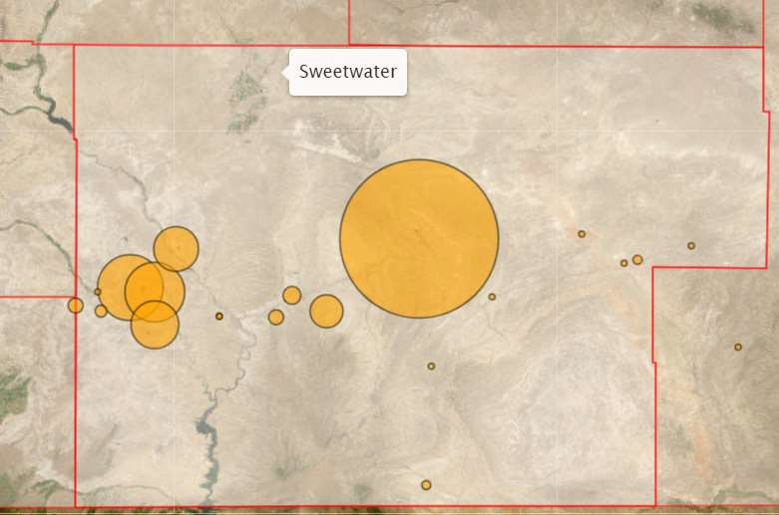


CO₂ Sources: Greater Green River Basin
Sweetwater County: total CO₂e in 2022 = 17,574,630
Emission Source and Type Metric Tons CO₂e
Power Generation Jim Bridger Power Station | 11,115,560
Trona Production American Soda LLC | 1,025,302
Genesis Alkali Granger | 6,376
Genesis Alkali Westvaco | 1,984,817
Granger Gas Plant | 52,323
Sisecam Wyoming LLC | 843,706
Tata Chemicals (Soda Ash) Partners | 1,607,575
Fertilizer Production P4 Production, LLC | 166,049
Simplot Phosphates | 447,012
Natural Gas Production and Transportation MountainWest Pipeline | 89,150
Northwest Pipeline | 20,764
Echo Springs Compressor Station | 14,485
Blacks Fork Gas Plant | 112,718
CIG Station | 48,617
Vermillion Gas Plant | 30,697
Wamsutter Compressor Station | 9,479
SCS Hub
Notes:
Academic training is very interdisciplinary.
Strongly shaped my research to address interdisciplinary problems by combining physics, data, and system analysis.
Quickly introduce an overview of my research contributions.

Slide 5
Objectives
This project will develop one of the region’s first net negative carbon storage hubs – the SCS Hub. The SCS Hub will capture and store carbon from the nation’s largest trona mines and the largest proposed DAC facility in the Rocky Mountains.
There are three main objectives for this project that will advance commercialization:
Build three Underground Injection Control (UIC) Class VI injection wells, with attendant site characterization and science goals (Current Phase)
Complete capture & transport studies for two CO₂ sources (trona & DAC) and the pipelines to connect these sources to the storage hub.
Complete a National Environmental Policy Act (NEPA) analyses.
DOE Funding: $40,504,935
Non-DOE Funding: $10,135,000
Total Value: $50,639,935
Notes:
Academic training is very interdisciplinary.
Strongly shaped my research to address interdisciplinary problems by combining physics, data, and system analysis.
Quickly introduce an overview of my research contributions.

Slide 6
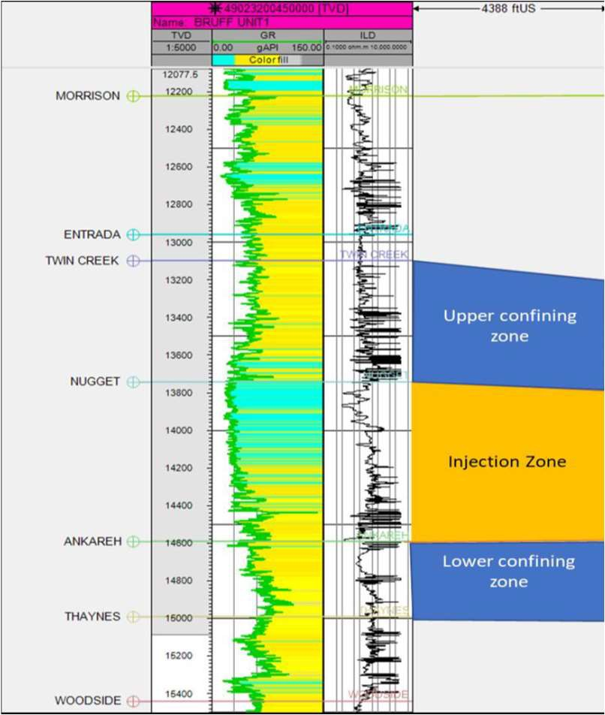
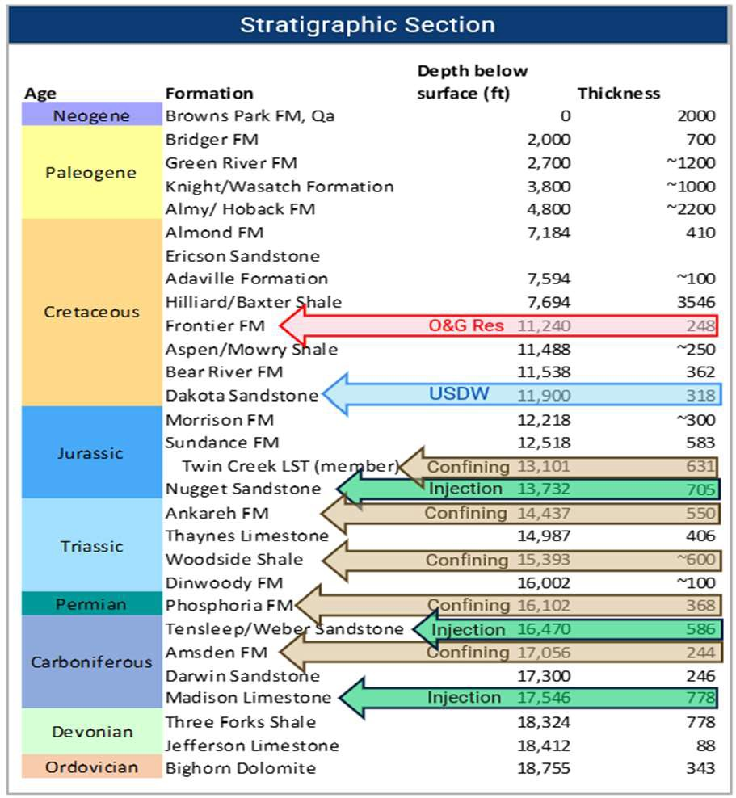




Targeted Stacked Storage Reservoirs
Priority Storage Reservoir: Nugget Sandstone
Targeted Stacked Aquifers
USDW
Nugget Sandstone
Weber Sandstone Madison Limestone
(from Bruff Unit 1)
Notes:
Academic training is very interdisciplinary.
Strongly shaped my research to address interdisciplinary problems by combining physics, data, and system analysis.
Quickly introduce an overview of my research contributions.

Slide 7
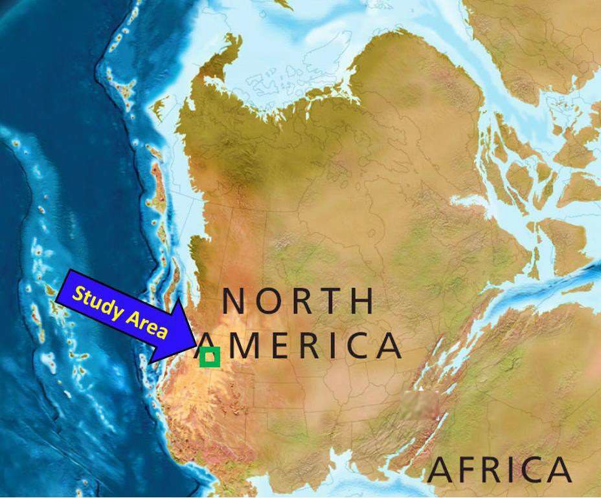
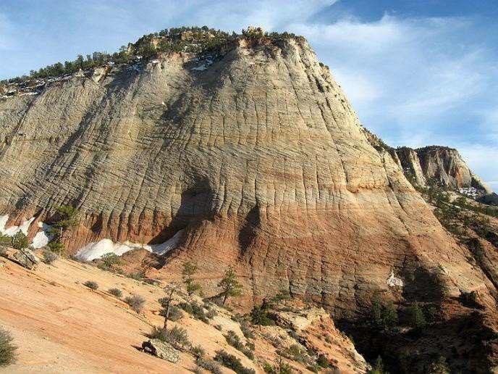
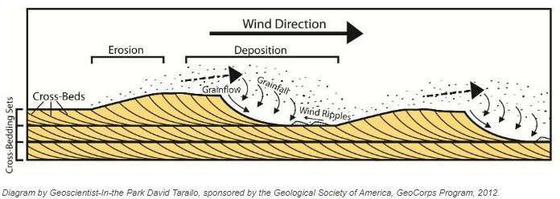
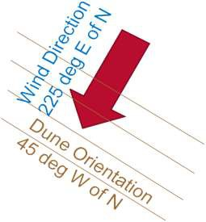
Storage Interval: Nugget Sandstone
Nugget is late Triassic to Early Jurassic in age
The Nugget (Navajo equivalent) developed in the largest dune field in Earth’s history
Dunes are transverse dunes with dominant wind direction about 45 deg E of N and dunes perpendicular to that (45 deg W of N)
Dune facies have the best porosity and permeability
The best reservoir qualities are expected in avalanche deposits, followed by grainfall deposits, and poor qualities in the toe ripples
Interdunes have the worst reservoir properties
Interpreted to form in interdunal lakes or during episodic flooding events
Dunes are stabilized in the presence of water and many dune fields show evidence of episodic flooding
Paleographic Map
Truncated Cross Beds
Checkerboard Mesa, Zion Modified: Melissa Northcott, Hass &Cobb
Depositional Processes Creating Dune Architecture
11
Notes:
Academic training is very interdisciplinary.
Strongly shaped my research to address interdisciplinary problems by combining physics, data, and system analysis.
Quickly introduce an overview of my research contributions.

Slide 8
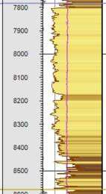
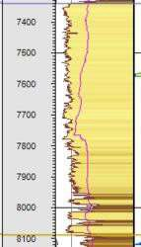
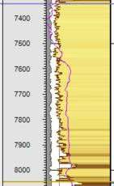
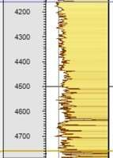
Storage Interval: Nugget Sandstone
S
N
Butcher Knife Springs
Church Buttes Unit
clean sand
Bruff Unit 1
Fontanelle
The Nugget has a high degree of lateral variability.
However, Nugget often shows a pattern of cleaner sand at the upper section, high cyclicity sand near the middle, and shaley intervals alternating with blocky sands at the base.
high cyclicity
Shaley Interval
Notes:
Academic training is very interdisciplinary.
Strongly shaped my research to address interdisciplinary problems by combining physics, data, and system analysis.
Quickly introduce an overview of my research contributions.

Slide 9
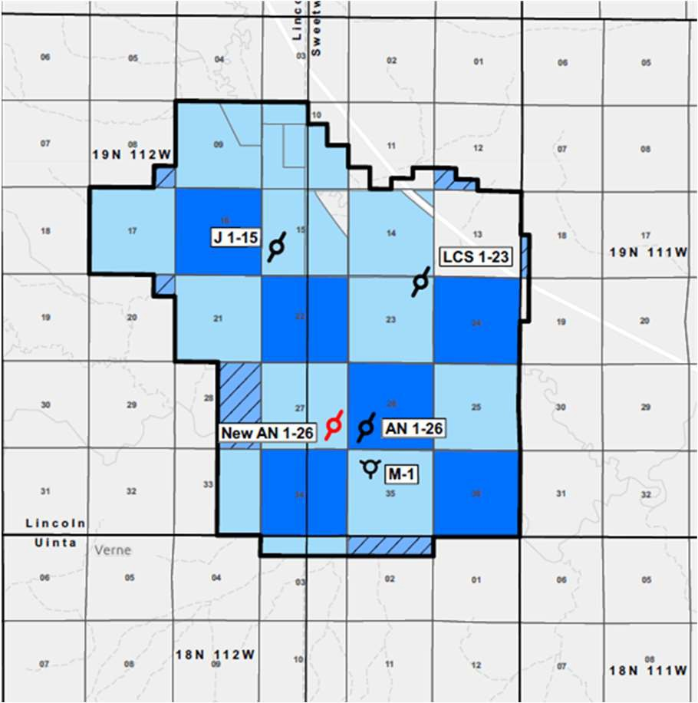
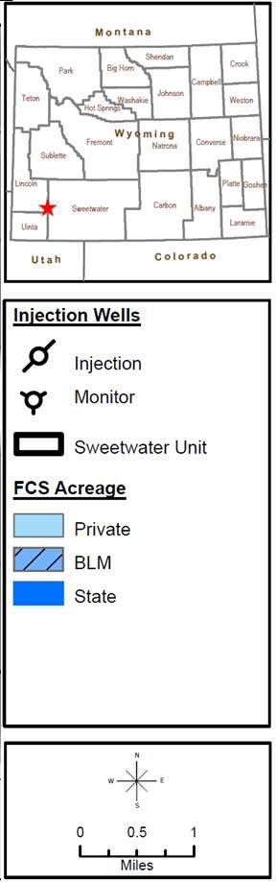
Scope of Work
The Scope of Work includes both Technical and non-technical aspects and is developed to meet or exceed CarbonSAFE program objectives and SCS Hub commercialization goals.
The technical scope of work includes
Completing site characterization of the SCS Hub
Constructing three injection wells to meet research objectives and commercial injection goals
Completing CO₂ capture engineering work for a trona mining and processing facility, and assessing carbon capture capacity with the Project Bison’s DAC facility
Completing a FEED assessment for in-field CO₂ pipelines
Finalizing risk assessments and the MVA and mitigation strategies
Drafting the Storage Field Development Plan
Proposed Sweetwater Hub Unit Boundary
19
At J1-15 well, Nugget sandstone layer: 13887 to 13983 ft
Average Temperature: 229 F
Reservoir pressure: 5900 psi
Notes:
MVA: subsurface monitoring (track plume), verification measures (ensure CO2 containment, risk analysis) and accounting (quantify CO2 storage)

Slide 10
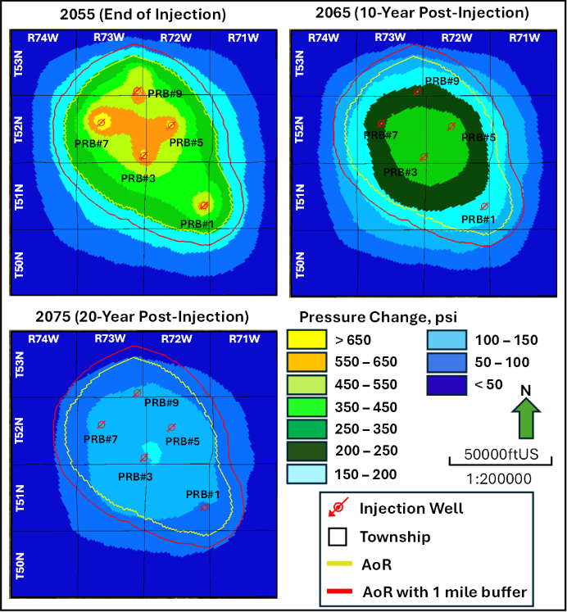
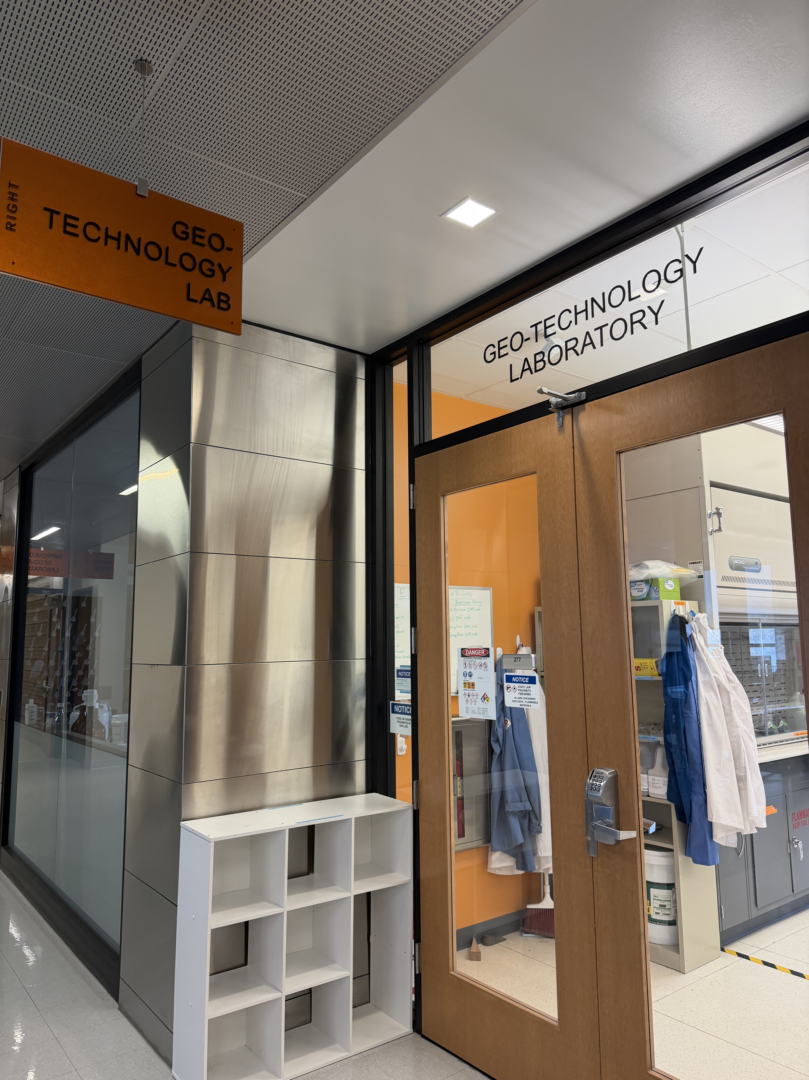
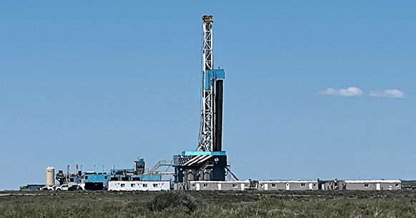
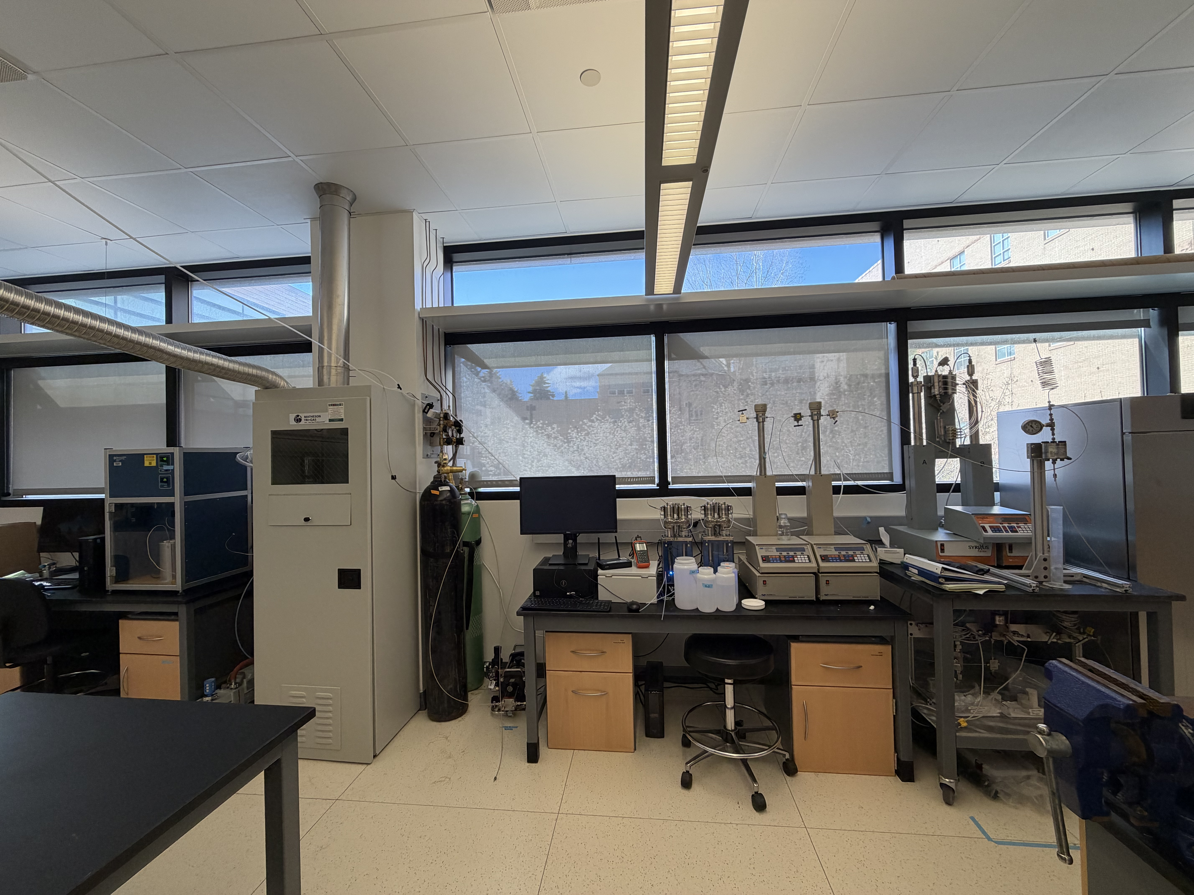
Workflow
Goal: Build three Underground Injection Control (UIC) Class VI injection wells, with attendant site characterization and science goals (Current Phase)
Geo-Technology Lab
Sweetwater CarbonSAFE
AoR Modeling

Slide 11
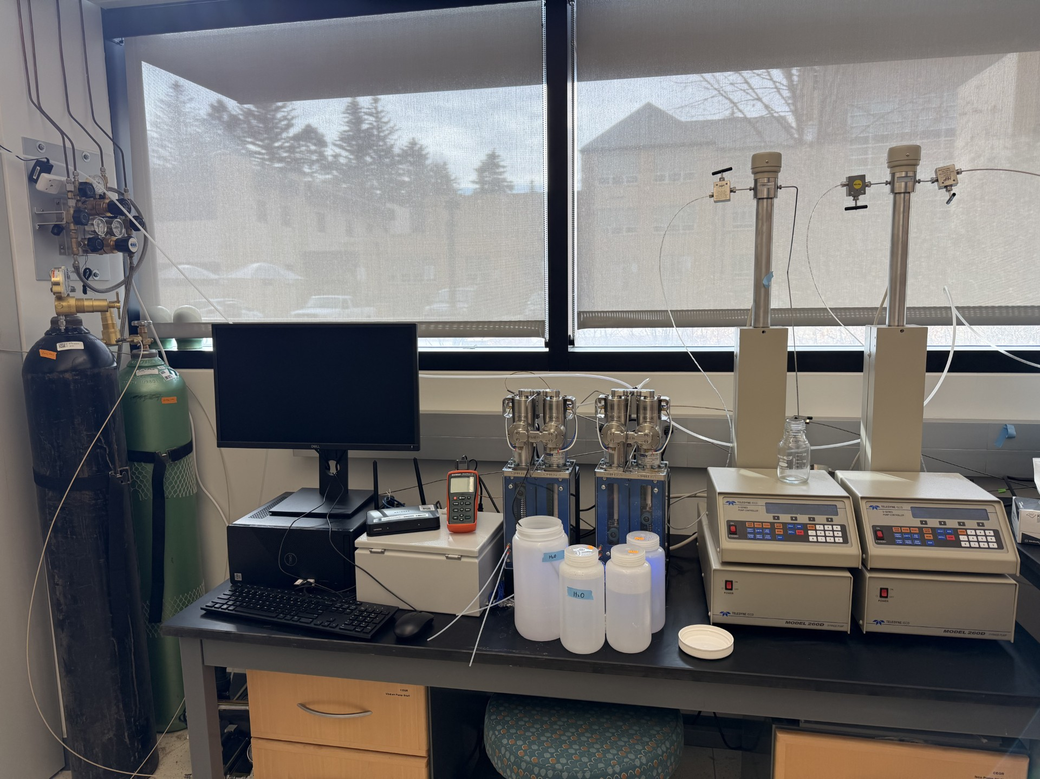
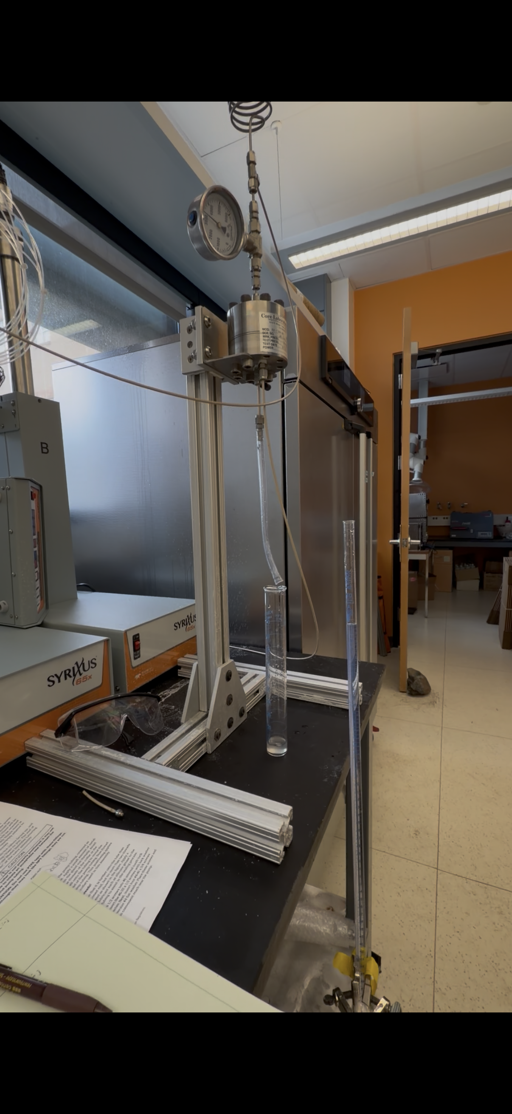
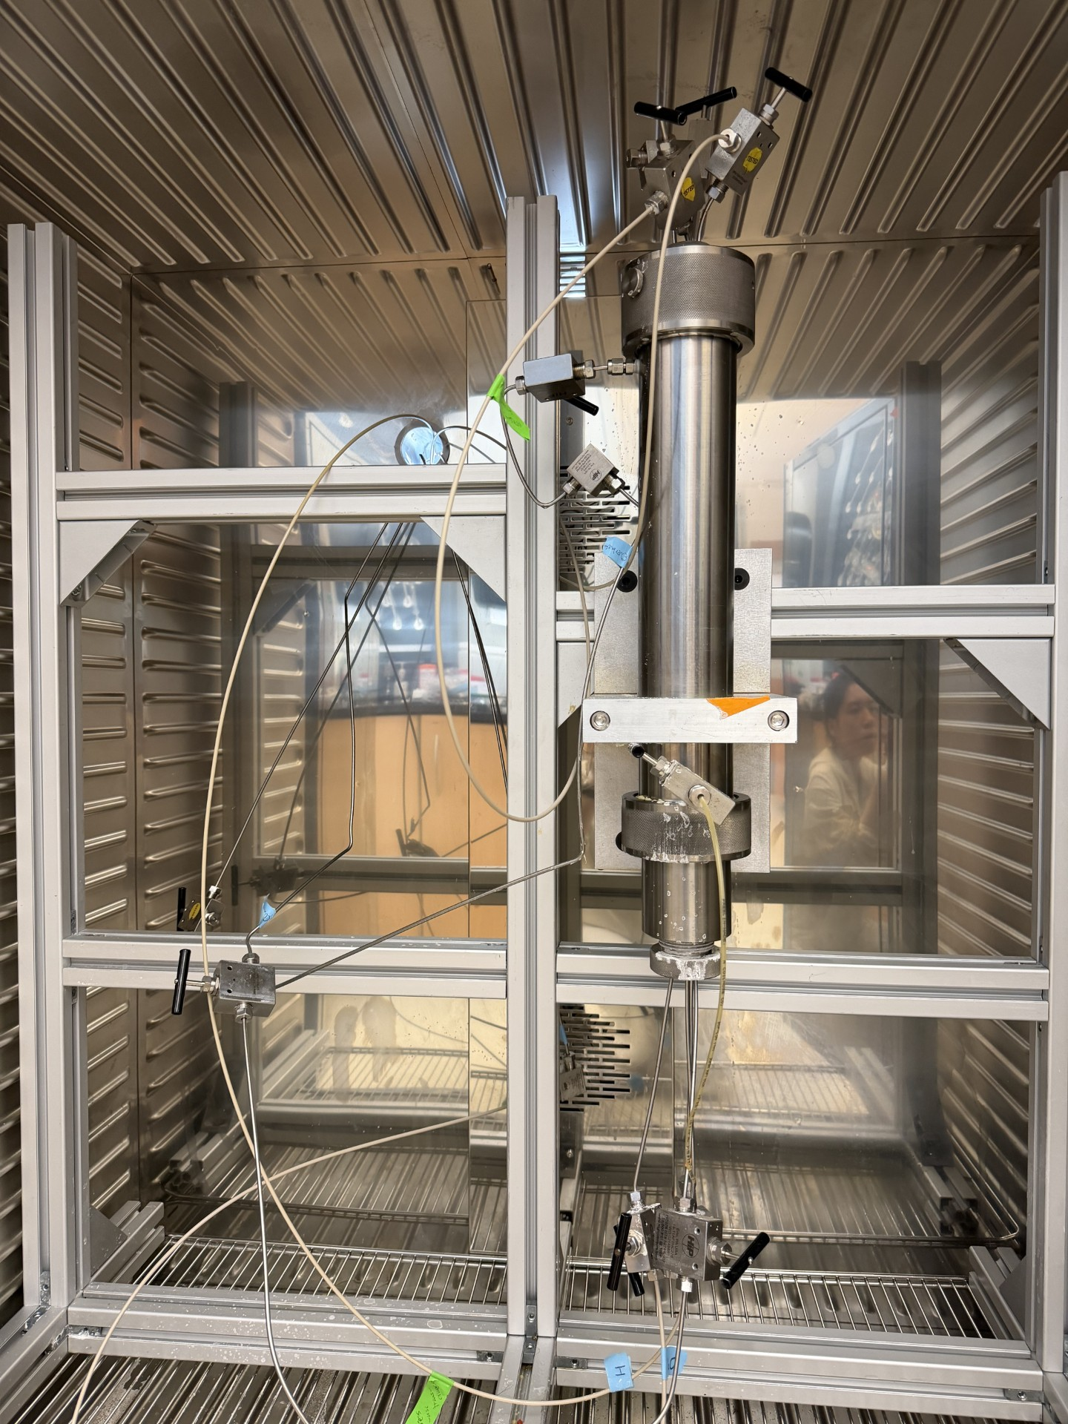
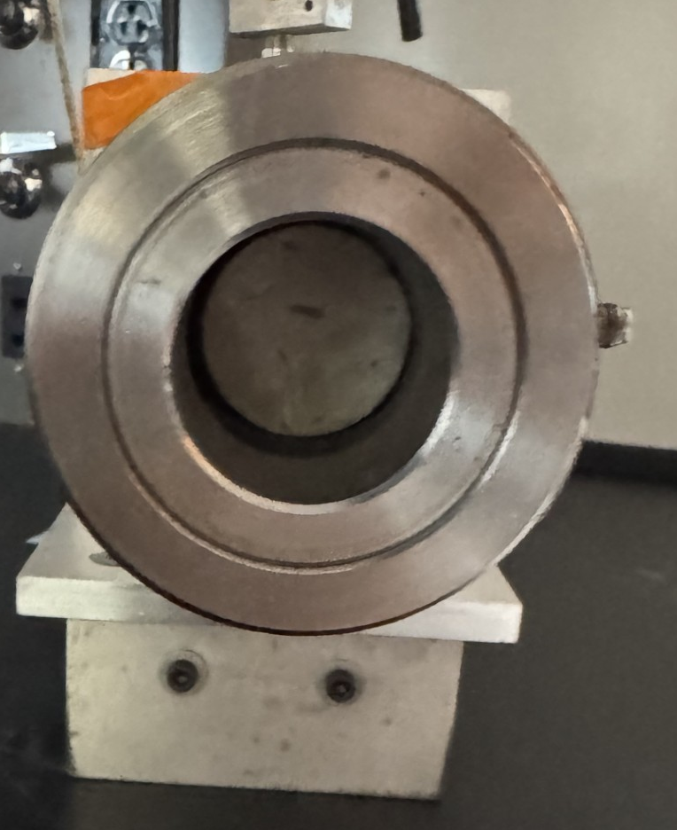
Core Flooding System
Data acquisition
Pump controller
Collection unit
Flowing unit
Nugget sandstone
Confining pressure
Back pressure
ΔP reading
injection rate
CO₂
water
CO₂
gas cylinder
The system was fully integrated, including high-pressure pumps, back-pressure regulation, core holder with overburden confinement, and temperature control to maintain isothermal conditions at the targeted experimental setpoints. Absolute permeability was measured using brine injection under steady-state flow conditions, and permeability was calculated using Darcy’s law after establishing stable differential pressure and flow rate.
Subsequently, two-phase CO₂–brine flow experiments were initiated to determine relative permeability characteristics. Experiments were conducted at the specified pressure and temperature to ensure appropriate CO₂ phase behavior and interfacial properties.
Notes:
Academic training is very interdisciplinary.
Strongly shaped my research to address interdisciplinary problems by combining physics, data, and system analysis.
Quickly introduce an overview of my research contributions.

Slide 12
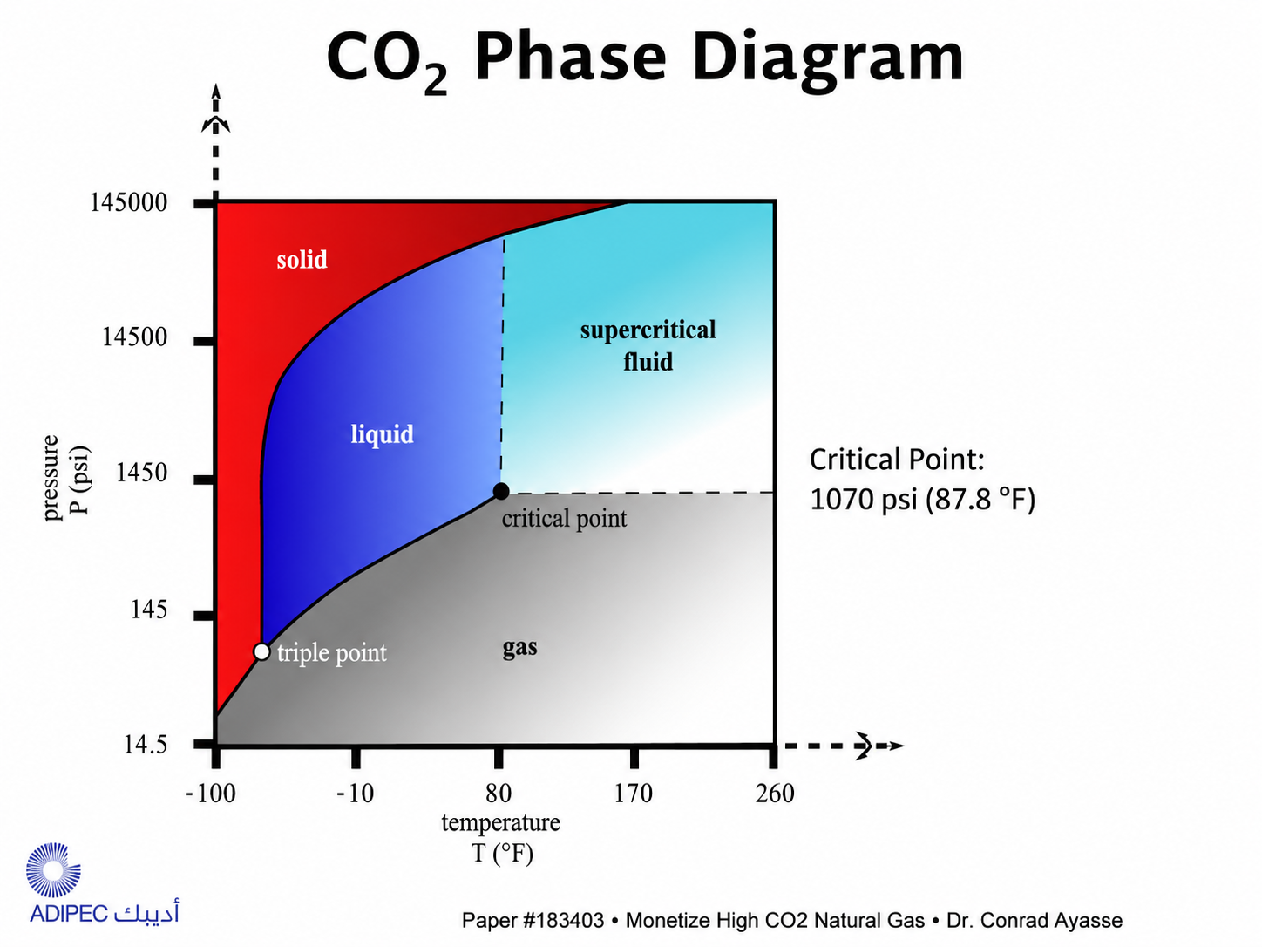
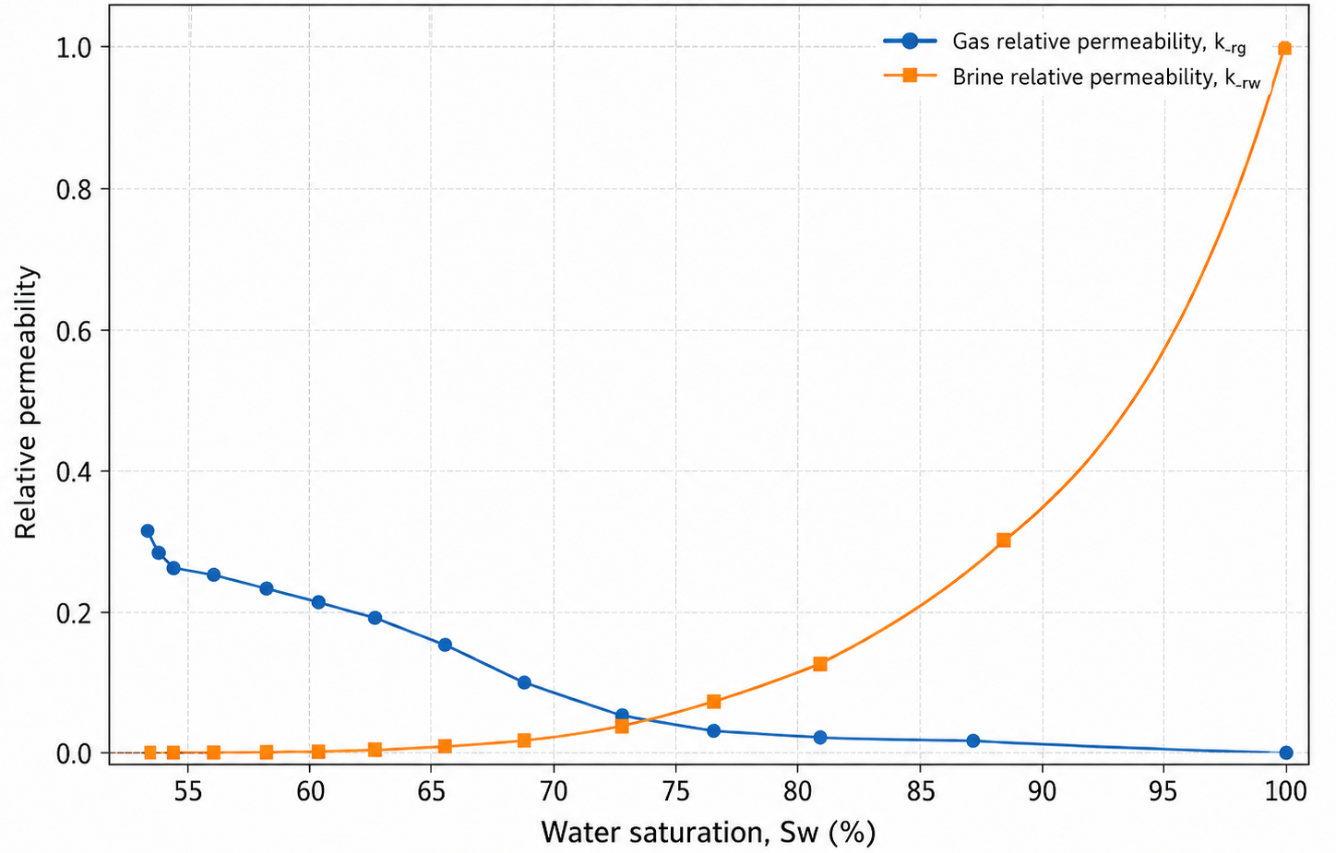
Core Flooding System
Nugget Sandstone Properties:
Absolute permeability: 0.521 mD (unsteady-state method adopted)
Porosity: 7.6%
Relative permeability for supercritical CO₂ and brine at reservoir conditions
T: 221 F (Reservoir Temperature)
P: 14.7 psi
Gas phase CO₂-brine relative perm
Irreducible water saturation: 54.74%
Endpoint of CO₂ relative permeability: 0.307
Strong water retention for Nugget Sandstone
Limited CO₂ capacity
Notes:
Academic training is very interdisciplinary.
Strongly shaped my research to address interdisciplinary problems by combining physics, data, and system analysis.
Quickly introduce an overview of my research contributions.

Slide 13
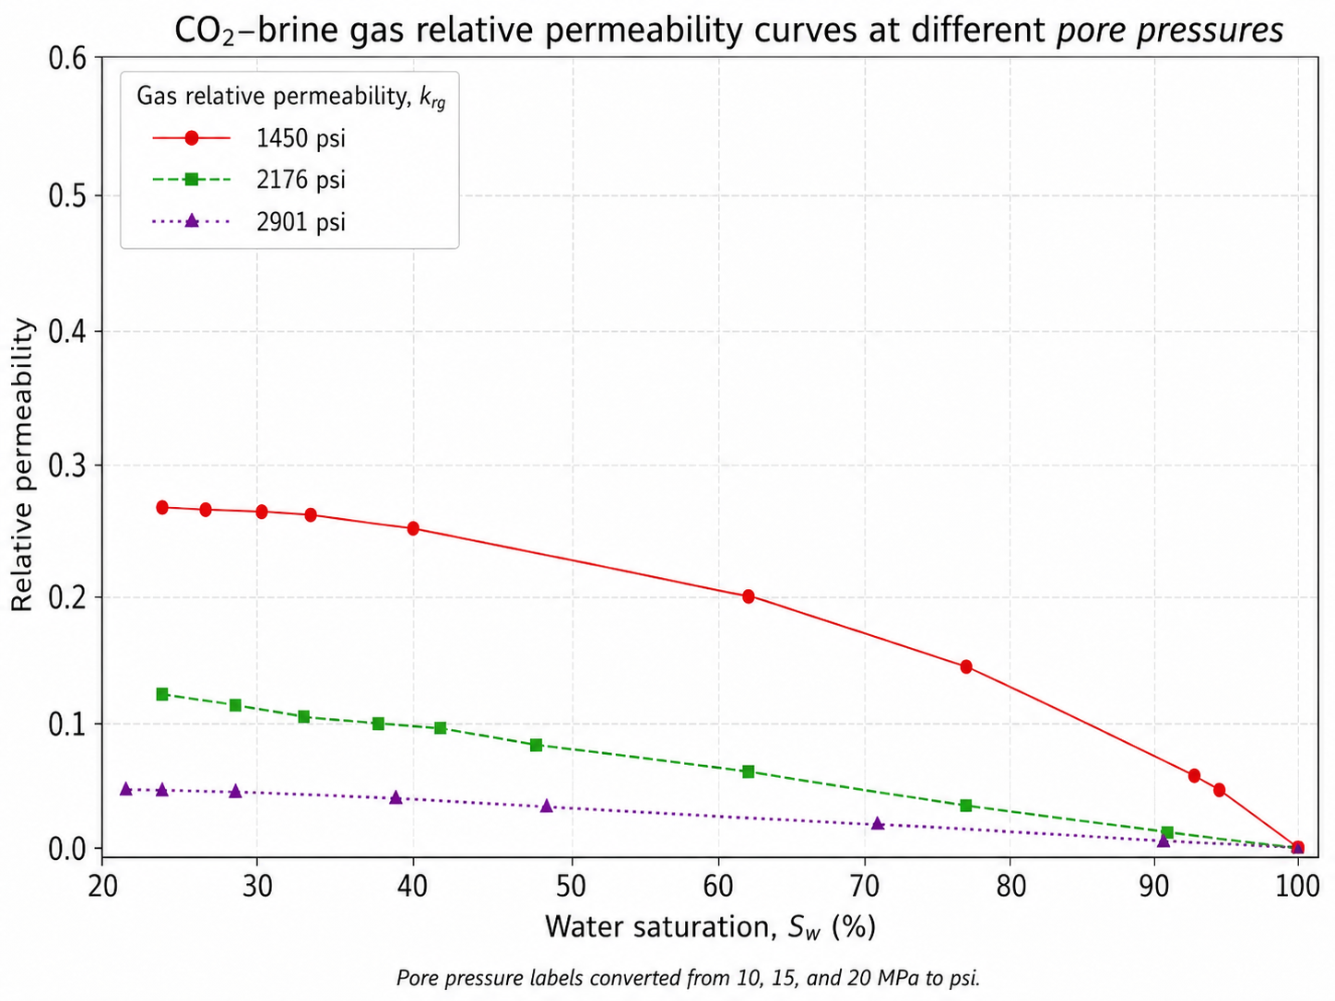
Core Flooding System
Nugget Sandstone Properties:
Effect of Pressure on Absolute Permeability: Absolute permeability increases as pore pressure increases.
Effect of Pressure on Gas Relative Permeability: Increasing pore pressure decreases gas relative permeability.
T: 221 F (Reservoir Temperature)
Liquid and supercritical CO₂-brine relative perm
Higher CO₂ viscosity leads to lower K_{rg}
Notes:
Academic training is very interdisciplinary.
Strongly shaped my research to address interdisciplinary problems by combining physics, data, and system analysis.
Quickly introduce an overview of my research contributions.

Slide 14
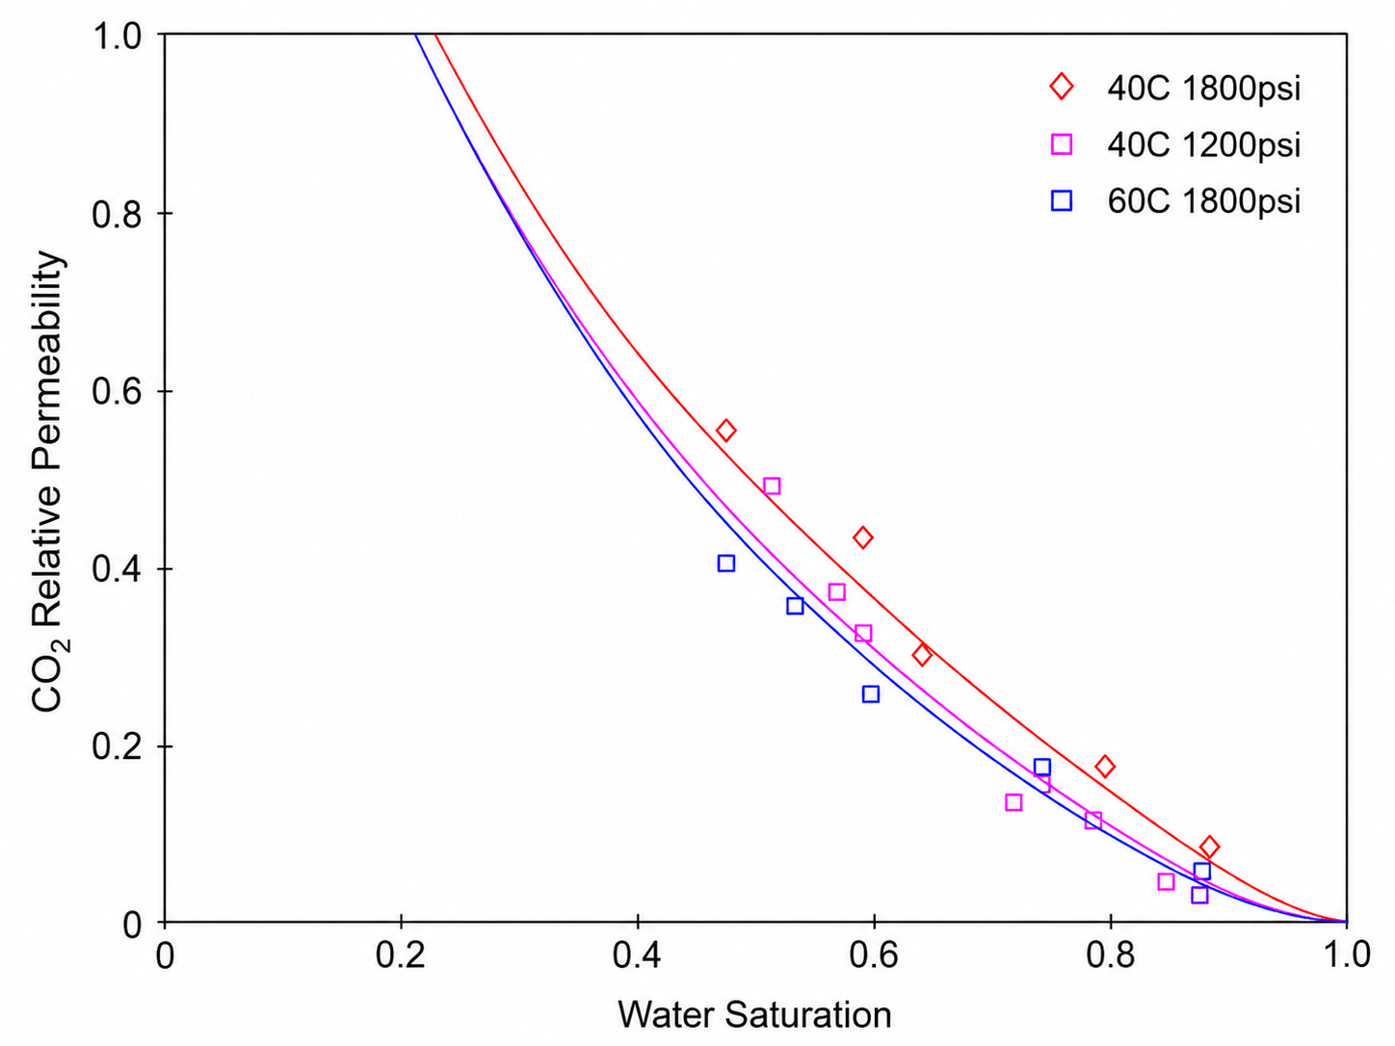
Core Flooding System
Berea Sandstone Properties:
Relative permeability for supercritical CO₂ and brine at reservoir conditions
Chen et al., 2017
Contrary to Berea Sandstone findings, increasing pressure has a large effect on K_{rg} values.
Practical implications: For tight rocks, relative permeability measurements has to be conducted at in-situ conditions.
Notes:
Academic training is very interdisciplinary.
Strongly shaped my research to address interdisciplinary problems by combining physics, data, and system analysis.
Quickly introduce an overview of my research contributions.

