Slide 1





When Structure Matters: Heterogeneity in the Poromechanics of Periodically Pulsed Soft Porous Materials
Matilde Fiori, Sylvie Lorthois
May 22nd 2026
From cartilage…

Slide 2
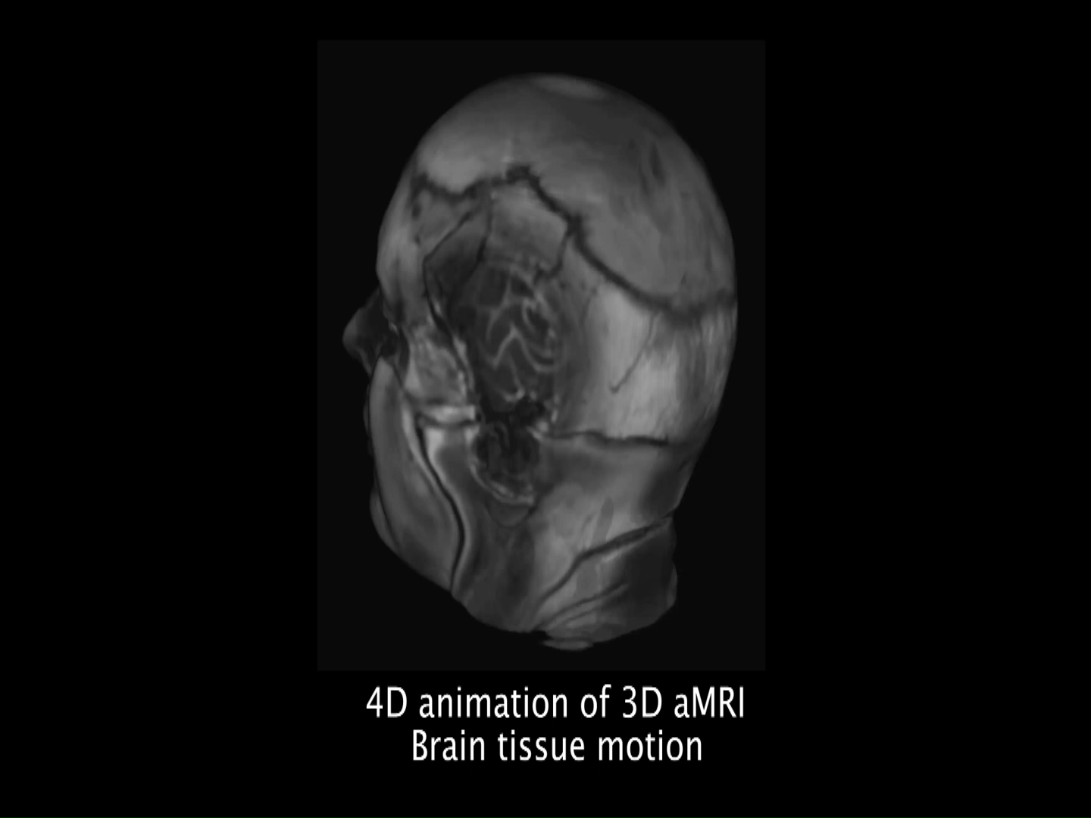
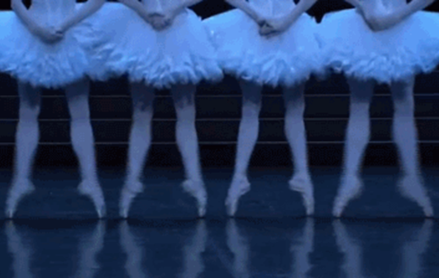
When Structure Matters: Heterogeneity in the Poromechanics of Periodically Pulsed Soft Porous Materials
Matilde Fiori, Sylvie Lorthois
May 22nd 2026
From cartilage…
…to brain,
Terem et al., 2021 (amplified signal)
… to many more!

Slide 3
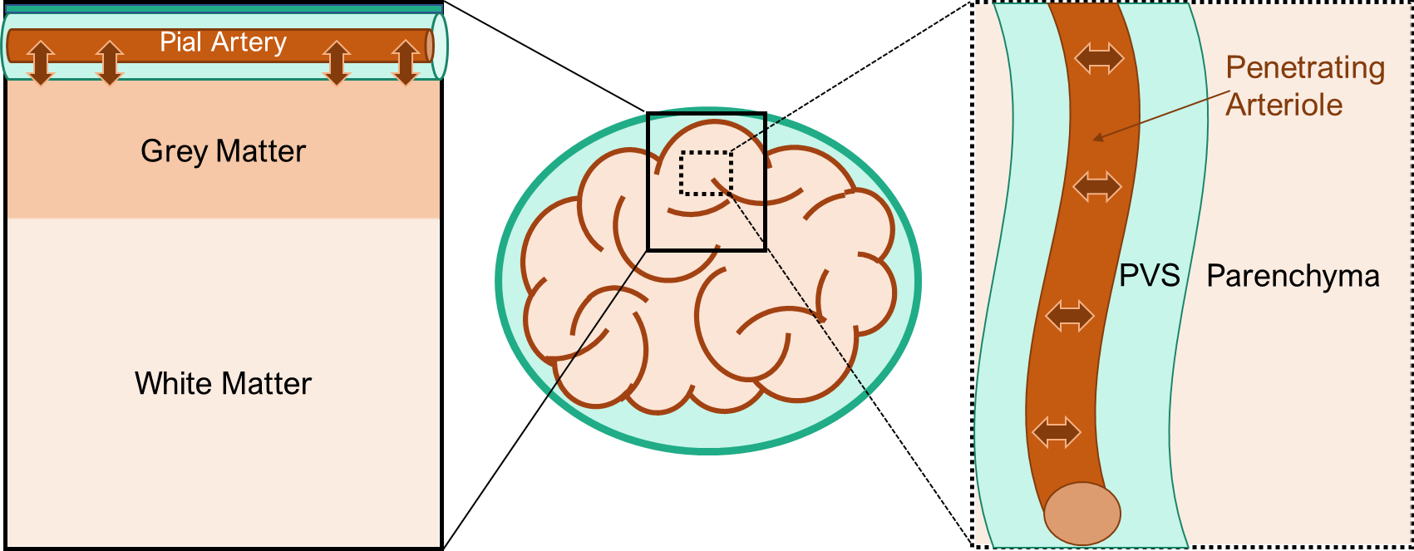
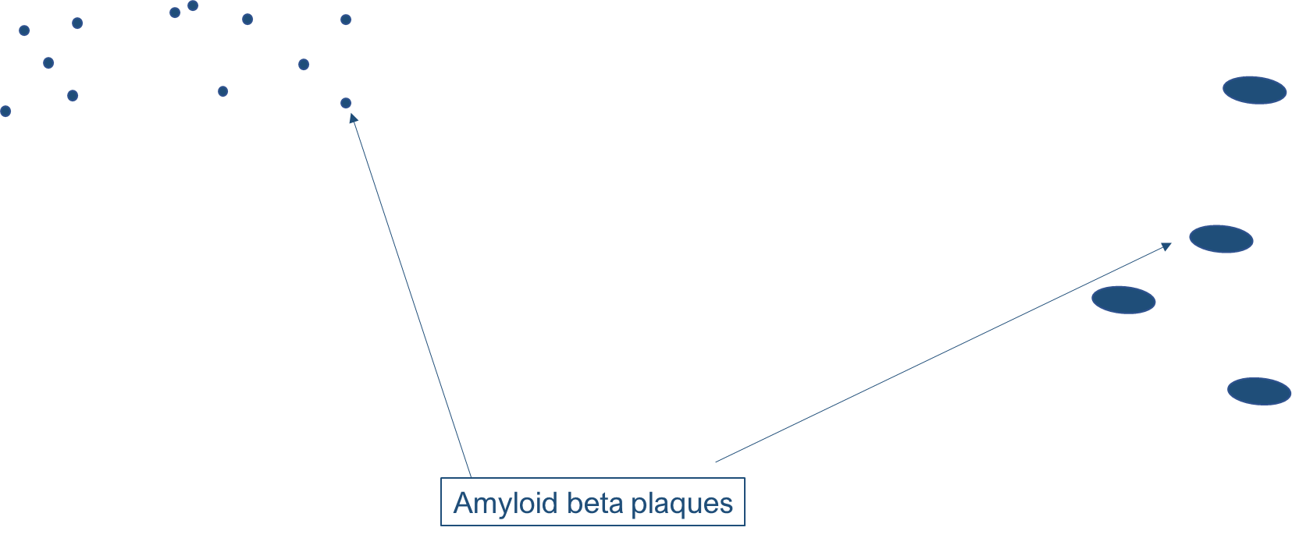
Layers in soft porous media: brain tissue
Layers at macroscale (Grey Matter – White Matter) and at mesoscale (PVS – Parenchyma)
Different properties (stiffness, permeability, porosity)
Delicate structural equilibrium (still not fully understood) for clearance from metabolic waste (e.g.: changes of porosity in sleep vs wake)
Impaired clearance (e.g., Alzheimer’s disease) changes in layer properties!

Slide 4
Objectives
Fundamental study on pulsatile poromechanics of Heterogeneous vs Homogeneous materials
Application to the system of brain grey matter and white matter to better understand brain clearance

Slide 5

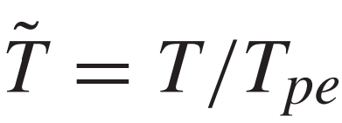





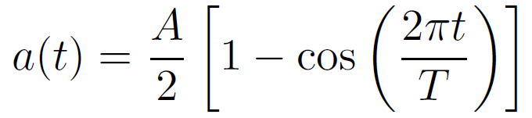
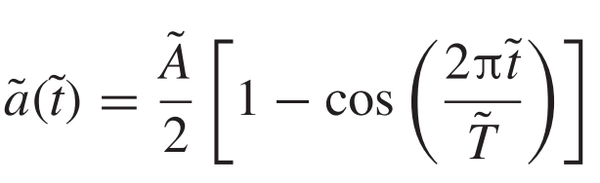



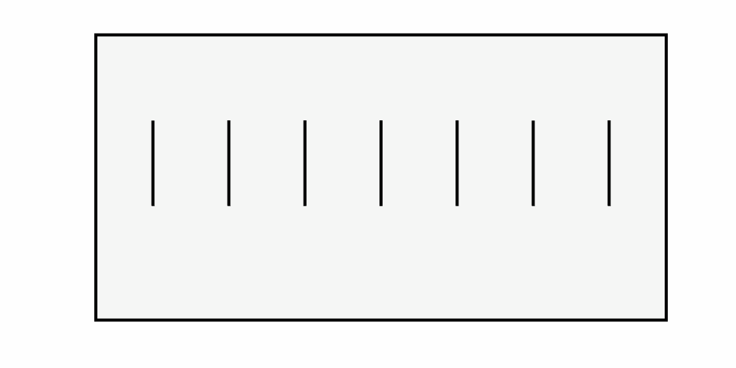
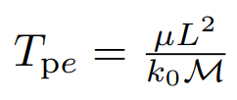



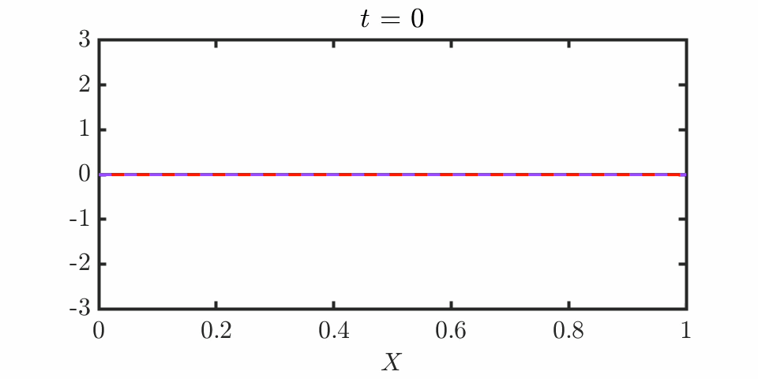
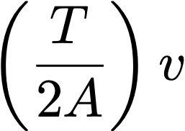
Homogeneous case
a(t)
strain
Squeezing slowly or fast relative to poroelastic diffusion
Viscosity
Permeability
Length
P-wave modulus
Fiori et al., JFM 2023

Slide 6
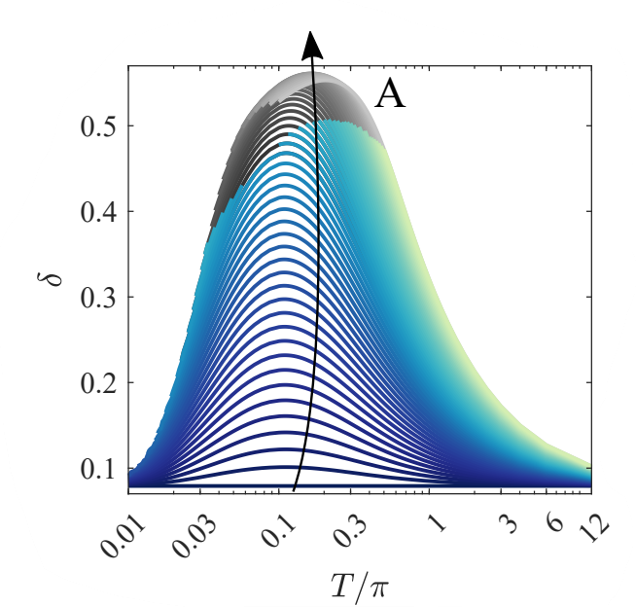
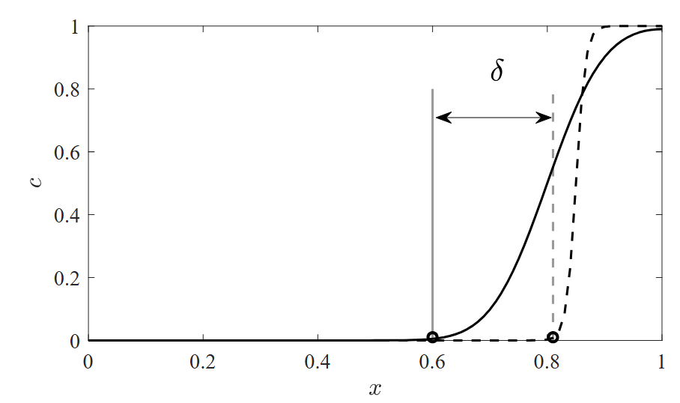
Homogeneous case – solute transport
For a given Amplitude, Tpe controls the response!
Solute stripe of width l
a(t)
=0.2
Initial width
Travel distance
Travel distance
A=0.004
Fiori et al., JFM 2025

Slide 7
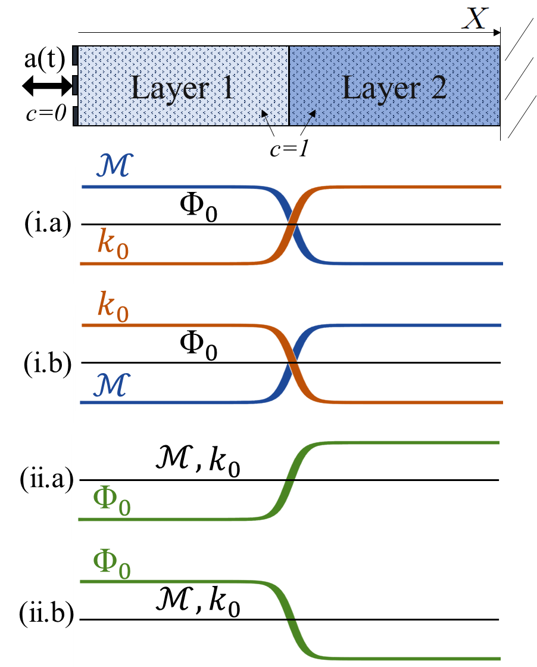
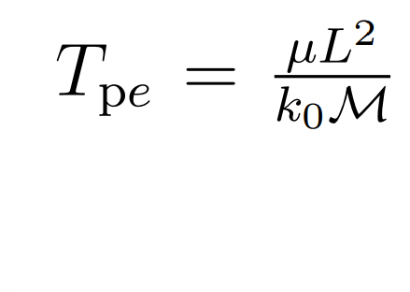
Method
Domain: two layers
displacement-driven, periodic load with fixed A and T
concentration c=1 inside and c=0 outside
viscosity
length
Layer properties:
Changing the properties individually alters the Poroelastic timescale:
altering LOCALISATION (= space distribution)
permeability
P-wave modulus
To isolate the impact of the heterogeneity: constant Tpe!

Slide 8

Parameters explored
unvaried
Case (i.a): $ℳ$= 10 – 0.1
$$k_{0}=0.1−10$$
Case (i.b): $ℳ$= 0.1 – 10
$$k_{0}=10−0.1$$
constant
“less-more deformable”
“more-less deformable”

Slide 9
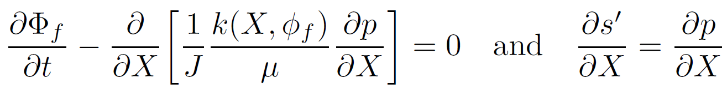
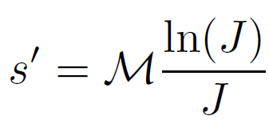
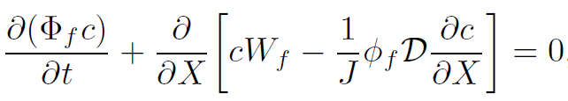
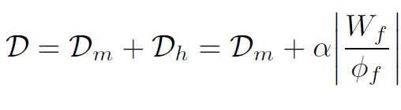
Model
Poromechanics
Pore pressure
with
Porosity field
From Darcy’s law
From Terzaghi’s principle + mechanical equilibrium
Solute transport
with
Concentration
Molecular Diffusion Coefficient
Hydrodynamic Dispersion Coefficient

Slide 10
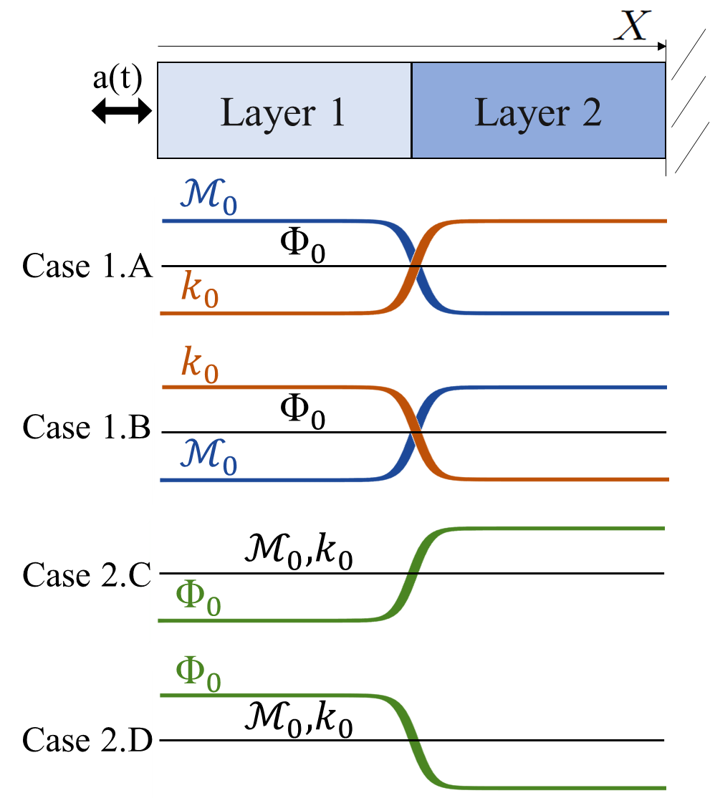



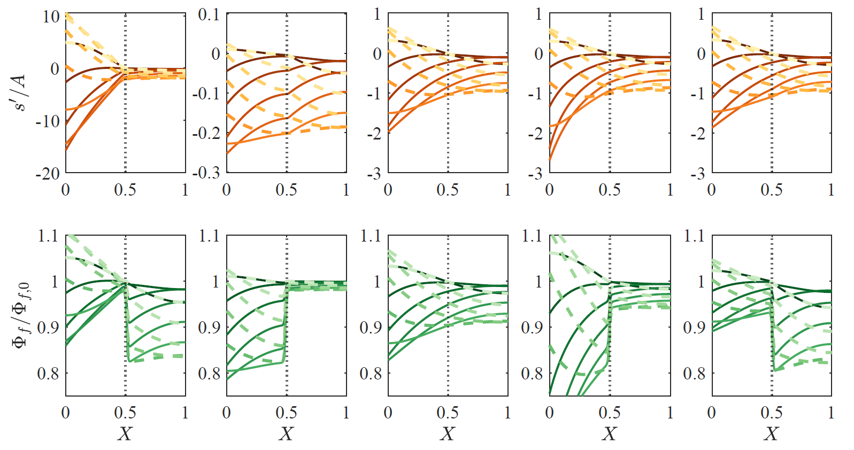
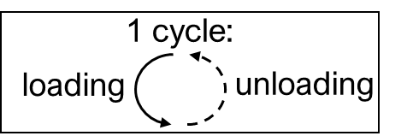
Poromechanical effects
Solid Stress
t = nT
t = (n+0.5)T
t = (n+1)T
Deformation
t = nT
t = (n+0.5)T
t = (n+1)T

Slide 11
Poromechanical effects
Solid Stress
t = nT
t = (n+0.5)T
t = (n+1)T
Deformation
t = nT
t = (n+0.5)T
t = (n+1)T
Localisation

Slide 12
Poromechanical effects
Solid Stress
t = nT
t = (n+0.5)T
t = (n+1)T
Deformation
t = nT
t = (n+0.5)T
t = (n+1)T
Propagation

Slide 13
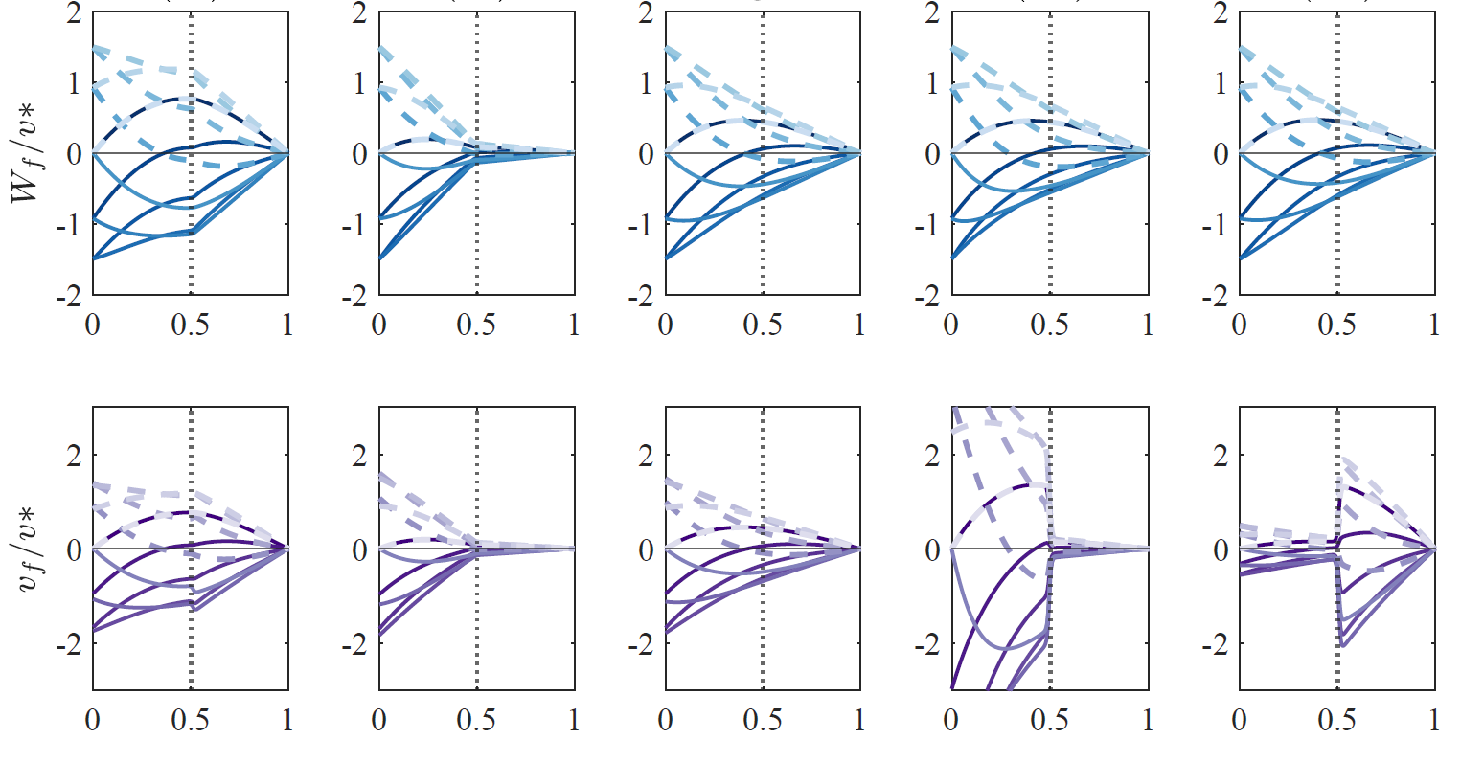
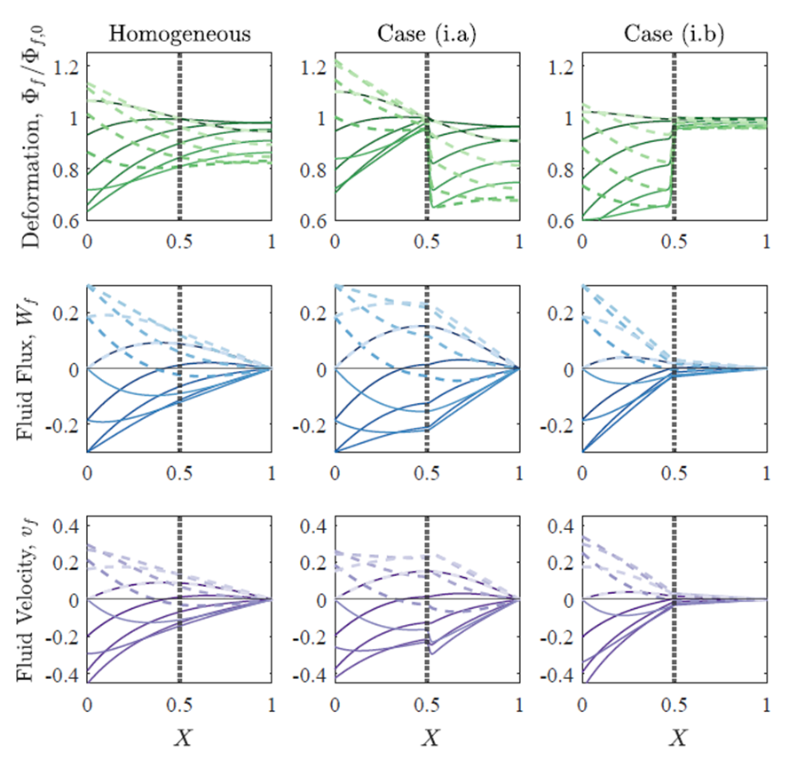
Poromechanical effects
Fluid Flow
t = nT
t = (n+0.5)T
t = (n+1)T
Fluid velocity
t = nT
t = (n+0.5)T
t = (n+1)T
Localisation/propagation have specific impact on solute transport

Slide 14
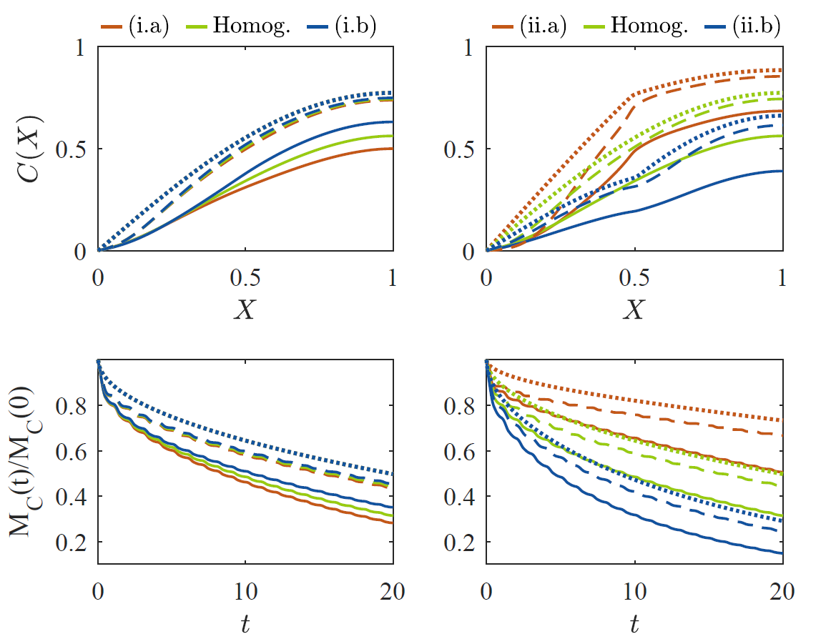
Impact on Solute transport
Total solute mass during 20 cycles:
(i.a)
(i.b)
Diffusion only
Advection-Diffusion
Advection-Diffusion-Dispersion
Layers tune transport dynamics!

Slide 15
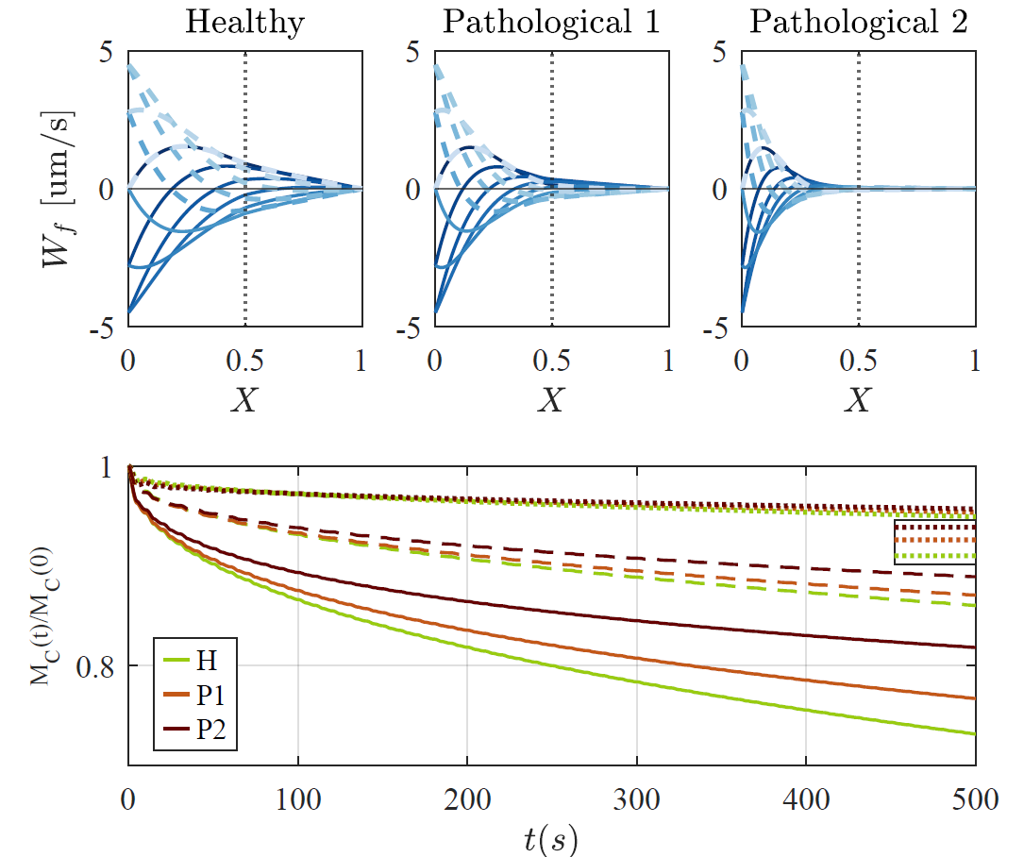
Simple example: healthy vs pathological GM - WM
Grey M.
White M.
Amyloid-β deposition in GM tissue
Vicious circle!
Pathological grey matter:
Lower solid stiffness (cell death)
Lower permeability (clogging)
Lower porosity (clogging)
Impaired Amyloid-β clearance
Diff. only
ADD, α=0.01
ADD, α=0.05

Slide 16
Key Results
Heterogeneous vs Homogeneous materials: same Tpe leads to different distributions of strain, fluxes and solute concentration fields.
The order of the layers matters!
Heterogeneous architecture in tissues potentially more efficient response to a fixed oscillating boundary condition.
In brain clearance, these results suggest a possible vicious circle, with damaged tissue further impairs clearance.

Slide 17
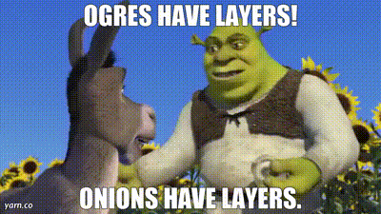
…Questions/ Comments?
Thank you!
Reach out to me!
matilde.fiori@imft.fr

Slide 18
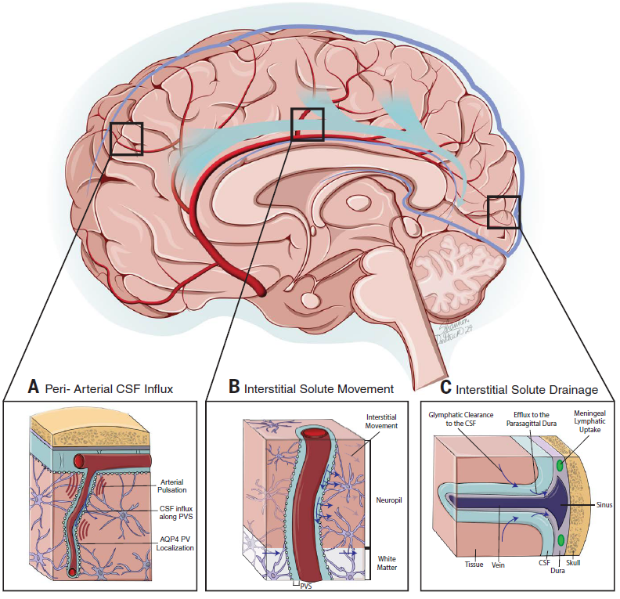
The problem of Brain Clearance
Neuronal activity metabolic waste, but highly shielded system
Brain clearance through flow of CerebroSpinal Fluid (CSF): complex mechanism, not fully understood
Blood vessel pulsations at the surface and along the penetrating arteries, surrounded by PeriVascular Spaces (PVS)
Keil et al., 2025

Slide 19
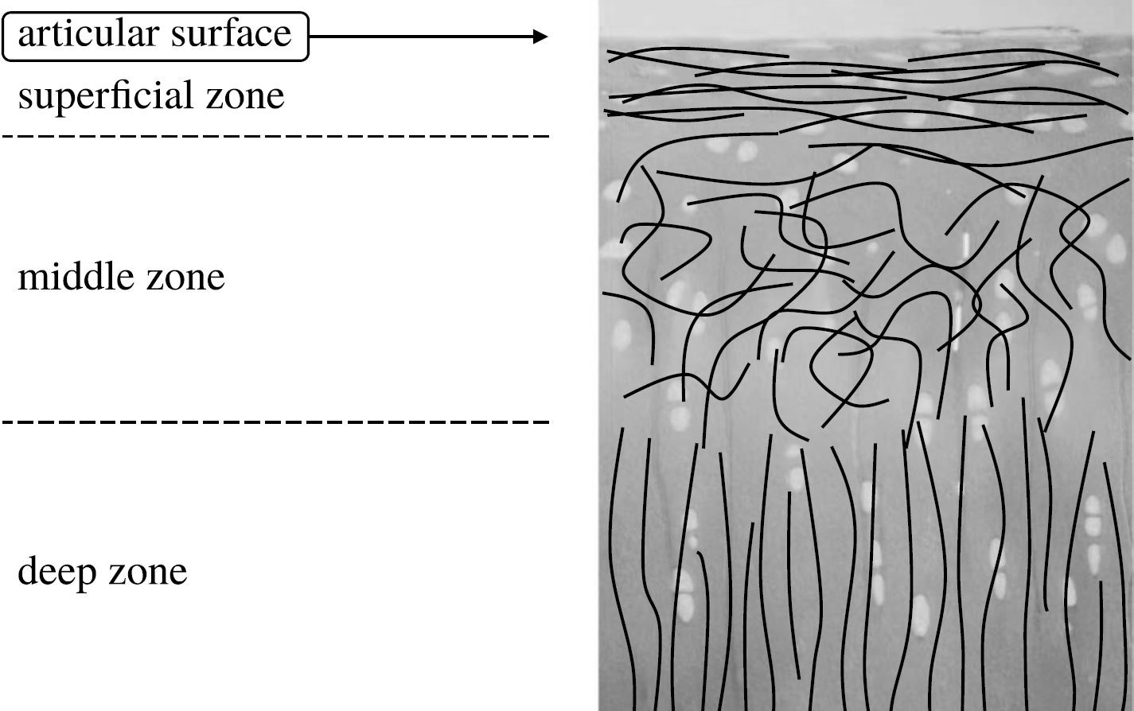
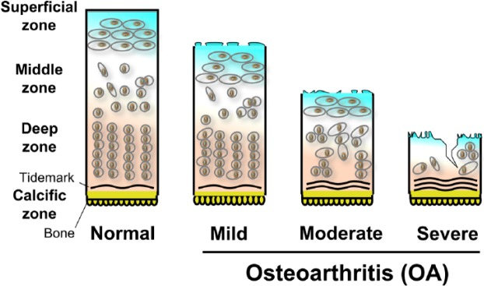
Layers in soft porous media: cartilage
Divided into three layers (“zones”)
Each layer with specific properties (stiffness, permeability, porosity)
Depth-dependent solute transport properties
Damaged structure (e.g., osteoarthritis) loop of further damage
layers are functional to the whole tissue!
Articular cartilage
Maleki et al., 2019
Tiku and Sabaawi, 2015c

Slide 20
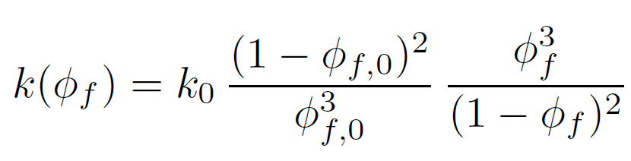

Porosity, Permeability, Stiffness
Same initial fluid fraction ${\text{Φ}}_{0}$, but decreasing initial permeability ${\text{k}}_{0}$ from left to right.
Kozeny-Carman permeability to describe the strain-dependent behaviour of k:
${\text{k}}_{0}$=0 !
Same initial permeability ${\text{k}}_{0}$, but decreasing initial fluid fraction ${\text{Φ}}_{0}$ from left to right.
Same initial permeability ${\text{k}}_{0}$and fluid fraction ${\text{Φ}}_{0}$, but decreasing initial p-wave modulus $\text{M}$ from left to right.

Slide 21
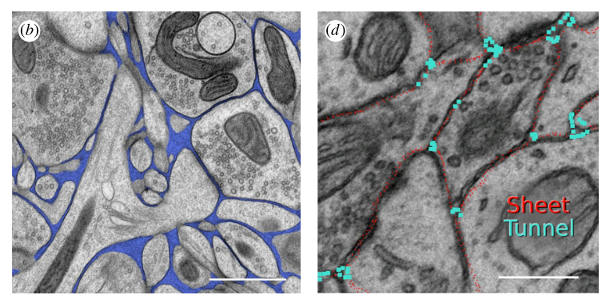
Examples in the brain tissue
C. Nicholson, 2023
In the brain tissue, voids occupied by the fluid can be very tortuous and have complex geometries.

Slide 22
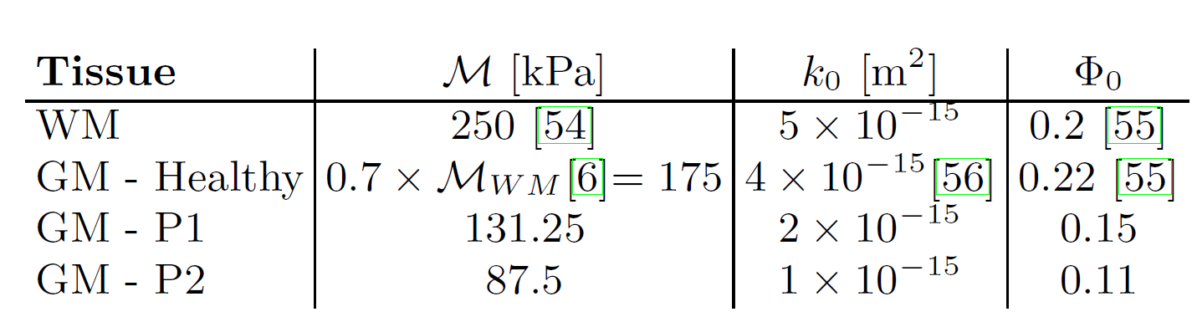
Parameters
[1]
[4]
[2]
[3]
[4]
[1] Franceschini et al., Brain tissue deforms similarly to filled elastomers andfollows consolidation theory, J. Mech. and Phys. Solids, 2006
[2] Budday et al., Mechanical properties of gray and white matter brain tissue by indentation, J. Mech. Behav. Biomed. Mat., 2015
[3] Greiner et al., Model-driven exploration of poro-viscoelasticity in human brain tissue, Interface Focus, 2024
[4] Lehmenkuhler et al., Extracellular space parameters in the rat neocortex and subcortical white matter during postnatal development determined by diffusion analysis, Neuroscience, 1993

Slide 23
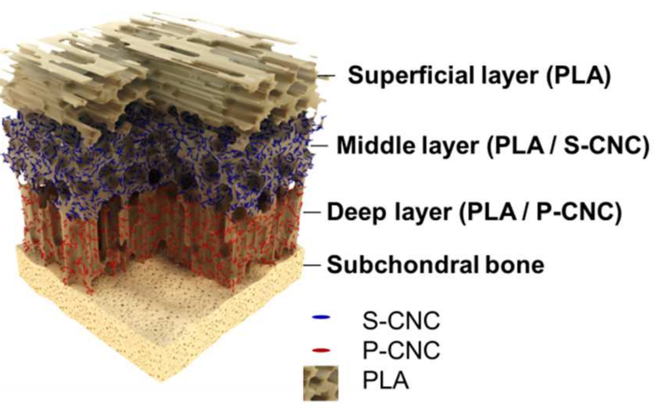
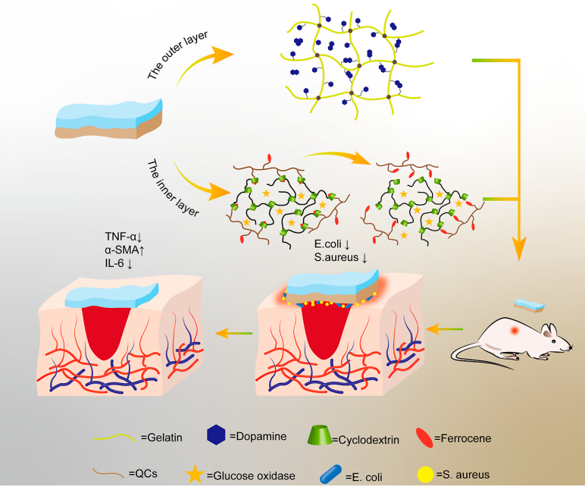
Layers in soft porous media: scaffolds for tissue engineering
Camaero-Espinosa et al., 2016
Tang et al, 2023
In general, layers seem to be beneficial for different tissues/scaffolds.
However, rarely the focus of poroelasticity has been put on heterogeneous materials, especially when subject to periodic pulsations!

Slide 24
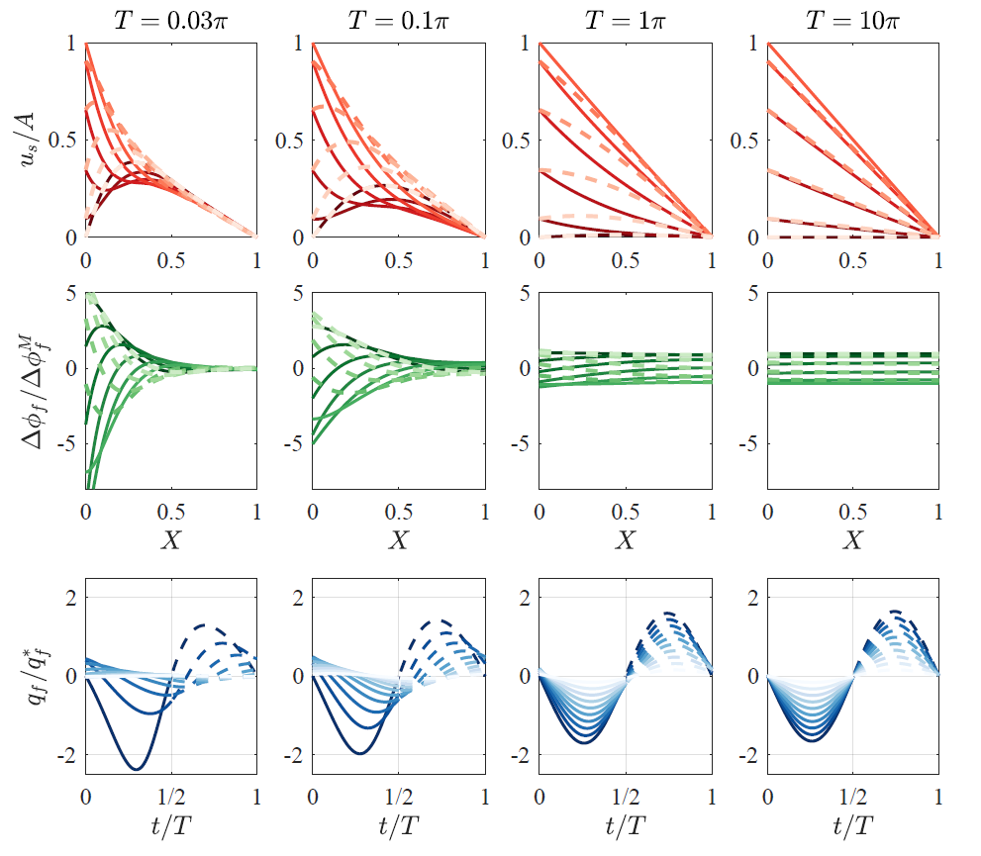
Take home message:
T and A impact on
Localisation, magnitude and “asymmetry” of deformation
Delay in fluid-flow response
displacement
porosity
change
fluid flux
Fiori et al., JFM 2023

Slide 25
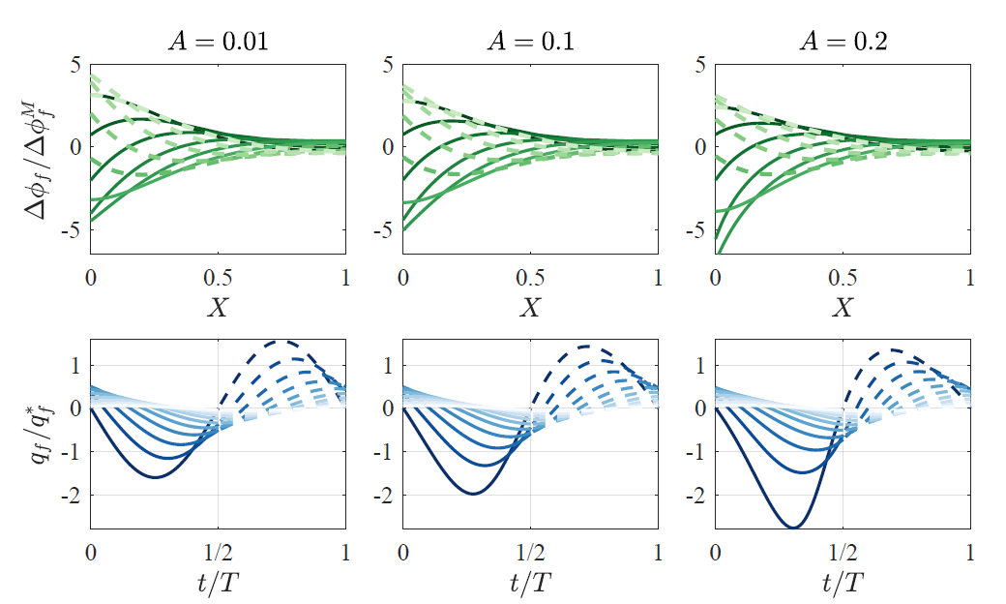
Take home message:
T and A impact on
Localisation, magnitude and “asymmetry” of deformation
Delay in fluid-flow response
porosity
change
fluid flux
Fiori et al., JFM 2023

Slide 26
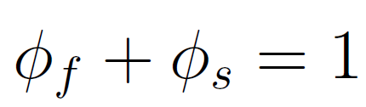


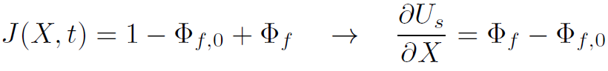
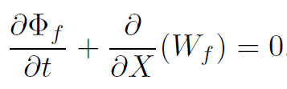
Model (complete)
For the fluid and solid phases:
Given ,
Both fluid and solid individually incompressible, but volume changes due to outflow/inflow:
Continuity reads:

Slide 27
Model – solute transport
Concentration
Advective Flux
Diffusive-like Flux
Molecular Diffusion Coefficient
Hydrodynamic Dispersion Coefficient

Slide 28

Parameters explored
First two cases: keeping the fluid fraction constant, changing the properties defining the denominator:
Case (i.a): $ℳ$= 10 – 0.1
$$k_{0}=0.1−10$$
Case (i.b): $ℳ$= 0.1 – 10
$$k_{0}=10−0.1$$
Second two cases: keeping properties constant, changing the values of the initial fluid fraction:
Case (ii.a): ${\text{Φ}}_{0}=0.25 −0.75$
Case (i.b): ${\text{Φ}}_{0}=0.75 −0.25$
unvaried
constant
“less-more deformable”
“more-less deformable”
“less-more deformable”
“more-less deformable”

Slide 29
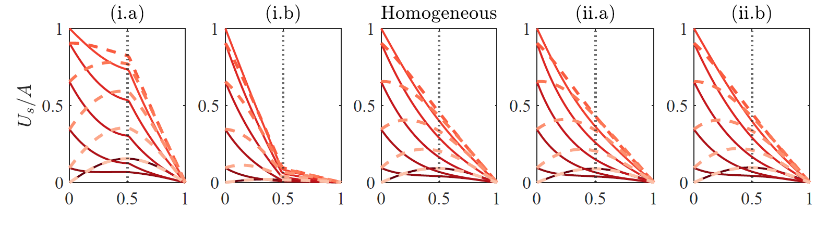
Results
Displacements are affected in cases (i.a) and (i.b), but not in (ii.a) and (ii.b)

Slide 30


Poromechanical effects
Solid Stress
t = nT
t = (n+0.5)T
t = (n+1)T
Deformation
t = nT
t = (n+0.5)T
t = (n+1)T

Slide 31
Poromechanical effects
Solid Stress
t = nT
t = (n+0.5)T
t = (n+1)T
Deformation
t = nT
t = (n+0.5)T
t = (n+1)T
Localisation

Slide 32
Poromechanical effects
Solid Stress
t = nT
t = (n+0.5)T
t = (n+1)T
Deformation
t = nT
t = (n+0.5)T
t = (n+1)T
Propagation

Slide 33
Fluid Flow
(driving dispersion)
Fluid velocity
(driving advection)
Poromechanical effects
Fluid Flow
t = nT
t = (n+0.5)T
t = (n+1)T
Fluid velocity
t = nT
t = (n+0.5)T
t = (n+1)T
Localisation/propagation have specific impact on solute transport

Slide 34
Impact on Solute transport
(i.a)
Diffusion only
Advection-Diffusion
Advection-Diffusion-Dispersion
(i.b)
Layers tune transport dynamics!

Slide 35
Impact on Solute transport
(i.a)
(ii.a)
(i.b)
(ii.b)
Diffusion only
Advection-Diffusion
Advection-Diffusion-Dispersion

Slide 36
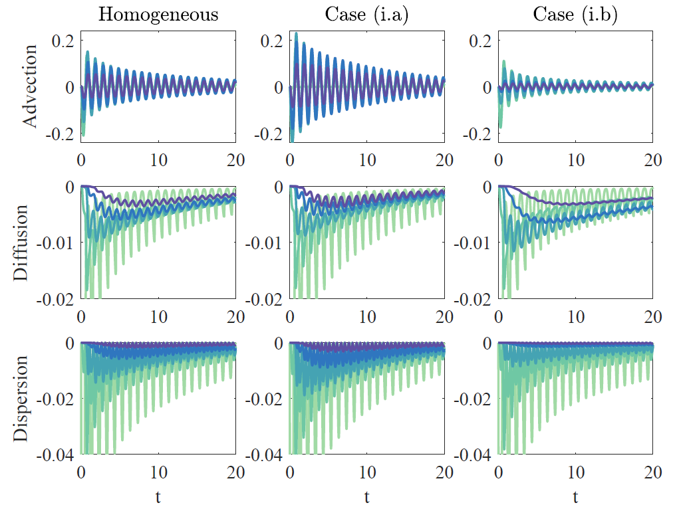
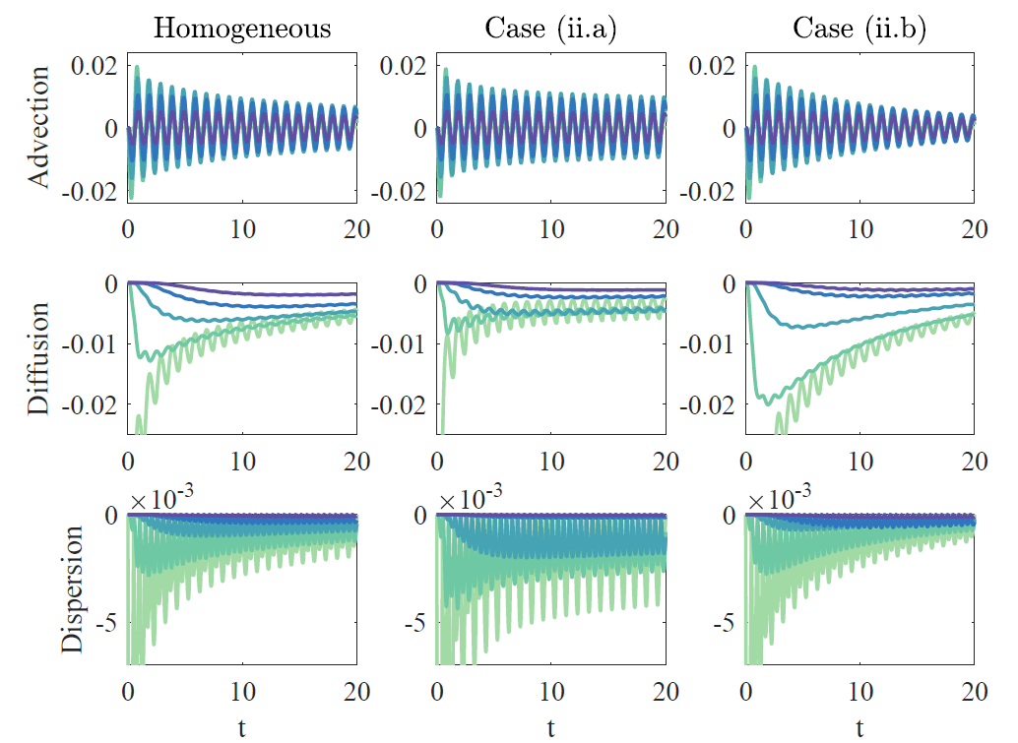

Isolation of solute transport fluxes
Evaluated at different points in space: during 20 cycles

Slide 37
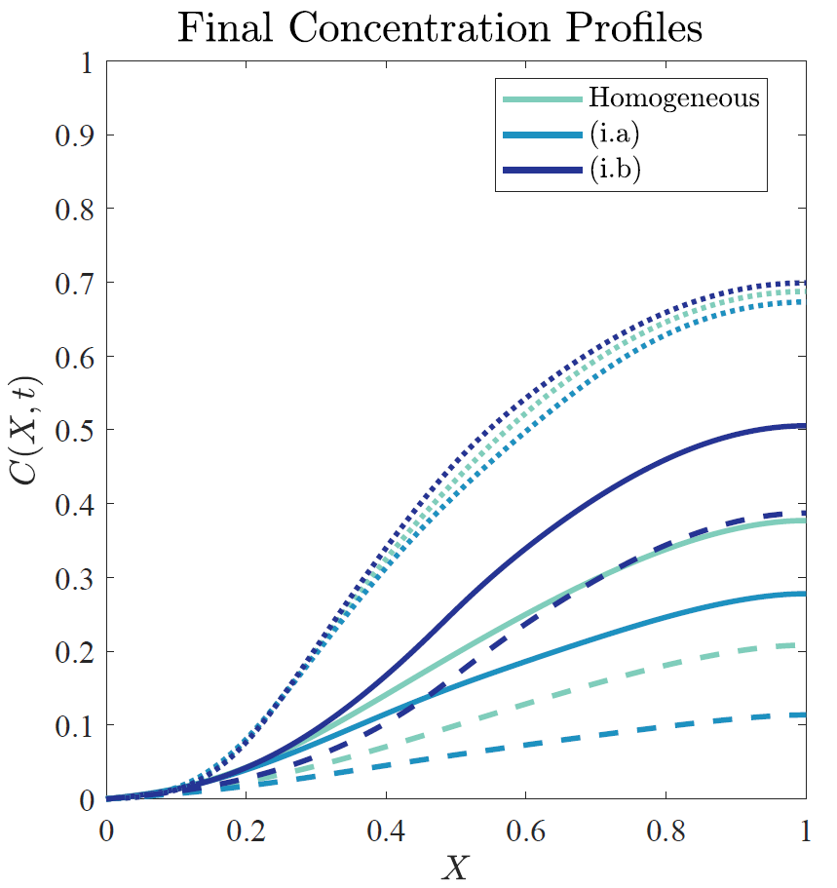
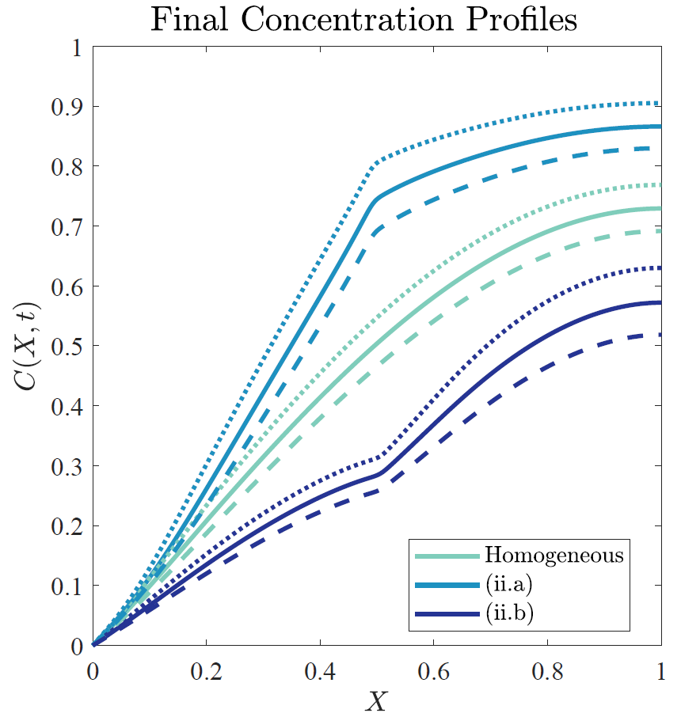
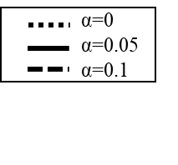
Discussion / Feedback
Is there a way to describe the effective behaviour analytically?
“less-more deformable”
“more-less deformable”

