Slide 1

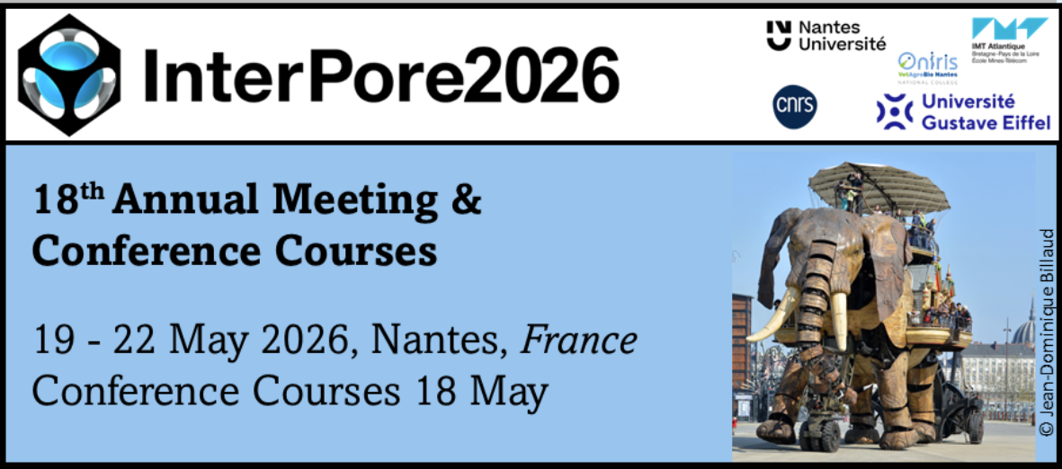
Multiscale CT-based characterization of pore structures and a sliding-layer method for permeability estimation based on local connectivity
Hongyang Ni, Hai Pu, Jiangfeng Liu
China University of Mining and Technology
2026-05-19

Slide 2
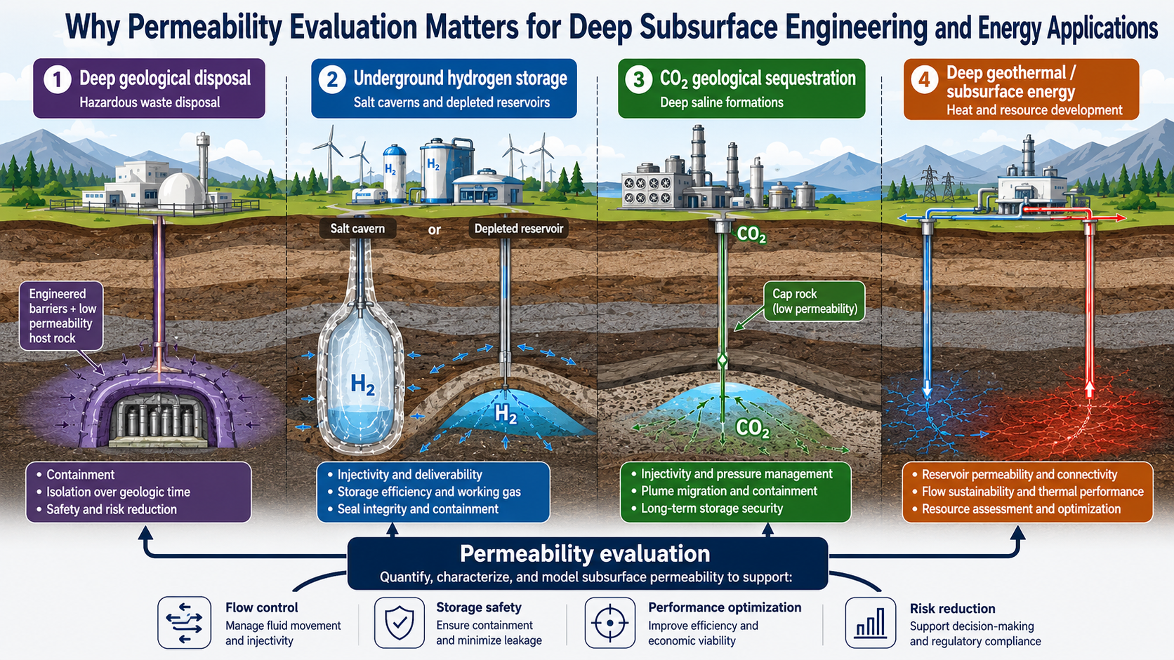

Slide 3
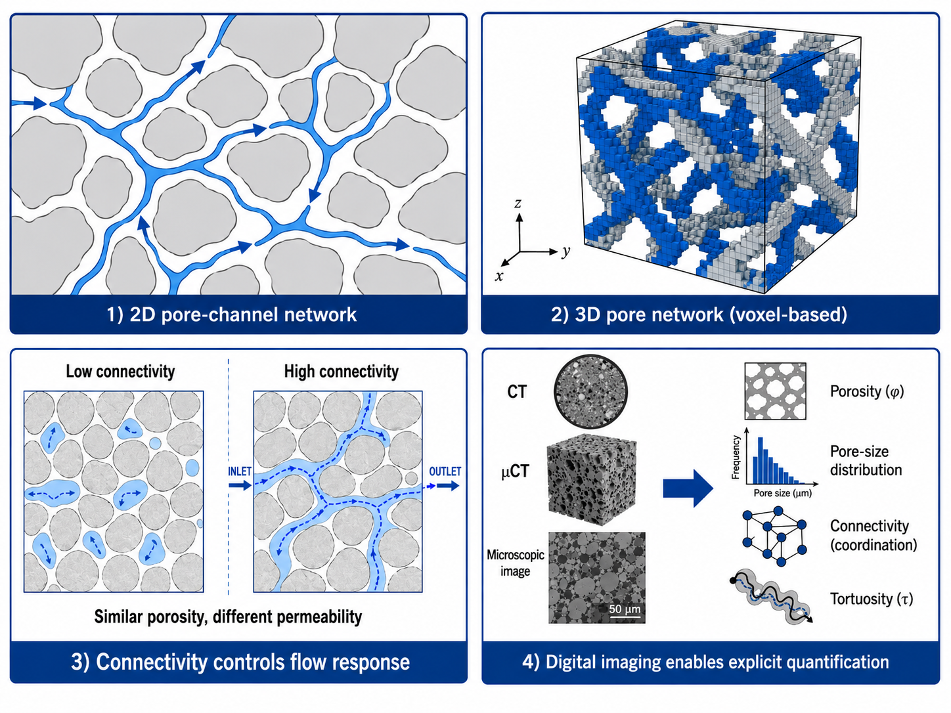
Pore structure is the microstructural basis of permeability
Flow occurs in multiscale pore/fracture networks
Flow response is controlled by pore connectivity.
Similar porosity may produce very different permeability.
Conventional “experiment + single permeability” descriptions are often insufficient
Connectivity, throat size, and dead-end pores matter.
Tortuosity, anisotropy, and bedding also affect flow.
Digital imaging explicitly quantifies pore structure
CT, μCT, and microscopy quantify pore geometry and connectivity.
These descriptors provide the basis for permeability prediction.
1
2
3
Image-based quantification of multiscale pore structure provides the physical basis for permeability prediction and model construction

Slide 4
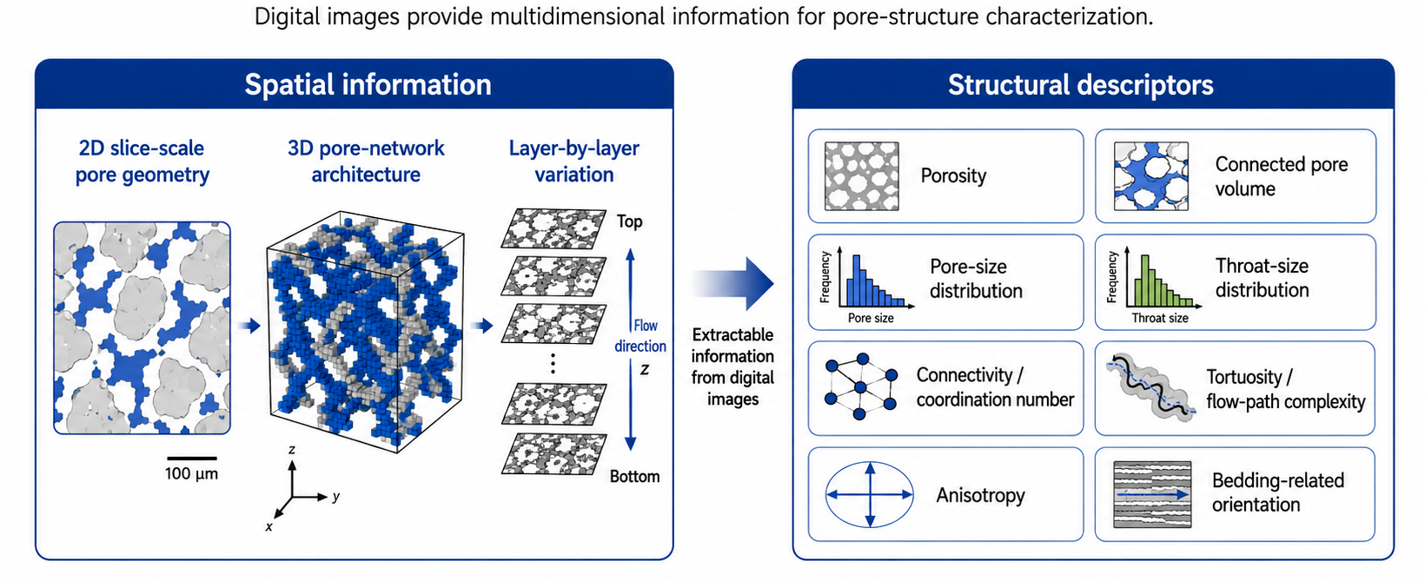
Extractable pore-structure information from digital images
Digital images convert complex pore structures into measurable descriptors for structure-permeability analysis

Slide 5
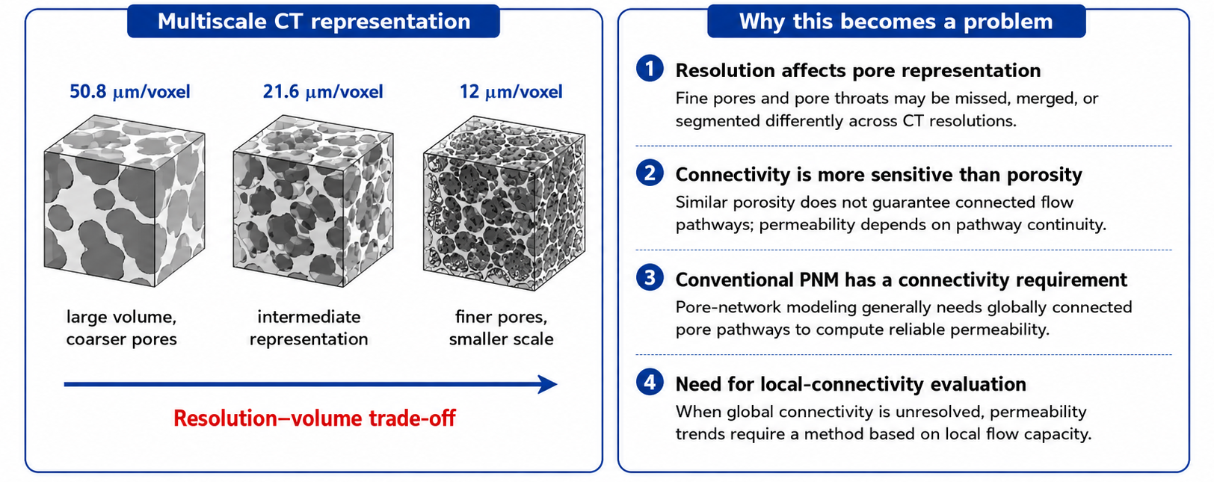
CT resolution can strongly affect pore connectivity and permeability estimation
Key challenge: How can permeability trends be evaluated when CT-resolved global connectivity is incomplete?
This motivates the sliding-layer local-connectivity method used in this study

Slide 6
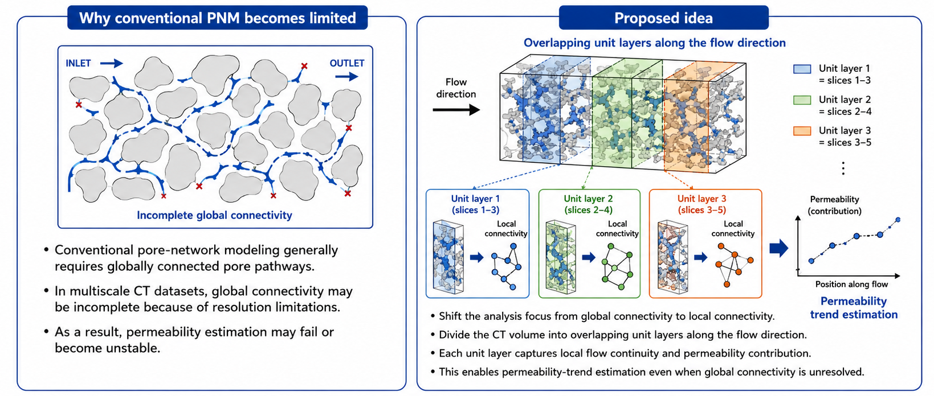
Core idea of the proposed sliding-layer local-connectivity method
The proposed method evaluates permeability from locally connected pore structures rather than relying only on globally connected pathways

Slide 7
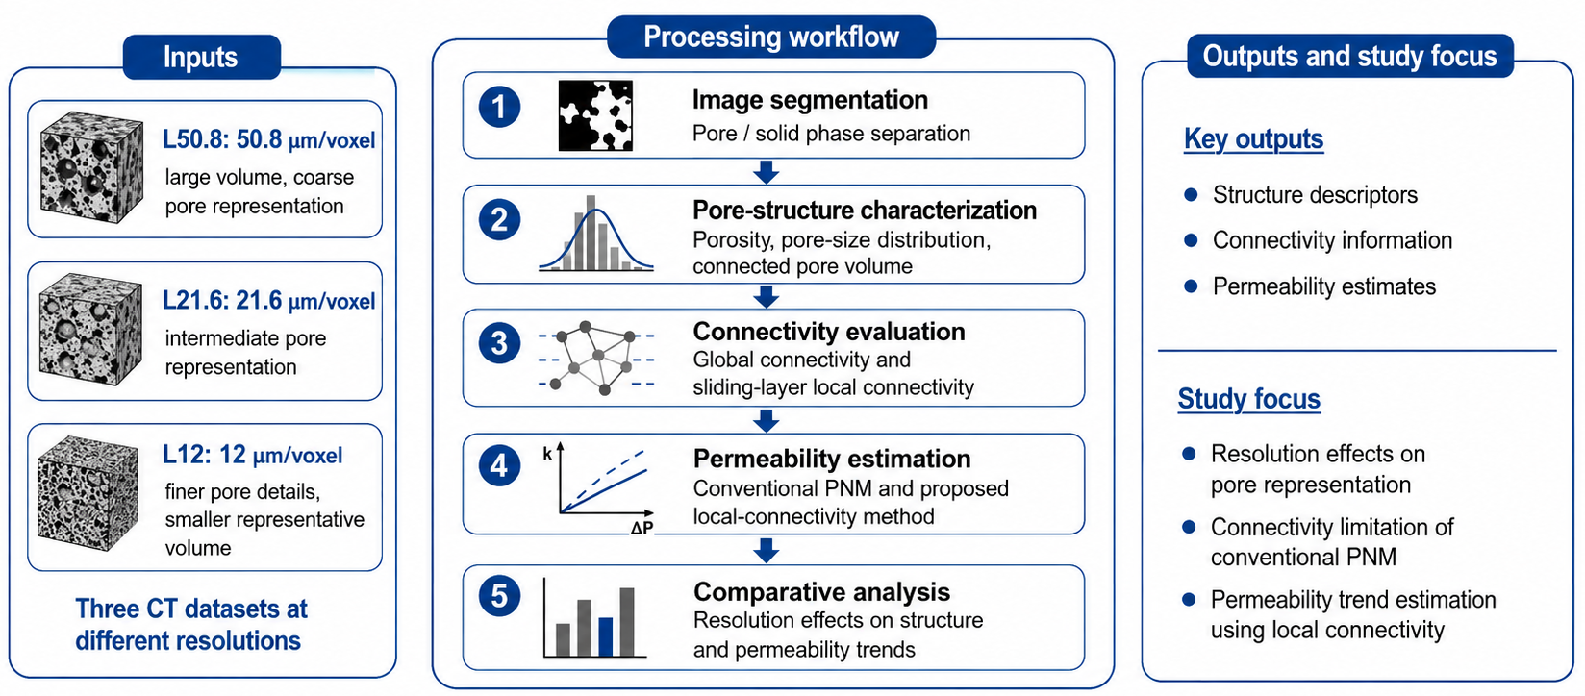
Overall analysis workflow of this study
This workflow links multiscale CT-resolved pore structure to connectivity analysis and permeability evaluation

Slide 8
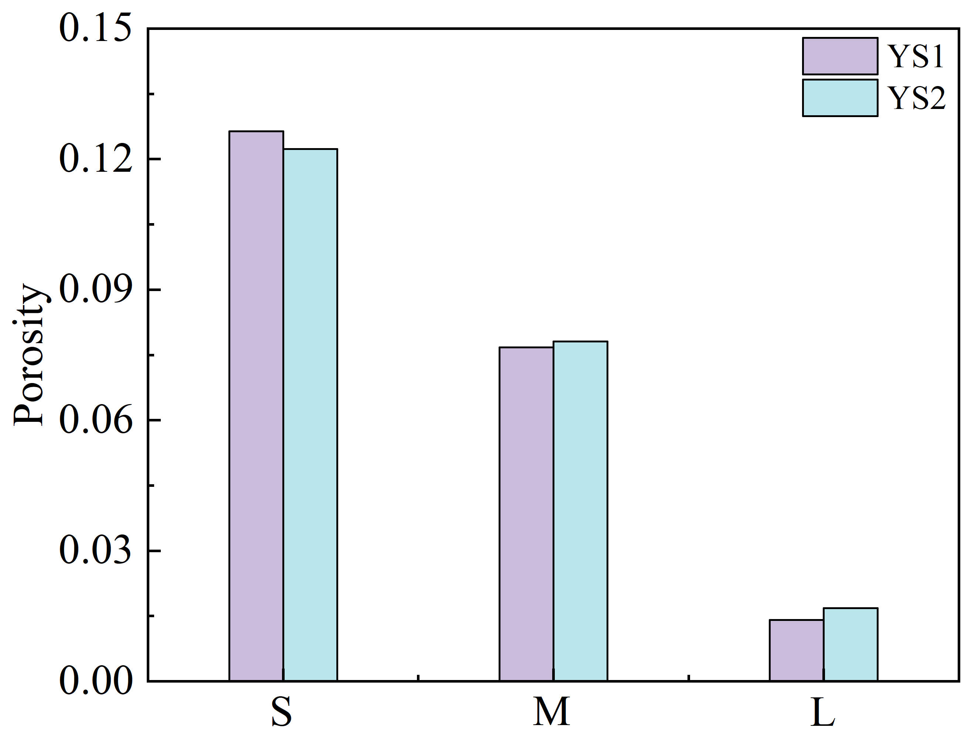
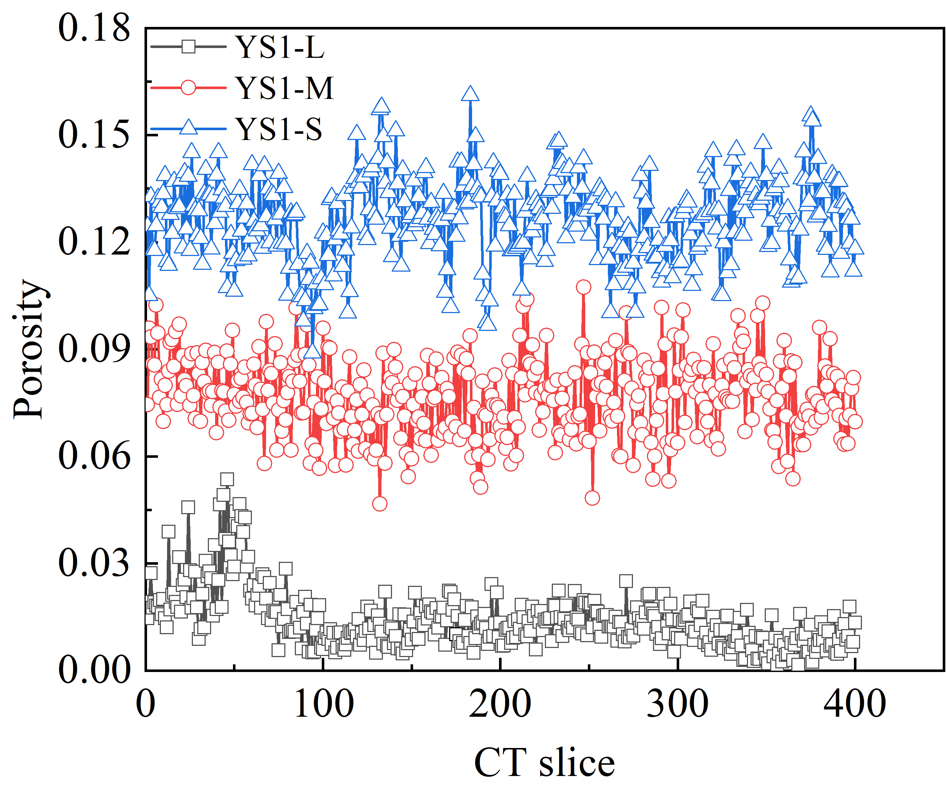
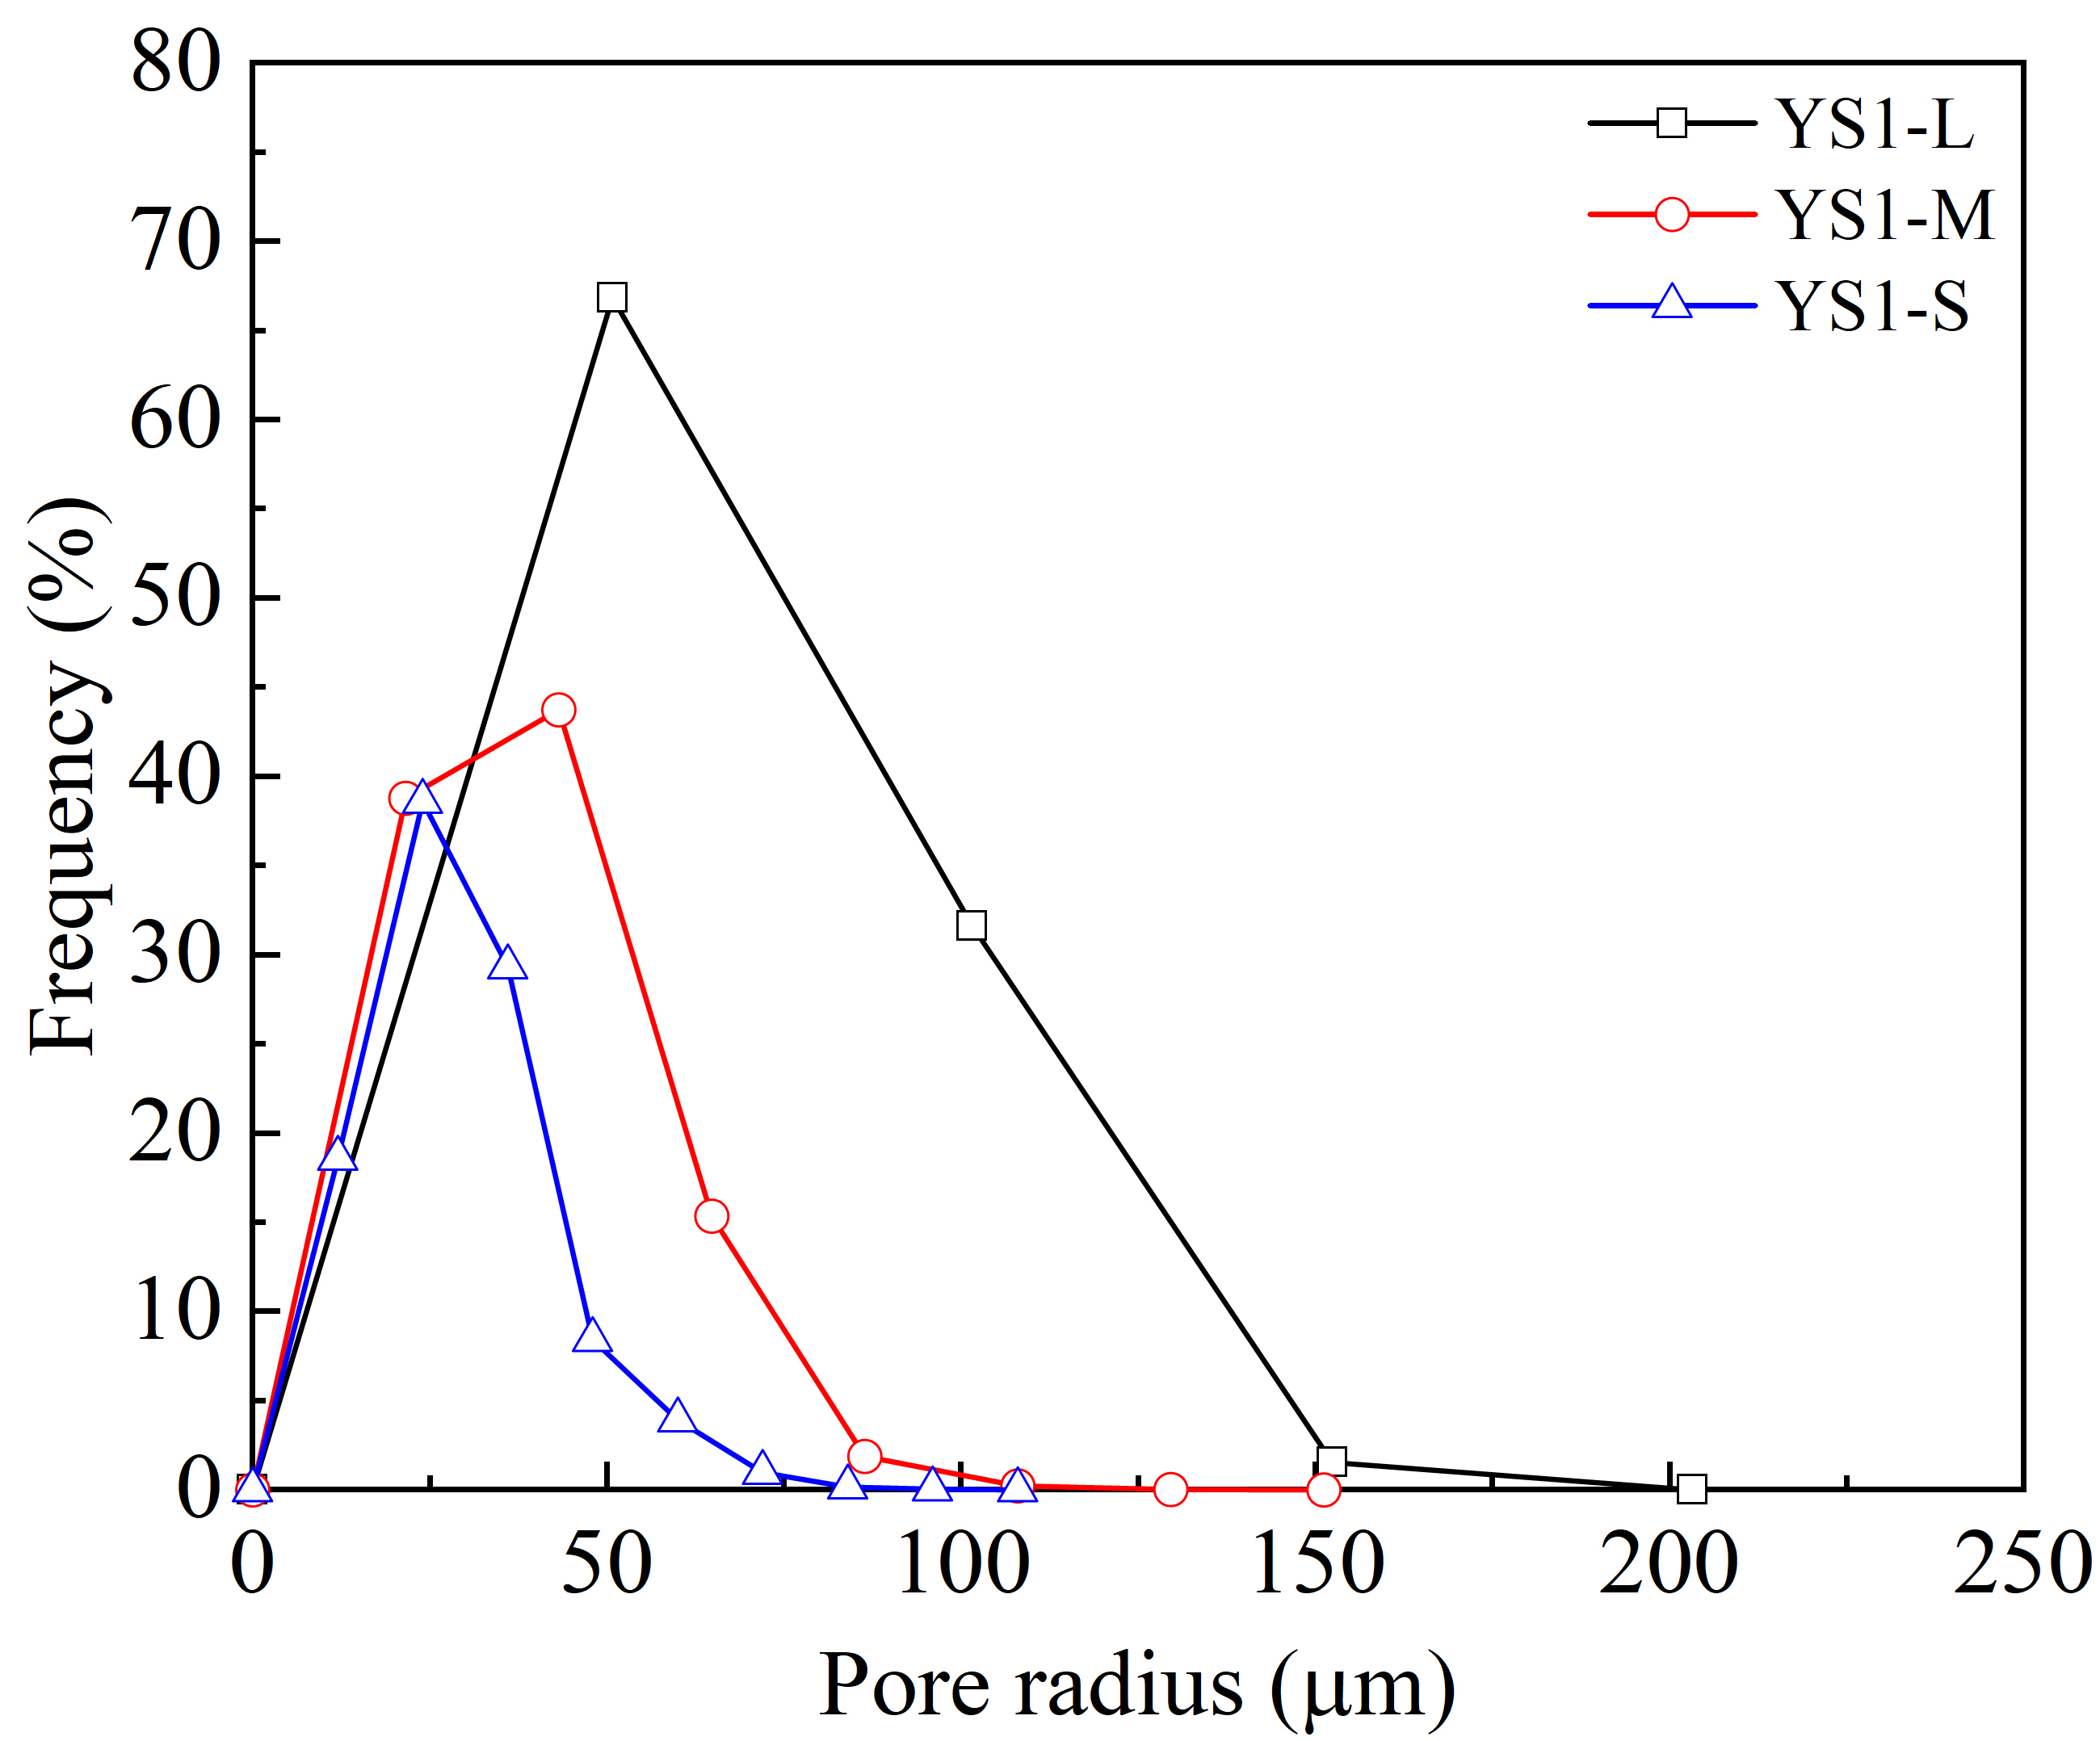
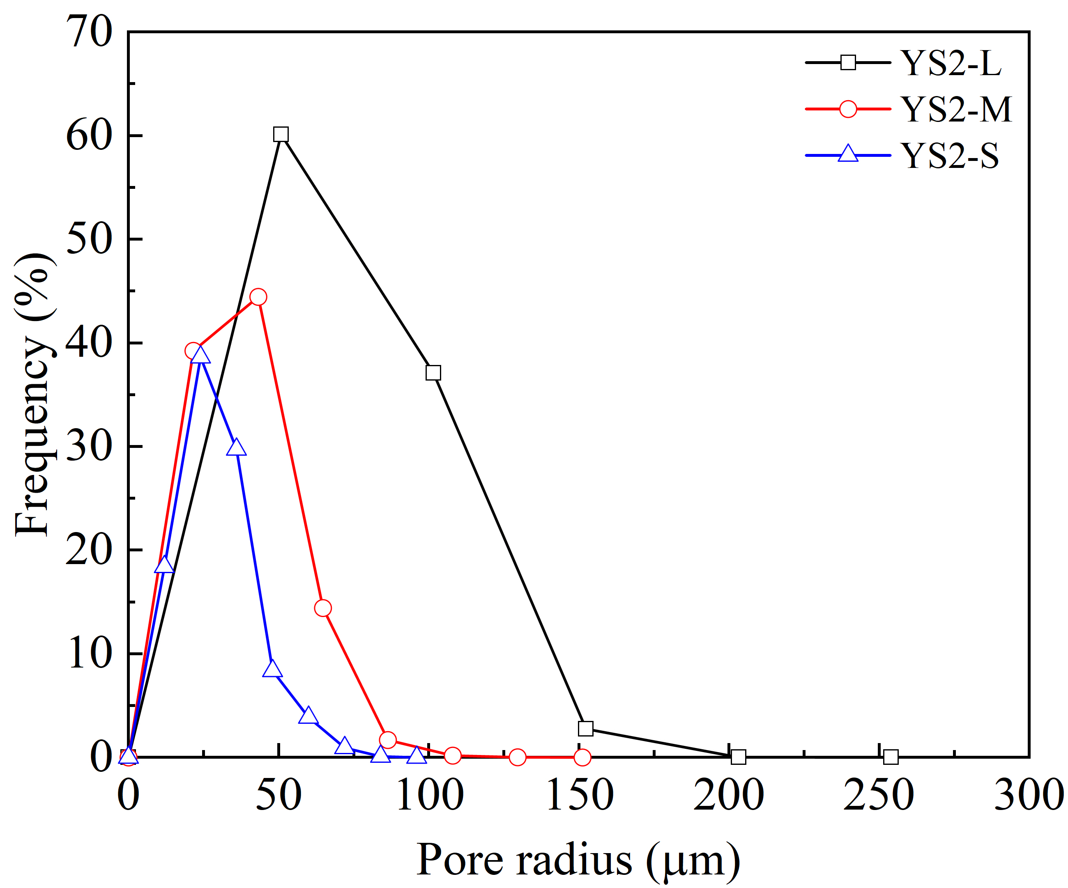
Resolution effects on pore-structure characterization
Pore structure descriptors
Key observations
Porosity decreases systematically from S to M to L in both YS1 and YS2.
1
Pore-radius distributions shift with scale, with coarser datasets showing larger apparent pores.
2
(a) Porosity
Finer-resolution representations capture a greater proportion of small pores and more detailed boundaries.
3
Resolution affects not only pore quantity, but also the geometric basis for connectivity and permeability evaluation.
4
(b) Pore size distribution
Resolution changes how pore space is represented, quantified, and interpreted

Slide 9
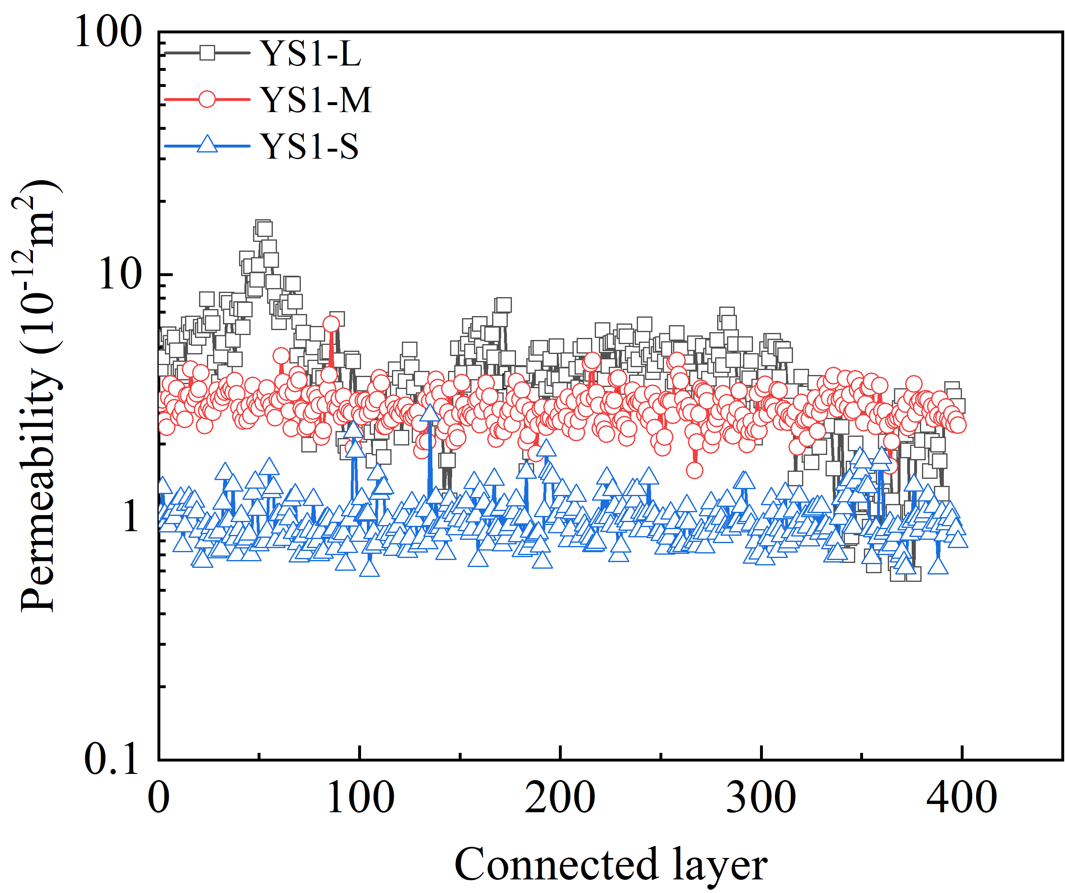
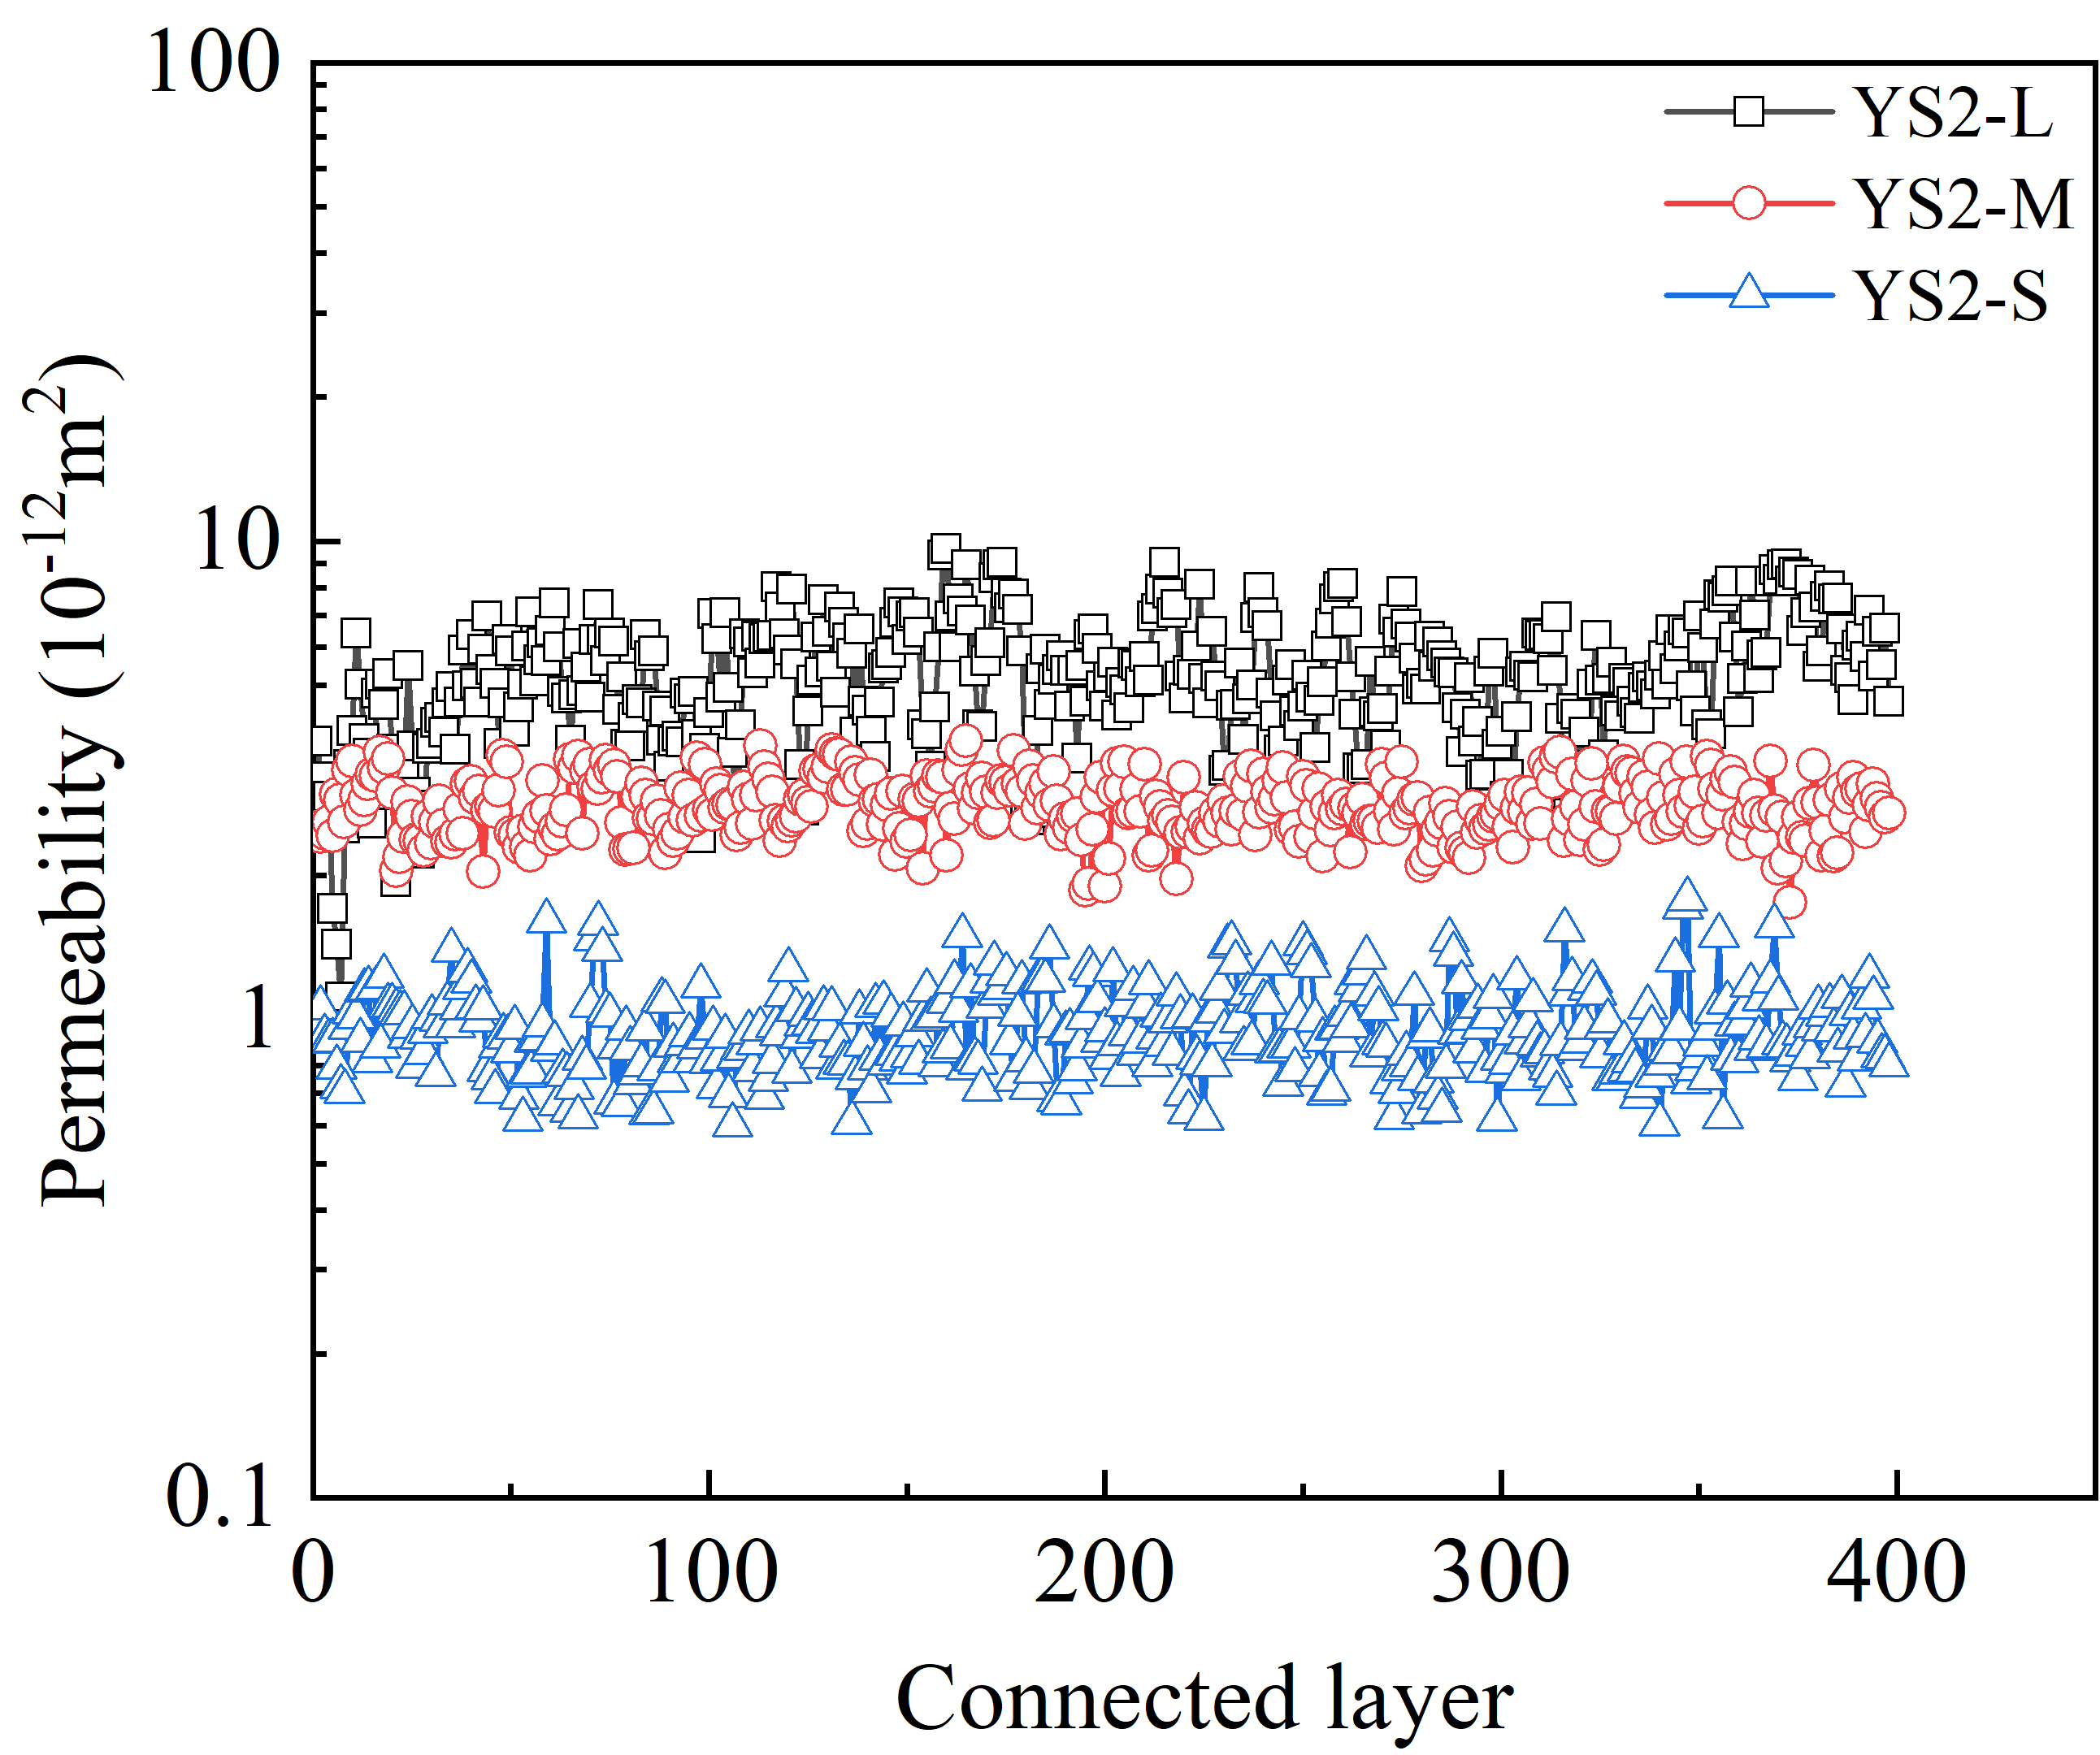
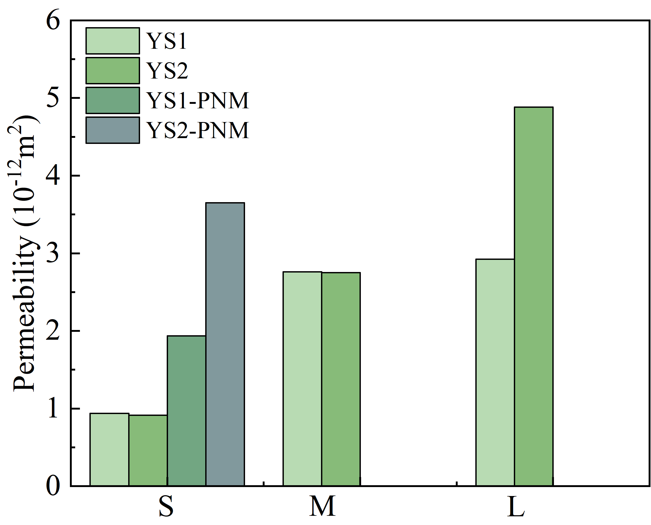
Permeability estimation and method comparison
Permeability results
Key findings
Layer-wise permeability remains ordered as L > M > S for both YS1 and YS2.
1
The proposed local-connectivity method provides permeability trends across all three scales.
2
(a) Layer-wise permeability trend
Conventional PNM yields values only for the S dataset, highlighting the limitation imposed by incomplete global connectivity.
3
Permeability is controlled more strongly by connectivity continuity than by porosity alone.
4
(b) Overall permeability comparison
The proposed method extends permeability evaluation from globally connected networks to locally connected multiscale CT datasets.

Slide 10
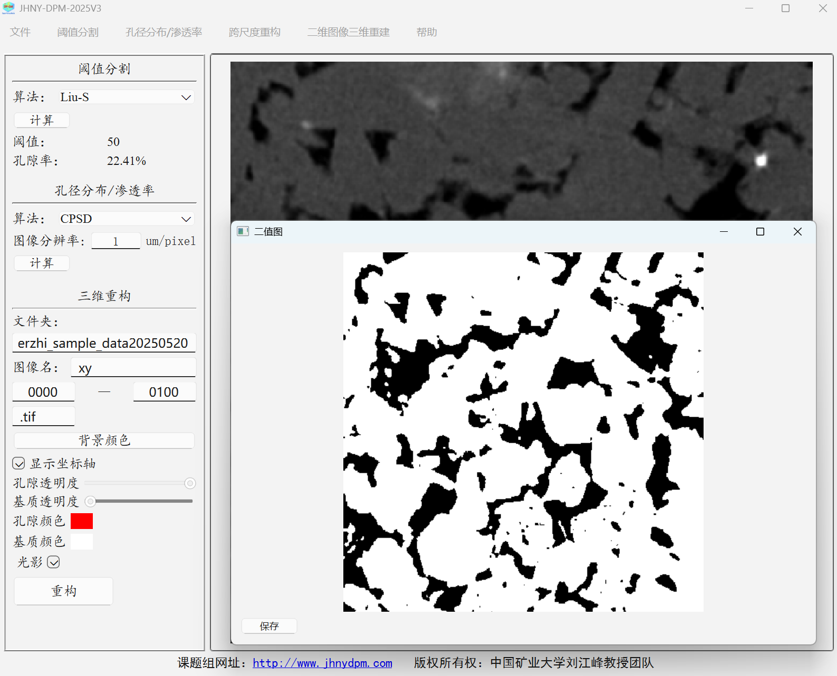
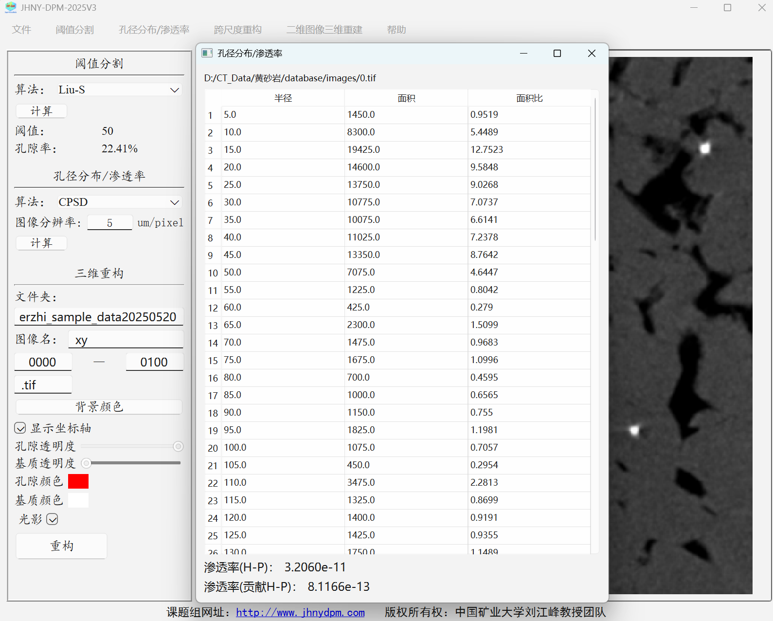
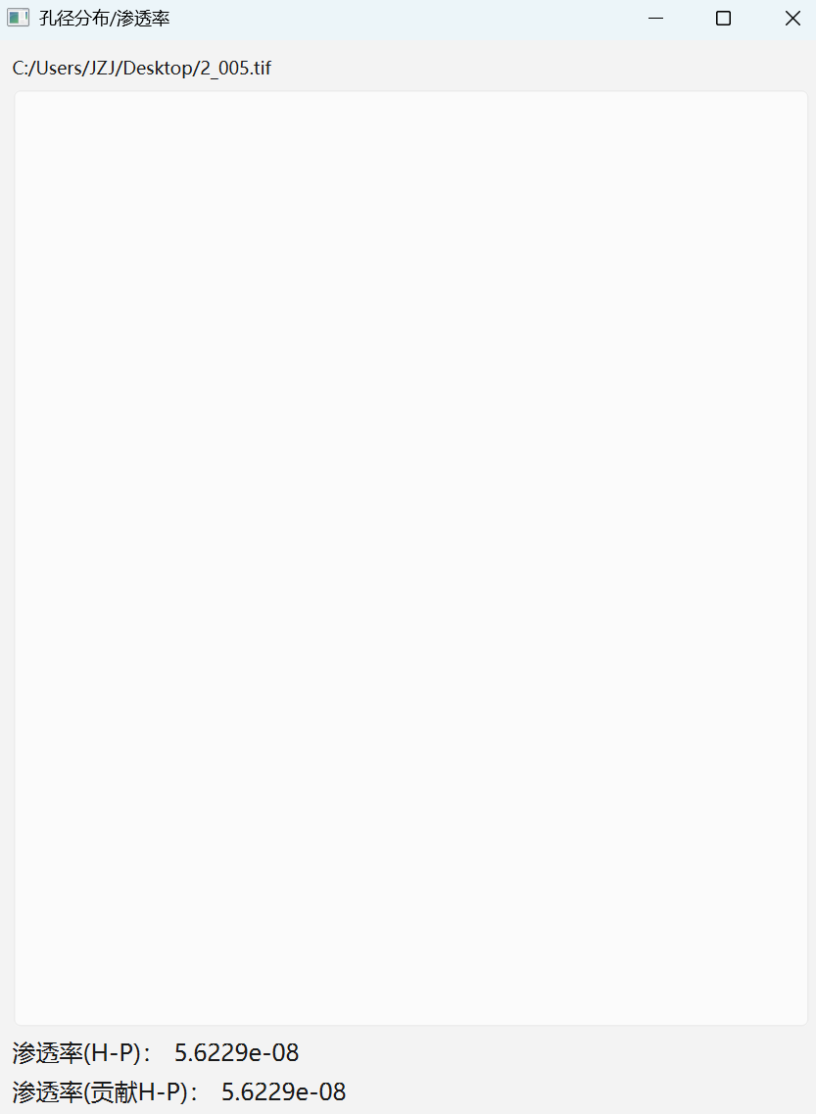
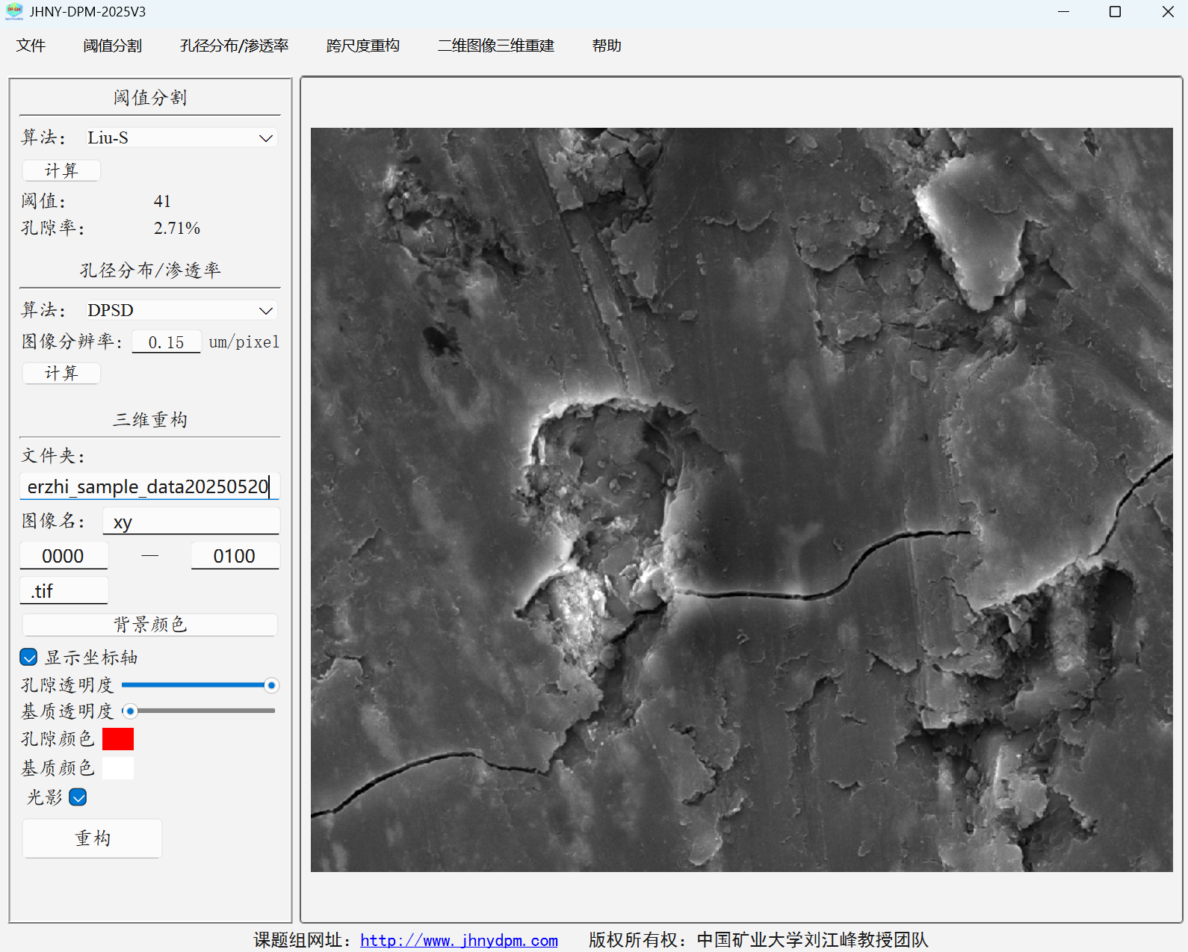
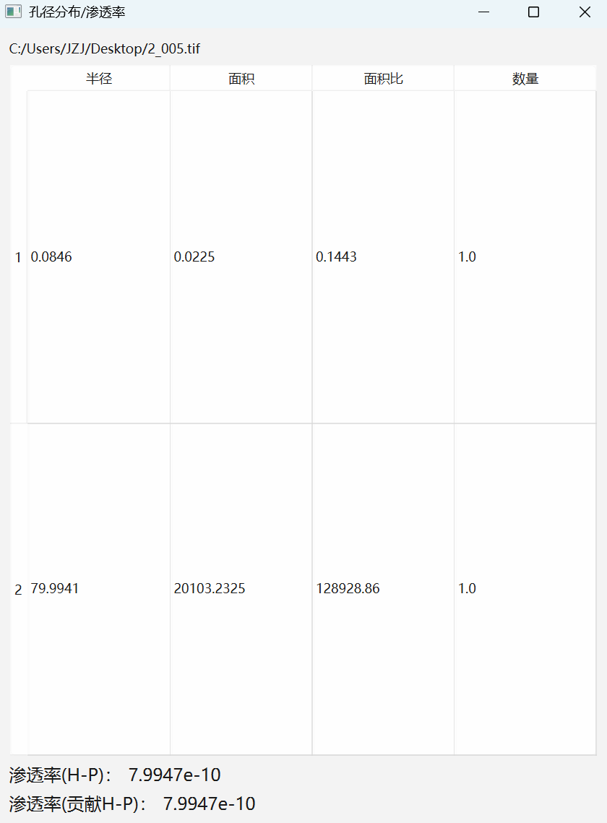
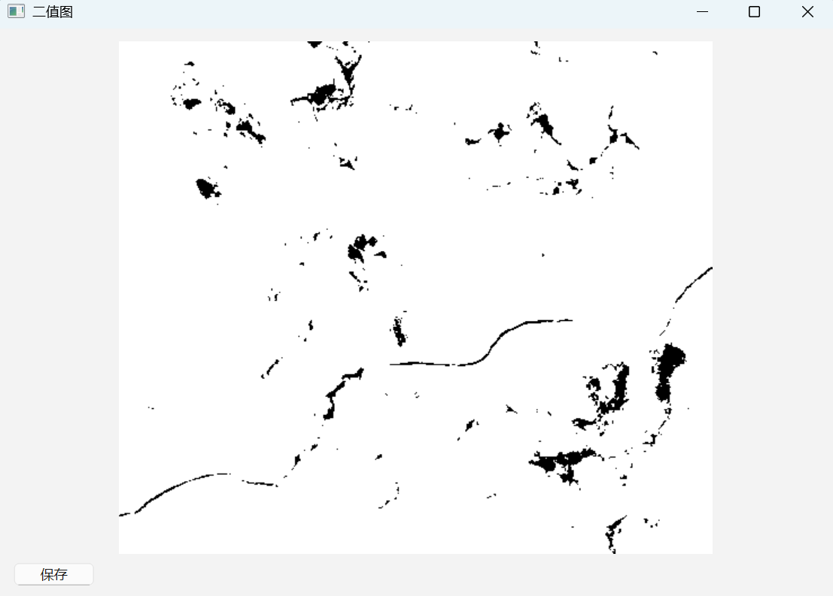
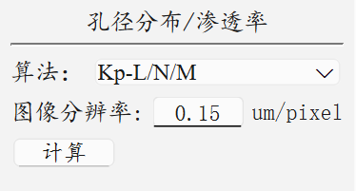
Application of permeability analysis: JHNY-DPM digital rock software
Pore-size-based permeability
Pore/fracture
Ni HY, Liu JF* , et al. International Journal of Geomechanics, 2021, 21(8): 04021144; Journal of Petroleum Science and Engineering, 2022, 211: 110107.

Slide 11
Key implications and conclusions
1
2
Connectivity matters more than porosity alone
Resolution changes pore representation
CT resolution systematically affects pore morphology, pore-size distribution, and connected pore volume across scales.
Similar porosity does not guarantee similar flow behavior; permeability is more strongly controlled by pore connectivity and pathway continuity.
3
Local connectivity extends permeability evaluation
4
Practical value for under-resolved porous media
The sliding-layer local-connectivity method enables permeability-trend estimation even when globally connected pore pathways are incomplete in CT images.
The proposed framework provides a practical strategy for multiscale flow characterization in porous materials where conventional PNM is limited by incomplete global connectivity.
Local-connectivity analysis enables permeability-trend evaluation beyond the limits of globally connected PNM.

Slide 12
Thank you
Hongyang Ni
China University of Mining and Technology
Email: nhyang@cumt.edu.cn

