Slide 1
Stochastic Modeling of Particle Transport in Micrographs of Porous Shale Media Using Cellular Automata: Validation with Carman-Kozeny Presented by:
Escobar-Hernández Leonel

Slide 2
Table of contents
Introduction
Objectives
Methodology
Study Area
Fieldwork
Image Processing
Particle Simulation
Results and Calculations
Literature Data
Conclusions and References
1
2
3
4
5
6
7
8
9
10
FCT/UANL | InterPore | May 21, 2026

Slide 3
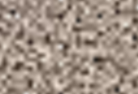
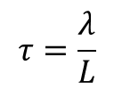
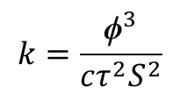
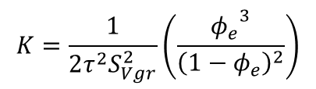

Kozeny-Carman Equation
Introduction
Kozeny's law relates permeability (k) to the geometric properties of the porous medium, such as porosity (ϕ), specific pore surface area (S), and an empirical parameter (c), which in most cases is close to 0.2 (Kozeny, 1927; Carman, 1938).
$$k=\frac{{\text{ϕ}}^{3}}{cτ^{2}S^{2}}$$
$$τ=\frac{λ}{L}$$
(1)
(2)
L
Kozeny-Carman equation for shale
$$λ$$
$$K=\frac{1}{2τ^{2}S_{Vgr}^{2}}\left(\frac{{φ_{e}}^{3}}{{\left(1−φ_{e}\right)}^{2}}\right)$$
(3)
Figure 1. Representation of a tortuous system
FCT/UANL | InterPore | May 21, 2026
3

Slide 4
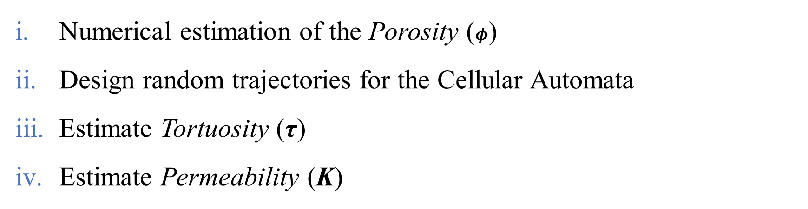
Introduction> Objectives
Objectives
Numerical estimation of the Porosity ($φ$)
Design random trajectories for the Cellular Automata
Estimate Tortuosity (τ)
Estimate Permeability (K)
FCT/UANL | InterPore | May 21, 2026

Slide 5
Introduction> Objectives> Methodology
Methodology
Sampling and retrieval of Eagle Ford shale cores
Preparation of thin sections and SEM micrographs
Digital processing of SEM micrographs
Estimation of porosity, surface area and tortuosity
Permeability estimation
Validation of estimates against established literature data
FCT/UANL | InterPore | May 21, 2026

Slide 6
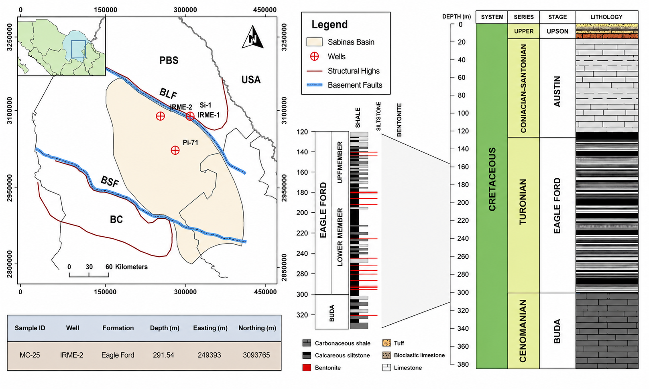
Introduction> Objectives> Methodology> Study Area
Study Area
Figure 2. Study area location and stratigraphic column.
FCT/UANL | InterPore | May 21, 2026
6

Slide 7
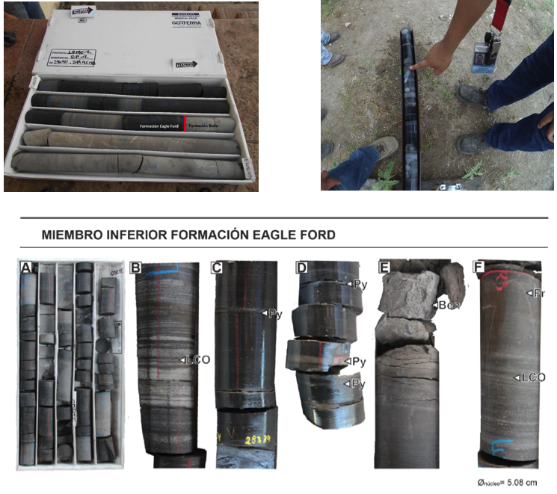

Fieldwork
Introduction> Objectives> Methodology> Study Area>Fieldwork
Figure 3. Photographs of the main sedimentological features of the lower member of the Eagle Ford Formation.
(A)-Interbedding of limestone and shale
(B)-Plane-parallel lamination, note the alternation of light and dark laminae
(C)-Carbonaceous shale with pyrite laminae
(D)-Pyrite laminae
(E)-Bentonite horizon
(F)-Calcite-filled fracture
LOC: light and dark laminae
Py: pyrite
Ben: bentonite
Fr: calcite-filled fracture.
Lower member of the Eagle Ford Formation
$${\text{Ø}}_{core}=5.08 cm$$
FCT/UANL | InterPore | May 21, 2026
7

Slide 8
Image Processing
Introduction> Objectives> Methodology> Study Area>Fieldwork>Image Processing
Figure 4. SEM image processing in ImageJ
FCT/UANL | InterPore | May 21, 2026
8

Slide 9
Image Processing
Introduction> Objectives> Methodology> Study Area>Fieldwork>Image Processing.
Figure 4.1 SEM image processing in ImageJ
FCT/UANL | InterPore | May 21, 2026
9

Slide 10
Particle Simulation
Introduction> Objectives> Methodology> Study Area >Fieldwork>Image Processing>Particle Simulation
Figure 5. Representation of particle trajectories; 50 particles were used for this example.
FCT/UANL | InterPore | May 21, 2026
10

Slide 11
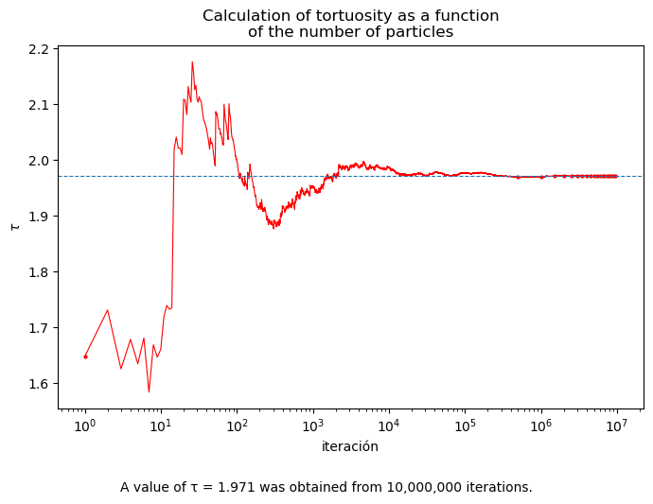



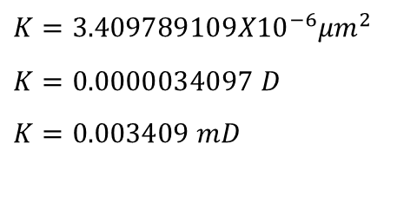
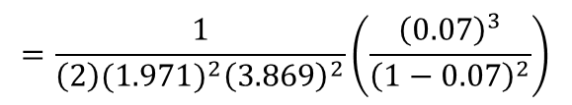
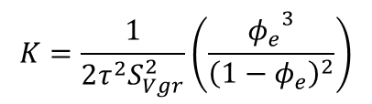
Introduction> Objectives> Methodology> Study Area >Fieldwork>Image Processing>Particle Simulation>Calculations and Results
Calculations and Results
(4)
$$φ_{b}=\frac{Ap}{AT}×100$$
$φ_{e }$= 7%
$$φ_{b}=25.68\%$$
$$K=\frac{1}{2τ^{2}S_{Vgr}^{2}}\left(\frac{{φ_{e}}^{3}}{{\left(1−φ_{e}\right)}^{2}}\right)$$
$$=\frac{1}{\left(2\right){{(1.971)}^{2}\left(3.869\right)}^{2}}\left(\frac{{\left(0.07\right)}^{3}}{{\left(1−0.07\right)}^{2}}\right)$$
(3)
$$K=3.409789109{X10}^{−6}{μm}^{2}$$
$$K=0.0000034097 D$$
$K=0.003409 mD$
iteration
Figure 6. Calculation of tortuosity as a function of the number of particles. A value of 𝜏 = 1.971 was obtained from 10,000,000 iterations.
FCT/UANL | InterPore | May 21, 2026

Slide 12
Introduction> Objectives> Methodology> Study Area >Fieldwork>Image Processing>Particle Simulation>Results and Calculation> Literature Data
Literature Data
Name of the Rock Cores | Length of the Core | Cutting Direction | Porosity (%) | Permeability (mD)
Sample 1-Chicontepec | 5 cm | Parallel | 10.7 | undefined
Sample 2-Chicontepec | 5 cm | Perpendicular | 8.0 | 0.001
Sample 1-Amaxac | 6 cm | Parallel | 7.0 | 0.002
Sample 2-Amaxac | 5 cm | Perpendicular | 8.1 | 0.041
Table 1. Petrophysical values ​​of rock samples from Chicontepec and Amaxac outcrops
FCT/UANL | InterPore | May 21, 2026
Tabla 1. Valores de porosidad y permeabilidad, tomado de Han, et al. (2016)

Slide 13
Introduction> Objectives> Methodology> Study Area >Fieldwork>Image Processing>Particle Simulation>Results and Calculation> Literature Data> Conclusions and References
Conclusions
This work represents a low-cost alternative for estimating petrophysical parameters compared to laboratory experiments.
The results are consistent with those found in the literature.
Particle simulation within the porous medium allows us to measure their trajectories to estimate tortuosity, a crucial parameter in petrophysics.
Since permeability is a parameter that is highly difficult to measure, these types of experiments allow us to calculate more realistic values, as approximations can be numerically controlled.
FCT/UANL | InterPore | May 21, 2026

Slide 14
Introduction> Objectives> Methodology> Study Area >Fieldwork>Image Processing>Particle Simulation>Results and Calculation> Literature Data> Conclusions and References
References
Djebbar Tiab, E. C. (2012). Petrophysics Theory and Practice of Measuring Reservoir Rock and Fluid Transport Properties (Third Edition ed.). (G. P. Publishing, Ed.) Oxford, Uk.
LIMARINO, L. I. (2000, Noviembre). Caracterización y origen de la porosidad en areniscas de la sección inferior del Grupo Paganzo (Carbonífero superior), Cuenca Paganzo, Argentina. (A. Revista, Ed.) Asociación Argentina de Sedimentología , 7, 72.
Van Rossum, G., & Drake Jr, F. L. (1995). Python reference manual. Centrum voor Wiskunde en Informatica Amsterdam.
Carrillo, J. A. B., Villalobos, R. S., Madera, C. G. A., & Ramos, A. (2016). Estimación de porosidad en areniscas a partir de micrografías digitales utilizando R-Studio.
C.G. Aguilar-Madera, J.V. Flores-Cano, V. Matías-Pérez, J.A. Briones-Carrillo, F. Velasco-Tapia, Computing the permeability and Forchheimer tensor of porous rocks via closure problems and digital images,
Advances in Water Resources, Volume 142, 2020,103616,ISSN 0309-1708, https://doi.org/10.1016/j.advwatres.2020.103616.
Altawati, F. (2021). An experimental study to investigate the physical and dynamic elastic properties of Eagle Ford shale rock samples. Springer Nature. https://link.springer.com/article/10.1007/s13202-021-01243-w#auth-Faisal-Altawati-Aff1
González, A. T. F. (2023). Estudio teórico y experimental de inyección de surfactantes como método de Recuperación Mejorada de aceite de la Formación Chicontepec.
FCT/UANL | InterPore | May 21, 2026

Slide 15
Colaboradores
Introduction> Objectives> Methodology> Study Area >Fieldwork>Image Processing>Particle Simulation>Results and Calculation> Literature Data> Conclusions and References
Collaborators
M.C. Briones-Carrillo Jorge Alberto
Obregón-González Benny
Ruíz-Ramos Roberto
Farrera-Salazar Darío
Romo-Castillo Sebastián
Acevedo-González Juan Emiliano
Valenzuela-Gutiérrez Valeria
Linares, Nuevo León, México.
May 2026
FCT/UANL | InterPore | May 21, 2026

