Slide 1
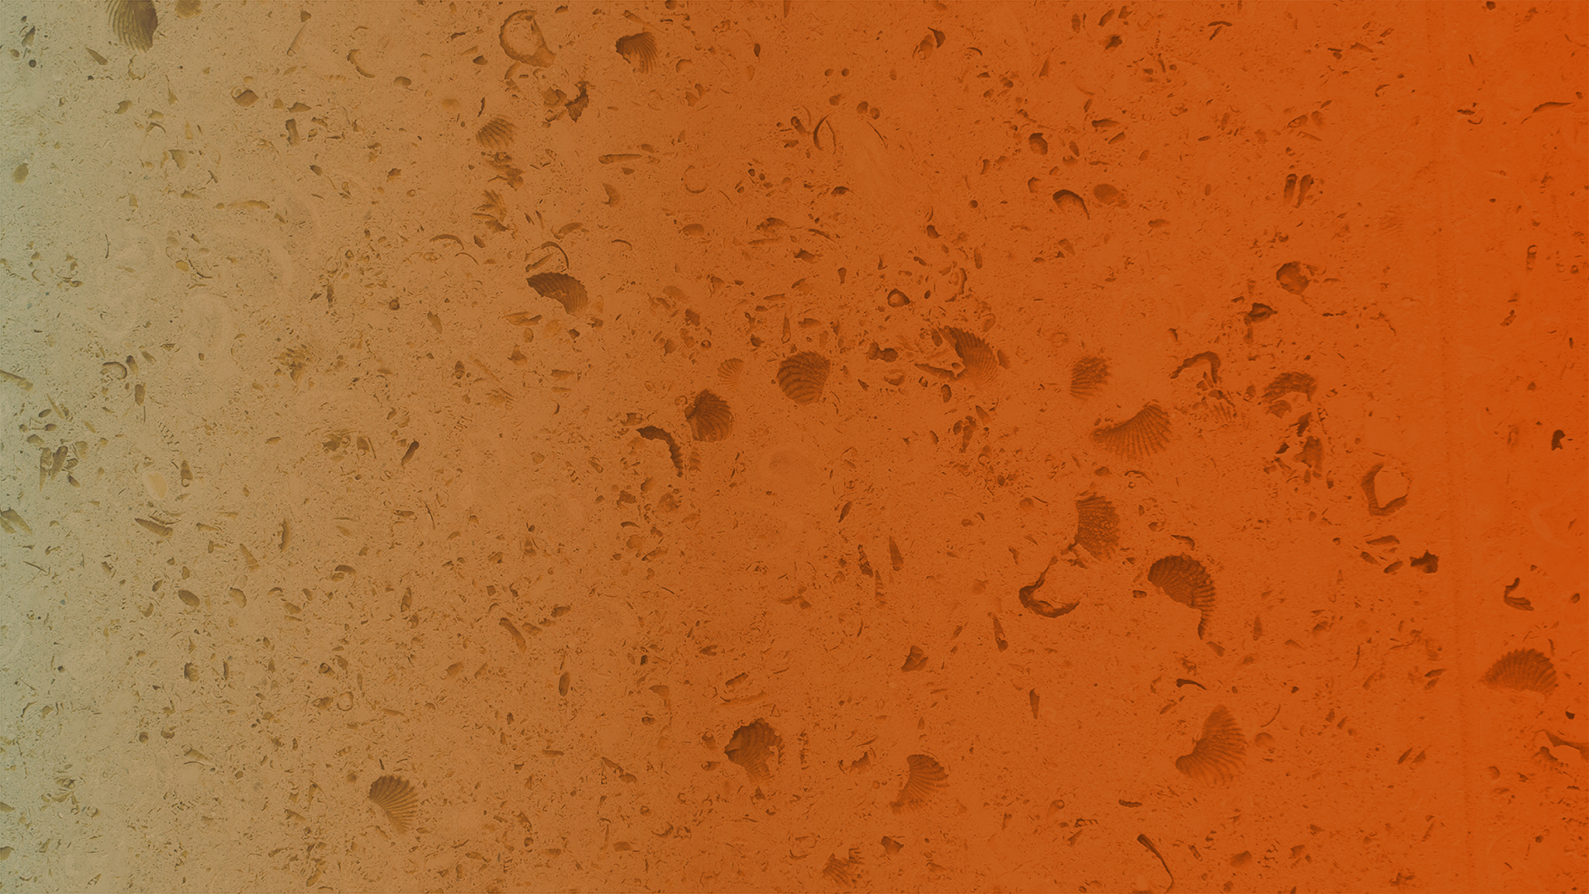



May 20, 2025
Improving Density and Atomic Number Estimation by Mitigating Beam Hardening
Çınar Turhan, Bernard Chang, Richard Ketcham, Rodolfo A. Victor, JONATAS CASTRO Einsiedler, MAšA Prodanović

Slide 2

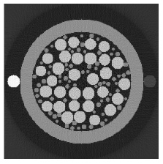
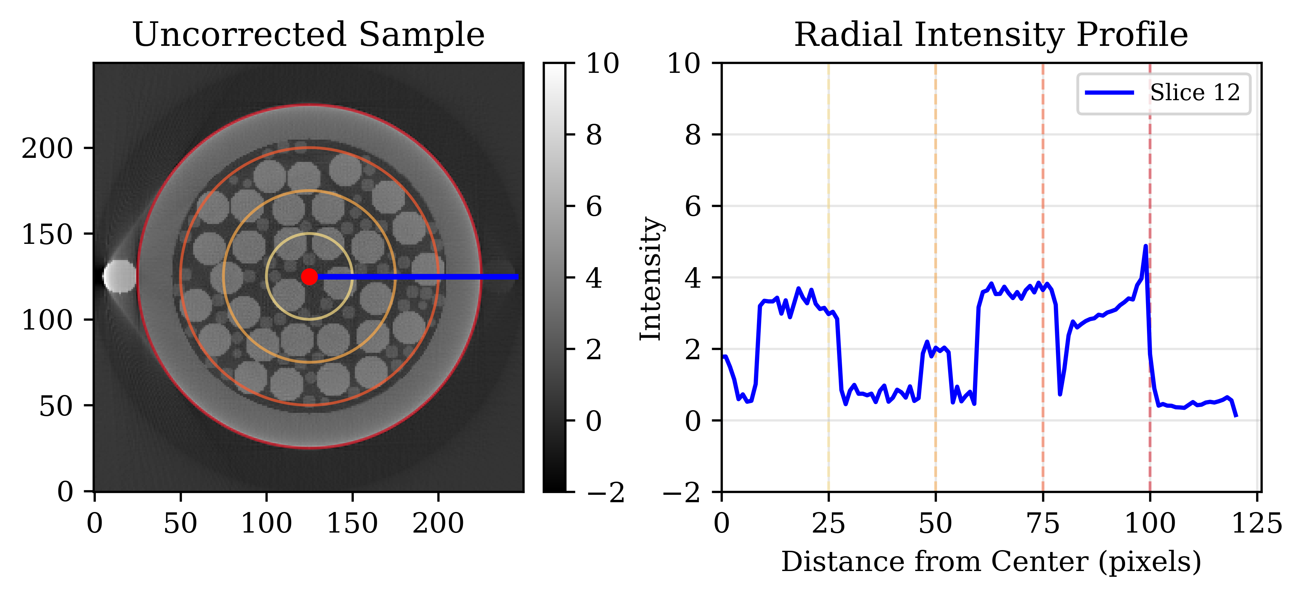
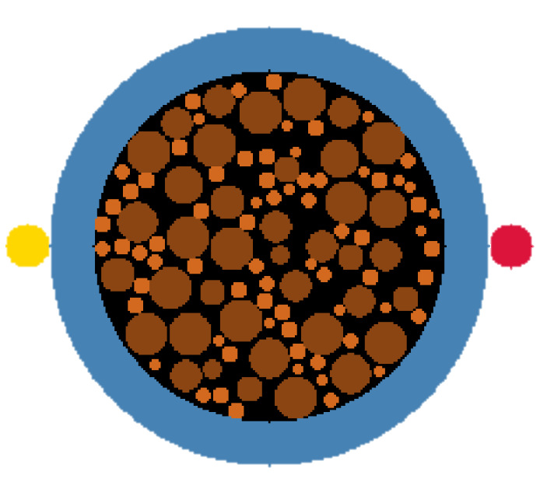
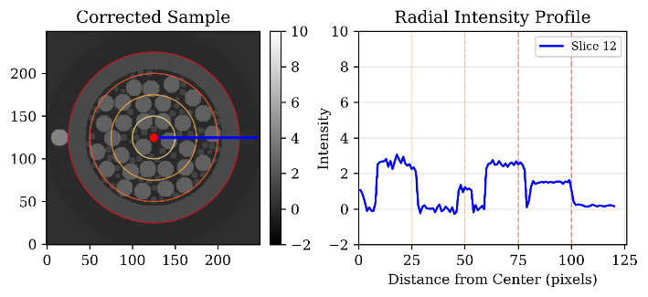
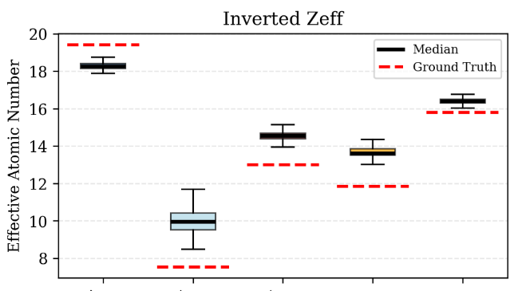
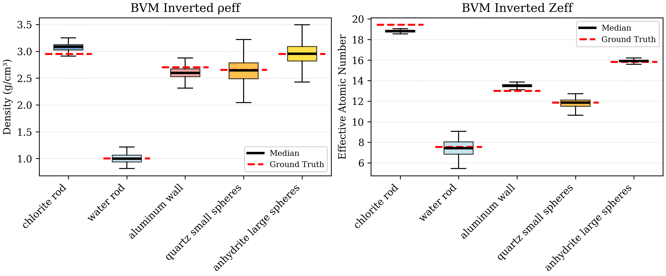
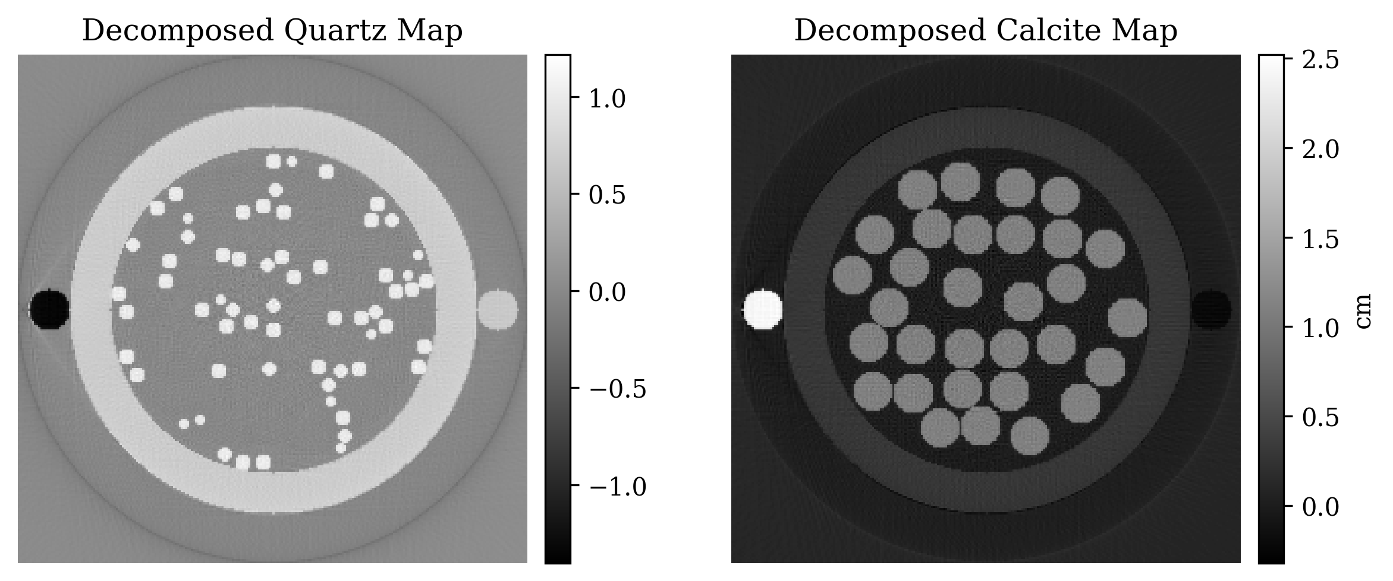
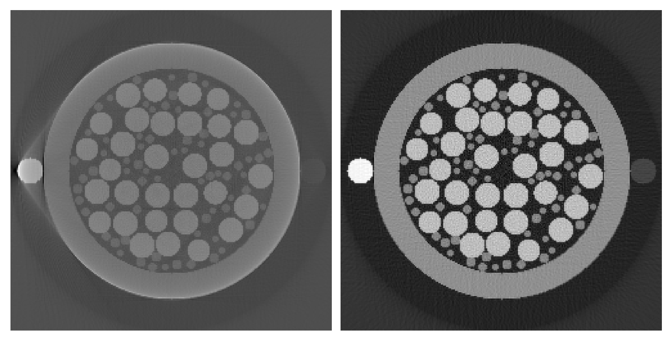
EXECUTIVE SUMMARY
INTRODUCTION
BEAM HARDENING
RESULTS
Reconstruction
APPLICATIONS
Digital Petrophysics
Well Log Correlation
Wet Lab Imaging
Rock Characterization
Pore Scale Flow Simulations
METHOD – BASIS MATERIAL DECOMPOSITION
Mat 1
Mat 2
Mat 3
Mat 4
Mat 5
DUAL ENERGY CT
Atomic Number &
Density
Mat 1
Mat 2
Mat 3
Mat 4
Mat 5

Slide 3
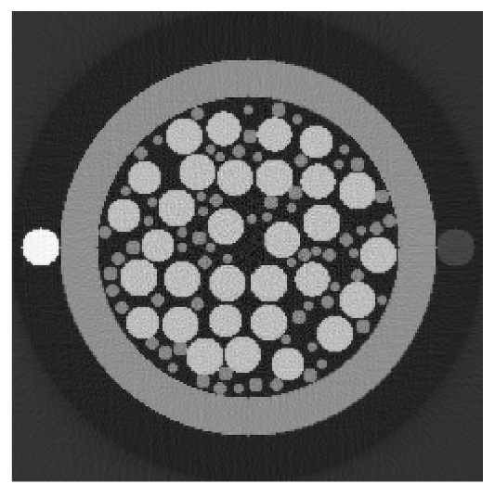
Computed Tomography (CT)
INTRODUCTION
CT Scanner - Simplified
Reconstruction
Source
Detector

Slide 4

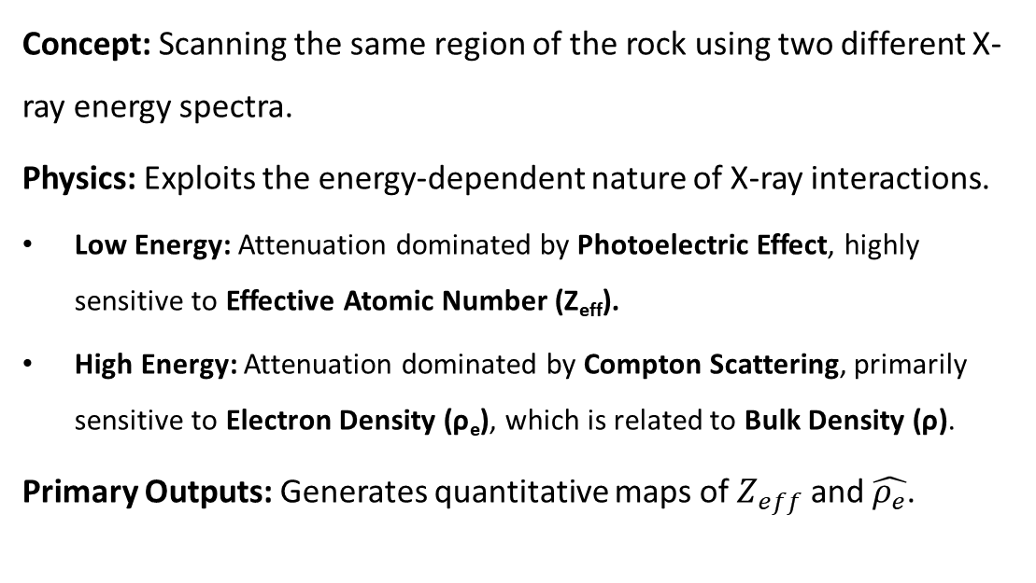
Dual Energy Computed Tomography (DECT)
INTRODUCTION
Concept: Scanning the same region of the rock using two different X-ray energy spectra.
Physics: Exploits the energy-dependent nature of X-ray interactions.
Low Energy: Attenuation dominated by Photoelectric Effect, highly sensitive to Effective Atomic Number (Z_{eff}).
High Energy: Attenuation dominated by Compton Scattering, primarily sensitive to Electron Density (ρ_{e}), which is related to Bulk Density (ρ).
Primary Outputs: Generates quantitative maps of $Z_{eff}$and $\hat{ρ_{e}}$.

Slide 5
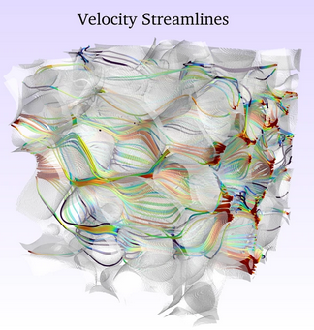
Literature Review – DECT
INTRODUCTION
Applications
Fluid flow visualization studies
Porosity quantification
Mineralogy evaluation
Cross-correlation with well logs
Detecting and characterizing fractures, vugs, bedding planes, fossils, and bioturbation
Other: Biology, orthodontics, archeology, etc
(Santos et al., 2022)*
*Santos, J. E., Chang, B., Gigliotti, A., Yin, Y., Song, W., Prodanović, M., Kang, Q., Lubbers, N., & Viswanathan, H. (2022). A Dataset of 3D Structural and Simulated Transport Properties of Complex Porous Media. Scientific Data, 9(1), 579. https://doi.org/10.1038/s41597-022-01664-0

Slide 6
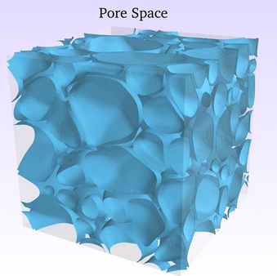
Literature Review – DECT
INTRODUCTION
Applications
Fluid flow visualization studies
Porosity quantification
Mineralogy evaluation
Cross-correlation with well logs
Detecting and characterizing fractures, vugs, bedding planes, fossils, and bioturbation
Other: Biology, orthodontics, archeology, etc
(Santos et al., 2022)*
*Santos, J. E., Chang, B., Gigliotti, A., Yin, Y., Song, W., Prodanović, M., Kang, Q., Lubbers, N., & Viswanathan, H. (2022). A Dataset of 3D Structural and Simulated Transport Properties of Complex Porous Media. Scientific Data, 9(1), 579. https://doi.org/10.1038/s41597-022-01664-0

Slide 7

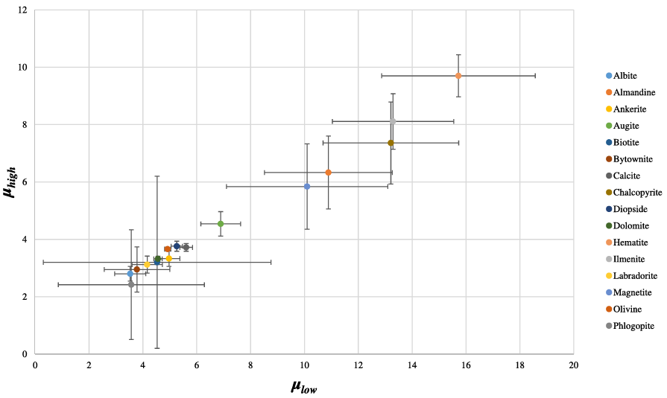
Literature Review – DECT
INTRODUCTION
Applications
Fluid flow visualization studies
Porosity quantification
Mineralogy evaluation
Cross-correlation with well logs
Detecting and characterizing fractures, vugs, bedding planes, fossils, and bioturbation
Other: Biology, orthodontics, archeology, etc
(Martini et al., 2021)*
*Martini, M., Francus, P., Di Schiavi Trotta, L., & Després, P. (2021). Identification of Common Minerals Using Stoichiometric Calibration Method for Dual-Energy CT. Geochemistry, Geophysics, Geosystems, 22(11), e2021GC009885. https://doi.org/10.1029/2021GC009885

Slide 8
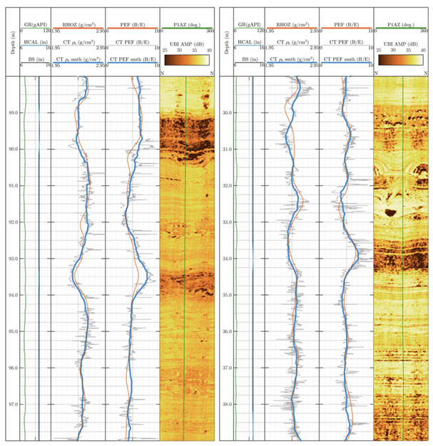
Literature Review – DECT
INTRODUCTION
Applications
Fluid flow visualization studies
Porosity quantification
Mineralogy evaluation
Cross-correlation with well logs
Detecting and characterizing fractures, vugs, bedding planes, fossils, and bioturbation
Other: Biology, orthodontics, archeology, etc
(Victor et al., 2017)*
*Victor, R. A., Prodanović, M., & Torres-Verdín, C. (2017). Monte Carlo Approach for Estimating Density and Atomic Number From Dual-Energy Computed Tomography Images of Carbonate Rocks. Journal of Geophysical Research: Solid Earth, 122(12), 9804–9824. https://doi.org/10.1002/2017JB014408

Slide 9
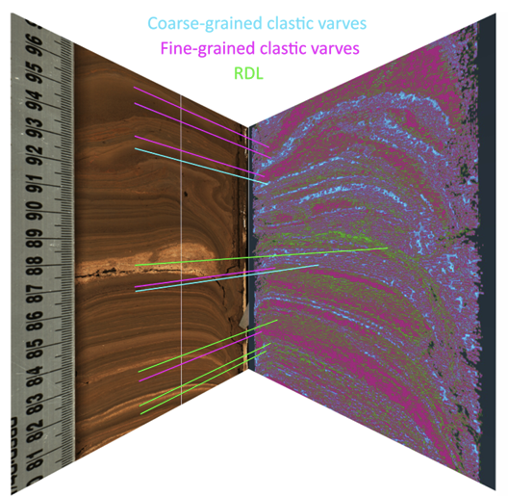
Literature Review – DECT
INTRODUCTION
Applications
Fluid flow visualization studies
Porosity quantification
Mineralogy evaluation
Cross-correlation with well logs
Detecting and characterizing fractures, vugs, bedding planes, fossils, and bioturbation
Other: Biology, orthodontics, archeology, etc
(Martini et al., 2024)*
*Martini, M., Francus, P., Di Schiavi Trotta, L., Letellier, P., Des Roches, M., & Després, P. (2024). Exploring the application of dual-energy CT to discriminate sediment facies in a varved sequence. The Depositional Record, 10(1), 231–244. https://doi.org/10.1002/dep2.271

Slide 10
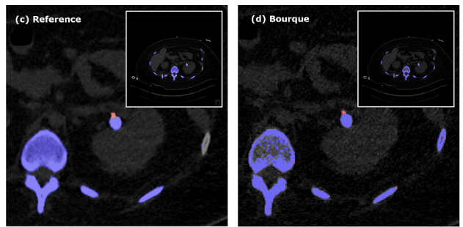
Literature Review – DECT
INTRODUCTION
Applications
Fluid flow visualization studies
Porosity quantification
Mineralogy evaluation
Cross-correlation with well logs
Detecting and characterizing fractures, vugs, bedding planes, fossils, and bioturbation
Other: Biology, orthodontics, archeology, etc
(Liu et al., 2021)*
*Liu, T., Hong, G., & Cai, W. (2021). A comparative study of effective atomic number calculations for dual-energy CT. Medical Physics, 48(10), 5908–5923. https://doi.org/10.1002/mp.15166

Slide 11
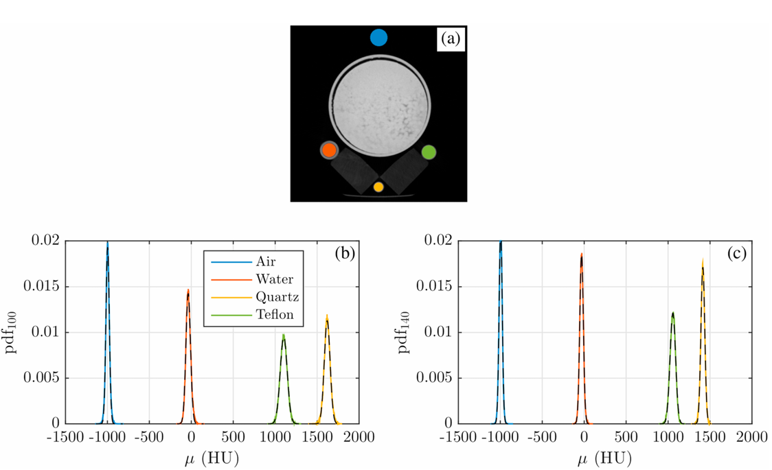
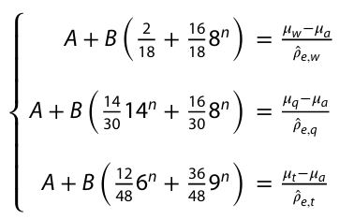
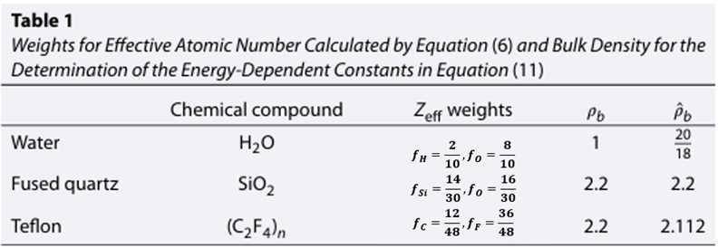




Atomic Number and Density Inversion
INTRODUCTION
$$μ\left(E\right)=\hat{ρ_{e}}\left(A+BZ_{eff}^{n}\right)+C$$
$Z_{eff}={\left(\sum_{i}{f_{i}Z_{i}^{n}}\right)}^{\frac{1}{n}}$.
Air
Water
Teflon
Quartz
$A, B, and n are estimated.$
$\hat{ρ_{e}} \left(A_{140}+B_{140}Z_{eff}^{n_{140}}\right)=μ_{140}−μ_{a,140}$
$\hat{ρ_{e}} \left(A_{100}+B_{100}Z_{eff}^{n_{100}}\right)=μ_{100}−μ_{a,100}$
$$Z_{eff} and \hat{ρ_{e}} are estimated.$$
*Victor, R. A., Prodanović, M., & Torres-Verdín, C. (2017). Monte Carlo Approach for Estimating Density and Atomic Number From Dual-Energy Computed Tomography Images of Carbonate Rocks. Journal of Geophysical Research: Solid Earth, 122(12), 9804–9824. https://doi.org/10.1002/2017JB014408
Notes:
fraction of electrons in the ith atomic number species

Slide 12
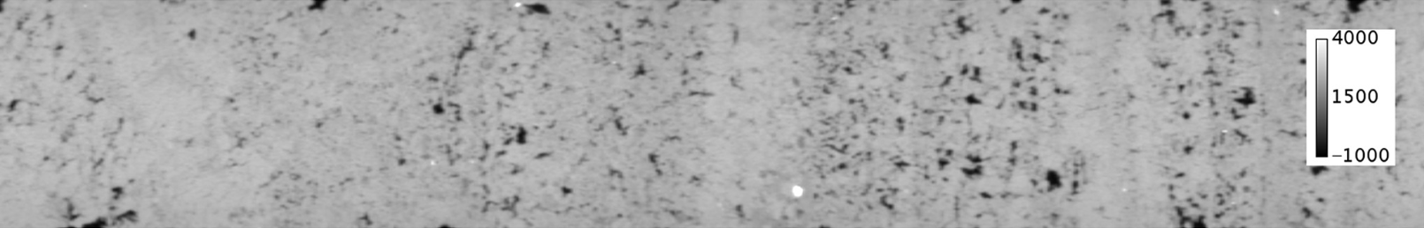
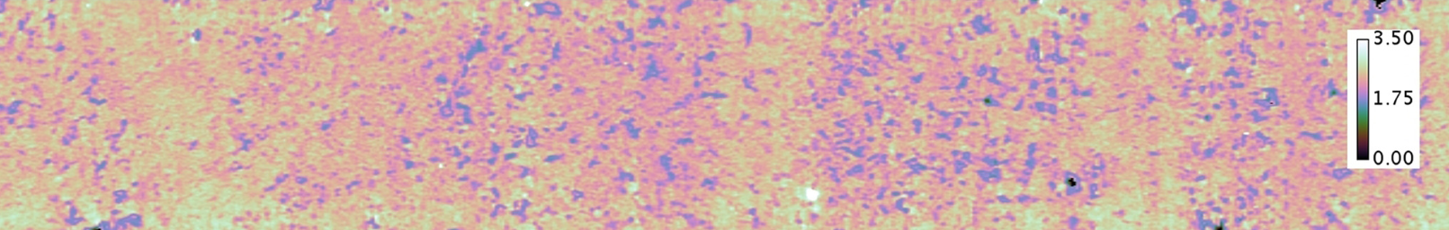
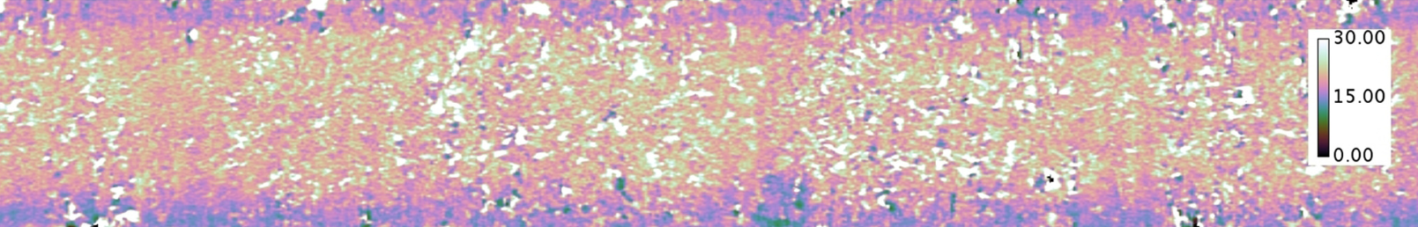


Atomic Number and Density Inversion
INTRODUCTION
Original Cross Section
$\hat{ρ_{e}}$ Result
$Z_{eff} R$esult
*Victor, R. A., Prodanović, M., & Torres-Verdín, C. (2017). Monte Carlo Approach for Estimating Density and Atomic Number From Dual-Energy Computed Tomography Images of Carbonate Rocks. Journal of Geophysical Research: Solid Earth, 122(12), 9804–9824. https://doi.org/10.1002/2017JB014408

Slide 13
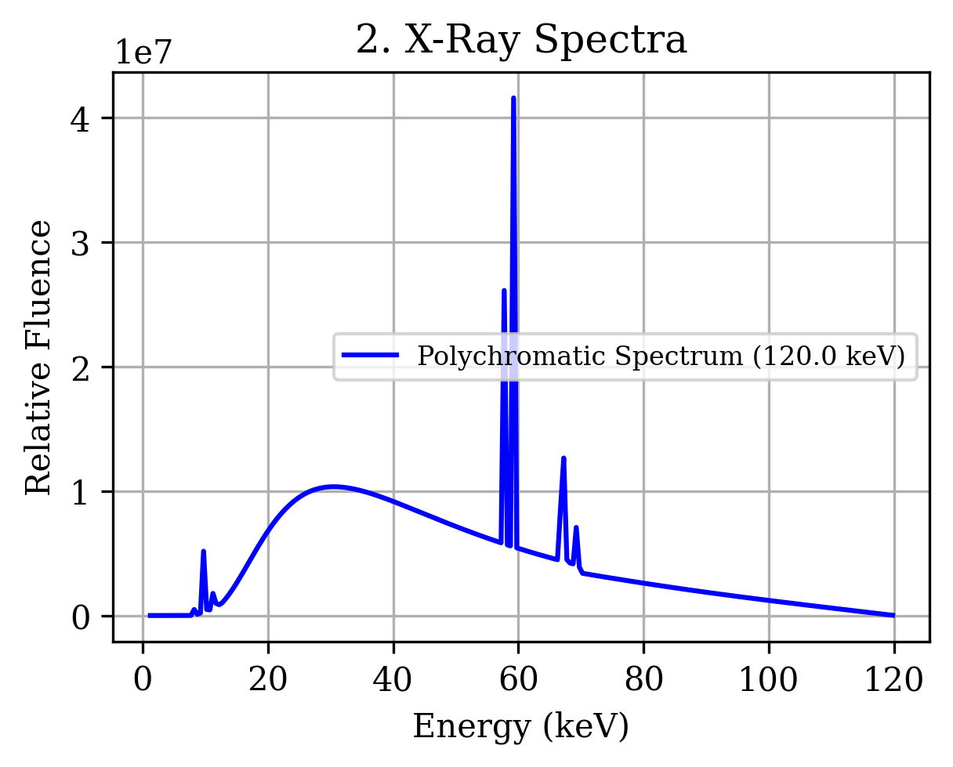
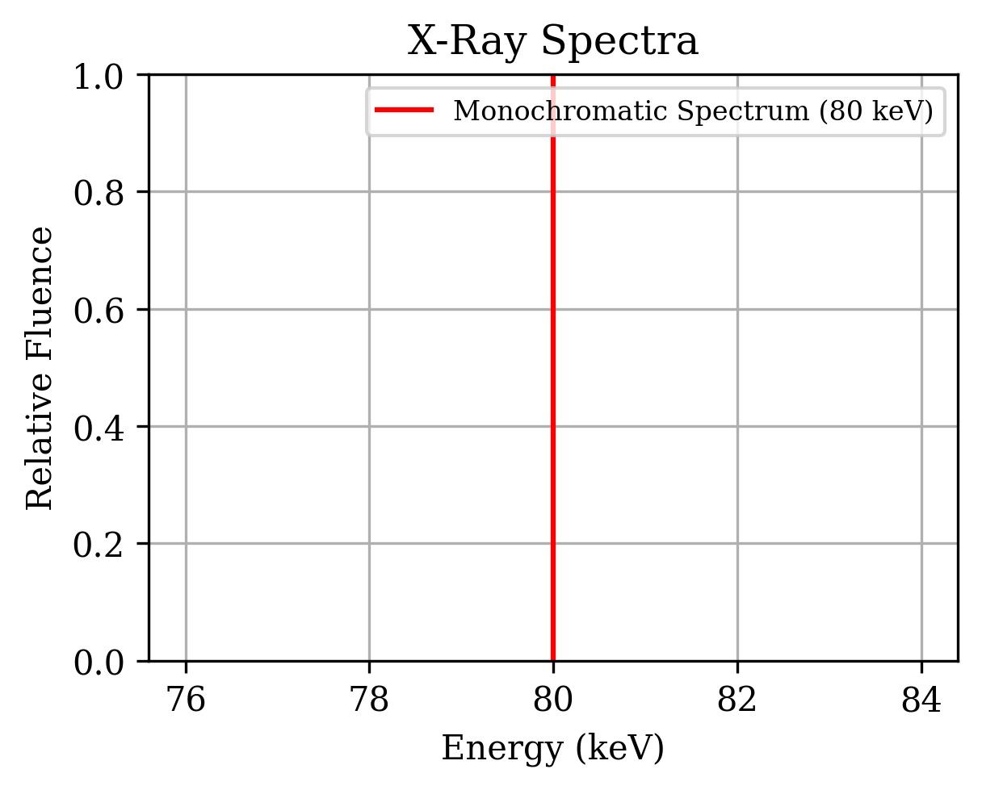

Beam Hardening
INTRODUCTION
Beer-Lambert Law
I = transmitted intensity
I₀ = initial intensity of the radiation
μ = linear attenuation coefficient
x = thickness
Lower energy photons are more easily absorbed than higher energy photons in a sample. This causes the beam to “harden”.
$$I=I_{0}e^{μx}$$

Slide 14
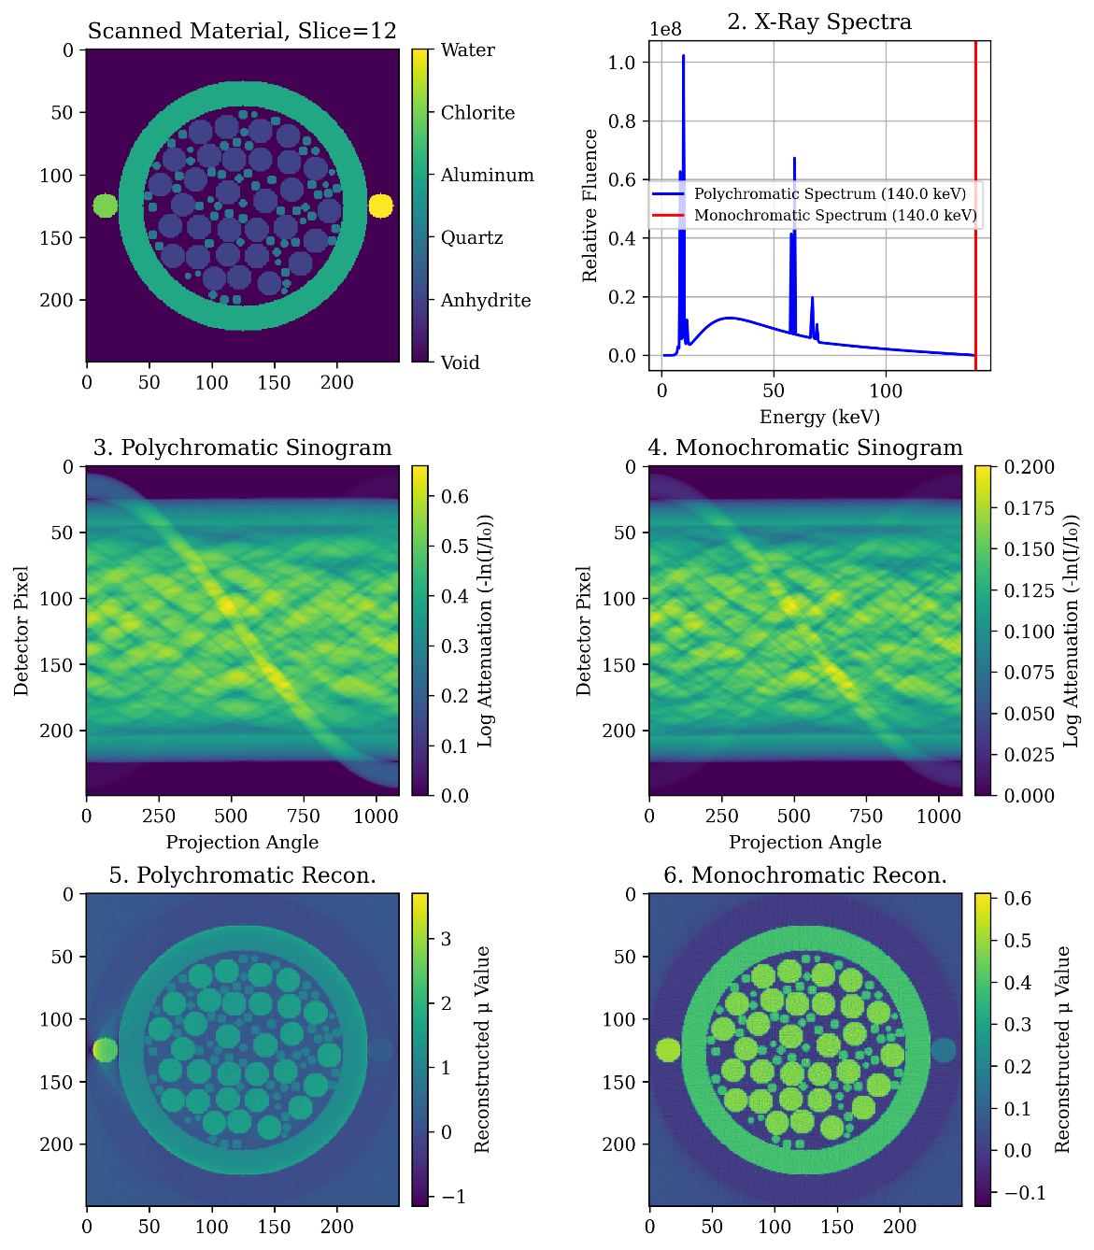
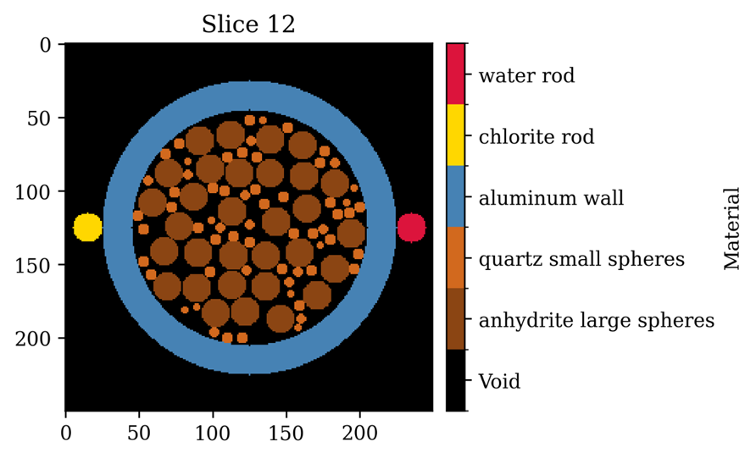
Simulating a μCT Scan of a Digital Sample
METHOD

Slide 15

Standard Correction
METHOD
Scan a homogenous body and fit a polynomial calibration curve.
Use that curve to fix the intensities in the scanned image.
Herman, G. T. (1979). Correction for beam hardening in computed tomography. Physics in Medicine and Biology, 24(1), 81–106. https://doi.org/10.1088/0031-9155/24/1/008

Slide 16
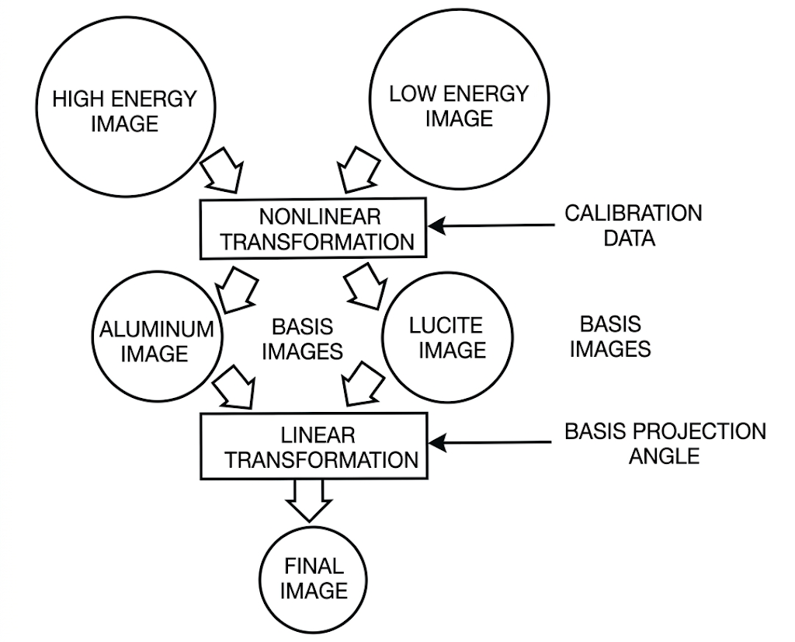
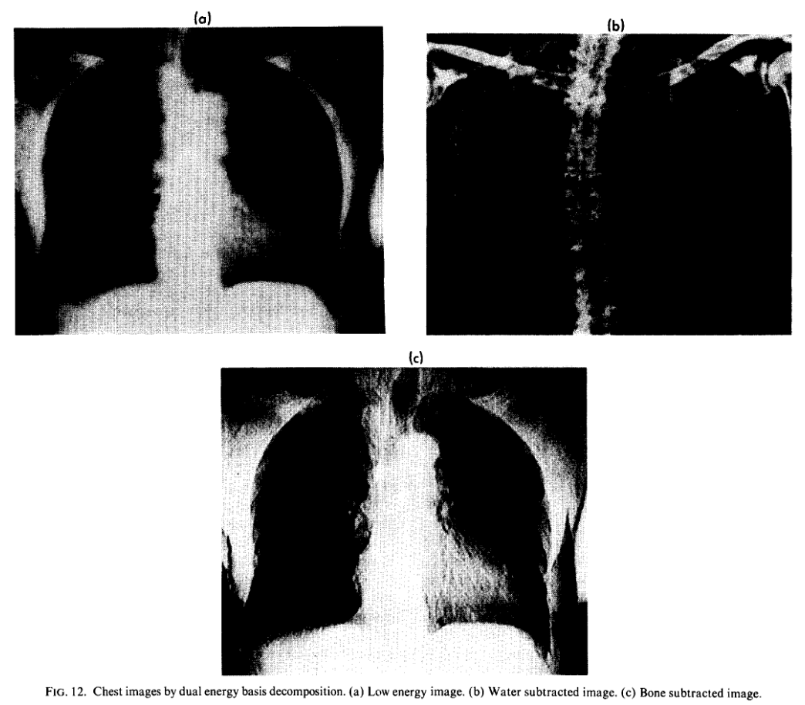
Basis Vector Method (Lehmann et al. 1981)
METHOD
$$C=A_{1}\cos{Φ}+A_{2}\sin{Φ}$$
*Lehmann, L. A., Alvarez, R. E., Macovski, A., Brody, W. R., Pelc, N. J., Riederer, S. J., & Hall, A. L. (1981). Generalized image combinations in dual KVP digital radiography. Medical Physics, 8(5), 659–667. https://doi.org/10.1118/1.595025

Slide 17
Basis Vector Method
METHOD
Focus on Images
Focus on Physics

Slide 18
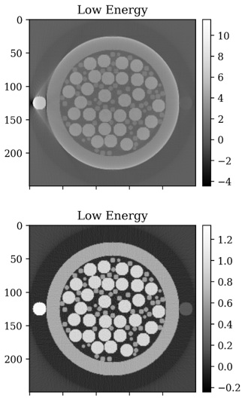
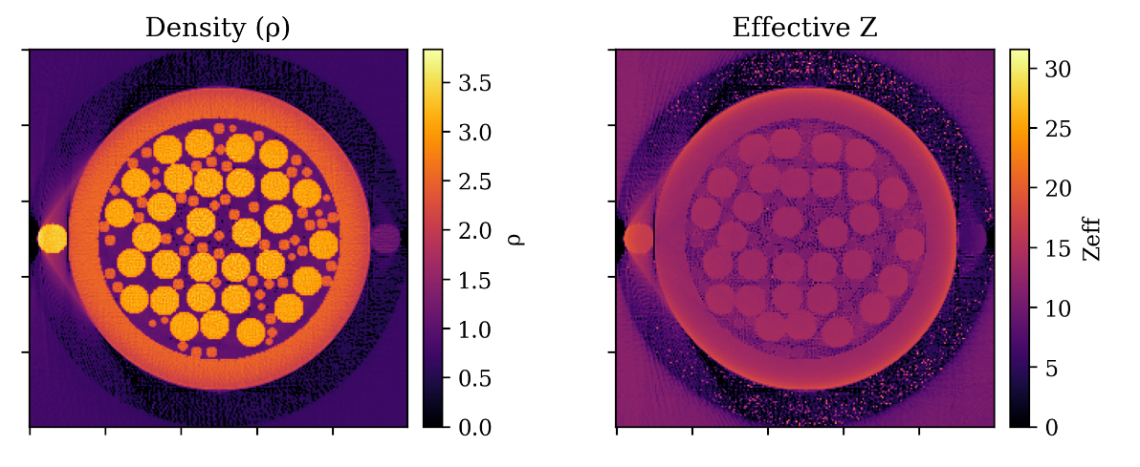
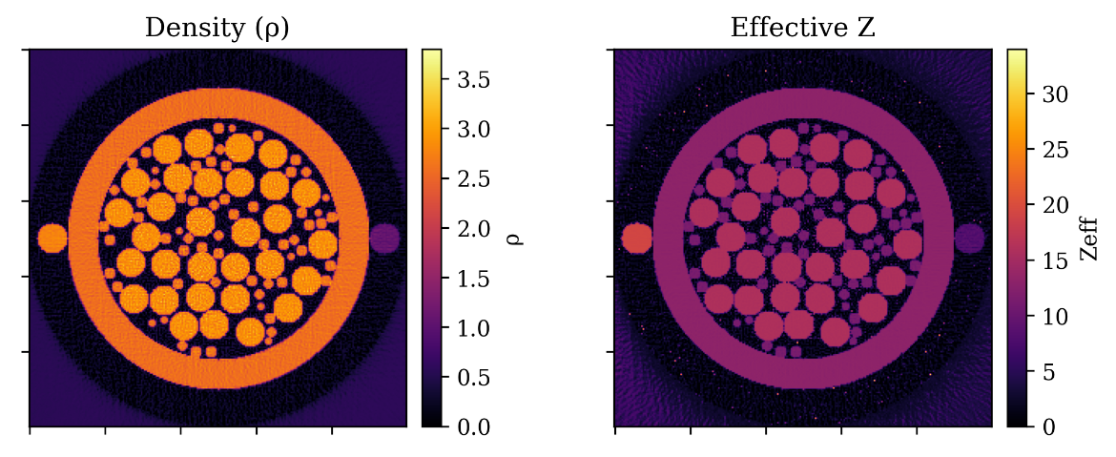
Inversion Results
RESULTS
Polychromatic
Monochromatic

Slide 19
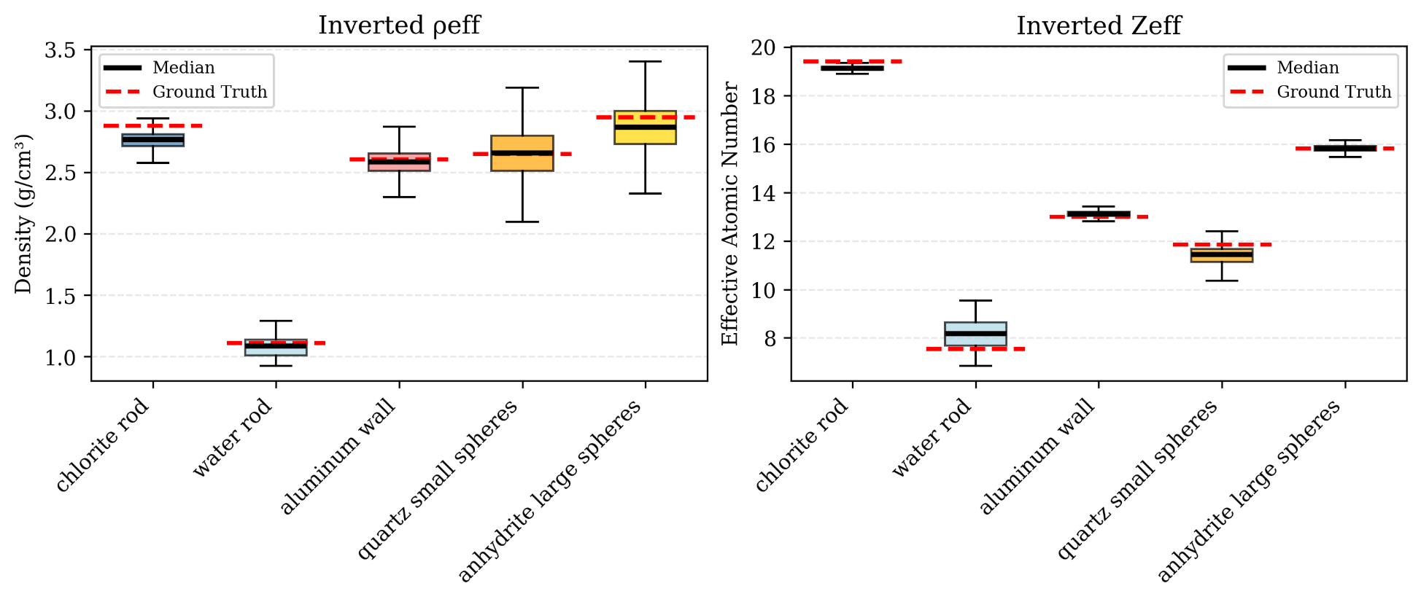
Boxplots – Monochromatic
RESULTS

Slide 20
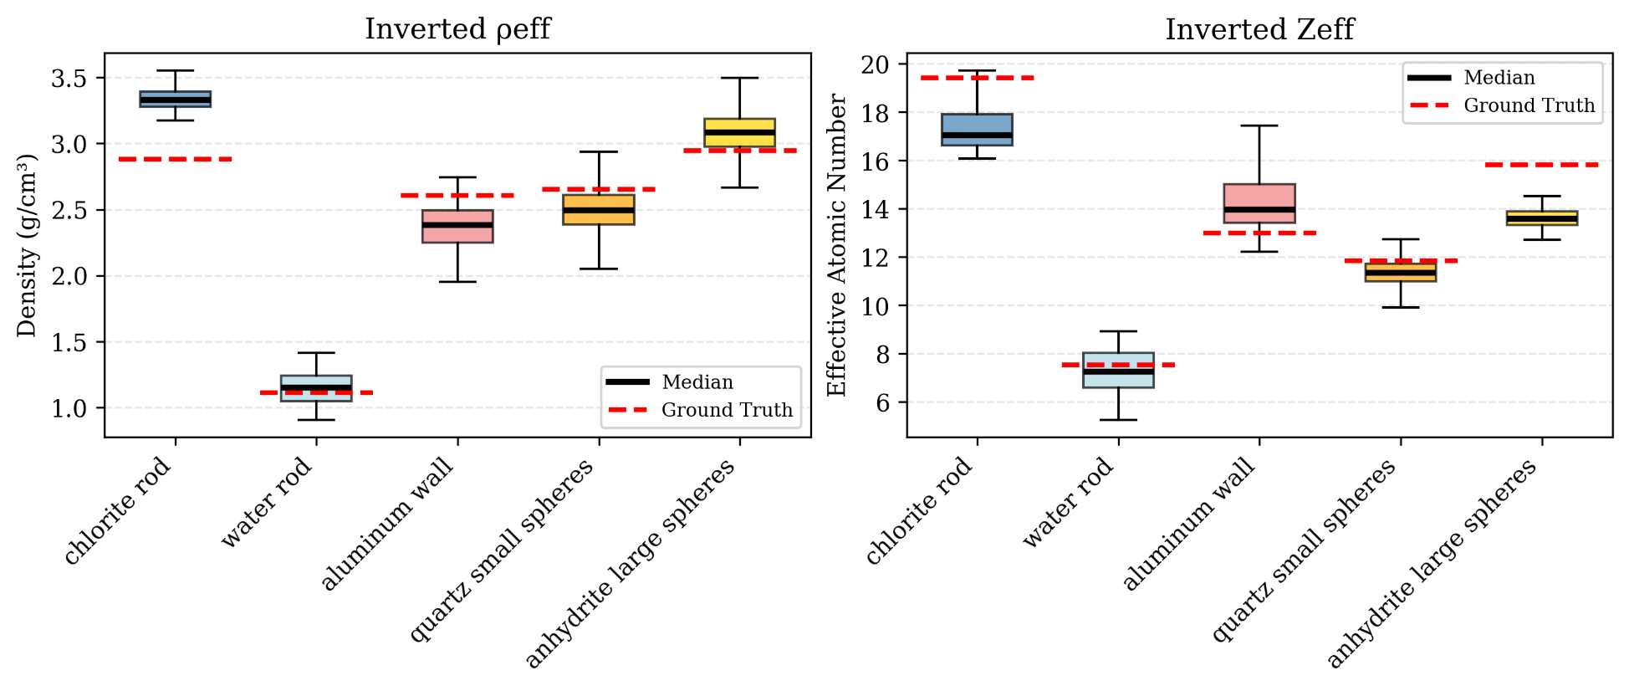
Boxplots – Polychromatic
RESULTS

Slide 21
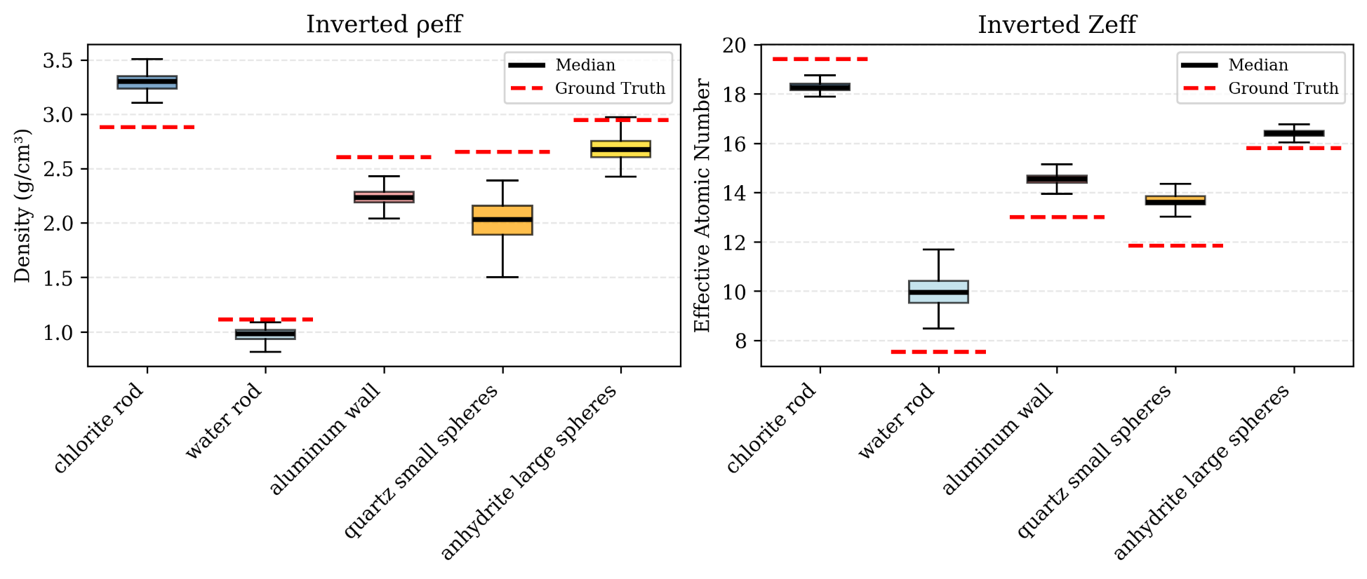
Boxplots – Linearization Correction
RESULTS

Slide 22
Boxplots – BVM Approach
RESULTS

Slide 23
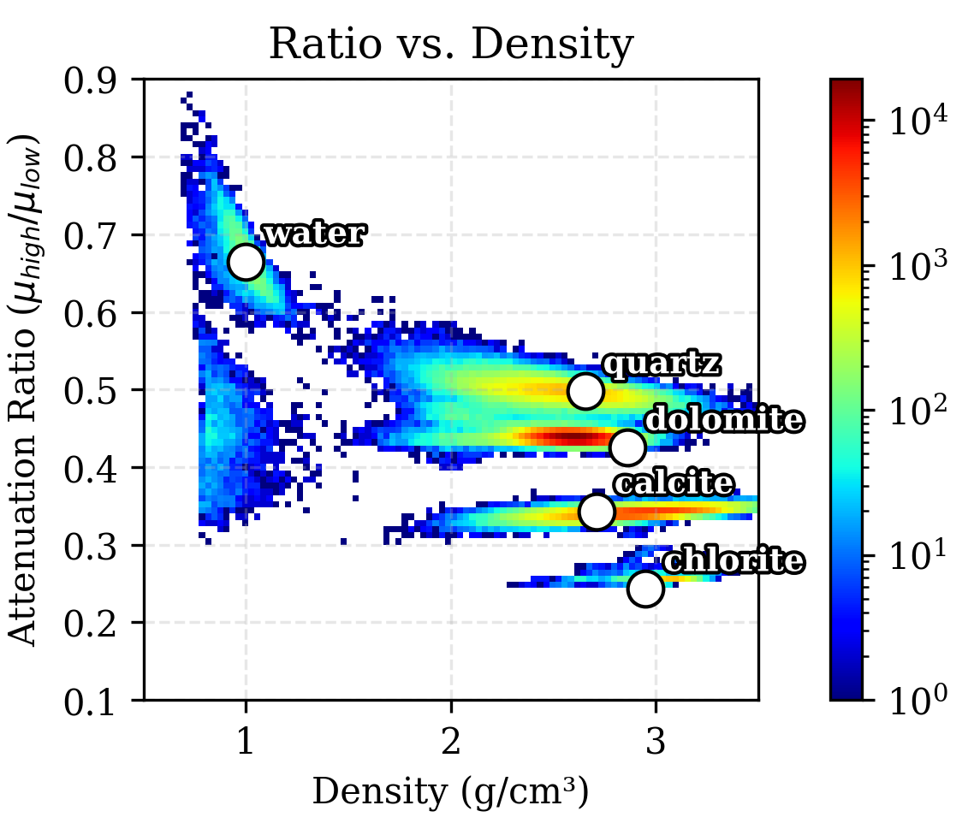
Conclusions and Future Directions
BVM is superior to linearization correction.
We can address BH without disrupting physics.
This approach minimizes the requirement of additional scanning methods for mineralogy.
Expanding this experiment to 3D.
Comparing the digital CT simulation results with real CT results.

Slide 24
References
Lehmann, L. A., Alvarez, R. E., Macovski, A., Brody, W. R., Pelc, N. J., Riederer, S. J., & Hall, A. L. (1981). Generalized image combinations in dual KVP digital radiography. Medical Physics, 8(5), 659–667. https://doi.org/10.1118/1.595025
Hanna, R. D., & Ketcham, R. A. (2017). X-ray computed tomography of planetary materials: A primer and review of recent studies. Geochemistry, 77(4), 547–572. https://doi.org/10.1016/j.chemer.2017.01.006
Herman, G. T. (1979). Correction for beam hardening in computed tomography. Physics in Medicine and Biology, 24(1), 81–106. https://doi.org/10.1088/0031-9155/24/1/008
Liu, Tianyu, Guobin Hong, and Wenli Cai. “A Comparative Study of Effective Atomic Number Calculations for Dual-Energy CT.” Medical Physics 48, no. 10 (2021): 5908–23. https://doi.org/10.1002/mp.15166.
Martini, M., P. Francus, L. Di Schiavi Trotta, P. Letellier, M. Des Roches, and P. Després. “Exploring the Application of Dual-Energy CT to Discriminate Sediment Facies in a Varved Sequence.” The Depositional Record 10, no. 1 (2024): 231–44. https://doi.org/10.1002/dep2.271.
Romano, C., Minto, J. M., Shipton, Z. K., & Lunn, R. J. (2019). Automated high accuracy, rapid beam hardening correction in X-Ray Computed Tomography of multi-mineral, heterogeneous core samples. Computers & Geosciences, 131, 144–157. https://doi.org/10.1016/j.cageo.2019.06.009
Victor, Rodolfo A., Maša Prodanović, and Carlos Torres-Verdín. “Monte Carlo Approach for Estimating Density and Atomic Number From Dual-Energy Computed Tomography Images of Carbonate Rocks.” Journal of Geophysical Research: Solid Earth 122, no. 12 (2017): 9804–24. https://doi.org/10.1002/2017JB014408.

Slide 25
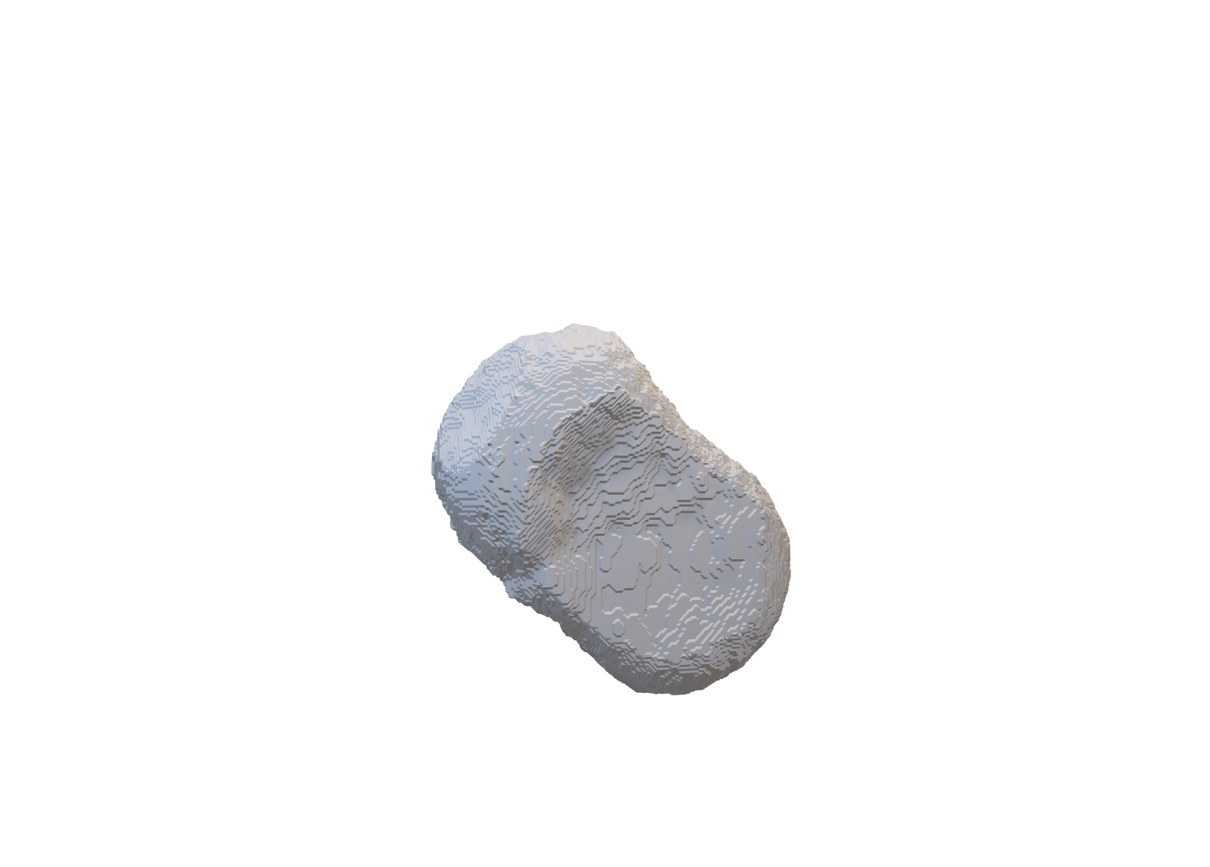
Questions?

Slide 26
Additional Slides

Slide 27
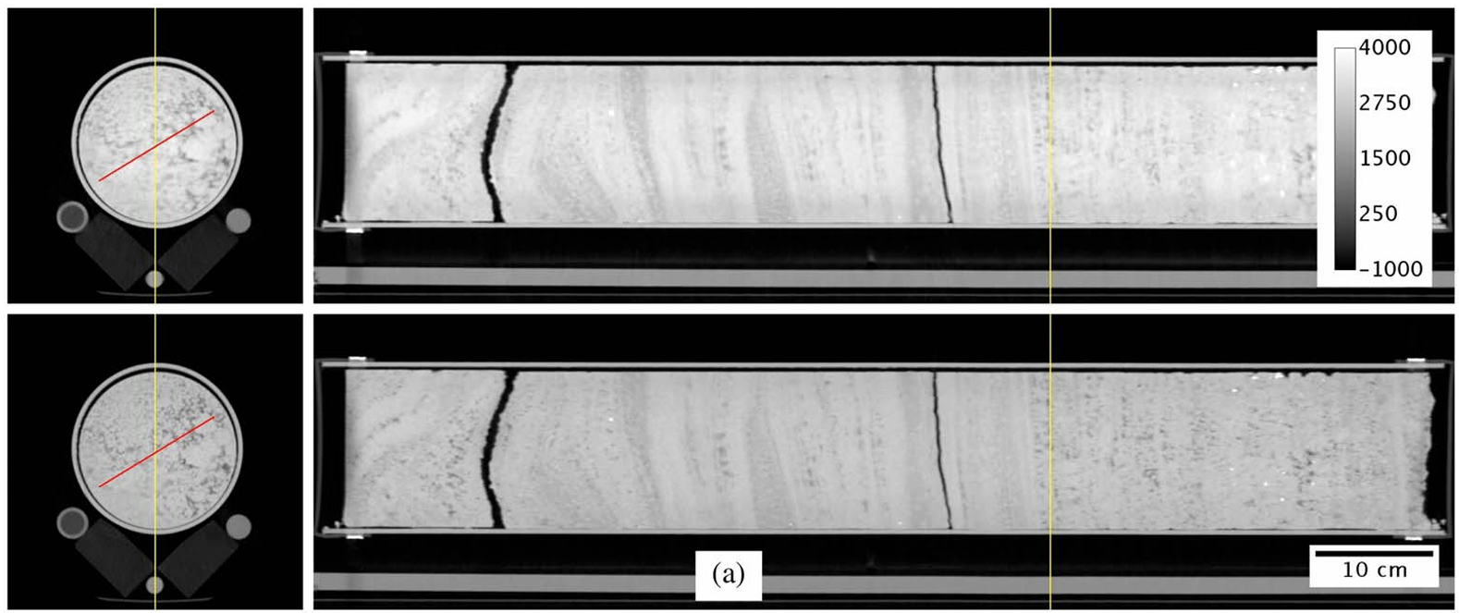
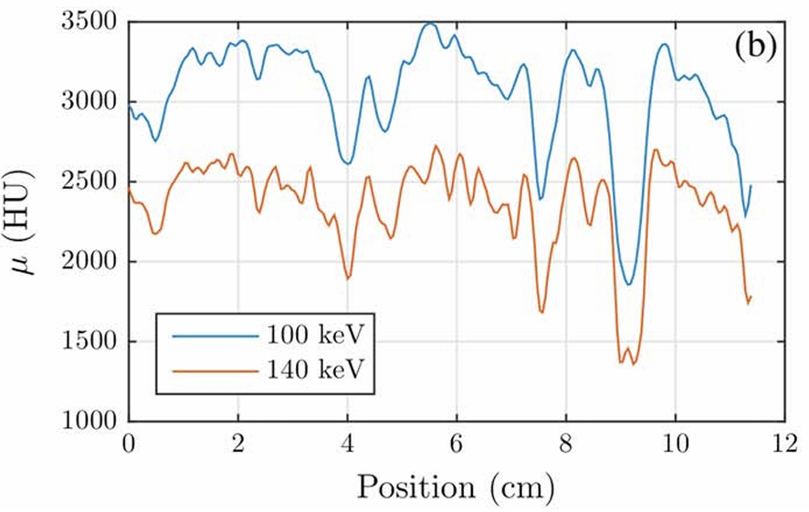
Atomic Number and Density Inversion - Monte Carlo Approach
INTRODUCTION
Fig. 3 in Victor et al. (2017)
3D Tomograms
(a-Top) 100 kEV
(a-Bottom) 140 kEV
Line Profile
(b) Attenuation profile along the red line

Slide 28
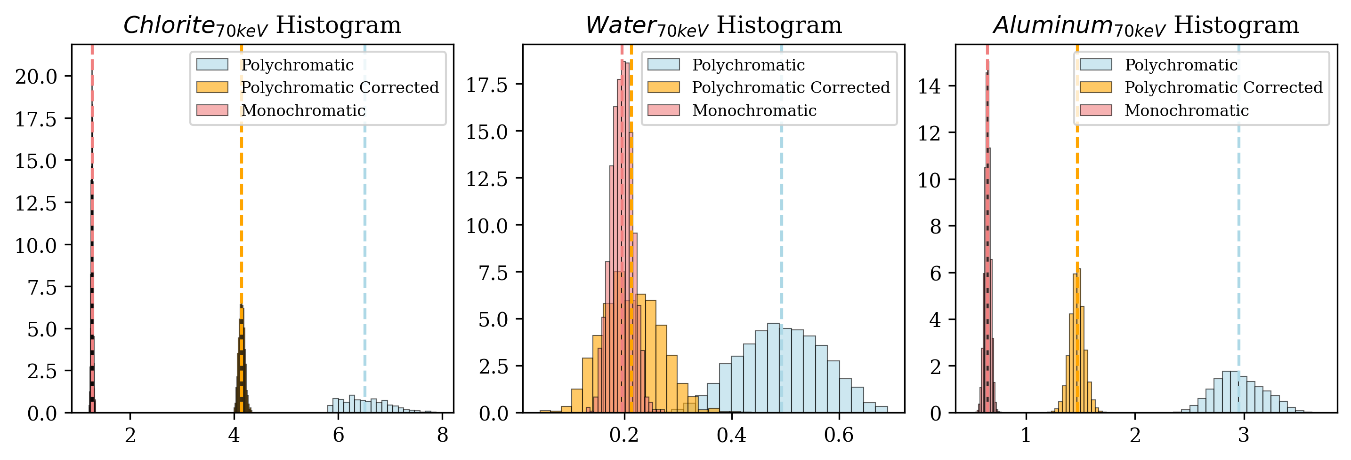
Effect on Distributions
RESULTS

Slide 29
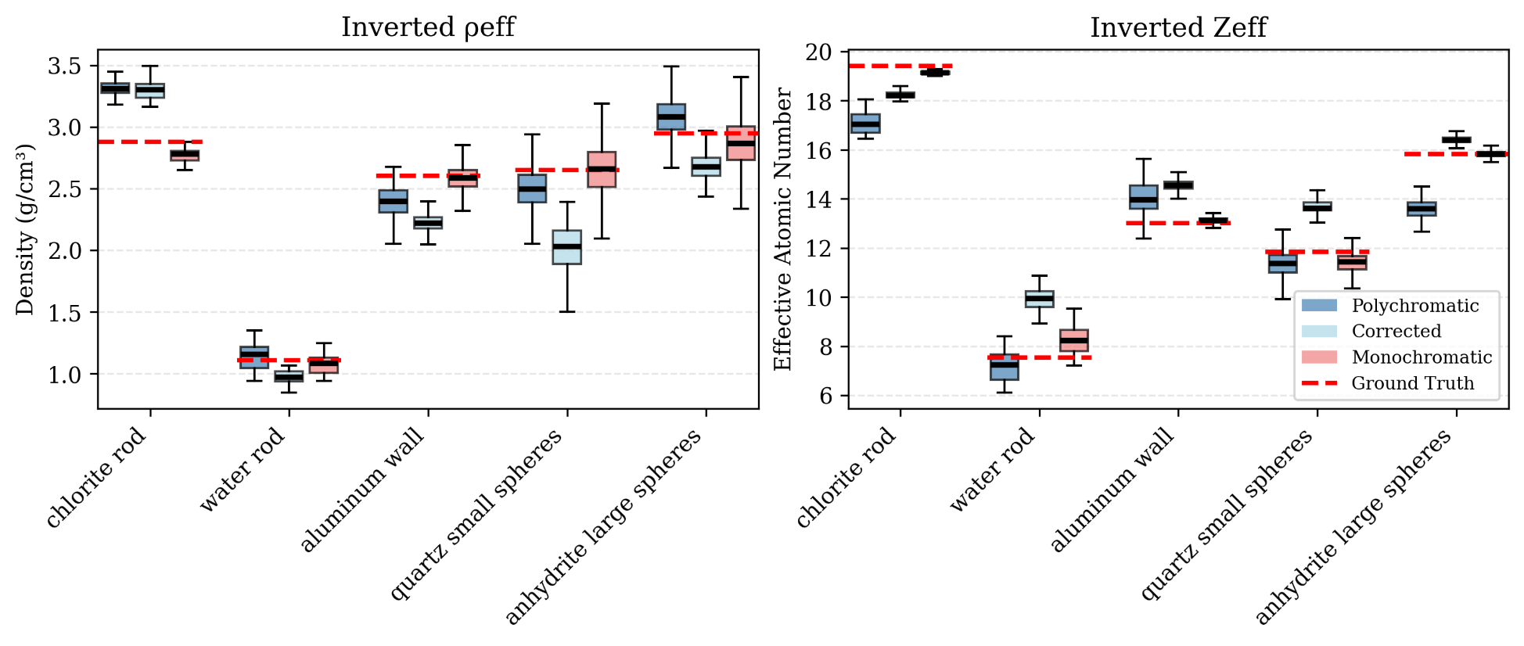
Boxplots – Comparison
RESULTS

Slide 30
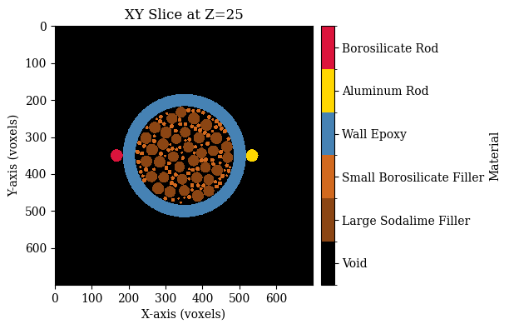
Upcoming Experiment
Simplified Version
Digital Version
Epoxy
Borosilicate
Soda Lime
Aluminum

Slide 31
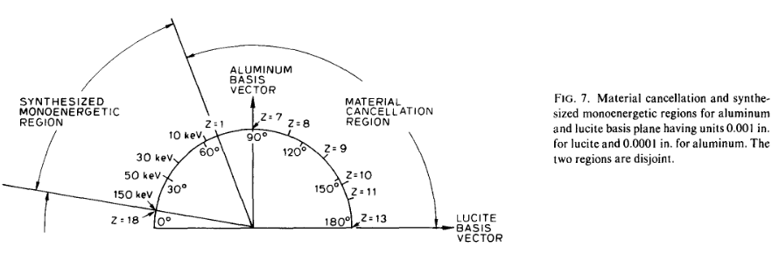
Basis Vector Method (Lehmann et al. 1981)

Slide 32
Upcoming Experiment
Inner sphere sizes:
0.2 mm
0.5 mm
Volumetric ratios of different materials:
0 % - 100%
50% - 50%
100% - 0%
BHC: Applied or not
Resolution: Higher and lower
Spectrum: Does not change.
Dual energy scan energy levels:
80 keV and 140 keV.
Filtering: No filters.
Constituent materials: Aluminum, epoxy, borosilicate glass, air, soda lime glass
Filling medium: Air
Projections: Fixed
Cylinder Height: 5-10 mm
Cylinder Diameter: 5 mm (outer)
Rod Diameter: 0.5 – 1 mm
Scanner Hardware
Reconstruction Algorithm

Slide 33
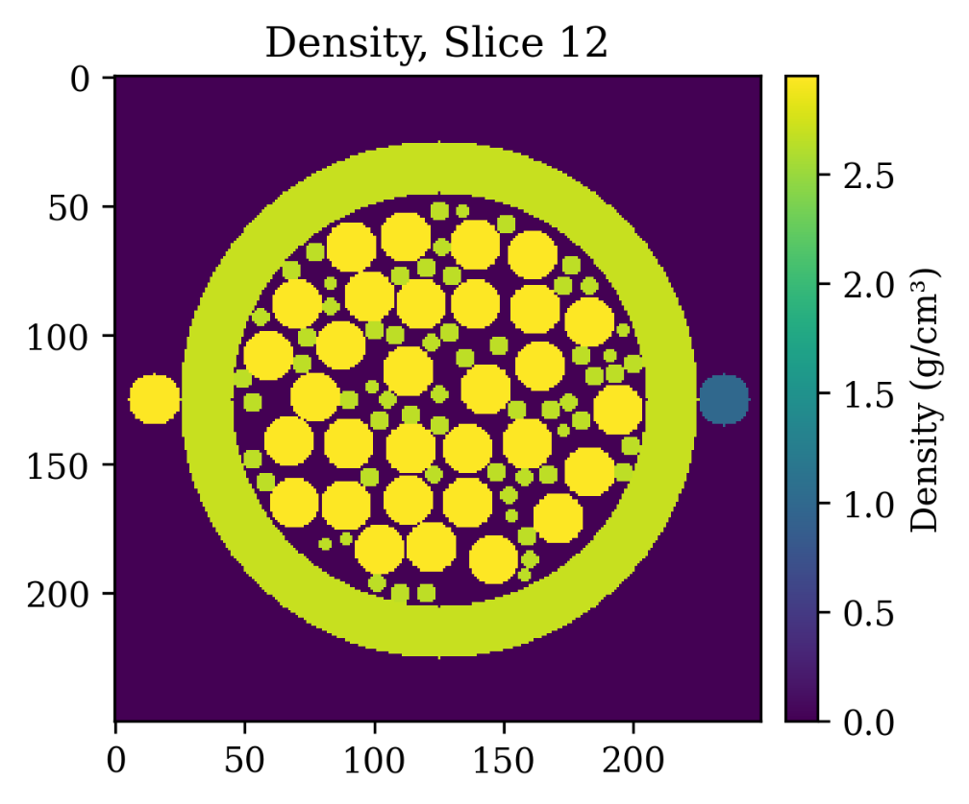
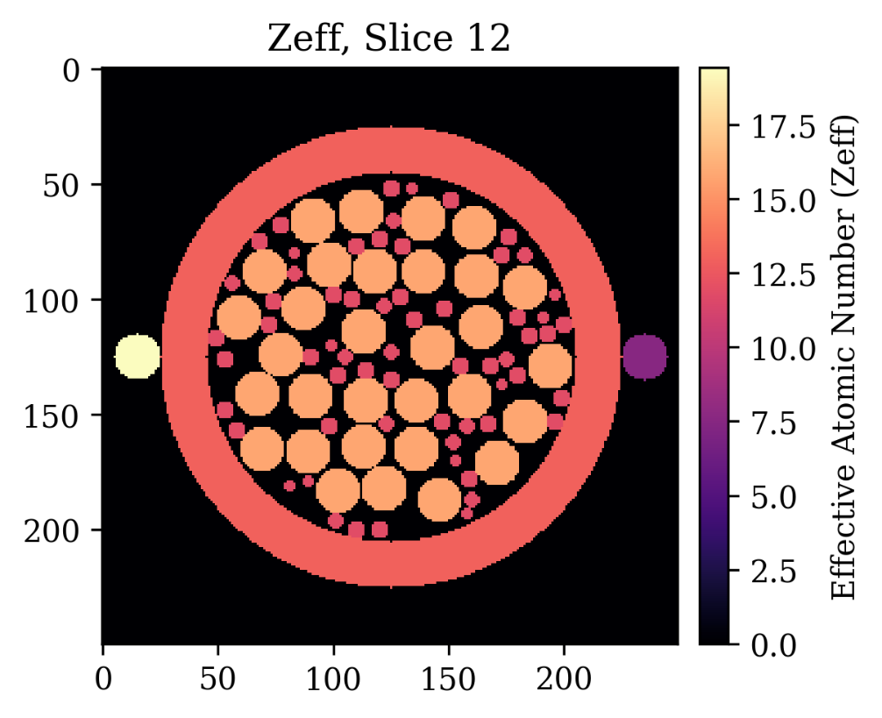
Simulating a μCT Scan of a Digital Sample

Slide 34

Polychromatic vs Monochromatic Scans

Slide 35
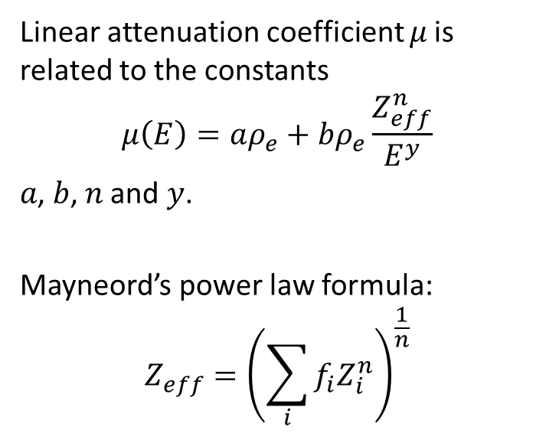
Methods to Estimate the Atomic Numbers from DECT
Linear attenuation coefficient 𝜇 is related to the constants
$$μ\left(E\right)=aρ_{e}+bρ_{e}\frac{Z_{eff}^{n}}{E^{y}}$$
𝑎, 𝑏, 𝑛 and 𝑦.
Mayneord’s power law formula:
$$Z_{eff}={\left(\sum_{i}{f_{i}Z_{i}^{n}}\right)}^{\frac{1}{n}}$$
f can be the:
fraction of electrons in i^{th} element;
fraction of atoms of i^{th} element;
mass fraction of i^{th} element.
The exponent n is assumed constant, having a wide range of reported values.

Slide 36
Methods to Estimate the Atomic Numbers from DECT
Mayneord’s formulation: Uses a power-law formula to calculate Zeff. Fundamental and accurate. Useful for materials with known elemental composition.
Rutherford’s formulation: Includes corrections for coherent scattering and electron binding effects. Zeff is found by solving an equation that relates the linear attenuation coefficients of materials at two different energy levels. Useful if the elemental composition is not known.
Bourque’s formulation: Uses average electron microscopic cross-sections. It uses a polynomial function to approximate these cross-sections and then calculates Zeff by inverting this function. This method has weak energy dependence, so it has lower uncertainty compared to the other methods.
Taylor’s formulation: Uses average electron microscopic cross-sections. Calculates 𝜇 of a mixture and derives Zeff using a parametric equation. This method has strong energy dependence.
Manohara’s formulation: Calculates Zeff by dividing the average atomic microscopic cross-section by the effective electron microscopic cross-section. Its formulation is mathematically questionable.

Slide 37
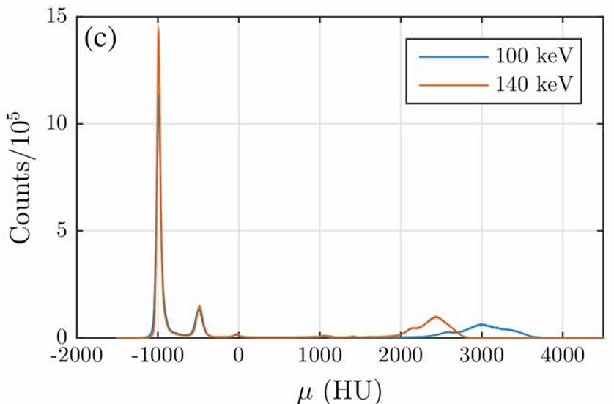
1. Literature Review - Monte Carlo Approach for DECT (Victor et al., 2017)
Figure 3 in Victor et al. (2017):
3D Tomograms
(a-Top) 100 kEV
(a-Bottom) 140 kEV
Line Profiles
(b-left) Attenuation profile along the red line
(b-right) Histogram for the full images

Slide 38
1. Literature Review - Monte Carlo Approach for DECT (Victor et al., 2017)
Air
Teflon
Water
Quartz
Figure 4 in Victor et al. (2017)
pdf’s of calibration materials
CT cross-section with calibration materials masked
100 kEV histogram
140 kEV histogram

Slide 39
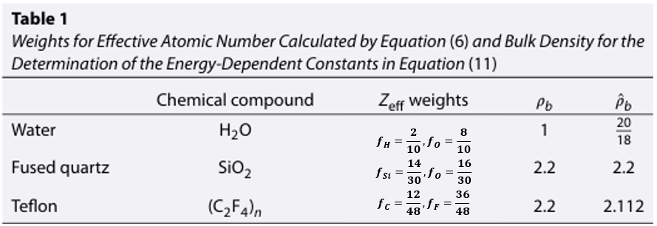
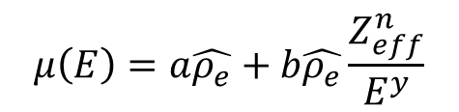
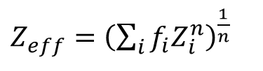


1. Literature Review - Monte Carlo Approach for DECT (Victor et al., 2017)
$$μ\left(E\right)=a\hat{ρ_{e}}+b\hat{ρ_{e}}\frac{Z_{eff}^{n}}{E^{y}}$$
$$μ\left(E\right)=\hat{ρ_{e}}\left(A+BZ_{eff}^{n}\right)+C$$
$Z_{eff}={\left(\sum_{i}{f_{i}Z_{i}^{n}}\right)}^{\frac{1}{n}}$.
$A, B, and n are estimated$
Notes:
F is electron number fraction of ith element

Slide 40





1. Literature Review - Monte Carlo Approach for DECT (Victor et al., 2017)
$$μ\left(E\right)=\hat{ρ_{e}}\left(A+BZ_{eff}^{n}\right)+C$$
$A, B, and n are estimated$
$Z_{eff}={\left(\sum_{i}{f_{i}Z_{i}^{n}}\right)}^{\frac{1}{n}}$.
$\hat{ρ_{e}} \left(A_{100}+B_{100}Z_{eff}^{n_{100}}\right)=μ_{100}−μ_{a,100}$
$\hat{ρ_{e}} \left(A_{140}+B_{140}Z_{eff}^{n_{140}}\right)=μ_{140}−μ_{a,140}$
$$Z_{eff} and \hat{ρ_{e}} are estimated.$$

Slide 41


1. Literature Review - Monte Carlo Approach for DECT (Victor et al., 2017)
(c) $\hat{ρ_{e}}$ mean (g/cm3), (d) $\hat{ρ_{e}}$ standard deviation (g/cm3), (e) $Z_{eff}$ mean, and (f) $Z_{eff}$ standard deviation. Horizontal axis shows depth increasing to the right.
Low 𝜌 values will lead to high uncertainty in the corresponding $Z_{eff}$ values, as observed in these figures.

Slide 42


2. Hypotheses and Methods
Mineral | $$Z_{eff}$$ | $$ρ$$
Na-Montmorillonite | 11.46 | 2.65
Na-Feldspar | 11.55 | 2.61
Quartz | 11.56 | 2.65
Chlorite | 11.64 | 2.9
K-Feldspar | 13.39 | 2.53
Dolomite | 13.74 | 2.87
Calcite | 15.08 | 2.35
Halite | 15.33 | 2.71
Anhydrite | 15.68 | 2.95
Data used from (*Martini et al., 2021; **Siddiqui & Khamees, 2004)
*Martini, M., Francus, P., Di Schiavi Trotta, L., & Després, P. (2021). Identification of Common Minerals Using Stoichiometric Calibration Method for Dual-Energy CT. Geochemistry, Geophysics, Geosystems, 22(11), e2021GC009885. https://doi.org/10.1029/2021GC009885
**Siddiqui, S., & Khamees, A. A. (2004, September 26). Dual-Energy CT-Scanning Applications in Rock Characterization. SPE Annual Technical Conference and Exhibition. https://doi.org/10.2118/90520-MS

Slide 43
2. Hypotheses and Methods
Mineral | $$Z_{eff}$$ | $$ρ$$
Na-Montmorillonite | 11.46 | 2.65
Na-Feldspar | 11.55 | 2.61
Quartz | 11.56 | 2.65
Chlorite | 11.64 | 2.9
K-Feldspar | 13.39 | 2.53
Dolomite | 13.74 | 2.87
Calcite | 15.08 | 2.35
Halite | 15.33 | 2.71
Anhydrite | 15.68 | 2.95
Data used from (*Martini et al., 2021; **Siddiqui & Khamees, 2004)
*Martini, M., Francus, P., Di Schiavi Trotta, L., & Després, P. (2021). Identification of Common Minerals Using Stoichiometric Calibration Method for Dual-Energy CT. Geochemistry, Geophysics, Geosystems, 22(11), e2021GC009885. https://doi.org/10.1029/2021GC009885
**Siddiqui, S., & Khamees, A. A. (2004, September 26). Dual-Energy CT-Scanning Applications in Rock Characterization. SPE Annual Technical Conference and Exhibition. https://doi.org/10.2118/90520-MS

Slide 44

Monte Carlo Approach for Estimating Density and Atomic Number from DECT (Victor et al., 2017)
Applying a normalization by some data-derived constants to account for the miscalibration of $μ_{water}$.
$$μ\left(E\right)=\frac{μ\left(E\right)−μ_{1}}{μ_{2}}=\frac{ρ_{e}}{μ_{2}}\left(a+b\frac{Z_{eff}^{n}}{E^{y}}\right)−\frac{μ_{1}}{μ_{2}}$$
$$ρ_{e}=ρ_{b}\frac{Z}{M_{w}}N_{A}$$
Where $\frac{Z}{M_{w}}$ is $\sim$ ½ for most rock minerals. Therefore, one can use the electron density index:
$${\hat{ρ}}_{e}=2\frac{Z}{M_{W}}ρ_{b}$$

Slide 45

Generating X-Rays
https://doi.org/10.1118/1.598170

Slide 46

Monte Carlo Approach for Estimating Density and Atomic Number from DECT (Victor et al., 2017)
$${\hat{ρ}}_{e}=2\frac{Z}{M_{W}}ρ_{b}$$
Since, bulk density is known for the calibration materials, one can make the following approximation:
$${\hat{ρ}}_{e}≈aρ_{b}$$
And add the correction term for the bulk density later on. By incorporating the last equation and grouping the constants, one can get the final equation:
$$μ\left(E\right)=\hat{ρ_{e}}\left(A+BZ_{eff}^{n}\right)+C$$

Slide 47







A potentially robust method (Lehmann et al. 1981)

