Slide 1
DYRECT: Dynamic Reconstruction of Events in micro-CT data of multiphase flow in porous media
Wannes Goethals, Robert van der Merwe, Jan Aelterman, Matthieu Boone, Tom Bultreys
19/05/2026
Notes:
Last presentation before reception
My goal is to show that we can get much more out of our µCT datasets, which makes 4DµCT with X-rays more practical for exploring new and unexpected fundamental dynamics

Slide 2
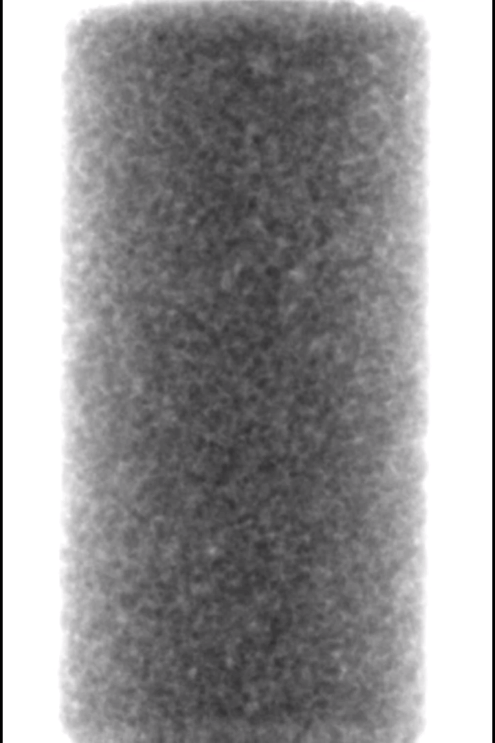
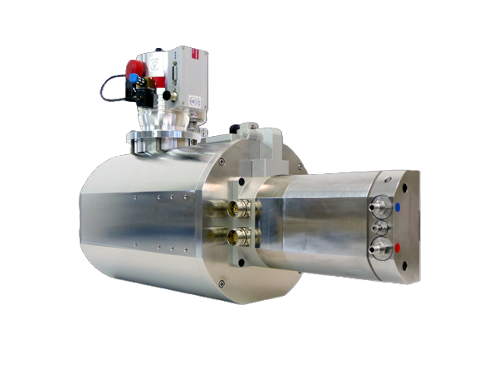
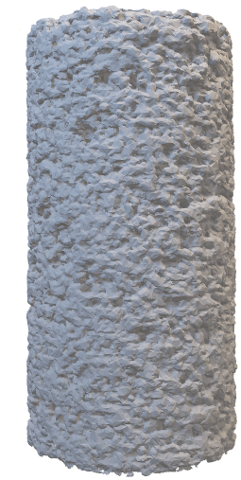
Dynamic X-ray µCT to reveal in-situ 3D pore-scale processes
X-ray source
Dynamic object
Detector
fluid migration: pore fillings + particle tracks
mineral weathering: dissolution + precipitation
mechanical dynamics: strain + ruptures
Notes:
This is a typical µCT setup.
Using X-rays, we can see through our object and the contrast we see in our radiographs is an aggregation of all features along the lines of the X-rays.
To know where the features are along the ray paths, we need a relative rotation of the object in our system to reconstruct a 3D image.
When we continue to rotate, we can see the evolution of our dynamic object.
This is how we can visualize dynamic processes in opaque media like fluid migration, mineral weathering and mechanical dynamics.
In-situ and non-destructively

Slide 3
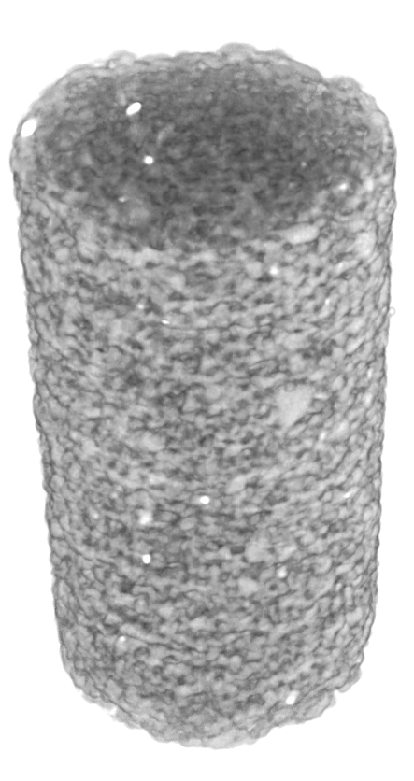
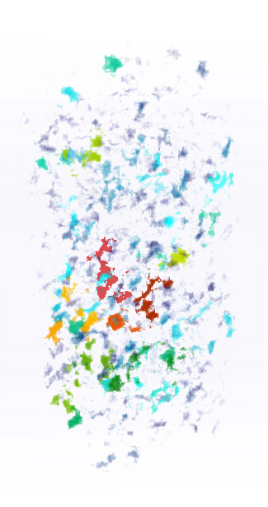
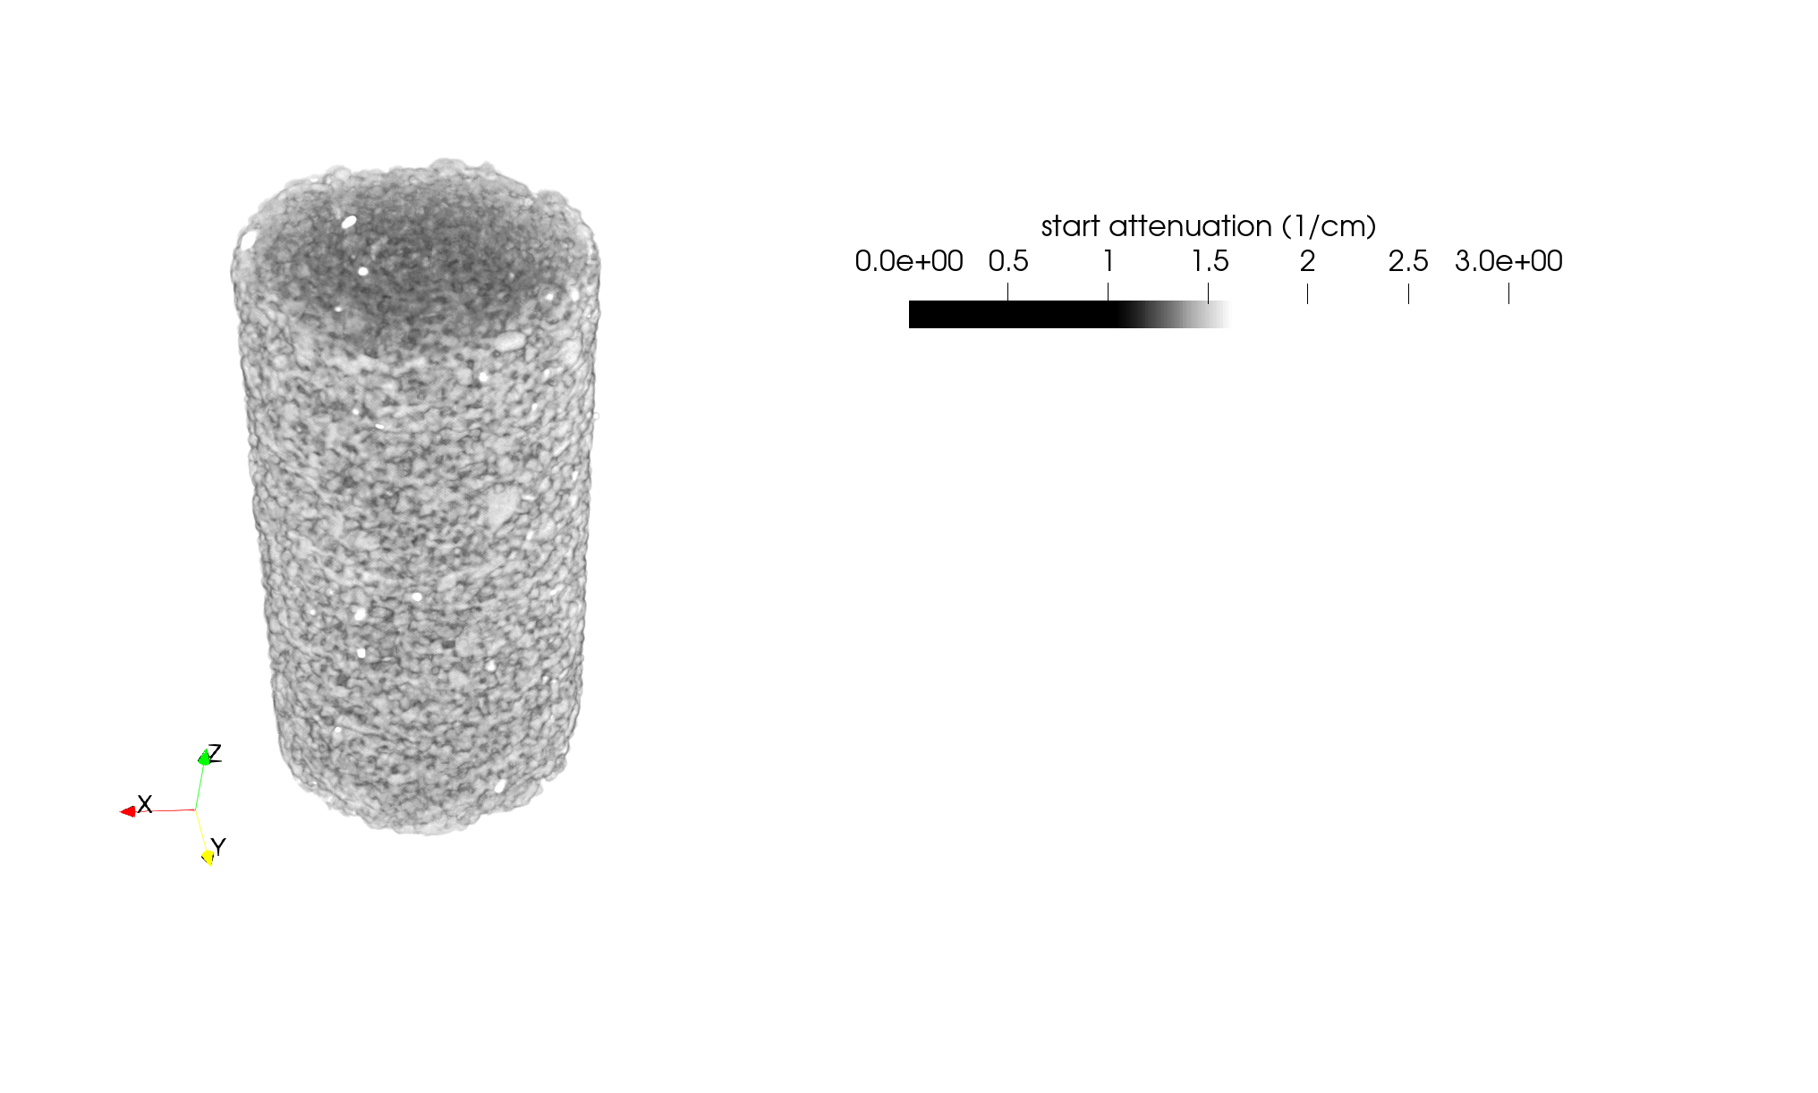
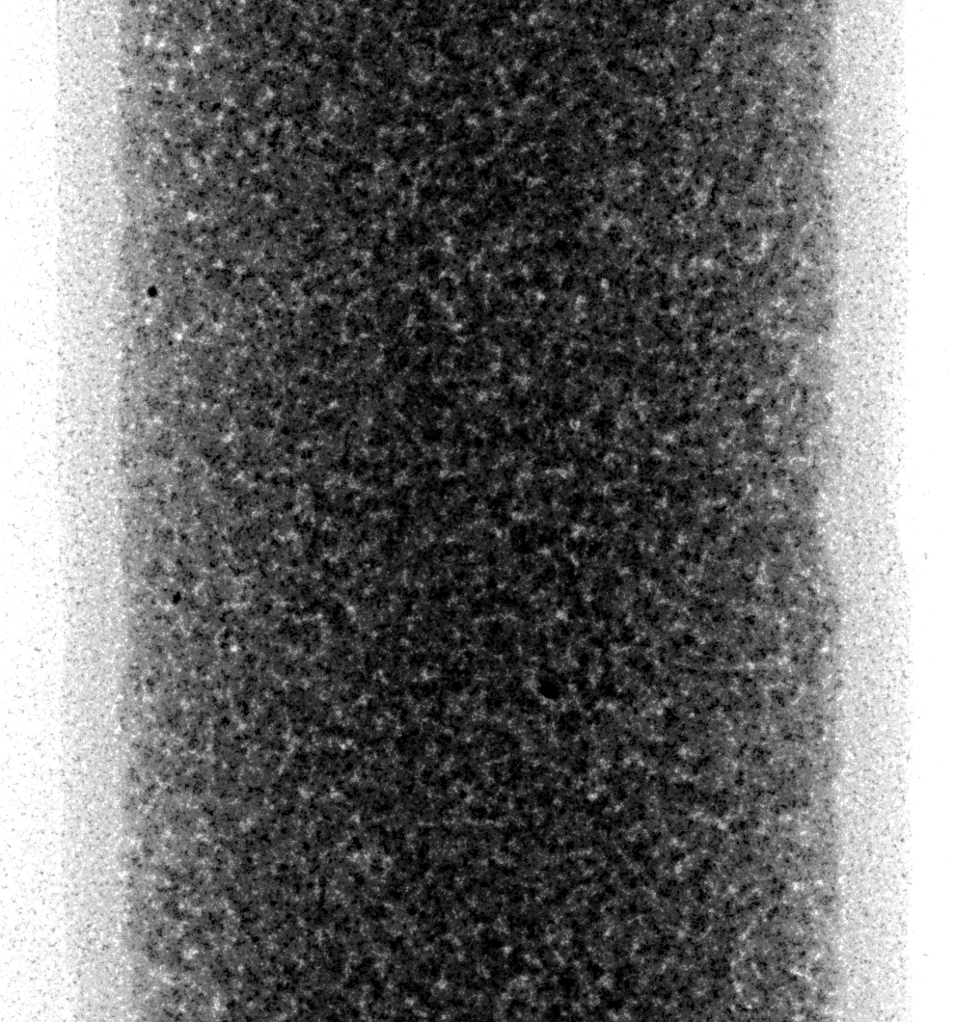
Current Frame-based dynamics workflow has limited time resolution + Loses information
Raw data:
Radiographs from different viewing angles
Reconstructed data
Segmented data
3D volume at each time step
(= 360° viewing angles)
Remove noise
Identify materials
RECONSTRUCTION
PROCESSING
ANALYSIS
…
Time
Time
Time
Notes:
The most common approach to dynamic CT imaging is illustrated here.
We convert the groups of radiographs into CT frames.
Typically, one frame corresponds to one rotation, and we assume that the sample remains static during this time frame, or we get motion blur.
So you see from this that the rotation speed determines the time resolution.

Slide 4

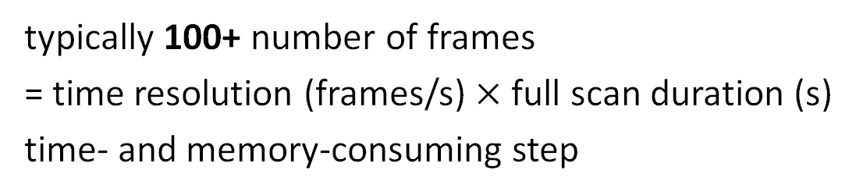
Current Frame-based dynamics workflow has limited time resolution + Loses information
Raw data:
Radiographs from different viewing angles
Reconstructed data
Segmented data
Salient dynamic features
3D volume at each time step
(= 360° viewing angles)
Remove noise
Identify materials
Saturation
RECONSTRUCTION
PROCESSING
ANALYSIS
…
Time
Time
Time
Time
typically 100+ number of frames
= time resolution (frames/s) $×$ full scan duration (s)
time- and memory-consuming step
Notes:
Then, each frame is segmented into different phases to do quantitative analysis.
Here I show 4 frames, but in realistic high-speed scans we typically generate 100+ of frames that we then need to analyse.
This is because we predefine the time resolution to see the fastest dynamics, but we don’t always know when the magic happens.
This cannot fit all in memory at the same time, so frames are segmented sequentially as if they were static images.

Slide 5
Current Frame-based dynamics workflow has limited time resolution + Loses information
Reconstructed data:
Segmented data
Salient dynamic features
3D volume at each time step
(= 360° viewing angles)
Remove noise
Identify materials
Saturation
PROCESSING
ANALYSIS
Time
Time
Time
Notes:
After these analyses, we look at the temporal evolution for all relevant properties that we need to interpret our dynamic experiment.
It is important to notice how, at this point, we completely lost the ability to trace our salient dynamic features back to the original projections,
and how we cannot recover the temporal resolution that we lost by this frame-based workflow.
Any fluctuation faster than the time resolution cannot be recovered.

Slide 6
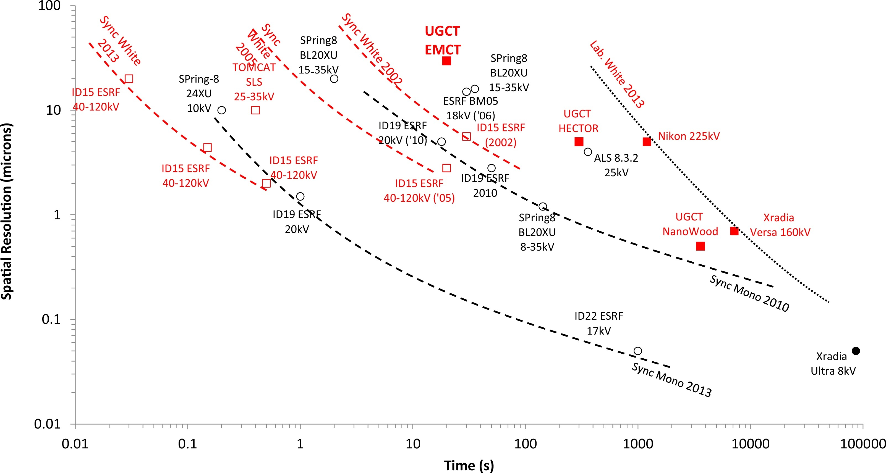
Research goals for dynamic µCT
pinpoint events at sub-frame time resolution
scan larger objects (with better resolution)
analyse the experiments faster
Adapted from Bultreys et al. 2016
Notes:
To cover even the fastest processes, we need better temporal resolution in our reconstructed image.
So increase the frame rate, rotate faster etc.
But, have a look at this graph. This shows the trade-off in spatial and temporal resolution for a range of systems at the limit of their X-ray flux:
how small can the voxel size be for the time it took to acquire enough projections for a single frame (1000)?
Let’s say we wanted to scan large samples, like Nathaly, at the spatial resolution for a sample half the size, with the same contrast to noise ratio.
You could do this with pixels that are half their size, so 1/4th their normal area and you would need double the number of projections.
This leads to a cubic relationship, which means that this classical approach makes it very hard to scan the fastest processes in high resolution.

Slide 7
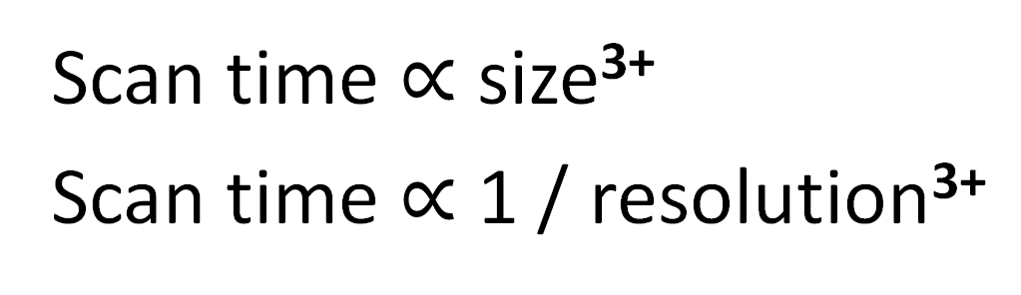
trade-off: temporal vs spatial resolution
Large samples:
REV
Small samples
Pore size
Scan time $∝$ size³⁺
Scan time $∝$ 1 / resolution³⁺
Adapted from Bultreys et al. 2016
Pore-scale processes cover a wide range in time
Notes:
To cover even the fastest processes, we need better temporal resolution in our reconstructed image.
So increase the frame rate, rotate faster etc.
But, have a look at this graph. This shows the trade-off in spatial and temporal resolution for a range of systems at the limit of their X-ray flux:
how small can the voxel size be for the time it took to acquire enough projections for a single frame (1000)?
Let’s say we wanted to scan large samples, like Nathaly, at the spatial resolution for a sample half the size, with the same contrast to noise ratio.
You could do this with pixels that are half their size, so 1/4th their normal area and you would need double the number of projections.
This leads to a cubic relationship, which means that this classical approach makes it very hard to scan the fastest processes in high resolution.

Slide 8
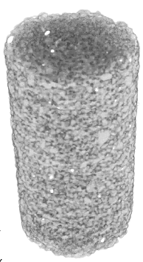

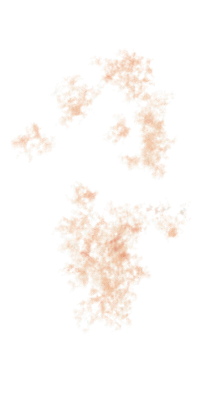
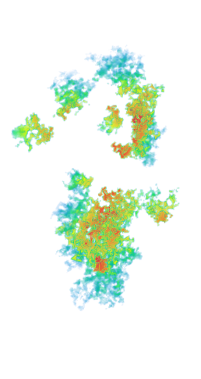


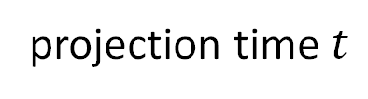


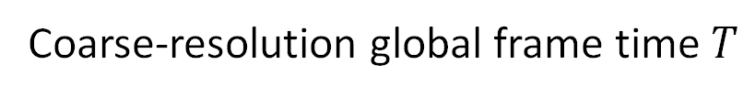
Asynchronous event model: high-resolution transition time
Frame-based 4DµCT
Event-based 4DµCT
Goethals et al., DYRECT (2025)
…
$$μ_{0}(x)$$
$$μ_{2}(x)$$
$$μ_{1}(x)$$
$$μ_{3}(x)$$
projection time $t$
Coarse-resolution global frame time $T$
Notes:
So what can we do to improve the time resolution?
The answer is in directly observing local changes at the time scale of the original projections.
When you think of typical dynamics: like pore filling, like dissolution etc., you should think of these as local events.
When you limit yourself to global frames, your model explicitly assumes that all events are synchronized on a very coarse time grid.
So what we did with DYRECT, is a drastic approach that completely gets rid of the classical time series of 3D frames.
We use a representation with local events, that we link through iterative CT reconstruction to pinpoint these events to the original projections.
That is how we aim to gain two orders of magnitude in temporal resolution.

Slide 9
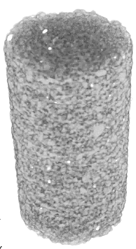
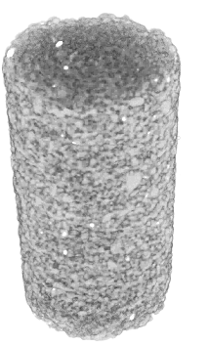

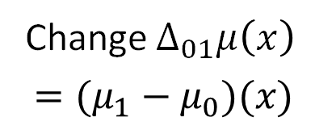
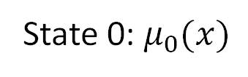
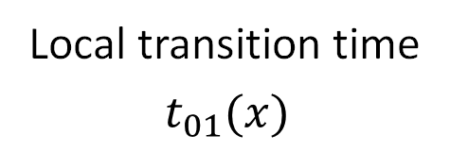
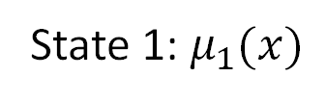
Asynchronous event model: high-resolution transition time
Frame-based 4DµCT
Event-based 4DµCT
Goethals et al., DYRECT (2025)
…
$$μ_{0}(x)$$
$$μ_{2}(x)$$
State 0: $μ_{0}(x)$
Change $Δ_{01}μ\left(x\right)$
$$=(μ_{1}−μ_{0})(x)$$
State 1: $μ_{1}(x)$
$$μ_{1}(x)$$
$$μ_{3}(x)$$
projection time $t$
Coarse-resolution global frame time $T$
Local transition time
$$t_{01}(x)$$
Notes:
The simplest implementation of this is a model with a single transition per voxel.
We need three volumes for this: the initial state, the final state, and the volume of local transition times.
These local transition times store the projection index, so the time at which the attenuation changed.
Depending on your application, this can be the arrival time of a fluid front, or the time at which some material dissolved for every voxel individually.
So you see that in many applications, it is enough to compute only these three volumes; it is the starting point of all analysis.
Also note that on a decent workstation, you can keep these three in memory.
You cannot keep hundreds of frames in memory, which limits you in observing all dynamics and using filtering over the time domain.
These two states aggregate all statistics before and after a transition, so the contrast to noise ratio improves massively.

Slide 10


DYRECT: Dynamic Reconstruction of Events in micro-CT
Simulate 4DµCT projections of dynamic sample
RECONSTRUCTION
Update local details
Notes:
In the previous slide, I got rid of the static frames.
So how do I link these features, like the transition time, to the projections?
What I do in DYRECT is a different kind of iterative CT reconstruction.
I simulate 4DµCT projections of a dynamic sample, I compare them to the recorded projections and use this information to update the local details.

Slide 11
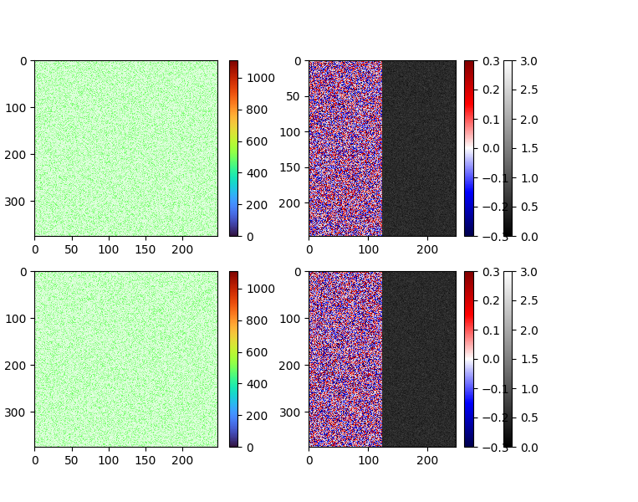
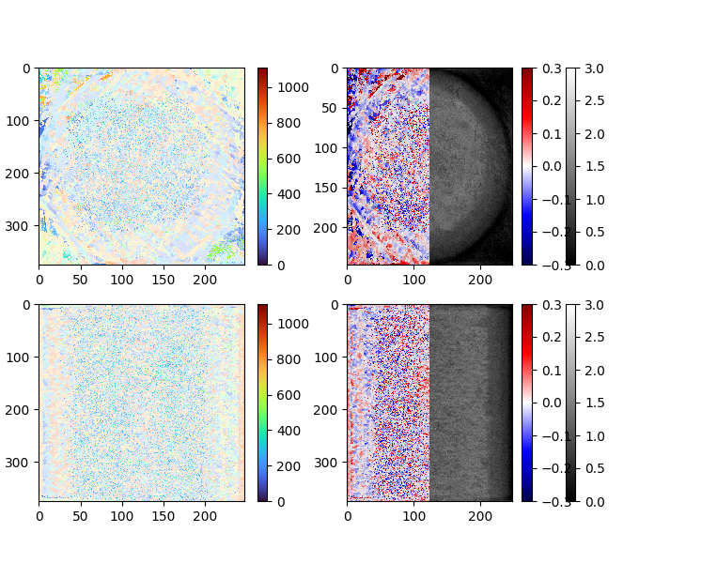
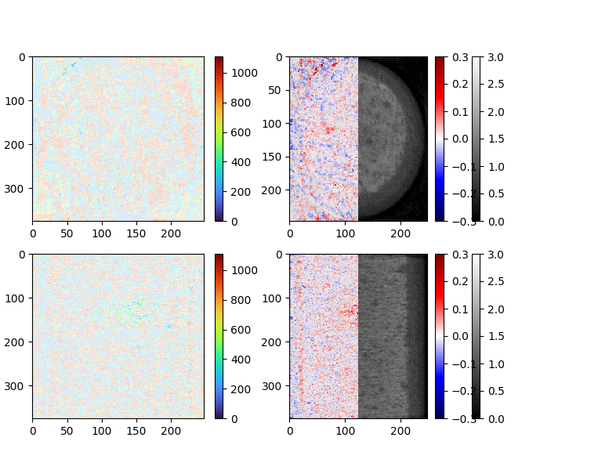
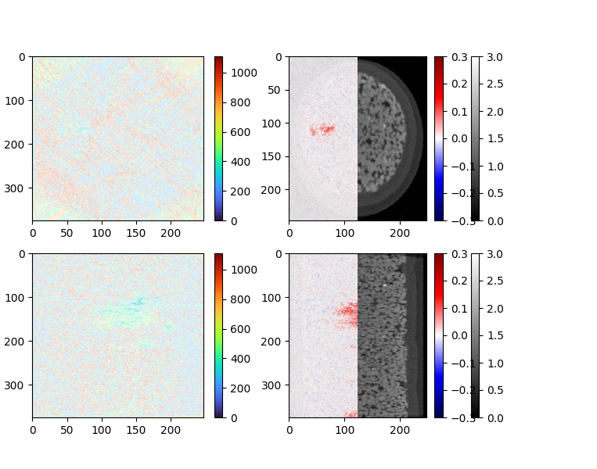
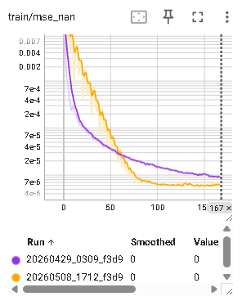
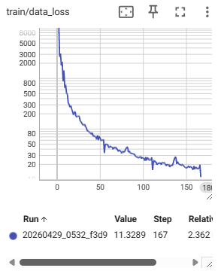

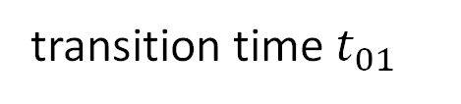









4D µCT iterative reconstruction: compute $t_{01},Δμ, μ_{0}$
transition time $t_{01}$
$$Δμ$$
$$μ_{0}$$
horizontal slice
vertical slice
$$Δμ$$
$$μ_{0}$$
$$0$$
$$|Δμ|$$
$$0.3$$
$$0$$
$$|Δμ|$$
$$0.3$$
Notes:
So this is what it looks like in practice.
The initial image does not show anything.
For each step, we update all three parameters based on a selection of projections.
And gradually, you see more structure appear:
on this overlay, you clearly see the transition by this change in attenuation indicated in red or blue.
In those regions, you see what was the projection time associated to those transitions:
When was each pore filled? What direction did the fluid go to? Did we have smooth or intermittent flow?
That’s a lot of information we can get from a single volume.
20260424_2323_f3d9
20260429_0309_f3d9: lr 0.8, subset size 20, step_tv_weight 0.001, spatial_tv_weight 0.001, step_contrast_weight 0, SSD, weighted_step_tv_weight 10, SGD
20260508_1712_f3d9: static

Slide 12
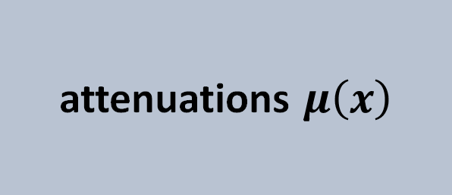
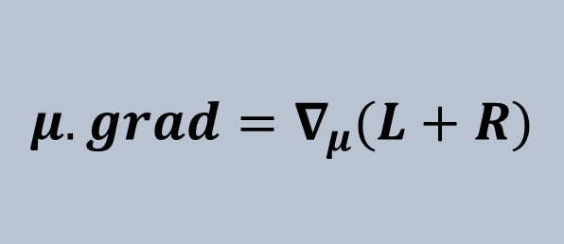
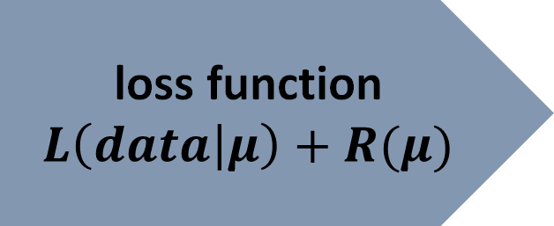
basics: static iterative reconstruction (1 frame)
attenuations $μ\left(x\right)$
model.forward
loss function
$$L\left(data | μ\right)+R(μ)$$
optimizer.step()
$$μ.grad=∇_{μ}(L+R)$$
model.backward
loss.backward()

Slide 13
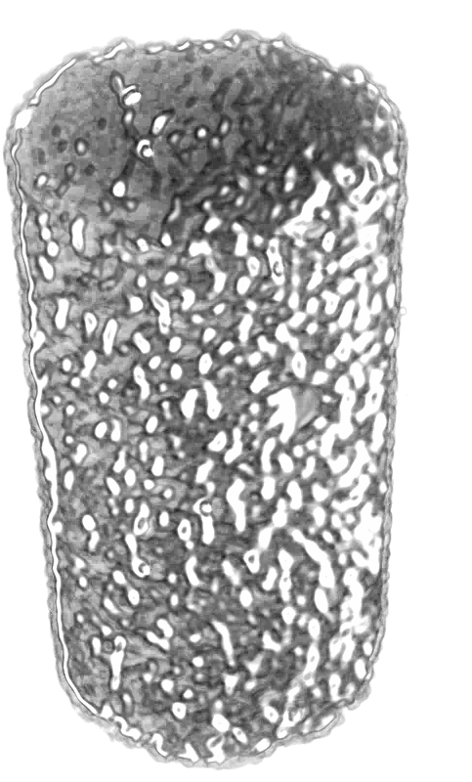
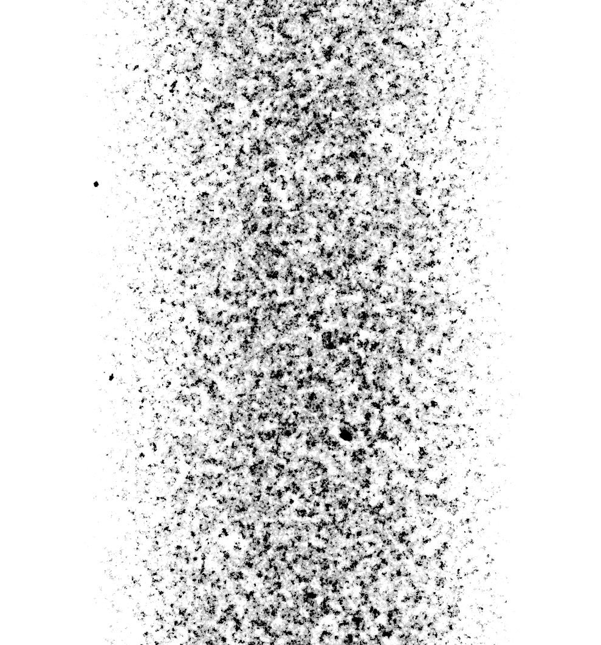
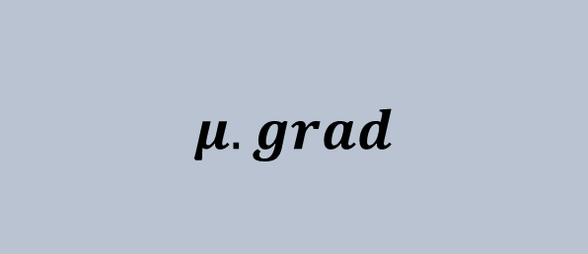
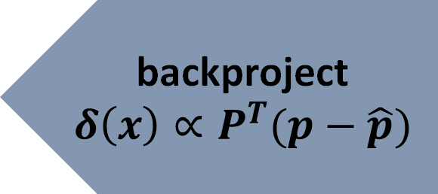
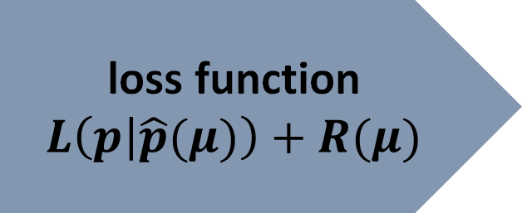
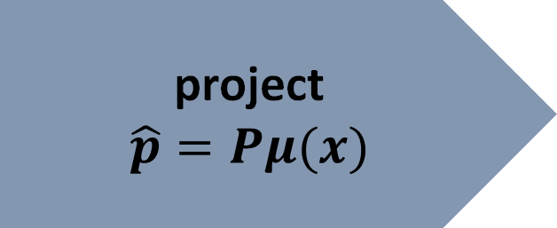
static iterative reconstruction only computes $μ$
attenuations $μ\left(x\right)$
project
$$\hat{p}=Pμ(x)$$
loss function
$$L\left(p | \hat{p}(μ)\right)+R(μ)$$
optimizer.step()
-
=
$$μ.grad$$
backproject
$$δ\left(x\right)∝P^{T}(p−\hat{p})$$
loss.backward()
Notes:
Schematically, this looks very much like static iterative reconstruction:
You have your volume of attenuations and simulate projections.
Then, you compare them, and assign a loss that tells you how likely it was to observe those pixel intensities for the current attenuation model of your sample.
Under gaussian noise you can expect some residual differences, but they should be small. So you want to minimize this loss.
That is done by updating the attenuations, and the update terms for each voxel are computed by backprojecting the residuals.
This is the basis for many different reconstruction techniques, which may extend these with extra terms that use some prior information to achieve a realistic reconstruction.

Slide 14
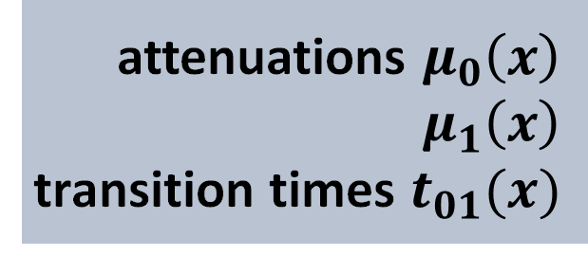


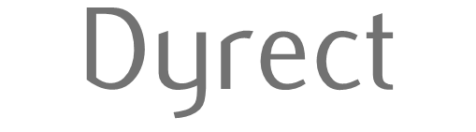
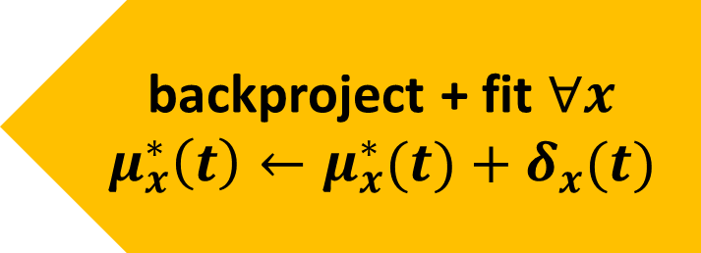
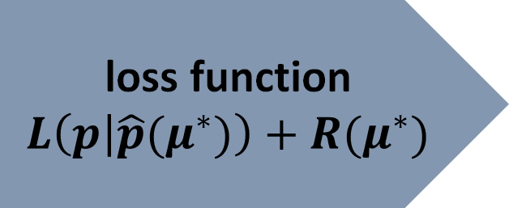
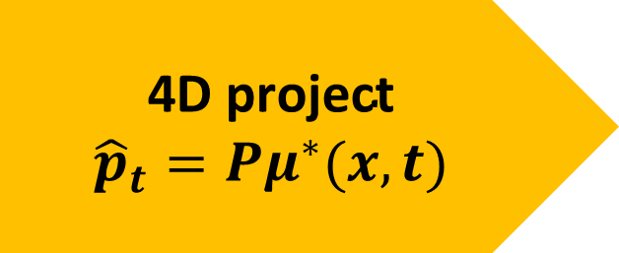
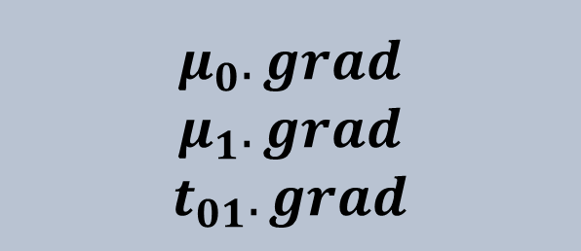
Dyrect: Fit local time functions to CT backprojection
attenuations $μ_{0}\left(x\right)$
$μ_{1}\left(x\right)$
transition times $t_{01}(x)$
$$\text{4}\text{D} \text{project}$$
$${\hat{p}}_{t}=Pμ^{∗}(x,t)$$
loss function
$$L\left(p | \hat{p}(μ^{∗})\right)+R(μ^{∗})$$
optimizer.step()
$$μ_{0}.grad$$
$$μ_{1}.grad$$
$$t_{01}.grad$$
backproject + fit $∀x$
$$μ_{x}^{∗}\left(t\right)←μ_{x}^{∗}(t)+δ_{x}(t)$$
loss.backward()
Notes:
Returning to this schematic, you can see how we only needed minimal changes to our existing reconstruction framework.
For convenience, I define my simpler models and regularization terms using pytorch because that supports automatic differentiation or autograd.
For the projection and backprojection, I use CUDA to write custom GPU kernels, and wrap this into a pytorch module to support the automatic differentiation.

Slide 15

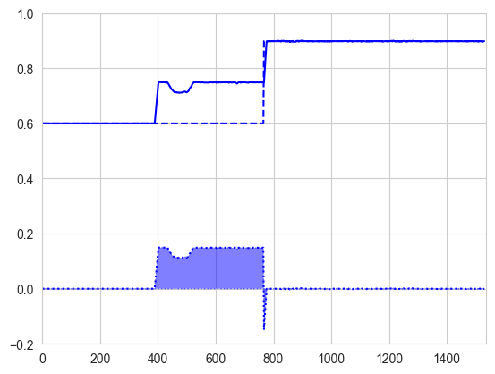
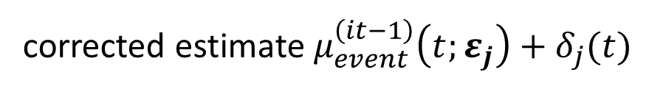

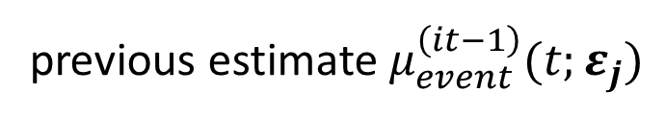
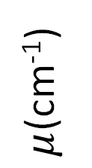

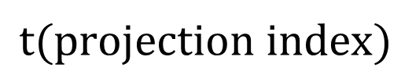
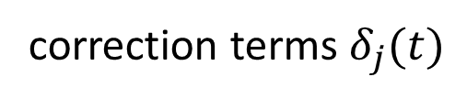
Dyrect: Fit time functions to CT projections per voxel
backproject + fit $∀x$
$$μ_{x}^{∗}\left(t\right)←μ_{x}^{∗}(t)+δ_{x}(t)$$
previous estimate $μ_{event}^{\left(it−1\right)}(t;ε_{j})$
$μ$(cm⁻¹)
$$t_{01,j}^{(it−1)}$$
corrected estimate $μ_{event}^{\left(it−1\right)}\left(t;ε_{j}\right)+δ_{j}(t)$
correction terms $δ_{j}(t)$
Technique can be extended to
other time profiles
$$t(projection index)$$
Fast approximate results
using subsets of projections:
Get early insight!
Notes:
Let’s say we select some ordered subset of projections to compare our simulations to. When we backproject the residuals from the pixels that correspond to a certain voxel, we would simply take a sum of all the residuals.
But when you take a sum, the order of your terms is irrelevant, so all time information is lost when you do this.
If projection A happened before projection B, you could calculate A+B or B+A and have the same result.
So instead, when we execute the backprojection on the GPU, we update our initial estimate of the temporal evolution in that voxel.
We then perform a fit to that corrected signal, to get new estimates for the three event parameters.
This may seem like a costly operation, but this can be optimized a lot.
For a single event, we can do a linear search of the best transition time by computing running sums, so the number of computations scales linearly with the number of projections.
Additionally, we can get faster approximate results if we use only a subset of the projections for each update.
Like this, we can gradually converge to a solution with better accuracy.

Slide 16


fluid flow Simulation study visual assessment of CT reconstructions
CT Subtrajectory
transition time variations
within a single rotation
Ground truth phantom
DYRECT reconstruction
Notes:
To test the accuracy in the reconstruction of the transition times, I performed a simulation study that mimics fluid flow in a sandstone.
On the left, you can see the ground truth situation that we want to achieve again.
On the right, you see the result of a DYRECT reconstruction. In general, you can see that we can temporally resolve pore filling events in the same slice within a fraction of a CT rotation.
slice 500/989
Standard deviation 0.08 rotations
Mean -0.0087 rotations
reconstruction took 3698.7334 seconds, or 01h01m39s for 10 iterations on a volume of 200x989x989 voxels for 4446 projections (3x360° rotations) of 1528x989 pixels

Slide 17


Transition time precision = 1/10th of a CT rotation No angular dependence of accuracy observed
2x improvement
absolute error $t_{01}(×360°)$
0.076
0.090
0.059
0.059
0.052
0.050
10x improvement
propagation - CT vector angle
Notes:
What this simulation study showed is that the precision in estimation the transition time went down to a tenth of a CT rotation.

Slide 18
fluid flow Simulation study noise in transition time remains an important challenge
CT Subtrajectory
transition time variations
within a single rotation
Ground truth phantom
DYRECT reconstruction
Notes:
When you zoom in, there are some residual fluctuations, artefacts that should not be there.
This is because the update of the transition times in the backprojection is rather violent: all of these features and noise around the pore can have a strong effect that we need to understand further.
In this case, I did not add regularization over the transition time volume to study the convergence in absence of any other priors.
slice 500/989
Standard deviation 0.08 rotations
Mean -0.0087 rotations
reconstruction took 3698.7334 seconds, or 01h01m39s for 10 iterations on a volume of 200x989x989 voxels for 4446 projections (3x360° rotations) of 1528x989 pixels

Slide 19
Conclusion & outlook
10-fold time-resolution improvement for same experiment no need for faster rotations & exploding data rates
Dynamic µCT experiments on larger objects at high resolution gathering statistics over multiple rotations to resolve fine features
Integrated analysis in reconstruction for fast end-to-end interpretation keeping a minimum of 3 volumetric feature maps in memory

Slide 20




Thanks to Tom Bultreys Jan Aelterman Matthieu Boone Robert van der Merwe
Contact me at
wannes.goethals@ugent.be
DYRECT: Dynamic Reconstruction of Events in micro-CT data of multiphase flow in porous media
Thank you for your attention & questions!

Slide 21



Interpret dynamics from difference map and Transition map
Attenuation at coordinate $x,t$ under the single event model:
$$μ_{event}\left(x,t\right)=μ_{0}(x)⋅\left(t<t_{01}\left(x\right)\right)+μ_{1}(x)⋅\left(t_{01}\left(x\right)≤t\right)$$
Static segmentation $s_{T}(x)$ of a phase $φ$ at global state time $T$:
$$s_{φ,T}\left(x\right)=s_{φ}\left(μ_{T}\left(x\right), Δμ\left(x\right)\right)$$
Dynamic segmentation
$$s_{φ}\left(x,t\right)=s_{φ,0}(x)⋅\left(t<t_{01}\left(x\right)\right)+s_{φ,1}(x)⋅\left(t_{01}\left(x\right)≤t\right)$$
Saturation of wetting phase $w$ as a function of time:
$$S_{w}\left(t\right)={∫s_{w}\left(x,t\right)dx}/{∫s_{pore}\left(x\right)dx}$$
Local velocity vector of event propagation
$$v\left(x\right)≈\frac{s_{φ}\left(x\right) ∇_{x}\left(t_{01}\left(x\right)\right)}{{\left|∇_{x}\left(t_{01}\left(x\right)\right)\right|}^{2}}$$

Slide 22


Dynamic X-ray µCT at UGCT’s labs @ Ghent University
Notes:
UGCT

Slide 23

Conclusions & Outlook
Spatial features: higher CNR
Temporal resolution: 10-fold improvement
Compression: keep everything in memory
Holistic: analysis in reconstruction
allows analysis and advanced regularization
Required temporal resolution depends on time between two events at the same position, not two events globally
Discovery mode: no need to scan continuously at predefined highest temporal resolution
Can prioritize spatial resolution in long dynamic scans
X-ray statistics gathered over longer time intervals to reconstruct internally consistent states $μ_{0}(x)$ and $μ_{1}(x)$
Next step: multiple steps

Slide 24
Interpret dynamics from difference map and Transition map

Slide 25

3 complementary motion models

