Slide 1


Spontaneous Imbibition and Multiphase Flow Behavior in a Pre-Salt Rock: Insights from Time-Resolved X-ray Microtomography
18º Annual Conference
Authors:
Maira C.O. Lima, Mirele Bispo, Julia Favoreto, Amir Raoof, Leonardo Borghi, José Drumond, Paulo Couto

Slide 2
Introduction
18º Annual Conference
Spontaneous imbibition is essential for predicting and optimizing fluid displacement processes in porous media across various fields of engineering and geosciences (Lake & Lake, 2014), especially in the following contexts:
Wettability and porous media characterization
EOR projects
Study about contaminated soil remediation
Multiphase flow modeling and simulation
The behavior of multiphase flow is governed by the interaction between capillary and viscous forces, which determine how fluids occupy pore spaces and how their distribution evolves over time (Data et al., 2014).

Slide 3
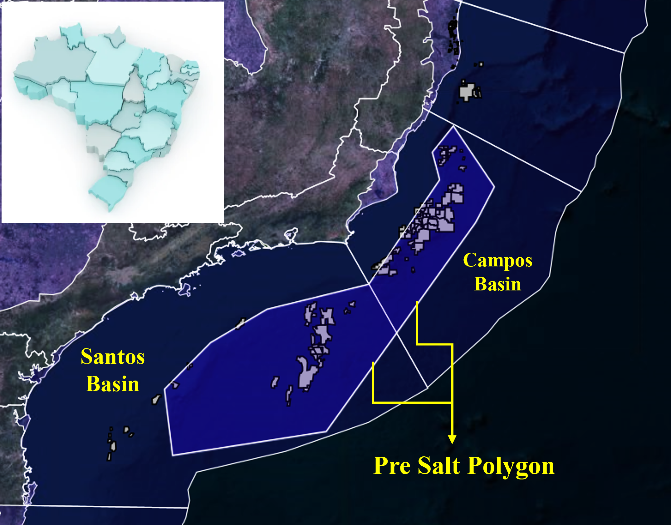
Introduction
18º Annual Conference
The pre-salt reservoirs along Brazil’s eastern margin represent some of the most important petroleum discoveries of recent decades. Formed during the breakup of Gondwana, these rift- and sag-related reservoirs comprise lacustrine carbonates and coquina deposits, which have become major exploration targets in the Campos and Santos basins, particularly in fields such as Búzios Field and Libra Field;
Coquinas exhibit textural heterogeneity due to depositional and diagenetic influences, leading to complex pore systems and wide variations in porosity and permeability (Belila et al., 2018; Zielinski et al., 2018);
Geomaps, ANP (2025)

Slide 4
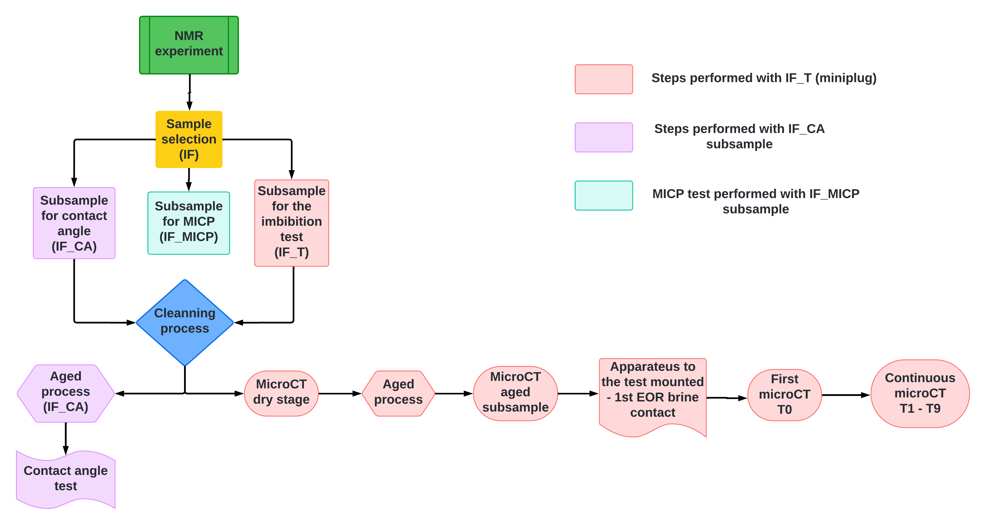
Methodology
18º Annual Conference

Slide 5
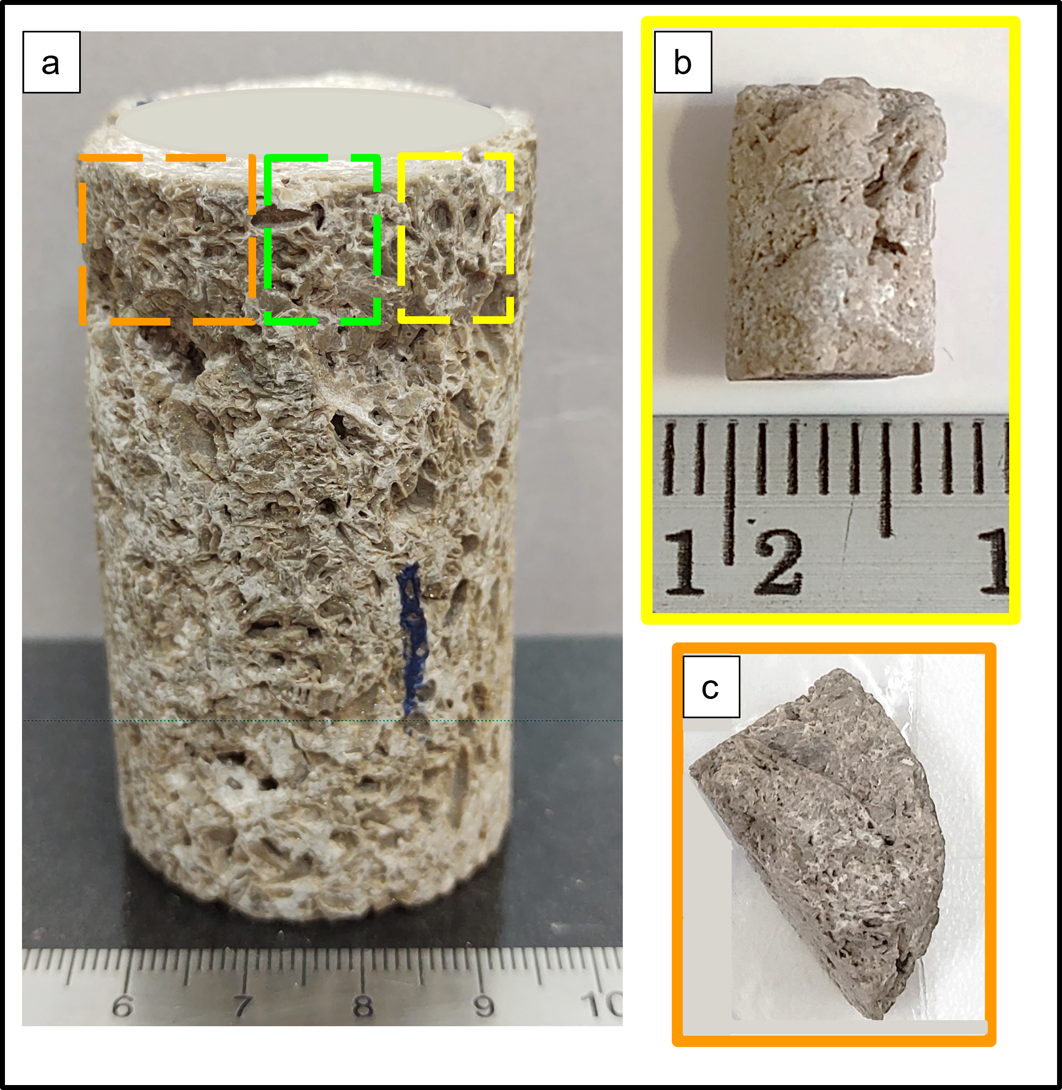
Methodology
18º Annual Conference
NMR
Sample
The NMR experiments were carried out in a low-field spectrometer GeoSpec2 (Oxford Instruments, UK), having a magnetic field equal to 0.047 T and a frequency of 2 MHz;
The sample was saturated with a 30,000 ppm of KCl;
CPMG pulse sequences was applied for obtain T₂ times
Coquina IF
Miniplug IF-T
IF_CA
Green dashed line IF_MICP

Slide 6
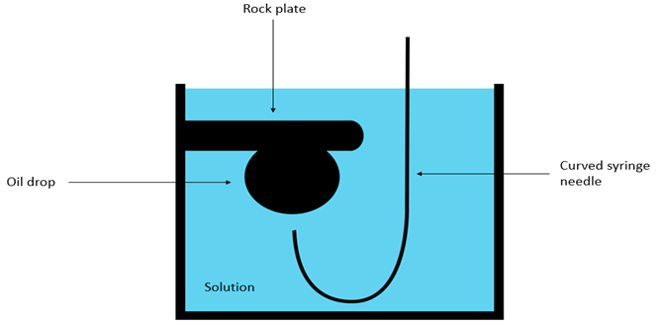

Methodology
18º Annual Conference
MICP
Contact Angle Test
MICP is a destructive technique;
The fragment was first subjected to vacuum, followed by a gradual increase in pressure up to 70,000 psi to determine accessible pore volumes at various pressure levels;
By Washburn equation, the mercury intrusion pressure can be converted on pore radius
Contact angle tests using the captive bubble method were performed at 25°C and atmospheric pressure with a drop-shape analyzer, measuring dynamic behavior over 3600 seconds;

Slide 7
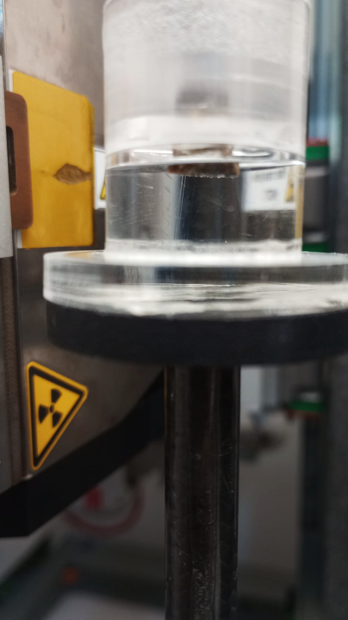
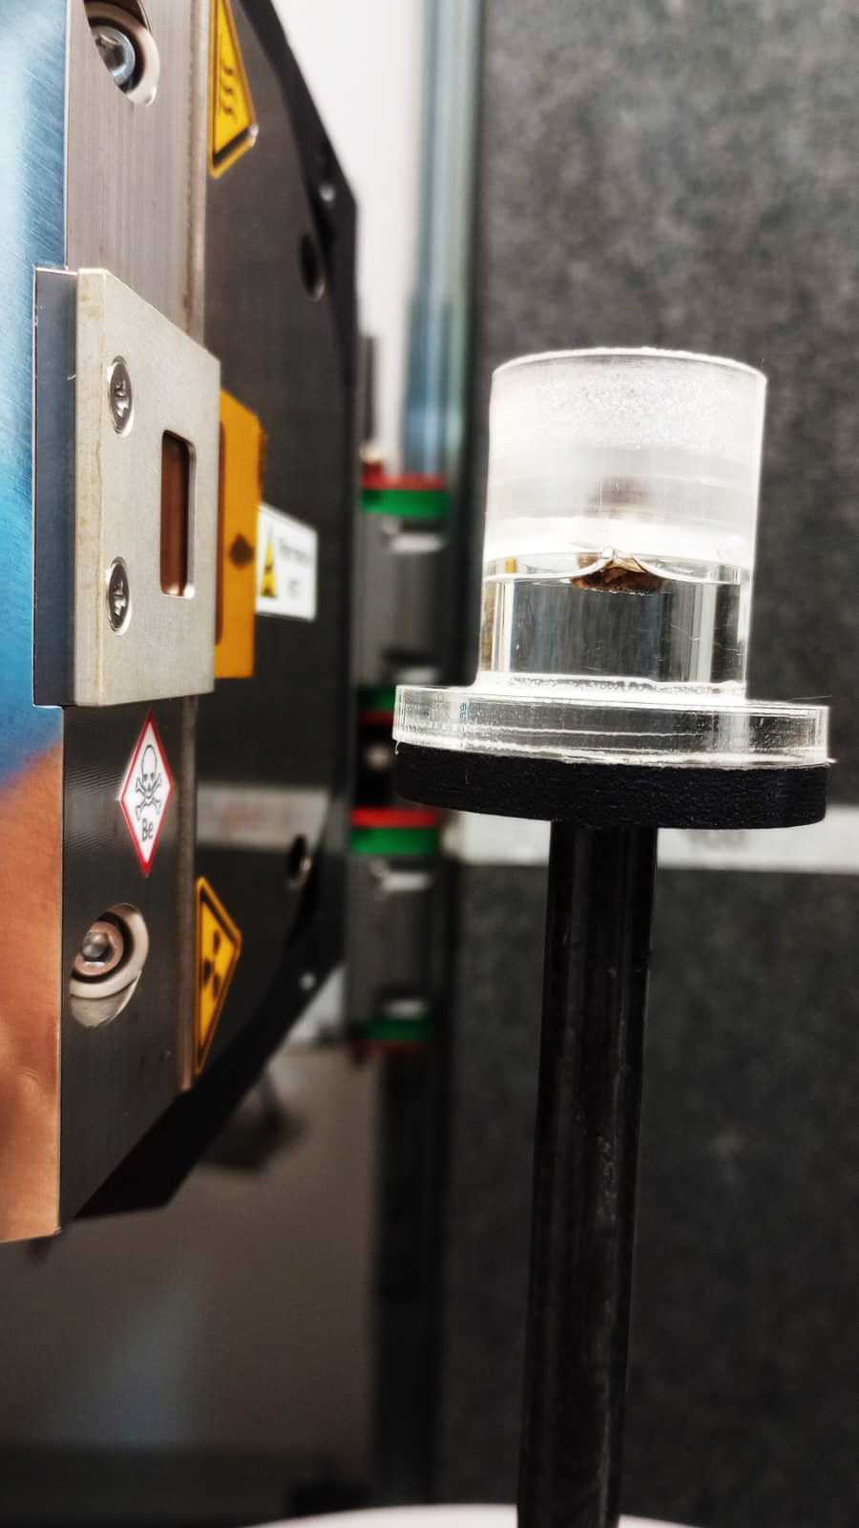
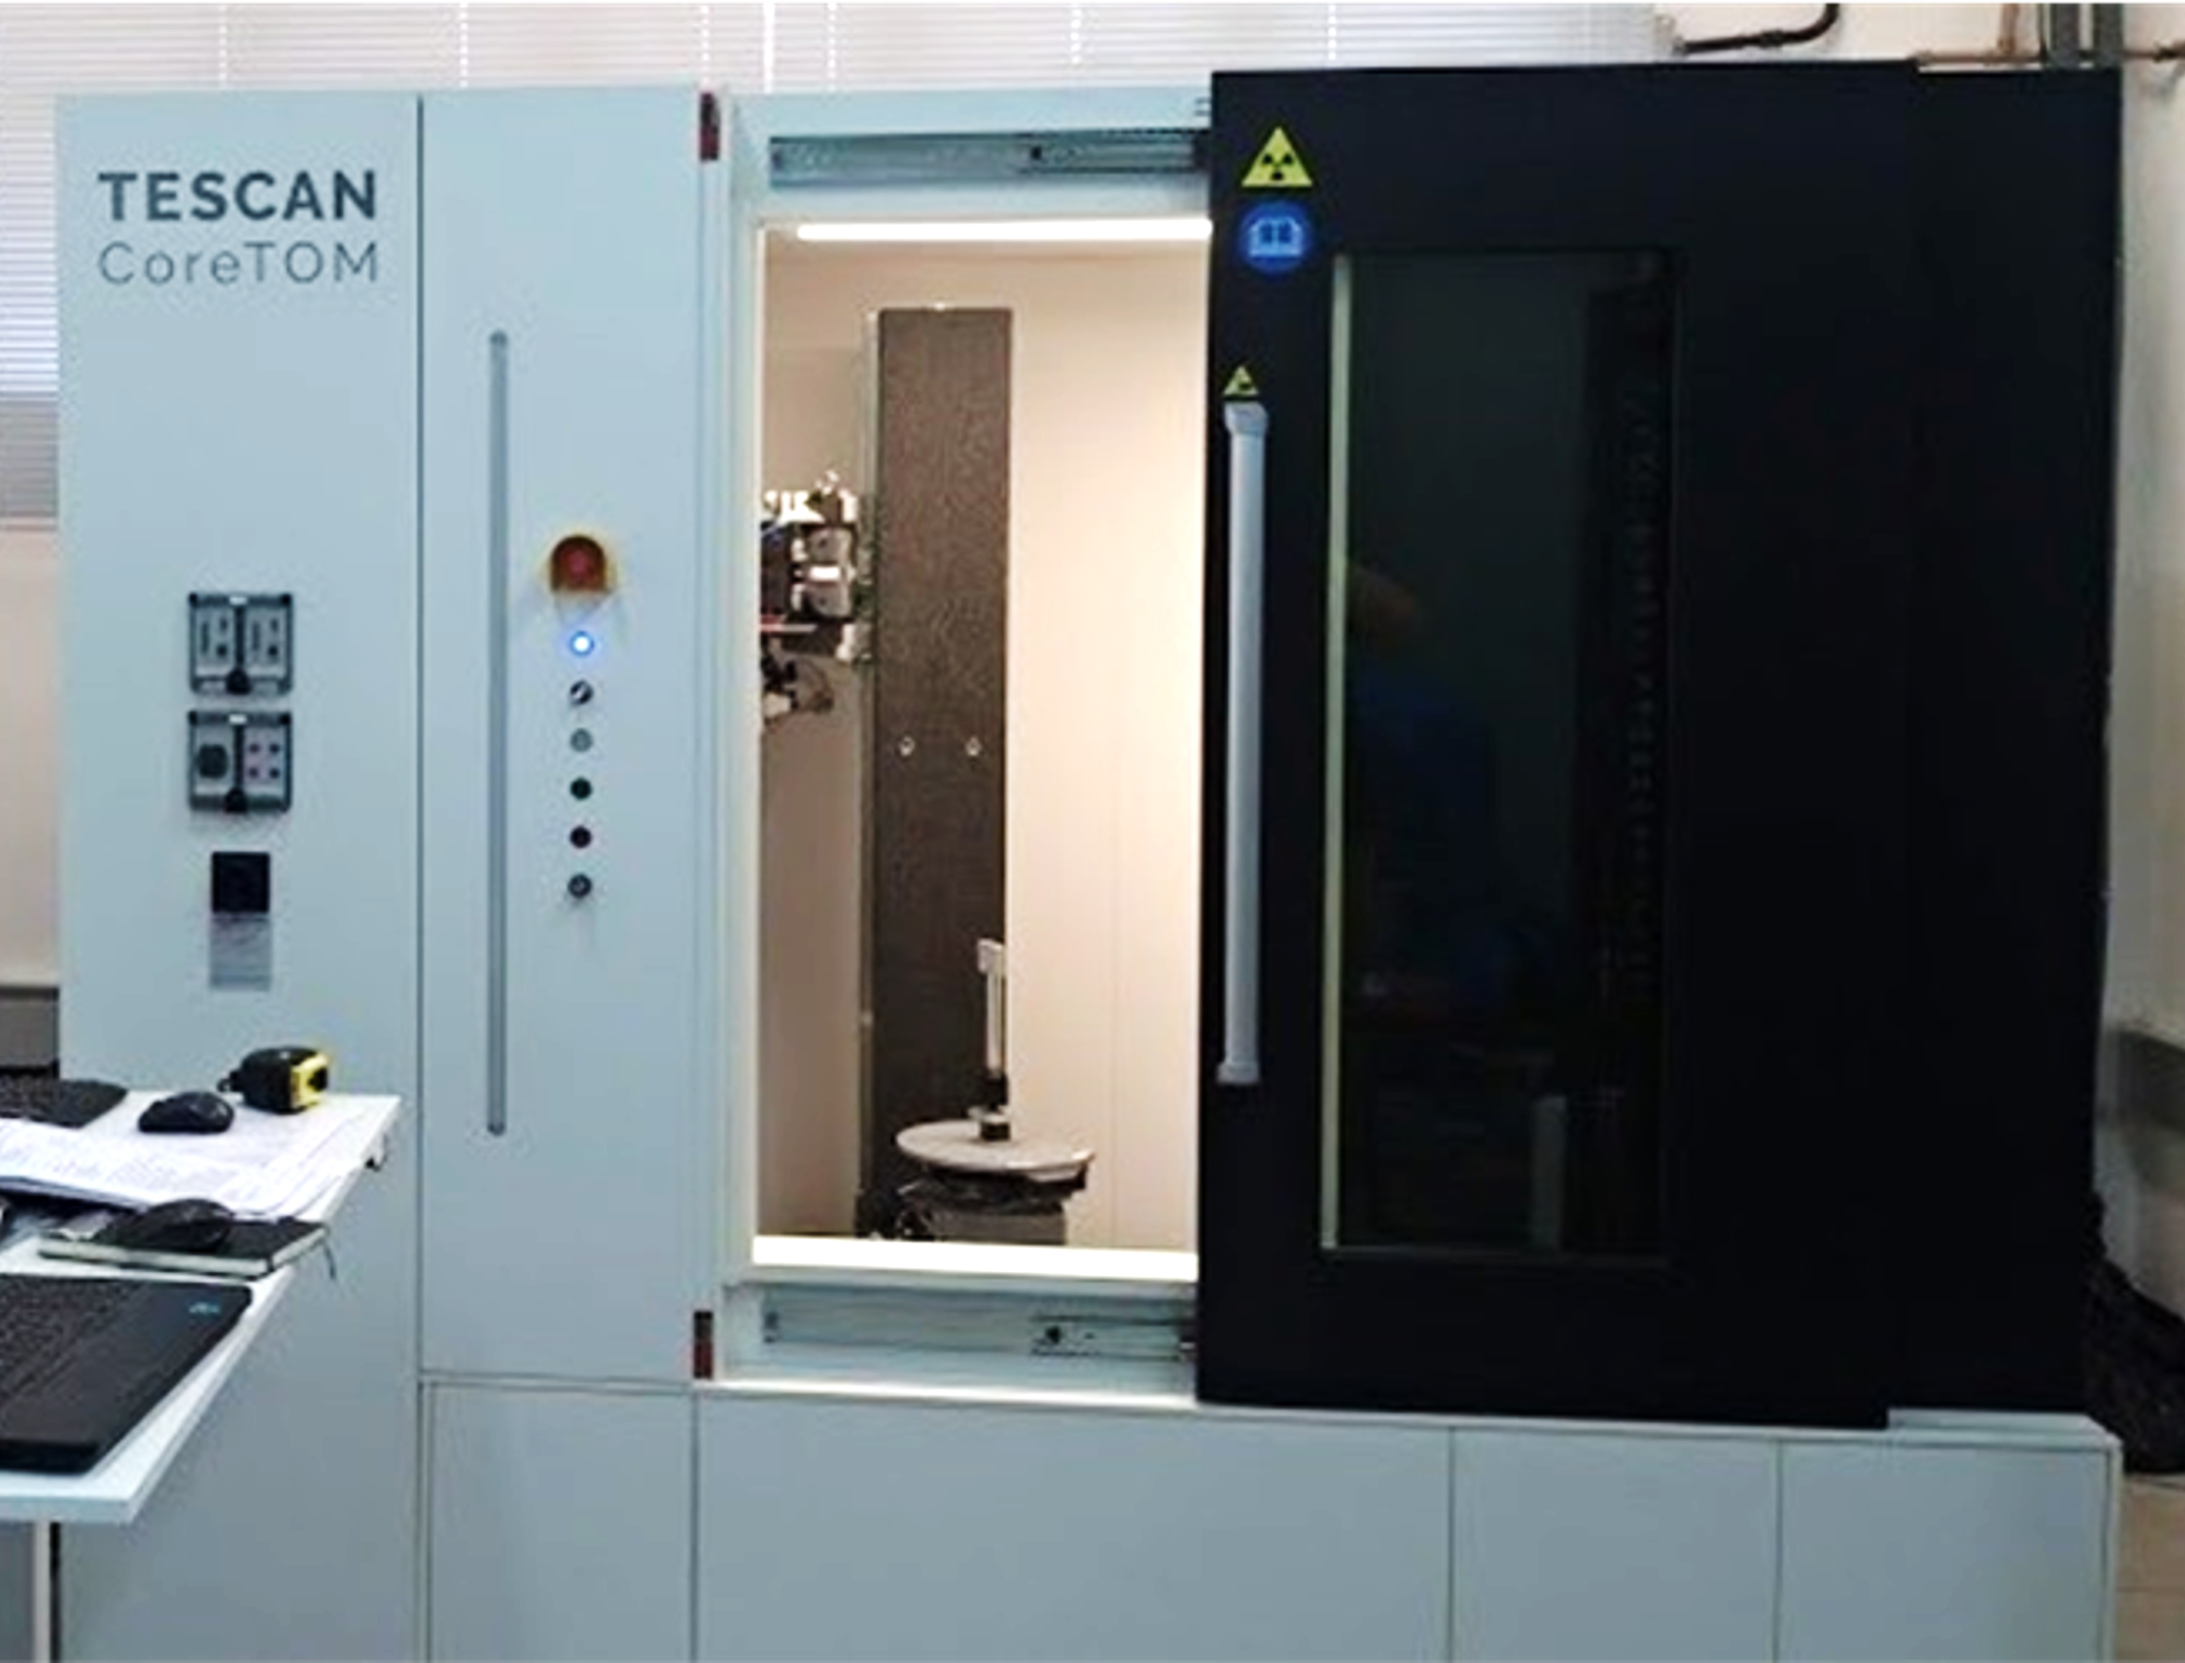
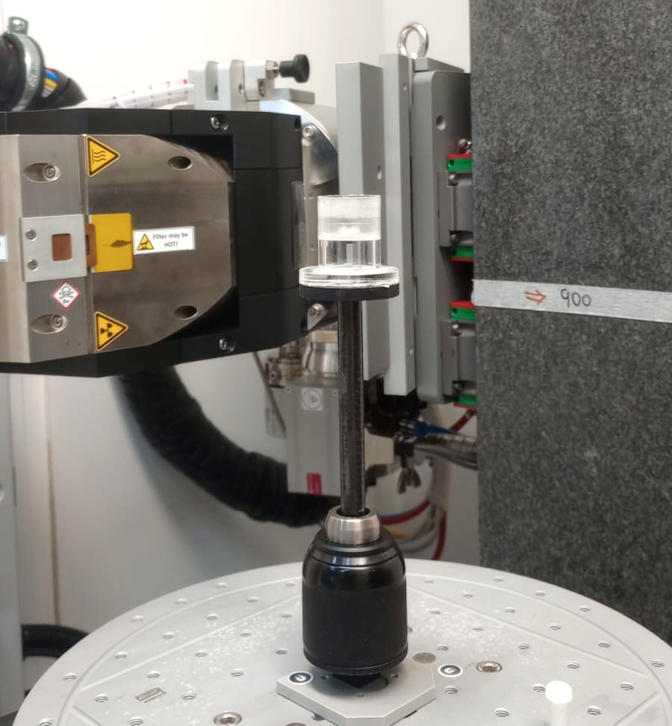
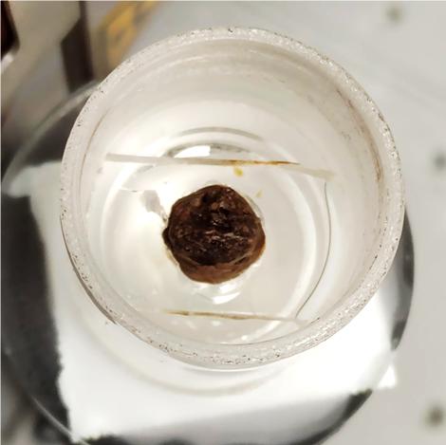
Methodology
18º Annual Conference
X-ray Microtomography
MicroCT scanners enable non-destructive 3D imaging of internal structures, allowing pore-scale analysis from micrometers to millimeters;
Time-lapse imaging was conducted using the CoreTOM system (Tescan/XRE) at a voxel size of 9 µm, resulting in a total of 10 images acquired over 119 hours.
1st contact
During the test
After 119h

Slide 8
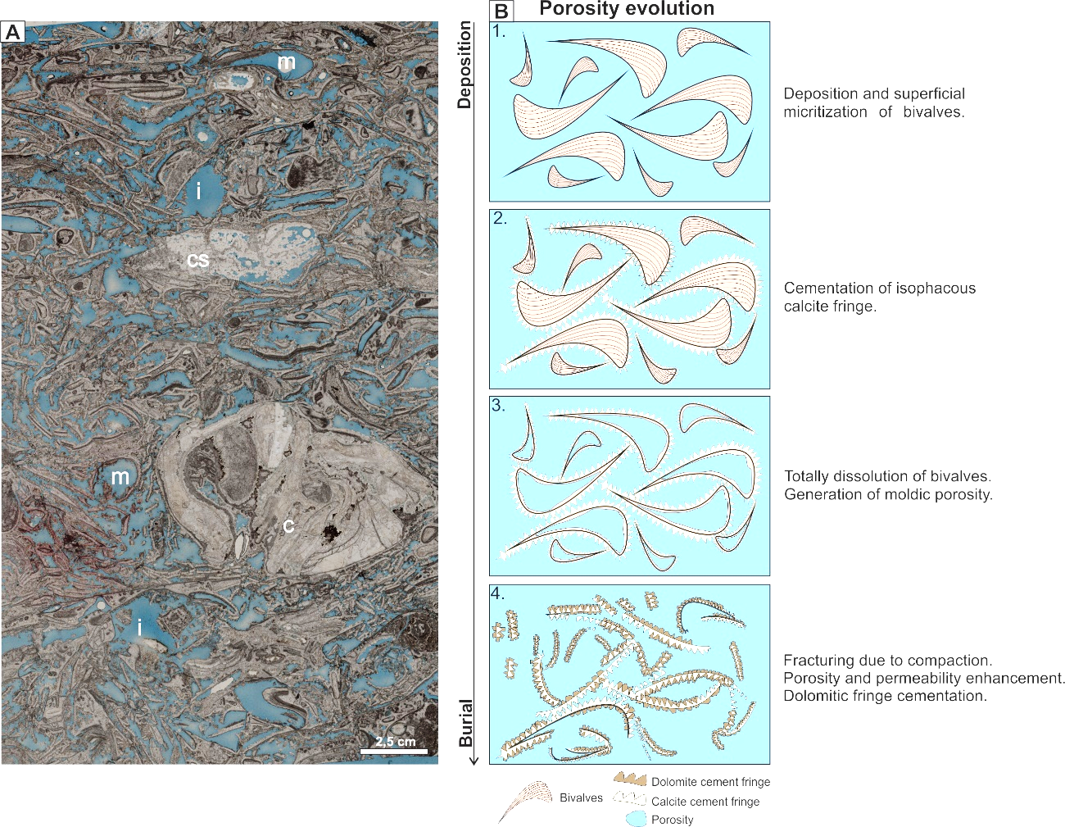
Results
18º Annual Conference
  Porosity evolution (Coquina IF)
Thin-section analysis reveals its compositional constituents, primarily bivalve fragments, coquina clasts (c), silicified coquina clasts (cs), moldic porosity (m), and interparticle porosity (i).
The porosity evolution follows distinct diagenetic stages
1 - Deposition and Micritization
2 – Eodiagenesis
3 – Meteoric Dissolution
4 – Burial Conditions

Slide 9
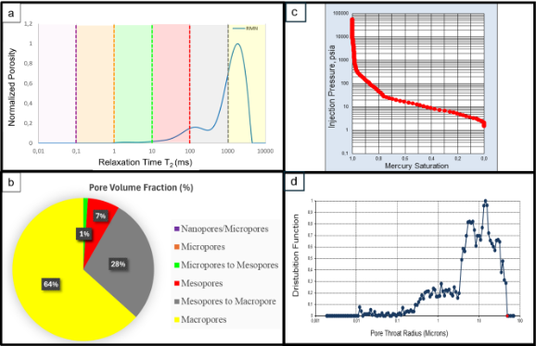
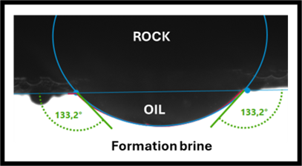
Results
18º Annual Conference
NMR – bimodal distribution
Pore Volume Fraction – 64% of macroporos
Hg Saturation x Injection pressure – 80% of pore throats were intruded with less than 100psi of pressure
The pore radius curve showed a similar shape to the NMR curve. Most of the throats are above 5µm
Oil-wet system

Slide 10
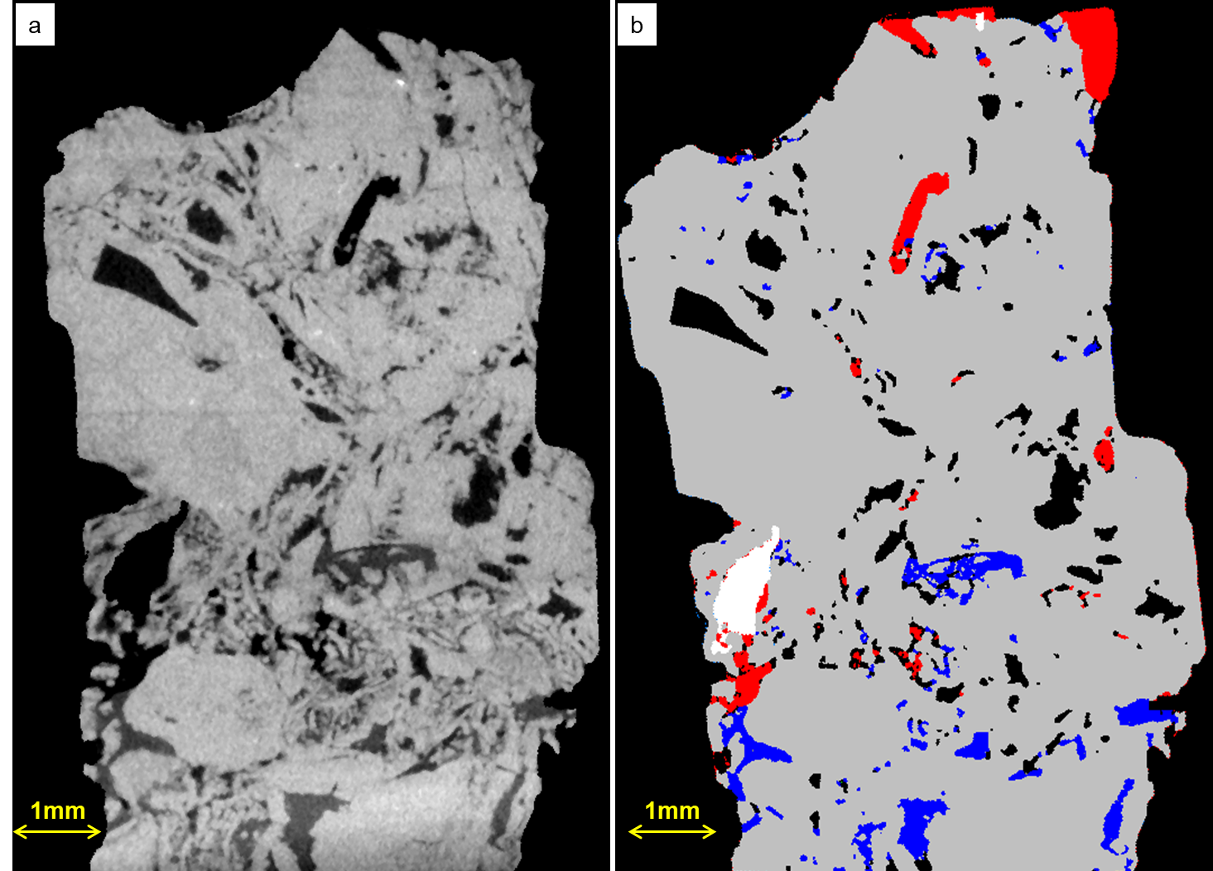
Results
18º Annual Conference
Image
Segmentation
Air
Oil
Brine
Rock

Slide 11
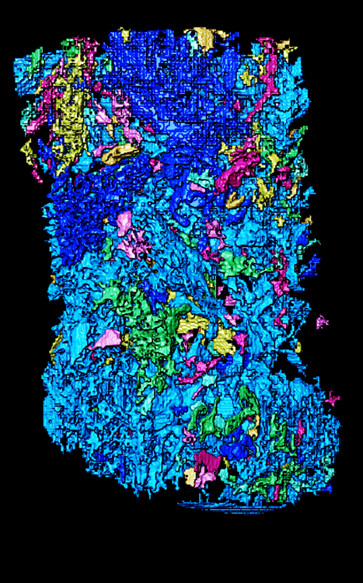
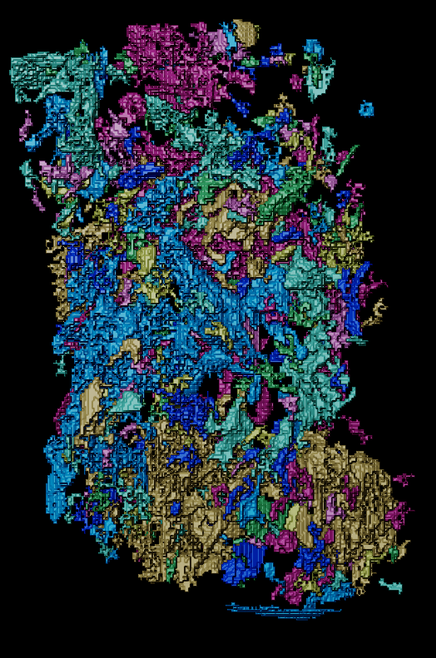
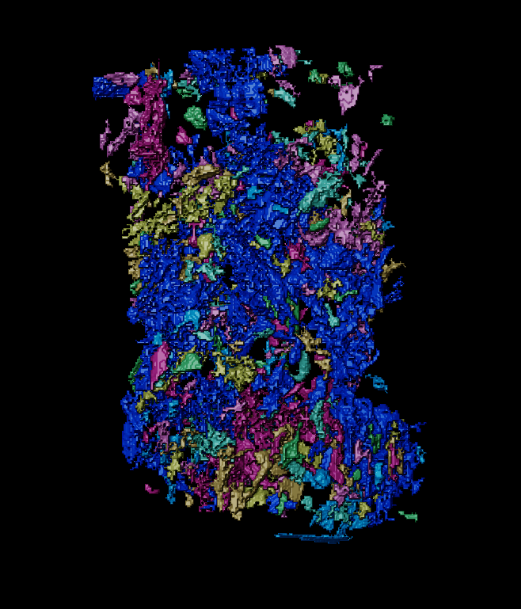
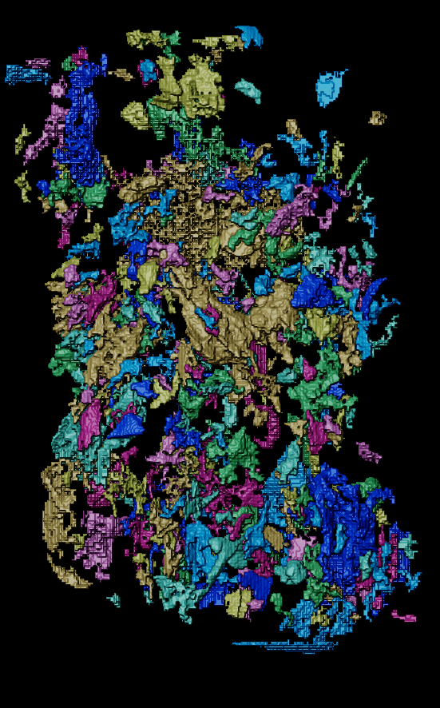
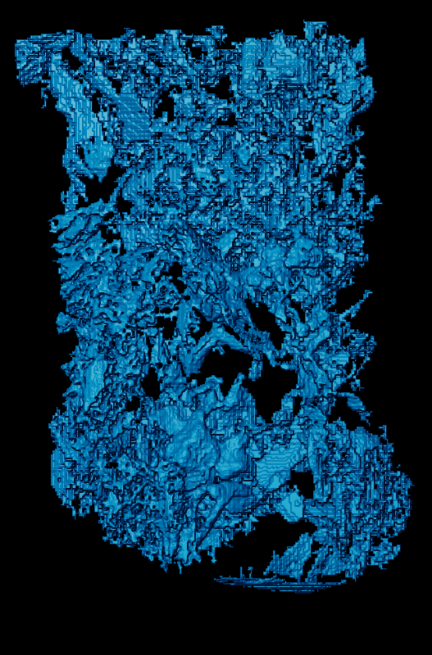
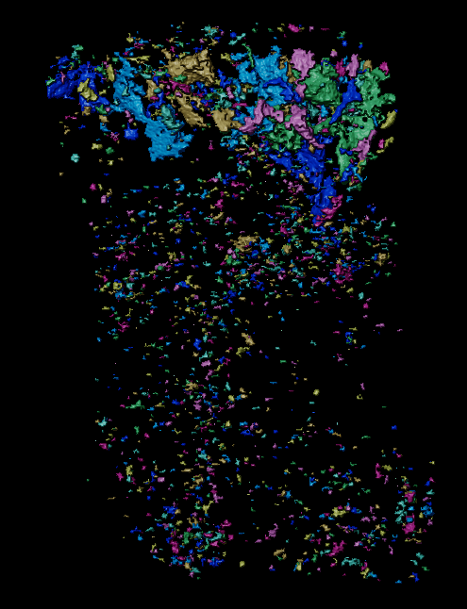
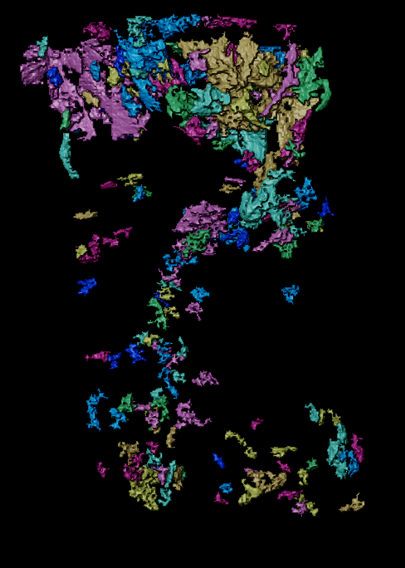
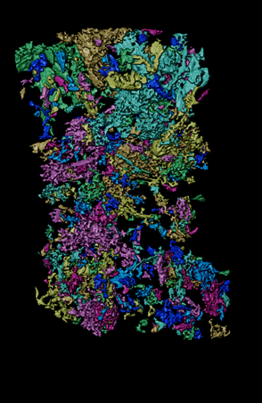
T0
T1 – 20h
T4 – 34h
T5 – 40h
Oil saturation
Oil saturation
Oil saturation
Oil saturation
Oil saturation
Capillarity
Viscous Forces
Capillary Forces
Largest cluster – Oil saturation
Water saturation
Water saturation
Water saturation

Slide 12
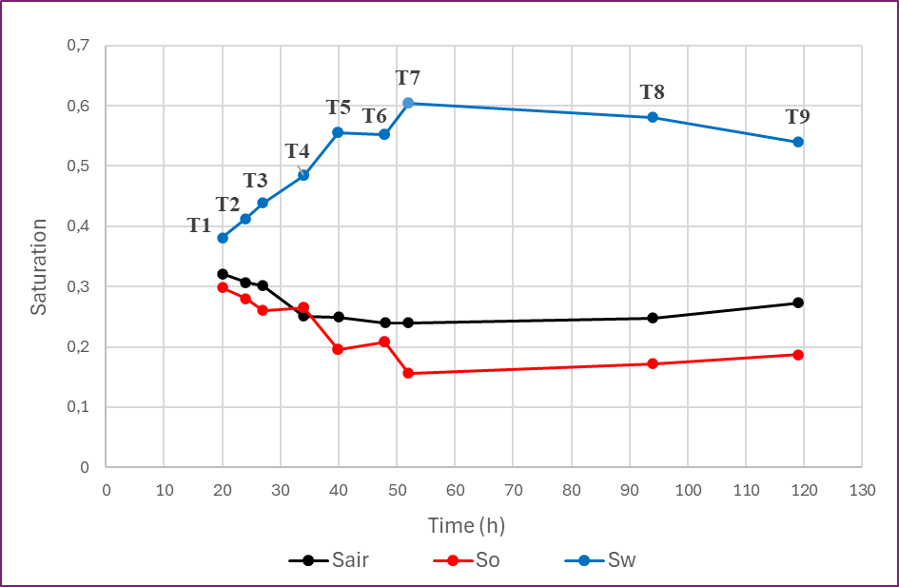
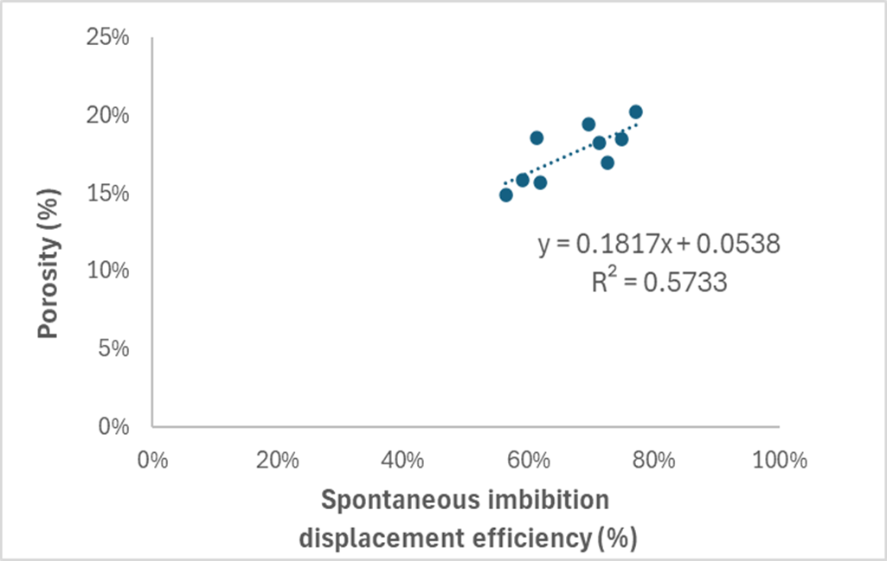
Results
18º Annual Conference

Slide 13
Conclusions
18º Annual Conference
This study investigated spontaneous imbibition in a coquina sample from Brazil's pre-salt reservoir using time-resolved X-ray microtomography. We captured pore-scale fluid displacement and distribution under dry, water-saturated, oil-aged, and recovery brine conditions, providing insights into fluid dynamics in complex carbonate systems.
Contact angle tests validated the wettability changes in oil-aged samples immersed in brine, simulating reservoir restoration
MicroCT imaging at multiple brine contact times revealed early-stage capillary-driven flow, followed by viscous dominance and preferential pathway development. In later stages, capillary forces redistributed fluids within the pore structure.
Oil displacement efficiency was quantified over time, highlighting the role of fluid-rock interactions in progressive oil

Slide 14



Acknoledgements
18º Annual Conference
This research was carried out in association with the ongoing R&D project registered as ANP nº 23020-1, “Análise Experimental da Recuperação Avançada de Petróleo em Reservatórios Carbonáticos do Pré-Sal do Brasil Através de Injeção Alternada de CO2 e Água – Fase II - Condições de Reservatório" (UFRJ/Shell Brasil/ANP), sponsored by Shell Brasil Petróleo Ltda under the ANP R&D levy as “Compromisso de Investimentos com Pesquisa e Desenvolvimento”.

Slide 15




18º Annual Conference
Thank you!
Prof. Maira Lima
maira.lima@petroleo.ufrj.br

