Slide 1
Quantifying Mass Transfer Between Partially-Soluble Fluids in Multiphase Systems
Anna L. Herring¹, Christopher Allison¹, Joe-Sam Nkuah¹
¹Civil and Environmental Engineering; University of Tennessee, Knoxville
Presented to Interpore 2026

Slide 2
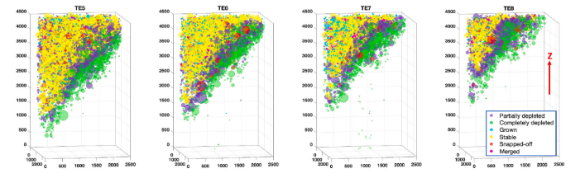
Goals:
Transport of Partially-Soluble Fluids
CO₂, H₂, NAPLs….
Many multiphase imaging experiments are conducted with fluids pre-mixed to acheive mutual solubility and immiscible displacements
In the field, observe significant mass transfer between liquid/gas/supercritical phase and water (both dissolution and evaporation)
Subsequent movement by advection, diffusion, density-driven convection
How to quantify transport in both “pure” fluid phase and in aqueous phase?
Fresh water injection
Huang, R., Herring, A. L., & Sheppard, A. (2023). Investigation of supercritical CO2 mass transfer in porous media using X-ray micro-computed tomography. Advances in Water Resources, 171, 104338. https://doi.org/10.1016/j.advwatres.2022.104338
Interpore 2026

Slide 3
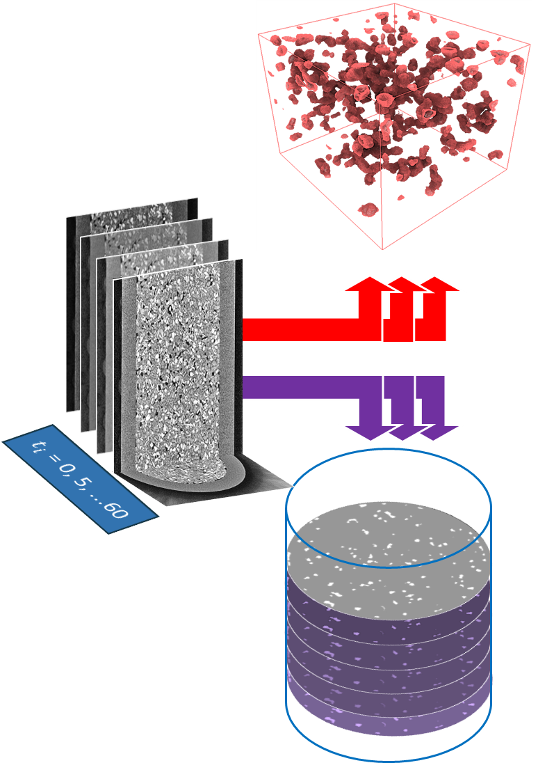
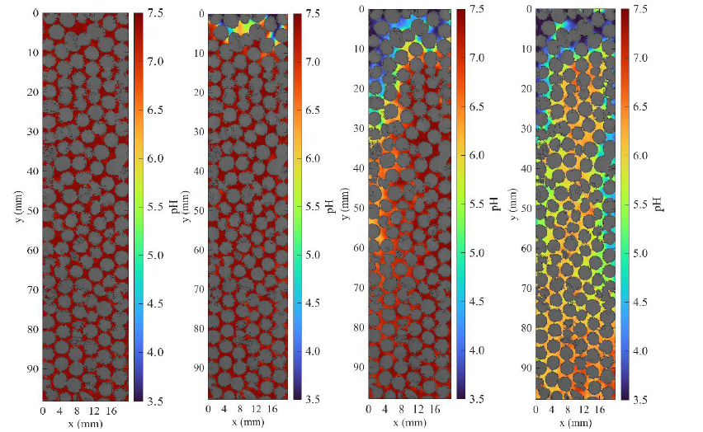
Two approaches we are pursuing
X-ray μCT Studies
Colorimetric Methods
Interpore 2026

Slide 4

Mass Transfer Coefficient and Aqueous Concentration
m = mass
ρ = density
V = volume
t = time
k = mass transfer coefficient
A = interfacial area
C_{sol} = aqueous concentration at the solubility limit
C = aqueous concentration
X-ray μCT Studies
Colorimetric Methods
Measure directly from image sequences, with some assumptions
(time & space resolution)
Measure directly from image sequences with some assumptions (3D → 2D), indicator applicability
Assume constant or estimate
Assume constant or estimate
Key Assumption: What is aqueous phase concentration C?
Interpore 2026

Slide 5
X-ray μCT
Key positive aspects
3D
Compatible with reservoir conditions
Opaque Samples
Key drawbacks
Most solutes of interest do not produce X-ray contrast
Aqueous concentration must be inferred
Interpore 2026

Slide 6
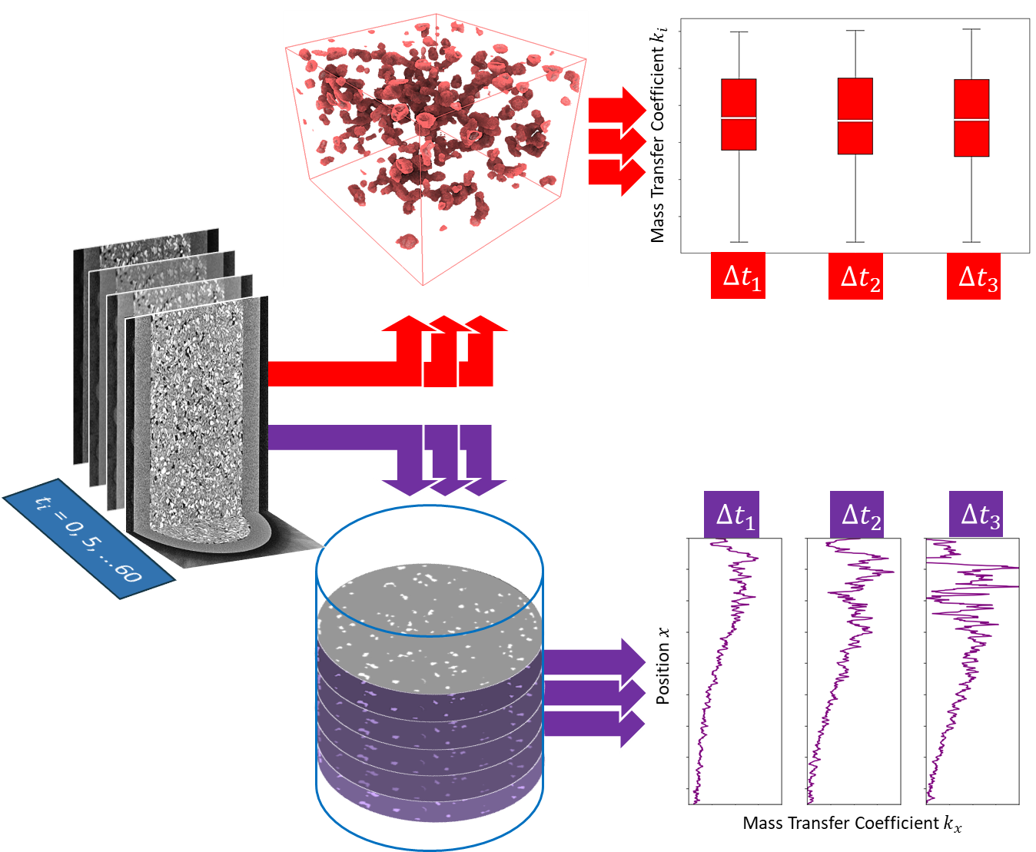
Quantifying the Effect of Assumptions
Key Assumption- What is aqueous phase concentration C?
Huang et al. (2023) identify clusters where safe to assume C=0; calculate k based on those clusters only
Patmonoaji et al. (2017, 2021, 2023) Apply a 1D Advection-Dispersion model to estimate concentration as function of length along core
2023
Allison et al. “Quantifying Injection-Driven Mass Transfer within Porous Media via Time-Elapsed X-ray micro-Computed Tomography.” under review arXiv:2604.07743 [physics.flu-dyn]

Slide 7
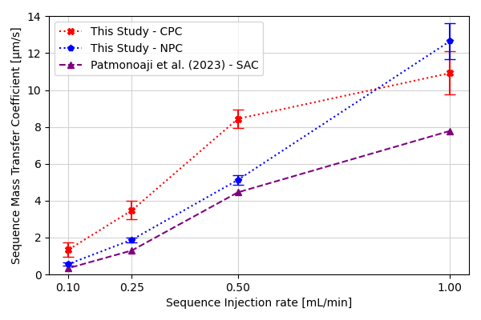
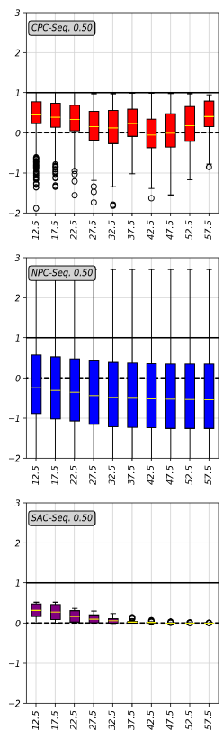
Quantifying the Effect of Assumptions
k_{MT}
three approaches investigated produce similar results
Aqueous Concentration Values
Wide range, variability depending on approach
Normalized H₂(aq) Concentration [-]
Allison et al. “Quantifying Injection-Driven Mass Transfer within Porous Media via Time-Elapsed X-ray micro-Computed Tomography.” under review arXiv:2604.07743 [physics.flu-dyn]

Slide 8
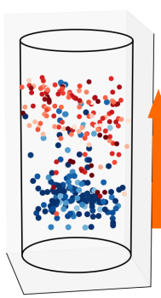

Surprising impact of cluster remobilization
Multiple systems evidence cluster displacement during “dissolution” flow
Huang et al., Investigation of Supercritical CO₂ Mass Transfer in Porous Media Using X-Ray Micro-Computed Tomography, Adv. Water Resour. 171, 104338 (2023).
Lv et al., CO₂-Brine Mass Transfer Patterns and Interface Dynamics under Geological Storage Conditions, Int. J. Heat Mass Transf. 222, (2024).
Now: Patmonoaji et al., Dissolution Mass Transfer of Trapped Gases in Porous Media: A Correlation of Sherwood, Reynolds, and Schmidt Numbers, Int. J. Heat Mass Transf. 205, 123860 (2023).
Mobilization can bias estimates of
Mass Transfer
Allison et al. “Quantifying Injection-Driven Mass Transfer within Porous Media via Time-Elapsed X-ray micro-Computed Tomography.” under review arXiv:2604.07743 [physics.flu-dyn]

Slide 9
Surprising impact of cluster remobilization
Excludes Data with Mobilization
Includes Data with Mobilization
Includes Data with Mobilization
Positive mass transfer at bottom balanced by negative mass transfer at top – mathematically works out
(in this case)
Allison et al. “Quantifying Injection-Driven Mass Transfer within Porous Media via Time-Elapsed X-ray micro-Computed Tomography.” under review arXiv:2604.07743 [physics.flu-dyn]

Slide 10
Aqueous concentration estimates do not agree, but they are providing estimates on different geometrical bases
Patmonoaji et al.
(2017, 2021, 2023)
1D Advection-Dispersion
Cross sectional average
Huang et al. (2023) Concentrations directly adjacent to gas bubbles
Allison et al. “Quantifying Injection-Driven Mass Transfer within Porous Media via Time-Elapsed X-ray micro-Computed Tomography.” under review arXiv:2604.07743 [physics.flu-dyn]

Slide 11
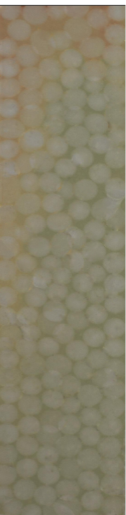
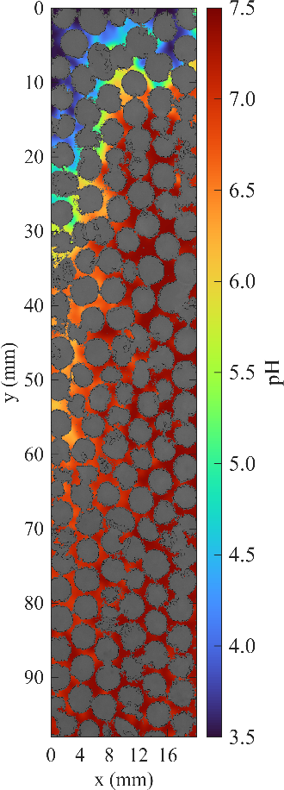
Colorimetric Quantification
Key positive aspects
Accessible
“Direct” measurement of concentration
Key drawbacks
2D or quasi-2D
Color is a vector rather than a scalar – quantification is tricky
Nkuah et al. “Spatial Colorimetric Mapping of pH and Dissolved Carbon during Convective Dissolution of CO₂: Constraints from Domain, Geometry, and Indicator Mix on Measurement Reliability”. In prep.

Slide 12
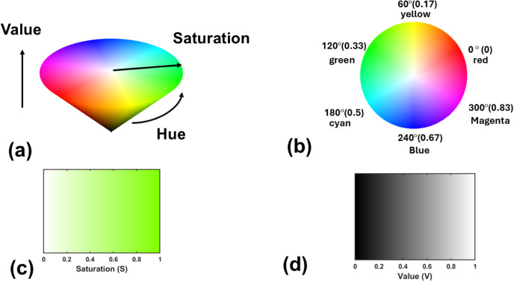
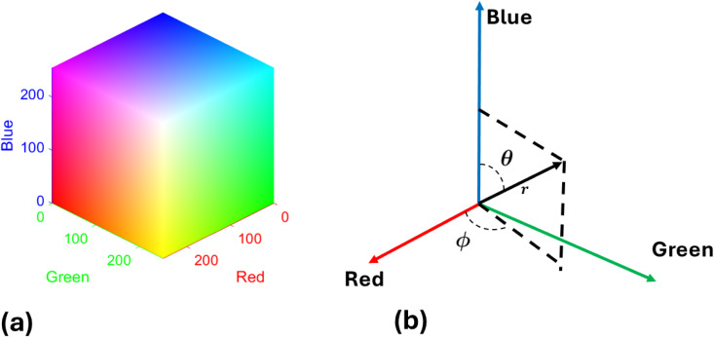


Colorimetric Quantification
Y. Xu, M. Moura, E. G. Flekkøy, and K. J. Måløy, Advances in Water Resources A Comparison of Different Image Analysis Techniques for Mapping Spatiotemporal PH and Carbon Dissolution in Density-Driven Convection of CO₂ in Water, Adv. Water Resour. 212, 105296 (2026).
Different Color Quantification Schemes
$$θ−φ$$
$$H−S−V$$
Notes:
[1]

Slide 13
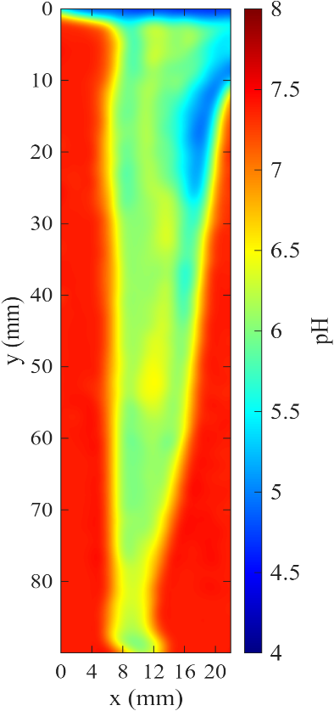
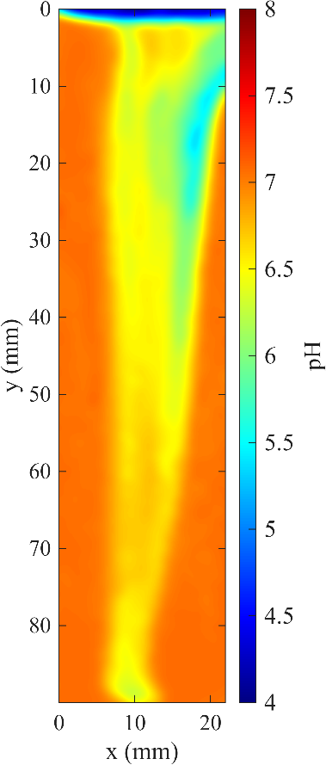
Choice of quantification scheme can impact results For pH indicators, errors propagate and amplify to concentration estimates
Nkuah et al. “Spatial Colorimetric Mapping of pH and Dissolved Carbon during Convective Dissolution of CO₂: Constraints from Domain, Geometry, and Indicator Mix on Measurement Reliability”. In prep.
RGB
HSV

Slide 14

Conclusions
Allison et al. “Quantifying Injection-Driven Mass Transfer within Porous Media via Time-Elapsed X-ray micro-Computed Tomography.” under review arXiv:2604.07743 [physics.flu-dyn]
How is CO₂ invasion into heterogeneities affected by partial solubility?
R. Huang, A. Herring, M. Saadatfar, and A. Sheppard, Impact of Heterogeneity and Miscibility on scCO₂ Drainage Flow Patterns and Implications for Experimental Interpretation, Water Resour. Res. 61, (2025).
X-ray µCT provides relatively robust estimates of mass transfer coefficient k in 3D
Regardless of quantitative approach
Ganglia / bubble remobilization impacts statistics- interpret with care
Aqueous concentrations still a challenge
Other methods – colorimetric – promising
Require precise calibration + quantification
Thank You!
This material is based upon work supported by the U.S. Department of Energy, Office of Science, Office of Basic Energy Sciences, Geosciences program under Award Number DE-SC0025400.
Interpore 2026

