Slide 1


Optimal transport metrics Analyzing variability in experimental images and simulations
Jakub Both and Olav Folkvord, Trygve Tegnander, Enrico Facca, Martin Fernø, Jan Martin Nordbotten University of Bergen InterPore 2026, Nantes, May 2026

Slide 2
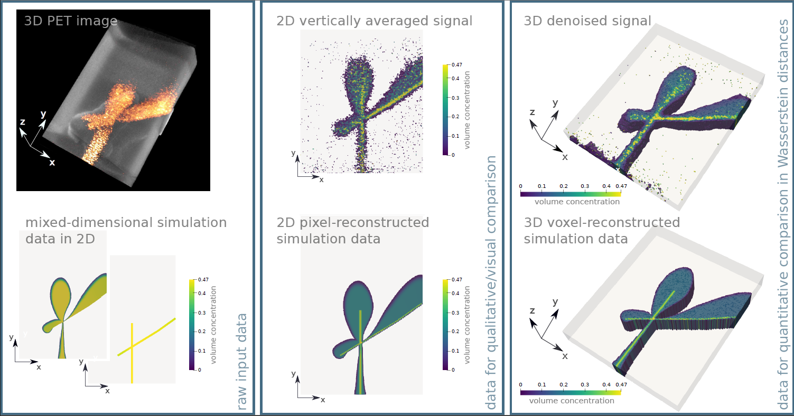
Data-model mismatch = ?
Model validation for transport in fractured media
=?
Both, Brattekås, Keilegavlen, Fernø, Nordbotten, High-fidelity experimental model verification for flow in fractured porous media, InterPore Journal 2024

Slide 3
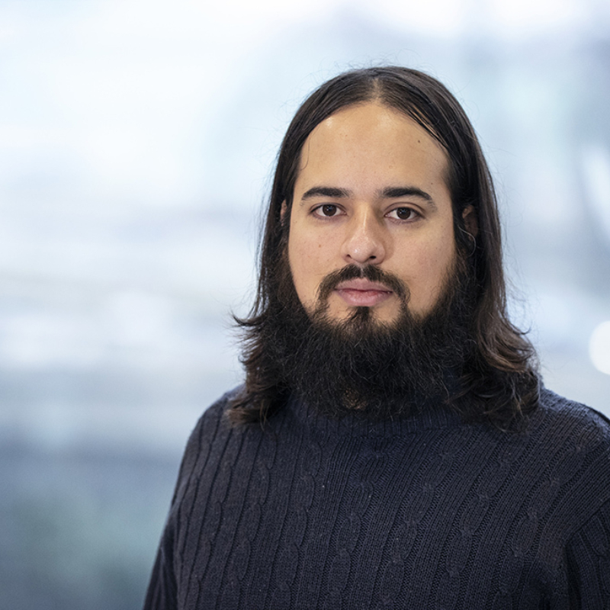
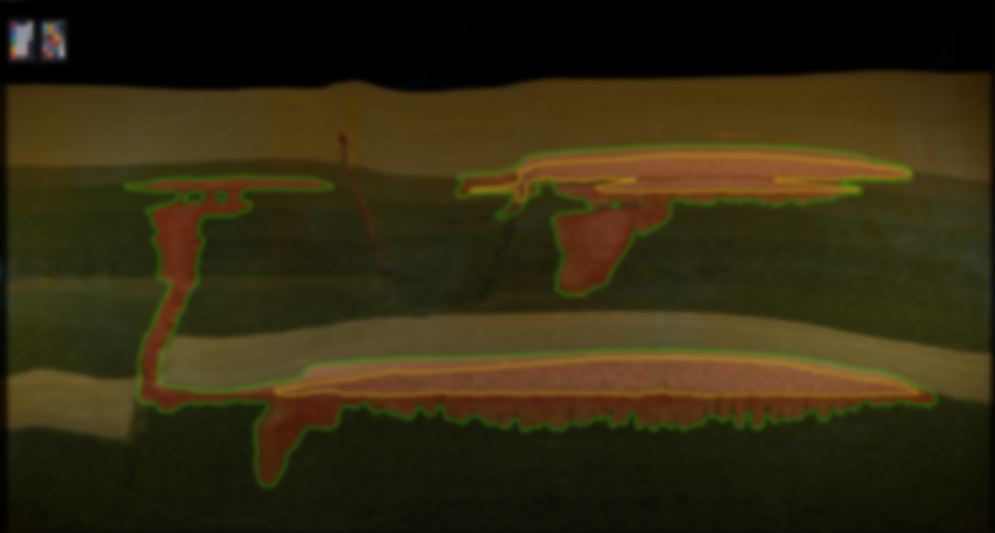
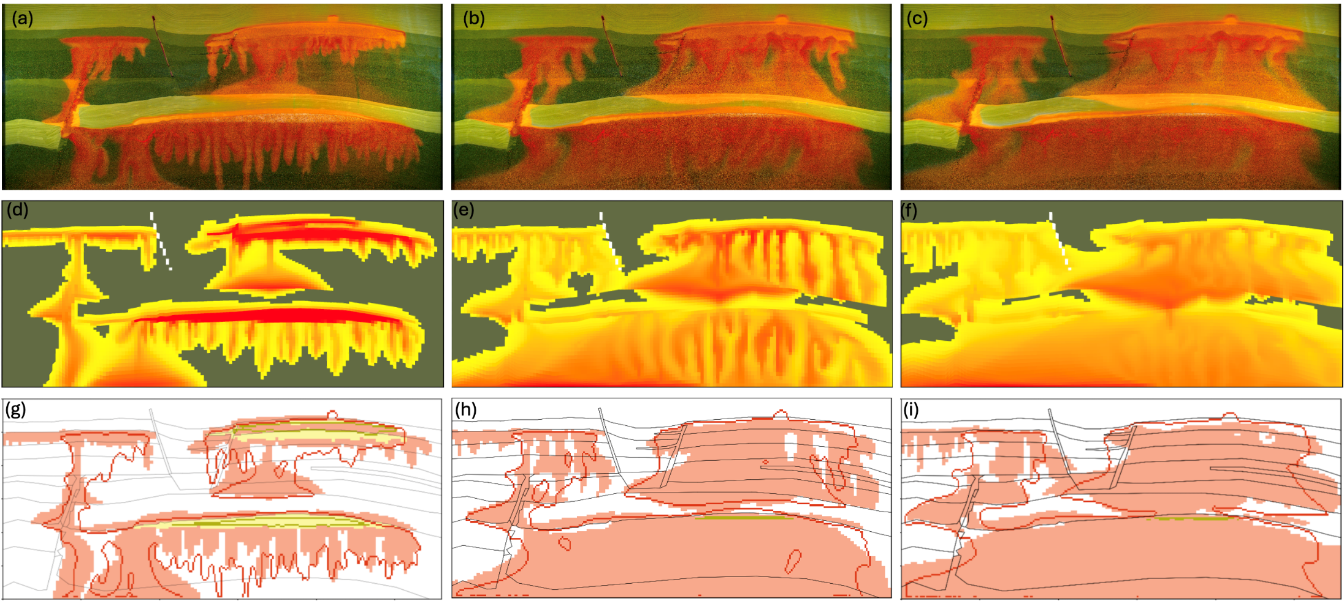

Data-model mismatch = ?
Image-based history matching for meter-scale CO₂ storage
Landa-Marbán, D., T. H. Sandve, J. W. Both, J. M. Nordbotten, S. E. Gasda, Performance of an open-source image-based history matching framework for CO2 storage, Transport in Porous Media, 2026.
Notes:
The experiment is hard to hindcast.
Using the metrics

Slide 4
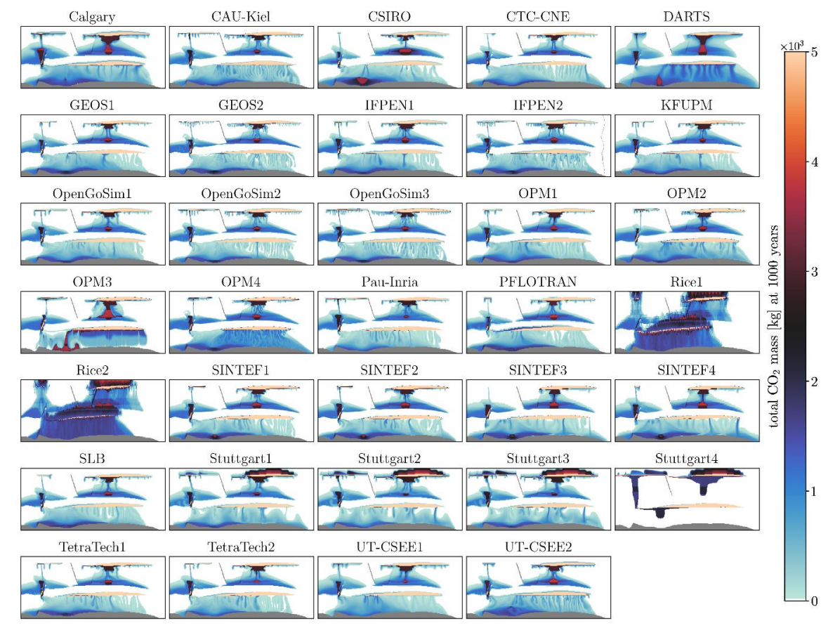
Model-model mismatch = ?
Model comparison for reservoir-scale simulations

Slide 5
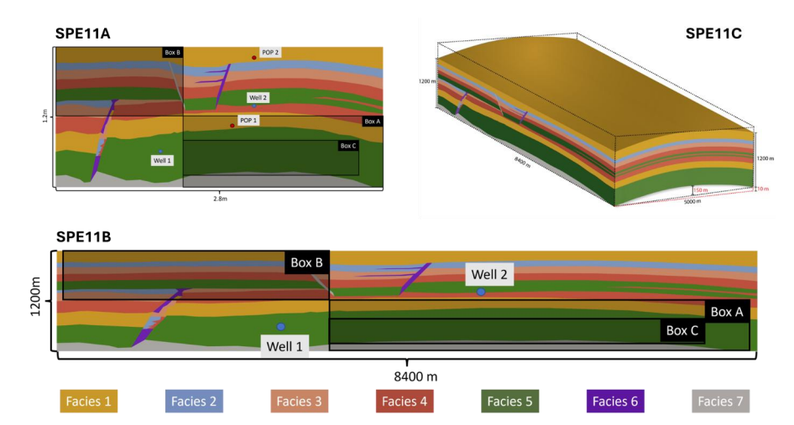
SPE11 data analysis
Comparison without a ground truth
34 submissions
SPE11 cases
Nordbotten, Fernø, Flemisch, Kovscek, Lie, Both, Møyner, Sandve et al (2025)

Slide 6
Example data

Slide 7
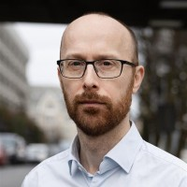
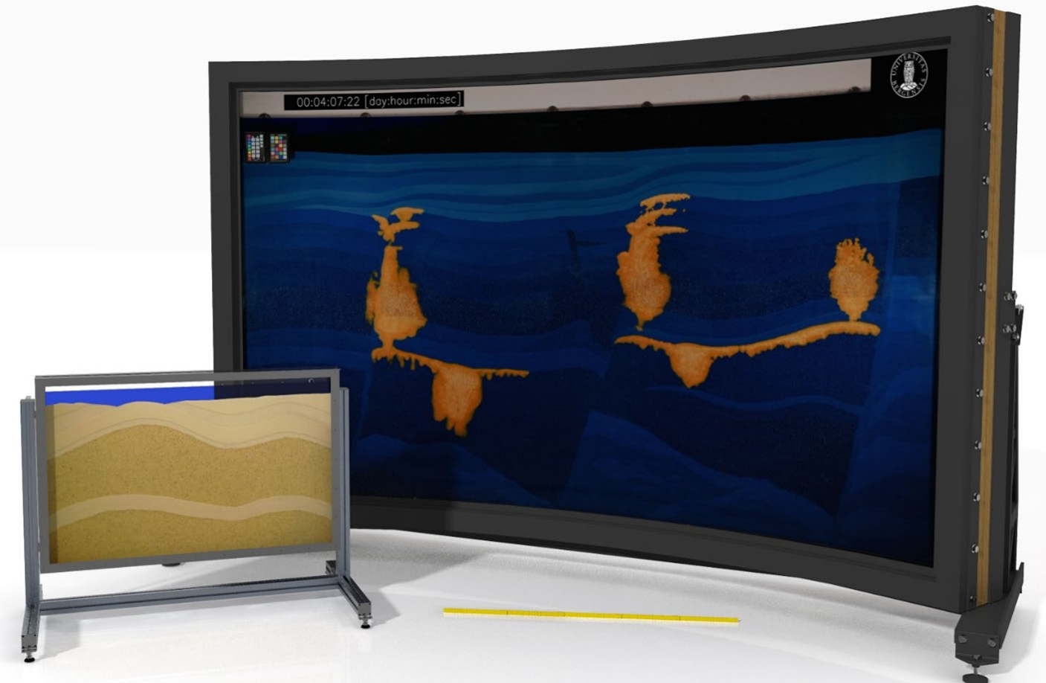
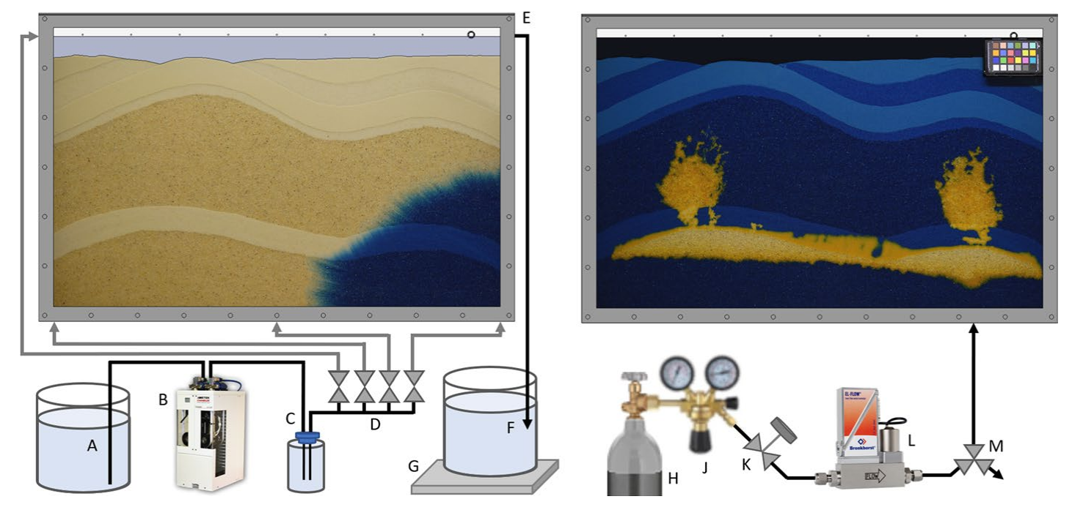
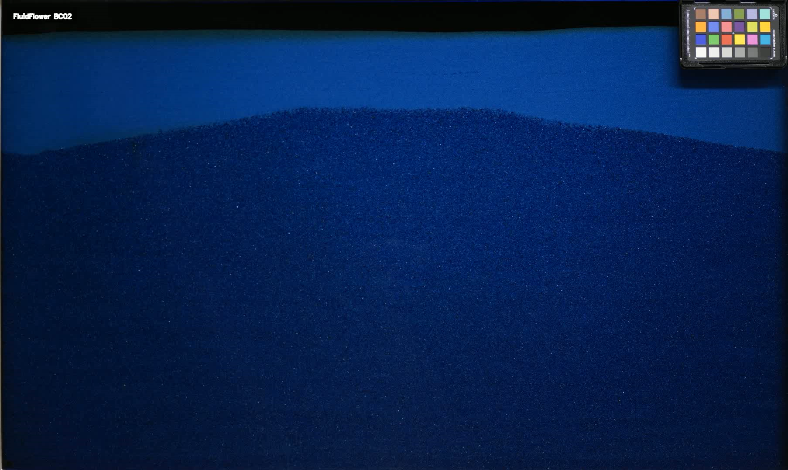
Meso-scale CO₂ storage experiments The FluidFlower concept
Eikehaug et al., Engineering meter-scale porous media flow experiments for quantitative studies of geological carbon sequestration, TiPM (2024) Fernø et al., Room-scale CO2 injections in a physical reservoir model with faults, TiPM (2024)
Nordbotten et al., DarSIA: An open-source Python toolbox for two-scale image processing of dynamics in porous media, TiPM (2024)
Notes:
Can we perform quantitative CCUS research?

Slide 8
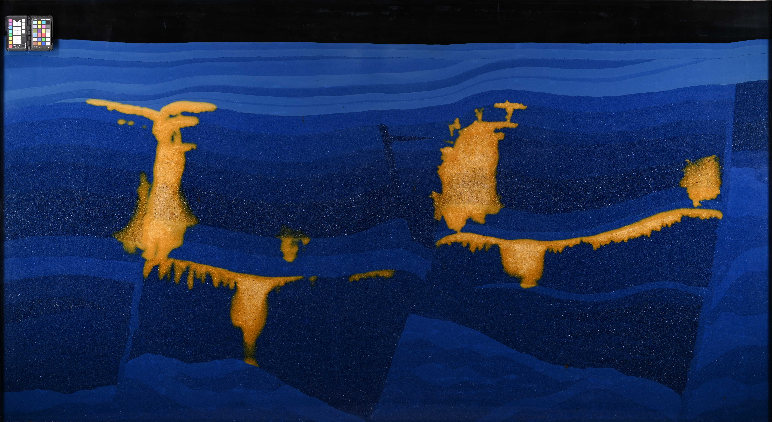
Access to meter-scale quantitative CCS research

Slide 9
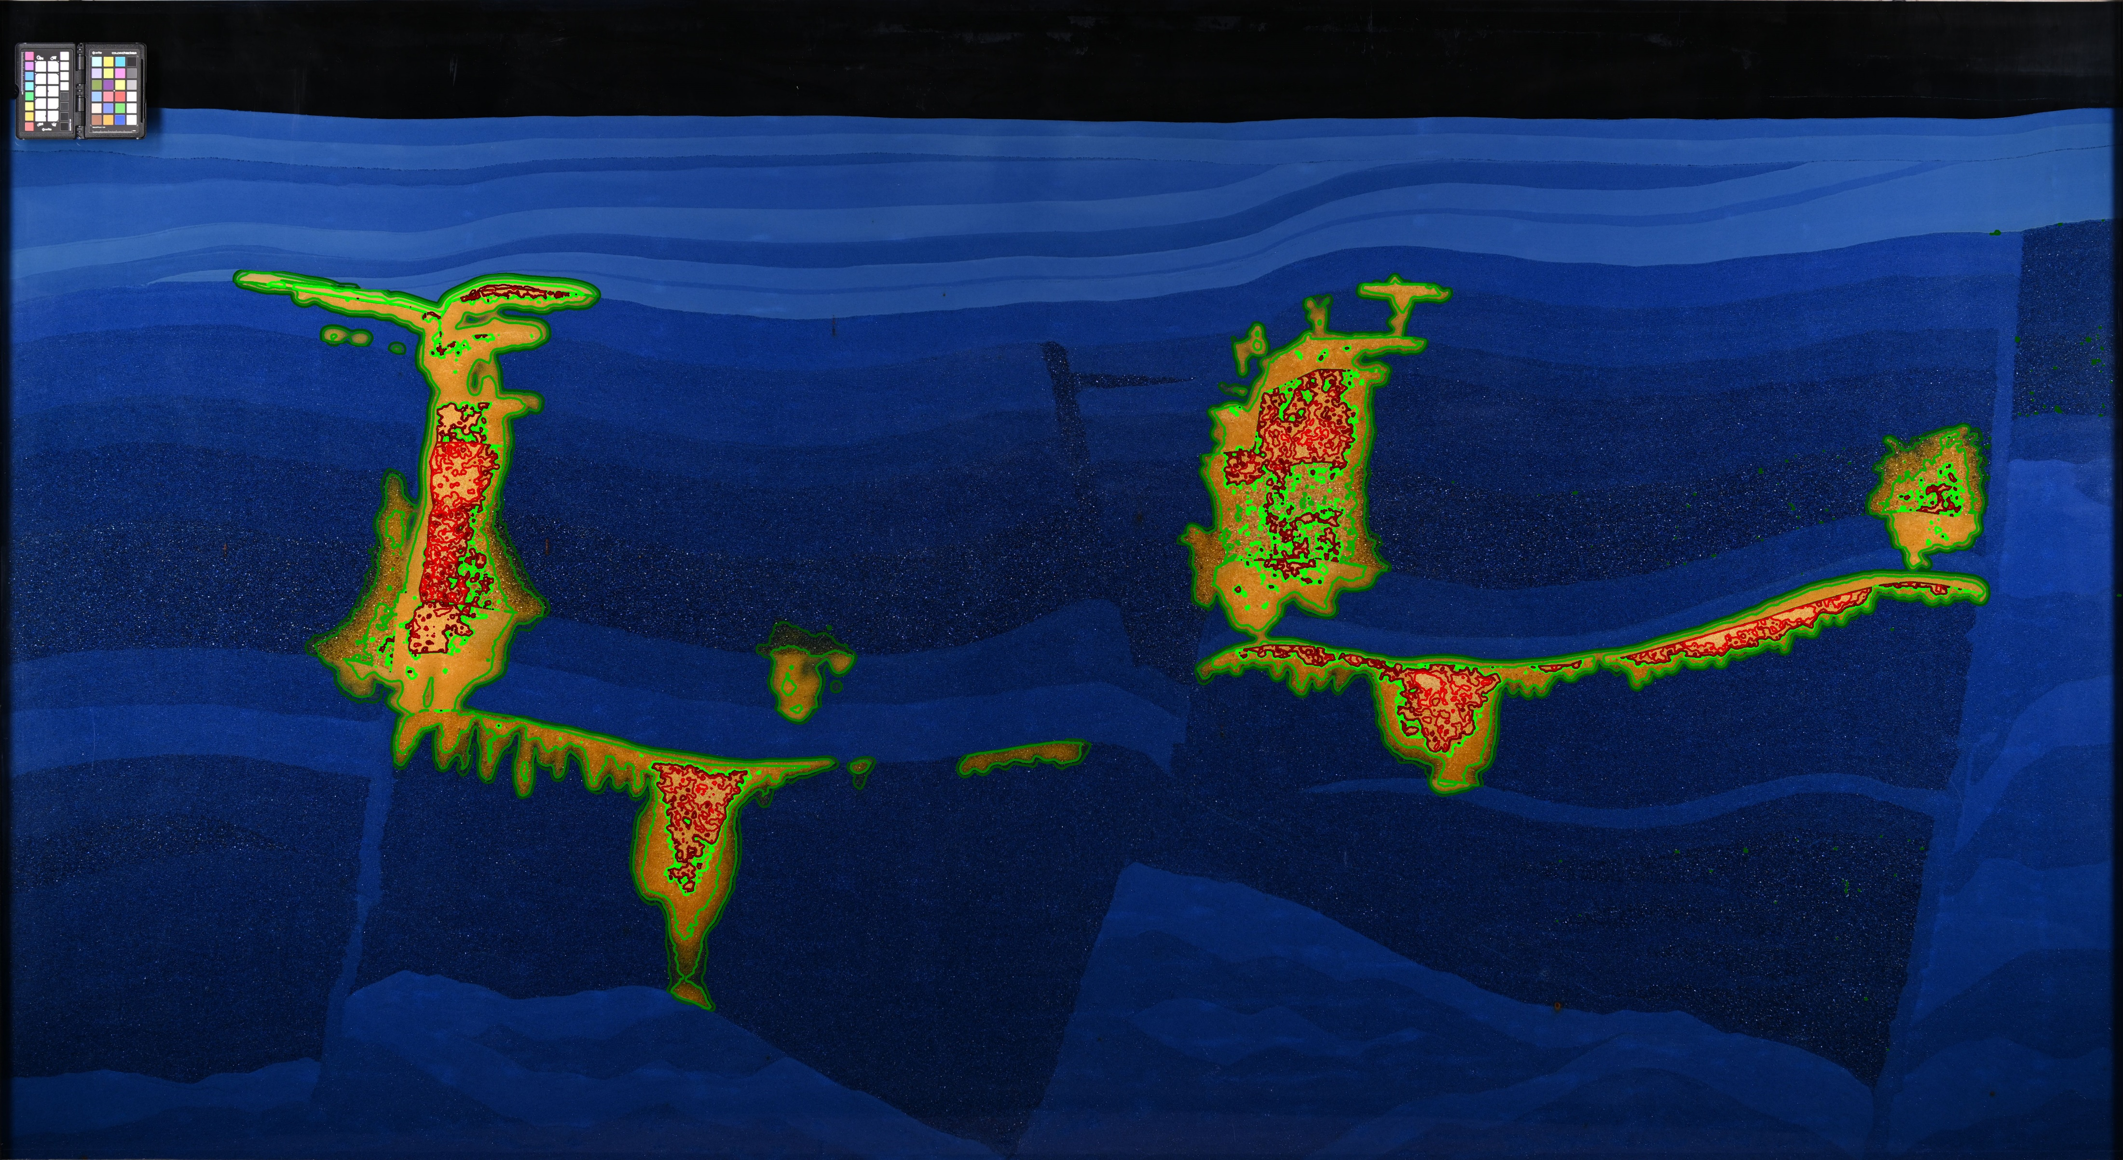
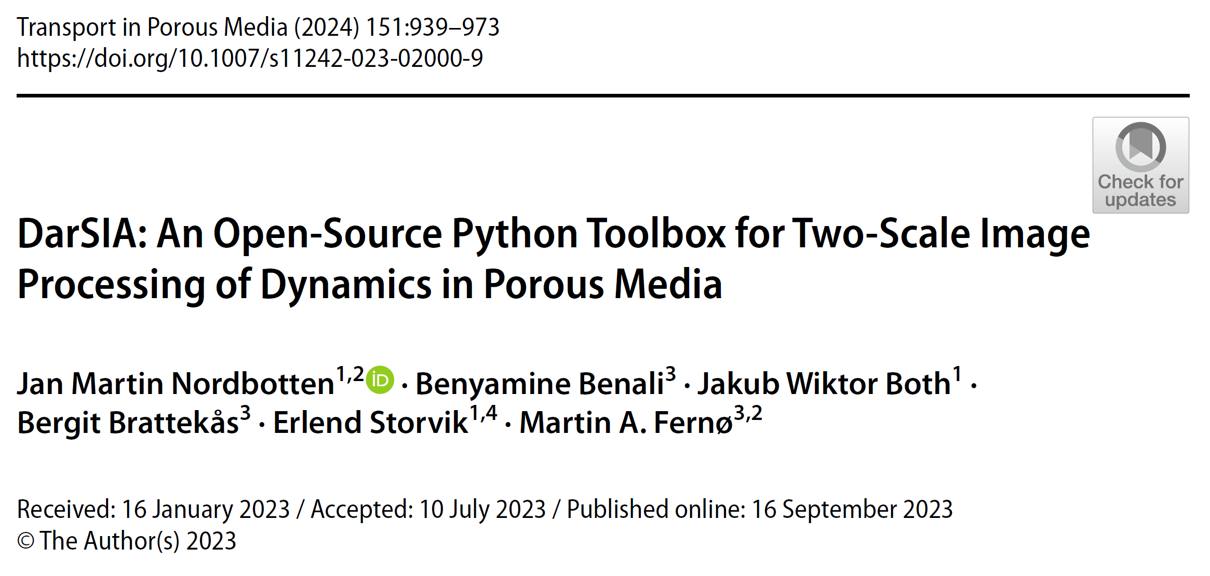
Access to meter-scale quantitative CCS research

Slide 10

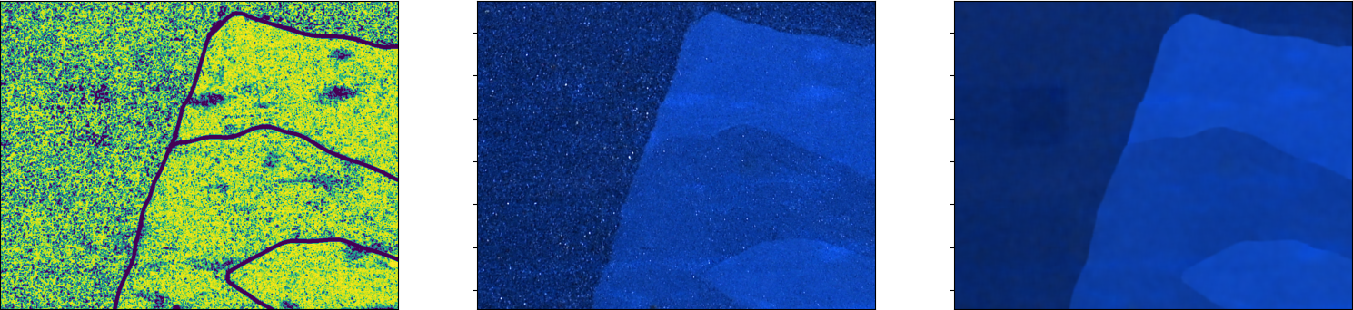
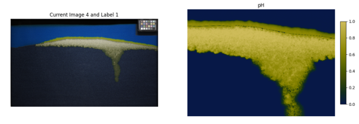
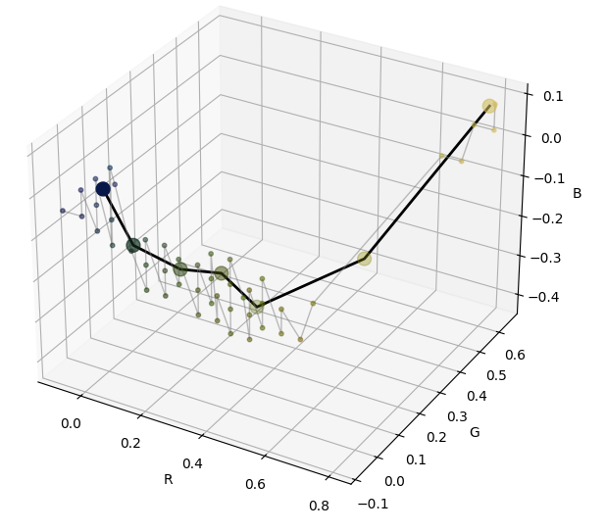
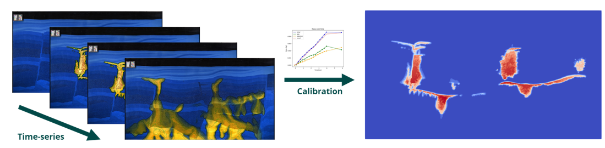
Design principles in image analysis
Multiscale nature| grains and facies
Colorimetry | from colors to signals
Calibration | mass, saturations, concentrations

Slide 11
Wasserstein distance A tool for comparing distributions

Slide 12
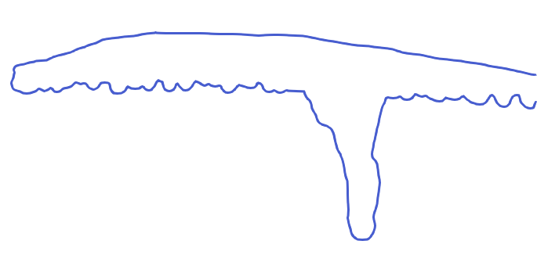
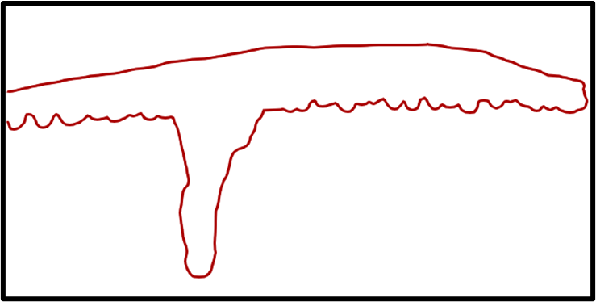
When features matter Link to Optimal transport
vs
Wishlist:
Quantify spatial closeness
Sensitive to perturbations
Allow for integrating physical information

Slide 13
When features matter Optimal transport for Darcy-scale dense data comparison

Slide 14
When features matter Optimal transport for Darcy-scale dense data comparison
Low perm

Slide 15
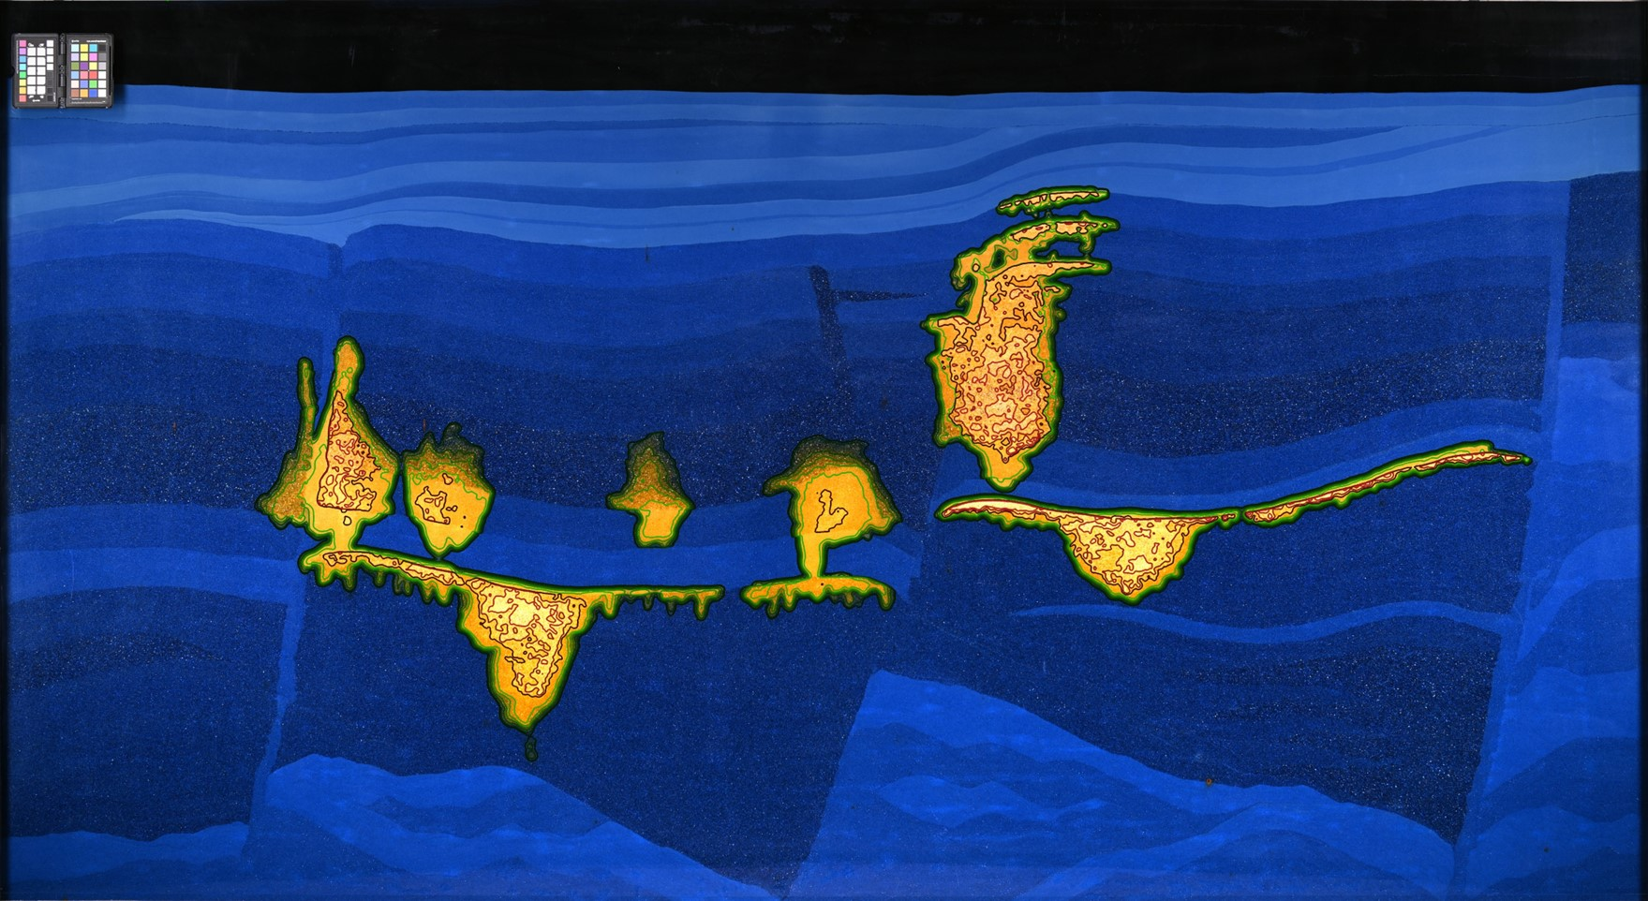
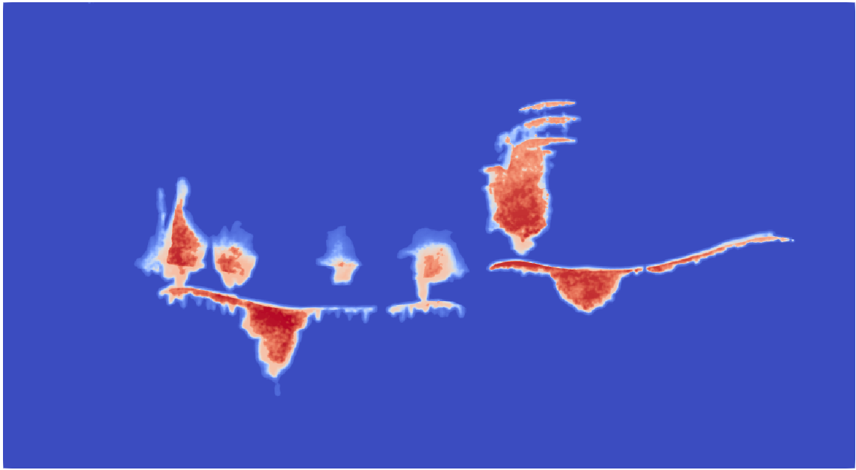
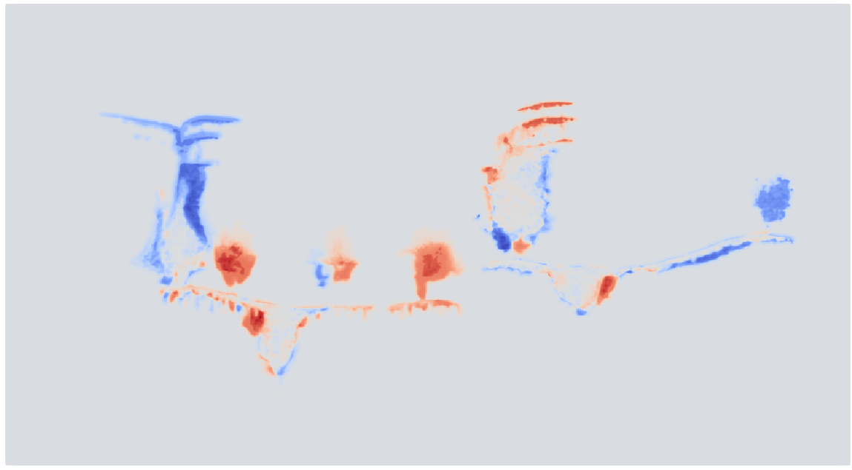
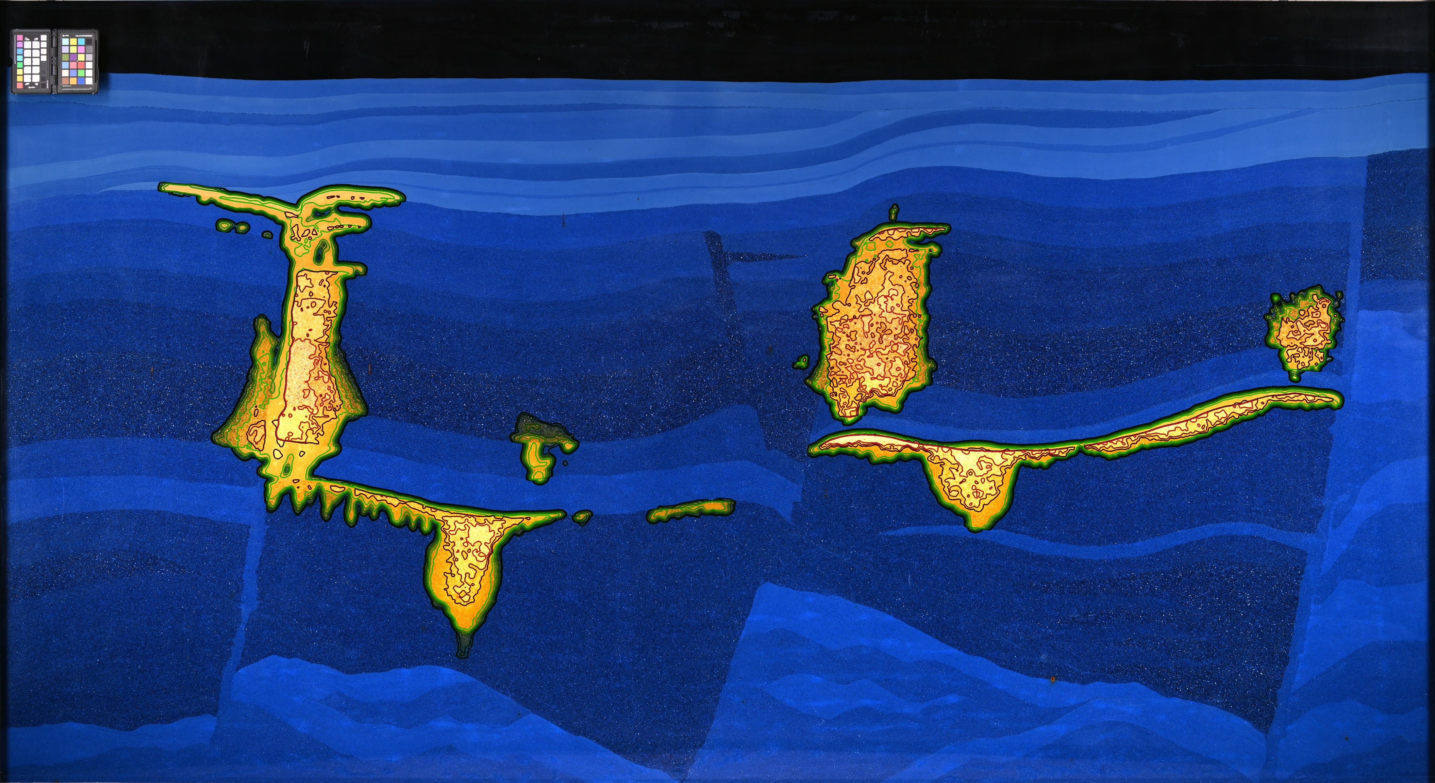
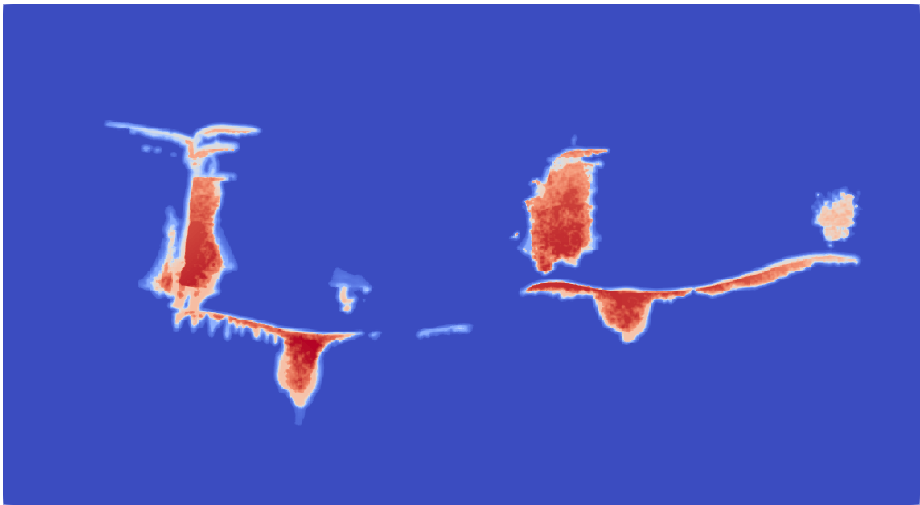
Darcy scale data comparison of two experimental runs
CO₂ density difference
Run A
Run A – CO₂ mass
Run A vs B
Run B
Run B – CO₂ mass
Require objective metric to measure similarity between experiments (across runs and time)
Measuring mass overlap vs difference [kg] does not capture spatial closeness …

Slide 16
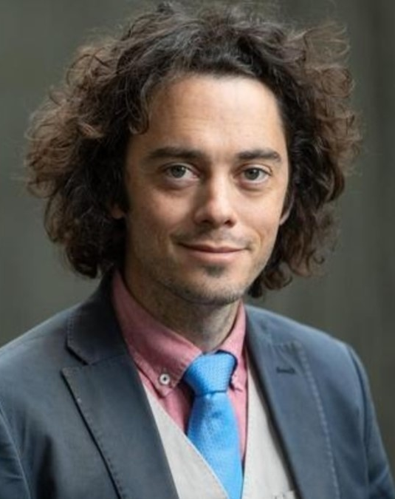
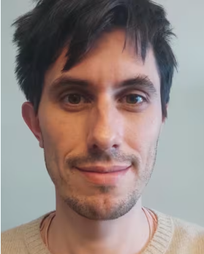
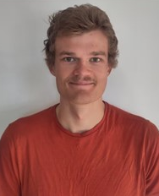
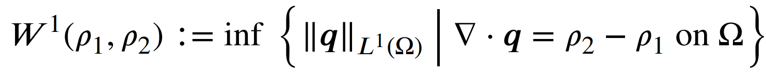

Wasserstein distance
Geometry-aware image registration of conserved transported quantities
Wasserstein distance:
Notes:
Wasserstein distance (L1 optimal transport metric) in 2D and 3D
Mass conservative finite volume approximation + efficient iterative solution

Slide 17
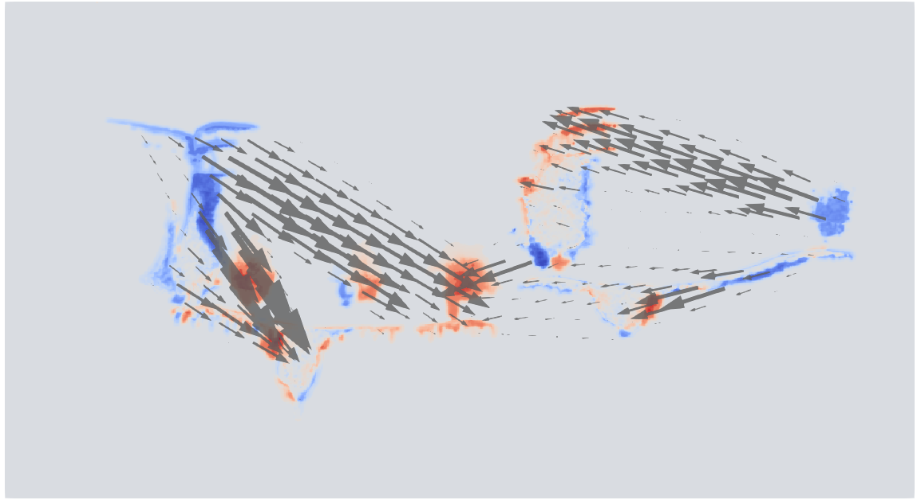
Wasserstein distance
Geometry-aware image registration of conserved transported quantities
Wasserstein distance:

Slide 18
Applications

Slide 19
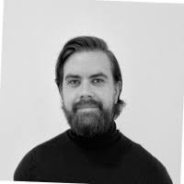
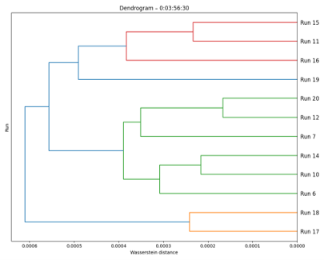
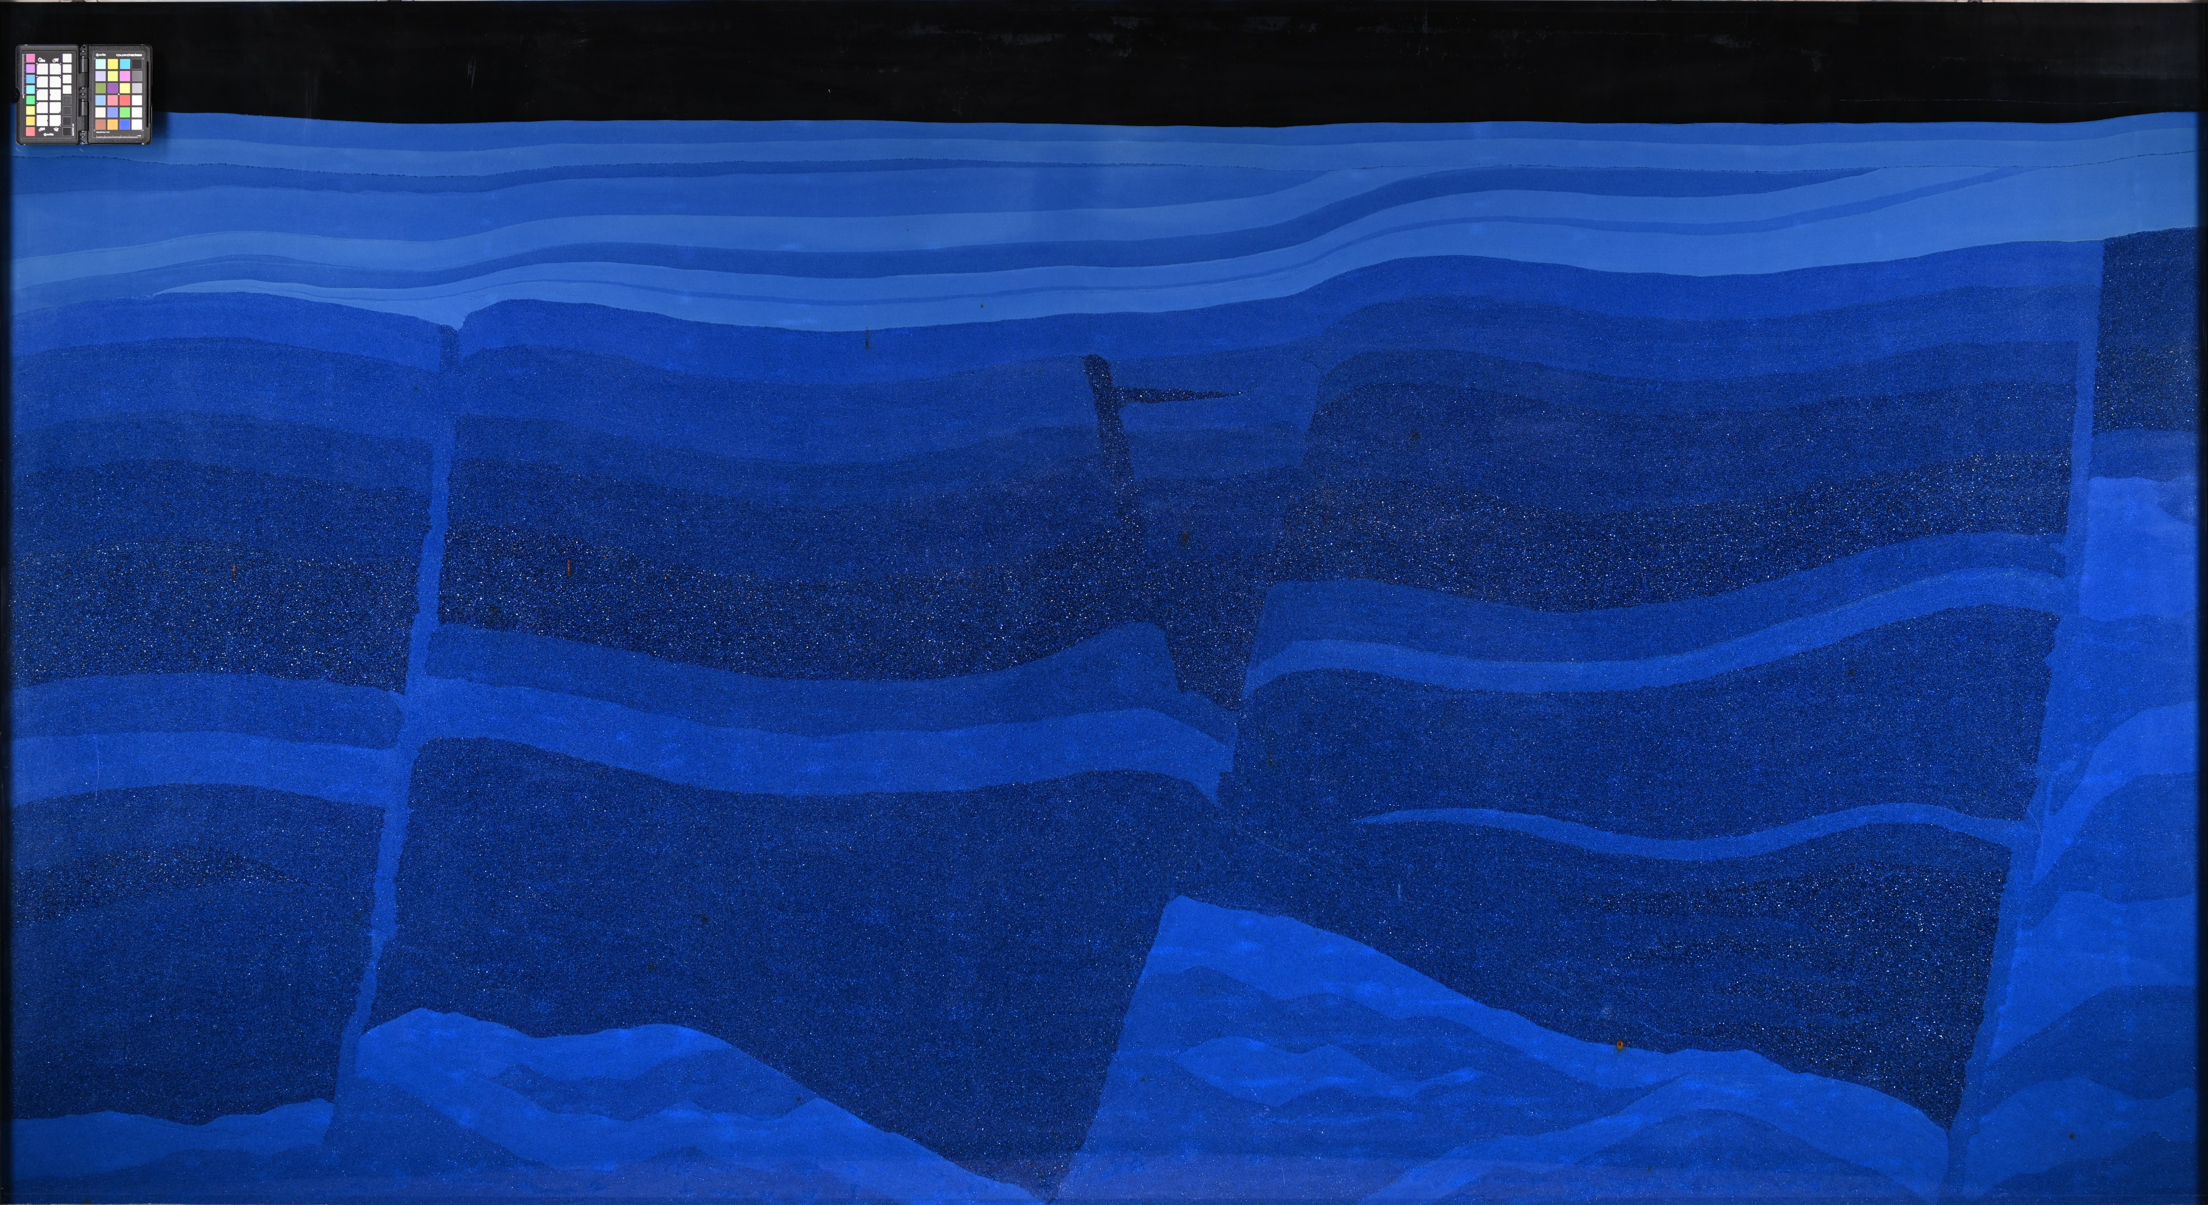
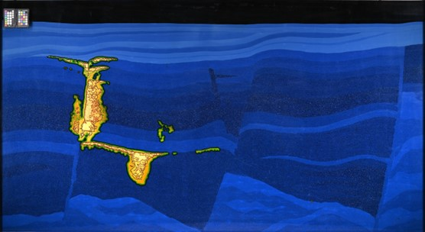
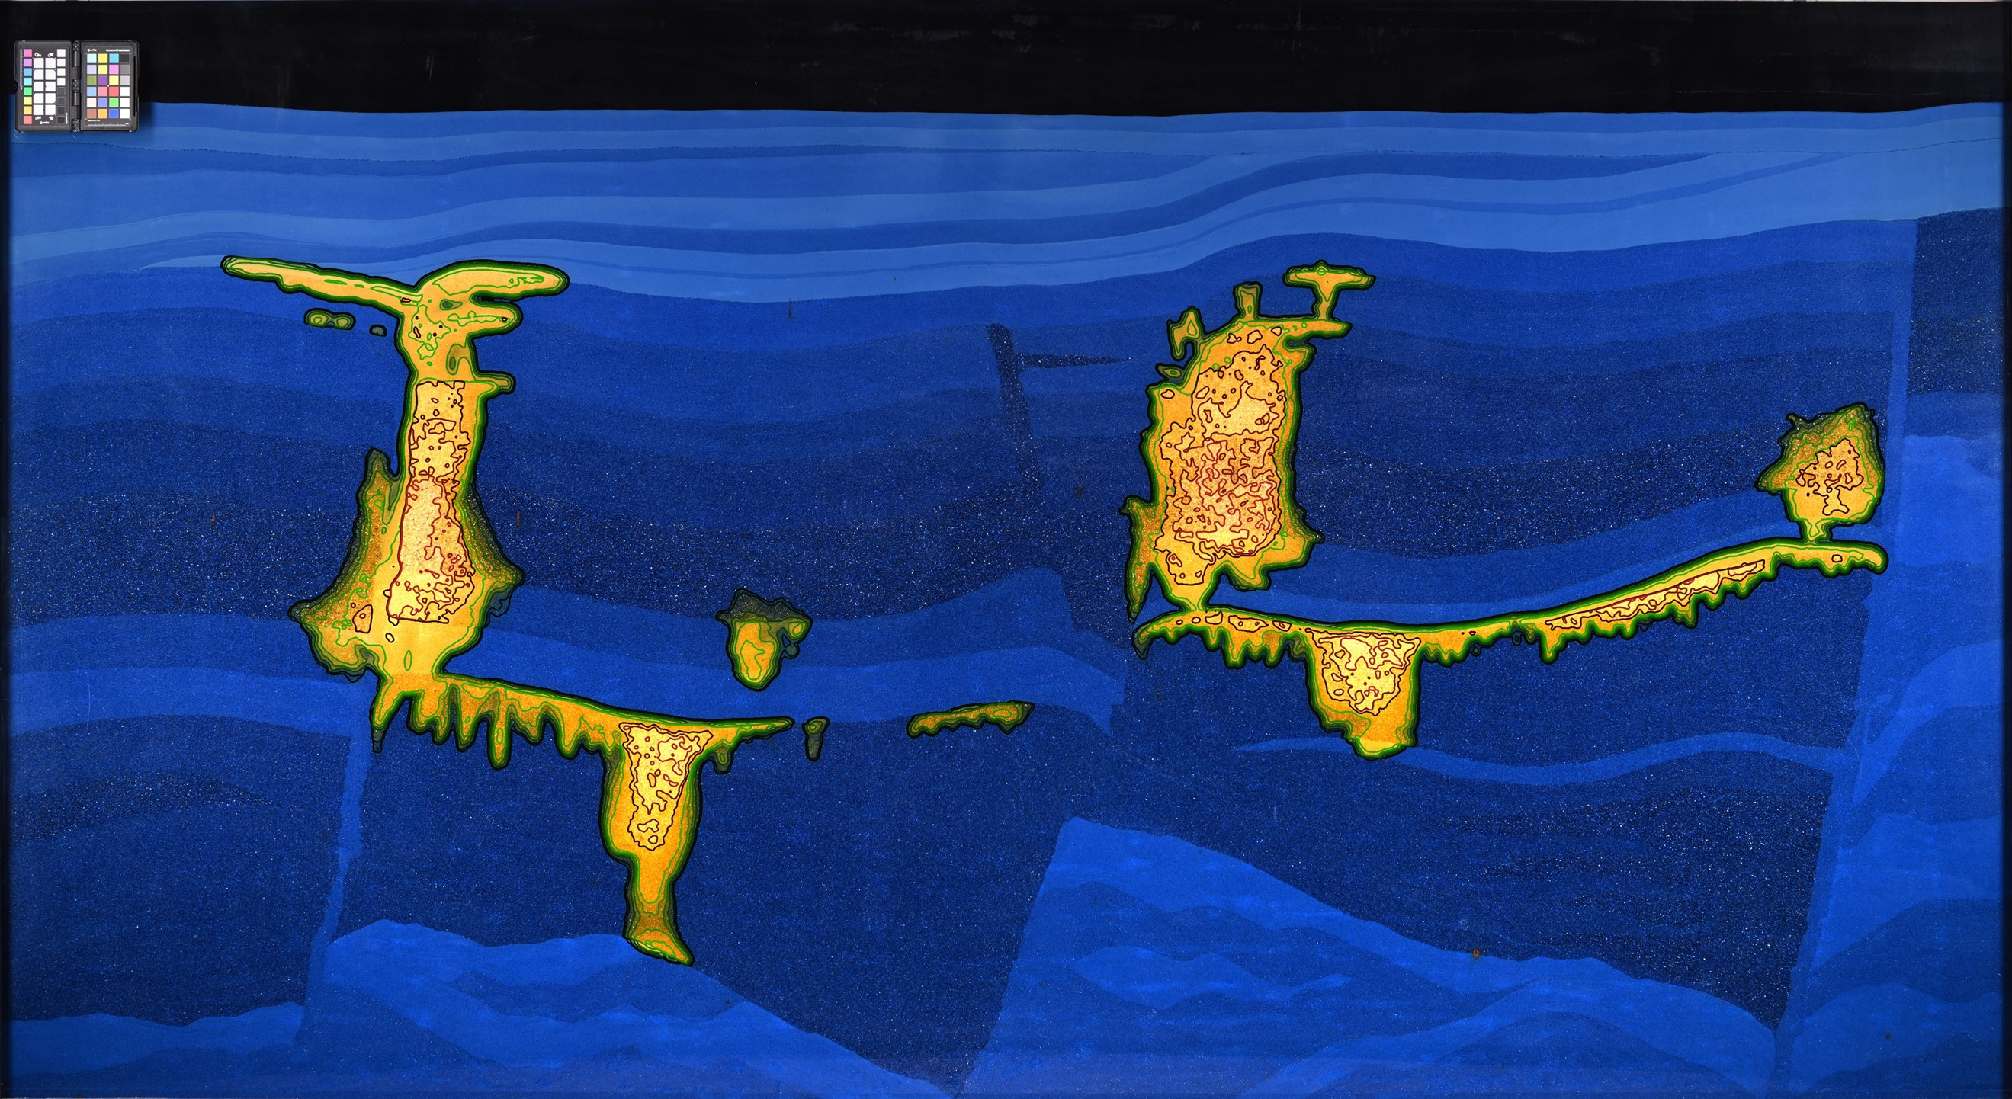
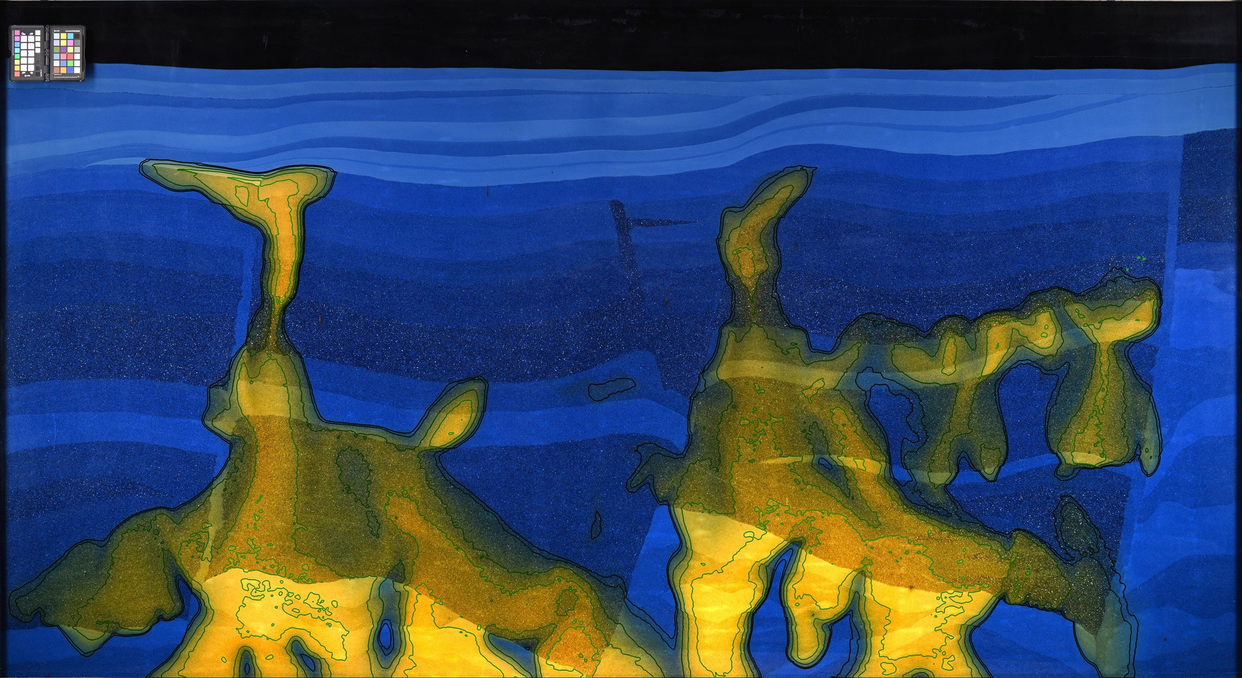
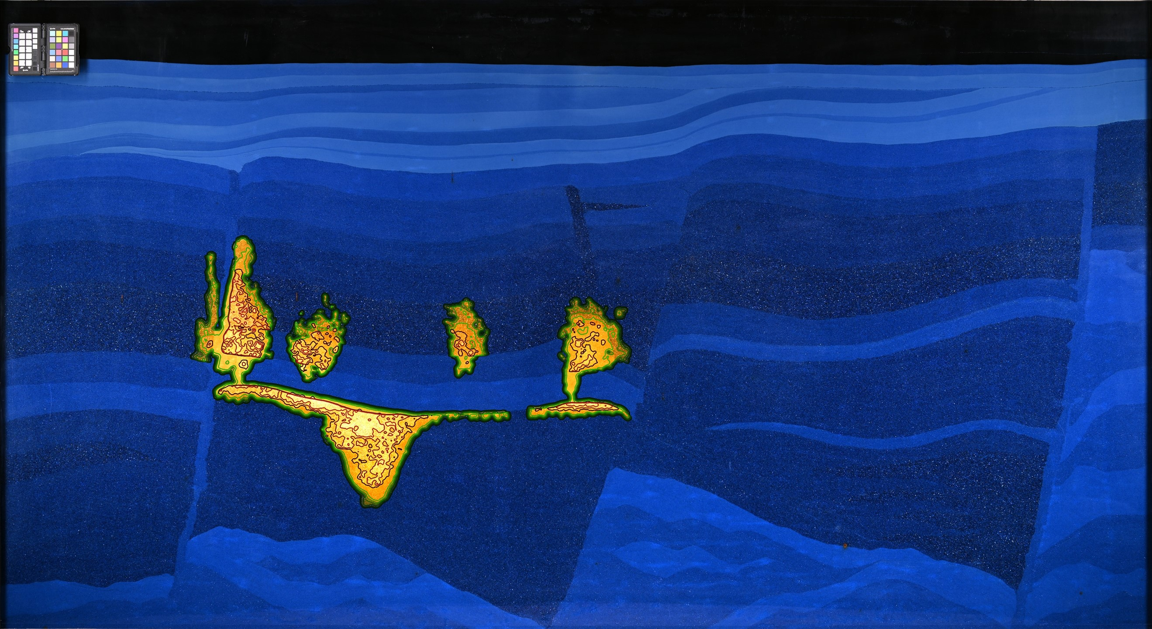
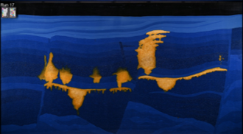
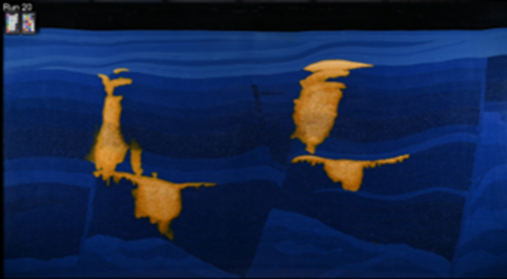
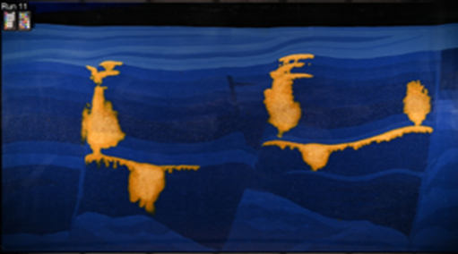
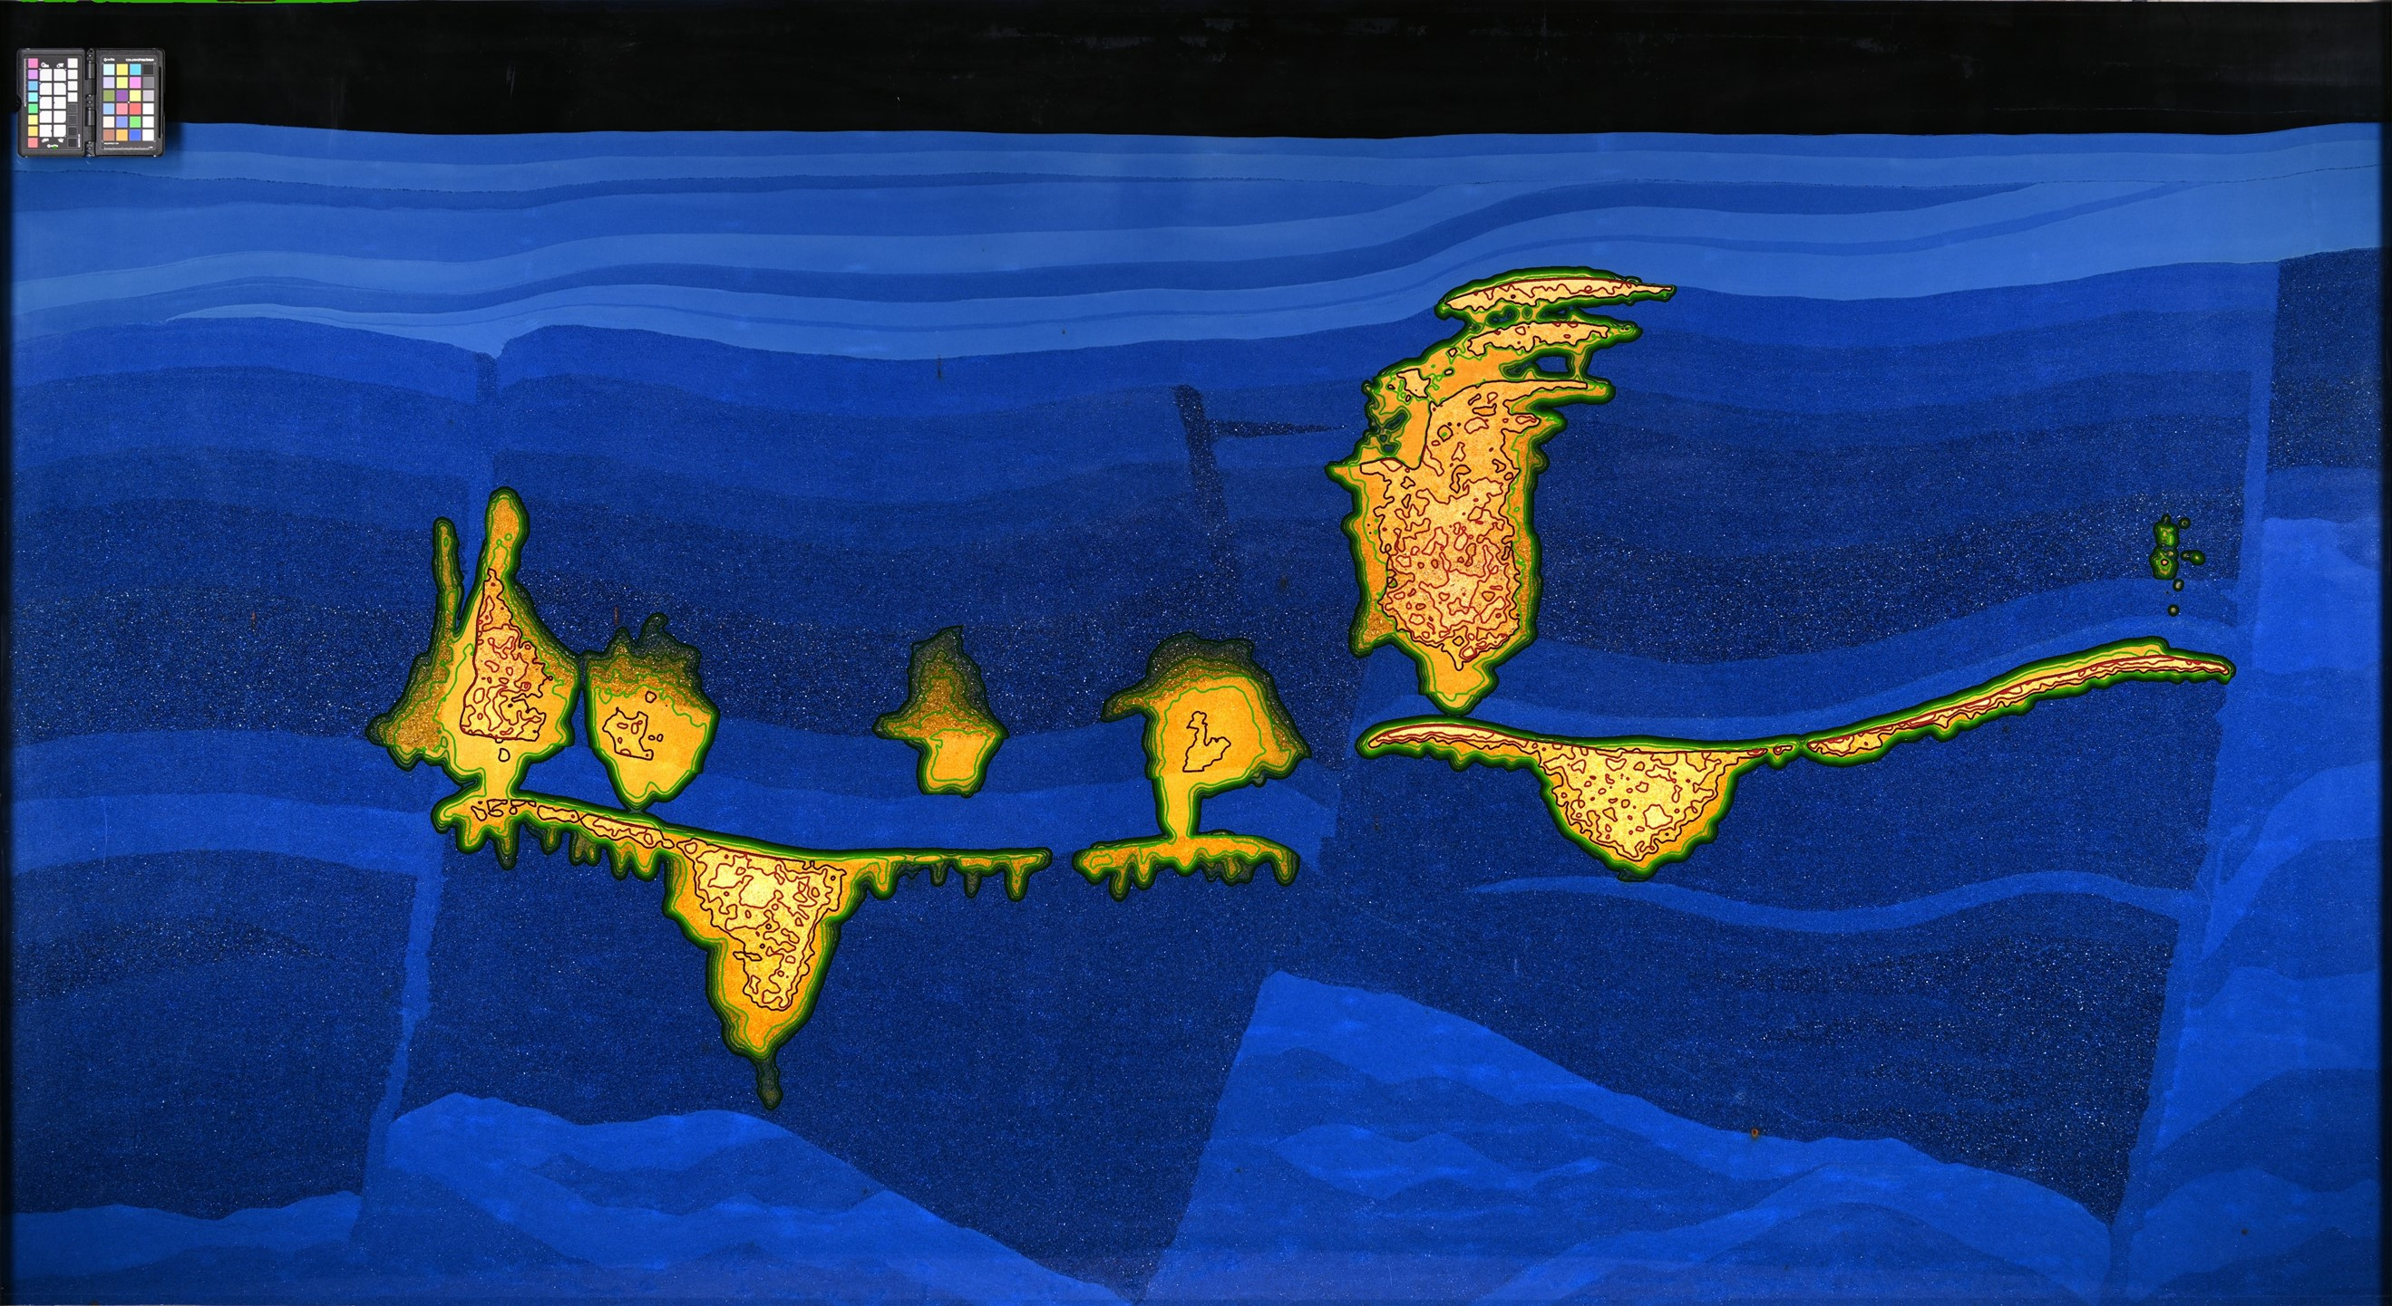
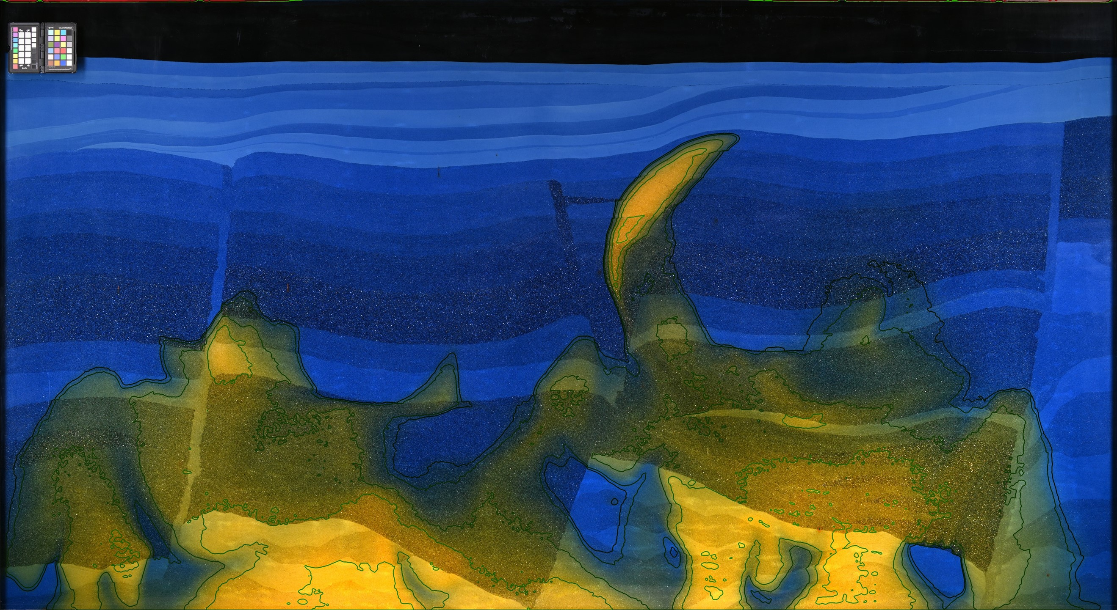
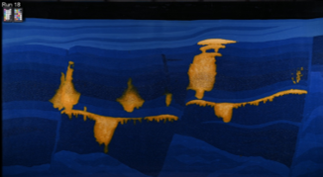
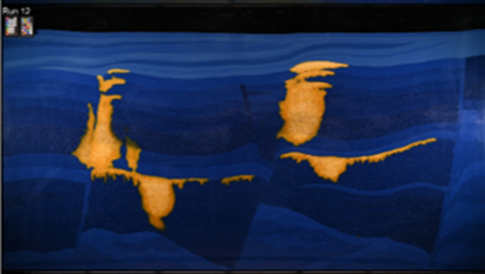
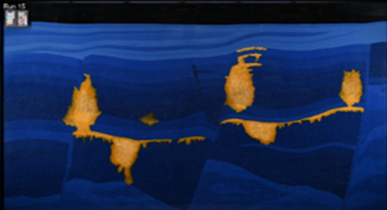
Analysis of structural variability
Cross comparison of experimental datasets
As opposed to SSIM. Measure of global geometric structural reconfiguration. In multi-data context. Distinguishes between random and systematic difference.
Run A
Run 17 and 18
Run 12 and 20
Run 11 and 15
Run B
Folkvord, Both, Nordbotten, Fernø (in preparation)

Slide 20
Putting SPE11 submissions into context
Characterizing variability (simulators | methods | humans)
Nordbotten, Fernø, Flemisch, Kovscek, Lie, Both, Møyner, Sandve et al (2025)

Slide 21
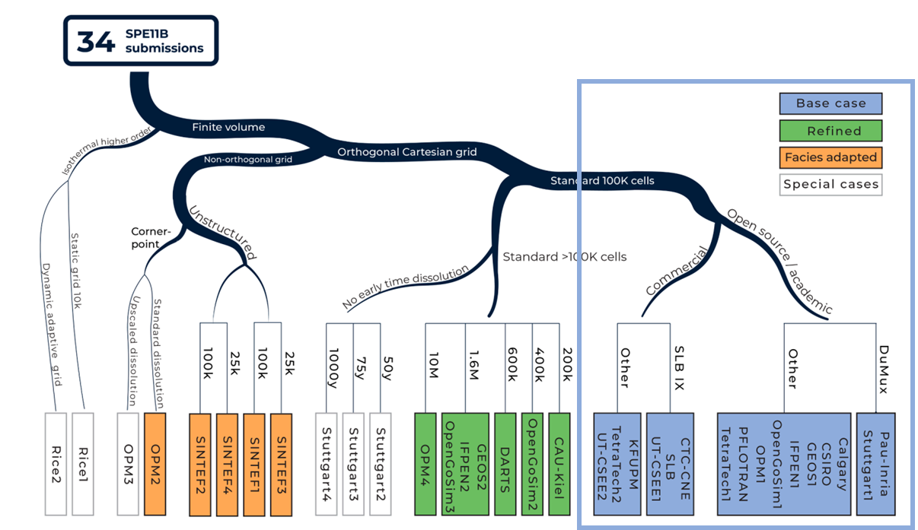
Putting SPE11 submissions into context
Characterizing variability (simulators | methods | humans)
Nordbotten, Fernø, Flemisch, Kovscek, Lie, Both, Møyner, Sandve et al (2025)

Slide 22
Putting SPE11 submissions into context
Characterizing variability (simulators | methods | humans)
34 submissions
Nordbotten, Fernø, Flemisch, Kovscek, Lie, Both, Møyner, Sandve et al (2025)

Slide 23
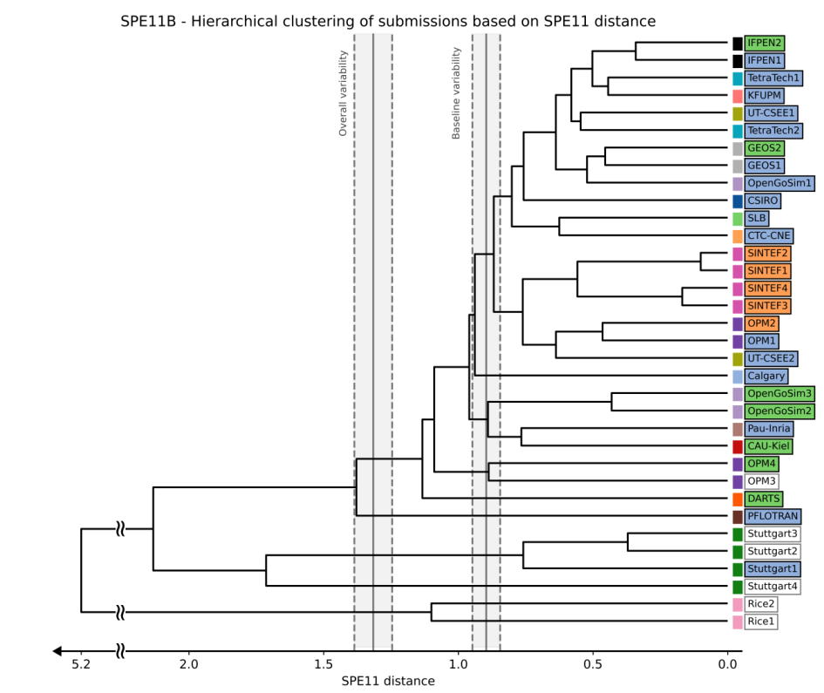
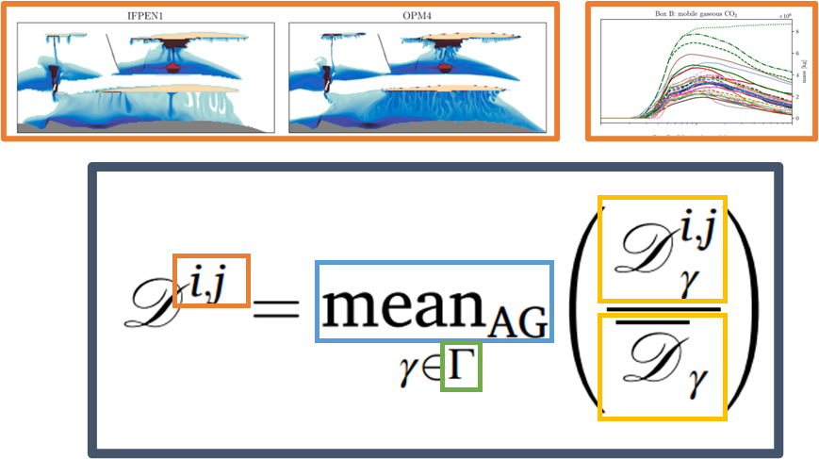
Putting SPE11 submissions into context
Characterizing variability (simulators | methods | humans)
Space-time multivariate distance and hierarchical clustering
34 submissions
Nordbotten, Fernø, Flemisch, Kovscek, Lie, Both, Møyner, Sandve et al (2025)

Slide 24
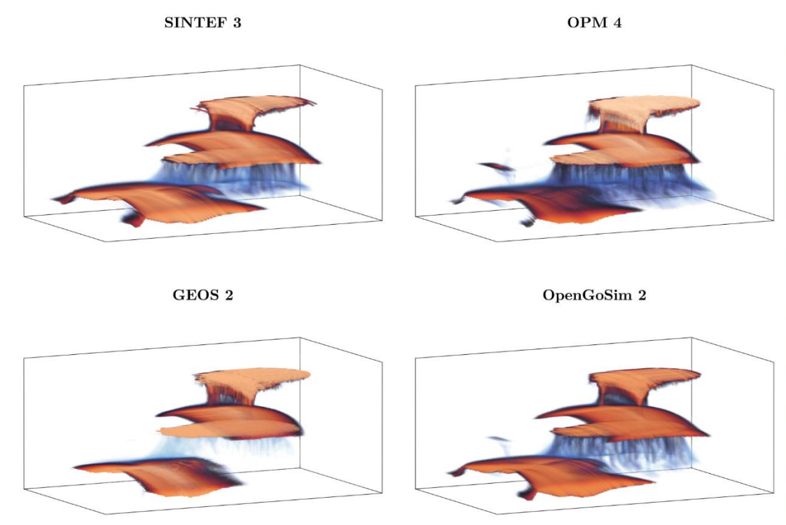
Putting SPE11 submissions into context
Characterizing variability (simulators | methods | humans)
Space-time multivariate distance and hierarchical clustering
Similarly in 3D
Nordbotten, Fernø, Flemisch, Kovscek, Lie, Both, Møyner, Sandve et al (2025)

Slide 25
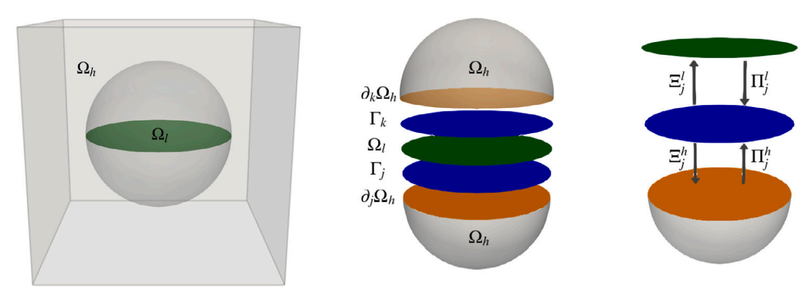
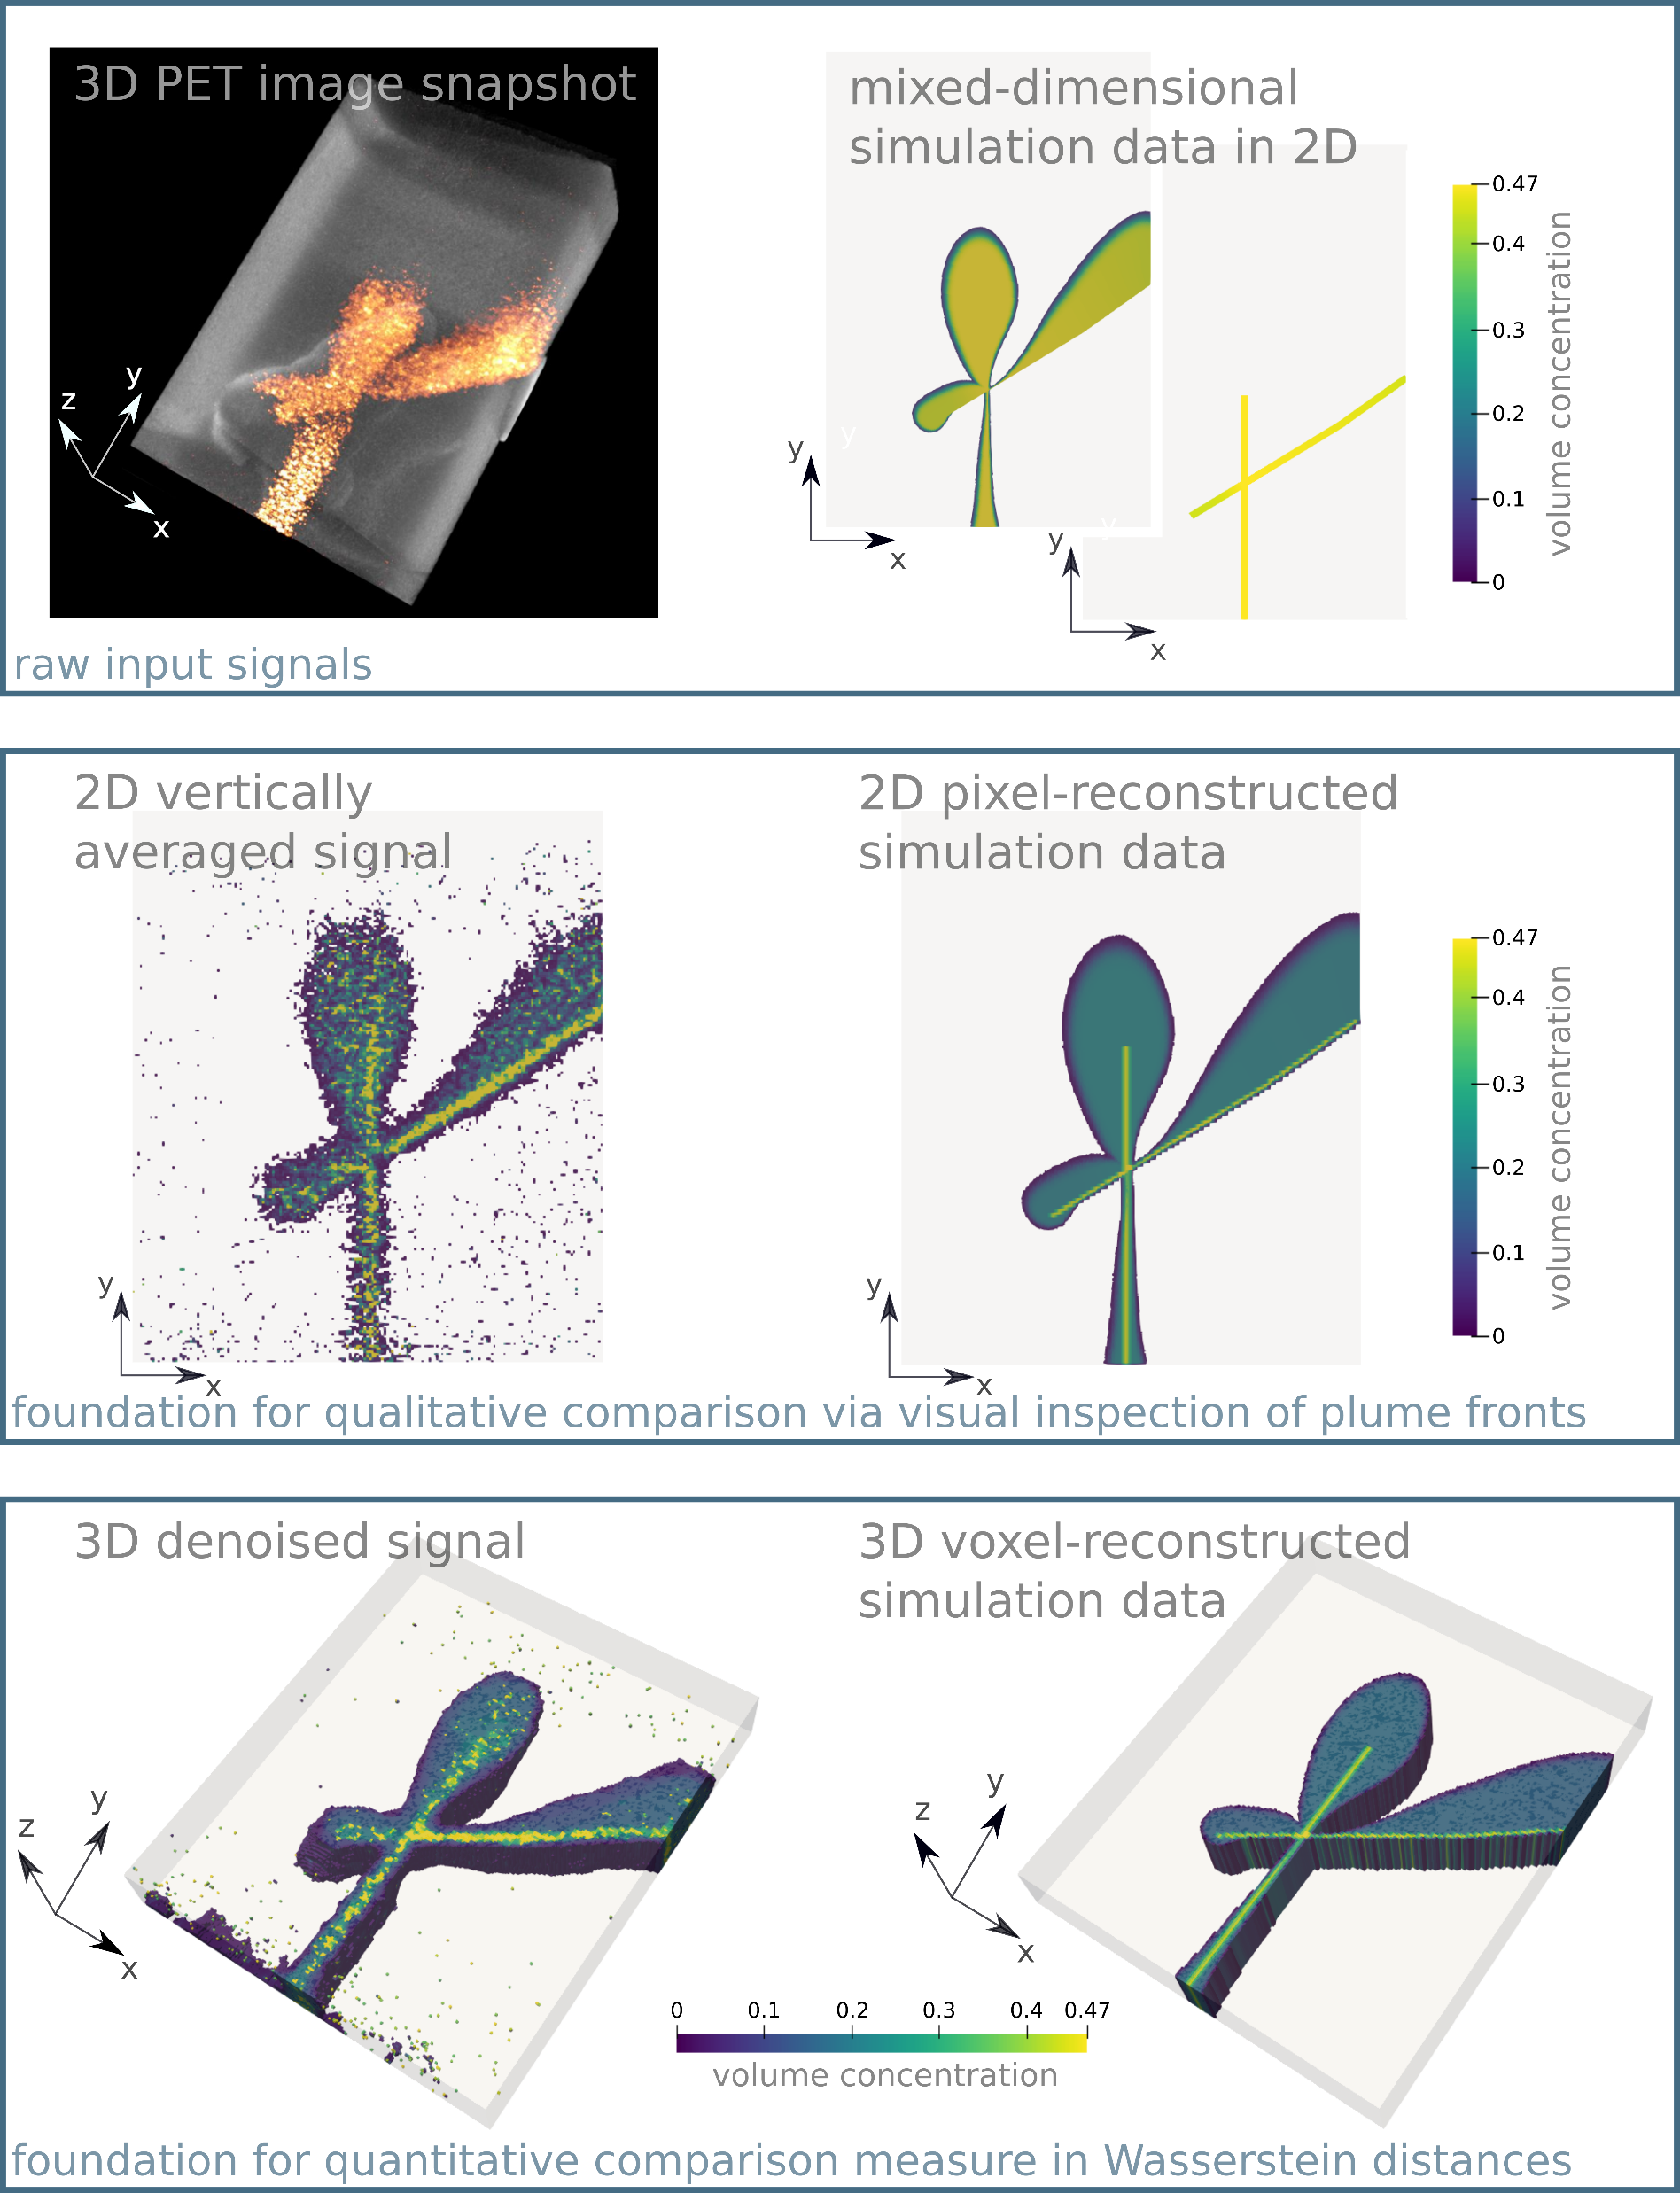


Model validation study Tracer transport in fractured porous media
Both, Brattekås, Keilegavlen, Fernø, Nordbotten (2024) High-fidelity experimental model verification for flow in fractured porous media, InterPore Journal
Notes:
Export to VTK

Slide 26

Optimal transport for guiding calibration
Image-based history-matching of OPM to FluidFlower data
Landa-Marbán, D., T. H. Sandve, J. W. Both, J. M. Nordbotten, S. E. Gasda, Performance of an open-source image-based history matching framework for CO2 storage, Transport in Porous Media, 2026.
Notes:
The experiment is hard to hindcast.
Using the metrics defined the FF BM study.
Still room for improvement (leaving the question whether this actually have been the right metrics!)

Slide 27








Future directions for image-based data comparison
Classical optimal transport ≠ Multiphase flow physics
Multiscale (global/local) image registration
Allow for uncertainty/noise in data
This research is funded by the Research Council of Norway under project TIME₄CO₂ (355188).

