Slide 1
Resolving Millimeter-Scale Heterogeneity to Understand CO₂ Spreading at the Otway International Test Centre
Catherine Spurin, Catherine Callas, Sharon Ellman, Sojwal Manoorkar, Tom Bultreys, and Sally Benson

Slide 2
Small-scale heterogeneities influence CO₂ flow across scales
They control plume spread and arrival time

Slide 3
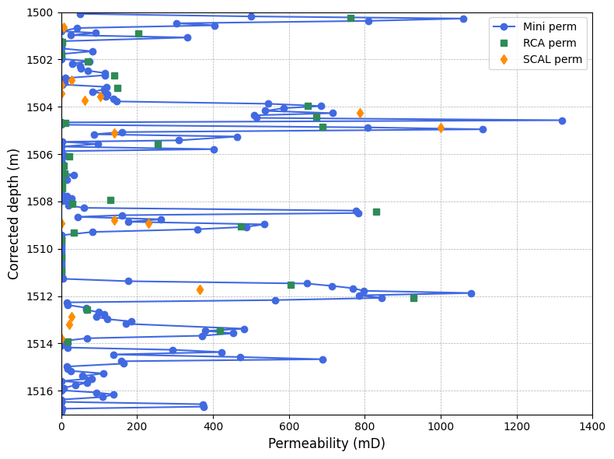
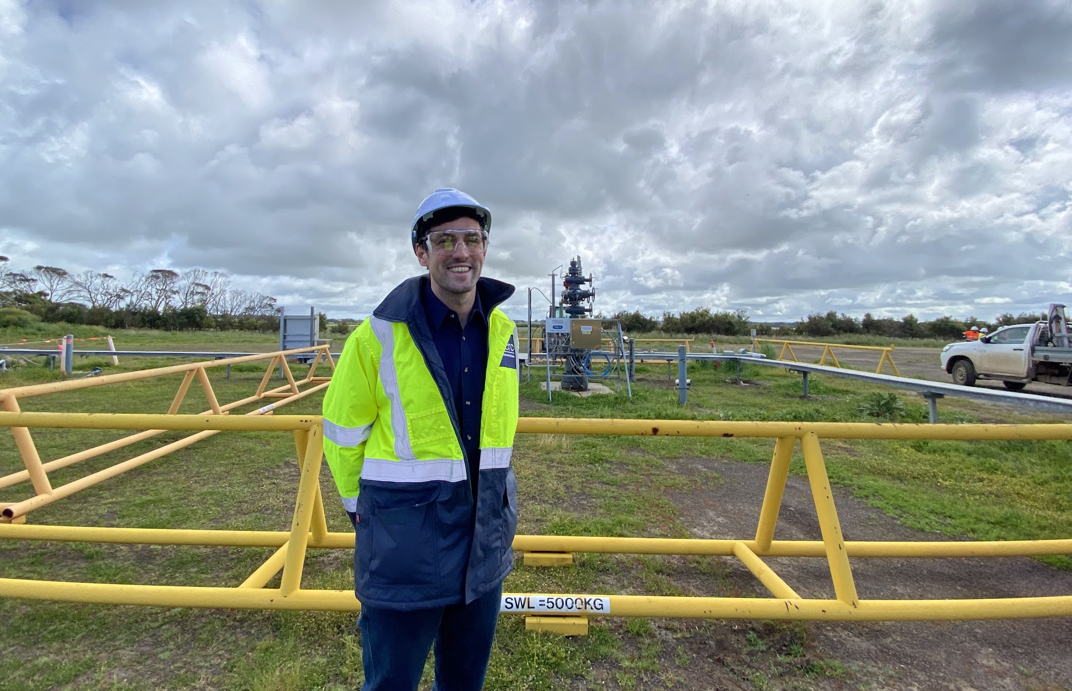
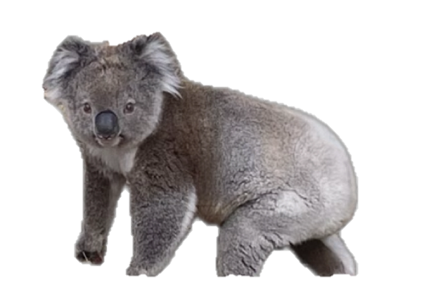
The Otway International Test Centre
Injection of ~10,000 tonnes of CO₂ into heterogeneous reservoir
Injection well

Slide 4
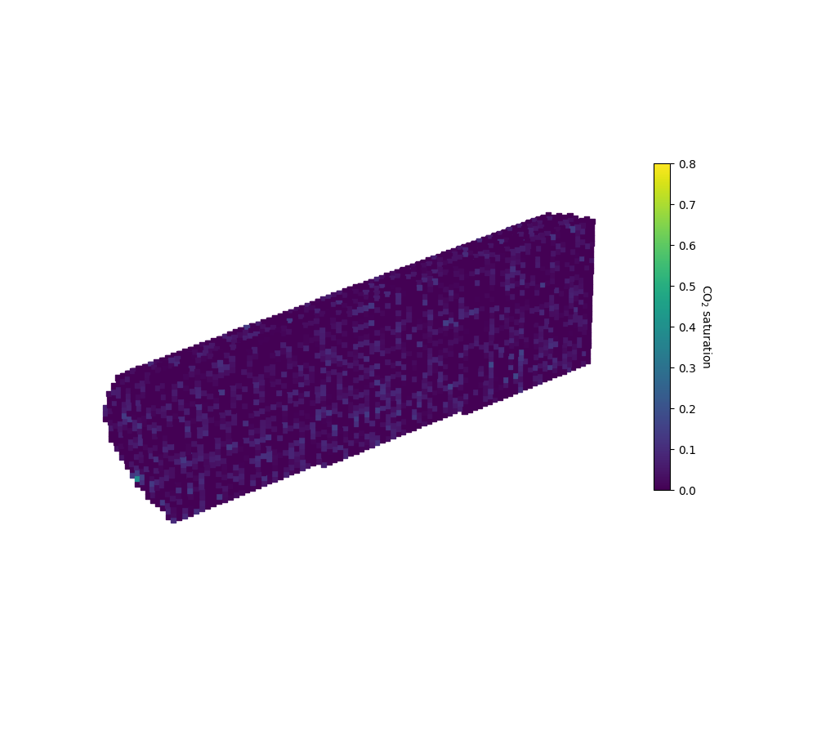
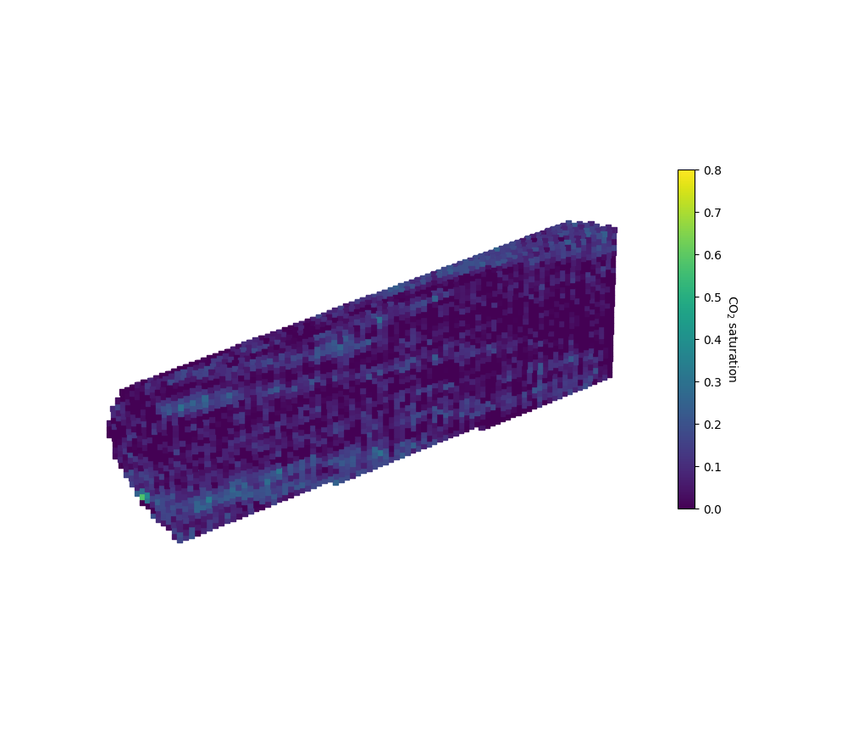
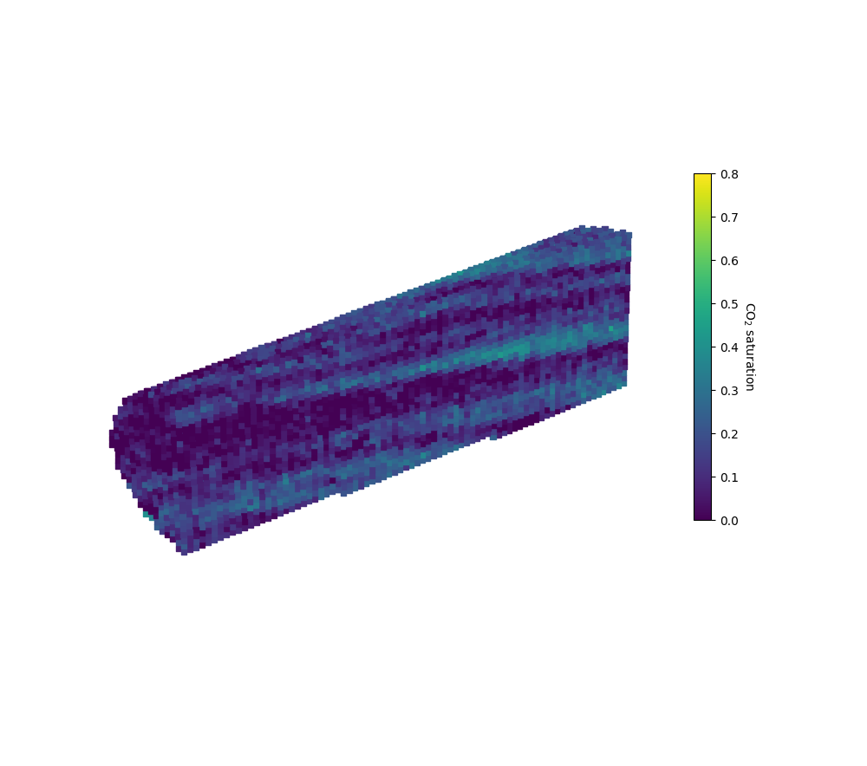
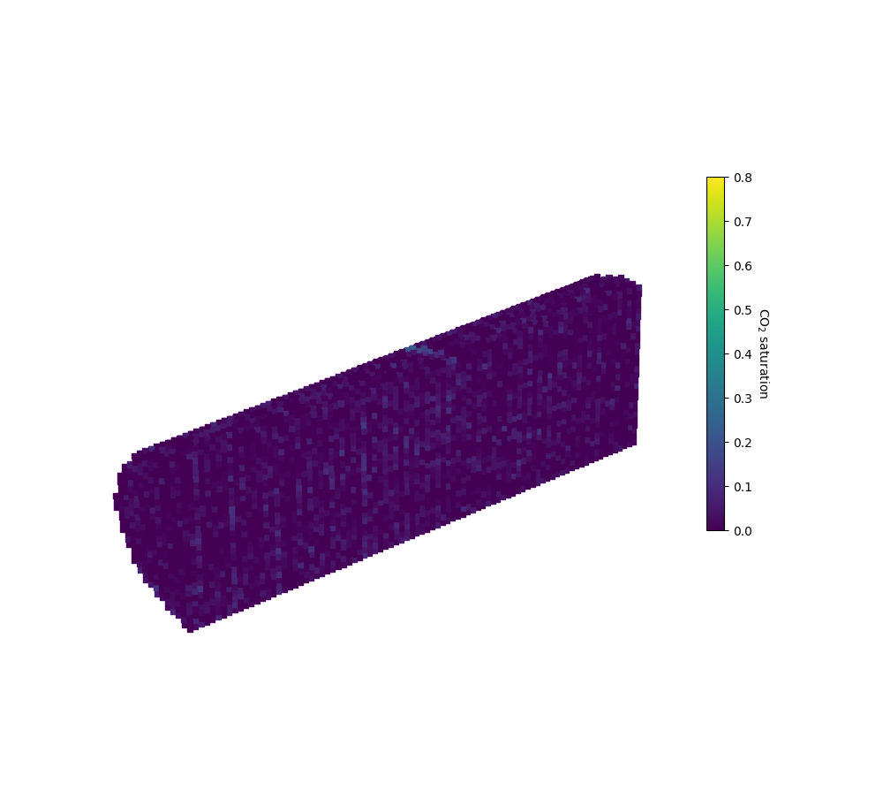


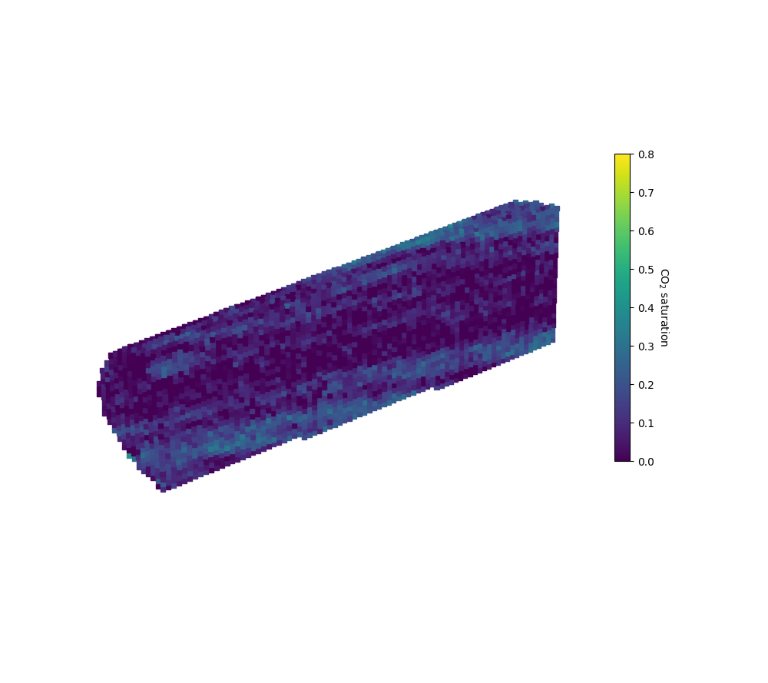
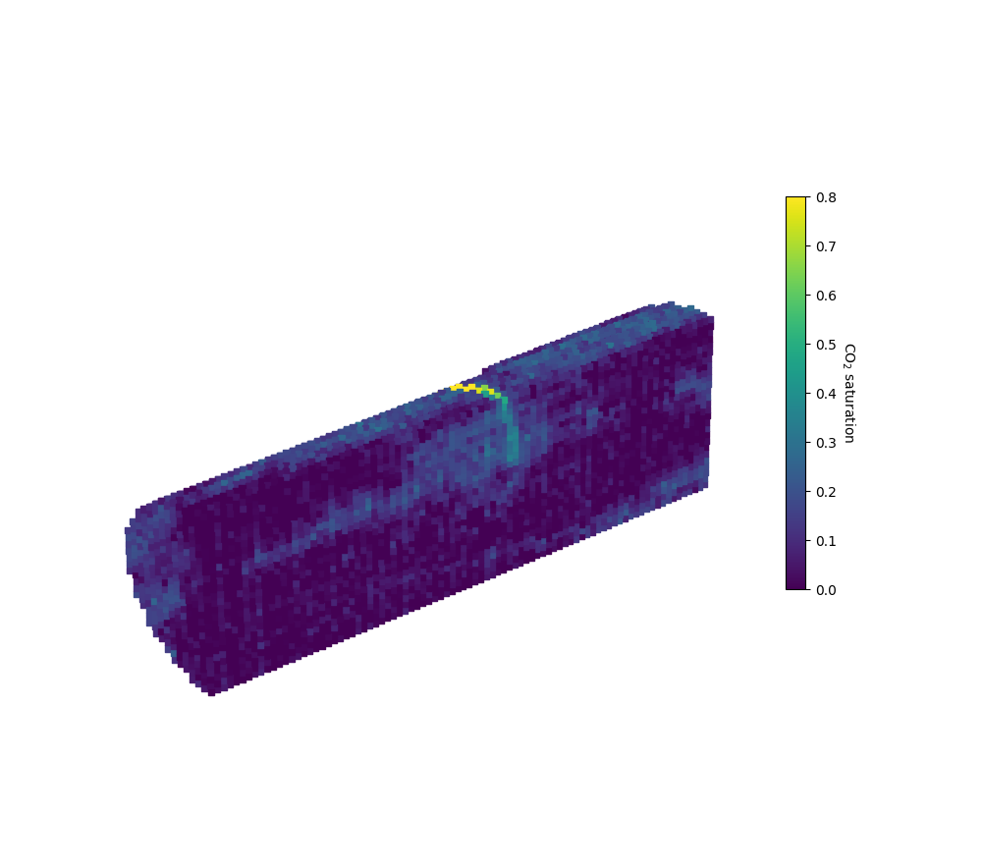
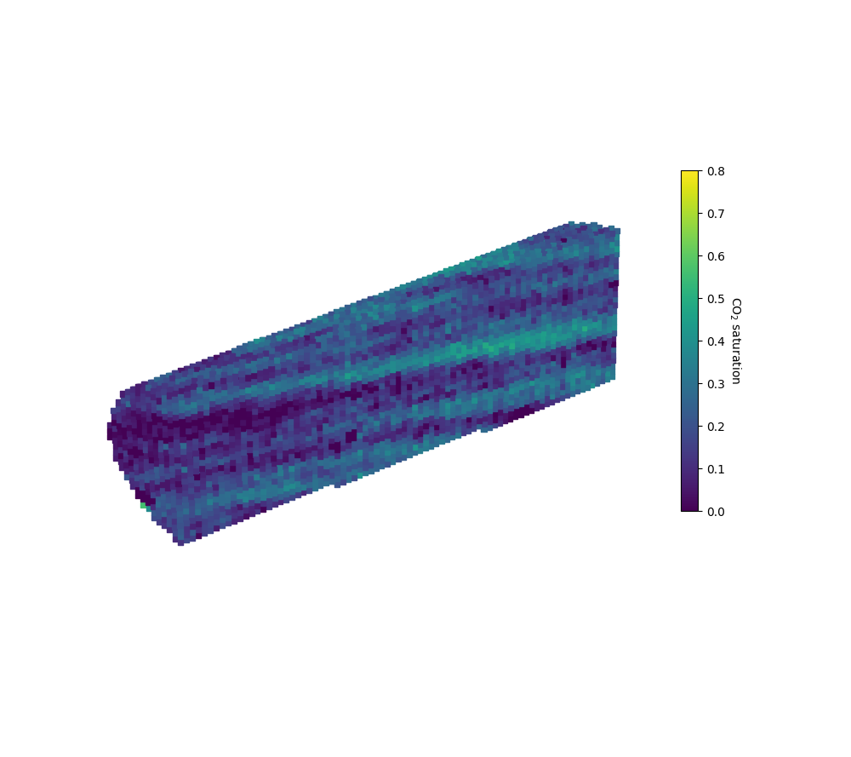
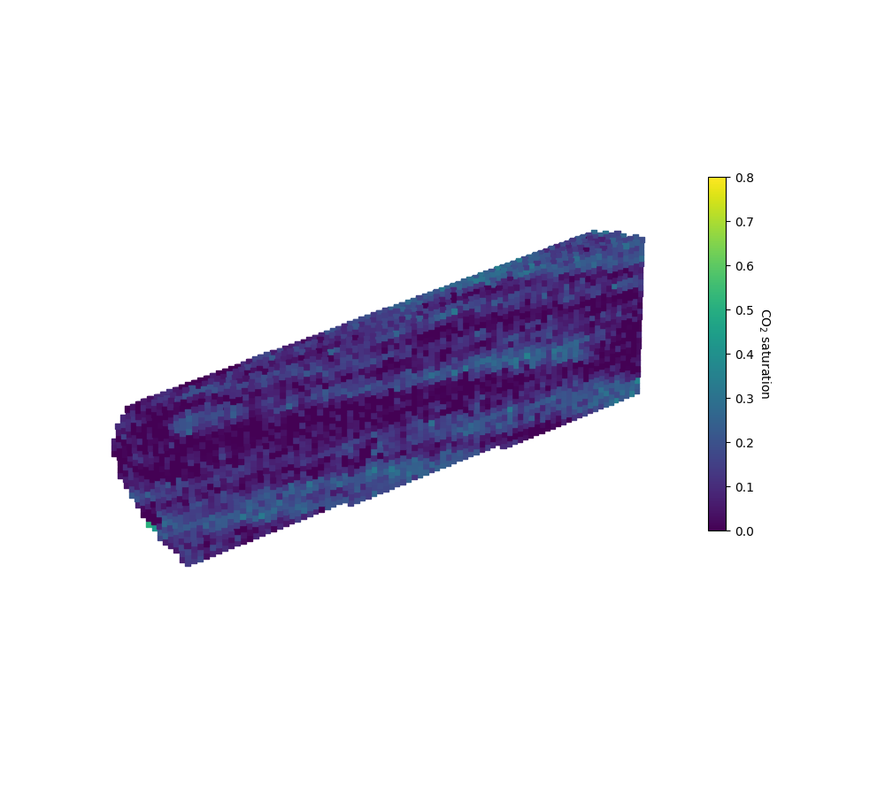
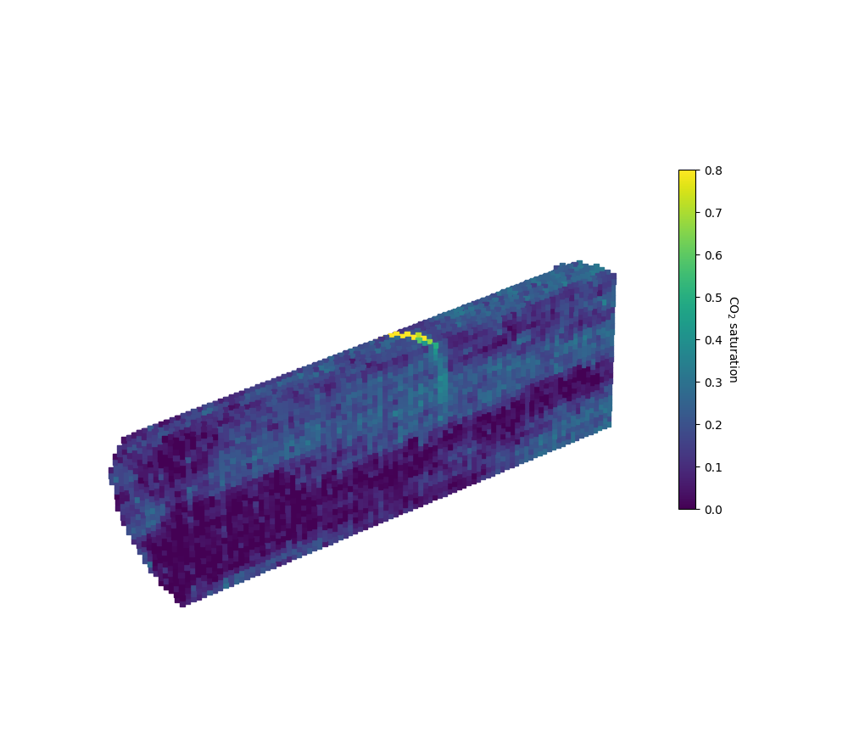

Core-scale experiments show impact of small-scale heterogeneity
Samples from same facies, taken 3 m apart. These would be modeled with same parameters!
10mD, ϕ = 0.26
63mD, ϕ = 0.32

Slide 5
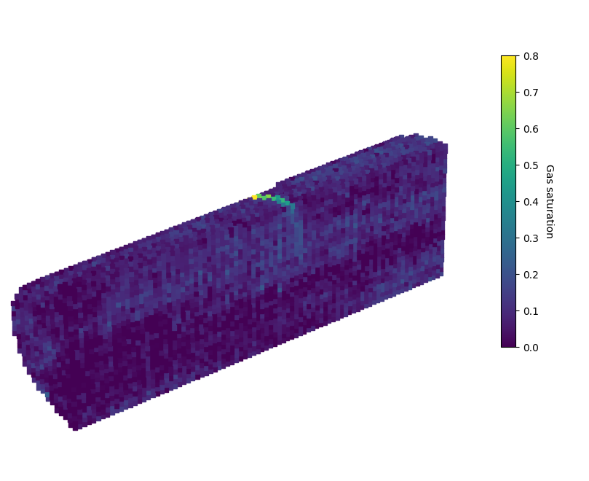
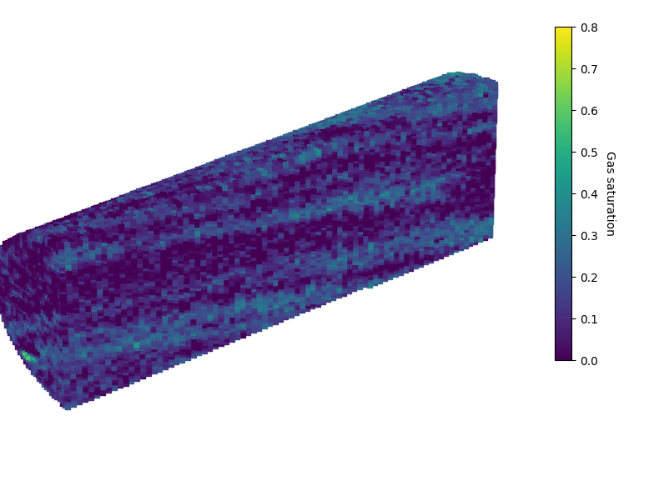
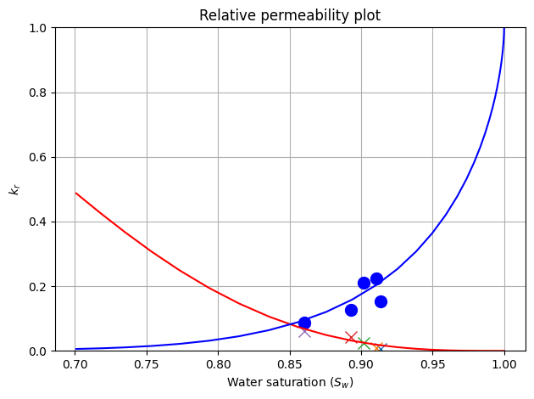
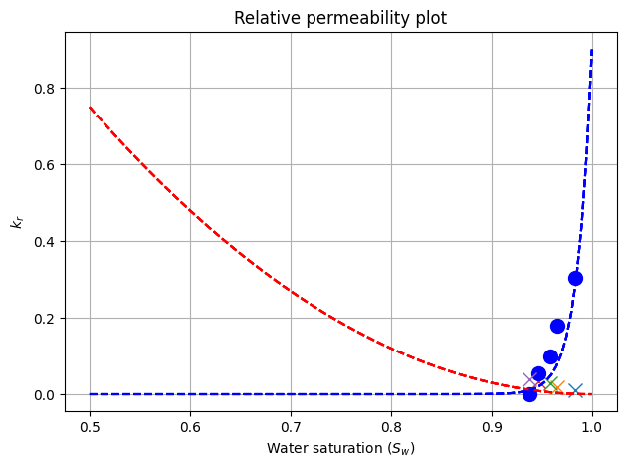
Impact of heterogeneity on relative permeability
Steep water rel perm
Low CO₂ saturations
Notes:
Big change in simulations

Slide 6
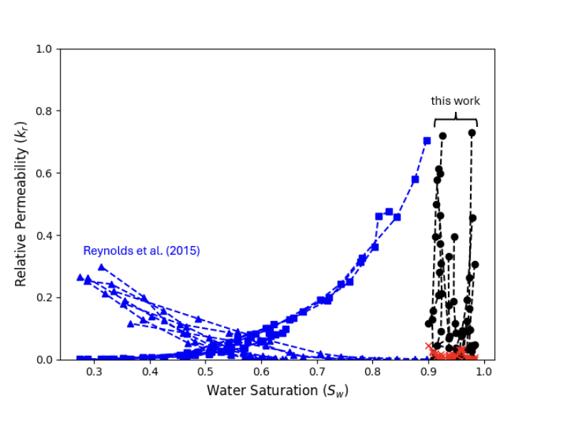
Comparison to other heterogeneous rocks
Otway is a deltaic depositional environment
Why is the water relative permeability so steep?
Why couldn’t we get more CO₂ into the rocks?
Well, we can’t see the CO₂ itself because of imaging resolution…

Slide 7
Micro-CT multiphase flow experiments
Sample saturated with CO₂ saturated water
CO₂ saturated water and CO₂ co-injected as a range of fractional flows
Pressure drop measured across core
Saturation measured with HECTOR (UGCT) -> 10-micron resolution

Slide 8
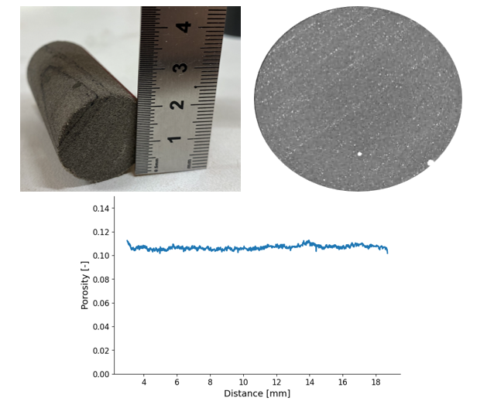
Characterization of heterogeneity prior to flow
It has some layers visible to the naked eye
Some that are only visible with 10-micron resolution
Pyrite along layers, makes up ~7% of the sample volume
This heterogeneity not seen in the porosity

Slide 9
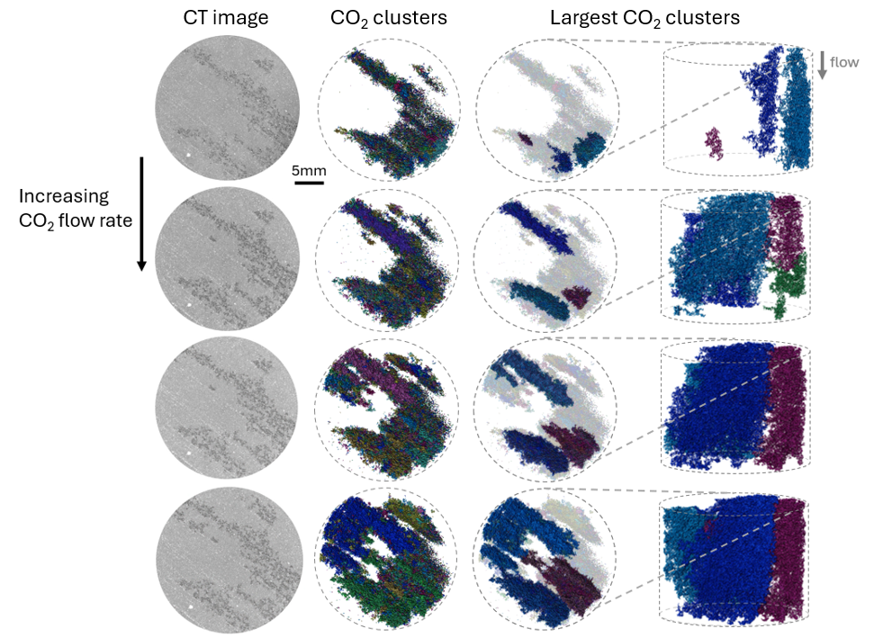
Layers control CO₂ flow
Sheet like layers
Heterogeneity not reflected in the porosity profile
Seemingly controlled by pyrite layers

Slide 10
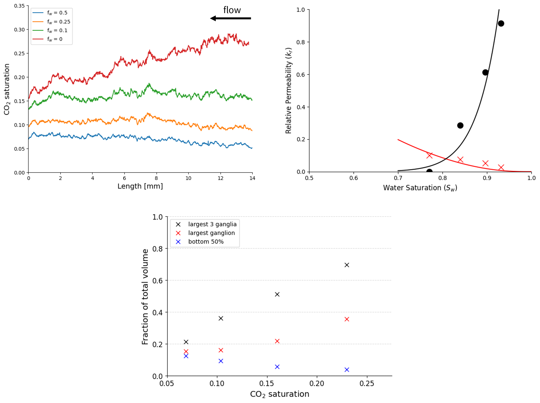
Steep water relative permeability curves

Slide 11
Connectivity evolves rapidly with saturation
CO₂ connectivity increases at the expense of brine connectivity.
Large changes in proportion of largest ganglia, with small changes in saturation

Slide 12
Conclusions from experiments
Highly channelized flow leads to low CO₂ saturations
CO₂ connectivity increased rapidly at the expense of brine connectivity
This leads to steep relative permeability curves typical for samples from Otway/ this depositional environment
Potential for this to influence flow at field scale

Slide 13
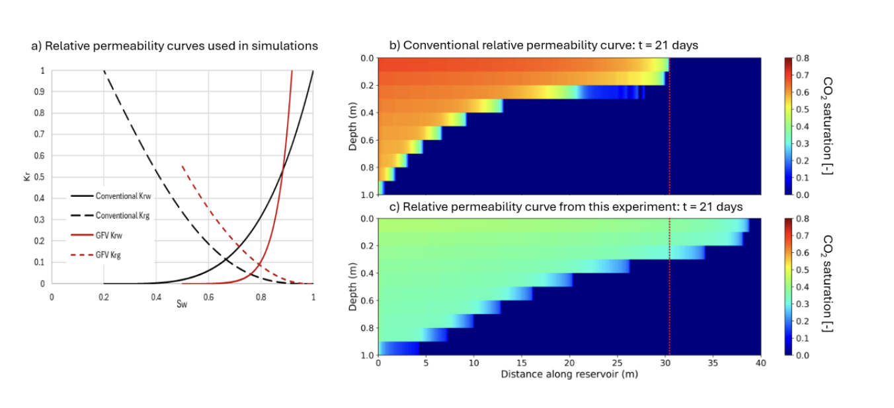
Potential impact of steep relative permeability curves
*simple toybox model

Slide 14






































CO2CRC acknowledges and appreciates the strong relationships it has with industry, community, government, research organisations, and agencies in Australia and around the world.
© CO2CRC Limited 2023

Slide 15
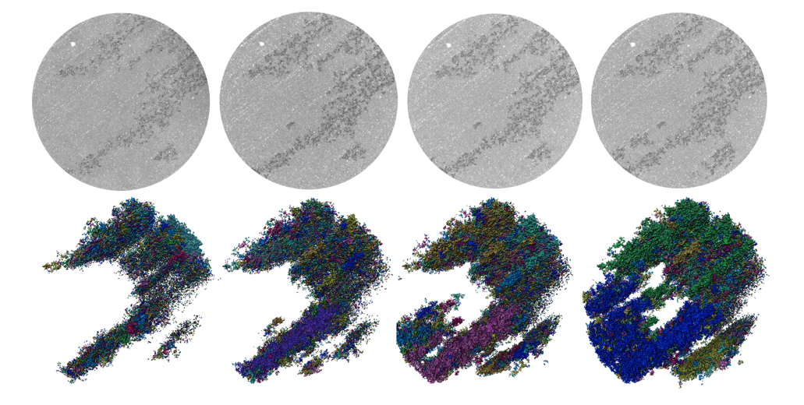
Thank you for listening!
Thanks to EXCITE for funding this collaboration

Slide 16
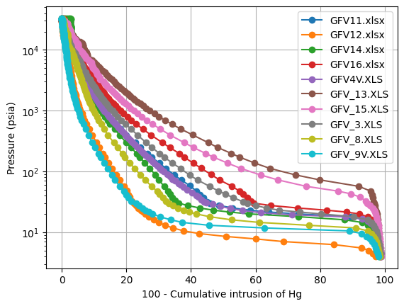
Capillary pressure measurements
Characterization using MICP
Again, the heterogeneity is evident
Note the huge difference between GFV12 and GFV13

Slide 17
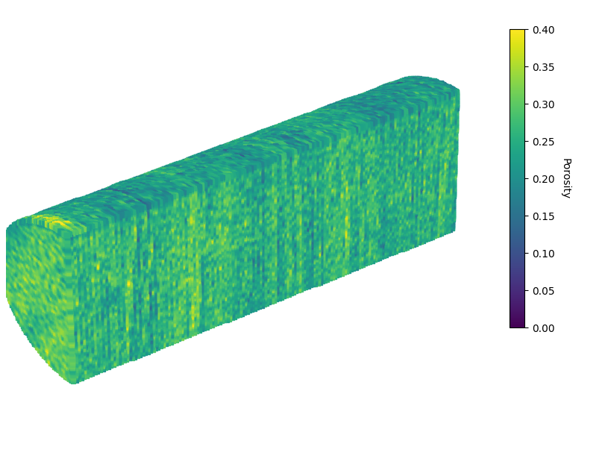
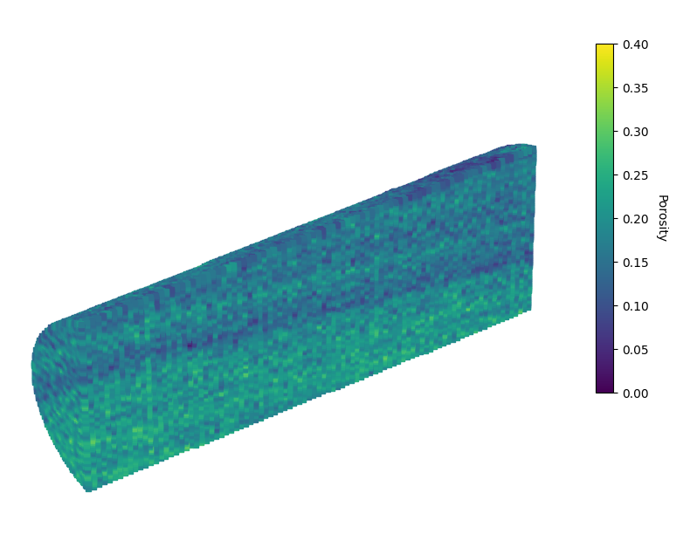
Extreme heterogeneity – comparison of vertical/ horizontal pairs
Core 1V – 1502.88m
Core 2 – 1503.08m
Difference in layers and porosity
Permeability ~ 26mD
Porosity - 0.26
Permeability ~ 0.2mD
Porosity – 0.19

Slide 18
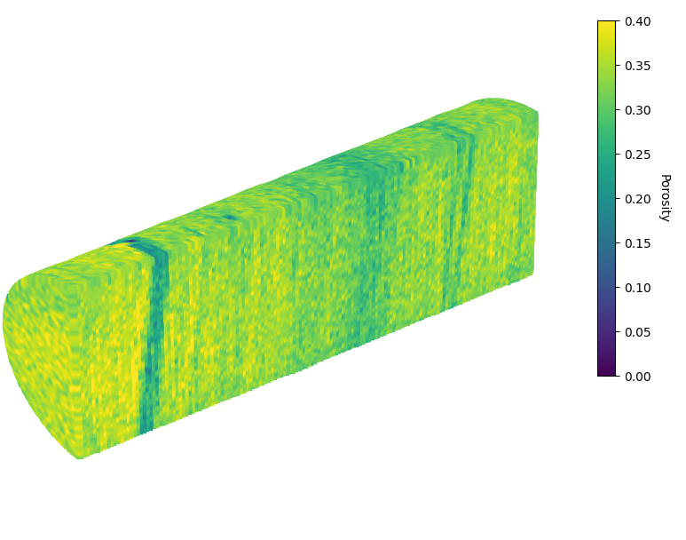
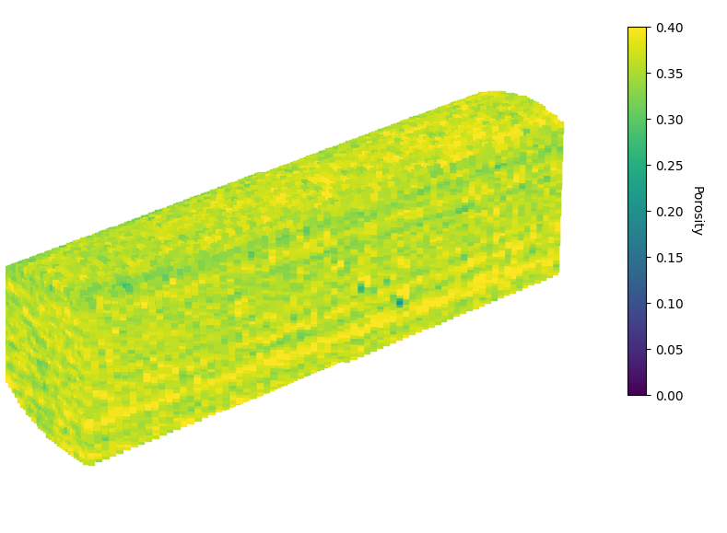
Extreme heterogeneity – comparison of vertical/ horizontal pairs
Core 7V – 1508.78m
Core 8 – 1508.93m
Permeability ~ 140mD
Porosity – 0.33
Permeability ~ 230mD
Porosity – 0.36

