Slide 1
MS10, 303
InterPore 2026
Observation of Gas and Water Distributions
in a Proton Exchange Membrane Water Electrolyzer
Using Operando X-ray CT
○ Satoru Kato , Tetsuichiro Hayakawa, Yuki Higuchi, Yusaku Nishimura, Toshikazu Satoh, Wataru Yoshimune
(TOYOTA Central R&D Labs., Inc.)

Slide 2
1. Introduction
Schematic of water electrolyzer
Anode
Porosity
30～70%
Pore size
1～100µm
Channel
O₂
e-
H₂O
PTL: Porous Transport Layer
CL: Catalyst Layer
Porosity
30～70%
Pore size
1nm～1µm
H₂O
H⁺
PEM: Proton Exchange membrane
CL
PTL
H₂
e-
Channel
Cathode
Porous materials enable complex transport in water electrolyzers.

Slide 3
1. Introduction
Variations in local structure and transport phenomena
Schematic of water electrolyzer
Good balance
of transport
Poor PTL/CL contact
Anode
Channel
O₂
e-
H₂O
PTL
CL
H₂O
H⁺
PEM
Bubbles blocks water transport
Dense PTL blocks water transport
CL
PTL
H₂
e-
Channel
Cathode
Anode reactions are inhibited by poor contact or water blockage.

Slide 4
2. Challenge & Approach
Suggested variation of local structure and transport phenomena
Approach:
Operando X-ray CT visualization of local structure and transport.
Good balance
of transport
Less contact
of PTL and CL
N₂,H₂,H₂O
O₂,H₂O
X-ray Camera
Dense PTL
block water
Bubble
block water
Cathode
Anode
N₂
H₂O
Challenge:
Clarify reaction distributions based on local structure and transport.

Slide 5
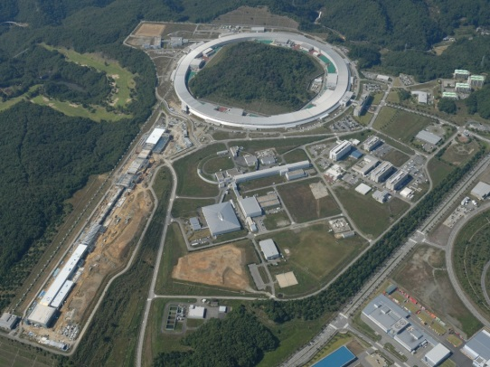
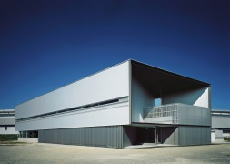
2. Experimental
Schematic of Operand X-ray CT measurement during water electrolysis.
Conducted at BL33XU (Toyota BL) at SPring-8
・ X-ray Energy 27 keV
・ Scan time 2 sec
・ Voxel resolution 3 μm
Sample
・ An-PTL : Titanium paper
・ An-CL : IrOx + Nafion
・ Membrane : NR211
・ Ca-CL : Pt/C + Nafion
・ Ca-PTL : Carbon – paper
Procedure
1. Scan under dry condition
2. Scan under water supplying condition
3. Scan under water electrolysis operation
N₂,H₂,H₂O
Toyota Beamline
O₂,H₂O
X-ray Camera
Since 2009
Cathode
Anode
N₂
H₂O

Slide 6
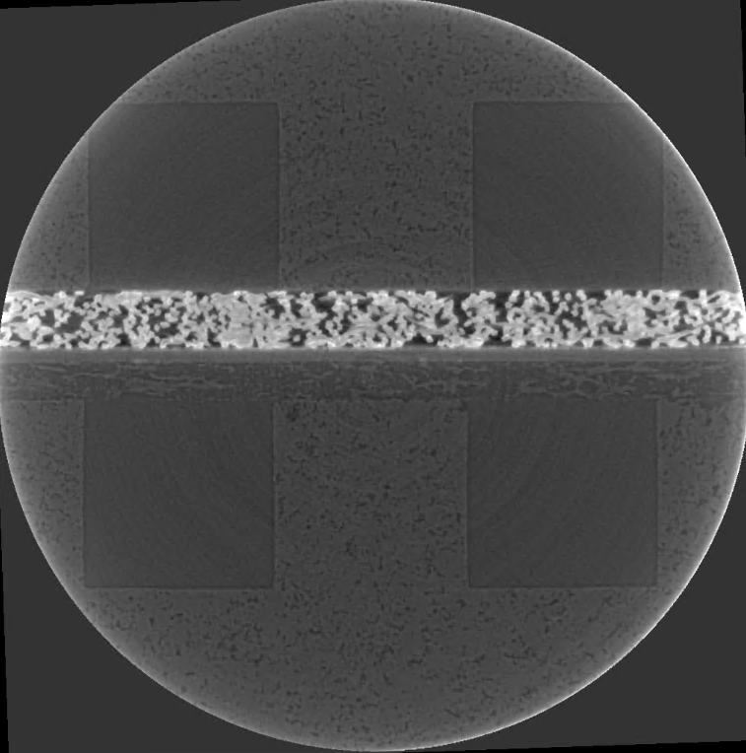
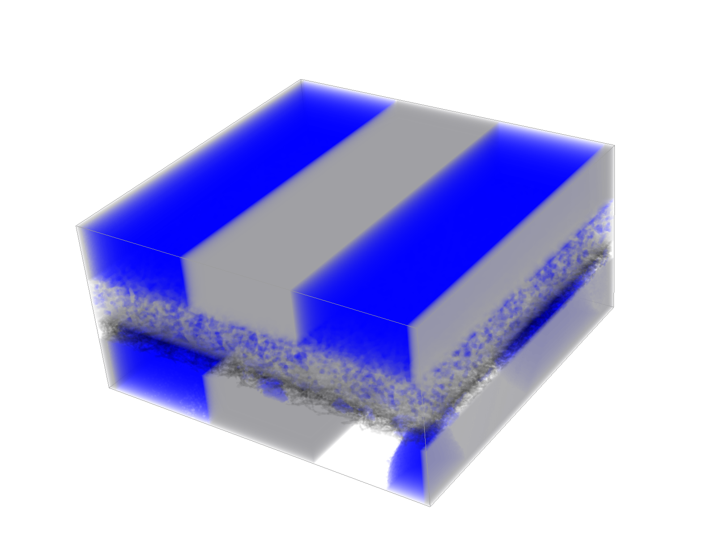
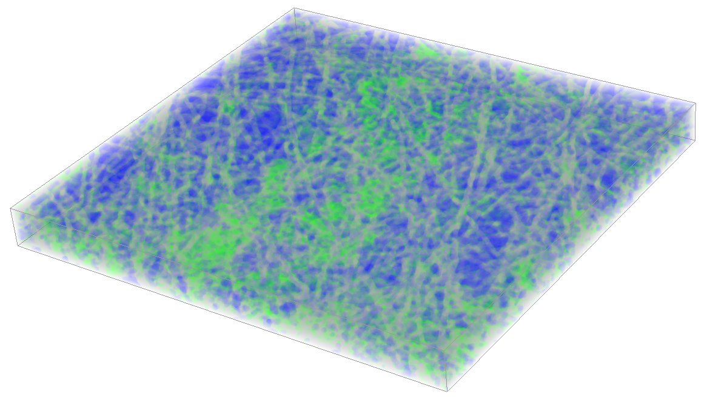
2. Experimental
Schematic of Operand X-ray CT measurement of during water electrolysis.
A series of sliced X-ray CT images.
N₂,H₂,H₂O
2.3 mm
O₂,H₂O
X-ray Camera
PTL
460
μm
CL
3 mm
PEM
CL
PTL
Cathode
3 mm
Segmented 3D image
Anode
N₂
H₂O
2.3 mm
1.2 mm
2.4 mm

Slide 7
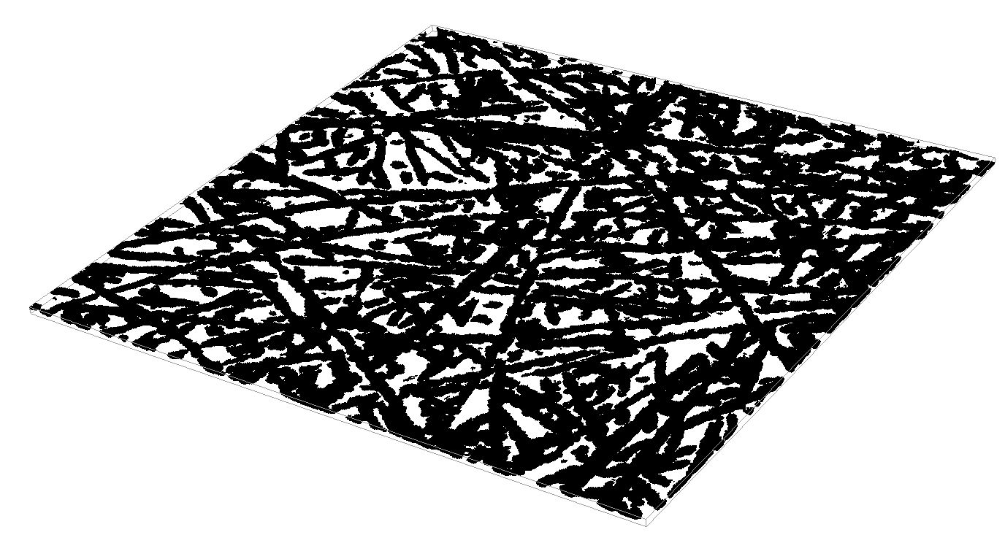
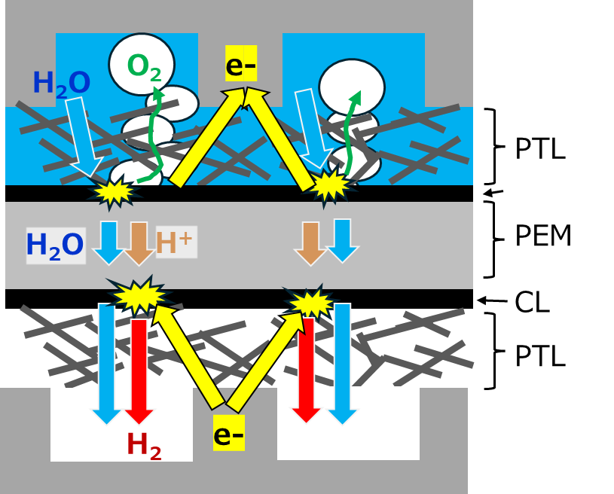
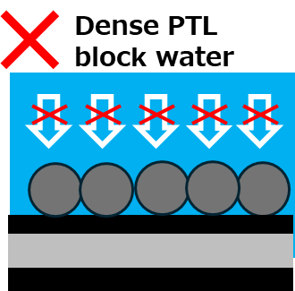
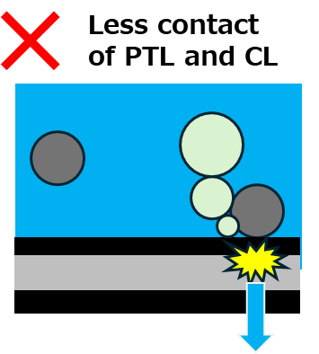
3. Result & Discussion
(1) 3D image of CL contacting PTL.
2.3 mm
“Dense” implies blocked water transport
Anode
“Coarse” implies poor PTL/CL contact.
Cathode
Heterogeneous CL/PTL contact is observed.

Slide 8
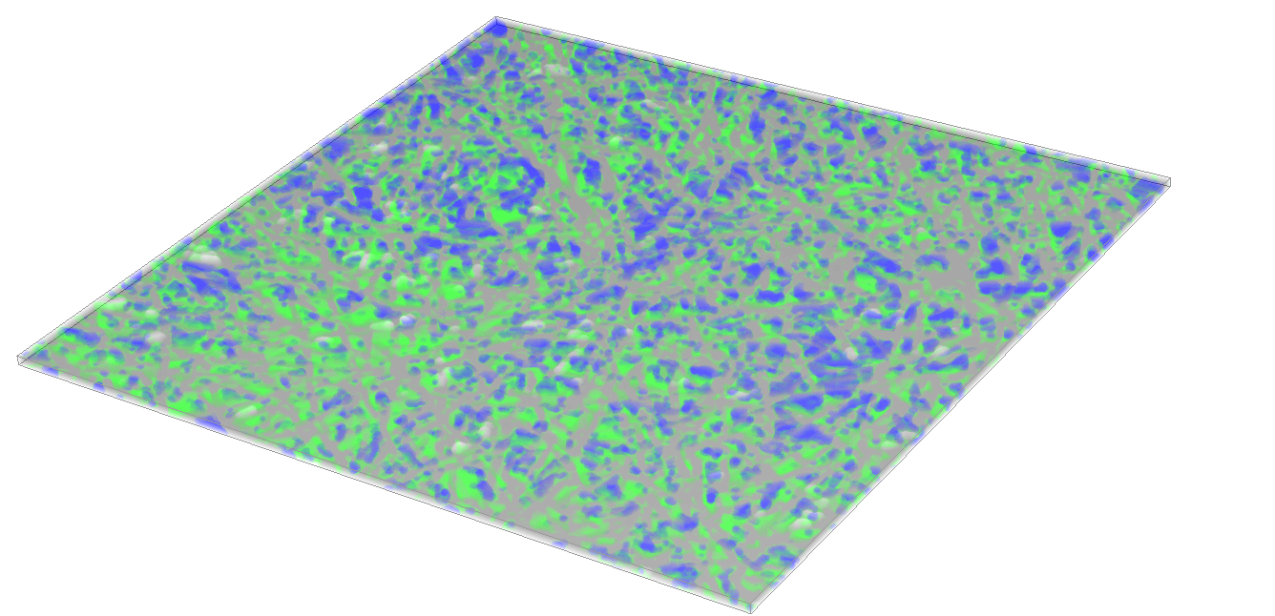
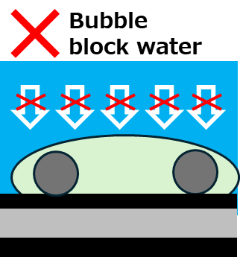
3. Result & Discussion
(2) 3D image of An-PTL during water electrolysis.
Extracted as 60μm thickness domain which close to An-CL.
2.3 mm
Anode
Oxygen occupation imply bubble block.
Cathode
Heterogeneous water/oxygen distribution near Anode-CL.

Slide 9
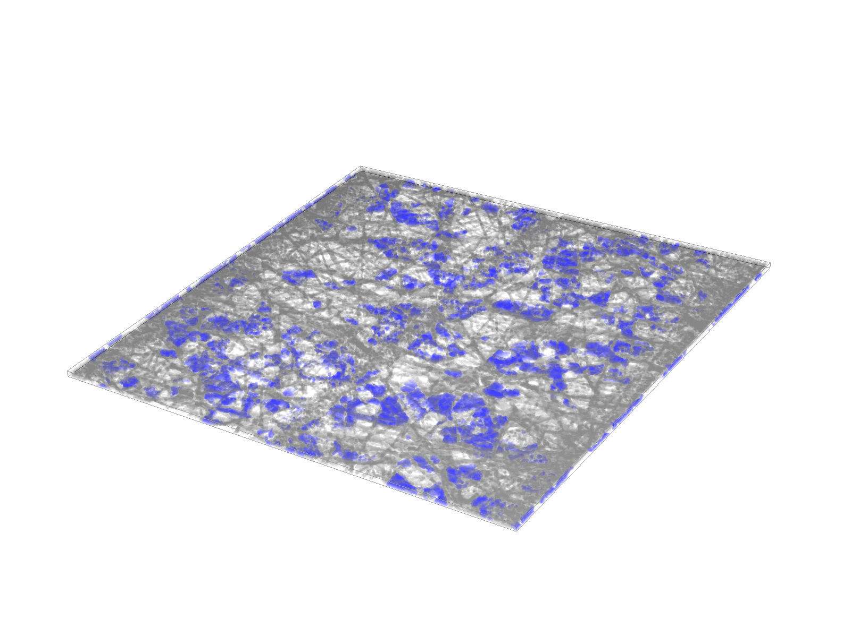
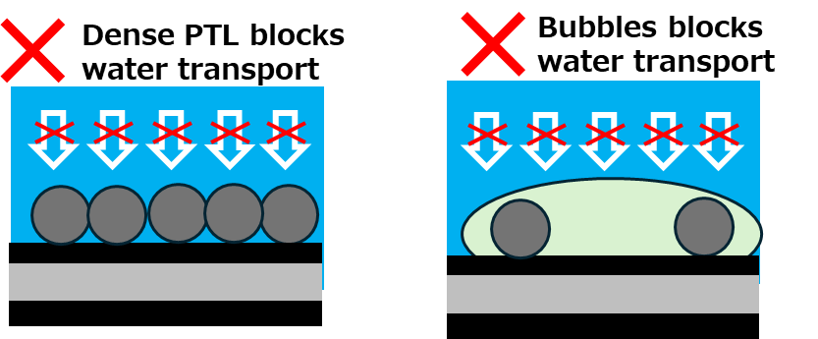
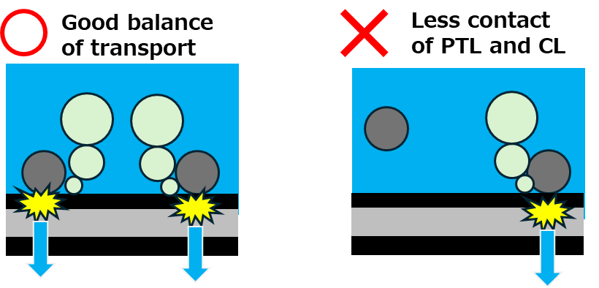
3. Result & Discussion
(3) 3D image of Ca-PTL during water electrolysis.
Extracted as 60μm thickness domain which close to Ca-CL.
“Water” implies low activity at the opposite Cathode-CL.
2.3 mm
Anode
or
“Water” implies activity at the oposite Cathode-CL.
Cathode
or
In Ca-PTL domain closing to Ca-CL, water distribute heterogeneously.

Slide 10
3. Result & Discussion
X
 |  | X
 |  | 0 | 15 | … | … | … | 650
Y | 0
 | 15
 | …
 | …
 | …
 | 650
scan
scan
(2) water saturation
in An-PTL
scan
Y
vs
Anode
scan
 |  | X
 |  | 0 | 15 | … | … | … | 650
Y | 0
 | 15
 | …
 | …
 | …
 | 650
scan
(1) PTL/CL contact
scan
vs
scan
(3) water saturation
in Ca-PTL
scan
 |  | X
 |  | 0 | 15 | … | … | … | 650
Y | 0
 | 15
 | …
 | …
 | …
 | 650
scan
Cathode
ROI scanning yields local water saturation and contact ratios.
Local correlations determined by comparing identical XY positions.

Slide 11
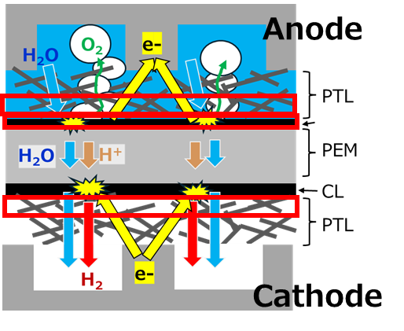
3. Result & Discussion
(2) water saturation in An-PTL
(1) PTL/CL contact
(3) water saturation in Ca-PTL
Water saturation
in Ca-PTL
Water saturation
in Ca-PTL
PTL/CL contact percentage
Water saturation in An-PTL
Most data points fall within a triangular domain.

Slide 12
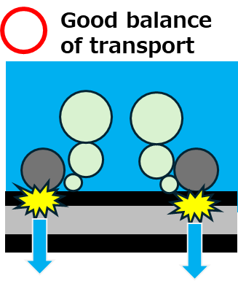
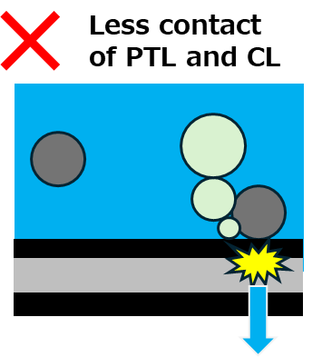

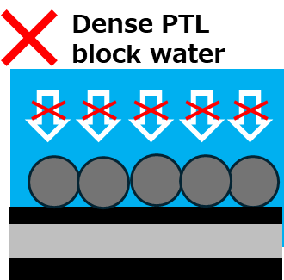
(2) water saturation in An-PTL
3. Result & Discussion
(1) PTL/CL contact
(3) water saturation in Ca-PTL
Water saturation
in Ca-PTL
Water saturation
in Ca-PTL
PTL/CL contact percentage
Water saturation in An-PTL

Slide 13
(2) water saturation in An-PTL
3. Result & Discussion
(1) PTL/CL contact
(3) water saturation in Ca-PTL
Water saturation
in Ca-PTL
Water saturation
in Ca-PTL
PTL/CL contact percentage
Water saturation in An-PTL
Explainable ?

Slide 14
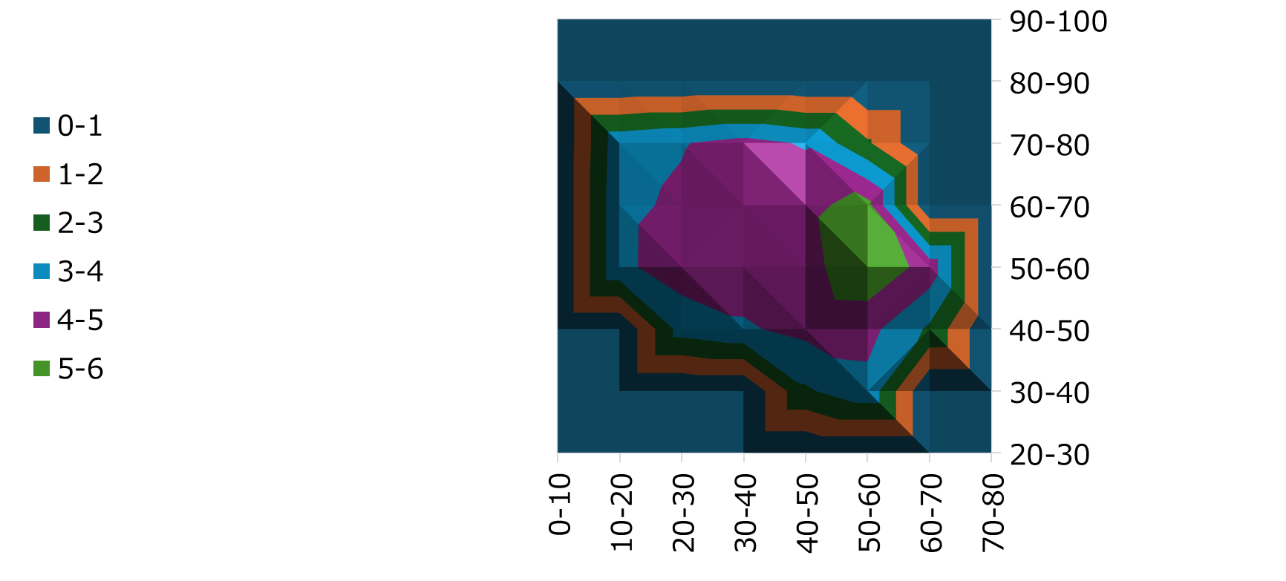

3. Result & Discussion
90-100
Water saturation
in Ca-PTL (%)
(Average in classes)
80-90
70-80
60-70
Water saturation
in An-PTL (%)
50-60
40-50
30-40
20-30
0-10
10-20
20-30
30-40
40-50
50-60
60-70
70-80
PTL/CL contact percentage(%)
Optimal PTL/CL contact: 40–60%

Slide 15

3. Result & Discussion
90-100
Water saturation
in Ca-PTL (%)
(Average in classes)
80-90
70-80
60-70
Water saturation
in An-PTL (%)
50-60
40-50
30-40
20-30
0-10
10-20
20-30
30-40
40-50
50-60
60-70
70-80
PTL/CL contact percentage(%)
Optimal PTL/CL contact: 40–60%

Slide 16
3. Result & Discussion
90-100
Water saturation
in Ca-PTL (%)
(Average in classes)
?
80-90
70-80
60-70
Water saturation
in An-PTL (%)
50-60
40-50
30-40
20-30
0-10
10-20
20-30
30-40
40-50
50-60
60-70
70-80
PTL/CL contact percentage(%)
Most regions can be explained by PTL/CL contact and Anode saturation.

Slide 17
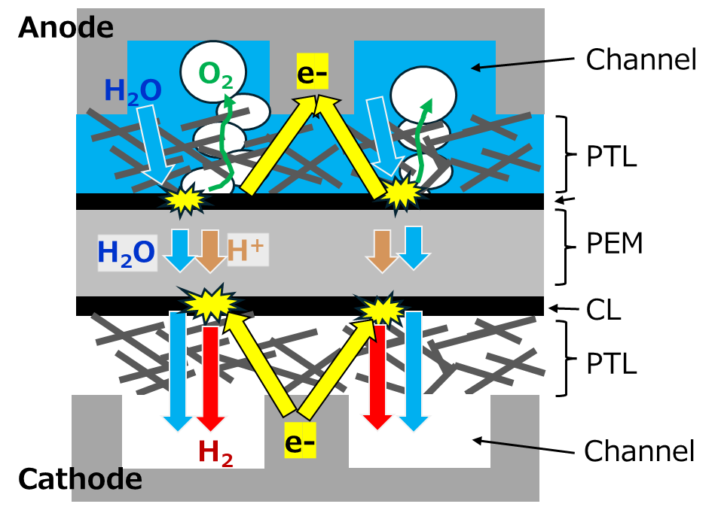
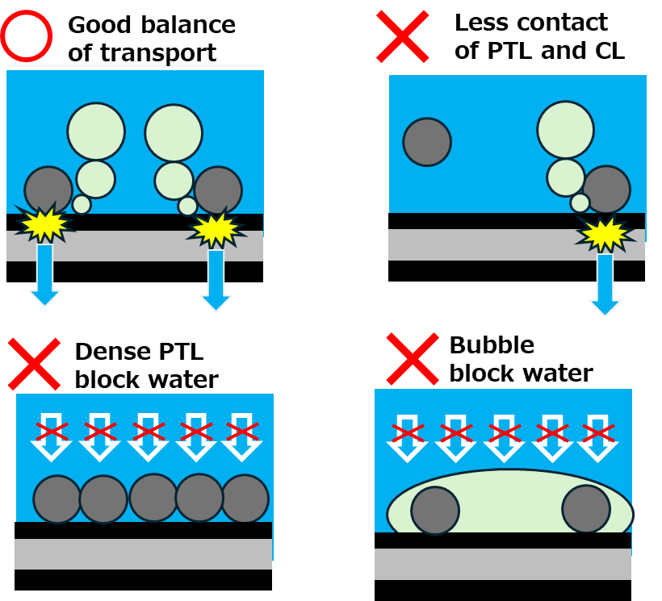
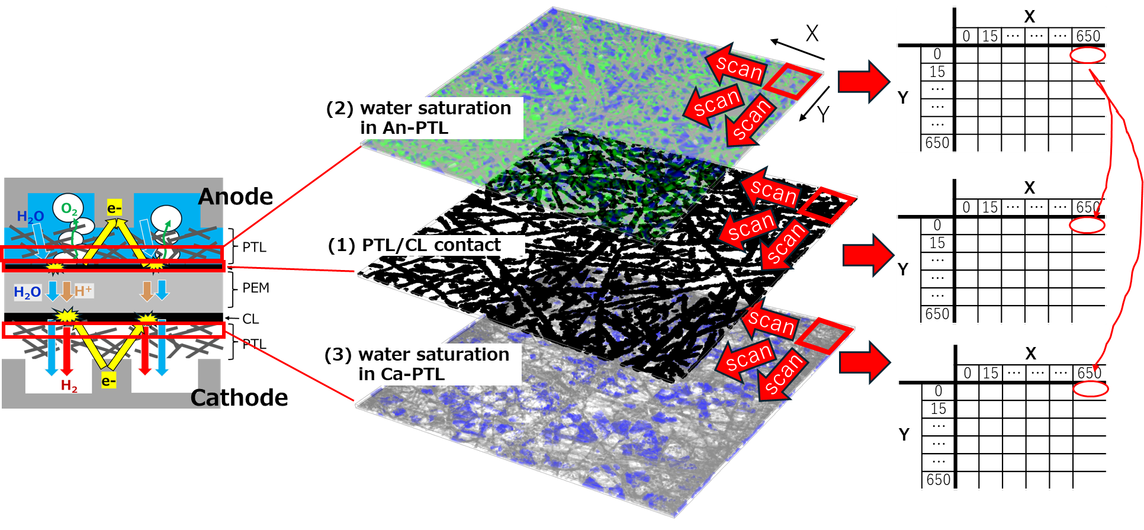
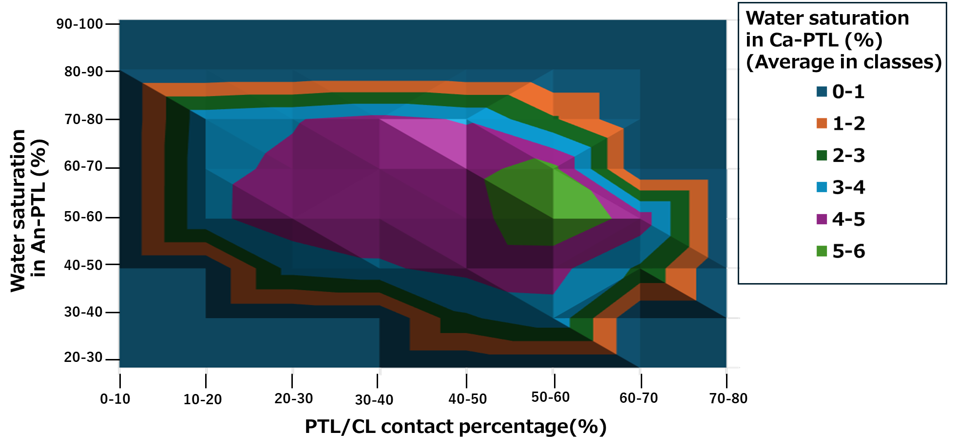
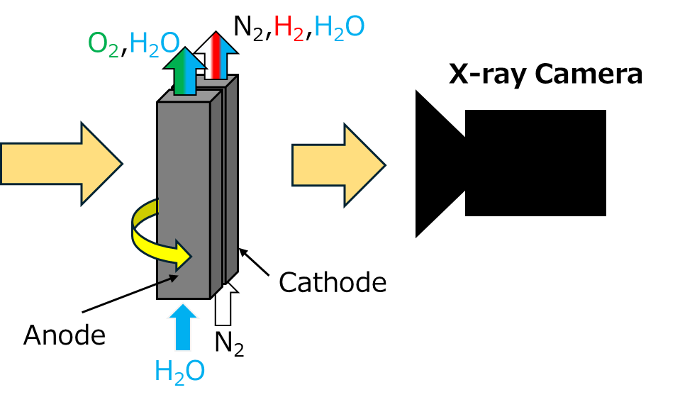
5. Conclusion
Analyze reaction distribution in PEM water electrolyzer based on 4 type phenomena resulting in local structure and transport phenomena.
Anode reaction distribution is mainly governed by contact and transport parameters.
Approach:
Visualizing local structure and transport phenomena by Operand X-ray CT under operating condition shows.

Slide 20
1. Introduction
Schematic of water electrolyzer
Cross sectional image of water electrolyzer
obtained by X-ray CT
Anode
Channel
O₂
e-
H₂O
PTL
Catalyst Layer
H₂O
H⁺
PEM
Catalyst Layer
PTL
H₂
e-
Channel
Cathode
X-ray CT can visualize water distribution and microstructure in electrode.

Slide 21
1. Introduction
Schematic of water electrolyzer
Heterogeneously water transport
Anode
Channel
O₂
e-
H₂O
PTL
Catalyst Layer
H₂O
H⁺
PEM
Catalyst Layer
H₂O
PTL
H₂
e-
Channel
Cathode
It is suggested that reaction occur at the catalyst layer witch contact with PTL
due to insufficient electroconductivity in catalyst layer.

Slide 22
1. Introduction
Schematic of water electrolyzer
Heterogeneously water transport
Anode
Channel
O₂
e-
H₂O
PTL
Catalyst Layer
H₂O
H⁺
PEM
Catalyst Layer
H₂O
PTL
H₂
e-
Channel
Cathode
It is suggested that reaction cannot occur under the dense PTL domain
due to the water transport blocking .

Slide 23
1. Introduction
Schematic of water electrolyzer
Heterogeneously water transport
Anode
Channel
O₂
e-
H₂O
PTL
Catalyst Layer
H₂O
H⁺
PEM
Catalyst Layer
PTL
H₂
e-
Channel
Cathode
It is suggested that reaction cannot occur due to oxygen bubble coverage on the catalyst layer surface.

