Slide 1



Micro-CT and SEM characterization on biochar-modified wellbore cement exposed to a CO₂-rich environment
Liwei Zhang, Theogene Hakuzweyezu, Yan Wang, Manguang Gan
2026.5

Slide 2
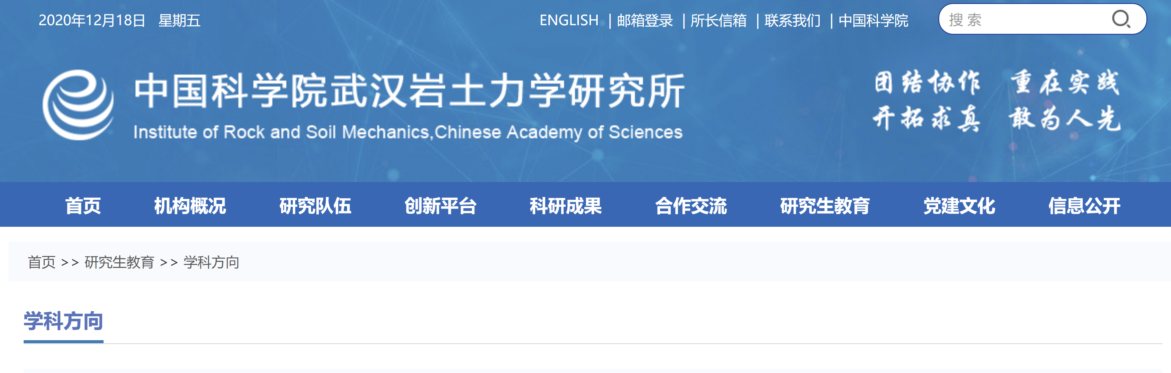

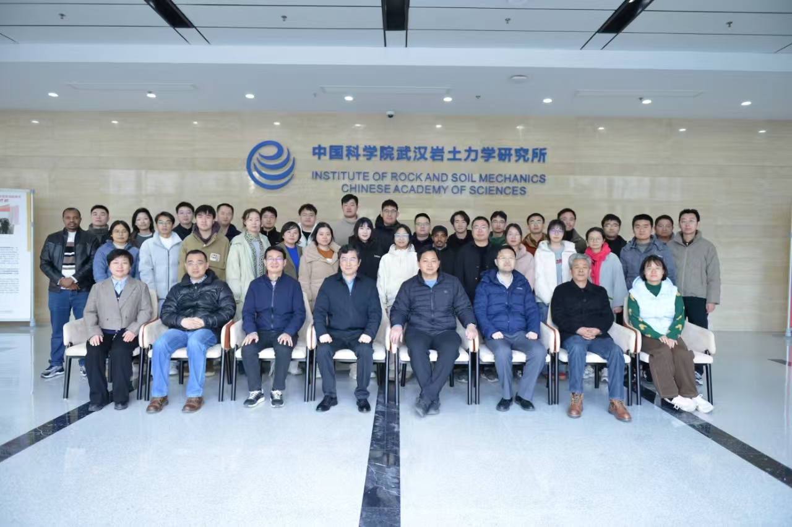
Geologic Carbon Storage and Engineering Safety Research Center
40+ full-time researchers (including postdocs and employed engineers)
Research directions cover almost all fields of CO₂ geological utilization and storage
Key research direction 1: Site selection and source-sink matching, system risks and cost analysis, regulation and commercialization
Key research direction 2: THMC coupling theory of CO₂-water-mineral systems
Key research direction 3: Evaluation and monitoring of CO₂ storage system integrity and mechanical stability
Key research direction 4: Characterization and control of CO₂ corrosion processes
The center was founded in 2004 and is one of the largest CCUS research centers in China.

Slide 3
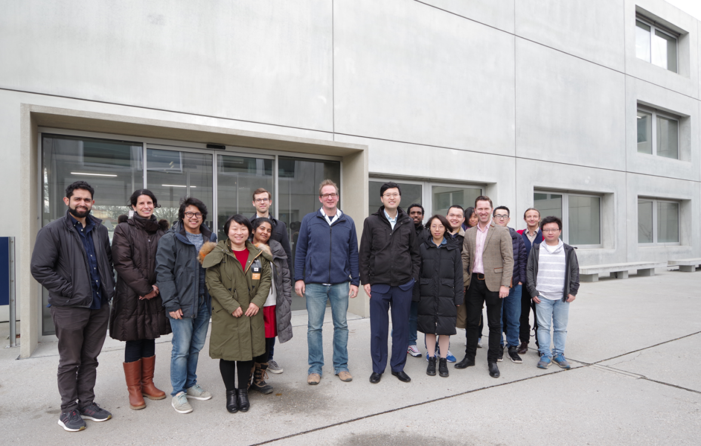
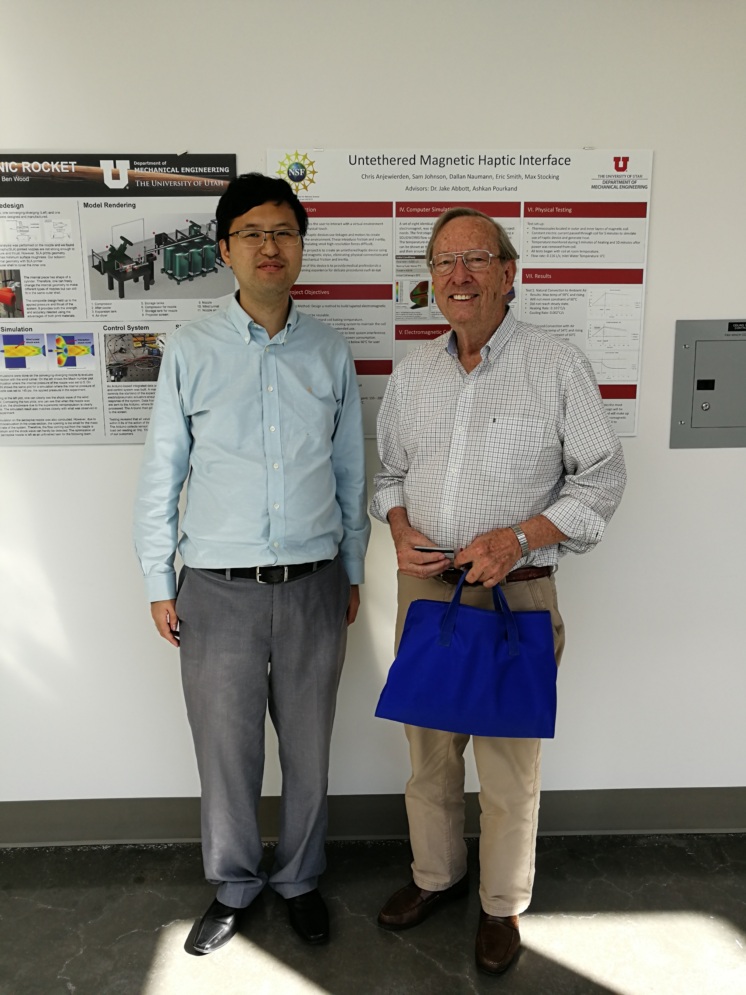
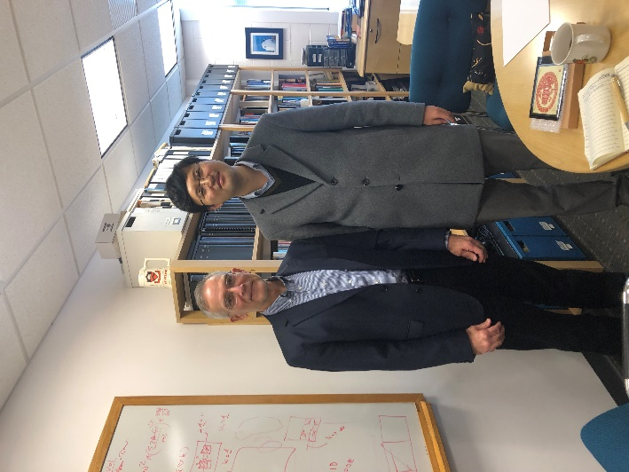
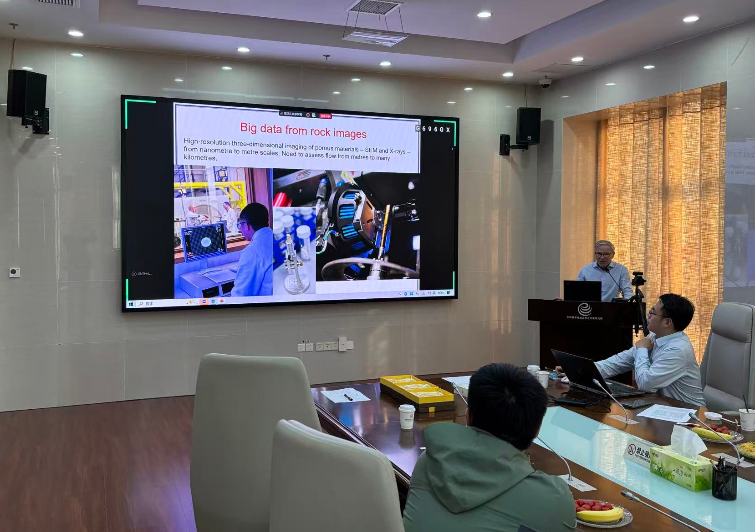
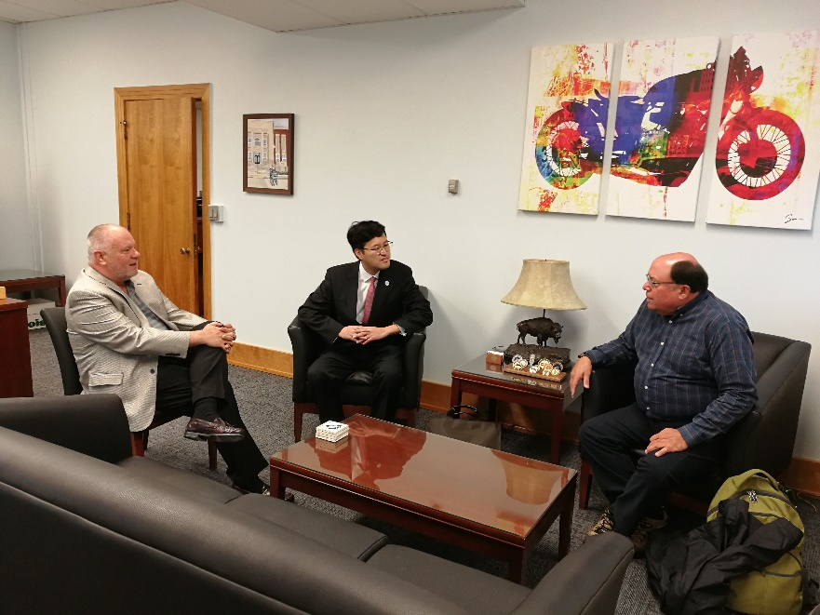
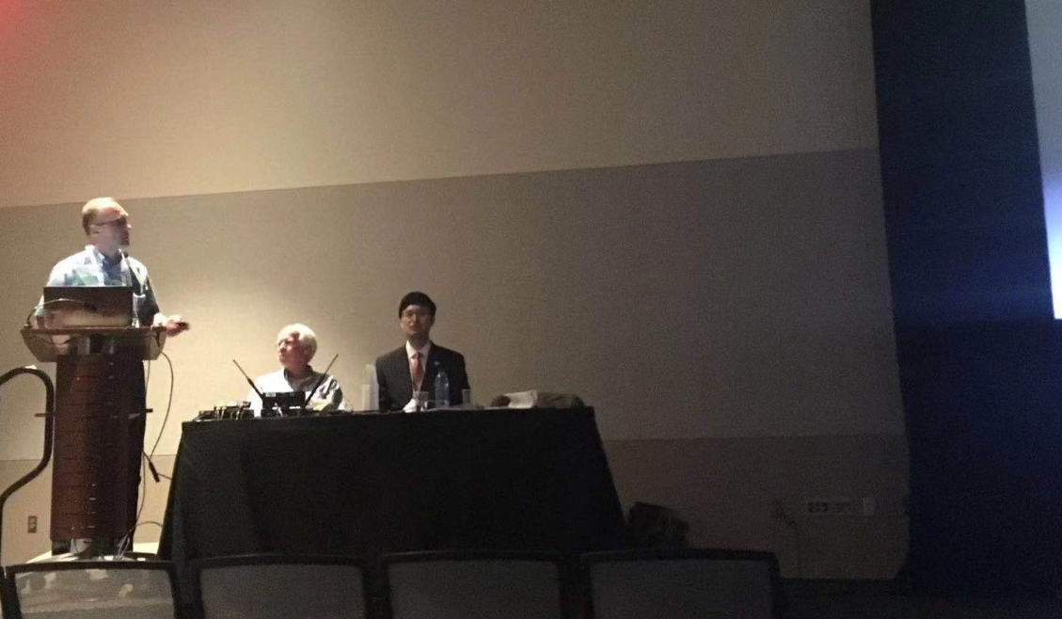
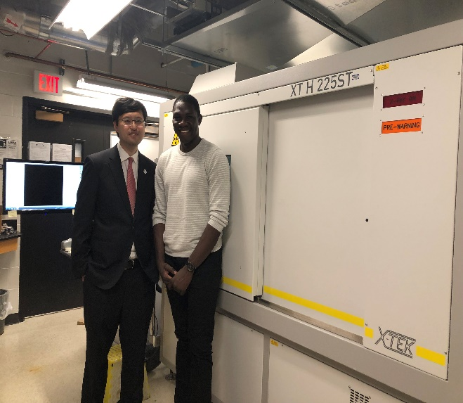
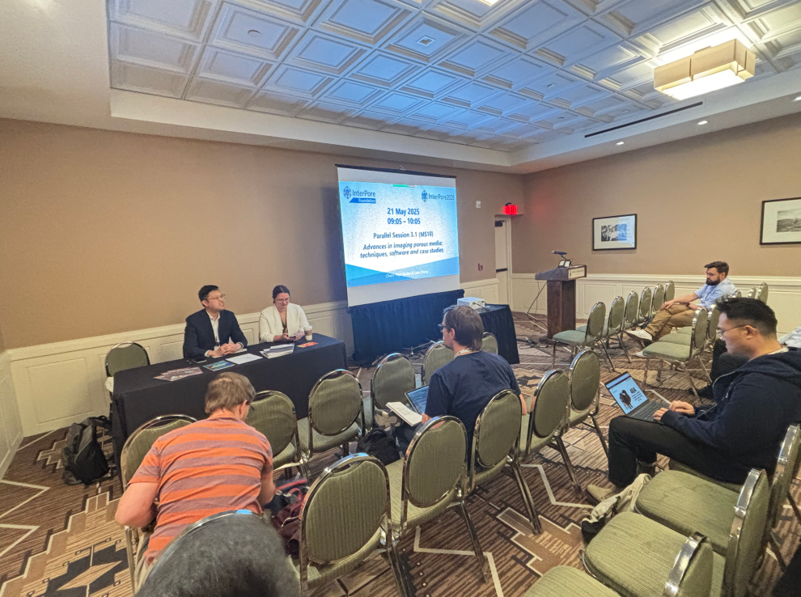
One of the most active international collaboration hubs in China to promote CCUS research
Meeting with Prof. Michael Celia at Princeton University
Visiting Institute for Modelling Hydraulic and Environmental Systems, University of Stuttgart
Meeting with Prof. Sidney Green at the University of Utah
Prof. Martin Blunt of Imperial College visited the center
Visiting South Dakota School of Mines and Technology
Hosting the session of“Carbon Sequestration in Underground Reservoirs”at GSA Annual Meeting
Hosting the session of“Advances in Imaging Porous Media”at InterPore Annual Meeting
Visiting the CT center at University of Michigan

Slide 4
1
Background and research objectives
2
Raw materials and experimental schemes
CONTENTS
3
Results and discussion
4
Conclusions
Notes:
I will introduce the content from the following four parts, the first one is background and objectives.

Slide 5

01
Background

Slide 6
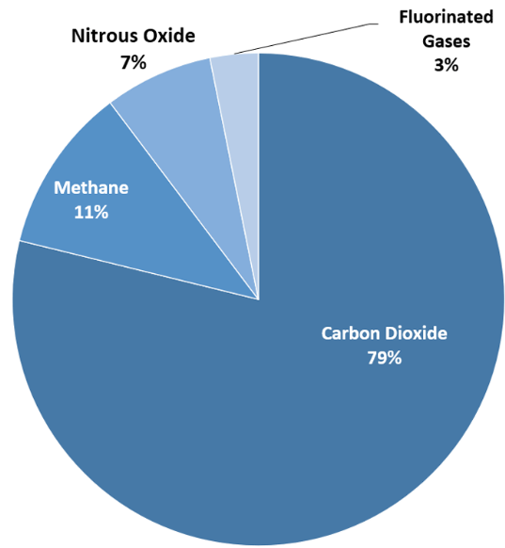

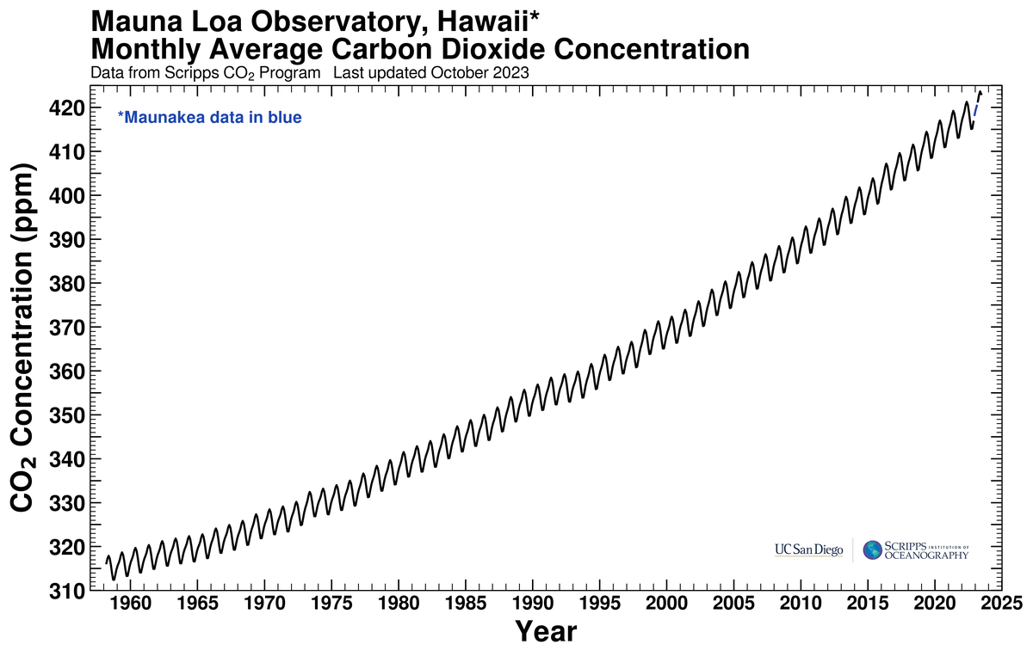

Background
CO₂ accounts for about 79% of the total greenhouse gas emissions, due to very significant global CO₂ emissions from various sectors.
Reason for CO₂ emissions: more than 80% of the world's primary energy supply is based on fossil fuels
Reducing GHG emissions is an important strategic requirement for the world
Call on reducing anthropogenic CO₂ emissions and achieve net zero emission by 2050
CO₂ data on Hawaii’s Mauna Loa constitute the longest record of direct measurements of CO₂ in the atmosphere
U.S. Environmental Protection Agency (2022), Inventory of U.S. Greenhouse Gas Emissions and Sinks: 1990-2020

Slide 7




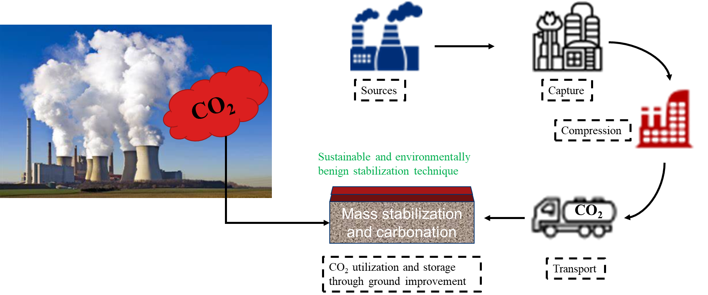
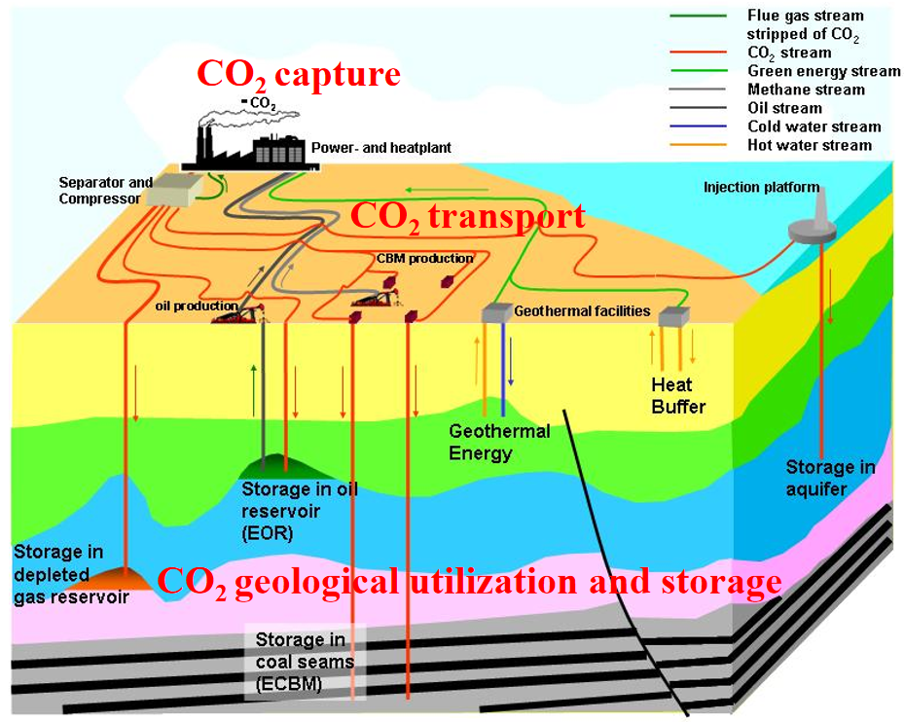
Background
The global pathway to net zero emissions
Pathways to net zero emissions
Carbon emission reduction
Zero-carbon emission
Carbon negative
Carbon utilization and removal
The green development of traditional fossil energy and the use of low-carbon energy
The development of new zero-carbon energy and zero-carbon industrial process
Strengthening CO₂ resource utilization and ecosystem carbon sequestration
A promising technology: CCUS (CO₂ capture, utilization, and storage)
CCUS refers to the industrial process of separating CO₂ from industrial emission sources and directly using or permanently storing it to achieve CO₂ reduction

Slide 8
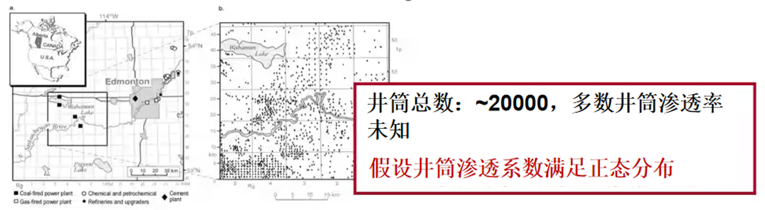
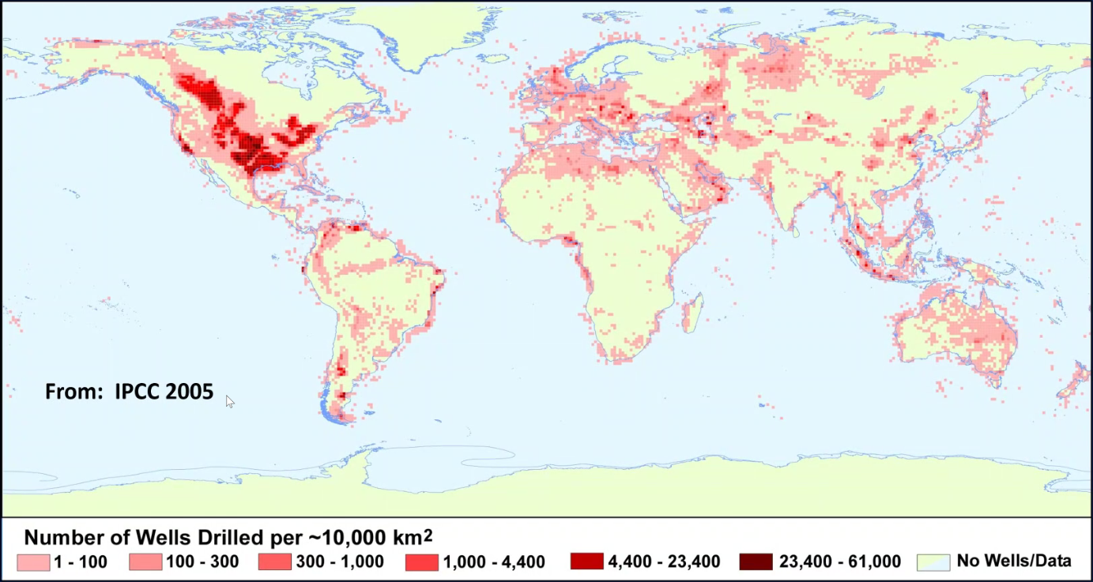
Background
For CCUS projects, CO₂ leakage via wellbores is a big concern
Well no.：
~20000
Unknown leakage risk for most wells
Distribution of Wellbores at the Weyburn
CO₂-EOR Project Site in Alberta, Canada
(Adopted from Laumb et al., 2016)
Distribution of oil and gas wells worldwide
(Adopted from IPCC, 2005)
Given that wellbores are globally distributed and are integral to CO₂ geological utilization and storage projects, it is imperative to study their leakage risks.

Slide 9
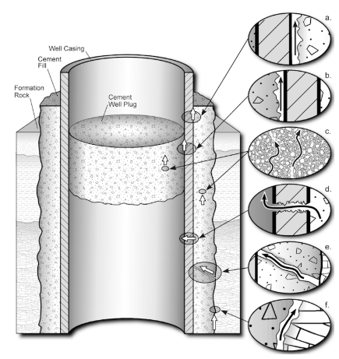
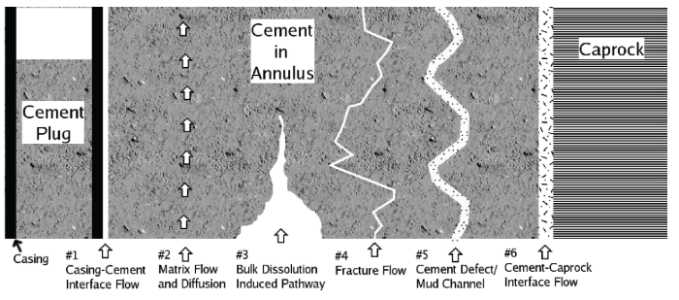
Background
CO₂ leakage from wellbores: a major CO₂ leakage pathway for CCUS projects
(Adopted from Viswanathan et al. 2008)
Casing-cement interface flow
Matrix flow and diffusion
Fracture/cement defect/mud channel flow
Cement-caprock interface flow
(Adopted from Gasda et al. 2004)
CO₂ leakage from wellbores impairs long-term safe CO₂ storage of CCUS projects and causes environmental concerns.

Slide 10
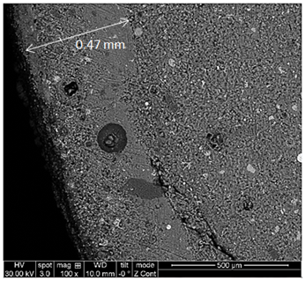
Background
Research needs
CCUS conditions: Low pH, high concentrations of CO₂, H₂S, SO₄²⁻, etc.
With large amounts of CO₂ injection, the pH of the formation water can drop below 3.0 w/o buffering effect
Exposure of wellbore cement to CCUS conditions: Permeability and porosity increase and loss of cement integrity
Wellbore cement: An alkaline porous material serving as a protective layer for wellbore casing. Hydrated wellbore cement contains calcium hydroxide, calcium silicate hydrate, ettringite, calcium sulphoaluminate hydrate, etc.
CO₂-rich environment
Most minerals in hydrated cement are prone to acid attack
(Zhang et al., 2013)
Permeability and porosity increase at the reaction zone

Slide 11
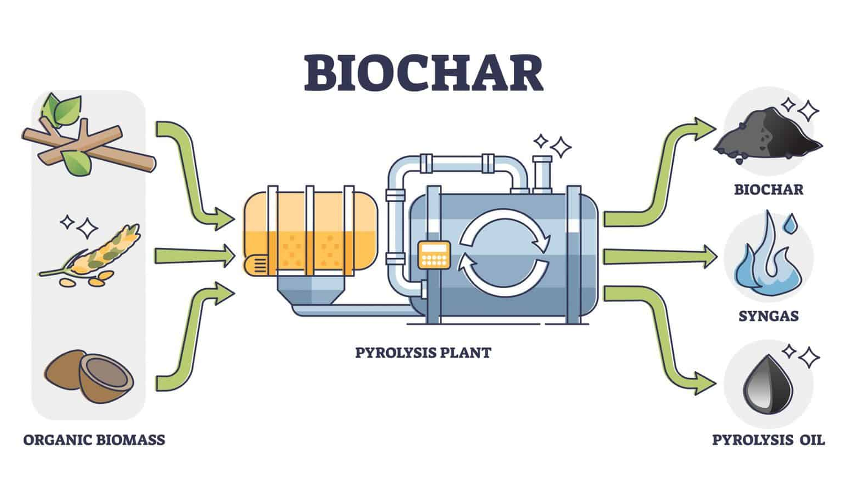
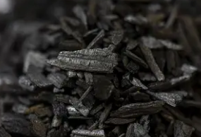
Background
Introduction to biochar
Biochar is a stable carbon-rich and porous material produced by heating organic biomass under oxygen-limited conditions. It has a high surface-to-volume ratio, porous structure, and enriched functional groups on the surface (such as –OH and –COOH).
Soil Fertility Improvement and Agricultural Production
https://growingthegoodlife.net/
Carbon Sequestration and Climate Change Mitigation
Soil and Water Pollution Remediation
Livestock Waste Management and Circular Agriculture
Enhancement of Ecological Restoration and Reforestation
Production of biochar
Applications of biochar
This study shows that biochar can also be utilized as a wellbore cement additive to mitigate CO₂ alteration to wellbore cement

Slide 12
Research objectives
Research objectives
Build cement degradation testing system under THMC coupled conditions and conduct cement degradation experiments for RF, BC and supercritical CO₂-treated biochar (SCBC) samples
Conduct CT, SEM and QEMSCAN characterization of cement samples after CO₂ reaction experiments to visualize cement integrity loss, and validate the CO₂-resisting performance of BC and SCBC samples
Study the mechanisms of BC and SCBC additives to resist CO₂ alteration

Slide 13
02
Raw materials and experimental schemes

Slide 14
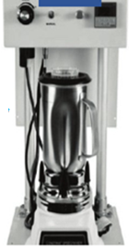
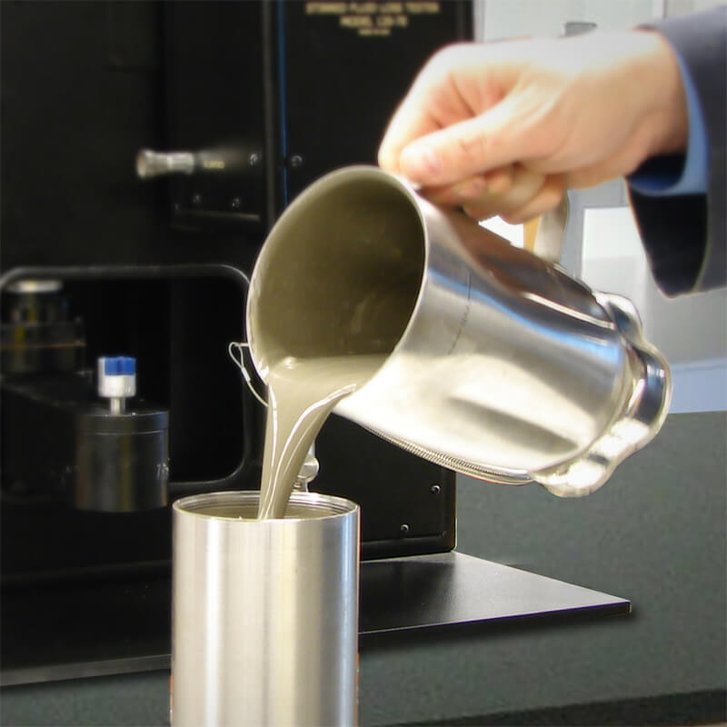
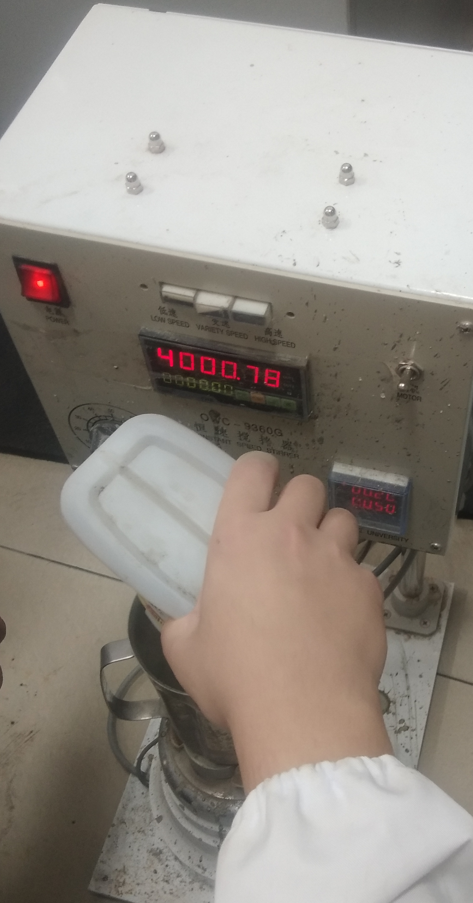

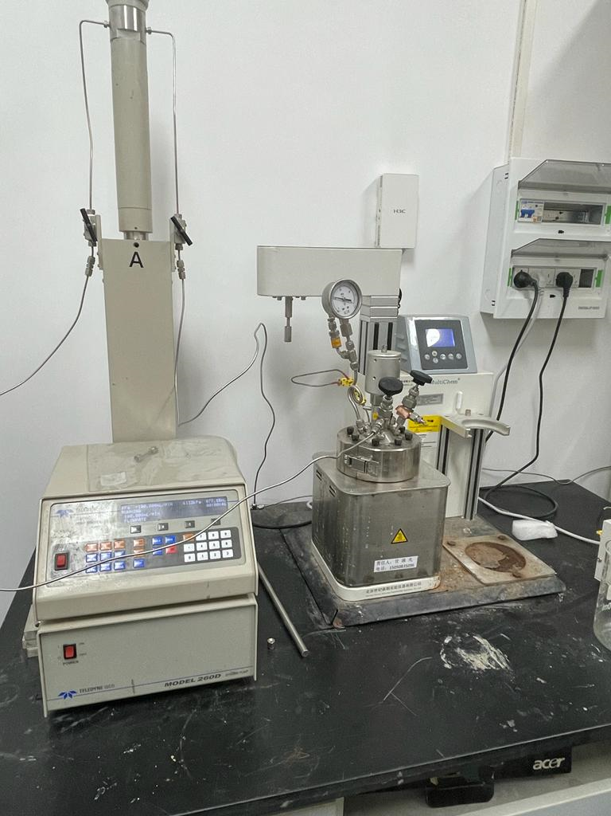
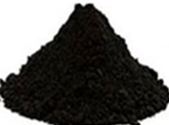
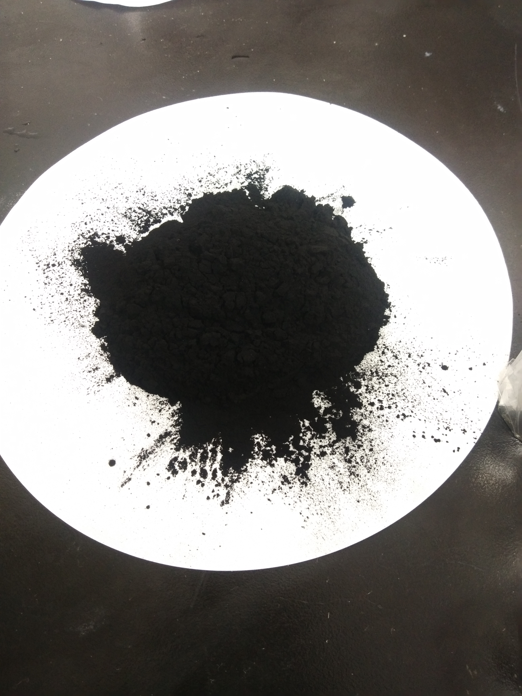
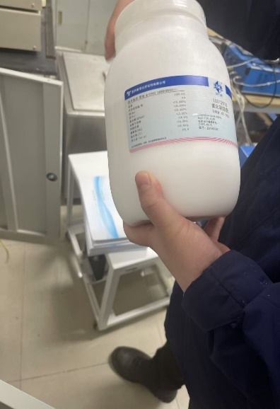
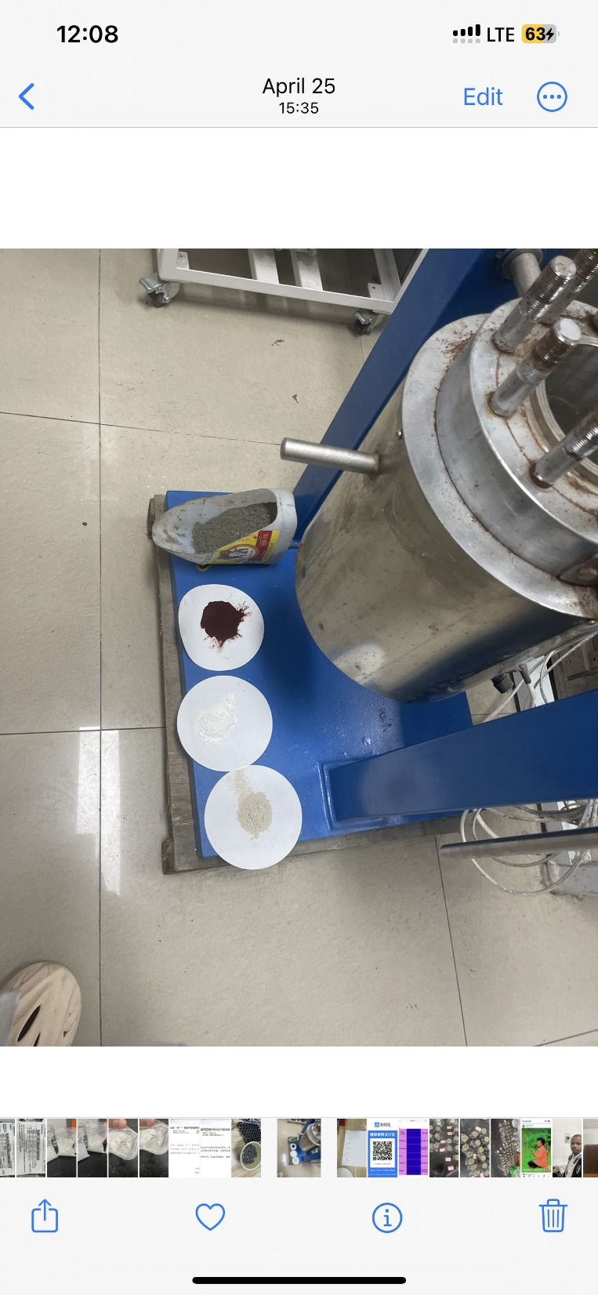
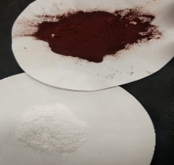
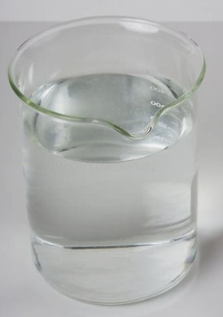
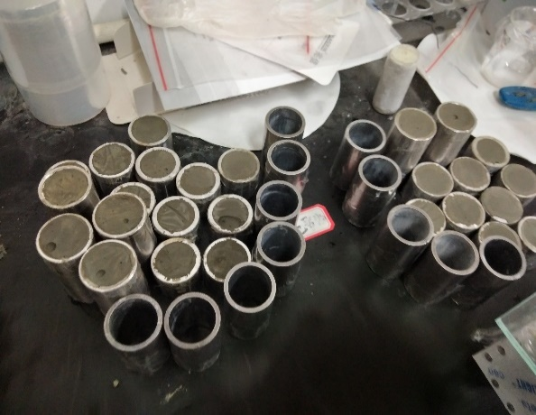
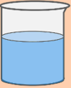
Raw materials and experimental schemes
Materials and testing method
1 wt.% NaCl
Curing and CO₂ reaction vessel
BC
SCBC
CO₂ cylinder
Dispersant
Water
Water
Water reducer
Cement
Slurry Mixer
Sample molding
(a)Raw materials
(b)Slurry and sample preparation
(c) Sample curing and CO₂ exposure
Mix proportions of control and biochar added cement mixes
Group | Cement | Water | Dispersant | Superplasticizer | Biochar | ScCO₂ treated biochar
RF | 200 | 88 | 3 | 4 | 0 | 0
SCBC | 200 | 88 | 3 | 4 | 0 | 4
BC | 200 | 88 | 3 | 4 | 4 | 0
Batches of cement slurries were prepared, and different tests were performed to evaluate their mechanical properties and physicochemical characteristics
Notes:
I will introduce the content from the following four parts, the first one is background and objectives.

Slide 15
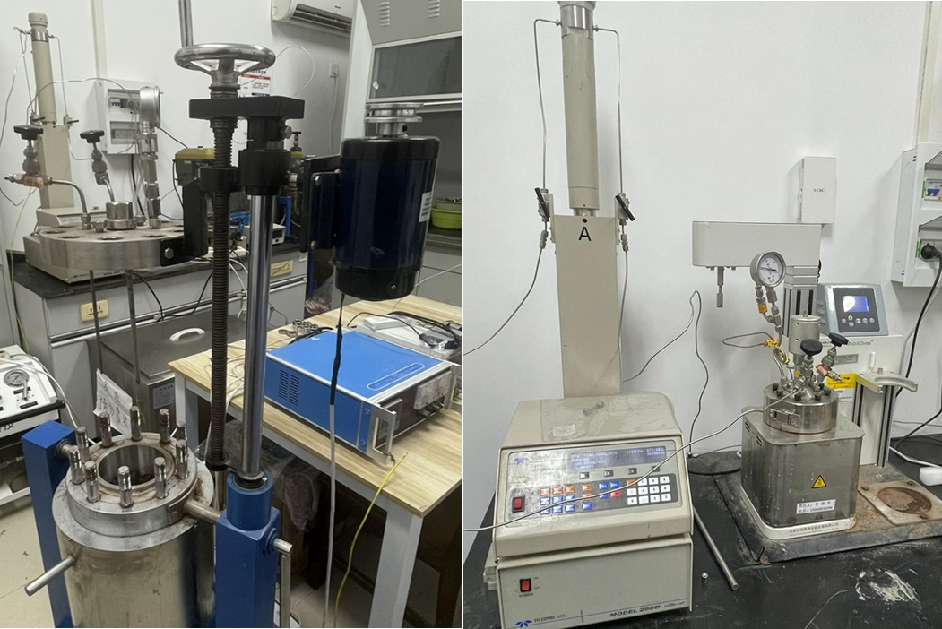
Raw materials and experimental schemes
HPHT curing/carbonation process
A schematic diagram illustrating the components of a HPHT curing/carbonation vessel
Curing and reaction devices used at IRSM-CAS
Experimental parameters
Curing
Reaction
Curing temperature: 62 ºC
Curing pressure : 17MPa
Solution: 1wt% NaCl
Curing time: 14 d
Reaction temperature: 62 ºC
Reaction time with CO₂: 14d
Reaction pressure : 17MPa
Solution: 1wt% NaCl
Notes:
I will introduce the content from the following four parts, the first one is background and objectives.

Slide 16
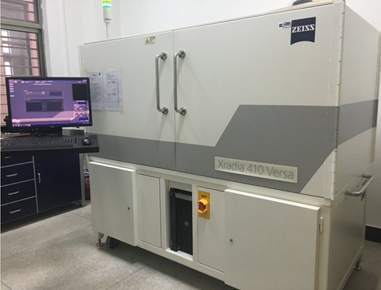
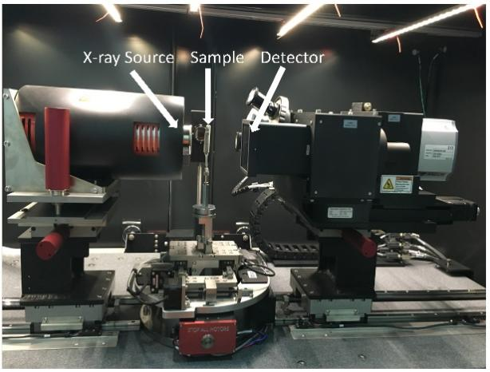
Raw materials and experimental schemes
Primary characterization method: micro-CT scanning
The pore size in cementitious materials generally falls within the range of 0.5–1000 nm. Consequently, micro-CT, with a highest resolution of around 0.5 μm, is inadequate for directly characterizing the pore structure of cement.
However, after cement reacts with CO₂, tiny pores in cement are connected due to the dissolution of cement materials, and the newly formed pores are large enough for micro-CT observation. Therefore, it is appropriate to use micro-CT to characterize the structural changes of cement after exposure to CO₂.
Zeiss Xradia 410 micro-CT scanner

Slide 17
Raw materials and experimental schemes
The workflow of CT image post-processing
Before
After
Before
After
Noise reduction and filtering of images (optional)
(a) Distinguish of features spots in cement surface before and after the reaction for registration purpose
(b) Selection of slices before and after the reaction, and then the slices were registered and aligned
(c) Acquisition of grayscale difference
(d) 2D and 3D visualization of cement degradation
(Miao et al., 2020; Gan et al., 2024)

Slide 18
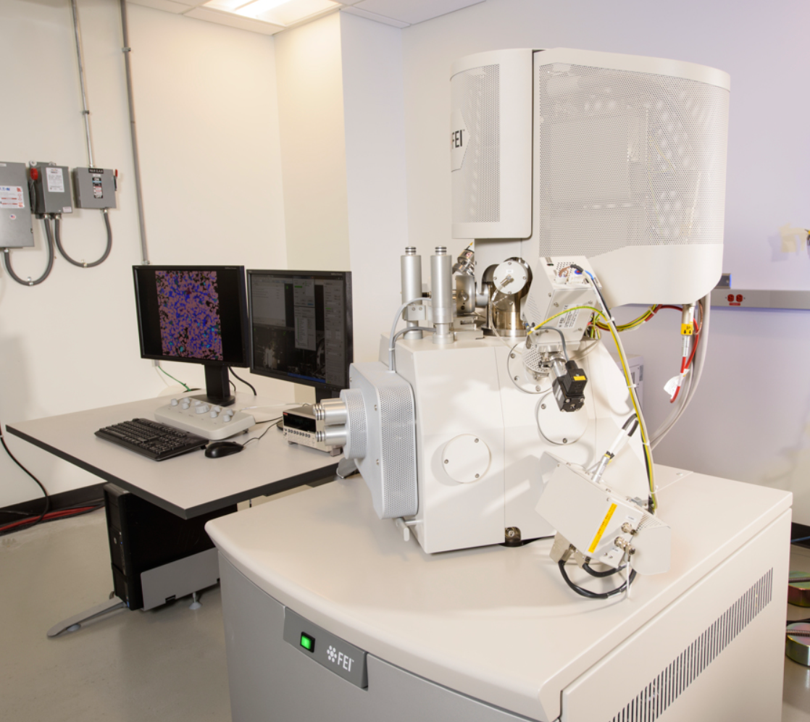
Raw materials and experimental schemes
FE-SEM and QEMSCAN
Although CT imaging can visualize the general evolution of pore structure in cement, its resolution limitations prevent the characterization of individual nanoscale pores after CO₂ reaction.
To fully capture the multiscale evolution of pore structure in wellbore cement following CO₂ corrosion, the combined use of CT scanning and high-resolution techniques (e.g., field emission SEM) is essential.
This study uses high-quality, high-resolution FE-SEM combined with QEMSCAN analysis to demonstrate the structural evolution of pores and mineral composition in different reaction zones within cement after reacting with CO₂.

Slide 19
03
Results and discussion

Slide 20
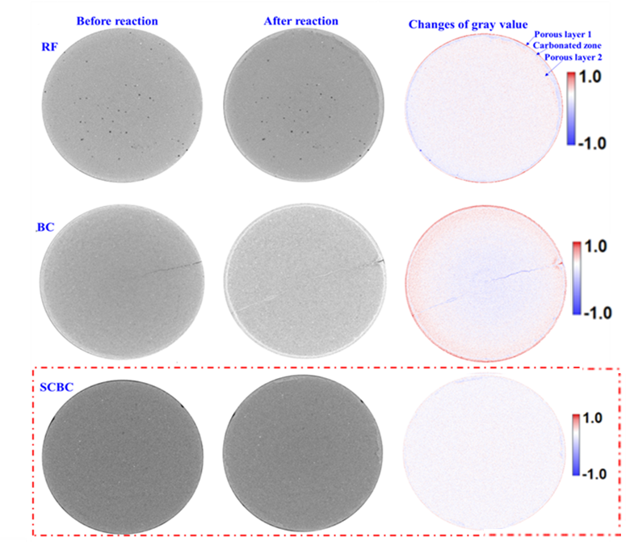
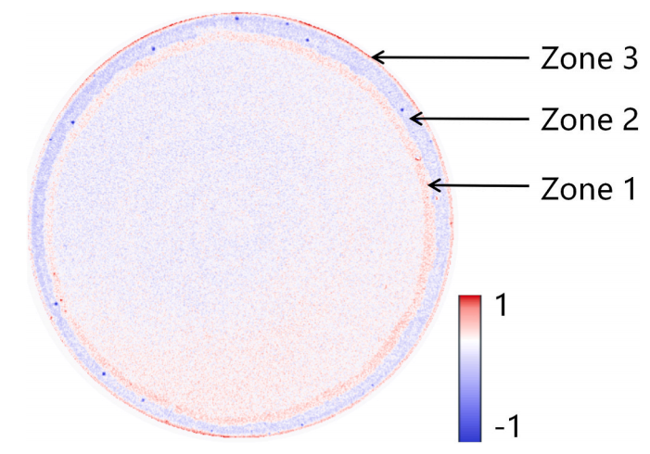
Micro-CT analysis
CT characterization results
Carbonation depth
Alteration depth
Wang et al., 2026
Hakuzweyezu et al., 2026a, 2026b
For BC, the carbonation region is smaller than that of RF, leading to a lower carbonation depth compared with RF
For BC, the dissolution region is larger than that of RF, leading to a higher alteration depth compared with RF
For SCBC, both the carbonation and dissolution regions are smaller than those of RF, leading to lower carbonation and alteration depths compared with RF The SCBC sample has the best alteration resistance
It is necessary to distinguish carbonation depth from alteration depth
Notes:
I will introduce the content from the following four parts, the first one is background and objectives.

Slide 21
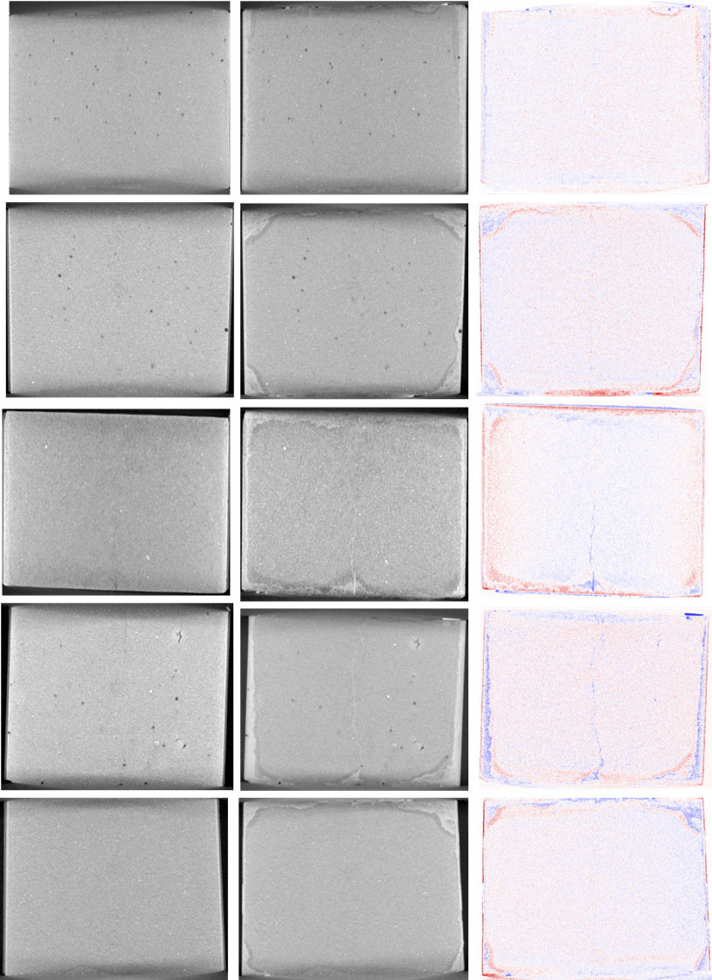
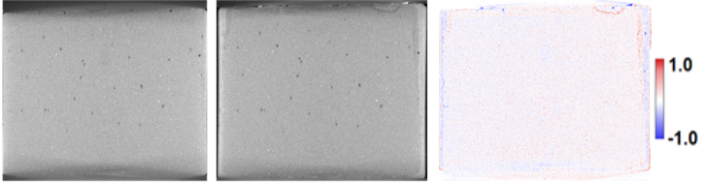

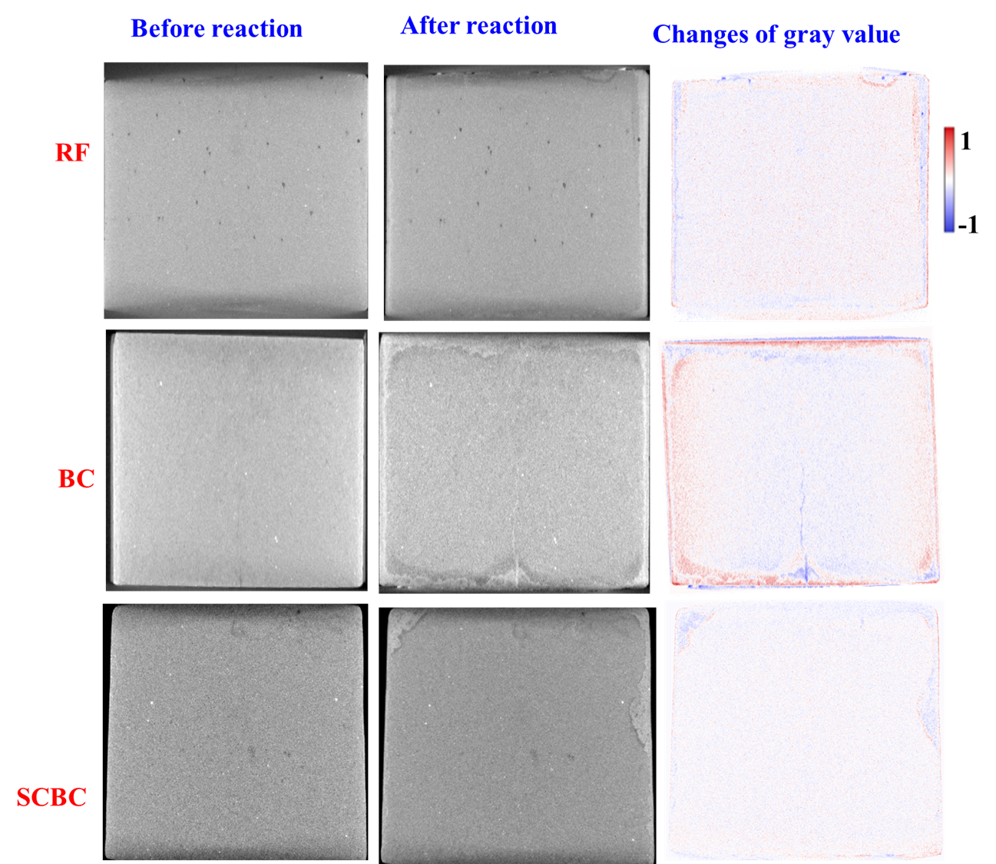
Micro-CT analysis
CT characterization results
Before reaction
After reaction
Gray value change
RF
BC
SCBC
CT slices revealing CO₂-induced chemical alteration (YZ direction)
Significant alteration occurs on the external surface of both RF and BC samples
For the SCBC sample, both the carbonation and the dissolution regions are smaller than those of the RF and BC samples
CT scanning has been proved to be a good tool to evaluate the level of CO₂-induced degradation of different cement samples
Notes:
I will introduce the content from the following four parts, the first one is background and objectives.

Slide 22
Analysis of carbonation depth
CT-derived carbonation depth results
Carbonation depth of the cement samples with different additives
Group | Carbonation depth/μm | Standard deviation | Inhibition efficiency/%
RF | 594.75 | 154.53 | —
CM | 332.84 | 35.92 | 44.04
BC | 556.13 | 38.46 | 6.49
CA | 807.55 | 116.00 | -35.78
GP | 438.82 | 29.52 | 26.17
SCBC | 410.56 | 30 | 30.9
Carbonation depth/µm
15.5
MgO | 502.4 | 20
The SCBC sample demonstrated superior resistance to CO₂ corrosion with a carbonation inhibition efficiency of 30.97%, compared to the BC, which had an efficiency of only 6.49%.
Notes:
I will introduce the content from the following four parts, the first one is background and objectives.

Slide 23
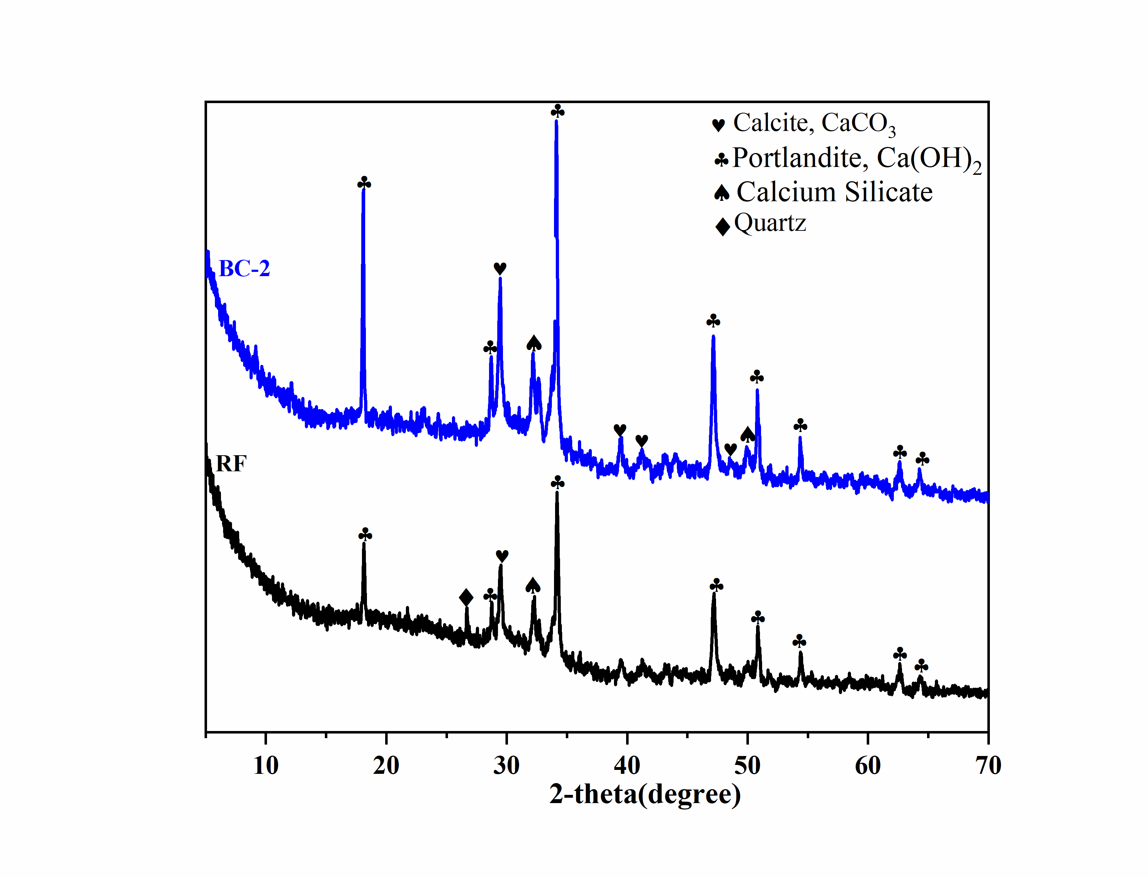
XRD analysis
XRD characterization results
XRD patterns of samples RF and BC
The XRD spectrum did not exhibit discernible peaks indicative of the formation of new minerals following the addition of BC.
Notes:
I will introduce the content from the following four parts, the first one is background and objectives.

Slide 24
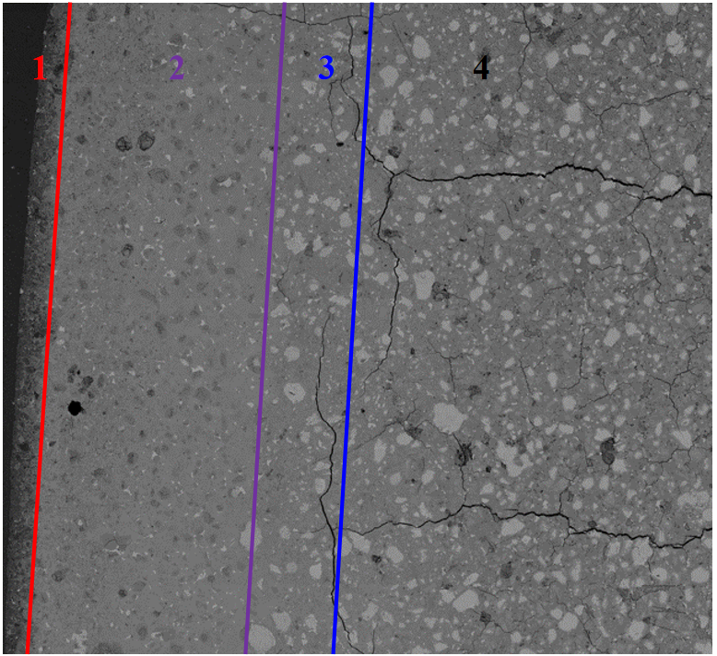
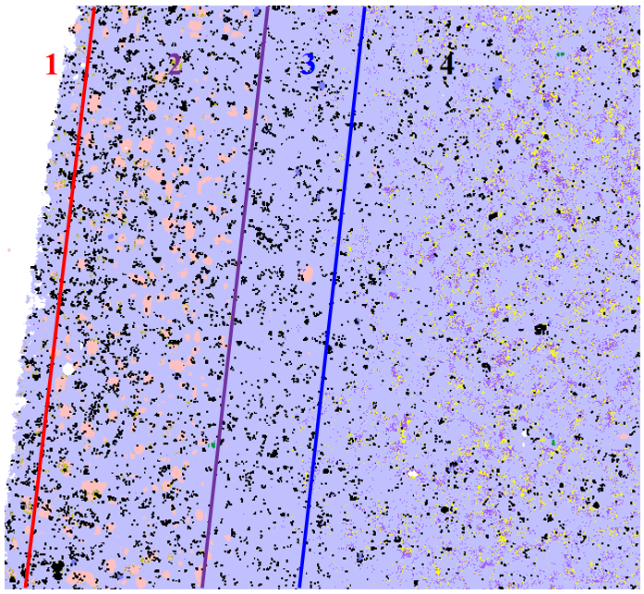
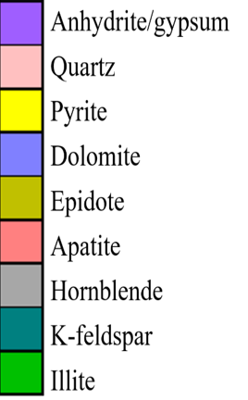
SEM and QEMSCAN mineralogical analysis of RF
FE-SEM and QEMSCAN results--RF
Scan area：1.4 x 1.2 mm
Scan area：1.5 x 1.5 mm
(Wang et al., 2026)
Gypsum (CaSO₄·2H₂O) was generated in the reaction layer 4.
Low
pH
High
Low
pH
High
A large amount of SiO₂ is observed in the dense carbonate layer (Layer 2), due to the dissolution of C-S-H.
In the Ca(OH)₂ dissolution layer (Layer 3), SiO₂ is scarce because very limited C-S-H gets dissolved (pH higher than that in Layer 2).
The main mineral blocking the internal nano-pores of the cement is gypsum due to dissolution of ettringite/monosulfate.
The pH gradient is the key factor to drive the reactions.

Slide 25
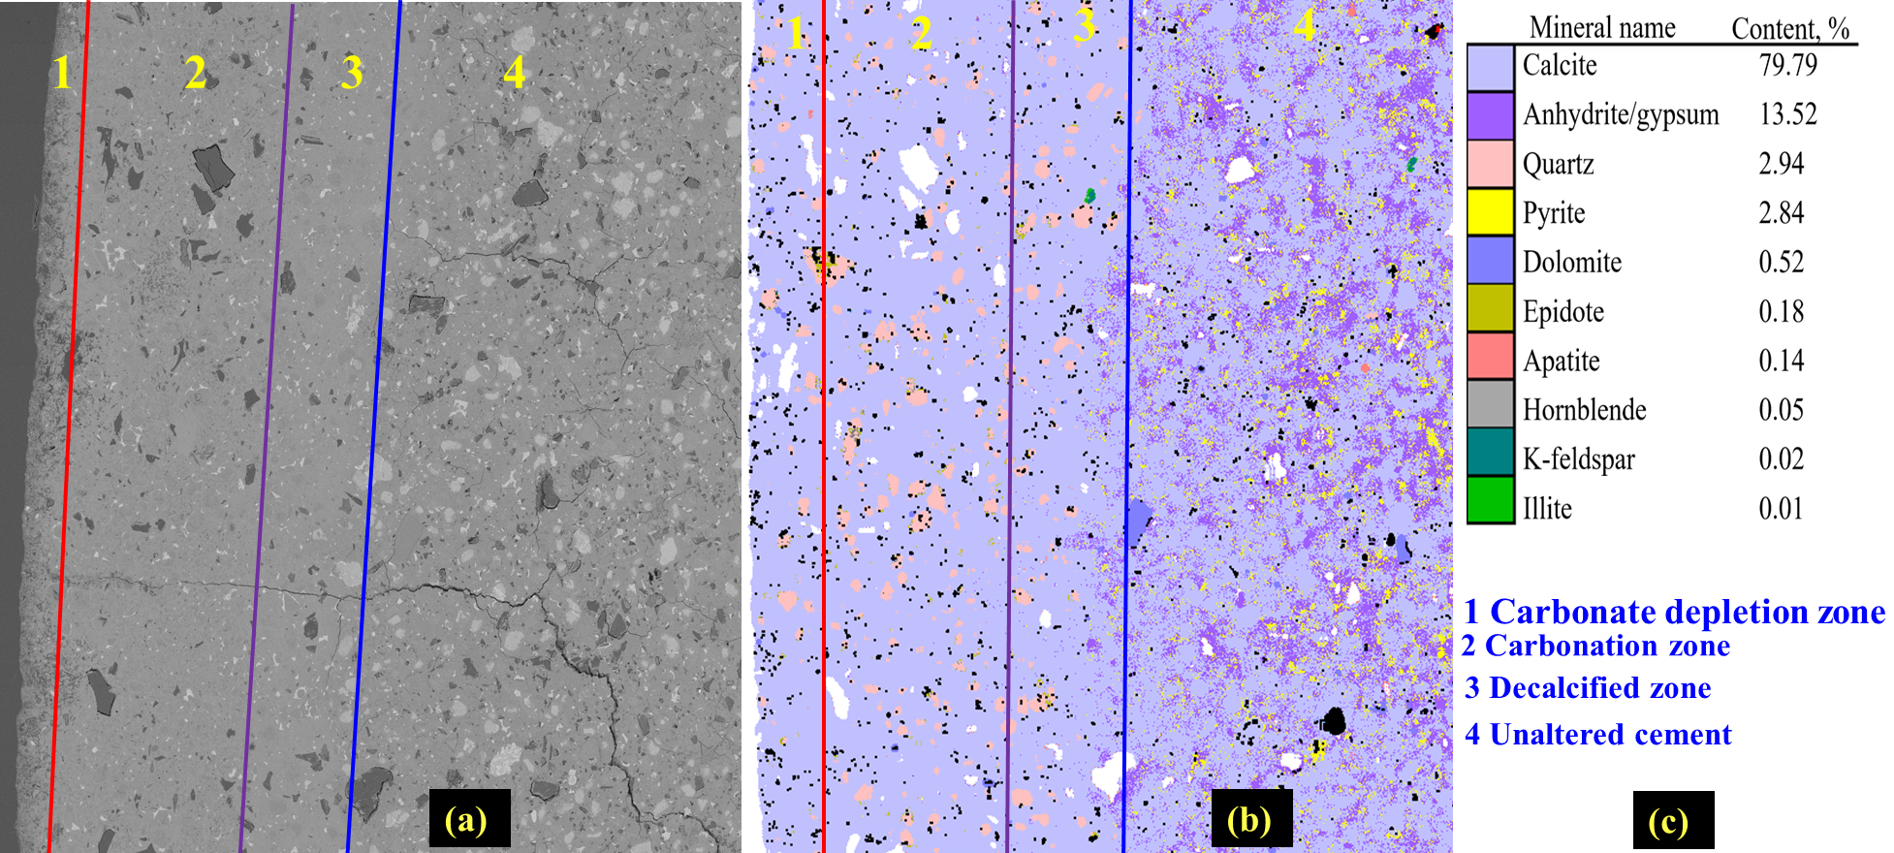

SEM and QEMSCAN mineralogical analysis of SCBC
FE-SEM and QEMSCAN results--SCBC
Scan area：1.5 x 1.5 mm
Scan area：1.3 x 1.4 mm
Biochar contains sulfur, promoting generation of gypsum (CaSO₄·2H₂O) in the reaction layer 4.
QEMSCAN mineral composition mapping results for the biochar-modified sample after reacting with CO₂. a) SEM of the SCBC sample after reaction with CO₂; b) Mineral maps of different zones; c) Mineral list.
SCBC sample shows a higher hydration rate than that of the control sample due to less presence of unhydrated cement grains
Based on the mineralogical distribution, it is evident that Zone 1 of the SCBC sample is less porous than that of the control sample.
Small biochar particles can “immerse into” the cement matrix, while large biochar particles are not compatible with cement matrix. Particle size of biochar needs to be carefully controlled
Notes:
I will introduce the content from the following four parts, the first one is background and objectives.

Slide 26

Mechanical strength analysis
Compressive strength test
RF sample’s compressive strength declined by 40.5% after 28 days of CO₂ exposure.
BC sample’s compressive strength declined by 20.5% after 28 days of CO₂ exposure.
The SCBC sample demonstrated superior resistance to CO₂ alteration. After 14 days of CO₂ exposure, the compressive strength of SCBC increased from 23.66 MPa to 29.97 MPa, reflecting a 26.7% improvement. The sample gained 34.4% in compressive strength after 28 days of CO₂ exposure.
SCBC outperforms all other samples in mechanical strength repair. Conversely, the compressive strengths of all other samples decreased under the same reaction condition.
Notes:
I will introduce the content from the following four parts, the first one is background and objectives.

Slide 27
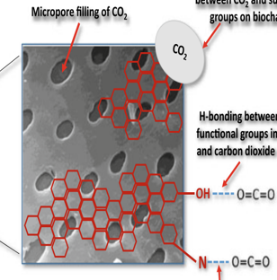
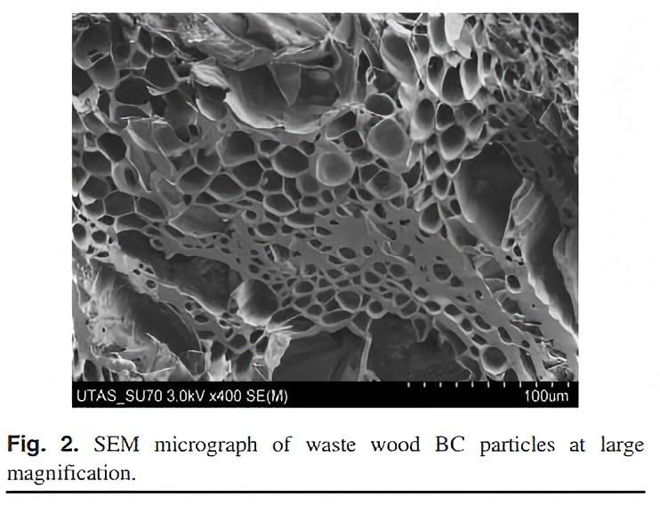
Discussion
Pores and functional groups in biochar treated by ScCO₂
Micropore filling of CO₂
Van der wall interaction between CO₂ and surface groups on biochar
ScCO₂
treatment
H-bonding between surface functional groups in biochar and CO₂
SEM micrograph showing pores created in biochar during pyrolytic conversion of saw dust to biochar
Lewis acid-base interaction between N-containing functional groups in biochar and CO₂
(Modified from Świechowski et al. 2022)
Notes:
I will introduce the content from the following four parts, the first one is background and objectives.

Slide 28
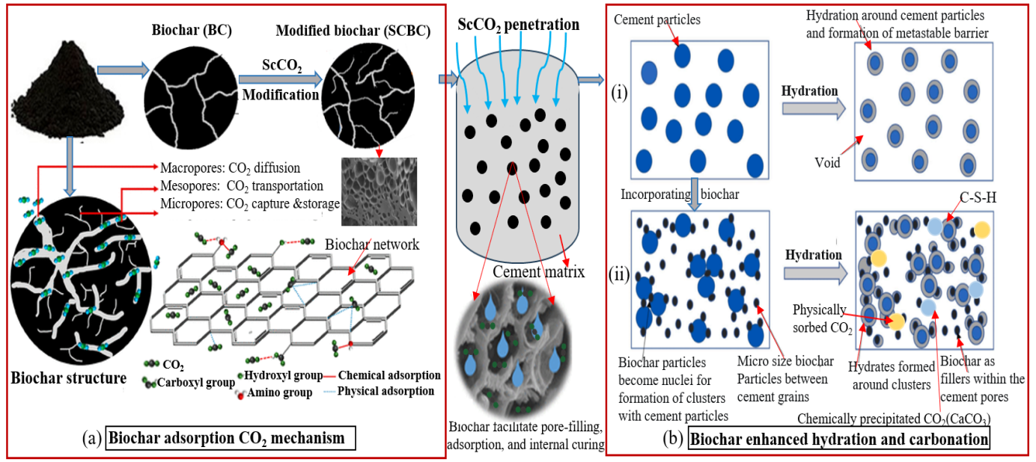
Discussion
Reinforcement mechanisms of SCBC
Schematic diagram illustrating the reinforcement mechanisms of supercritical CO₂ modified biochar in cement matrix: (i) showing cement-only system (ii) showing biochar-modified cement system
Key reinforcement mechanisms include: (a) pre-loaded CO₂ promoting pore-blocking carbonate growth within the cement, (b) CO₂ pre-treatment increasing biochar’s surface area for localized pH buffering, and (c) strong water holding capacity aiding in internal curing within the cement matrix.
Notes:
I will introduce the content from the following four parts, the first one is background and objectives.

Slide 29
04
Conclusions

Slide 30
Conclusions
Under GCS conditions, wellbore cement samples with no biochar additives experienced significant deterioration, whereas those containing BC and SCBC exhibited reduced damage.
Cement containing supercritical CO₂-modified biochar (SCBC) is effective in resisting CO₂ corrosion, with a carbonation inhibition efficiency of 30.97%, compared to the BC, which had an efficiency of only 6.49%.
After 14 d of CO₂ exposure, the compressive strength of SCBC increased from 23.66 MPa to 29.97 MPa, reflecting a 26.66% improvement. Conversely, the compressive strength of RF decreased by 28.66%, and the compressive strength of BC declined by 24.69% under the same conditions. This result suggests that SCBC outperforms unmodified biochar in mechanical strength repair.
SCBC’s reinforcement mechanisms included: (a) pre-loaded CO₂ promoting pore-blocking carbonate growth within the cement, (b) CO₂ pre-treatment increasing biochar’s surface area for localized pH buffering, and (c) strong water holding capacity aiding in internal curing within the cement matrix.

Slide 31

Thank You for Your Attention!
Contact: Liwei Zhang (lwzhang@whrsm.ac.cn)

Slide 32
Supporting slide
Typical composition of different materials (from XRF)
Typical composition of BC(biochar)
Biochar | Particle size (mesh) | Bulk Density (g/l) | Specific surface area (m²/g) | pH
Quantity | 200 | 400-450 | 900-1300 | 7-9
Oxide composition of SCBC determined by XRF
Oxide | Na₂O | MgO | Al₂O₃ | SiO₂ | P₂O₅ | SO₃ | Cl | CaO | Fe₂O₃ | Carbon
Wt.% | 1.330 | 0.042 | 0.174 | 1.328 | 4.661 | 0.508 | 0.155 | 0.072 | 0.064 | 91.667
Oxide composition of BC determined by XRF
Oxide | Na₂O | MgO | Al₂O₃ | SiO₂ | P₂O₅ | SO₃ | Cl | CaO | Fe₂O₃ | Carbon
Wt.% | 0.328 | 0.114 | 0.358 | 2.112 | 9.722 | 0.696 | 0.132 | 0.114 | 0.137 | 86.287

