Slide 1

Flow visualization in 3D porous media
How to see through the opaque ?
A.Gargasson
M.Souzy
19/05/2026

Slide 2
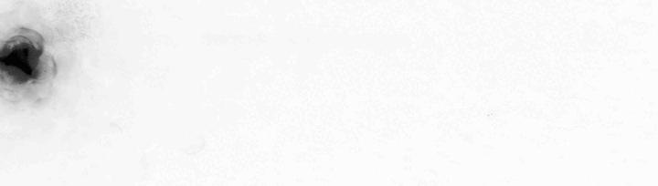
Mixing in porous media
https://mathieusouzy.wordpress.com/publications/
Porous media are able to mix liquids, even at low Reynolds number
Increasing dispersion allows a more efficient diffusion in space

Slide 3
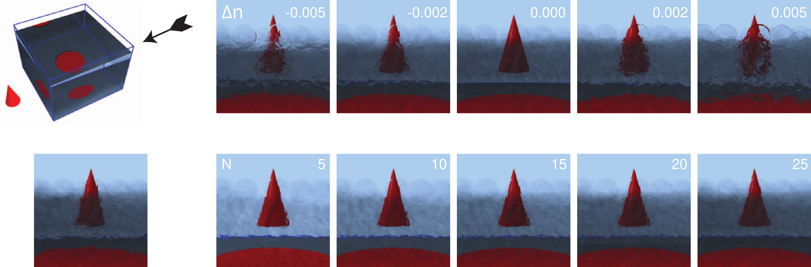
How to see through the opaque?
Each grain absorbs light
Each interface diffuses light
Several assays have already been made with PMMA beads and Triton X-100
How to make it for a micro-structured medium ?
One idea : 3D Printing !

Slide 4
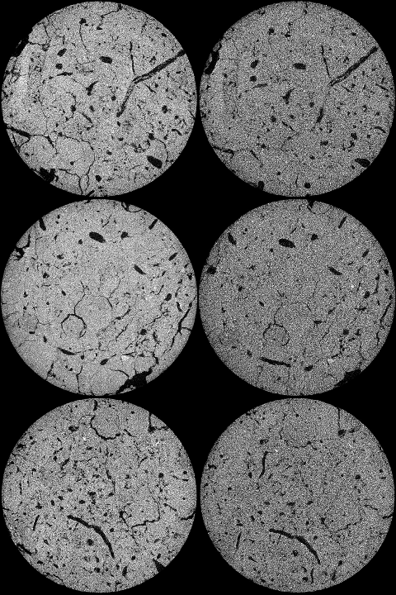
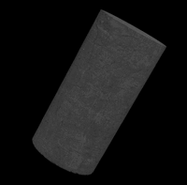
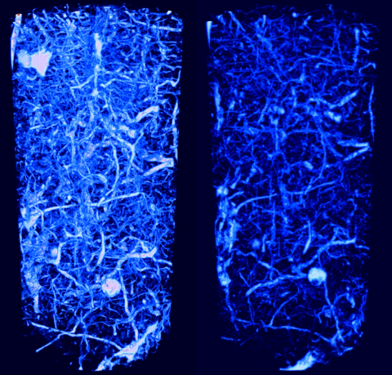
From an X-ray tomogram...
An 1.5 cm thick earth core is radiated with X-rays
The matter scatters light
Empty parts appear in light blue / dark
IVONIN, Dmitriy, KALNIN, Timofey, DEMBOVETSKIY, Alexandr, et al. Experimental data showing the effect of wetting on soil structure transformations: 3D images. Data in Brief, 2022, vol. 41, p. 107928.

Slide 5
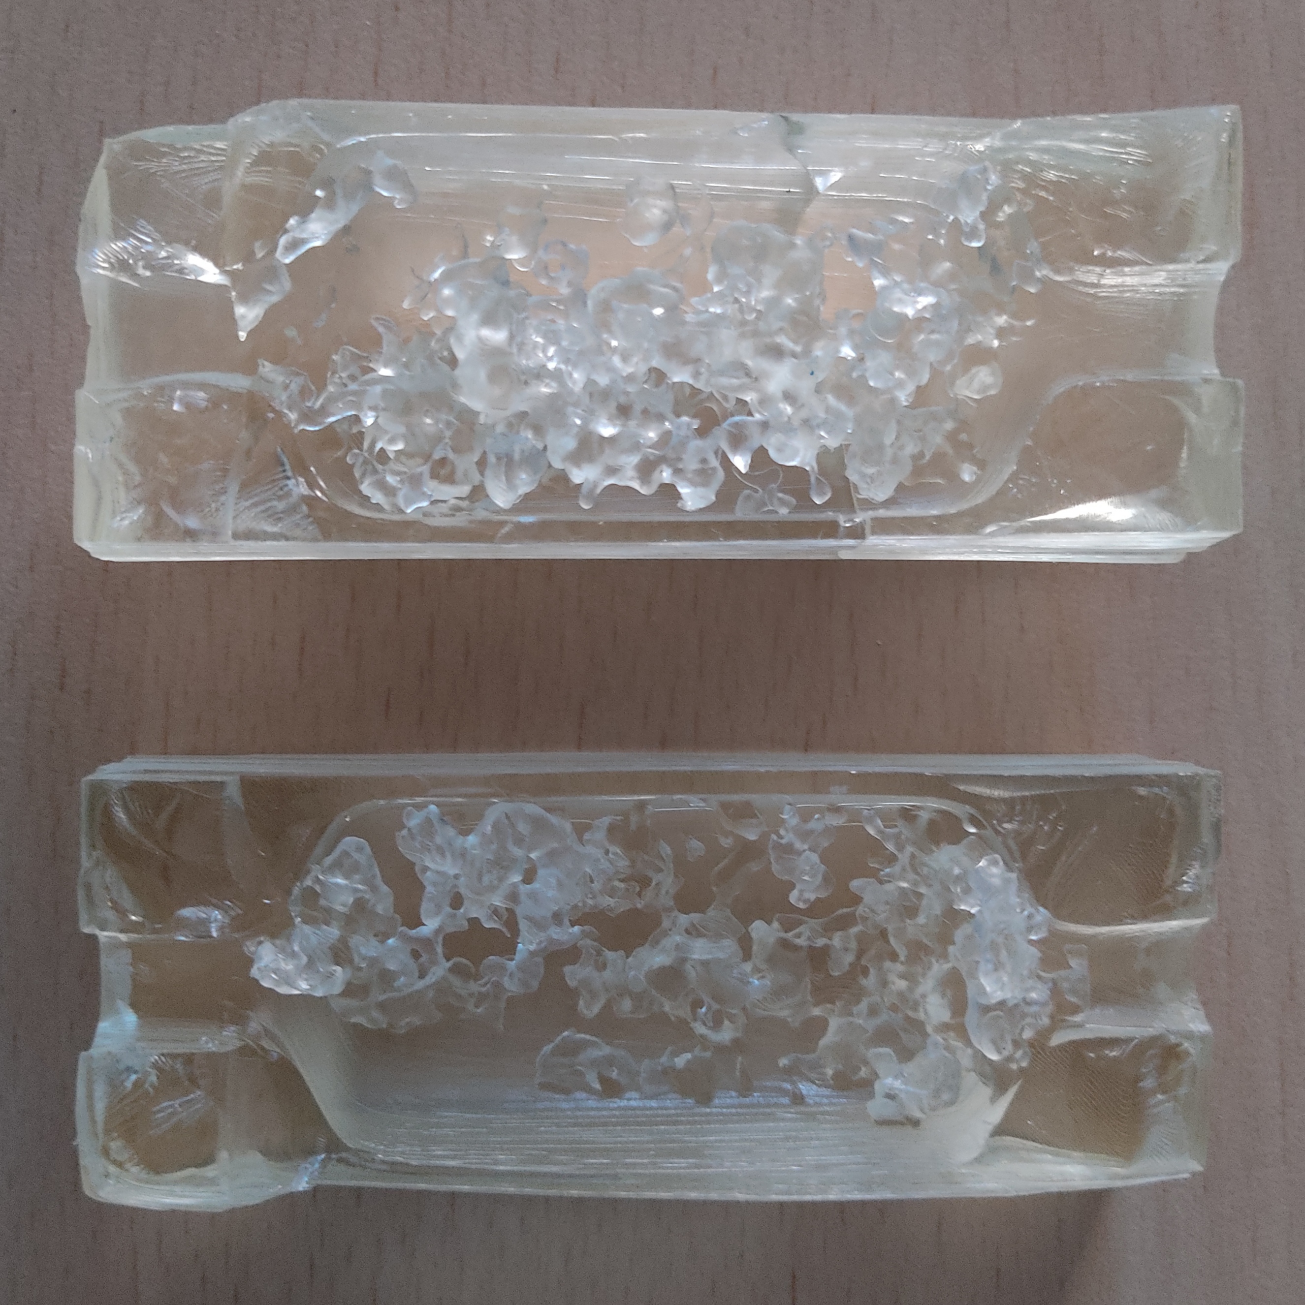
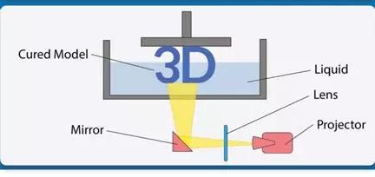

...to 3D Printing !
From the image stack is made an STL file.
The 3D surface file is transmitted to a DLS 3D printer.
The porous medium is replicated in a transparent resin

Slide 6
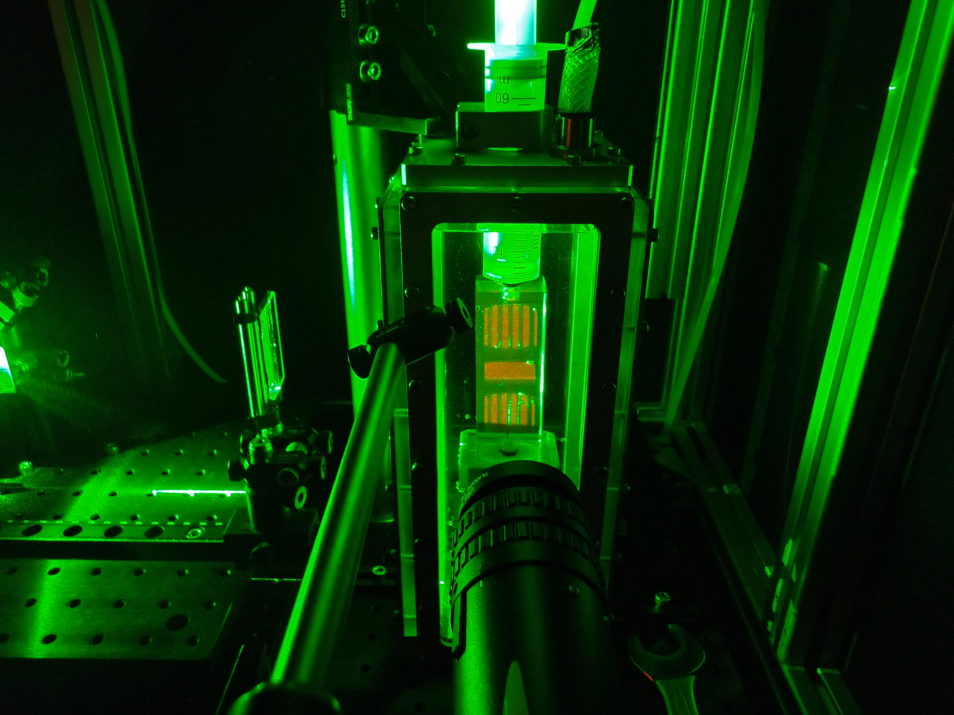
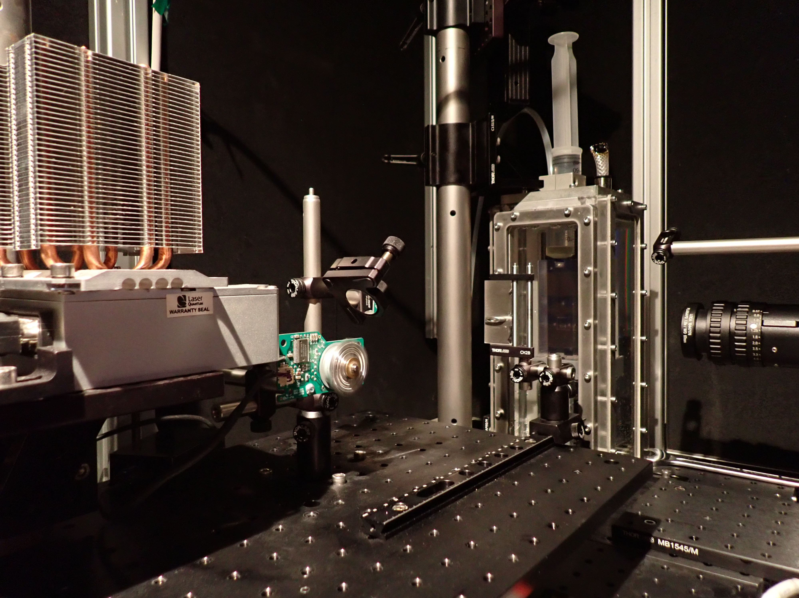
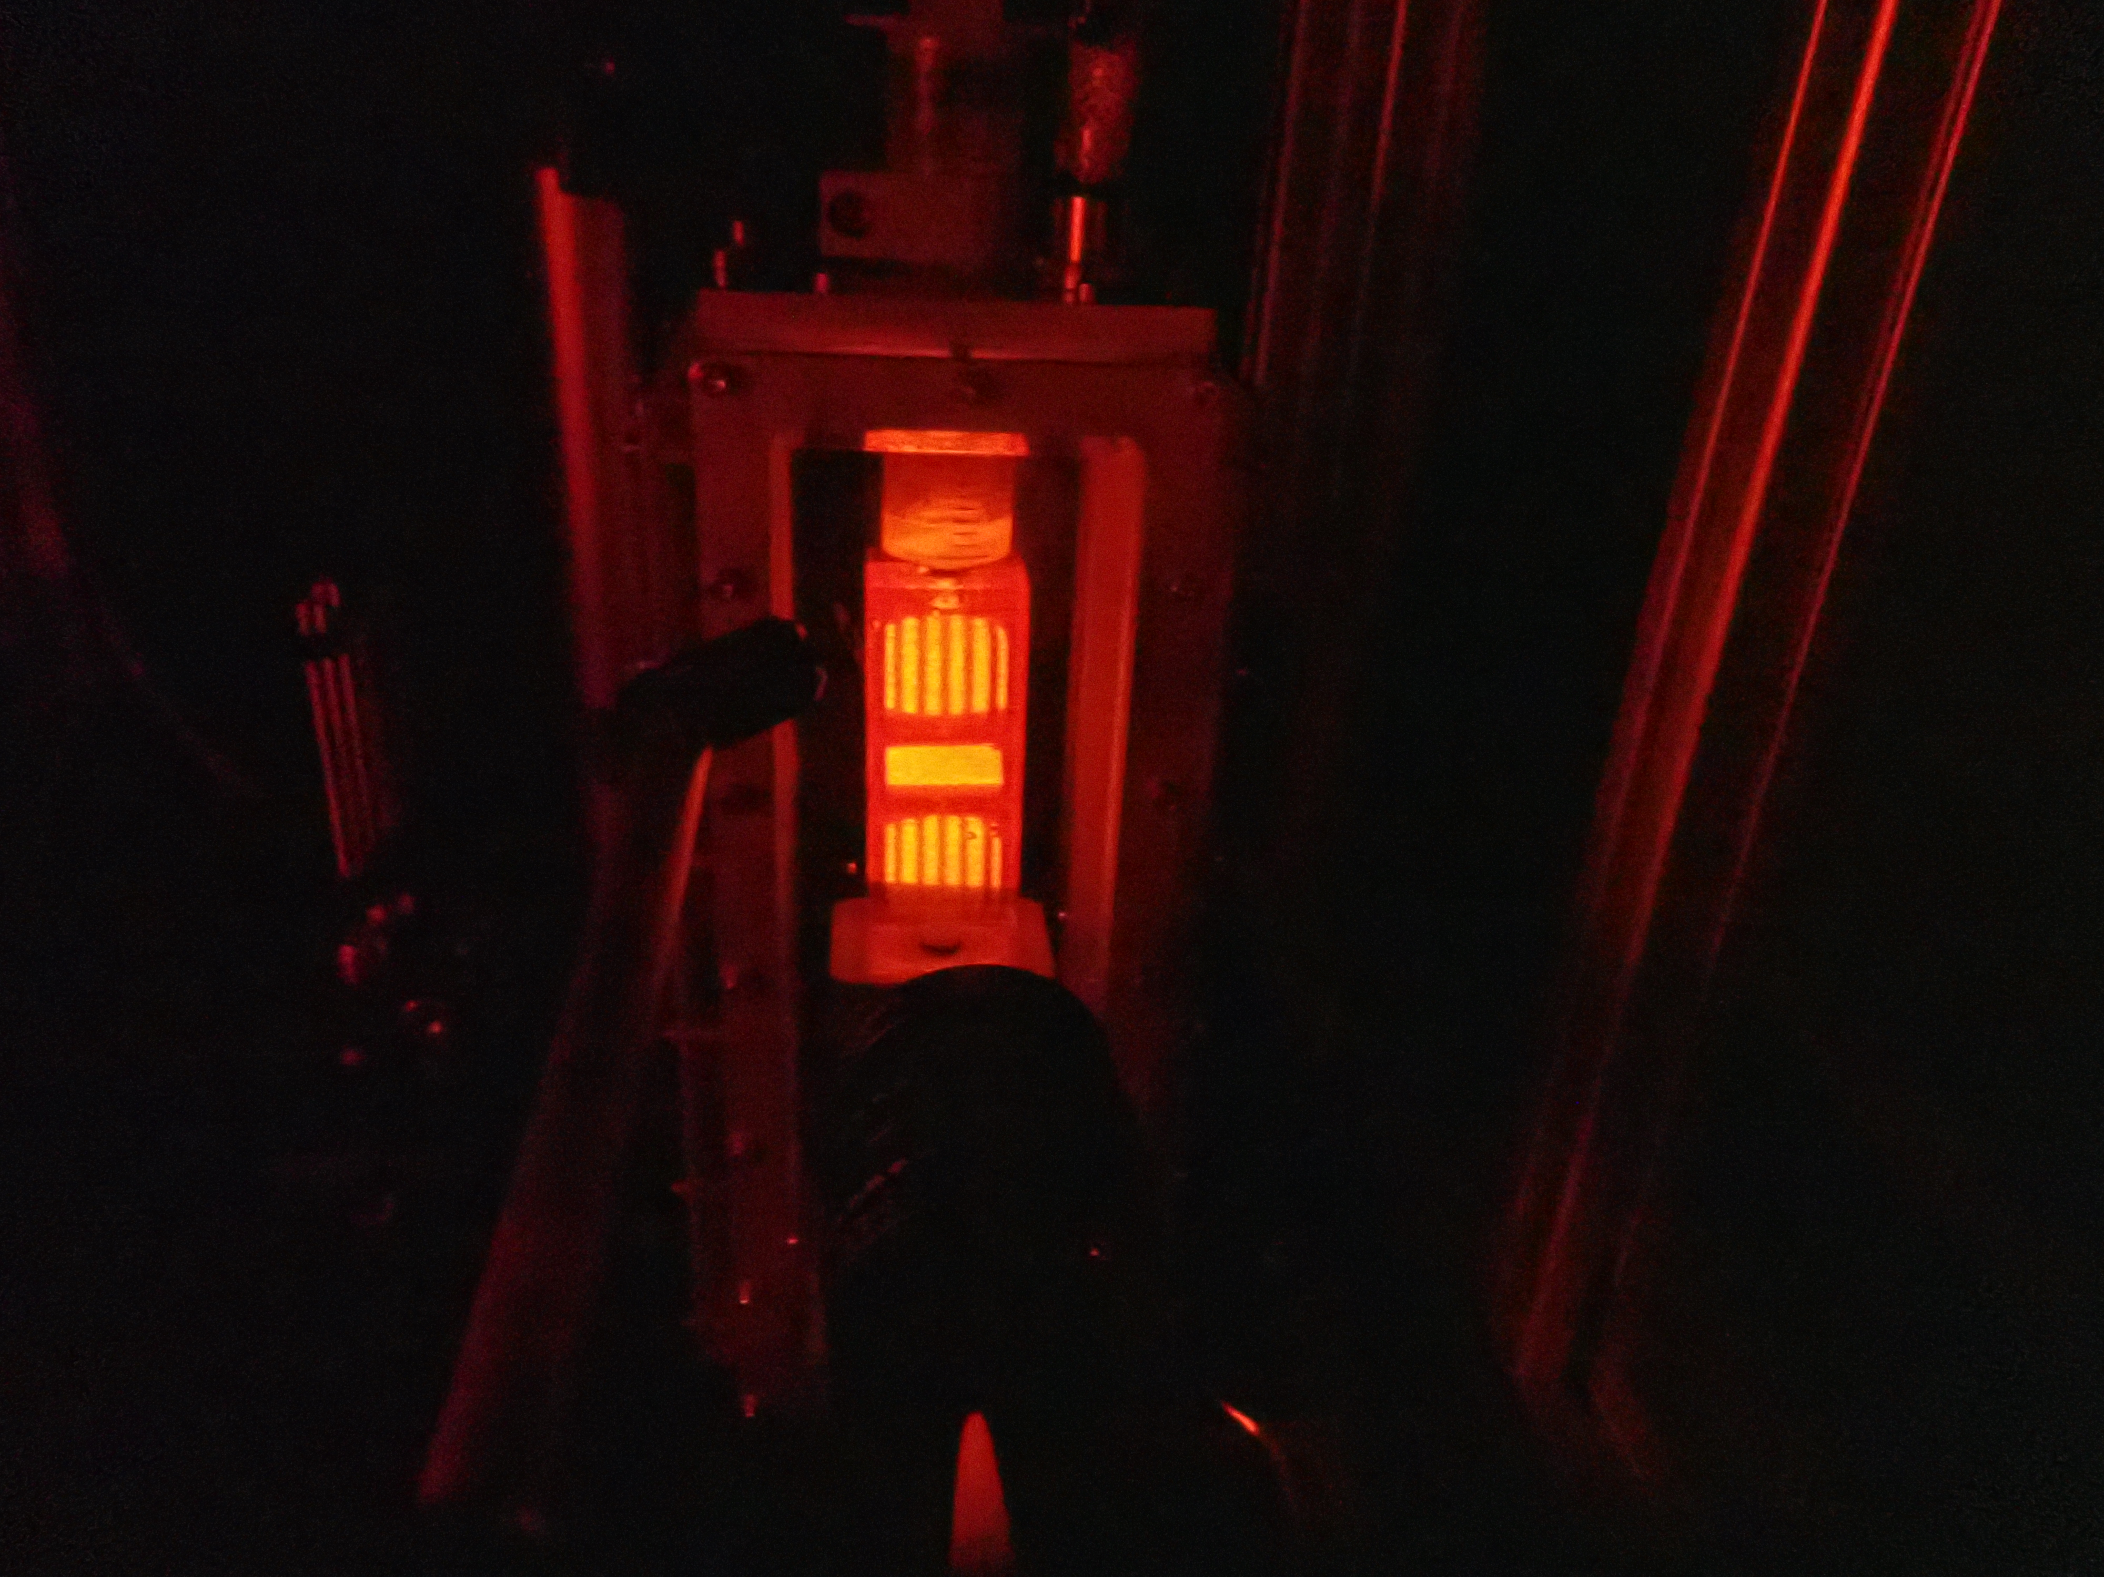
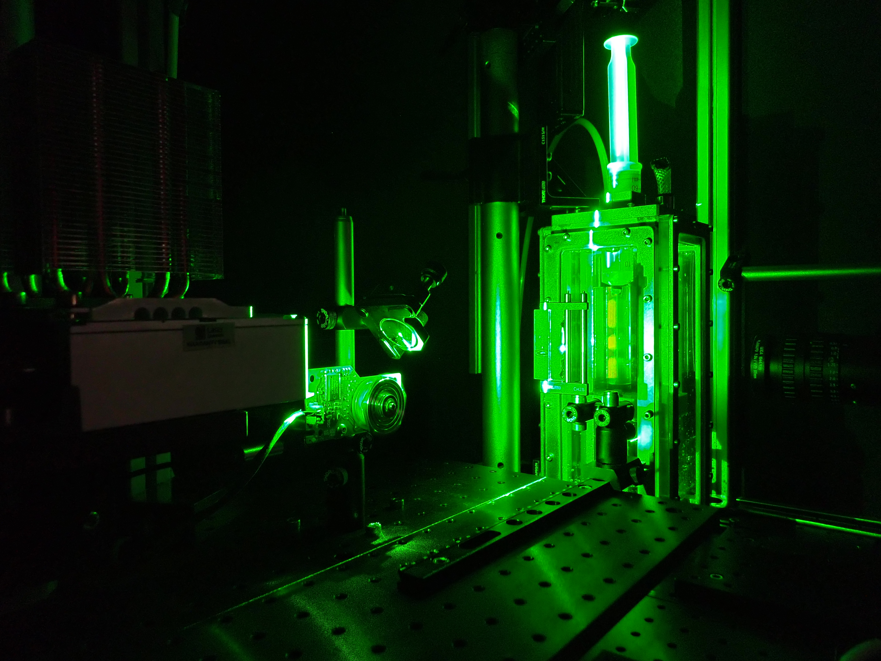
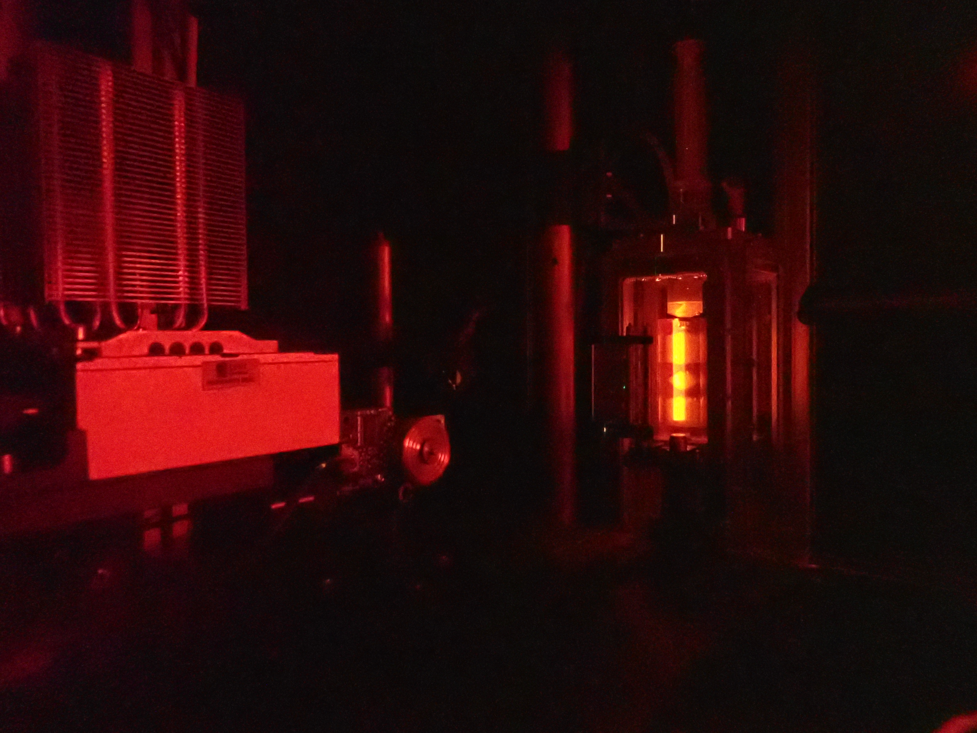
Flow Observation
We illuminate fluorescent tracers in the medium with a laser sheet on several layers.
The layers will allow us to reconstruct the 3D flow.

Slide 7
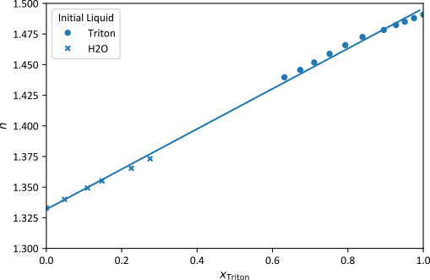
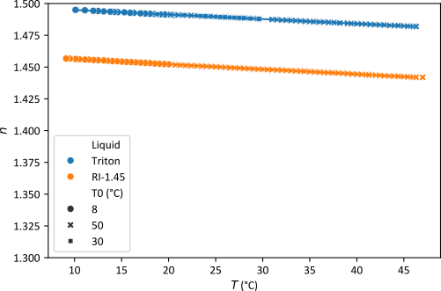
Index Matching
One is looking for a liquid that matches perfectly the resin RI.
For liquid Anicubic’s High Clear resin n = 1.485
A 95% mix Triton X-100 / H₂O matches the latter
Notes:
Graphes

Slide 8
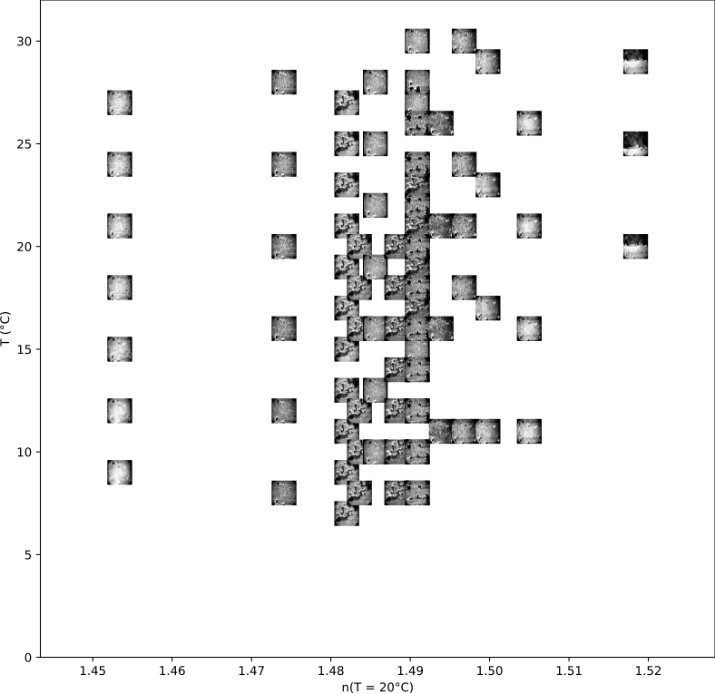
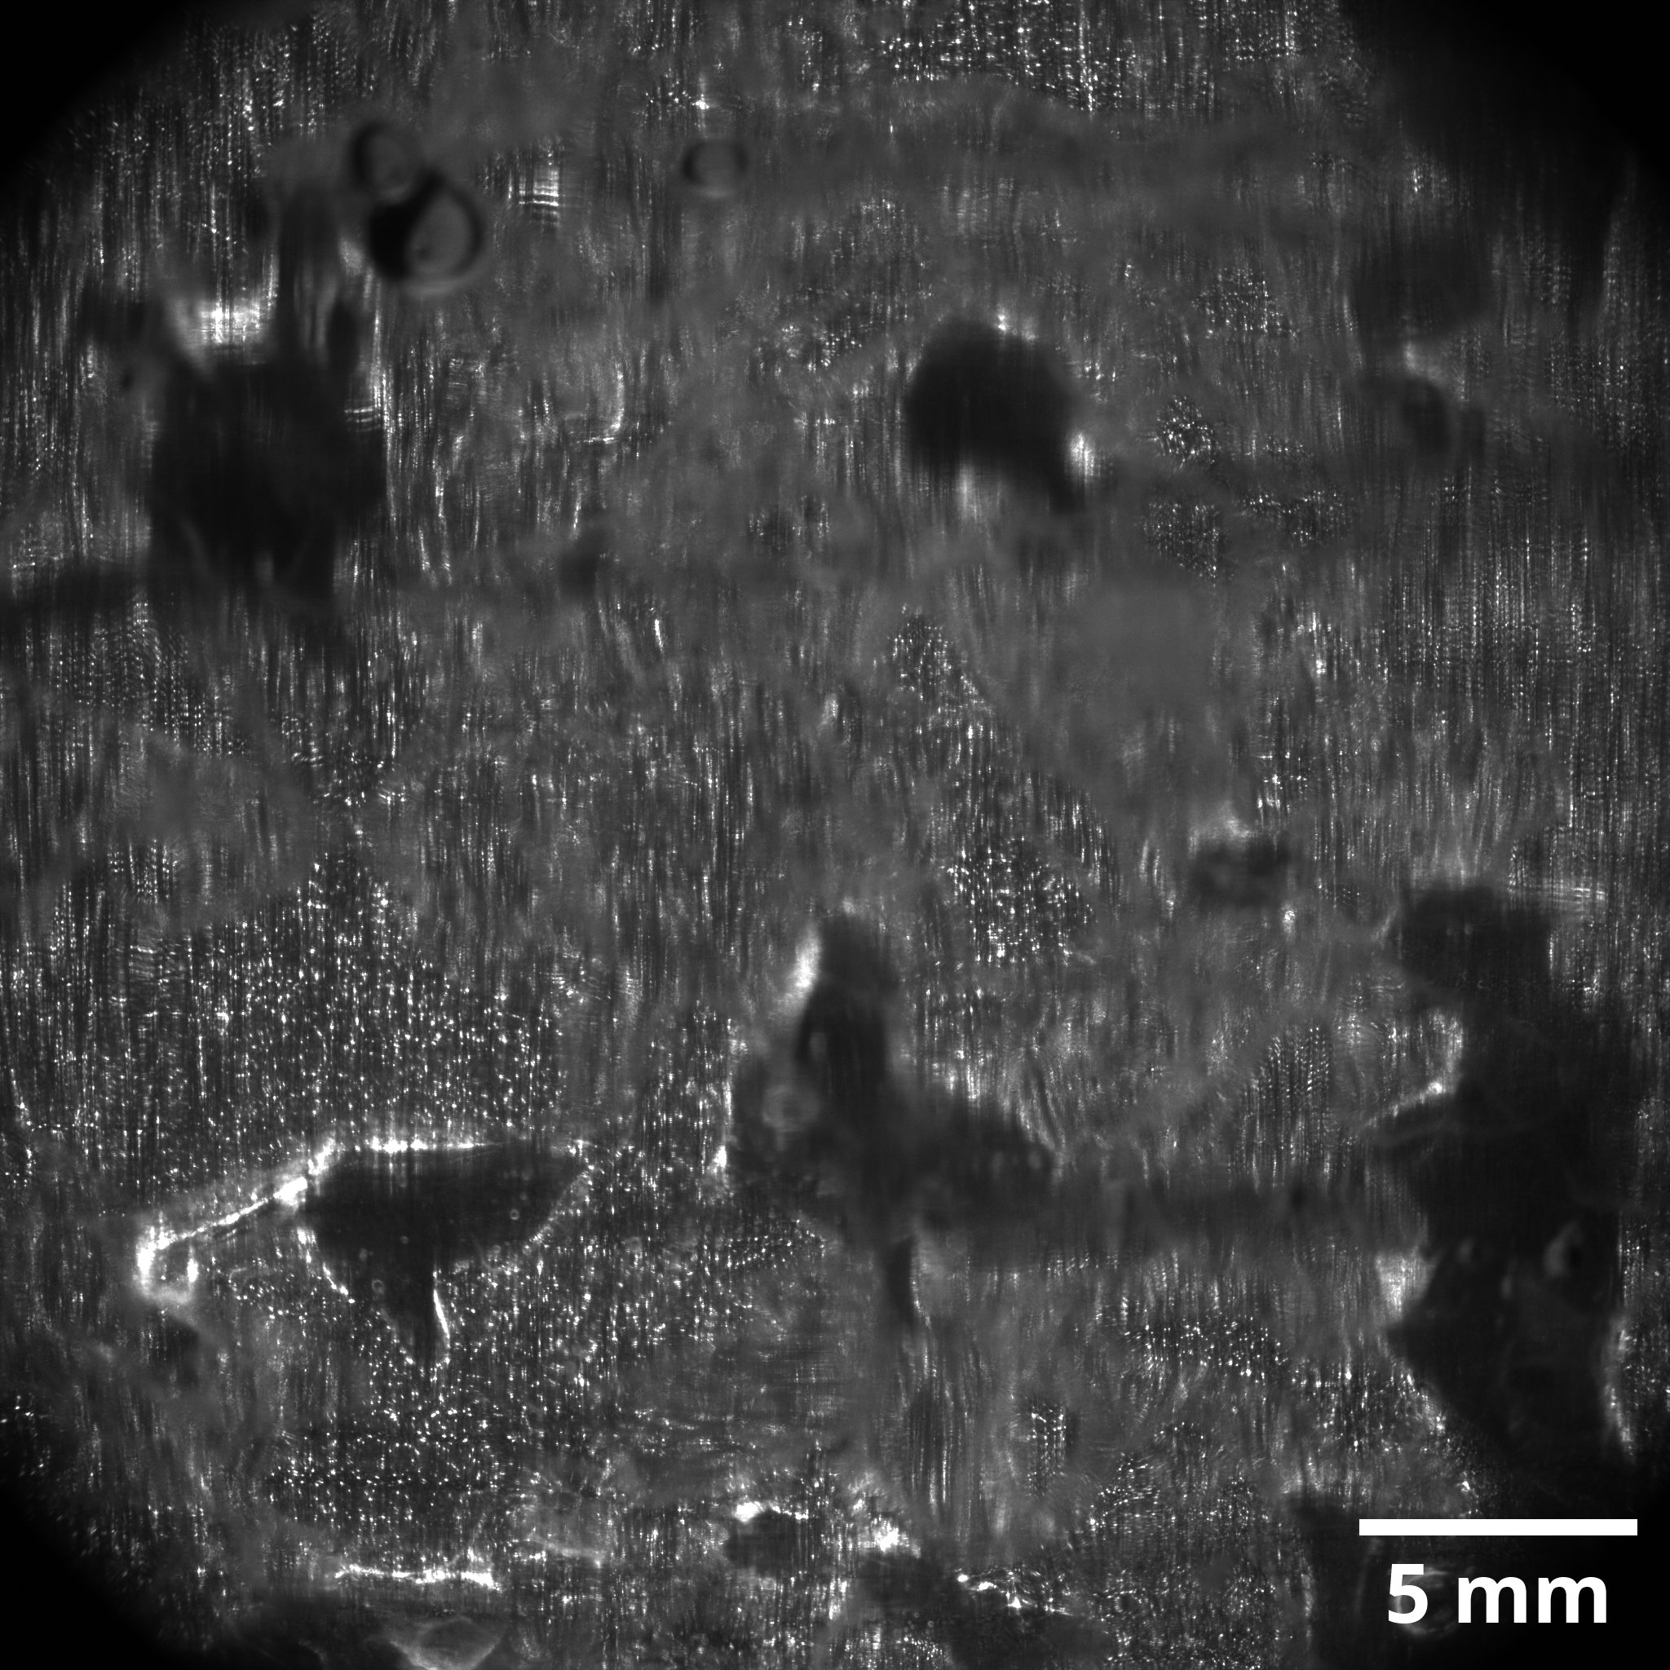
Flow Observation
The images have sharp and blurred zones
Assays are made in a wide range of refractive indices

Slide 9
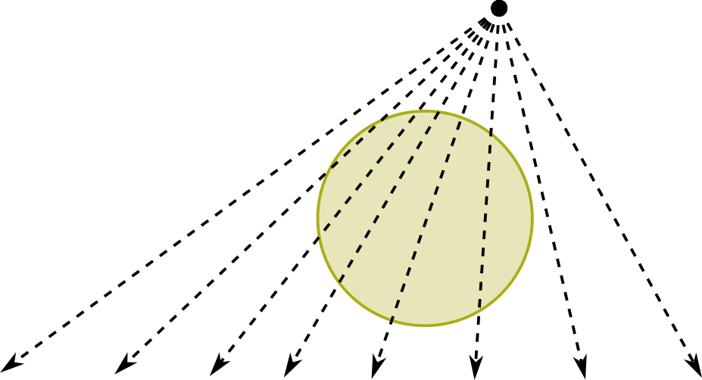
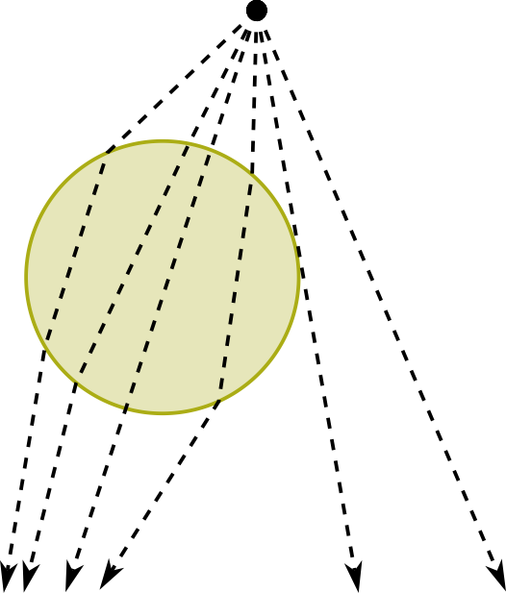
The problem of roughness
Initial guess : we want to see through « bead like » obstacles
Matched
Unmatched

Slide 10
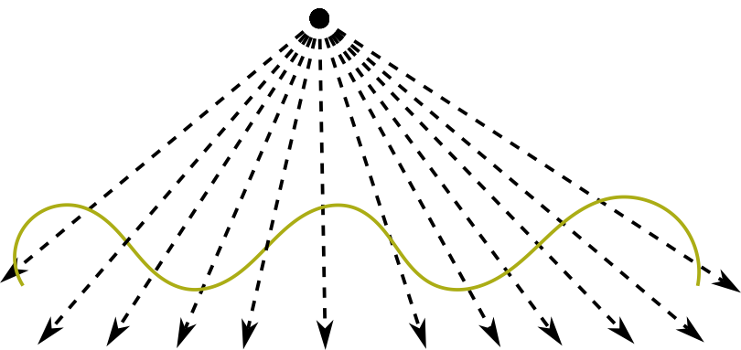
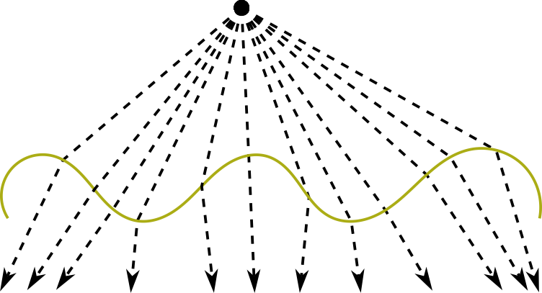
The problem of roughness
Actually, 3D printing makes every interface quite rough
This makes the observation more sensible to a refractive mismatch !
Matched
Unmatched

Slide 11
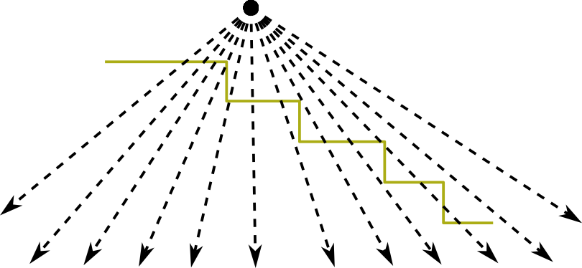
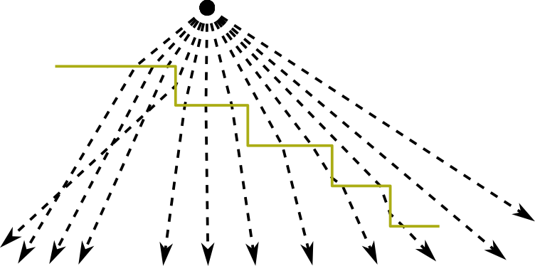
The problem of roughness
Moreover the printer’s z-resolution is 50 µm
This gives slopes a « stairs-like » aspect which deviates light even more
Matched
Unmatched

Slide 12
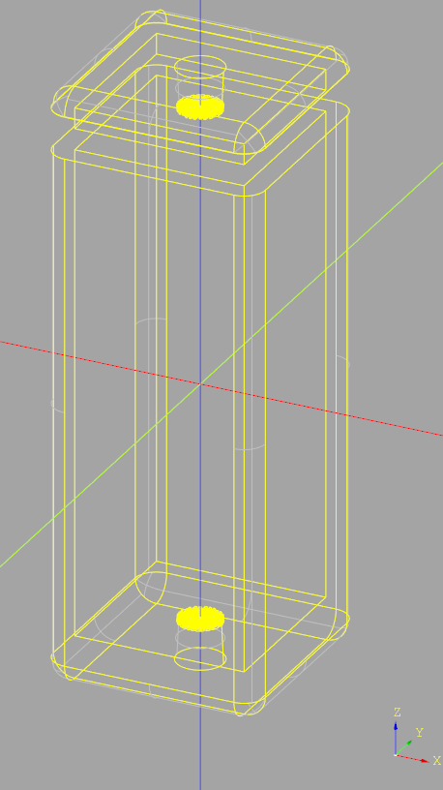
Next steps
A rigorous test is to inject the fluid in an empty container with rough walls
A series of refractive indices will be tested.
We will then observe the fluid as far as possible.
A clear image will indicate a good match.

Slide 13
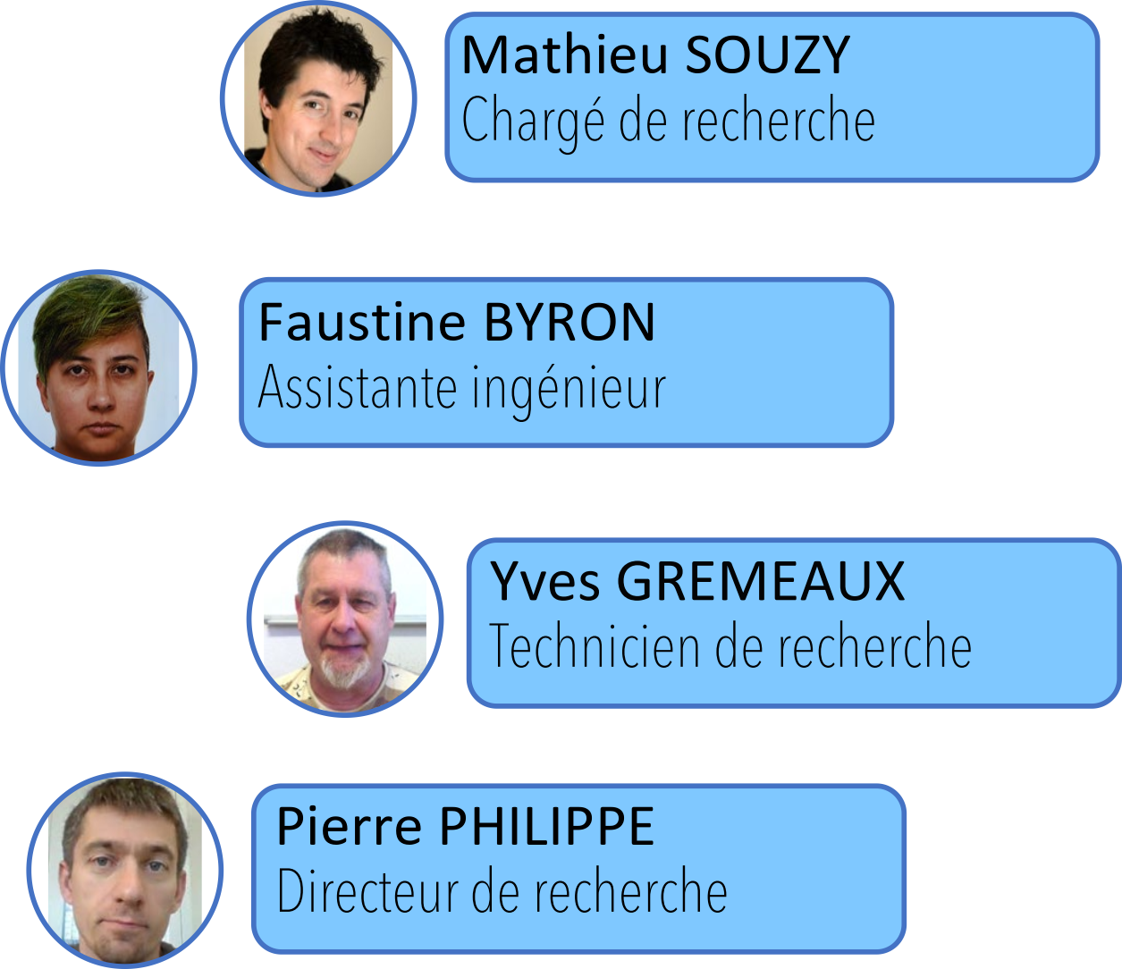
Many thanks to :
Any question?

