Slide 1



Pore-network modelling of buoyancy-driven microbubbles in a supergravity field
Kristoffer Skjelanger ¹,
Maziar Veyskarami ², Anna Mareike Kostelecky ², Timo Koch ².
¹ Western Norway University of Applied Sciences
² University of Stuttgart
InterPore Minisymposia 9
Pore-Scale Physics and Modeling
Nantes, May 22nd, 2026

Slide 2
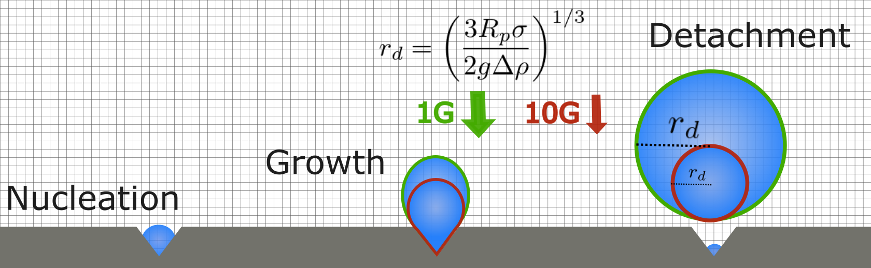
Motivation
When producing hydrogen in a PEM electrolyzer, efficiency is lost due to gas bubbles blocking the catalyst surface [1].
Higher G force → smaller bubbles

Slide 3

Motivation
When producing hydrogen in a PEM electrolyzer, efficiency is lost due to gas bubbles blocking the catalyst surface [1].
Higher G force → smaller bubbles
Rotating → higher efficiency
Rotating Electrolyser
RPM | Bond number
0 | 0.0027
500 | 0.06
1000 | 0.24
2000 | 0.97

Slide 4
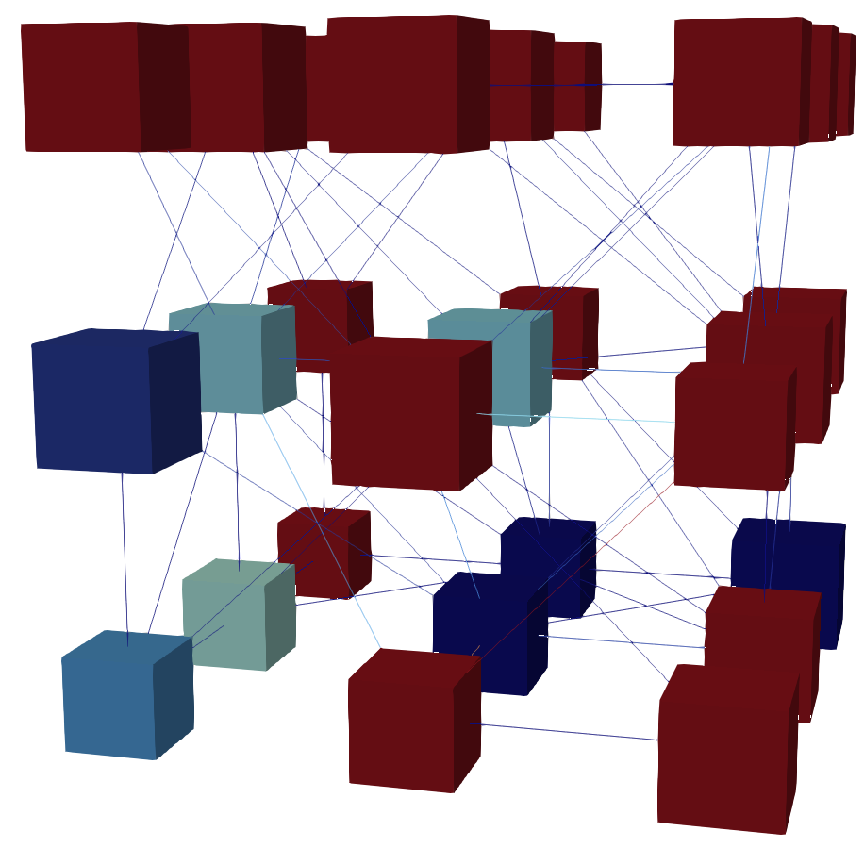
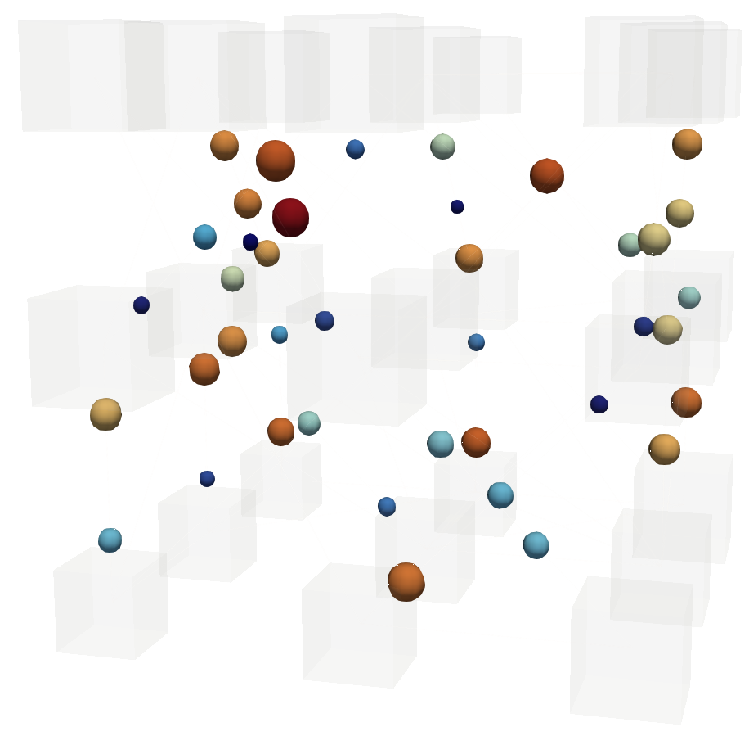
Hybrid Pore-network model
2-phase PNM
Lagrangian bubbles

Slide 5

Hybrid Pore-network model
Three «phases» (gas, liquid, bubbles)

Slide 6

Hybrid Pore-network model
Three «phases» (gas, liquid, bubbles)
Coupled mass balance
Bubble volume in pore
Mass transfer between bubbles and gas continuum
Coupled momentum balance
Bubble impact on throat conductance
Viscous pressure drop across bubble
Liquid volume displaced by bubble

Slide 7
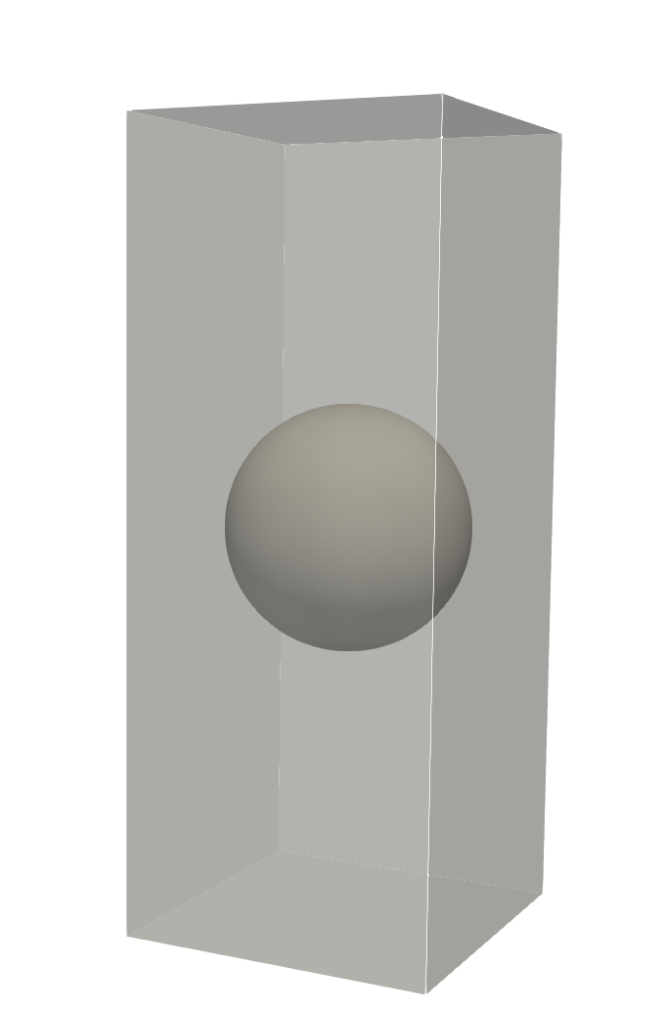







Local rules for bubbles
Bubble velocity
Bubble impact on throat conductance
Viscous pressure drop across bubble
Liquid volume displaced by bubble
$$U_{b}=F( , ΔP, G)$$
$$g_{α,ij}\left(r_{b,ij}\right)=F( )$$
$$∑p_{b,ij}=∑F( , U_{b})$$
$$B_{α,ij}=V_{b}⋅F( , ΔP, G)$$
$$U_{b}$$
$$ΔP$$
$$G$$

Slide 8
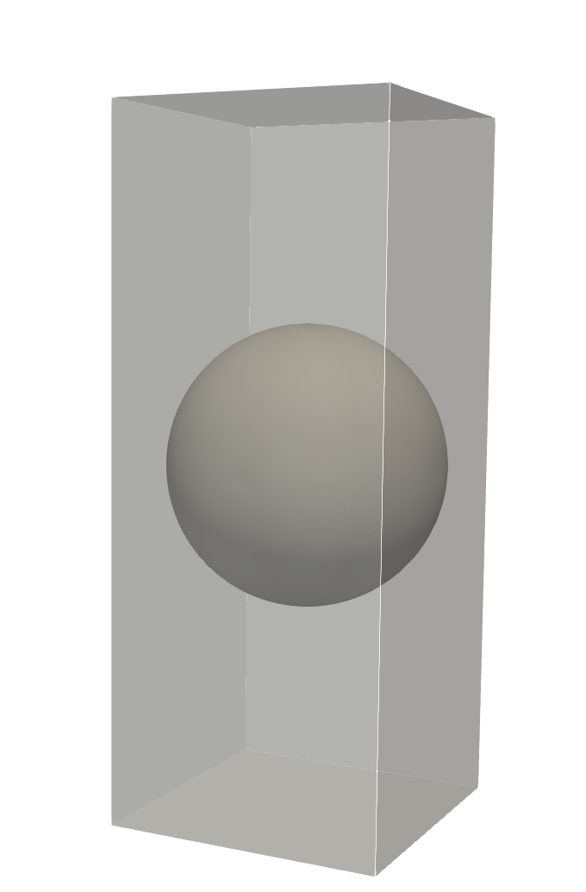

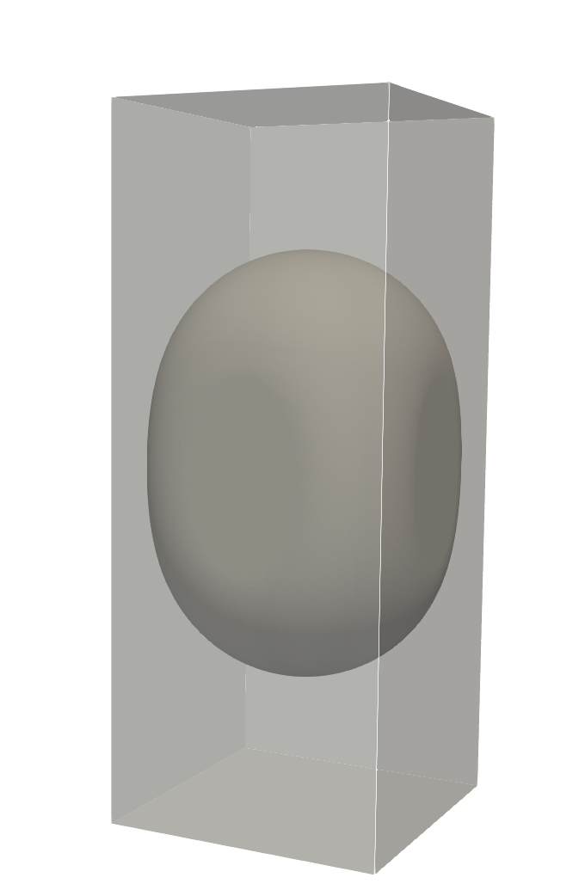

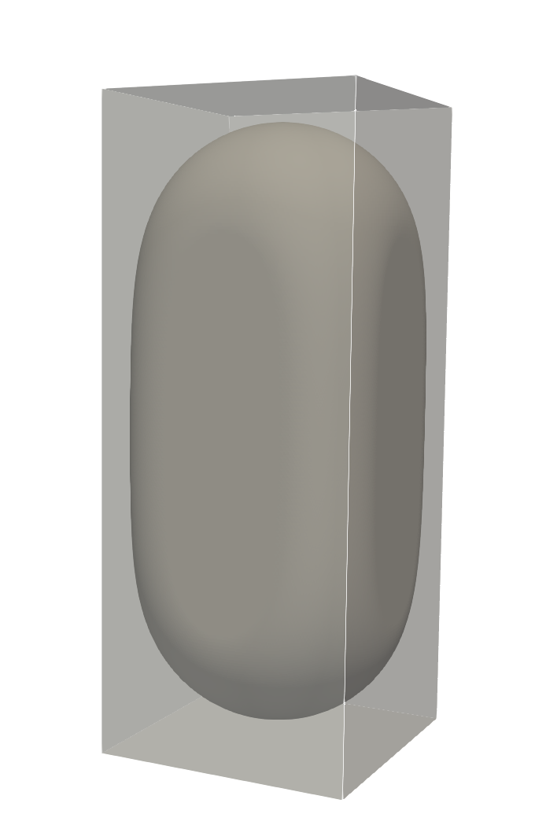
Local rules for bubbles
Bubble velocity
Bubble impact on throat conductance
Viscous pressure drop across bubble
Liquid volume displaced by bubble
$$U_{b}=F( , ΔP, G)$$
$$g_{α,ij}\left(r_{b,ij}\right)=F( )$$
$$∑p_{b,ij}=∑F( , U_{b})$$
$$B_{α,ij}=V_{b}⋅F( , ΔP, G)$$
$$U_{b}$$
$$ΔP$$
$$G$$

Slide 9
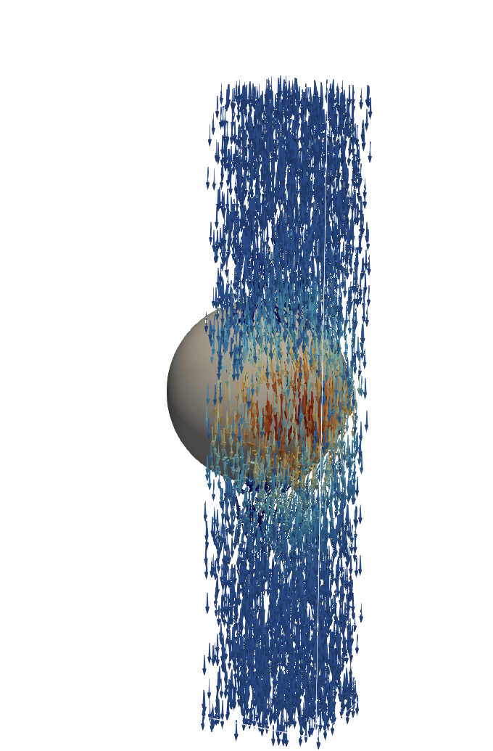
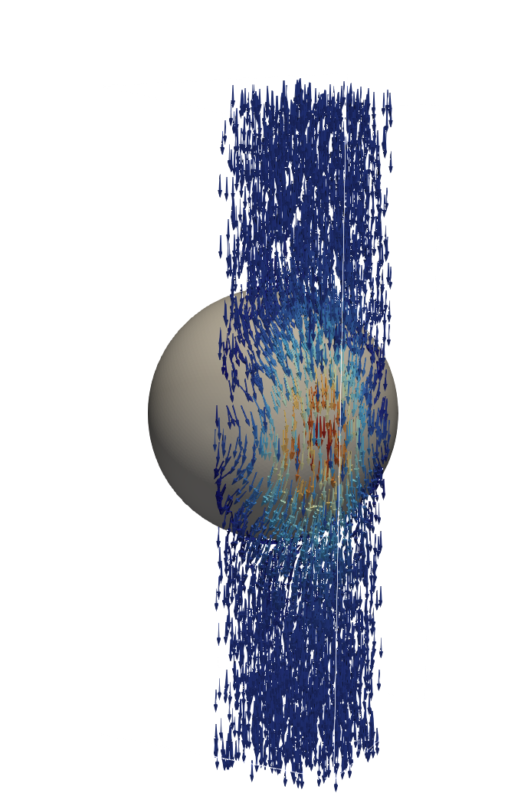
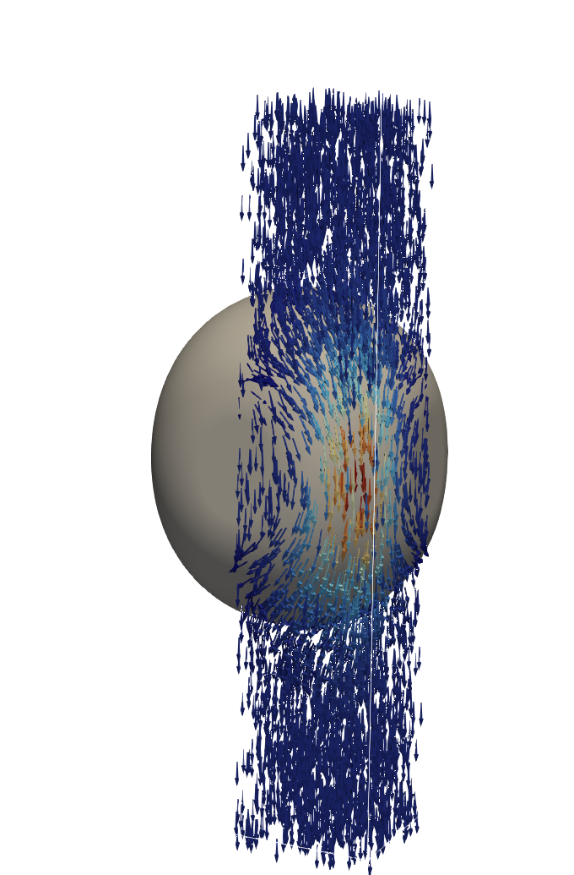
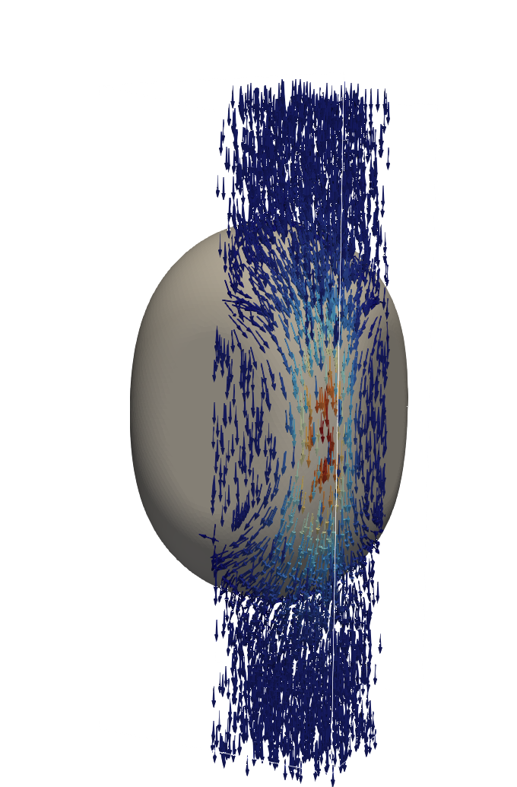
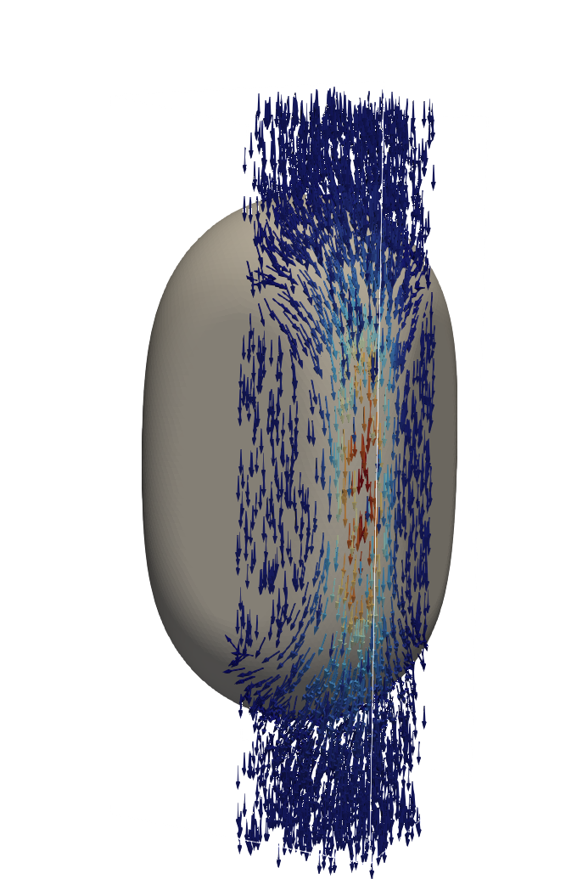
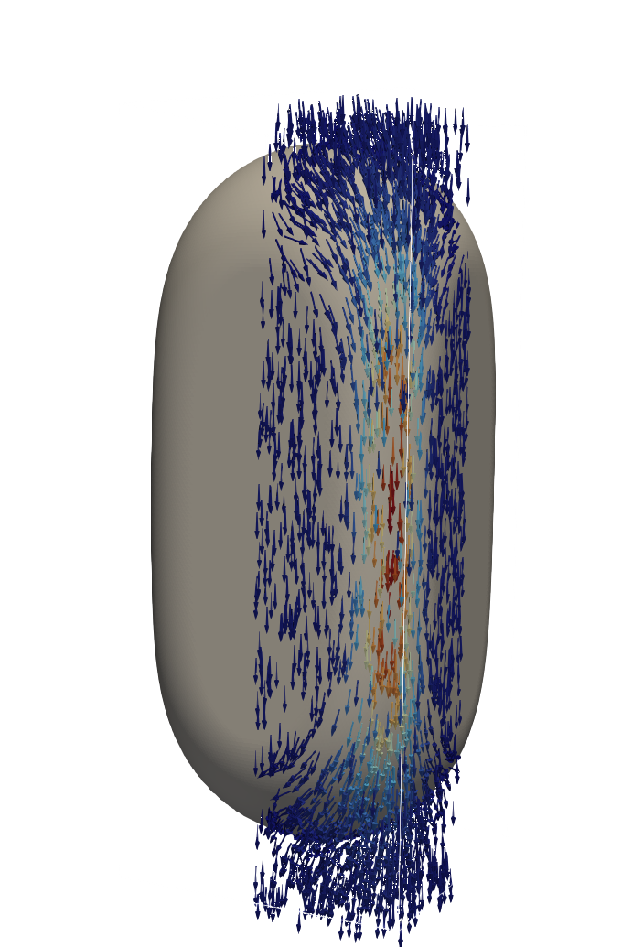
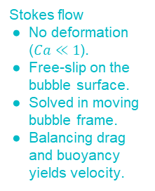
Local rules for bubbles
Bubble velocity
Bubble impact on throat conductance
Viscous pressure drop across bubble
Liquid volume displaced by bubble
$$U_{b}=F( , ΔP, G)$$
$$g_{α,ij}\left(r_{b,ij}\right)=F( )$$
$$∑p_{b,ij}=∑F( , U_{b})$$
$$B_{α,ij}=V_{b}⋅F( , ΔP, G)$$
Stokes flow
No deformation ($Ca≪1$).
Free-slip on the bubble surface.
Solved in moving bubble frame.
Balancing drag and buoyancy yields velocity.

Slide 10
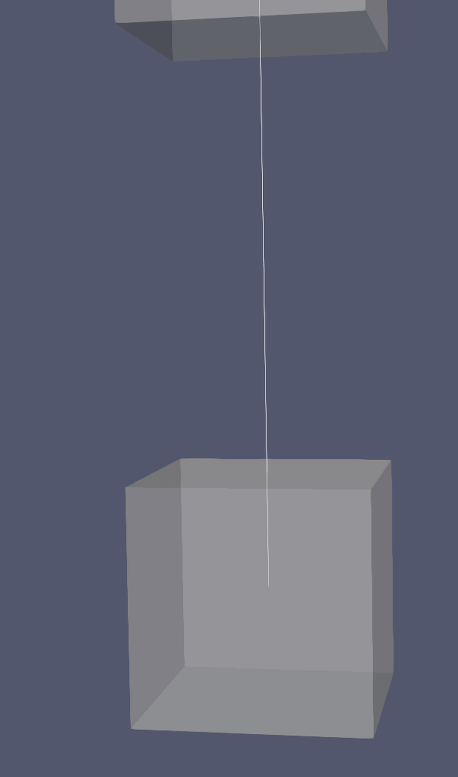

Movement of lagrangian bubbles
1) Formation and growth
$$G$$

Slide 11
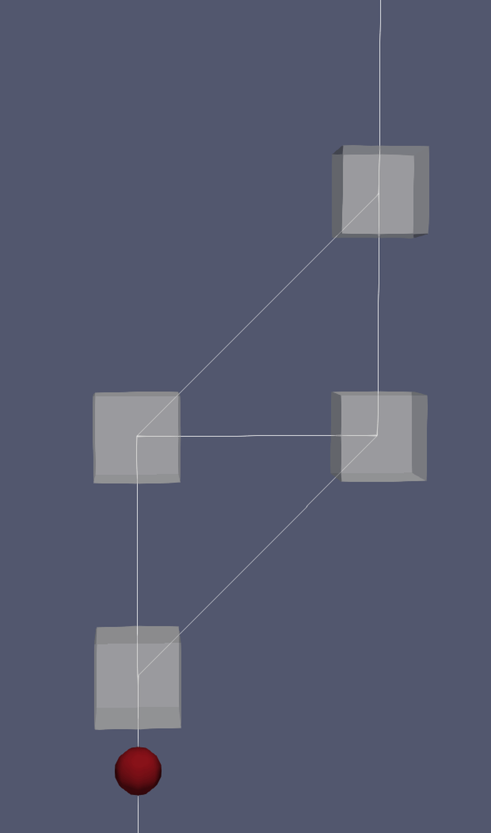
Movement of lagrangian bubbles
1) Formation and growth
2) Throat selection
$$G$$

Slide 12
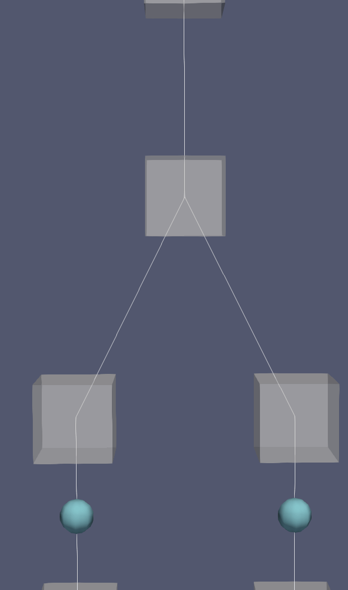
Movement of lagrangian bubbles
1) Formation and growth
2) Throat selection
3) Merging
$$G$$

Slide 13
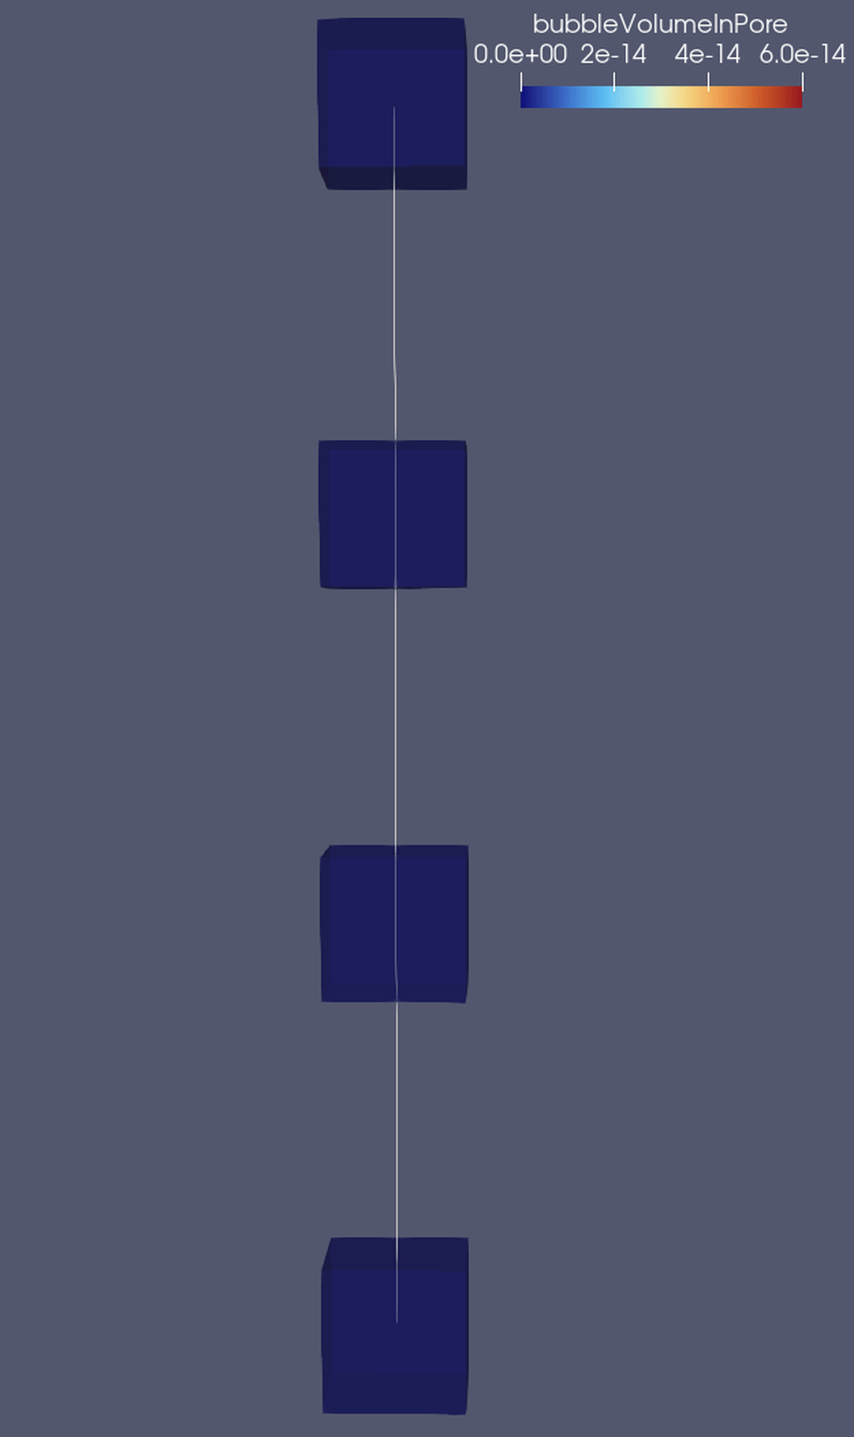
Mass balance verification
Bubble growth → flux away from the source-pore due to density differences.
Bubble moves → liquid flux moves opposite to fill the void space.
$$G$$

Slide 14
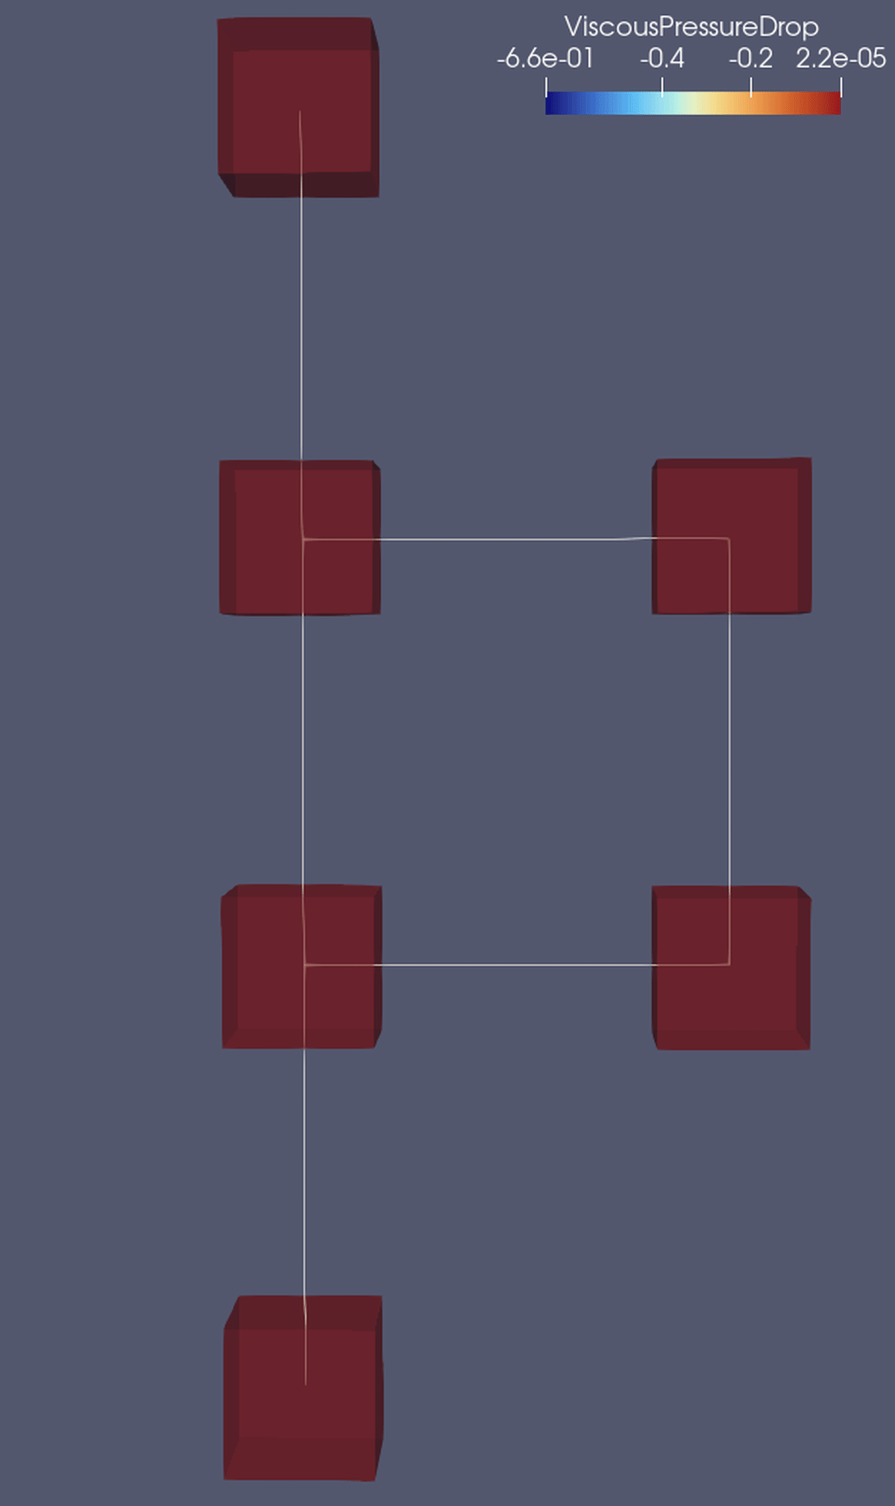
Viscous pressure drop - bypass flow
Viscous pressure drop across the bubble.
This pressure can equilibrate through the loop, inducing a flux.
The bubble will have an increased velocity due to advection.
$$G$$

Slide 15
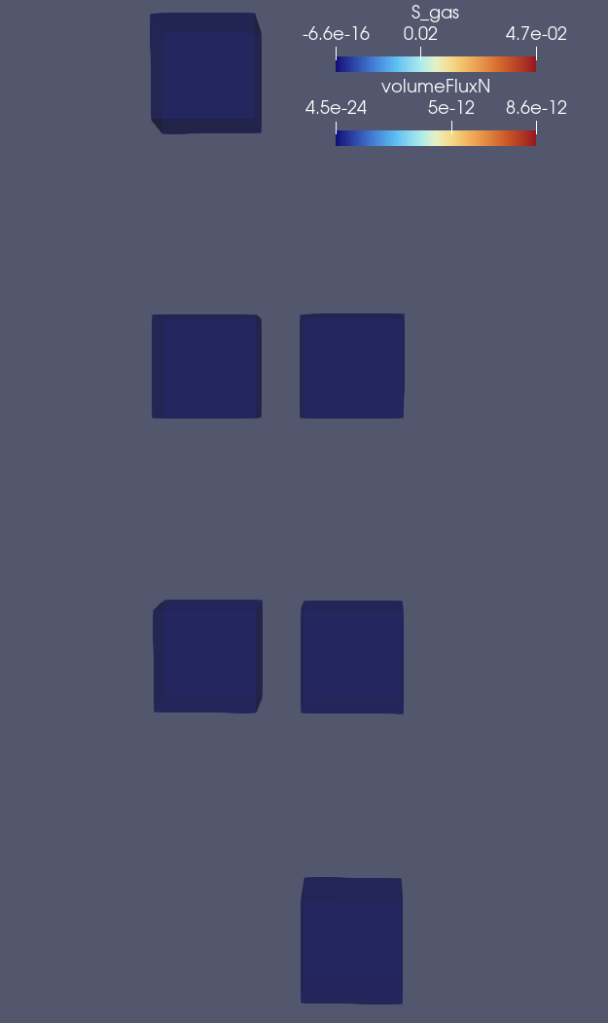
Bubble transfer to continuous phase
Network with paths and a “dead end trap”
$$G$$

Slide 16

Bubble transfer to continuous phase
Network with paths and a “dead end trap”
The bubbles get stuck in the corner pore.
The other bubbles dissolve due to invasion.
$$G$$

Slide 17
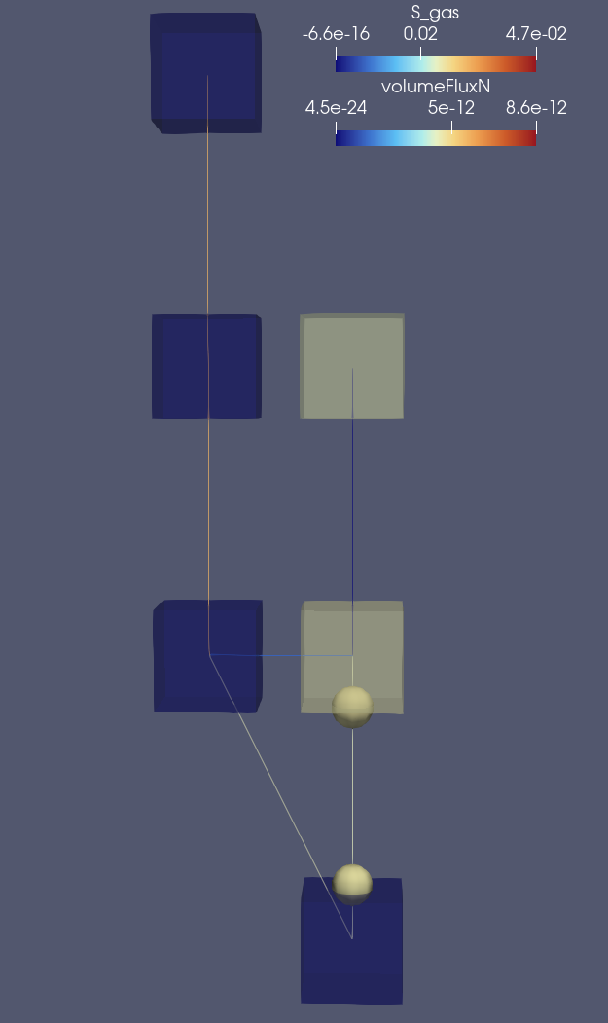
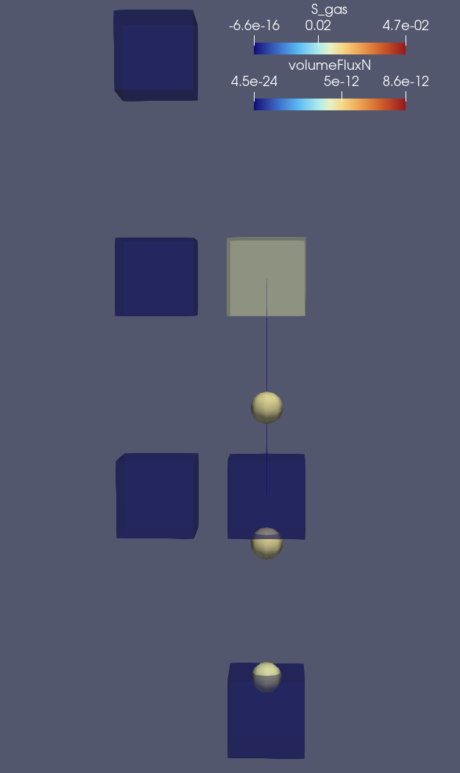
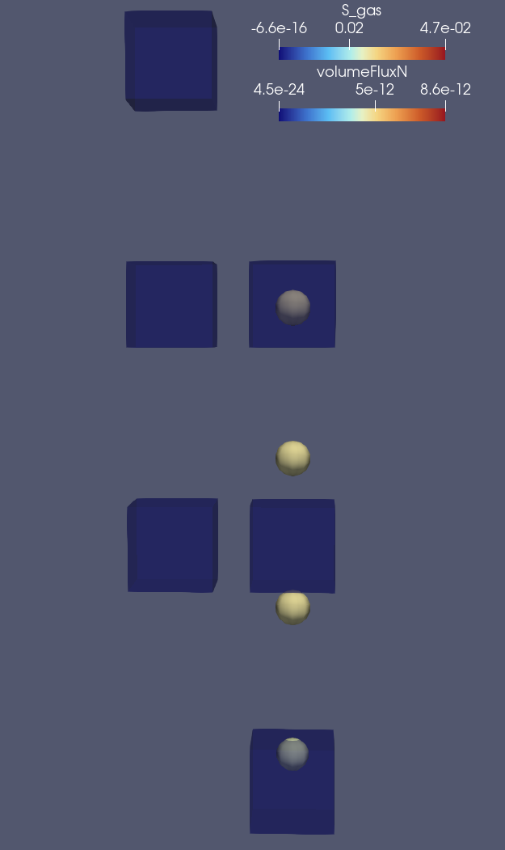
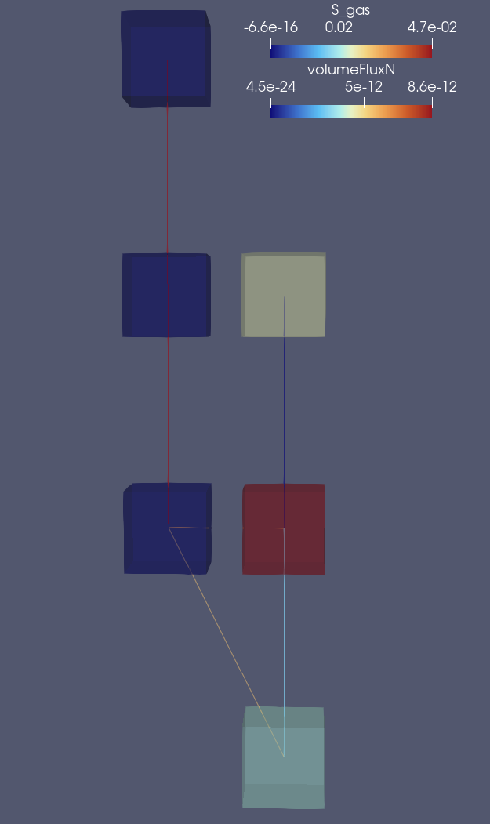
Bubble transfer to continuous phase
Network with paths and a “dead end trap”
The bubbles get stuck in the corner pore.
The other bubbles dissolve due to invasion.
$$G$$

Slide 18
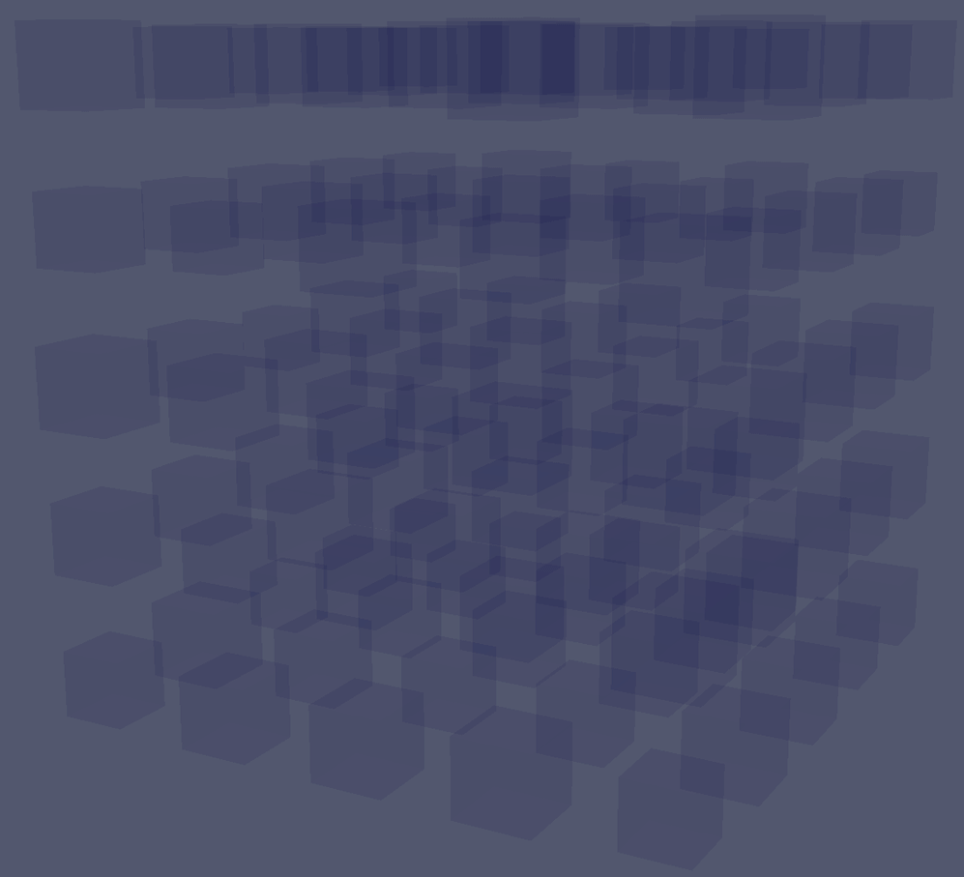

Flow regimes
Bubble flow regions
Continuous gas phase clusters
$$50G$$

Slide 19
Thank you!
Kristoffer Skjelanger ¹
Maziar Veyskarami ²
Anna Mareike Kostelecky ²
Timo Koch ²
¹ Western Norway University of Applied Sciences
² University of Stuttgart
The author gratefully acknowledge the financial support from the Research Council of Norway to the research school HySchool under RCN grant agreement number 332042.

