Slide 1
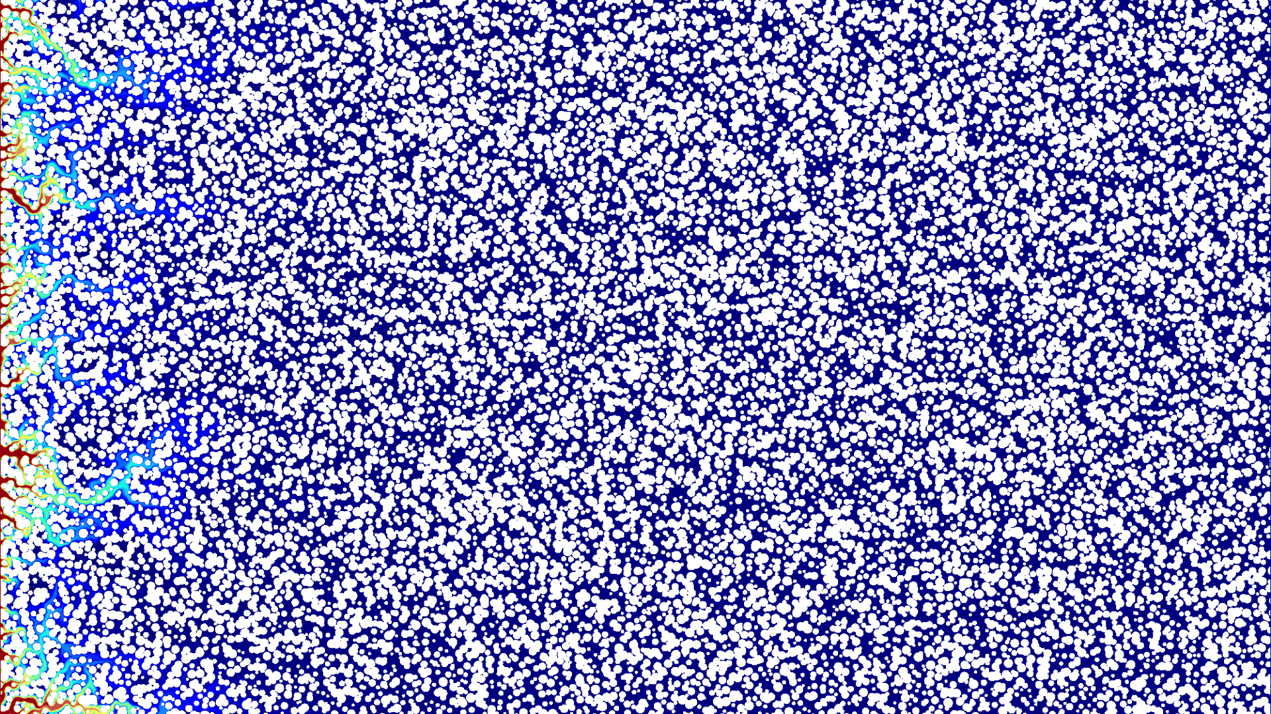

Deep learning for reactive transport modelling acceleration and upscaling workflows:
Can small pore-scale simulations
teach a Darcy-scale dissolution model?
Hannah P. Menke
Julien Maes
InterPore 2026 · Pore Scale Modelling
Notes:
Good morning, I’m Hannah Menke from Heriot-Watt University. And In this talk I’ll ask whether small pore-scale simulations can teach us a useful Darcy-scale model for reactive dissolution using machine learning.

Slide 2
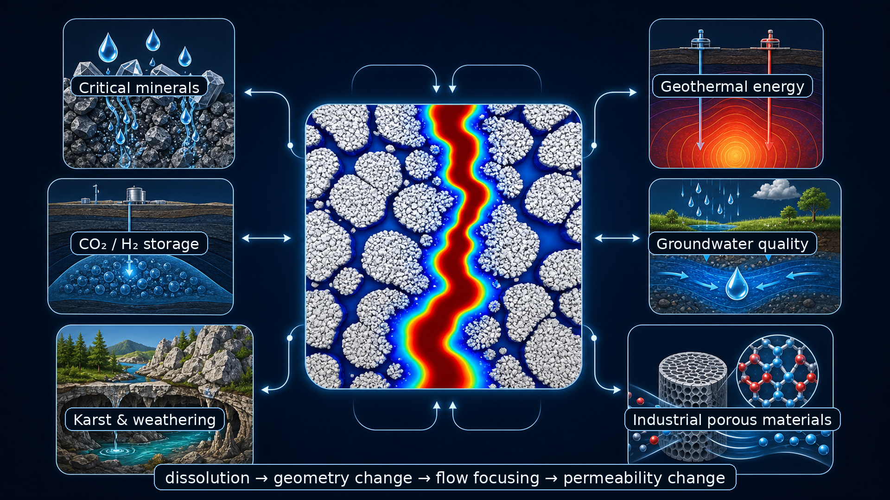
Reactive flow reshapes porous media
Notes:
So why should we care? Well, Reactive dissolution is not a niche problem. The same physical feedback shows up in critical-mineral leaching, geothermal systems, groundwater quality, etc etc. The applications are different, but the mechanism is shared: reaction changes pore geometry; geometry redirects flow; redirected flow changes where the next reaction happens. That feedback is why permeability can change by orders of magnitude and why simple upscaling is difficult.

Slide 3
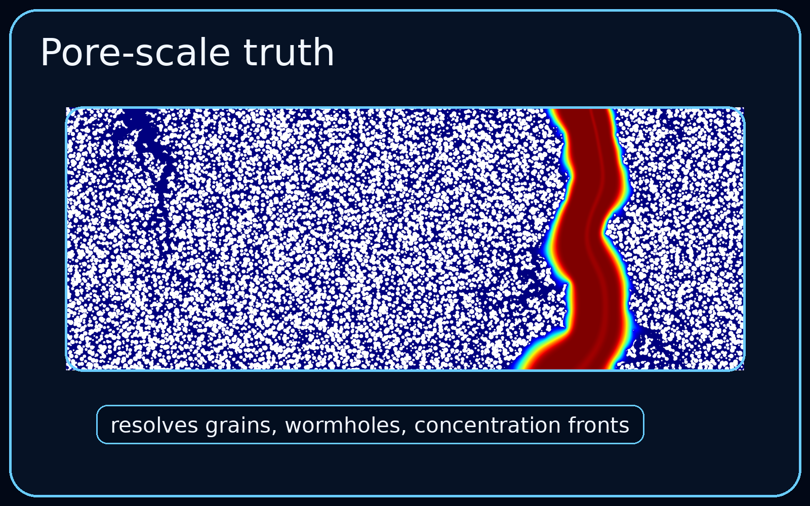
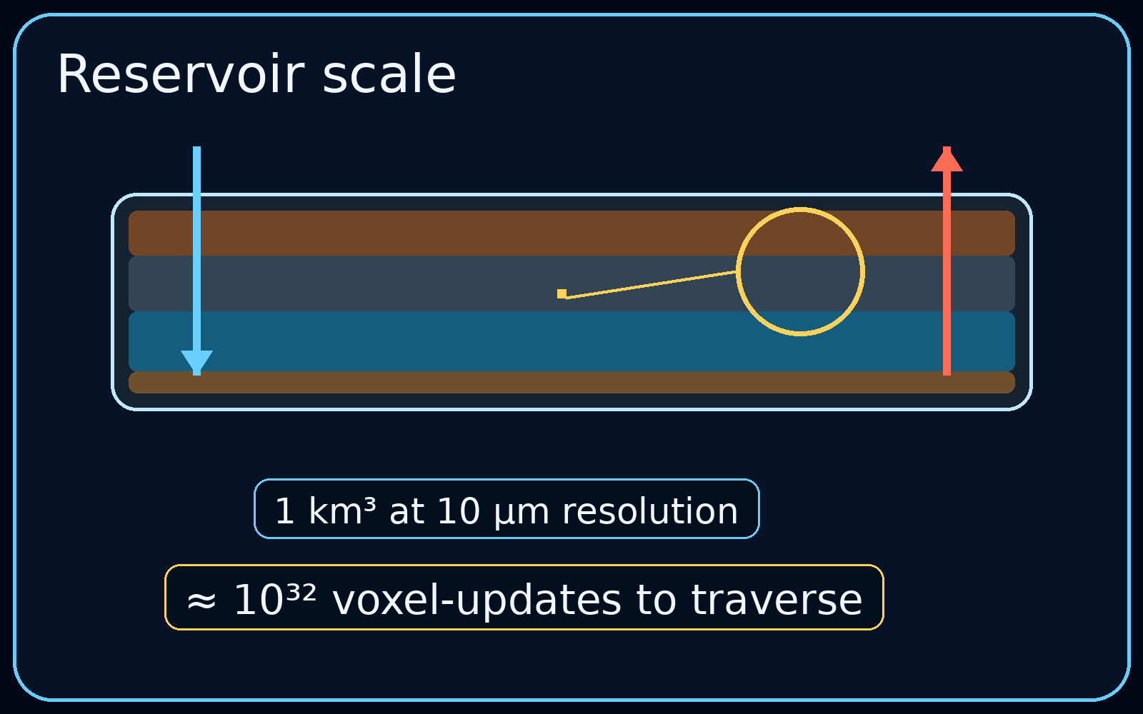
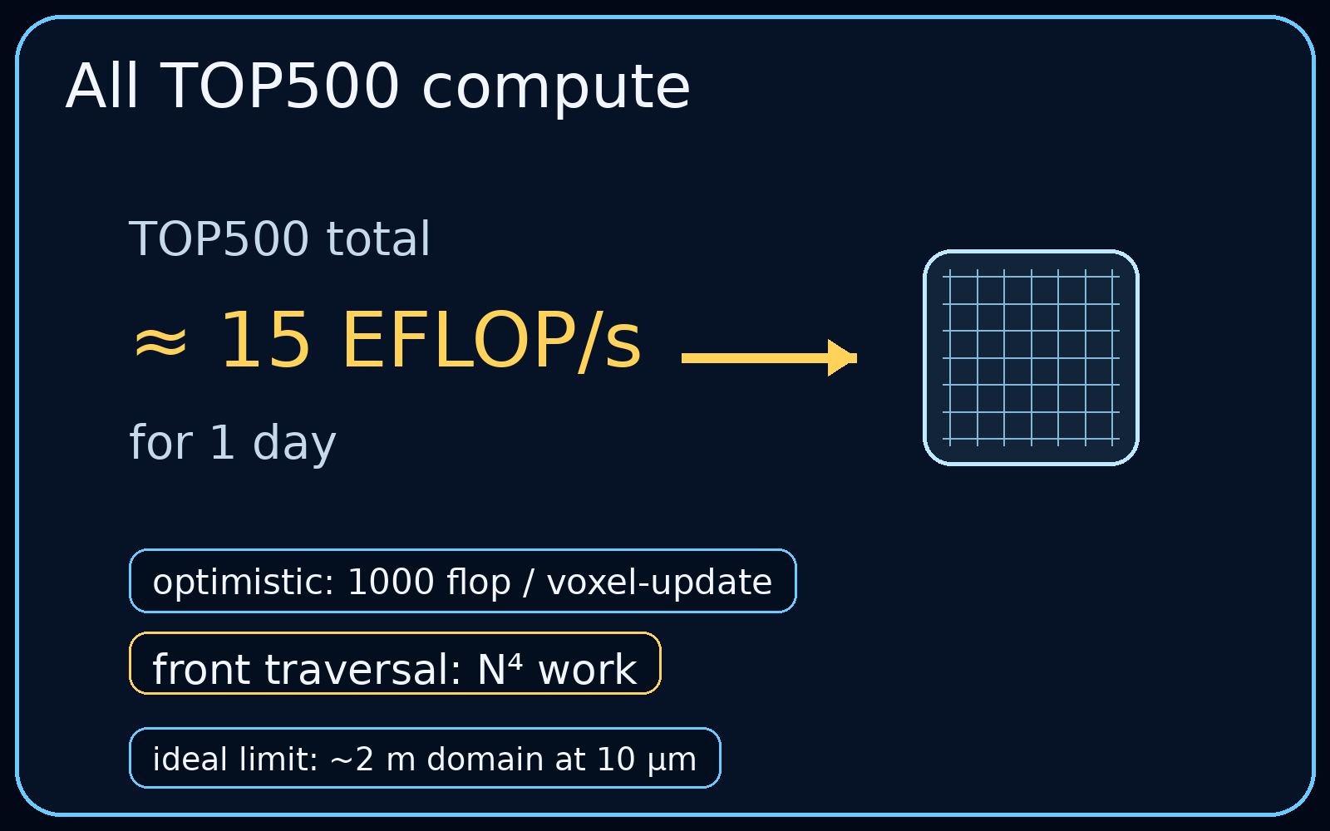
The scale gap is the problem
Notes:
So, if pore-scale feedback is the physics we care about, why not just simulate every pore directly? Well, let's do the math. Take every supercomputer on the TOP500 list — all of them — for a full day. Be absurdly generous about how cheap each calculation is. Whats the biggest domain we can do? You get... about two metres cubed. We need a kilometre for reservoir scale modelling. So we are comically not close.

Slide 4
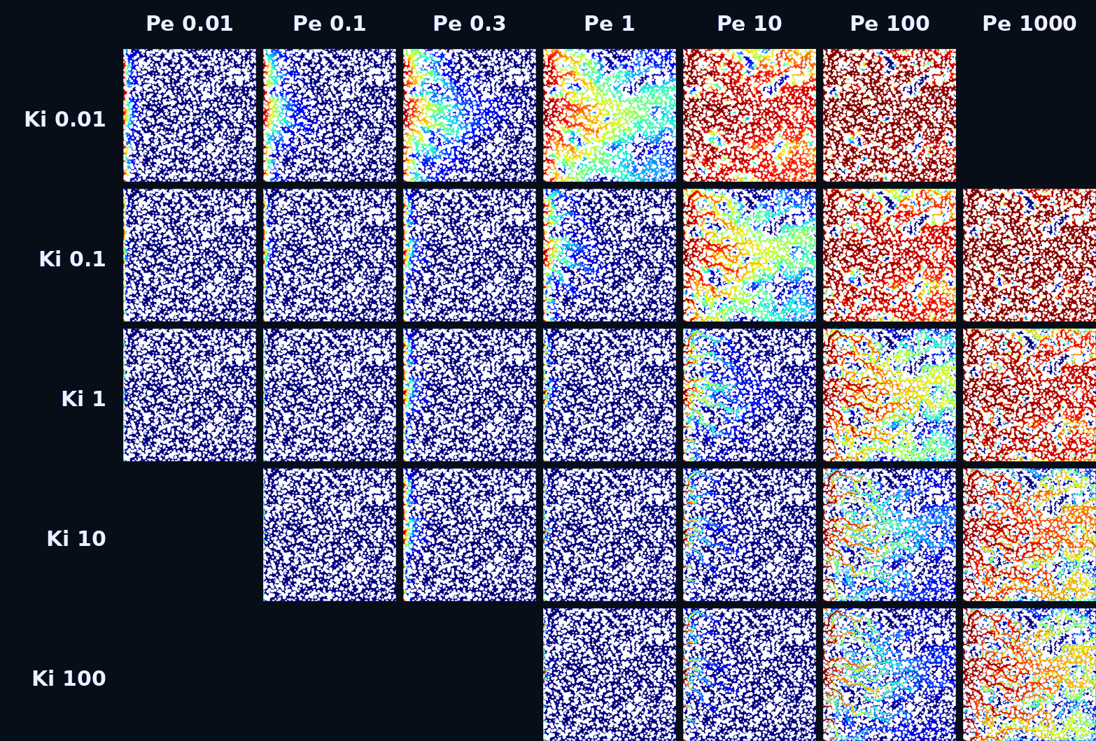
Training data: dissolution regimes across Pe–Ki space
Menke, H. P., Maes, J., & Geiger, S. (2023). Channeling is a distinct class of dissolution in complex porous media. Scientific Reports, 13(1), 11312.
Notes:
This is where the ML starts. We need pore-scale training data, and these come from my 2023 Scientific Reports study — GeoChemFoam simulations across a range of Peclet and kinetic numbers. Each tile in this map is a full reactive-transport simulation. Don't look at any single case — look at the spread. Broad dissolution here, wormholes over there. That variation is the whole point.
Every training example is a full pore-scale state — porosity, permeability, velocity stats, pore structure. The bet is it contains enough physics to learn a permeability rule. Next question: how do we test that?

Slide 5
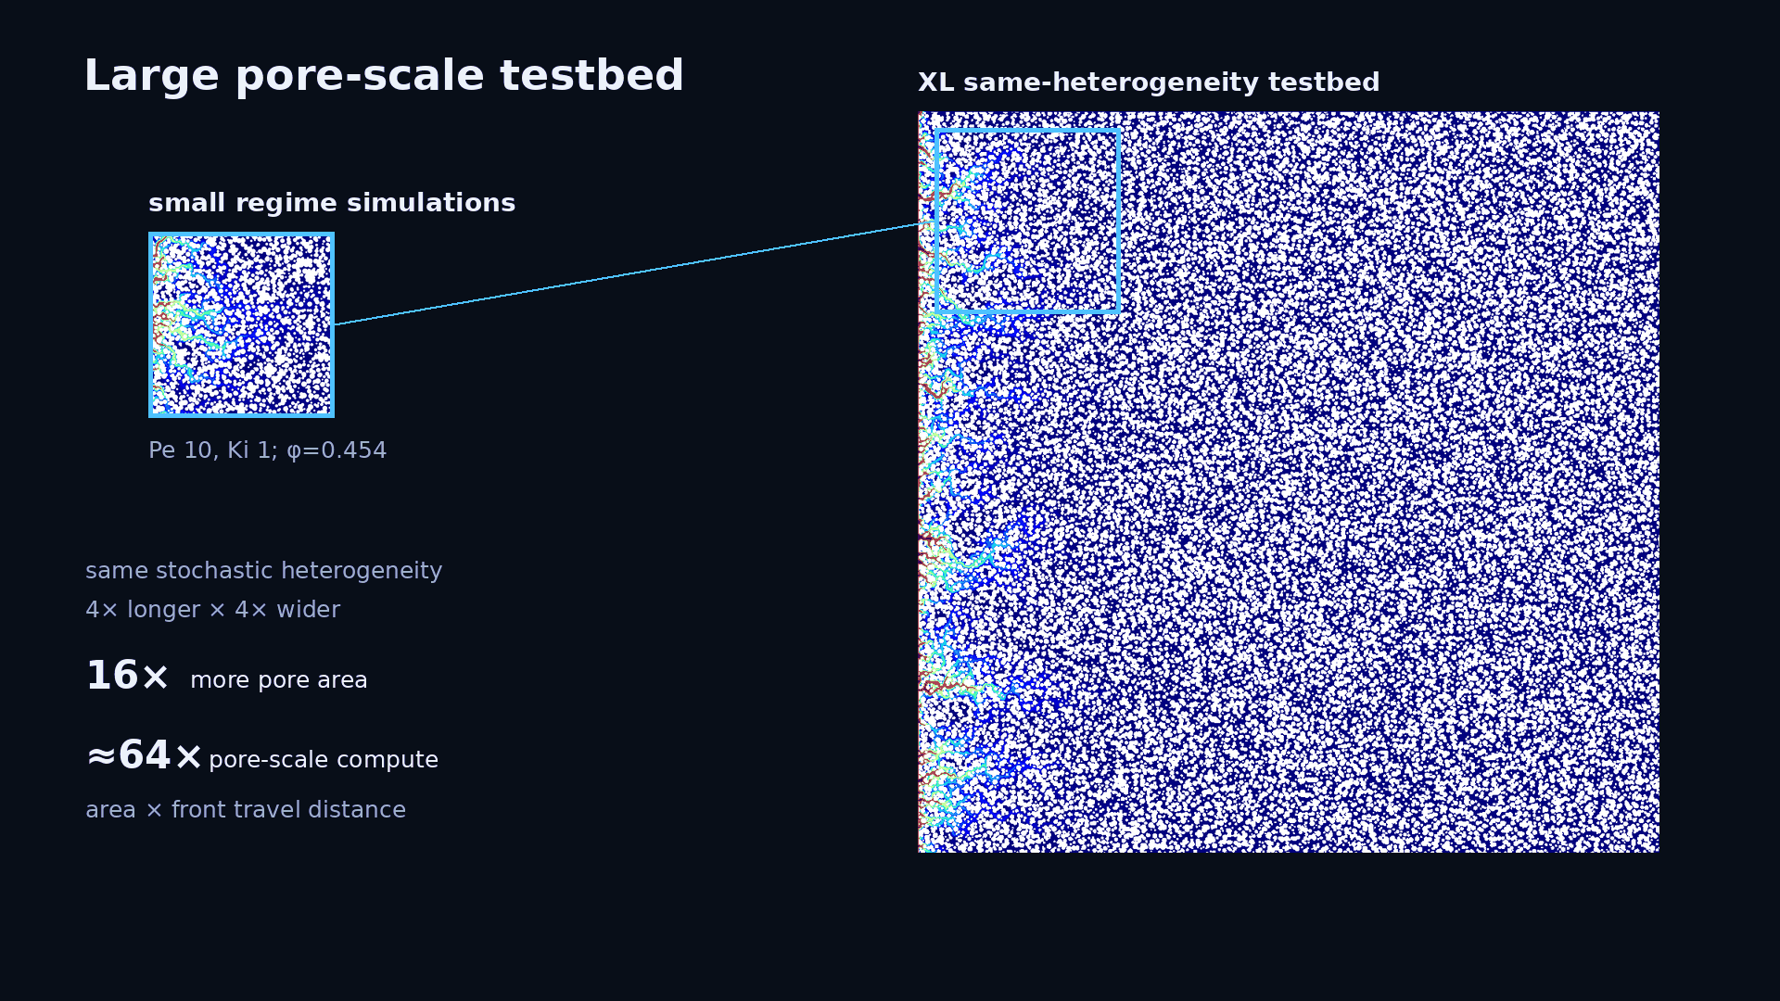
Notes:
But we need a groundtruth for the upscaling. Same micromodel heterogeneity — just bigger. Four times wider, four times taller. You can see the original at its true relative size here. That's sixteen times more pore area, which is great — we can finally ask real upscaling questions. But the compute cost isn't sixteen times. The dissolution front also has to travel four times further. So it's roughly sixty-four times more expensive per simulation. That cost is why we need the ML.

Slide 6
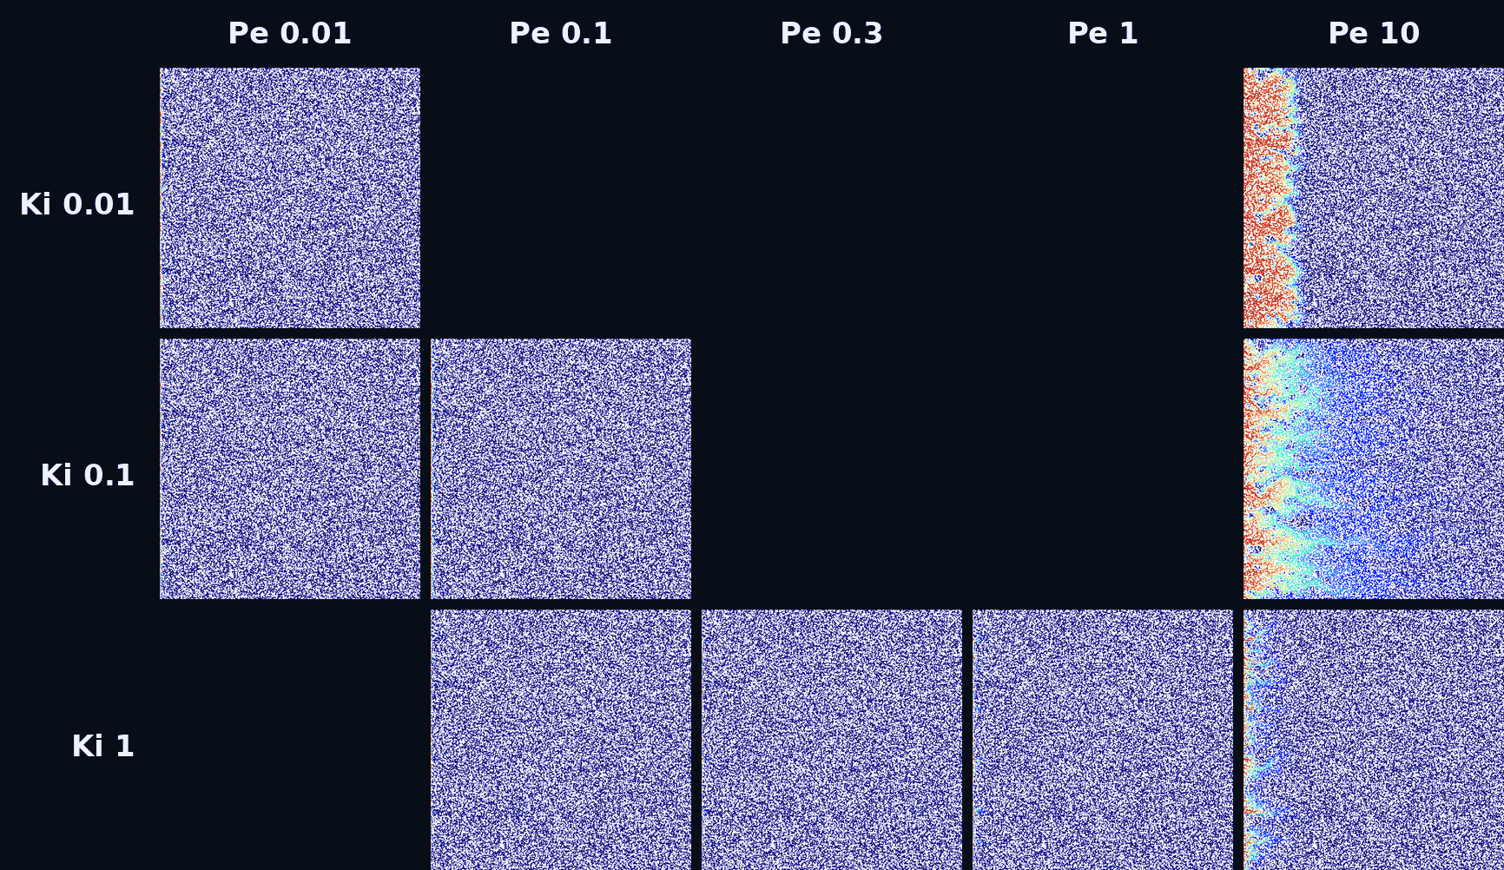
A larger pore-scale testbed for upscaling
Notes:
These are the large-scale simulations we benchmark against. They're expensive, so we picked them to cover the main dissolution regimes — broad fronts, localized fingers, strong channeling. This is test data. The ML model only sees the small-domain simulations. These large cases are where we ask — does it actually transfer?

Slide 7
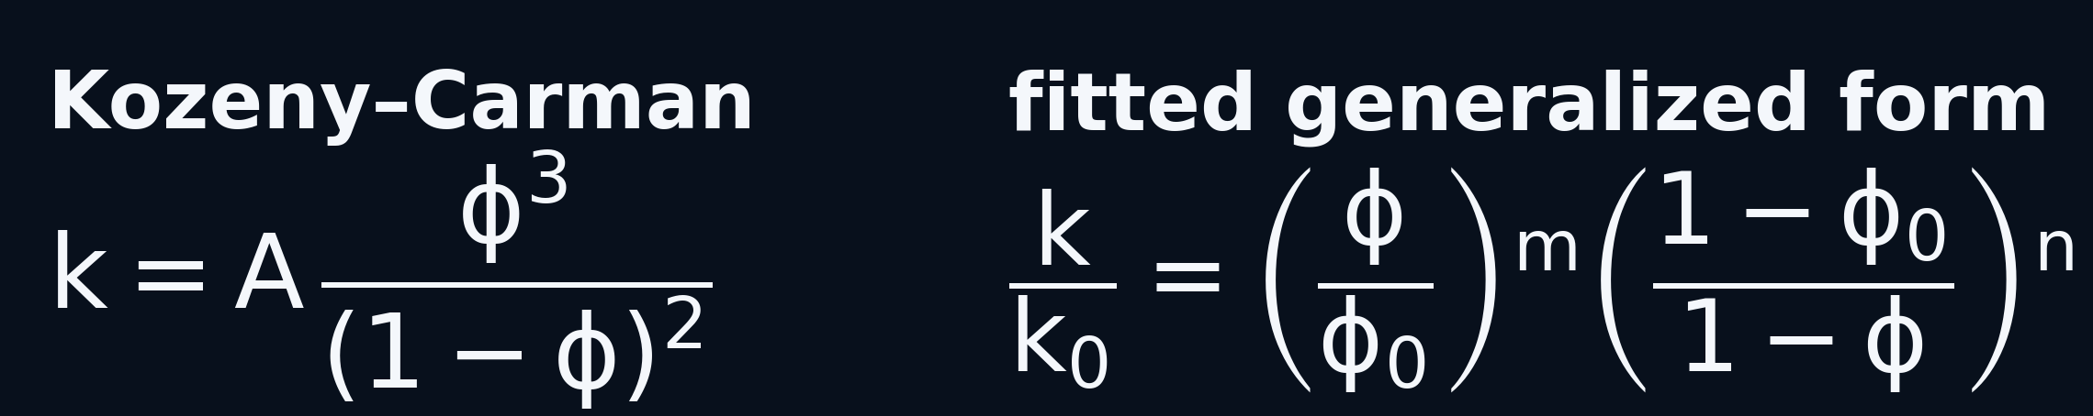
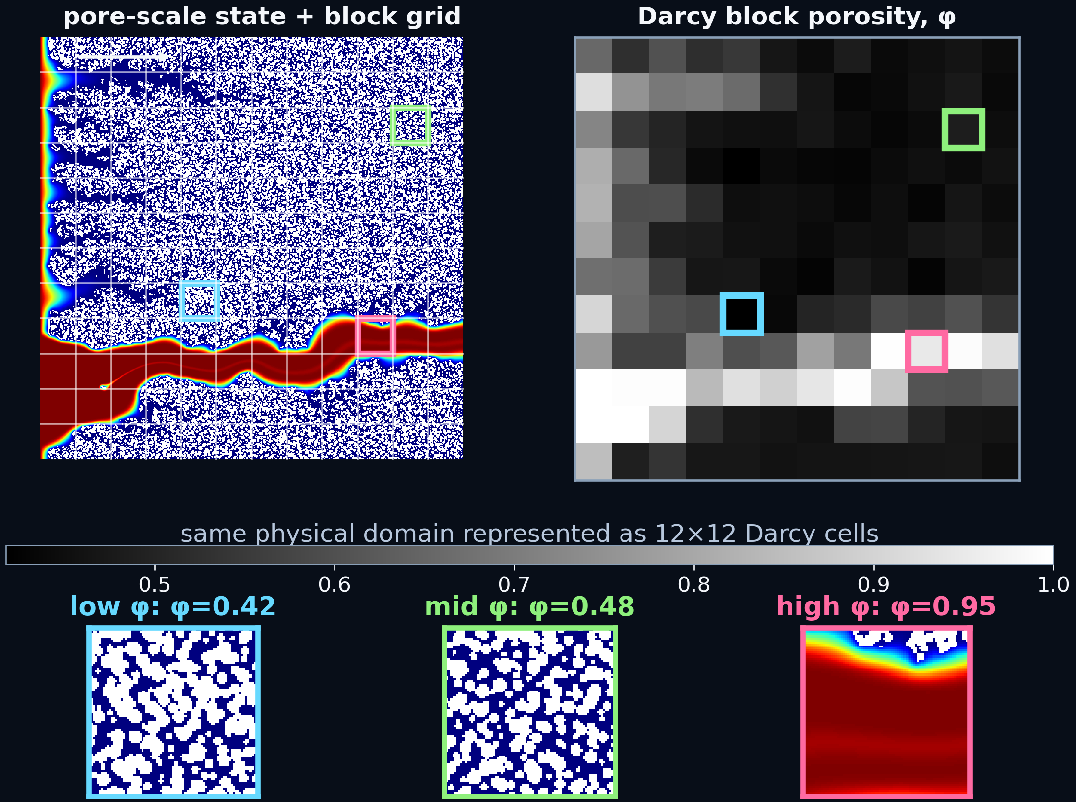
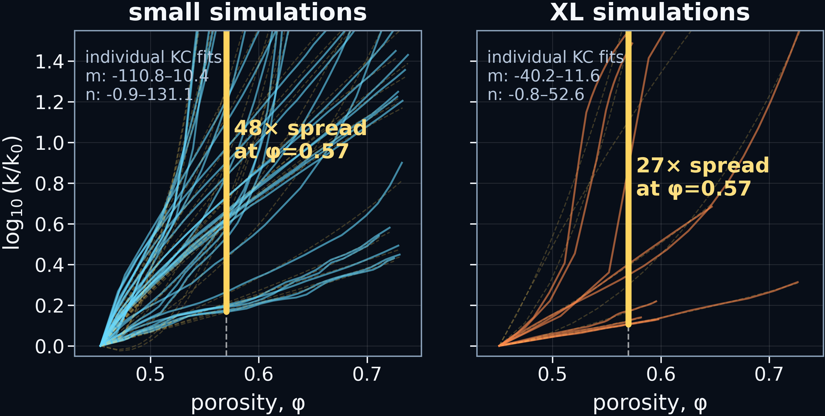
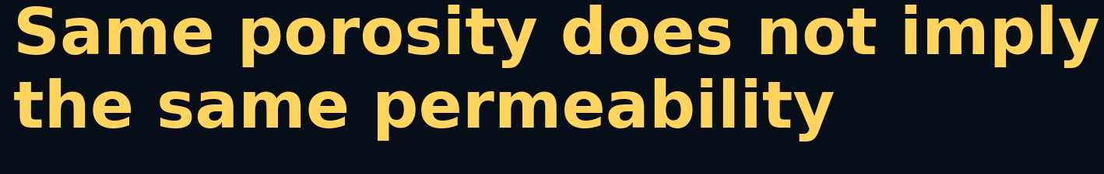
Why not just use Kozeny-Carmen?
Notes:
The obvious question: why not just use Kozeny-Carman? It's the standard porosity-permeability relation — one equation, been around forever. Here's the problem. Look at the left plots. At the same porosity — say 0.57 — you get a 48-times spread in permeability across different simulations. The XL cases show the same thing — 27-times spread. And you can see why on the right. These three Darcy blocks all come from the same simulation, but they look completely different. One's barely dissolved, one's got nice uniform dissolution going on, one's a wormhole. Same porosity does not imply the same permeability. Kozeny-Carman has no way to know which situation you’re in.
That's why we need a ML model that takes more than just porosity.

Slide 8
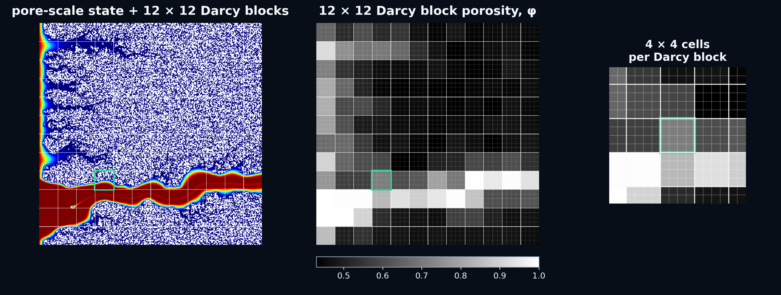
Creating the Darcy domain
*
*splitting blocks minimises numerical diffusion
Notes:
Here's how we go from pore scale to Darcy scale. Overlay a 12-by-12 grid, average/calculate each block's properties. Then split each block 4-by-4 for the transport solve — that keeps the reactive front sharp.

Slide 9
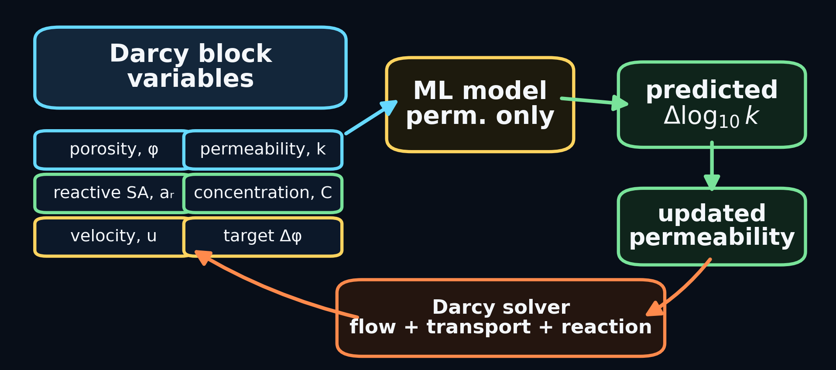
Designing a Darcy scale ML model integration
Notes:
Here's the ML loop. Each Darcy block knows its porosity, permeability, reactive surface area, concentration, and velocity. These are the Darcy scale variables. The ML model takes those and predicts a permeability update — delta log k. That gets fed back into the Darcy solver, which does the flow, transport, and reaction, which updates the block variables, and around we go.
The model only predicts permeability change. Everything else is handled by the physics solver. So we're replacing one variable, not the whole simulation.

Slide 10
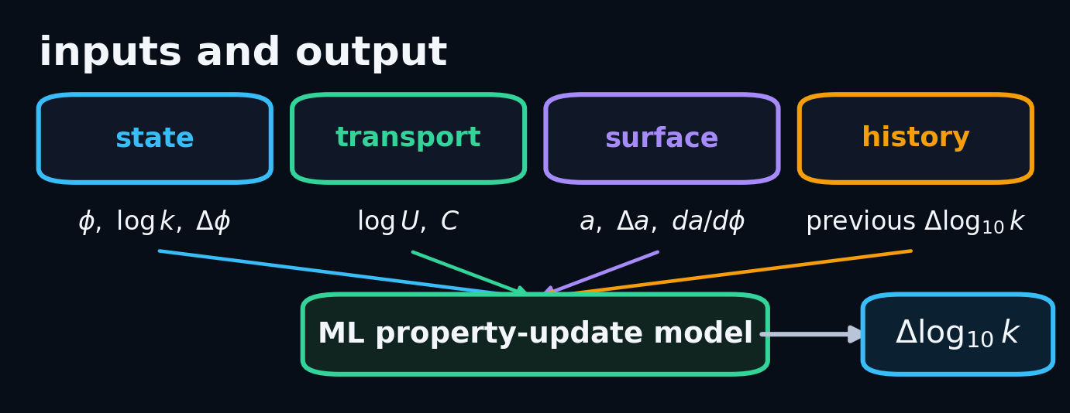
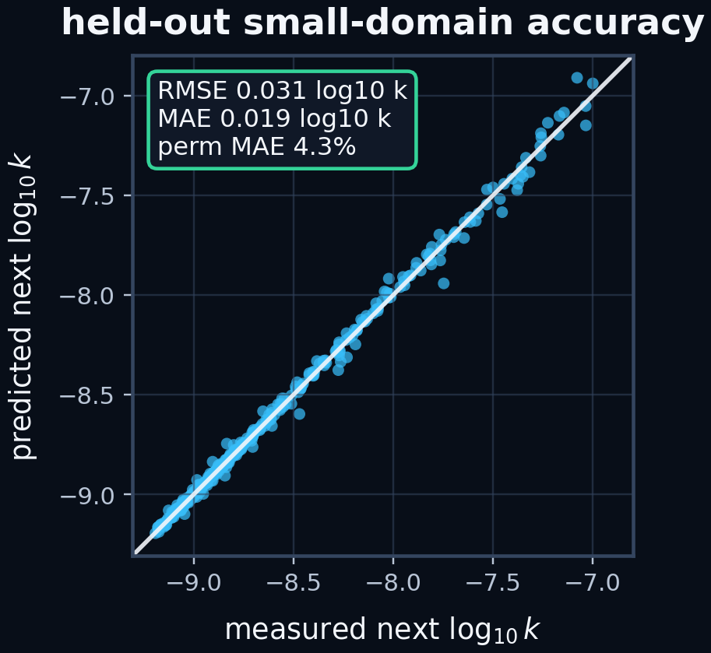
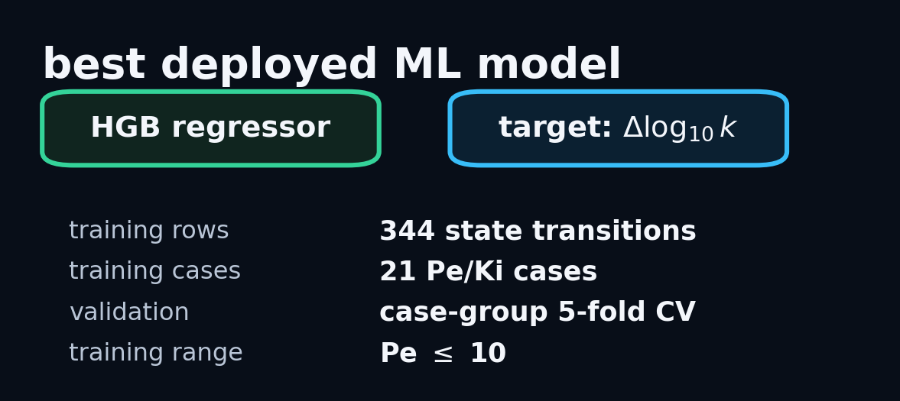
Learning permeability updates from pore-scale dissolution
Notes:
The ML model is a histogram gradient-boosted regressor. Nothing exotic. 344 training rows from 21 small-domain cases, validated with case-group cross-validation so it never sees its own simulation during testing. On held-out small-domain data, 4.3% mean absolute error on permeability. That scatter plot is tight. But this is the easy test — same domain size it trained on. The real question is whether it holds up on the large-scale cases.

Slide 11
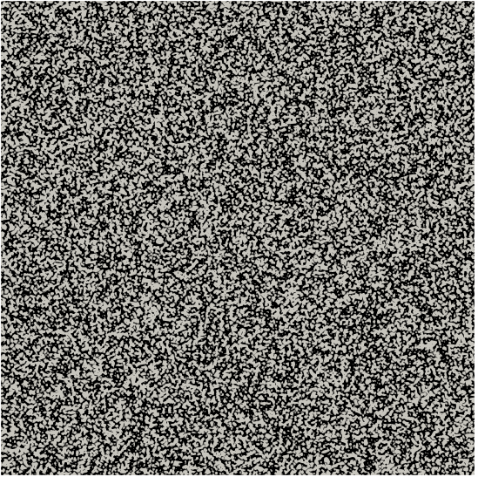
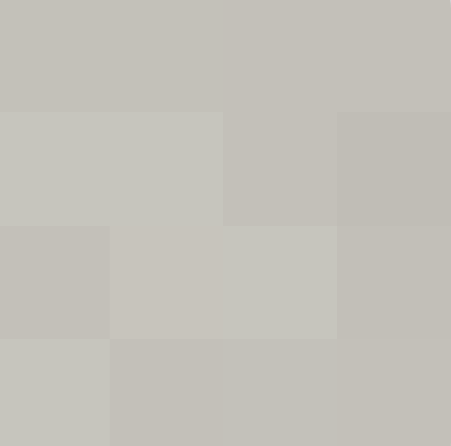
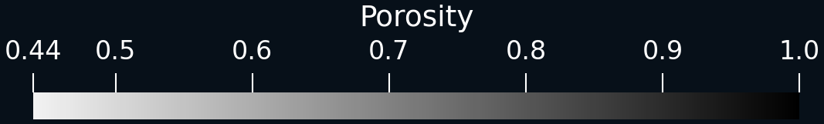
Upscaling comparison
Fully-resolved pore-scale model Pe=0.3 K=10
Kozeny-Carman Darcy-scale model Pe=0.3 K=10
Machine learning Darcy-scale model Pe=0.3 K=10
Notes:
On the left, pore-scale truth. 16 million cells, one week on 24 processors. Middle is Kozeny-Carman — dissolves too uniformly, overpredicts a dominant wormhole. On the right, our ML-coupled Darcy model which gets the conical wormhole regime right. For comparison the ML and KC take about Four minutes on one core. So multiple order of magnitude speed up.

Slide 12
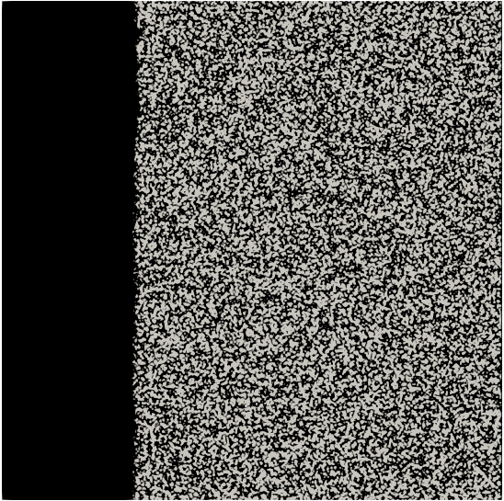
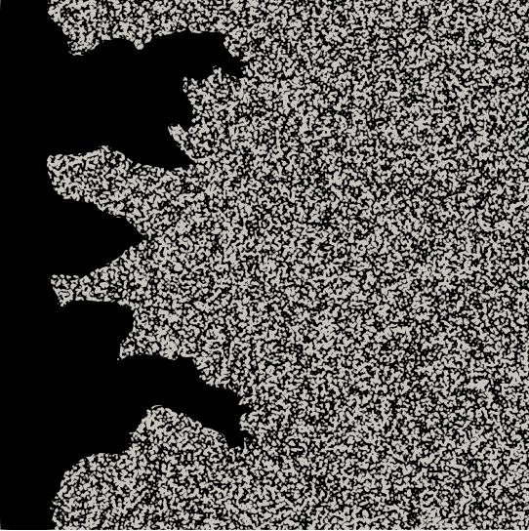
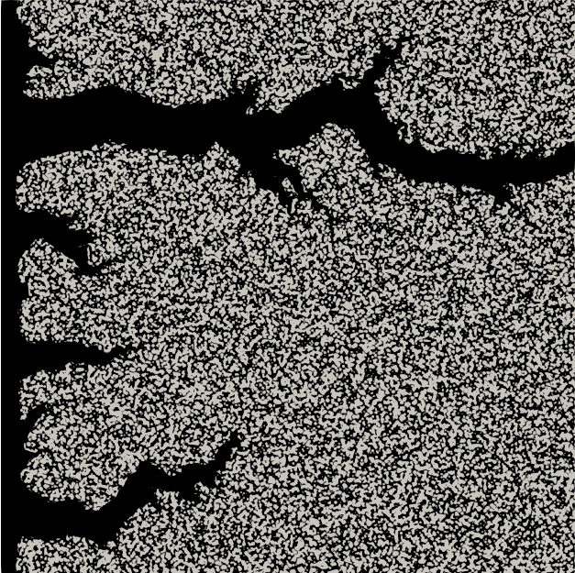
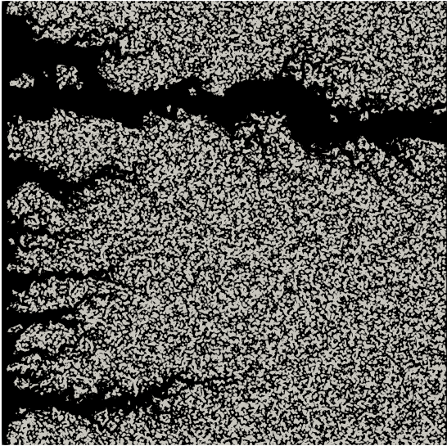

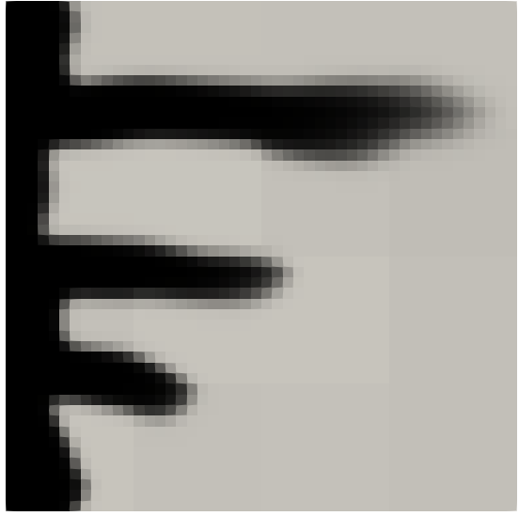
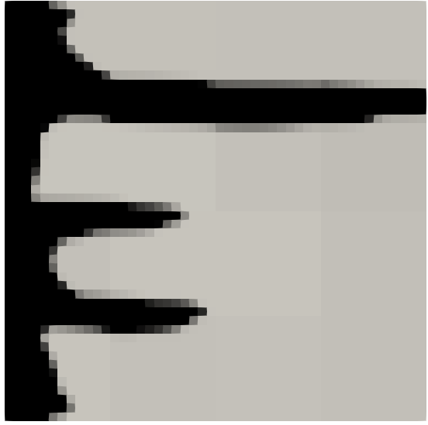
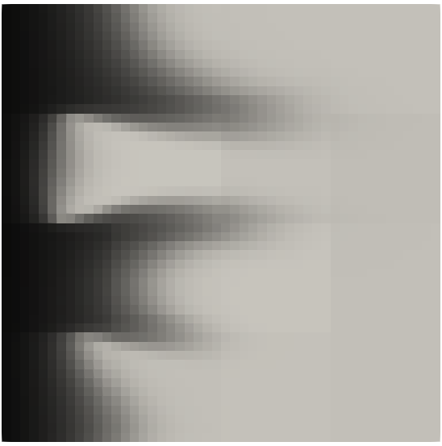

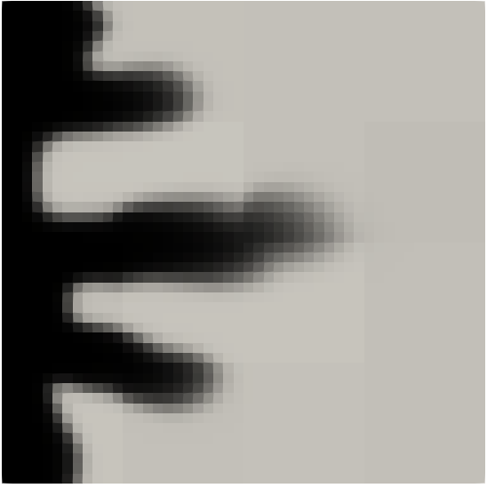
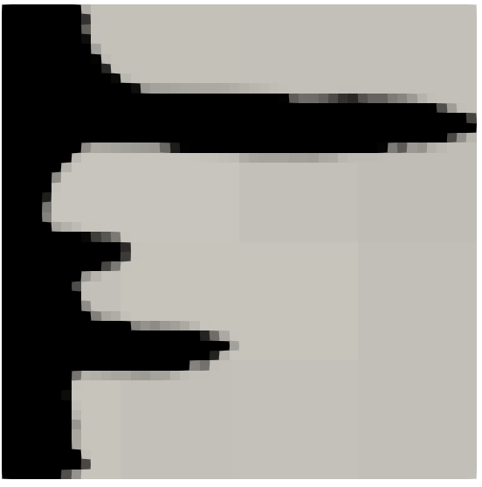
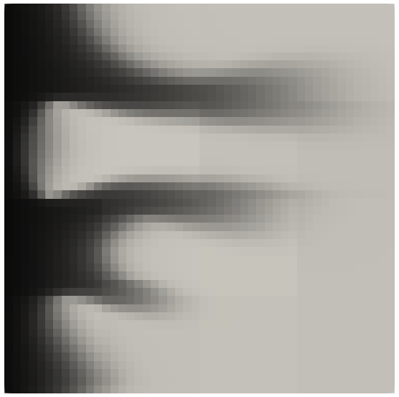
Compact
Pe=0.01, Ki=0.1
Conical
Pe=0.3, Ki=10
Dominant
Pe=1, Ki=1
Ramified/Channeling
Pe=10, Ki=1
Pore-scale
Darcy KC
Darcy ML
Notes:
Here are the results across regimes at different flow and reaction rates. In the middle of a regime — compact or dominant wormholing — KC and ML both do fine. The interesting cases are the transitions. Conical, channeling/ramified — where each block is shifting between regimes as conditions evolve. That's where the ML model pulls ahead.

Slide 13
Same regime, different path
winner
winner
Notes:
But let's look closer. The ML model gets the right dissolution regime — but not the right path. *The pore-scale wormhole goes one way, the ML Darcy model goes another. Same regime, different winner. And this is something I find... irksome. We tried everything with the permeability model to fix this but the path didn't move. Something else is picking which channel wins and its not the permeability.

Slide 14
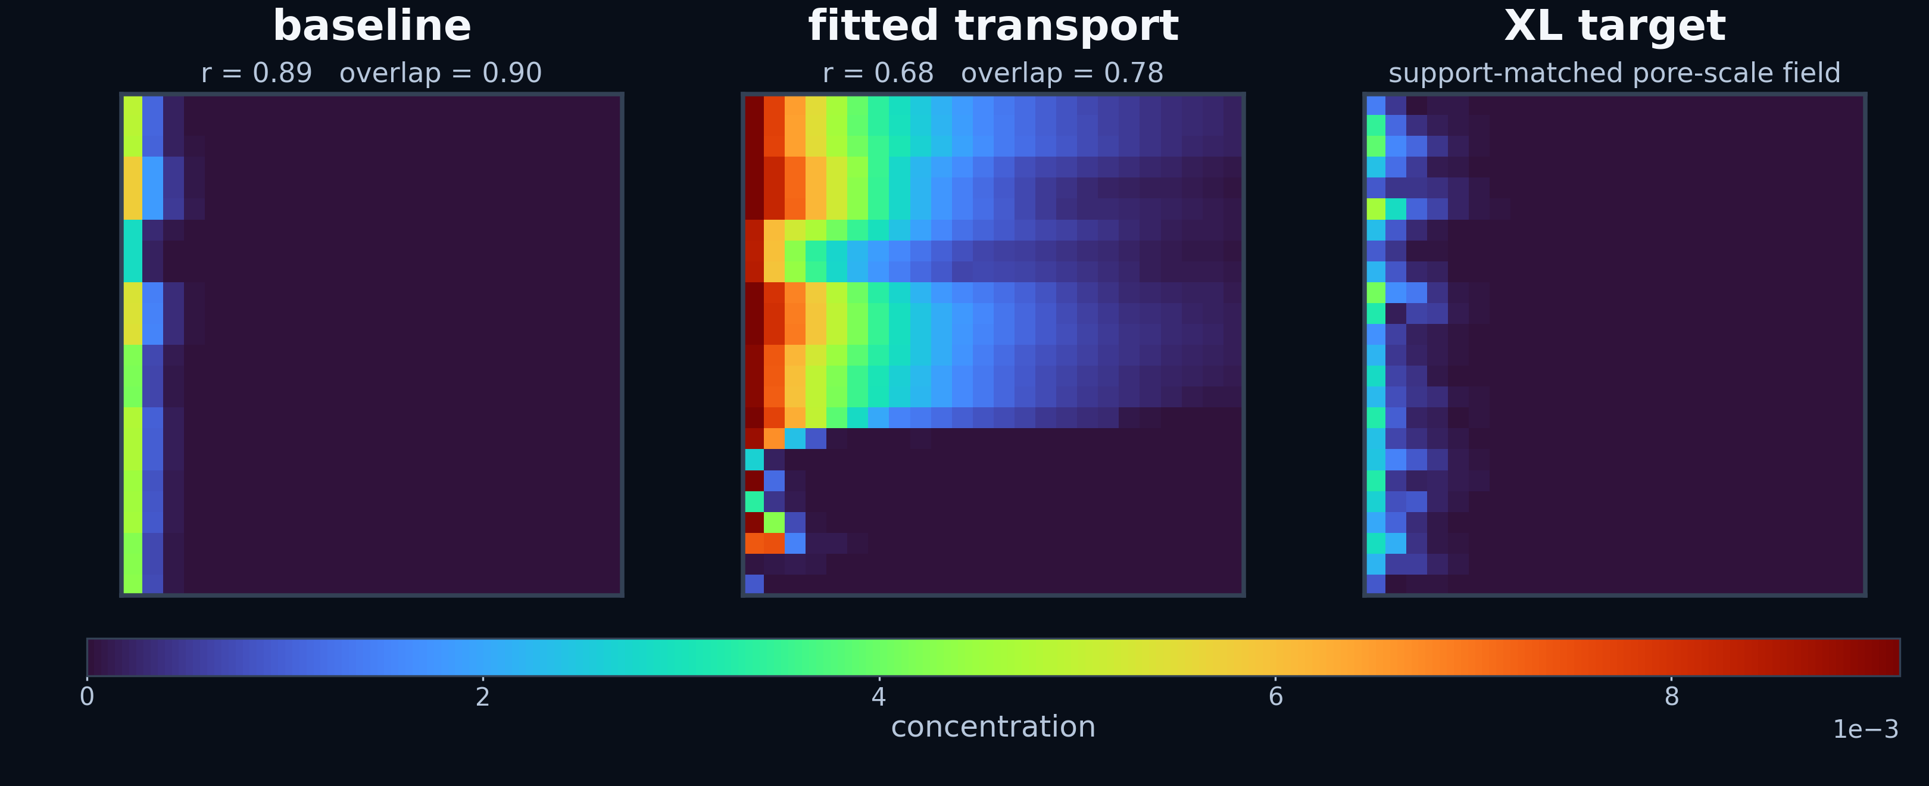

Is it just an initial state problem?
Notes:
So can we fix it by fitting the transport instead? We freeze the geometry and ask: can Darcy transport put the reactant in the right place? With measured permeability and no fitting, the front lands roughly right — around 0.89. Then we fit everything we can — effective diffusivity, reaction rate — using the actual pore-scale fields and OpenFOAM operators. It gets worse. r drops to 0.68. One Darcy velocity and one Darcy concentration can't capture correlated fast pathways. The problem isn't a bad parameter — it's a missing degree of freedom.

Slide 15
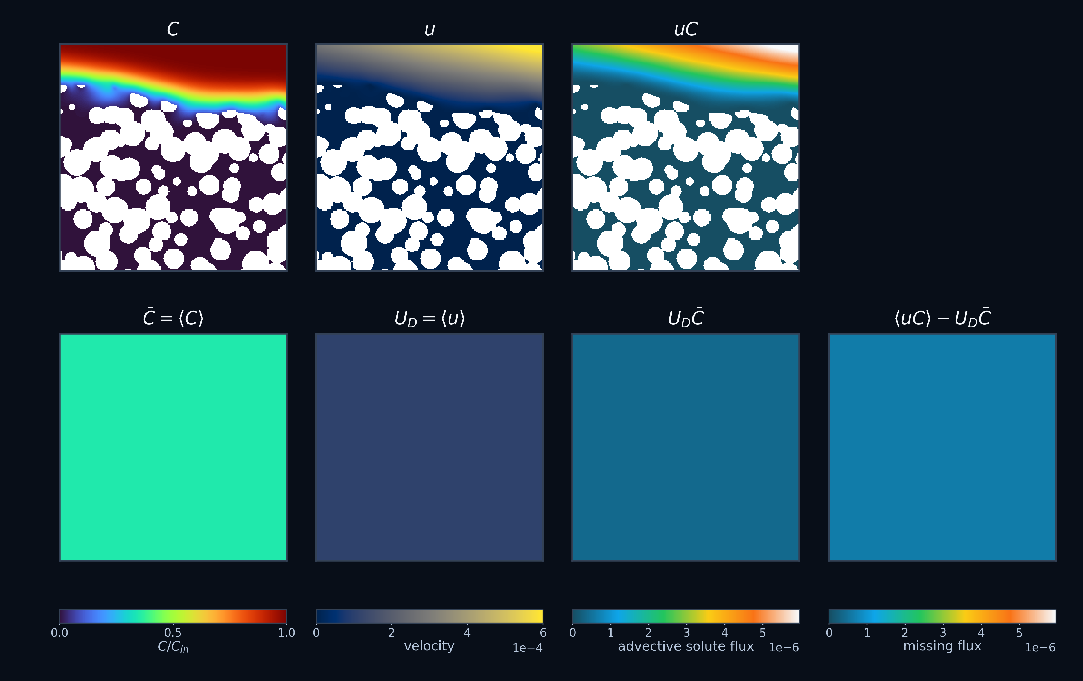

Where has all the flux gone?
pore-scale
Darcy-scale
62.2% not accounted for
Battiato & Tartakovsky 2011
Deng et al. 2025 GRL
Notes:
Here's what's actually happening. In dissolution, high concentration and high velocity live in the same place — the fast channels. **Average them separately and that correlation vanishes. The missing flux is comparable to the Darcy flux itself. That's why we keep picking the wrong channel winner.
**And people have long suspected Fickian closure fails for reactive transport. And here is the quantitative proof — and a budget for how much it fails. So, then we asked can we recover that information from Darcy-scale diagnostics, or do we need a different upscaling strategy?

Slide 16
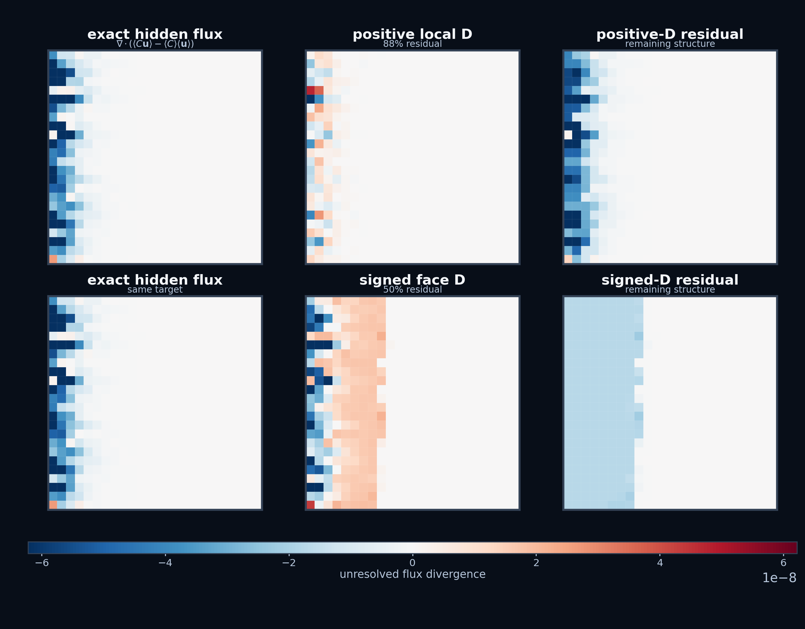


Non-Fickian transport: the proof
Notes:
We computed the exact missing flux — the difference between averaging C-times-U versus average-C times average-U. Then we asked: can any diffusion tensor represent this flux? Completely unconstrained — scalar, tensor, negative, anything goes and the missing flux is fifty percent unexplained. And the residual isn't noise — it follows the pore network, not the concentration gradient. If this transport were Fickian, our closure would have worked. It didn't. That's not a bad fit. No choice of D fixes this. The wormhole winner is decided by how much reactant is in the fast channels versus trapped in slow pockets. One block-averaged concentration conflates the two. The model literally doesn't know where the reactant is.

Slide 17
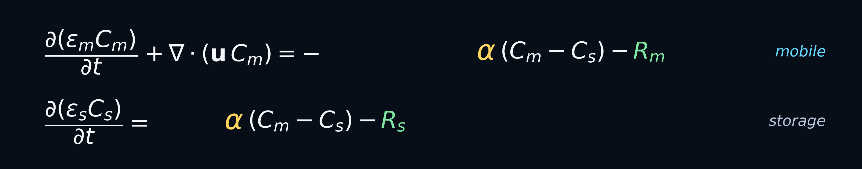
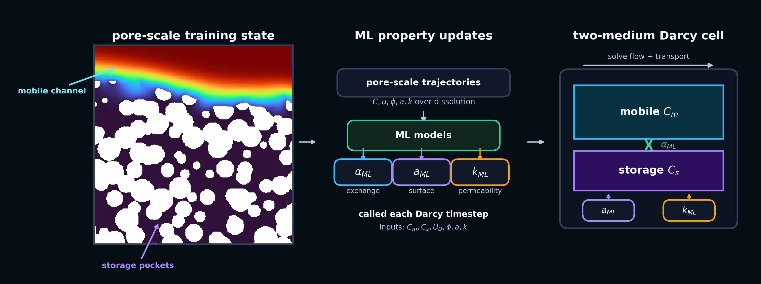
Where do we go from here?
two-medium transport model
Notes:
So how can we fix this? The fix is a two-medium model — one concentration for fast channels, one for slow pockets, with exchange between them. That's the minimum structure that carries the missing signal.
ML still has a role — learning exchange rates, surface evolution, and permeability. But those closures need the right equation underneath them. The small pore-scale simulations already contain this information. We just need a model with somewhere to put it. The goal for future work is to get both the right regime and right path. Trained small, tested large, with transport that can finally hear what the pore scale is saying.

Slide 18

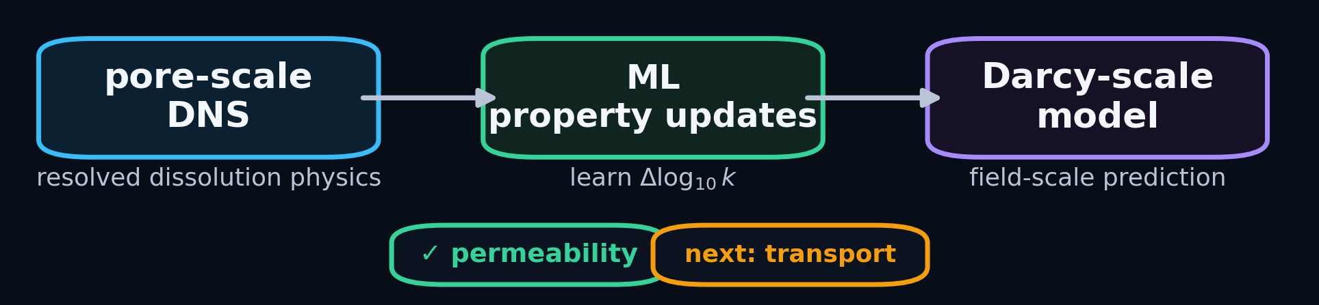

Thanks for listening!
Small pore-scale DNS can train useful Darcy-scale ML
Kozeny–Carman works within a regime → fails at transitions
ML fixes permeability evolution → transport upscaling remains
Next: two-medium transport + ML-learned exchange, surface area & permeability
Download GeoChemFoam:
github.com/GeoChemFoam
Notes:
So to wrap up: small pore-scale simulations can train useful Darcy-scale ML. Kozeny-Carman works in the middle of a regime but falls apart at transitions. ML fixes the permeability — but that revealed the real problem is transport upscaling. Next step is two-medium transport with ML-learned upscaling parameters. GeoChemFoam is open source if you want to try out our awesome iVOS solver that’s like 100x faster than other dissolution solvers — QR code is right there. If you're interested in pore scale modelling, follow us on our new Youtube channel. Thank you and I'll take any questions.

