Slide 1
Three-phase hysteresis in porous rock characterized with a discrete-domain model and direct pore-scale simulations.
Mohammadsajjad Zeynolabedini ^{a,*}, Espen Jettestuen ^{b}, Olav Aursjø ^{b}, Johan Olav Helland ^{b}
ª University of Stavanger, ^{b} NORCE – Norwegian Research Centre
* mohammadsajjad.zeynolabedini@uis.no

Slide 2
Introduction
Hysteresis plays an important role in modern reservoir applications due to the nature of cyclic fluid injections, which will lead to multiple drainage and imbibition processes in the reservoir.
Objectives of this work:
Extend the discrete-domain method for 3-phase capillary hysteresis (Helland, et al., WRR 2021) to real systems
This will provide efficient calculation of 3-phase capillary pressure curves with hysteresis in realistic porous media.
This includes replacing the phenomenological energy expressions with an energy landscape calculated from 3-phase pore-scale simulations compatible with the discrete-domain formulation.
2

Slide 3



Discrete-domain method
The discrete-domain model divides a porous medium with pore volume $V_{p}$, saturated by oil (o), water (w) and gas (g) into $N$ compartments. The Gibbs free energy ($G$) is:
$$G=\sum_{i=1}^{N}{v_{p,i}\sum_{α=o,w,g}{g_{α,i}=}}\sum_{i=1}^{N}{v_{p,i}\sum_{α=o,w,g}{(−p_{α}s_{α,i}+f_{α,i}{(s}_{α,i}))}}$$
$p_{α} =$ pressure of phase $α$
$v_{p,i} =$ pore volume of compartment $i$
$s_{α,i} =$ saturation of phase $α$ in compartment $i$
$g_{α,i}=G_{α,i}/v_{p,i}=$ Gibbs energy density contribution from phase $α$
$f_{α,i }={F_{α,i}}/{v_{p,i}}=$ Helmholtz energy density
contribution from phase $α$ (fluid/fluid & fluid/solid interfacial interactions)
$σ_{ow}=$ Interfacial tension
$θ =$ Contact angle
$a_{ow}=$Specific oil/water interfacial area
$a_{os} =$ Specific oil/solid interfacial area
In this «phase-by-phase» description, we need to determine the interfacial energy contribution $f_{α,i}$ for all phases $α$ and all compartments $i=1,…,N$.
For a 2-phase oil-water system,
$$f_{ow,i}=f_{o,i}+f_{w,i}=σ_{ow}\left(a_{os,i}\left(s_{w,i}\right)\cos{θ}+a_{ow,i}\left(s_{w,i}\right)\right), i=1,…,N,$$
where we may use $f_{o,i}=f_{w,i}=f_{ow,i}/2.$
3

Slide 4

Discrete-domain method
Energy minimization leads to evolution equations for the compartment saturations:
$$\frac{\text{∂}s_{α,i}}{\text{∂}t}=p_{α}+ λ_{i}\left(\sum_{β=g,o,w}{s_{β,i}−1}\right)−\frac{\text{∂}f_{α,i}}{\text{∂}s_{α,i}}, i=1,…,N, α=g,o,w$$
Here, $λ_{i}$ is a Lagrange multiplier for the constraint $s_{o,i}+s_{w,i}+s_{g,i}=1$.
With $\frac{\text{∂}s_{α,i}}{\text{∂}t}=0$ for all $α=g,o,w,$and $i=1,…,N,$ the above equation implies that an equilibrium state must satisfy:
$$P_{αβ}=p_{α}−p_{β}=−\left(\frac{\text{∂}f_{β,i}}{\text{∂}s_{β,i}}−\frac{\text{∂}f_{α,i}}{\text{∂}s_{α,i}}\right), αβ=go,ow,gw, i=1,…,N$$

Slide 5

Discrete-domain method
Gas invasion displacement protocols:
In pressure-controlled displacement, we specify a sequence of pressures $p_{g}$ (keeping $p_{o}$ and $p_{w}$ constant) and arrive at the following expression for the Lagrange multiplier $λ_{i}$:
$λ_{i}=− \frac{\sum_{α=g,o,w}{\left(p_{α}−\frac{{∂f}_{α,i}}{{∂s}_{α,i}}\right)}}{3\left(\sum_{α=g,o,w}{s_{α,i}−1}\right)}, i=1,…,N$
In saturation-controlled displacement, we instead specify a sequence of global gas saturations $S_{g}$:
$$S_{g} =\frac{1}{V_{p}}\sum_{i=1}^{N}{V_{p,i}s_{g,i}=const.}$$
The above constraint implies that $p_{g}$becomes a Lagrange multiplier, in addition to $λ_{i},i=1,…,N.$
In saturation-controlled displacement with constant global oil saturation $S_{o}$, the Lagrange multipliers are $p_{g},p_{o},λ_{i},i=1,…,N$.
5

Slide 6
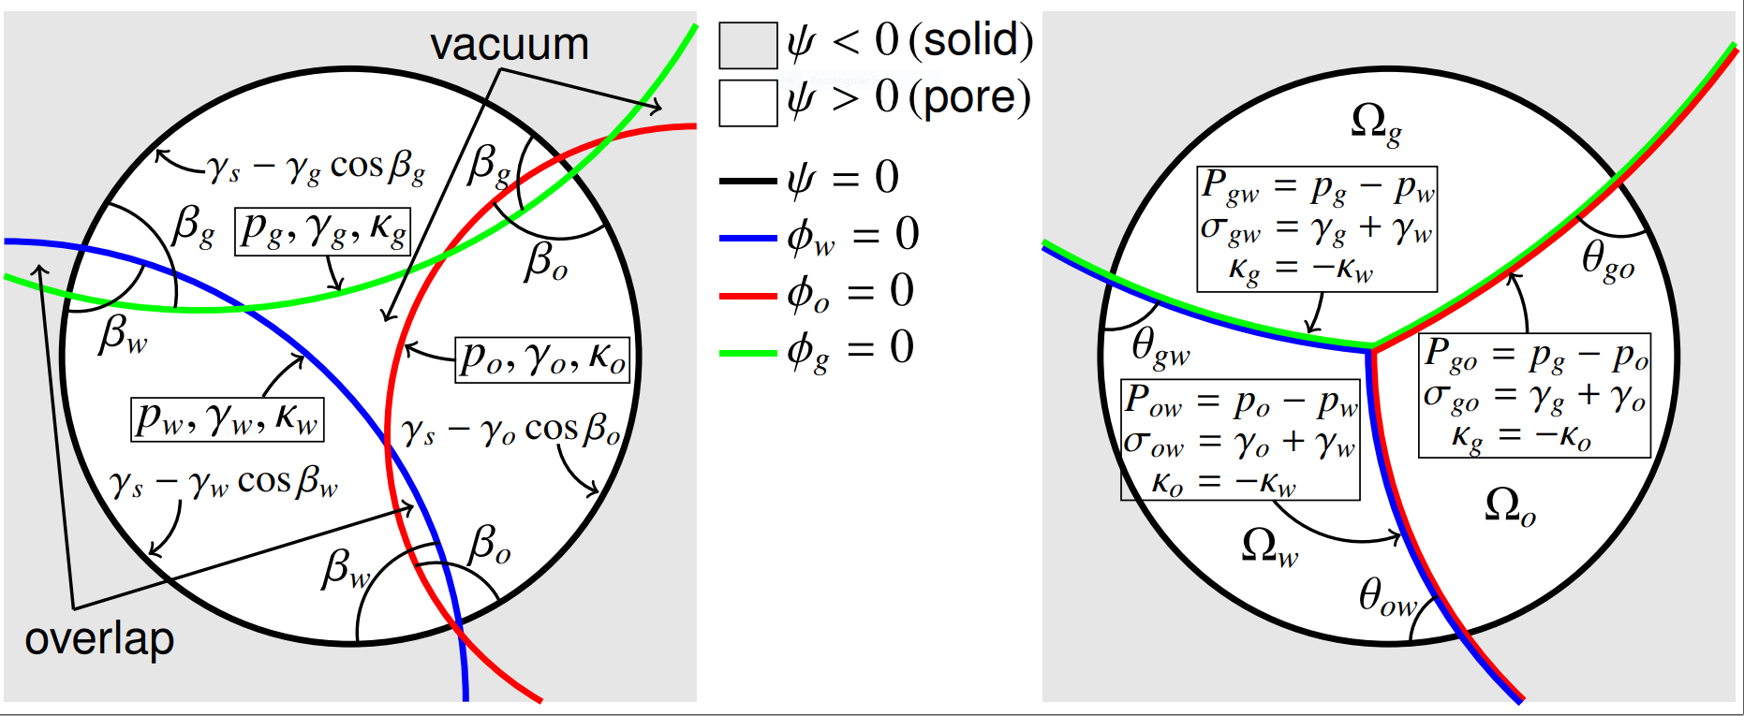



Level Set Method for 3-Phase Pore-Scale Simulations
One evolution equation per fluid:
${\left(φ_{α}\right)}_{t}+H\left(ψ\right)\left(p_{α}−γ_{α}κ_{α}\right)\left|∇φ_{α}\right|+\frac{H\left(−ψ\right)}{Δx}S\left(ψ\right)γ_{α}\left(∇φ_{α}⋅∇ψ−\cos{β_{α}}\left|∇φ_{α}\right|\left|∇ψ\right|\right)=0, α=g,o,w$
A projection step (Losasso et al., 2006) makes fluid regions unique ($φ_{α}=φ_{β}=0$).
At equilibrium:
(pore space)
(pore/solid surface)
$P_{αβ}=p_{α}−p_{β}=(γ_{α}+γ_{β})κ_{α}$ (pore space, Young-Laplace eq.)
$\cos{θ_{αβ}}=\frac{∇φ_{β}}{|∇φ_{β}|}⋅\frac{∇ψ}{|∇ψ|}=\frac{γ_{β}\cos{β_{β}}−γ_{α}\cos{β_{β}}}{γ_{α}+γ_{β}}$ (pore/solid surface, Young’s eq.)
For each fluid phase $α$:
$φ_{α}$ (LS function)
$p_{α}$ (phase pressure)
$γ_{α}$ (surface tension)
$β_{α}$ (fluid/solid
intersection angle)
$ψ$ (pore/solid LS function)
Projection step
Helland et al. (Chem. Eng. Sci. 2019)
6

Slide 7
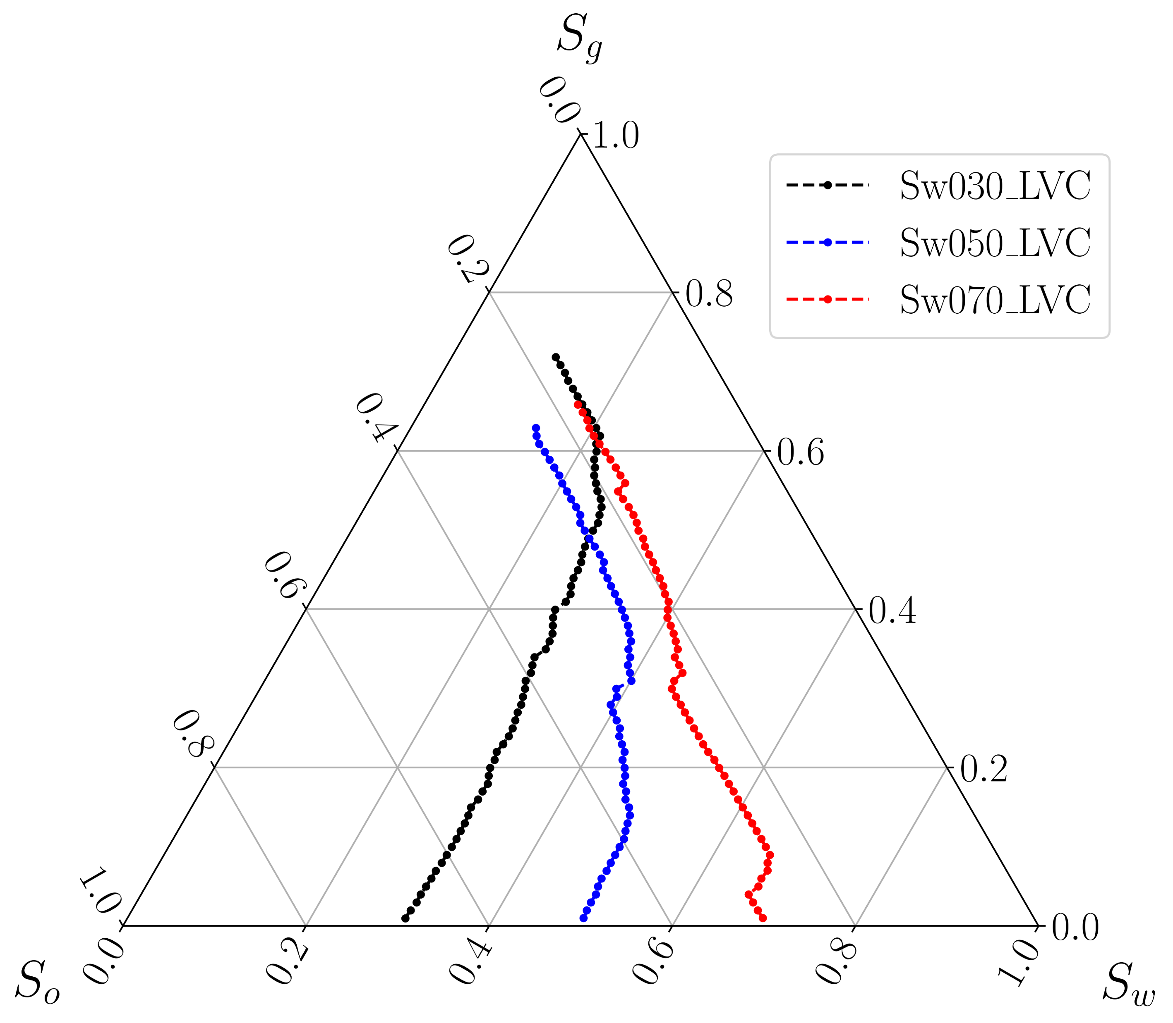
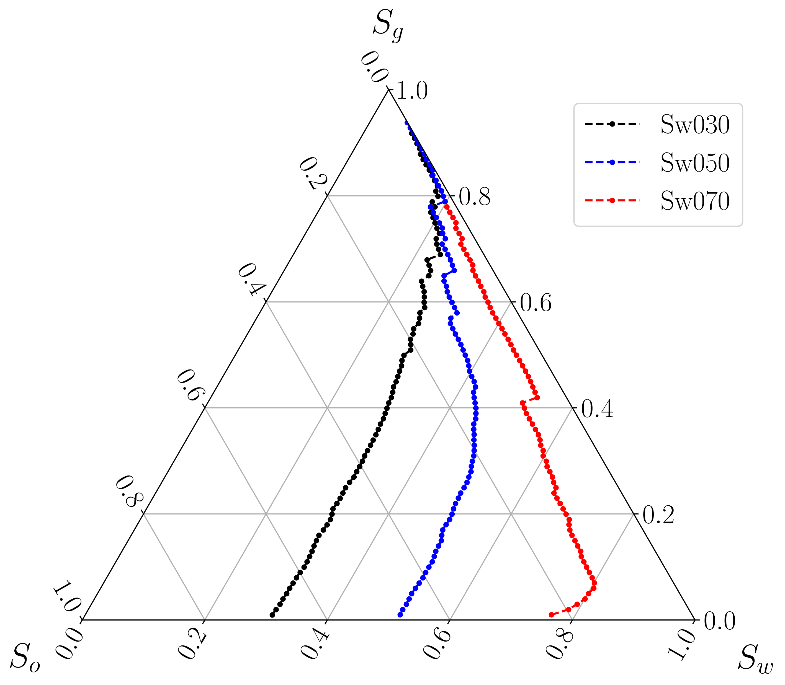
3-phase Level-Set Simulation Results (saturation-controlled gas invasion)
The left figure shows the ternary diagram for Local Volume Conservation of oil phase, in which we have different residual oil saturation for each case (≃0.23-0.17).
The right figure shows the similar result just without Local Volume Conservation of oil phase, in which we do not see residual oil saturation.
7

Slide 8
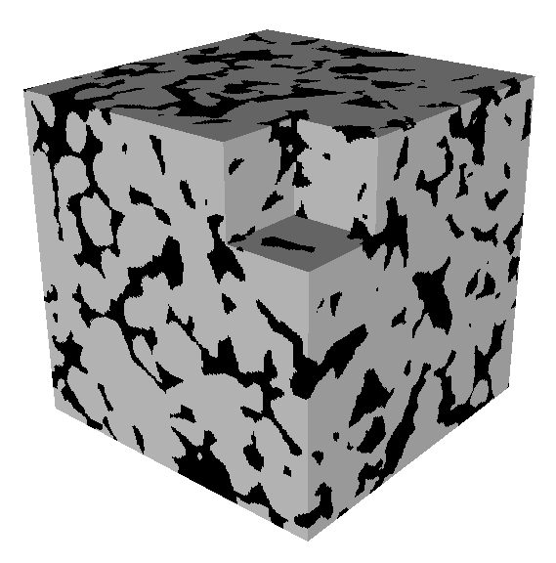
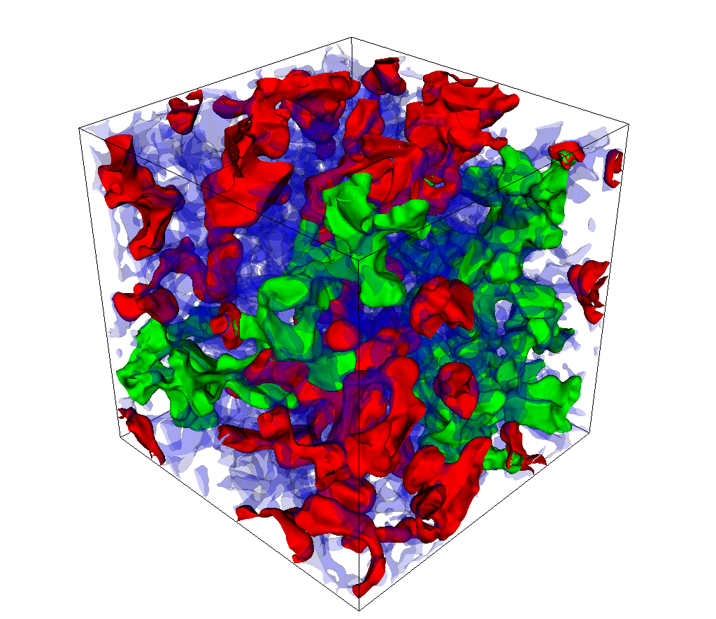
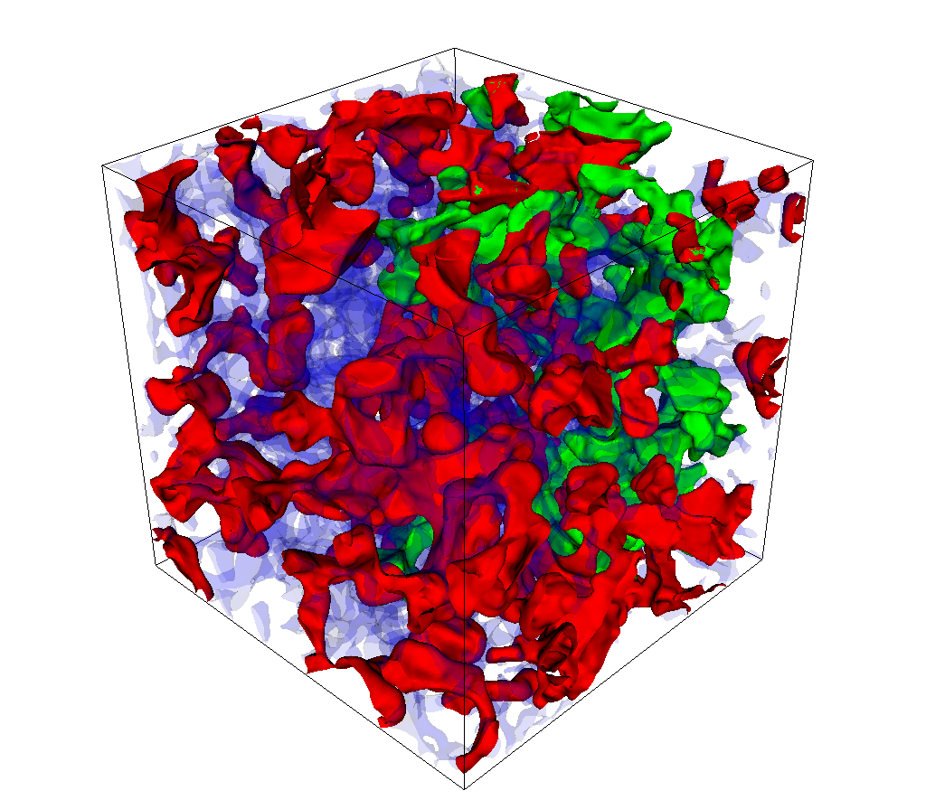
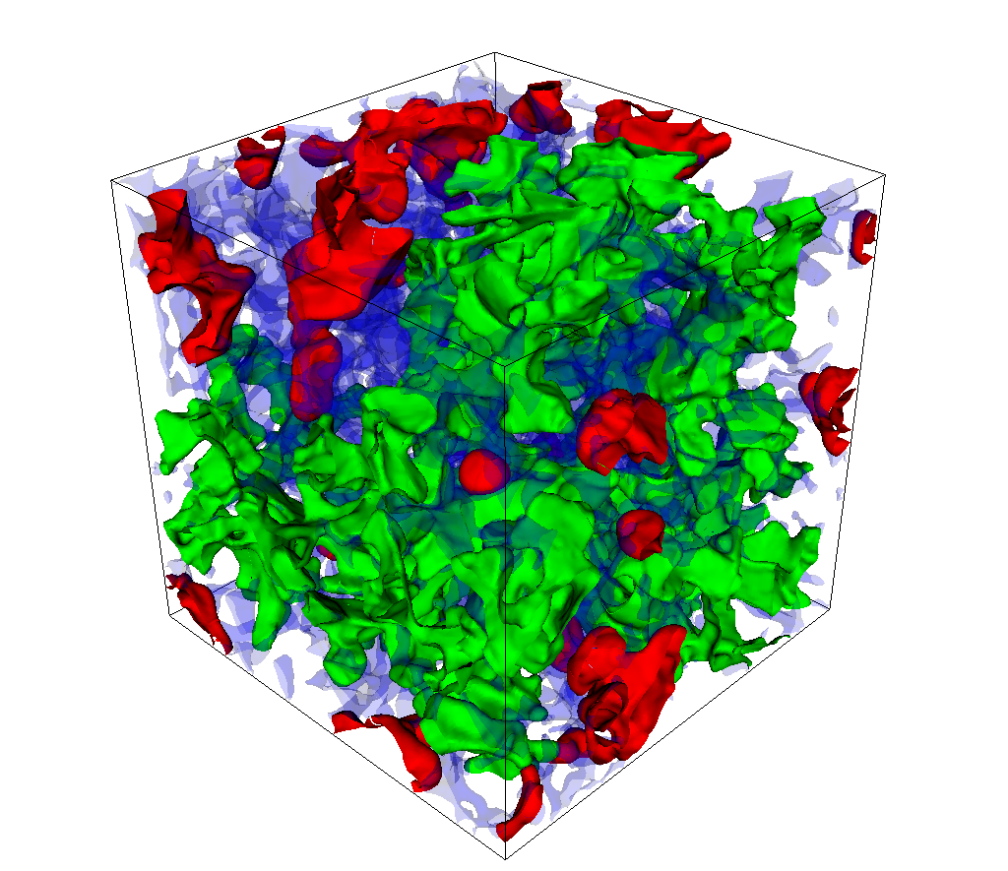
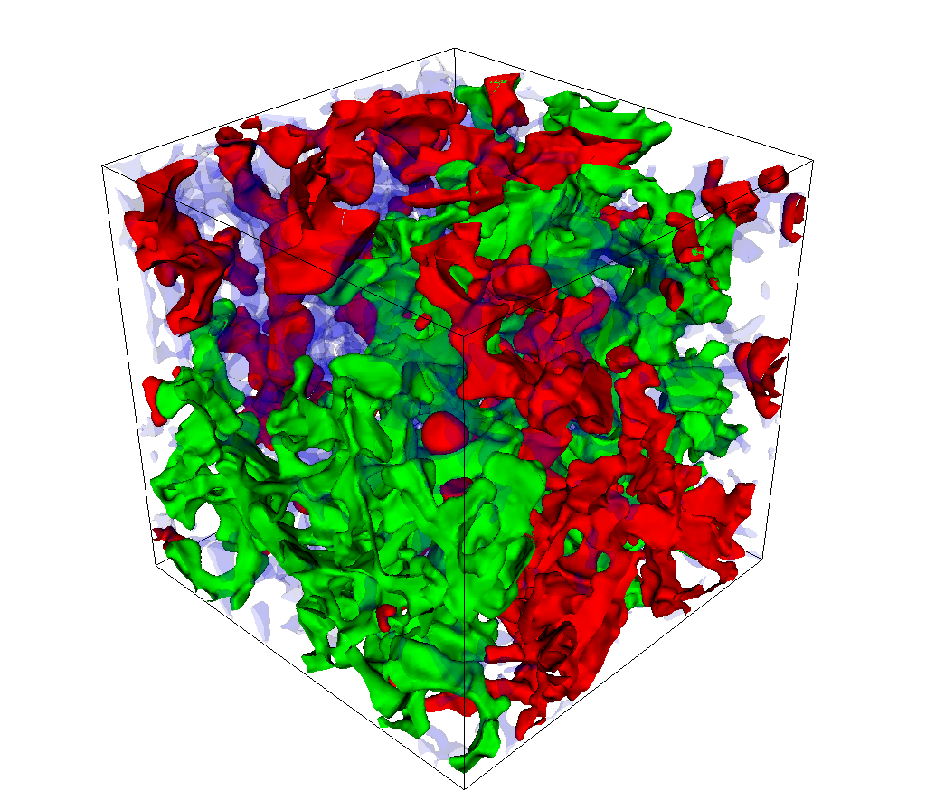





3-phase Level-Set Simulation Results
We used a cubic Castlegate sandstone pore geometry containing 200³ grid cells with porosity 22.7%.
Pore space
Gas invasion
without oil trapping:
Gas invasion
with oil trapping:
Solid grains
Oil
Gas
Water
$$S_{g}=0.25$$
$$S_{g}=0.25$$
Interfacial tensions:
$σ_{ow}=0.030$, $σ_{go}=0.013$, $σ_{gw}=0.040$N/m.
Contact angles:
$θ_{ow}={20}^{∘}$, $θ_{go}={39.1}^{∘},$ $θ_{gw}={16.9}^{∘}$
$$S_{g}=0.5$$
$$S_{g}=0.5$$
8

Slide 9




The energy functions $f_{α}(s_{α})$
Calculations are based on dividing the pore geometry with fluid configurations from the level set simulations into compartments
Cases considered:
    The whole geometry treated as one compartment ($N=1$)
    3 compartments stacked in the $z$-direction ($N=3$)
    Cubic 3x3x3 delineation ($N=27$)
Problem: How to formulate fluid-phase energy densities $f_{α,i}$ that satisfy $f_{αβ,i}=f_{α,i}+f_{β,i}=σ_{αβ}\left(a_{αs,i}\left(s_{α,i}\right)\cos{θ_{αβ}}+a_{αβ,i}\left(s_{α,i}\right)\right), αβ=go,ow,gw$
We propose to use concepts from the level-set method:
Suggested form:
$f_{α,i}\left(s_{α,i}\right)=a_{αs,i}\left(s_{α,i}\right)\left(γ_{s}−γ_{α}\cos{β_{α}}\right)+a_{α,i}\left(s_{α,i}\right)γ_{α}$ $, α=g,o,w, i=1,…,N.$
$$N=27$$
$σ_{αβ}=γ_{α}+γ_{β}$, and
$σ_{αs}=γ_{s}−γ_{α}\cos{β_{α}}$, $γ_{s}$ = const.
Young’s eq., $σ_{αβ}cosθ_{αβ}=σ_{αs}−σ_{βs}$, implies that $σ_{αβ}cosθ_{αβ}=γ_{β}\cos{β_{β}}−γ_{α}\cos{β_{α}}$ .
9

Slide 10


The energy functions $f_{α}(s_{α})$
Verification of the new energy functions:
Saturation derivatives:
$\frac{∂f_{α,i}}{∂s_{α,i}}=−\frac{∂a_{αs,i}}{∂s_{α,i}}$ $γ_{α}\cos{β_{α}}$+ $\frac{∂a_{α,i}}{∂s_{α,i}}$ $γ_{α}$ $,$ $α=g,o,w, i=1,…,N.$
Assume a 2-phase gas-water system (or a 3-phase system with oil as immobile phase). Then, $∂s_{g,i}=−∂s_{w,i}$, $∂a_{gs,i}=−∂a_{ws,i}$, and $∂a_{g,i}=∂a_{w,i}.$ At equilibrium:
$$P_{gw}=−\left(\frac{∂f_{w,i}}{∂s_{w,i}}−\frac{∂f_{g,i}}{∂s_{g,i}}\right)=−\left(−\frac{∂a_{ws,i}}{∂s_{w,i}}γ_{w}\cos{β_{w}}\text{+ }\frac{∂a_{w,i}}{∂s_{w,i}} γ_{w}+\frac{∂a_{gs,i}}{∂s_{g,i}}γ_{g}\cos{β_{g}}−\frac{∂a_{g,i}}{∂s_{g,i}} γ_{g}\right)$$
$=−\left(\frac{∂a_{gs,i}}{∂s_{w,i}}\left(γ_{w}\cos{β_{w}}−γ_{g}\cos{β_{g}}\right)+\frac{∂a_{g,i}}{∂s_{w,i}}\text{(}γ_{g}+γ_{w}) \right)$
$=−\left(\frac{∂a_{gs,i}}{∂s_{w,i}}σ_{gw}\cos{θ_{gw}}+\frac{∂a_{g,i}}{∂s_{w,i}}σ_{gw}\right)=−\frac{∂f_{gw,i}}{∂s_{w,i}}=−\frac{∂\left(f_{g,i }+f_{w,i}\right)}{∂s_{w,i}}$ .
Thus, $f_{gw}=f_{g}+f_{w}$. It works similarly for a gas/oil and oil/water fluid pair (with the 3rd phase absent or immobile) .
$$N=27$$
10

Slide 11
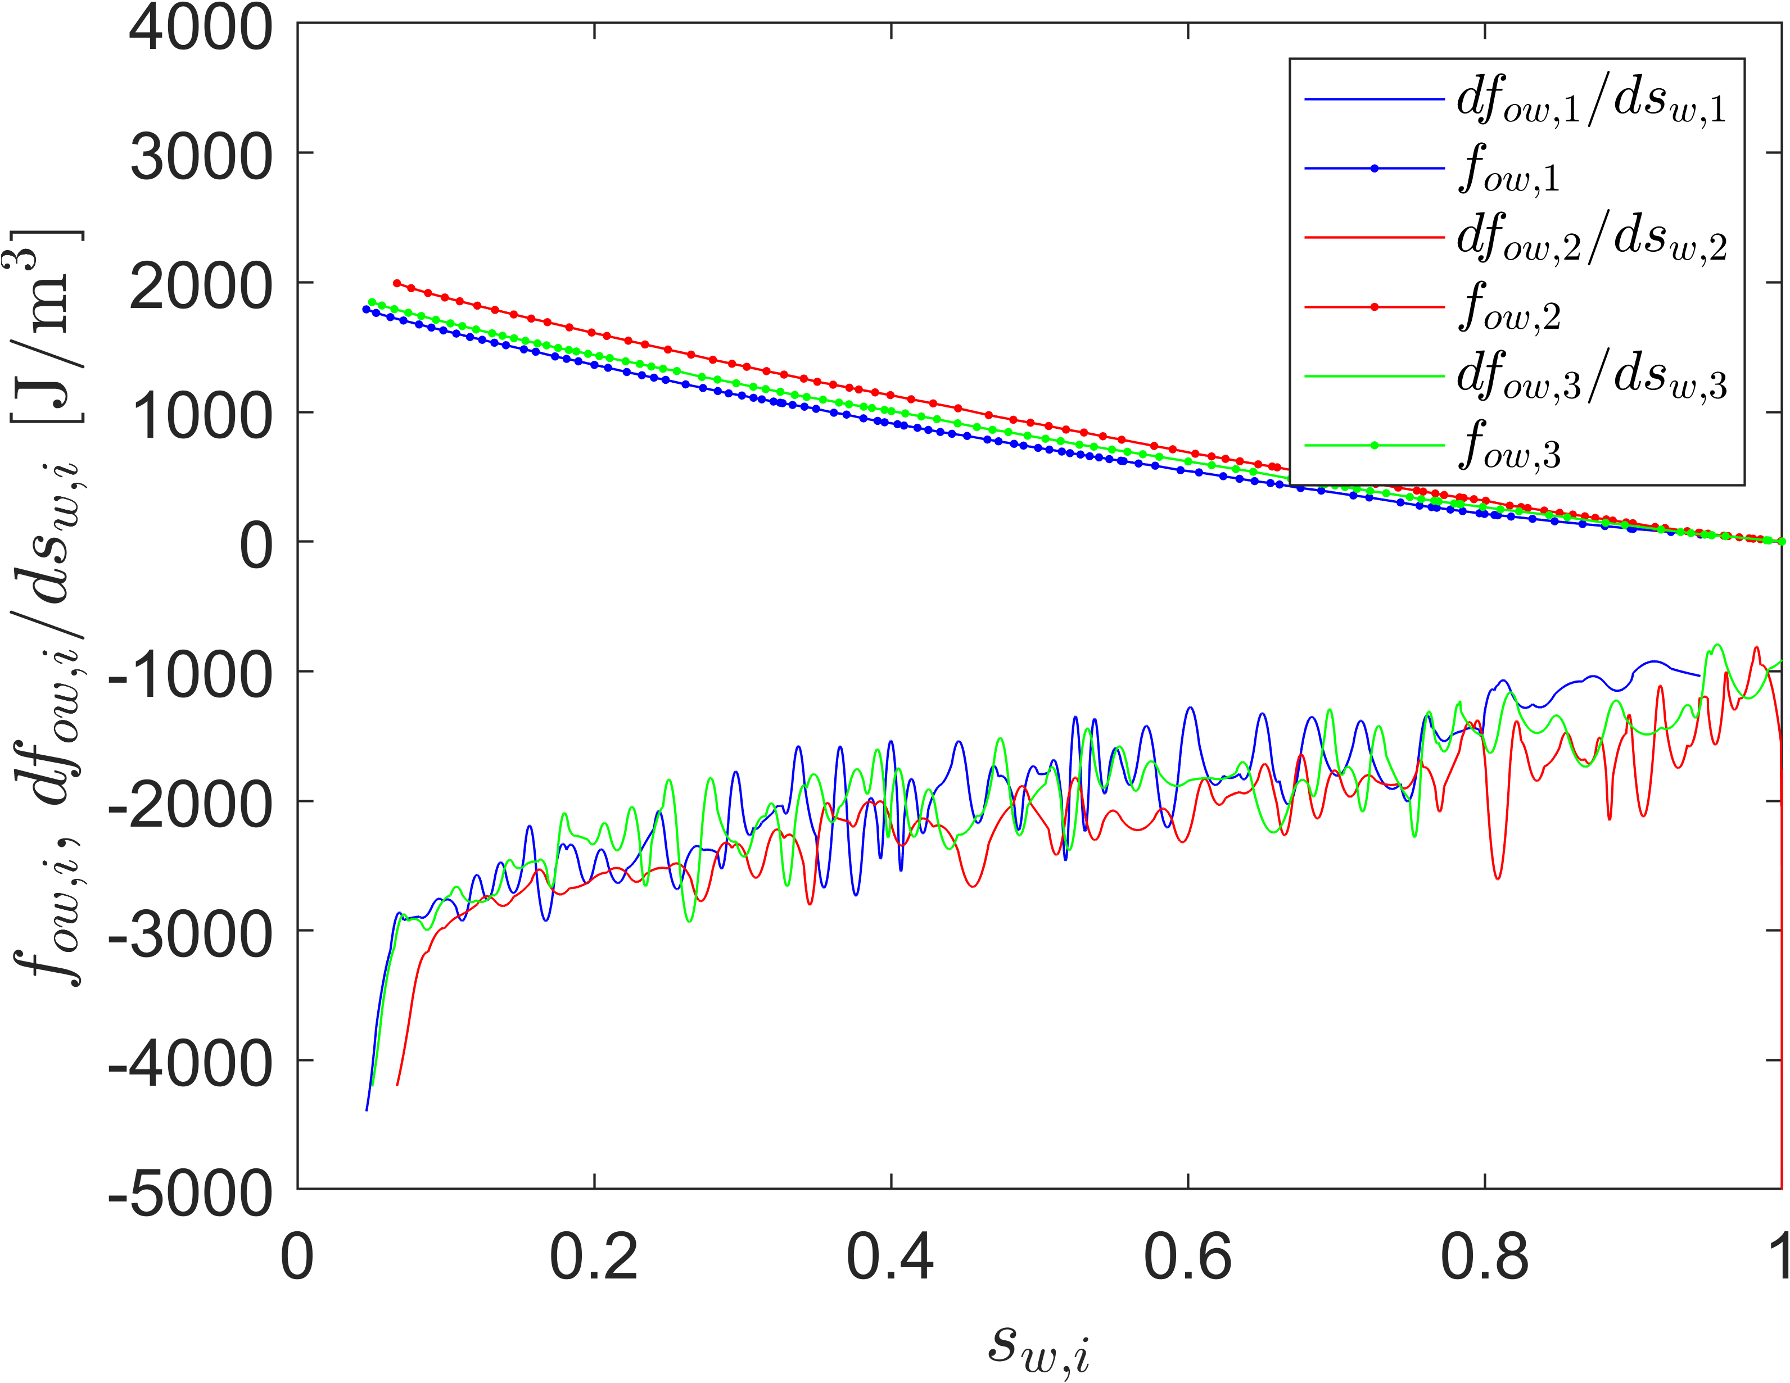
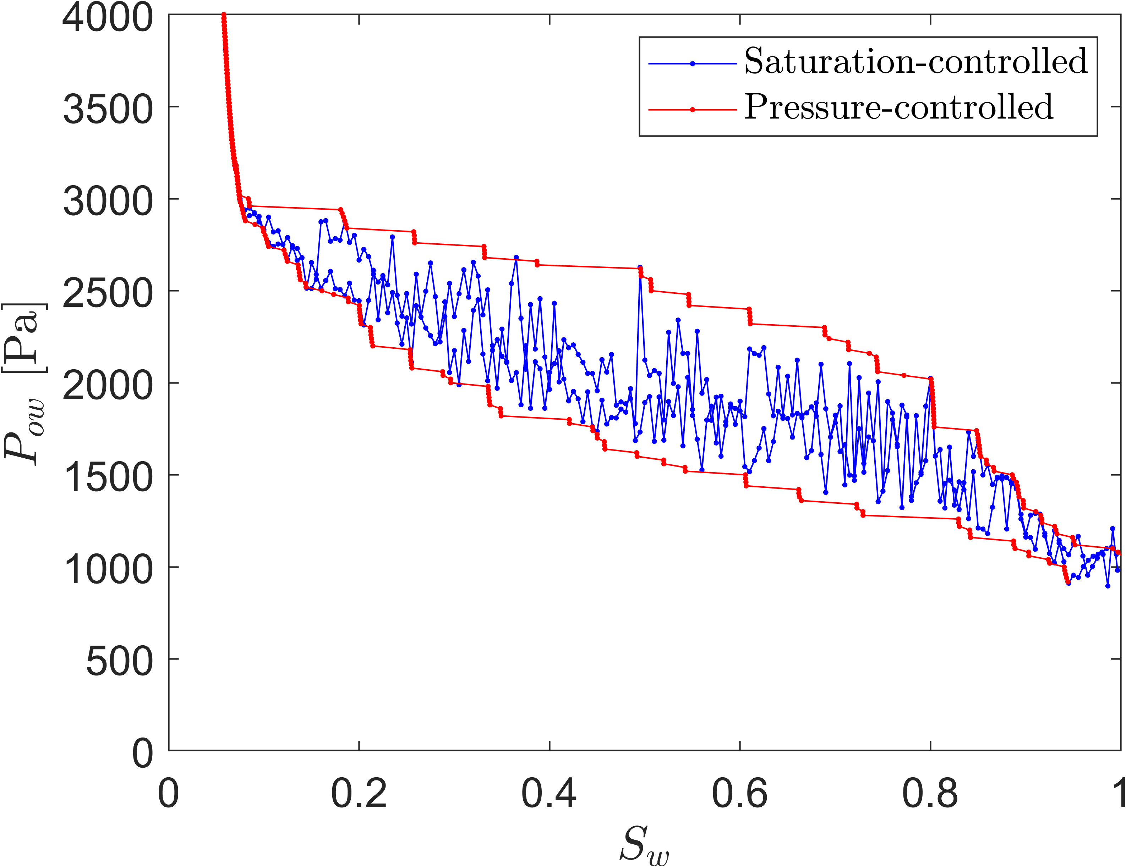
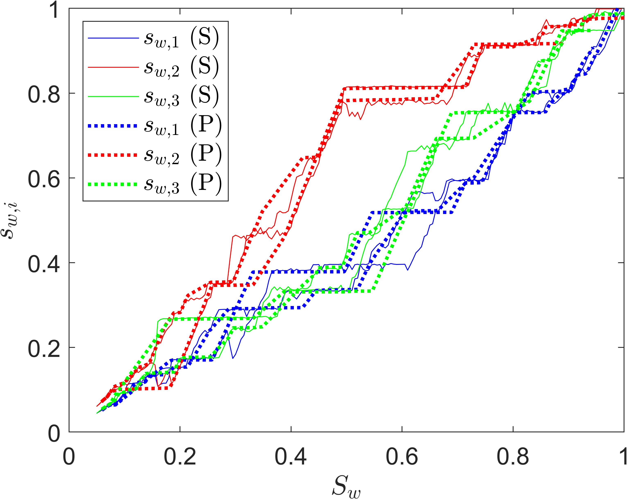

2-phase discrete-domain simulation results
Results from discrete-domain model for a partitioning of the Castlegate geometry into three compartments ($N=3$) stacked in the $z$-direction, using energy functions from main imbibition without local volume conservation:
Corresponding Pc(Sw)-curves for the bounding hysteresis loop.
Compartment saturation profiles from the saturation-controlled (S) and pressure-controlled (P) simulations.
The three total energy functions and their saturation derivatives using quadratic regression methods of the data over the moving window method and window size 5 for the smoothing of f_{ow,i} in all compartments.

Slide 12
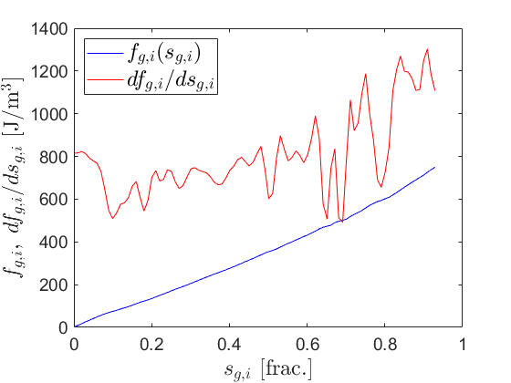
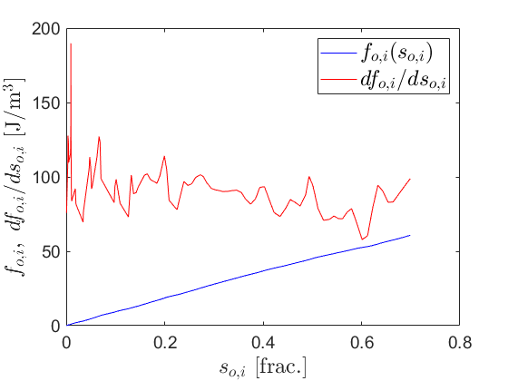
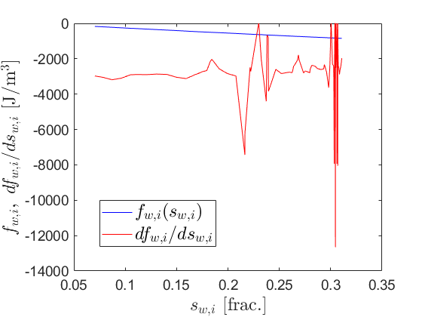
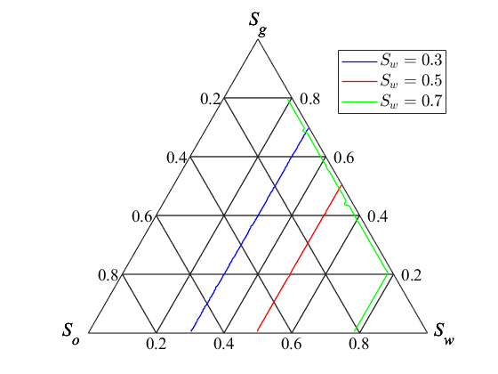
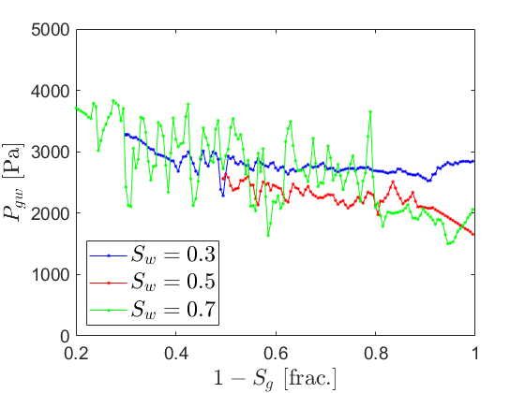
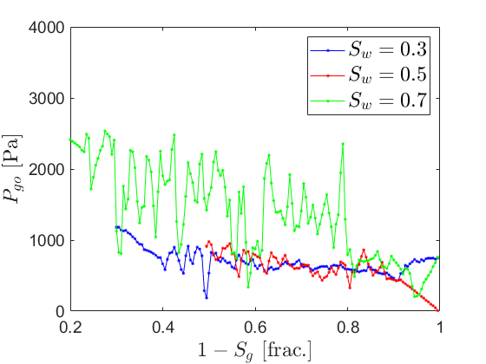


3-phase discrete-domain results (one compartment, $N=1$)
Saturation-controlled gas invasion.
Energy functions $f_{α}\left(s_{α}\right), α=g,o,w,$ are smoothed (using least-squares) before calculating saturation derivatives:
Saturation paths:
$P_{gw}(S_{g})$-curves:
$P_{go}(S_{g})$-curves:

Slide 13
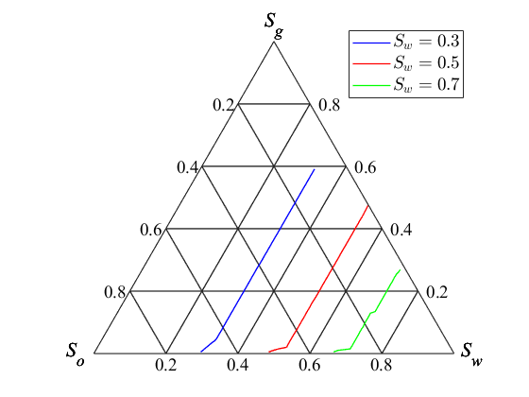
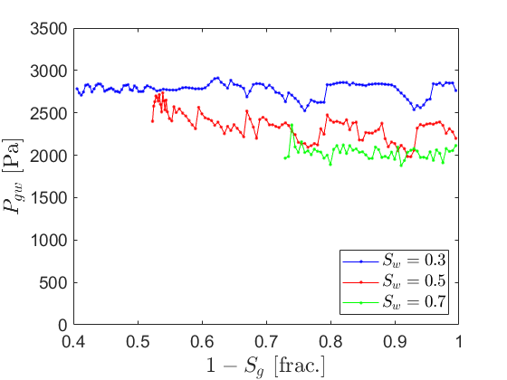
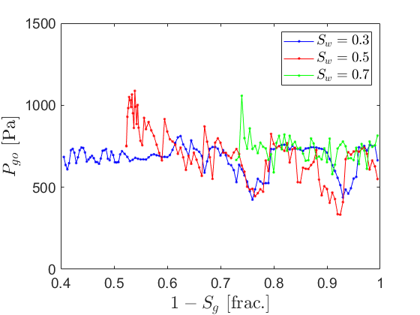



3-phase discrete-domain results ($N=3$)
Saturation-controlled gas invasion.
Compartments stacked in the $z$-direction.
Saturation paths:
$P_{gw}(S_{g})$-curves:
$P_{go}(S_{g})$-curves:
The $P_{go}$- and $P_{gw}$-curves show reasonable behaviour wrt. initial $S_{w}$ for the gas invasions.
Differences in results between discrete-domain model and level-set model are due to two sources:
  In the current discrete-domain model, all compartments are accessible for invasion.
  The smoothing of the energy functions impacts their saturation derivatives, which could impact the equilibrium conditions, the capillary pressure levels, and the saturation paths.

Slide 14
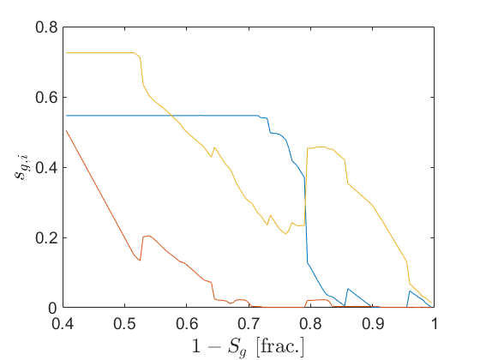
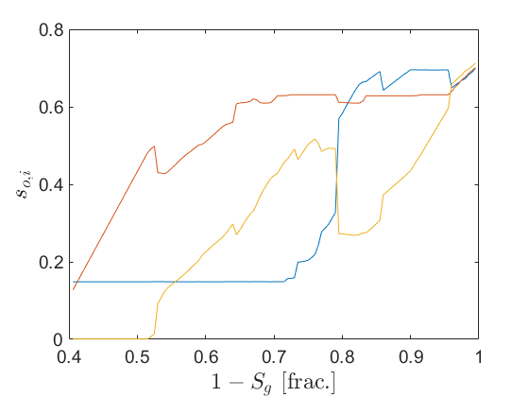
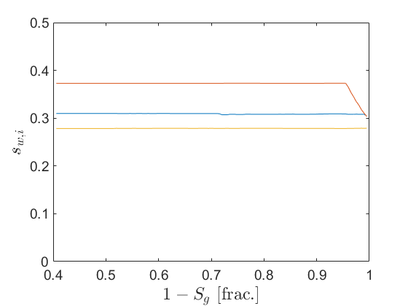
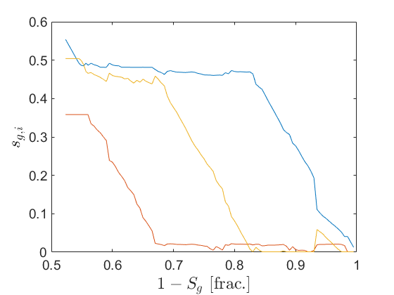
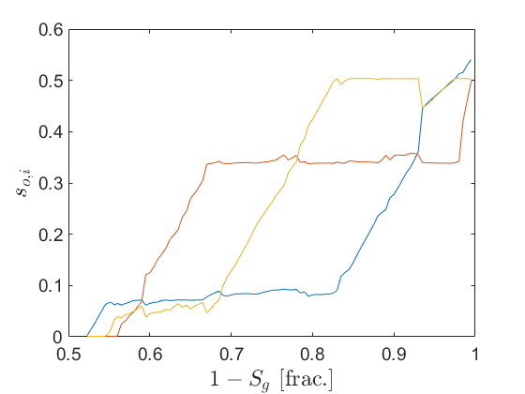
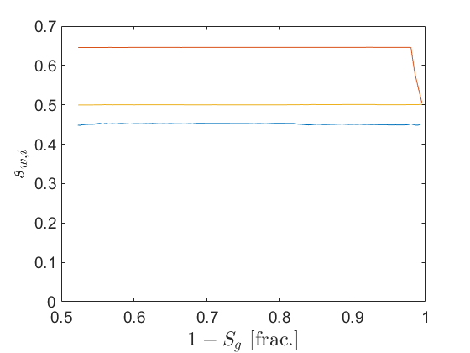
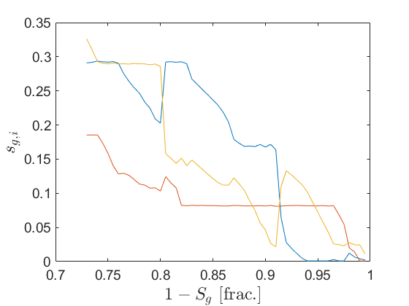
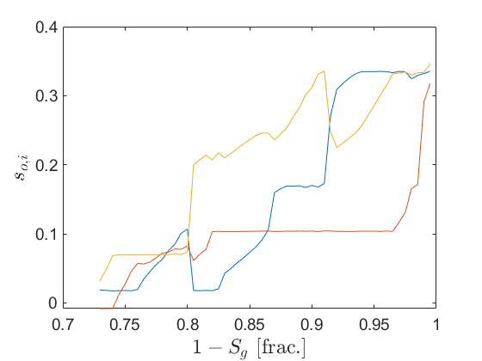
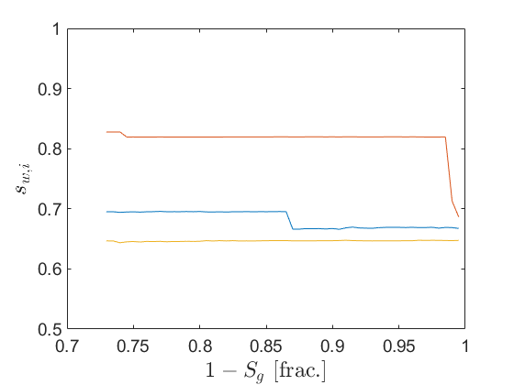






3-phase discrete-domain results ($N=3$)
Gas-saturation-controlled displacement.
Compartment saturation evolution:
$$s_{g,i}$$
$$s_{o,i}$$
$$s_{w,i}$$
$$S_{w}=0.3:$$
Non-monotonic evolution of local saturations indicate fluid redistribution between compartments (cooperative behaviour).
$$S_{w}=0.5:$$
$$S_{w}=0.7:$$

Slide 15
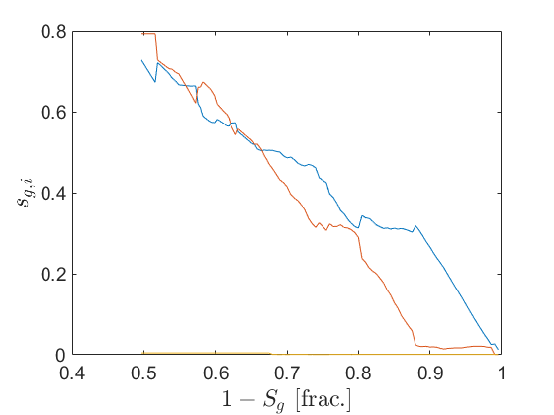
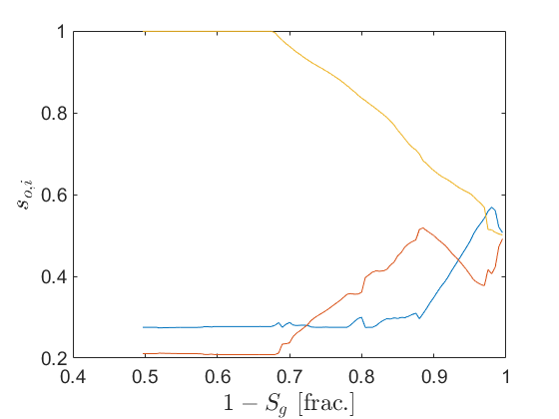
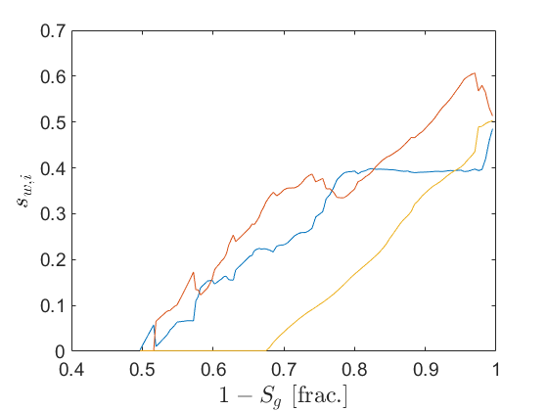
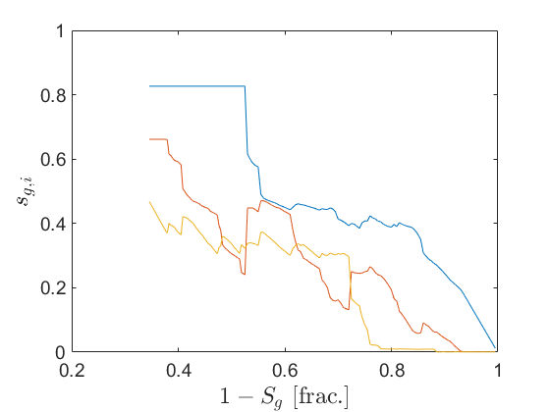
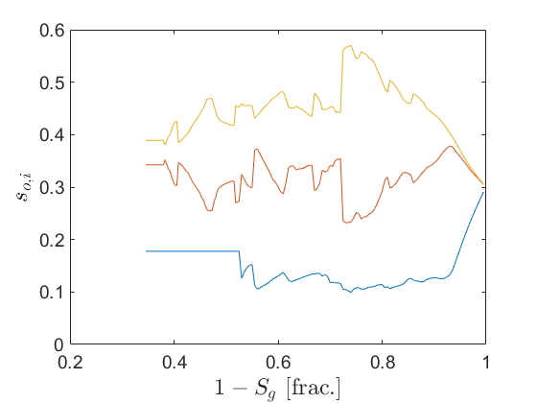
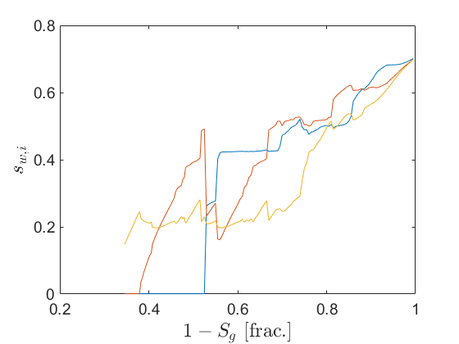
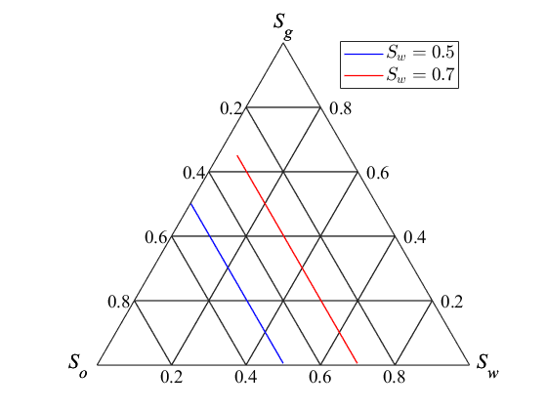
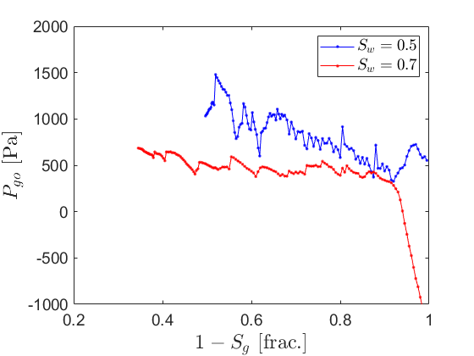
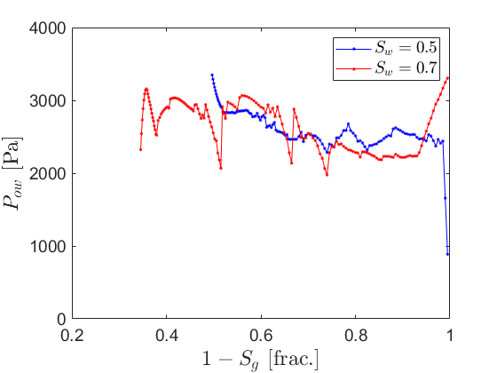
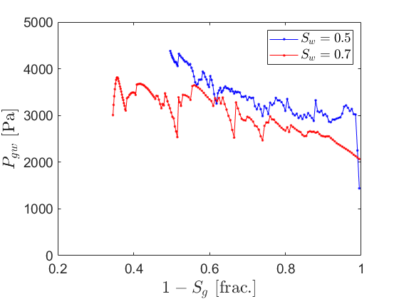






3-phase discrete-domain results ($N=3$)
Gas-saturation-controlled displacement with constant global oil saturation.
Compartment saturation evolution:
$$s_{g,i}$$
$$s_{o,i}$$
$$s_{w,i}$$
$$S_{w}=0.5:$$
Global saturation paths are fixed, while all the capillary pressures are calculated ($P_{g}$ and $P_{o}$ are Lagrange multipliers)
$$S_{w}=0.7:$$
Saturation paths:
$$P_{go}$$
$$P_{ow}$$
$$P_{gw}$$

Slide 16
Conclusion
The 3-phase discrete-domain model was extended to real porous rock geometries from 3D images, incorporating a compartmental description with variation of pore volumes and energy functions obtained from 3-phase level-set simulations.
Despite some deviations with level set model results, the discrete-domain model incorporate several realistic features, including cooperative behavior, and the expected dependency between 3-phase capillary pressure level and initial water saturation for the gas invasions.
A current challenge lies in the smoothing of the energy functions, which is needed for numerical stability but may impact the results.
Further work is needed to include a spatial correlation of the compartments, and to run simulations with a larger number of compartments.
Further work is also needed to investigate if statistically representative energy landscapes can be constructed for a given rock, enabling fast evaluation of drainage-imbibition hysteresis in 3-phase systems and offering potential for upscaling.
16

