Slide 1

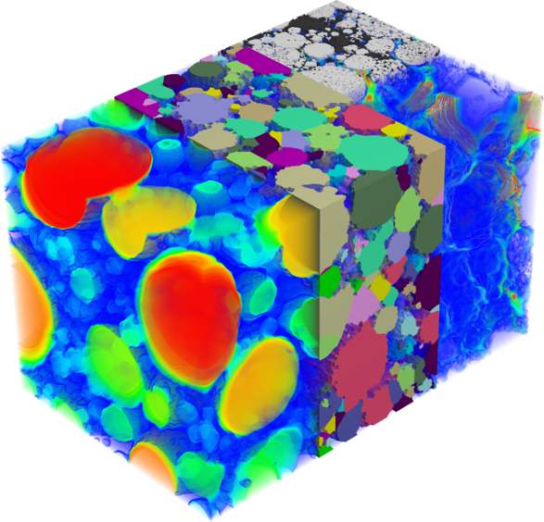
Image-to-Property Digital Workflows:
Linking 3D Microstructure, Transport, and Mechanics of Porous Media
May 2026
Anton du Plessis, Arne Jacob, Christian Hinz, Andreas Wiegmann
Math2Market GmbH, Kaiserslautern, Germany
Notes:
Welcome to my talk slide

Slide 2

Short Speaker Biography
since 2025 | Director Business Development EMEA at Math2Market North America Inc. (Remote)
Since 2026 | Affiliated professor, University of Texas at El Paso, United States (part time)
2021-2025 | Applications and business development at Comet technologies
2012-2021 | Manager CT Scanner Facility at Stellenbosch University (South Africa) Micro/nano CT scanner service lab for academics and industry Also research part time, accredited as associate professor since 2017 Also journal editor (Elsevier)
2006-2012 | Group leader at CSIR National Laser Centre (South Africa) Lab manager of government research institute, doing contract research
2006 | PhD in Physics from Stellenbosch University (South Africa)
Prof. Anton du Plessis
Notes:
Introduce myself slide

Slide 3
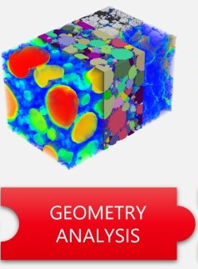
Microstructure drives performance
Measure
  Porosity: pore sizes, pore fractions
  Connectivity
  3D geometry of pore space
Notes:
The first thing we have to agree on, is that the microstructure of porous materials drive their performance. This microstructure can be well characterized geometrically using microCT or FIBSEM, and that can be used to indirectly make business decisions, e.g. does my material have enough pore space? Are my pores connected from one side to the other? Are my pores spherical? And so on.

Slide 4
Microstructure drives performance
Simulate
  Fluid flow through pore space
  Permeability
  Flow rates
  Identify constrictions
  And much more
Notes:
However, it is also possible to get more direct information of the material performance by applying simulations on the digital representation of the material. For example, fluid flow can be simulated giving permeability, local flow rates, identification of constrictions, and much more. The material performance can thus be directly obtained by simulation.

Slide 5
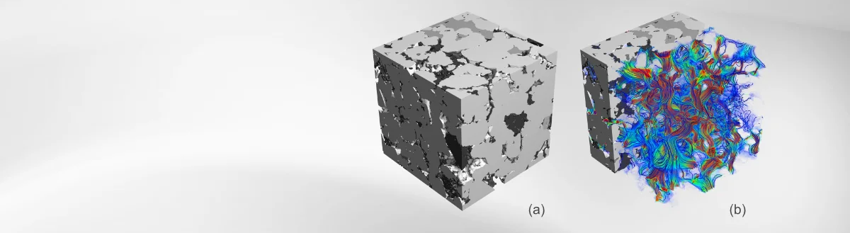
Microstructure drives performance
  Porosity: how much pore space
  Connectivity & tortuosity: are there continuous pathways
  Constrictions: where are the bottlenecks?
  Effective transport is governed by the connected 3D pore geometry, not by porosity alone.
  GEOmetry + preDICTion
Notes:
The key point is that the microstructure drives the performance of porous materials. Often, indirect measures e.g. of pore volume fraction, is not enough to fully understand the performance. For example two samples with the same total porosity, can have different permeability due to constrictions or bottlenecks, or tortuous connectivity between pore spaces. Simulation of digital porous materials offers a direct performance measure. This is the heart of GeoDict

Slide 6
Microstructure drives performance
  Large accessible inlet regions
  Narrow necks limit access
  Transport path dominated by constrictions after 3 µm
* Holzer et al., The influence of constrictivity on the effective transport properties of porous layers in electrolysis and fuel cells, Journal of Materials Science (2013). DOI: 10.1007/s10853-012-6968-z
Notes:
An example is shown here from Holzer et al 2013, where it was shown how constrictions drive the effective transport properties in fuel cells. And there are many more such examples.

Slide 7
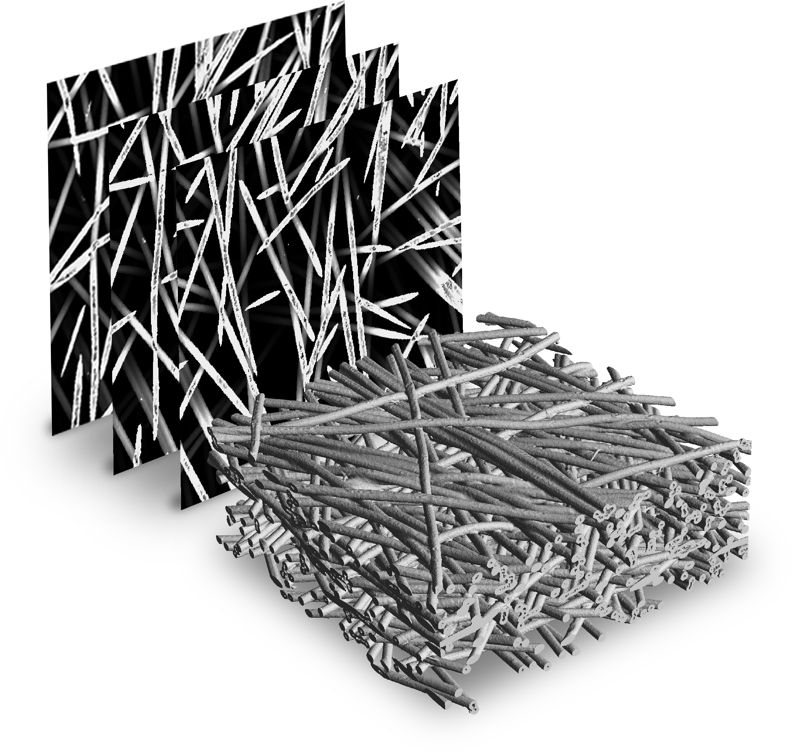
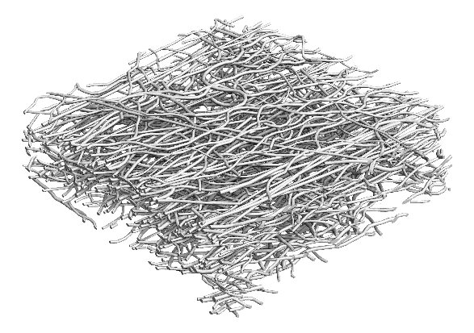
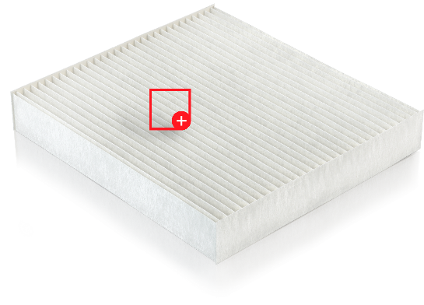
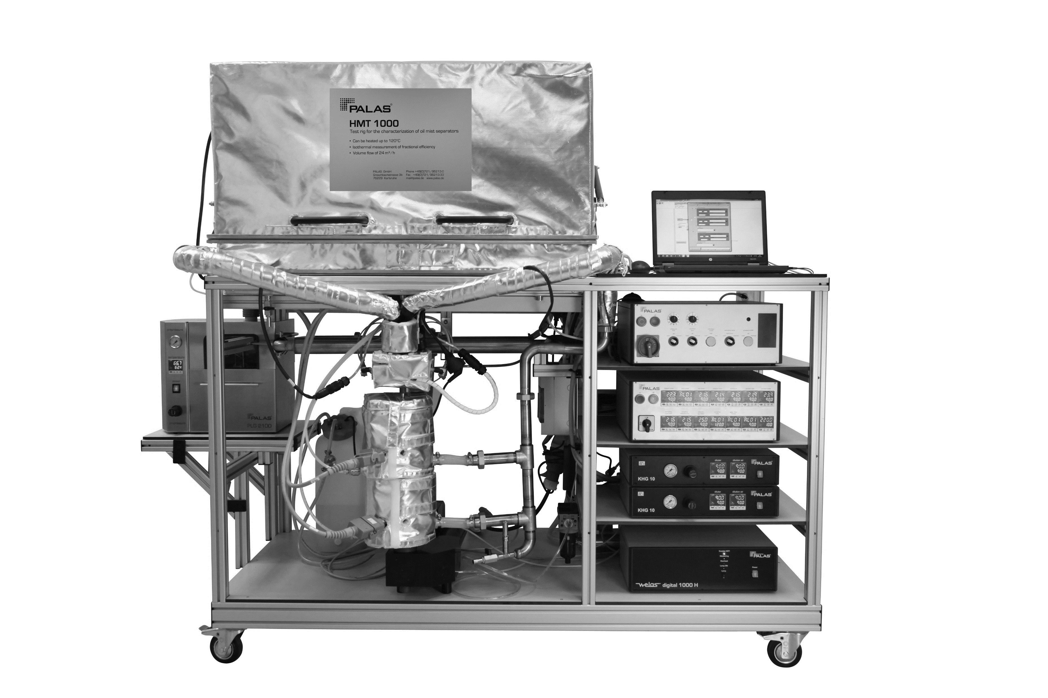
Build once, test many: the digital specimen workflow
acquire image
Experiments on real media
µCT scan
Simulation on material model
Filter media prototyping
3D image
Digital model
filter & segment
generate
Automatic parameter optimization
manufacture
next media
Voxel mesh
measure
compute
Properties
Properties
Notes:
The basic idea of the digital twin laboratory is this. Build once, test many times.

Slide 8
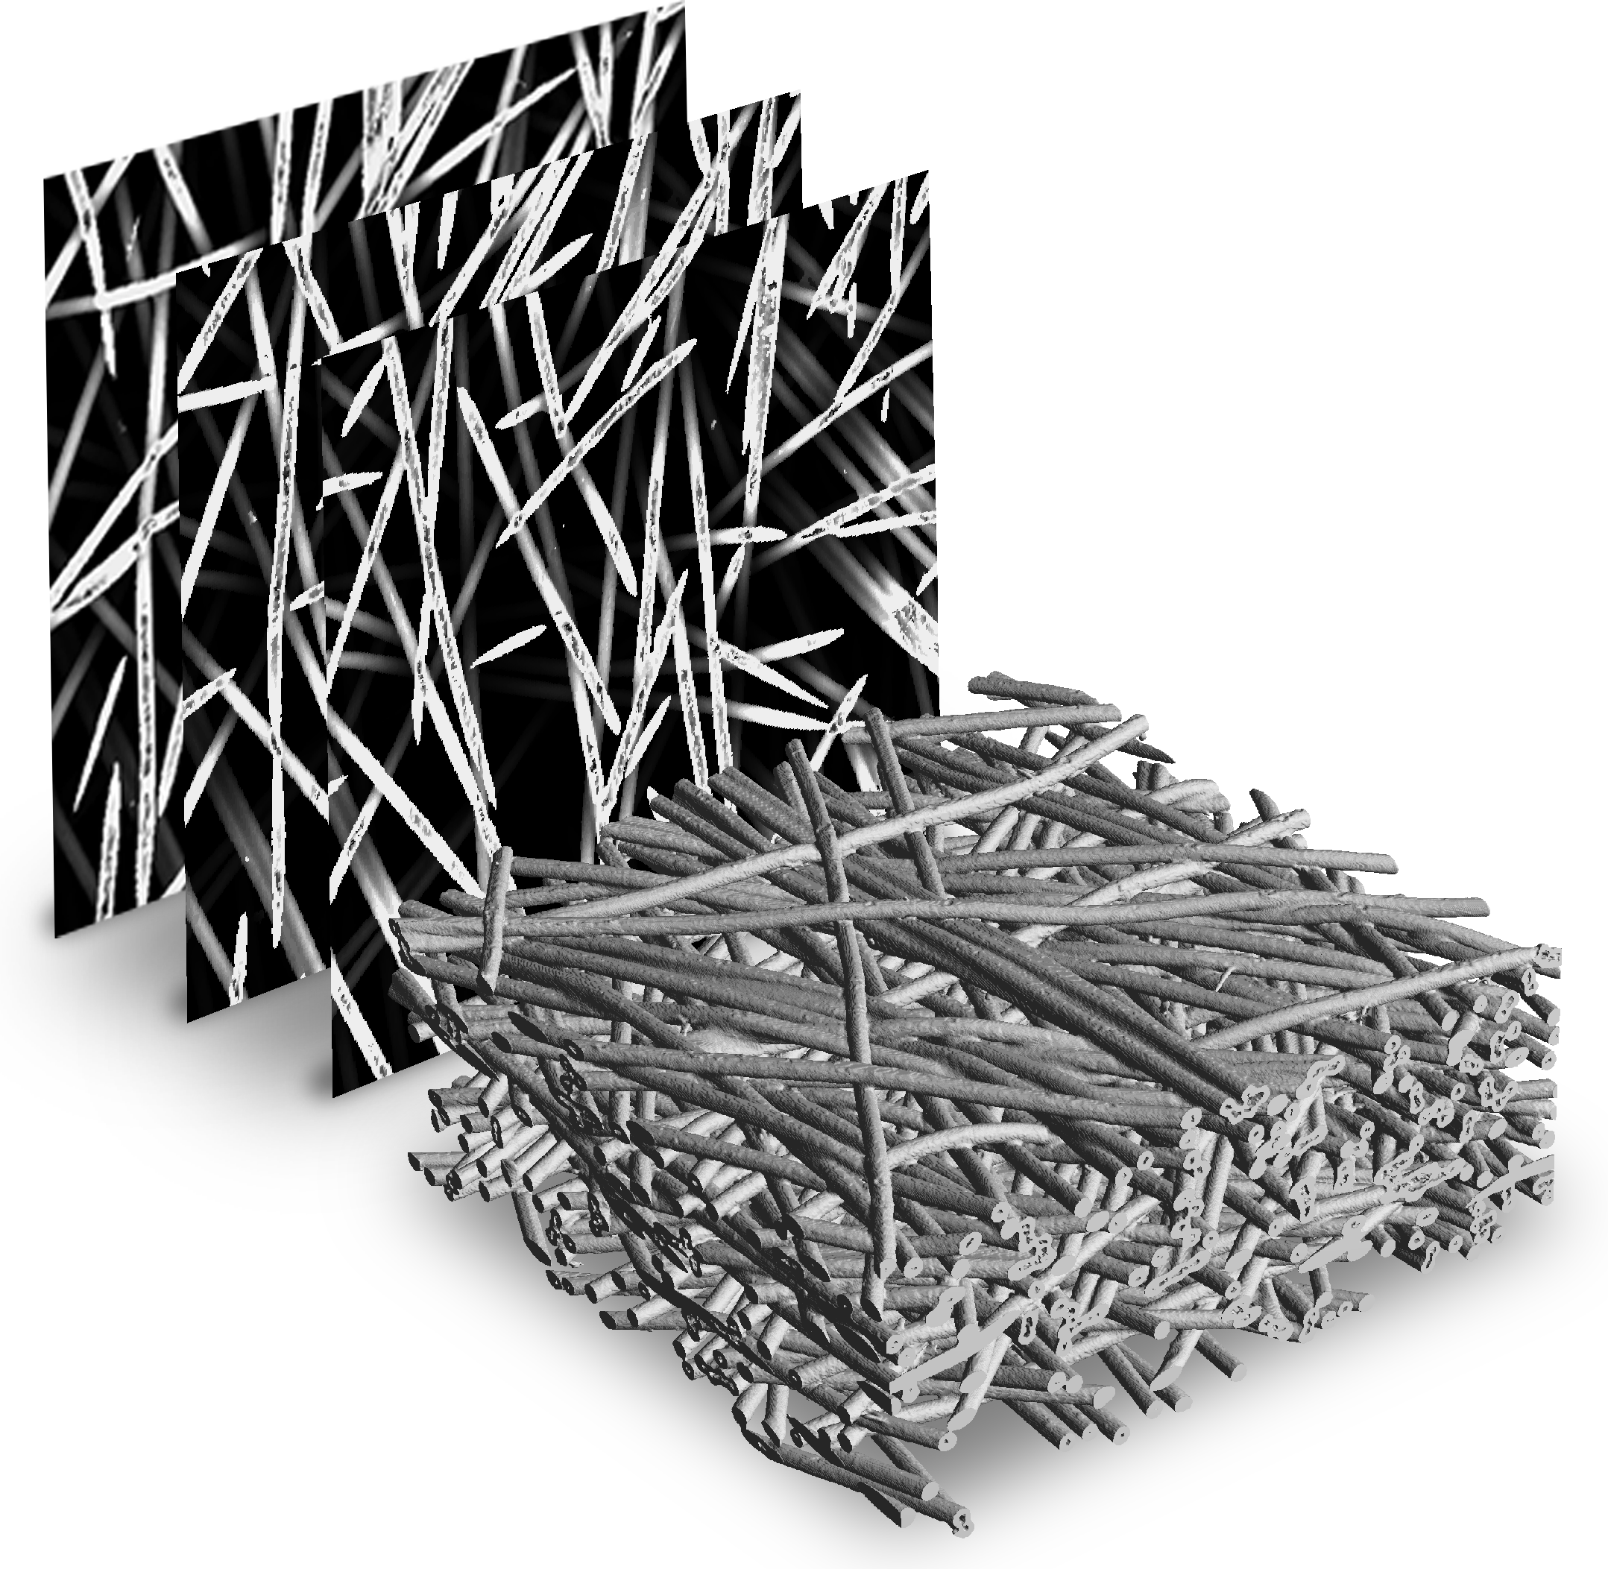
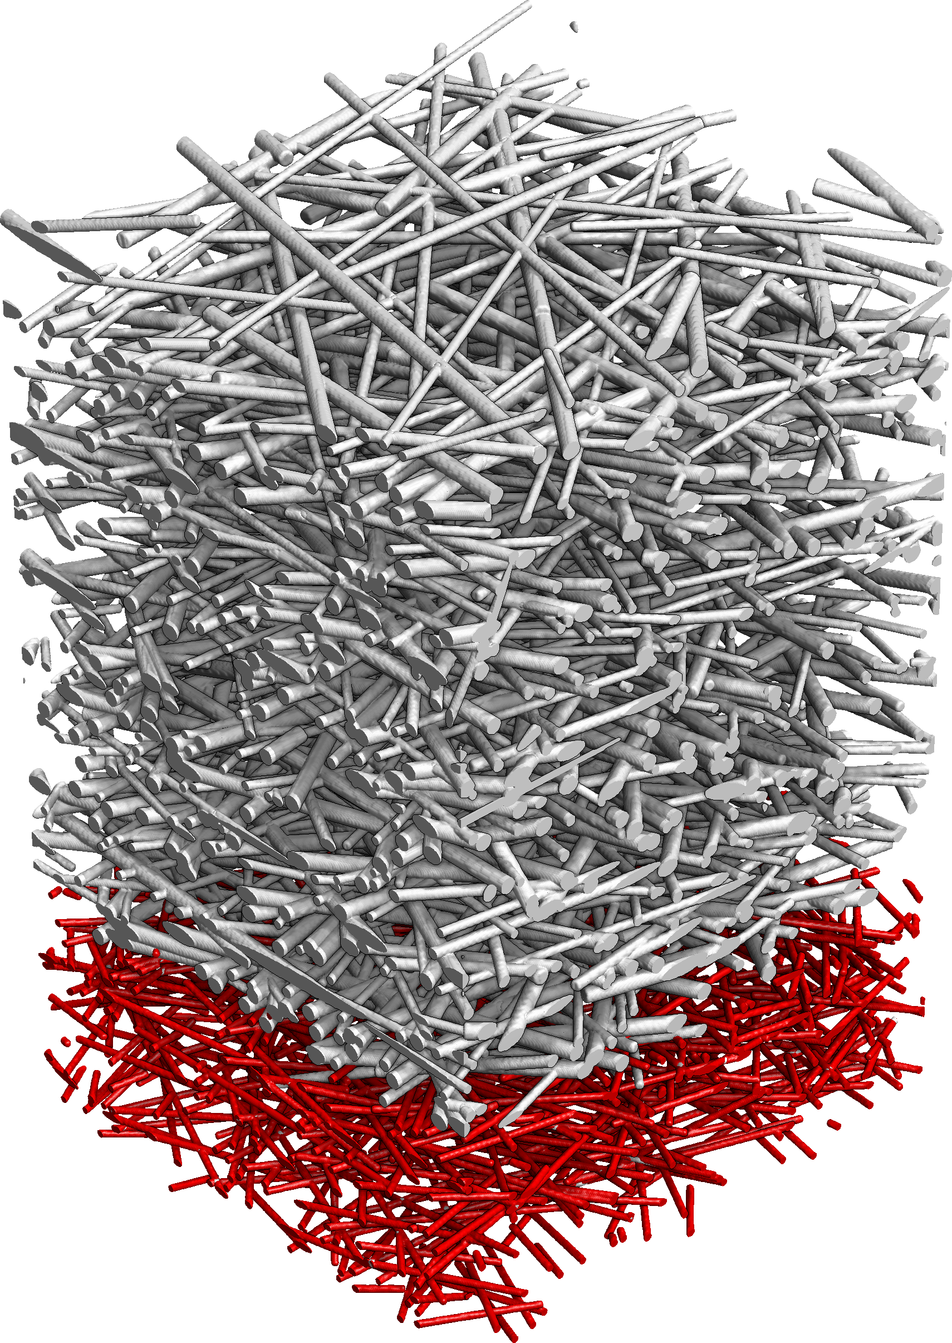
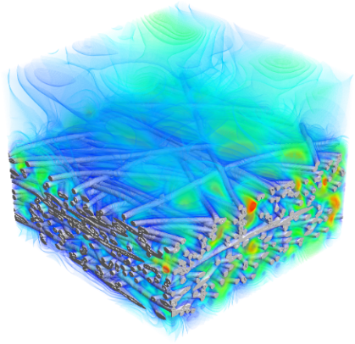

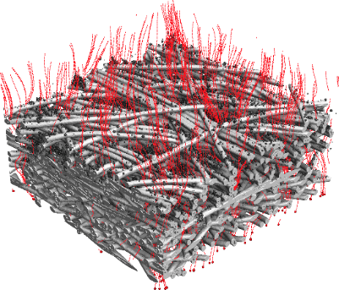
The GeoDict Workflow
»
»
»
»
Import | Analyze | Model | Design | Next Generation Material
Begin with an idea: a new material with ideal properties. Design a material from scratch or import images from a real material to create a digital material model. | Analyze geometric properties and compute physical properties of designed or real materials. Extract statistical data to create a Digital Twin. | A Digital Twin is the statistical representation of the real material. Modify the Digital Twin to create Digital Prototypes and begin the design process. | Digital prototypes are easily and rapidly created. Design, simulate, and predict in a loop to find the material with the desired properties. | The materials of the future are within reach and we help you develop them faster.
Digital Material | Statistical Model | Digital Twin | Digital Prototypes | This is innovation through simulation.
Notes:
This concept is not limited to one application area. And microstructure becomes a design variable

Slide 9
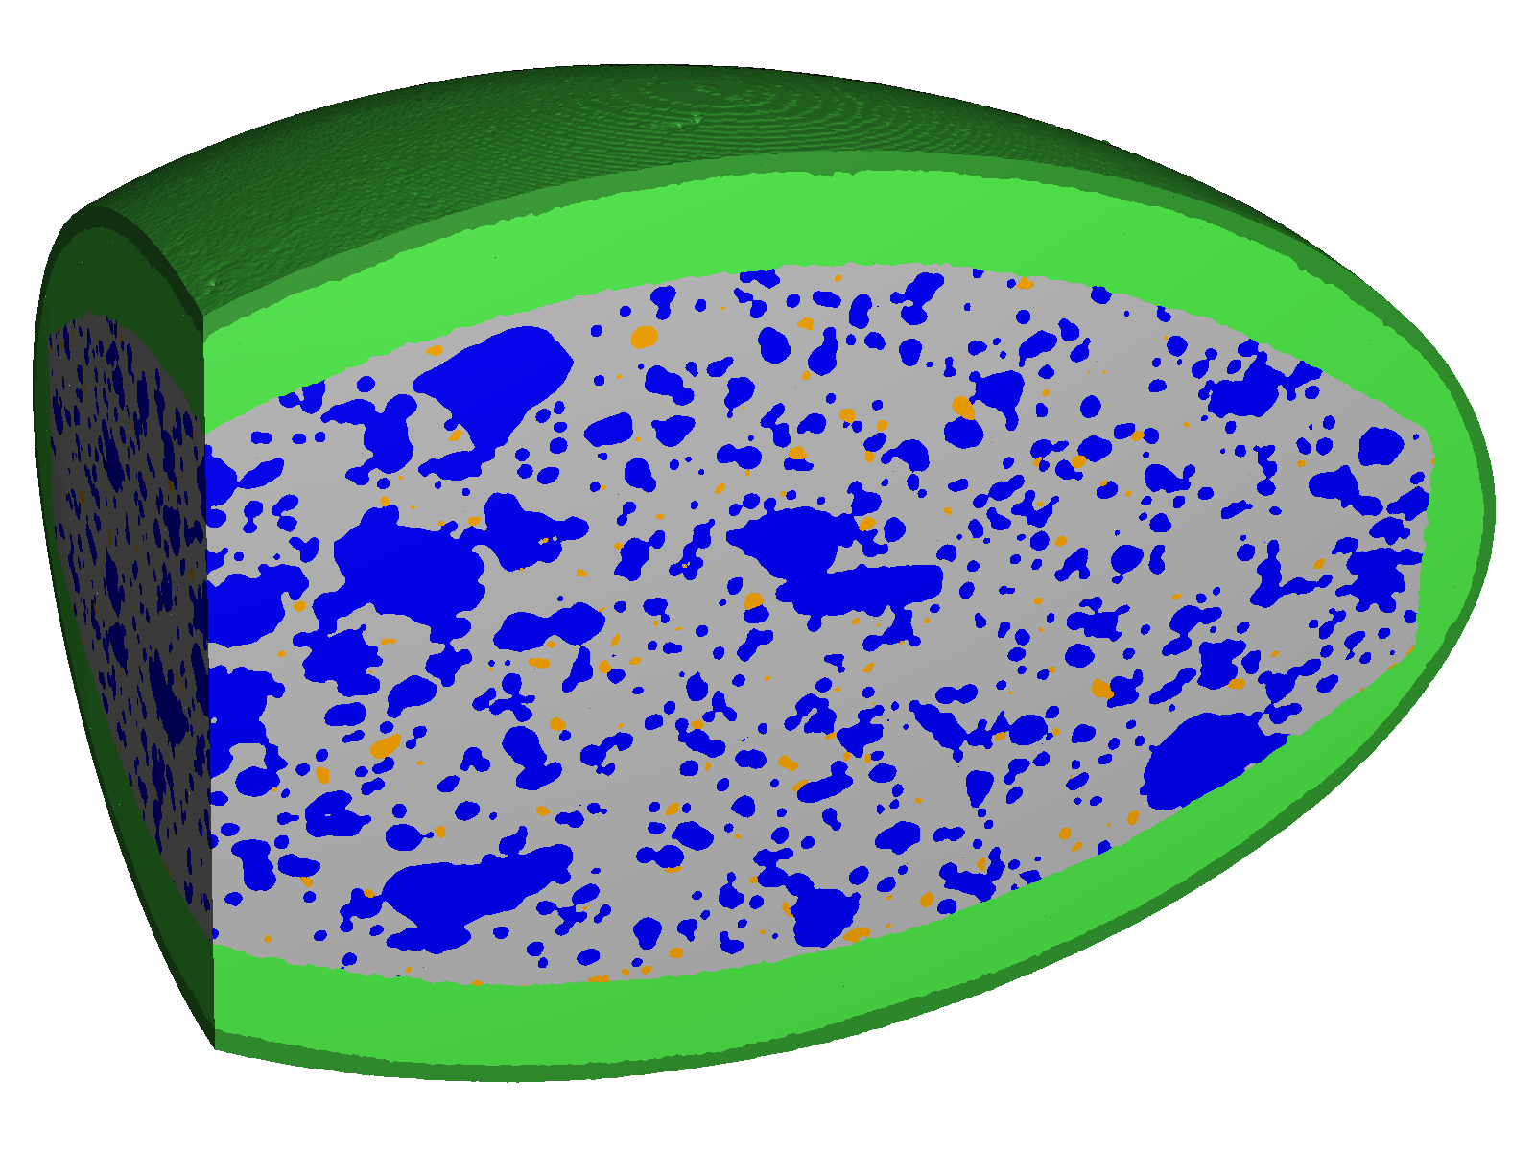
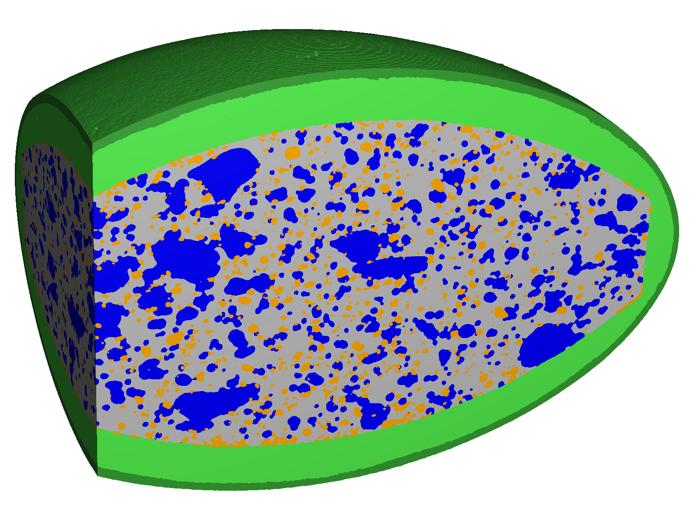
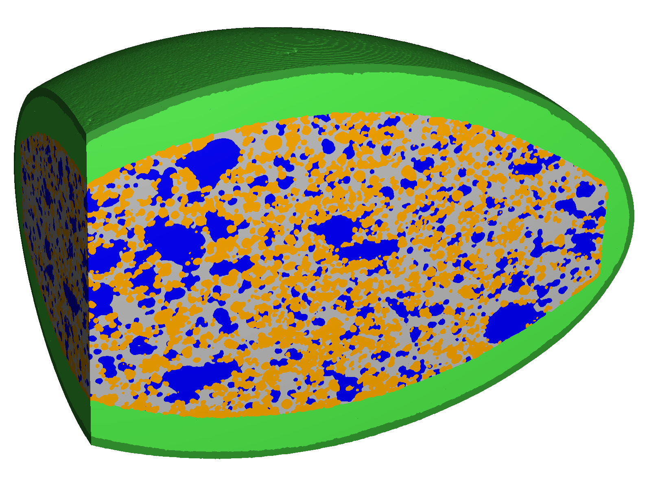
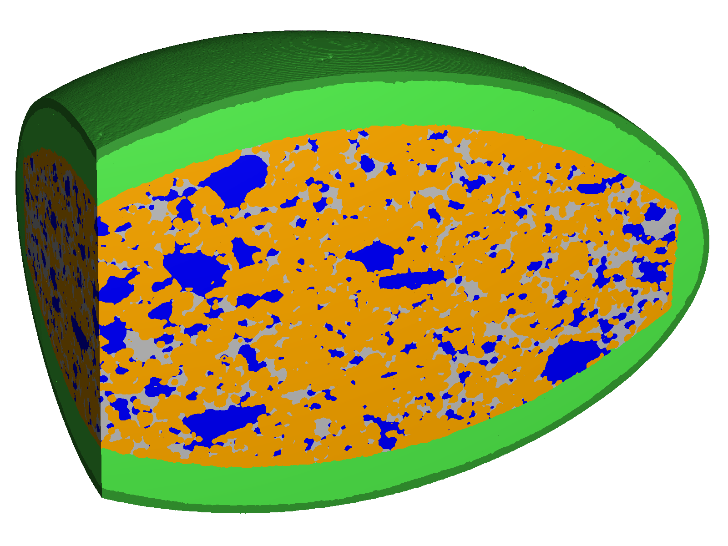
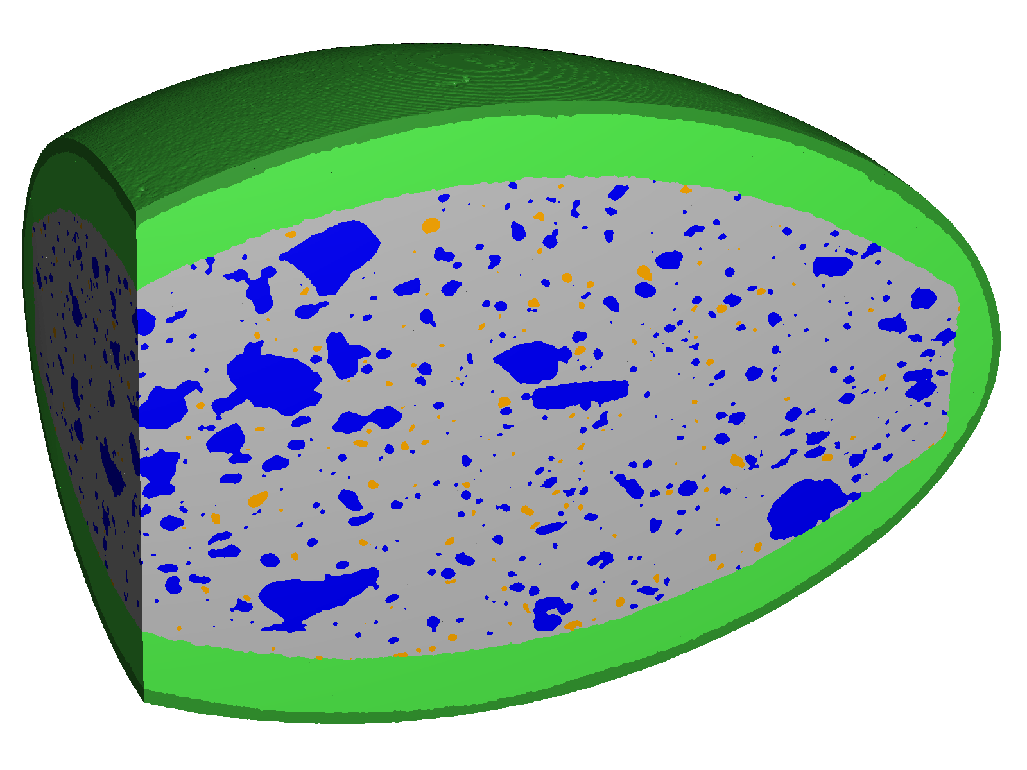
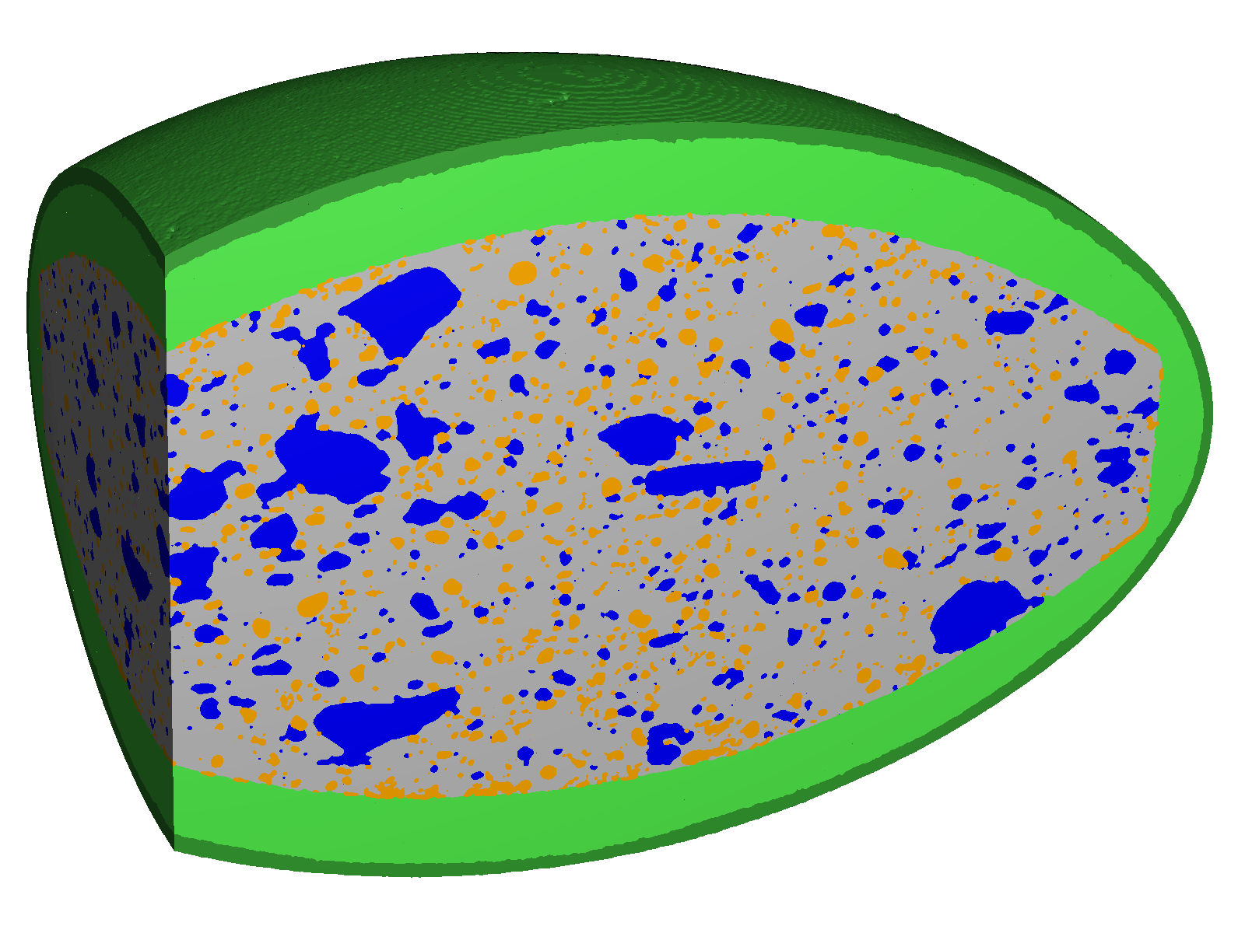
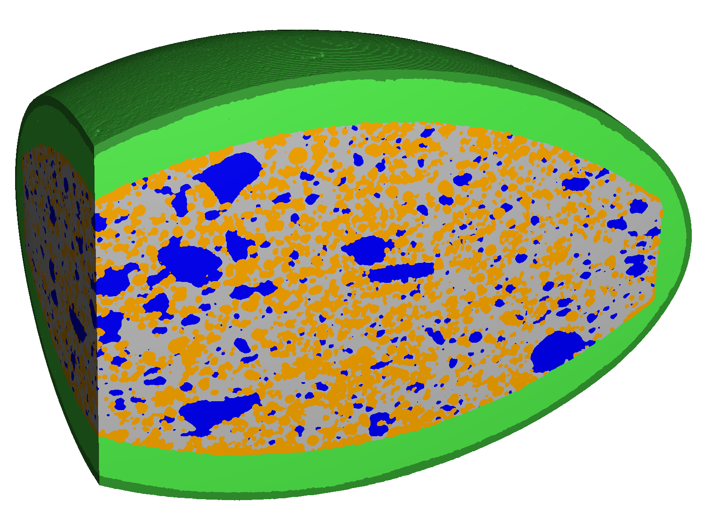
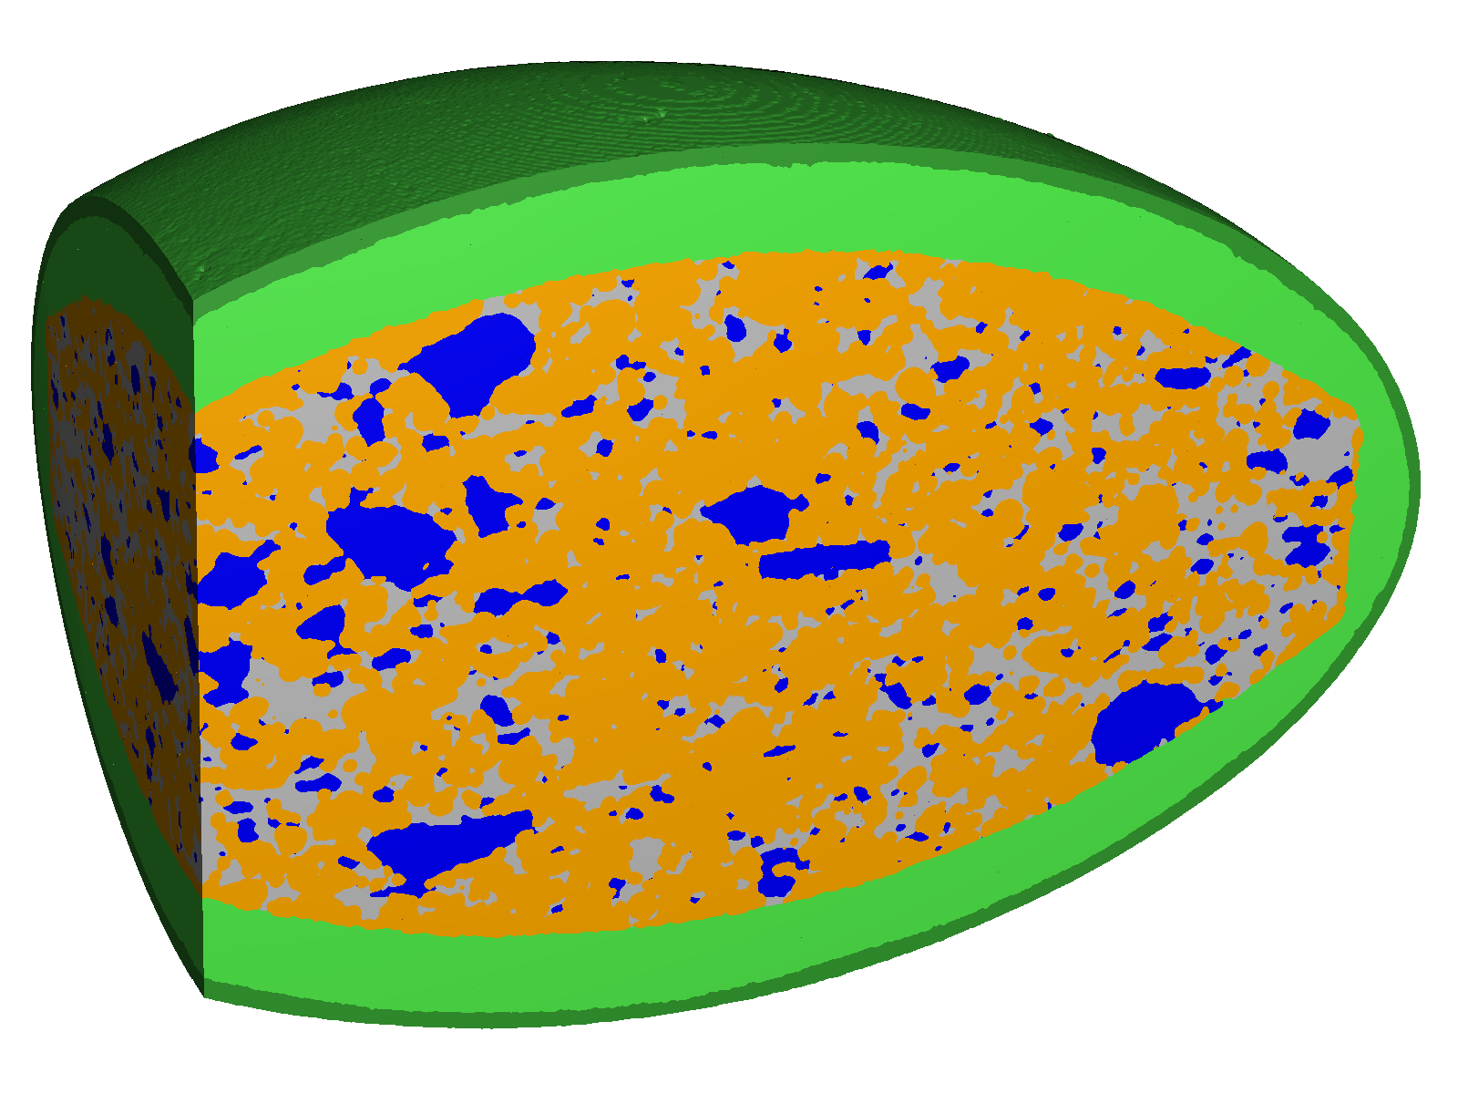
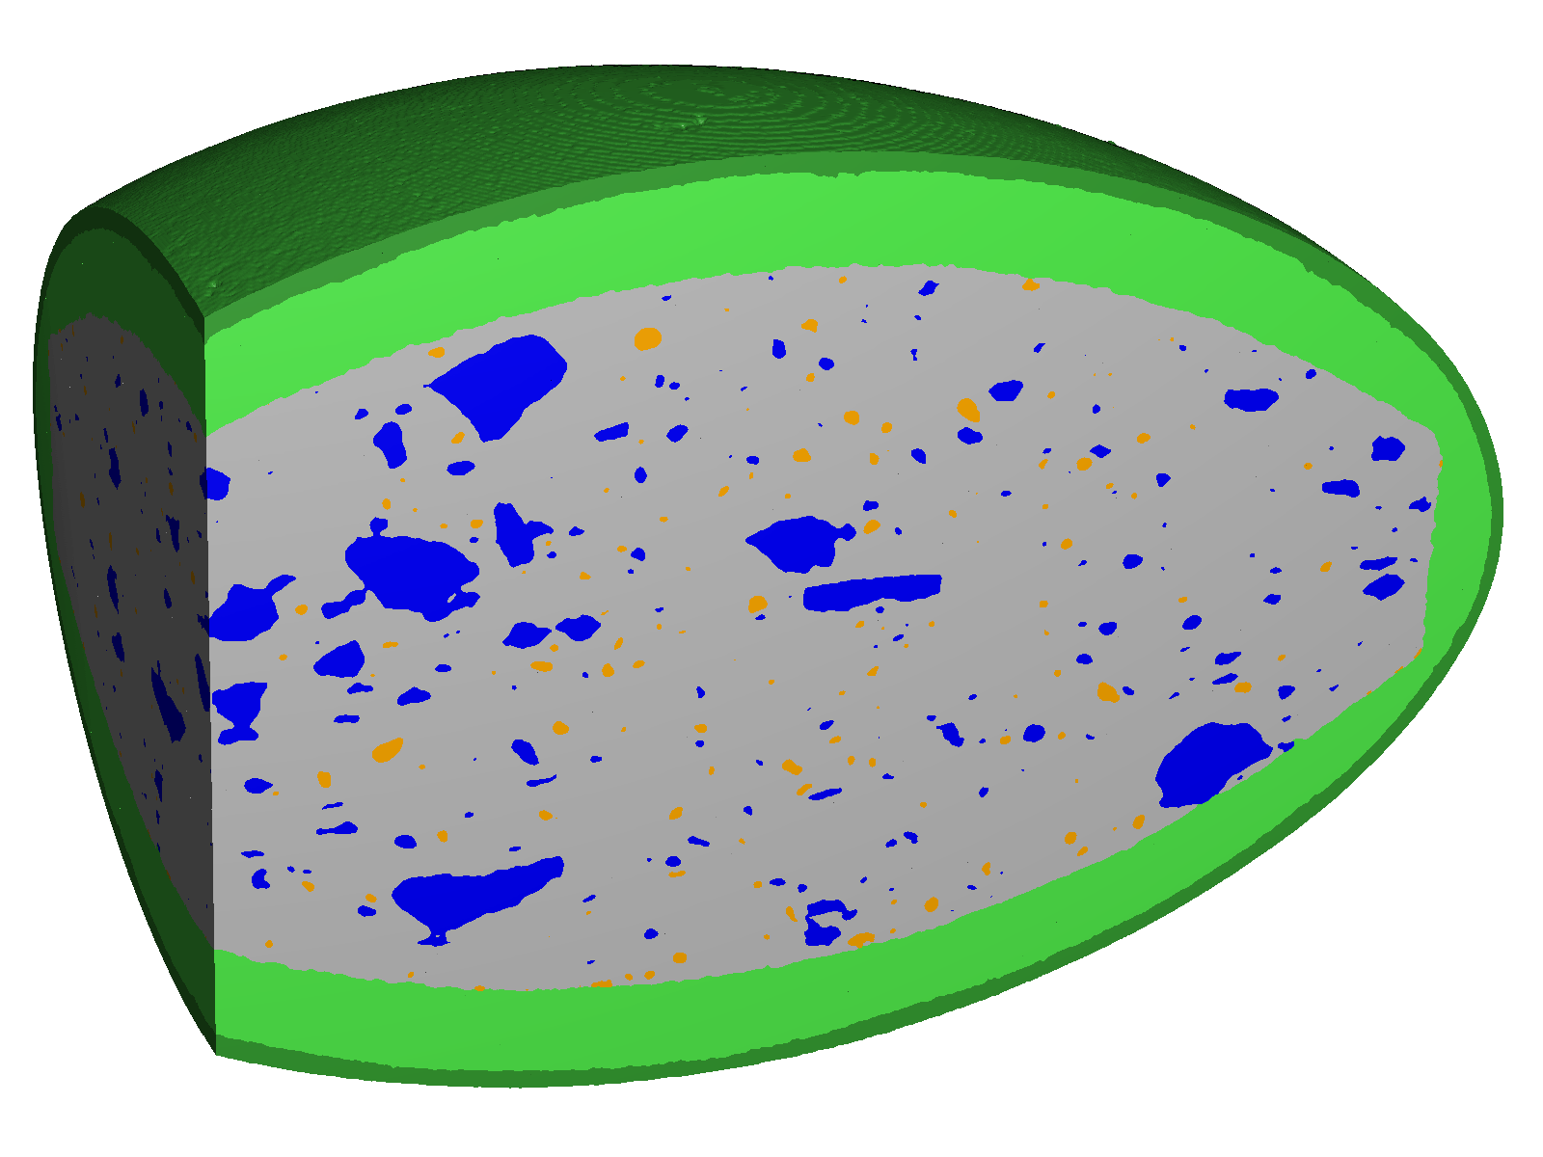



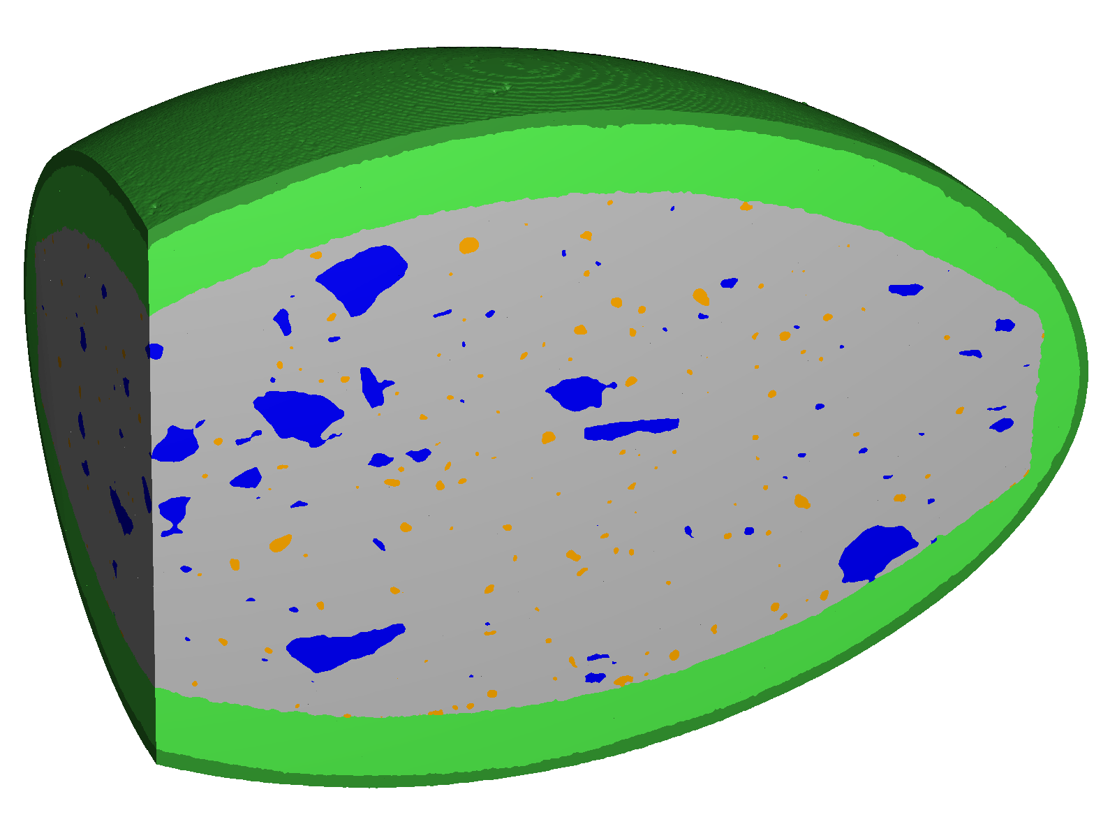

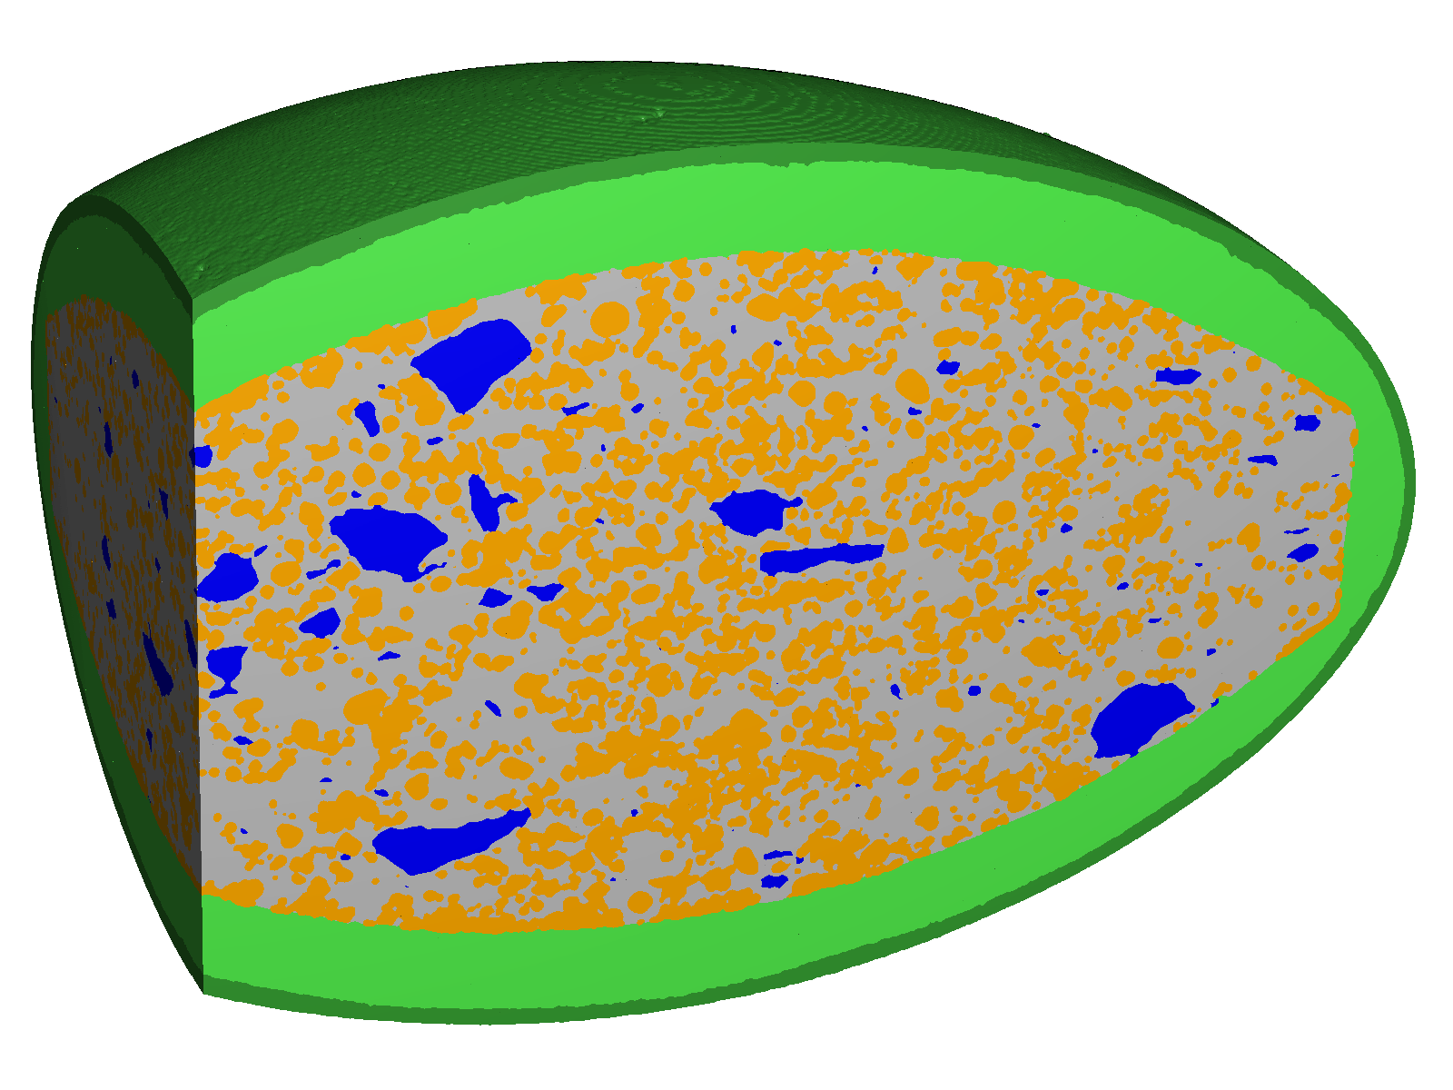
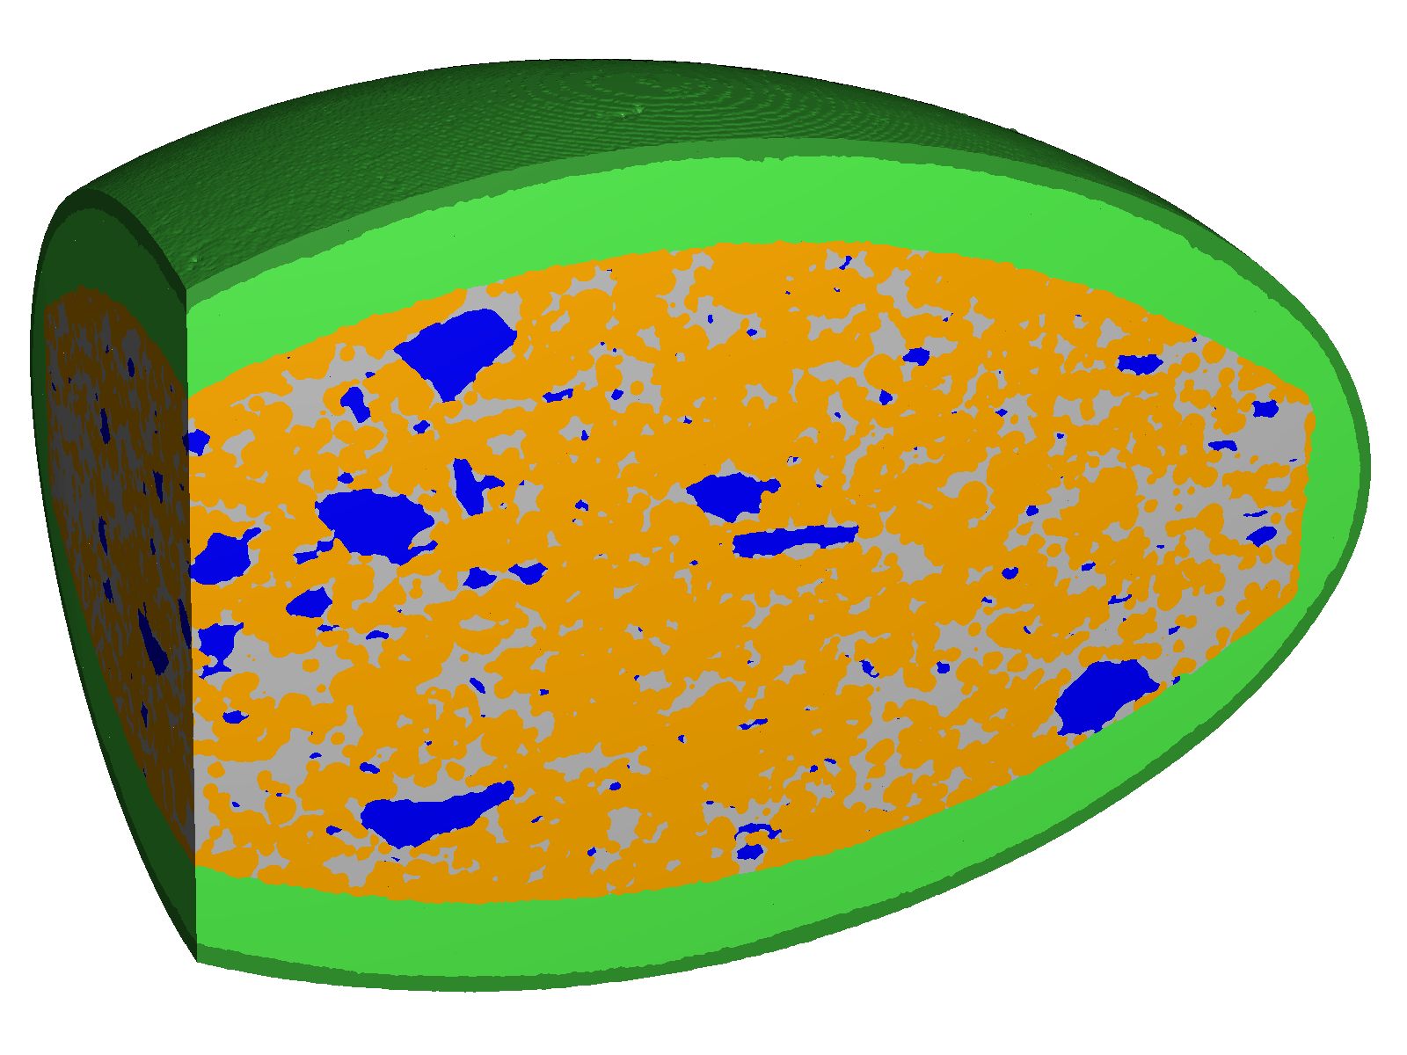
Digitize
Analyze
Model
Design
New Product
Minerals
[v%]
Create stochastical model (Digital Twin)
Conduct large parameter studies and create thousands of „Digital Siblings“
Build once, test many
Digital Twin & Siblings
Pores [v%]
Notes:
So you can generate many variations of your sample, and apply simulation to understand most important performance criteria. Like in this example for a pharmaceutical tablet that contains different minerals and pores quantities

Slide 10
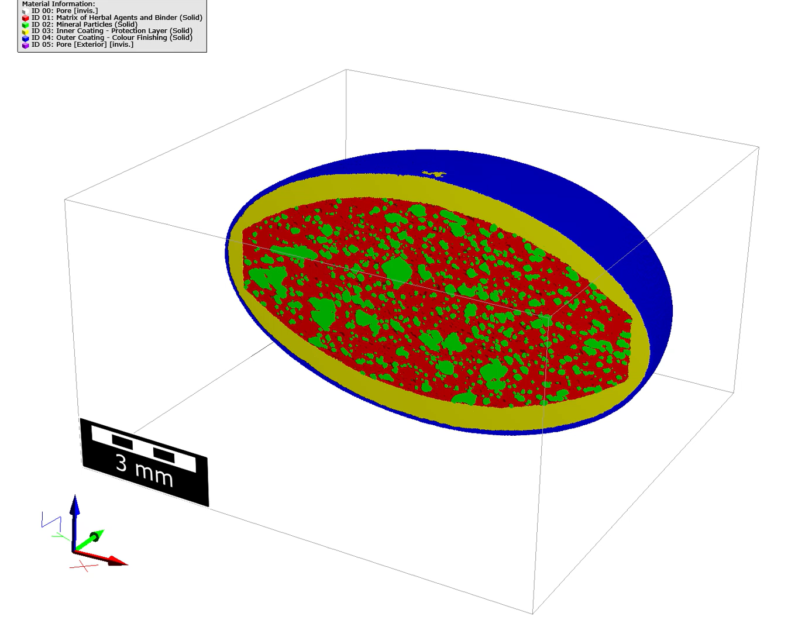
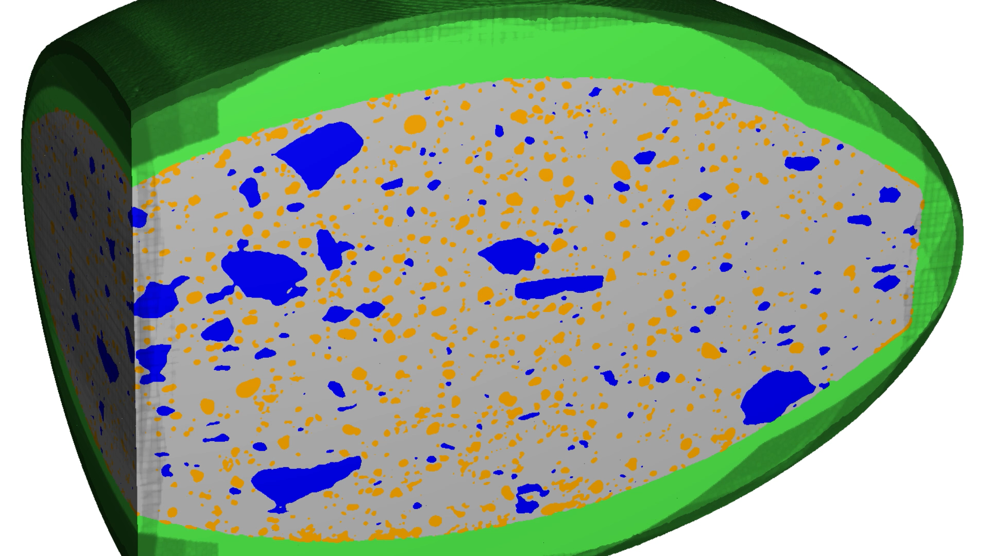
Digitize
Analyze
Model
Design
New Product
Try different microstructures
Simulate e.g. dissolution
Find your product design digitally!
Simulate & design
Notes:
By applying simulations to many digital prototypes, you can understand drug release rate, by only manufacturing one sample and testing many.

Slide 11
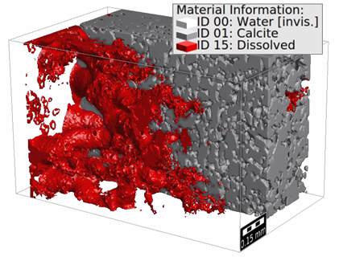
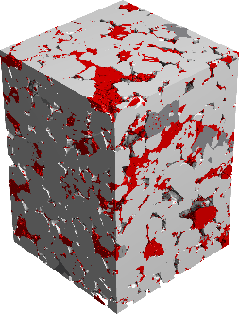
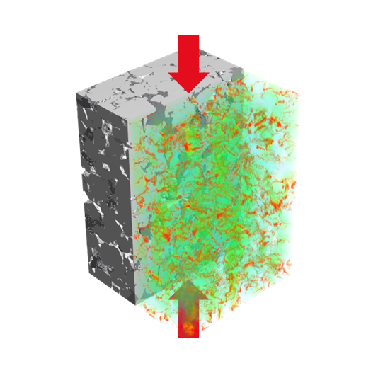
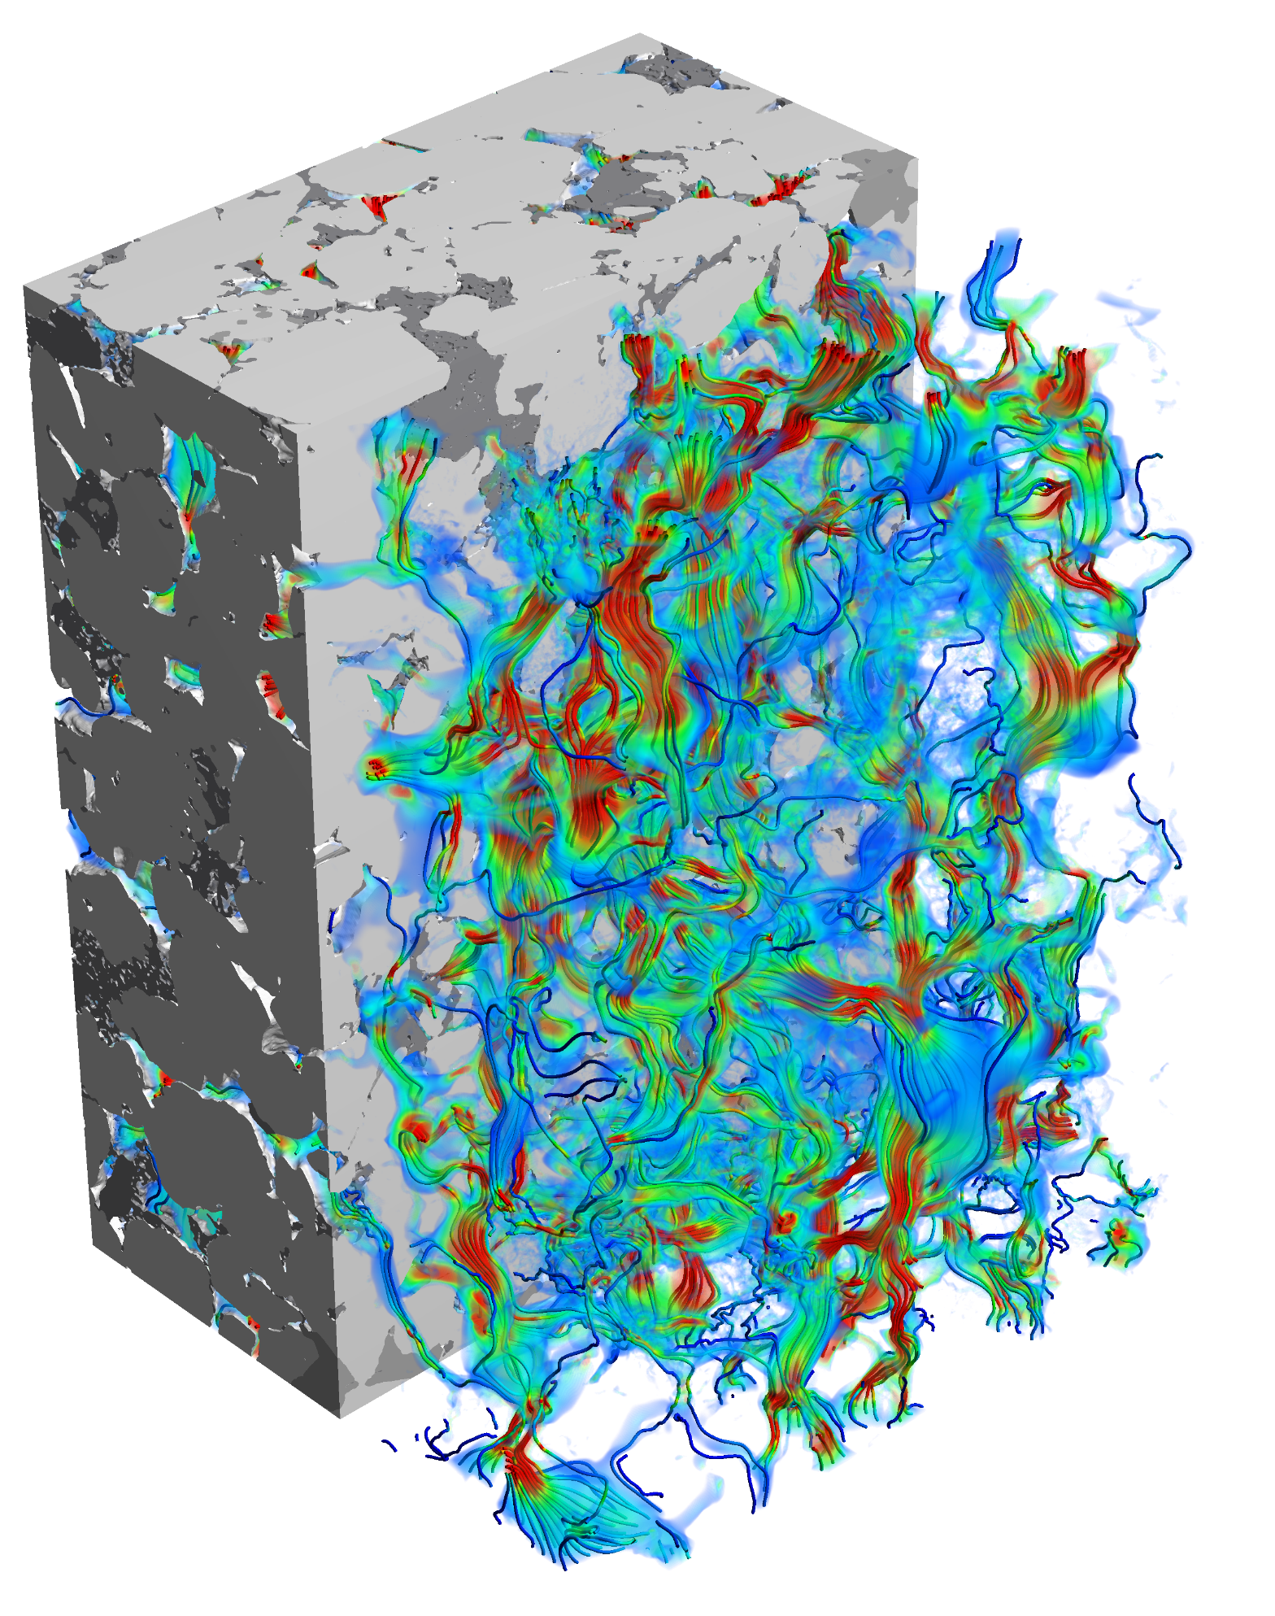
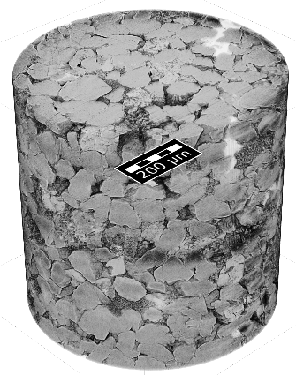
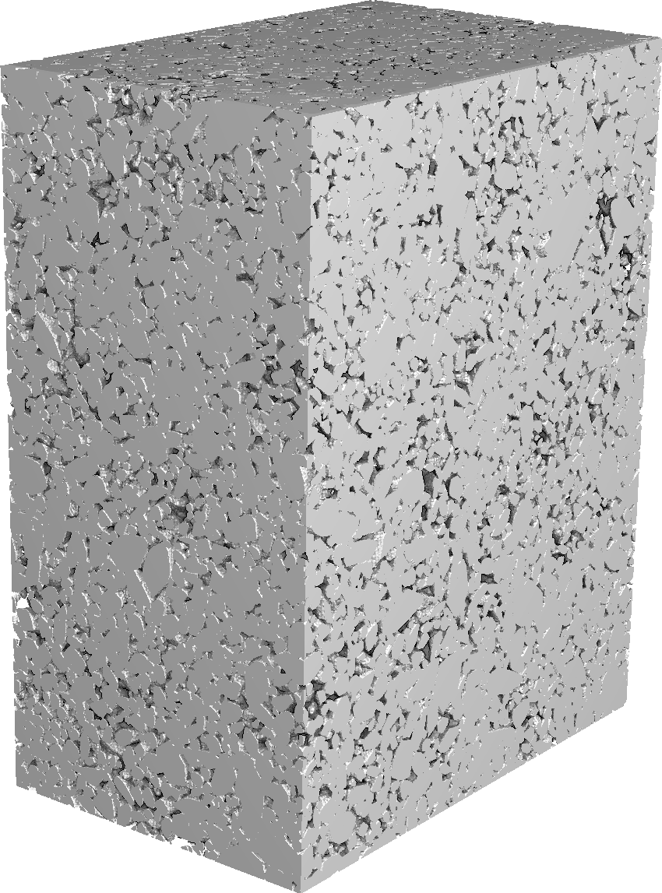
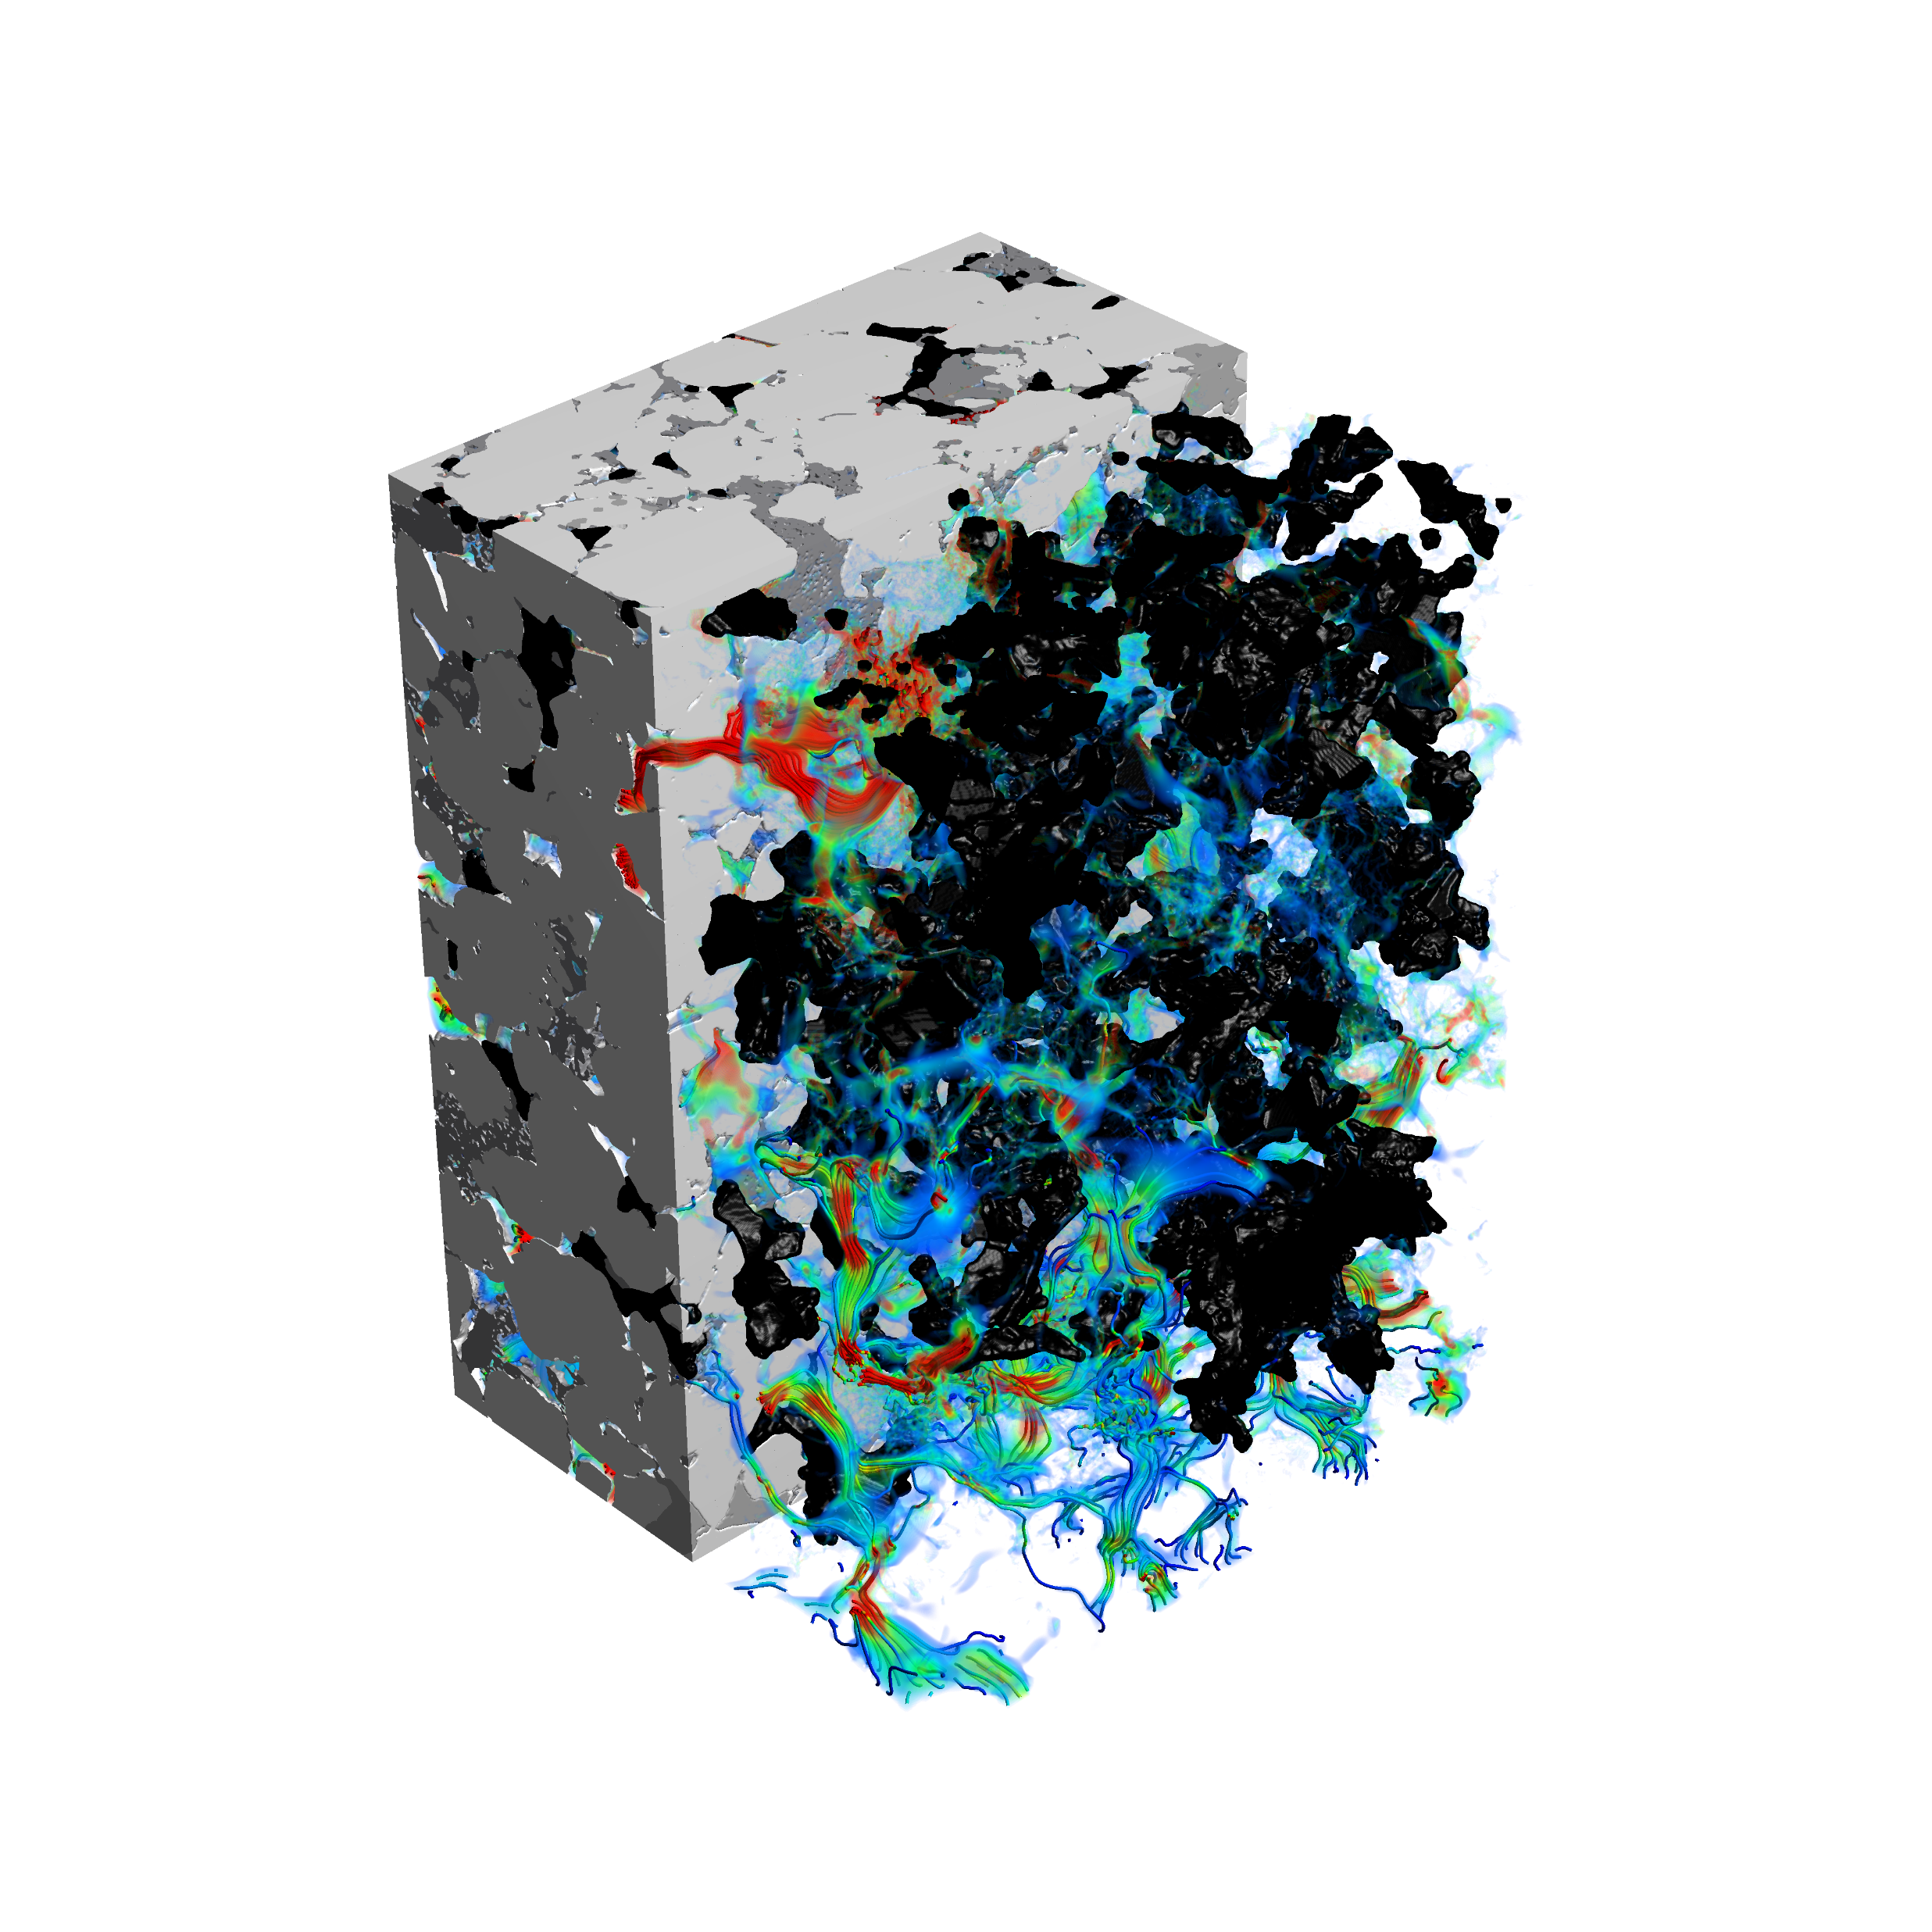
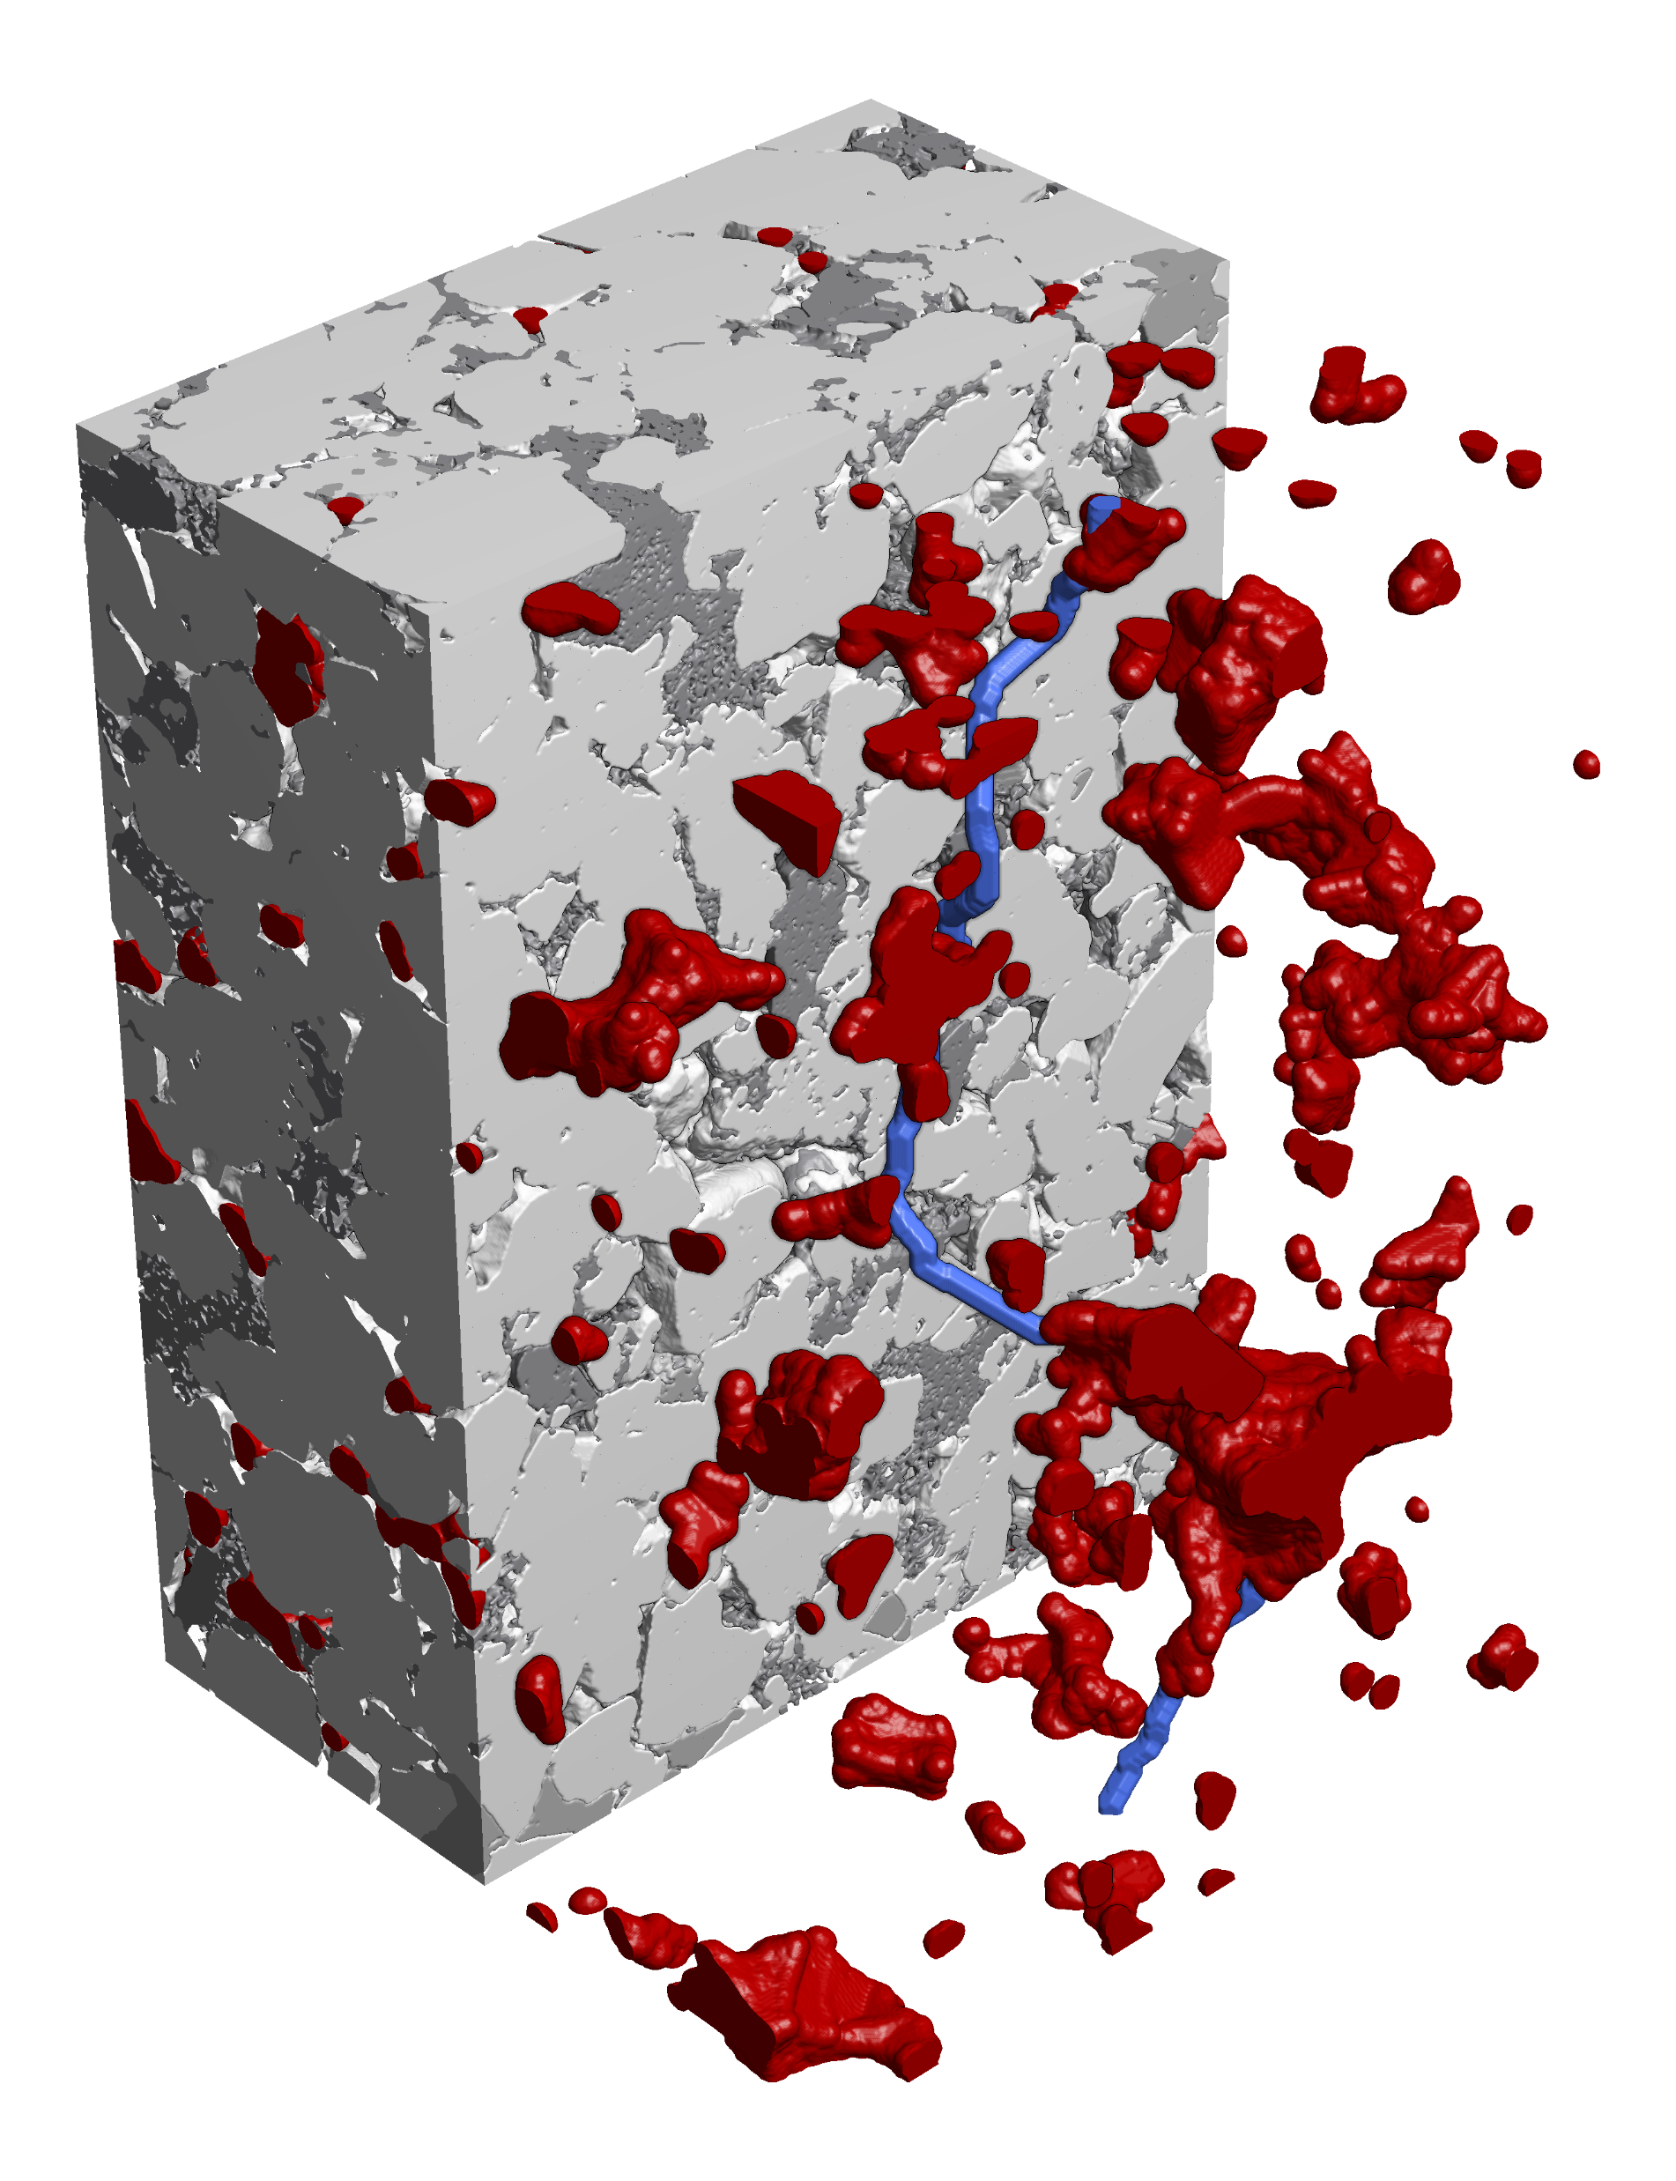
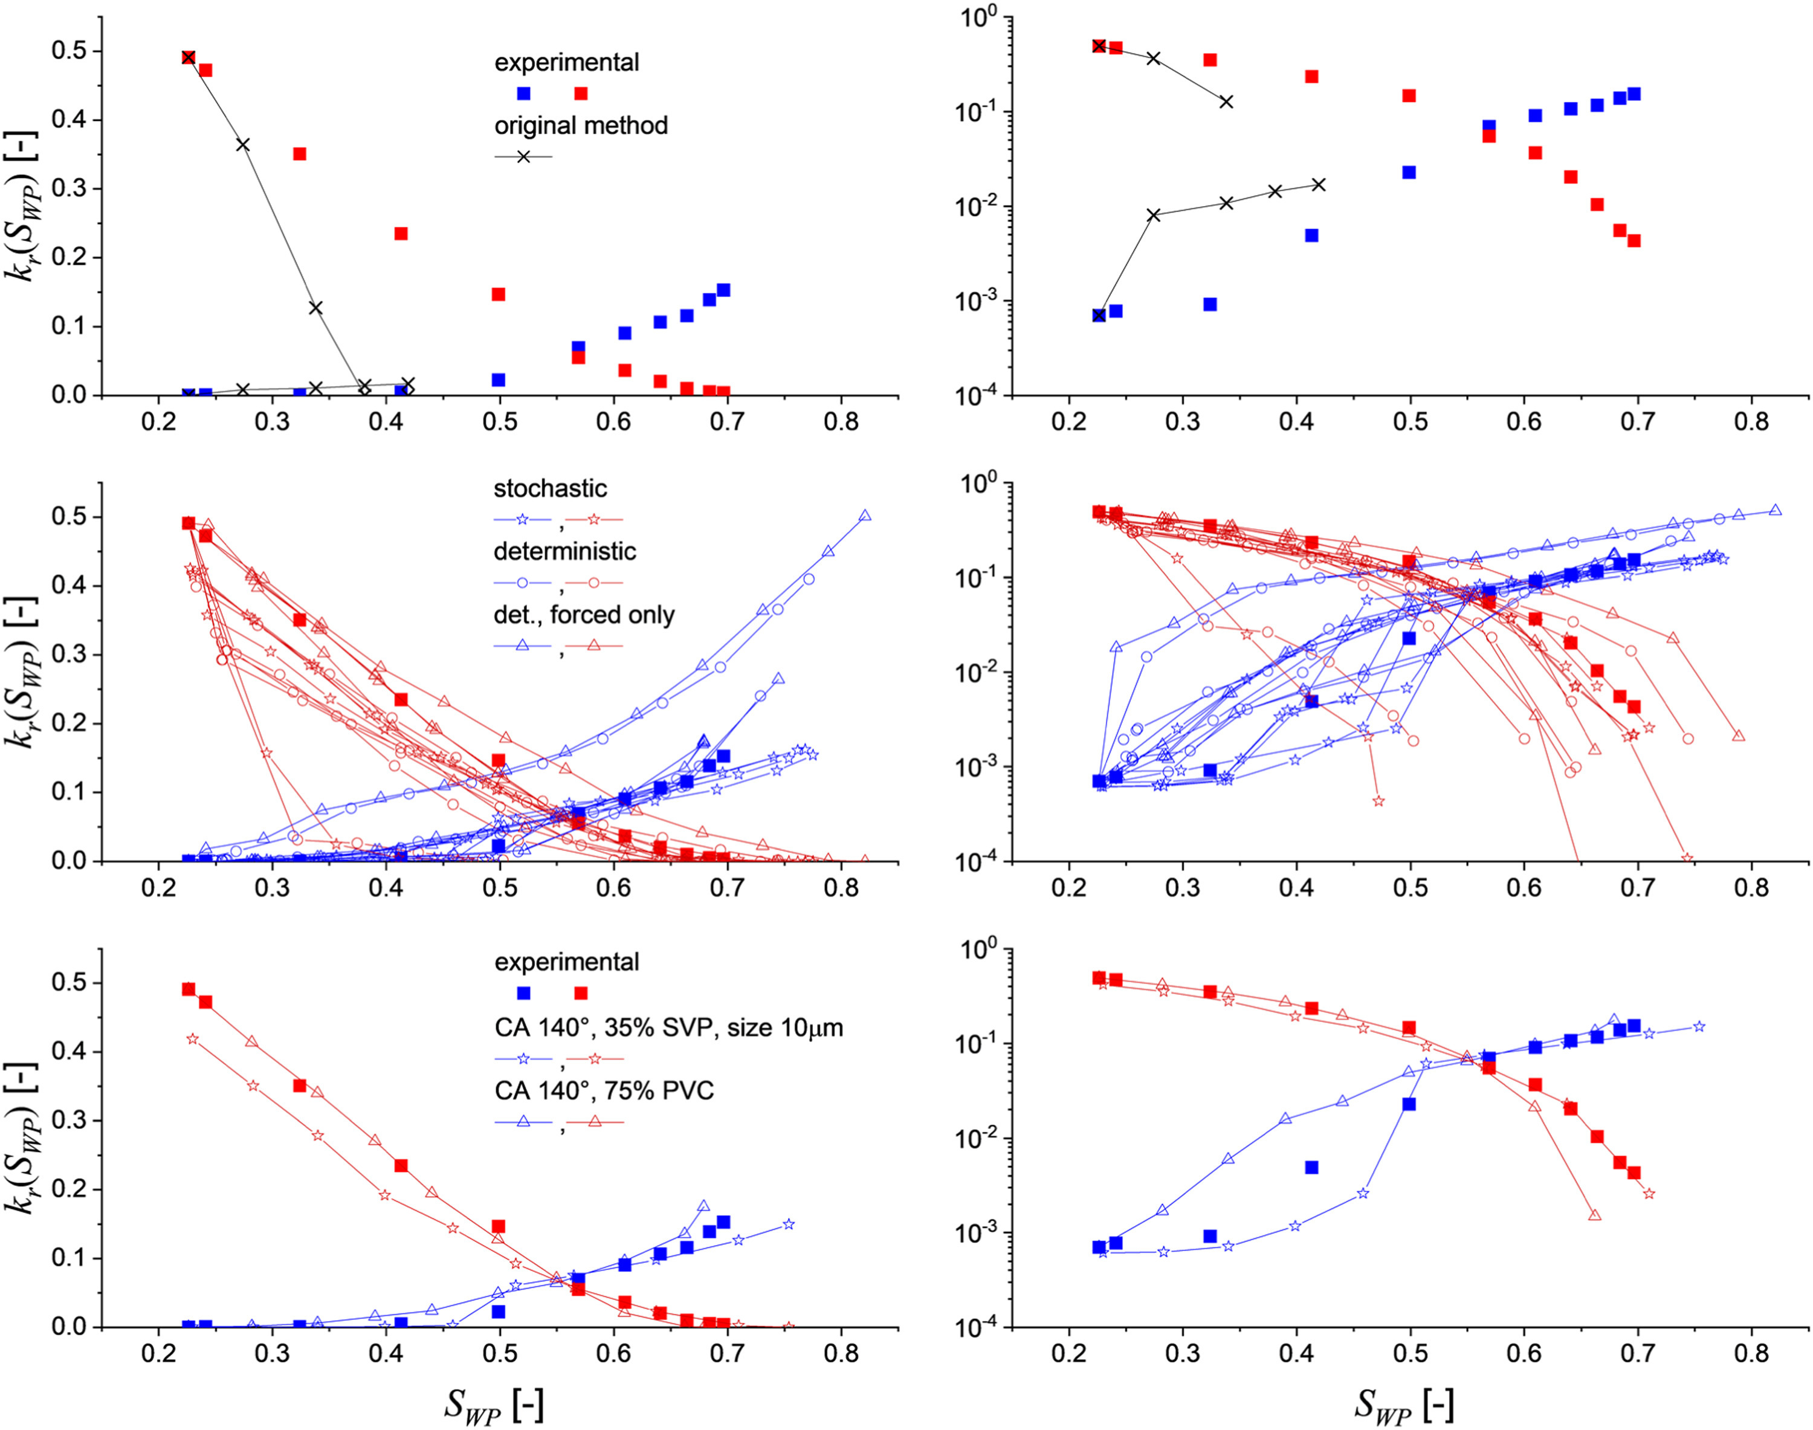
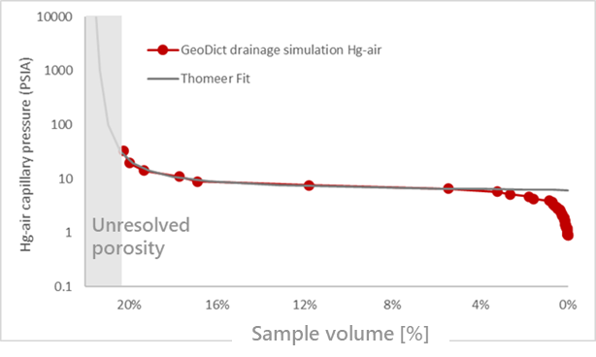
The same concept for Digital Rock Physics
Underground storage
Figure: Grosmont carbonate¹
6
1
Segment scan into pore & mineral phases
Geomechanics
5
2
Digital Routine Core Analysis
Import scan or generate 3D rock
Figure: Berea sandstone¹
Digital SCAL
4
3
Geometrical characterization
________________________________
¹ Andrae et al., 2013, https://doi.org/10.1016/j.cageo.2012.09.005
Notes:
The same concept can be applied to digital rock physics. Here the workflow is the following…many different simulations on the exact same sample.

Slide 12
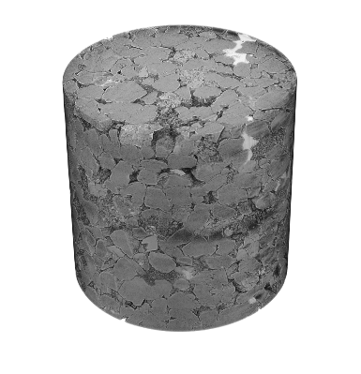
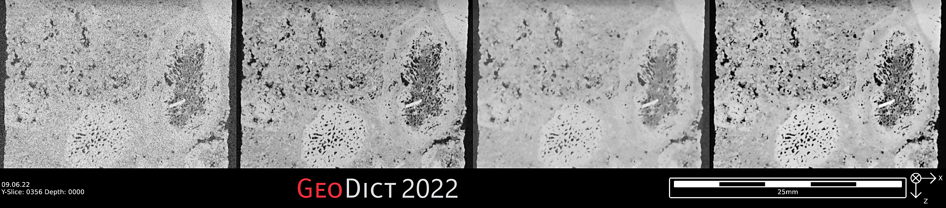
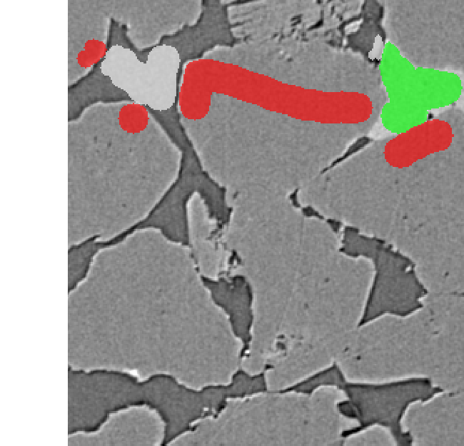
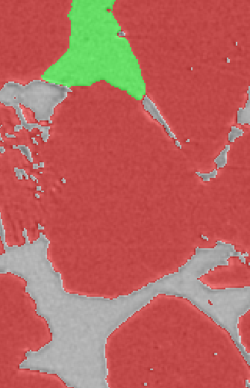

Import, Image Processing & Segmentation
ImportGeo-Vol
»
»
»
Import | Filter | Segment | Quality Control
Pore throat diameter | Segmentation uncertainty | Numerical uncertainty
≥10 voxels | ✔ | ✔
5-9 voxels | ✔/✘ | ✔⁽³⁾
1-4 voxels | ✘ | ✔³/✘
NLM
Random Forest
Figure. The importance of image resolution.
Import 2D / 3D image Crop to region of interest Scale resolution & gray values | Filter noise (NLM, …) Remove image artifacts AI-based image enhancement | Trainable AI-based segmentation Gray value thresholding Watershed segmentation | Pore throat diameter¹ Representative Elementary Volume²
3D Image | Filtered image | Segmented model | Start with rock analysis
________________________________
¹ Saxena et al., 2018, https://doi.org/10.1016/j.advwatres.2018.04.001
² Saxena et al., 2017, https://doi.org/10.1016/j.advwatres.2017.09.007
³ GeoDict 2025: introduction of sub-resolution grids
Notes:
So how does all of this actually work? Well, you start with a microCT scan, import the digital representation, apply image filters, segment the data into different phases, and apply some manual checks and quality control.

Slide 13
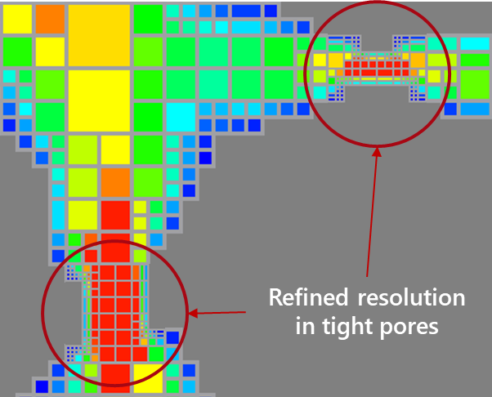
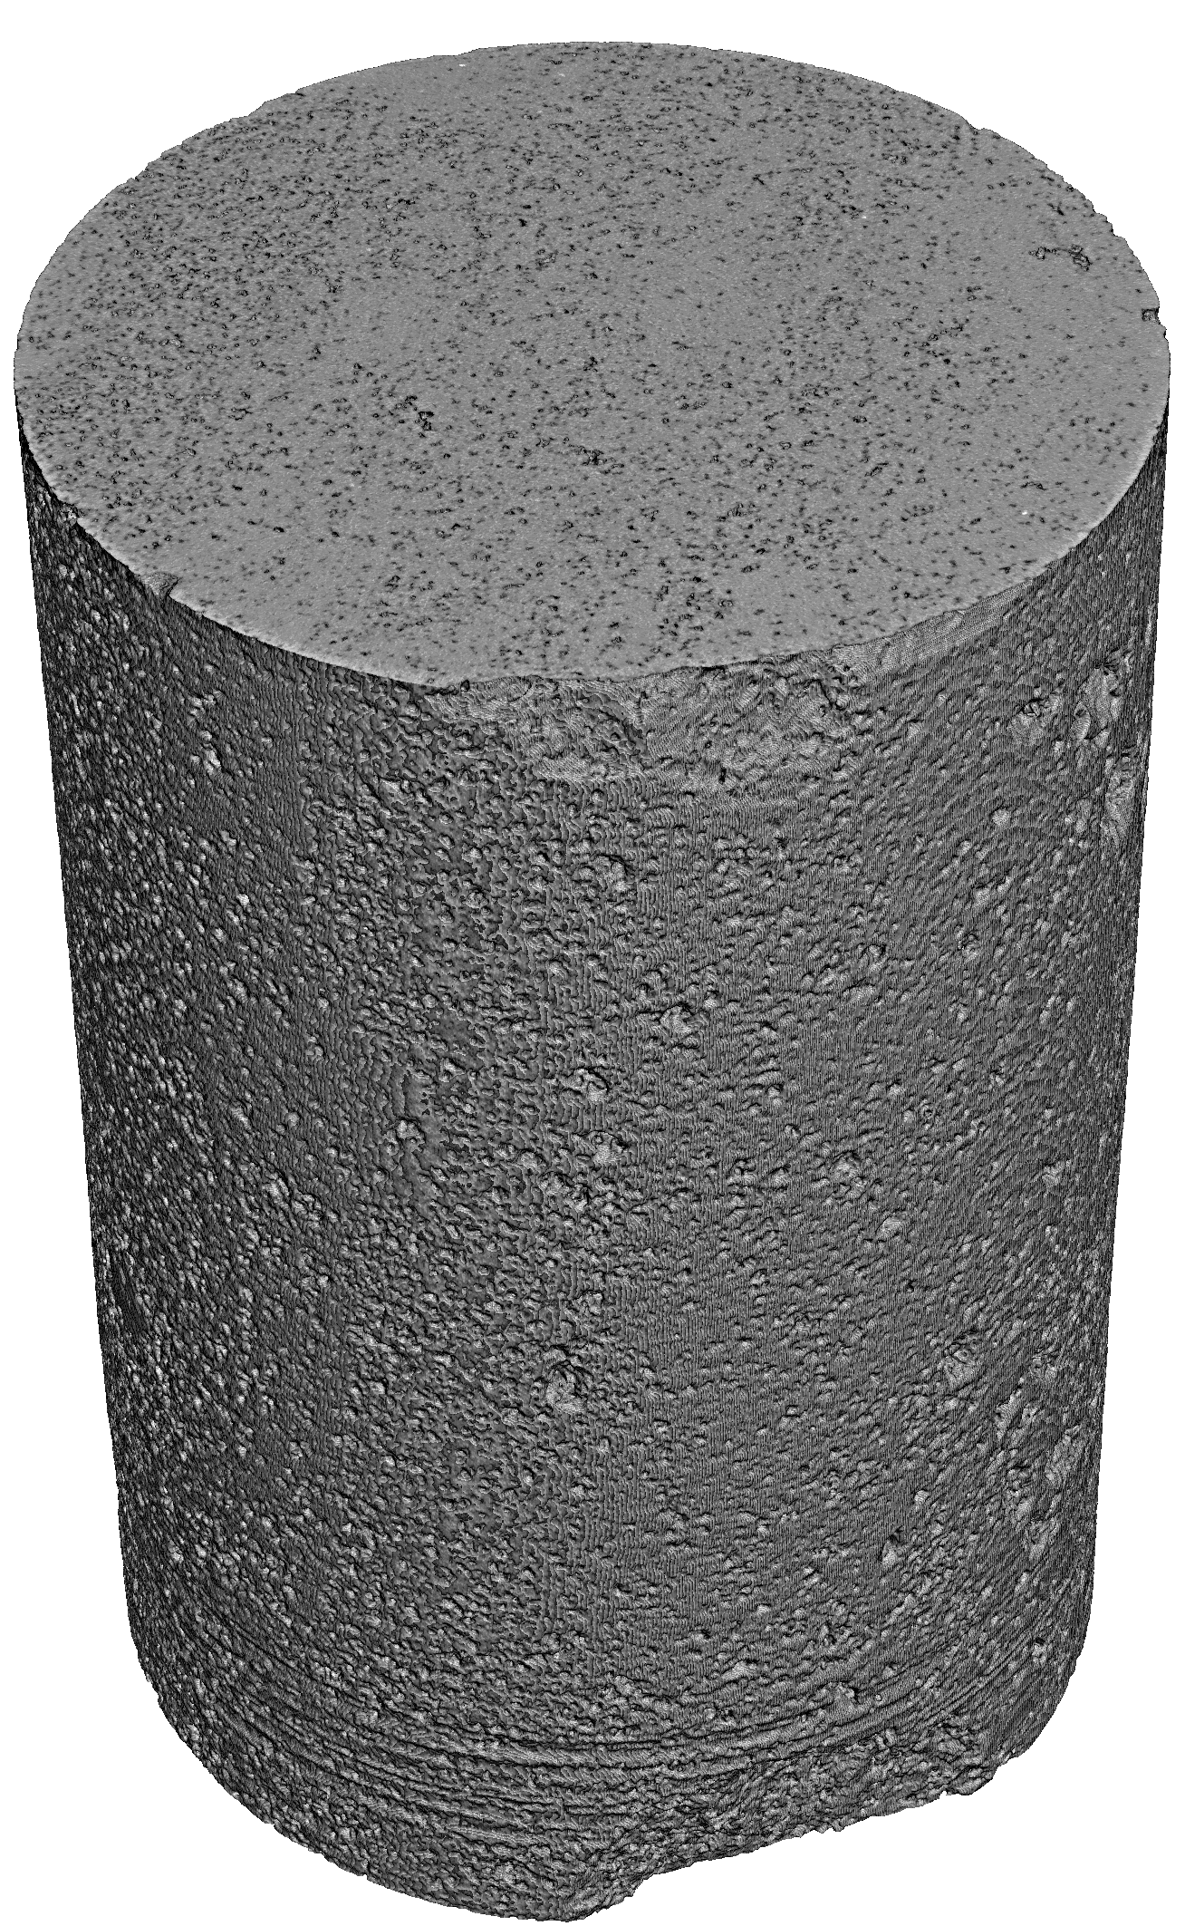


Absolute permeability – Resolution dependency
Quality Control | Grid refinement | Permeability Correction
Pore throat diameter | Segmentation uncertainty | Numerical uncertainty
≥10 voxels | ✔ | ✔
5-9 voxels | ✔/✘ | ✔⁽⁴⁾
1-4 voxels | ✘ | ✔⁴/✘
✔/✘
Adaptive grid of LIR solver: grid coarsening in large pores, grid refinement in tight pores (pore throats)
✔
✘
With the LIR grid refinement, GeoDict now predicts permeability wherever the flow paths are resolved with a few voxels.
________________________________
¹ Andrä et al., 2013, https://doi.org/10.1016/j.cageo.2012.09.008
² Alayfei et al., 2015, https://doi.org/10.1007/s11242-015-0563-0
³ Saxena et al., 2017, https://doi.org/10.1093/gji/ggaa321
⁴ GeoDict 2025, grid refinement to sub-voxel resolution, https://geodict-userguide.math2market.de/2025/flowdict_solvestokes_solver_advanced.html
Notes:
Since the fluid flow is strongly influenced by pore throats, it makes sense to show here the grid refinement approach used in GeoDict. The entire digital simulation is based on voxel data directly, no meshing step is needed. To make this efficient, the pore throats are refined in smaller voxels and larger pore regions into larger voxels. Here the comparison of the grid refinement simulation to that without grid refinement (much slower) and the experimental data for 5 different benchmark rock samples.

Slide 14
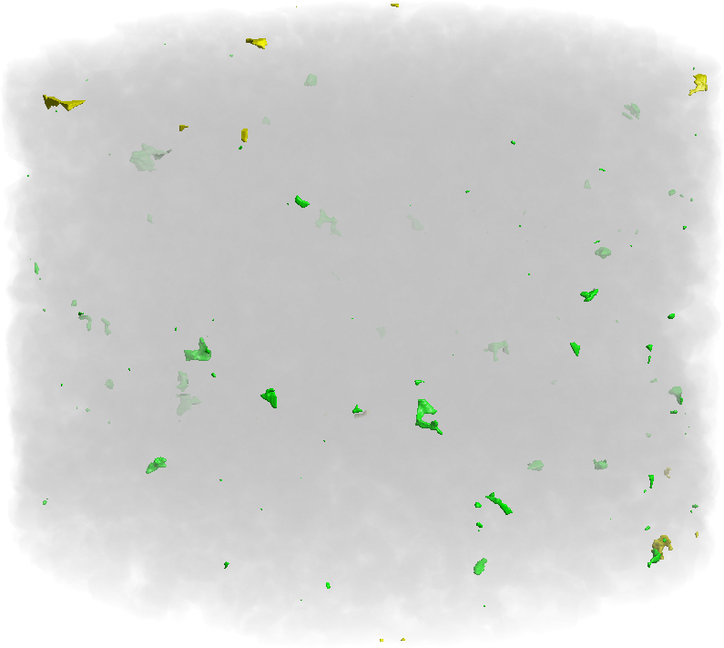
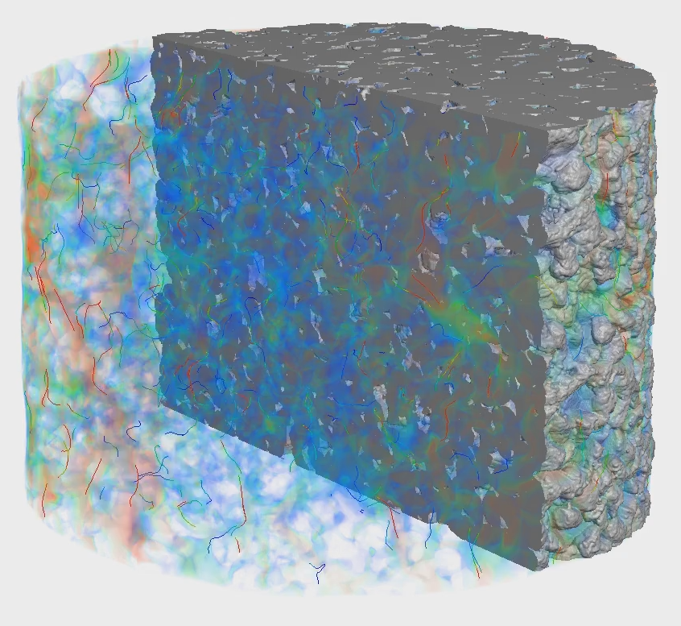
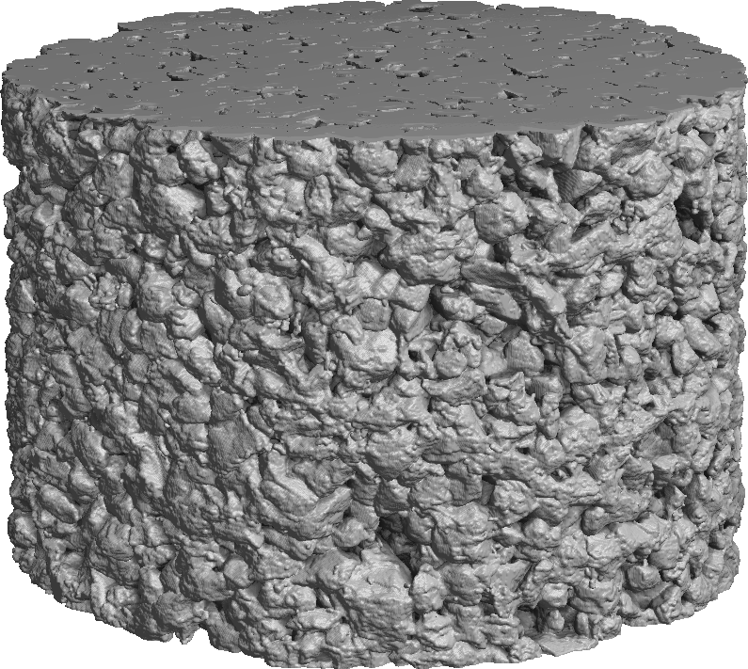
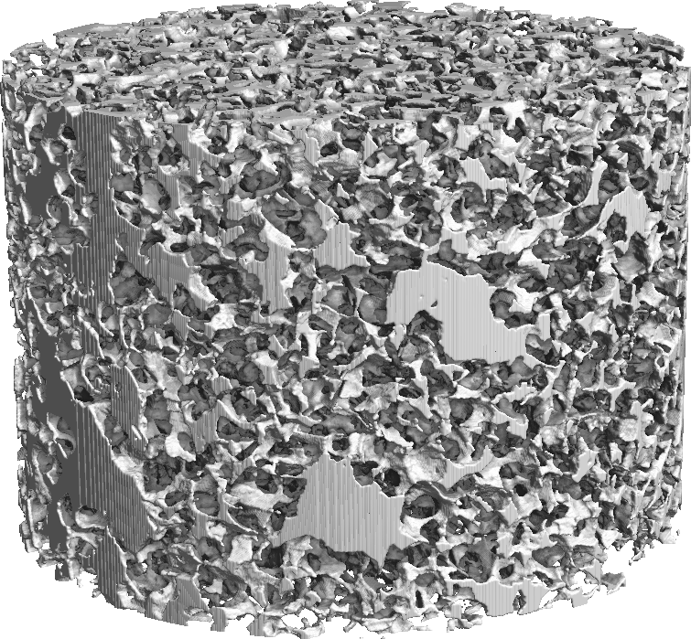

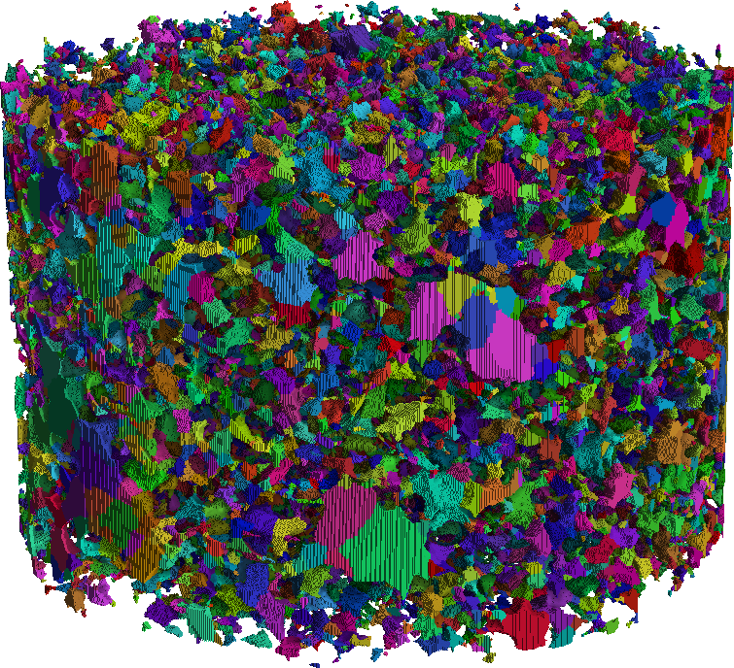
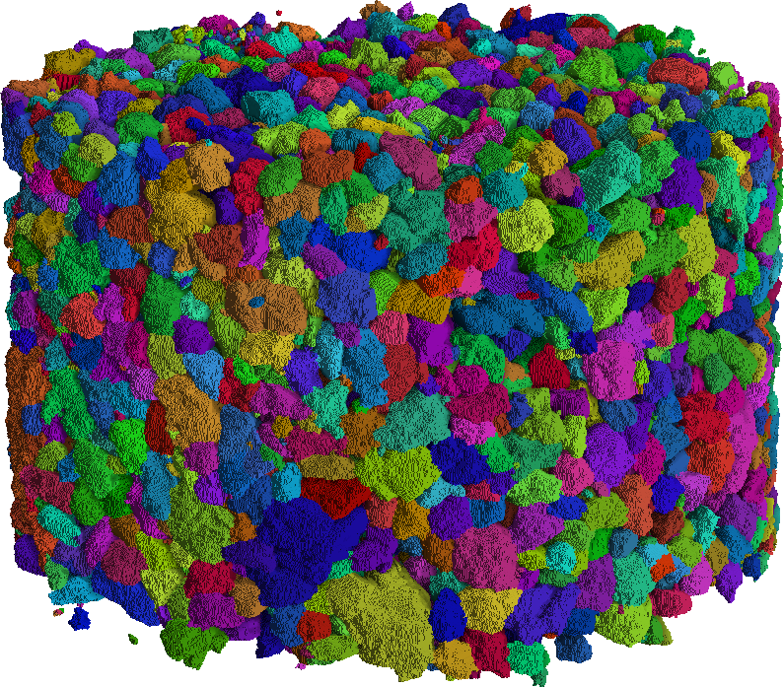
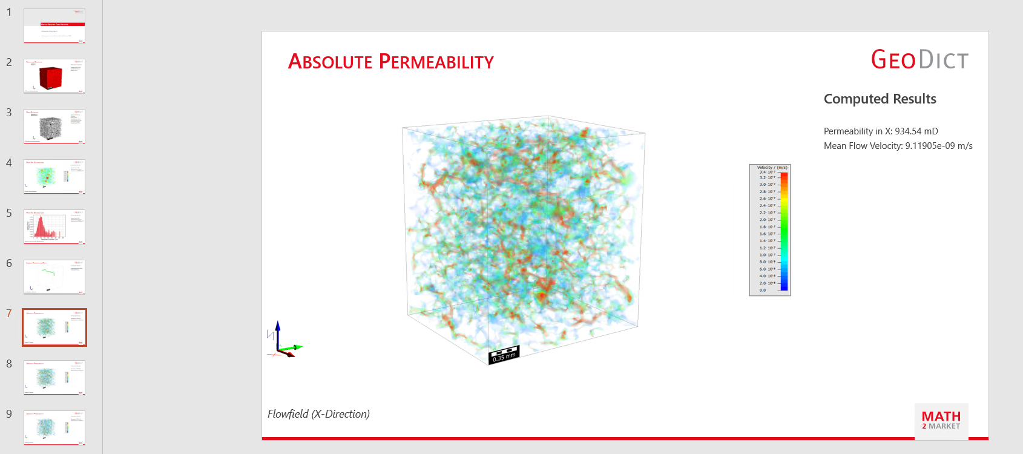
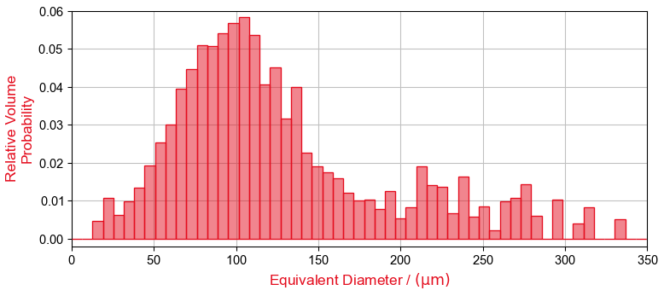
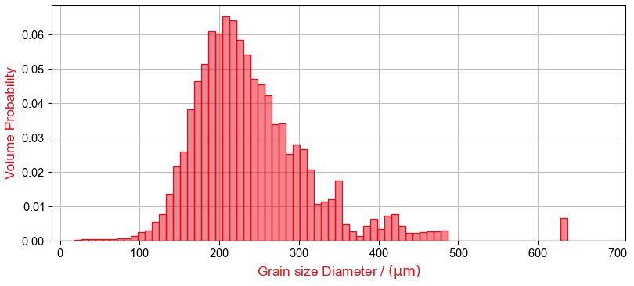
Digital Routine Core Analysis – dRCA
Automated workflow
Pores visualized
3D Gildehauser sandstone ¹
Visualized fluid velocity field
I. Density and sample statistics | II. Porosity classification | III. Absolute permeability
IV. Pore size distribution | V. Grain size distribution | VI. Automated PowerPoint Report
________________________________
¹ Berg et al., 2016, https://doi.org/10.1016/j.advwatres.2016.01.010
Notes:
The digital rock routine core analysis focuses on porosity, single phase flow permeability, pore sizes, grain sizes and an automated report containing absolute permeability and more information.

Slide 15


Reservoir Rock Characterization - automated
Automate import of digital rocks ^{1,2,3}
Automate individual post-processing for computed results
Gildehauser
sandstone
Berea sandstone
Automate computation of rock properties ¹
Example: total porosity and absolute permeability for rock characterization purposes
________________________________
¹ Automating the handling of multiple datasets with GeoPy, https://www.math2market.com/service-support/learning-opportunities/tutorials.html
² Berea & Grosmont: Andrae et al., 2013, https://doi.org/10.1016/j.cageo.2012.09.005
³ Gildehauser: Berg et al., 2016, https://doi.org/10.1016/j.advwatres.2016.01.010
Notes:
This entire workflow can be automated, so that many samples can be processed identically.

Slide 16




Imbibition – Relative Permeability
»
»
»
Primary Drainage | Simulate Aging | Imbibition | Relative Permeability
Validation versus K_{rel} lab data³
Method: upgraded, dynamic Pore Morphology Method^{1,2} (A) Simulate continuous displacement (unsteady-state) in voxel geometry | Method: aging of oil-rock interfaces in large pores³ (B) Identifies oil-rock interfaces, (C) separates those in large pores, (D) introduces oil-wet surfaces | Method: upgraded, dynamic Pore Morphology Method^{1,2} (E) Simulates unsteady-state imbibition based on previous steps | Method: Solve Stokes equation at selected saturation points^{5,6,7} (F) LIR-Stokes solver computes permeability for selected saturations, (G) Generates K_{rel} curve related to K_{abs}
Drainage P_{C} curve | Consider mixed-wet system | Imbibition P_{C} curve | Imbibition K_{rel} curve
________________________________
¹ Hilpert & Miller, 2001, https://doi.org/10.1016/S0309-1708(00)00056-7
² Schulz et al., 2015, https://doi.org/10.1007/s11242-014-0422-4
³ Arnold et al., 2023, https://doi.org/10.1016/j.advwatres.2023.104381
⁴ Berg et al., 2016, https://doi.org/10.1016/j.advwatres.2016.01.010
⁵ Schulz et al., 2007, https://doi.org/10.1149/1.2472547
⁶ Linden et al., 2015, https://doi.org/10.1016/j.gmod.2015.06.003
⁷ Wiegmann, A., Computation of the permeability […], Reports of Fraunhofer ITWM, 2007.
Notes:
Here some more advanced simulations show primary drainage, aging, imbibition and relative permeability.

Slide 17







CO2 Storage – Pore-to-Field-Scale Approach ^{1,3}
»
»
»
Capillary trapping | Reactive transport | Pore-scale Seismics | Upscaling
  Digital Core flood simulations (immiscible)
              unsteady-state, immiscible CO₂ injection
              ϕ, K_{abs}, K_{rel}
  Digital Core flood simulations (CO₂→brine)
              Mineral dissolution & crystallization ²
              ∆ϕ, ∆K_{abs}, ∆K_{rel}
        Compute p- & s- wave velocities (V_{p}/V_{s}) and acoustic impedance (I_{p}) ³
              Contact-based stiffness correction to address the overestimation of elastic moduli at grain contacts ³
              ∆V_{p}, ∆V_{s}, ∆$\frac{V_{p}}{V_{s}}$, ∆I_{p}
        Upscaling: Characterization of rock properties across pore-to-log-to-seismic scales
Contact stiffness
              Seismic-based conformance monitoring
              Storage security
              Risk assessment
              Injection strategy design (e.g., max P)
              Cost-efficient site characterization & Upscaling
________________________________
¹ Burmester et al., 2024, https://doi.org/10.3997/2214-4609.2024101128
² https://www.math2market.com/service-support/learning-center/reactive-flow-geoapp-for-co2-sequestration.html
³ Halisch et al., 2025, SCA annual symposium, https://doi.org/10.5281/zenodo.16814031
0
Notes:
In this example of work done with OMV, CO2 storage is investigated by capillary pressure flooding simulation, reactive transport by applying carbonate rock properties and computing pore scale acoustic properties based on mechanical simulation. This is all used in an upscaling approach to make log scale decisions.

Slide 18
Conclusions
Digital material workflows enable:
One digital sample → many virtual experiments
Traceable workflows from imaging to property prediction
Validation against experimental data
Rapid design exploration and sensitivity analysis
For Digital Rock Physics, this enables:
Porosity and permeability prediction
Two-phase flow and reactive transport workflows
Pore-scale micromechanics simulations
Integrated image-to-property analysis
Notes:
In conclusion, the GeoDict digital material workflows have in general the following benefits. …. And specifically for DRP, this enables ….

Slide 19

Thank you for your attention
Any Questions?
Thank you for your attention!
  You are welcome to our booth #7
  Also welcome to our user conference – the GeoDict Innovation Conference
  https://www.math2market.com/news/events/geodict-innovation-conference/information.html
Date
Sept 29-30, 2026
Location
Frankfurt (Germany)
& Online
Notes:
Finally, I want to invite you to our booth and also to our user conference, all are welcome there even if you are new to GeoDict. Thank you

