Slide 1
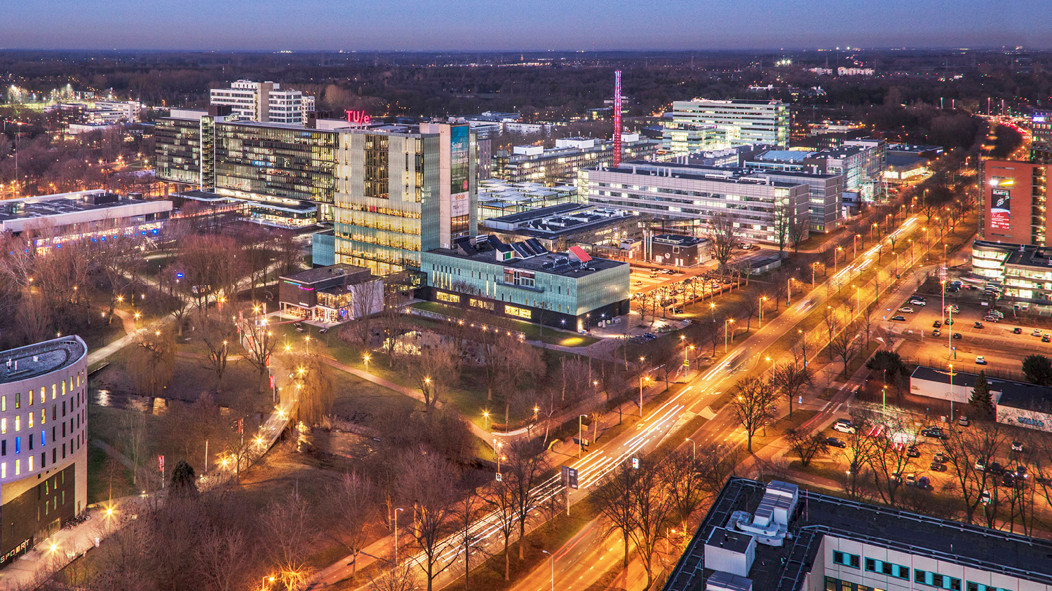
Development of an Image-Data-Driven Flow Solver for Investigating Intermittency Effects in Multiphase Flow
21-05-2026
Karlijn Smeulders, Maja Rücker, Tom Bultreys, David Rieder
ME engineering, Energy technology
Notes:
Focus on combination between experimental data and numerical method!!

Slide 2
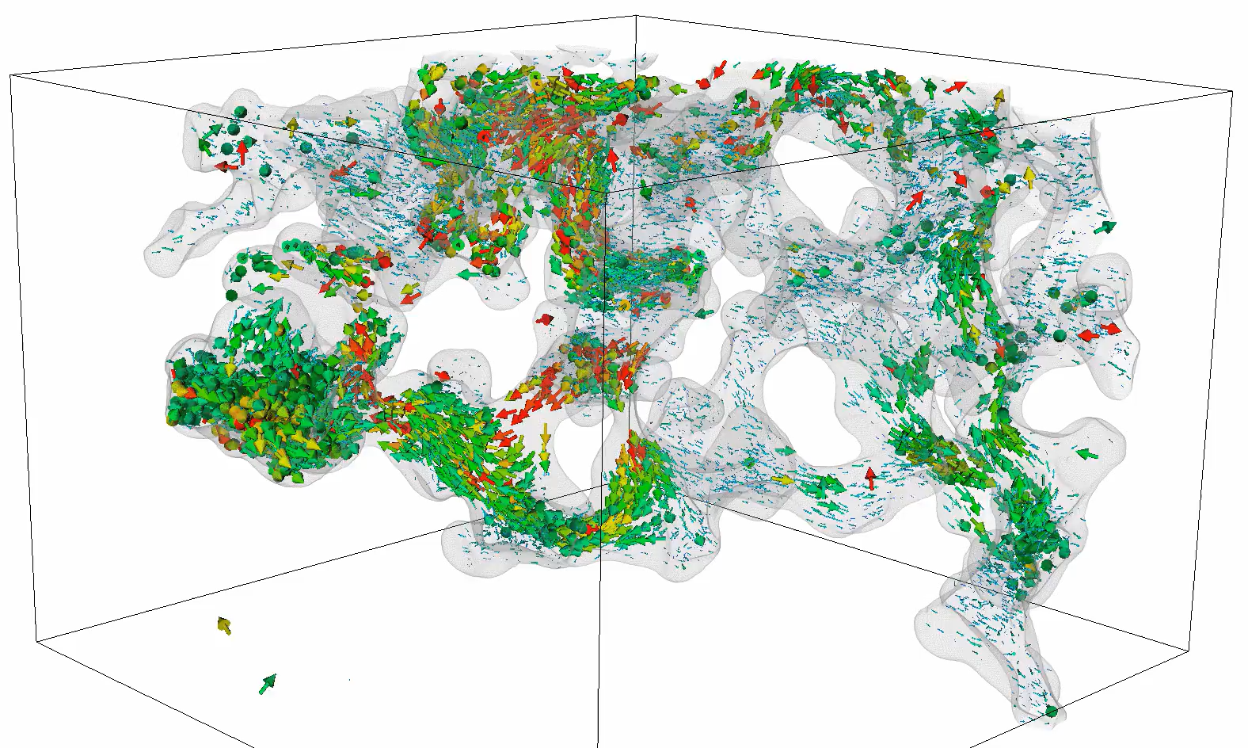
Intermittency
[1]: Bultreys T, Ellman S, Schlepütz CM, Boone MN, Pakkaner GK, Wang S, Borji M, Van Offenwert S, GoudarziNM, Goethals W, Winardhi CW, and Cnudde V. 4D microvelocimetry reveals multiphase flow field perturbationsin porous media. Proceedings of the National Academy of Sciences of the United States of America 2024 Mar;121.
Notes:
Multiphase flow is obvious. What are intermittency effects? Silver coated particles, X-ray. Small sample, 10^-4.

Slide 3
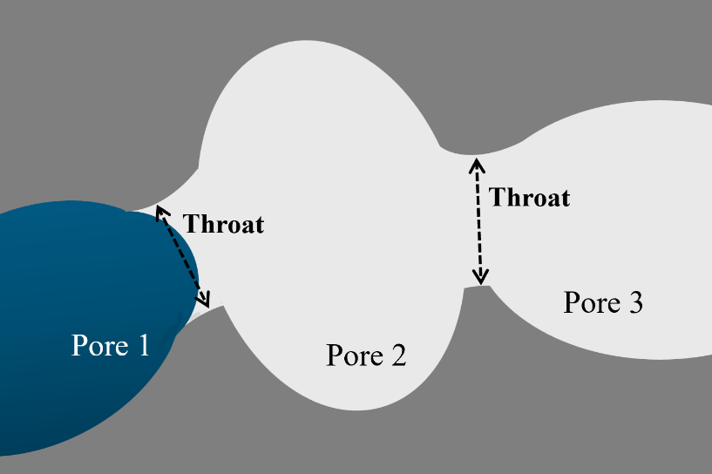

Haines jump
Notes:
Schematic of what we see happening. Greatly alter flow field compared to Darcy description

Slide 4
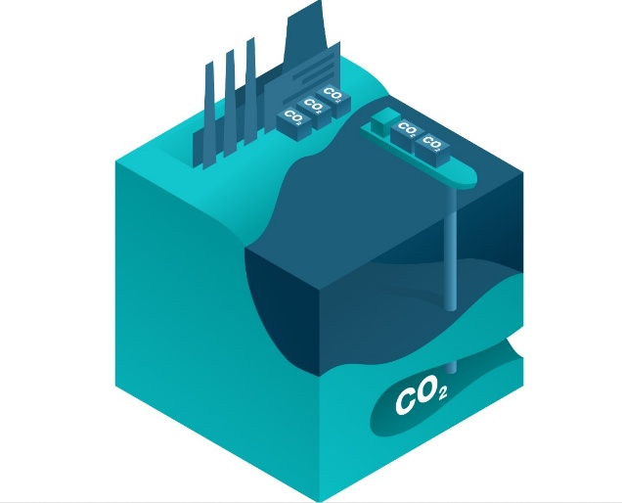
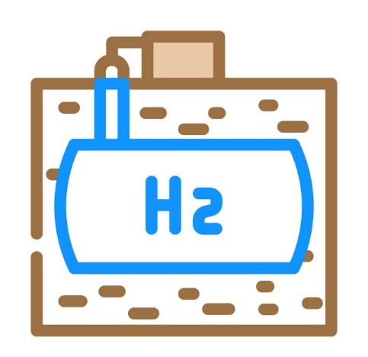
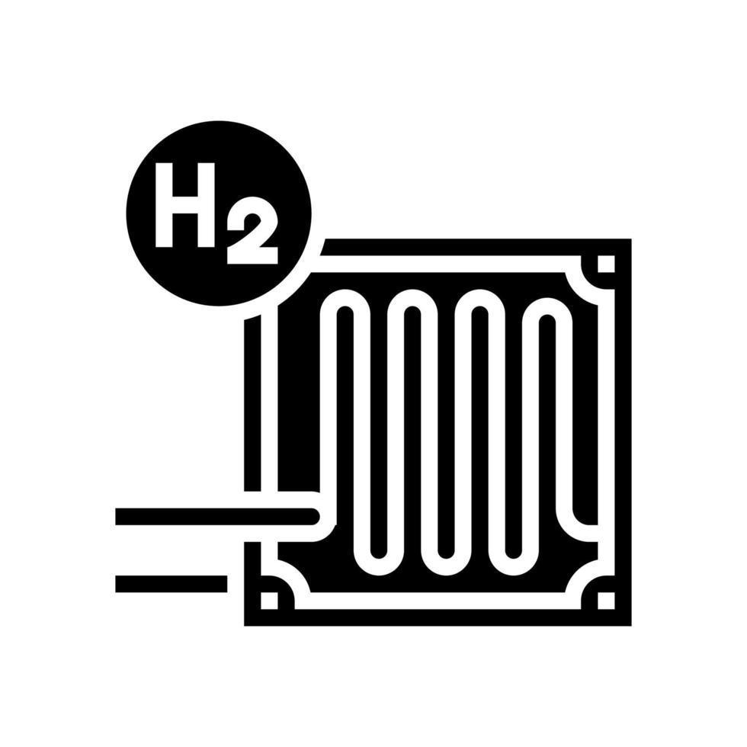
Applications
Notes:
Why do we care? Many applications -> many reasons to understand better and thus study -> different ways to do that

Slide 5
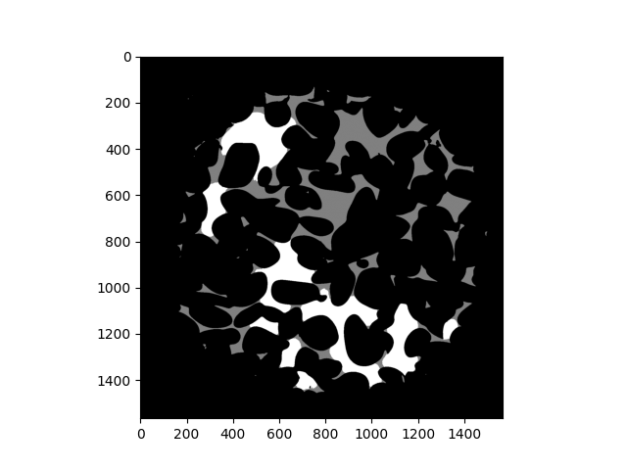
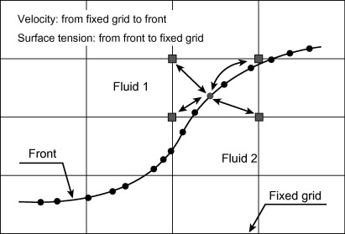
Experimental method
Numerical method
[1]
Solid
Non-wetting fluid
Wetting fluid
Notes:
Experimental data and numerically. Experimental doesn’t show pressure fields, numerical computationally heavy.

Slide 6
Methods
Extract interface from experimental data
Calculate surface tension force
Implement in flow solver
Velocimetry
[1]
Solid
Non-wetting fluid
Wetting fluid
Notes:
Instead of calculating front, extract it from image data. Interesting, numerical supervisor calls it a flow solver aided by image data, professor who supplied data says it is extended data processing using a flow solver.

Slide 7
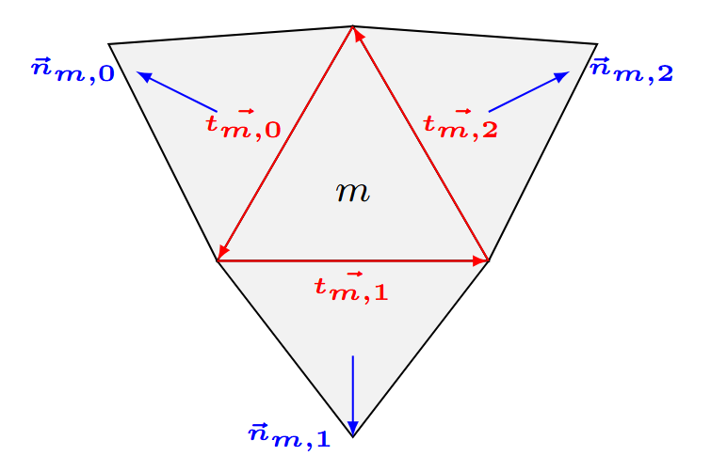
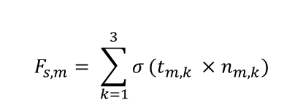
Pull-force method
Calculate force on surface through discretization over elements
$$F_{s,m}= \sum_{k=1}^{3}{σ}(t_{m,k} ×{ n}_{m,k})$$
[2]: Van Sint Annaland M, Dijkhuizen W, Deen NG, and Kuipers JA. Numerical simulation of behavior of gas bubblesusing a 3-D front-tracking method. AIChE Journal 2006 Jan; 52:99–110. DOI: 10.1002/aic.10607
Notes:
Pull force method, approximate interface fluid-fluid using triangular elements. Main part of method, static pressure analysis

Slide 8
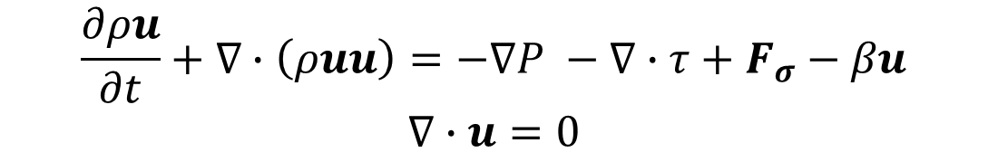
Flow solver
$$\frac{∂ρu}{∂t}+∇∙\left(ρuu\right)=−∇P −∇∙τ+F_{σ}−βu$$
$$∇∙u=0$$
Notes:
Now we have surface tension force, but let’s advance this using flow solver

Slide 9
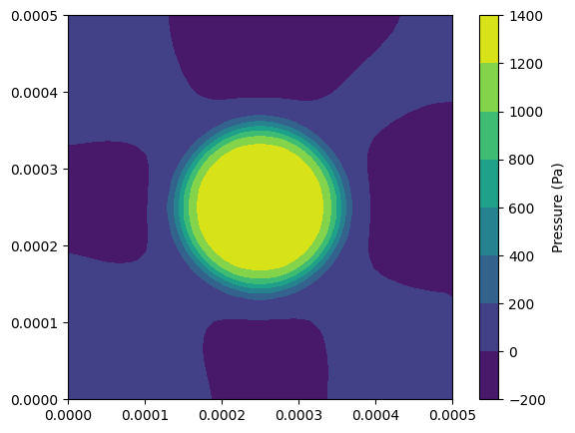
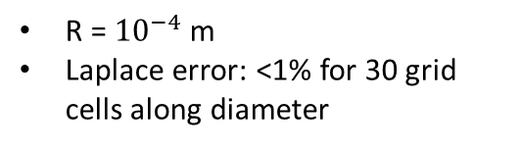
Static droplet
R = ${10}^{−4}$m
Laplace error: <1% for 30 grid cells along diameter
Notes:
Pause!! Then only looked at pressure fields, what would we expect the velocity fields to be?

Slide 10
Experimental data
Solid
Non-wetting fluid
Wetting fluid
Notes:
Let’s make it more complicated, real image data from Bultreys

Slide 11
Experimental data
Solid
Non-wetting fluid
Wetting fluid
Notes:
Let’s make it more complicated, real image data from Bultreys

Slide 12
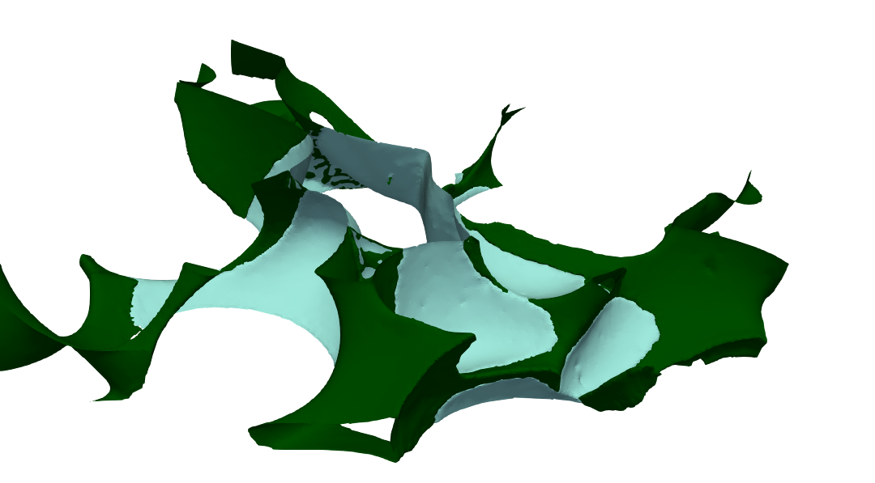
Static pressure analysis
Solid
Non-wetting fluid
Wetting fluid
Notes:
Solid is transparent

Slide 13
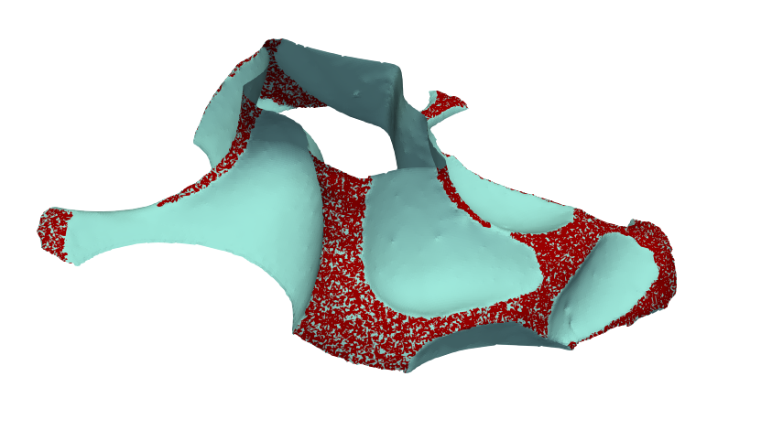
Static pressure analysis
Solid
Non-wetting fluid
Interface
Notes:
Interfaces identified, in expected range

Slide 14
Static pressure analysis
Expected pressure: ±420 Pa
Highest numerical pressure: 640 Pa
Solid
Non-wetting fluid
Interface
Notes:
Interfaces identified, in expected range. Localized pressure directly from pull force method

Slide 15
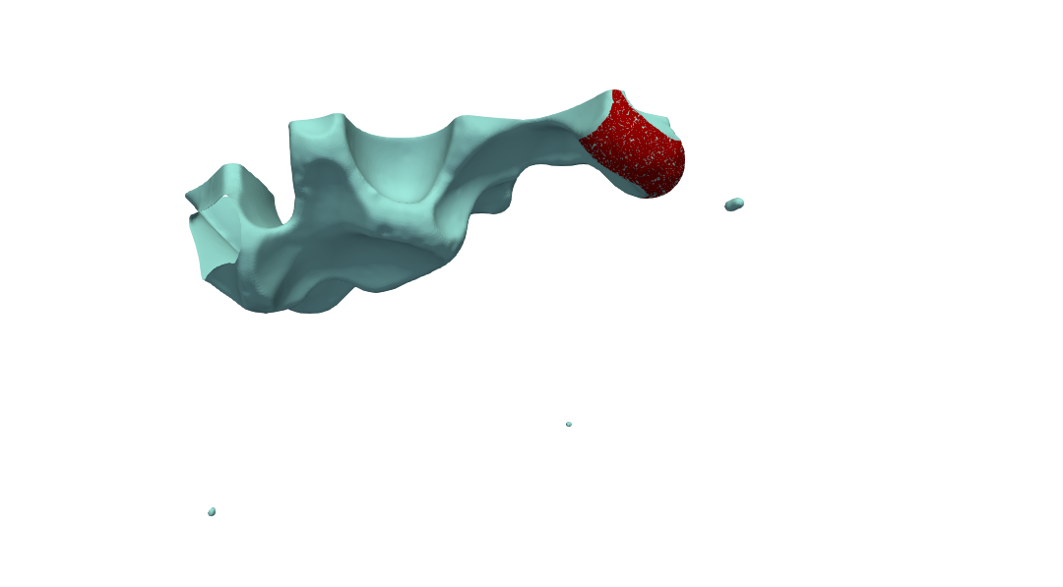
Static pressure analysis
Solid
Non-wetting fluid
Interface
Notes:
Identify separate elements and blobs -> pressure analysis

Slide 16
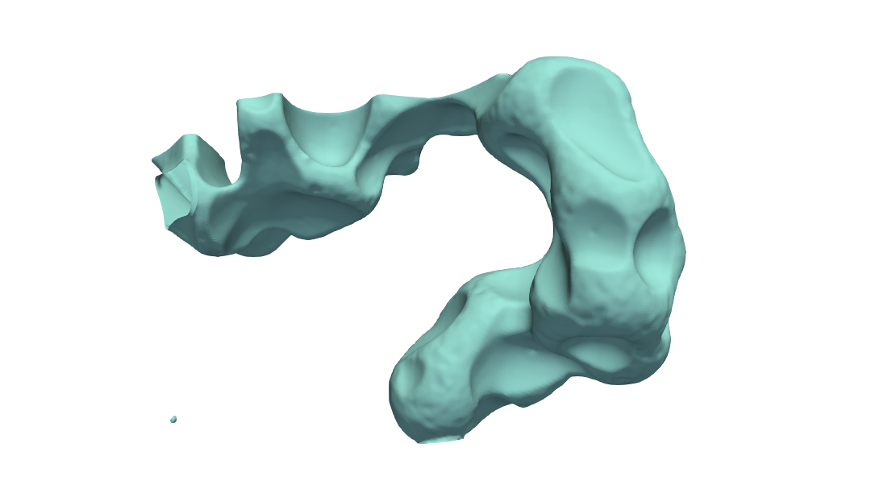
Static pressure analysis
Notes:
Identify separate elements and blobs -> pressure analysis

Slide 17
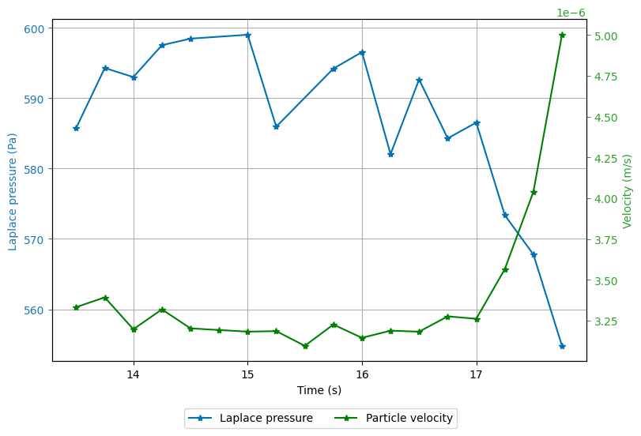
Energy conversion
Pressure change interface
Velocimetry velocity data
(μm/s)
Notes:
Pressure decreases thus curvature decrease, converted to kinetic energy. Belangrijke slide! Add legenda.

Slide 18
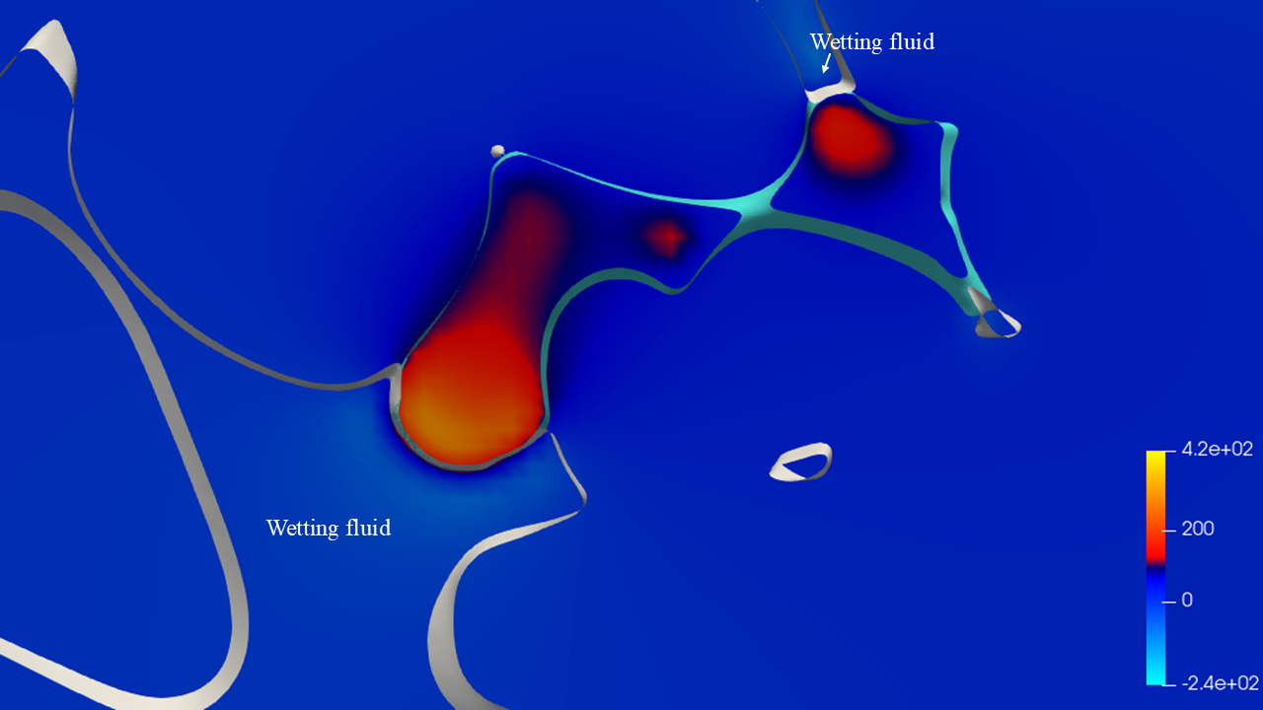
Flow solver
Notes:
Identify separate elements and blobs -> pressure analysis

Slide 19
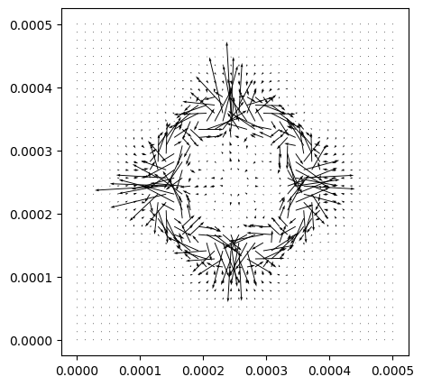
Static droplet

Slide 20
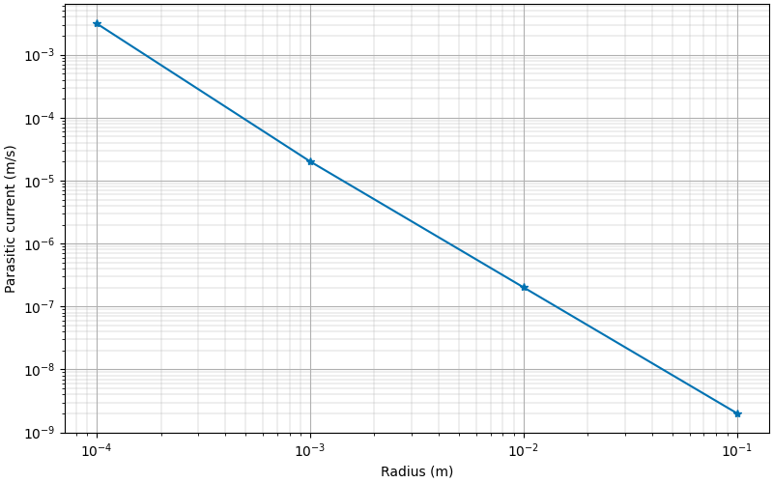
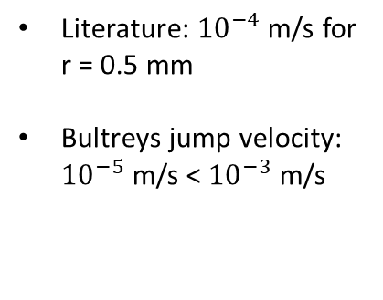
Static droplet
Literature: ${10}^{−4}$ m/s for r = 0.5 mm
Bultreys jump velocity: ${10}^{−5}$ m/s < ${10}^{−3}$ m/s

Slide 21

Conclusion and outlook
Open-source code to calculate pressure and velocity fields from image data
Reduce parasitic currents
Energy dissipation
Notes:
Tool shows lot of potential but issues need to be adressed. Take pause here to stress ending.

Slide 22
ME engineering, Energy technology

