Slide 1

Predicting Multiphase Transport in Technical Textiles via CFD
Bianca E., Perugini A., Beiginalou G., Ferri A., Marchisio, D., Boccardo G.

Slide 2
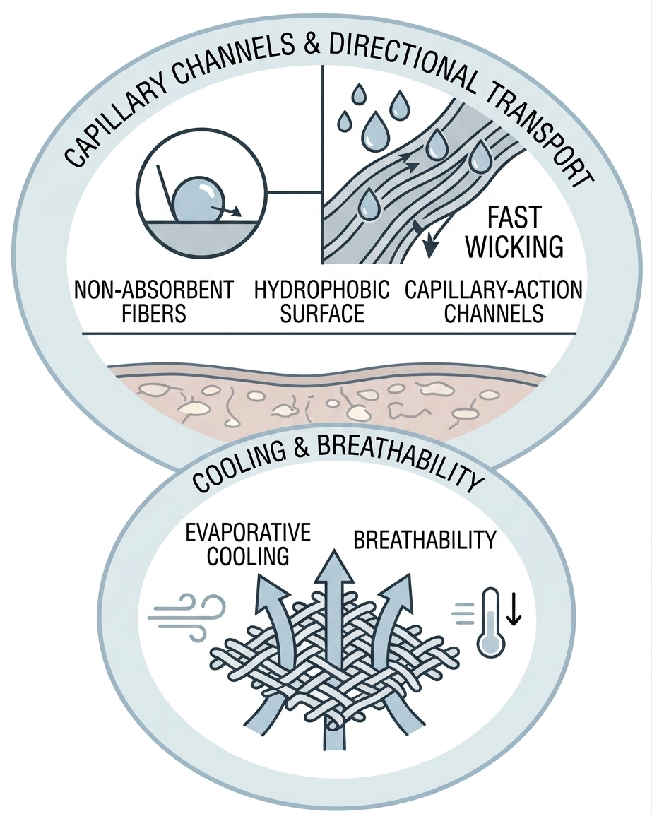
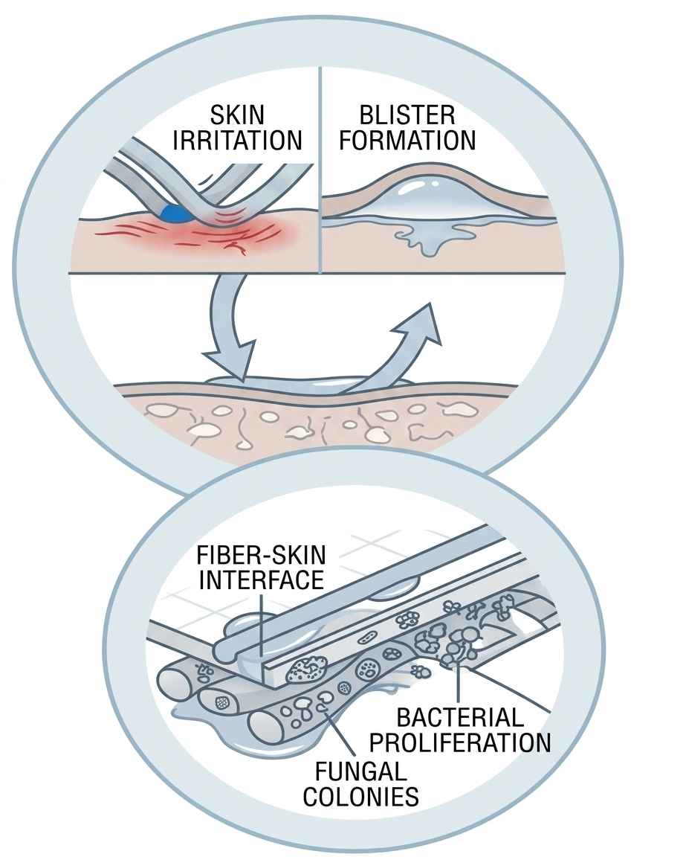
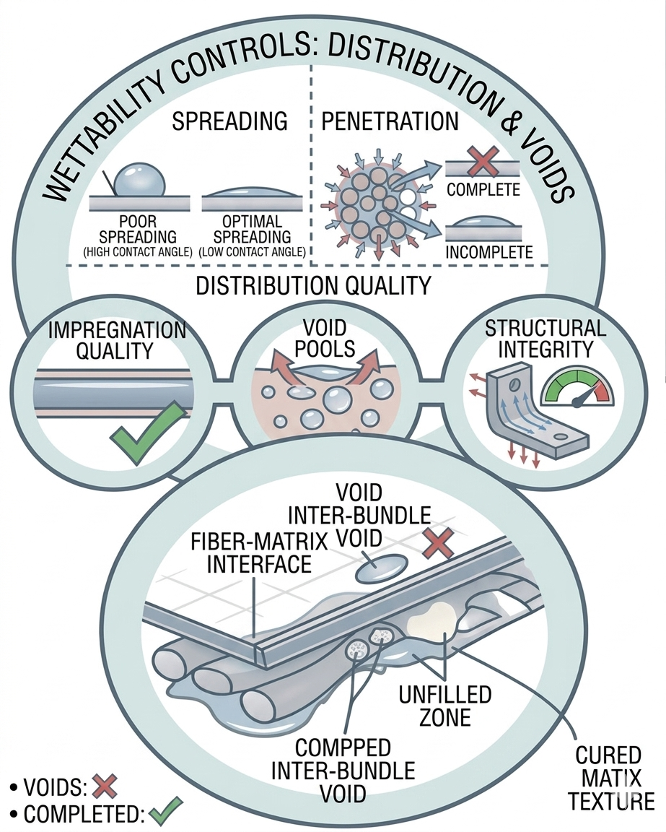
Relevance of Water–Fabric Interactions
MOISTURE TRANSPORT
&
THERMAL COMFORT
SKIN HEALTH
&
HYGIENE
COMPOSITE MANUFACTURING
&
MATERIAL INTEGRITY
Controls sweat transport, cooling and breathability.
Excess moisture increases friction, irritation, and microbial risk.
Controls resin flow, void formation, and final mechanical properties.
Predicting Multiphase Transport in Technical Textiles via CFD
Bianca E., Perugini A., Beiginalou G., Ferri A., Marchisio D., Boccardo G.\

Slide 3
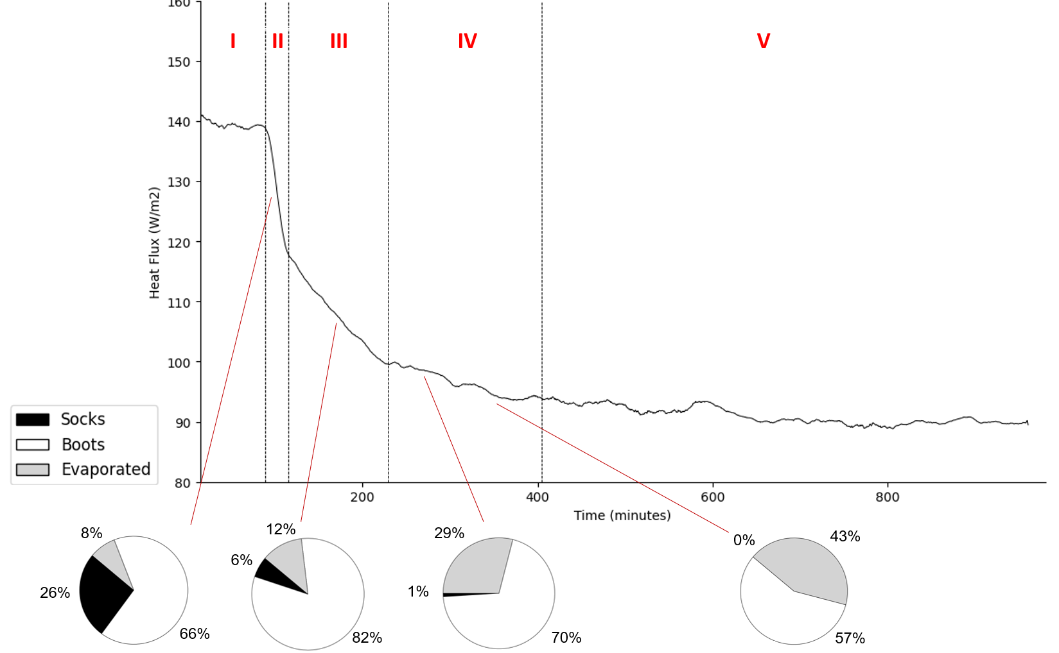
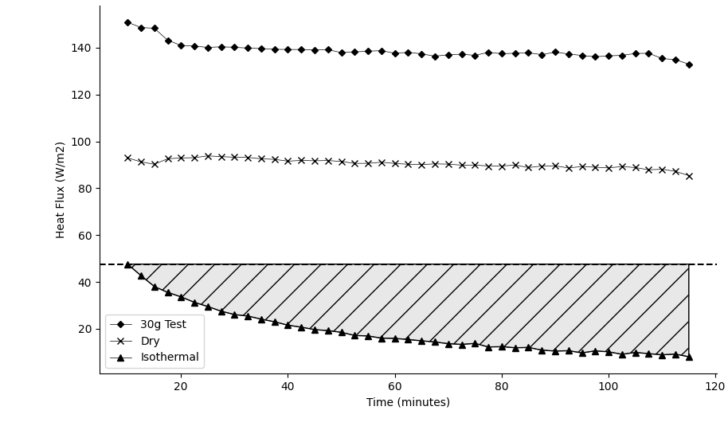


Experimental Evidence: Water Cycle in Textiles
160
Socks
140
Boot
Evaporation alone does not explain heat loss due to condensation and internal redistribution¹.
Evaporated
Heat flux ($\frac{W}{m^{2}}$)
120
100
140
120
80
Time (min)
100
Heat flux ($\frac{W}{m^{2}}$)
80
60
Moisture transport evolves through distinct phases with a changing in dominant mechanism¹.
40
20
Time (min)
[1] Bianca, Eleonora, et al. "Heat and mass transfer in footwear: Exploring the moisture evaporation and condensation cycle." Journal of Industrial Textiles 55 (2025): 15280837251325783.
Predicting Multiphase Transport in Technical Textiles via CFD
Bianca E., Perugini A., Beiginalou G., Ferri A., Marchisio D., Boccardo G.
Notes:
These results highlight that moisture behaviour cannot be described with simple metrics or steady-state assumptions. This complexity makes predictive modelling extremely challenging.

Slide 4

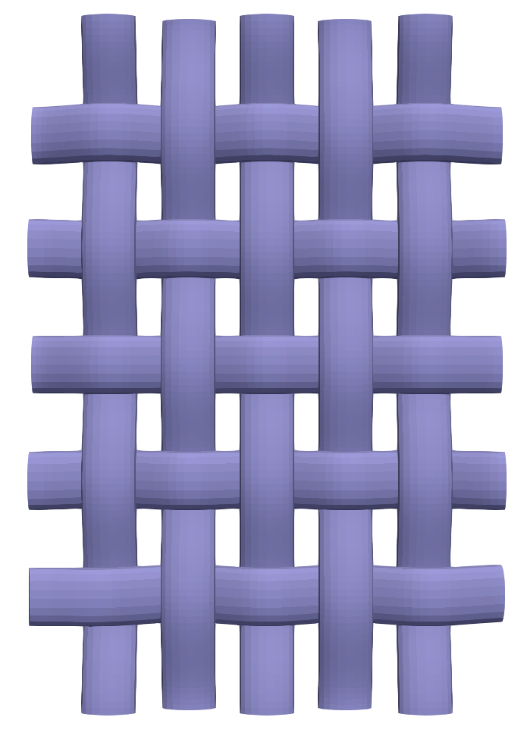
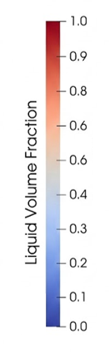
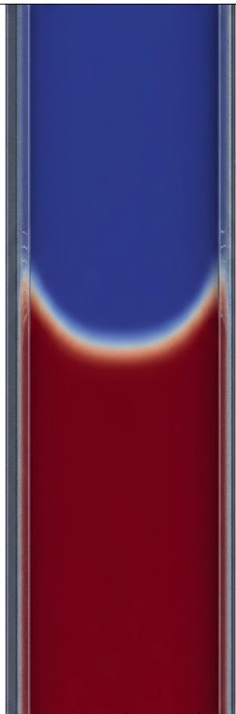
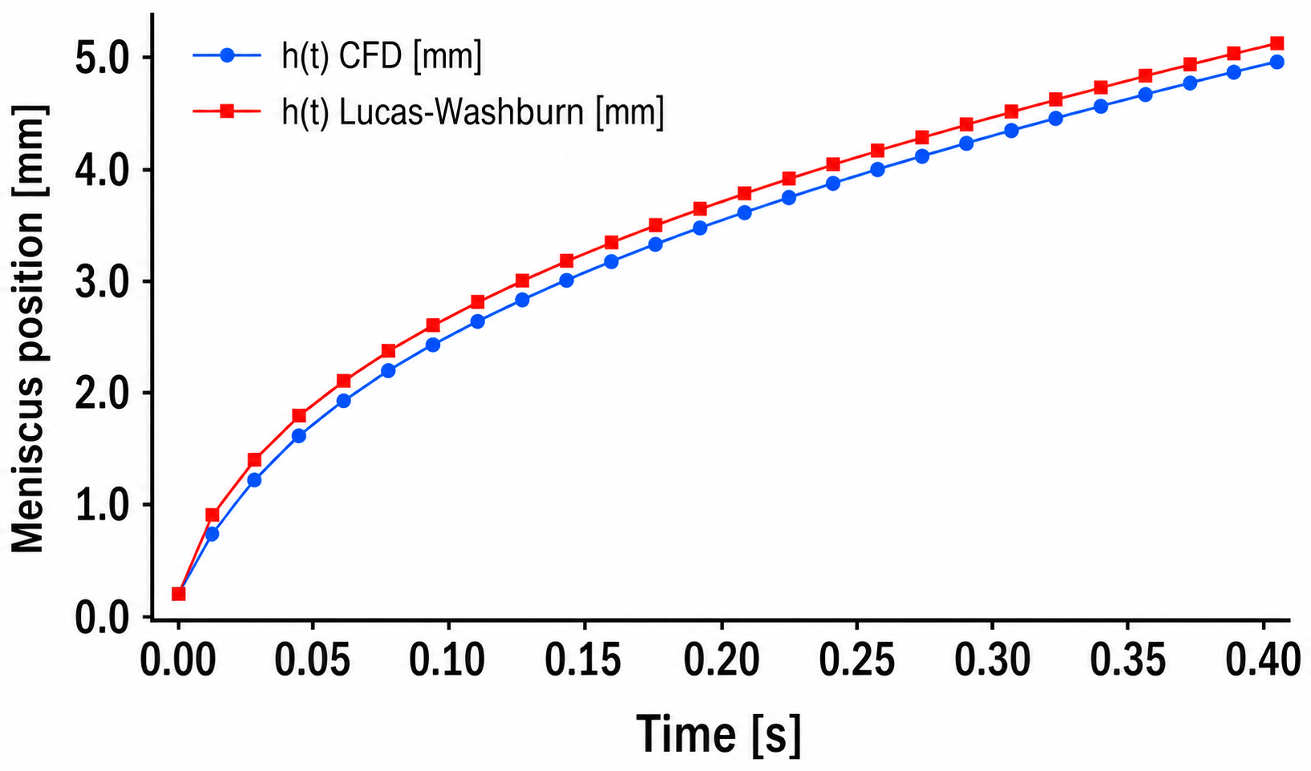


Our Approach
Building on previous work on air permeability, we adopted the same geometries².
Capillary flow was modelled using an equivalent hydraulic diameter representative of the pore structure.
Viscous regime – Lucas-Washburn⁴
$h^{2}=\frac{σRcosθ}{2μ}$t
$$t>τ$$
[2] Bianca, Eleonora, et al. "CFD and Machine Learning Approaches for Predicting Air Permeability in Technical Textiles." Textiles 6.1 (2026): 9.
[3] Schoelkopf, Joachim, et al. "Influence of Inertia on Liquid Absorption into Paper Coating Structures." Nordic Pulp & Paper Research Journal, vol. 15, no. 5, 2000, pp. 422-430.
[4] Quéré, D. (1997). Inertial capillarity. Europhysics Letters (EPL), 39(5), 533-538.
Predicting Multiphase Transport in Technical Textiles via CFD
Bianca E., Perugini A., Beiginalou G., Ferri A., Marchisio D., Boccardo G.
Notes:
Tau is the transition time between the visco-inertial and the viscous stage

Slide 5
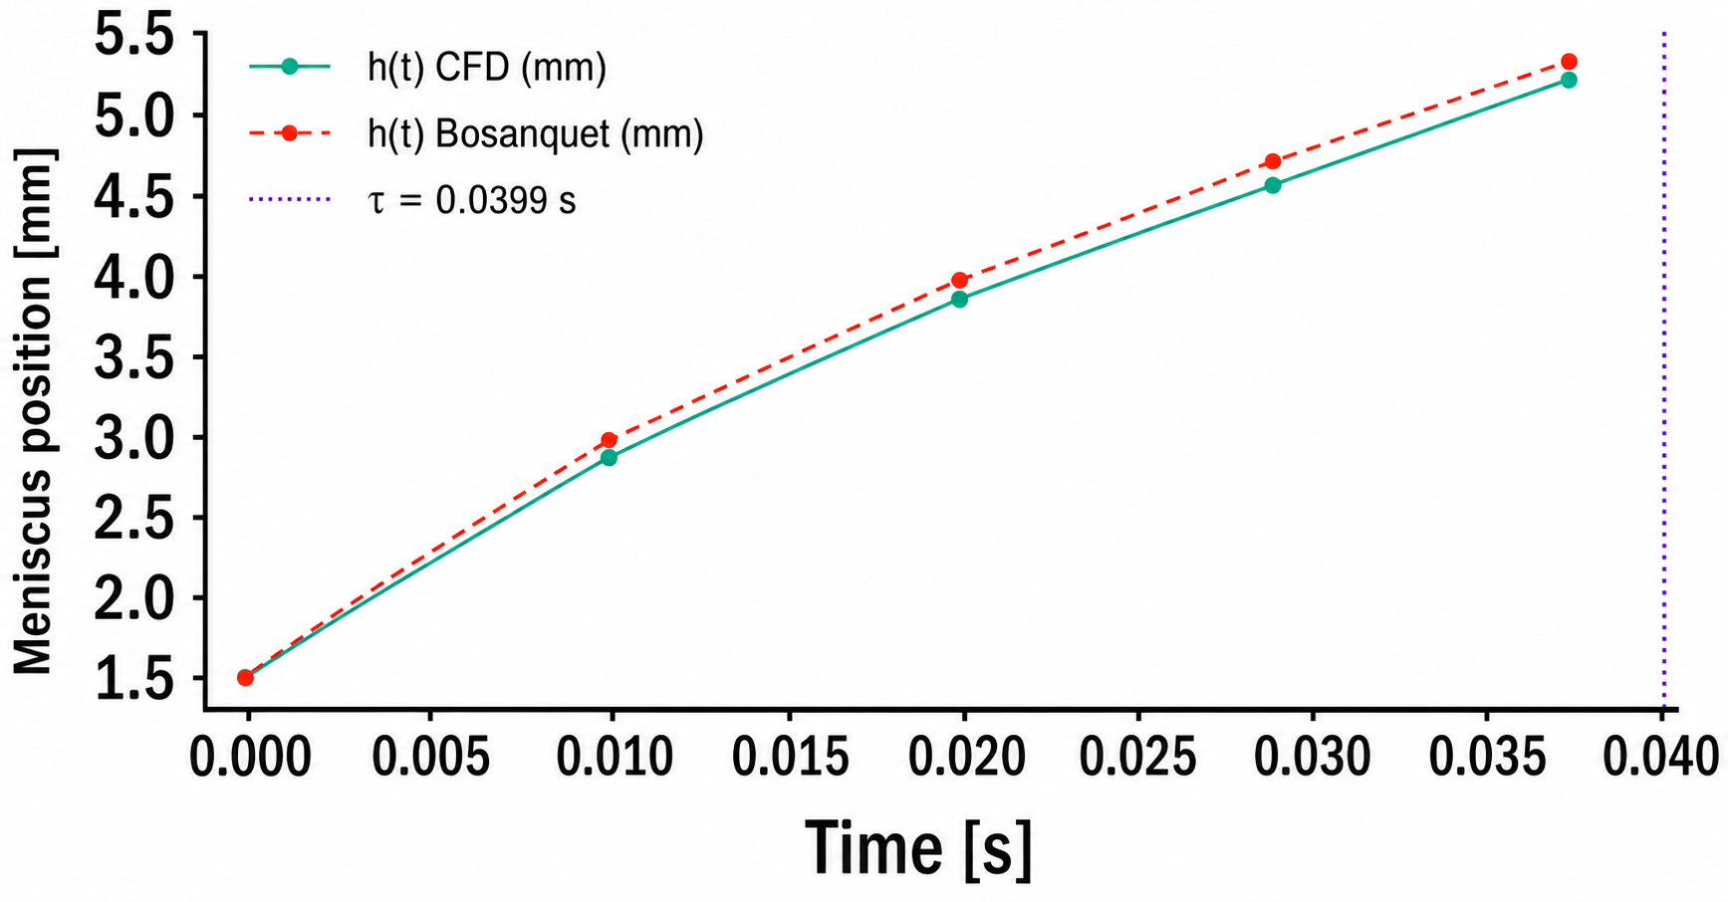


Our Approach
Building on previous work on air permeability, we adopted the same geometries².
Capillary flow was modelled using an equivalent hydraulic diameter representative of the pore structure.
Viscous regime – Lucas-Washburn⁴
Visco-inertial regime – Bousanquet³
$$h^{2}=\frac{2b}{a}\left[t−\frac{1}{a}(1−e^{−at}\right]$$
$h^{2}=\frac{σRcosθ}{2μ}$t
$$t>τ$$
$$0<t≪τ$$
[2] Bianca, Eleonora, et al. "CFD and Machine Learning Approaches for Predicting Air Permeability in Technical Textiles." Textiles 6.1 (2026): 9.
[3] Schoelkopf, Joachim, et al. "Influence of Inertia on Liquid Absorption into Paper Coating Structures." Nordic Pulp & Paper Research Journal, vol. 15, no. 5, 2000, pp. 422-430.
[4] Quéré, D. (1997). Inertial capillarity. Europhysics Letters (EPL), 39(5), 533-538.
Predicting Multiphase Transport in Technical Textiles via CFD
Bianca E., Perugini A., Beiginalou G., Ferri A., Marchisio D., Boccardo G.
Notes:
Tau is the transition time between the visco-inertial and the viscous stage

Slide 6
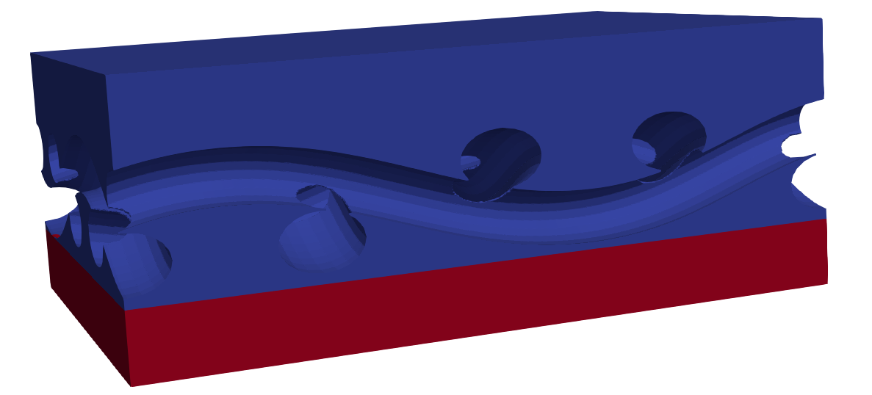
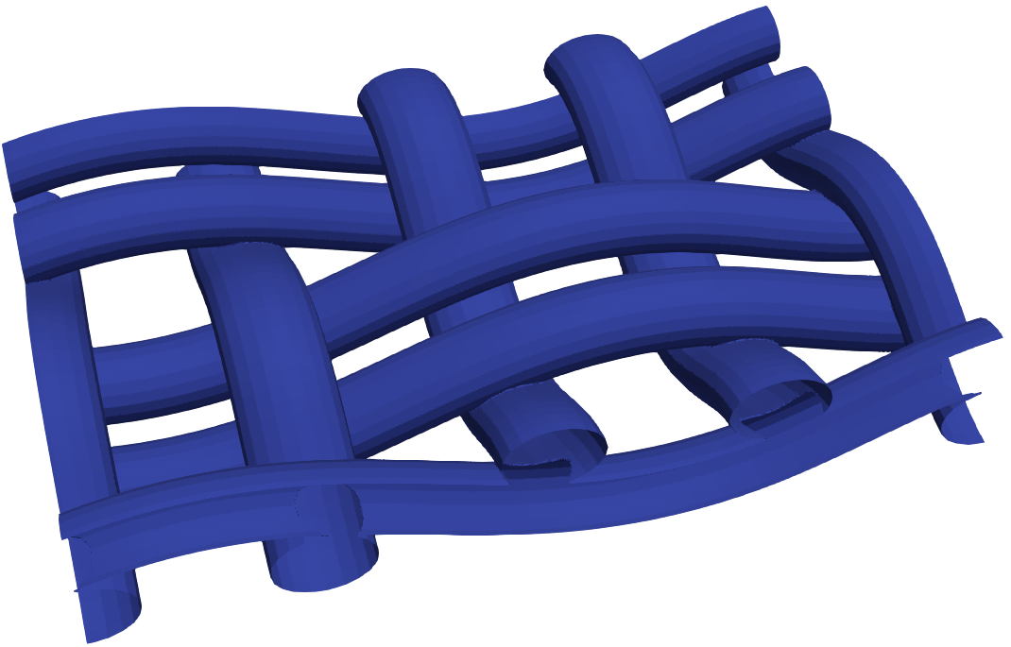
Numerical Setup
The computational domain was divided into three regions to capture the capillary-driven transport across the fabric thickness.
The setup ensures that flow is driven solely by capillary effects.
Water
PRESSURE FIELD
Uniform initial condition;
Fixed pressure at inlet and outlet;
Zero-flux condition at walls.
Dry fabric
TOP air zone
FABRIC zone
WATER reservoir
VELOCITY FIELD
Pressure-driven inlet/outlet condition;
No-slip condition at walls
Predicting Multiphase Transport in Technical Textiles via CFD
Bianca E., Perugini A., Beiginalou G., Ferri A., Marchisio D., Boccardo G.

Slide 7
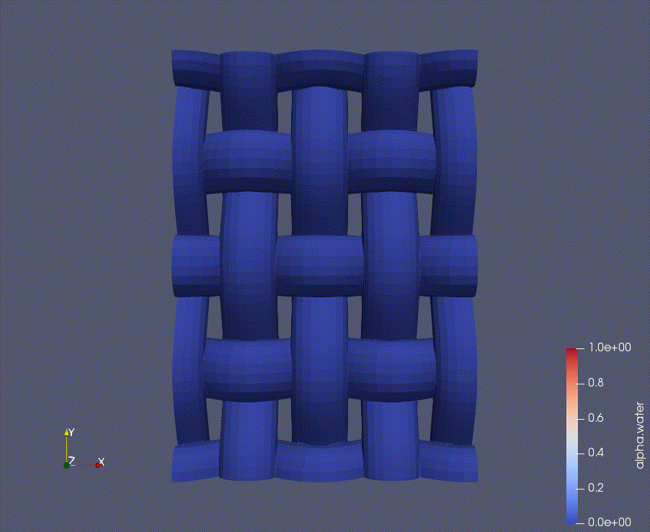
Numerical Setup
Starting from a single pore of the full geometry, capillary rise was first investigated at the mesoscale.
The domain was then extended to the fabric Representative Elementary Volume (REV).
Water
Surface wettability assumptions
Contact angle fixed and homogeneous.
Two representative cases:
  Hydrophilic surface (θ = 40°)
  Less wetting surface (θ = 80°)
Dry fabric
This assumption isolates the effect of wettability, neglecting dynamic contact angle and hysteresis.
Predicting Multiphase Transport in Technical Textiles via CFD
Bianca E., Perugini A., Beiginalou G., Ferri A., Marchisio D., Boccardo G.
Notes:
θ più basso → maggiore forza capillare
→ avanzamento più rapido
→ penetrazione più uniforme
Tradotto per slide:
“Wettability directly controls capillary driving forces and penetration rate.”
contatto reale ≠ costante
nei tessuti:
roughness
heterogeneity
hysteresis
quindi:
“Real fabrics exhibit heterogeneous and dynamic wetting behavior not captured in this model.”
The simplified approach allows controlled comparison between material behaviors.

Slide 8
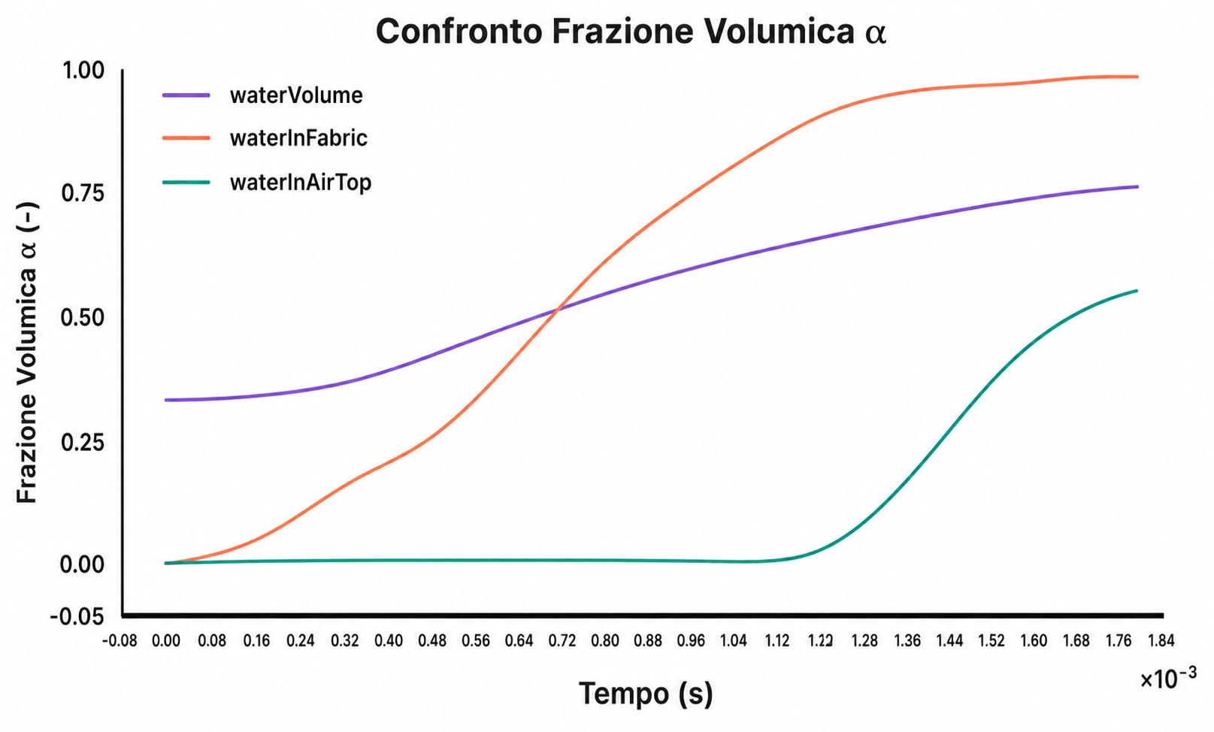

Breakthrough Time and Wettability
Breakthrough time was evaluated as the onset of water in the top air region.
Hydrophilic fabric (θ = 40°)
1.00
Water in TOP
Water in FABRIC
Water VOLUME
Capillary-driven transport behaviour:
Initial delay due to pore-filling.
Rapid saturation of the fabric structure.
Breakthrough occurs once capillary pathways are established.
0.75
Volume fraction α (-)
0.50
0.25
0.00
0.00
0.50
1.00
1.50
1.80
Time (s)
$${∙10}^{−3}$$
High wettability enables efficient liquid transport across the fabric. Still, a breakthrough is governed by the formation of connected capillary pathways.
Predicting Multiphase Transport in Technical Textiles via CFD
Bianca E., Perugini A., Beiginalou G., Ferri A., Marchisio D., Boccardo G.

Slide 9
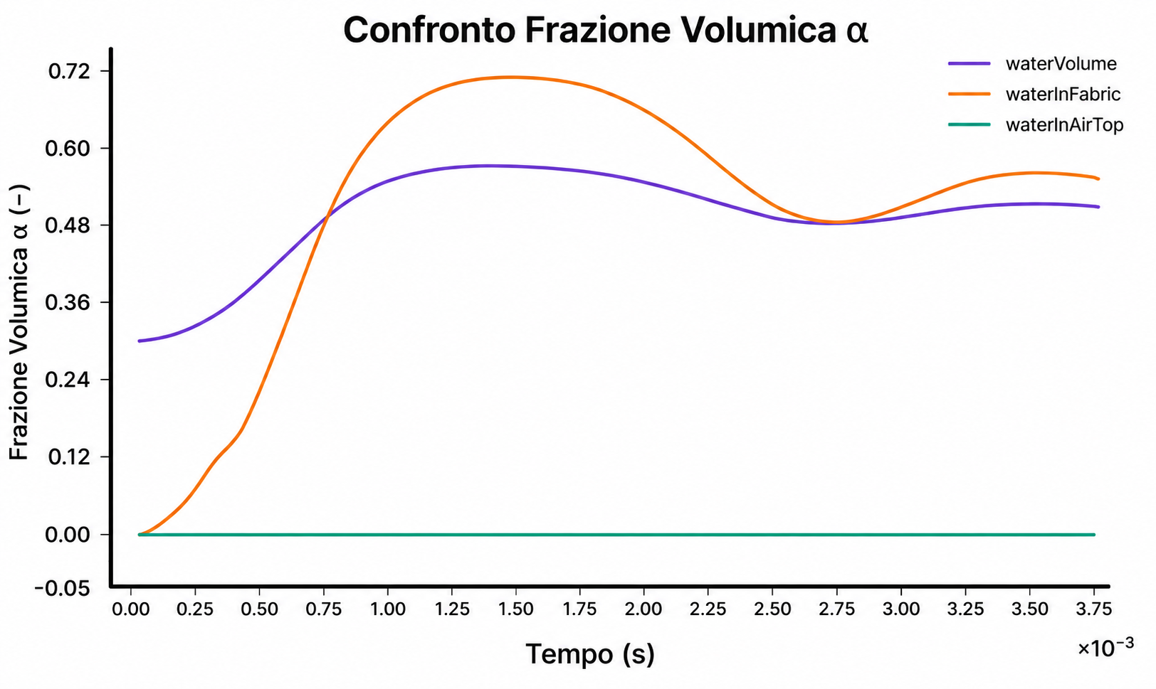
Breakthrough Time and Wettability
Breakthrough time was evaluated as the onset of water in the top air region.
Hydrophobic fabric (θ = 80°)
Water in TOP
0.75
Water in FABRIC
Water VOLUME
Capillary-driven transport behaviour:
Initial penetration is limited by low capillary forces.
Partial saturation of the fabric structure.
No Breakthrough liquid does not reach the top region.
0.5
Volume fraction α (-)
0.25
0.00
0.00
1.00
1.75
3.00
3.80
Time (s)
$${∙10}^{−3}$$
Low wettability leads to liquid trapping and prevents through-thickness transport.
Predicting Multiphase Transport in Technical Textiles via CFD
Bianca E., Perugini A., Beiginalou G., Ferri A., Marchisio D., Boccardo G.
Notes:
In this case, the liquid is able to enter the structure, but capillary forces are not sufficient to sustain upward transport. As a result, water redistributes within the fabric without reaching the top region.
In absence of structural and surface engineering, low wettability alone is not sufficient to ensure liquid transport.
In real textiles, efficient moisture transport is not achieved by wettability alone, but by the interplay between surface properties and engineered pore structure.

Slide 10
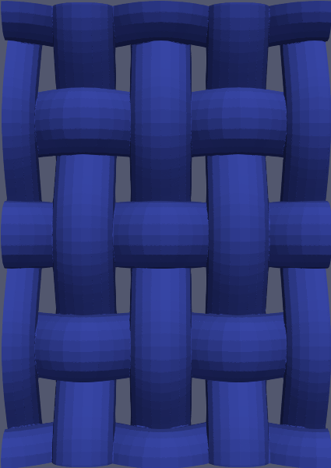
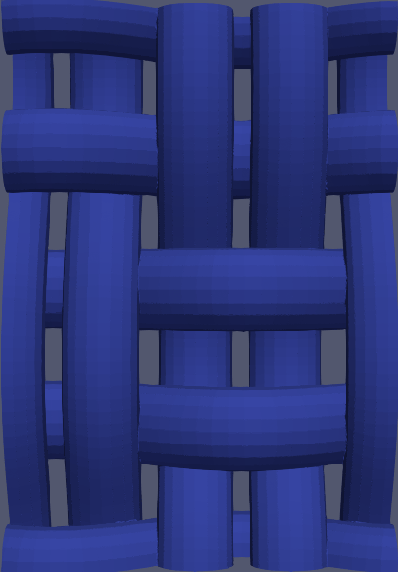
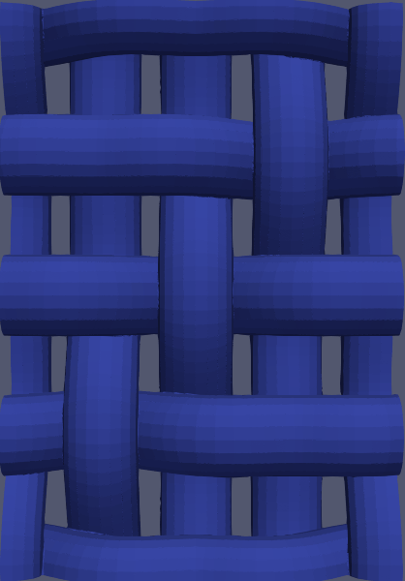
Role of Fabric Structure in Capillary Transport
Geometry controls connectivity, which ultimately governs whether transport is uniform or channel-dominated.
PLAIN WEAVE
BASKET WEAVE
TWILL
Uniform distribution
Multiple pathways
Faster spreading
Preferential channels
Localised transport
Delayed spreading
Anisotropic flow
Channelling
Heterogeneous
Predicting Multiphase Transport in Technical Textiles via CFD
Bianca E., Perugini A., Beiginalou G., Ferri A., Marchisio D., Boccardo G.
Notes:
After isolating wettability, we investigated the role of textile architecture. Keeping the same contact angle, differences in water evolution can be attributed to pore connectivity, local hydraulic diameter, and tortuosity.
Even with the same contact angle, the liquid follows completely different pathways depending on the fabric architecture. In some cases, transport is distributed across multiple pores, while in others it is confined to preferential channels, leading to heterogeneous saturation.
Different architectures promote different transport mechanisms rather than universally better performance. Capillary pathways correspond to connected pore spaces that allow continuous liquid advancement.
In the first structure, transport is distributed across multiple pathways. In the second, flow becomes channelized, with liquid moving through preferential paths. In the third, poor connectivity leads to heterogeneous and inefficient transport.

Slide 11
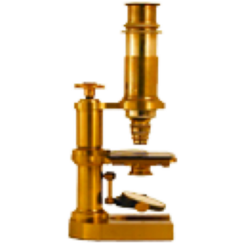
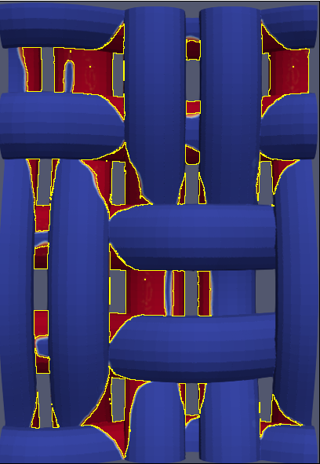
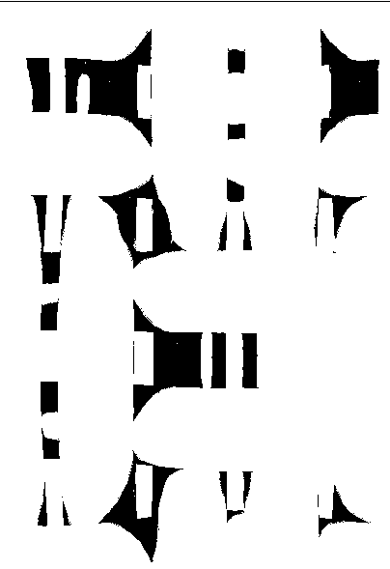


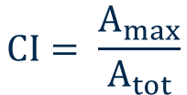

Role of Fabric Structure in Capillary Transport
Geometry controls connectivity, which ultimately governs whether transport is uniform or channel-dominated.
$$A_{i}=area of cluster i$$
$$CI= \frac{A_{max}}{A_{tot}}$$
$$N=cluster number$$
$$A_{tot}=\sum_{i}{A_{i}}$$
Structure | CI | N clusters | Interpretation
PW | 0.998 | 8 | continuous pathway
BW | 0.17 | 41 | fragmented
TW | 0.28 | 35 | partial connectivity
Predicting Multiphase Transport in Technical Textiles via CFD
Bianca E., Perugini A., Beiginalou G., Ferri A., Marchisio D., Boccardo G.
Notes:
A clear correlation is observed between capillary rise velocity and connectivity index: structures promoting continuous liquid pathways exhibit faster invasion dynamics.
La struttura controlla la connettività che a sua volta influenza la veloicità.

Slide 12

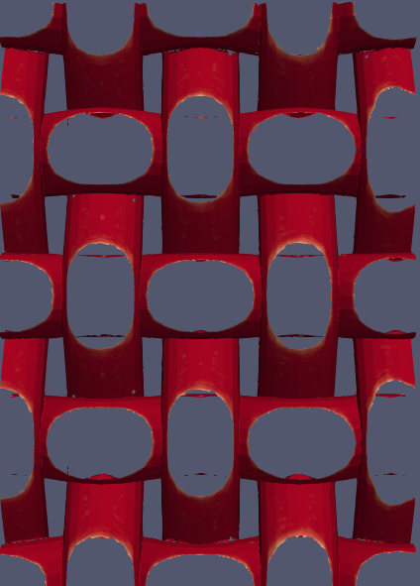
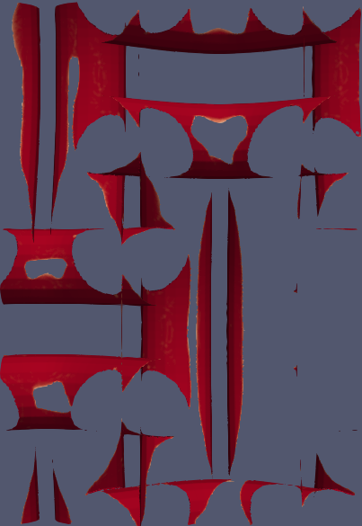
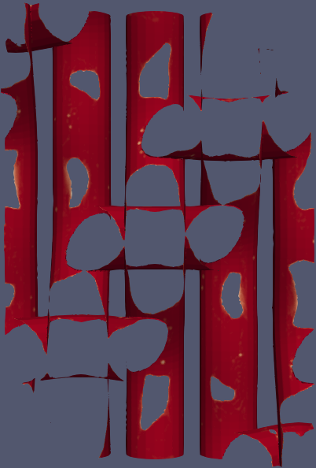
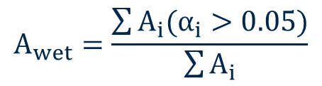

Capillary Rise vs Surface Spreading
Fabric architecture controls both capillary rise dynamics and surface distribution.
Structure | Rise velocity [α/s] | Relative to PW
PW | 810.0 | 100%
BW | 680.5 | −16.0%
TW | 721.5 | −10.9%
Water penetration through the fabric thickness across different fabric structures.
$$A_{wet}=\frac{\sum{A_{i}(α_{i}>0.05)}}{\sum{A_{i}}}$$
$$α=α_{water}$$
Structure | Water area [%] | Interpretation
PW | 62.3% | distributed
BW | 20.33% | localised
TW | 41.2% | intermediate
PW
BW
TW
Predicting Multiphase Transport in Technical Textiles via CFD
Bianca E., Perugini A., Beiginalou G., Ferri A., Marchisio D., Boccardo G.
Notes:
While rise velocity characterises internal capillary invasion, surface spreading reveals how efficiently the liquid redistributes across the structure.
At fixed wettability, fabric architecture significantly affects capillary invasion dynamics: plain weave promotes the fastest water rise, while basket weave shows the slowest response.
Capillary rise alone is not sufficient to describe performance, as different structures exhibit similar invasion but very different surface spreading.

Slide 13
Conclusions & Future Work
Conclusions:
Fabric architecture controls both capillary rise and surface distribution;
Velocity alone is not sufficient: connectivity and spreading determine performance;
Different structures lead to distinct transport regimes (distributed vs channelling).
Limitations:
Simplified model: no fibre porosity and no absorption within yarns
Future Work:
Multiscale modelling: Incorporate fibre-level porosity to capture absorption mechanisms
Surrogate modelling: Enabling fast prediction of capillary behaviour across textile designs;
Coupled heat and mass transfer: Integration with existing air permeability models for full textile characterisation.
Predicting Multiphase Transport in Technical Textiles via CFD
Bianca E., Perugini A., Beiginalou G., Ferri A., Marchisio D., Boccardo G.
Notes:
The ultimate goal is to move from descriptive analysis to predictive design of textile performance.

Slide 14
Thank You
For your attention

