Slide 1



Manifold Tortuosity for Heterogeneous Microstructures Characterisation
J. Chaniot, M. Moreaud, L. Sorbier,
J.-M. Becker, T. Fournel, Y. Gavet

Slide 2
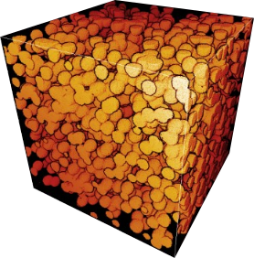
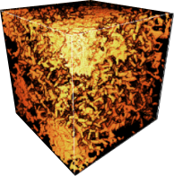
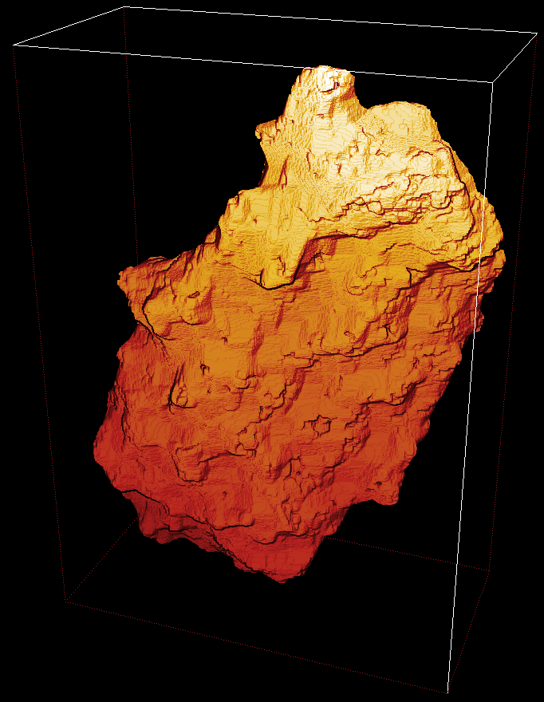
CONTEXT
Manifold Tortuosity for Heterogeneous Microstructures Characterisation
Real porous microstructures analysis requires:
Complex Situations handling
Aggregation Phenomenon sensitivity
TORTUOSITY
→
→
Aggregation
[0] plugIm!, https://www.plugim.fr/
[1] Batista A.T.F., […] Chaniot J et al. (2020). ACS Catalysis

Slide 3
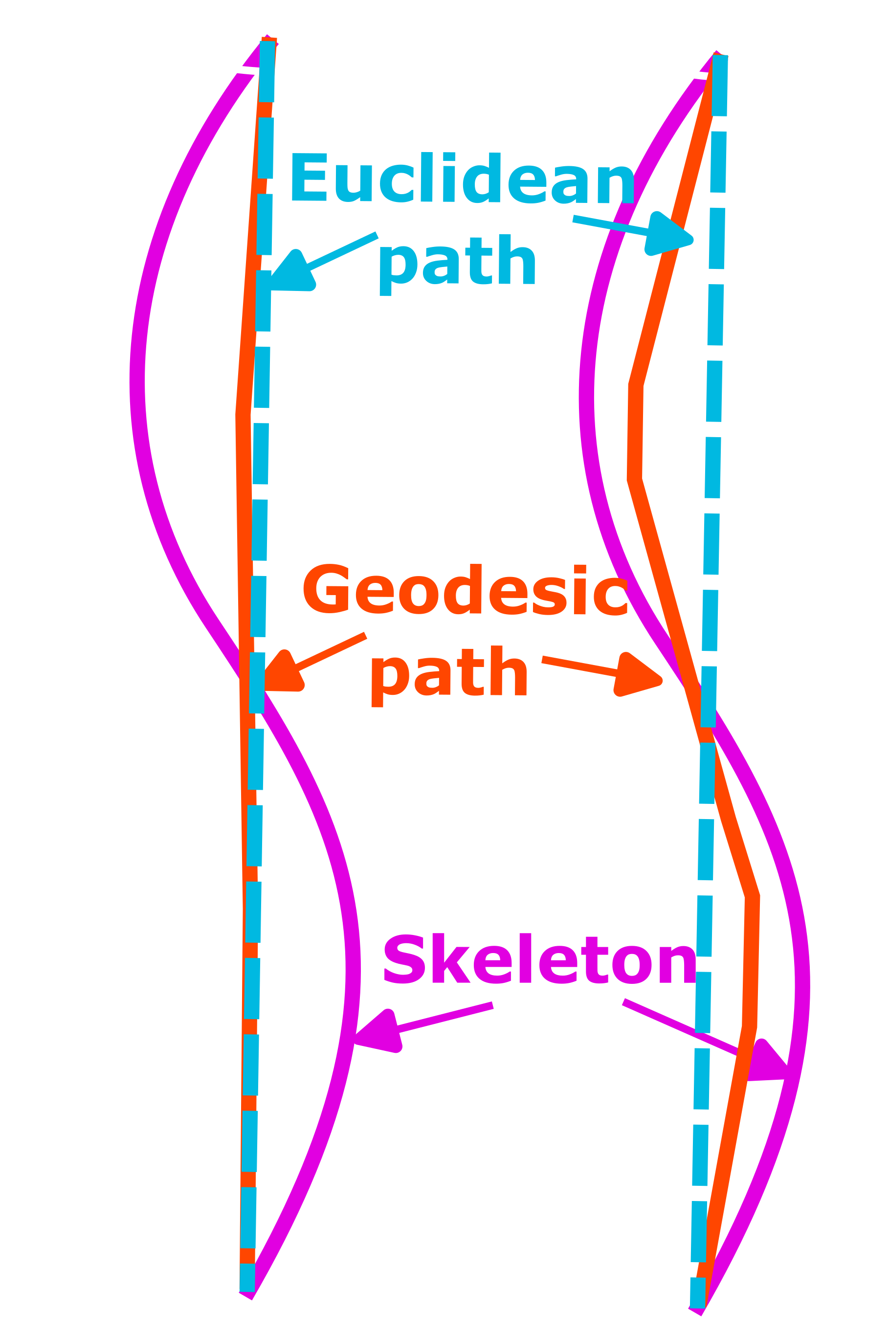
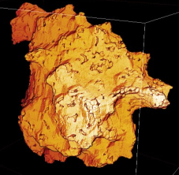
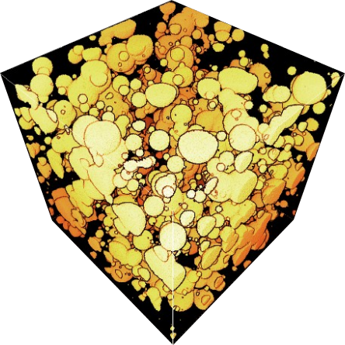
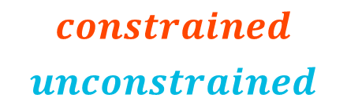



WHY TORTUOSITY?
Manifold Tortuosity for Heterogeneous Microstructures Characterisation
Why? Object’s structure ↔ Use properties
Transports in Materials Science
Aggregation Phenomenon…
Tortuosity
$$τ=\frac{D_{G}}{D} →$$
$$\frac{constrained}{unconstrained}$$
Complex Situations handling
Aggregation Phenomenon sensitivity
[2] Dullien, F.A.L. (1979). Academic press / [3] Digne, M. (2013). Editions Technip / [4] Bara, C. (2015). Thèse de doct. / [5] Serra J (1980). Computer Graphics and image Processing / [6] Matheron G (1967). Eléments pour une théorie des milieux poreux / [7] Mecke K et Arns CH (2005). Journal of Physics: Condensed Matter / [8] Garcia E (2012). Thèse de doct. / [9] Matéos M-J et al. (2024). BMC Medical Imaging / [10] Chaniot J et al. (2020). Image Analysis & Stereology / [11] Carman, P.C. (1937). Transactions-Institution of Chemical Engineeres / [12] Clennell MB (1997). Geological Society / [13] Ghanbarian B et al. (2013b). Soil science society of America journal / [14] Holzer L et al. (2023). Tortuosity and Microstructure Effects in Porous Media: Classical Theories, Empirical Data and Modern Methods

Slide 4
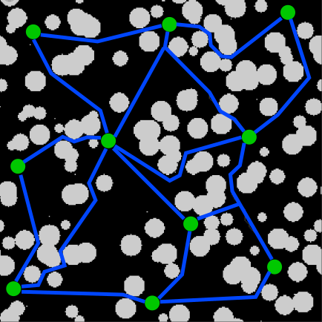
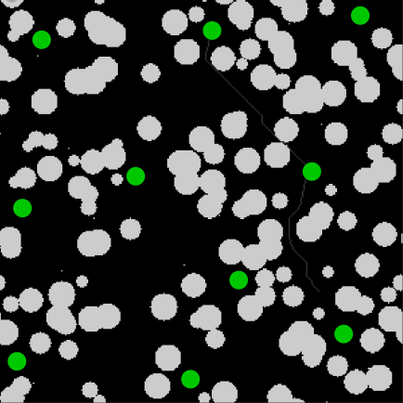
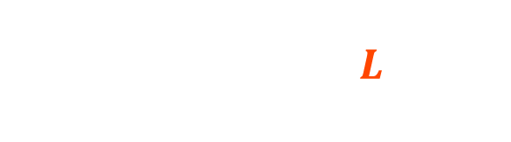

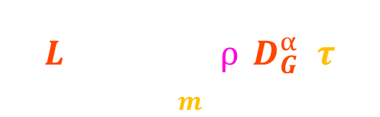
MANIFOLD TORTUOSITY
Manifold Tortuosity for Heterogeneous Microstructures Characterisation
M-tortuosity characterization
Stochastic point sampling in the microstructure to analyze
Local insights (one per point):
Paths between points → scalar value
Representative tortuosity (average) :
Final scalar value
$$L=\frac{1}{W}.\sum_{m}{ρ.D_{G}^{α}}.τ$$
Complex Situations handling
Aggregation Phenomenon sensitivity
$$τ_{M}=\frac{1}{N}.\sum{L}$$
$$W=\sum_{m}{ρ.D_{G}^{α}}$$
Boolean « percolation » value
[20] Chaniot J et al. (2024). Science and Technology for Energy Transition [21] Chaniot J et al. (2019). Image Analysis & Stereology

Slide 5
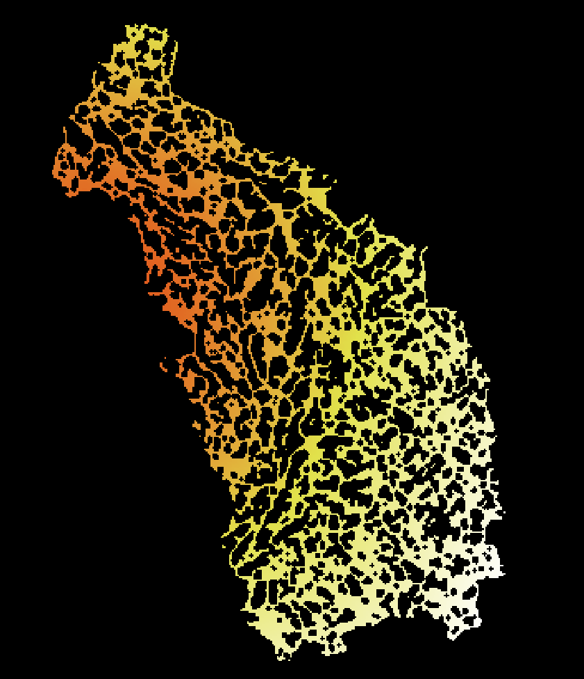
COMPLEX SITUATIONS HANDLING
Manifold Tortuosity for Heterogeneous Microstructures Characterisation
M-tortuosity characterization
Stochastic point sampling in the microstructure to analyze
Local insights (one per point):
Paths between points → scalar value
One Map per point → distribution
Representative tortuosity (average) :
Final scalar value
Final Distribution
Average Tortuosity Distribution
[20] Chaniot J et al. (2024). Science and Technology for Energy Transition [21] Chaniot J et al. (2019). Image Analysis & Stereology

Slide 6
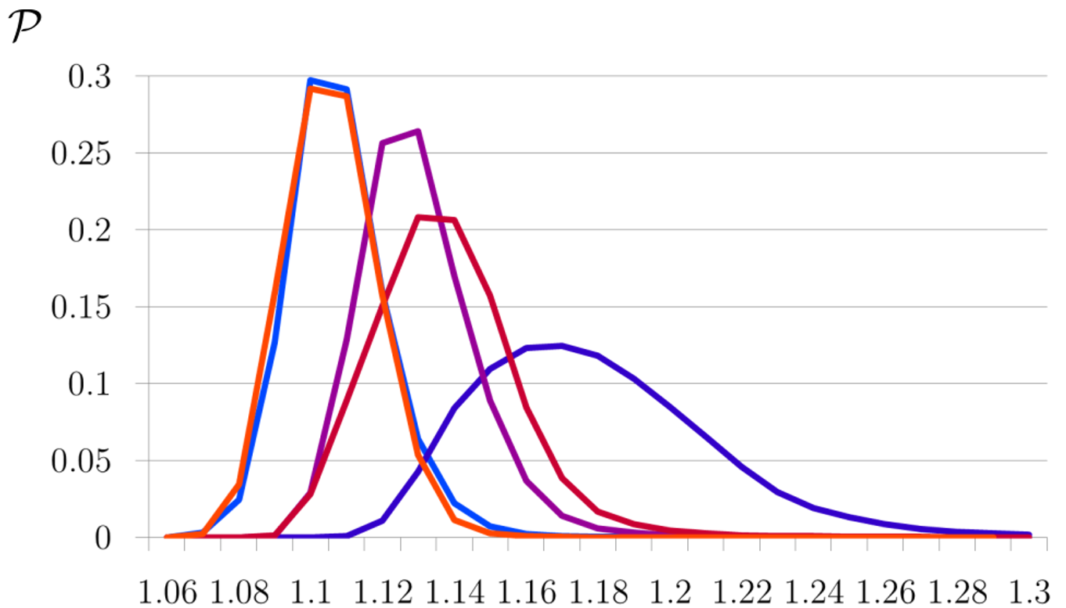





COMPLEX SITUATIONS HANDLING
Manifold Tortuosity for Heterogeneous Microstructures Characterisation
Average Tortuosity Distribution
5 different Real Microstructures
$${\hat{τ}}_{M}=1,117±0,025$$
$${\hat{τ}}_{M}=1,104±0,025$$
$${\hat{τ}}_{M}=1,132±0,027$$
$${\hat{τ}}_{M}=1,137±0,021$$
Complex Situations handling
Aggregation Phenomenon sensitivity
[1] Batista A.T.F., […] Chaniot J et al. (2020). ACS Catalysis
[22] Tran VD et al. (2014). Oil & Gas Science and Technology
[23] Moreaud M., Chaniot J., et al. (2021). WO/2021/122191
[24] Nieto-Draghi C., […], Chaniot J. et al. (2024). ACS Applied Engineering Materials

Slide 7
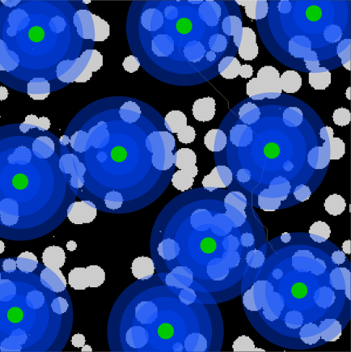
AGGREGATION PHENOMENON SENSITIVITY
Manifold Tortuosity for Heterogeneous Microstructures Characterisation
M-tortuosity characterization
Stochastic point sampling in the microstructure to analyze
Local insights (one per point):
Paths between points → scalar value
Function of neighborhood → curve
Representative tortuosity (average) :
Final scalar value
Final curve
Tortuosity as a function of the distance
[10] Chaniot J et al. (2020). Image Analysis & Stereology
[21] Chaniot J et al. (2019). Image Analysis & Stereology

Slide 8
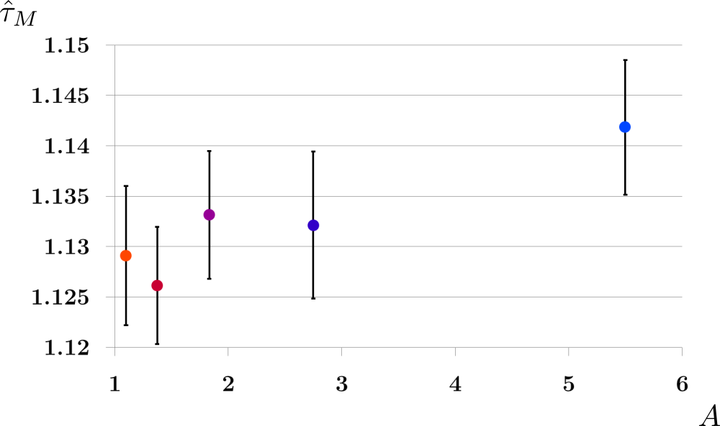
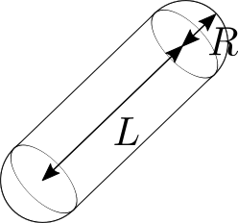
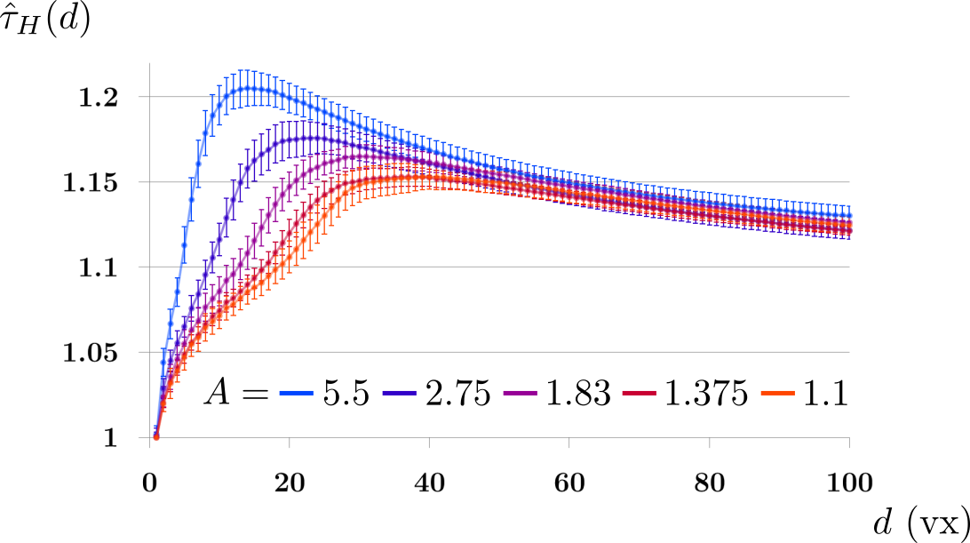
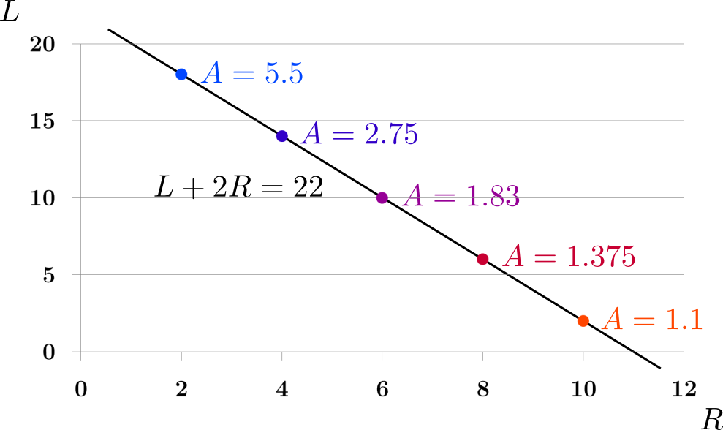
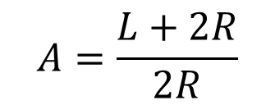
AGGREGATION PHENOMENON SENSITIVITY
Manifold Tortuosity for Heterogeneous Microstructures Characterisation
Aggregation = « Creation of bigger sticks »
Simulation: Boolean models of spherocylinders
$$A=\frac{L+2R}{2R}$$
[25] Matheron G (1975). J. Wiley
[26] Chaniot J (2020). Thesis, Univ. de Lyon, Univ. Jean-Monnet de St-Etienne, IFPEN

Slide 9
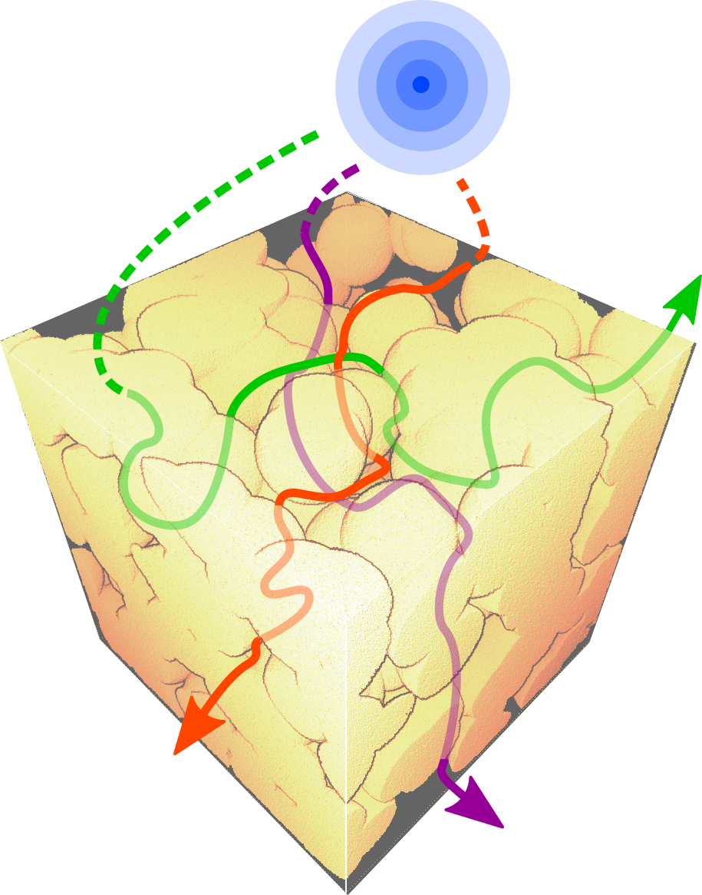
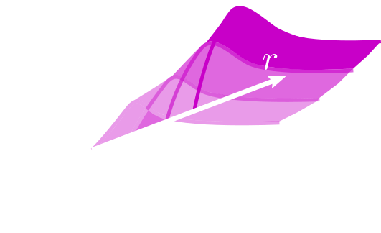
AGGREGATION PHENOMENON SENSITIVITY
Manifold Tortuosity for Heterogeneous Microstructures Characterisation
A-protocol = Constrictivity & Pore size Distribution
Iterative Erosions with increasing radius
Discriminative Power Improvement by increasing the number of dimensions
Complex Situations handling
Aggregation Phenomenon sensitivity
[10] Chaniot J et al. (2020). Image Analysis & Stereology
[27] Chaniot J et al. (2022). Computational Material Science
[28] Vogel (1997). European Journal of Soil Science
[29] Serra J (1983). Academic Press, Inc.

Slide 10
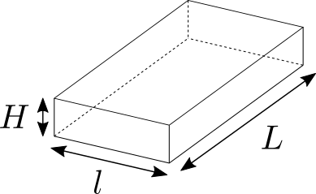
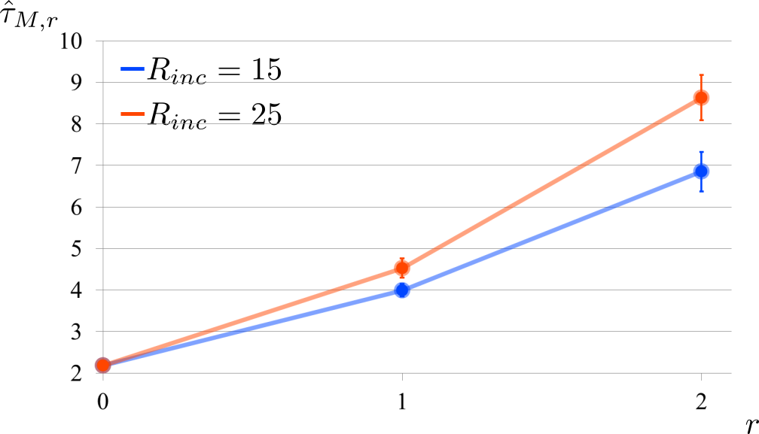
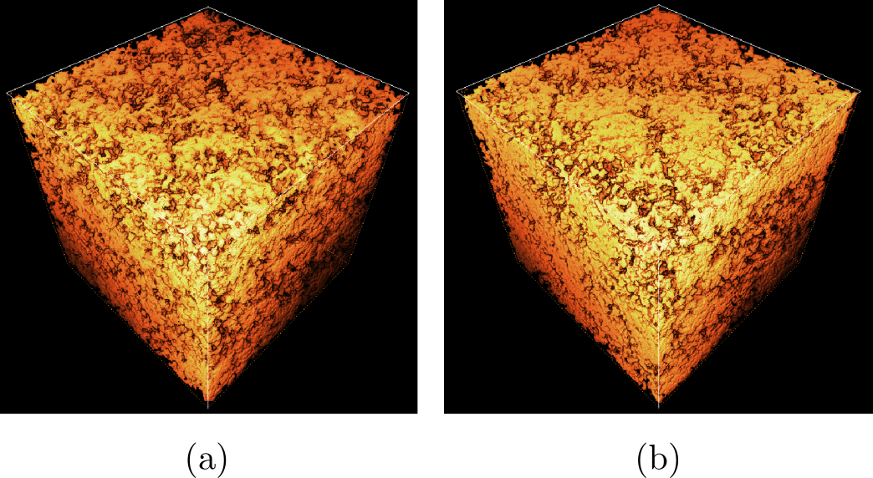


AGGREGATION PHENOMENON SENSITIVITY
Manifold Tortuosity for Heterogeneous Microstructures Characterisation
Aggregation = Heterogeneous Microstructures
Simulation: Cox models of Platelets
Aggregate’s size = 15, density = 30%
Aggregate’s size = 25, density = 40%
$${\hat{τ}}_{M}=2,186±0,010$$
$${\hat{τ}}_{M}=2,184±0,012$$
[30] Jeulin D (2012). CR Mecanique
[31] Chiche D et al. (2008). AlOOH, The Journal of Physical Chemistry C,
[32] Wang H (2016). Ph.D. Thesis, PSL Research University

Slide 11
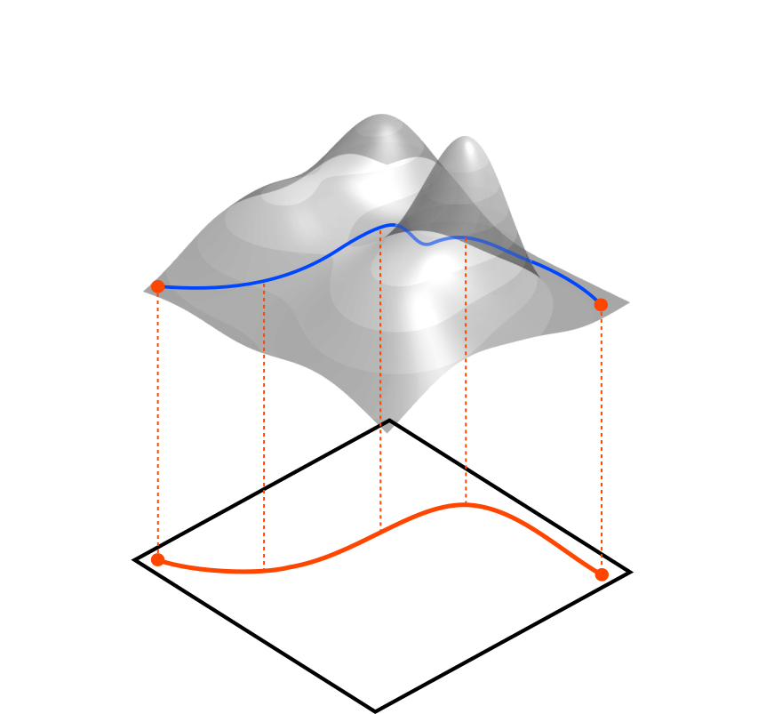
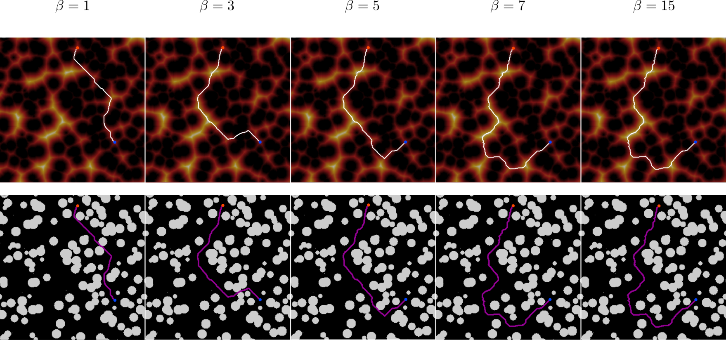
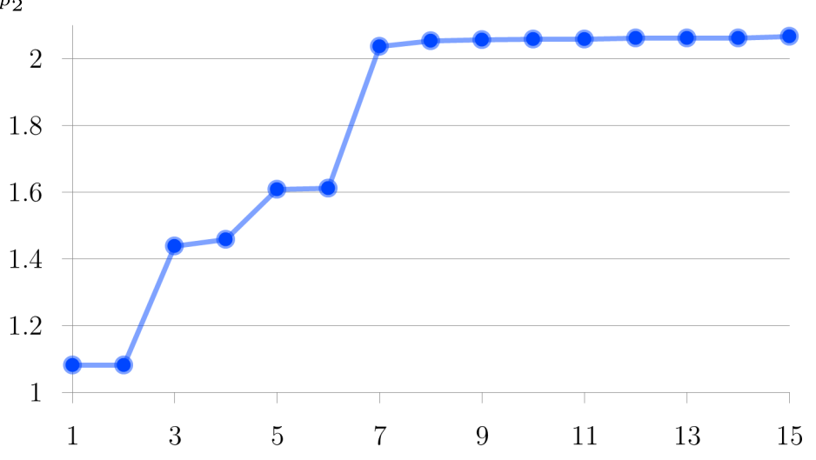
FIRST STEPS TOWARD GRAYSCALE EXTENSION
Manifold Tortuosity for Heterogeneous Microstructures Characterisation
Path on valued skeleton with local narrowness [26, 34] → mix of Tortuosity & Constrictivity
Local Narrowness ~ inverse of the distance from solid phase
Close to Curvature → « mix of Tortuosity definitions »
Sensitivity to gray-scales →
Gray-scale constraint
→
2
Tortuosity
Binary constraint
→
1
Sensitivity
[26] Chaniot J (2020). Thesis, Univ. de Lyon, Univ. Jean-Monnet de St-Etienne, IFPEN
[34] Lohou C, Bertrand G (2005). Discrete applied mathematics

Slide 12
CONCLUSION
Manifold Tortuosity for Heterogeneous Microstructures Characterisation
Manifold Tortuosity for complex materials analysis using
Scalar values,
Average Tortuosity Maps / Distributions,
Curves → function of the distance OR the probe’s size,
Surfaces → function of the distance AND the probe’s size

Slide 13
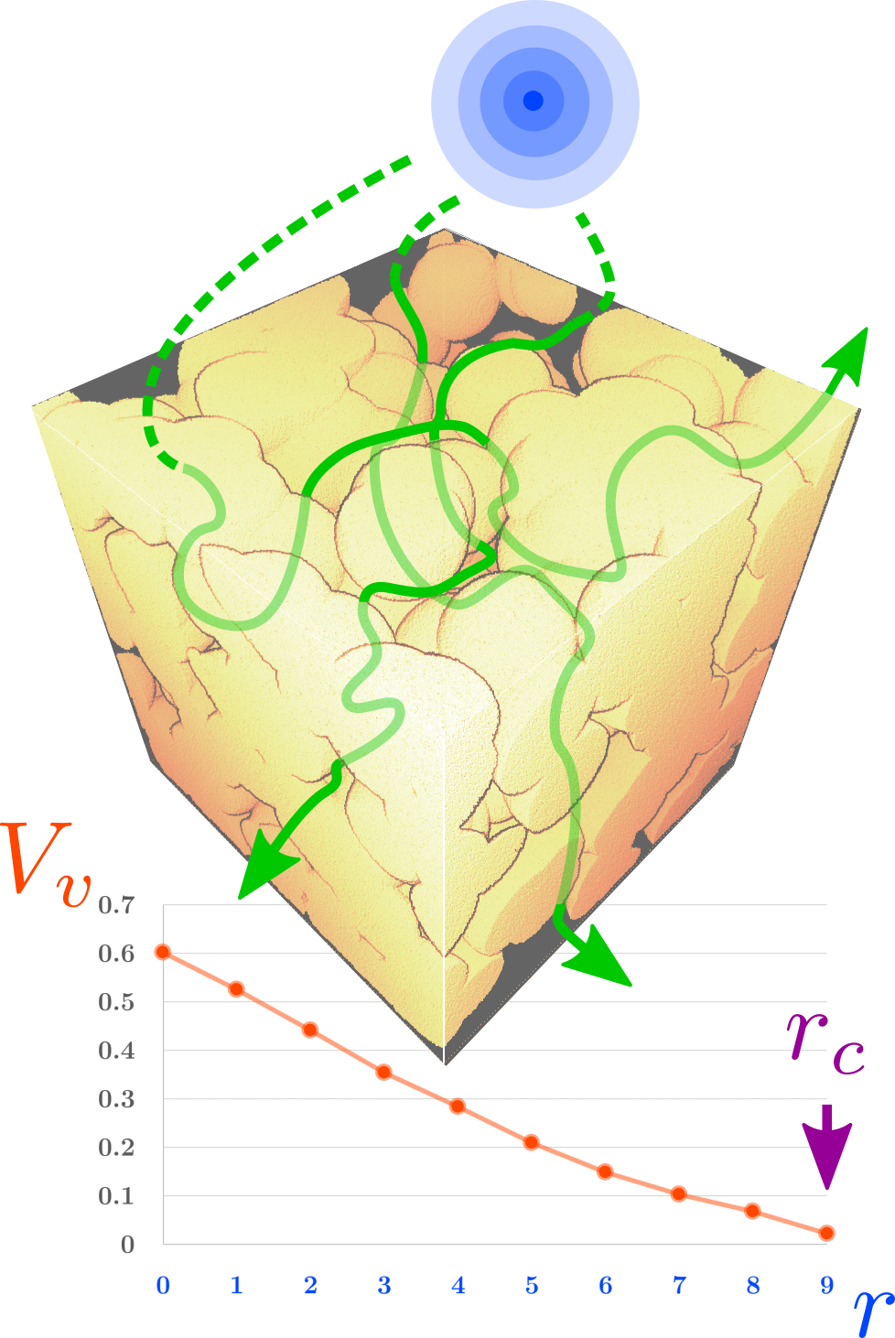
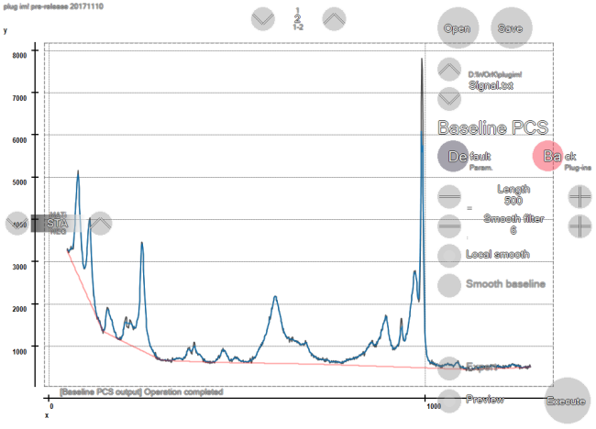
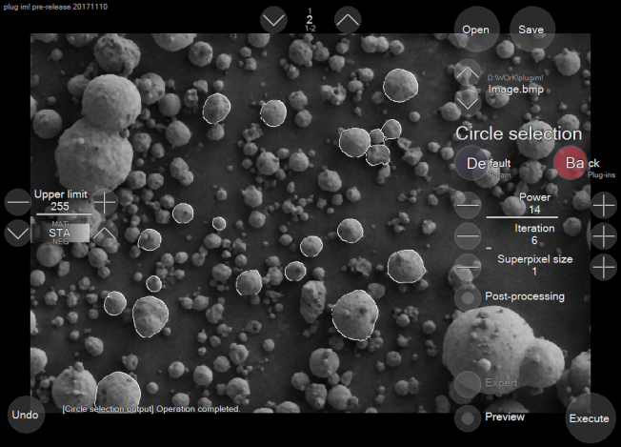
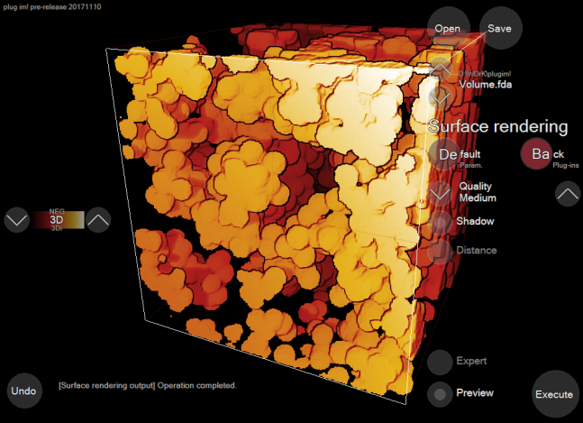

THANK YOU FOR YOUR ATTENTION
Manifold Tortuosity for Heterogeneous Microstructures Characterisation
OPEN ACCESS NUMERICAL SOLUTIONS
EASY-TO-USE PLUG-INS IN plugim!
PYTHON CODES IN GitHub
johan.chaniot@emse.fr

