Slide 1
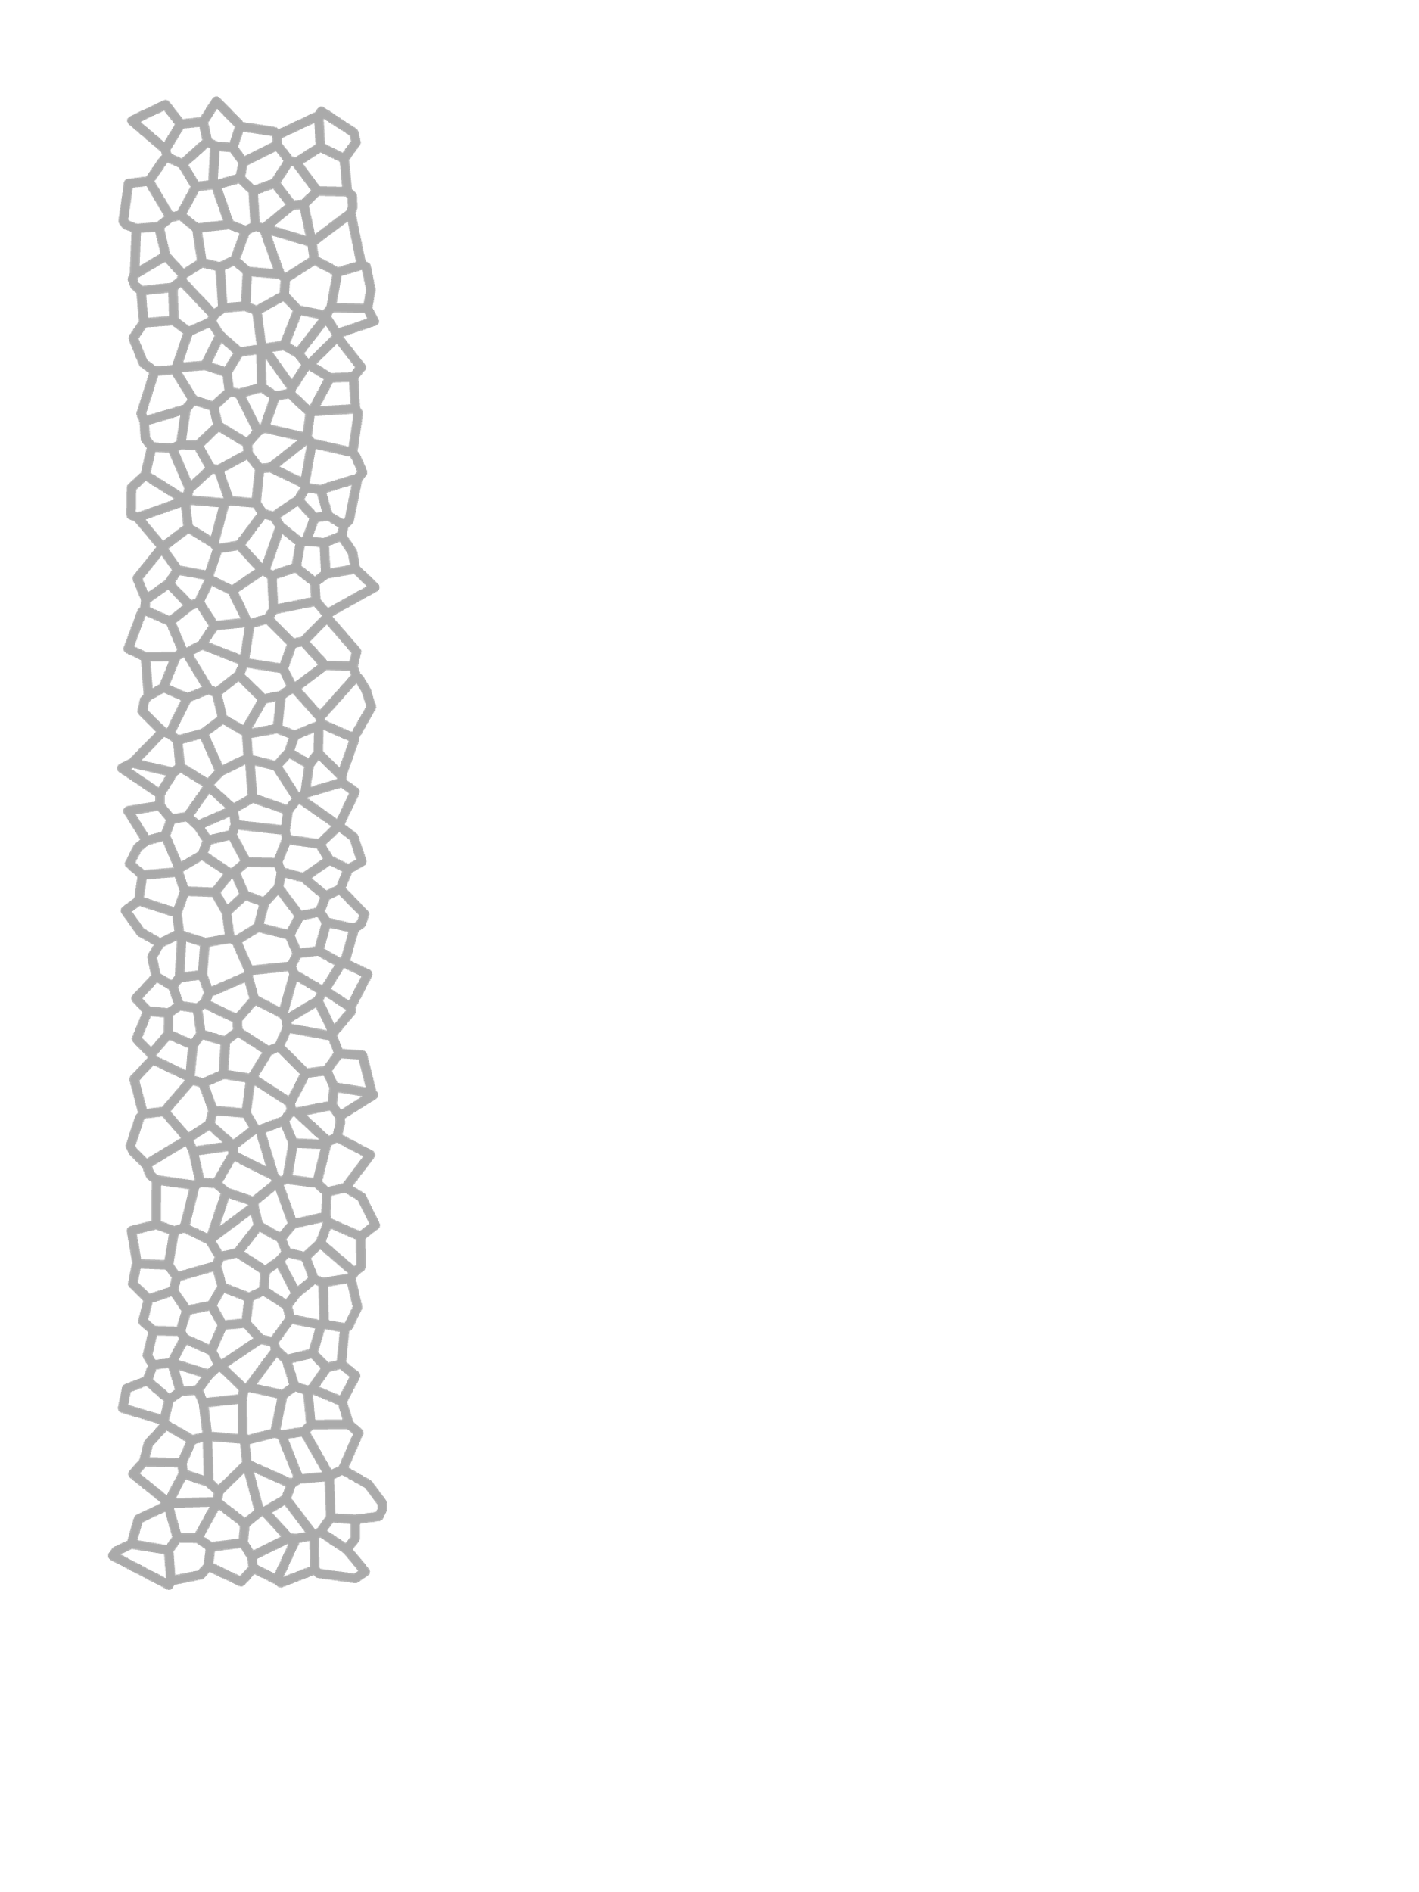
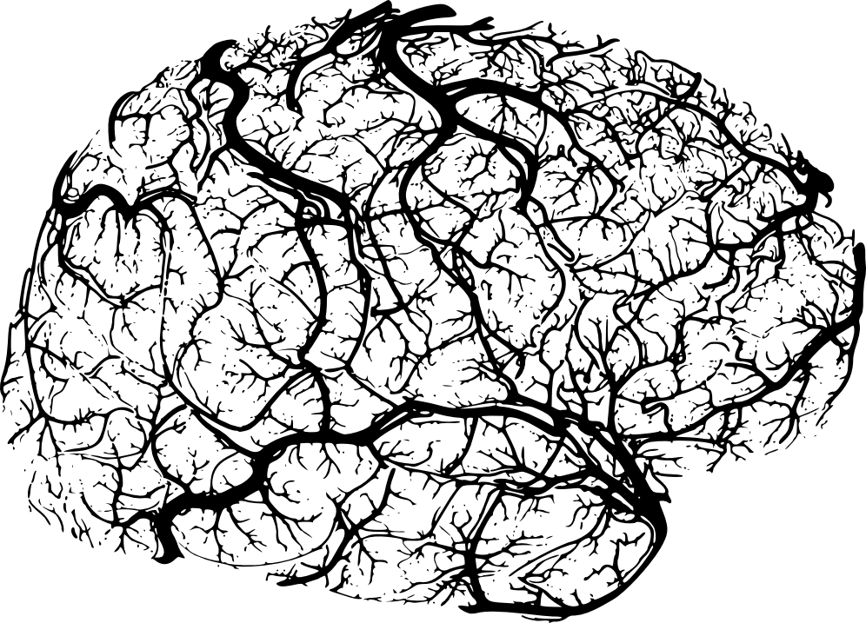
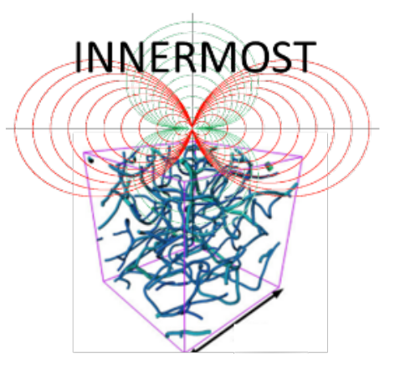



From anomalous transport of red blood cells
to oxygen delivery in the brain
Hugo Blons, PhD
Géosciences Rennes & IMFT
Supervisors :Sylvie Lorthois
Tanguy Le Borgne
Joris Heyman
Duvernoy et al. (1981),
Brain Research Bulletin
CNRS-MITI 80 | Prime
Geobrain

Slide 2
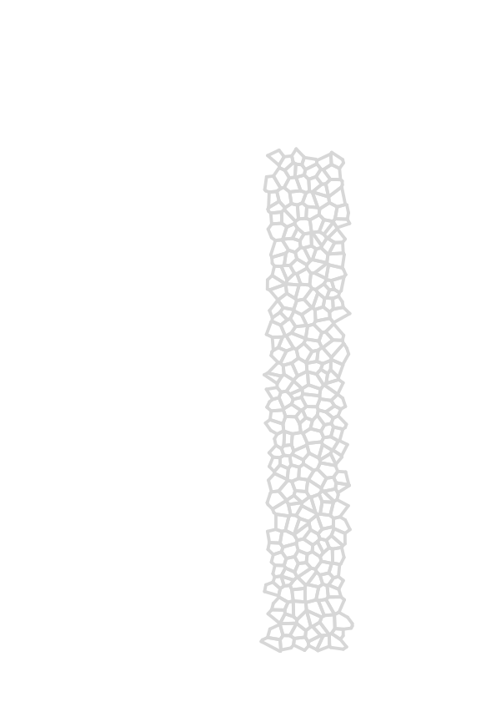
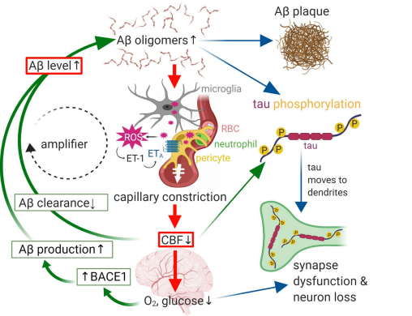
Alzheimer disease, and blood flow.
Korte et al. (2020),
Acta Neuropathologica

Slide 3
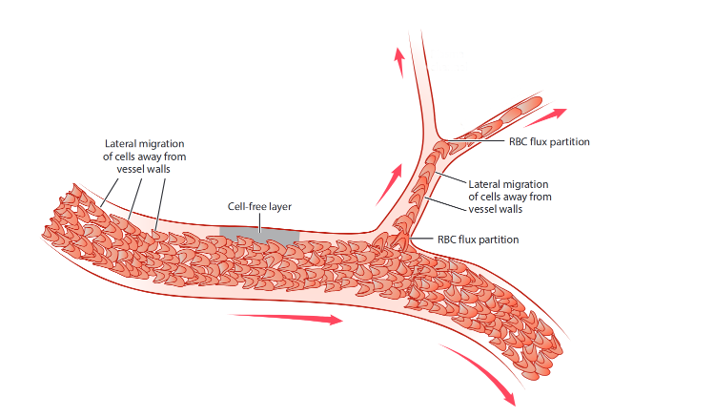
Red blood cells mechanics.
Phase separation
Adapted from Secomb (2017),
Annual Review of Fluid Mechanics

Slide 4
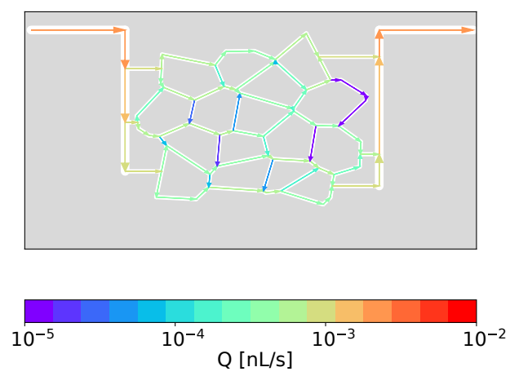
Numerical flow resolution.
Eulerian flow map
Art
Ven

Slide 5
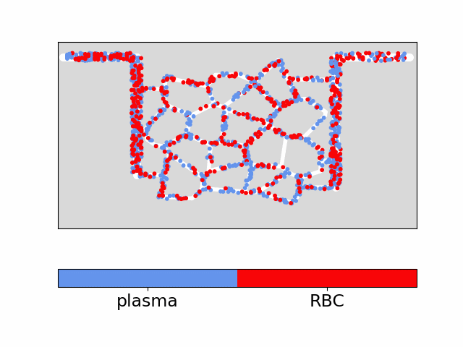
Two-phase particle tracking, travel time heterogeneity.
Lagrangian trackers
Art
Ven

Slide 6
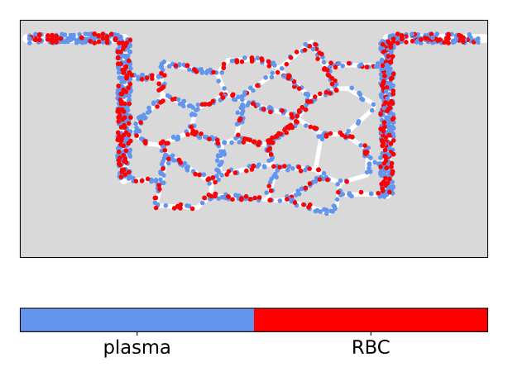

Two-phase particle tracking, travel time heterogeneity.
Lagrangian trackers
Art
Ven

Slide 7
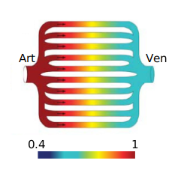
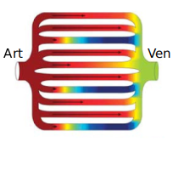
Travel time heterogeneity.
1
0.4
Jespersen et Østergaard (2012),
Journal of Cerebral Blood Flow & Metabolism

Slide 8
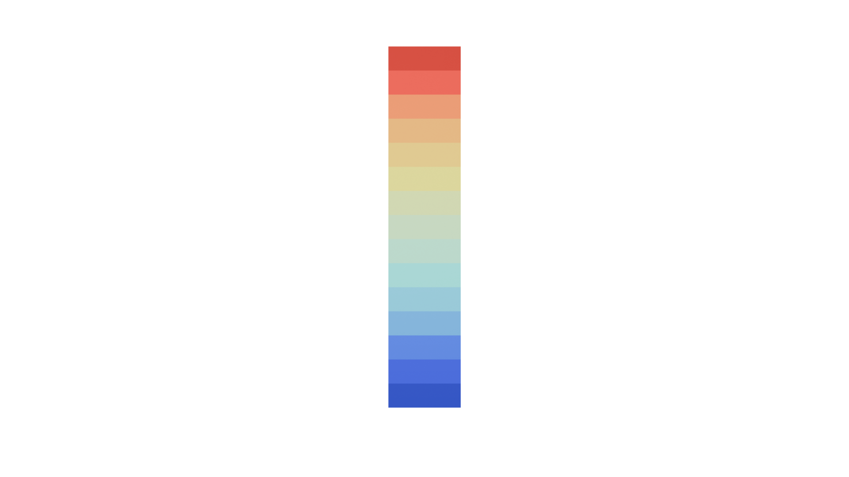
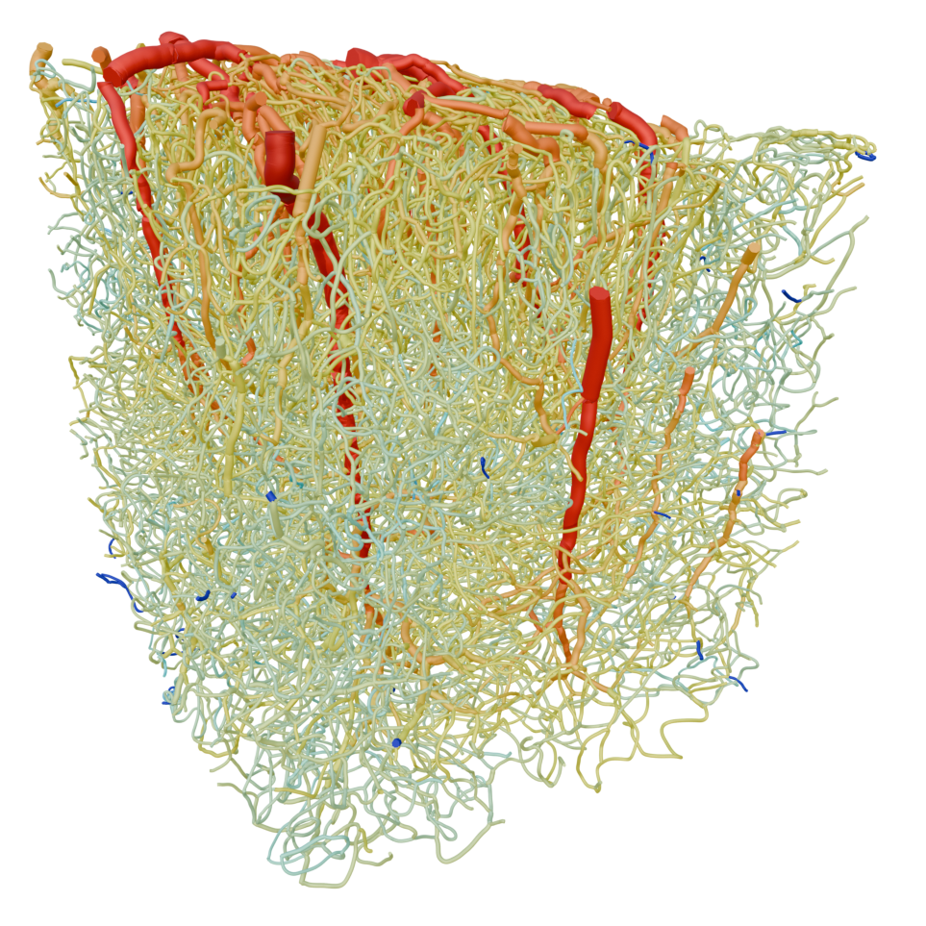
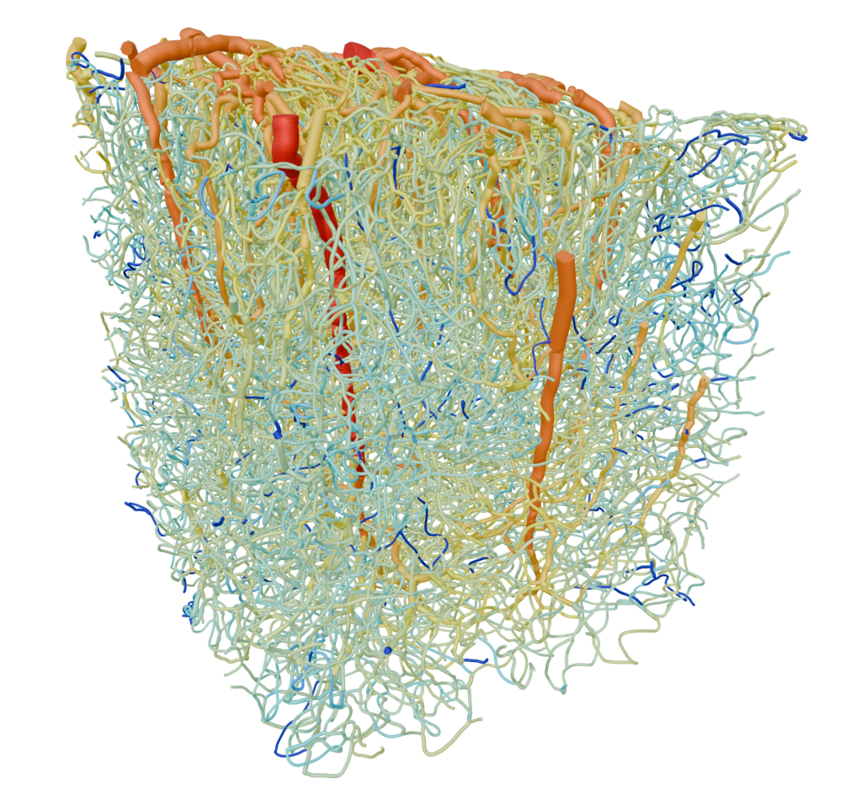
Blood flow rate
Anatomical network : flow rates.
RBC flow rate
[nL/s]

Slide 9
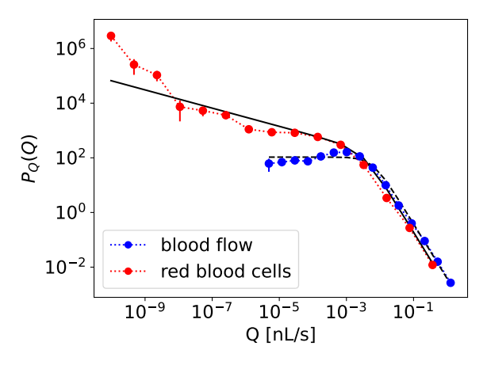
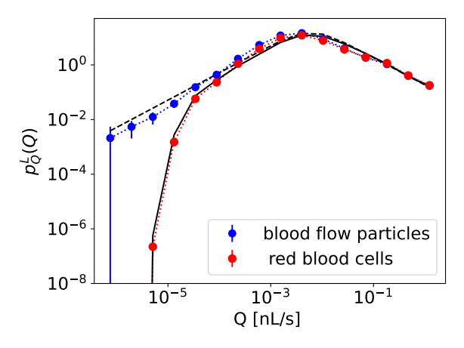
Flow rate distributions.
Eulerian Lagrangian

Slide 10
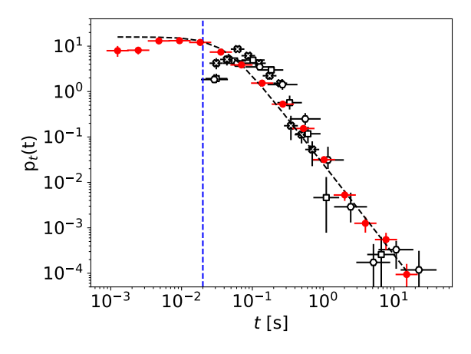
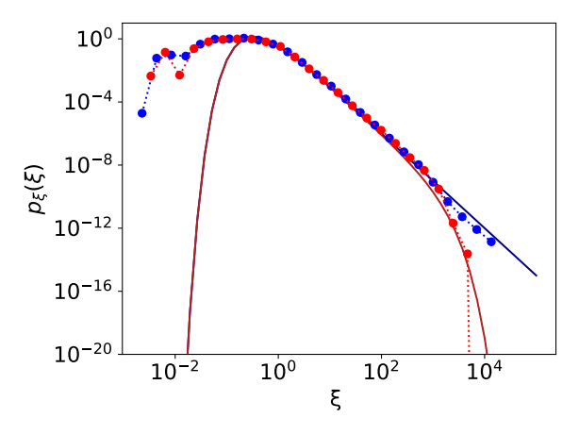
Transit time distributions : comparison with in vivo experiment
Eulerian Lagrangian (noise contribution)
Measurement limit
In vivo measurement from Chalard et al. (2025), Neurophotonics

Slide 11
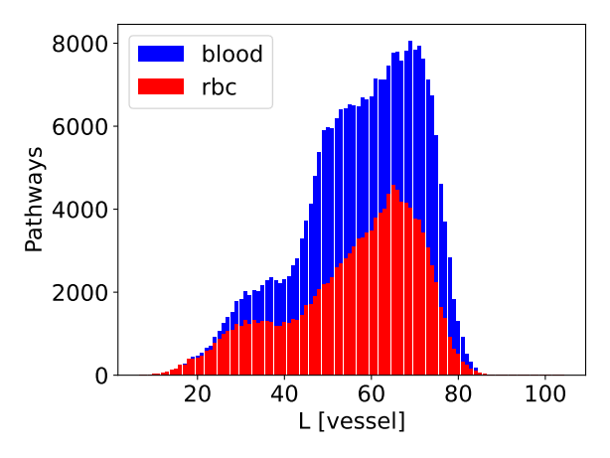
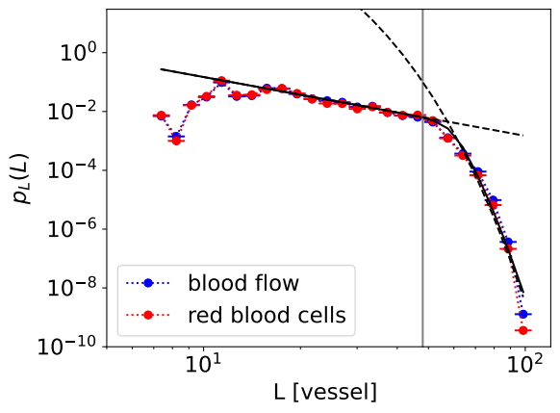
Pathways distributions.
Possible trajectories Lagrangian distribution

Slide 12
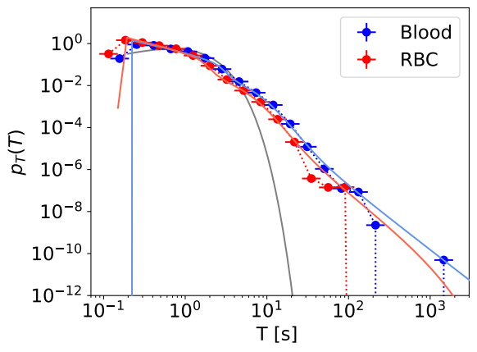
Travel times distributions, random walk model.

Slide 13
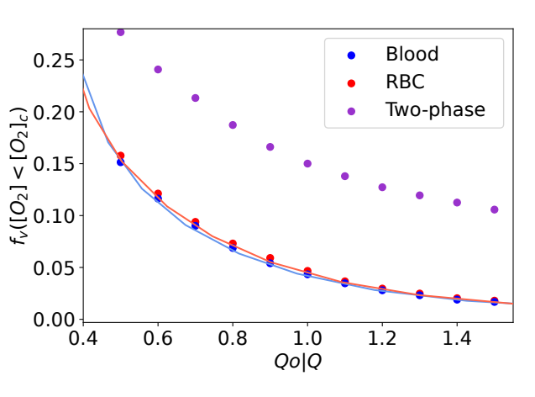
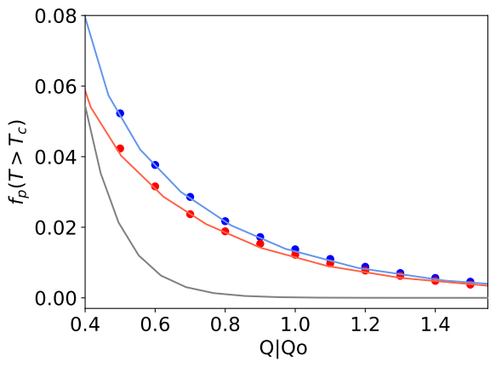
Anomalous transport and vessel oxygen delivery.
Fraction of long travel times Fraction of hypoxic vessels
Lagrangian Eulerian
Dynamics of RBC are similar to that of solute in blood, leading to an increase of hypoxic vessels with decreasing CBF
RBC concentration heterogeneity is a secondary driver of hypoxia

Slide 14
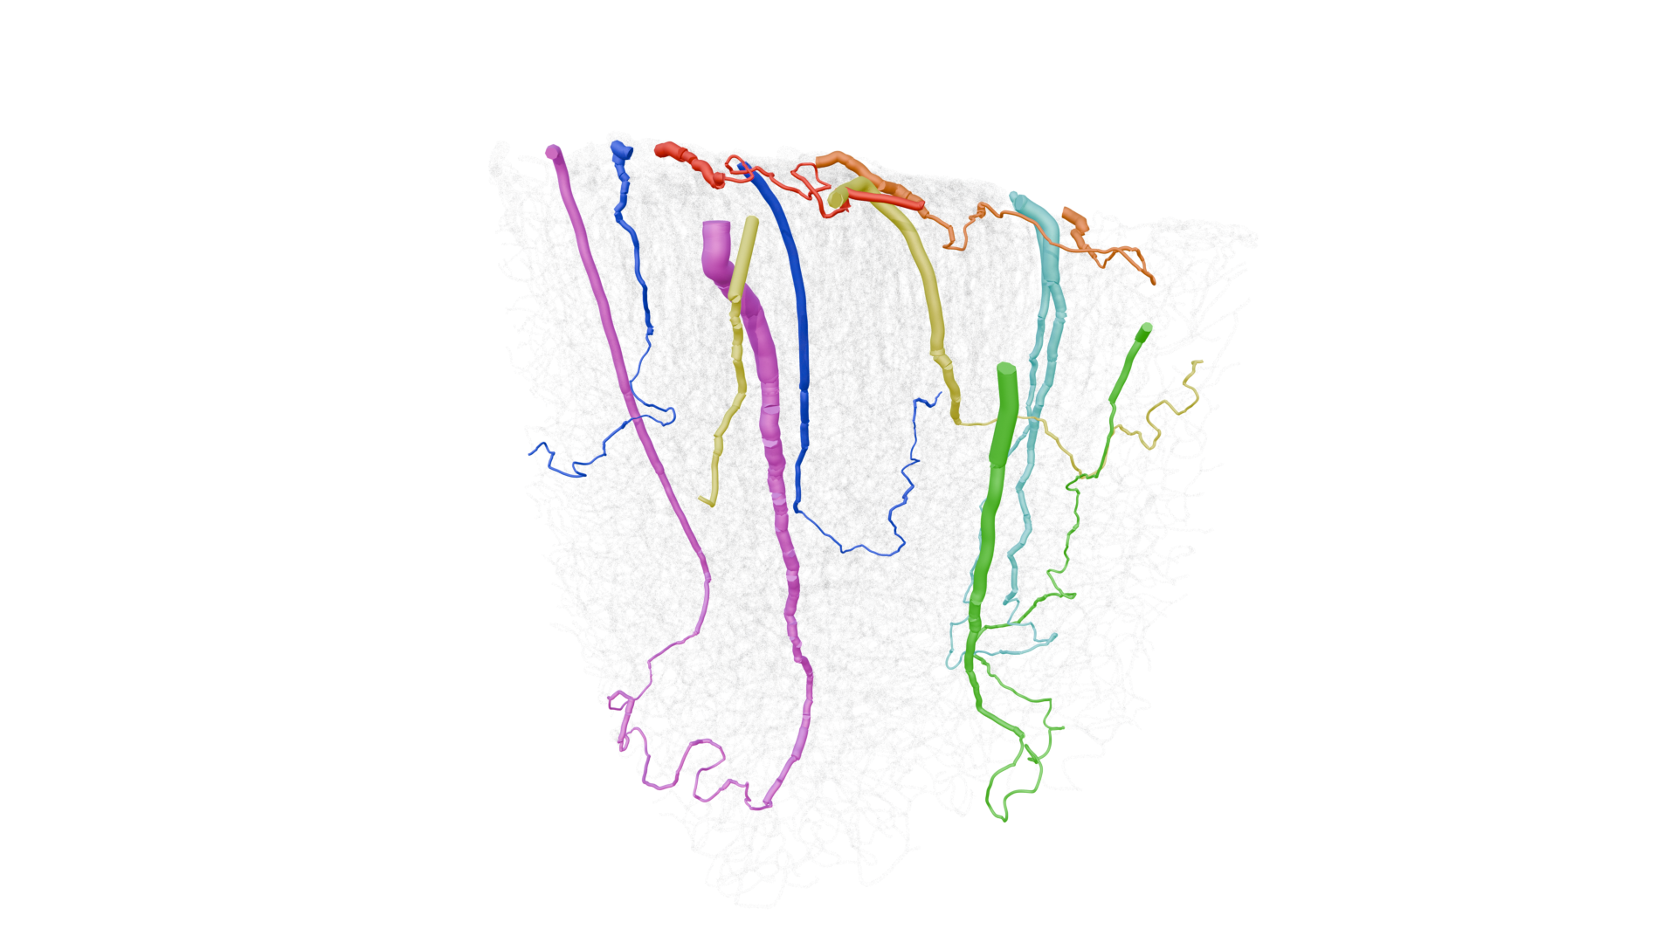
Questions ?
Hugo Blons, PhD
Géosciences Rennes & IMFT
Supervisors :Sylvie Lorthois
Tanguy Le Borgne
Joris Heyman
Collaboration
University of Montpellier & CHU Montpellier
Kévin Chalard
Yan Chastagnier
Vivien Szabo
CNRS-MITI 80 | Prime
Geobrain

