Slide 1





Depth-Integrated Modeling of Immiscible Two-Phase Flow in Rough Fractures: Comparison with Experimental Observations
Rahul Krishna, Amin Rezaei, Oshri Borgman, Francesco Gomez, Isabelle Bihannic, Yves Méheust, Insa Neuweiler
Notes:
Just introduction who is who

Slide 2
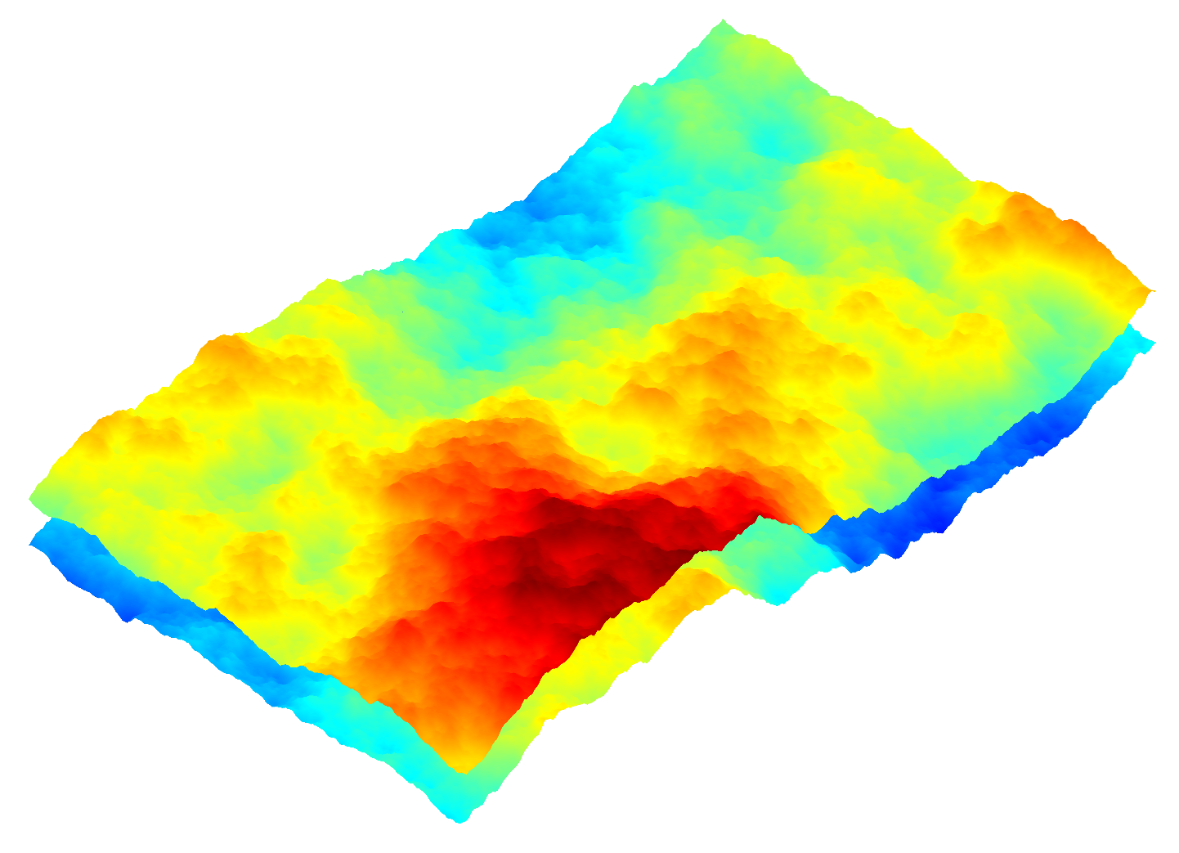
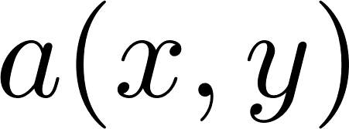
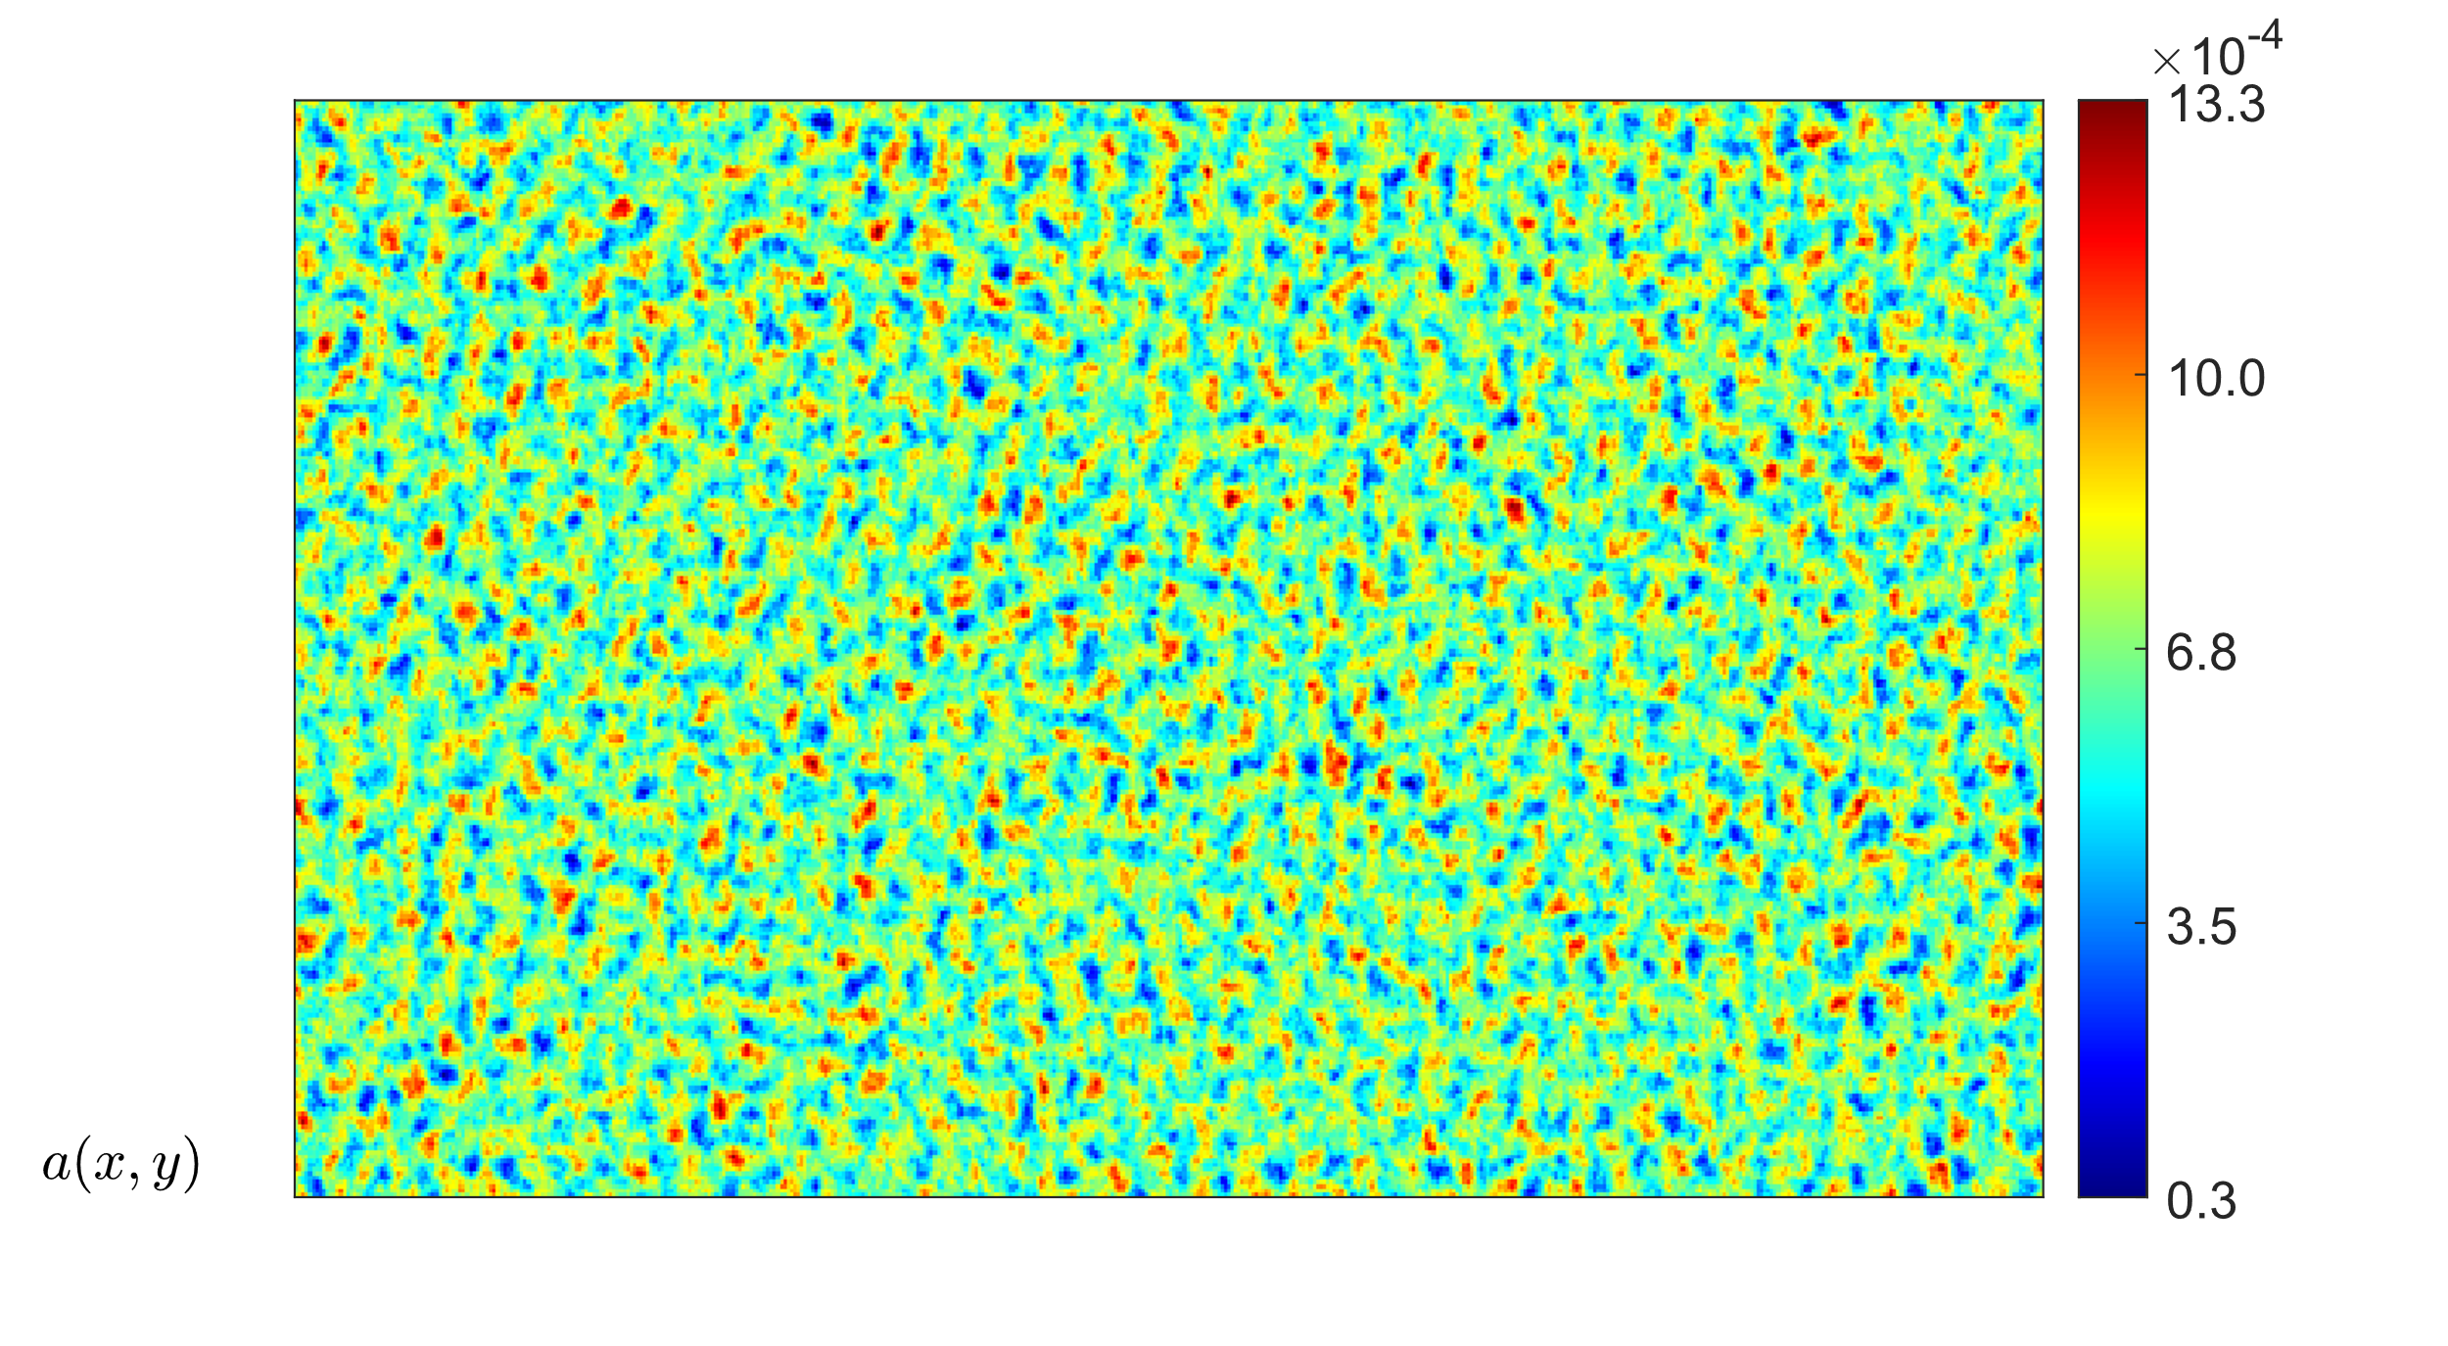
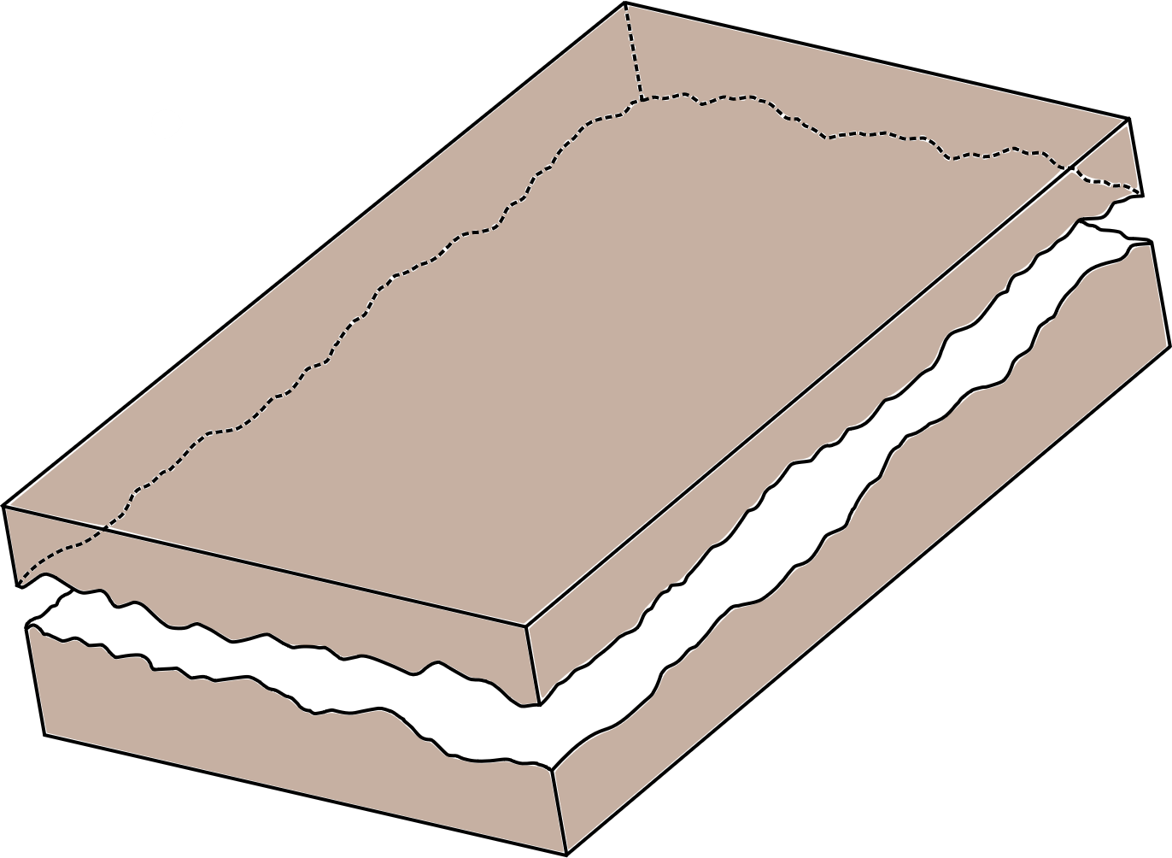
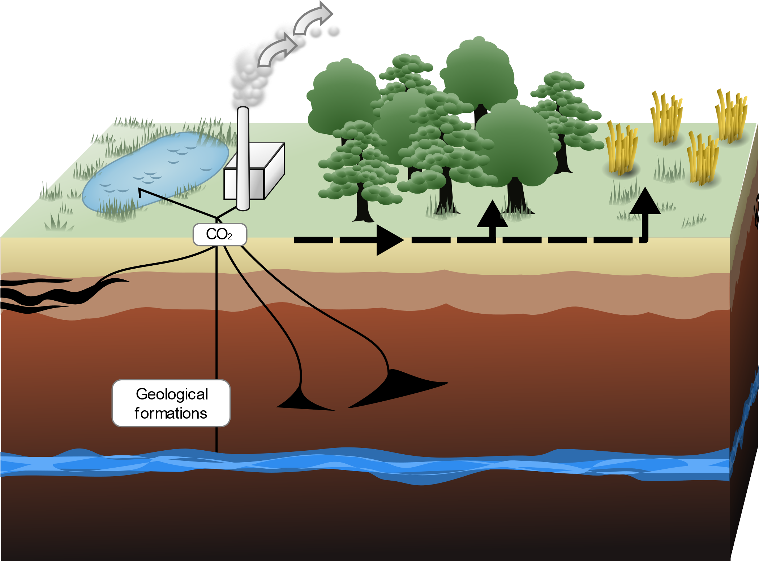
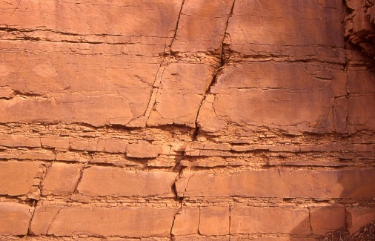


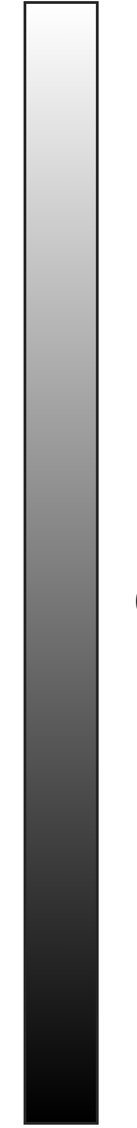


Introduction
Many critical subsurface technologies rely on one fluid displacing another
Aperture field
Hydrodynamic (Pore) Scale
10 cm
Defending fluid
Invading fluid
Continuum (Darcy) Scale
1
Adapted from https://ukccsrc.ac.uk/ccs-explained/
0
100 m
Rahul Krishna | Depth-Integrated Modeling of Immiscible Two-Phase Flow in Rough Fractures: Comparison with Experimental Observations
1 / 8

Slide 3
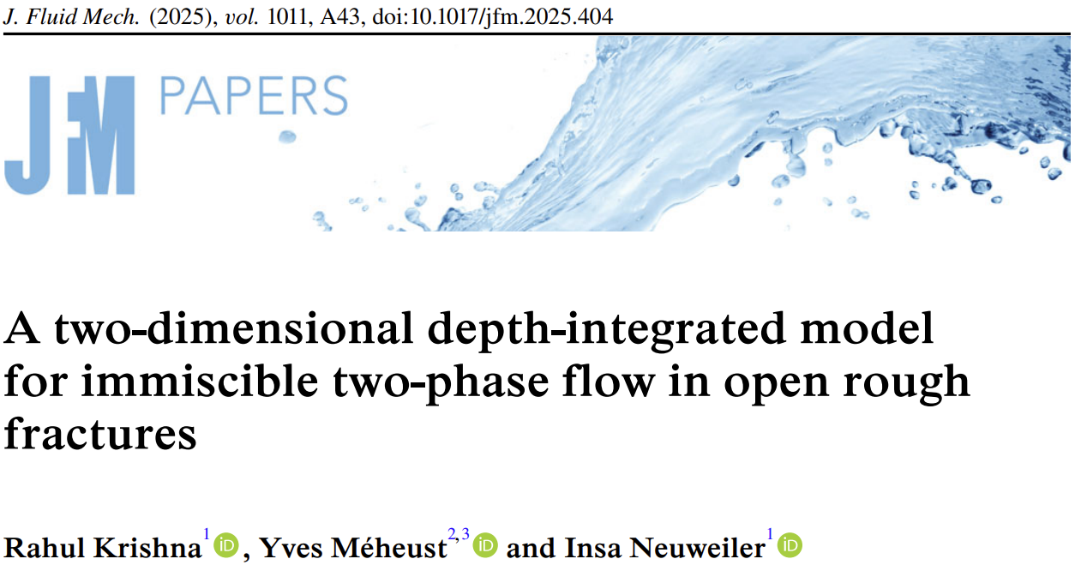
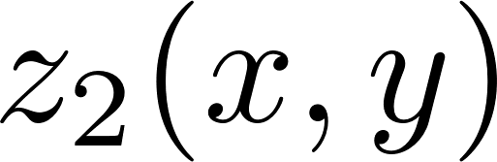
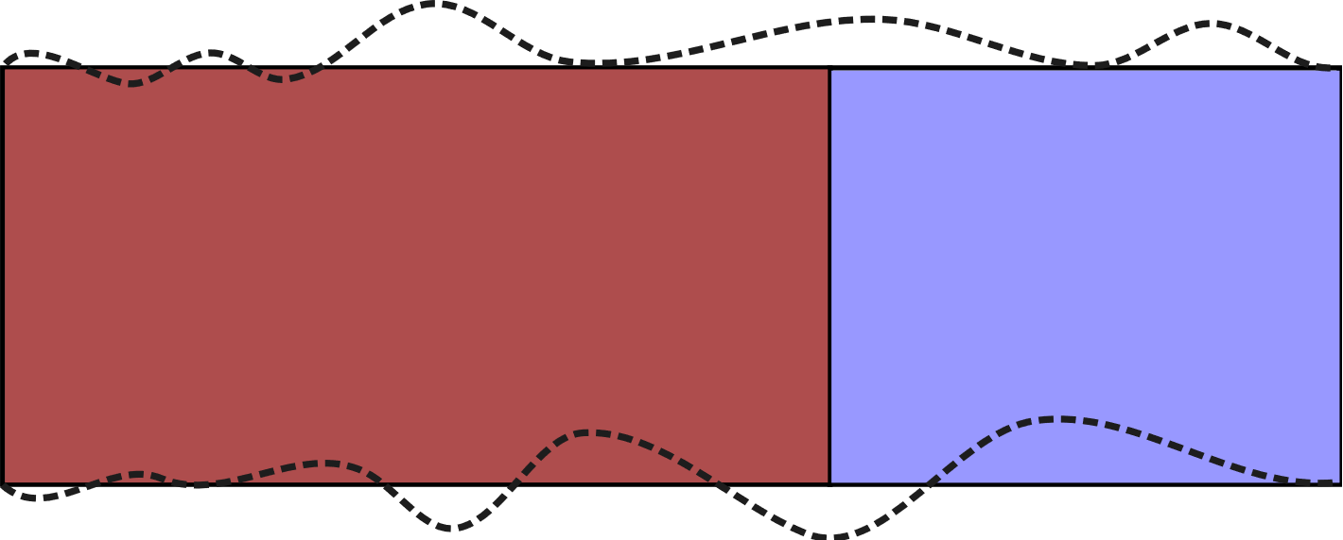
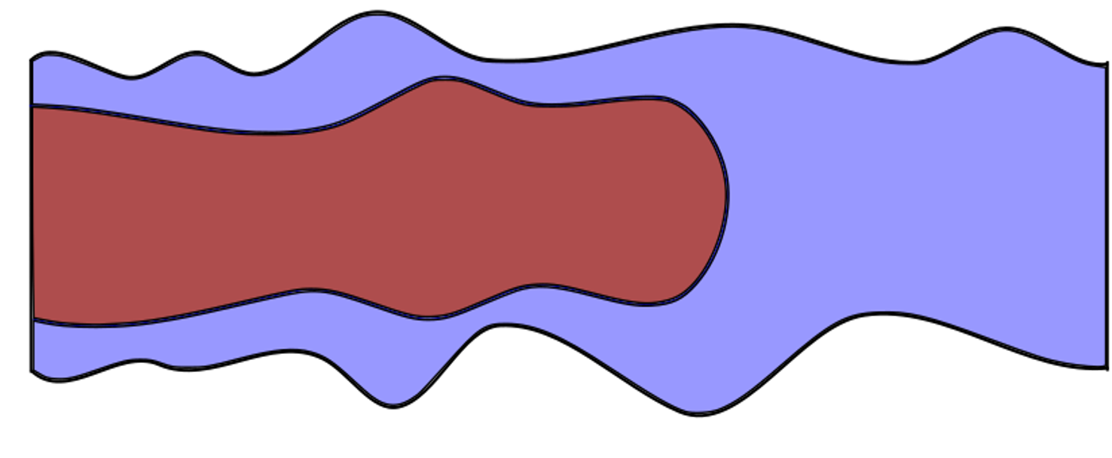
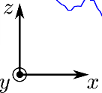
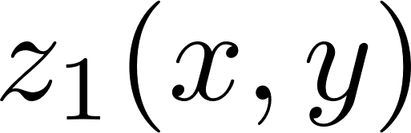

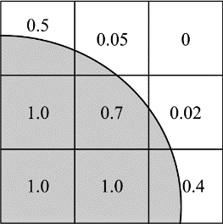
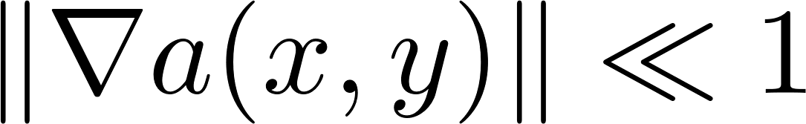

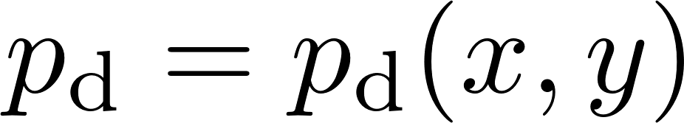



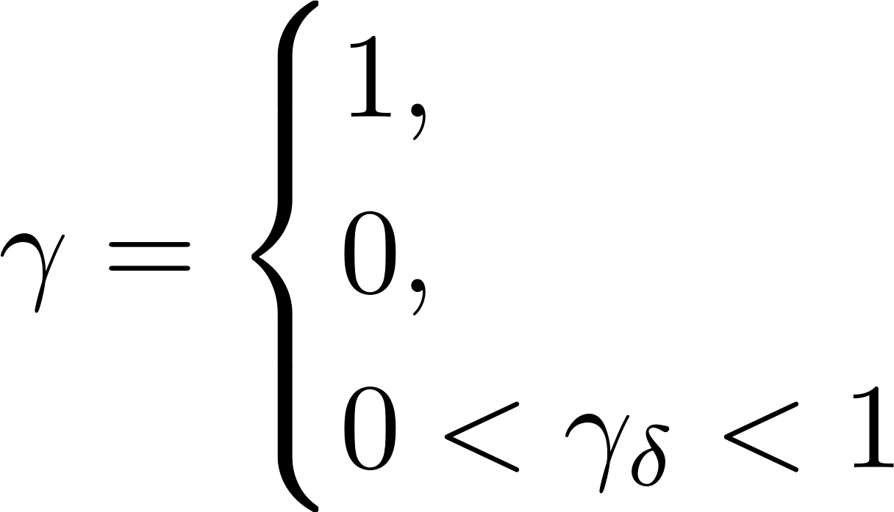
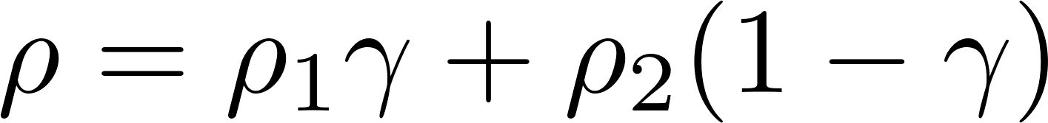
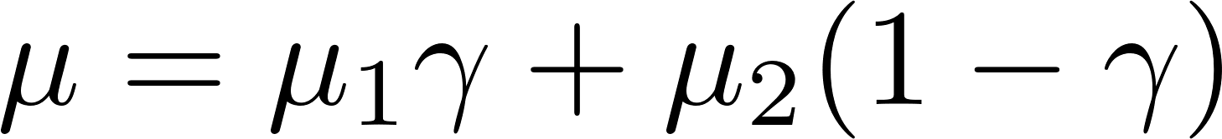
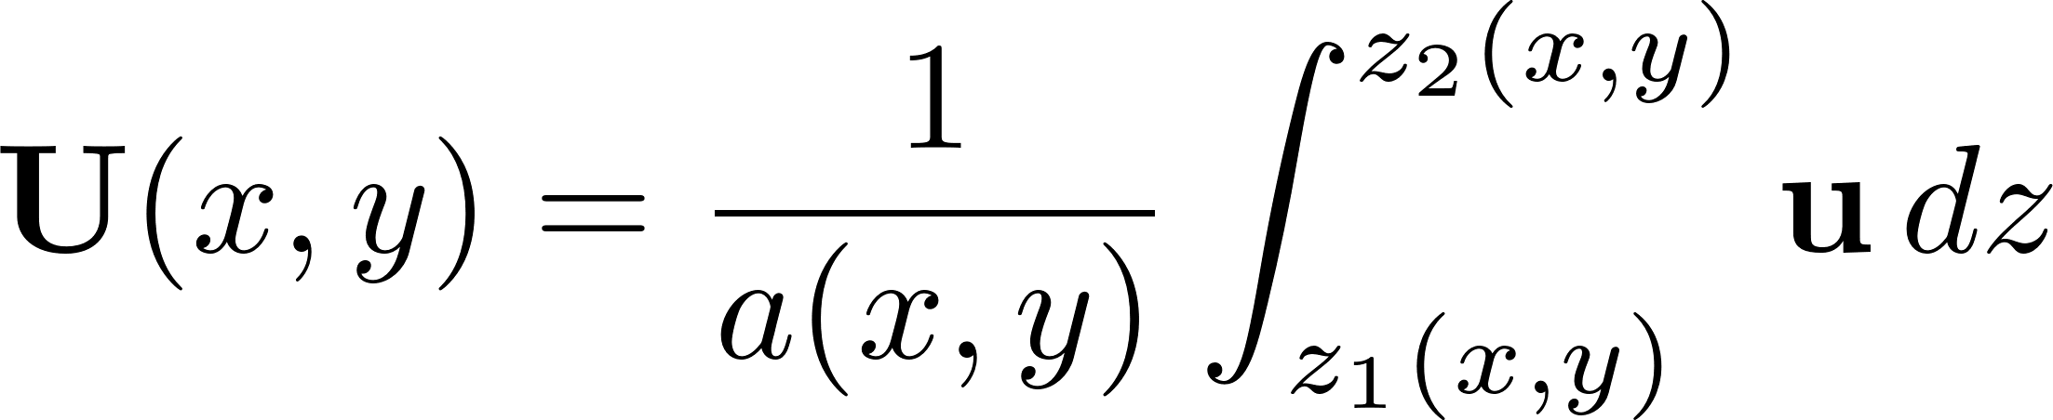
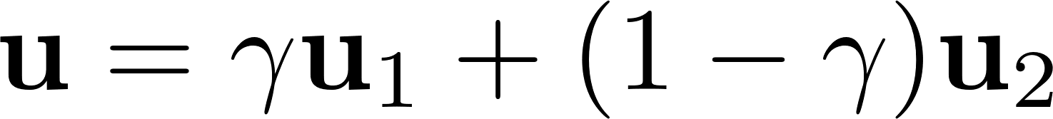

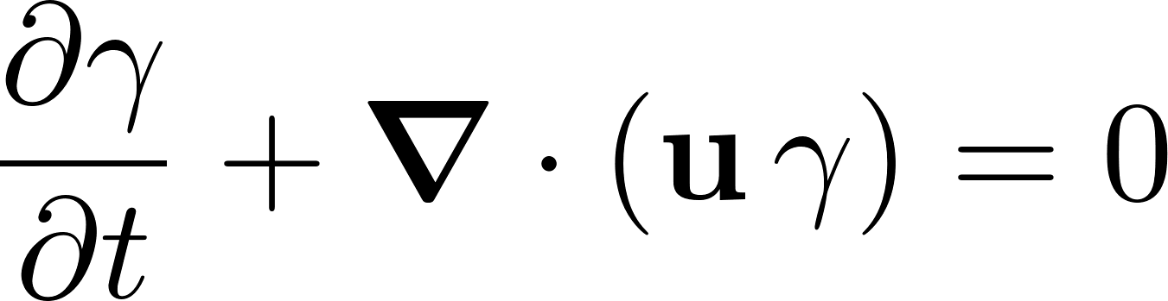
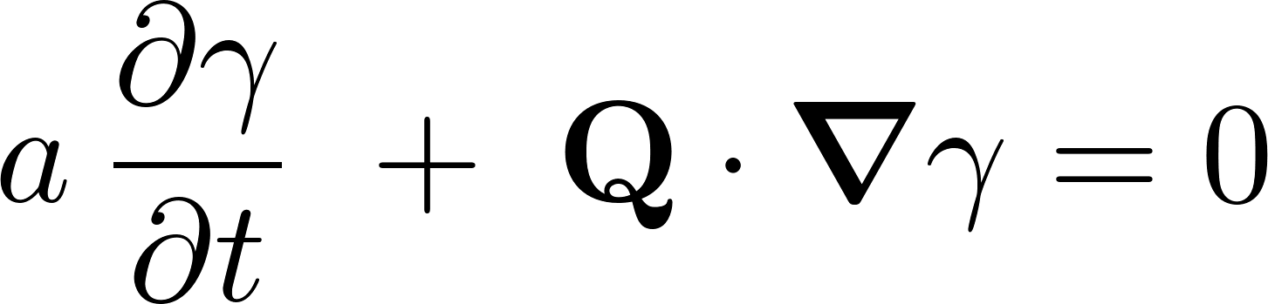

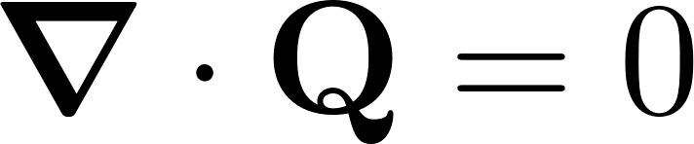
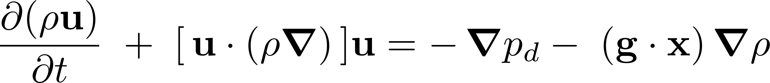
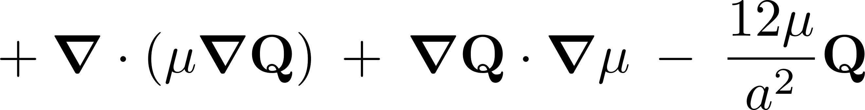
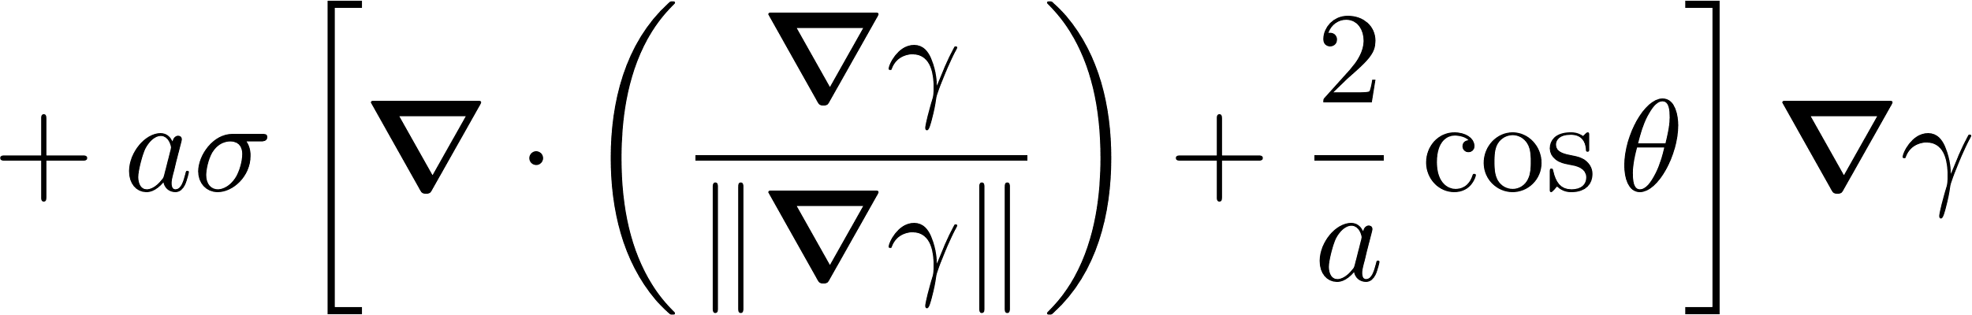
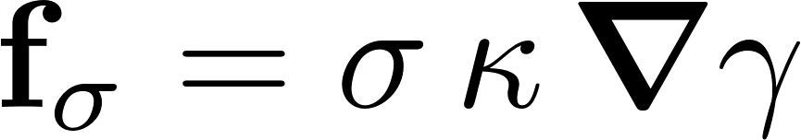
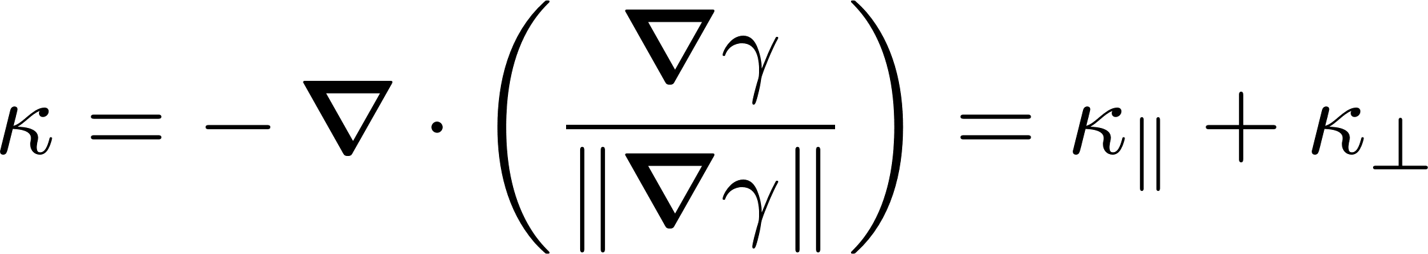
Two-phase Depth-Integrated 2-D Model
3-D Hydrodynamic-scale governing Eq. | DNS | VOF | OpenFOAM
Fluid 1
Fluid 2
Fluid 1
Fluid 2
Incompressible, isothermal Navier-Stokes eqs
Single fluid formulation using indicator function
Simplifying assumptions:
A. Smoothly varying aperture:
B. Wetting-films are neglected:
fluid 1
fluid 2
transition
Indicator function advection
Indicator function advection
Mass conservation
Local-flux conservation
Momentum conservation
Local-flux transport
Continuum surface force model
Rahul Krishna | Depth-Integrated Modeling of Immiscible Two-Phase Flow in Rough Fractures: Comparison with Experimental Observations
2 / 8

Slide 4
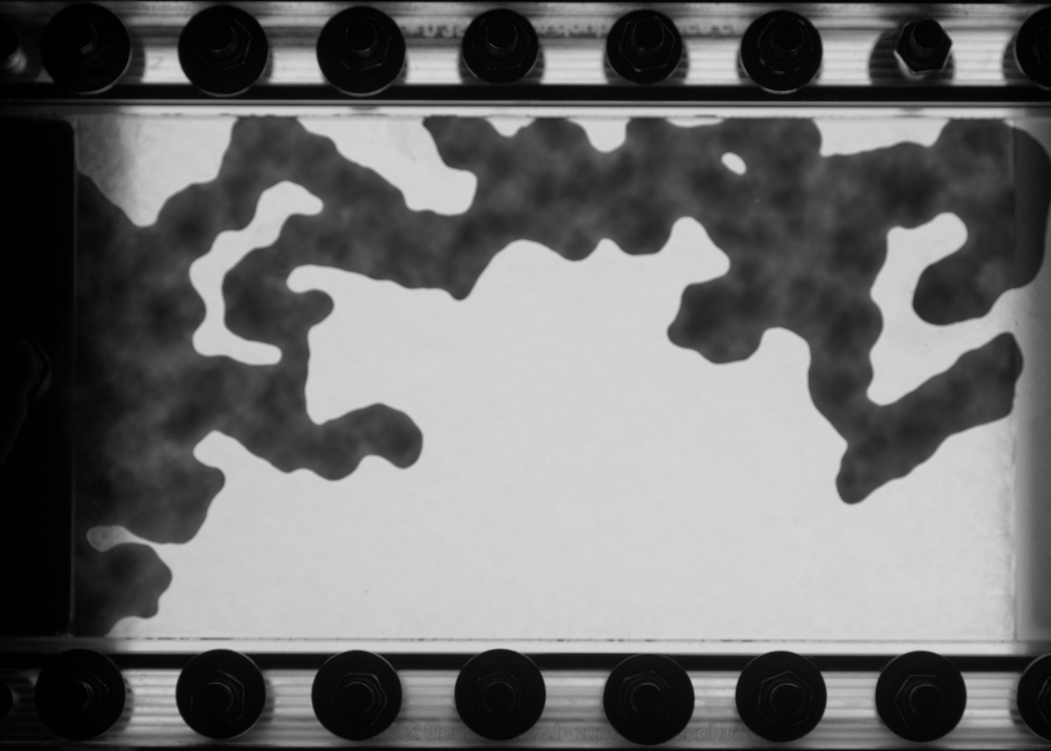

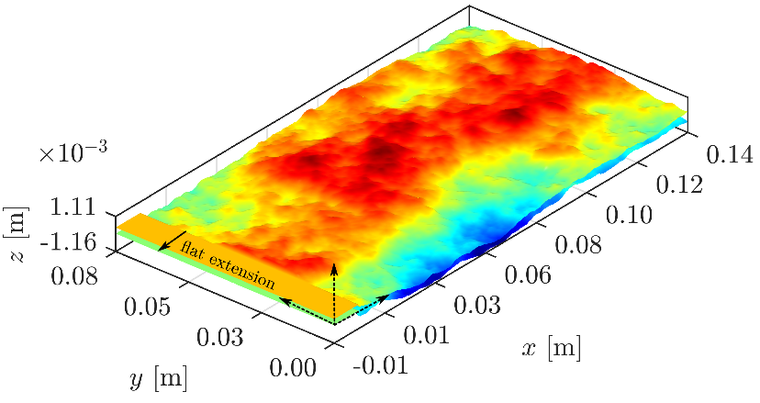
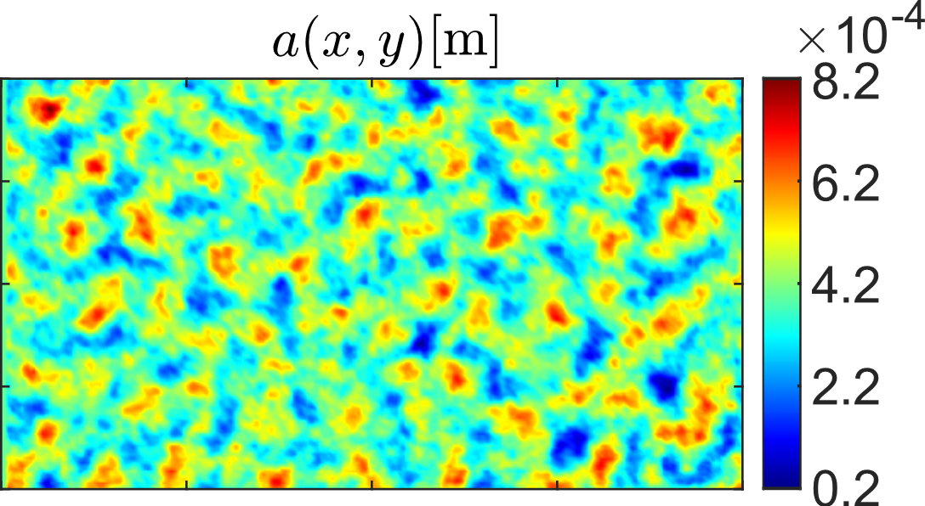
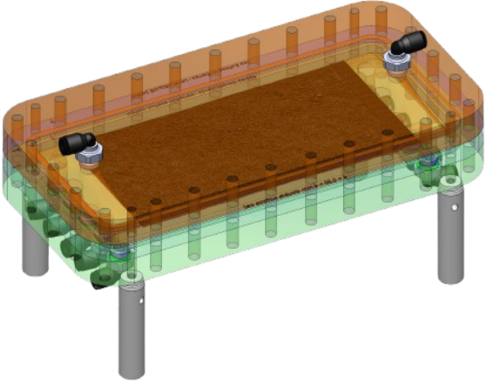
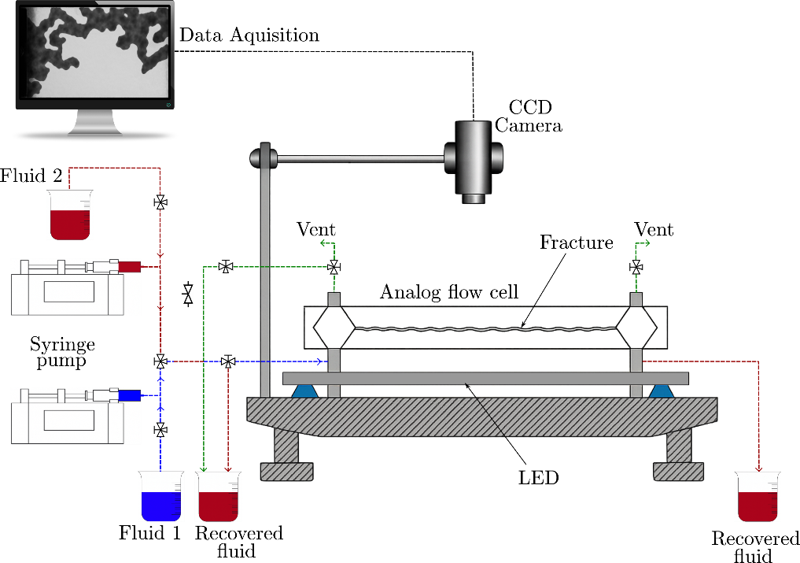
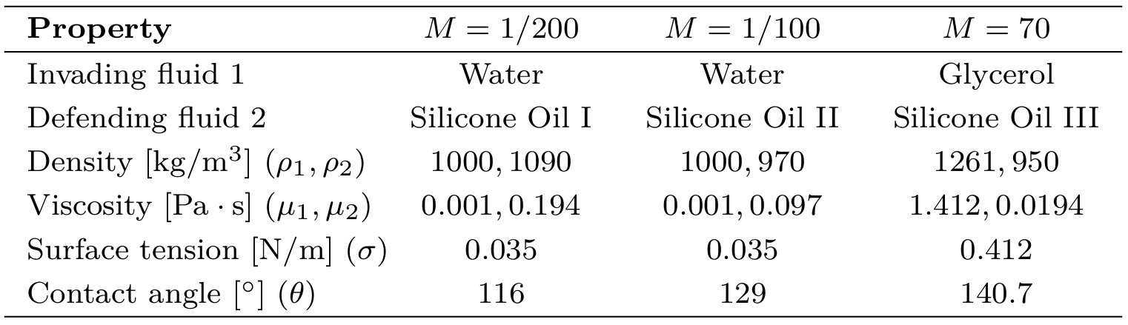
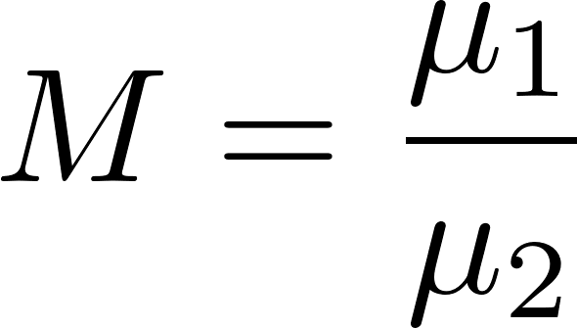
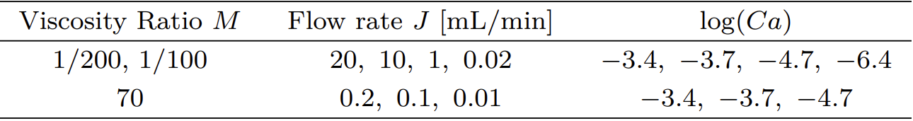
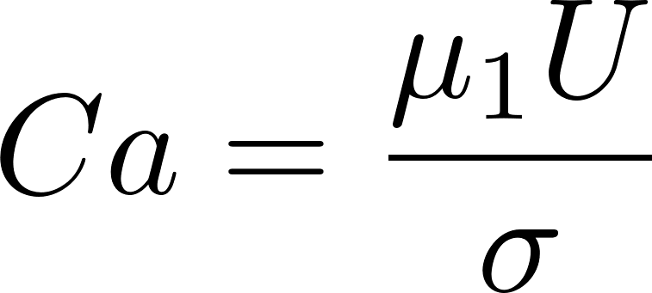
Two-phase Drainage Experiment: Setup and Flow-conditions
Numerically generated “Theoretical” surface topographies and aperture field
Fabricated Fracture
Simulations were performed using the theoretical field
Wetting films are not resolved in 3-D simulations
Rahul Krishna | Depth-Integrated Modeling of Immiscible Two-Phase Flow in Rough Fractures: Comparison with Experimental Observations
3 / 8

Slide 5

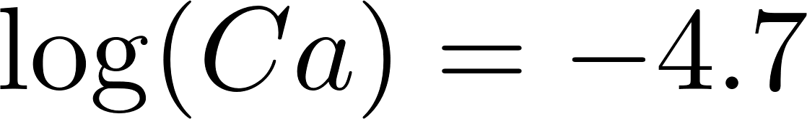




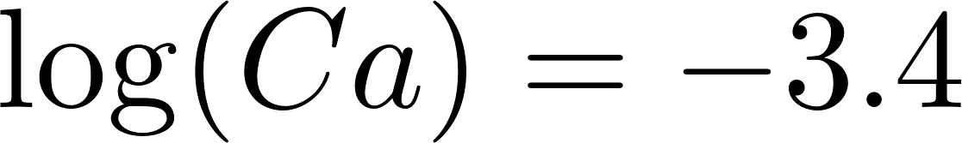



Results: Interface evolution
Experiment
3-D
2-D
Rahul Krishna | Depth-Integrated Modeling of Immiscible Two-Phase Flow in Rough Fractures: Comparison with Experimental Observations
4 / 8

Slide 6

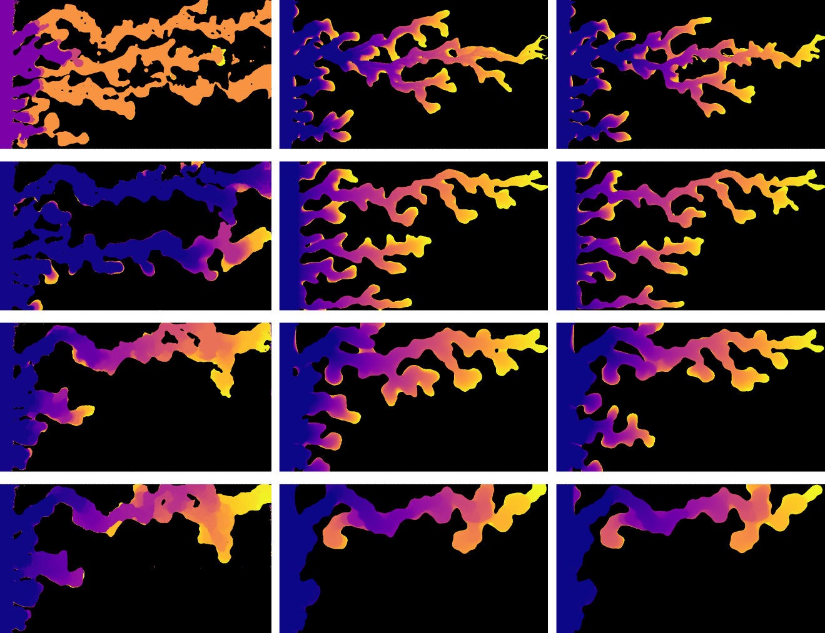
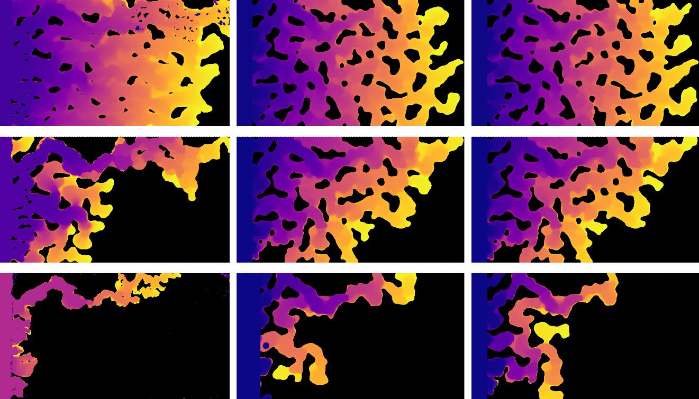



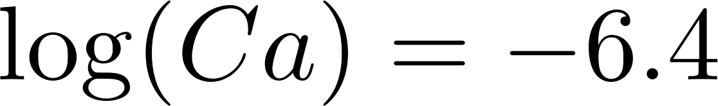
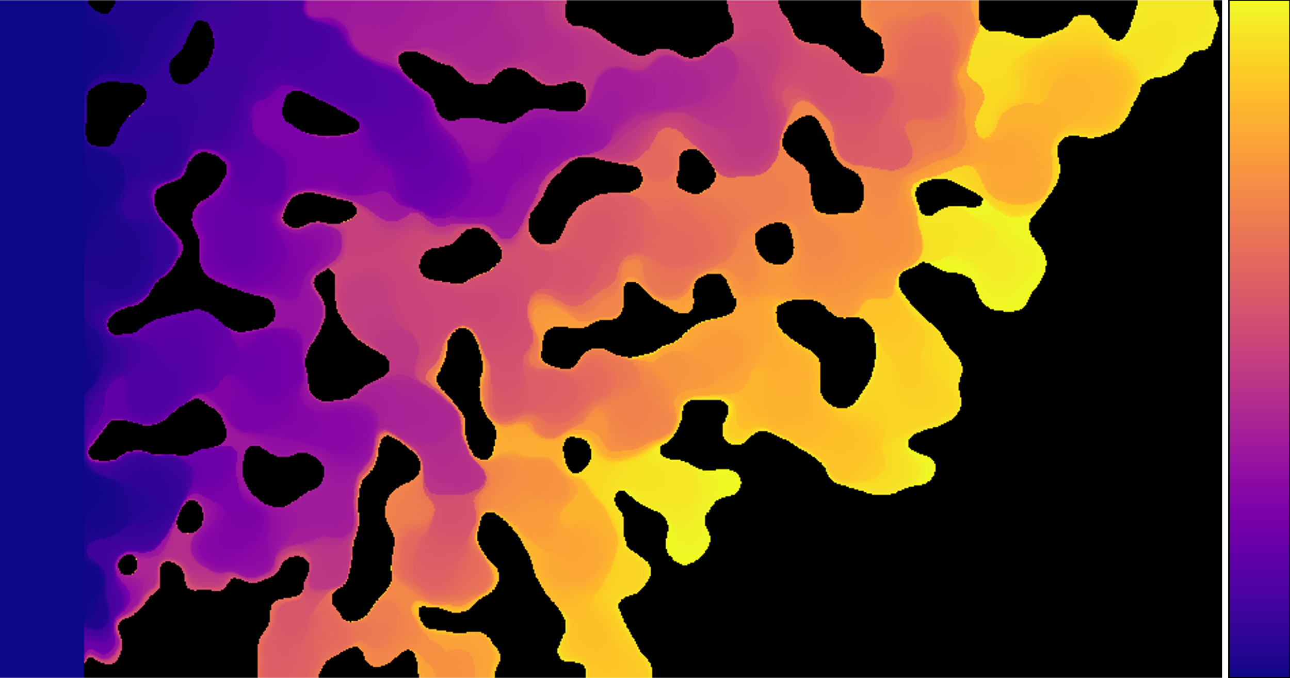
Results: Interface evolution
Experiment
3-D
2-D
Experiment
3-D
2-D
Time
Rahul Krishna | Depth-Integrated Modeling of Immiscible Two-Phase Flow in Rough Fractures: Comparison with Experimental Observations
5 / 8

Slide 7
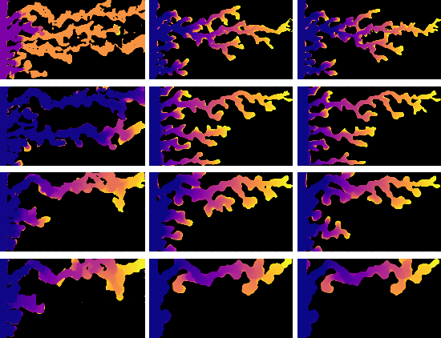
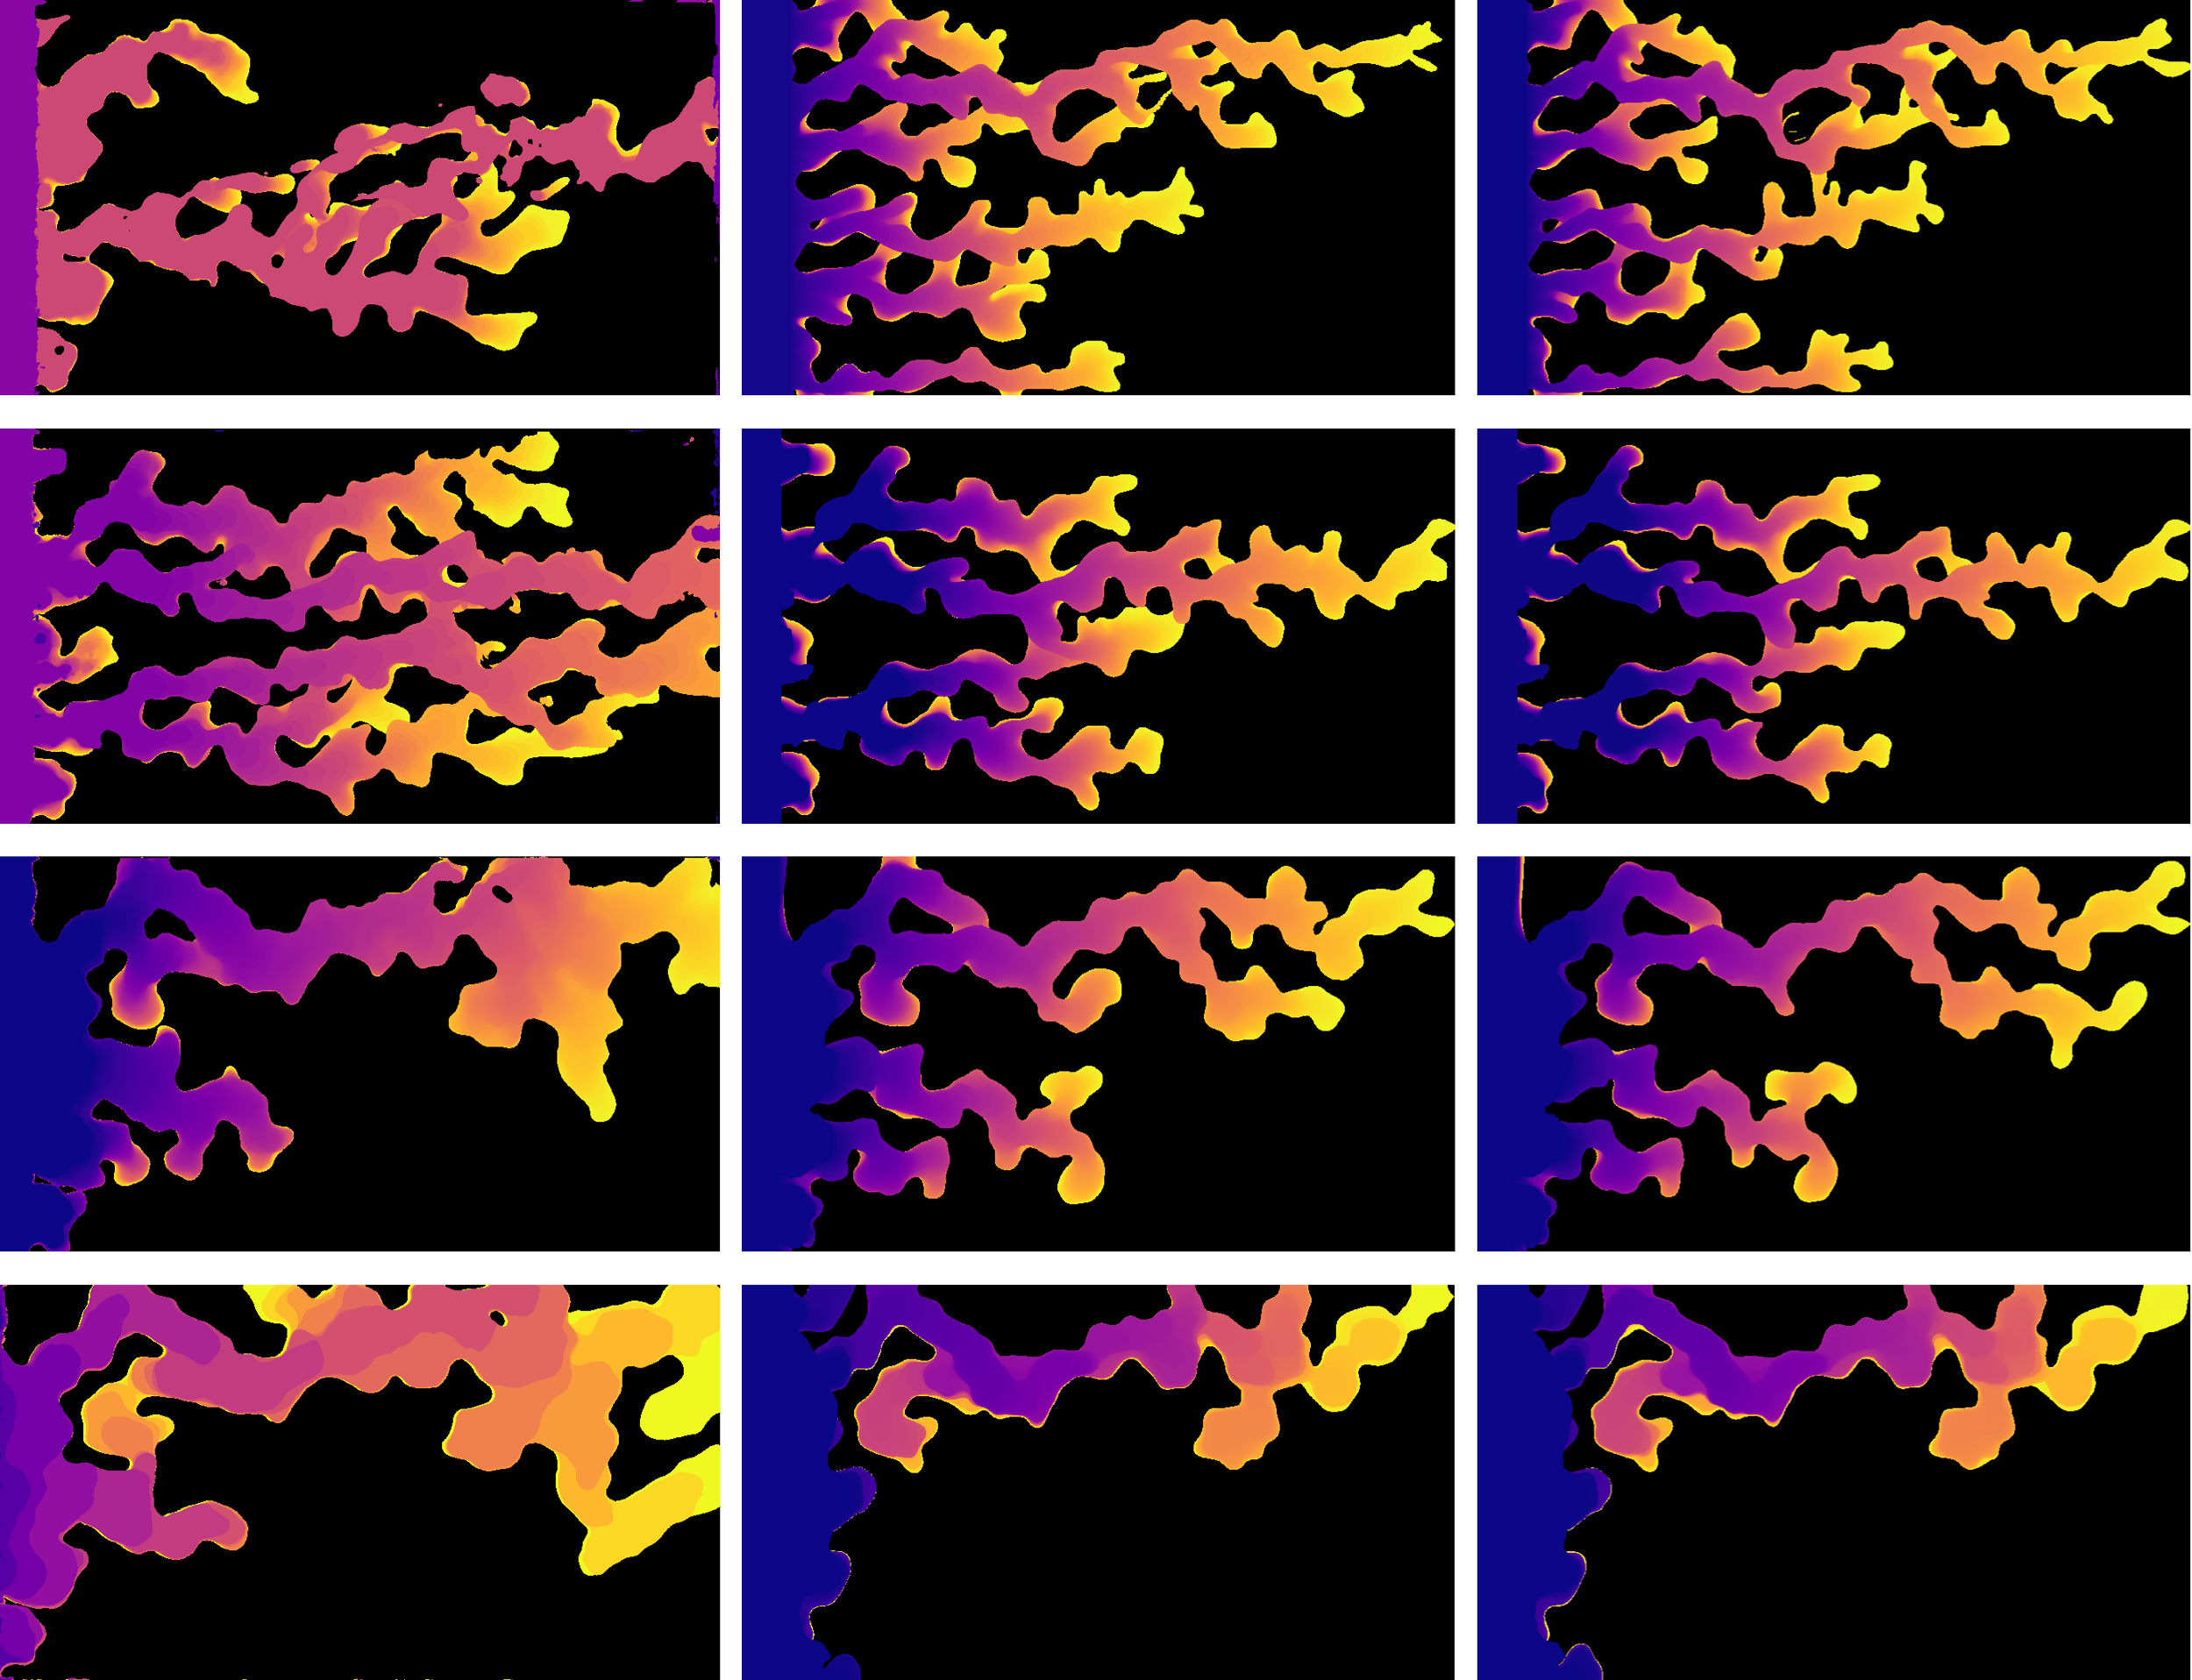

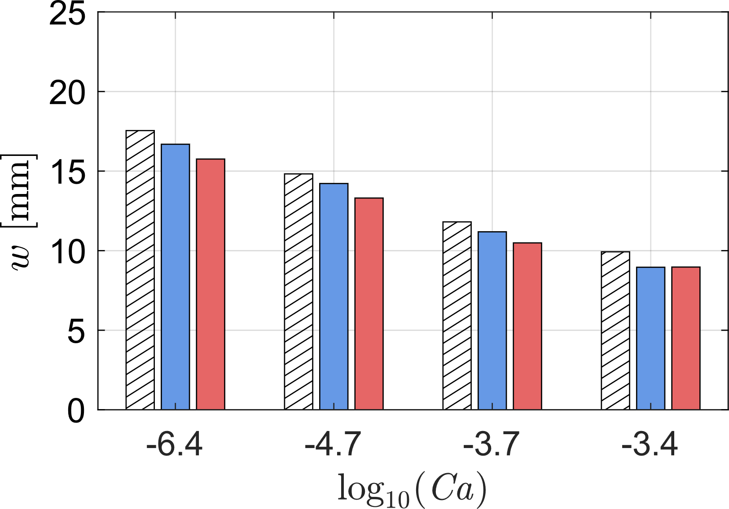
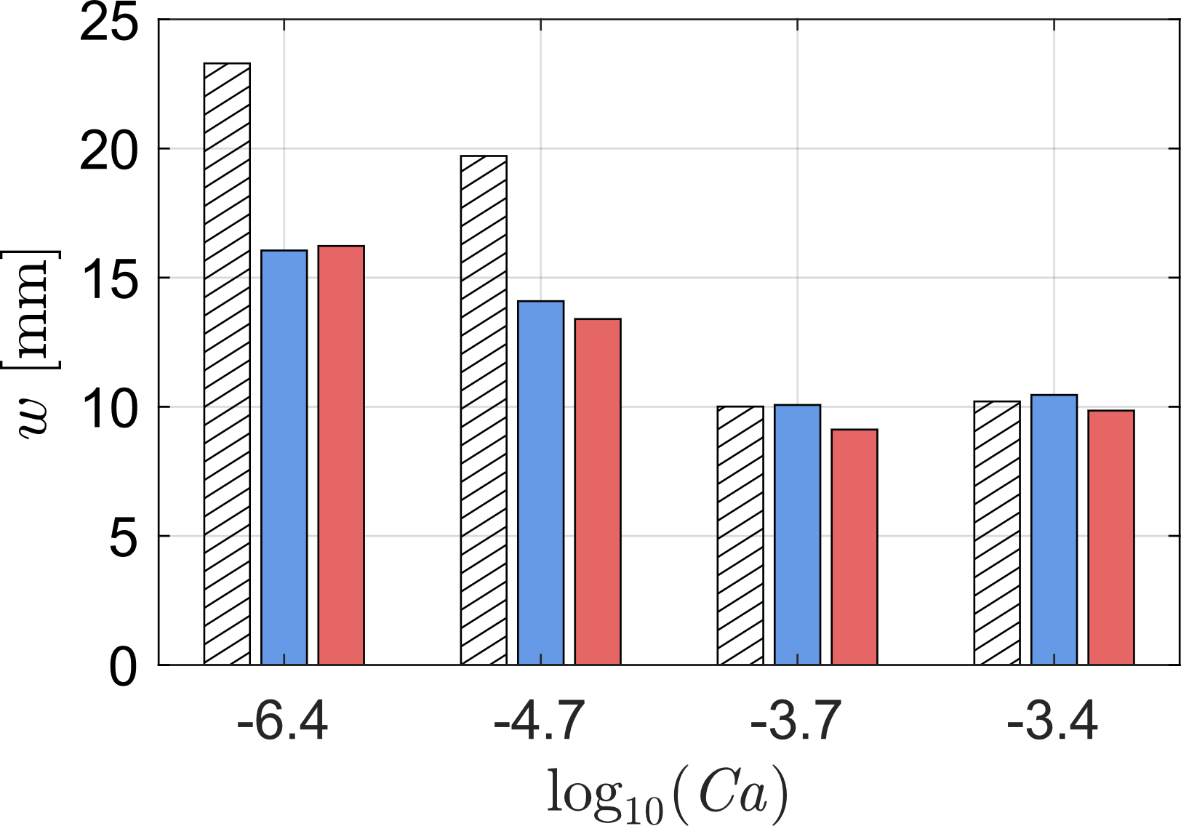
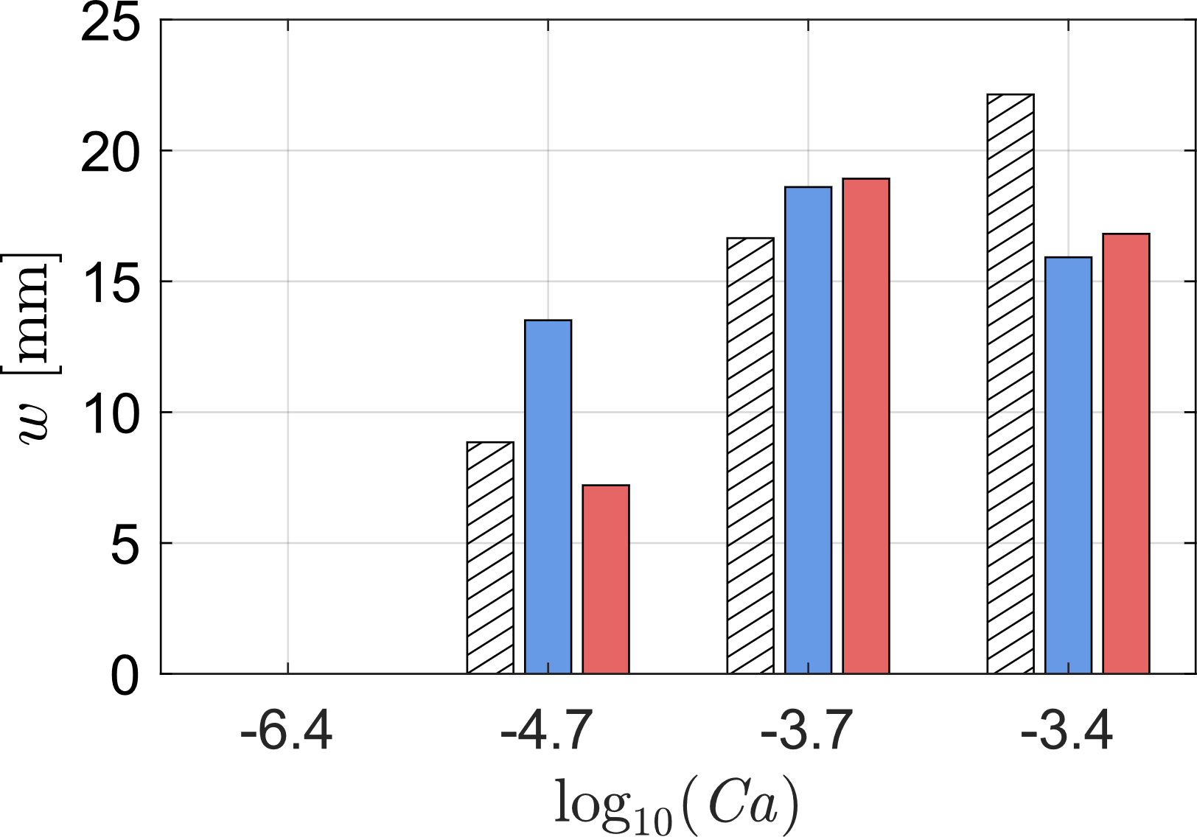
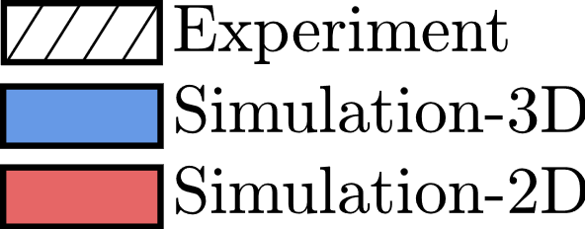
Results: Typical finger-width at breakthrough
Exp
3-D
2-D
Exp
3-D
2-D
Exp
3-D
2-D
Rahul Krishna | Depth-Integrated Modeling of Immiscible Two-Phase Flow in Rough Fractures: Comparison with Experimental Observations
6 / 8

Slide 8








Results: Interface length evolution
Exp
3-D
2-D
Exp
3-D
2-D
Exp
3-D
2-D
Rahul Krishna | Depth-Integrated Modeling of Immiscible Two-Phase Flow in Rough Fractures: Comparison with Experimental Observations
7 / 8

Slide 9


Conclusion
The depth-integrated 2-D model captures the essential drainage behavior observed experimentally.
3-D DNS remains the more faithful reference for detailed morphology.
2-D model’s strength is scale: it preserves key aperture-scale physics while enabling larger-scale and broader parameter studies.
The 2-D model is therefore not a replacement for 3-D DNS, but a computationally efficient bridge toward larger-scale predictive modeling.
Custom solvers and meshing utilities
twoPhaseCustomSolvers
rough-Fracture-Mesh-Generation
Rahul Krishna | Depth-Integrated Modeling of Immiscible Two-Phase Flow in Rough Fractures: Comparison with Experimental Observations
8 / 8

Slide 10
Thank you for your attention!

