Slide 1
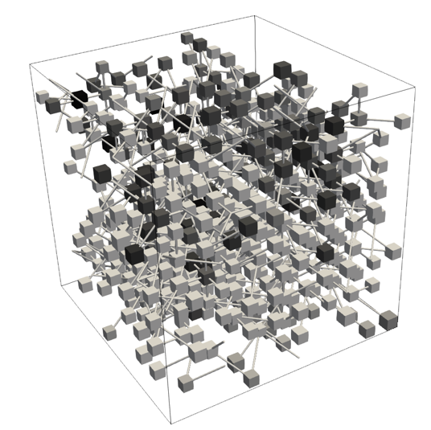

Quasi-static Pore-Network Modeling for Evaporation-Driven Salt Transport and Precipitation in Porous Media
Zhixin Chen¹, Bo Guo², Mathis Kelm¹,
Theresa Schollenberger¹, Rainer Helmig¹
¹ Institute for Modelling Hydraulic and Environmental Systems, University of Stuttgart, Stuttgart, Germany
²Department of Hydrology and Atmospheric Sciences, University of Arizona
May, 2026
Nantes, France
Notes:
Good morning everyone. Welcome to my presentation. My name is Zhixin Chen, from the University of Stuttgart.
Today I’m going to present a work that grew out of our collaboration with Bo Guo at the University of Arizona and Rainer Helmig’s group in Stuttgart.
The topic of my talk is quasi-static pore-network modeling for evaporation-driven salt transport and precipitation in porous media.

Slide 2
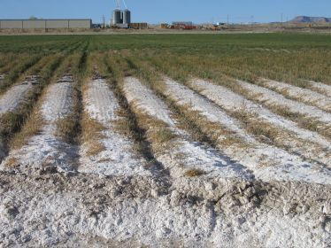
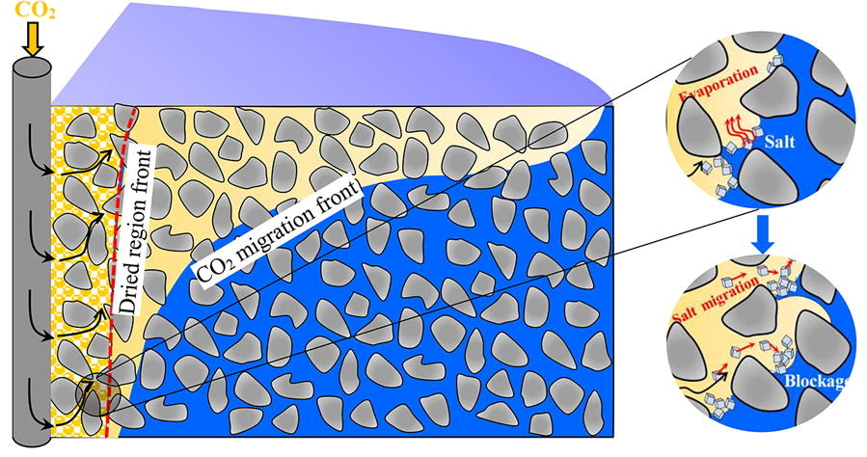
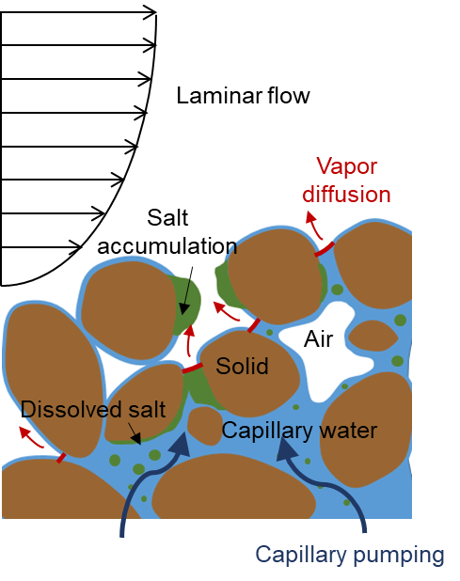
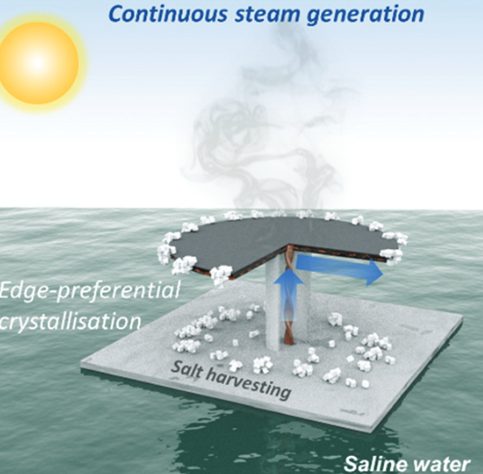
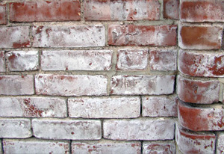
Motivation
Brine aquifer CO₂ storage
Soil salinization
Schematic figure of evaporation-driven salt precipitation
Weathering of building materials
Solar-driven seawater desalination
Evaporation-driven salt precipitation is a common phenomenon with adverse impacts across a wide range of systems
Notes:
Let me start with the motivation.
Evaporation-driven salt precipitation is common in porous media, with examples including soil salinization, weathering of building materials, CO2 storage, and solar-driven seawater desalination.
The basic mechanism is shown on the right. Evaporation removes water from the surface, creating a capillary pressure difference between the surface and the wetter interior.
This pressure difference drives liquid toward the evaporative surface, which is known as capillary pumping. For brine, this flow also transports dissolved salt toward the surface.
As evaporation continues, salt accumulates and may precipitate, which will clog the pore space and affect the performance of these systems.
To predict where salt accumulates and precipitates, we need to look at the pore scale.

Slide 3
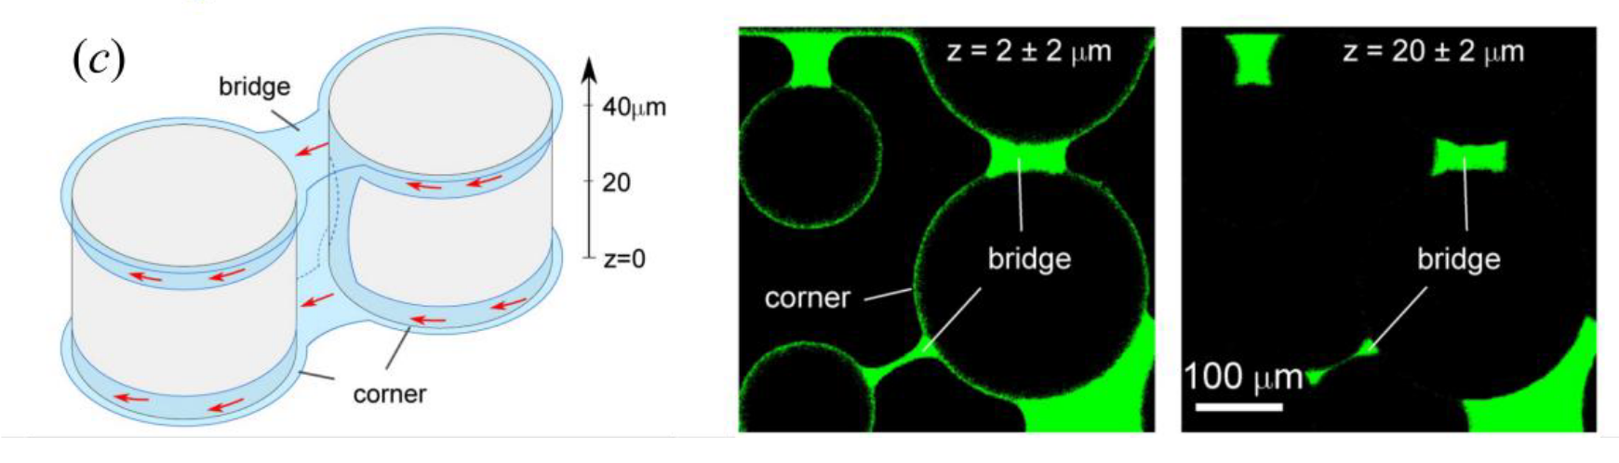
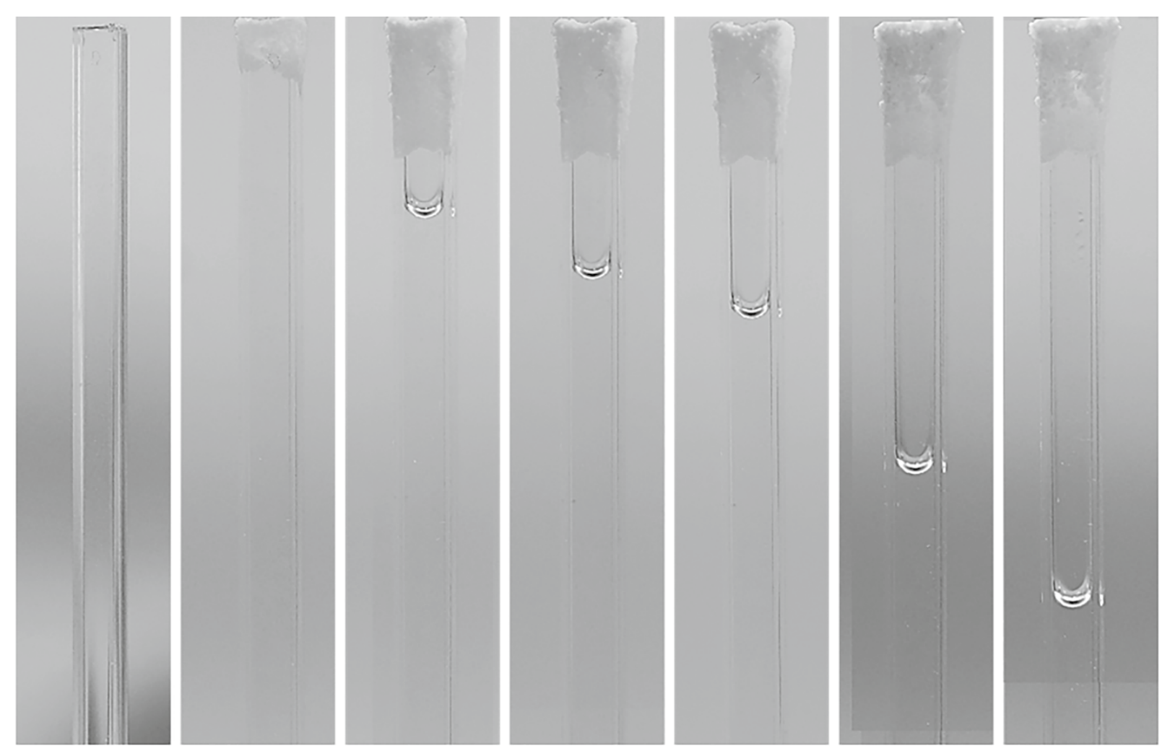
Motivation
Corner liquid
Salt crystallization and evolution of meniscus position in the square capillary tubes (Dong et al., 2024)
Corner flows in porous media (Lan et al., 2024)
Corner flow is an important pathway for liquid flow and salt transport
Notes:
At this scale, local phase distribution and liquid connectivity become important. One key example is corner flow: even when gas occupies the center of a pore or throat, liquid can remain connected and flow along the corners.
The left image shows corner flow observed in a microfluidic porous medium. The right experiment shows why it matters: during evaporation in a square capillary tube, corner liquid remains in the four corners and continues to transport salt toward the surface, leading to crystallization on the evaporation surface, which indicate Corner flow is an important pathway for liquid flow and salt transport

Slide 4
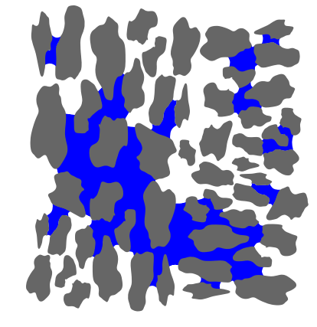
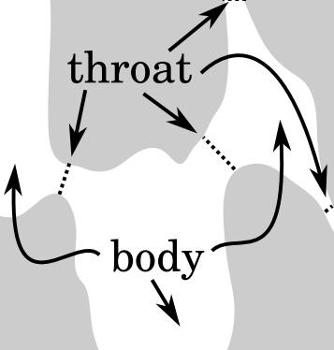
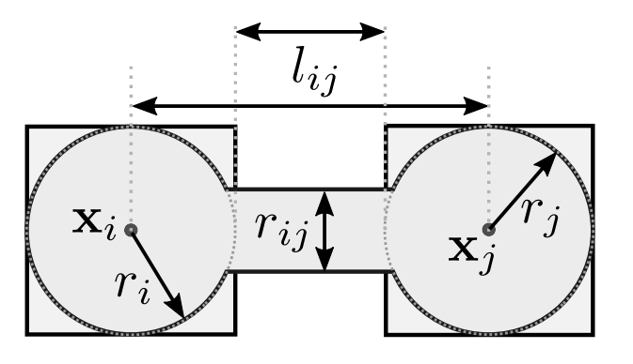
Motivation
Pore network model
Feature
Dynamic Pore-Network Model
(DPNM)
Quasi-static Pore-Network Model
(QSPNM)
Dominant
forces
Coupled capillary–viscous effect
Capillary-dominated (Ca → 0)
Governing
equations
Mass conservation with momentum balance
Young–Laplace relation determines capillary entry pressure at throats
Time
treatment
Fully transient: pressure fields and interface velocities evolve during each time step.
Time-discretized for drying/transport, but each step assumes capillary equilibrium
Computational
cost
High; requires solving a global pressure system at each time step.
Low; efficient for large networks and long-duration simulations.
Notes:
Pore-network models are useful for this problem because they preserve essential pore-scale physics while remaining computationally efficient.
There are generally two types of pore-network models. Dynamic pore-network models solve pressure and flow fields during each time step, so they can describe transient capillary-viscous effects. However, they are computationally expensive and often require small time steps.
Quasi-static pore-network models are much more efficient. They assume capillary equilibrium and are especially suitable for capillary-dominated drying processes, where the capillary number is small. But traditional quasi-static models do not directly provide liquid fluxes during instantaneous redistribution events. This makes it difficult to model advective salt transport.
So the key question of this work is: can we keep the efficiency of a quasi-static model, while still reconstructing the liquid flux needed for salt advection?

Slide 5
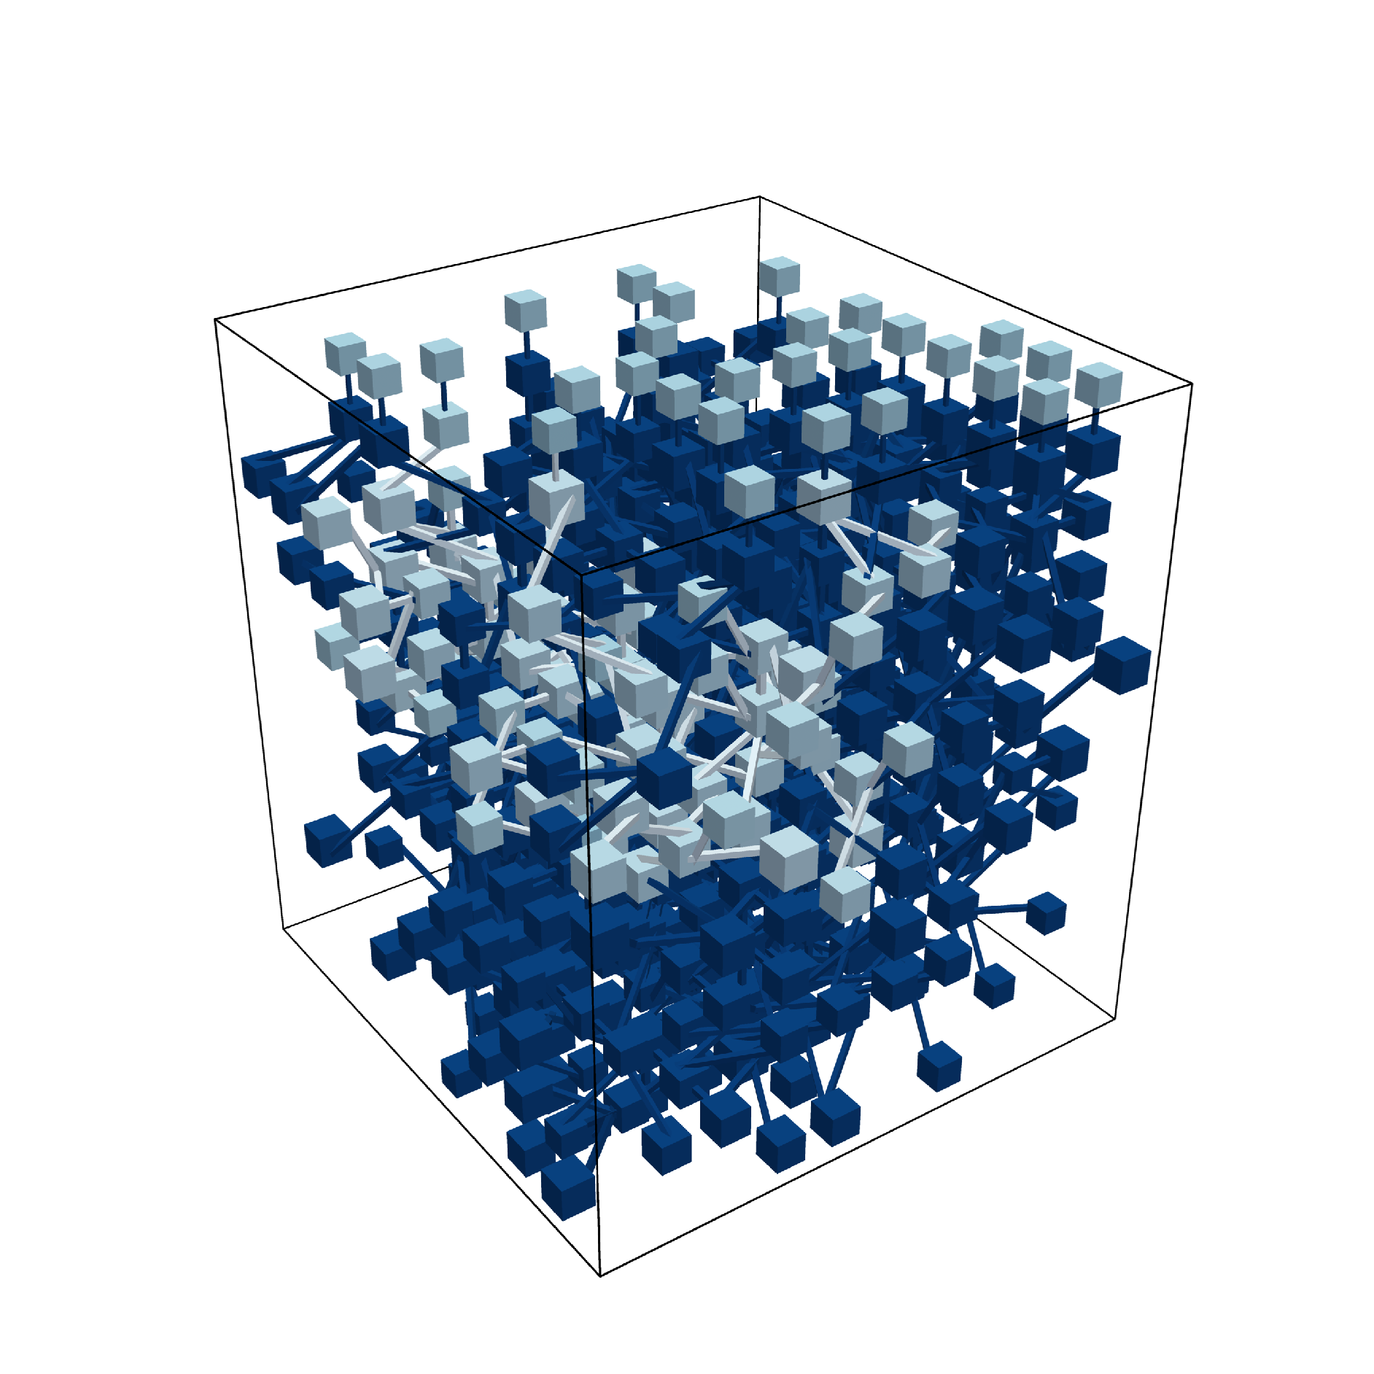
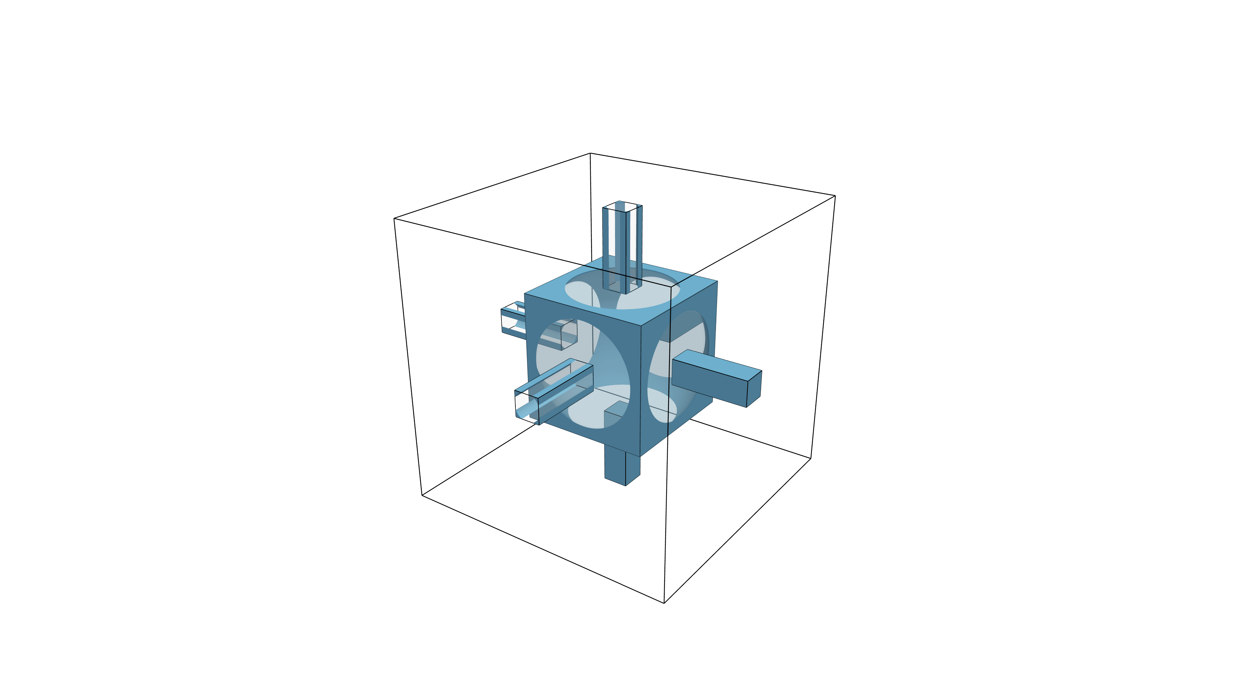
Pore Network Representation
Evaporative surface
Top pores
Corner liquid
Pore body
Invaded cluster
Uninvaded pore throat
Uninvaded cluster
(a) Pore network
(b) A pore body and its connecting pore throats
Notes:
We start with our pore network representation. The schematic figure of pore network structure is shown on the left, where the dark blue pore is the saturated pore, and the cluster of them is named uninvaded clusters
We set the top surface as evaporative surface, where we define the evaporative flux at the top pore bodies, while all other boundaries are impermeable
During the evaporation, gas will get invaded to the pore throat and the connecting pore bodies, which is denoted as the light blue, and the set of them is the invaded cluster.
To explicitly capture corner films, we adopt the geometry shown on the right: cubic pore bodies connected by square cross-section pore throats. This geometric choice is crucial. When gas invades a throat, the bulk liquid is displaced, but the square cross-section allows the liquid phase to remain connected through the four corner films.

Slide 6
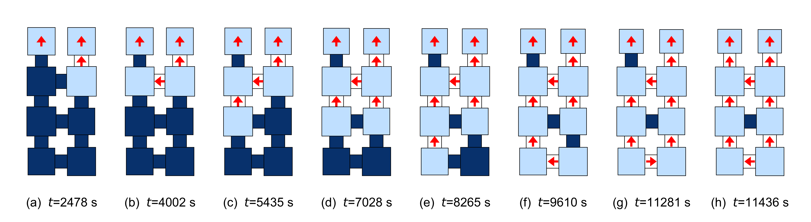
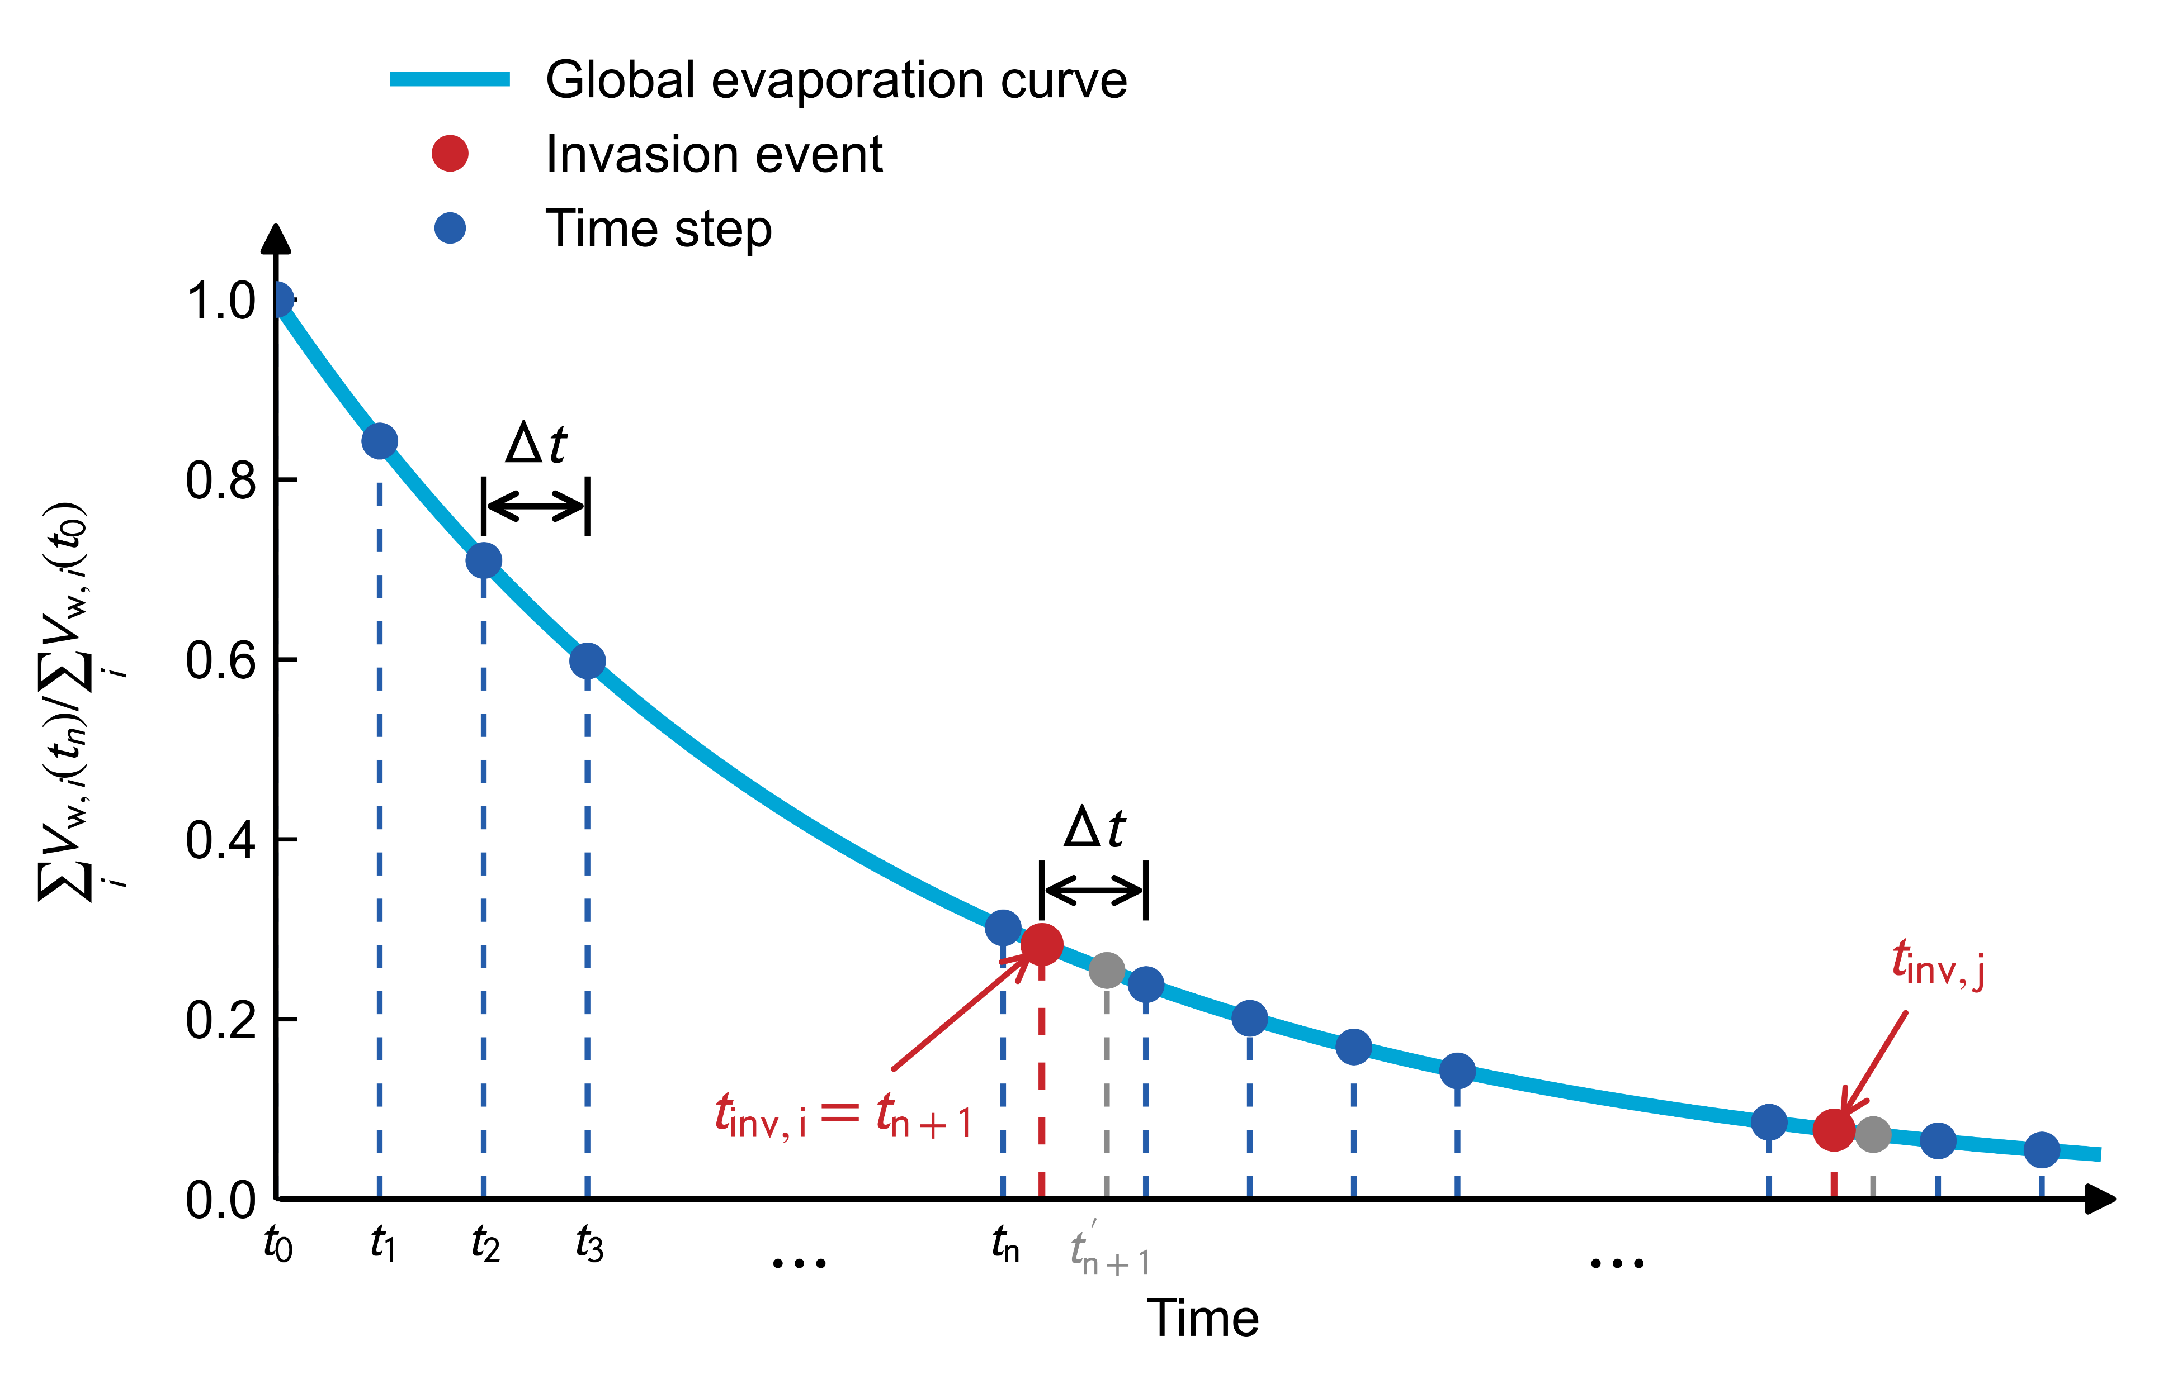
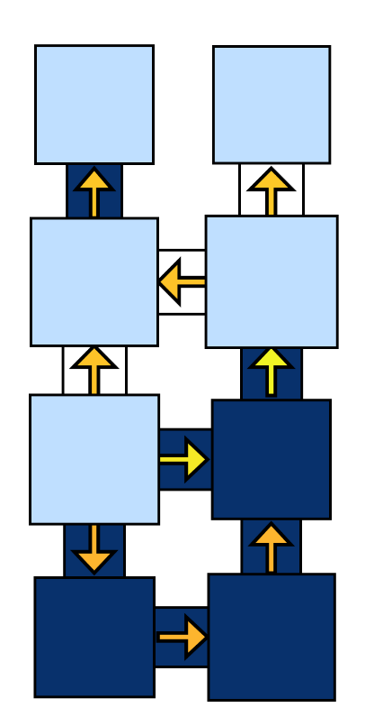
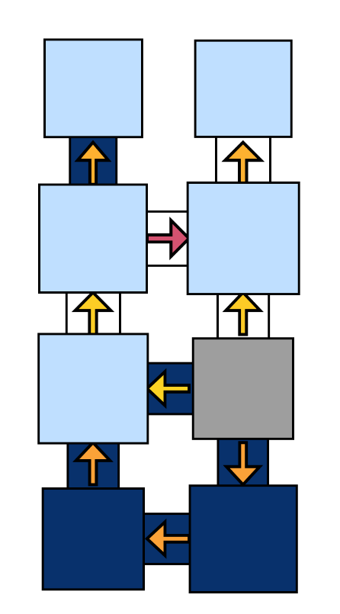

QSPNM framework
Vapor diffusion
& salt diffusion
Time splitting method:
Slow process: Vapor diffusion (gas phase)
Fast process: Capillary flow (liquid phase)
Liquid redistribution
& salt advection
& salt precipitation
Invasion event
& salt convection
& salt precipitation
Vapor flux
Liquid volume transfer
Uninvaded pore
Newly invaded pore
Invaded pore
Notes:
The figure on the left demonstrate our QSPNM framework, we discrete the drying process as many time step.
The model is based on a time-splitting strategy.
We separate slow and fast processes. Vapor diffusion in the gas phase and salt diffusion are treated as time-dependent processes. In contrast, capillary-driven liquid redistribution is treated as a fast process, or approximately instantaneous.
During each time step, evaporation changes the liquid saturation. This may trigger liquid redistribution or invasion events. These redistribution events cause liquid volume transfer, and therefore also salt advection. Salt precipitation is then calculated based on the updated concentration.
This separation allows us to model the dominant capillary-controlled physics without solving a full dynamic pressure system at each small time step.

Slide 7
Numerical Algorithm
Start
Invasion?
No
Initialization
Yes
Determine invasion time t_{inv}
Vapor diffusion
Restore backup state at t_{n}
Recompute the above processes with
Drying-induced liquid redistribution
Invasion-induced liquid redistribution
Salt advection
Salt precipitation
Reach target time step?
No
Salt diffusion
Yes
End
Notes:
The numerical algorithm follows this sequence.
First, we initialize the pore network. Then we solve vapor diffusion, update drying-induced liquid redistribution, calculate salt advection, salt diffusion, and salt precipitation.
If no invasion occurs, the simulation proceeds to the next time step. If invasion occurs within the time step, we determine the invasion time, restore the backup state, recompute the processes up to the invasion time, and then apply invasion-induced liquid redistribution.
This structure allows the model to handle both gradual drying and discrete invasion events.
As time is limited, I will not jump into details of each subprocess, but one of the most significant part is how we can handle the missing liquid flux during the liquid redistribution process to solve the salt advection.

Slide 8
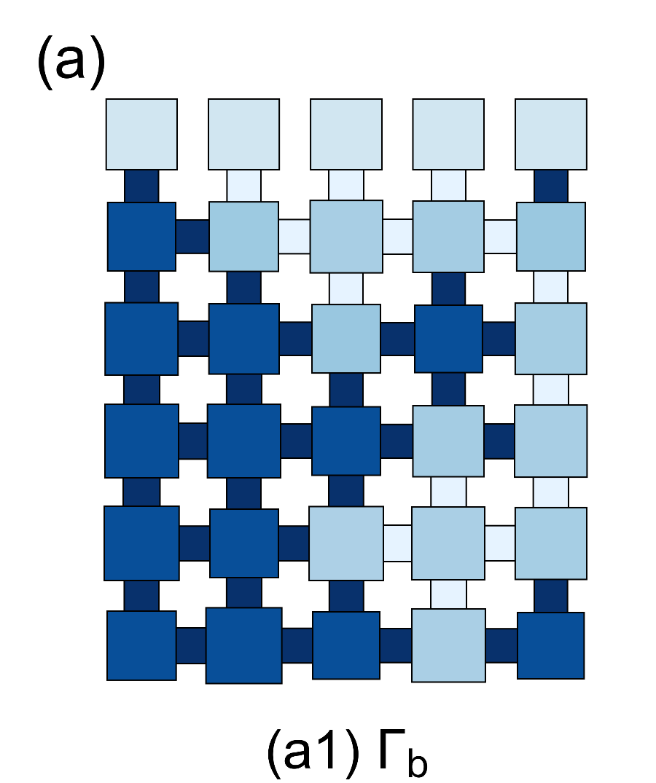
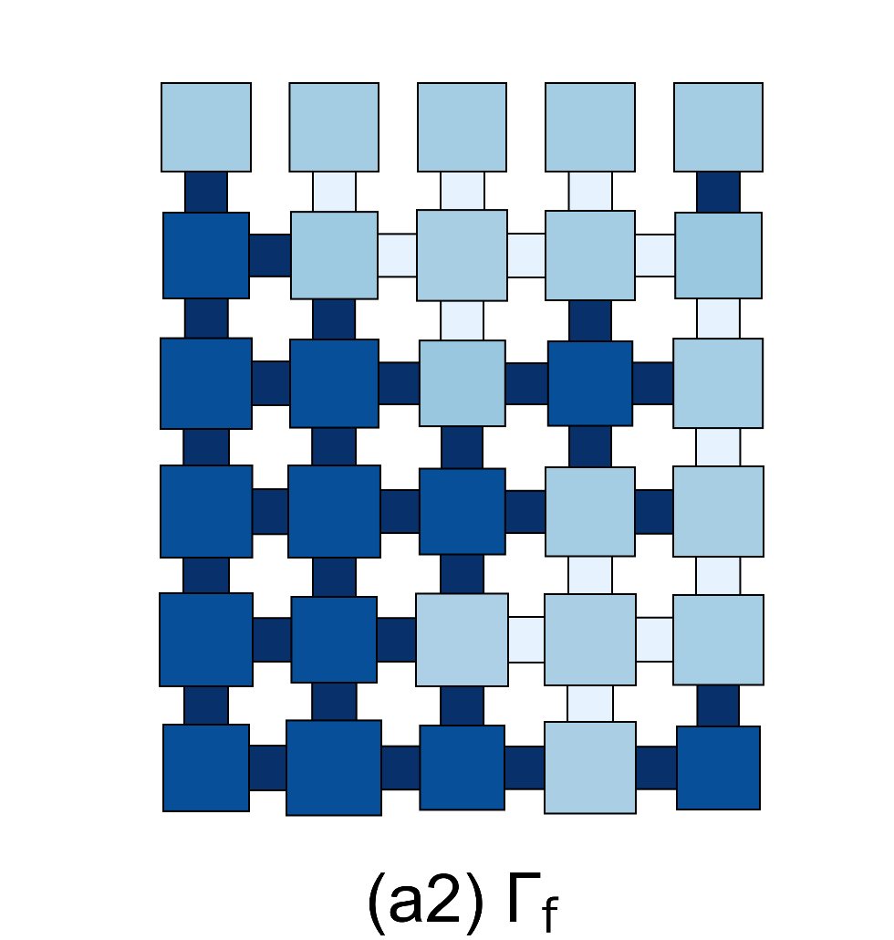
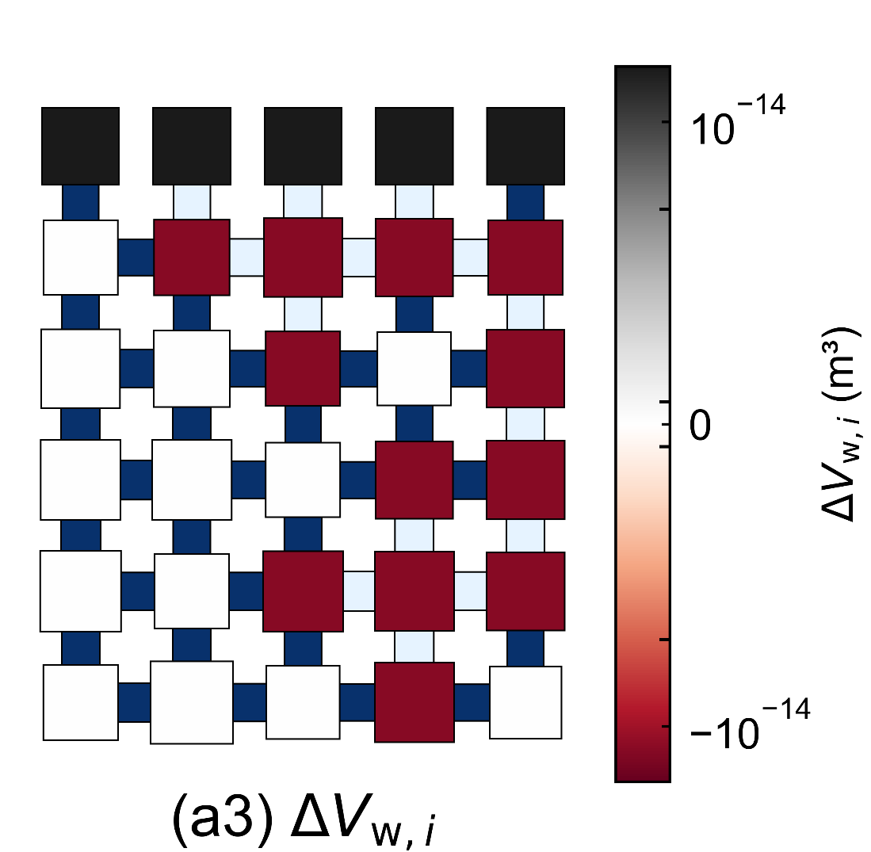
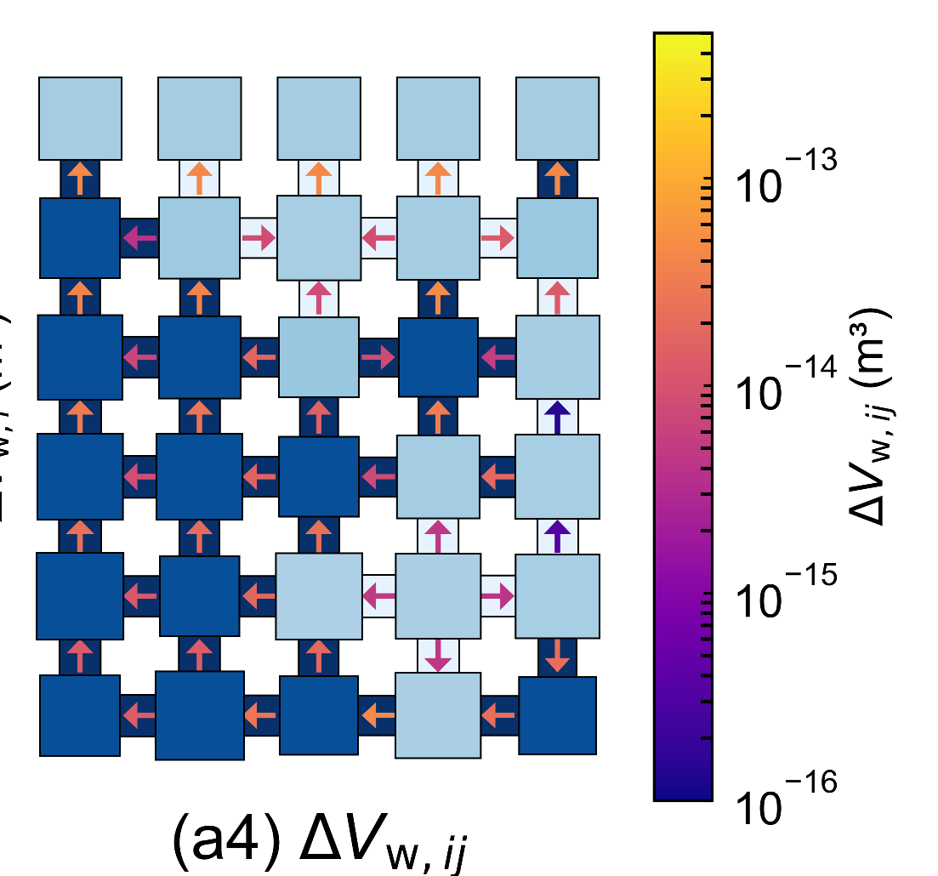
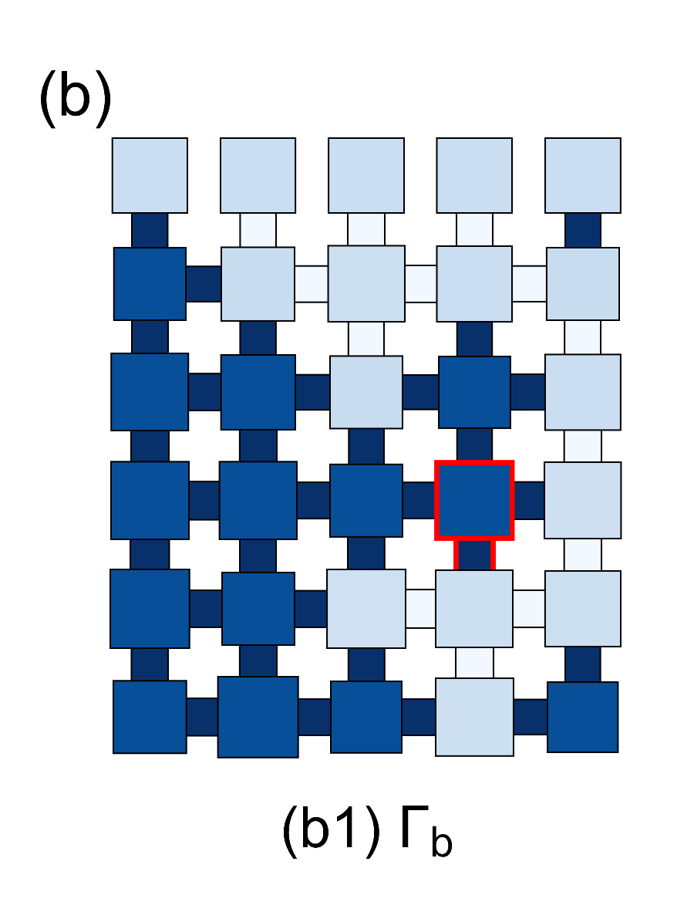
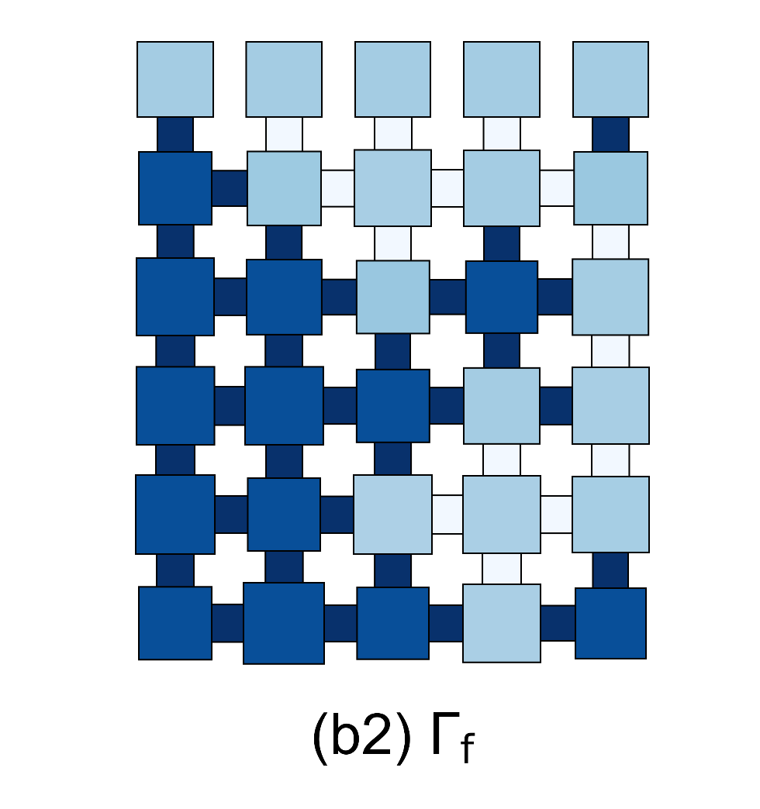
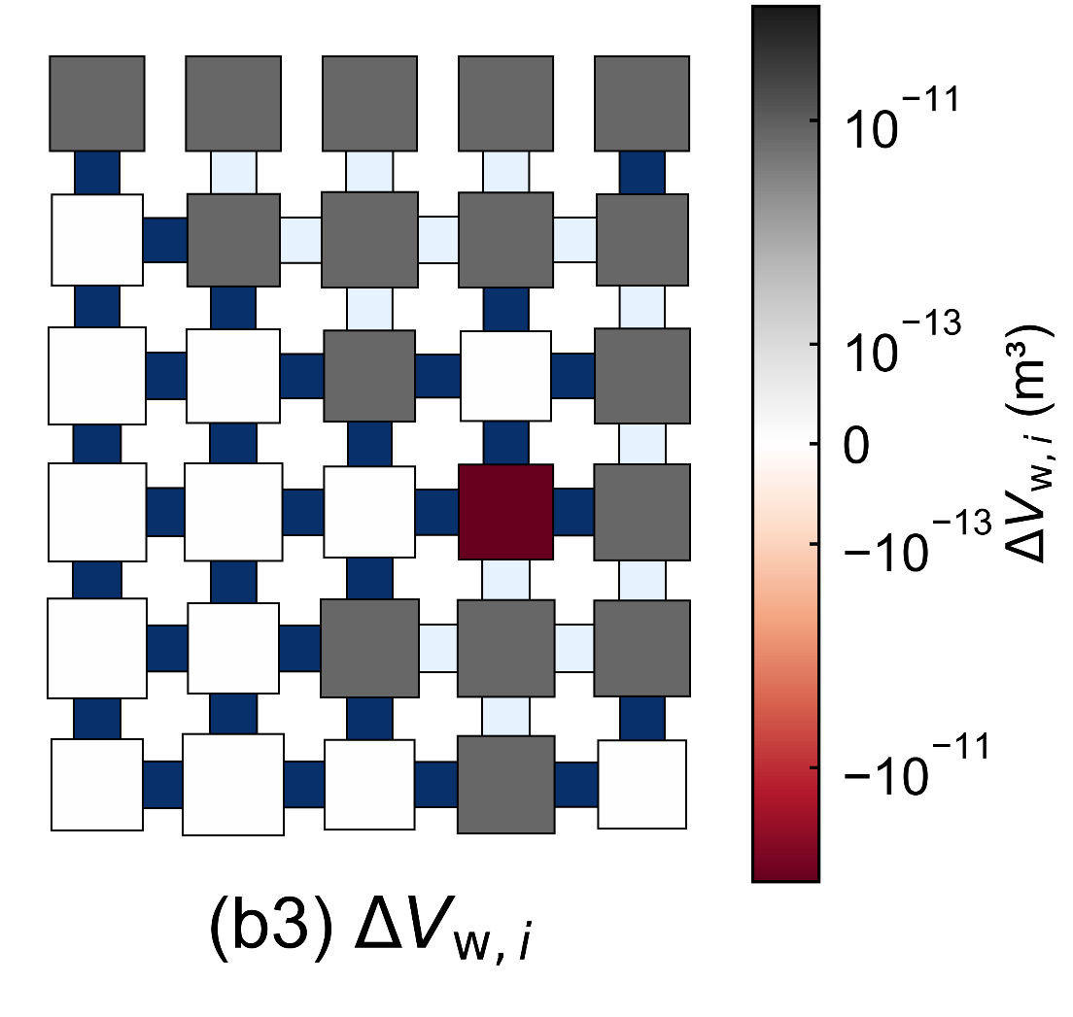
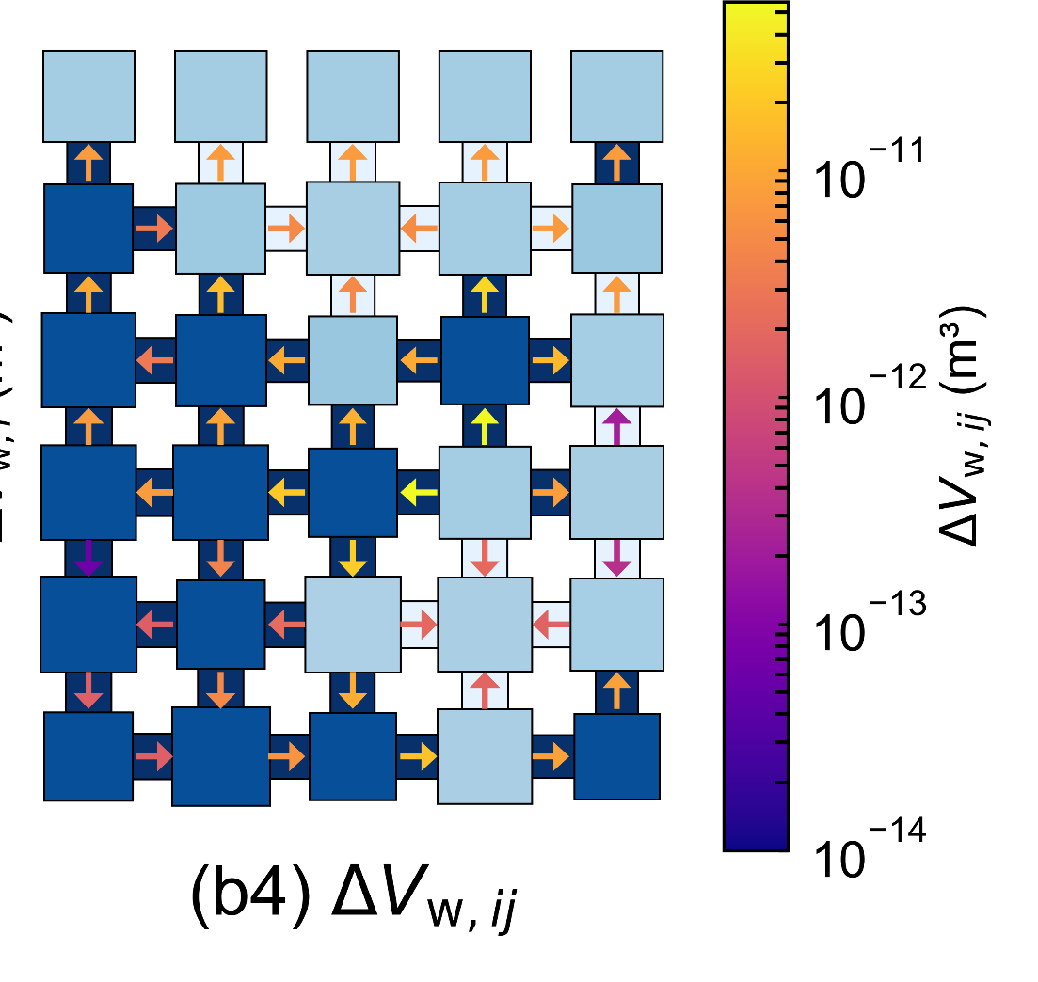
Time-Integrated Liquid Flux During Redistribution Events
Reconstruct the liquid flux during liquid redistribution
Drying-induced liquid redistribution
Invasion-induced liquid redistribution
Notes:
The central part of the method is the reconstruction of time-integrated liquid flux during redistribution events.
In a quasi-static model, redistribution happens instantaneously. Therefore, we do not directly know the transient liquid velocity. But for salt advection, we do not necessarily need the full velocity history. What we need is the time-integrated liquid volume passing through each throat.

Slide 9
Time-Integrated Liquid Flux During Redistribution Events
Liquid flux approximation for salt advection
Liquid redistribution occurs in δt (δt → 0)
Time-integrated liquid flux ∆V_{w,ij} through pore throat:
Approximate liquid flux:
Nodal source at pore i is obtained from the saturation change:
Solve continuity equation of liquid:
Solve with a selected δt
Notes:
Our idea is to reconstruct this integrated liquid flux from mass conservation. The saturation change gives the net liquid volume change in each pore. Then we solve a liquid continuity equation to obtain the flux through each connecting throat.

Slide 10
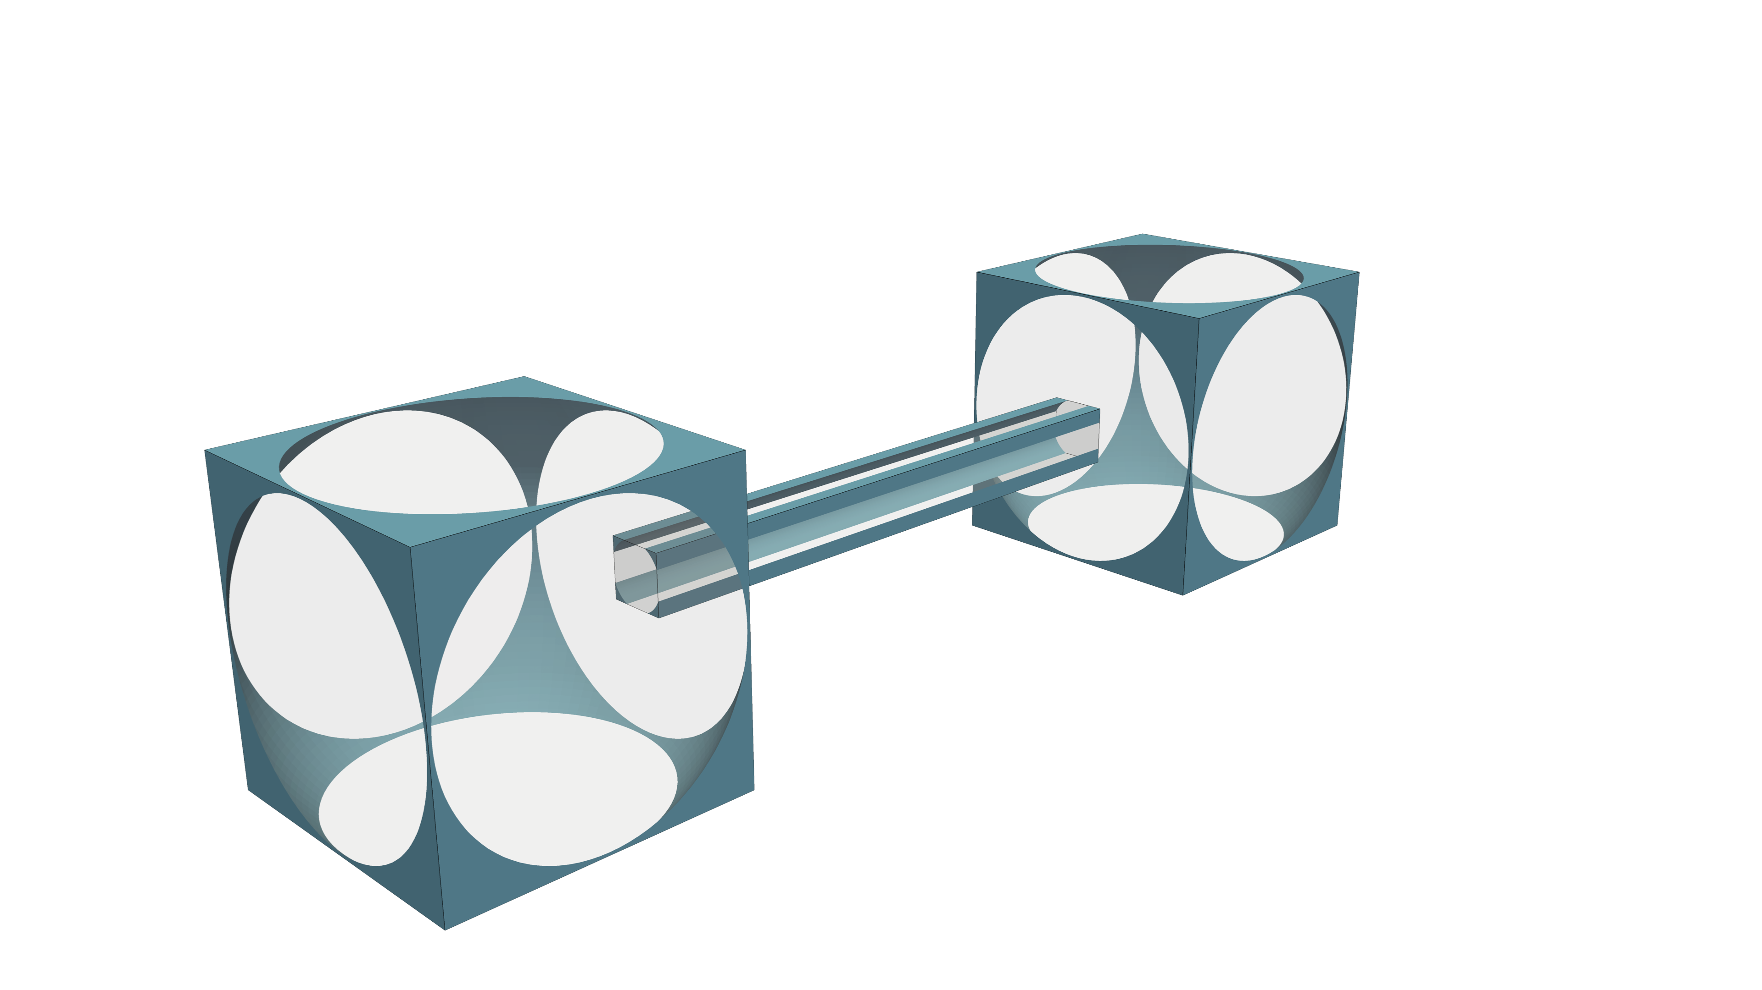
Salt advection
Implicit upwind scheme
Mass conservation for each pore
ΔV_{w,ij}
Pore j
Solve linear system with the known ∆V_{w,ij}
Pore i
Notes:
Once this time-integrated flux is known, we use an implicit upwind scheme for salt advection. The upwind concentration is selected according to the direction of the reconstructed liquid flux. This gives a conservative way to update salt concentration during both drying-induced and invasion-induced redistribution events.

Slide 11
Salt precipitation
Precipitation and pore-space alternation
Precipitation / dissolution rate
Precipitated salt is uniformly distribute on the wall of the pore body:
Precipitated salt inside the pore throat will decrease the area section of the pore throat, which will influence the hydraulic conductance:
Notes:
After salt transport, we calculate precipitation and dissolution based on the local salt concentration.
When the concentration exceeds the solubility limit, salt precipitates. In the pore body, the precipitated salt is distributed on the surface. In the pore throat, precipitation reduces the available cross-sectional area, which changes hydraulic conductance and feeds back into subsequent transport.

Slide 12
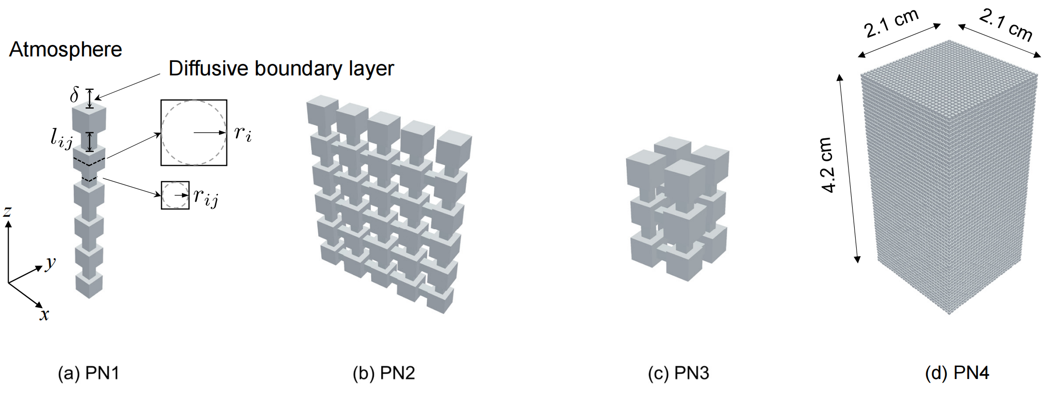
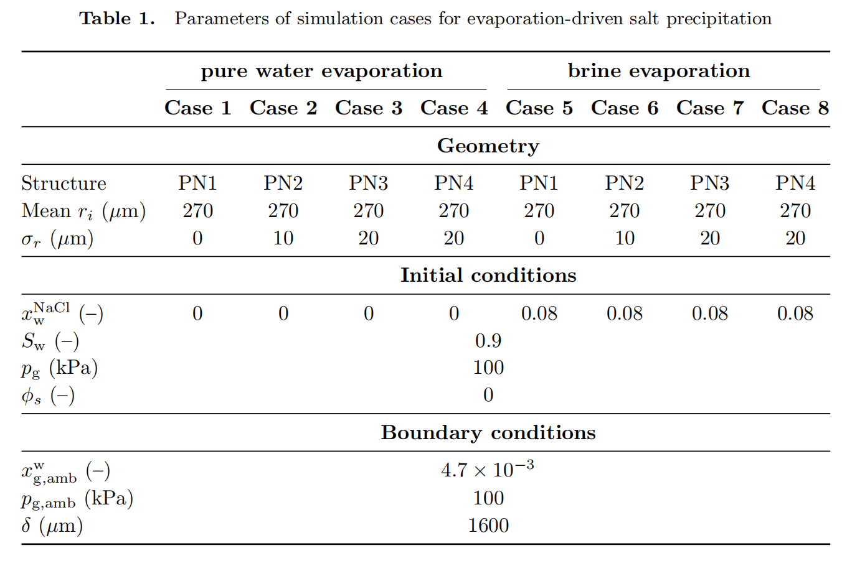
Numerical cases
Notes:
We test the model using several pore networks. These include small networks for comparison with a dynamic pore-network model, and larger three-dimensional networks to demonstrate computational capability.
The cases include both pure water evaporation and brine evaporation. We assume the porous media is open to the stagnant atmosphere with lower relative humidity. The capillary number in those scenaries is very small, below 3 times 10 to the minus 9, so the system is in a capillary-dominated regime. This is exactly the regime where a quasi-static approach should be appropriate.

Slide 13
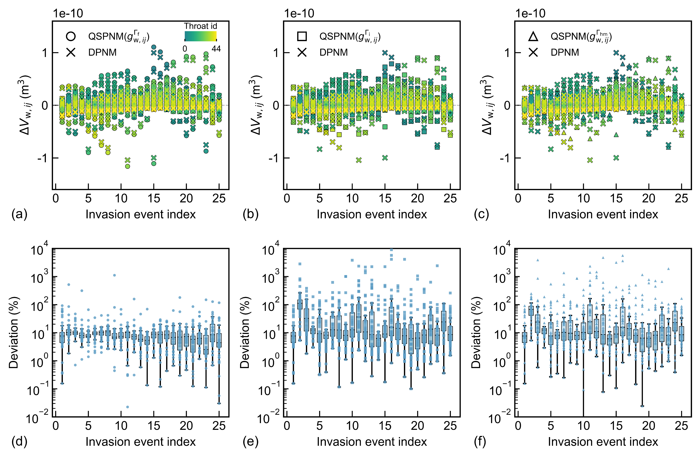
Comparison against DPNM
Time-Integrated Liquid Flux Approximation with different g_{w,ij}
Model using the throat conductance after invasion yields the smallest relative error
Median relative error is less than 10%
Comparison of ∆V_{w,ij} between the QSPNM and the DPNM in PN2.
Notes:
We first compare the reconstructed liquid flux against results from the dynamic pore-network model.
We test different choices of throat conductance in the flux reconstruction. The results show that using the throat conductance after invasion gives the smallest relative error. The median relative error is less than 10 percent.

Slide 14
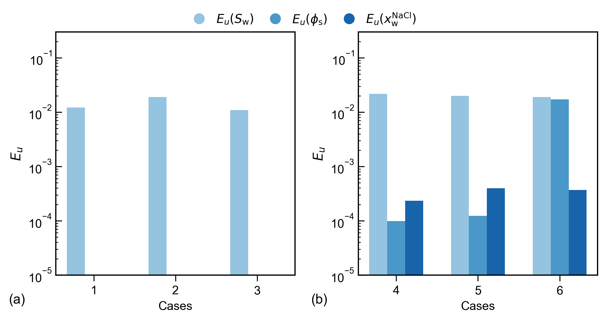
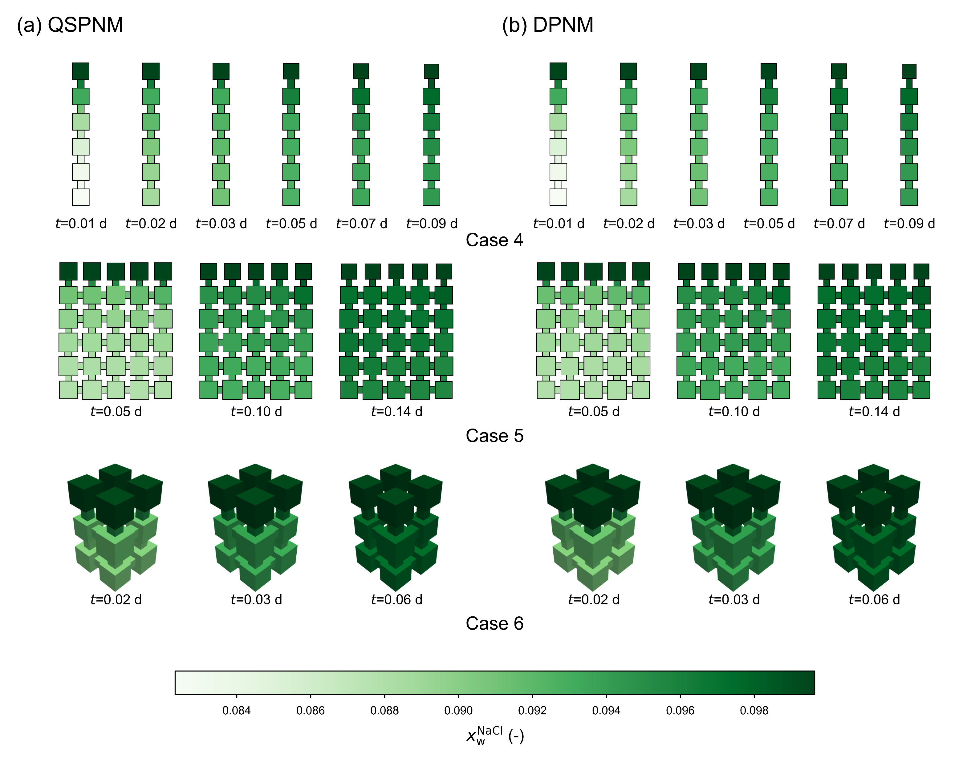
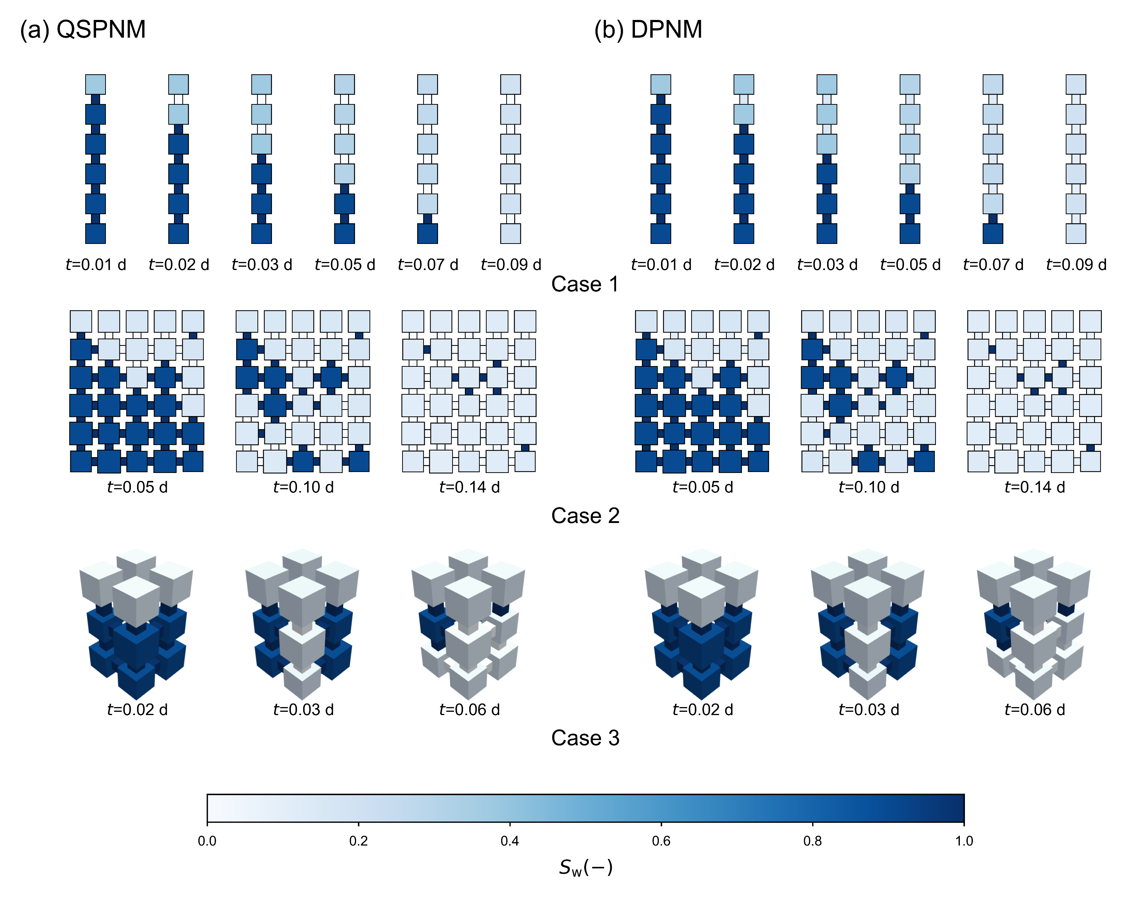
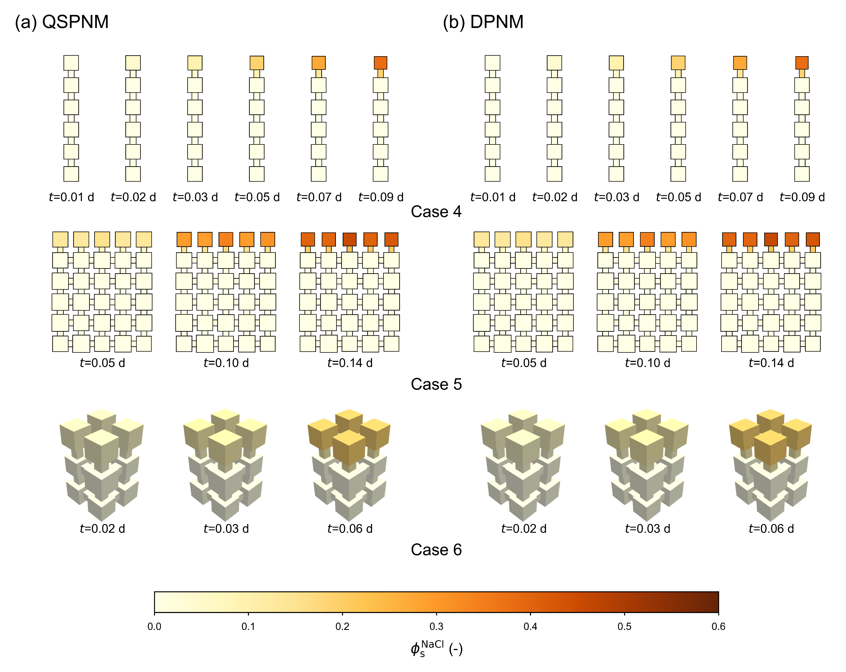
Comparison against DPNM
Notes:
Then we compare the full QSPNM results with DPNM results on the key quantities, including saturation, salt concentration and salt precipitation. Overall, the spatial patterns and temporal evolution agree well, and the absolute error is less than 0.01, indicating that the reconstructed flux is sufficient to capture the dominant advective salt transport during redistribution events.

Slide 15
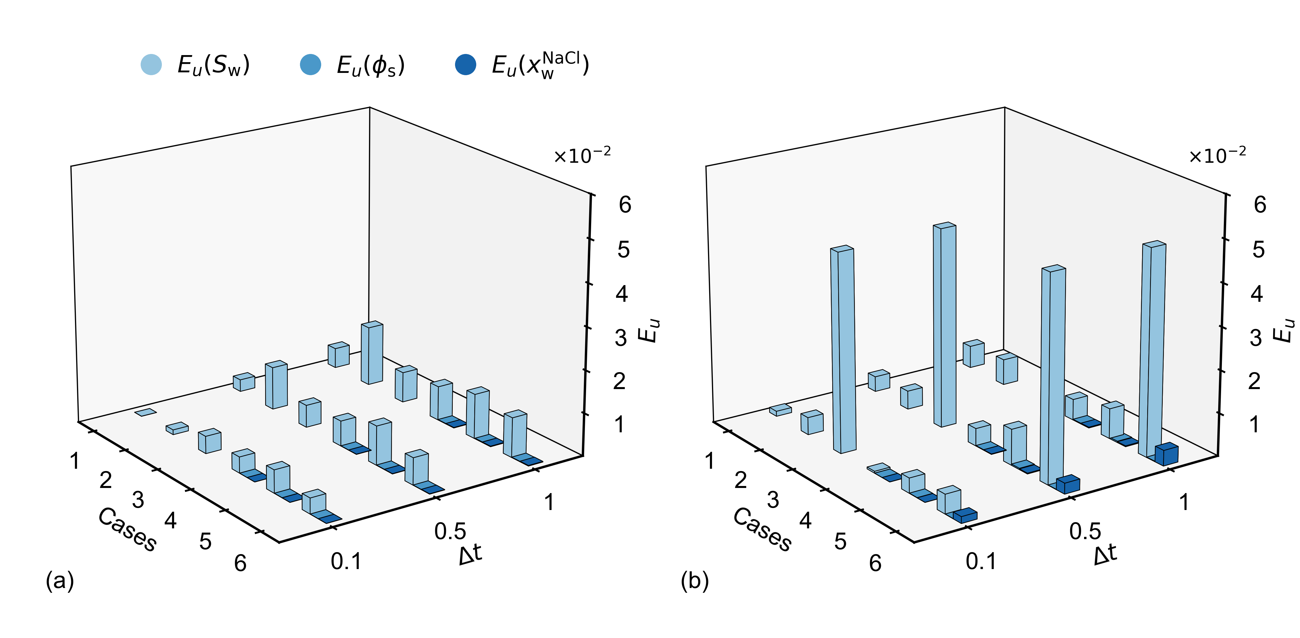
Numerical convergence
The proposed QSPNM achieves stable convergence for all cases, even with ∆t = 1 s
E_{u}(S_{w}) for the DPNM is relatively large and it fails to converge with ∆t = 1 s in Case 3
Temporal convergence of key quantities comparing different ∆t against the reference
(∆t = 0.01 s): (a) QSPNM and (b) DPNM.
Notes:
Next, we examine numerical convergence.
The proposed QSPNM shows stable convergence for all tested cases, even with a time step of one second. In contrast, the DPNM shows larger errors for some quantities and fails to converge with a one-second time step in one case.
This is important because it means the quasi-static can also use larger time steps for comparable accuracy.

Slide 16
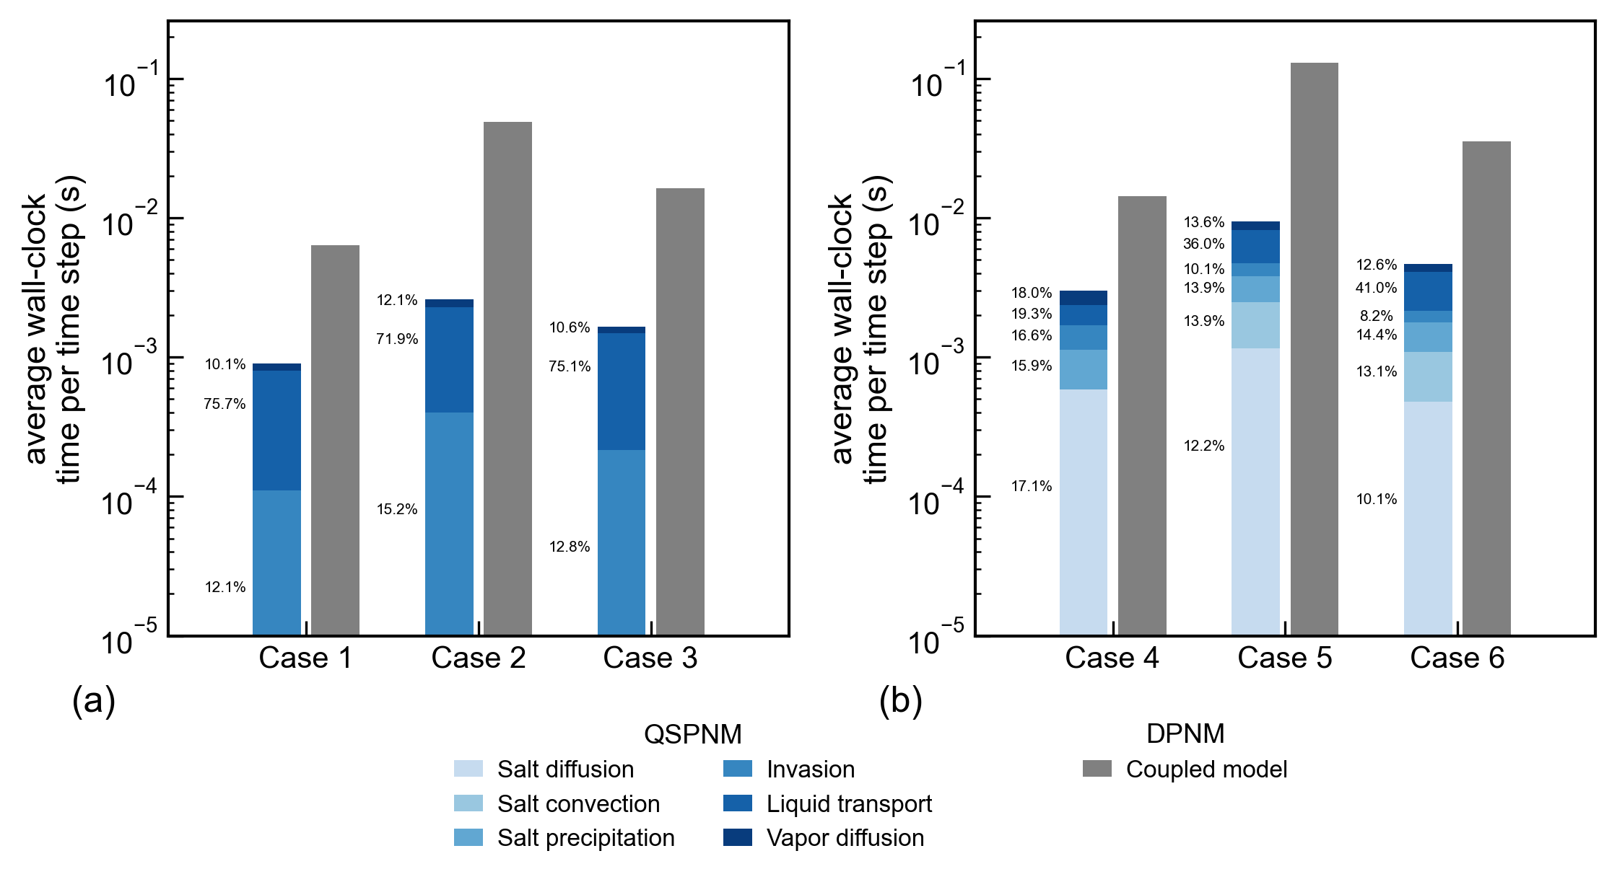
Numerical efficiency
The QSPNM is approximately 6.9 to 18.6 times faster in pure water evaporation and it is 5.5 to 13.6 times faster in Brine evaporation
Notes:
In terms of computational efficiency, the QSPNM is substantially faster.
For pure water evaporation, it is approximately 6.9 to 18.6 times faster than the DPNM. For brine evaporation, it is about 5.5 to 13.6 times faster.

Slide 17
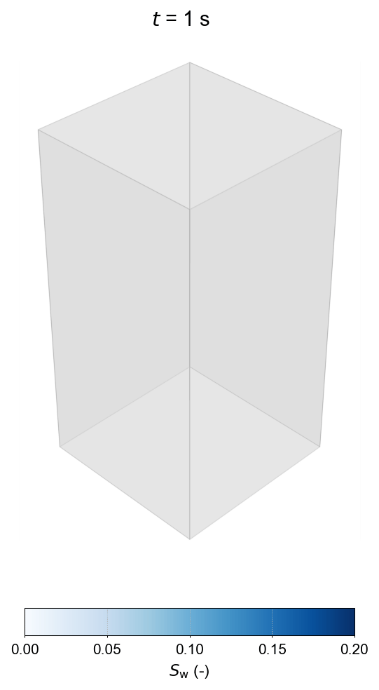
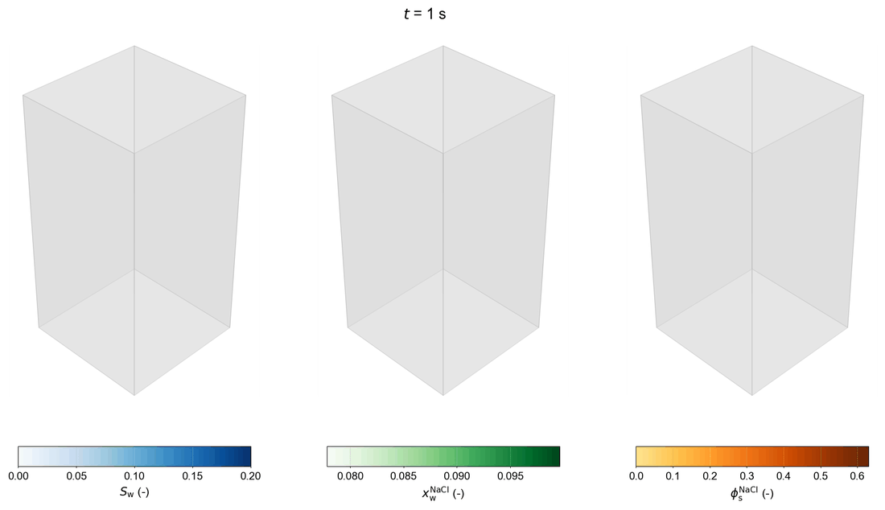
Showcases
Pure water evaporation
Brine evaporation
Notes:
Finally, we apply the model to larger three-dimensional networks.
These examples demonstrate that the model can simulate evaporation, salt migration, and precipitation in larger domains. This is important for moving toward REV scale simulations, where fully dynamic pore-scale models may become too expensive.

Slide 18
Take-home message
Corner flow is a key pathway for evaporation-driven salt migration.
A time-integrated flux reconstruction enables advective salt transport in QSPNM.
The proposed QSPNM agrees well with DPNM while being substantially faster and more robust for larger networks.
Notes:
To summarize, I would like to highlight three points.
First, corner flow is a key pathway for evaporation-driven salt migration in porous media.
Second, by reconstructing the time-integrated liquid flux during capillary redistribution, we can include advective salt transport in a quasi-static pore-network model.
Third, the proposed QSPNM agrees well with dynamic pore-network results, while being substantially faster and more robust for larger pore networks.

Slide 19
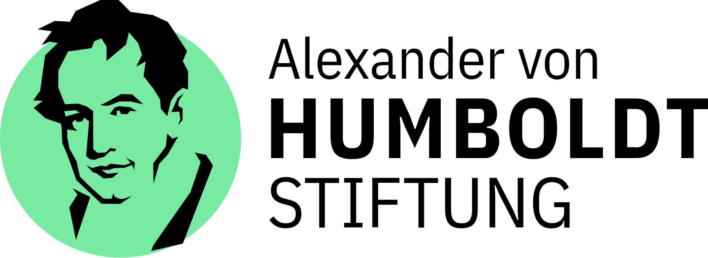

Thank you!
Zhixin Chen
E-mail: zhixin.chen@iws.uni-stuttgart.de
Phone: +49(0)15203634070
University of Stuttgart
Department of Hydromechanics and Modelling of Hydrosystems
Pfaffenwaldring 61 70569 Stuttgart, Germany
Notes:
If you are interested in more details of our work, please feel free to scan the QR code on the screen or contact me directly.
With that, I will conclude my presentation.
Thank you very much for your attention. I would be happy to take questions

Slide 20
Vapor diffusion in gas phase
Evaporative surface (boundary condition)
Vapor mass flux at the evaporative surface:
Vapor diffusion within the invaded cluster
In the invaded throats:
(Brine)
For the pore in the invaded cluster, solve continuity equation of water:
Vapor diffusion
Update saturation and salt concentration

Slide 21
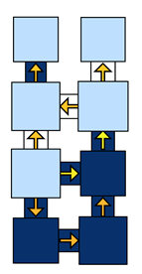

Percolation process in liquid phase
invaded cluster C_{k}
Liquid phase redistribution
Solve mass conversation equation after each drying step
Constrain: capillary pressure equilibrium in the invaded cluster C_{k}
Interfacial throats τ
Drying-induced liquid redistribution
Identification of invasion events
Invasion criteria:
Obtain the invasion time with interpolation:
Invasion-induced liquid redistribution

Slide 22
Salt diffusion
Implicit scheme
Mass conservation for each pore
Solve the salt concentration at the new time:
CFL-stability condition:

Slide 23
Salt precipitation
Precipitation and pore space alternation
Precipitation / dissolution rate
Precipitated salt is uniformly precipitated on the surface of the pore body:
Precipitated salt inside the pore throat will decrease the area section of the pore throat, which will influence the hydraulic conductance:

