Slide 1
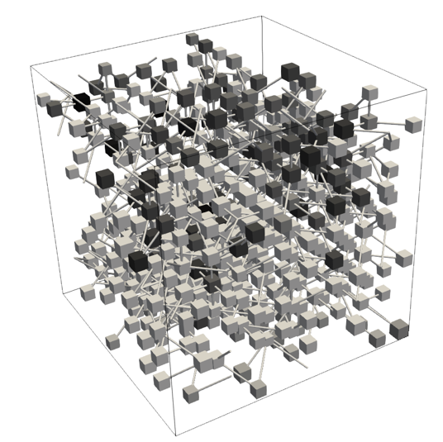

Quasi-static Pore-Network Modeling for Evaporation-Driven Salt Transport and Precipitation in Porous Media
Zhixin Chen¹, Bo Guo², Mathis Kelm¹,
Theresa Schollenberger¹, Rainer Helmig¹
¹ Institute for Modelling Hydraulic and Environmental Systems, University of Stuttgart, Stuttgart, Germany
²Department of Hydrology and Atmospheric Sciences, University of Arizona
May, 2026
Nantes, France

Slide 2
Outlines
Motivation
QSPNM for pure water
QSPNM for saline water
Computation efficiency
Summary and outlook

Slide 3
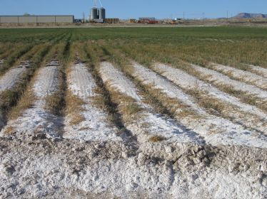
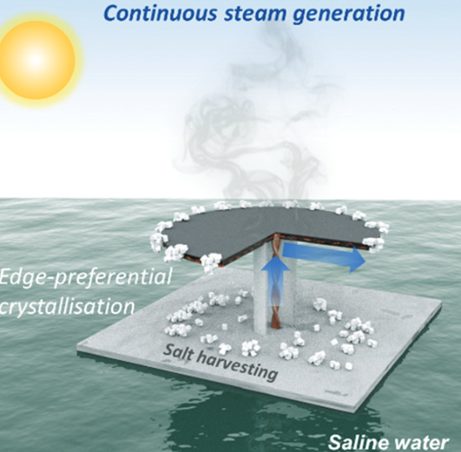
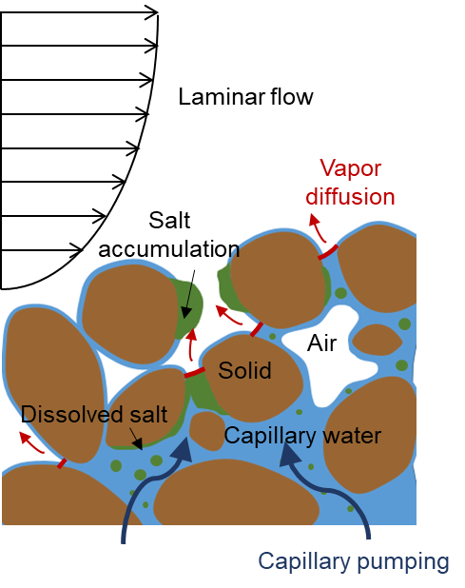
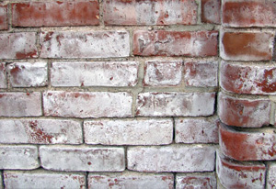
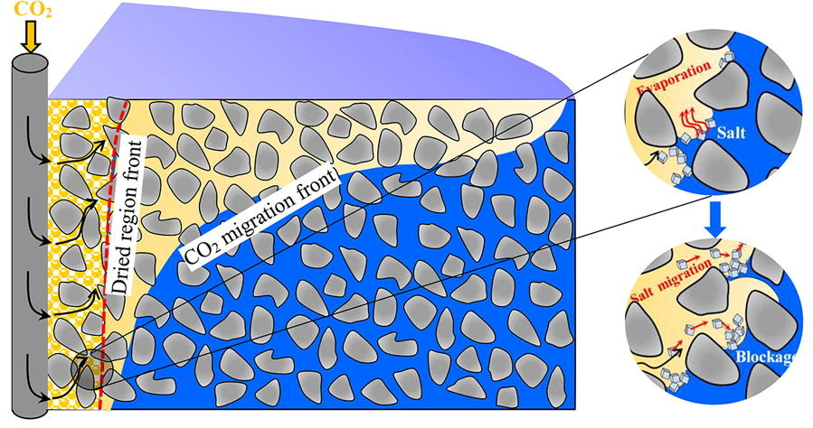
Motivation
Soil salination
Solar-driven desalination
Schematic figure of evaporation driven salt precipitation
Brine aquifer CO₂ storge
Weathering of building materials
A common phenomena with adverse impacts across a wide range of systems
Pore-scale modeling is significant for predicting and upscaling to REV scale

Slide 4
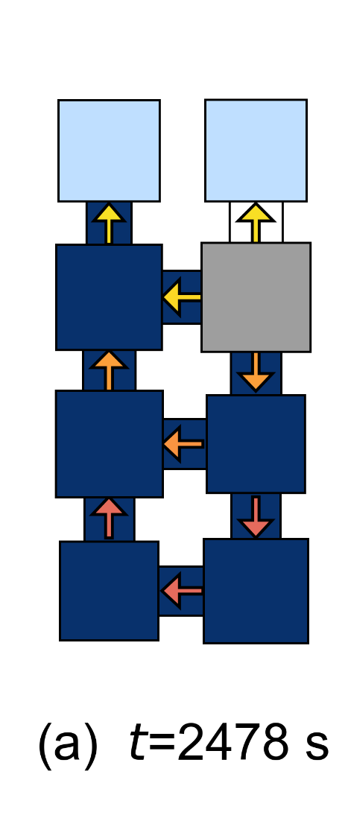
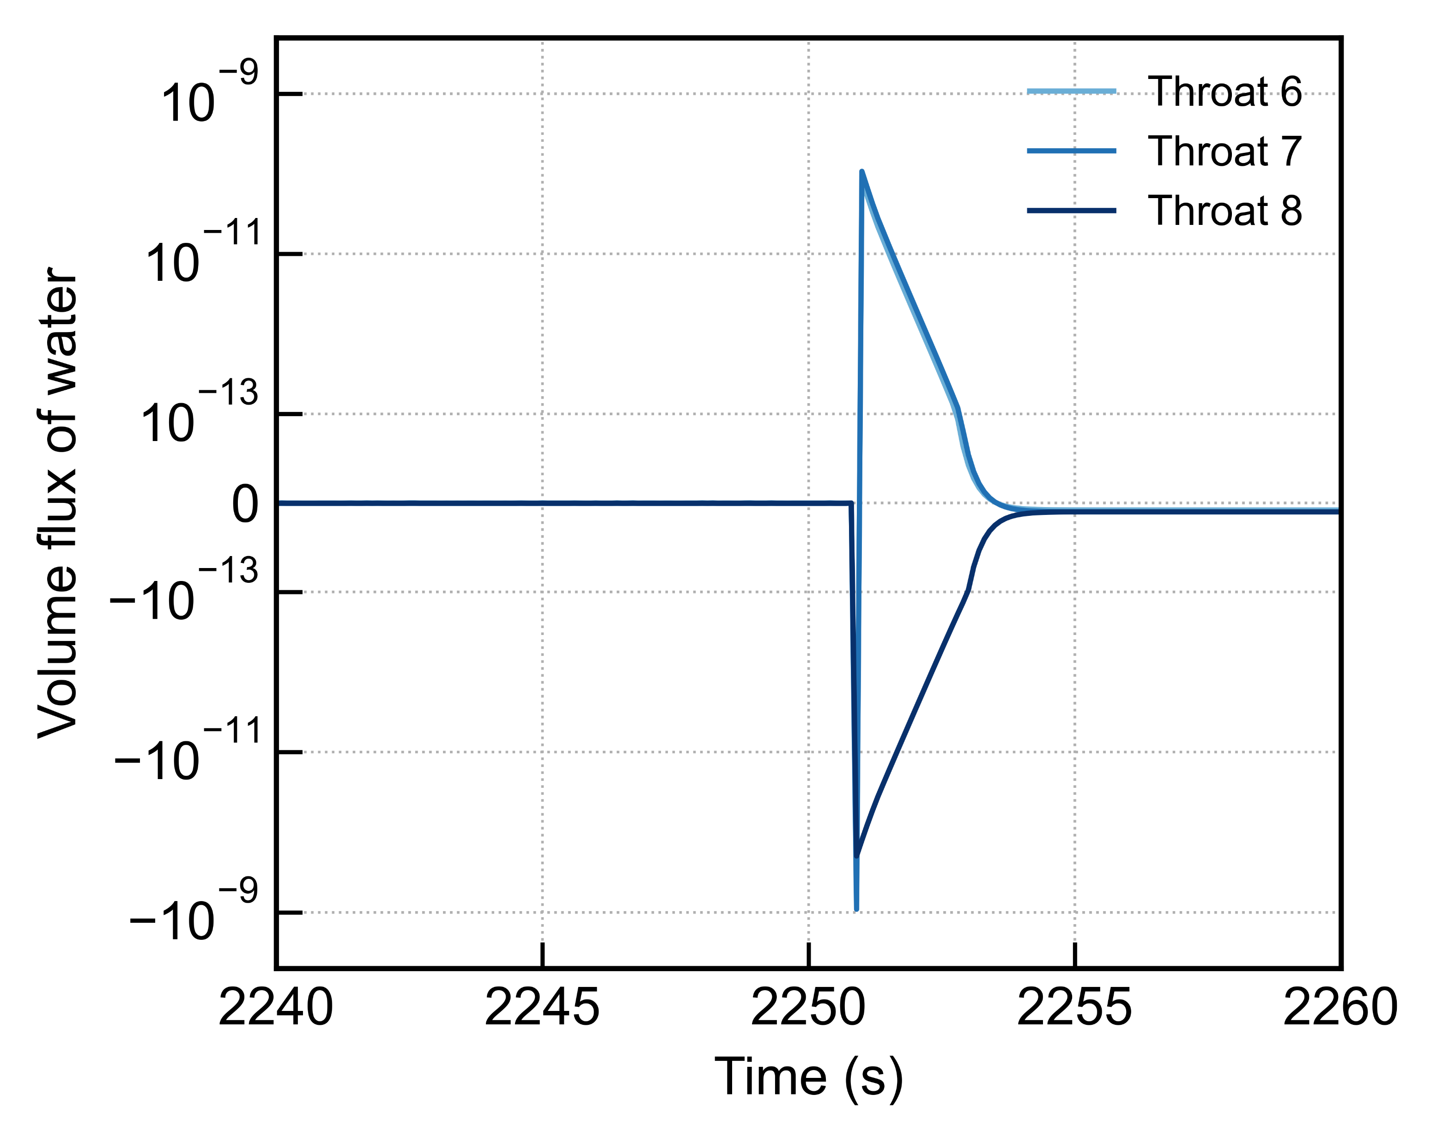
Motivation
Pore network model
Dynamic pore network model (DPNM): transient process
Quasi-static pore network model (QSPNM): a sequence of quasi-static state
Throat 7
Throat 8
Throat 6
Invasion event
Discontinuities in throat conductance introduce severe numerical stiffness in DPNMs
It leads to convergence problems when invasions events happen
Notes:
compute the transient flow and transport by solving coupled conservation equations

Slide 5
QSPNM for pure water
Physical model
Simulation framework
Verification

Slide 6
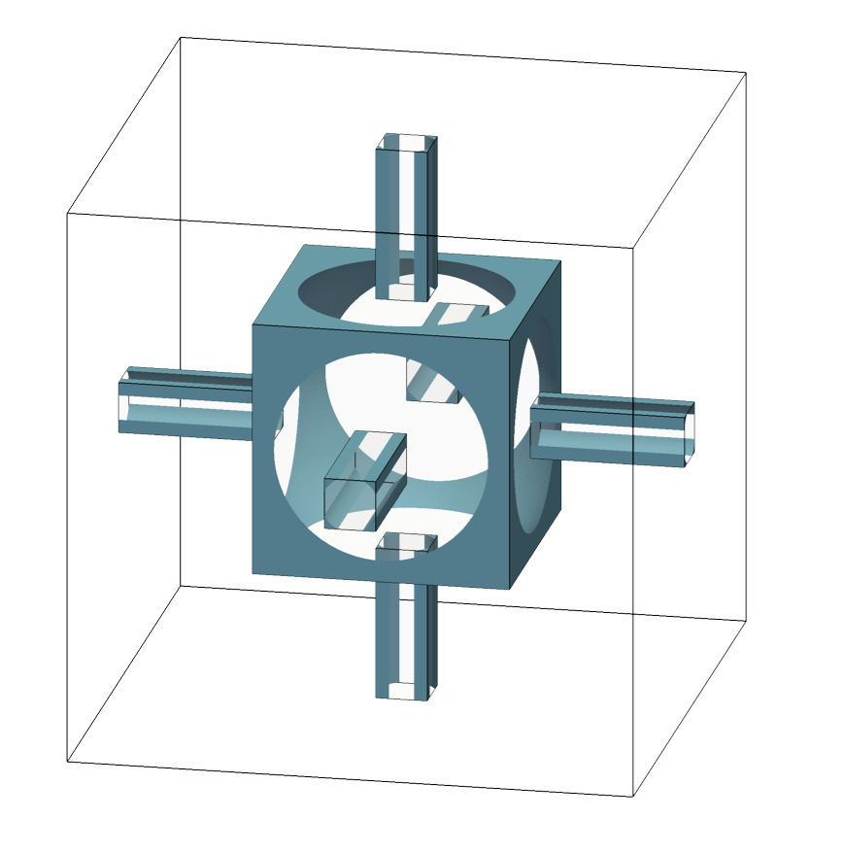
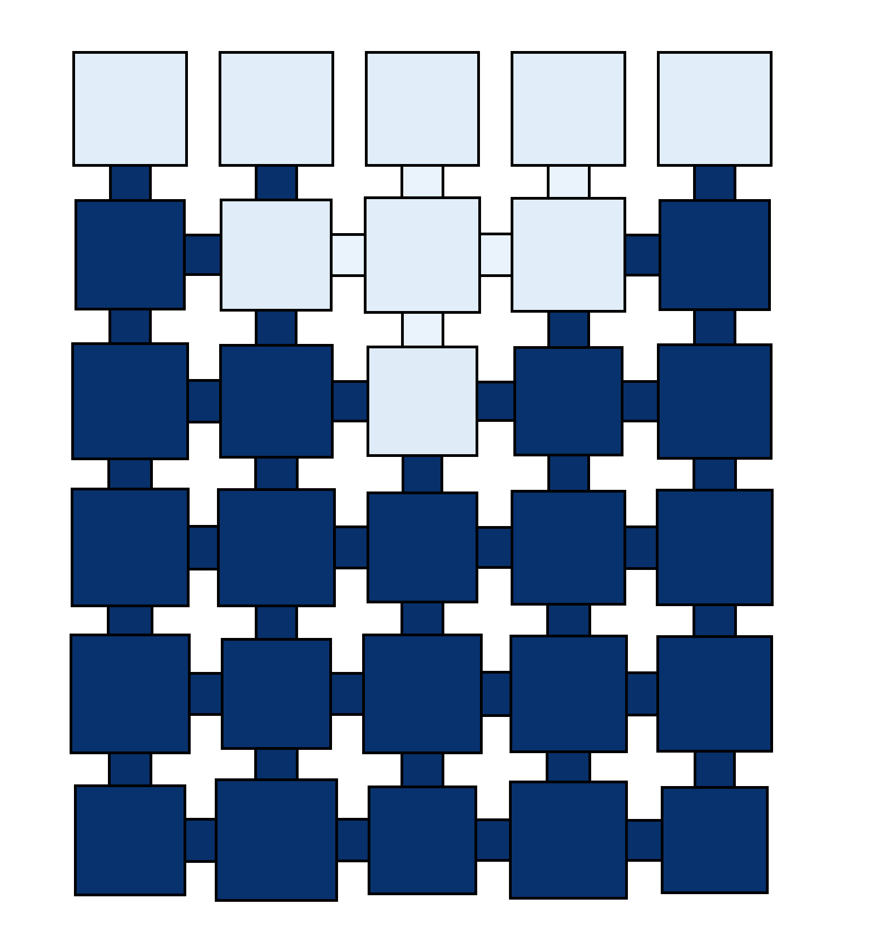
Physical model
Simulation Regime
Isothermal condition
No flow in ambient air
Isobaric gas pressure
Ca << 1 (slow evaporation rate)
Corner-film flow
Gas-liquid phase equilibrium
Invaded cluster
Corner film flow
Pore: cube
Throat: tube with square cross-section
Invaded pore:
Saturated vapor
Uninvaded pore

Slide 7
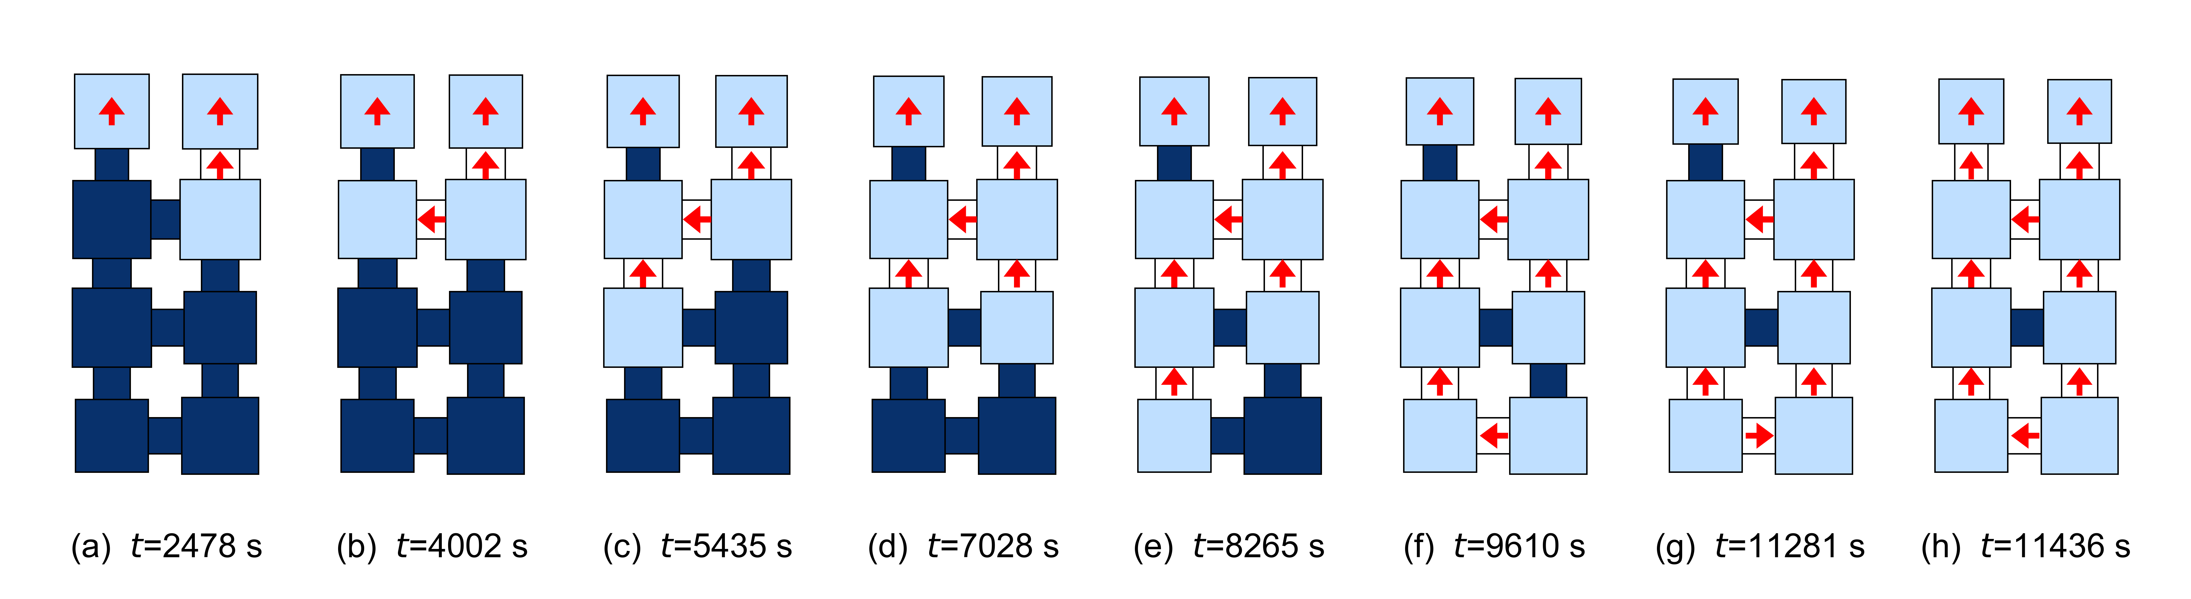
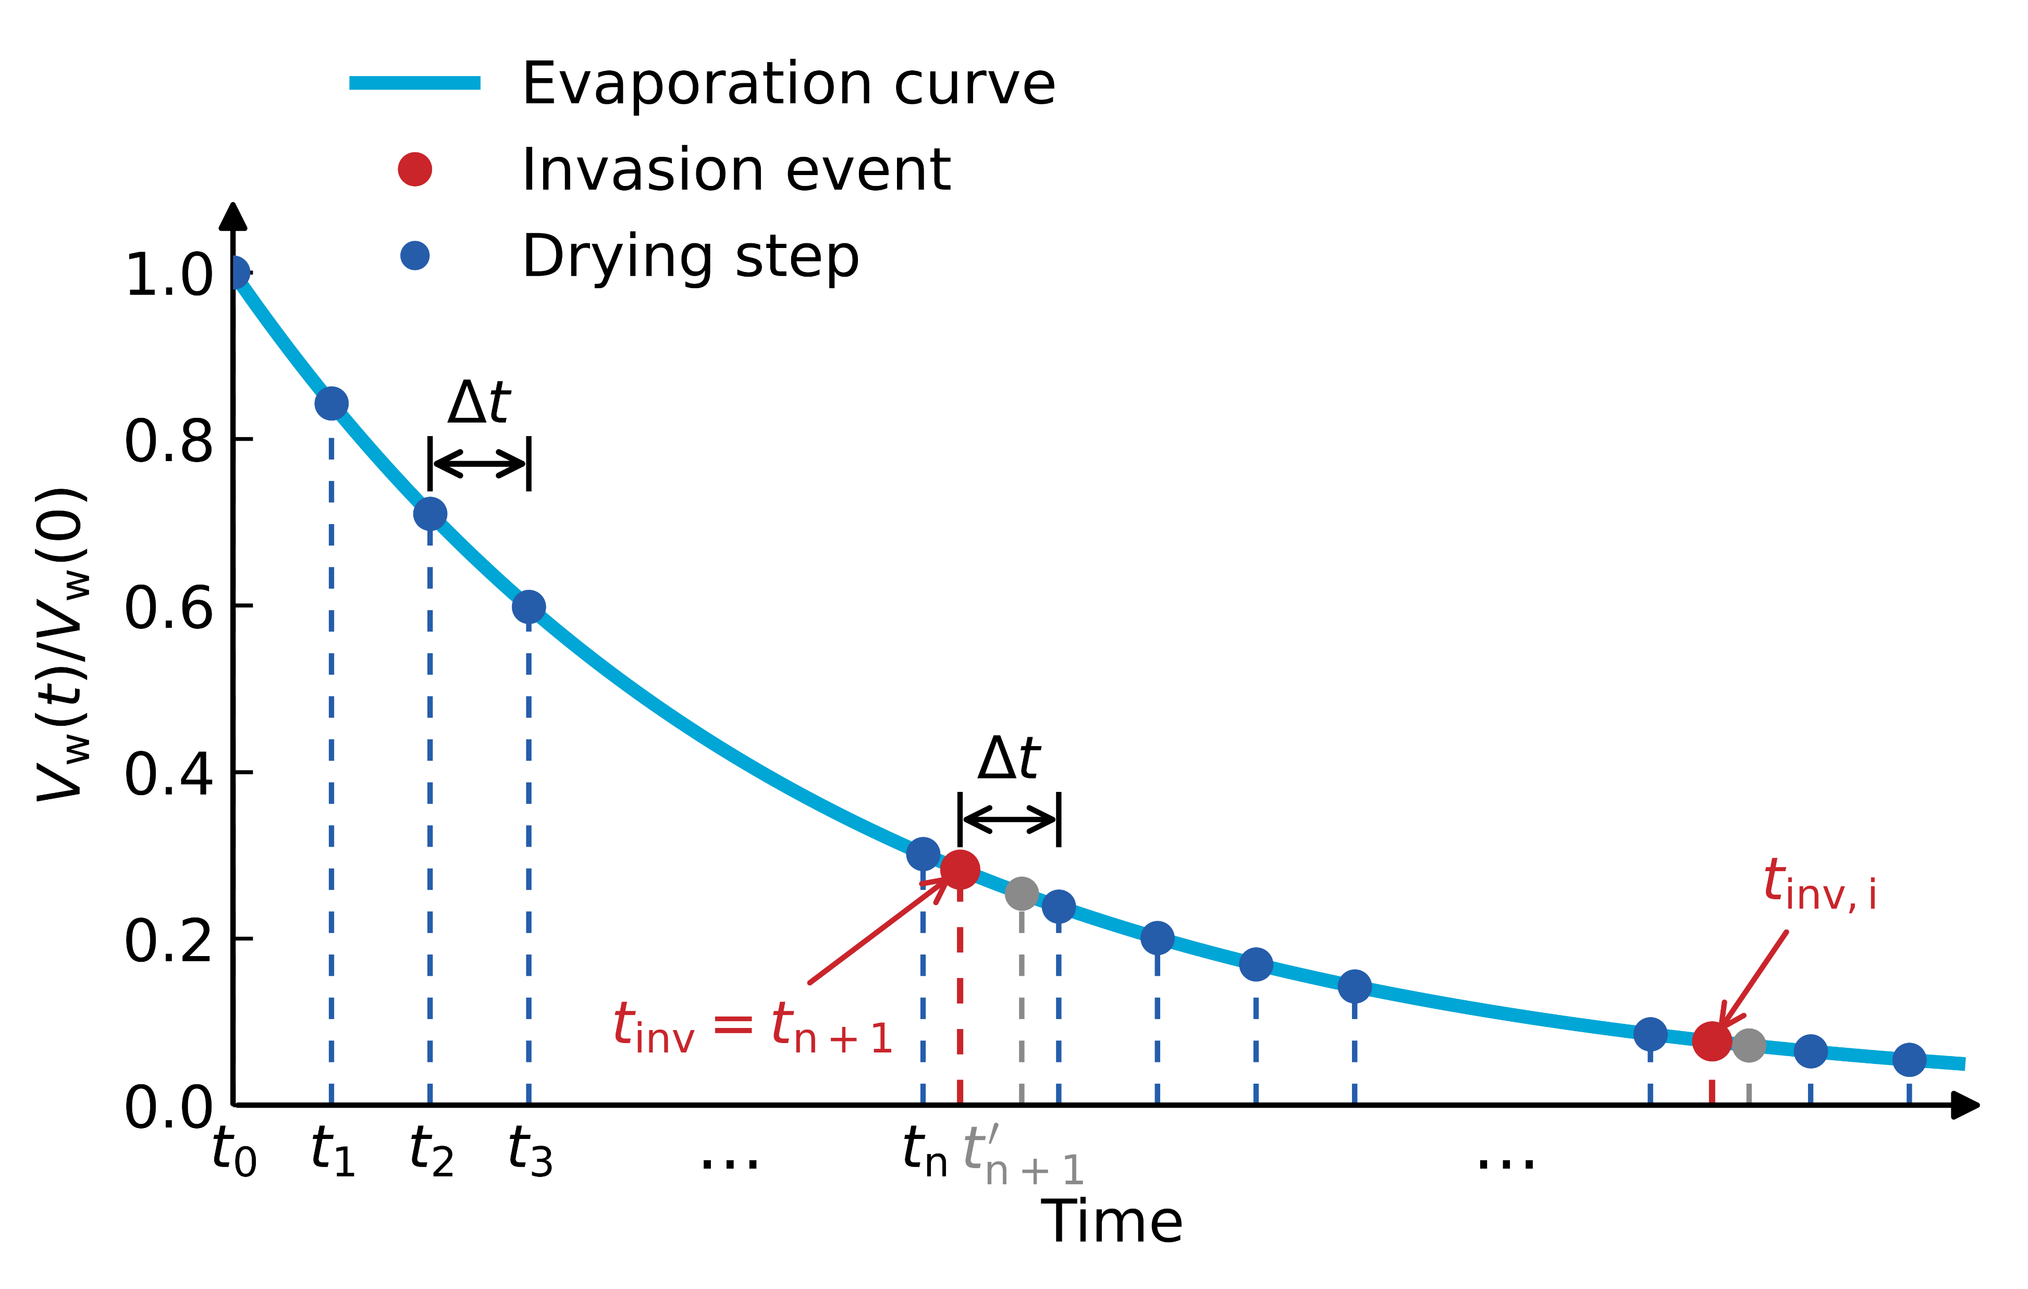
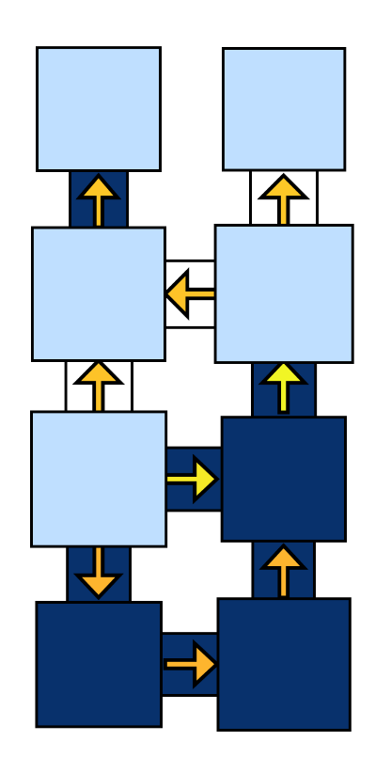

Model framework
Vapor diffusion
Time scale analysis
Capillary flow after drying
Vapor diffusion:
Capillary flow:
Invasion
Simplification:
Liquid phase can reach capillary pressure equilibrium simultaneously after each drying step Δt
The dynamic process of liquid phase is a series of quasi-static state

Slide 8
Vapor diffusion in gas phase
Evaporative surface
Vapor mass flux at the evaporative surface:
Vapor diffusion within the invaded cluster
In the invaded throats:
(Saline water)
For the pore in the invaded cluster, solve continuity equation of water:
Update saturation and salt concentration

Slide 9
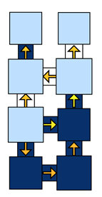

Percolation process in liquid phase
Liquid phase redistribution
Solve mass conversation equation with the saturation updated after each drying step
Constrain: capillary pressure equilibrium in the invaded cluster C_{k}
Identification of invasion events
Capillary flow after drying
Invasion criteria:
Obtain the invasion time with interpolation:
Capillary flow after invasion

Slide 10
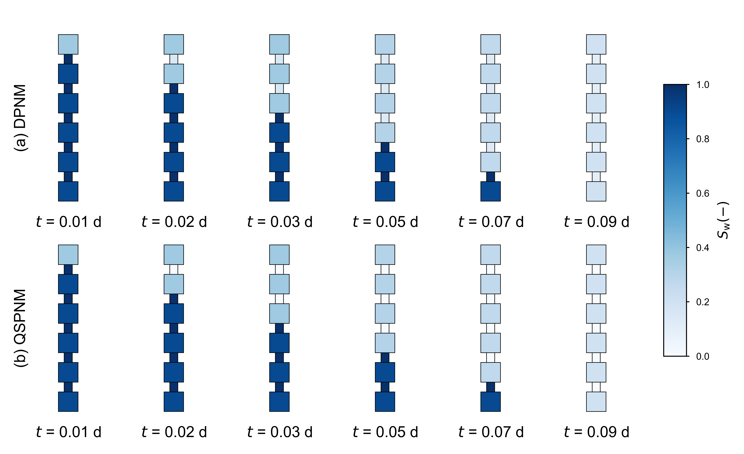
Verification
Case 1
Homogeneous

Slide 11
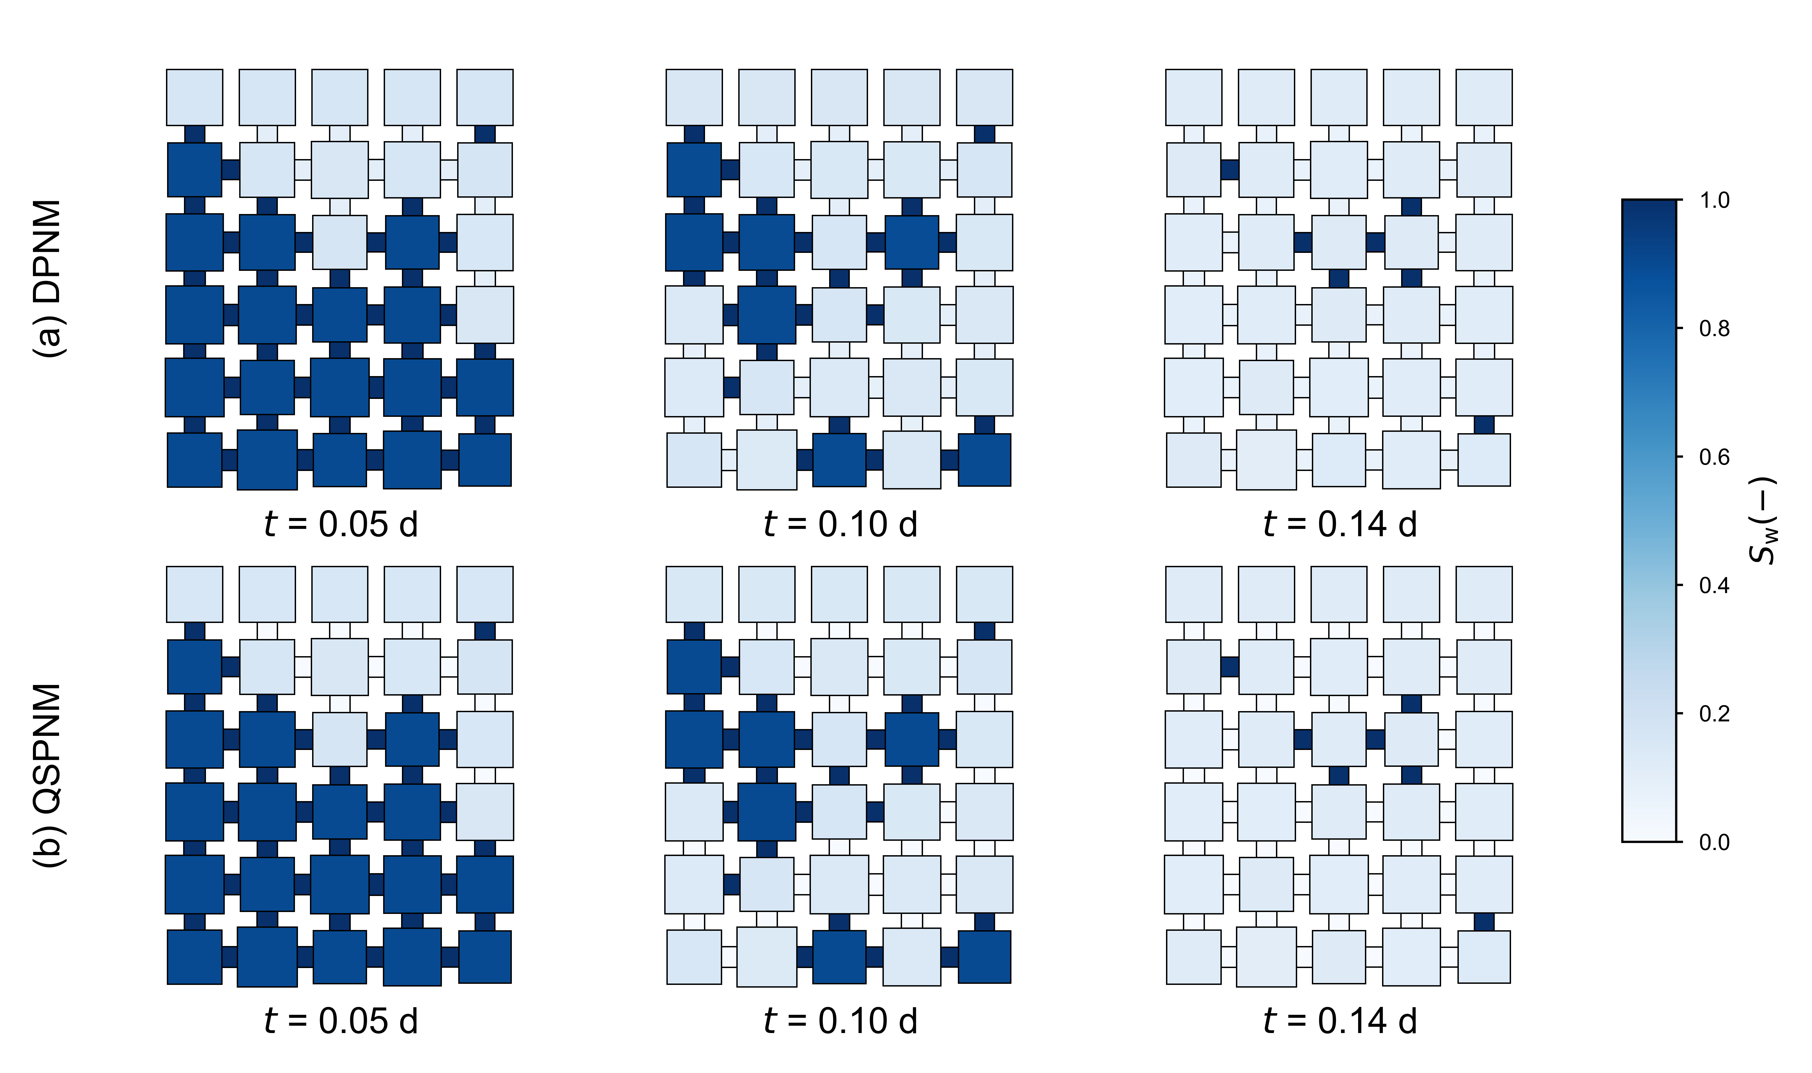
Verification
Case 2
Standard deviation of pore body size: 10 μm

Slide 12
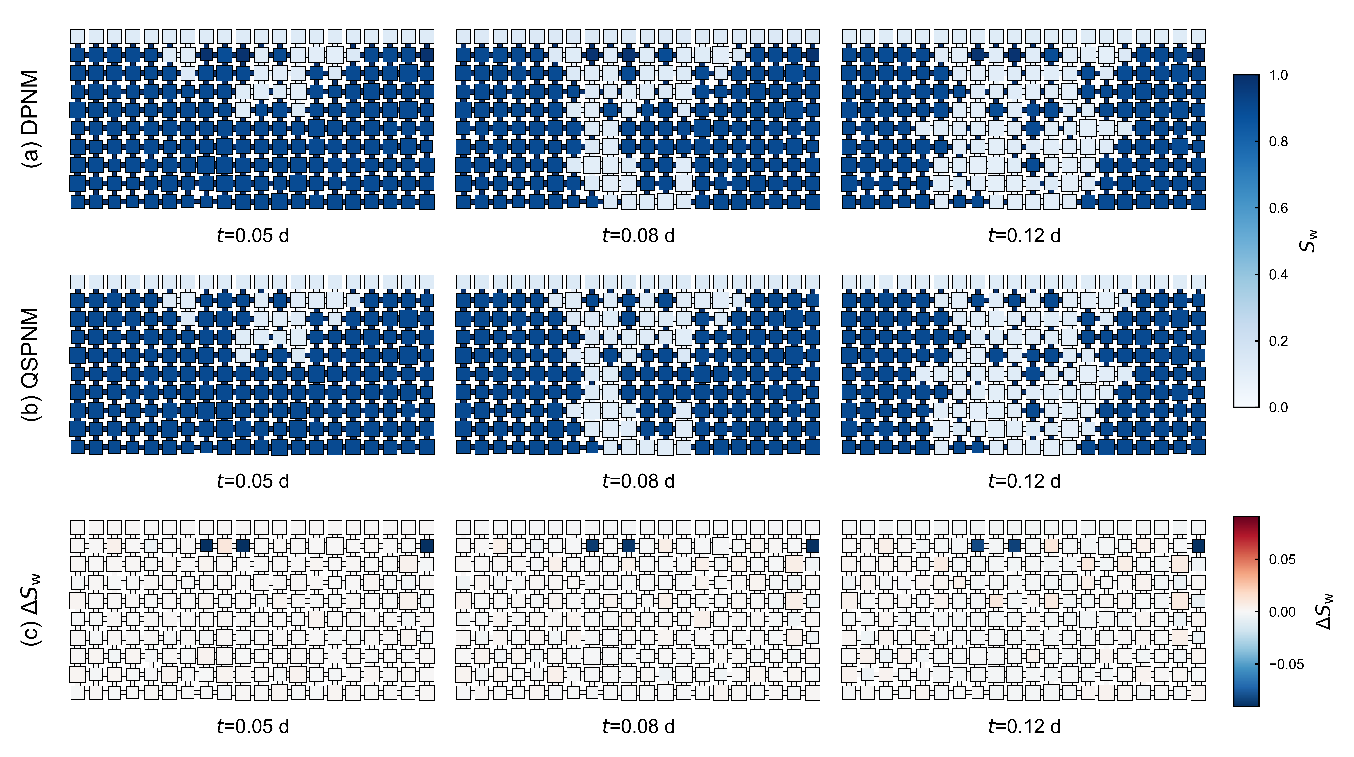
Verification
Case 3
Standard deviation of pore body size: 20 μm

Slide 13
QSPNM for saline water
Simulation framework
Verification

Slide 14
Model framework
Vapor diffusion + salt diffusion
Capillary flow after drying
+ salt advection
+ salt precipitation
Solve vapor diffusion and salt diffusion at each drying step
Invasion
+ salt advection
+ salt precipitation
Invasion
Yes
No
Solve capillary flow and salt convection due to invasion
Solve capillary flow and salt convection at the end of each drying step
Check Salt precipitation

Slide 15
Salt convection
Unsaturated Flow in a Pore Network
Set the state of PNM before and after liquid redistribution as Γ_{i} and Γ_{f}
Assume the redistribution happen in Δt_{r} (Δt_{r} → 0)
Liquid-volume transfer ∆V_{w,ij} through pore throat:
Approximate liquid-volume transfer:
Capillary flow after drying
Nodal source at pore i is obtained from the saturation change:
Solve continuity equation of liquid:
Solve with a selected Δt_{r}
∆V_{w,ij}
Notes:
.

Slide 16
Salt convection
Implicit upwind scheme
Mass conservation for each pore
k
k
i
Solve linear system with the known ∆V_{w,ij}
m

Slide 17
Salt diffusion
Explicit scheme
Mass conservation for each pore
Solve the salt concentration at the new time:
CFL-stability condition:

Slide 18
Salt precipitation
Precipitation and pore space alternation
Precipitation / dissolution rate
Precipitated salt is uniformly precipitated on the surface of the pore body:
Precipitated salt inside the pore throat will decrease the area section of the pore throat, which will influence the hydraulic conductance:

Slide 19
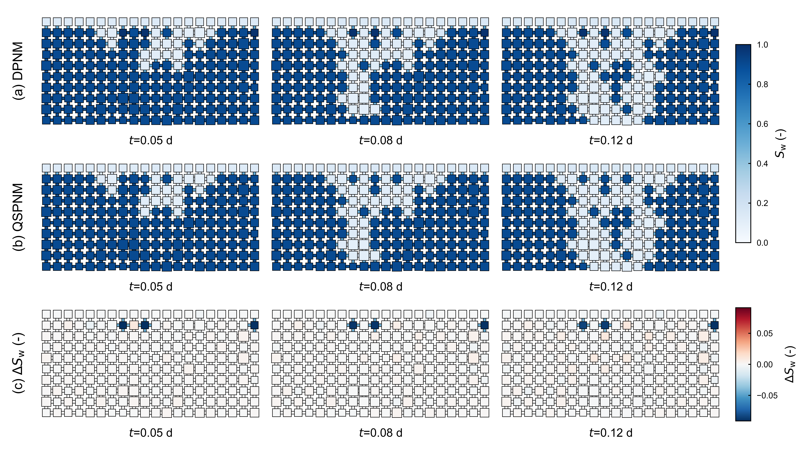
Verification
Case 3
Saturation field

Slide 20
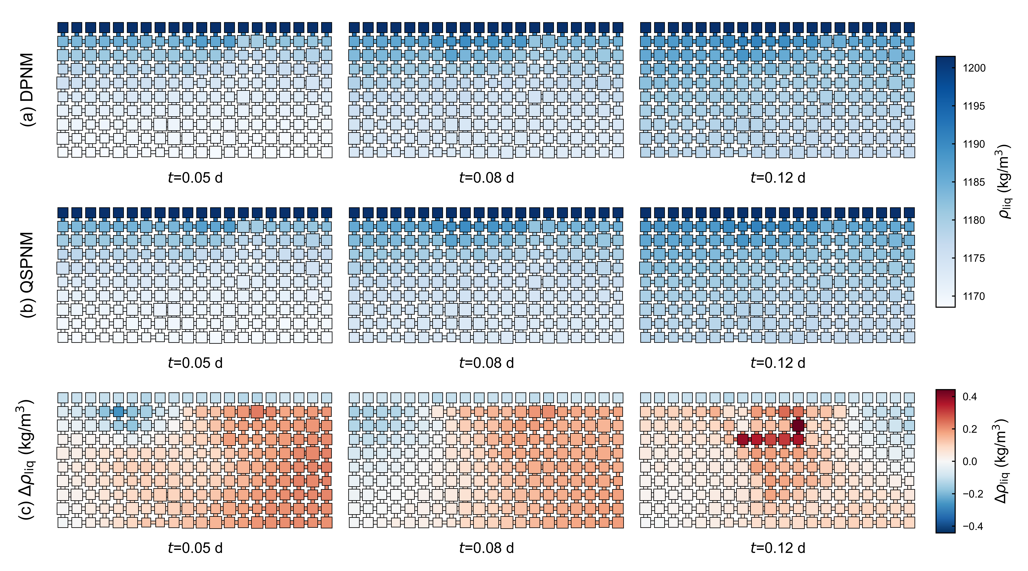
Verification
Case 3
Saline water density field

Slide 21
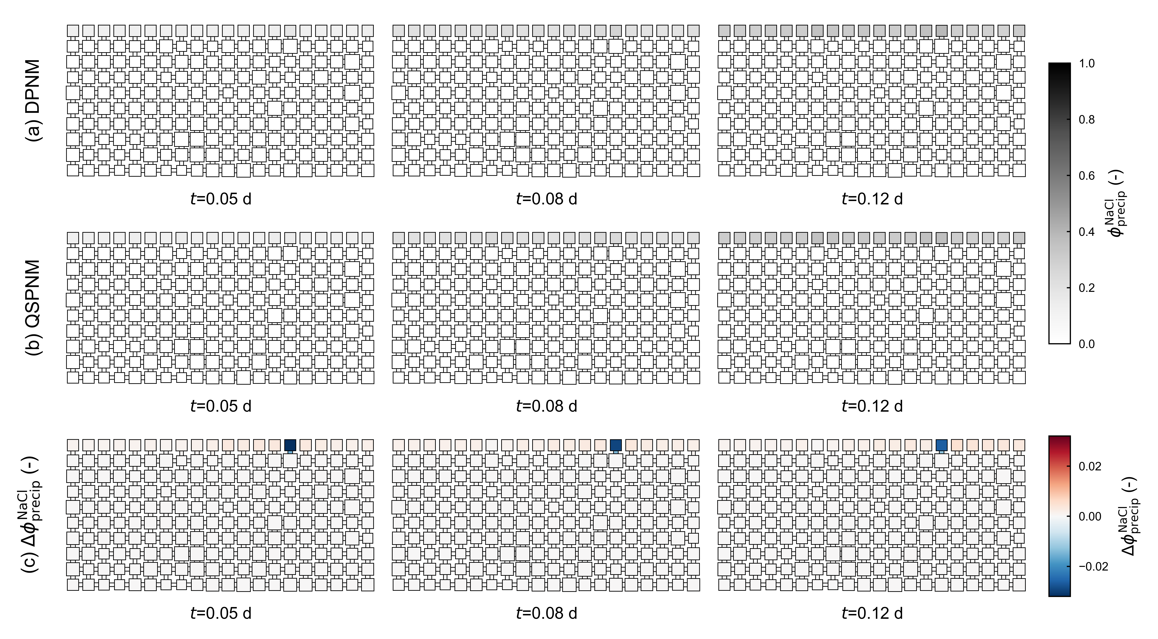
Verification
Case 3
Saline water density field

Slide 22
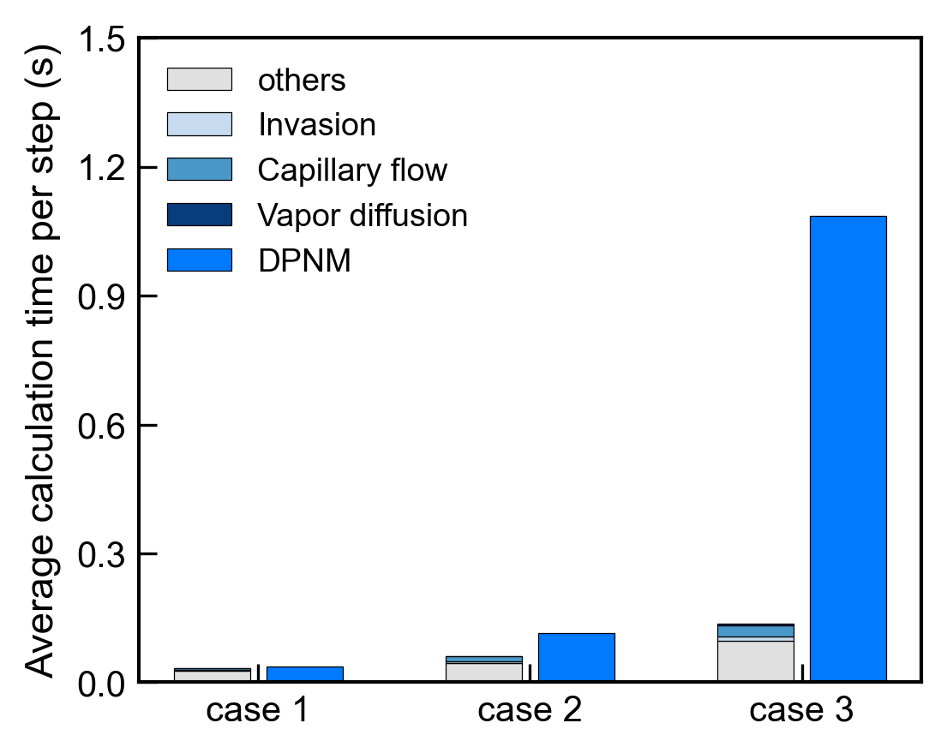
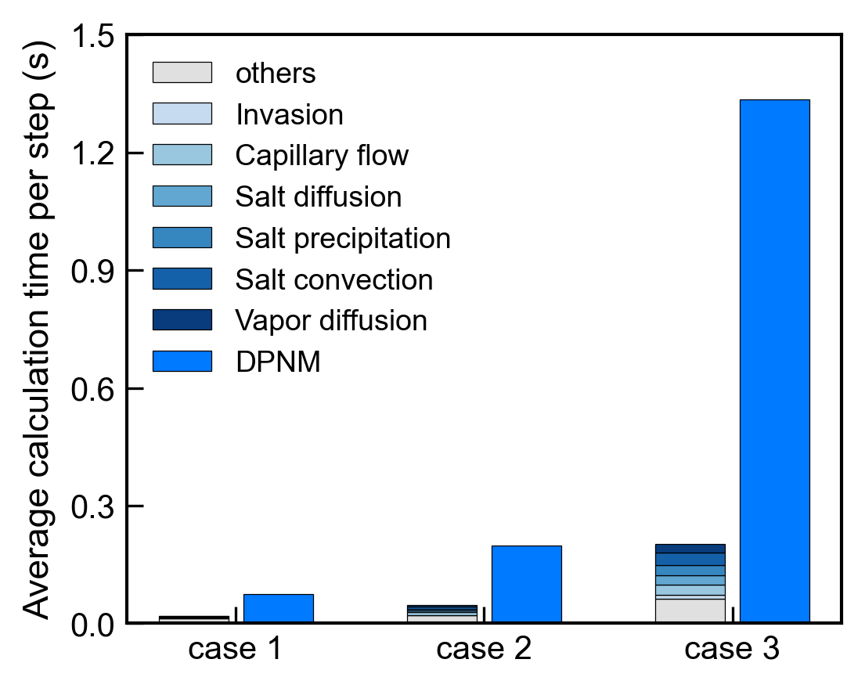
Computation efficiency
Pure water
Saline water

Slide 23
Summary and outlook
We develop a quasi-static pore-network model for evaporation-driven salt transport and precipitation processes.
The model shows good agreement with dynamic pore-network model while substantially reduces computational cost.
Larger PNM will be performed for upscaling to REV scale

Slide 24
Thank you!
Zhixin Chen
E-mail: zhixin.chen@iws.uni-stuttgart.de
Phone: +49(0)15203634070
University of Stuttgart
Department of Hydromechanics and Modelling of Hydrosystems
Pfaffenwaldring 61 70569 Stuttgart, Germany

