Slide 1
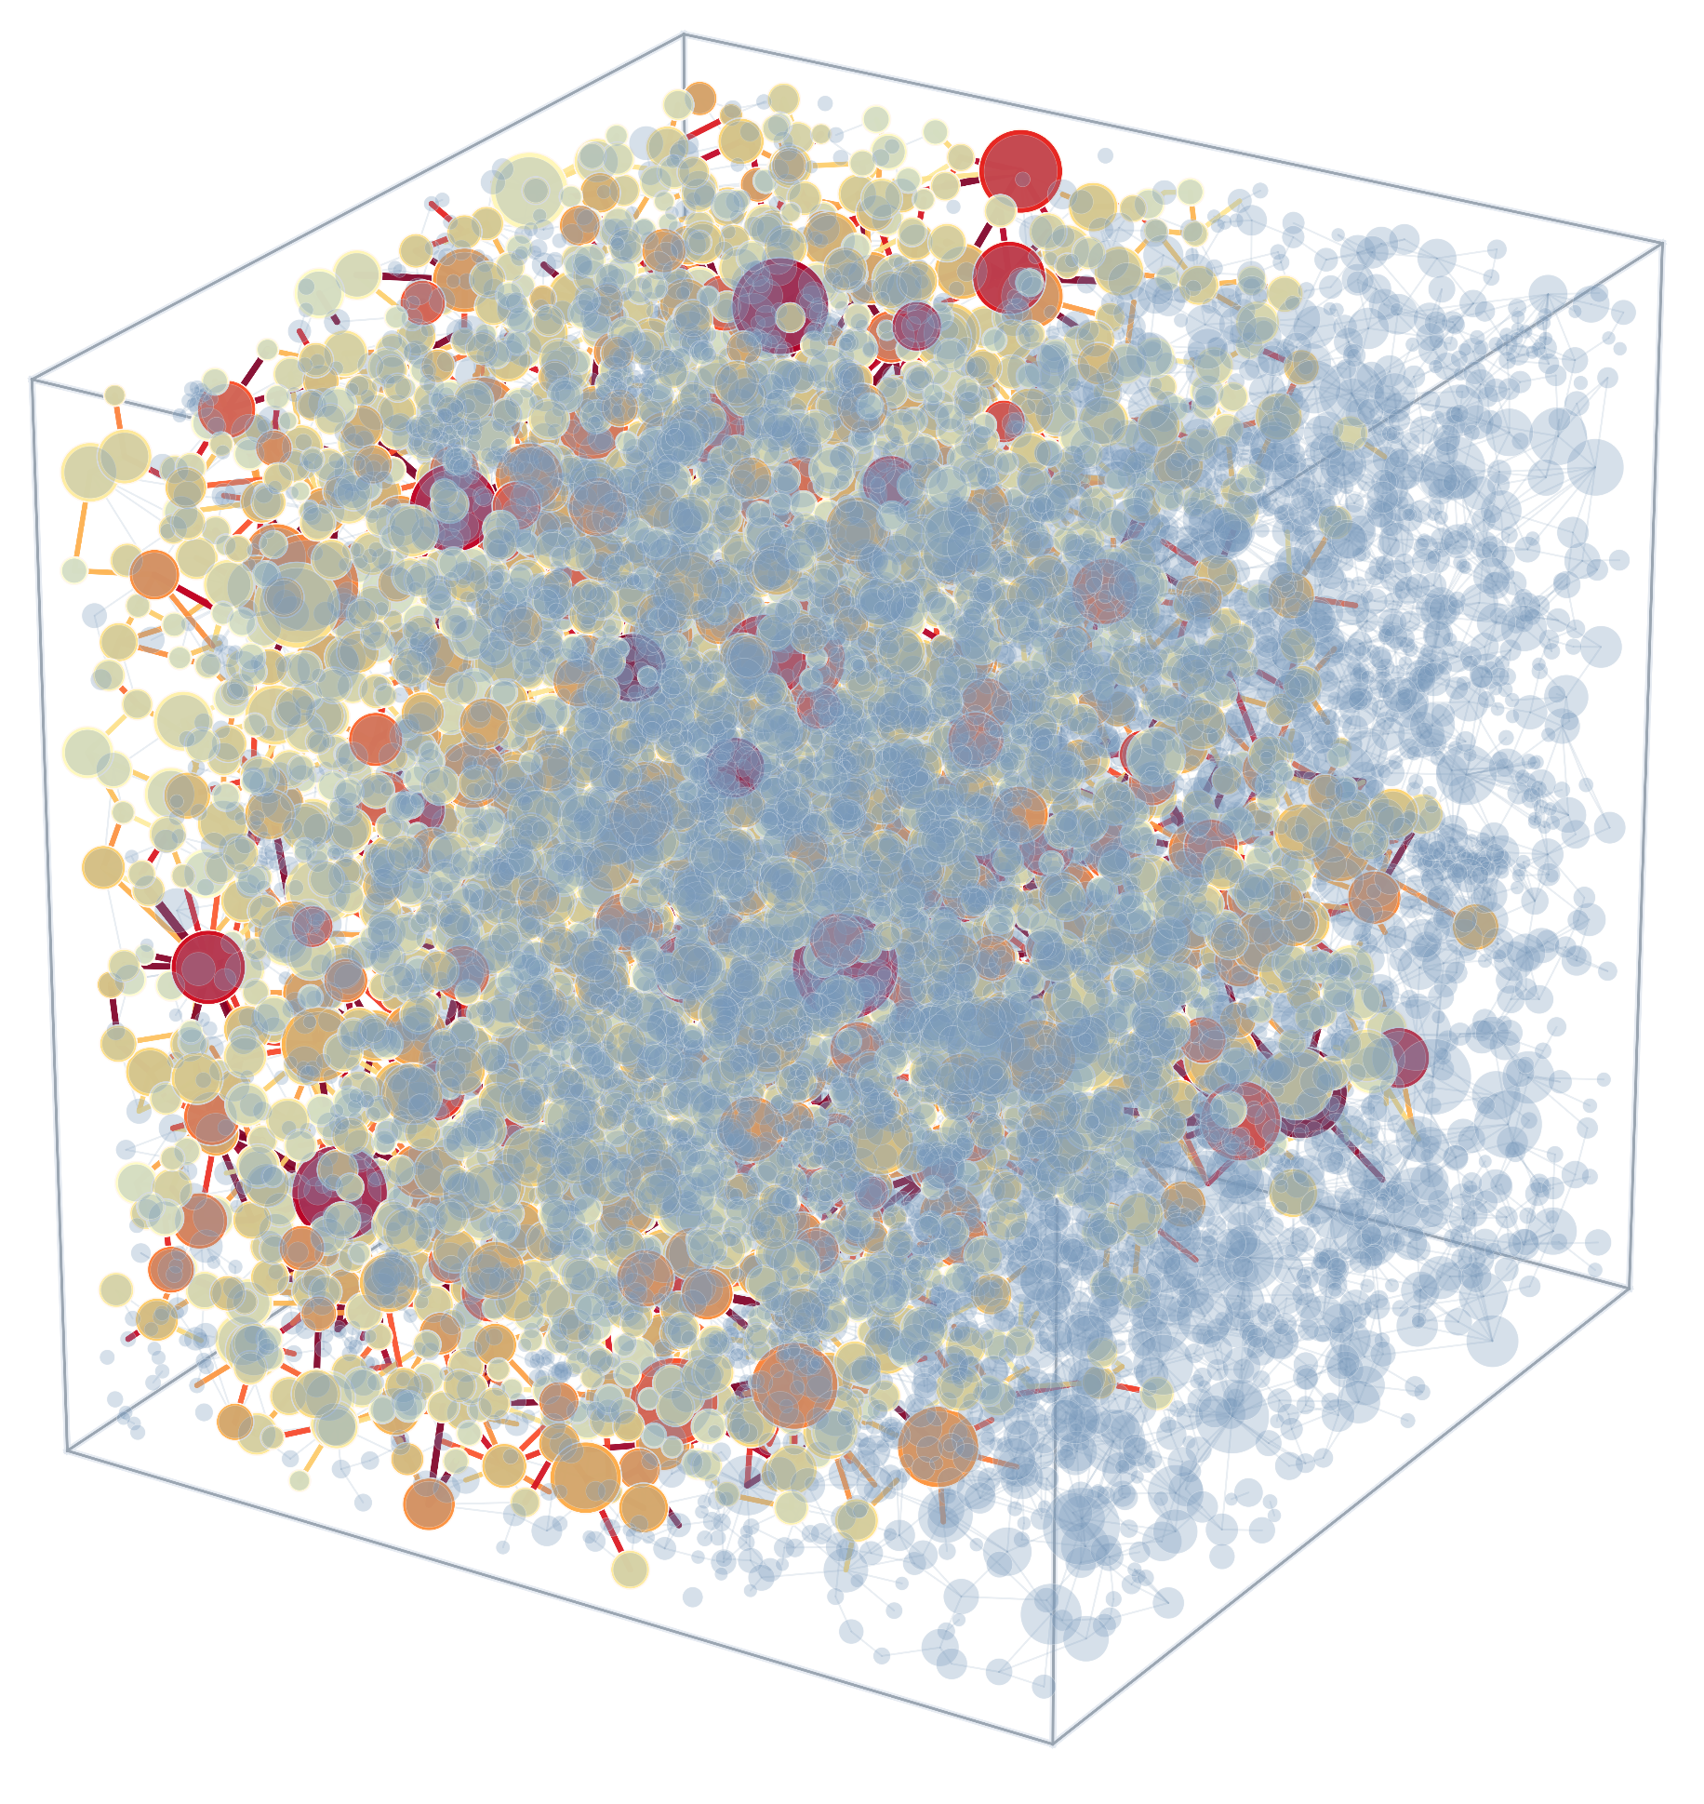
Salt Precipitation Dynamics in Carbon Dioxide Storage: A Pore-Network Modelling Study
Yuxi Liang
Department of Earth Science & Engineering
Supervisors: Prof. Martin Blunt, Dr. Branko Bijeljic
22/05/2026

Slide 2
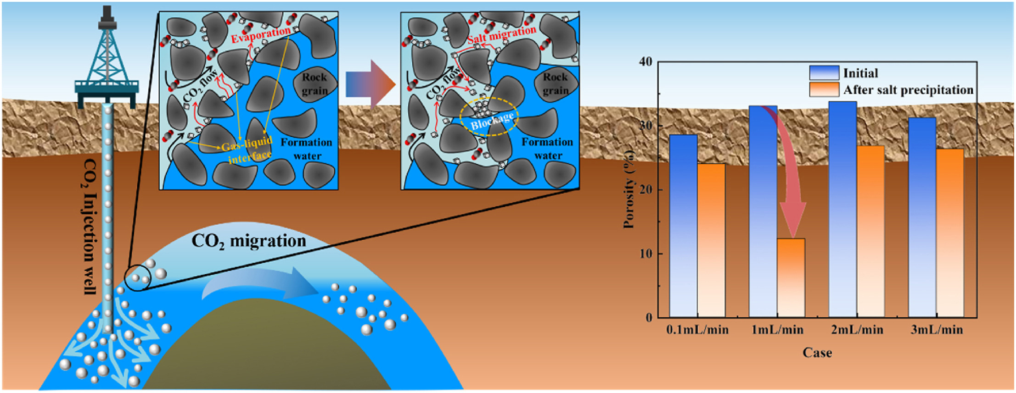
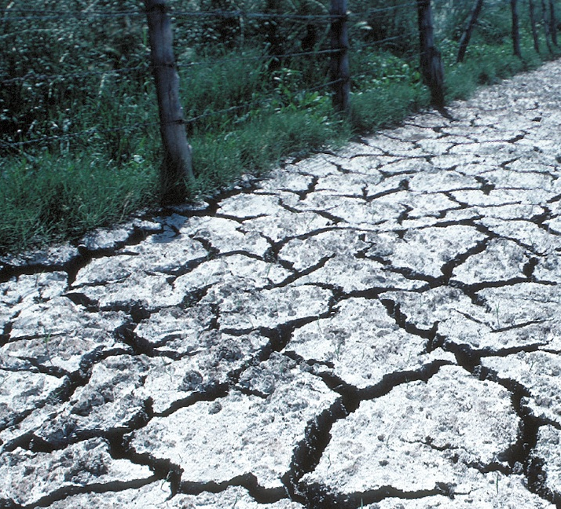
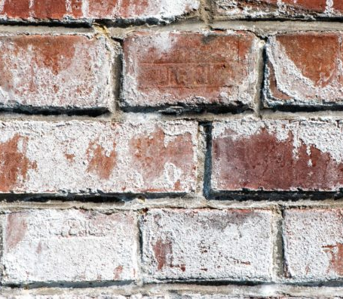
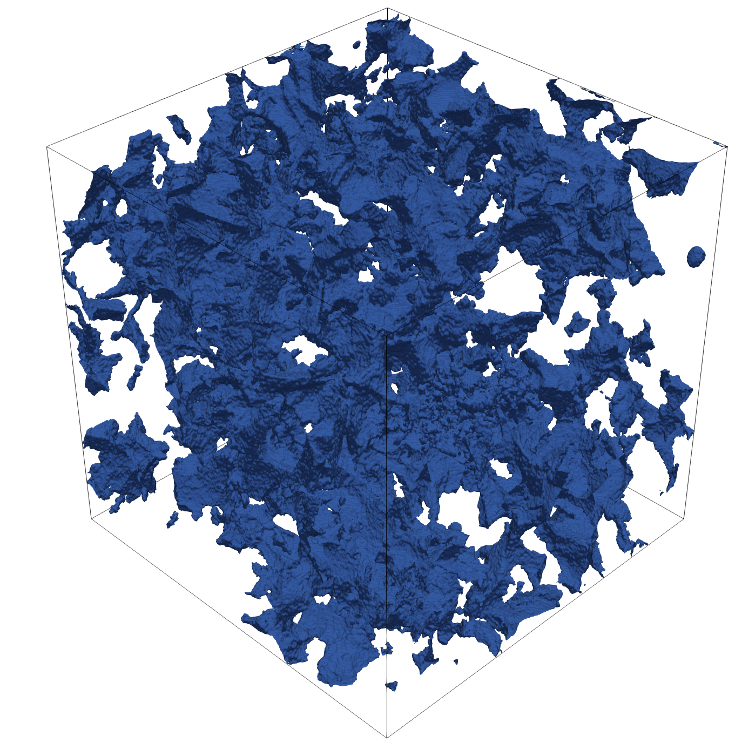
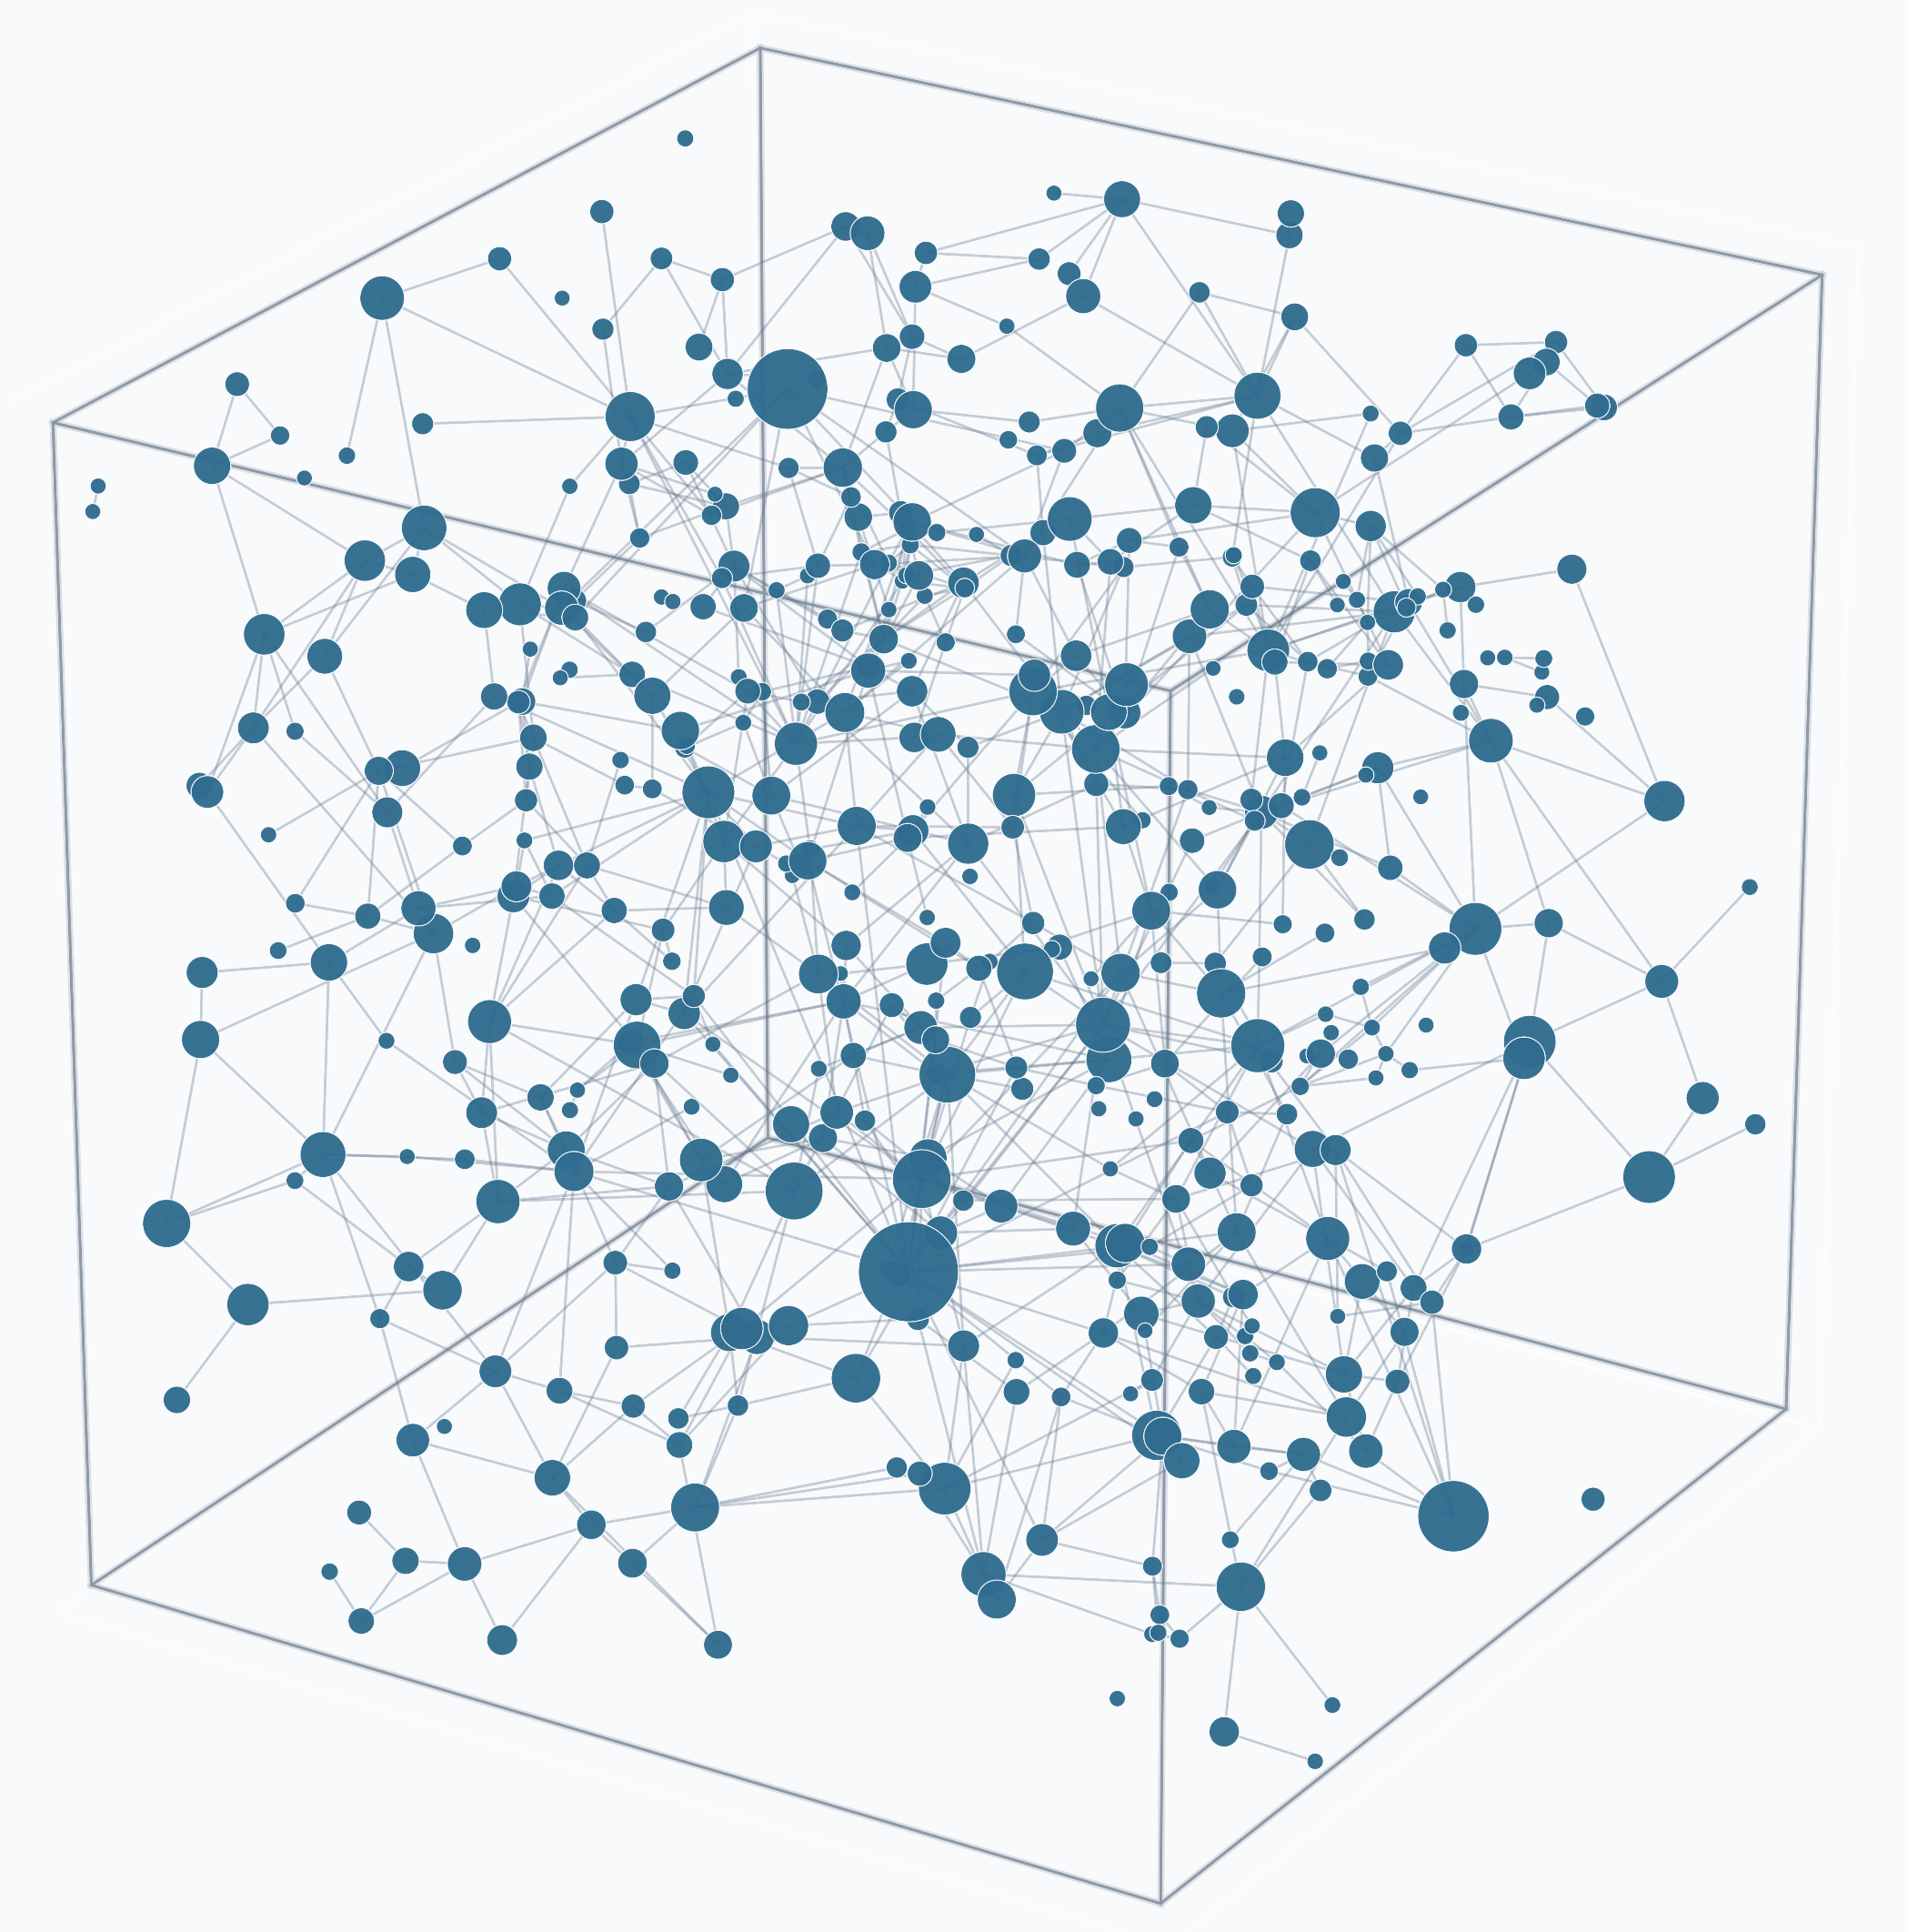
Section 1. Introduction & Motivation
Why Salt Precipitation Matters During CO₂ Storage
Dry CO₂ Injection into Saline Aquifer
1
Physical Process
Dry CO₂ injection into saline aquifers:
Brine evaporation into CO₂
Increasing local salinity
Salt precipitation in pores / throats
Why it Matters
Salt precipitation may:
Block pores & throats
Reduce permeability & injectivity
Affect long-term storage performance
Why Pore-Scale Modelling?
Process is strongly pore-scale dependent:
Multiphase transport
Evaporation & precipitation coupling
Strong heterogeneity effects
Pore-network modelling:
Captures pore-scale physics
Computationally efficient
Bridges micro-CT and continuum behaviour
2
3
Adapted from Zhang et al., J. Cleaner Production (2025)
Similar Precipitation Phenomena in Other Environments
Pore-Scale Heterogeneity & Modeling
Soil salinization (Agriculture)
Salt Damage in Infrastructure
2
Pore-Network Model
Micro-CT of Porous Rock

Slide 3
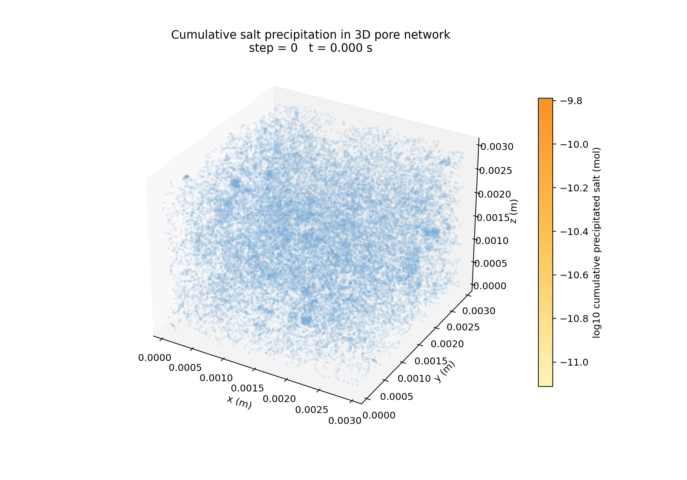
Section 1. Introduction & Motivation
3D Visualization of Salt Precipitation Evolution in Bentheimer Sandstone
Visualisation of precipitation evolution during dry CO₂ injection (Video shows cumulative salt precipitation only).
NaCl (solid)
What is shown in the video
Dry CO₂
injection
Dry CO₂ enters from the inlet boundary (not explicitly visualised)
Drying initiates near the inlet boundary
The precipitation region propagates through the network
Precipitated salt becomes spatially heterogeneous over time
Salt precipitation evolves as a highly heterogenous pore-scale process.

Slide 4
Section 2. Salt Precipitation Framework
Pore-Scale Evolution During Dry CO₂ Injection
Dry CO₂ injection drives coupled evaporation and salt precipitation, leading to pore structure evolution and flow alteration.
2
Evaporation
Water evaporates from connected brine layers into the CO₂ phase.
Concentration increase
Salt concentration rises in remaining brine.
3
4
1
Precipitation
Salt precipitates in pores and throats.
Drainage
Dry CO₂ invades the pore network.
Dry CO₂
CO₂ (gas)
Brine (liquid)
Water vapour(gas)
NaCl (solid)
Evaporation increases brine salinity, leading to pore-scale salt precipitation.

Slide 5
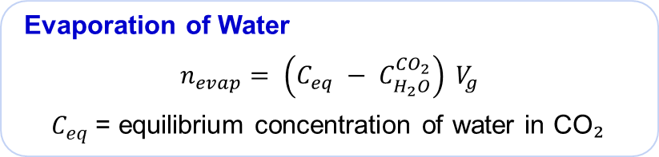
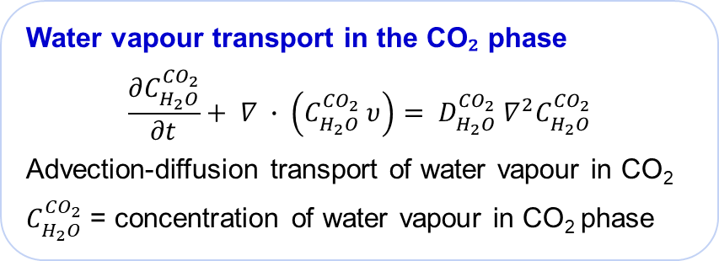
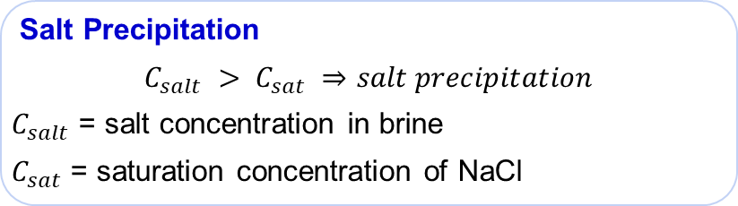
Corner water
Section 2. Salt Precipitation Framework
Coupled Evaporation-Precipitation Modelling Framework
We solve coupled transport, evaporation and precipitation processes sequentially at each time step.
Gas core
A. Numerical Coupling Loop (per time step)
B. Key Model Relations
Water vapour transport in the CO₂ phase
$$\frac{∂C_{H_{2}O}^{{CO}_{2}}}{∂t}+ ∇ ∙ \left(C_{H_{2}O}^{{CO}_{2}} υ\right)= D_{H_{2}O}^{{CO}_{2}} ∇^{2}C_{H_{2}O}^{{CO}_{2}}$$
Advection-diffusion transport of water vapour in CO₂
$C_{H_{2}O}^{{CO}_{2}}$ = concentration of water vapour in CO₂ phase
Initialise post-drainage brine configuration
Residual brine distribution after CO₂ drainage
Salt layer
Solve vapour transport
Advection-diffusion of water vapor in the CO₂ phase
Compute local evaporation
Evaporation occurs where CO₂ is undersaturated
Evaporation of Water
$$n_{evap}= \left(C_{eq} − C_{H_{2}O}^{{CO}_{2}}\right) V_{g}$$
$C_{eq}$= equilibrium concentration of water in CO₂
Update brine salinity
Salt concentration increases in remaining brine
Check precipitation criterion
Salt precipitates where brine is locally oversaturated
Salt Precipitation
$$C_{salt} > C_{sat} ⇒salt precipitation$$
$C_{salt}$ = salt concentration in brine
$C_{sat}$ = saturation concentration of NaCl
This is a coupled transport-evaporation-precipitation framework prior to hydraulic feedback (e.g. permeability evolution).

Slide 6
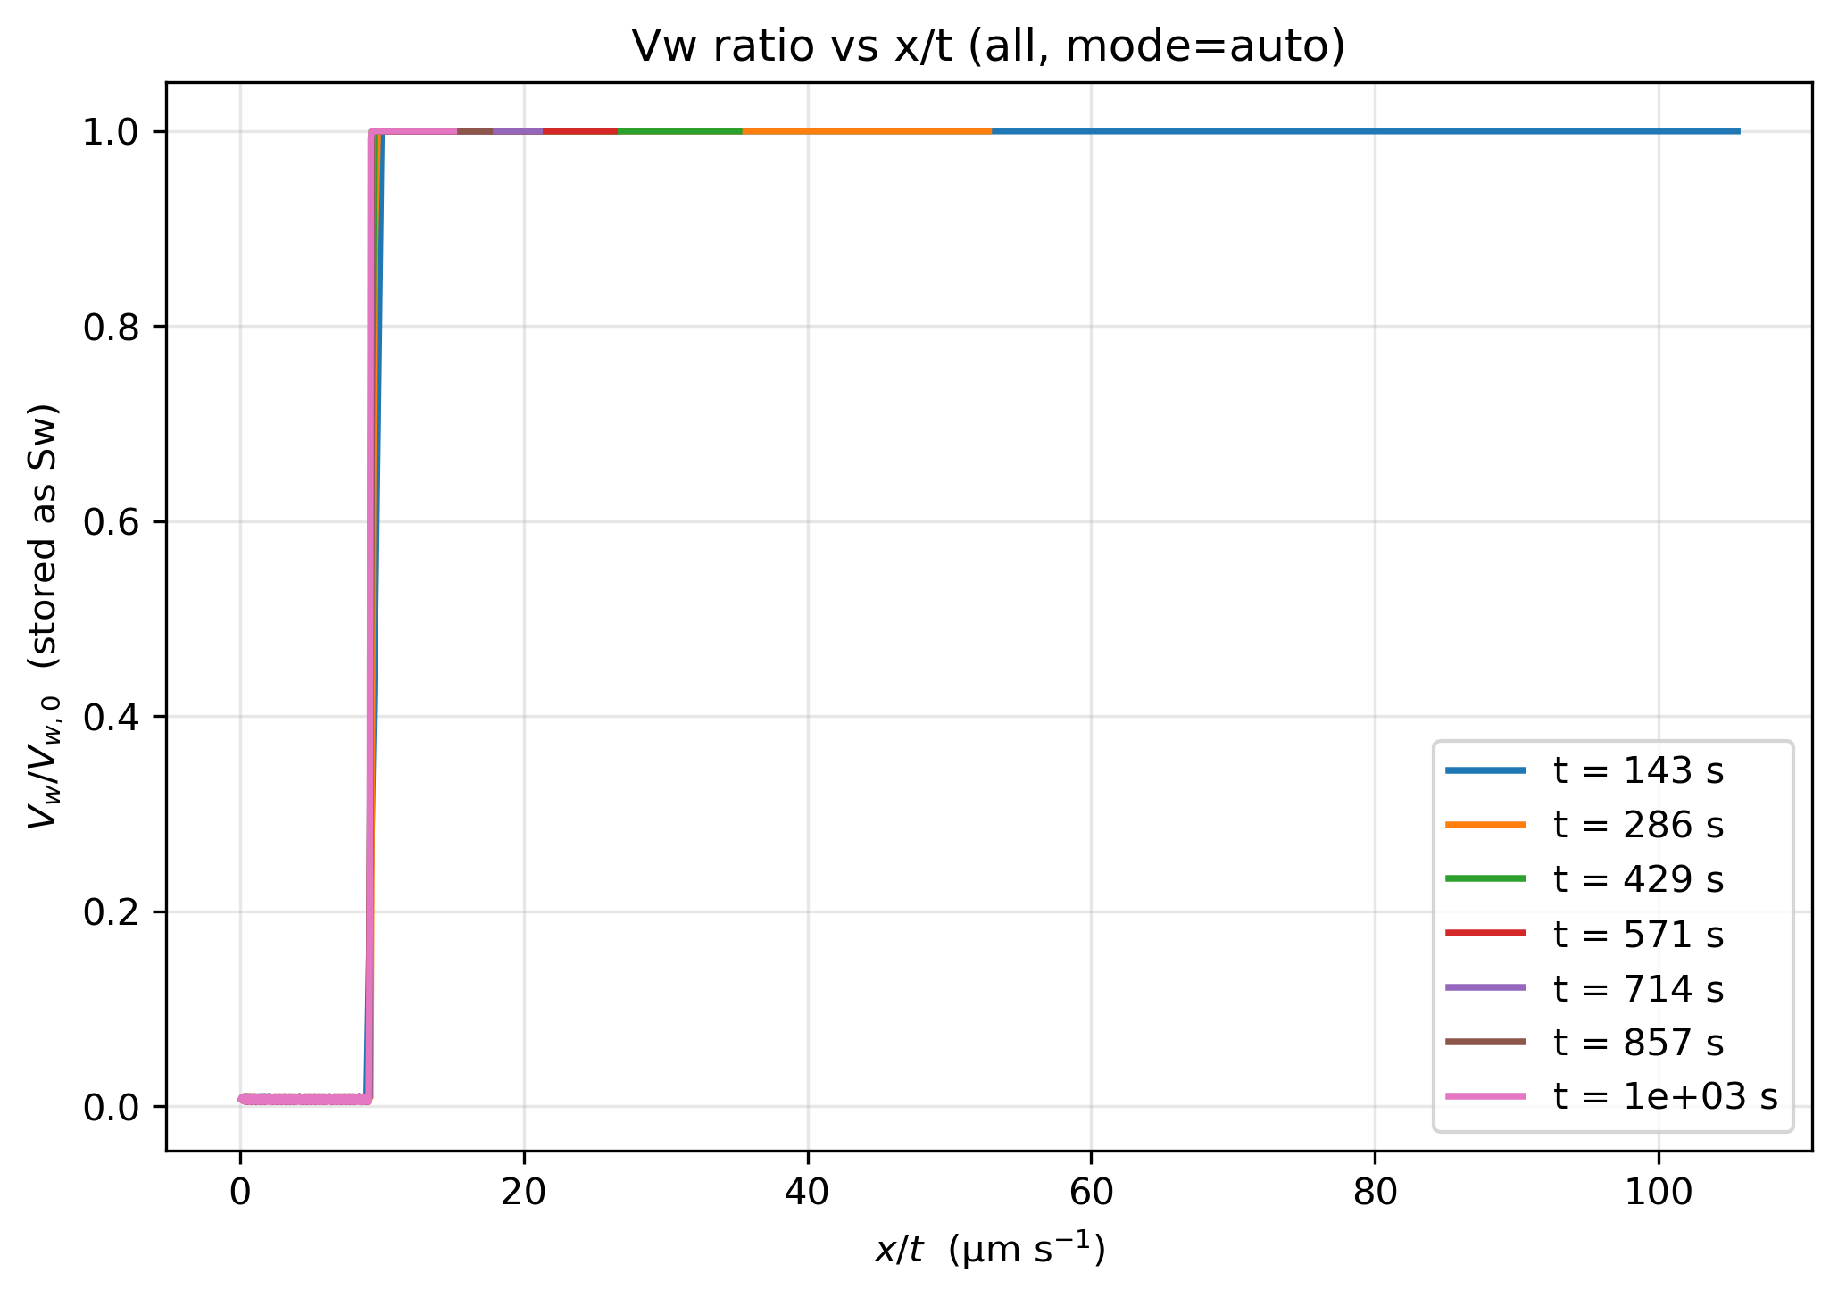
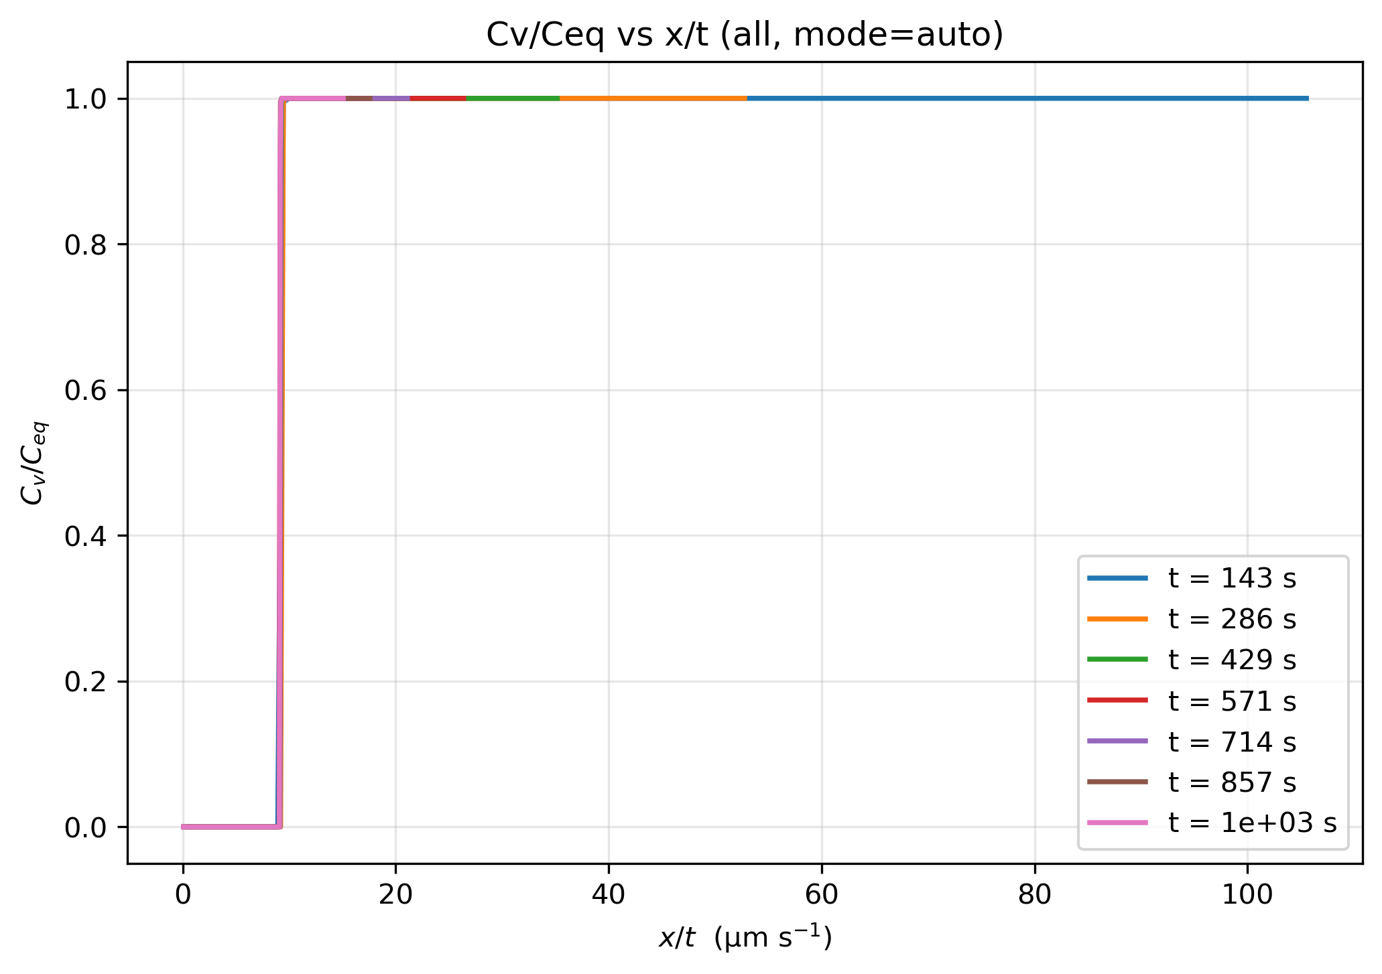
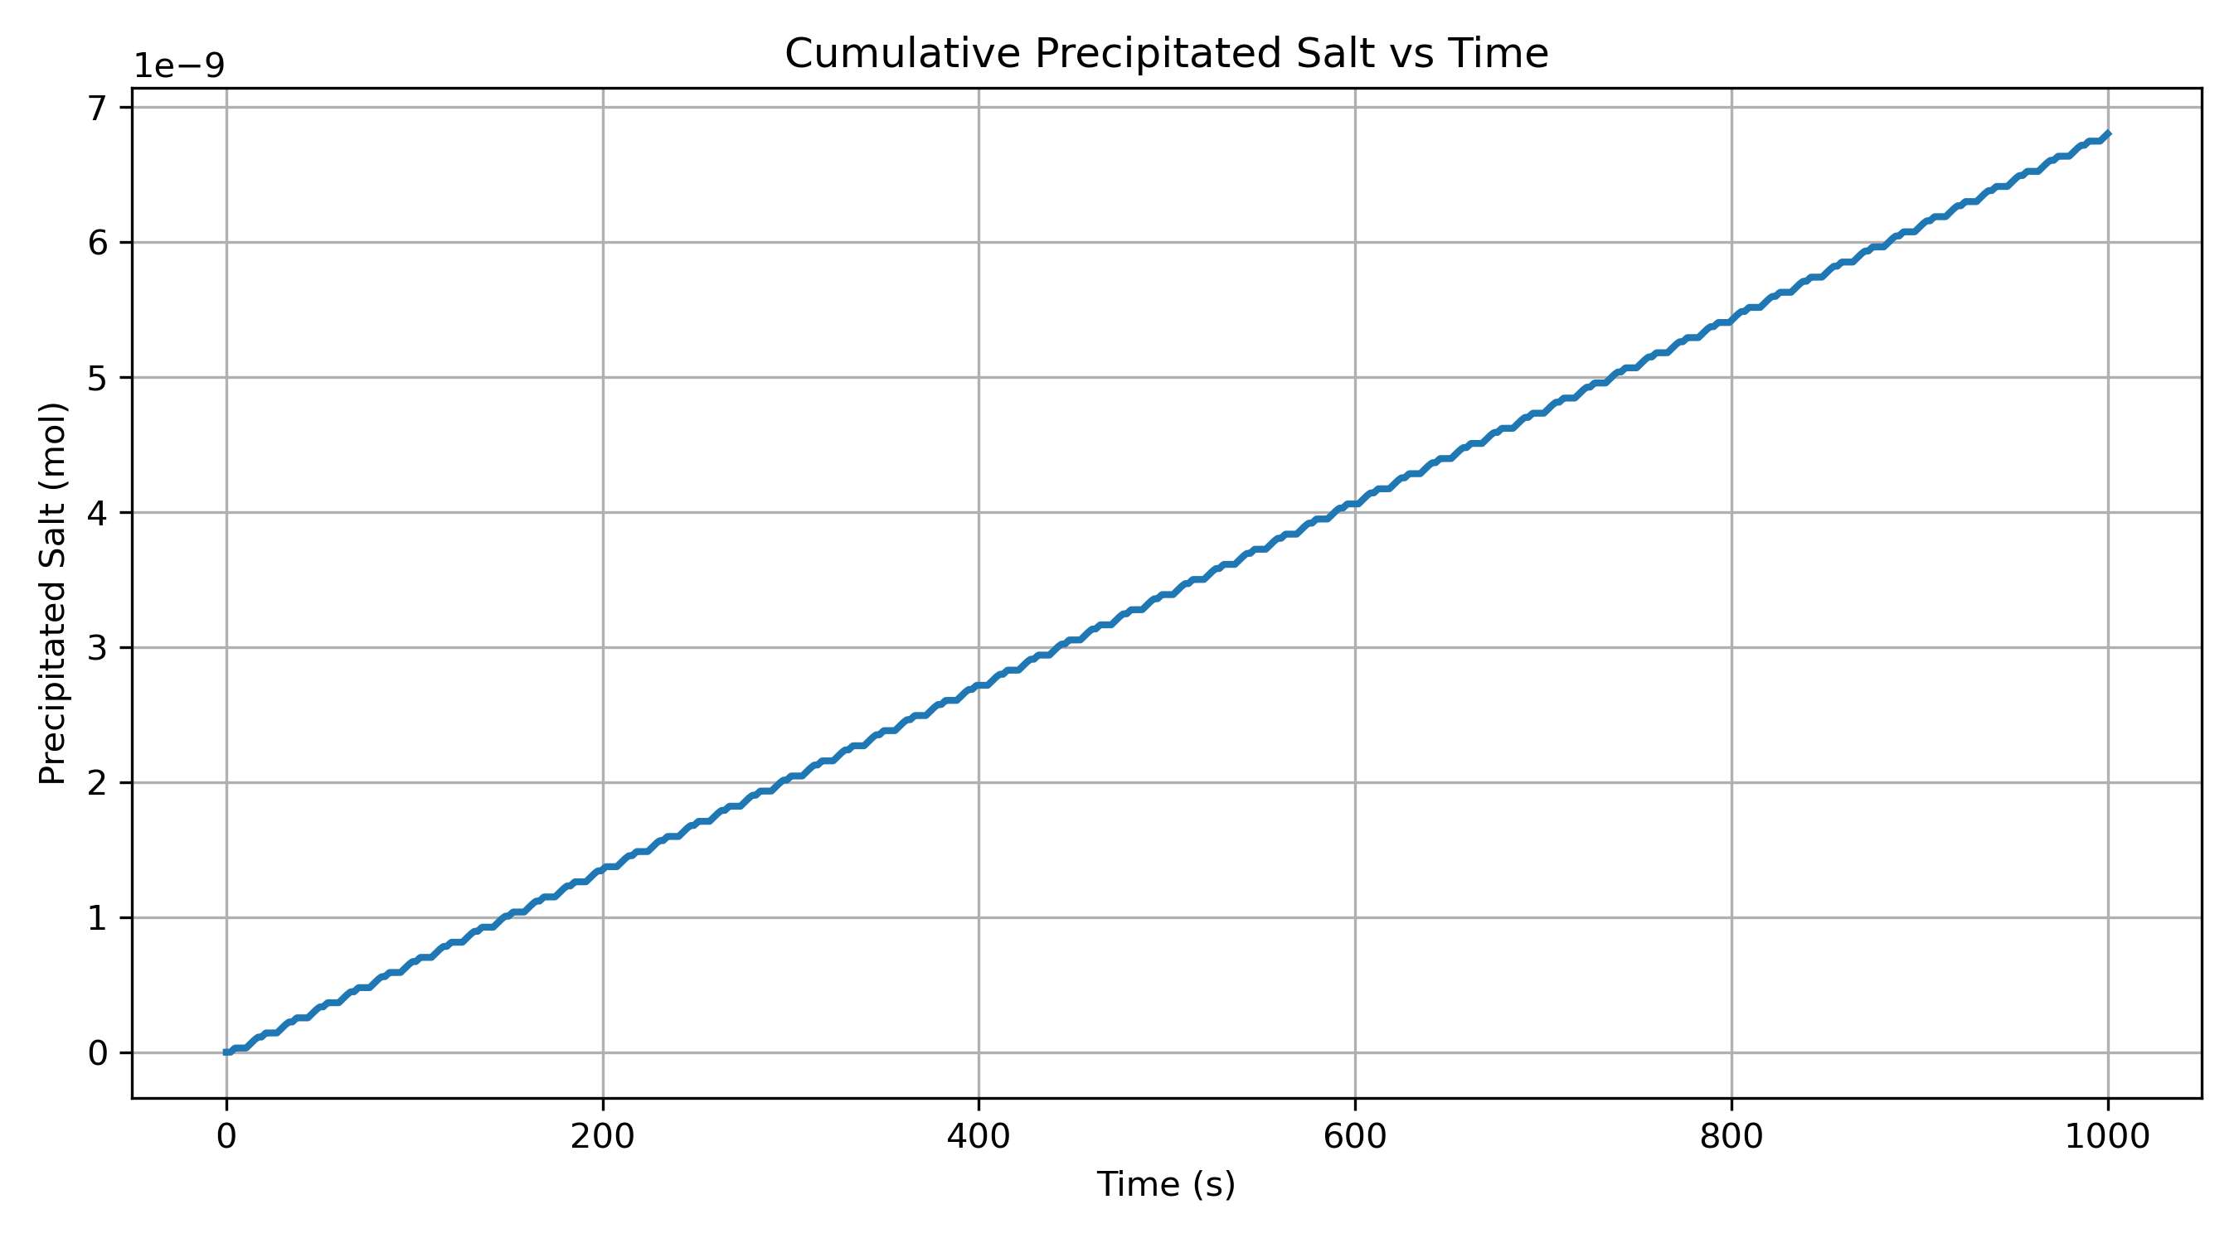
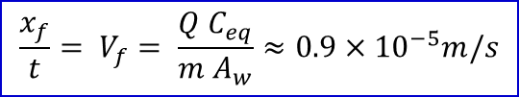

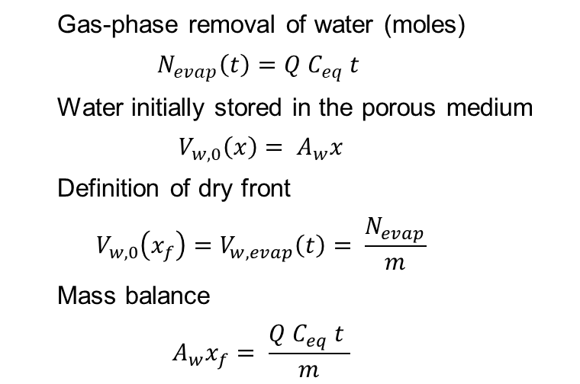
1-D Validation: Drying-Front Propagation
2. Numerical Results
Section 3. Validation & Results
1. Analytical Derivation
1 2 3 4 5 6 7 8
Dry CO₂ injection
Gas-phase removal of water (moles)
$$N_{evap}\left(t\right)=Q C_{eq} t$$
Water initially stored in the porous medium
$$V_{w,0}\left(x\right)= A_{w}x$$
Definition of dry front
$$V_{w,0}\left(x_{f}\right)=V_{w, evap}\left(t\right)= \frac{N_{evap}}{m}$$
Mass balance
$$A_{w}x_{f}= \frac{Q C_{eq} t }{m}$$
$$x/t≈9.4μm/s=0.94 × {10}^{−5} m/s$$
Excellent agreement between analytical prediction and numerical dry-front propagation validates the evaporation-driven transport framework.
3. Salt Precipitation
Salt precipitation initiates after local brine concentration reaches supersaturation
$$\frac{x_{f}}{t}= V_{f}= \frac{Q C_{eq}}{m A_{w}}≈0.9×{10}^{−5}m/s$$

Slide 7
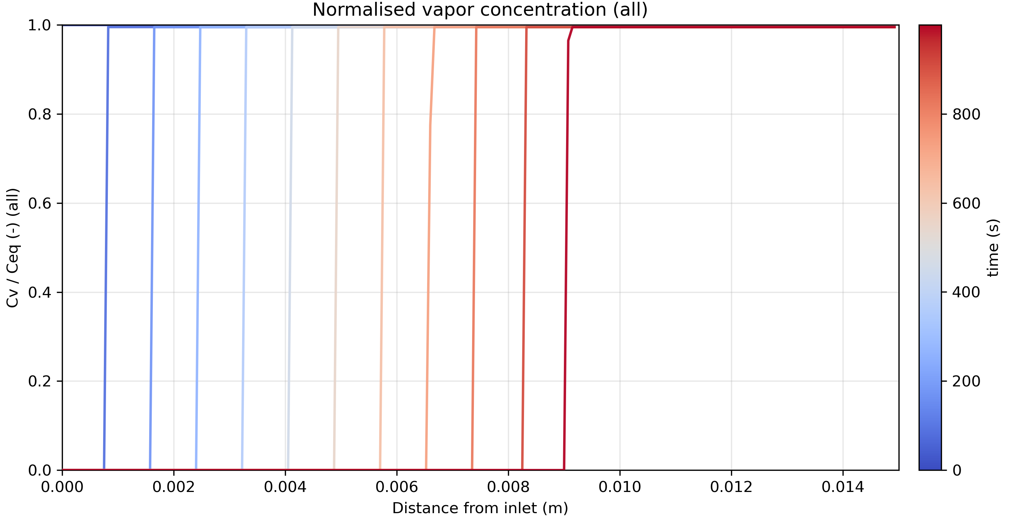
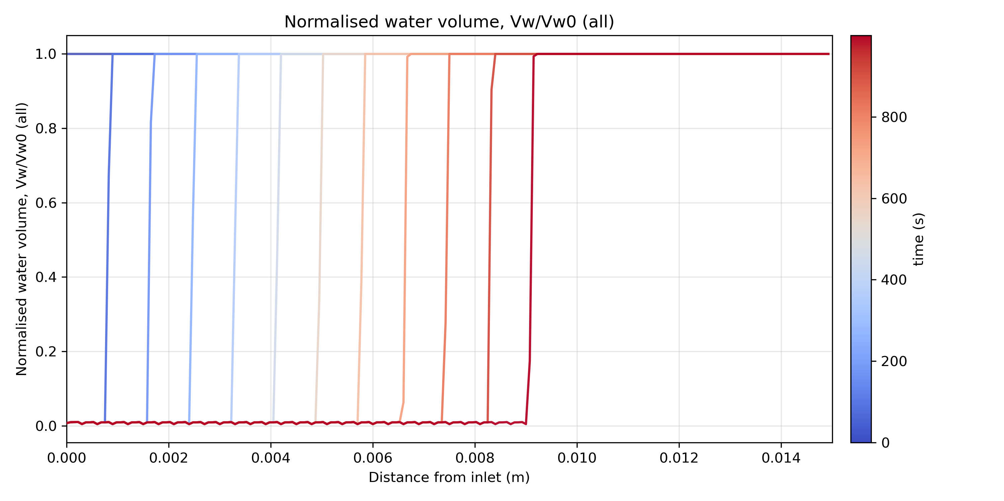
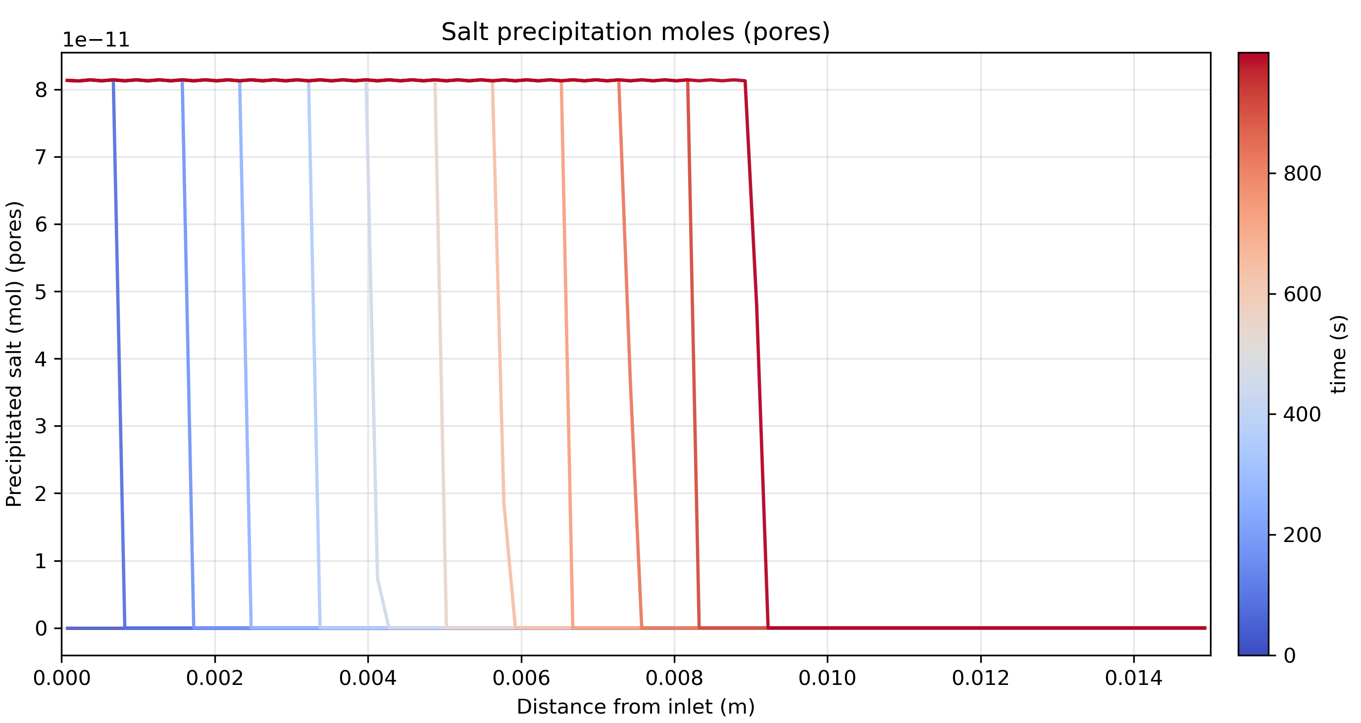
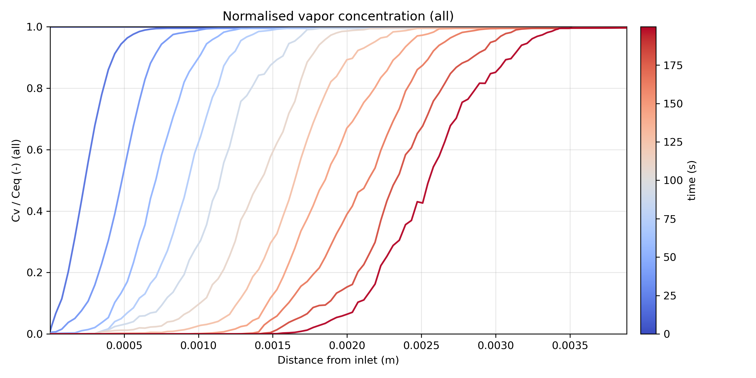
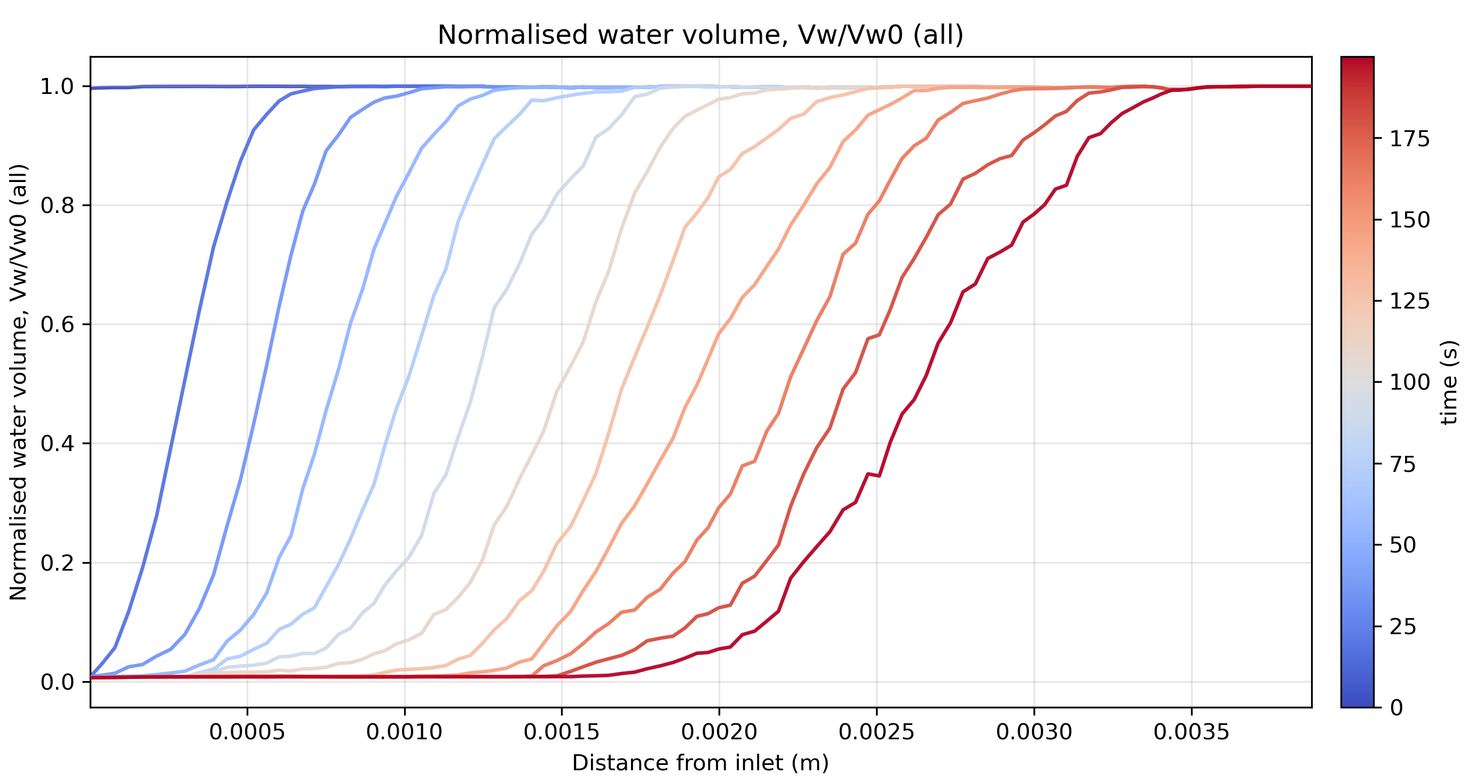
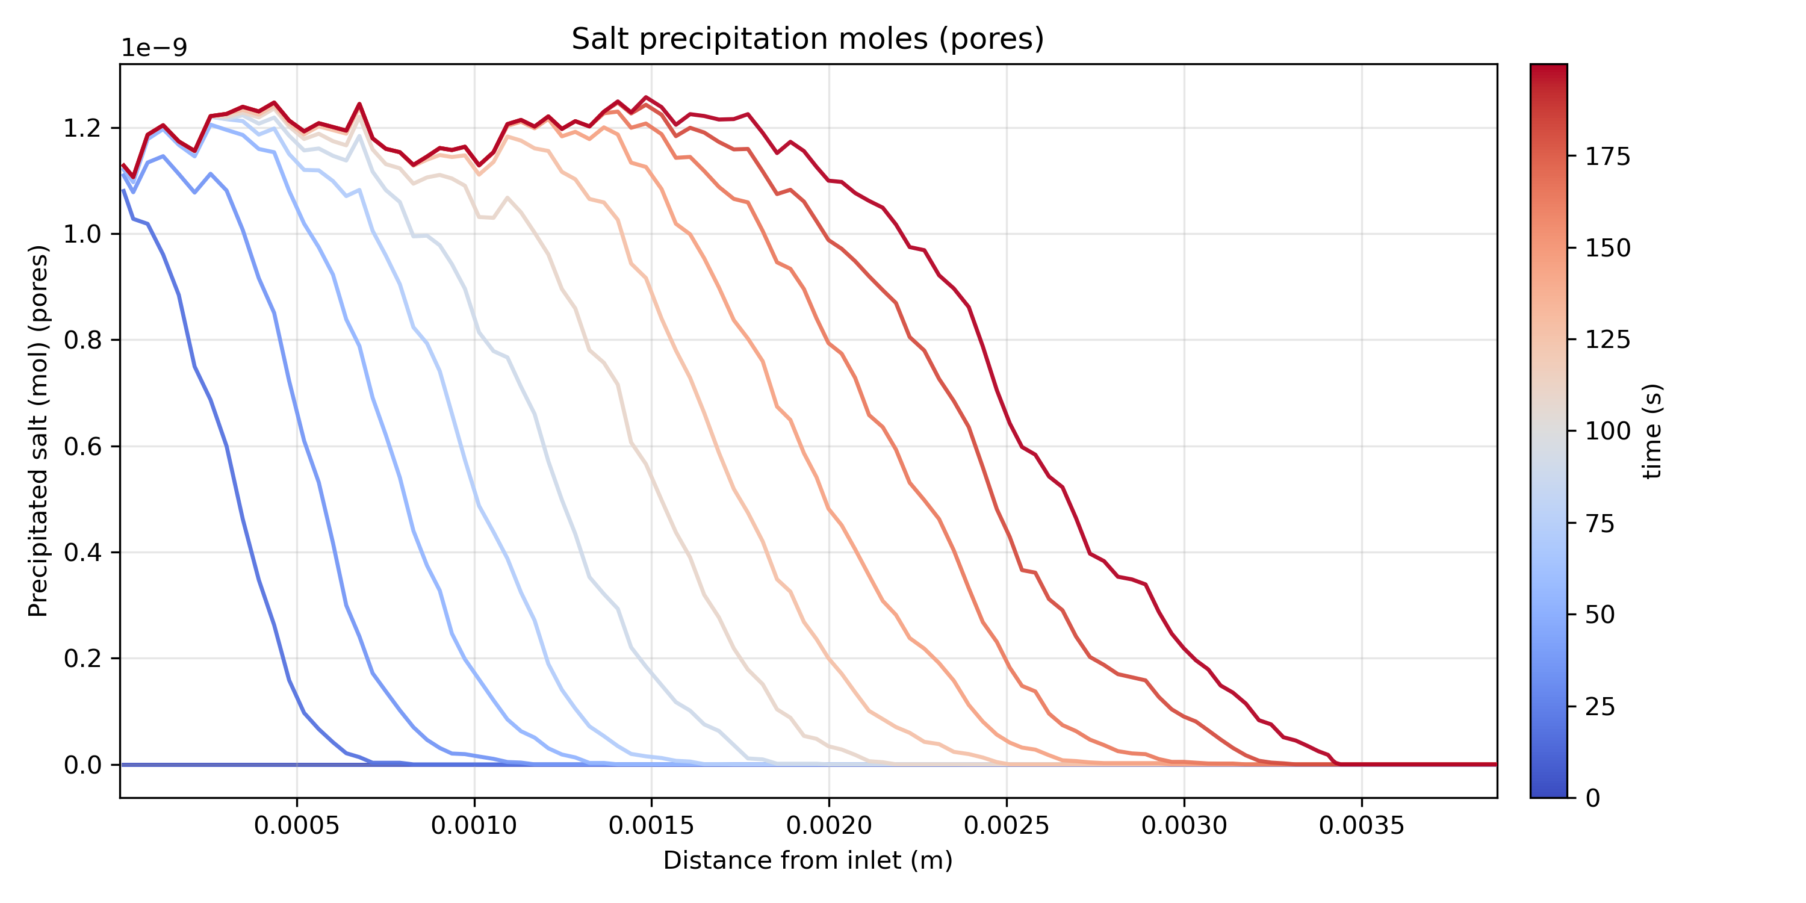

1D vs 3D Evaporation-Precipitation Dynamics
1D Chain Network 3D Bentheimer Pore Network
Section 3. Validation & Results
··· ···
Vapour Concentration (C_{v}/C_{v,eq}) Water Volume (V_{w}/V_{w0}) Salt Precipitation (n_{p}, mole)
1D Chain Network
3D
Pore Network
Key Takeaway
Both 1D and 3D models capture the same evaporation-driven transport trend, while 3D networks exhibit broader fronts and heterogeneous salt accumulation due to pore-scale connectivity effects.

Slide 8
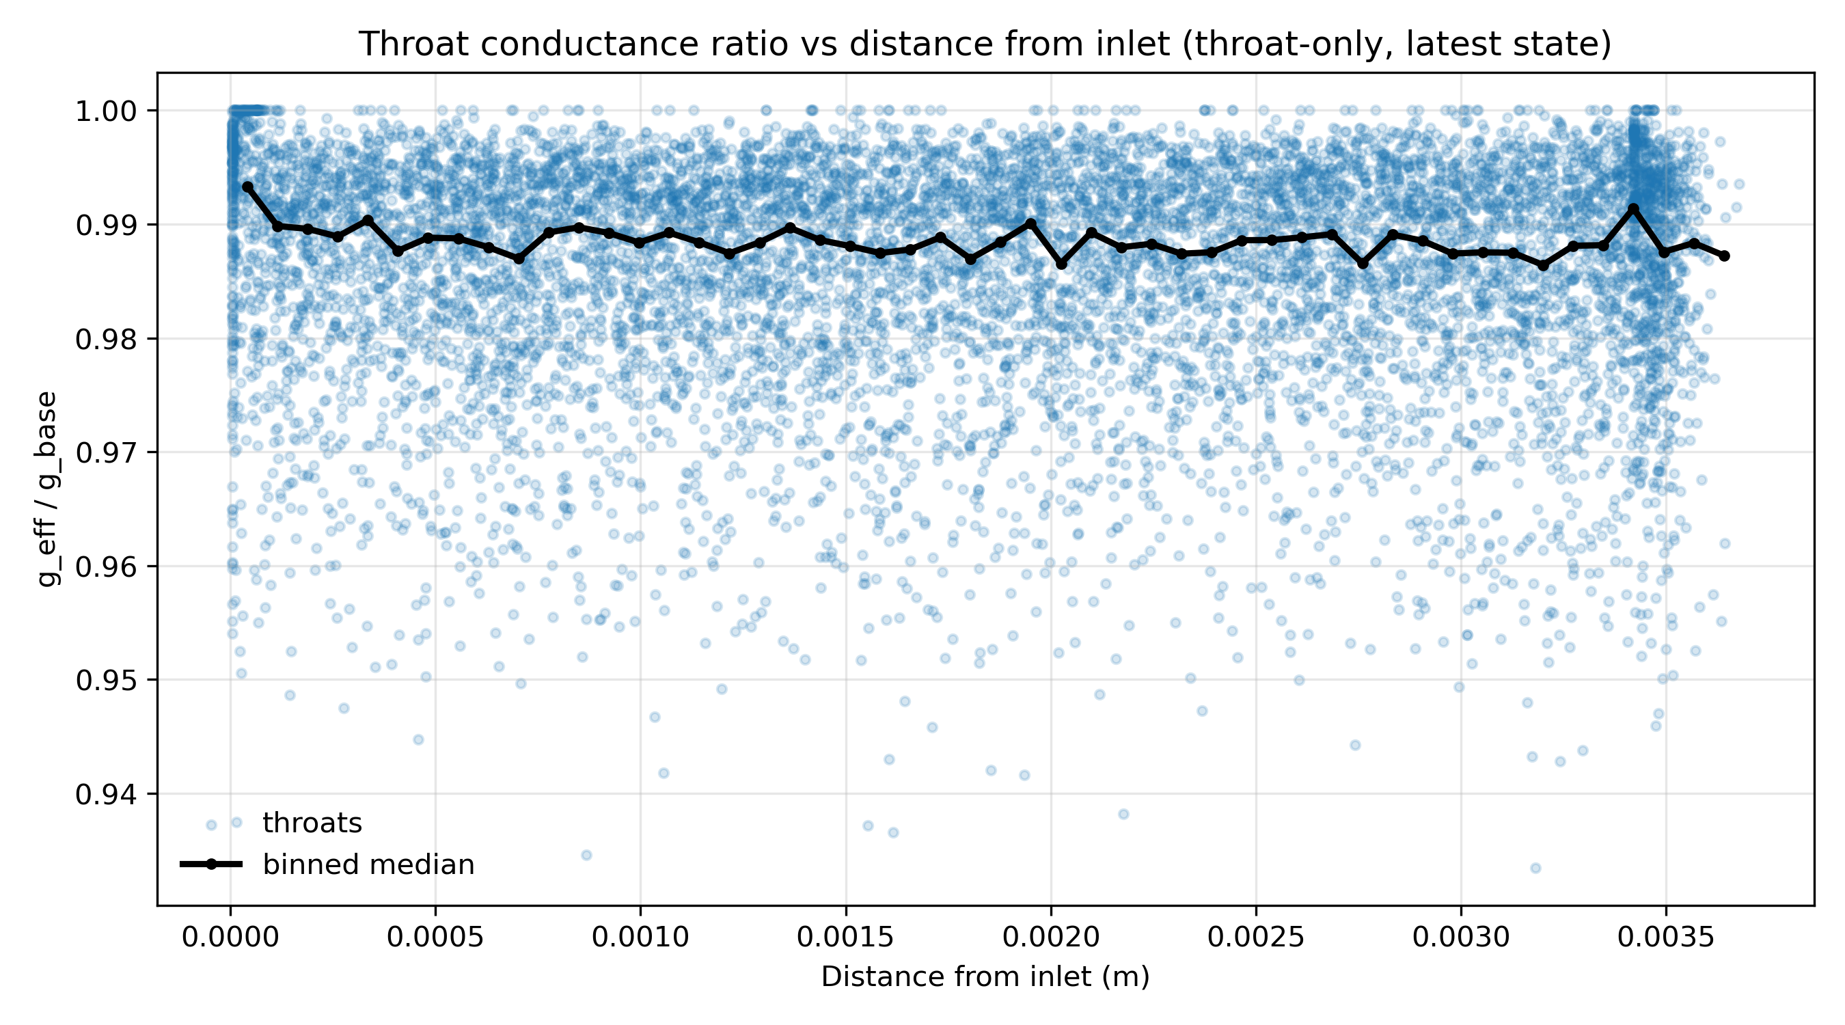
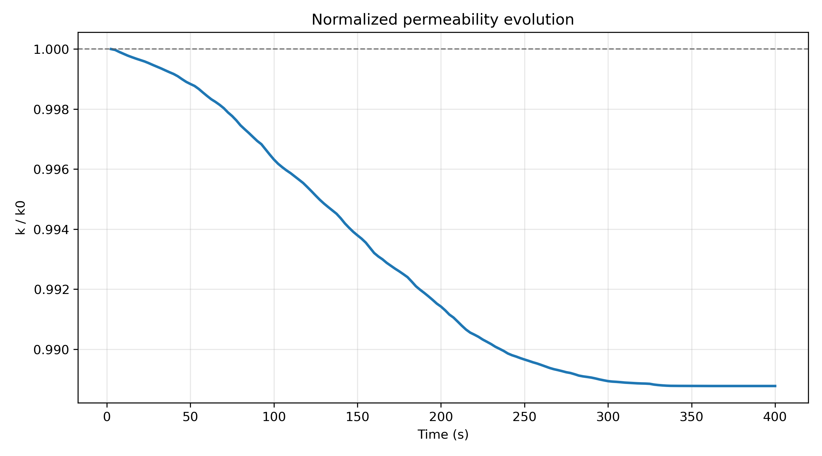

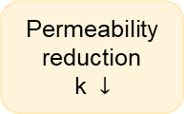
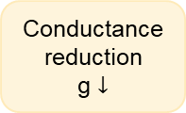


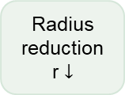
Section 3. Validation & Results
Permeability Reduction & Flow Redistribution
Mechanism: Salt-Induced Throat Constriction
Key Relations
Results: Local Conductance & Permeability Evolution
Clean pore-throat
Initial radius r₀
Conductance g₀
Conductance reduction
$$g= g_{0}{\left(1−f_{s}\right)}^{2}$$
Spatially heterogeneous conductance changes
Salt precipitation
Salt accumulates on pore / throat surfaces
g₀: initial throat conductance
g: current throat conductance
f_{s}: local precipitated salt fraction (cross-sectional area ratio)
Radius reduction
Effective radius r_{new}
( <r₀ )
Permeability update
$$k= k_{0} {\left(\frac{r_{new}}{r_{old}}\right)}^{2}$$
Conductance reduction & flow update
Lower conductance g
Recompute flow field
k₀: initial permeability
r_{old}: original pore / throat radius
r_{new}: updated effective radius
Only modest permeability reduction (~1%)
Brine
Salt
Local throat
constriction
Radius reduction
r $↓$
Conductance reduction
g $↓$
Permeability reduction
k $↓$
Flow redistribution
Without re-imbibition, salt precipitation alone leads to only modest permeability reduction (~1%) under dry-CO₂ conditions.
This motivates the next step: capillary-driven re-imbibition
Key Takeaway

Slide 9
Section 4. Re-imbibition Physics
1
Salt precipitation changes pore geometry
Salt deposits reduce radius of pores & throats and alter capillary entry conditions.
Remaining corner water creates capillary suction
Thinning layers in corners generate higher capillary pressure.
Corner brine can flow back into dried/partially dried regions
Capillary-driven backflow occurs spontaneously without external brine injection.
This may enhance local salt redistribution and blockage
Salt can dissolve, transport and re-precipitate, further modifying geometry and flow.
Why Re-imbibition Matters
New physics after salt precipitation during dry CO₂ injection.
2
Corner water in a pore
Dry CO₂
Corner water
3
Gas core
4
Salt layer
CO₂ (gas)
Brine (liquid)
Water vapour (gas)
NaCl (solid)
Outcome
Enhanced wetting-phase connectivity.
Salt redistribution and possible re-precipitation.
Potential hydraulic feedback on pore transport and connectivity.
CO₂
Remaining corner water (thin films)
Film swelling (capillary-driven)
Enhanced wetting connectivity

Slide 10

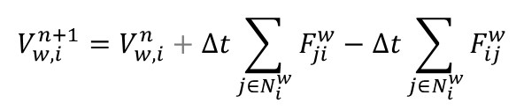

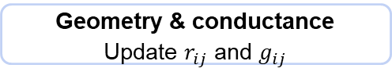



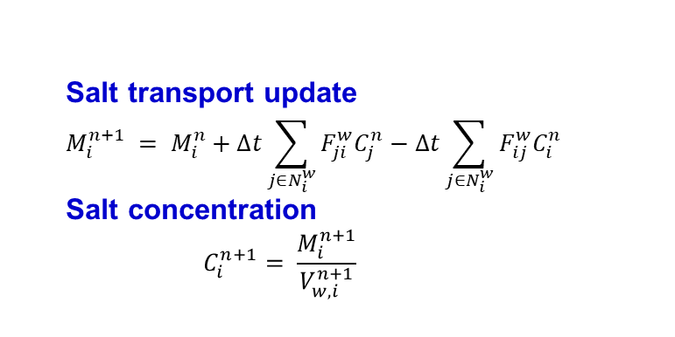

Section 4. Re-imbibition Physics
Numerical Re-imbibition Workflow
Corner-water flux between elements
Numerical update sequence (per time step)
$$q_{4}$$
$$q_{1}$$
Compute pressures
compute P_{c,i} and water pressure P_{w,i}
$$q_{2}$$
Corner-water redistribution
$$V_{w,i}^{n+1}=V_{w,i}^{n}+∆t\sum_{j∈N_{i}^{w}}{F_{ji}^{w}}−\text{​}Δt\sum_{j∈N_{i}^{w}}{F_{ij}^{w}}$$
$$q_{3}$$
Water flux
Compute fluxes $F_{ji}^{w}$
Wetting layer growth
Update corner water volume
Salt transport update
$$M_{i}^{n+1} = M_{i}^{n}+∆t\sum_{j∈N_{i}^{w}}{F_{ji}^{w}C_{j}^{n}}−\text{​}Δt\sum_{j∈N_{i}^{w}}{F_{ij}^{w}C_{i}^{n}}$$
Salt concentration
$$C_{i}^{n+1}= \frac{M_{i}^{n+1}}{V_{w,i}^{n+1}}$$
Corner-film expansion
Update wetting-layer connectivity
If $C_{i}^{n+1} > C_{sat}$, precipitate
Salt transport
Advective transport of salt
Geometry and flow field feedback
Precipitation / dissolution
Check C_{i} vs. C_{sat}
Geometry & conductance
Update $r_{ij}$ and $g_{ij}$
Salt precipitation
Radius reduction
Conductance reduction
Updated flow field

Slide 11
Section 5. Conclusions & Outlook
Conclusions & Outlook
Outlook: Re-imbibition
Pore-scale evaporation and salt precipitation influence transport and hydraulic evolution during dry CO₂ injection into saline aquifers.
CO₂
Remaining corner water may generate capillary-driven backflow after precipitation.
Key Findings
Dry CO₂ injection drives evaporation-induced salt precipitation at pore scale.
The 1D analytical solution shows excellent agreement with numerical dry-front propagation, validating the evaporation-driven transport framework.
3D pore networks exhibit broader drying fronts and stronger spatial heterogeneity than 1D systems.
Salt precipitation alters local geometry and flow, but re-imbibition should be included to capture the full hydraulic feedback
Salt redistribution and re-precipitation may further modify pore geometry and flow connectivity.
··· ···
A numerical re-imbibition algorithm has been developed and will be coupled with the evaporation-precipitation framework.
Why it Matters
Re-imbibition introduces potential feedback on pore connectivity, salt transport and long-term storage performance.
Take-Home Message
Pore-scale heterogeneity, salt-precipitation and re-imbibition jointly control hydraulic evolution during dry CO₂ injection into saline aquifers.
Questions?
Thank you!

