Slide 1

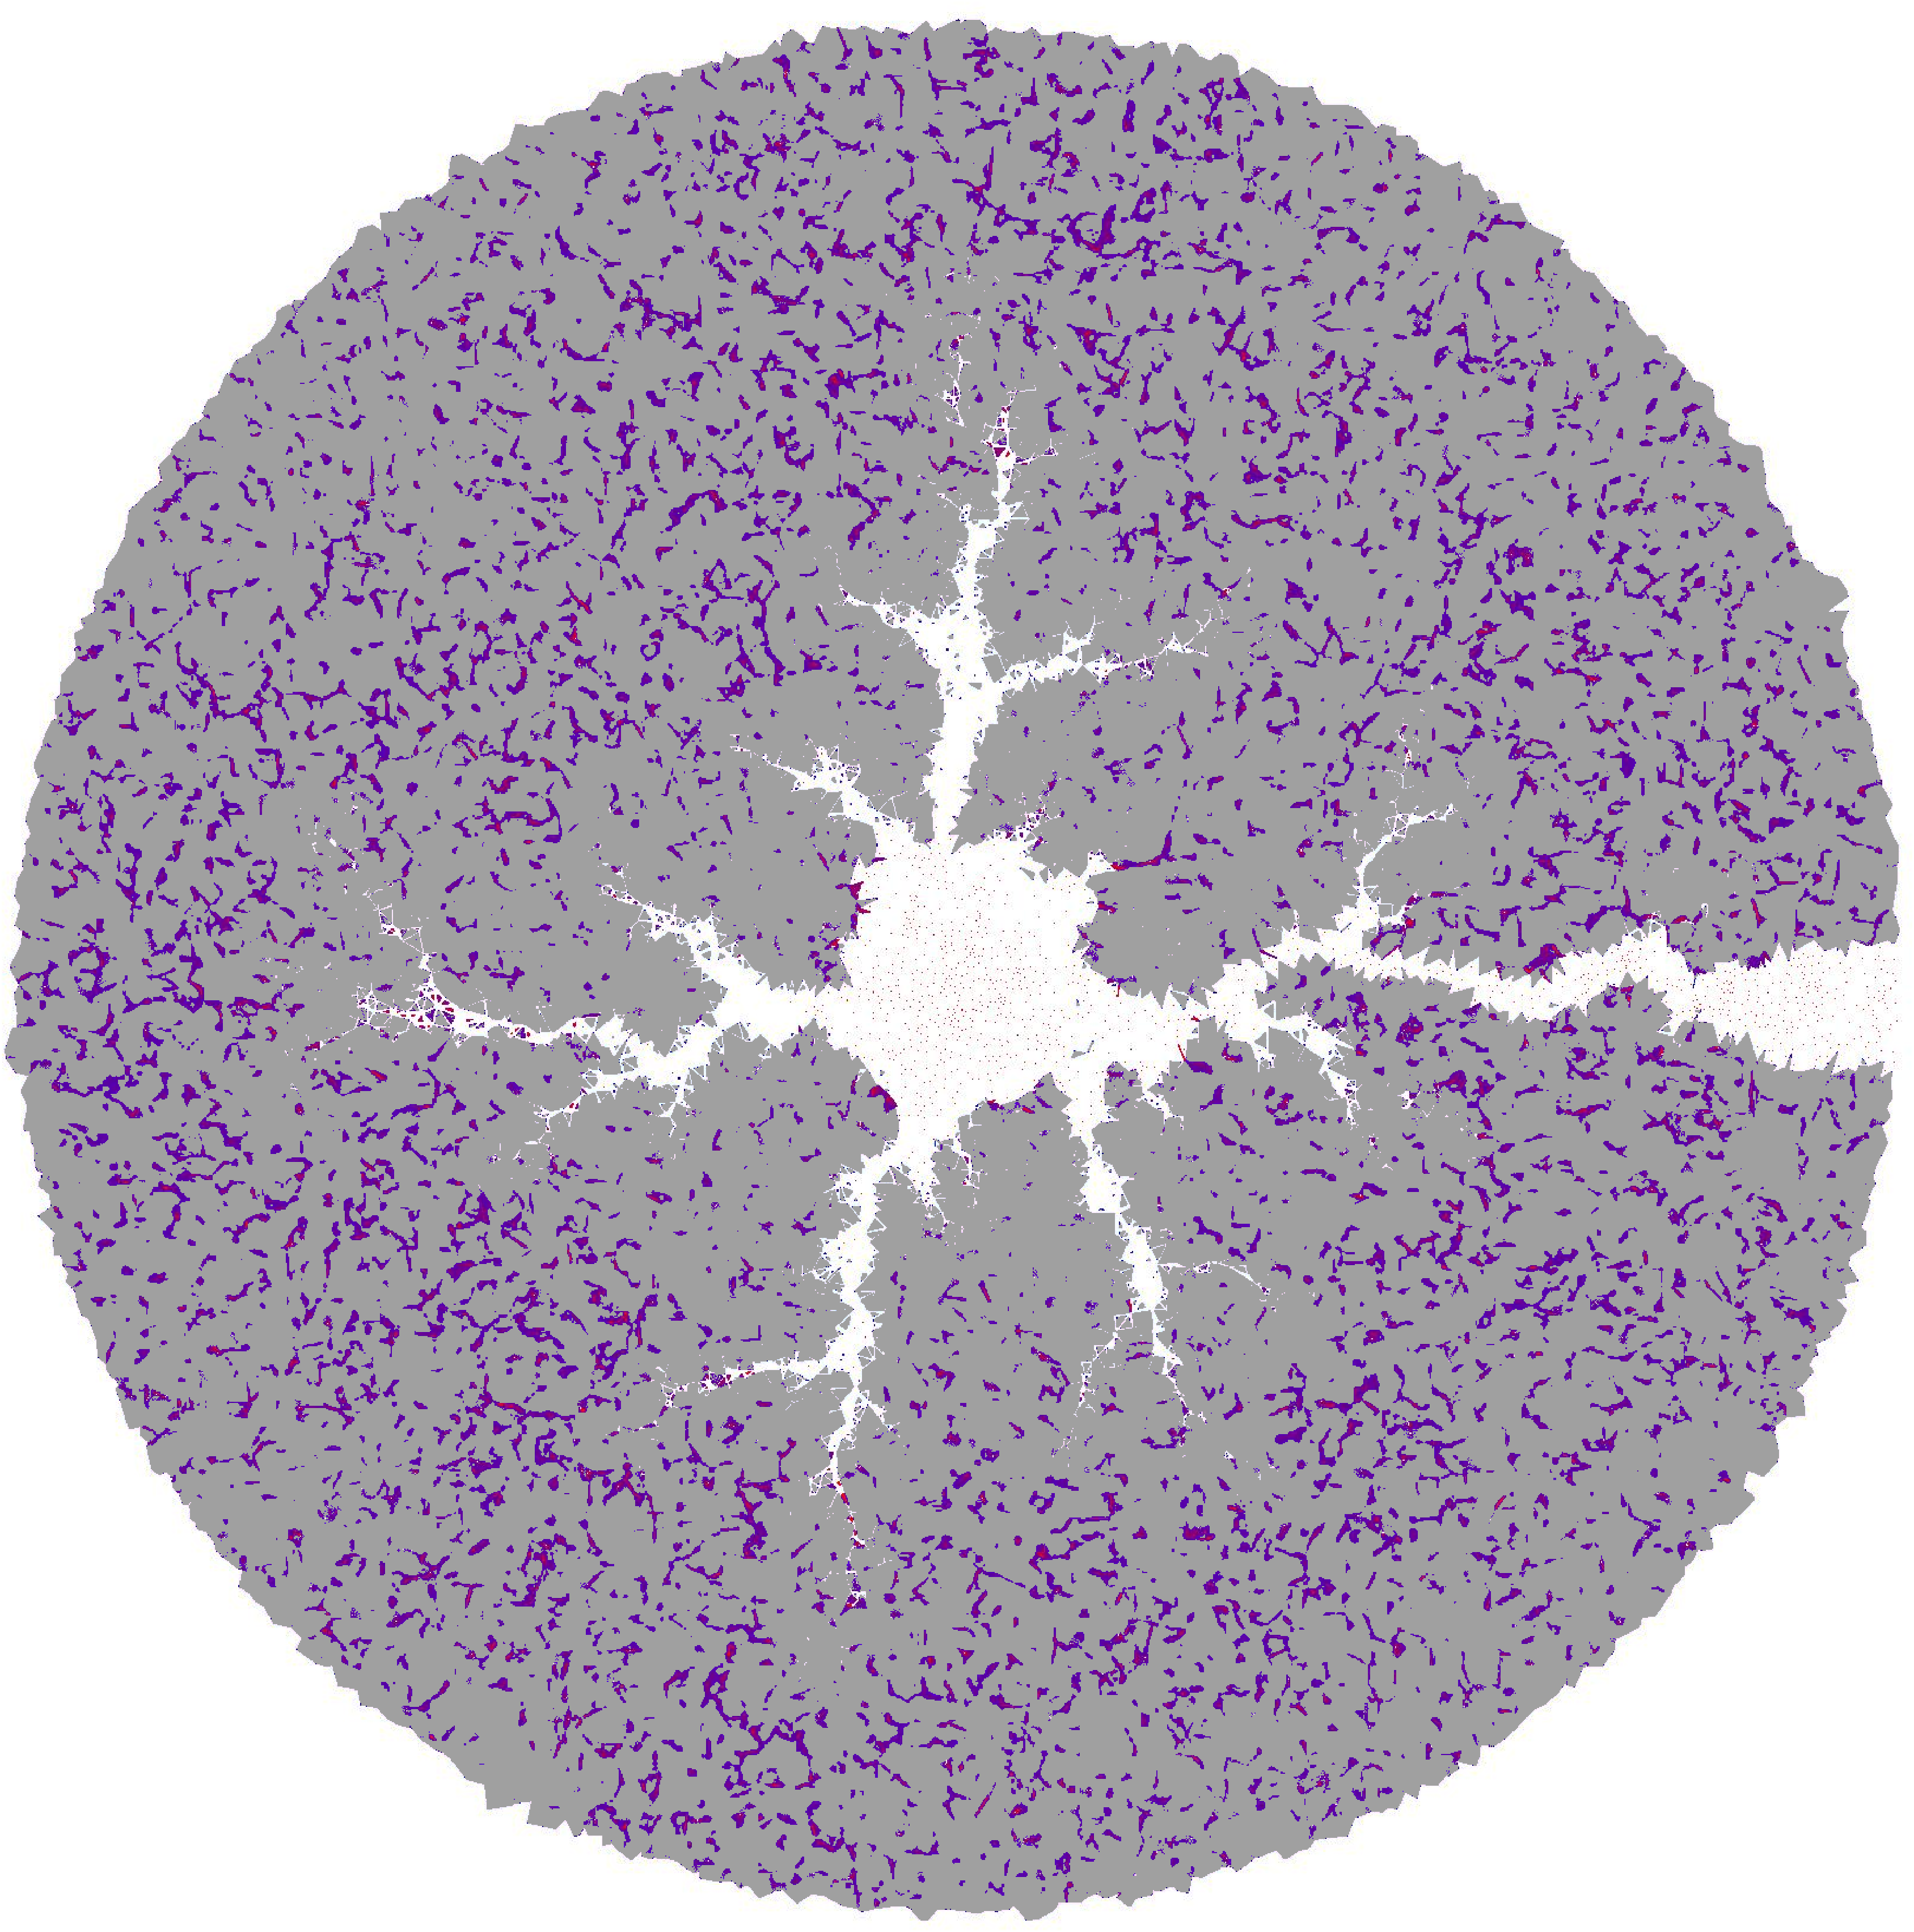
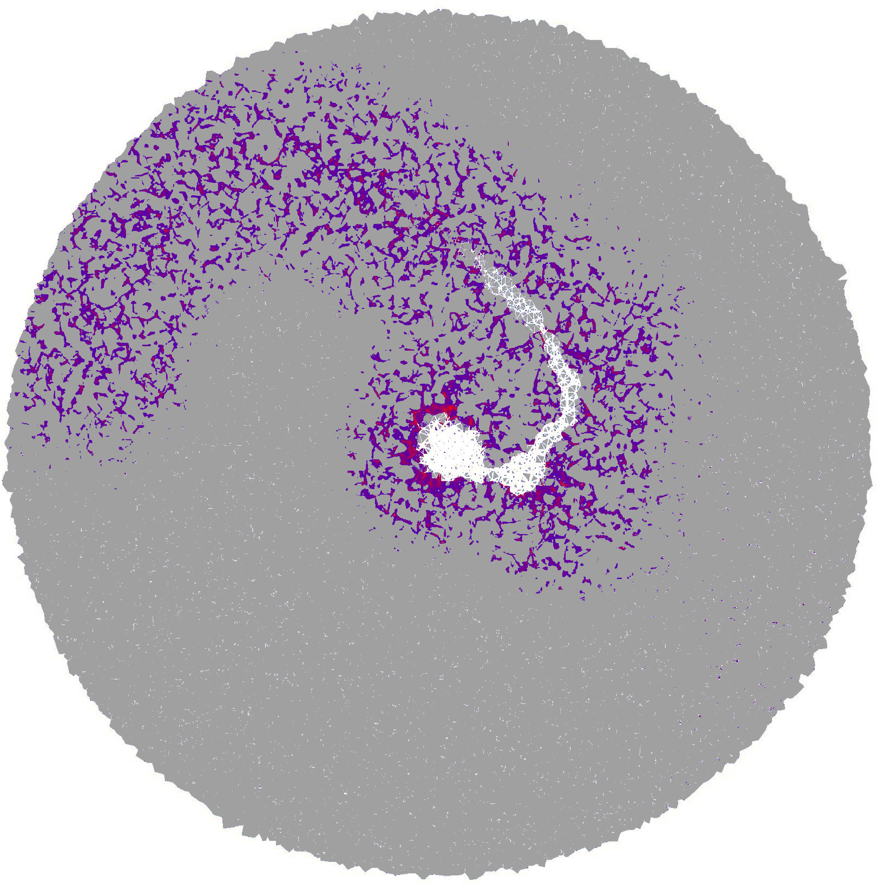
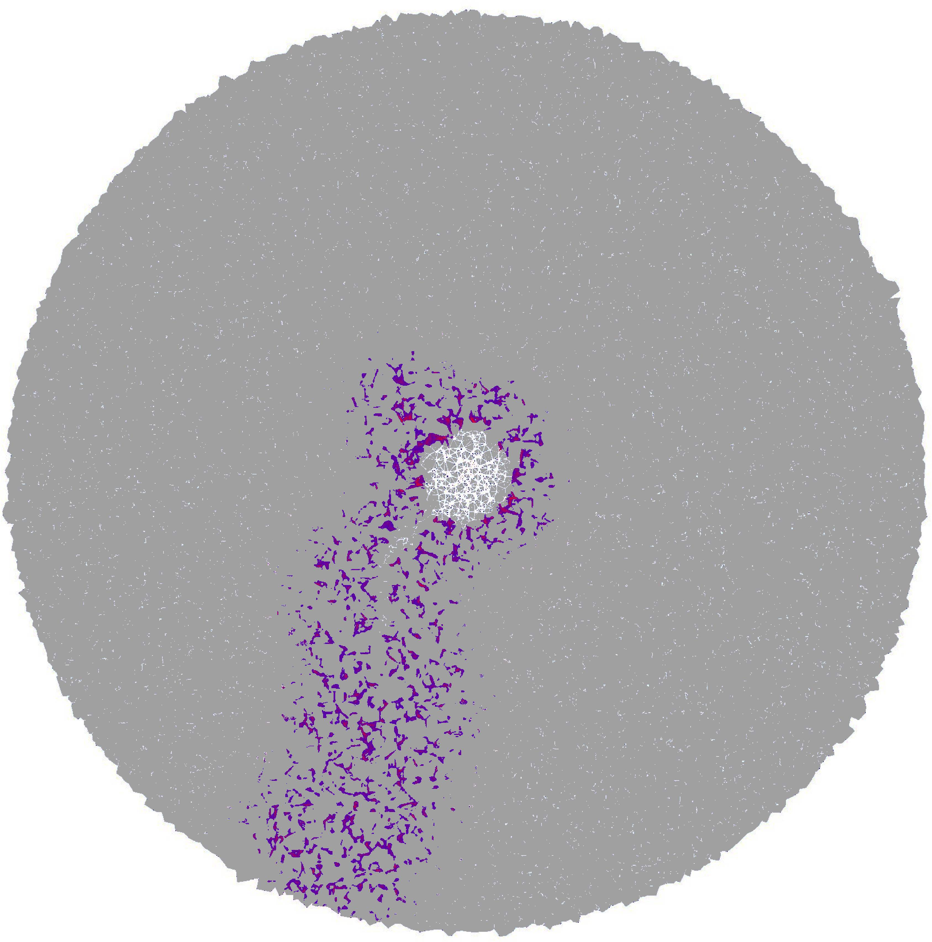
Redissolution Controls Clogging Dynamics During Coupled Mineral Dissolution and Precipitation
MS09: Pore-Scale Physics and Modeling
Abstract ID: 272
Jingxuan Deng^{1,2}, Agnieszka Budek¹, Piotr Szymczak³, Peter K Kang^{*1,2}
1 Department of Earth and Environmental Sciences, University of Minnesota – Twin Cities, Minneapolis, MN, USA
2 Saint Anthony Falls Laboratory, University of Minnesota – Twin Cities, Minneapolis, MN, USA
3 Institute of Theoretical Physics, Faculty of Physics, University of Warsaw, Poland
May 20, 2026

Slide 2
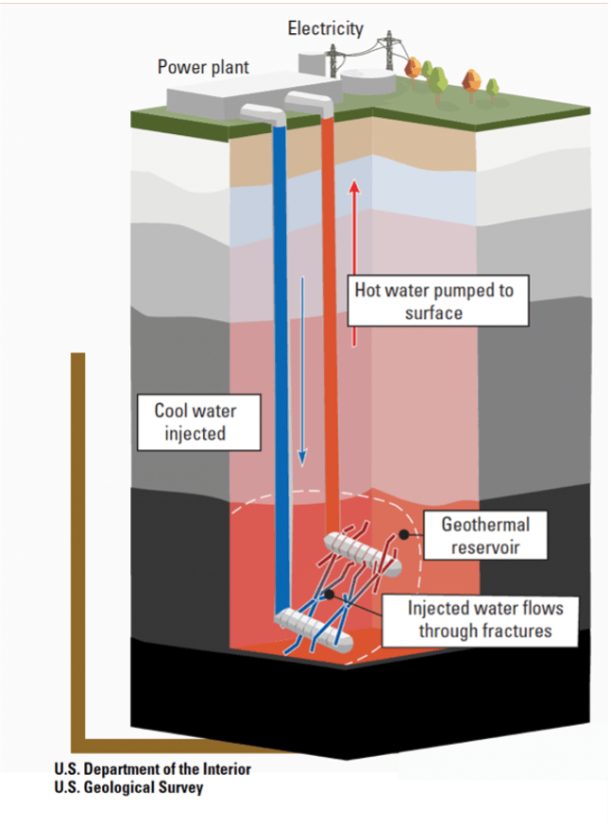
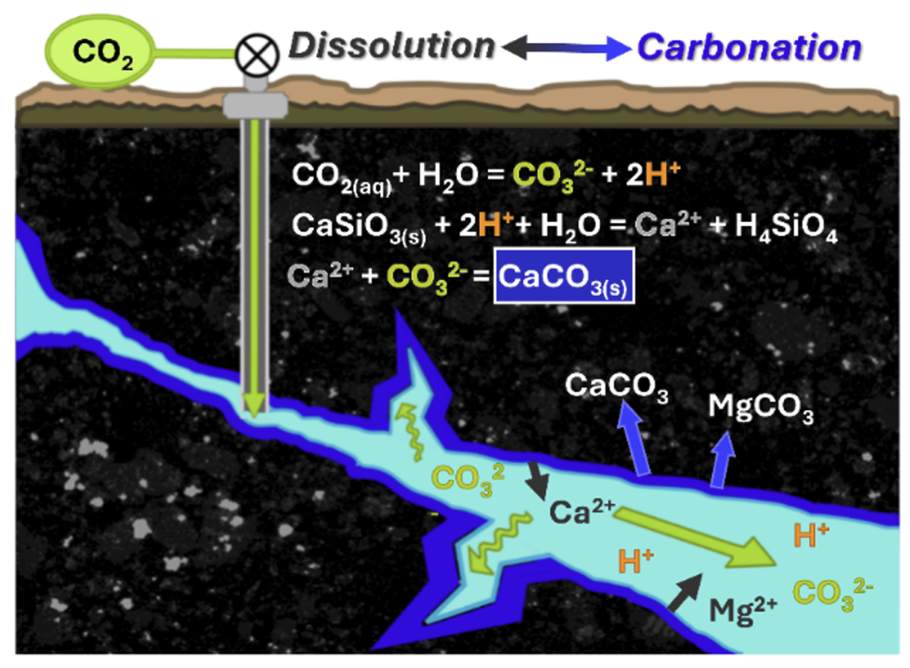
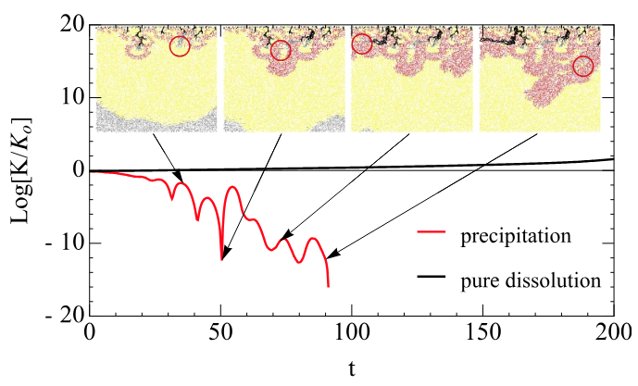
Clogging Emerges During Coupled Dissolution–Precipitation
Geothermal energy production
Carbon mineralization
Precipitation-induced clogging
dissolution
precipitation
Source: https://iee.psu.edu/news/blog/carbon-sequestration-and-mineralization [adapted from Menefee et al. (2017)]
Budek, A., & Szymczak, P. (2025)
Dissolution and precipitation reshape the pore structure
Dissolution → enlarges pores & releases dissolved species
Precipitation → redistributes minerals & constricts pore space
Precipitation-induced clogging can limit further reaction
Source: https://utahcleanenergy.org/geothermal-primer-part-1/

Slide 3
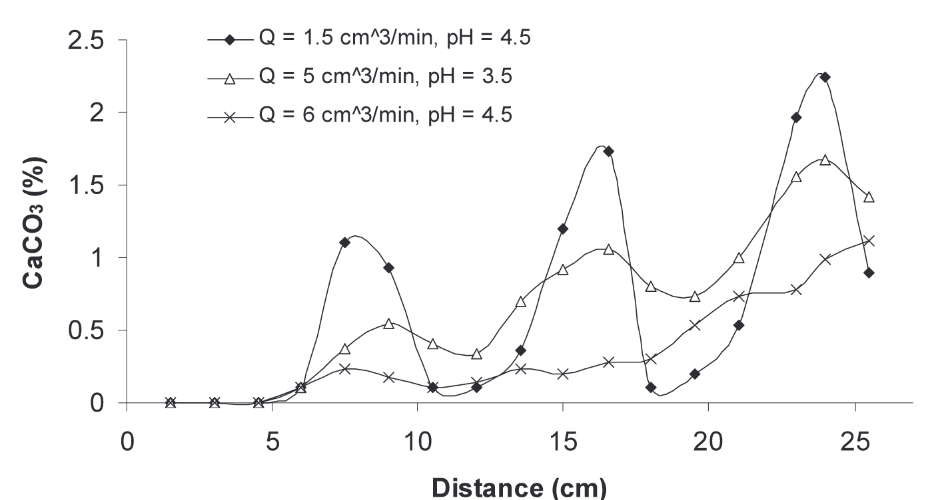
What If Clogged Pores Can Dissolve Again?
Redissolution occurs under changing chemical conditions, e.g. due to
low pH fluids,
undersaturation,
or mixing between chemically different fluid
redissolution
Open question
Can redissolution relieve clogging?
Or can it actually make clogging worse downstream?
Knowledge gap
Mechanistic framework of coupled dissolution, precipitation, and redissolution is lacking
Precipitation of CaCO3 along large columns during flow experiments. Singurindy et al. (2003)

Slide 4
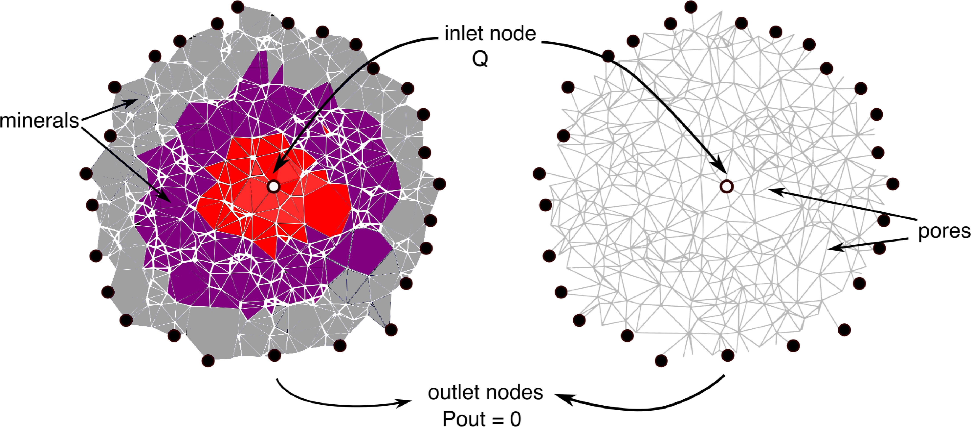
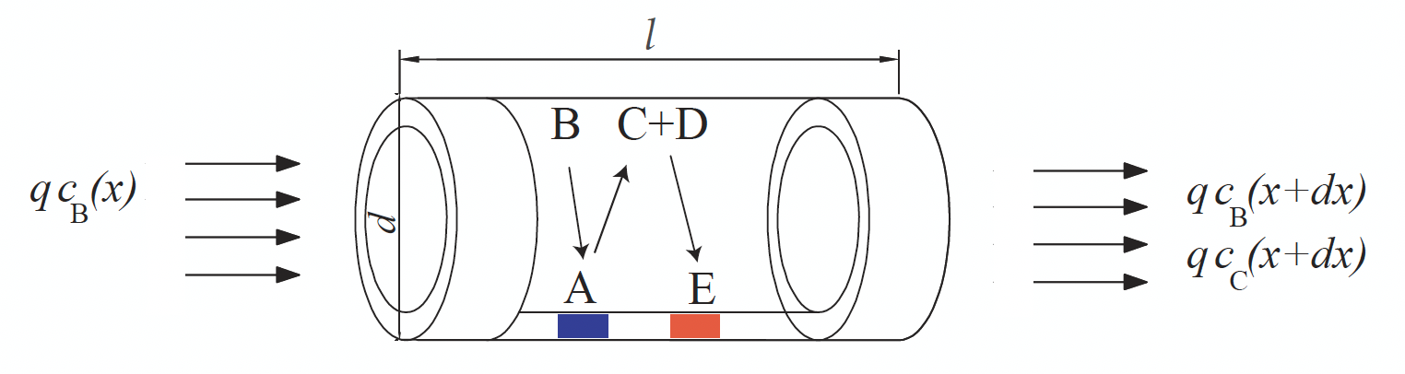

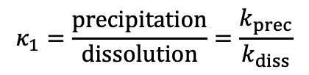




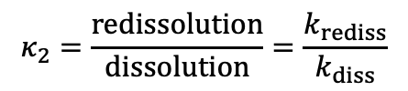

Pore-Network Model
Dissolution of mineral A
Mineral A + Acid B → Dissolved Species C
$$χ_{A}A+χ_{B}B→C,$$
$$R_{diss}=k_{diss}c_{B}$$
Precipitation of mineral E
Dissolved species C + Ion D → Mineral E
$$C+χ_{D}D→χ_{E}E↓,$$
$$R_{prec}=k_{prec}c_{C}$$
Redissolution of mineral E
Mineral E + Acid B → Dissolved species C
$$χ_{E}E+χ_{B}B→C,$$
$$R_{rediss}=k_{rediss}c_{B}$$
$$κ_{1}=\frac{precipitation}{dissolution}=\frac{k_{prec}}{k_{diss}}$$
$$κ_{2}=\frac{redissolution}{dissolution}=\frac{k_{rediss}}{k_{diss}}$$
Budek, A., & Szymczak, P. (2025)

Slide 5
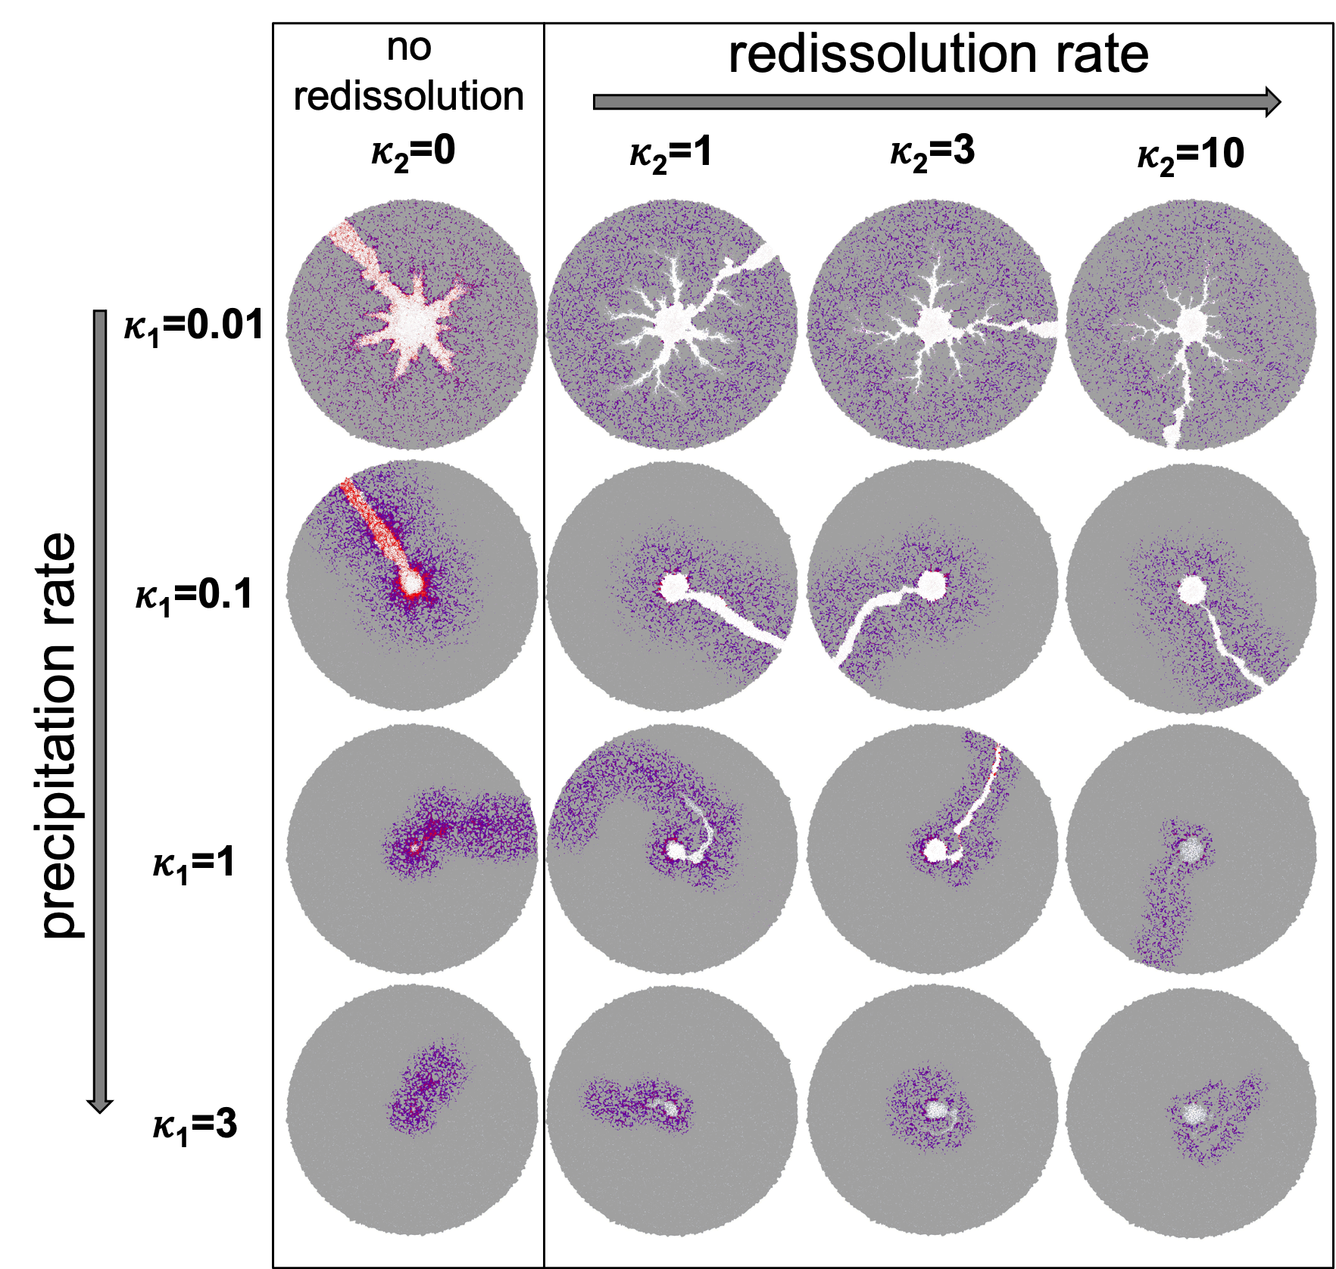
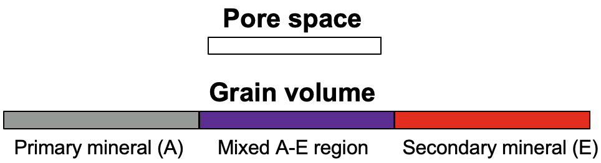




Redissolution Fundamentally Reshapes Spatial Dynamics of Dissolution and Clogging
Da=0.5, d₀=0.24 ($φ_{0}$~0.3), 𝛤=4
$$κ_{1}=\frac{precipitation}{dissolution}=\frac{k_{prec.}}{k_{diss.}}$$
$$κ_{2}=\frac{redissolution}{dissolution}=\frac{k_{rediss.}}{k_{diss.}}$$
Molar volume ratio $\text{Γ}=\frac{{χ_{E}ν}_{prec.}}{χ_{A}ν_{diss.}}$

Slide 6
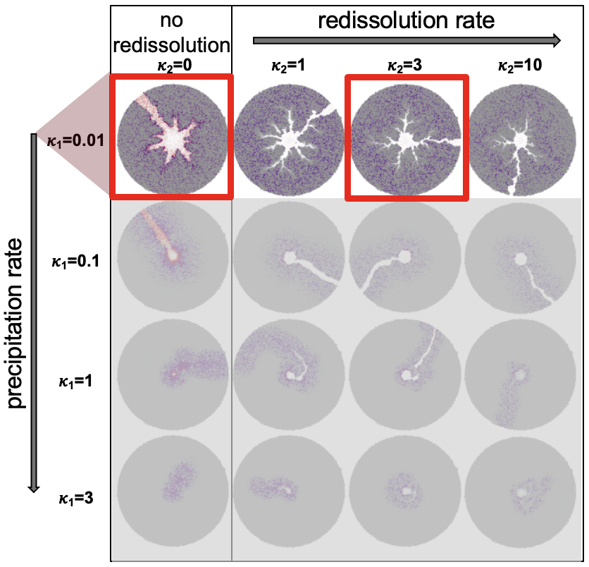
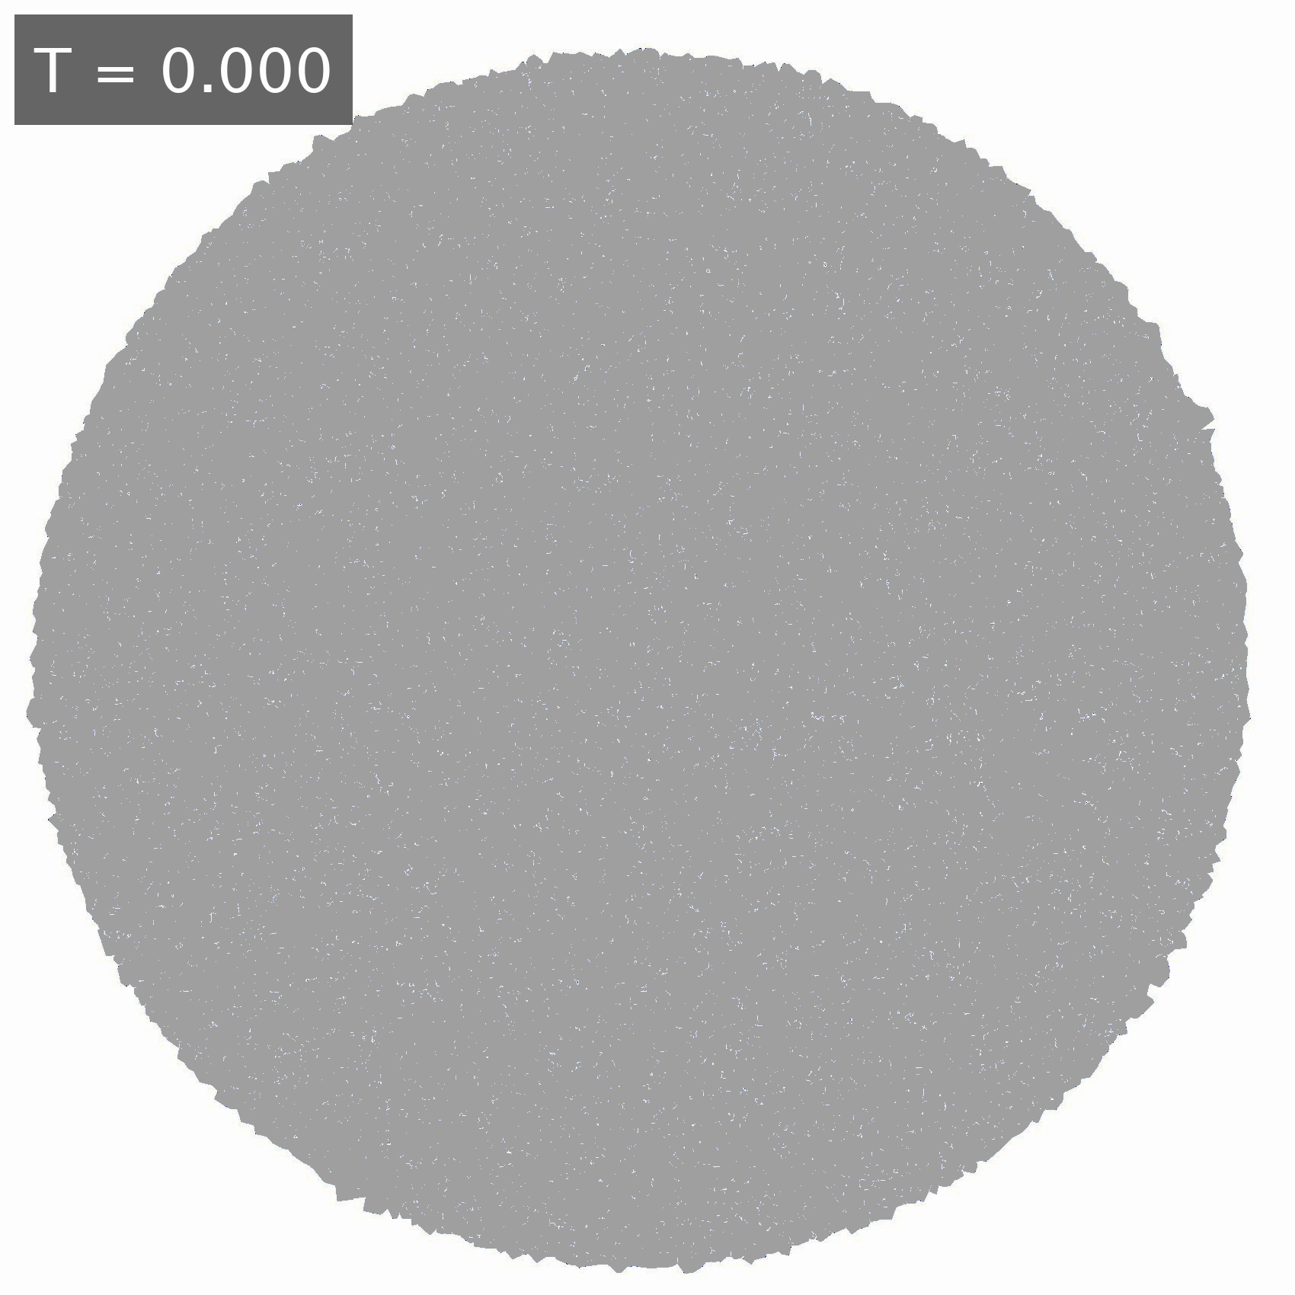
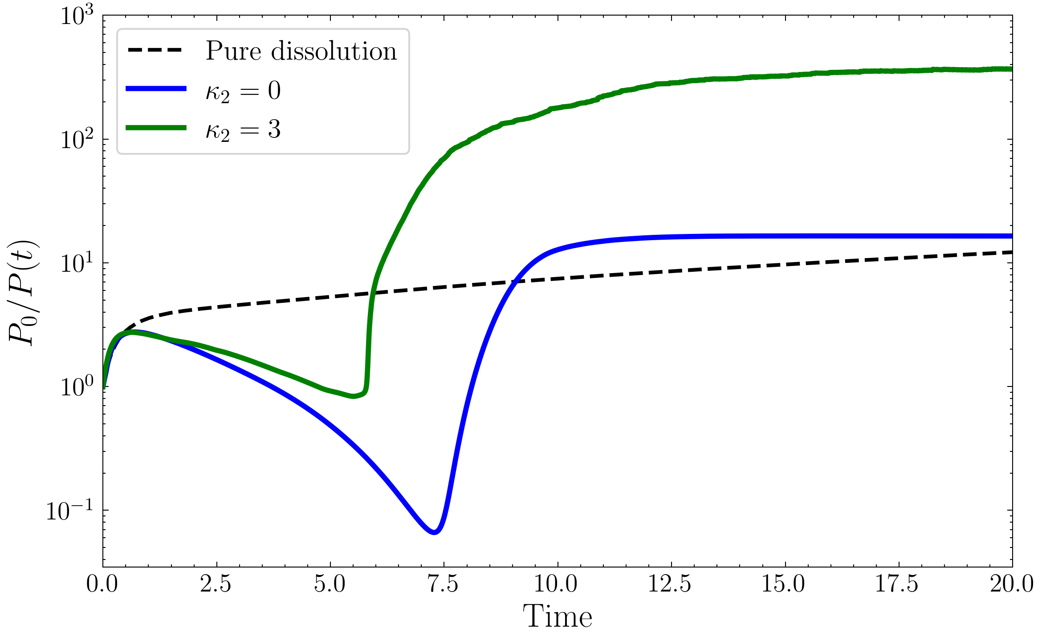
Redissolution Promotes More Distributed Dissolution Patterns and Enhances Permeability
𝜅₁=0.01 𝜅₂=0
𝜅₁=0.01 𝜅₂=3
Permeability
Redissolution competes for acid, suppressing channel growth
breakthrough
Weak, distributed precipitation → no global clogging
local clogging
Partial precipitate redissolution in secondary channels → delayed local clogging via flow-path reactivation

Slide 7
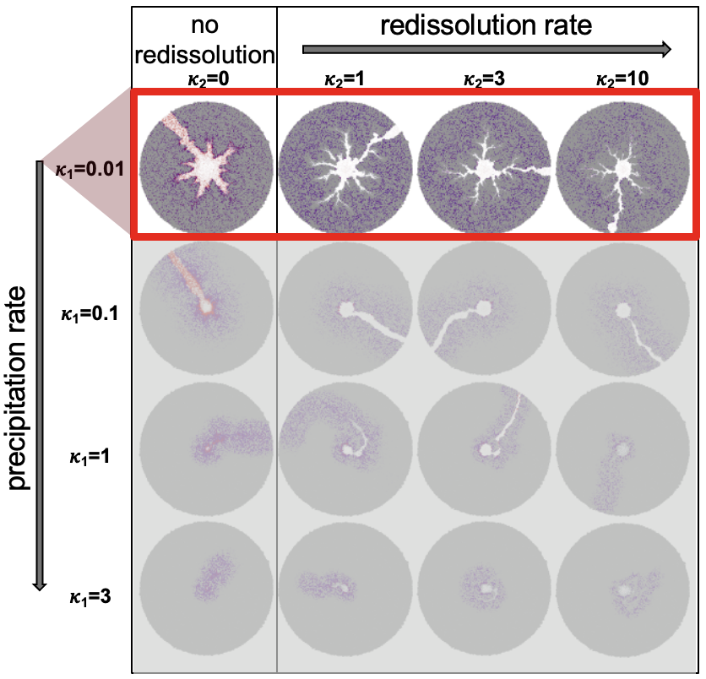
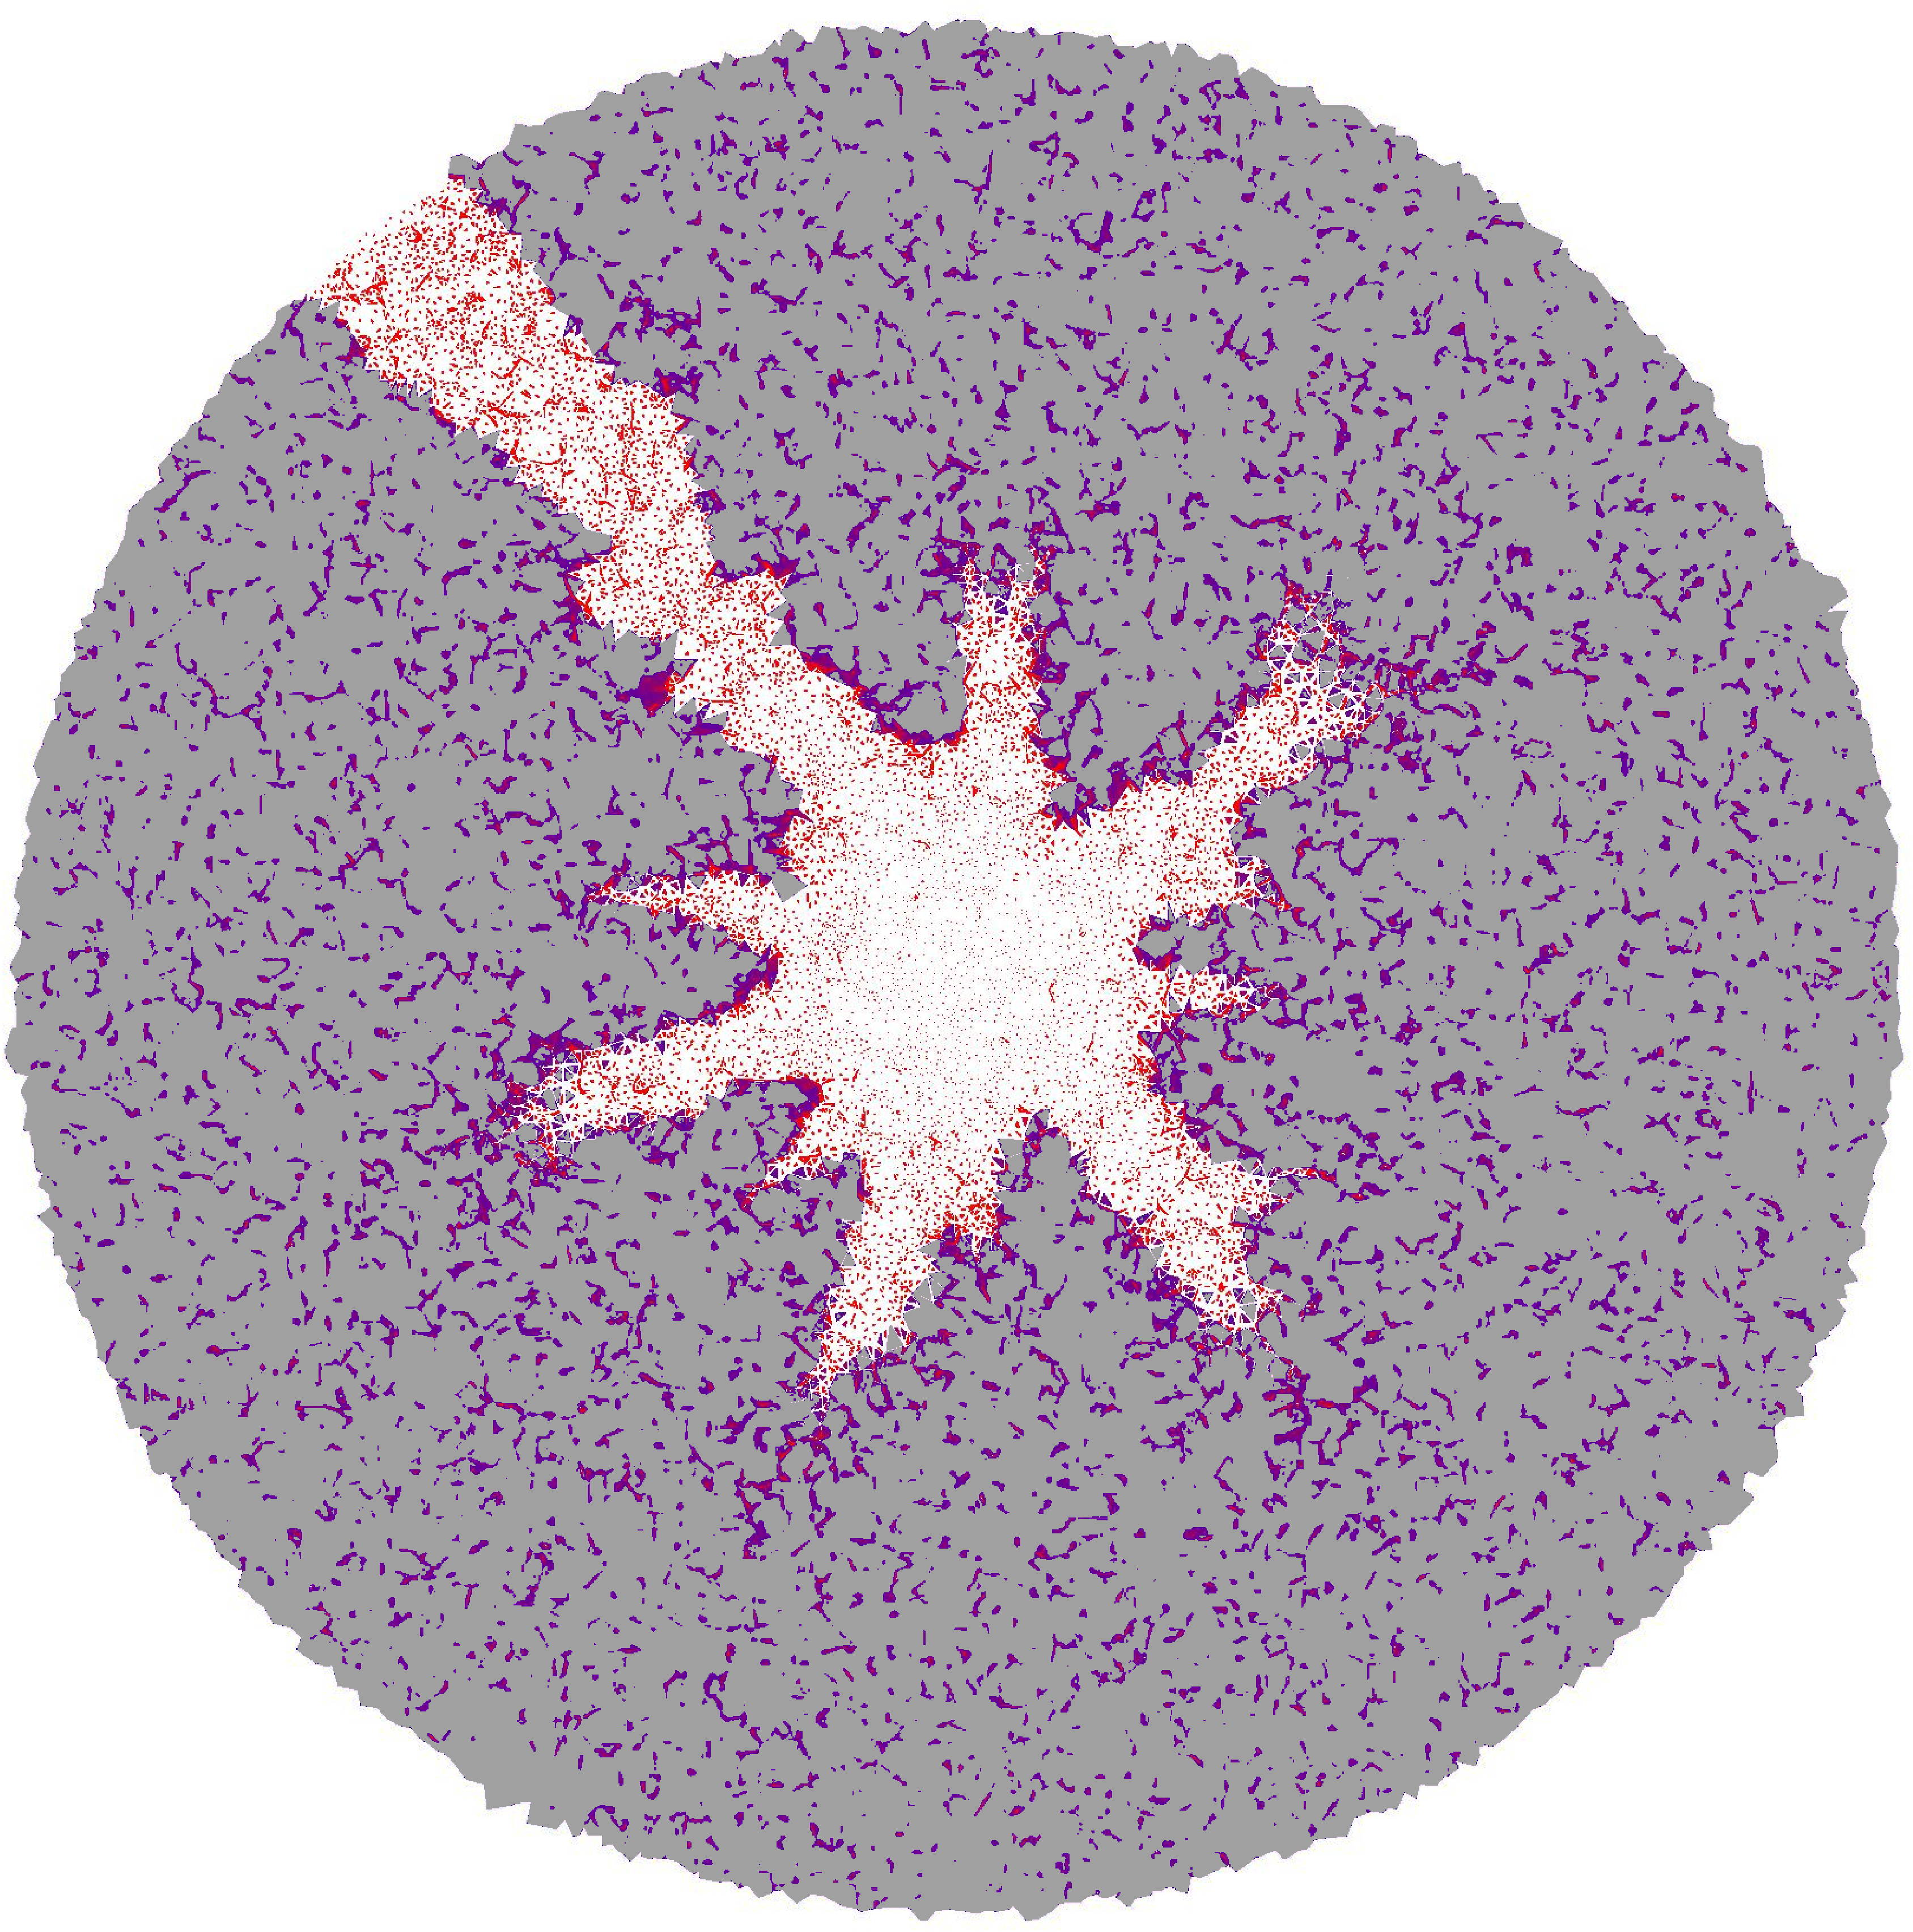
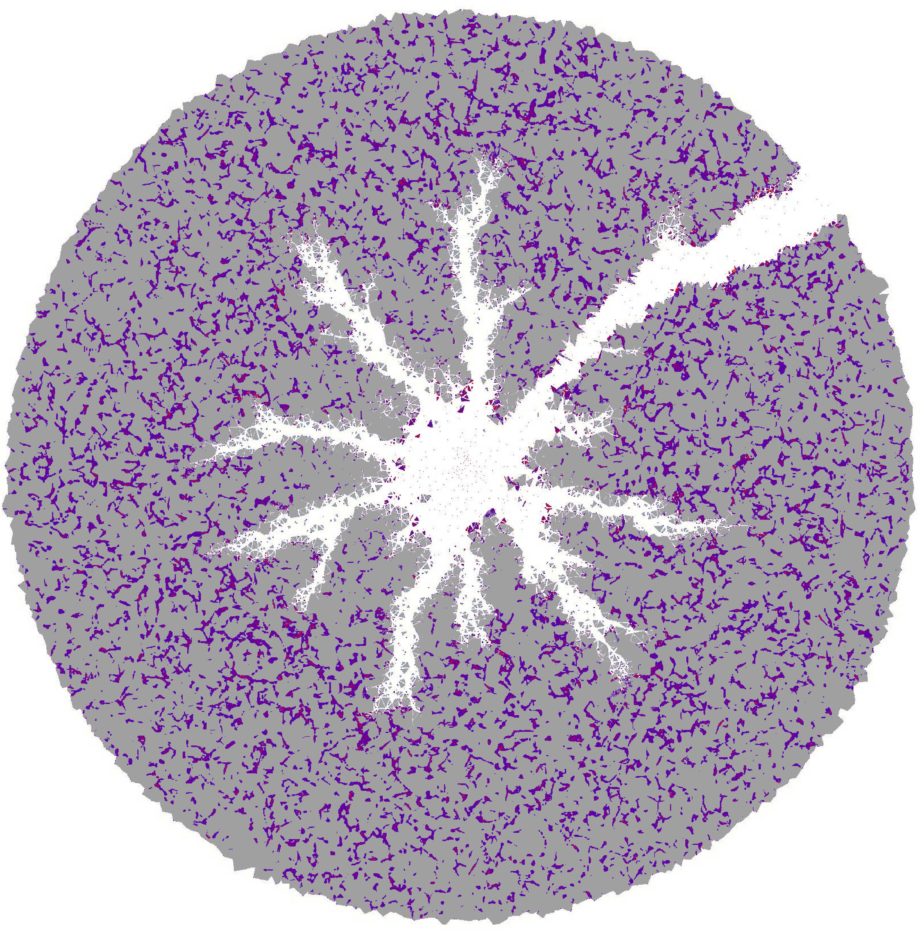
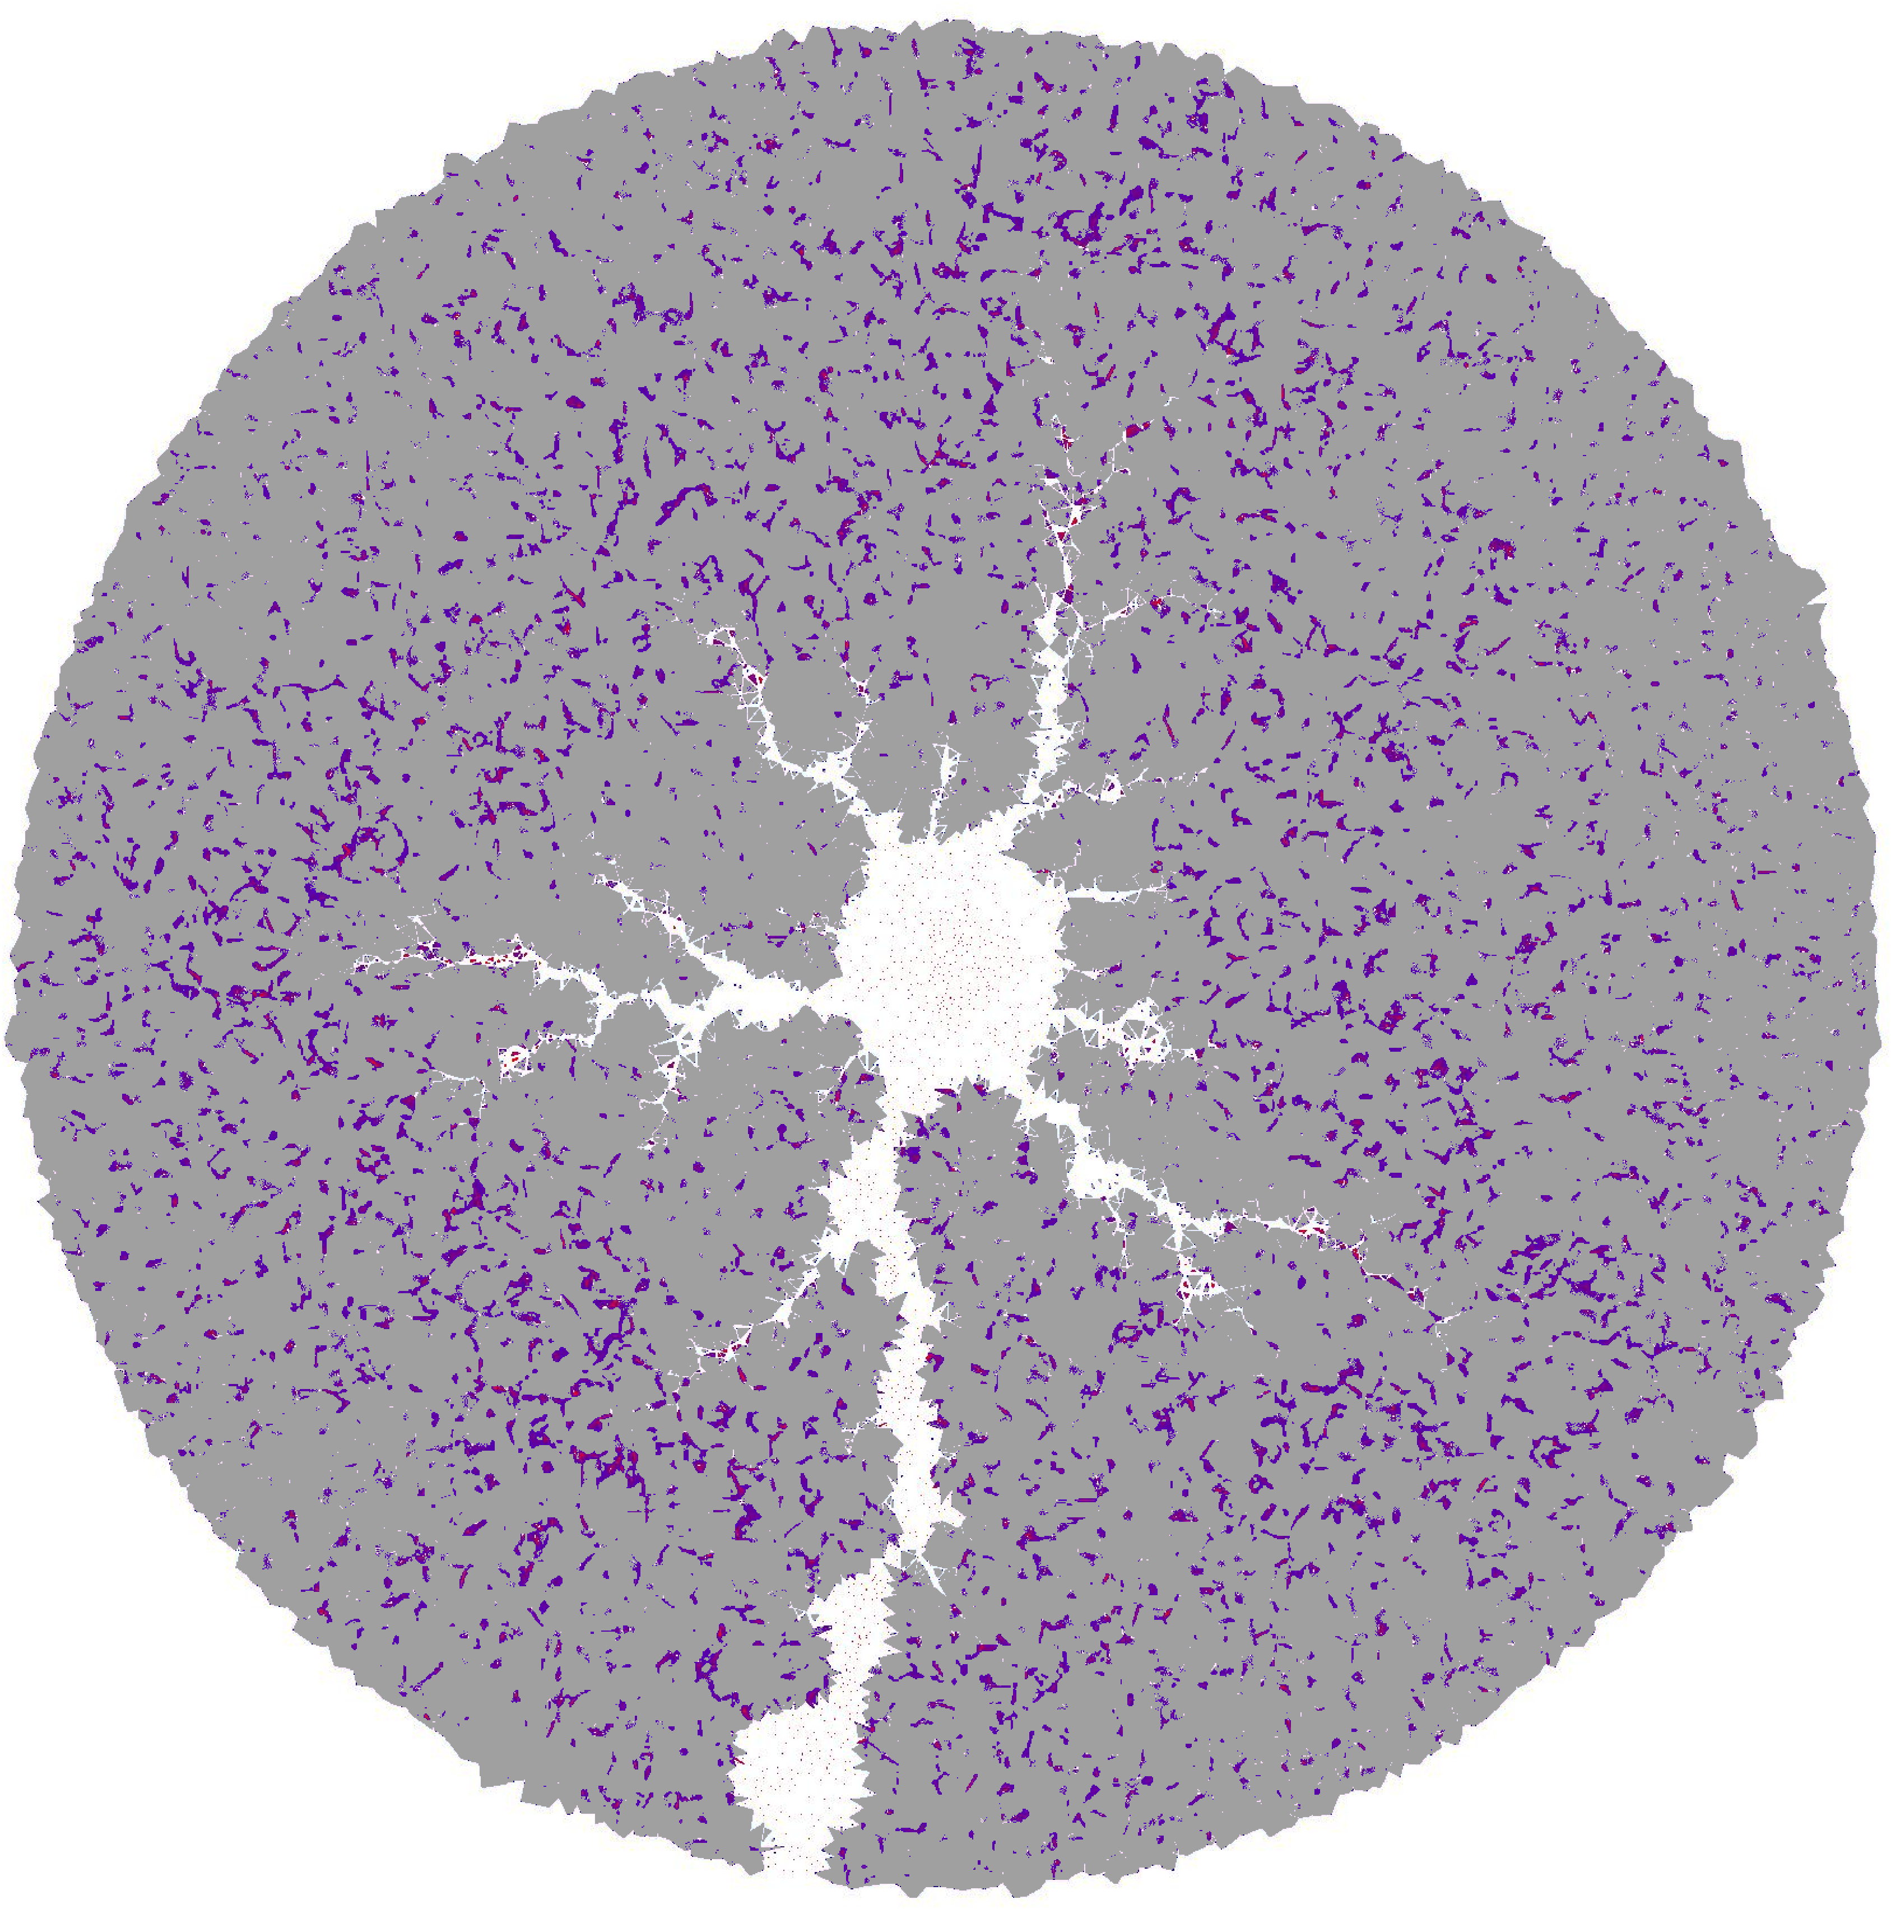
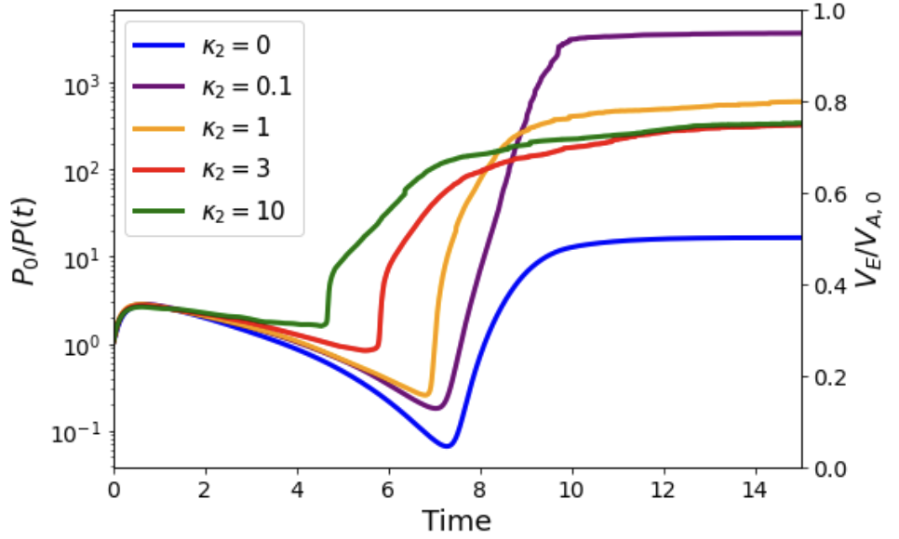
Redissolution Produces Nonmonotonic Permeability Enhancement
𝜅₂=0
𝜅₂=0.1
𝜅₂=10
Higher final permeability
Enhanced secondary channel growth
Non-monotonic permeability enhancement
Earlier dominant channel breakthrough
breakthrough
Redissolution creates a competition between channel spreading and breakthrough

Slide 8
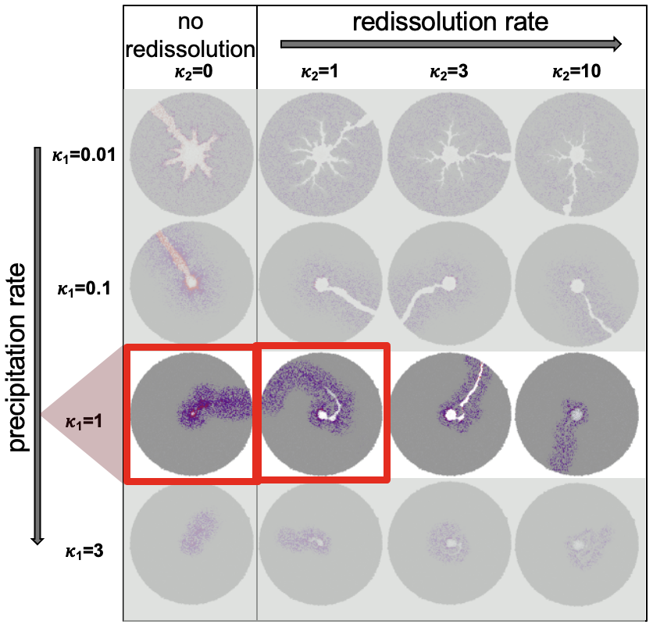
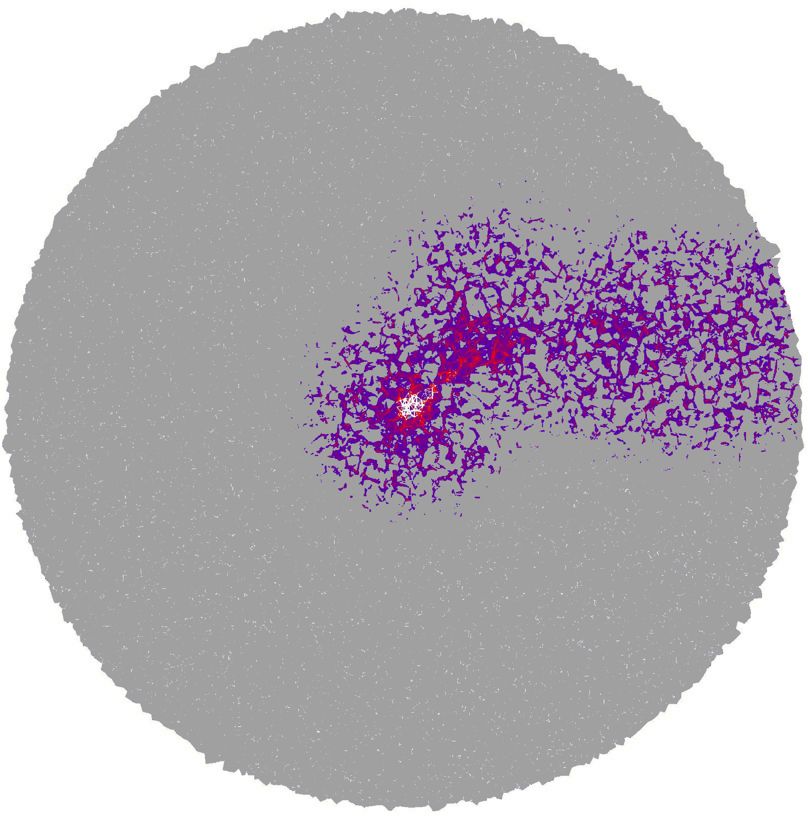
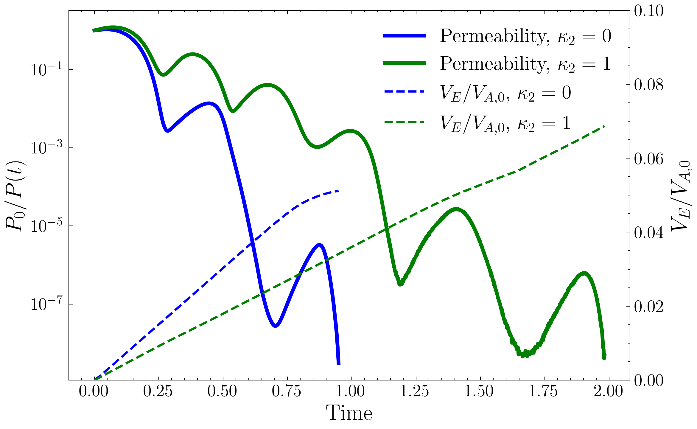
Redissolution Can Reopen Constricted Pathway and Delays Global Clogging
𝜅₁=1 𝜅₂=0
𝜅₁=1 𝜅₂=1
Permeability
V_{E}/V_{A,0}, 𝜅₁=1
V_{E}/V_{A,0}, 𝜅₁=0
Strong precipitation → rapid local clogging and channel isolation
Delayed clogging allows greater total mineralization
No redissolution → early global clogging
Redissolution → reopens pathways, delays permeability collapse

Slide 9
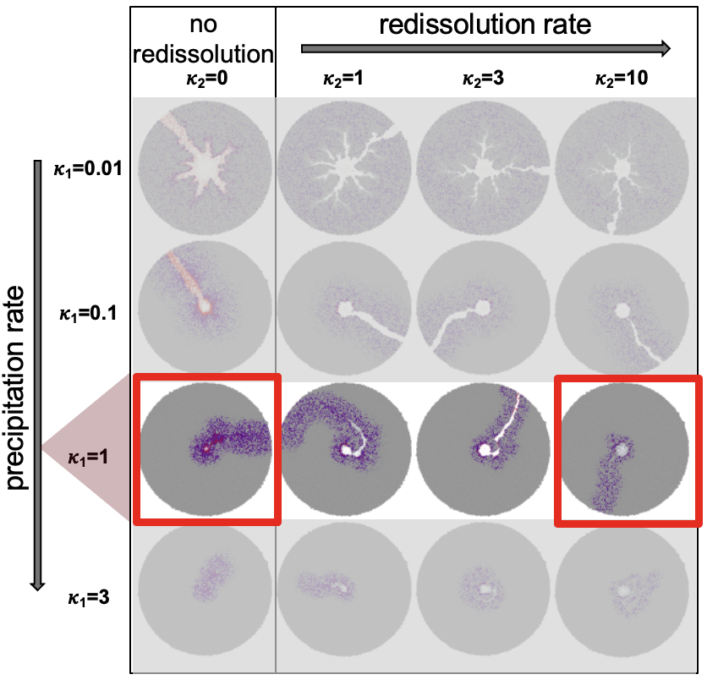
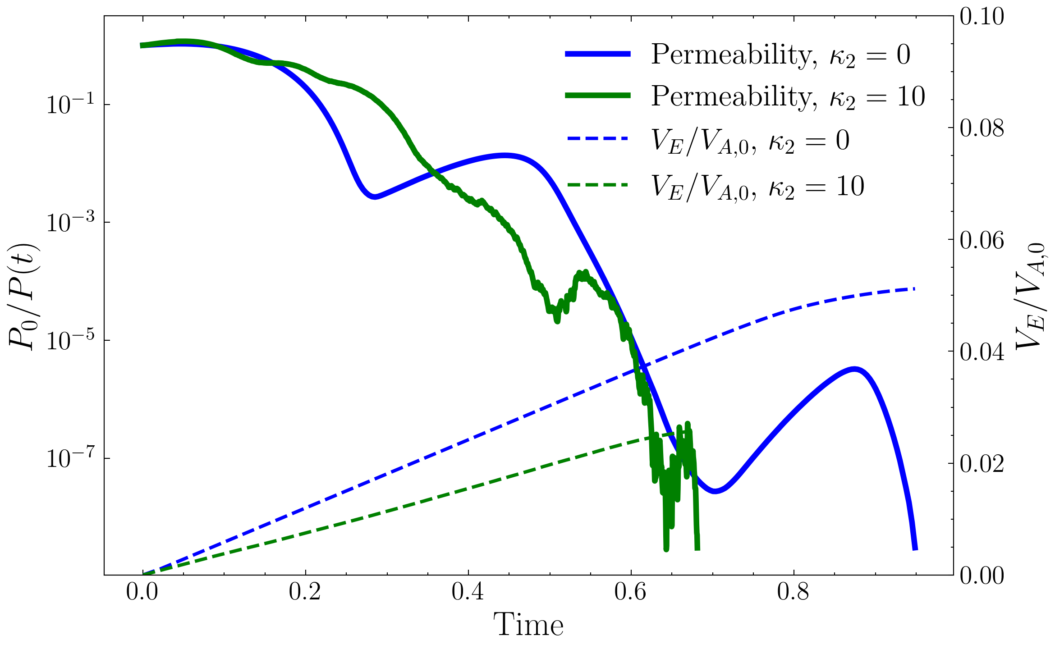
Redissolution Can Intensify Downstream Clogging
𝜅₁=1 𝜅₂=0
𝜅₁=1 𝜅₂=10
Permeability
V_{E}/V_{A,0}, 𝜅₁=1
V_{E}/V_{A,0}, 𝜅₁=0
Reduced channel penetration depth
Downstream clogging intensification
Too much redissolution turns clogging mitigation into clogging amplification.

Slide 10
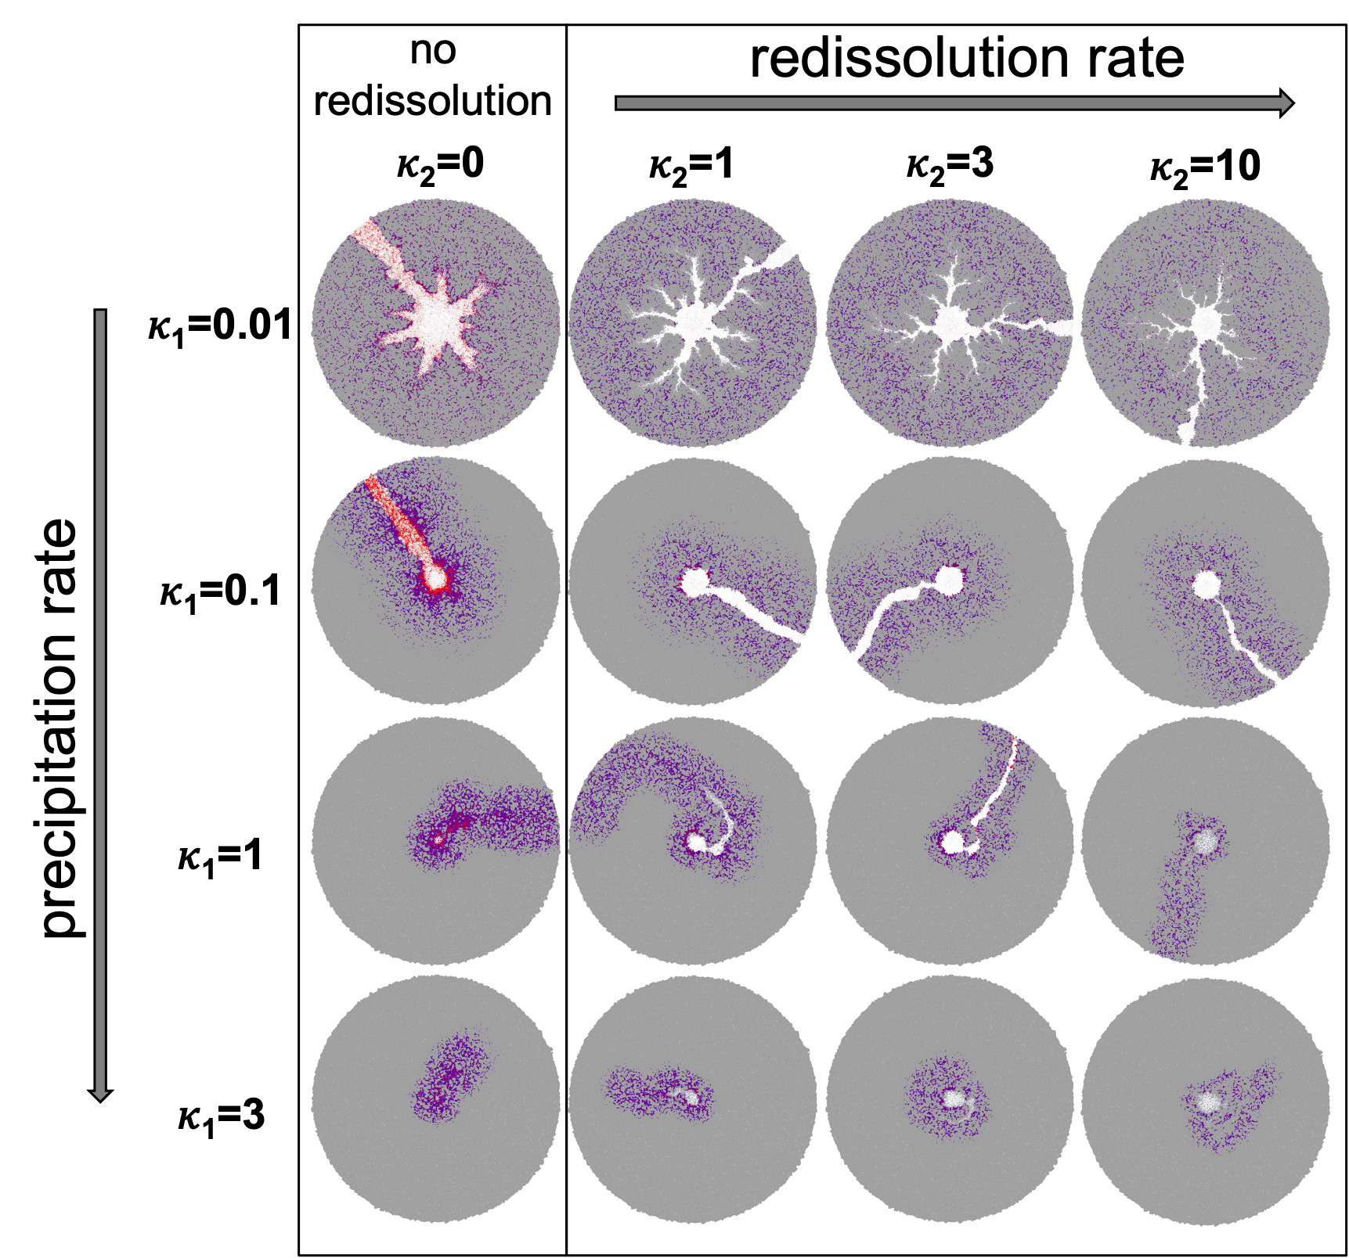
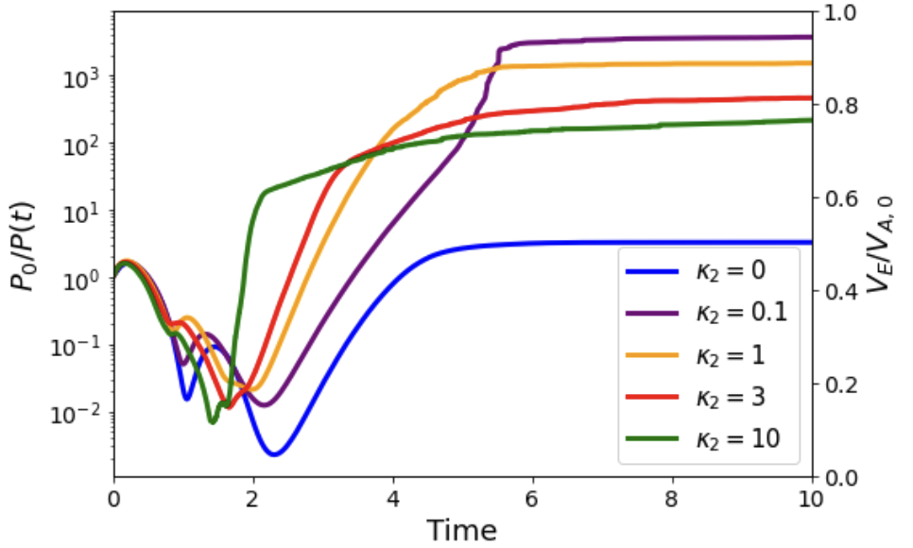
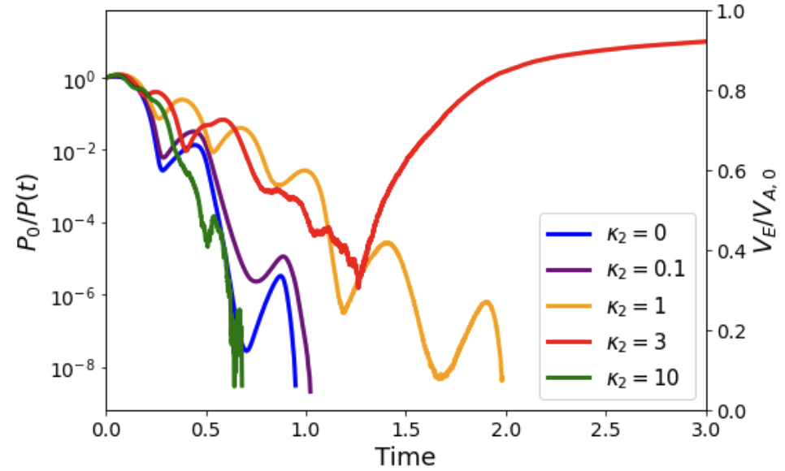
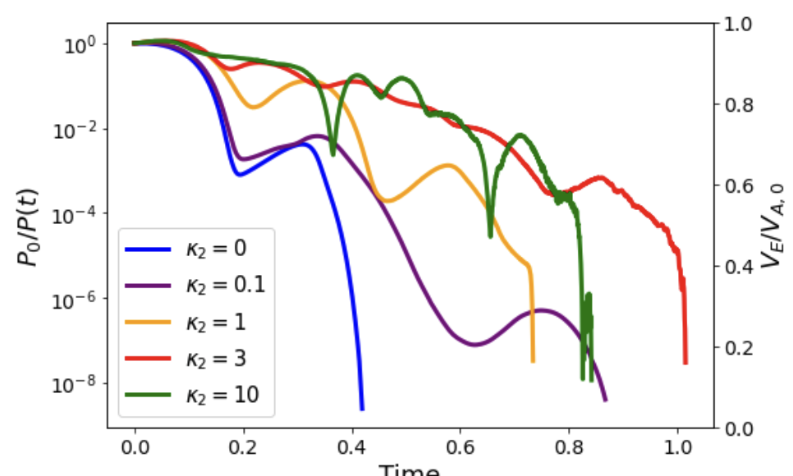
Overall patterns is governed by precipitation, but we cannot neglect redissolution.
Permeability evolution
𝜅₁=0.01
𝜅₁=0.1
𝜅₁=1
𝜅₁=3
Delayed/Mitigated clogging
Clogging
Delayed Clogging
Clogging
𝜅₁ = 0.01 ~0.1→ nonmonotonic permeability enhancement.
𝜅₁ = 1 → Transition regime
𝜅₁ = 3 → Clogging regime

Slide 11
Conclusion
Redissolution fundamentally reshapes clogging dynamics
Moderate redissolution can delay clogging and sustain permeability.
But excessive redissolution can intensify downstream clogging and reduce system accessibility.
Overall, precipitation controls the large-scale behavior, but redissolution strongly reorganizes the spatial evolution of clogging.
Thank you!

Slide 12


