Slide 1
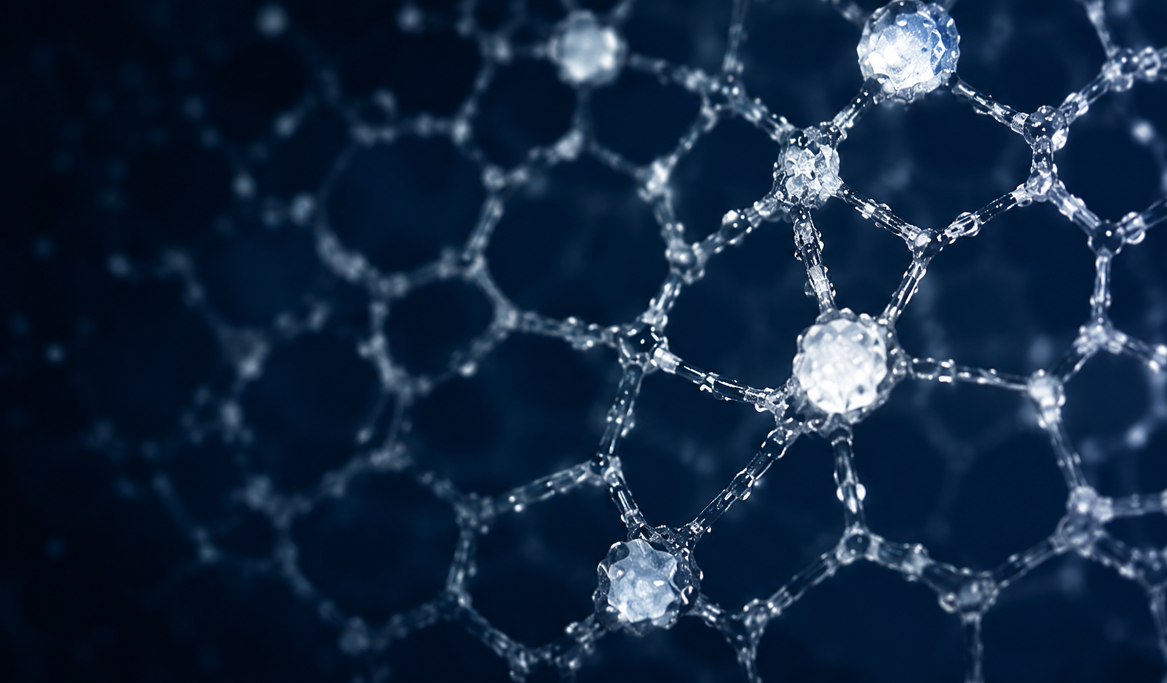
1
Pore-scale dynamics of salt precipitation during brine-CO₂ displacement in micromodels
Lijuan Shi & Alexander Shapiro
CERE – Center for Energy Resources Engineering
Chemical and Biochemical Engineering,
Technical University of Denmark

Slide 2
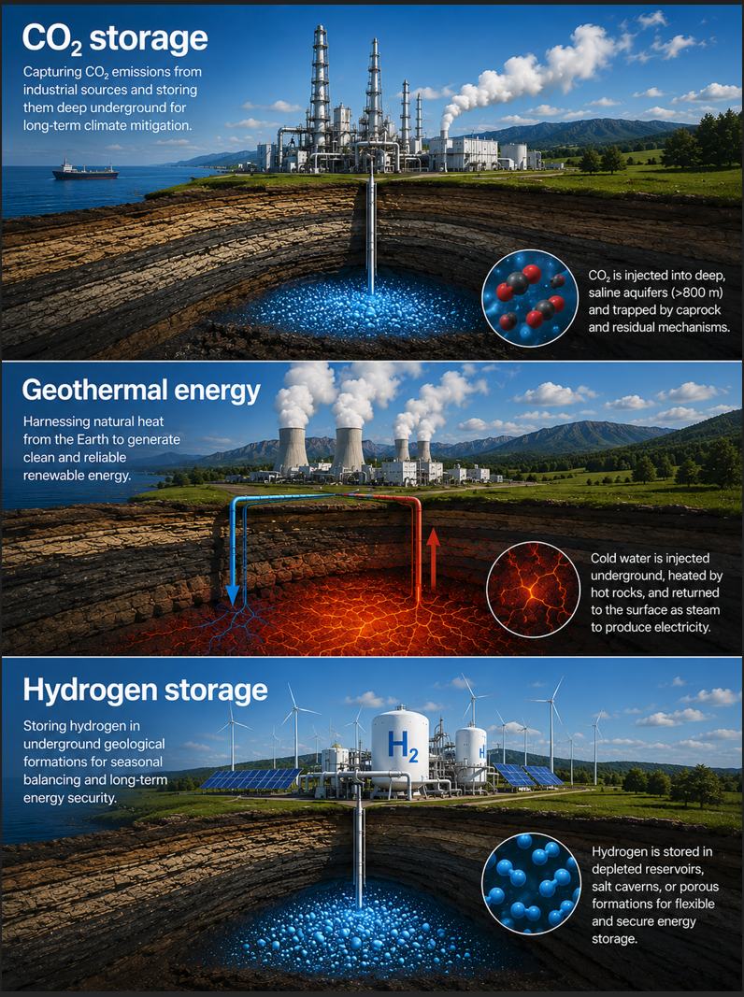
2
Why do we care?
Salt precipitation controls injectivity in subsurface applications
Where does salt precipitate?
What controls the precipitation dynamics at the pore scale?
How fast does salt grow?
What controls the growth dynamics at the pore scale?
How does injection rate matter?
How does injection pressure influence breakthrough, dry-out, and salt distribution?
Ai generated

Slide 3
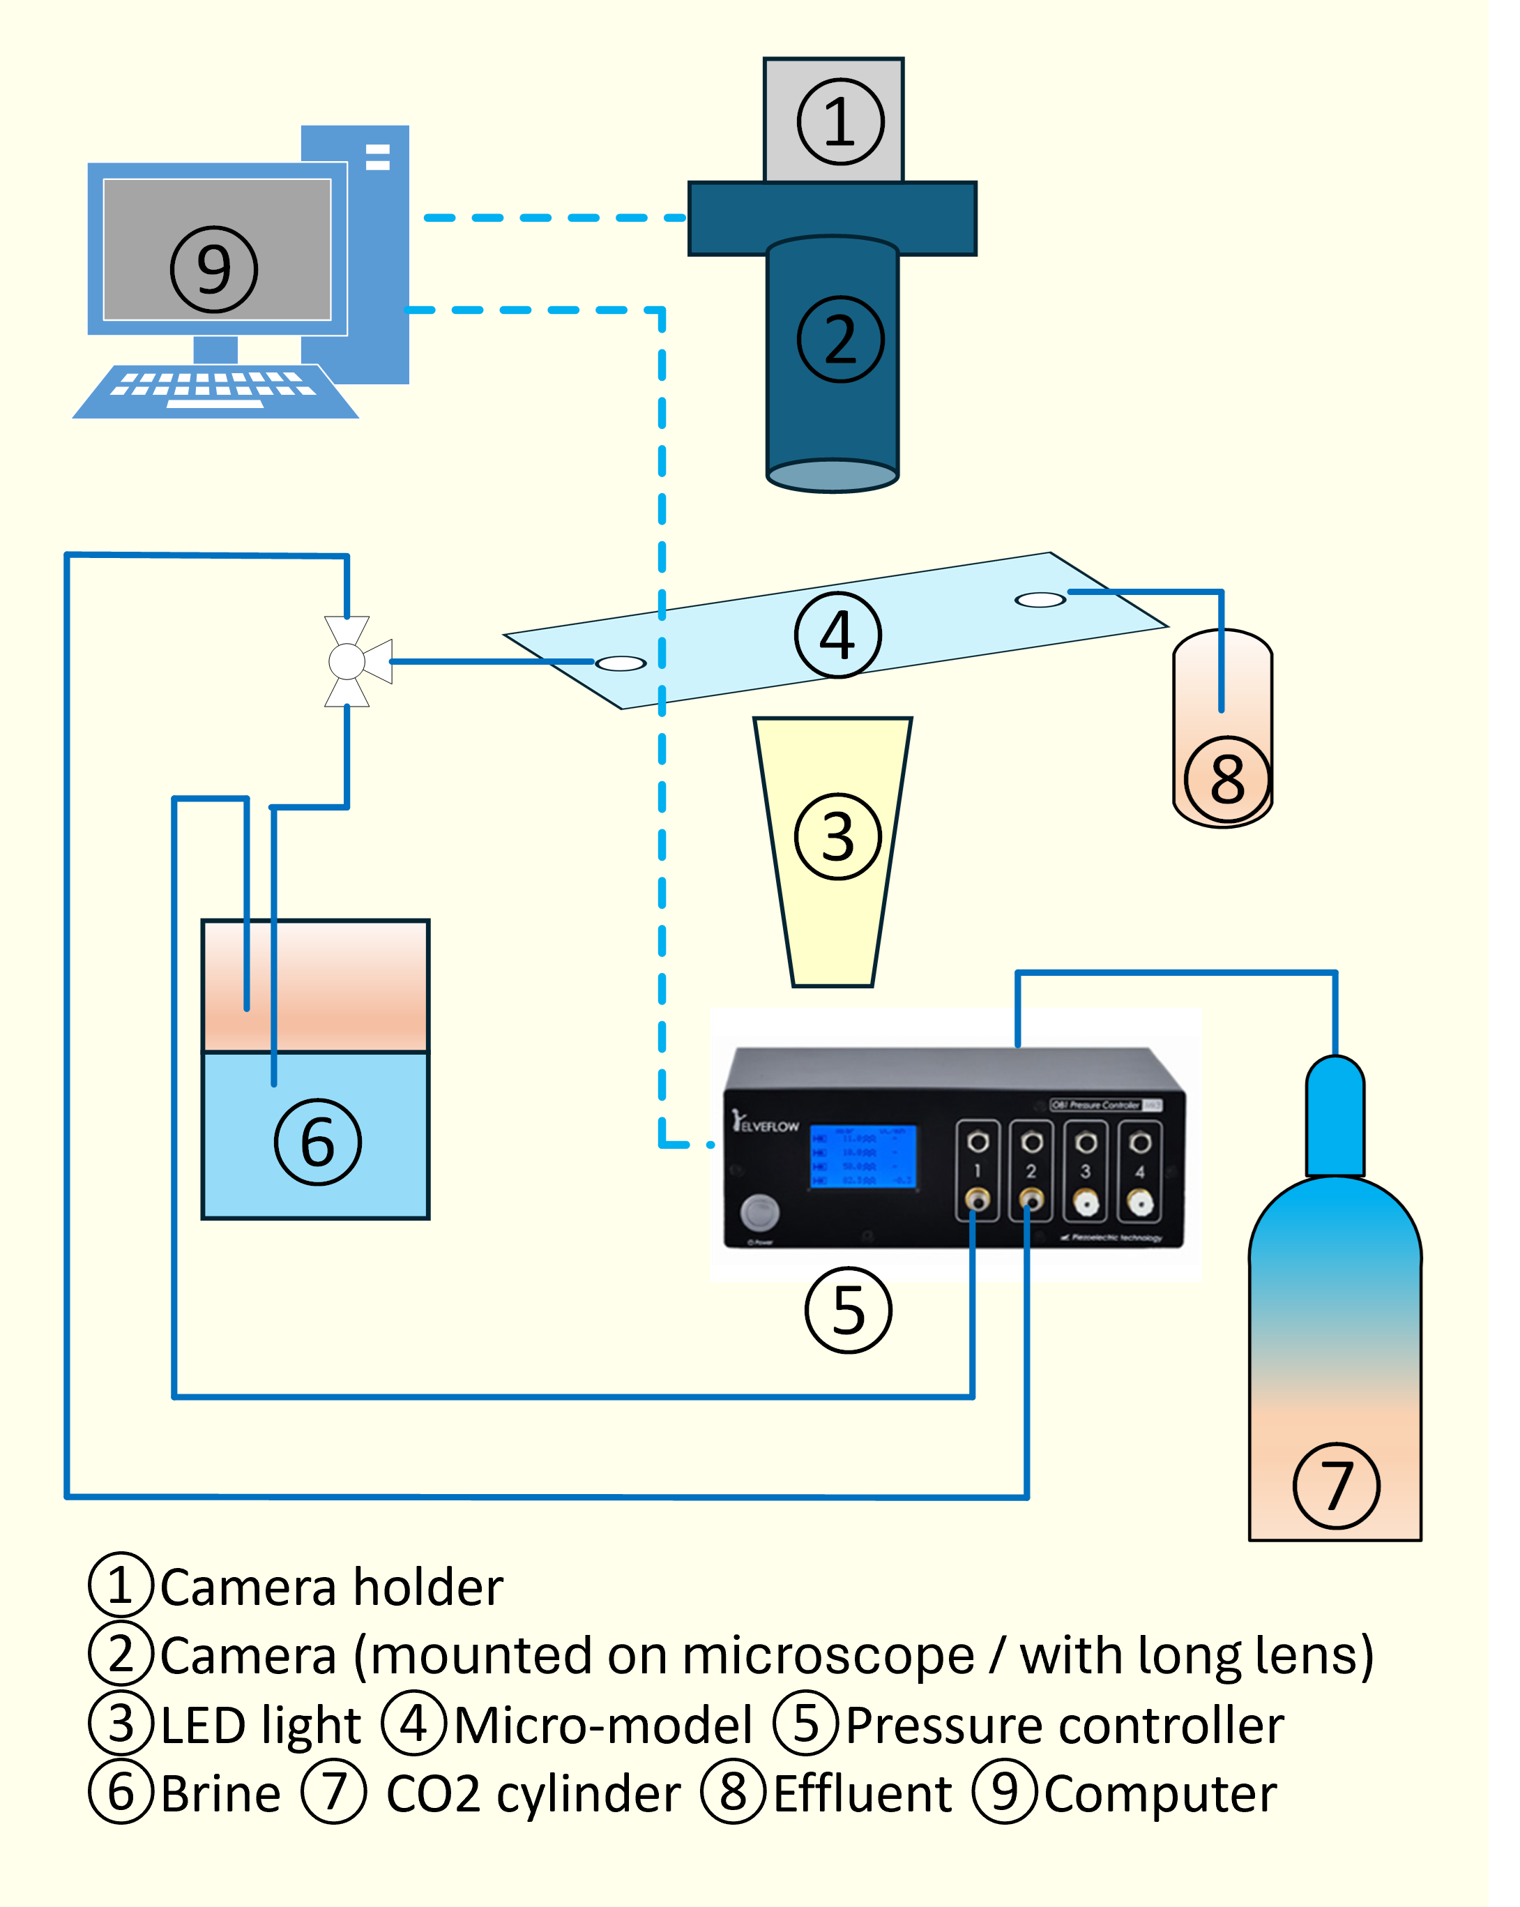

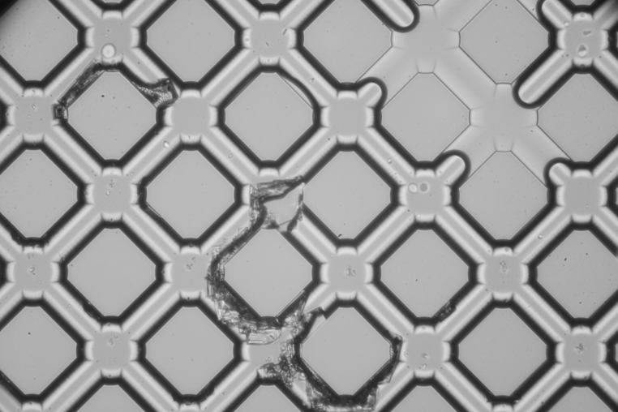
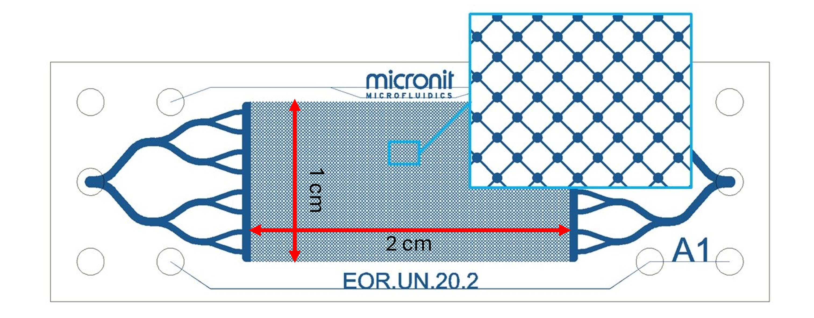
3
Experimental Strategy
Micromodel experiments with dual imaging systems
Dual Imaging Systems
1. Chip Cleaning and Drying
Water flushing, followed by CO₂ injection removes residual moisture
Field of view:
2.5 × 1.7 cm
Resolution:
8192 × 5464
3.05 µm/pixel
FFIS (chip-scale)
2. Brine Saturation
150 g/L NaCl brine injected until full saturation
3. CO₂ Injection and Imaging
Continuous imaging during displacement and dry-out
4. Cleaning and Reuse
Water flushing followed by CO₂ drying
MIS (pore-scale)
Field of view:
782 × 521 µm
Resolution:
4752 × 3168
0.165 µm/pixel
inlet
outlet
Chip type uniform
Pore volume 2.08 µL
Size (L×W) 20×10 mm
Chanel Depth 20 µm
Permeability 8.43-10.14 D
Porosity 52%

Slide 4
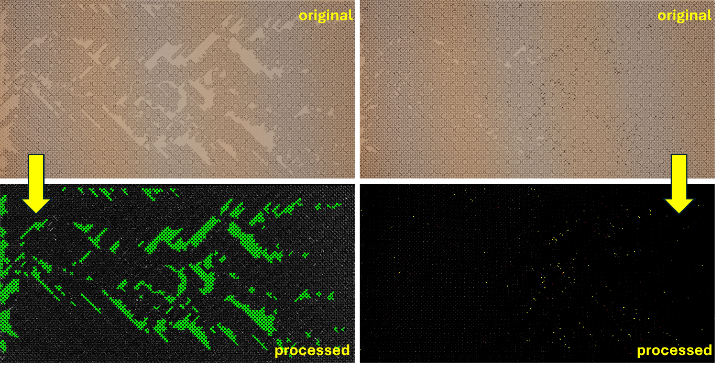
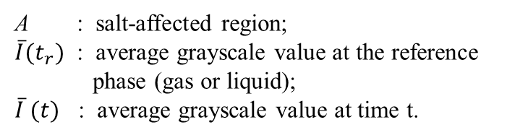

4
Image analysis
Microscopic image
Full-view image
Salt Precipitation Index (SPI)
Quantifies salt accumulation based on the salt-covered area and grayscale evolution
OpenCV-based segmentation
$$SPI \left(t\right)=A×\left[\left.{\overline{I}\left(t\right.}_{r}\right)−\overline{I} \left(t\right)\right]$$
A : salt-affected region;
${\overline{I}(t}_{r})$ : average grayscale value at the reference
phase (gas or liquid);
$\overline{I} (t)$ : average grayscale value at time t.
Brine (green)
Salt (yellow)

Slide 5
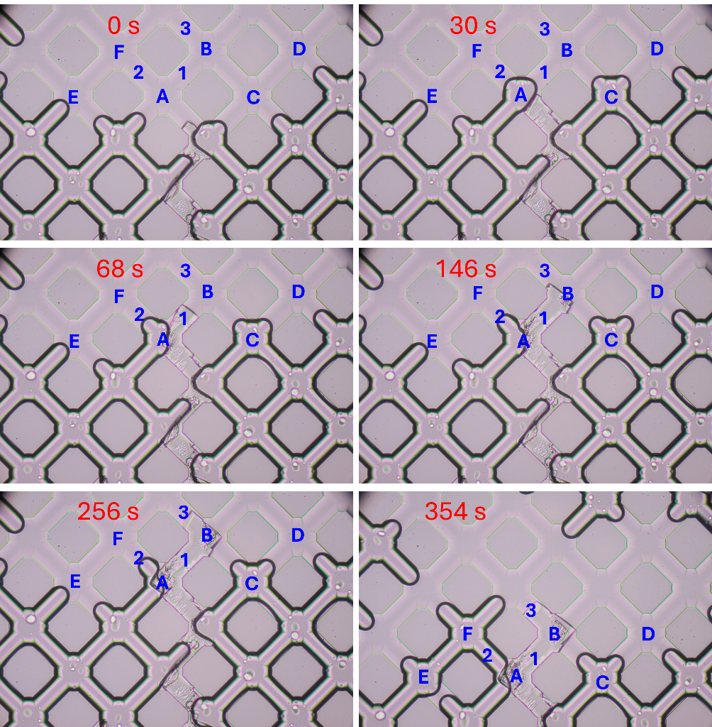
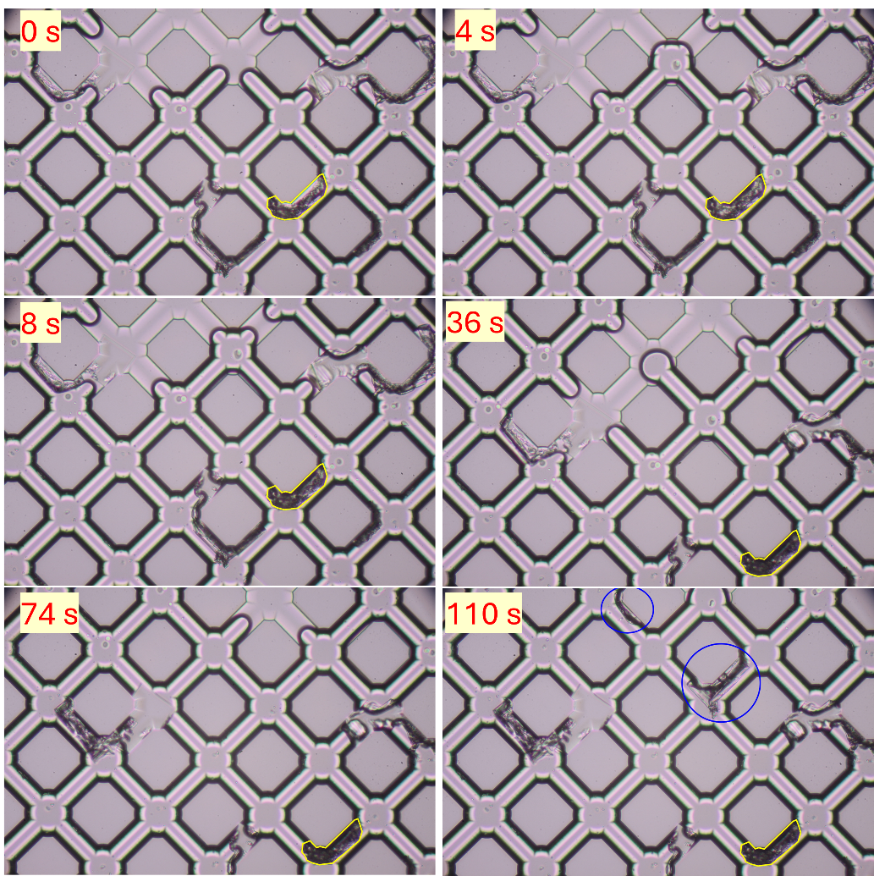
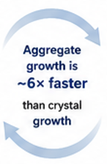
5
Two distinct salt morphologies emerge
Dark porous aggregates
(gas-dominated regions)
Form in gas-filled pores with residual brine nearby
Rapid accumulation
Irregular porous structure
Transparent crystals
(liquid-rich regions)
Form near water–gas interfaces
Slow and localized growth
Well-defined crystal structure
Aggregate growth is
~6× faster
than crystal growth
Different local conditions lead to fundamentally different salt structures and growth rates.

Slide 6
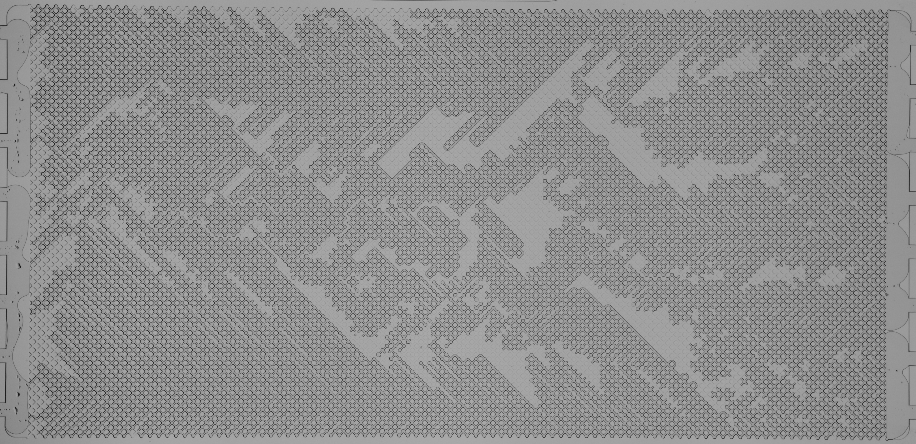
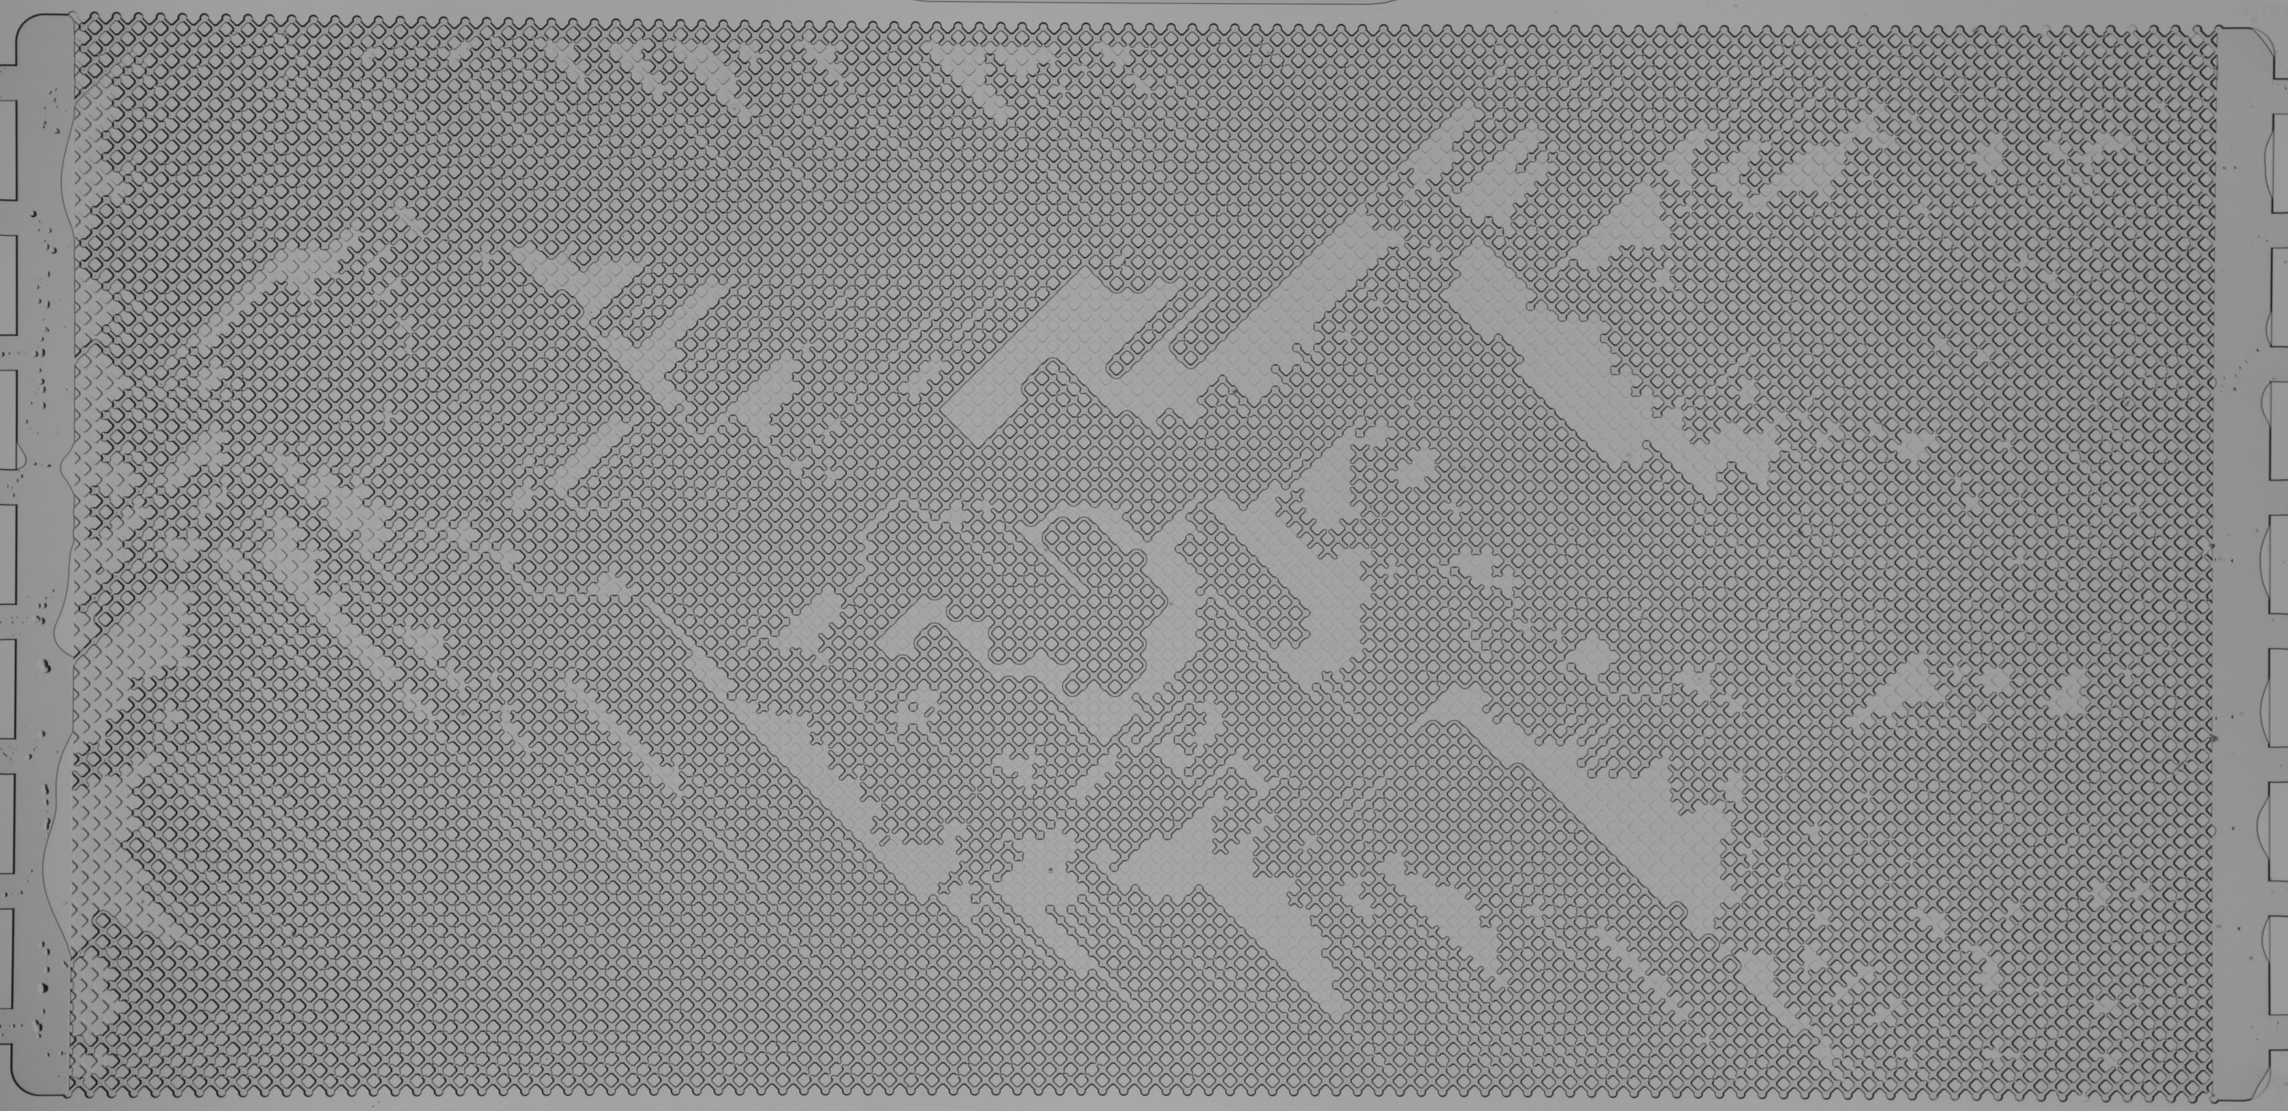
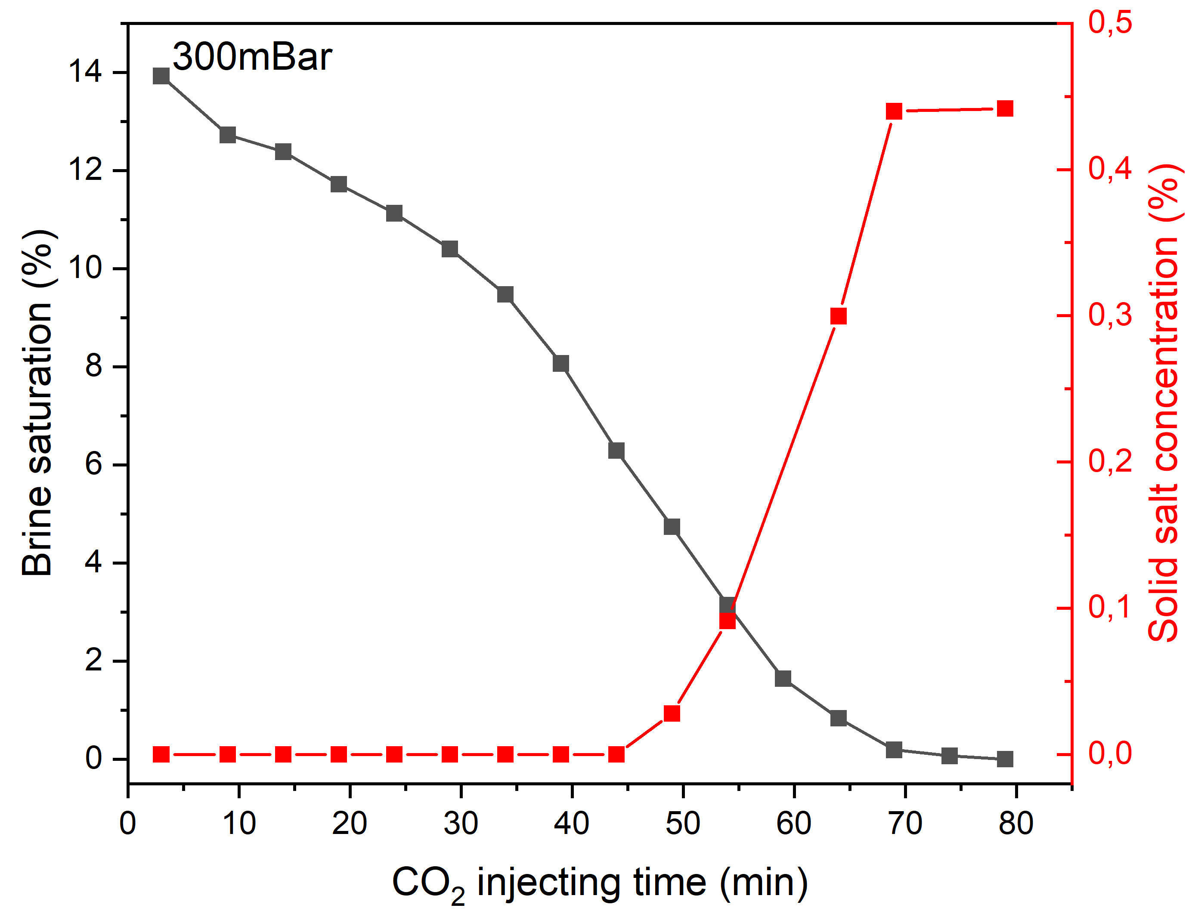
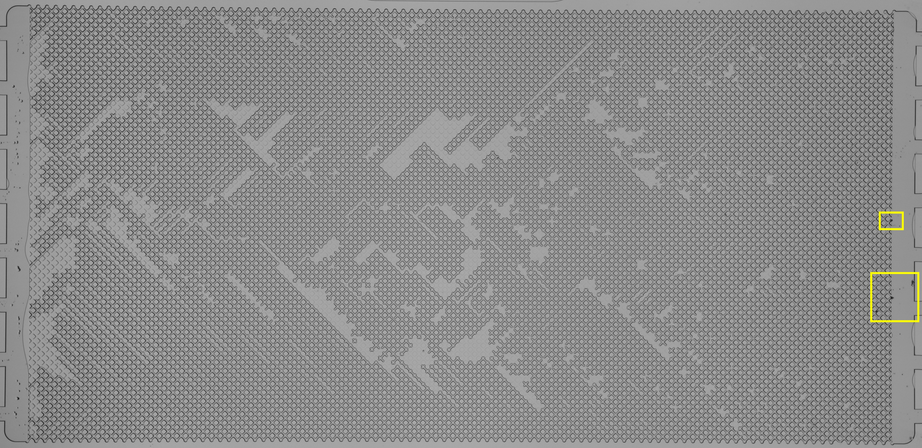
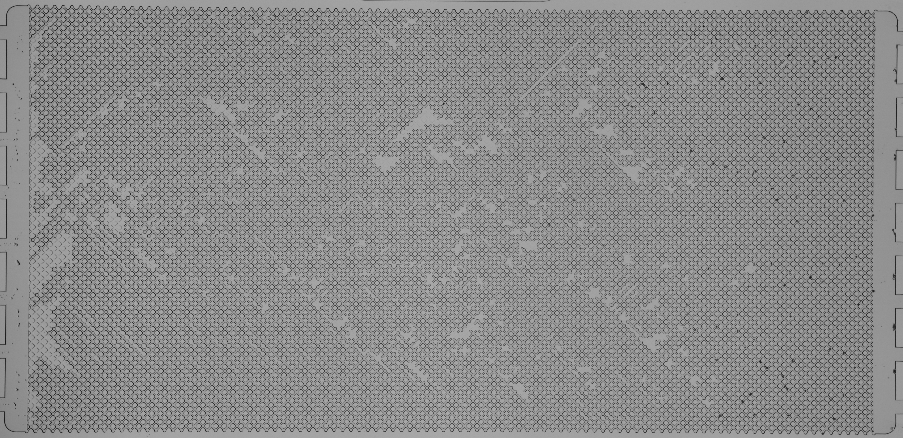
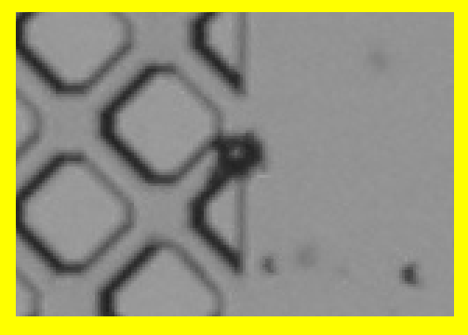
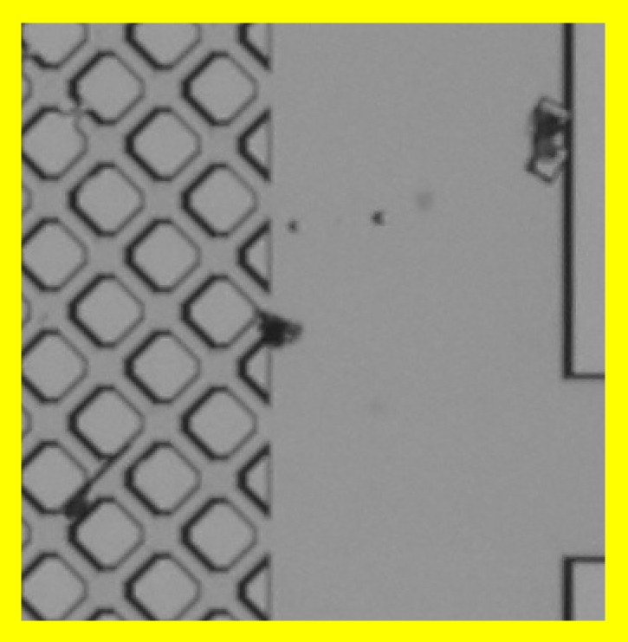
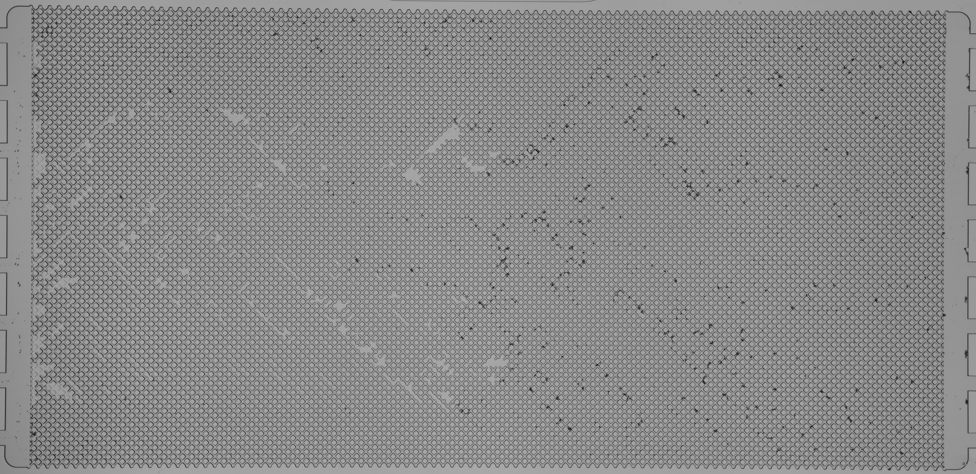
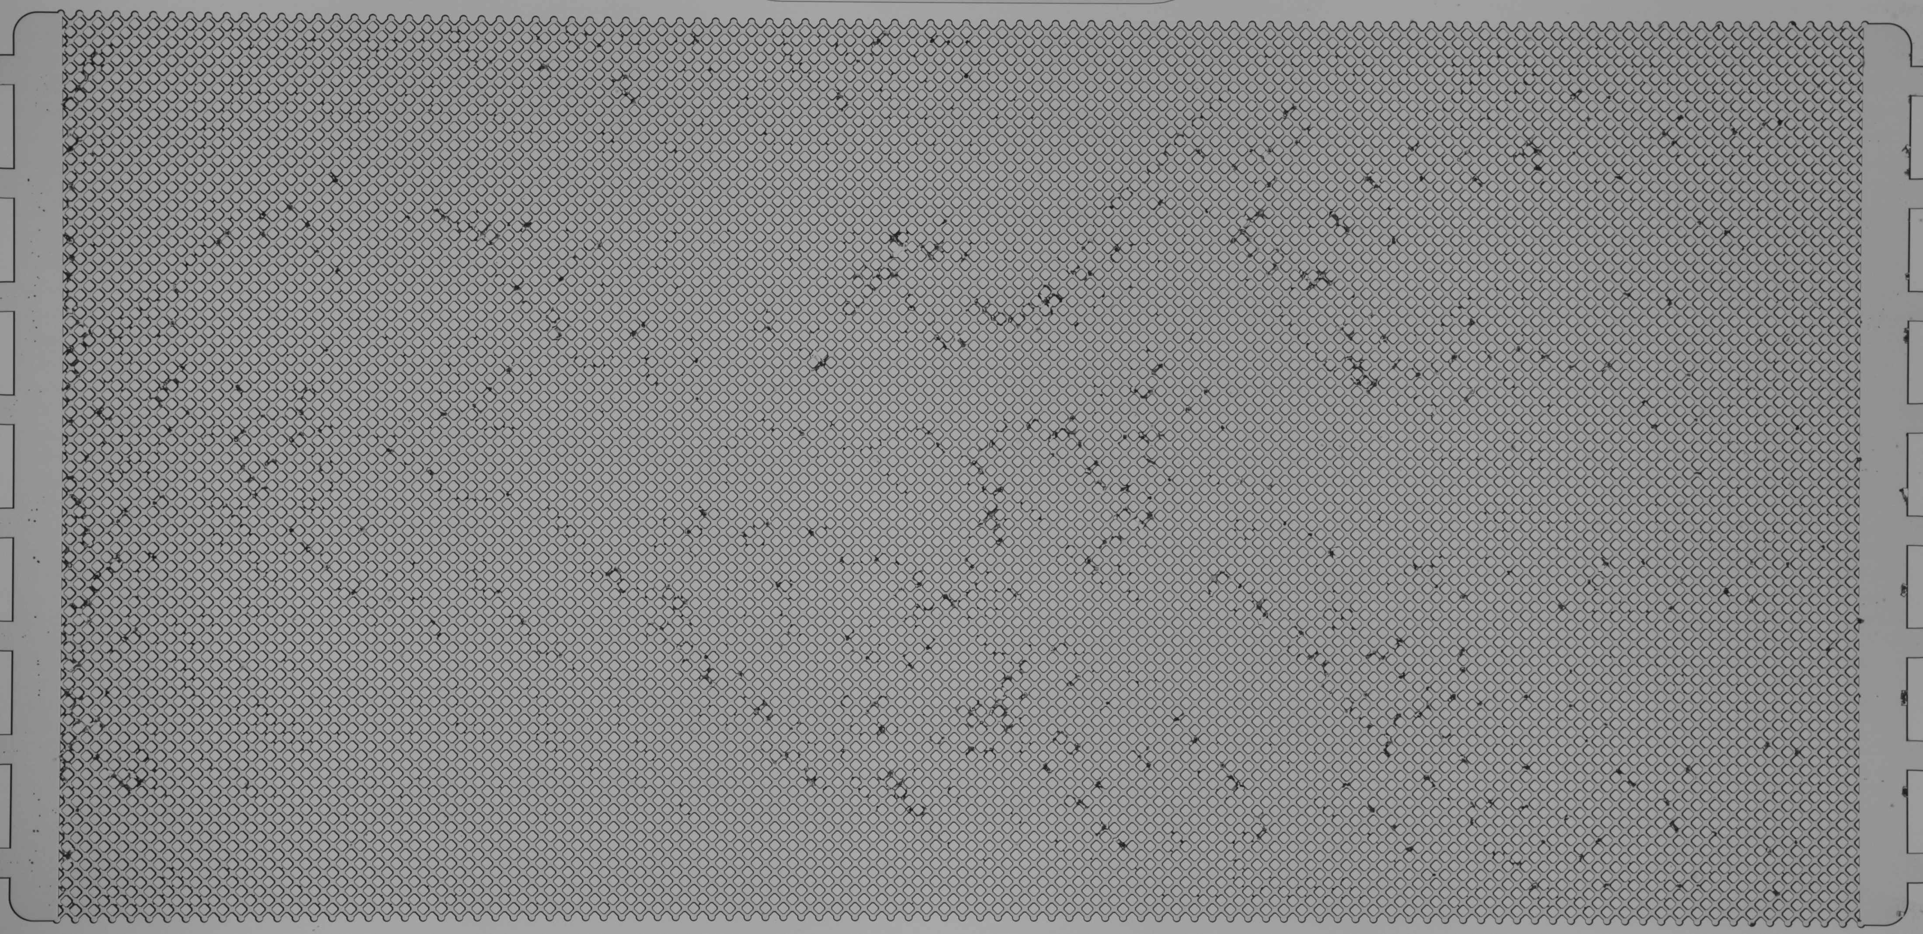
6
Dry-out Dynamics: CO₂-driven dry-out proceeds through three stages
3min
29min
Stage 1
Slow displacement
Stage 1
Stage 2
Stage 3
44min
54min
Stage 2
Rapid displacement
and salt onset
64min
79min
Stage 3
Slow-down and
final salt precipitation
Salt precipitation fundamentally alters the displacement dynamics during CO₂-driven dry-out.

Slide 7
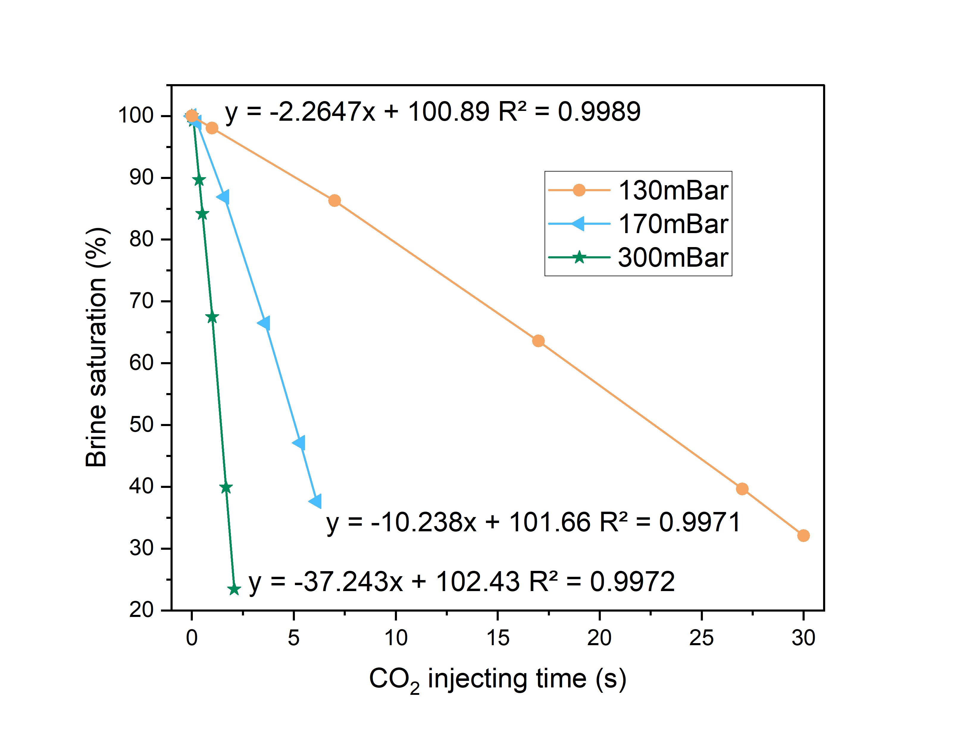
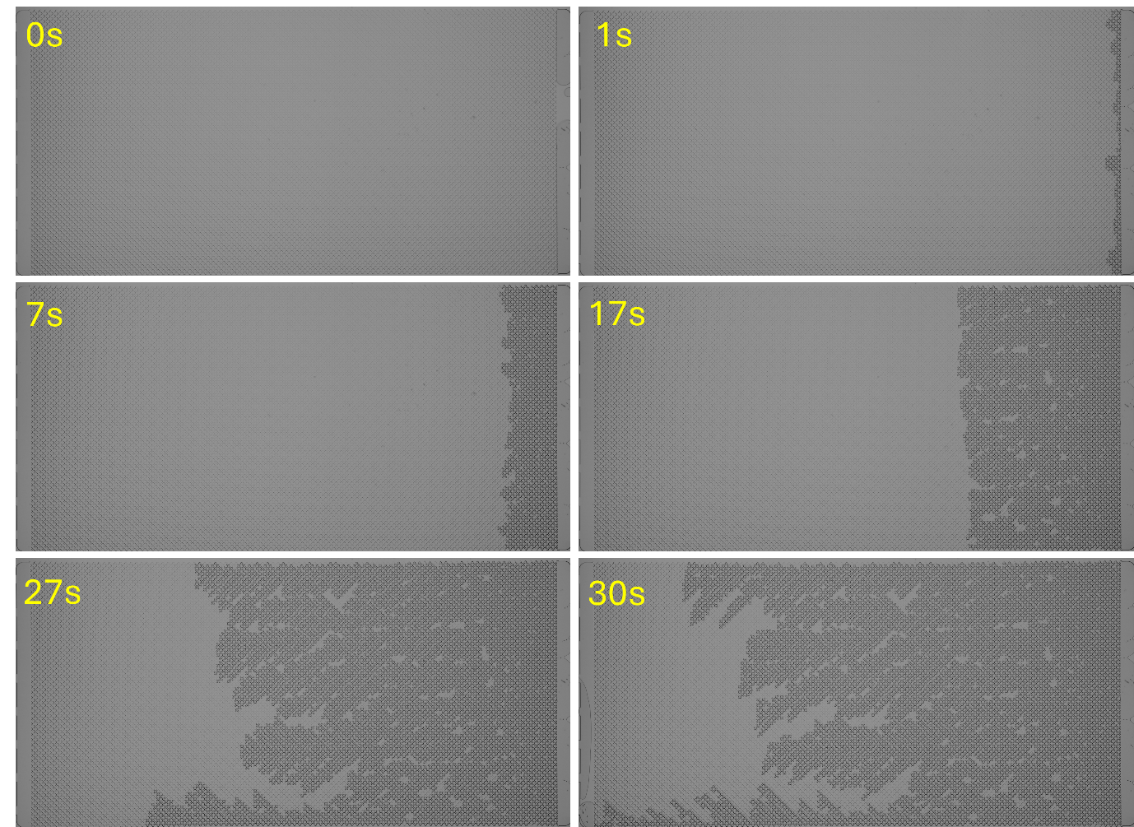
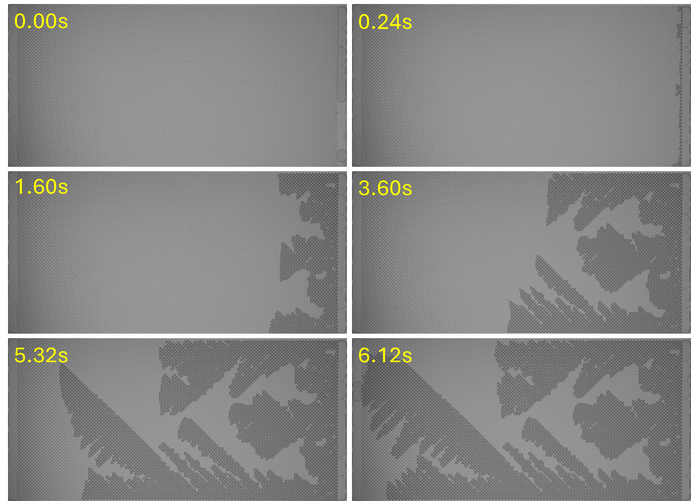
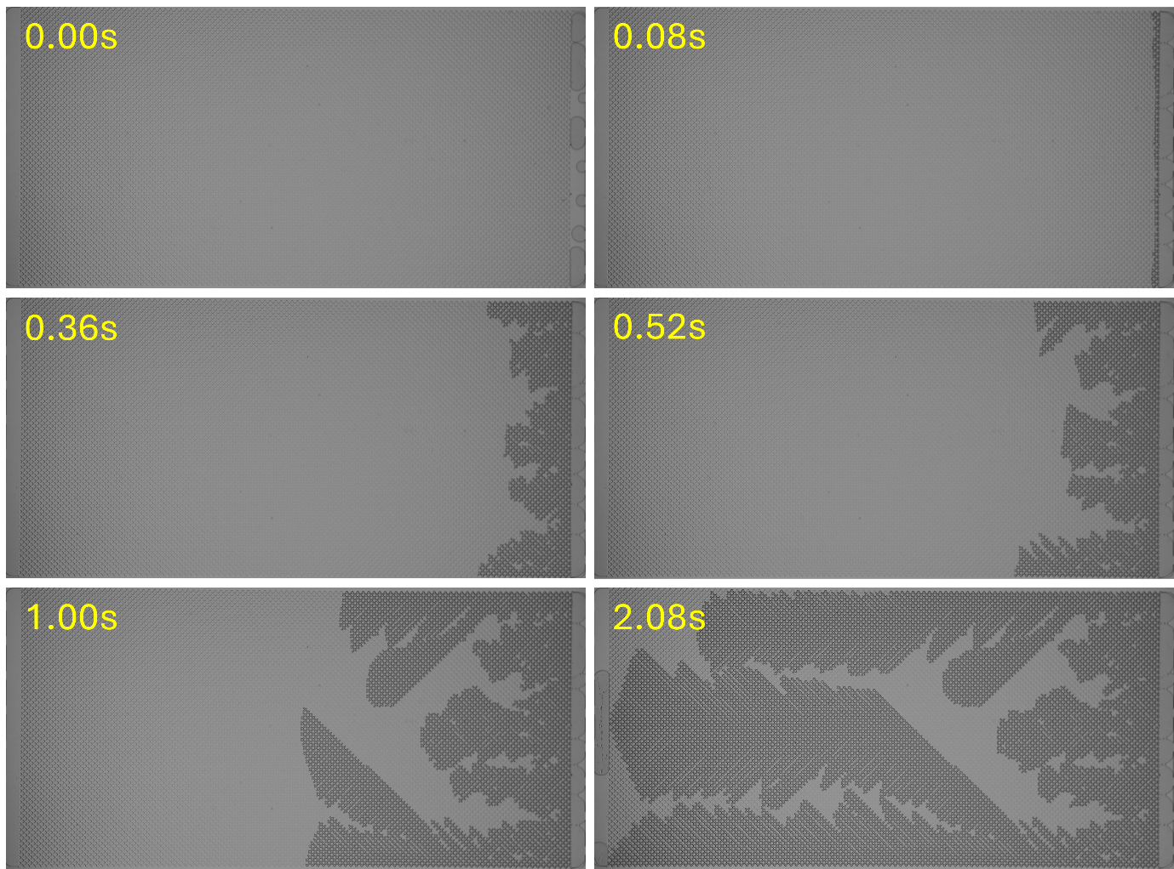
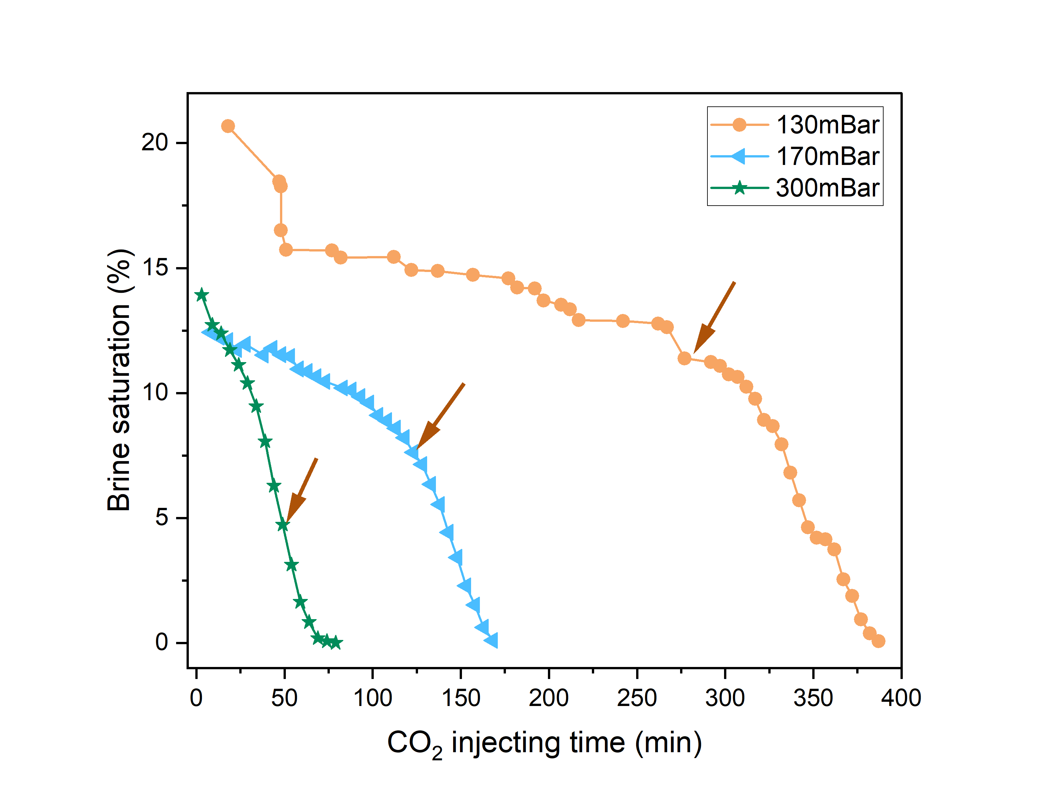
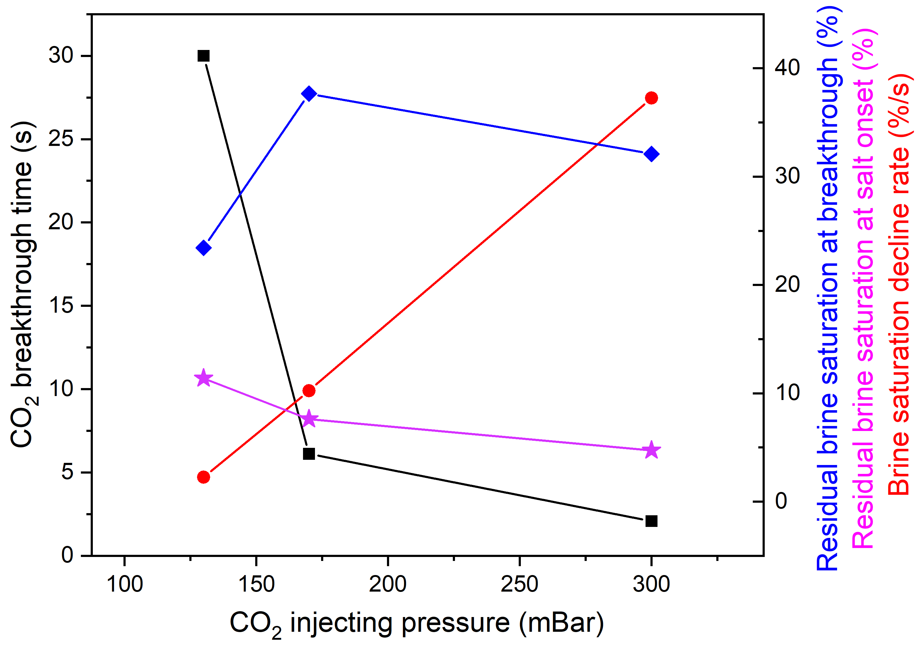
7
Injection Rate Effect
Higher injection rates may result in instable displacement
130 mBar
170 mBar
300 mBar
Before breakthrough
Brine saturation decreases linearly
2.26%/s at 130mBar, 10.24%/s at 170 mBar, 37.24%/s at 300 mBar.
1. Breakthrough time decreases (black line)
2. Brine saturation decline rate increases (red line)
3. Residual brine saturation first increases then decreases (blue line)
4. Residual brine saturation at the onset of salt precipitation
After breakthrough

Slide 8
8
Mechanisms
Salt onset is governed by the competition between evaporation and displacement
pressure (mBar) | saturation at breakthrough (%) | saturation at salt onset (%) | The actual reduction (%) | water loss due to evaporation (%)
130 | 23.4 | 11.4 | 12.0 | 12.7
170 | 37.6 | 7.6 | 30.0 | 20.4
300 | 32.1 | 4.7 | 27.4 | 17.4
Low pressure (~130 mbar)
Displacement is relatively uniform and stable
Evaporation dominates after breakthrough
CO₂ invasion becomes weaker
Salt forms at higher residual brine saturation
High pressure (~300 mbar)
Displacement is finger-like (unstable)
CO₂ continues displacing brine after breakthrough
Fingering persists
Salt onset occurs at much lower brine saturation
Pressure shifts the balance : evaporation-dominated →displacement dominated

Slide 9
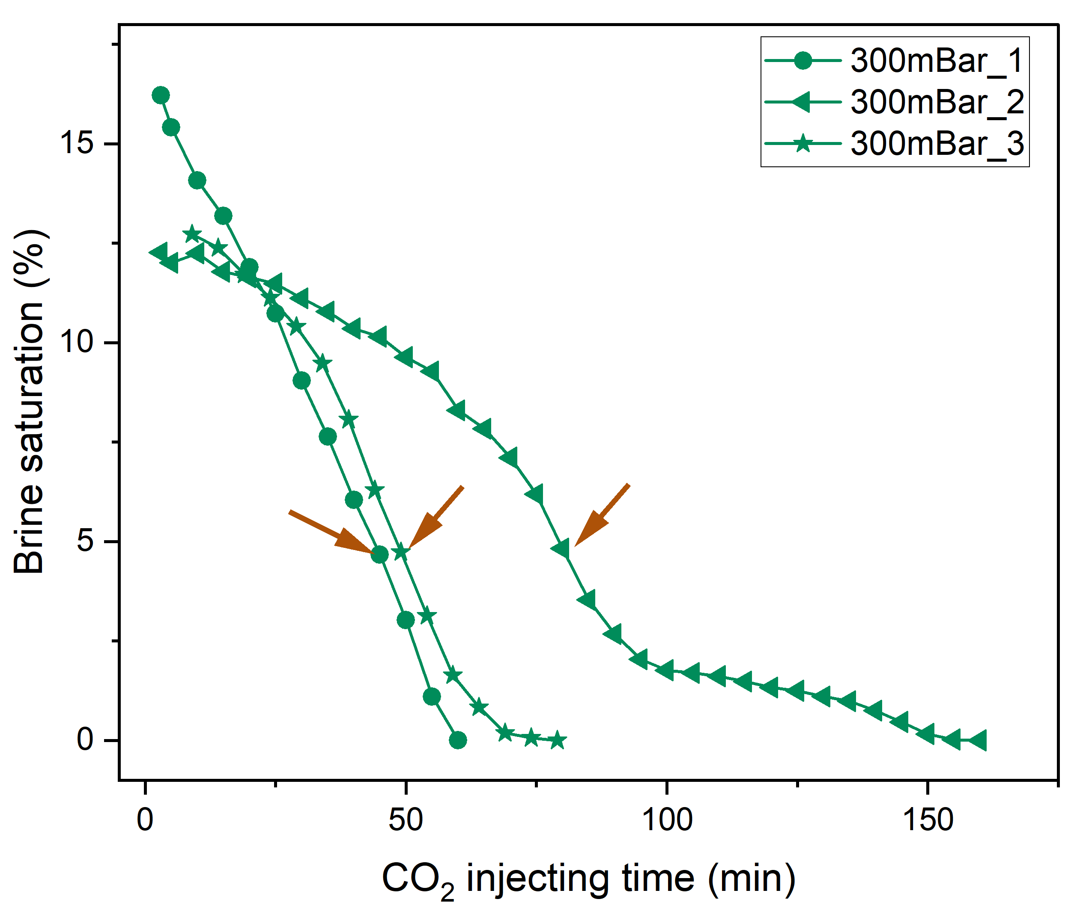
9
Stochasticity
Dry-out dynamics are highly stochastic even under identical conditions
Large variation in dry-out time
60-160 min
After-breakthrough brine saturation varies
12% - 16%
The process is inherently unstable and stochastic
Small pore-scale differences amplify into large-scale variability.

Slide 10
10
Take-home Messages
Two distinct salt morphologies
Crystals in liquid-rich zones; aggregates in gas-dominated regions. Aggregates grow ~6× faster.
1
Pressure controls the dry-out pathway
Higher pressure accelerates breakthrough and shifts the balance from evaporation to continued displacement.
2
The process is inherently unstable
Large run-to-run variability makes salt precipitation difficult to predict.
3

