Slide 1


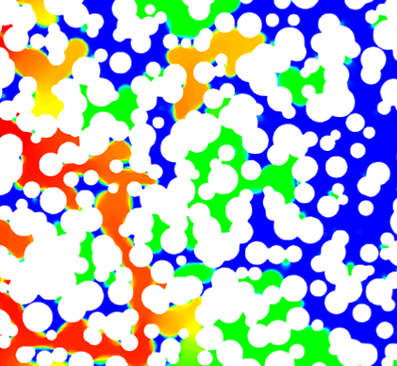





Unravelling Reactive Transport in Subsurface Rocks: Can We Predict What We Measure?
Jacqueline Mifsud¹*, Hannah Menke¹, Florian Doster¹, Callum Robinson², Sam Shaw², Katherine Morris², Jingyue Hao³, Lin Ma³, Aislinn Boylan⁴, Liam Abrahamsen-Mills⁴, Vasileios Tsitsopoulos⁴, Keith Bateman⁵, Julien Maes¹
¹ Institute of GeoEnergy Engineering, Heriot-Watt University, Edinburgh, EH14 4AS, UK
² Department of Earth and Environmental Sciences, The University of Manchester, Manchester, M13 9PL, UK
³ Department of Chemical Engineering, The University of Manchester, Manchester M13 9PL, UK
⁴ United Kingdom National Nuclear Laboratory, Warrington, Cheshire WA3 6AE, UK
⁵ British Geological Survey, Environmental Science Centre, Keyworth, Nottingham, NG12 5GG, UK
*Email: J.Mifsud@hw.ac.uk
Interpore 2026, MS09 – Pore-Scale Physics and Modelling
19th May 2026
In collaboration with:
Funded by:
The
GeoChemFoam
Project
Notes:
Good afternoon everyone, I’m Jacqui, I’m a post-doc at Heriot-Watt working on the GeoSafe project. I will speak to you today about some of the work that I have been doing since joining the university, and specifically my talk today will look at “Unravelling Reactive Transport in Subsurface Rocks, and discuss whether we can reconcile some experimental data with numerical models.

Slide 2
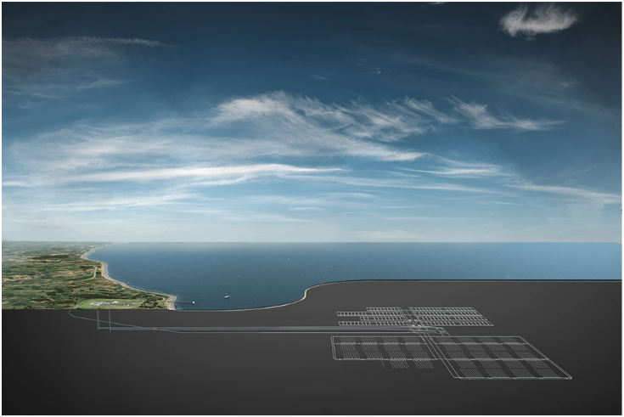




GeoSafe Project Overview
To undertake fundamental research that will advance our understanding related to hosting a Geological Disposal Facility (GDF) for radioactive waste within Lower Strength Sedimentary Rock formations.
3 challenge areas:
Geological isolation
Contaminant pathways
Mathematical modelling
7 UK research organisations
5 universities:
Imperial College London
University of Manchester
University of Liverpool
University of Leeds
Heriot-Watt University
2 institutions:
United Kingdom National Nuclear Laboratory
British Geological Survey
Project website now live: https://geosafeproject.co.uk/
Underground tunnels and vaults of a GDF in an inshore location.
Up to 1000m underground. Source: https://www.nuclearwasteservices.uk/disposal/geological-disposal/
Notes:
My work at Heriot-Watt is part of the GeoSafe project so I thought it would be good to introduce the scope of the project. The aim of the GeoSafe project is to conduct fundamental research that will advance our understanding related to hosting a Geological Disposal Facility (GDF), for radioactive waste, within Lower Strength Sedimentary Rock formations in the UK. We are predominantly looking at 3 challenge areas, Geological isolation, contaminant pathways, and mathematical modelling. The project is between 7 UK research organisations, 5 universities, Imperial, Manchester, Liverpool, Leeds, Heriot-Watt and two institutions, the UK National Nuclear Laboratory and the British Geological Survey.
If you are interested in more detail on the project, the project website is now live. ** Geological isolation challenges: characterisation and conceptualisation of geological complexity and heterogeneity at multiple length and time scales within LSSRs
Contaminant pathways: developing a mechanistic understanding of retention and/or transport within LSSRs
Mathematical models: development of system level mathematical models of key sedimentary systems.

Slide 3
GeoSafe Project Overview
Reactive Transport Modelling
Radiochemistry
Biogeochemistry
Rock Characterisation
Multi-scale Imaging
Hydro-Mechanical Modelling
Notes:
It is a highly collaborative effort between the various institutions, and brings together experts from all over the UK. The following schematic gives an overview of the different bits of research being conducted and where, so we have people working on rock characterisation, multi-scale imaging, radiochemistry etc, and you can see that here at Heriot-Watt in Edinburgh we are predominantly concerned with the reactive transport modelling and specifically we are looking at pore-scale reactive transport modelling.
(We are also mainly working with colleagues working on multi-scale imaging and radiochemistry.)

Slide 4
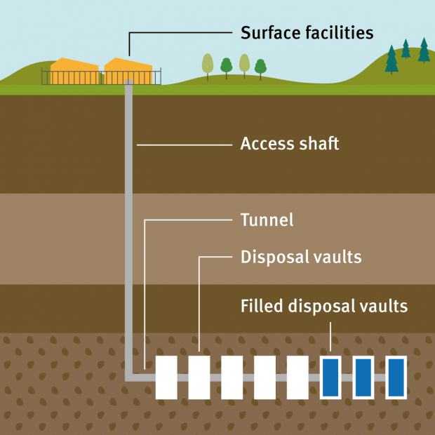
How is pore-scale reactive transport modelling relevant to GeoSafe?
Relevance to Geological Disposal Facility (GDF) programme
Geochemistry impacts fate of radionuclides in the subsurface
Small scale characterisation will lead to better modelling at the larger scale
This work investigates subsurface rocks targeted by GeoSafe
Experimental parameters can affect reactive constants:
Simulations facilitate relatively inexpensive parametric studies to quantify effects (e.g. different flowrates)
INSERT GDF figure
U⁶⁺
U⁶⁺
^{Precipitation}
^{Quartz}
^{adsorption}
^{UO}₂
^{Clay}
^{Quartz}
^{Quartz}
Notes:
So how is our work at Heriot-Watt relevant to the GDF programme?
Many of you will know that geochemistry impacts the fate of radionuclides in the subsurface. What we are concerned with in our work is the pore-scale which might not seem immediately relevant to the large-scale of a GDF. Yet this small-scale characterisation will lead to better modelling at the larger scale.
Also although the workflow I will show today can be applied to any rock, we are specifically investigating subsurface rocks targeted by GeoSafe.
Finally, one of the benefits of modelling is that we can perform parametric studies fairly quickly in comparison to experiments, and this helps us understand effects e.g. how does a higher or lower flowrate impact radionuclide transport?
And more broadly, output parameters from our simulations will output directly to reactive transport upscaling.
(Refer to comments from Julien’s talk in March meeting.)

Slide 5
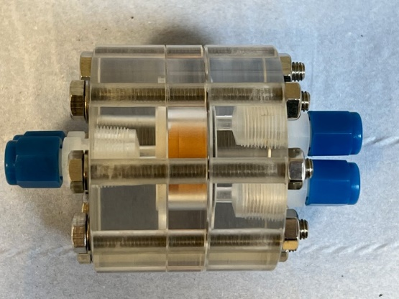
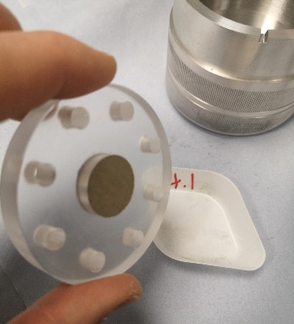
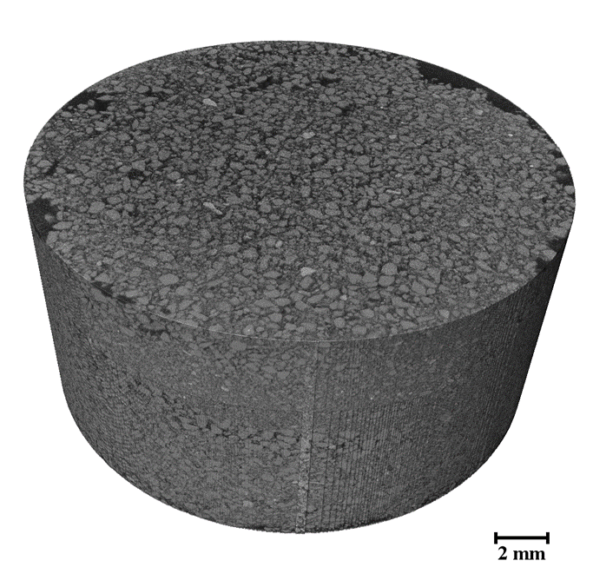
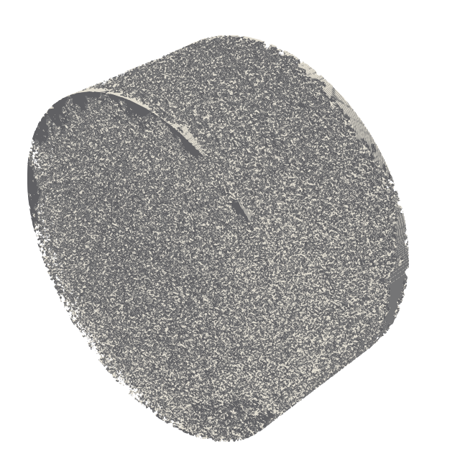
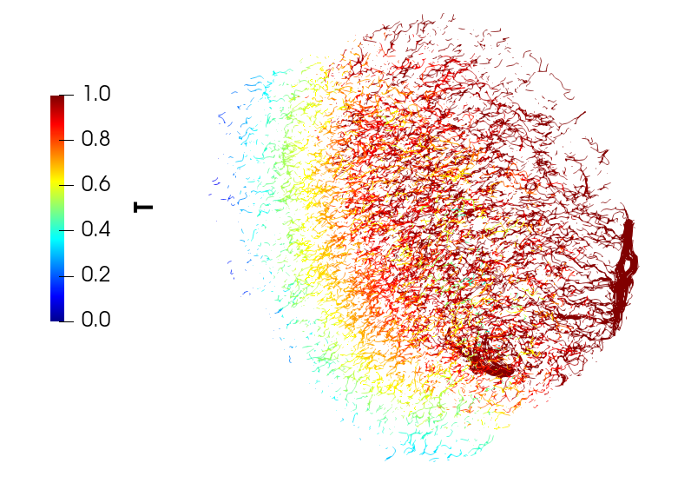
Overview of GeoSafe Collaboration
University of Manchester: Flow-through & batch experiments on pellet sample
University of Manchester: Image pellet sample in 3D
Modelling results
and
experimental data
validation
Heriot-Watt & UKNNL: Simulate (radionuclide) transport using 3D images and experimental parameters
Notes:
So hopefully by this point you have a better idea of the capabilities of GeoChemFoam, now in the next part of my talk I will discuss how we apply this open-source code and leverage some of its capabilities in our GeoSafe project.
(A few slides back I introduced the concept of Digital Rock Physics and how we can perform simulations on the exact pore-space.) In this part of our GeoSafe work we are working closely with the University of Manchester, and the UK National Nuclear Laboratory. So first our collaborators are running some experiments on this flow through cell, so it’s a sample of crushed rock pressed into this perspex slide, then this same sample is sent to another group at Manchester which performs the imaging, and finally that experimental data and images come to us at Heriot Watt where we plug them into our simulator.

Slide 6
Overview of GeoSafe Collaboration
University of Manchester: Flow-through & batch experiments on pellet sample
University of Manchester: Image pellet sample in 3D
Modelling results
and
experimental data
validation
Heriot-Watt & UK NNL: Simulate (radionuclide) transport using 3D images and experimental parameters

Slide 7
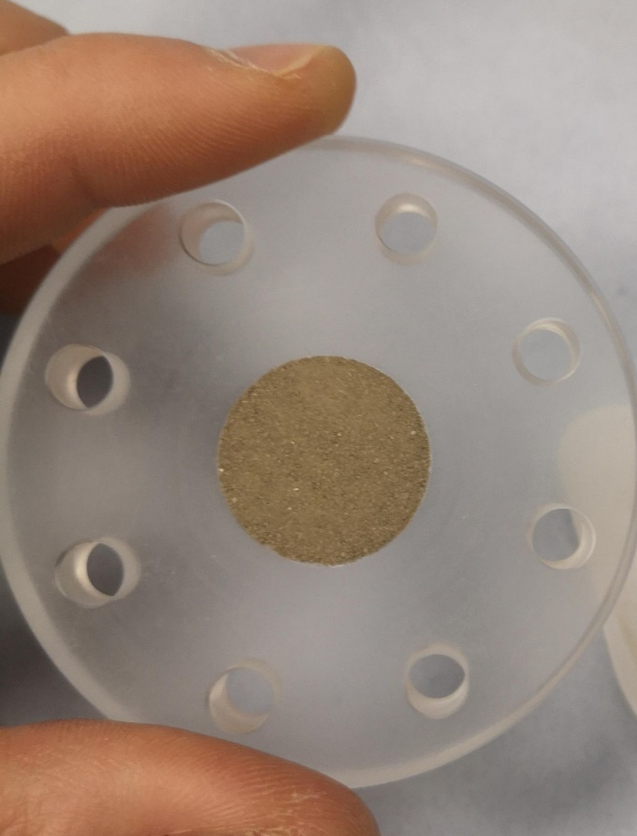
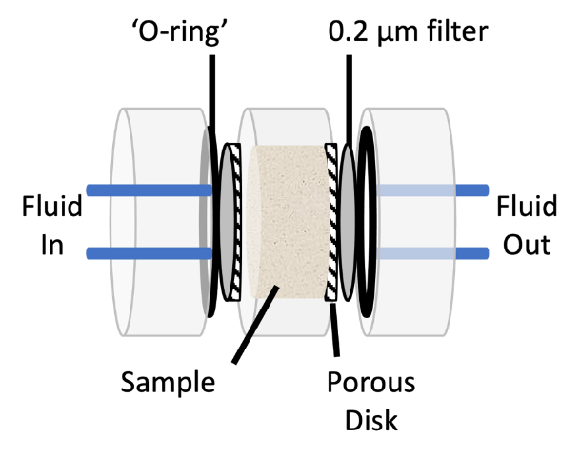


Experiments: Advective Flow Column
Flow experiment on reaggregated pressed pellet of rock
Performed by colleagues at the University of Manchester (UoM)
Flow cells developed by British Geological Survey (BGS)¹
Breakthrough curve with fluorescein:
Flowrate: $Q=$ 0.55 ml/hr
Porosity: 40%
2 cm
Pressed pellet of rock. Sample size (cylindrical), 2cm diameter, 1cm length.
$$PV_{injected}=\frac{Qt}{φV}$$
Flow cells developed by BGS¹
¹Bateman, K. et al. Evolution of the Reaction and Alteration of Granite with Ordinary Portland Cement Leachates: Sequential Flow Experiments and Reactive Transport Modelling. Minerals 2022, 12 (7).

Slide 8
Overview of GeoSafe Collaboration
University of Manchester: Flow-through & batch experiments on pellet sample
University of Manchester: Image pellet sample in 3D
Modelling results
and
experimental data
validation
Heriot-Watt & UK NNL: Simulate (radionuclide) transport using 3D images and experimental parameters

Slide 9
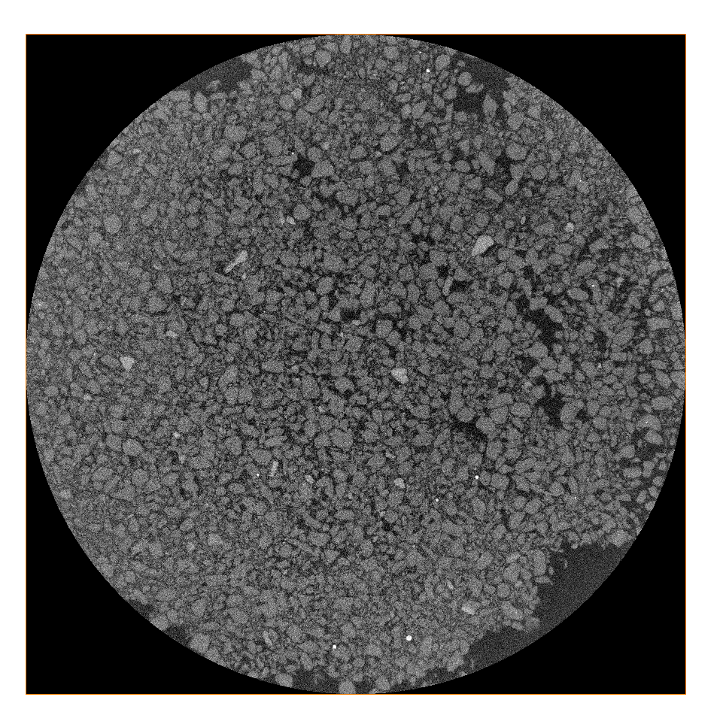
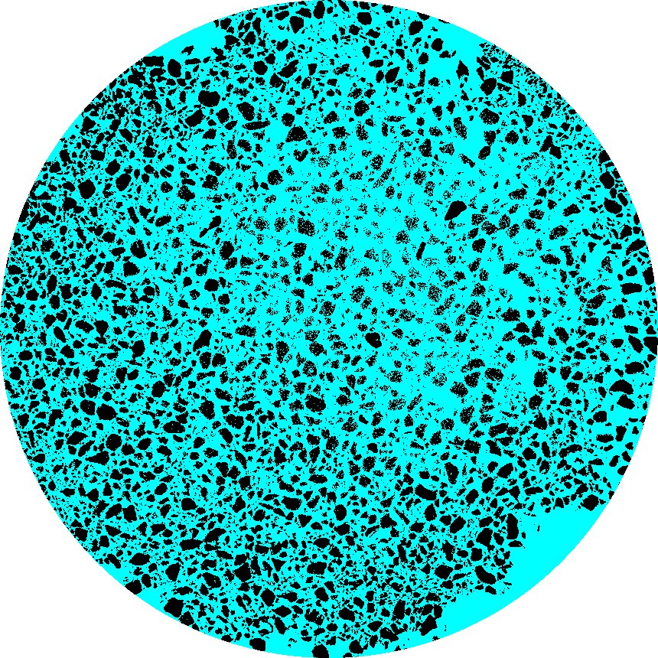


CT-Image Analysis: Pressed Pellet
Several CT scans at voxel resolution of $5.5μm$ performed by University of Manchester
CT-image chosen for computational domain is 3442 x 3442 x 1609 voxels
Computational domain is slightly smaller than in experiments (1.89cm x 1.89cm x 0.88cm in image vs. 2cm x 2cm x 1cm in experiments)
Sample is clay-rich rock that has been crushed
hence may not resemble typical clay microstructure (layers etc.)
Grains
Pores
Voxel size 5.5$μm^{3}$, 3442 x 3442 x 1609 voxels.
Segmented CT image of pressed column of clay-rich rock.

Slide 10
Overview of GeoSafe Collaboration
University of Manchester: Flow-through & batch experiments on pellet sample
University of Manchester: Image pellet sample in 3D
Modelling results
and
experimental data
validation
Heriot-Watt & UK NNL: Simulate (radionuclide) transport using 3D images and experimental parameters

Slide 11
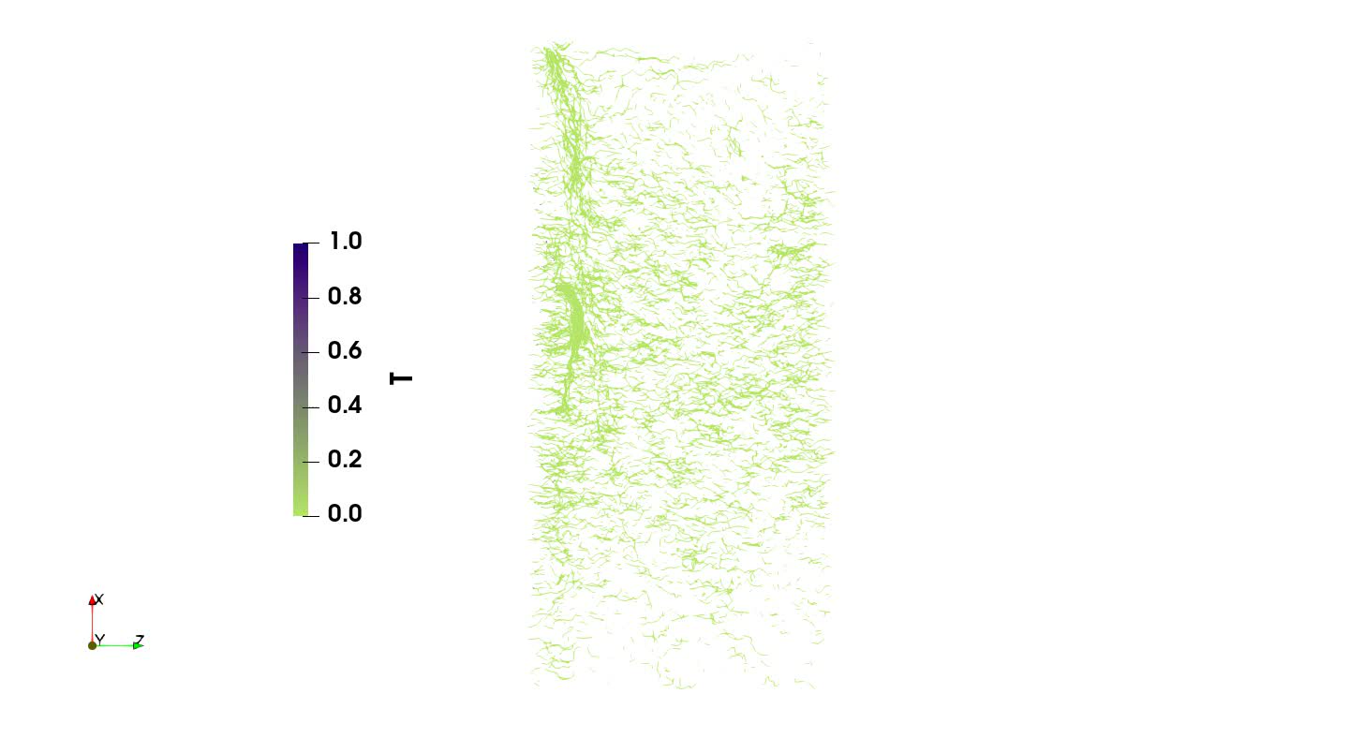

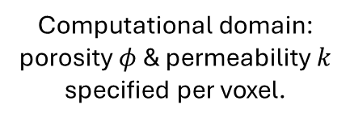
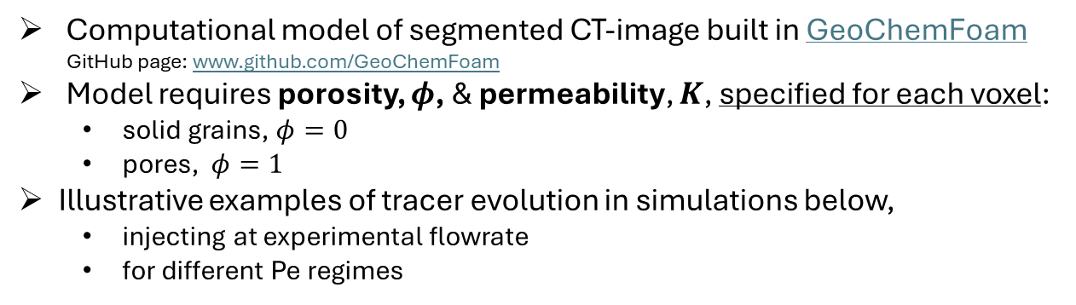


Simulations: From CT-image to computational model
Computational model of segmented CT-image built in GeoChemFoam
GitHub page: www.github.com/GeoChemFoam
Model requires porosity, $φ$, & permeability, $K$, specified for each voxel:
solid grains, $φ=0$
pores, $φ=1$
Illustrative examples of tracer evolution in simulations below,
injecting at experimental flowrate
for different Pe regimes
In GeoChemFoam model:
The
GeoChemFoam
Project
flow direction
$$Pe_{pore}=0.01$$
$$Pe_{pore}=1$$
CT image
Computational domain: porosity $φ$ & permeability $k$ specified per voxel.
Velocity streamlines show tracer concentration T against time for different pore-scale Peclet numbers $Pe_{pore}=\frac{U_{D}L_{pore}}{φD}$. Concentration of T: Purple = 1; Green = 0. Side view.
Notes:
Note that these animations assume the porosity is 10%, i.e. microporosity is fully non-porous.
Different Peclet numbers modelled by changing value of diffusion coefficient $D$

Slide 12

Preliminary results: Validation with Experiments
Experimental breakthrough curve of fluorescein in reaggregated pellet
Our initial attempts at matching tracer transport simulations with the experimental results revealed that our timescales are dissimilar, and breakthrough happens much faster in simulations…
$$PV_{injected}=\frac{Qt}{φV}$$
$Q −$ flowrate
$t −$ time
$φ−$ porosity
$V −$ volume
1. Sorption
2 important features will help improve our agreement with the experiments:
2. Dispersivity
Notes:
These preliminary results show that in our simulations, the outlet is reach after around, 2-3 PV_injected. Yet, in the experiments, this takes over 15 pore-volumes injected, so having consulted our colleagues on this the first suspicion is that there is some sorption going on in the experiments, which was not anticipated.

Slide 13
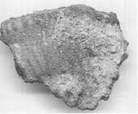
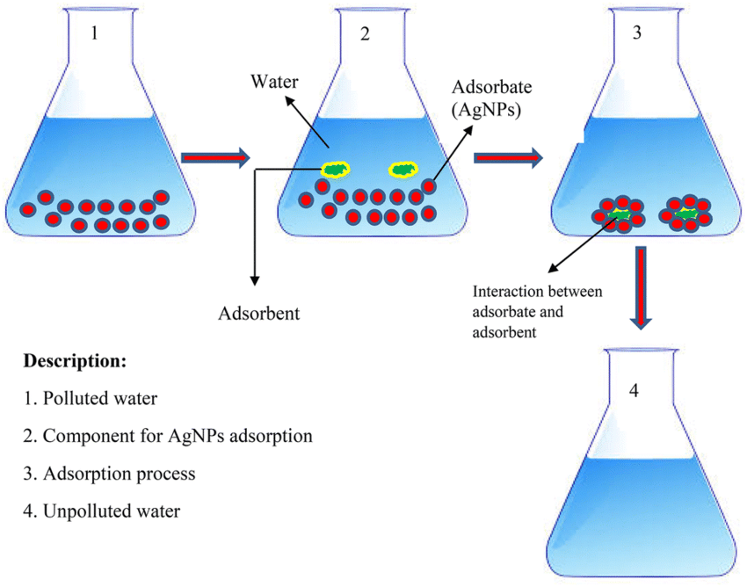

Batch sorption experiments: Fluorescein
1g disaggregated rock and 30ppm fluorescein in 10ml of groundwater.
After an equilibration period, the amount of fluorescein sorbed is measured.
Distribution coefficient, $K_{d}$
$K_{d}=\frac{A_{i}−A_{e}}{A_{e}}\left(\frac{V}{W}\right)=1.96$ ml/g;
$A_{i}$ initial concentration, $A_{e}$ final concentration, $V$ volume ($ml$), $W$ mass ($g$).
Rock sample
Water
Fluorescein
7 days
Fluorescein
Rock minerals
Notes:
So, in order to determine how much sorption there is, they perform some batch sorption experiments, so the idea is to take 1g of disaggregated rock and 30ppm fluorescein in 10ml of groundwater, then after an equilibration period of one week they measure the amount of fluorescein sorbed, and we have this value of distribution coefficient Kd here which is equal to 1.96ml/g.
(i.e. we assume that after 7 days that fluorescein has equilibrated).
https://taylorandfrancis.com/knowledge/Medicine_and_healthcare/Pharmaceutical_medicine/Distribution_coefficient/

Slide 14


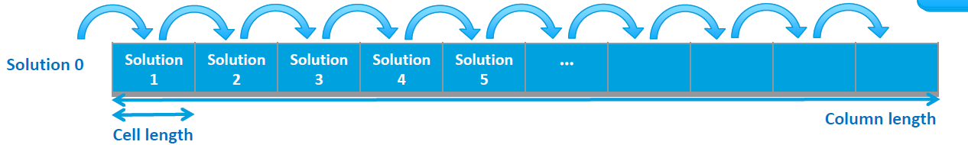

1D Reactive Transport Modelling in PHREEQC
1D RT model in PHREEQC (code developed by US Geological Survey)
Transport model developed by UKNNL
Linear sorption model,
$S=K_{d}C$,
where $S$ sorbed concentration,
$C$concentration in solution,
$K_{d}=1.96$ ml/g (from batch experiments).
inlet
outlet
Example TRANSPORT block in PHREEQC model:
TRANSPORT
-cells 10
-shifts 219
-time_step 822.5 s
-boundary_conditions constant flux
-lengths 10*1e-3
-dispersivities 0.001 #initial guess
-punch_cells 10
-print_cells 10
*2025, PHREEQC Version 3, Software release, https://www.usgs.gov/software/phreeqc-version-3.

Slide 15
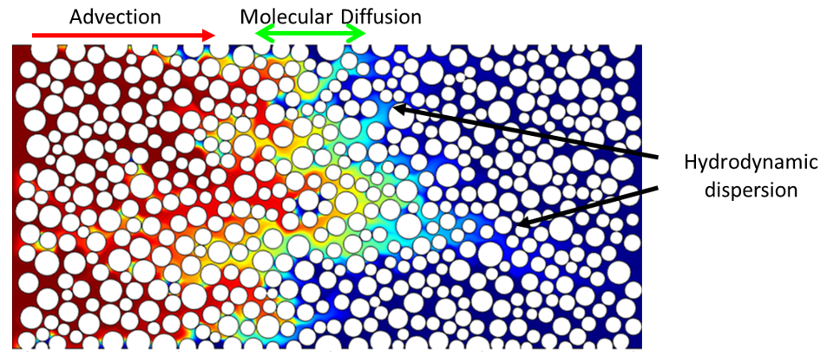
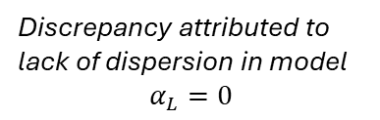
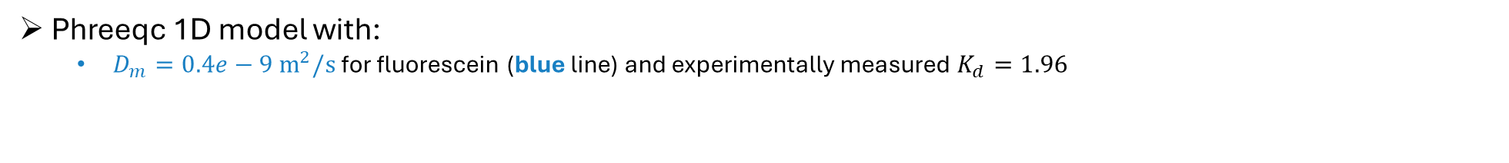
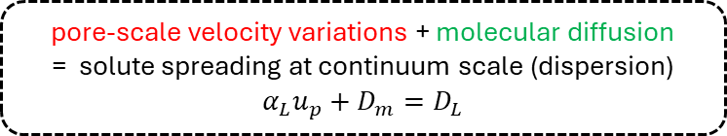
Influence of diffusion & dispersivity Comparing experimental data & PHREEQC 1D model
Phreeqc 1D model with:
$D_{m}=0.4e−9{ m}^{2}/s$ for fluorescein (blue line) and experimentally measured $K_{d}=1.96$
The longitudinal dispersion $D_{L}$ ($m^{2}/s$) is related to the dispersivity $α_{L}$ ($m$), pore-velocity $u_{p}$ ($m/s$) and molecular diffusion $D_{m}$ ($m^{2}/s$) in the porous medium
pore-scale velocity variations + molecular diffusion = solute spreading at continuum scale (dispersion)
$$α_{L}u_{p}+D_{m}=D_{L}$$
Discrepancy attributed to lack of dispersion in model $$α_{L}=0$$
Dispersion is important for modelling & predicting contaminant and radionuclide transport in the subsurface
yet correct value to use is geometry-specific & unknown a priori!
15
Notes:
So even by implementing the linear sorption model in the 1D Phreeqc model we see a huge improvement in the match with the experiments, however there is still some deviation between the experiments and the Phreeqc model, which we want to try and improve if we can. We attribute this to dispersion, but we do not know how much dispersion we have in our geometry.

Slide 16
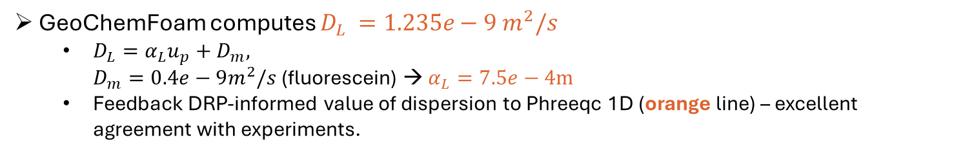
Calculating dispersivity in GeoChemFoam
dispersionFoam* solver in GeoChemFoam accurately quantifies dispersion on a micro-CT image of the rock sample – solves a closure problem
GeoChemFoam computes $D_{L} =1.235e−9{ m}^{2}/s$
$D_{L}=α_{L}u_{p}+D_{m},$ $D_{m}=0.4e−9m^{2}/s$ (fluorescein) → $α_{L}=7.5e−4m$
Feedback DRP-informed value of dispersion to Phreeqc 1D (orange line) – excellent agreement with experiments.
In GeoChemFoam model:
CT image
inclusion of dispersion in model yields better agreement with experiments
GeoChemFoam links flow experiments & PHREEQC model, eliminating the need to guess dispersivity (or use as a fitting parameter)
Computational domain: porosity $φ$ & permeability $k$ specified per voxel.
*Maes & Menke, Journal of Environmental Chemical Engineering (2024)

Slide 17
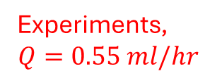
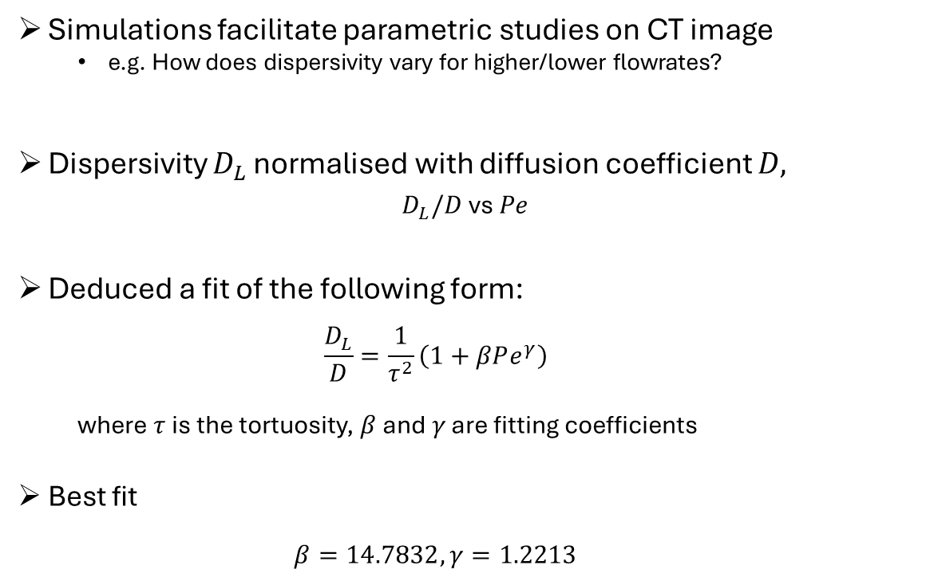

Dispersivity predictions vs Peclet number (flowrate)
Simulations facilitate parametric studies on CT image
e.g. How does dispersivity vary for higher/lower flowrates?
Dispersivity $D_{L}$ normalised with diffusion coefficient $D,$
$D_{L}/D$ vs $Pe$
Deduced a fit of the following form:
$$\frac{D_{L}}{D}=\frac{1}{τ^{2}}\left(1+βPe^{γ}\right)$$
where $τ$ is the tortuosity, $β$ and $γ$ are fitting coefficients
Best fit
$$β=14.7832, γ=1.2213$$
Experiments, $$Q=0.55 ml/hr$$
Increasing flowrate
Expressed in terms of Peclet number
$Pe=\frac{U_{D}L}{φD}$
varying $U_{D}$ (flowrate),
where $φ$ – porosity, $L$ – characteristic pore-size
Simulations complement experimental dataset by simulating different conditions (e.g. flowrates)

Slide 18
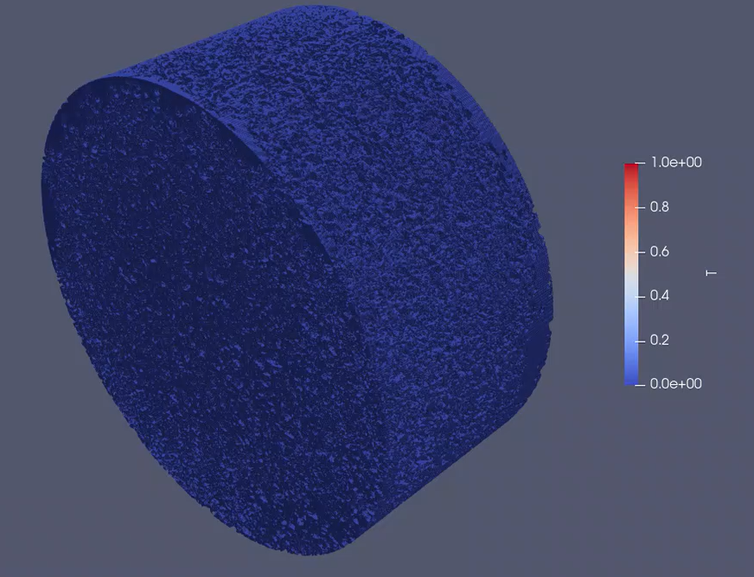
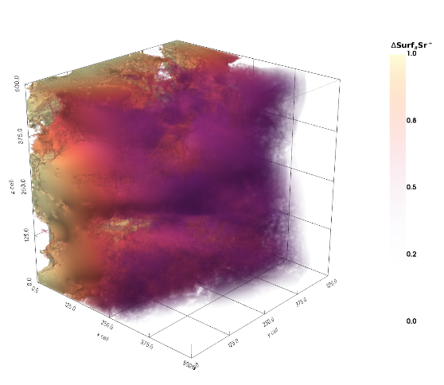

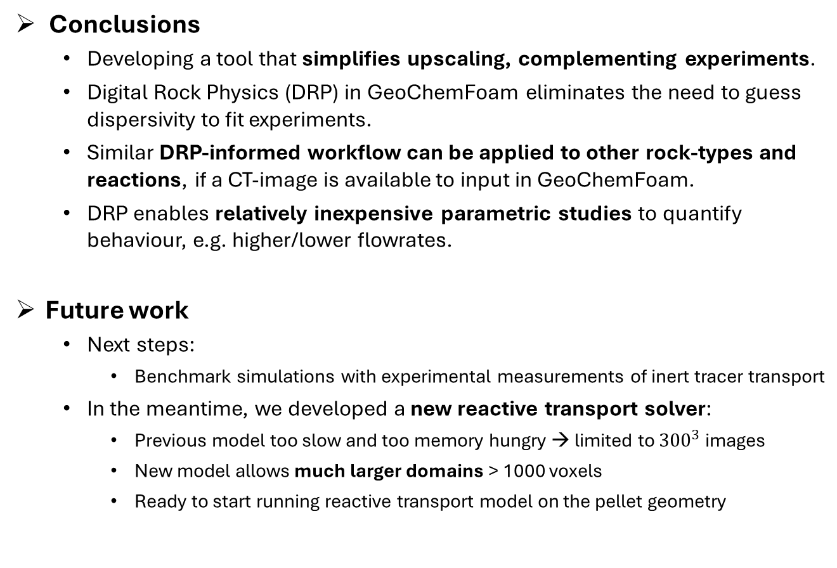
Conclusions & Future work
Conclusions
Developing a tool that simplifies upscaling, complementing experiments.
Digital Rock Physics (DRP) in GeoChemFoam eliminates the need to guess dispersivity to fit experiments.
Similar DRP-informed workflow can be applied to other rock-types and reactions, if a CT-image is available to input in GeoChemFoam.
DRP enables relatively inexpensive parametric studies to quantify behaviour, e.g. higher/lower flowrates.
Future work
Next steps:
Benchmark simulations with experimental measurements of inert tracer transport
In the meantime, we developed a new reactive transport solver:
Previous model too slow and too memory hungry → limited to ${300}^{3}$ images
New model allows much larger domains > 1000 voxels
Ready to start running reactive transport model on the pellet geometry
Numerical simulation of non-reactive transport in reaggregated oxford clay sample
Numerical simulation of Strontium adsorption (illustrated on ${512}^{3}$Estaillades image)

Slide 19
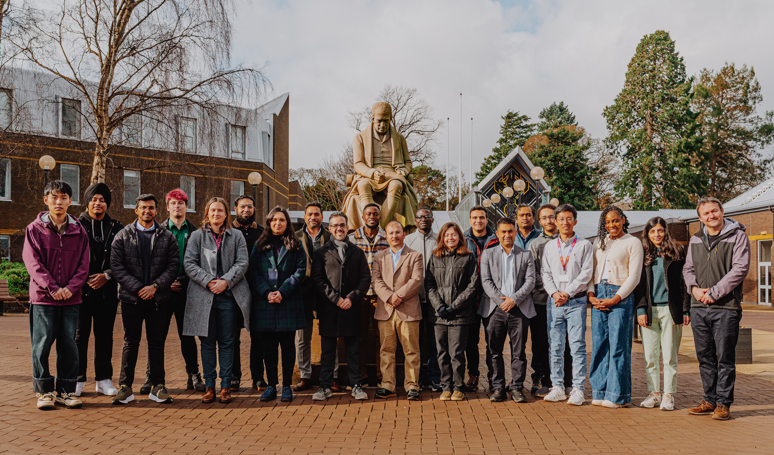



Acknowledgements
Collaborators:
DigiPorFlow Group at Heriot-Watt https://digiporflow.site.hw.ac.uk/
GeoSafe colleagues https://geosafeproject.co.uk/:
Heriot-Watt: Julien Maes, Hannah Menke, Florian Doster
University of Manchester: Jingyue Hao, Lin Ma, Kevin Taylor Callum Robinson, Sam Shaw, Katherine Morris
UK National Nuclear Laboratory: Vasileios Tsitsopoulos, Aislinn Boylan, Liam Abrahamsen-Mills
British Geological Survey Keith Bateman, Ruth Delina-Agillon
Funding:
NERC Grant: NE/Y002504/1 (PI: Florian Doster) Towards Safe Geological Disposal of Radioactive Waste in Lower-Strength Sedimentary Rocks (GeoSafe)
Nuclear Waste Services https://www.nuclearwasteservices.uk/
HPC facilities and associated support services:
UK national supercomputing facility ARCHER2 https://www.archer2.ac.uk. Beckett, G., Beech-Brandt, J., Leach, K., Payne, Z., Simpson, A., Smith, L., Turner, A., & Whiting, A. (2024). ARCHER2 Service Description. Zenodo. https://doi.org/10.5281/zenodo.14507040
DigiPorFlow group, 2025.
Scan to be directed to the 9th Annual UK Interpore Chapter Conference 2026 website for details! 1-2 September 2026, Heriot-Watt University, Edinburgh, United Kingdom
The
GeoChemFoam
Project

Slide 20
Thank you for your attention!
Any questions?
In collaboration with:
Funded by:
The
GeoChemFoam
Project

