Slide 1






Mechanical behavior of dense suspensions in porous media: A pore-scale model
Nassim Cheikh¹, Emmanuel Le Trong¹, Cyprien Soulaine¹
¹Orléans Institute of Earth Sciences, France
InterPore 2026 meeting
May 21, 2026
nassim.cheikh@cnrs-orleans.fr

Slide 2
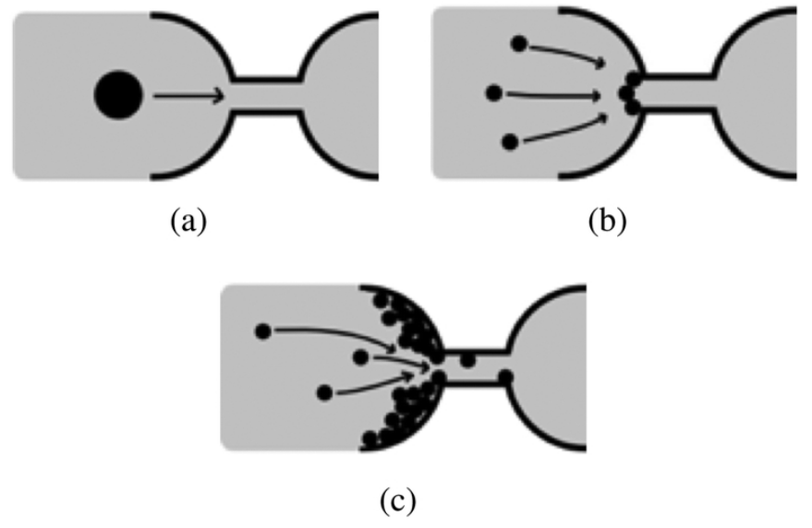
Context – Pore clogging
Sieving, bridging and aggregation
Lagrangian approaches: accurate but computationally expensive
Move into Euler-Euler approaches
Sieving
Bridging
Aggregation
Modified from Dressaire and Sauret (2017)
InterPore 2026 Meeting
Mechanical behavior of dense suspensions in porous media: A pore-scale model
May 21, 2026
2

Slide 3
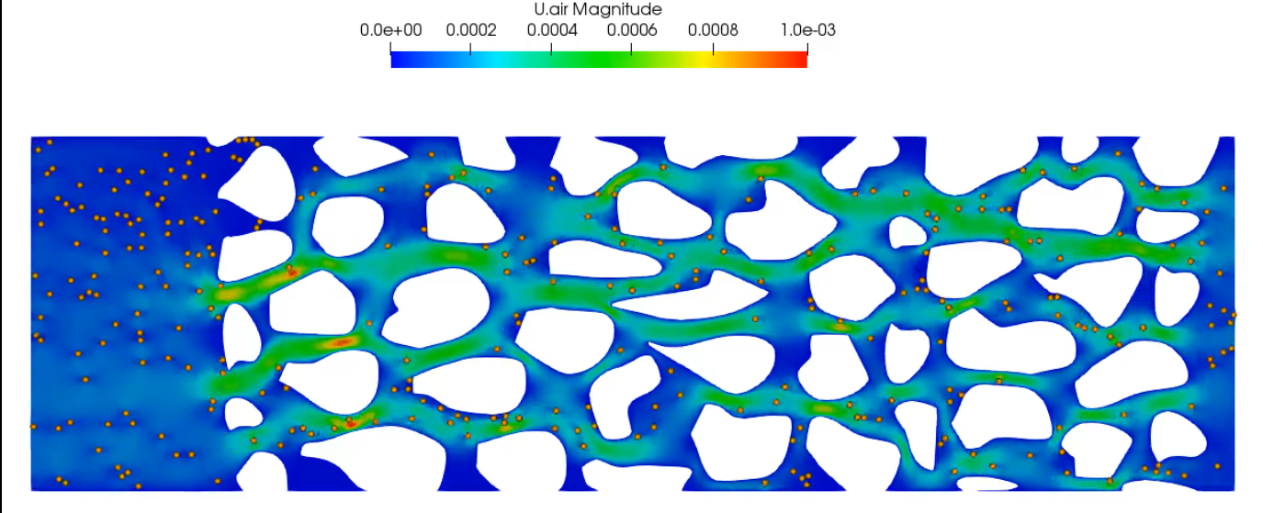
Euler-Lagrange simulations
Euler-Lagrange simulation of particle transport and retention at pore scale
Accurate but very costly in terms of time and resources
This simulation ~ 1 week
The same in Euler-Euler ~ 4 hours
Simulation of the permeability reduction test on a complex geometry (Maya Fogouang 2025).
InterPore 2026 Meeting
Mechanical behavior of dense suspensions in porous media: A pore-scale model
May 21, 2026
3

Slide 4
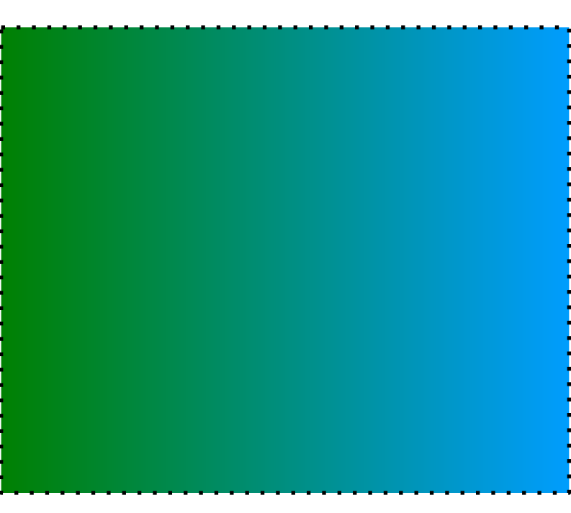
Euler-Euler model
Volume Averaging Method
Euler-Euler
Euler-Lagrange
Fluid
Particles
+ Boundary Conditions
Mass conservation
Momentum equation
InterPore 2026 Meeting
Mechanical behavior of dense suspensions in porous media: A pore-scale model
May 21, 2026
4

Slide 5
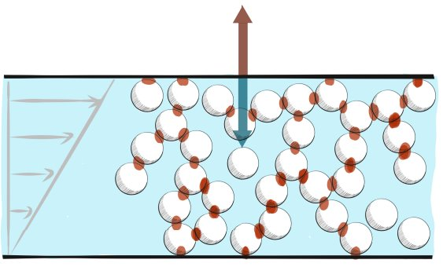
Particle pressure
Particle pressure : normal stress applied on the wall by particles
Suspension is incompressible so the particle pressure is balanced by fluid pressure
Particles interactions in shear stress flow (Guazzelli and Pouliquen, 2025)
InterPore 2026 Meeting
Mechanical behavior of dense suspensions in porous media: A pore-scale model
May 21, 2026
5

Slide 6
Particle pressure & viscosity
Particle pressure
Shear effective viscosity
Gidaspow and Ettehadieh / Krieger
Boyer et al. / Boyer et al.
InterPore 2026 Meeting
Mechanical behavior of dense suspensions in porous media: A pore-scale model
May 21, 2026
6

Slide 7
Compression in a single pore
Gidaspow and Ettehadieh solid pressure
Nondeformable particles
Solid phase cannot go out: it will compress
Comparison with analytical solution (Hewitt et al., 2016)
ΔP
Water flow
InterPore 2026 Meeting
Mechanical behavior of dense suspensions in porous media: A pore-scale model
May 21, 2026
7

Slide 8
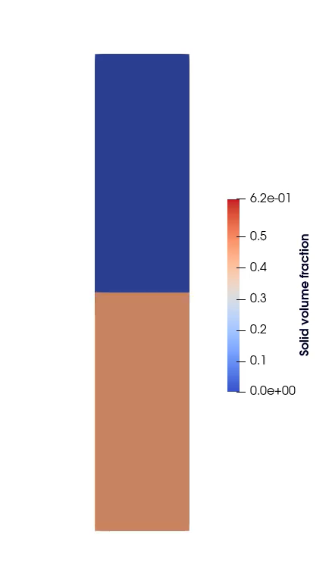
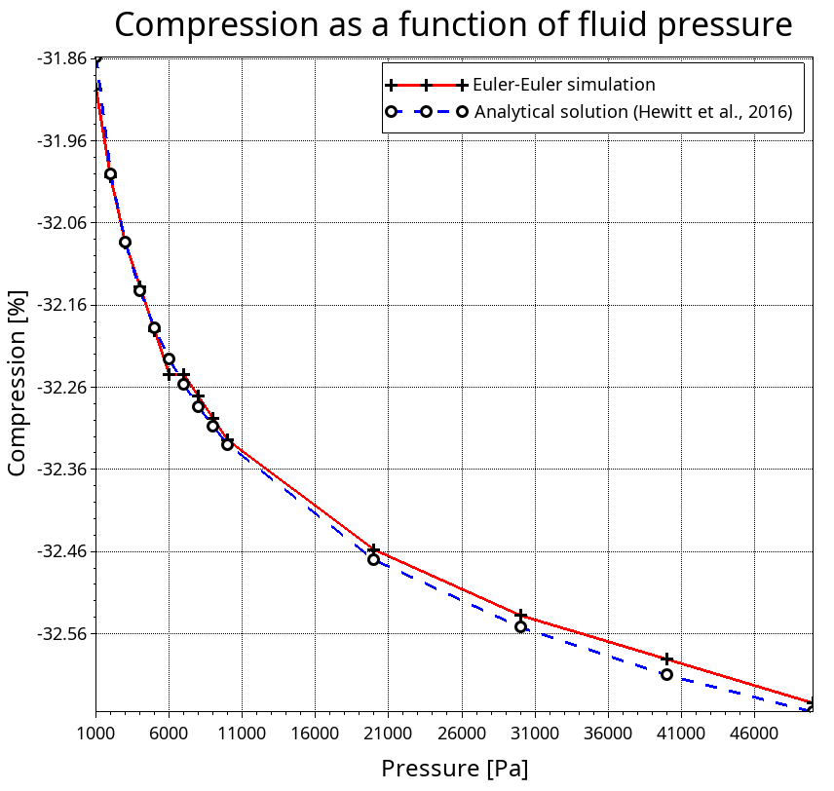
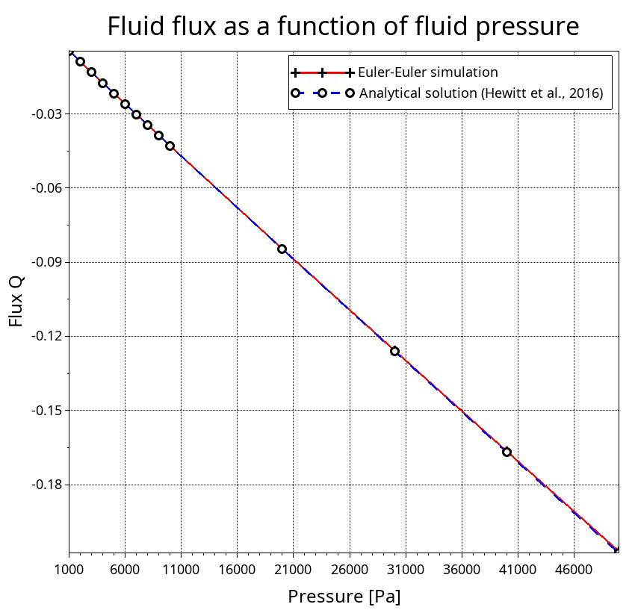
Compression in a single pore
InterPore 2026 Meeting
Mechanical behavior of dense suspensions in porous media: A pore-scale model
May 21, 2026
8

Slide 9
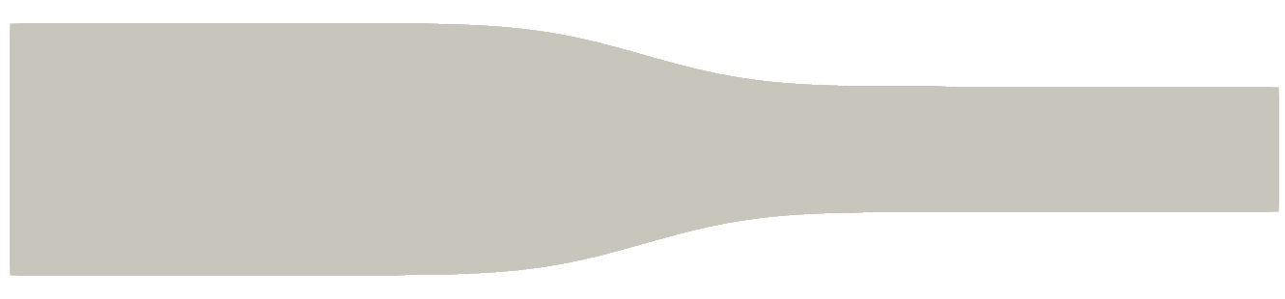
Clogging in a single pore
D
W
Injection of solid phase in constricted channel
Boyer et al. solid pressure
Important parameters: W/D, solid volume fraction
InterPore 2026 Meeting
Mechanical behavior of dense suspensions in porous media: A pore-scale model
May 21, 2026
9

Slide 10
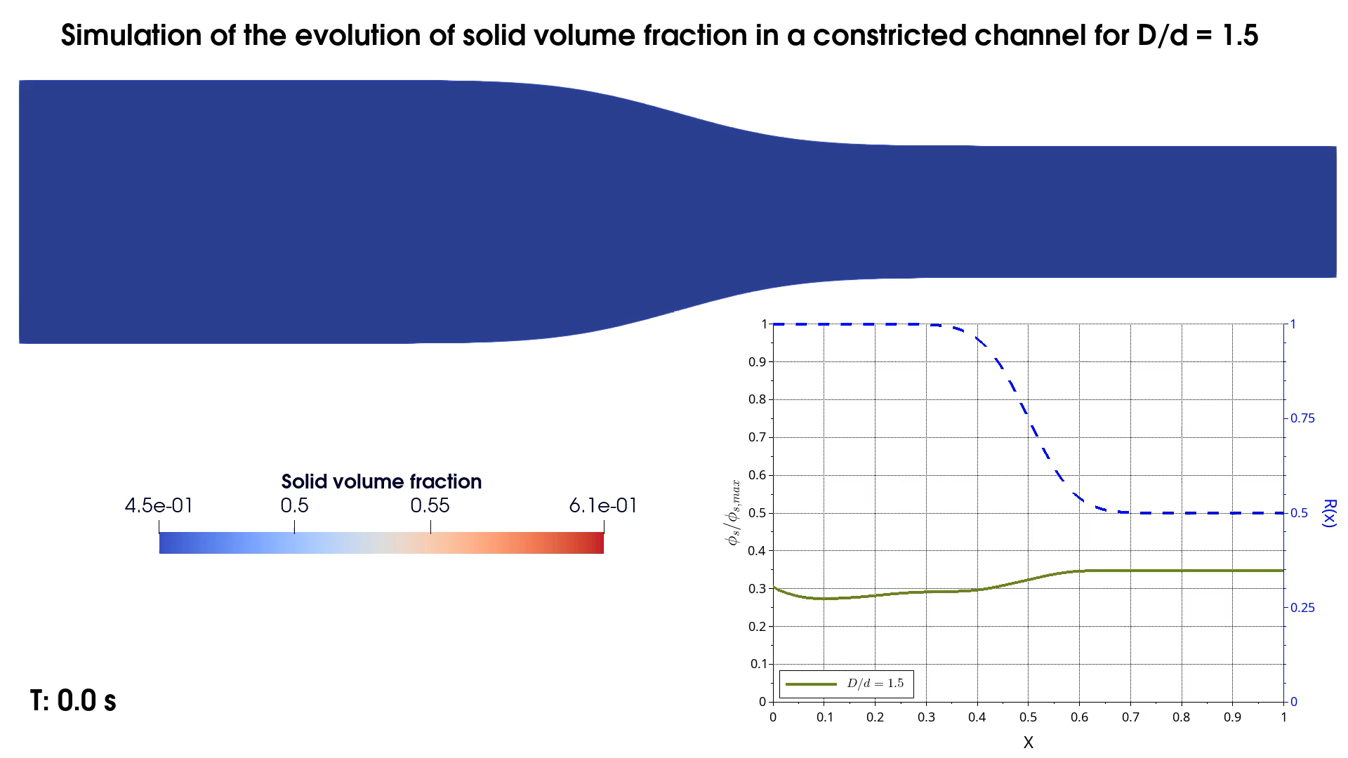
Clogging in a single pore
InterPore 2026 Meeting
Mechanical behavior of dense suspensions in porous media: A pore-scale model
May 21, 2026
10

Slide 11

Clogging in a single pore
InterPore 2026 Meeting
Mechanical behavior of dense suspensions in porous media: A pore-scale model
May 21, 2026
11

Slide 12
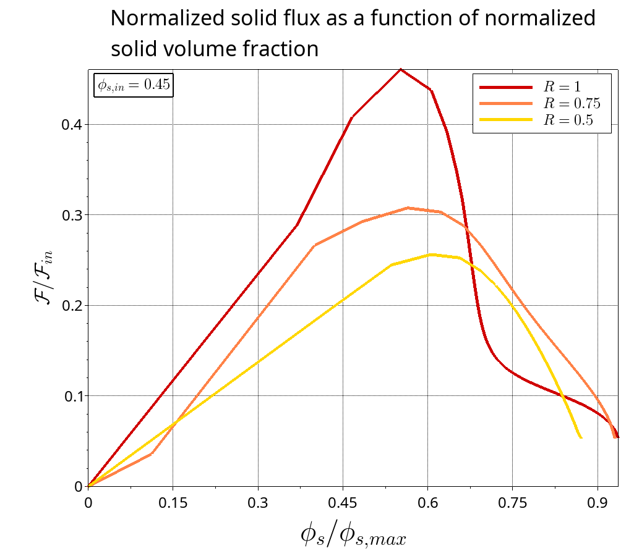
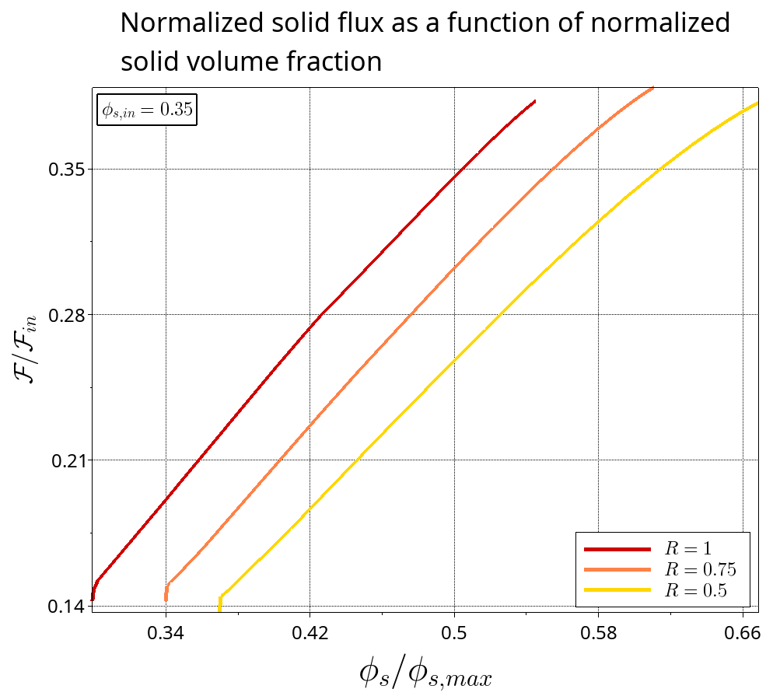
Solid Flux analyses
Maximum flux
Final flux
InterPore 2026 Meeting
Mechanical behavior of dense suspensions in porous media: A pore-scale model
May 21, 2026
12

Slide 13
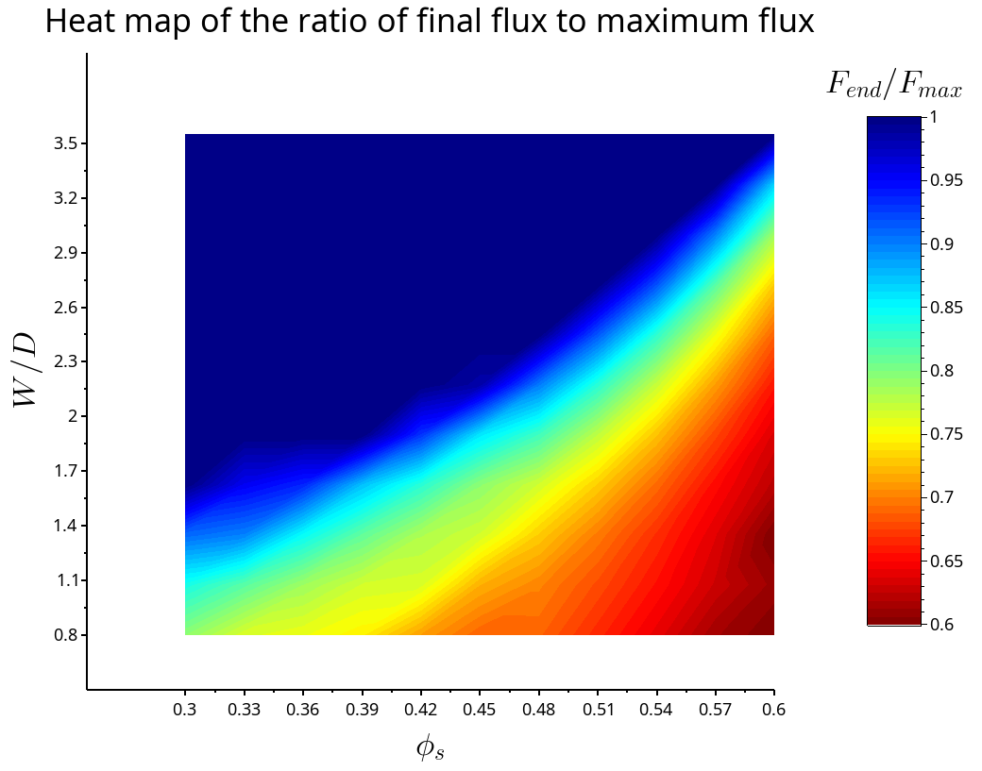
Heat map of clogging
121 simulations in constricted channels
Solid pressure and effective viscosity from Boyer model
varying from 0.3 to 0.6 and varying from 3.5 to 0.8
Ratio of maximum flux to final flux as clogging factor
InterPore 2026 Meeting
Mechanical behavior of dense suspensions in porous media: A pore-scale model
May 21, 2026
13

Slide 14
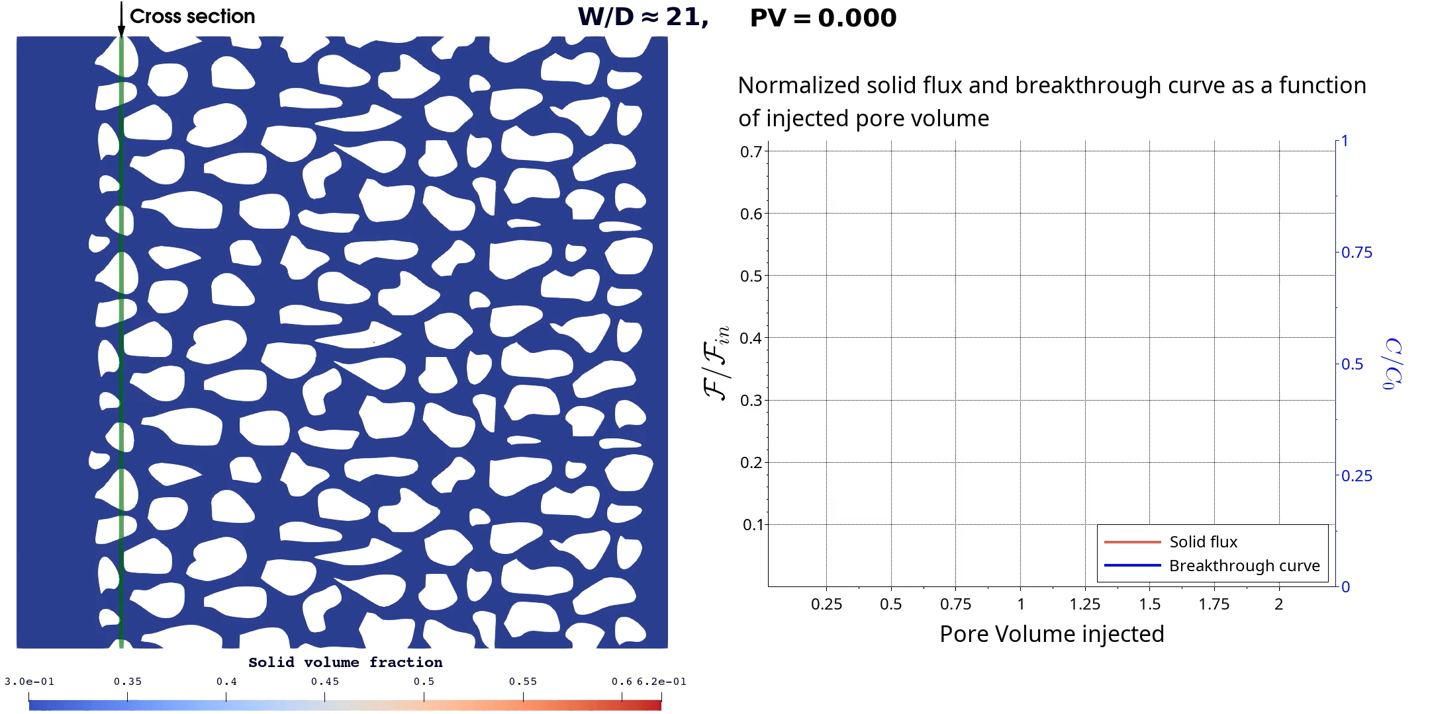
Clogging in a complex geometry
InterPore 2026 Meeting
Mechanical behavior of dense suspensions in porous media: A pore-scale model
May 21, 2026
14

Slide 15
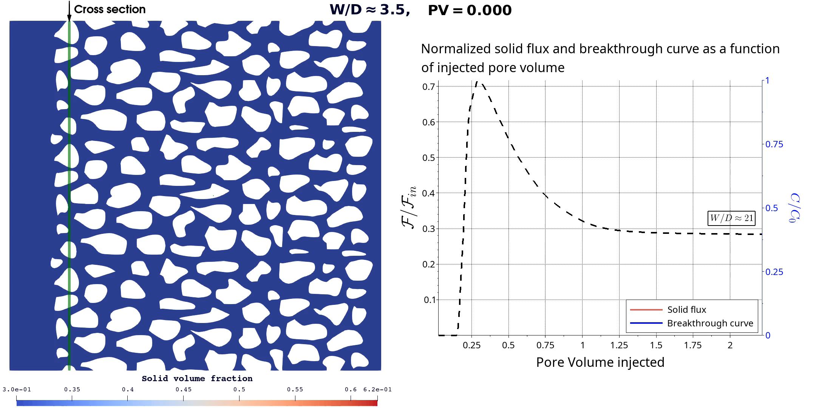
Clogging in a complex geometry
InterPore 2026 Meeting
Mechanical behavior of dense suspensions in porous media: A pore-scale model
May 21, 2026
15

Slide 16
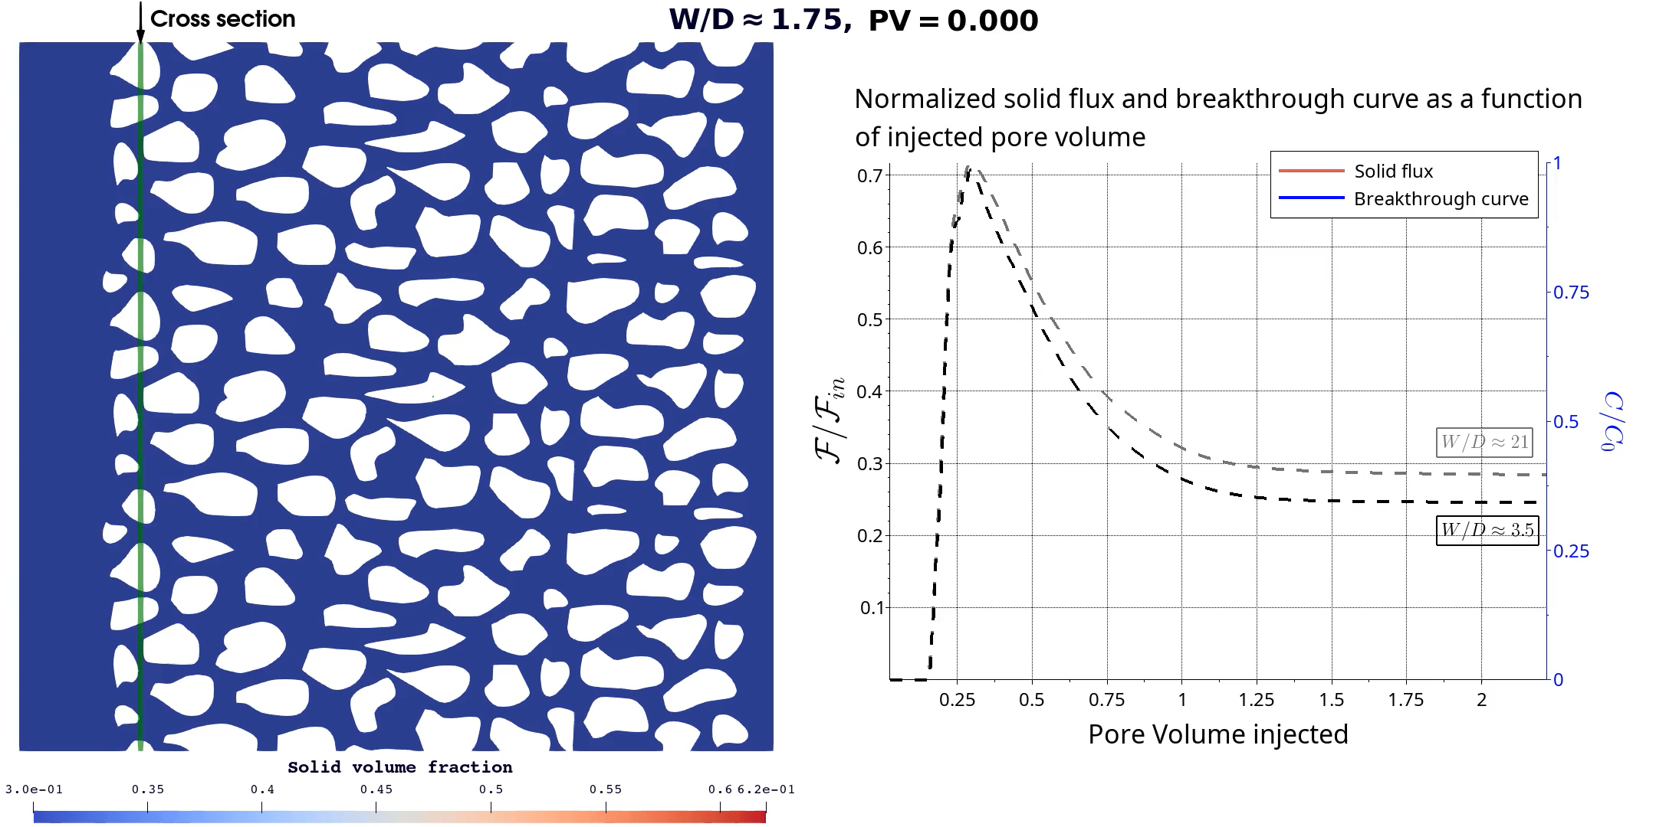
Clogging in a complex geometry
InterPore 2026 Meeting
Mechanical behavior of dense suspensions in porous media: A pore-scale model
May 21, 2026
16

Slide 17
Conclusion
A pore-scale Euler-Euler model developed to simulate the transport and retention of dense suspensions
Considering proper rheology for dense suspension according Boyer et al.
Ability of simulating clogging by sieving or bridging in constricted channel and complex geometry (test done on over 120 simulations)
Perspectives: Adapt the model to dilute suspensions by considering other rheological models. Add clogging by aggregation in the model.
InterPore 2026 Meeting
Mechanical behavior of dense suspensions in porous media: A pore-scale model
May 21, 2026
17

Slide 18


Acknowledgement
We would like to acknowledge European Union for funding this project
(ERC COCONUT n°101043288)
nassim.cheikh@cnrs-orleans.fr
InterPore 2026 Meeting
Mechanical behavior of dense suspensions in porous media: A pore-scale model
May 21, 2026
18

Slide 19
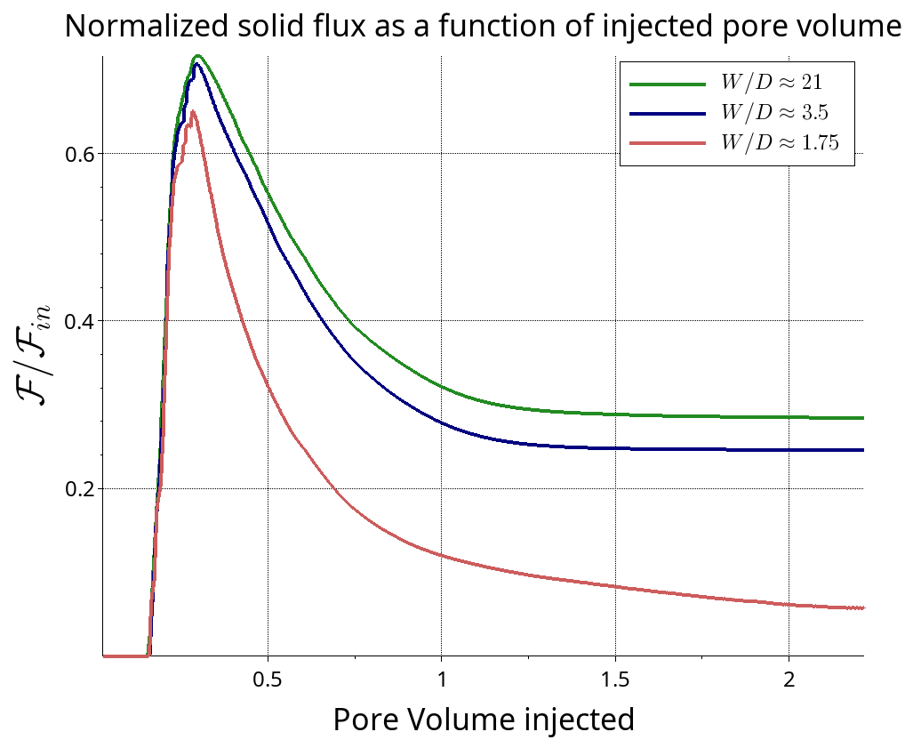
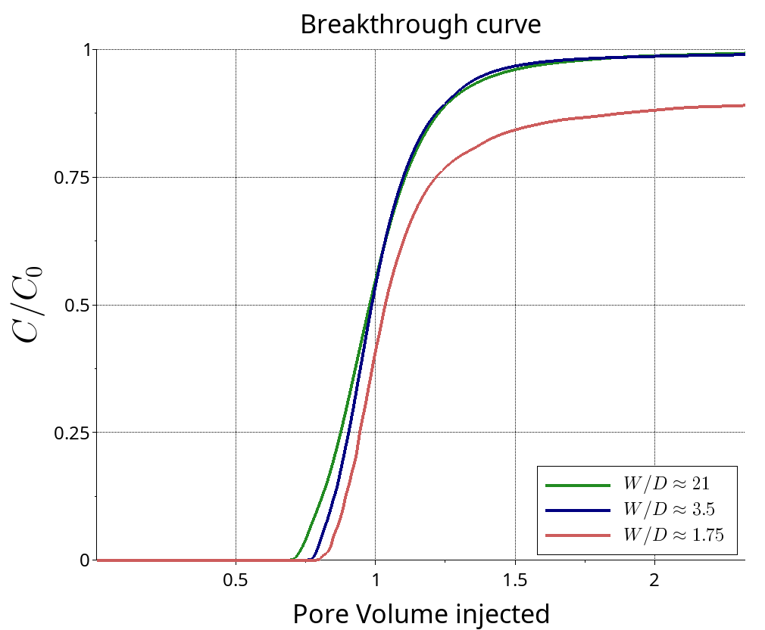
Clogging in a complex geometry
InterPore 2026 Meeting
Mechanical behavior of dense suspensions in porous media: A pore-scale model
May 21, 2026
19

Slide 20
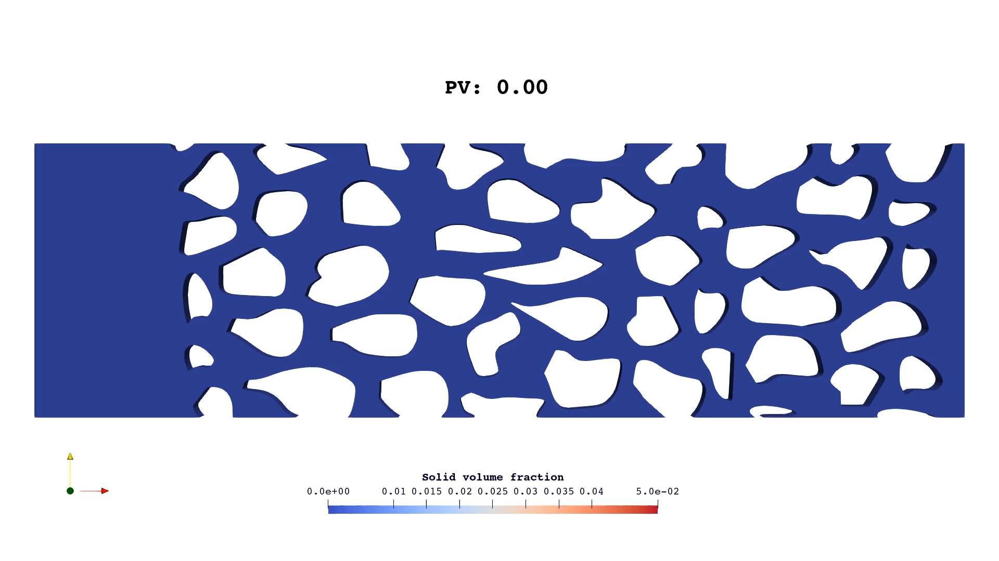
Permeability reduction test
InterPore 2026 Meeting
Mechanical behavior of dense suspensions in porous media: A pore-scale model
May 21, 2026
20

Slide 21
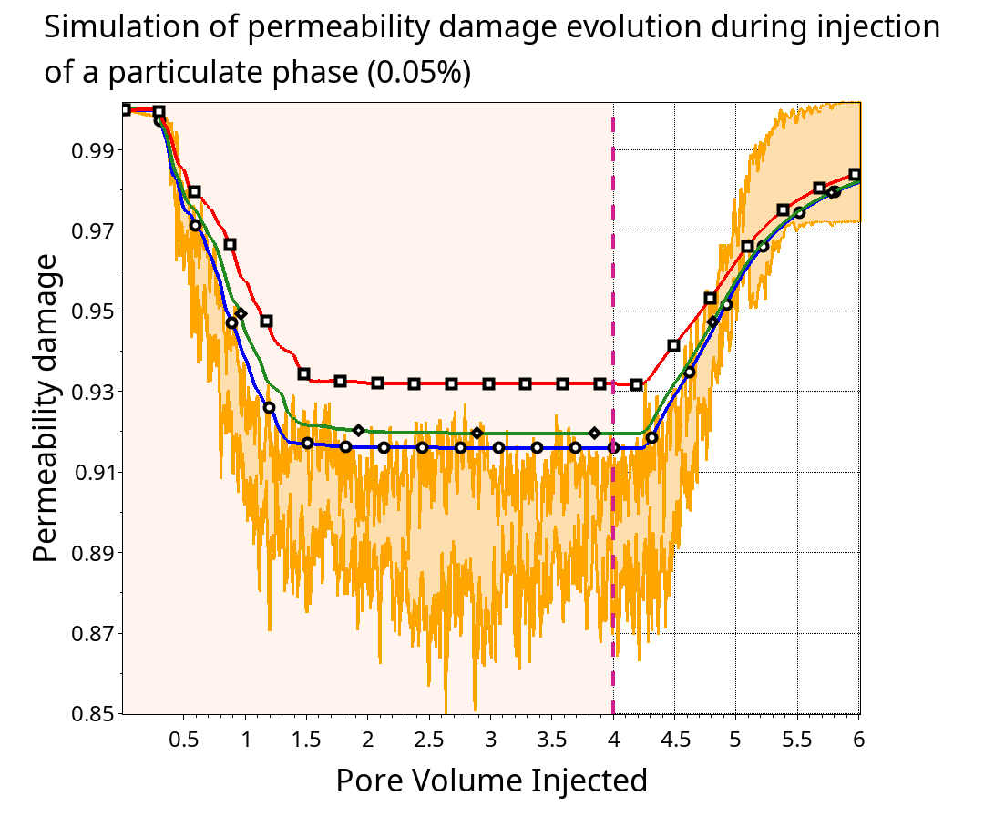
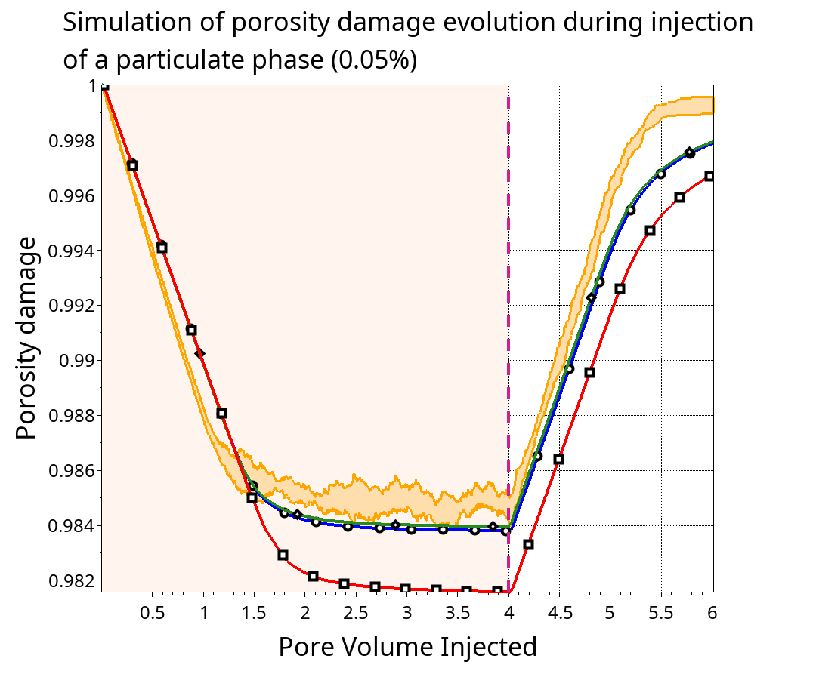
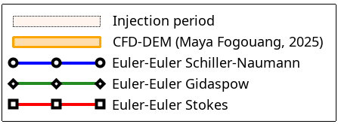
Permeability reduction test
InterPore 2026 Meeting
Mechanical behavior of dense suspensions in porous media: A pore-scale model
May 21, 2026
21

Slide 22
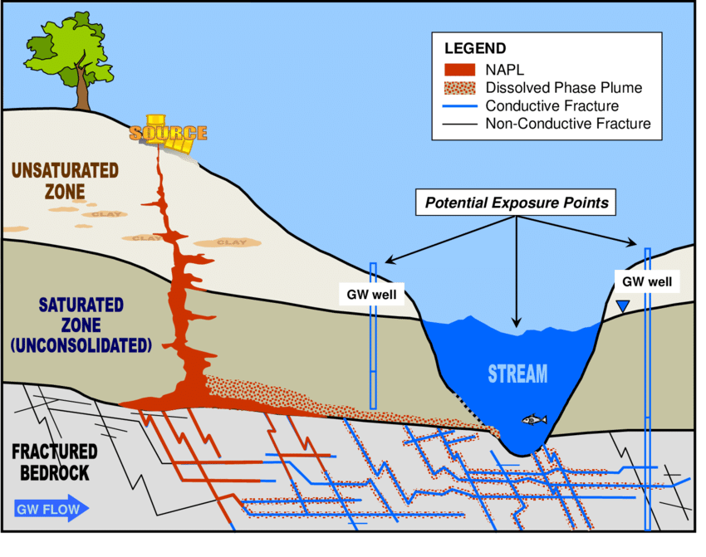
Context - NAPL pollution
Non-aqueous phase liquids (NAPL) : water-immiscible pollutants
Two types : Light NAPL and Dense NAPL
Long-term source of pollution
Trapping of NAPL droplets by capillarity
Generalized Conceptual Site Model (CSM) with Nonaqueous Phase Liquid (NAPL) Release into the Subsurface (Ford et al., 2014)
InterPore 2026 Meeting
Mechanical behavior of dense suspensions in porous media: A pore-scale model
May 21, 2026
22

Slide 23
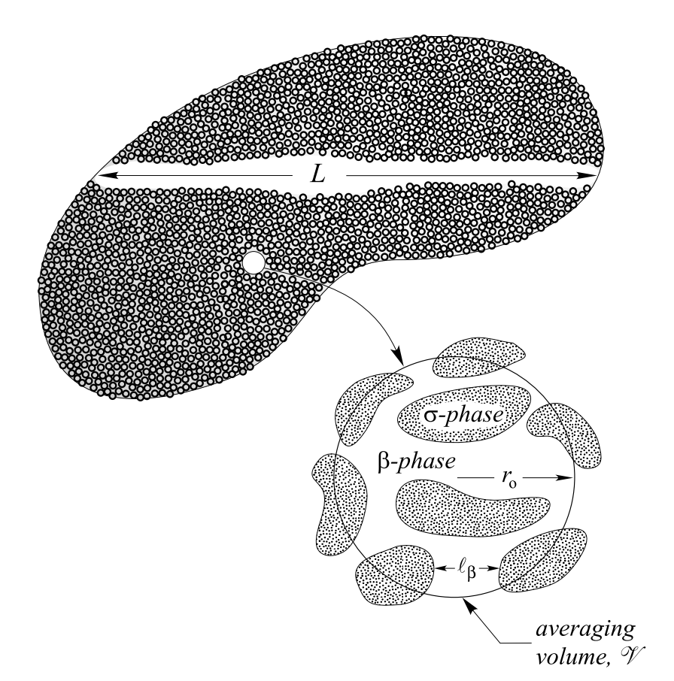
Volume Averaging Method
Intrinsic average
Superficial average
Macroscopic region and local averaging volume (Whitaker, 1997)
Note that :
InterPore 2026 Meeting
Mechanical behavior of dense suspensions in porous media: A pore-scale model
May 21, 2026
23

