Slide 1

Improved Invasion Percolation Algorithm with Trapping for Pore Network Modeling
Homam Khatirzad Baboli¹, Hans Janssen², Stefan Vandewalle¹
¹ Department of Computer Science, Numerical Analysis and Applied Mathematics
² Department of Civil Engineering, Building Physics and Sustainable Design

Slide 2
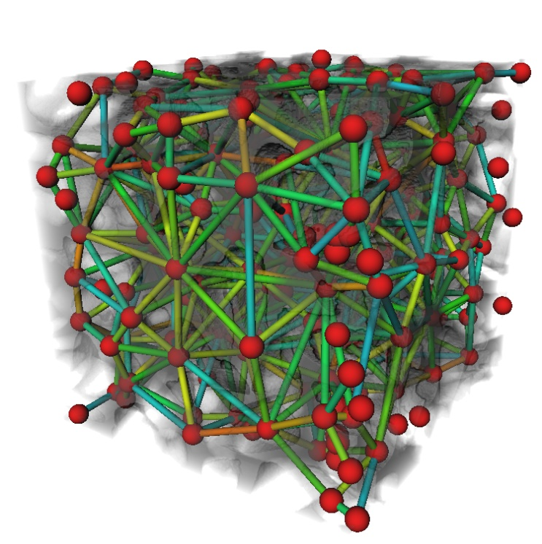
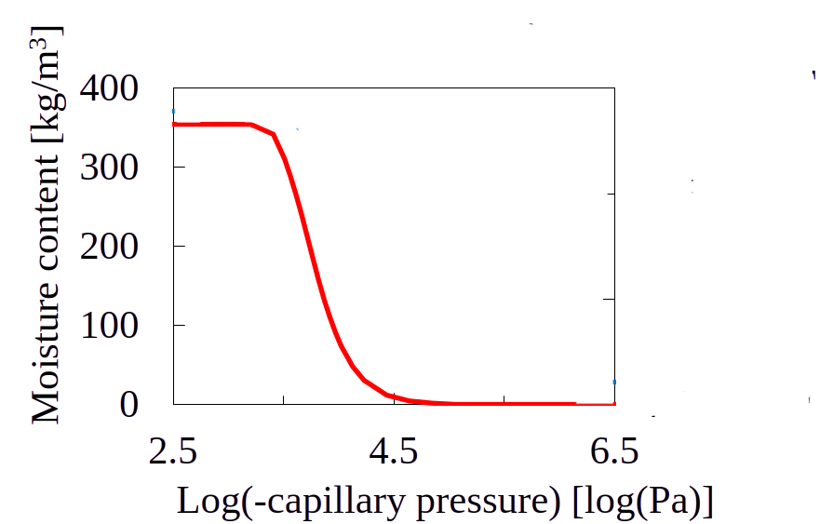
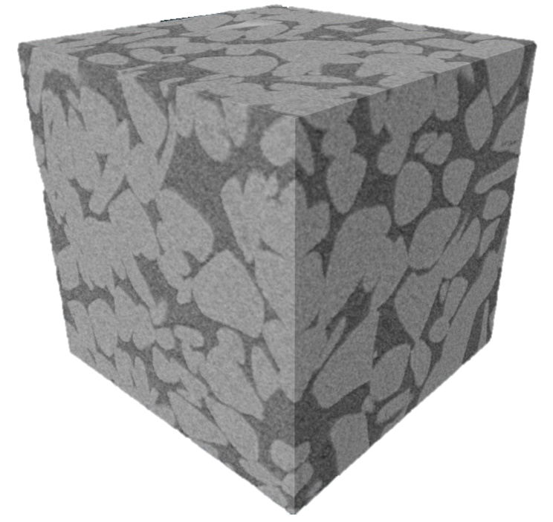
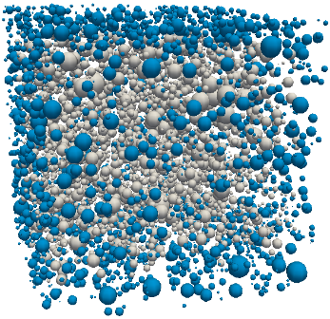
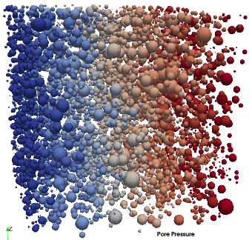
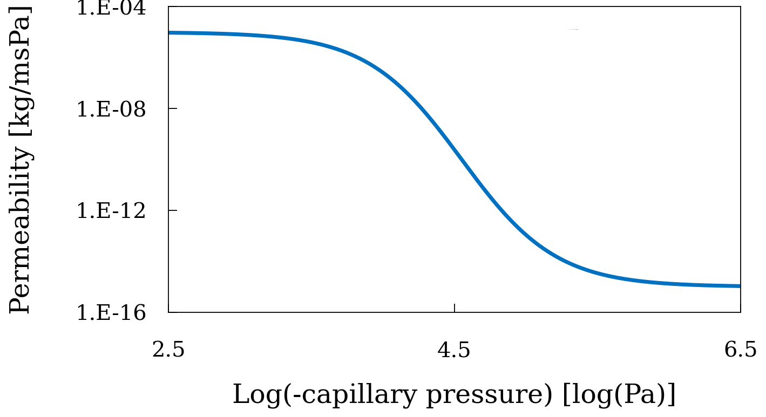
Introduction: pore network modeling (PNM)
Objective: Using static PNM to study hygric properties of building materials
XCT 3D imaging
Pore network extraction
Invasion simulation
Moisture content calculation
Permeability simulation
Permeability calculation

Slide 3
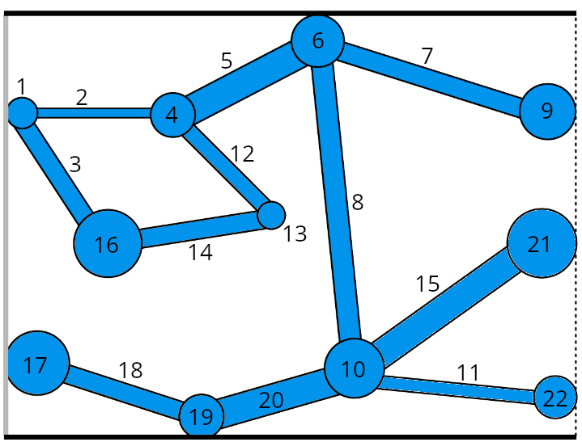
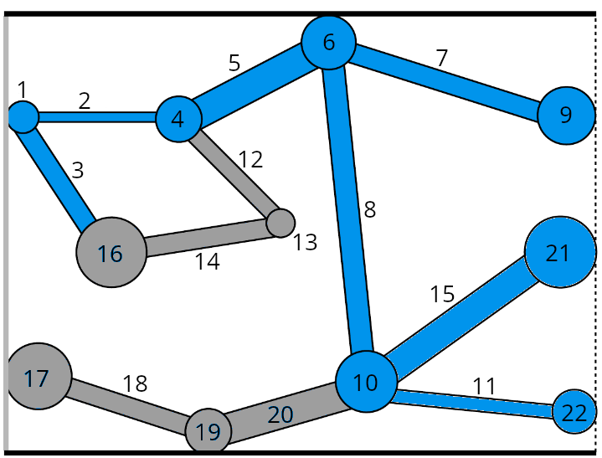
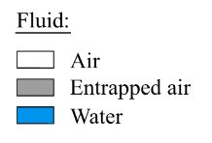
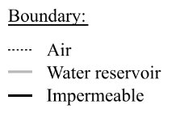
Introduction: invasion percolation with trapping
Trapped pores: disconnected from air pathway
Invasion: through the lowest entry pressure path
Inlet
Outlet
Step 1: Fully saturated network
Step 2: Identifying the trapped pores

Slide 4
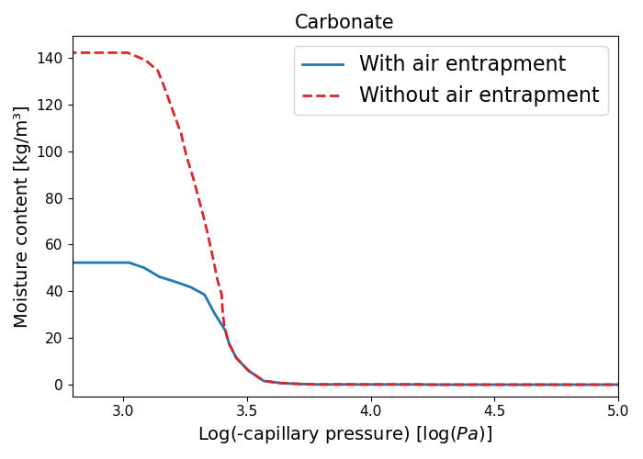
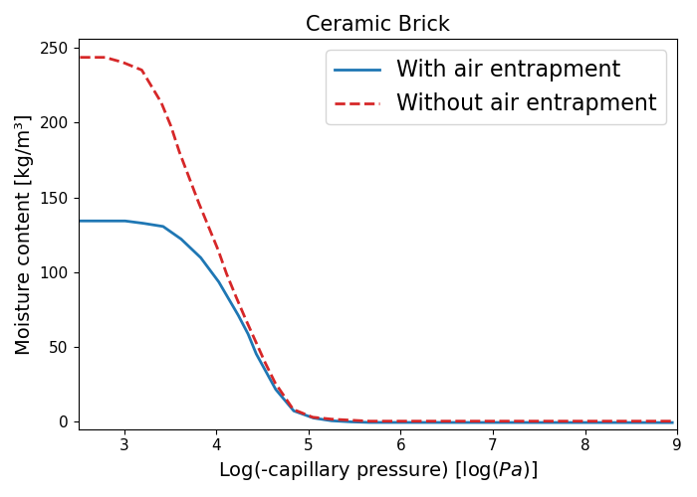
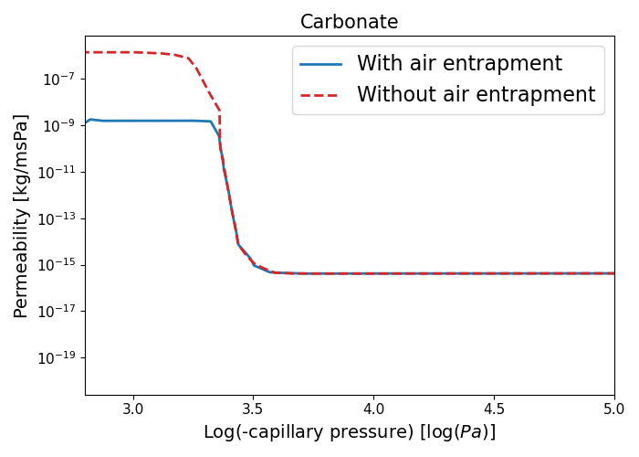
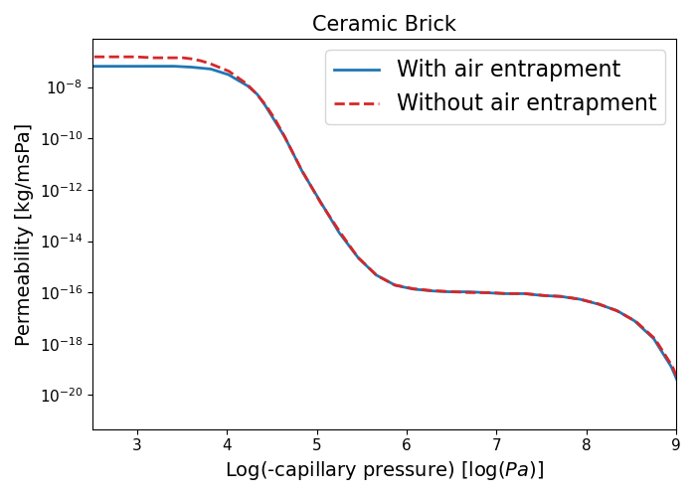
Introduction: importance of trapping
Trapping affects network properties.
Computationally expensive
 | Runtime
Invasion without Trapping | 42 min
Invasion with Trapping | 7 hours
# Pore bodies: ~190K
# Pore throats: ~250K
Trapping: 90% of IP

Slide 5
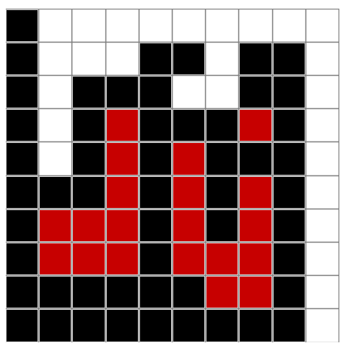
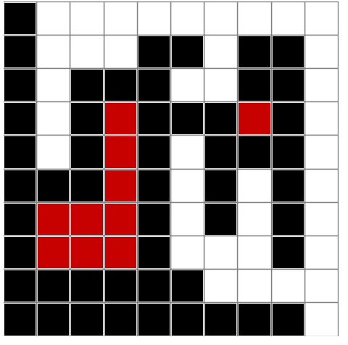
Methodology: classical trapping
Classical trapping algorithm:
Start from the first invaded pore
Check the entire network for the outlet connectivity
Trapped pore → no outlet path exists
Disadvantage:
Going through entire network in each iteration
O(M.N)
Impermeable
Invaded
Trapped
Inlet
Outlet
Connected to outlet
Impermeable
Invasion step: i
Invasion step: i+1
Invasion step: i+2

Slide 6
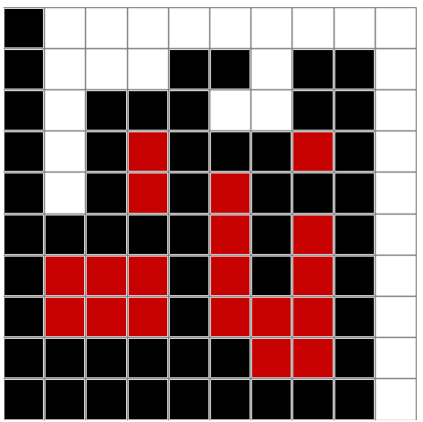
Methodology: backward trapping
Impermeable
Invaded
Trapped
Inlet
Outlet
Connected to outlet
Impermeable
Invasion step: j
Invasion step: j-1
Invasion step: j-2
Benefits:
Avoid full network searches
Check local neighbors' connectivity
O(M.N) → O(N)
Masson, Y. (2016). A fast two-step algorithm for invasion percolation with trapping. Computers & Geosciences.

Slide 7
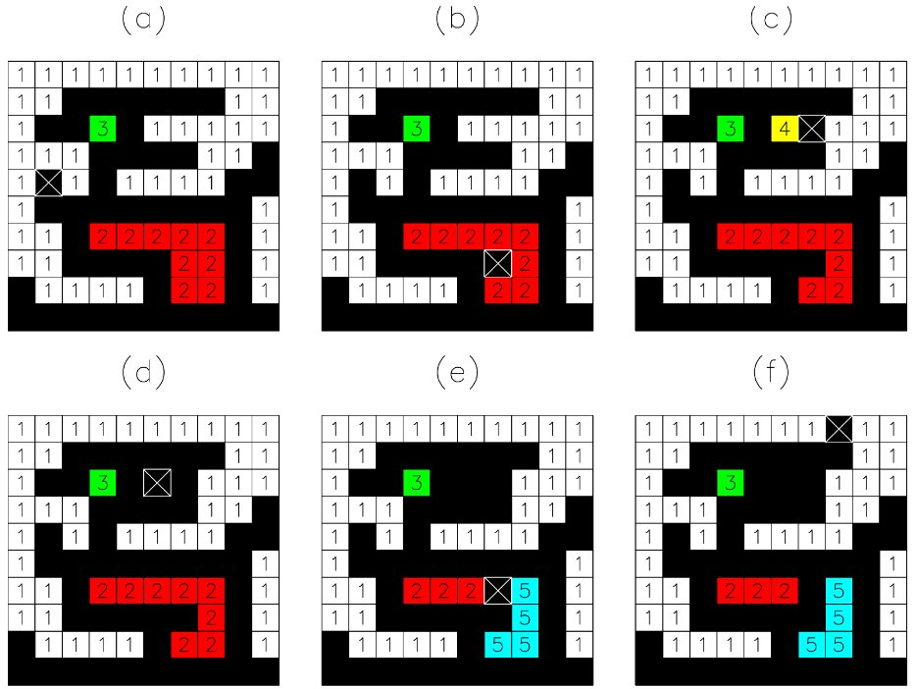
Methodology: trapping algorithm
Algorithm customization:
Masson (2016)​
This work
Pore trapping
Pore body + throat trapping
Structured lattice
Unstructured network
Separated invasion
Simultaneous invasion

Slide 8
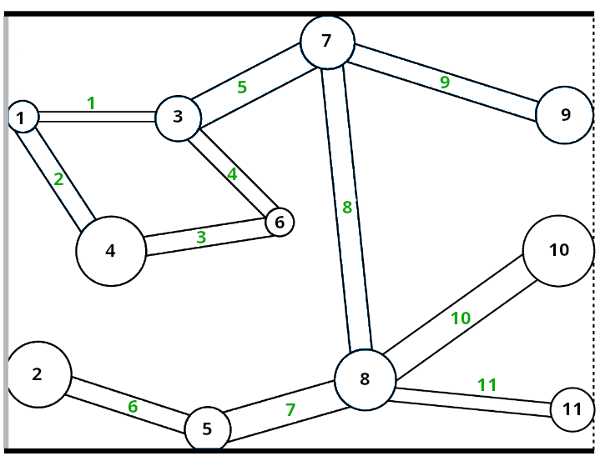
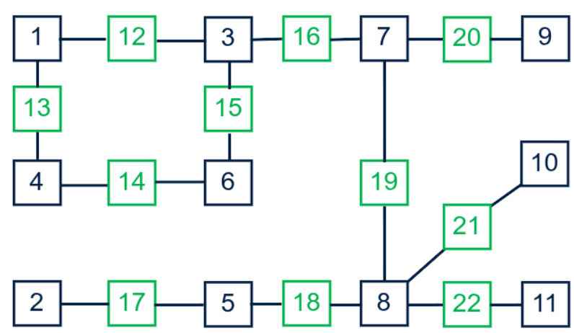
Methodology: implementation
Pore network
Node-based network

Slide 9
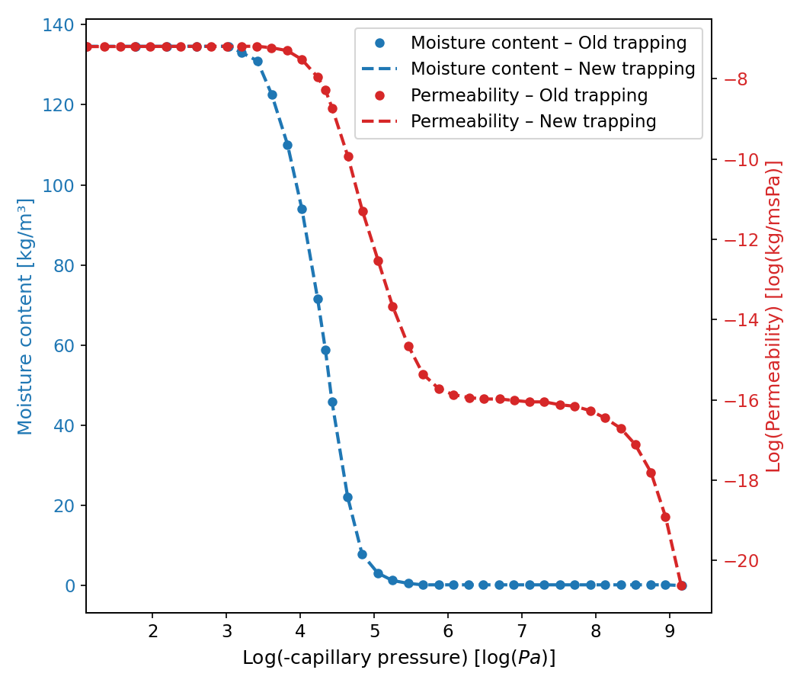
Results: moisture content and permeability
Network size | Runtime (old algorithm) | Runtime (new algorithm) | Efficiency
# Pore bodies: ~72K # Pore throats: ~78K | ~ 25 min | 4 sec | 99.7%

Slide 10
Results: moisture content and permeability
Network size | Runtime (old algorithm) | Runtime (new algorithm) | Efficiency
# Pore bodies: ~72K # Pore throats: ~78K | ~ 25 min | 4 sec | 99.7%
# Pore bodies: ~132K # Pore throats: ~114K | ~ 44 min | 5 sec | 99.8%

Slide 11
Results: moisture content and permeability
Network size | Runtime (old algorithm) | Runtime (new algorithm) | Efficiency
# Pore bodies: ~72K # Pore throats: ~78K | ~ 25 min | 4 sec | 99.7%
# Pore bodies: ~132K # Pore throats: ~114K | ~ 44 min | 5 sec | 99.8%
# Pore bodies: ~190K # Pore throats: ~250K | ~ 5 h | 22 sec | 99.9%

Slide 12
Results: moisture content and permeability
Network size | Runtime (old algorithm) | Runtime (new algorithm) | Efficiency
# Pore bodies: ~72K # Pore throats: ~78K | ~ 25 min | 4 sec | 99.7%
# Pore bodies: ~132K # Pore throats: ~114K | ~ 44 min | 5 sec | 99.8%
# Pore bodies: ~190K # Pore throats: ~250K | ~ 5 h | 22 sec | 99.9%
# Pore bodies: ~260K # Pore throats: ~330K | ~ 11 h | 44 secs | 99.9%

Slide 13
Conclusion
Trapping in a PN is important in obtaining accurate result.
The classical trapping, is not efficient.
The backward algorithm only checks the neighbors.
A backward trapping algorithm is applied which resulted in >99% runtime reduction.

Slide 14

Thank you for your attention!

