Slide 1

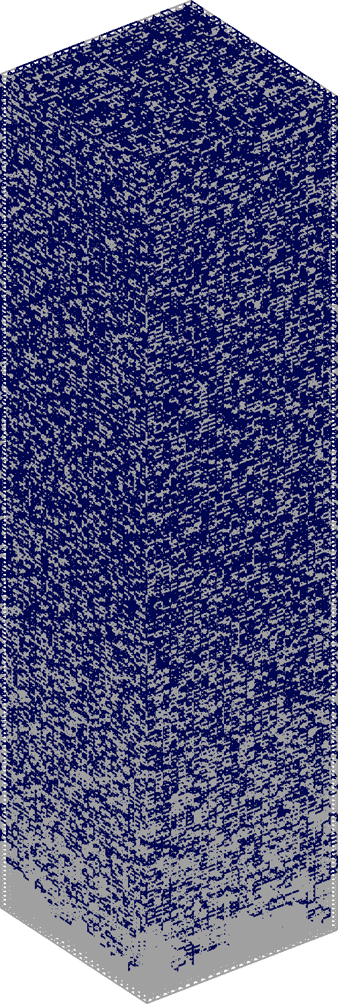
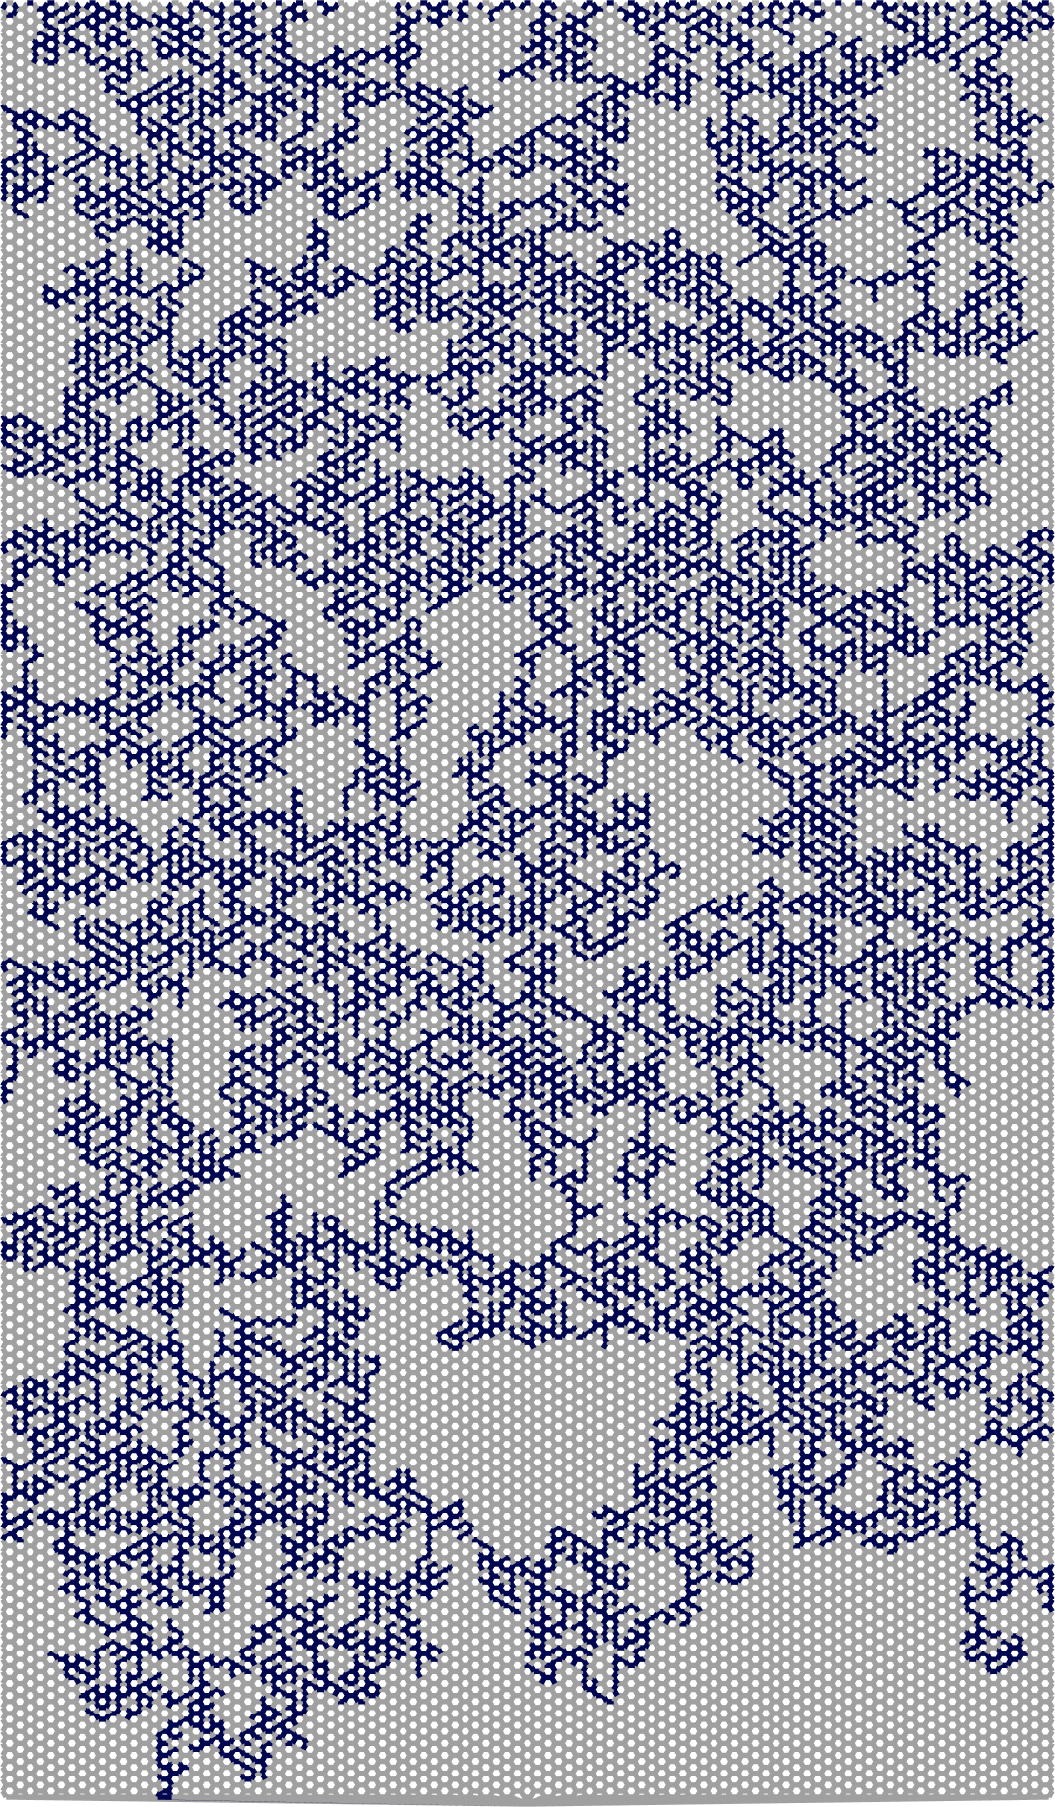


A Theoretical Model for Stable Drainage Fronts in 3D Porous Media
Paula Reis
Knut Jørgen Måløy
Can we theoretically predict 3D front characteristics
similarly to what is done in 2D?

Slide 2
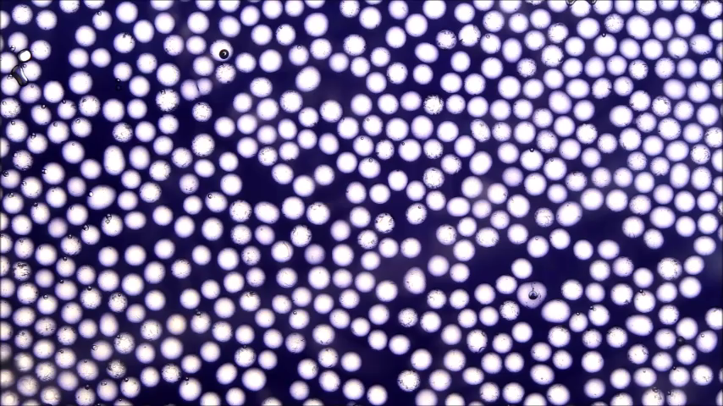
Drainage in porous media
Wetting fluid displaced by a non-wetting fluid
  Hele-Shaw cell filled with a layer of glass beads
  Water (dyed black) displaced by air

Slide 3
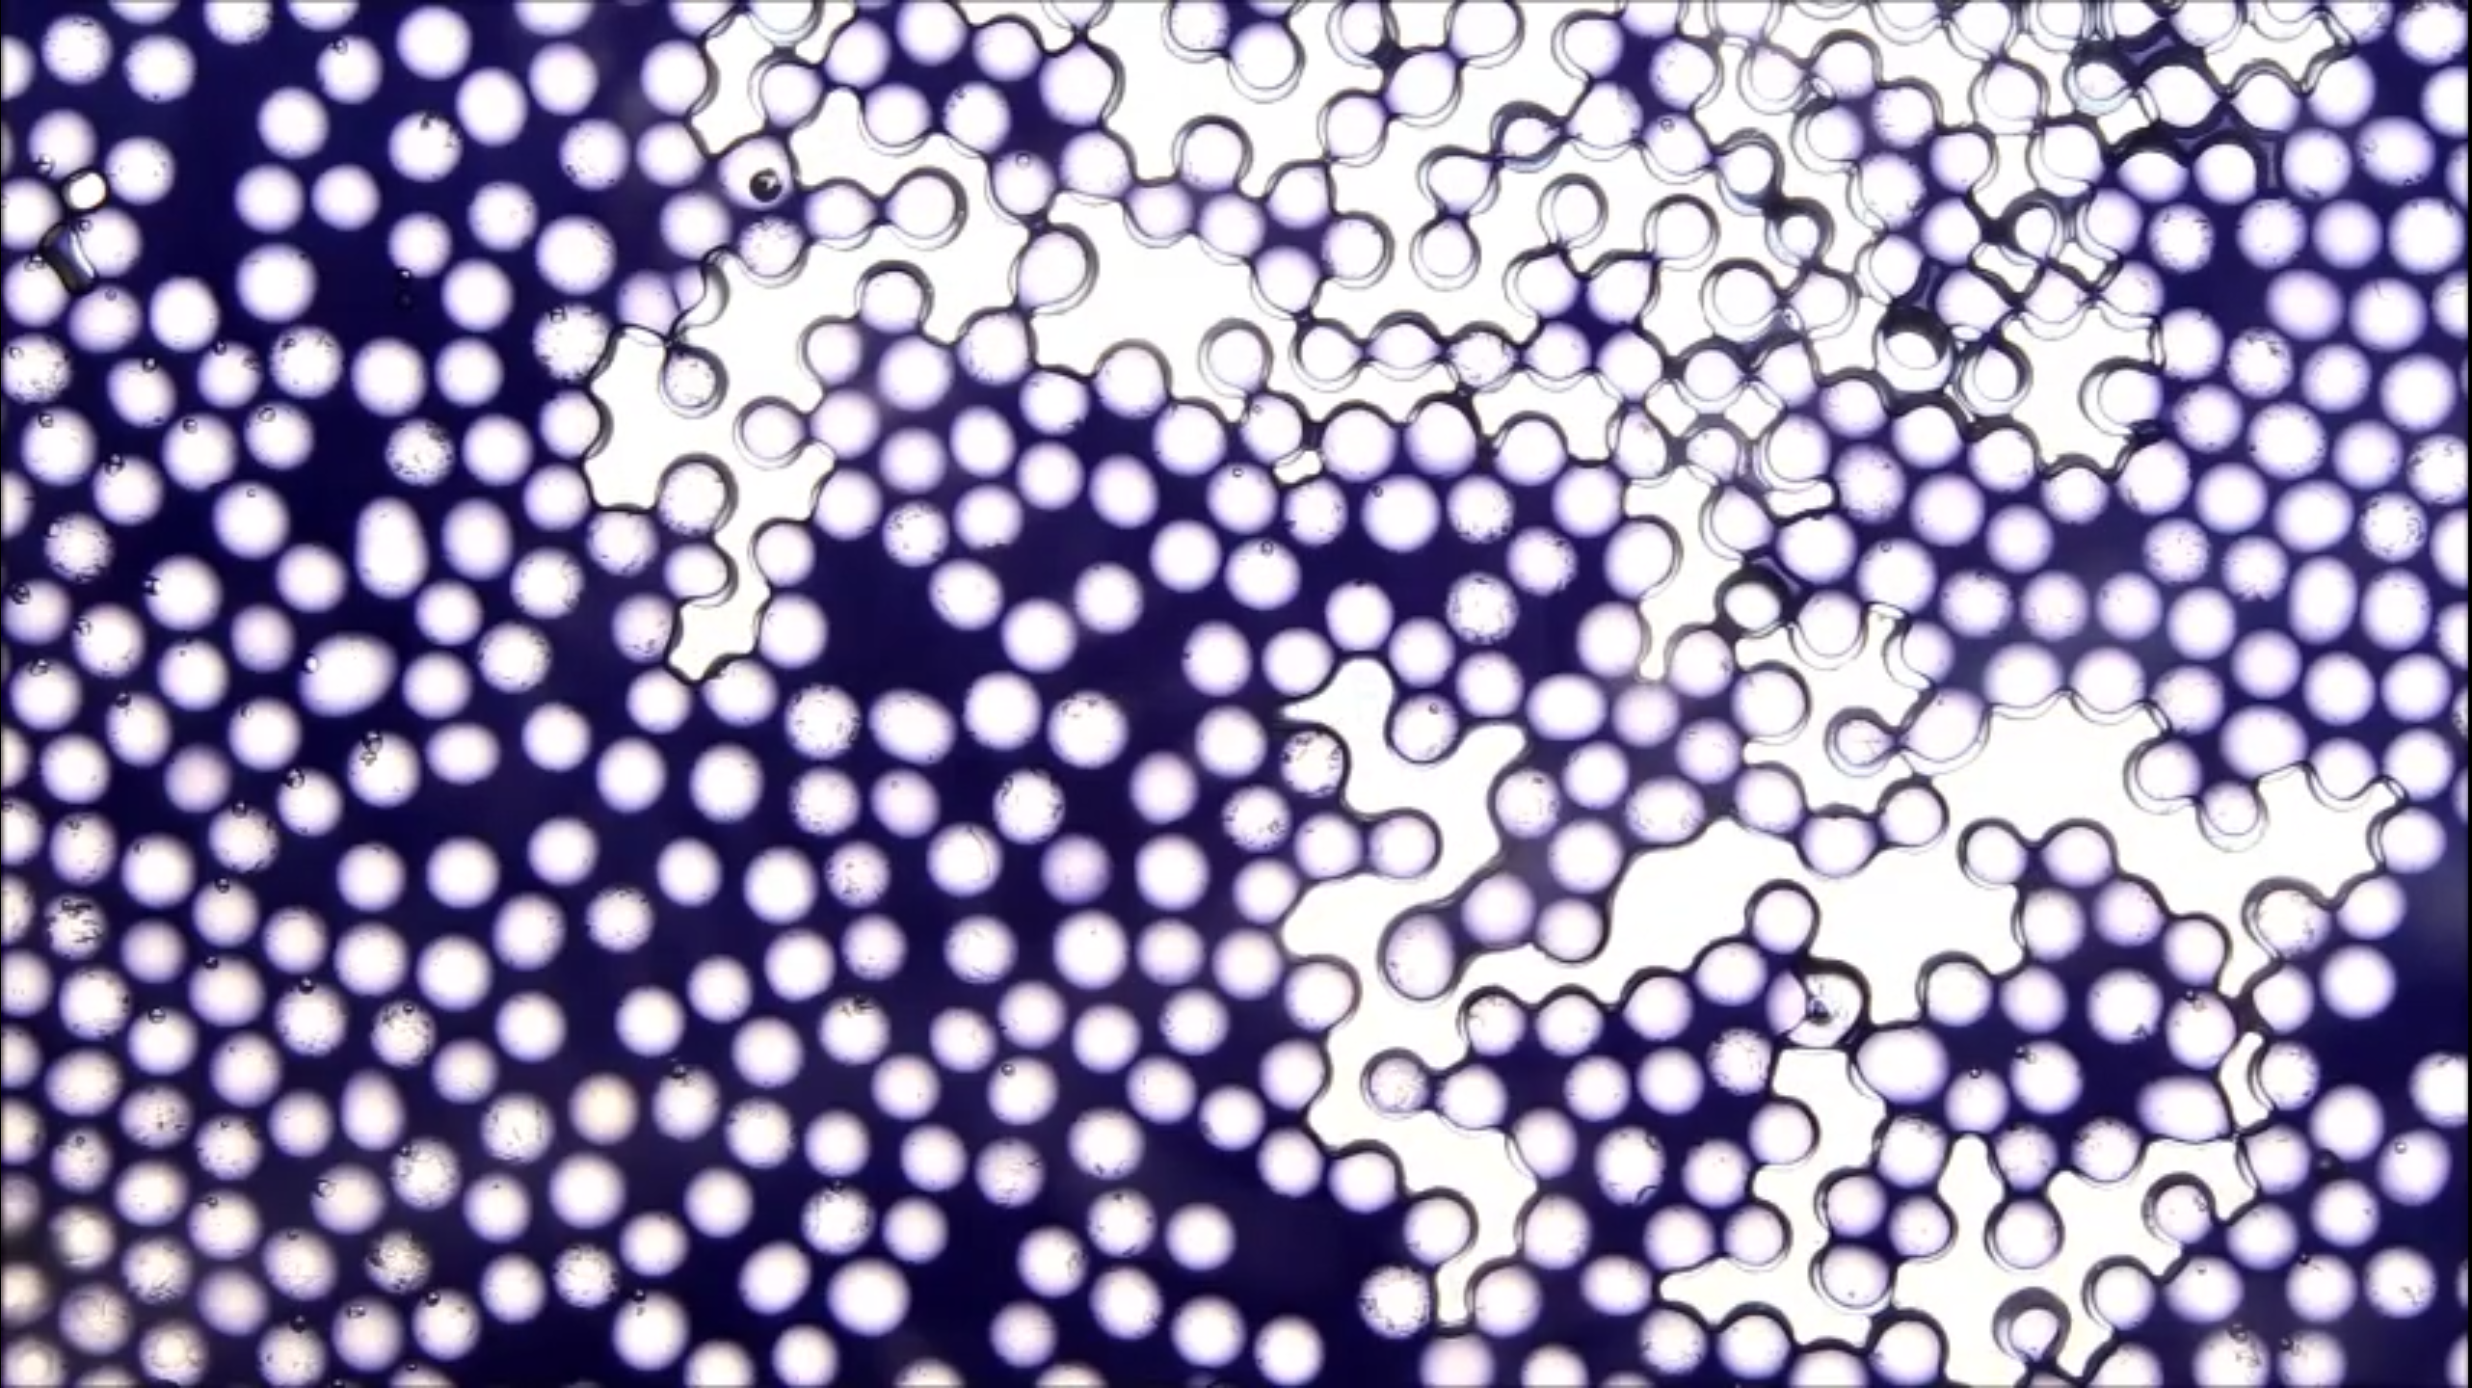

Slide 4
Drainage Front

Slide 5
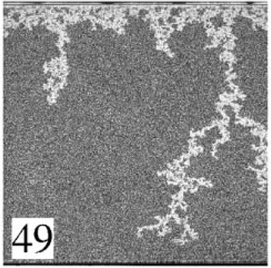
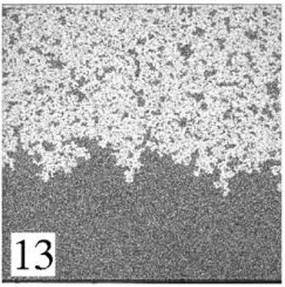

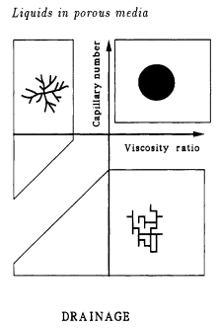

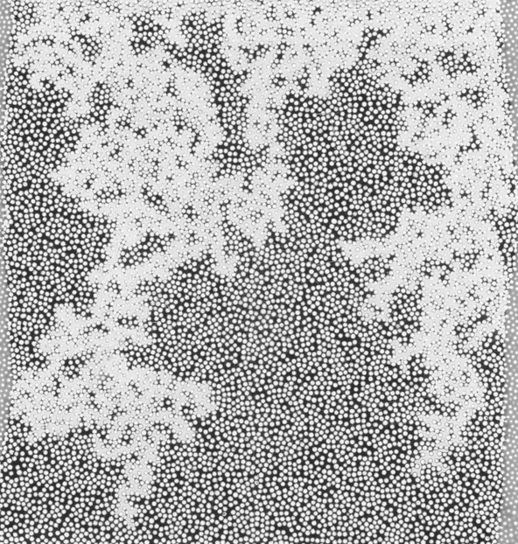
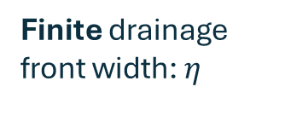

Drainage Patterns
Viscous Fingering
Stable Displacement
Also gravity-dominated flows
$$η$$
Finite drainage front width: $η$
Drainage Front
Méheust et al., PRE 2002
Méheust et al., PRE 2002
Capillary Fingering
Fingers grow unbounded
Lenormand, J. Phys.: Condens. Matter 1990
Marcel Moura, FlowConn Project

Slide 6


Stable Drainage
Why is the front width finite?
air
$$\vec{g}$$
$$η$$
water
Méheust et al., PRE 2002

Slide 7



Stable Drainage
Why is the front width finite?
How to predict the finite width?
$$1)↑∇P_{c} : ↓η$$
air
$$\vec{g}$$
$2)$ Porous medium structure and interface interactions
Easier to drain here
$$∇P_{c}$$
$$η$$
than here
water
Méheust et al., PRE 2002
Water pressure
$$P_{c}=P_{air}−P_{water}$$
Capillary pressure

Slide 8
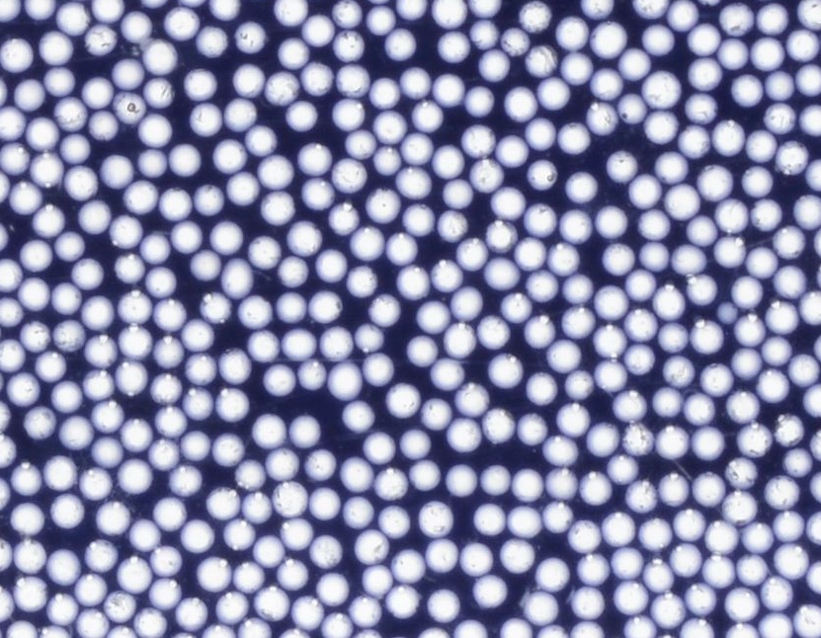




Stable Drainage
How to predict the finite width?
$$1)↑∇P_{c} : ↓η$$
air
$$\vec{g}$$
$2)$ Porous medium structure and interface interactions
$a)$Capillary pressure threshold distribution
$$P_{t}=P_{t}\left(γ,θ,r\right)$$
$$N\left(P_{t}\right)$$
$$∇P_{c}$$
$$η$$
$$P_{t}$$
water
Méheust et al., PRE 2002
Water pressure
$$P_{c}=P_{air}−P_{water}$$
Capillary pressure

Slide 9

Stable Drainage
How to predict the finite width?
$$1)↑∇P_{c} : ↓η$$
air
$$\vec{g}$$
$2)$ Porous medium structure and interface interactions
$a)$Capillary pressure threshold distribution
$$P_{t}=P_{t}\left(γ,θ,r\right)$$
$b)$Pore connectivity
$$N\left(P_{t}\right)$$
$$∇P_{c}$$
$$η$$
$$P_{t}$$
Pore network: network of sites (pores) connected by bonds (pore throats)
water
Méheust et al., PRE 2002
Percolation Theory
Water pressure
$$P_{c}=P_{air}−P_{water}$$
Capillary pressure

Slide 10
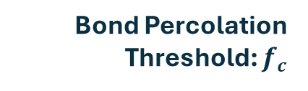



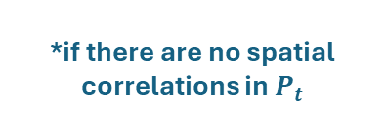
Stable Drainage
How to predict the finite width?
$$1)↑∇P_{c} : ↓η$$
air
$$\vec{g}$$
$2)$ Porous medium structure and interface interactions
$a)$Capillary pressure threshold distribution
$$P_{t}=P_{t}\left(γ,θ,r\right)$$
$b)$Pore connectivity
$$f_{c}=\int_{0}^{P_{c}^{crit}}{N\left(P_{t}\right)}{dP}_{t}$$
Bond Percolation Threshold: $f_{c}$
$$N\left(P_{t}\right)$$
$$f_{c}$$
$$∇P_{c}$$
$$η$$
$$P_{c}^{crit}$$
$$P_{t}$$
Minimum capillary pressure to percolate the porous medium
Pore network: network of sites (pores) connected by bonds (pore throats)
water
Méheust et al., PRE 2002
Percolation Theory
Water pressure
$$P_{c}=P_{air}−P_{water}$$
*if there are no spatial correlations in $P_{t}$
Capillary pressure

Slide 11


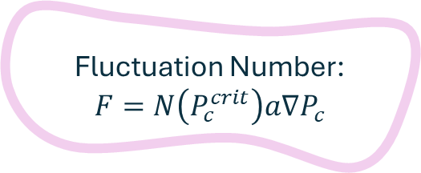

Stable Drainage
How to predict the finite width?
$$1)↑∇P_{c} : ↓η$$
air
$$\vec{g}$$
$2)$ Porous medium structure and interface interactions
$a)$Capillary pressure threshold distribution
$$P_{t}=P_{t}\left(γ,θ,r\right)$$
$b)$Pore connectivity
$$f_{c}=\int_{0}^{P_{c}^{crit}}{N\left(P_{t}\right)}{dP}_{t}$$
Bond Percolation Threshold: $f_{c}$
$$N\left(P_{t}\right)$$
$$f_{c}$$
$$∇P_{c}$$
$$η$$
$$P_{c}^{crit}$$
$$P_{t}$$
Fluctuation Number:
$$F=N\left(P_{c}^{crit}\right)a∇P_{c}$$
Pore network: network of sites (pores) connected by bonds (pore throats)
water
Méheust et al., PRE 2002
Percolation Theory
Auradou et al., PRE 1999
Water pressure
$$P_{c}=P_{air}−P_{water}$$
Capillary pressure

Slide 12

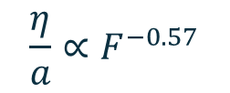


Stable Drainage
How to predict the finite width?
Well-stablished scaling law for 2D stable drainage fronts in porous media:
air
$$\vec{g}$$
The front is in a critical region – occupation near the percolation threshold – with width:
$$\frac{η}{a}∝F^{−ν/{1+ν}}$$
$$∇P_{c}$$
$$η$$
Critical exponent for the correlation length in 2D: $4/3$
$$\frac{η}{a}∝F^{−0.57}$$
Fluctuation Number:
$$F=N\left(P_{c}^{crit}\right)a∇P_{c}$$
Bond Percolation Threshold: $f_{c}$
water
Méheust et al., PRE 2002
Percolation Theory
Auradou et al., PRE 1999
Water pressure
$$P_{c}=P_{air}−P_{water}$$
Capillary pressure

Slide 13
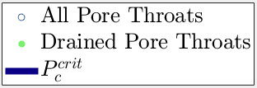
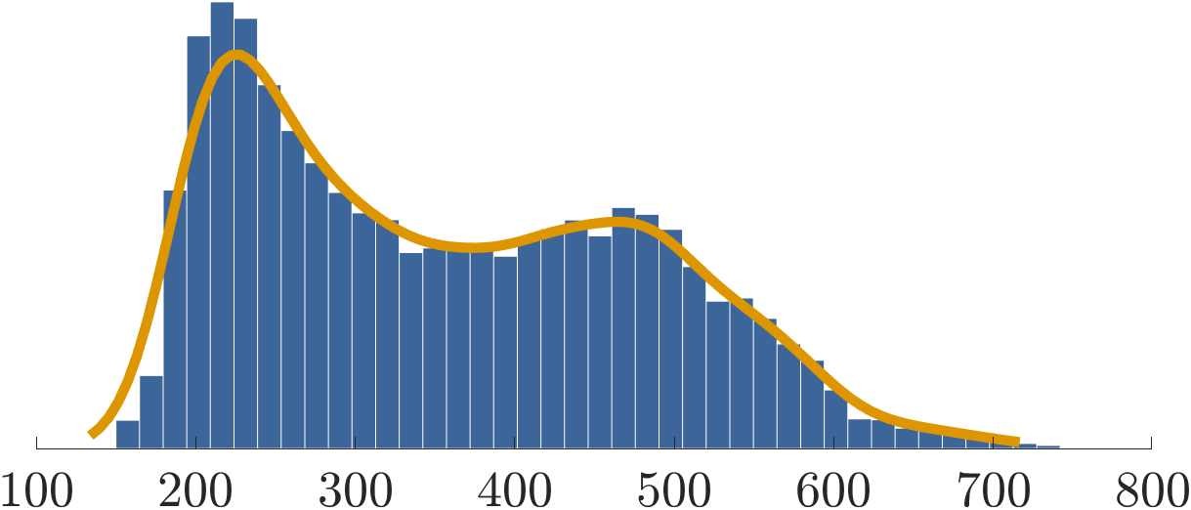


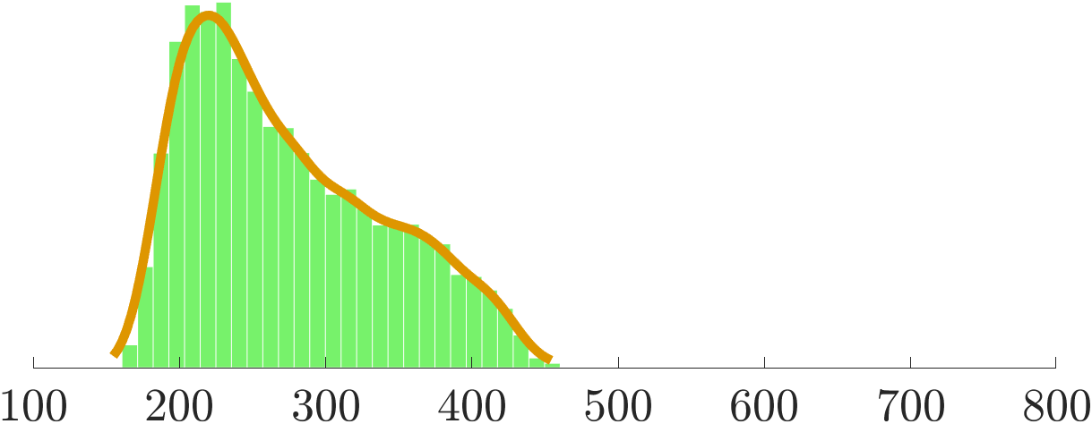
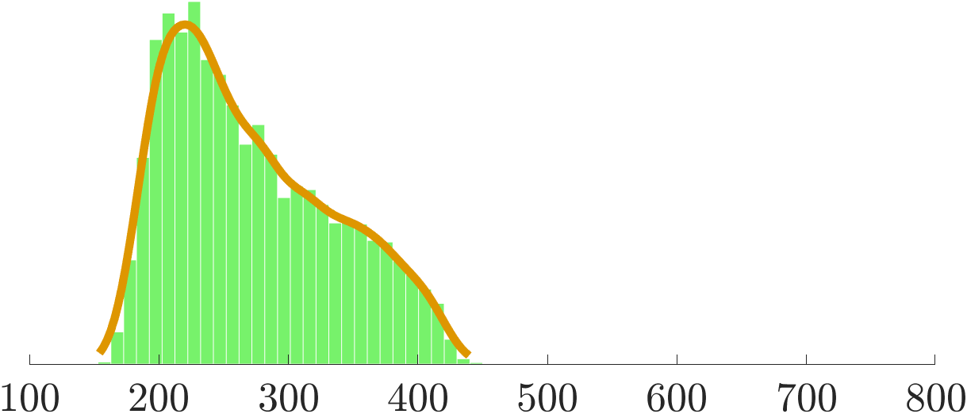
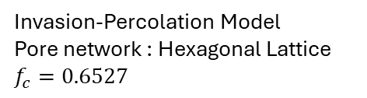






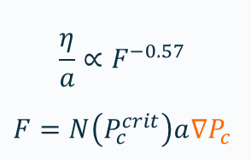


Stable Drainage in 2D
$$\frac{η}{a}∝F^{−0.57}$$
$$F=N\left(P_{c}^{crit}\right)a∇P_{c}$$
Invasion-Percolation Model
Pore network : Hexagonal Lattice
$$f_{c}=0.6527$$
$$∇P_{c}≈850 Pa/m$$
$$Histogram of P_{t}$$
$$∇P_{c}≈215 Pa/m$$
Non-wetting phase: lighter
0.6527
Non-wetting phase: lighter
Drainage Front
$$P_{c}^{crit}$$
Drainage Front
$$\vec{g}$$
$$\vec{g}$$
$$[Pa]$$
$$[Pa]$$
$$[Pa]$$
Wetting phase: heavier
Wetting phase: heavier

Slide 14
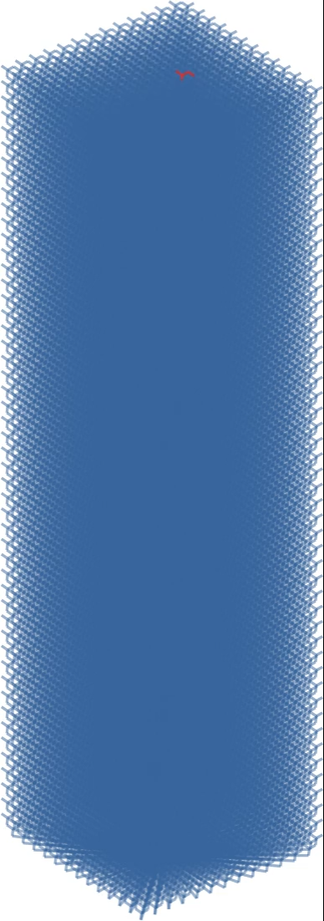
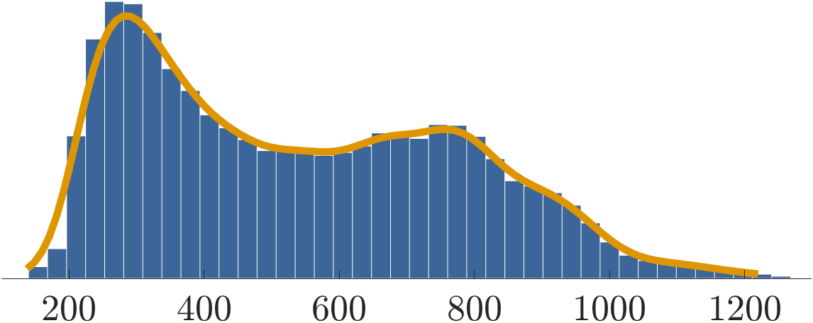
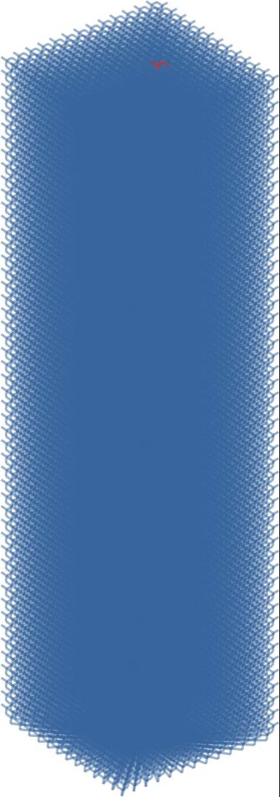
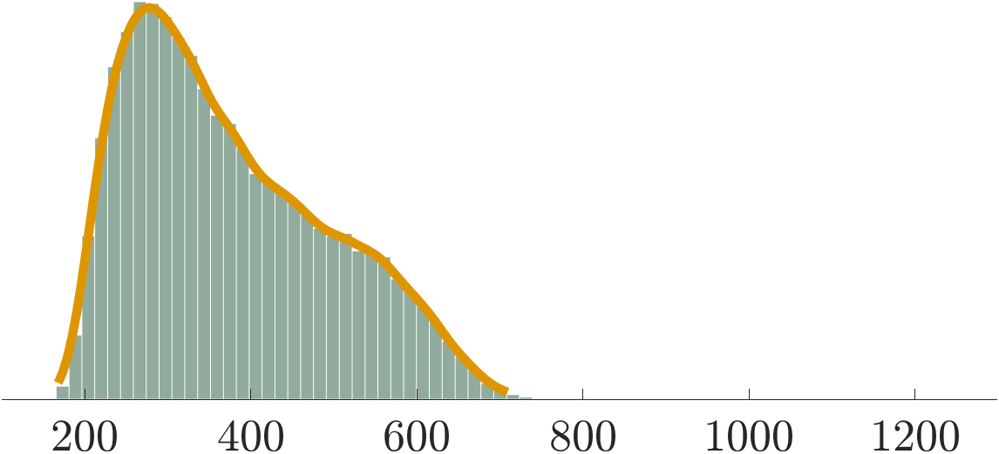
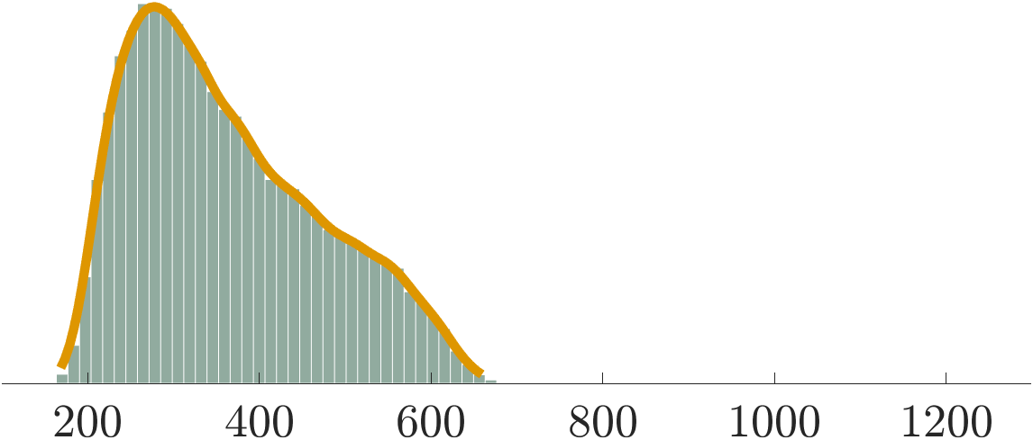
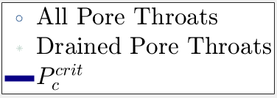






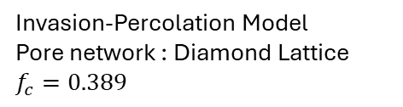

Stable Drainage in 3D
$$\frac{η}{a}∝F^{−ν/{1+ν}}$$
$$F=N\left(P_{c}^{crit}\right)a∇P_{c}$$
Invasion-Percolation Model
Pore network : Diamond Lattice
$$f_{c}=0.389$$
$$Histogram of P_{t}$$
Non-wetting phase: lighter
Non-wetting phase: lighter
Drainage Front
Drainage Front
0.389
$$P_{c}^{crit}$$
$$\vec{g}$$
$$\vec{g}$$
$$[Pa]$$
$$∇P_{c}≈2000 Pa/m$$
$$∇P_{c}≈700 Pa/m$$
$$[Pa]$$
$$[Pa]$$
Wetting phase: heavier
Wetting phase: heavier

Slide 15
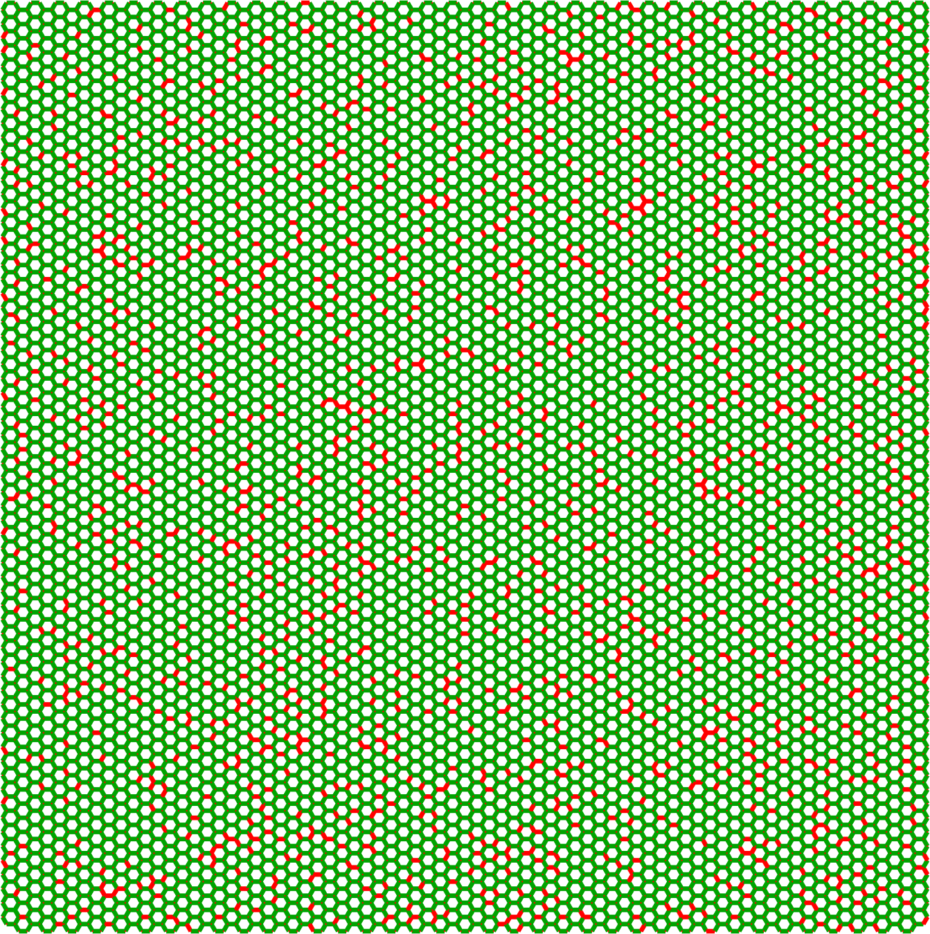
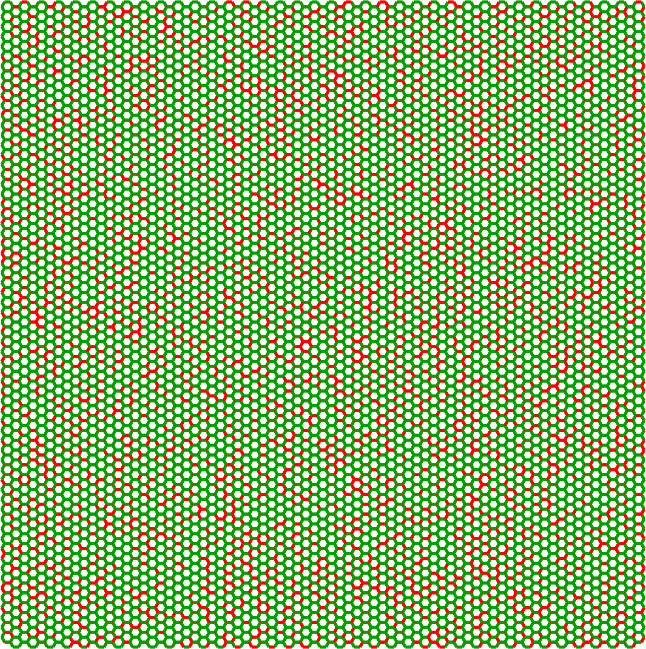
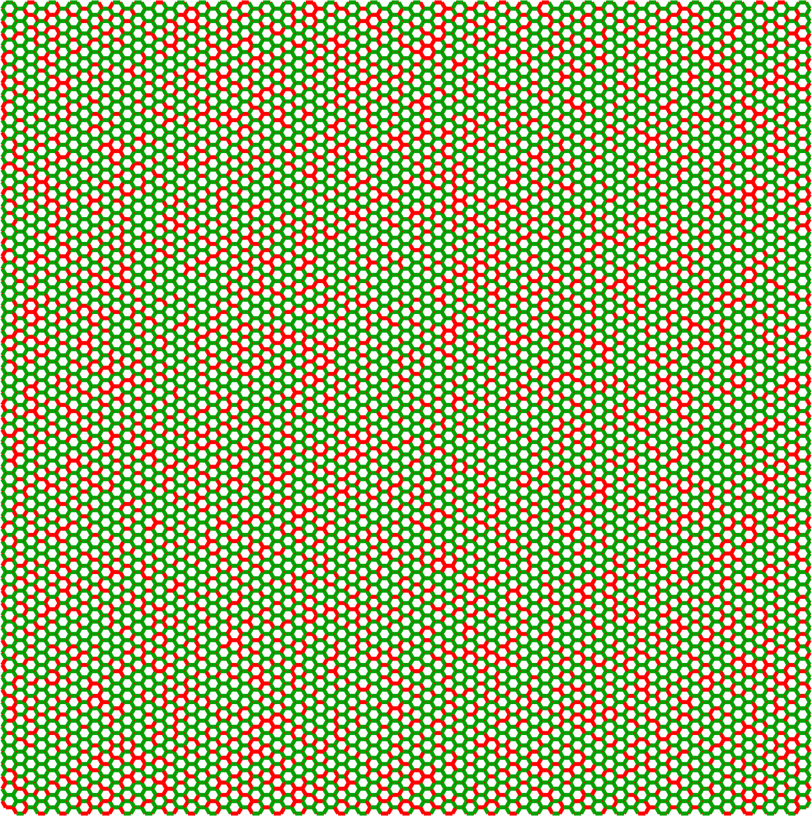
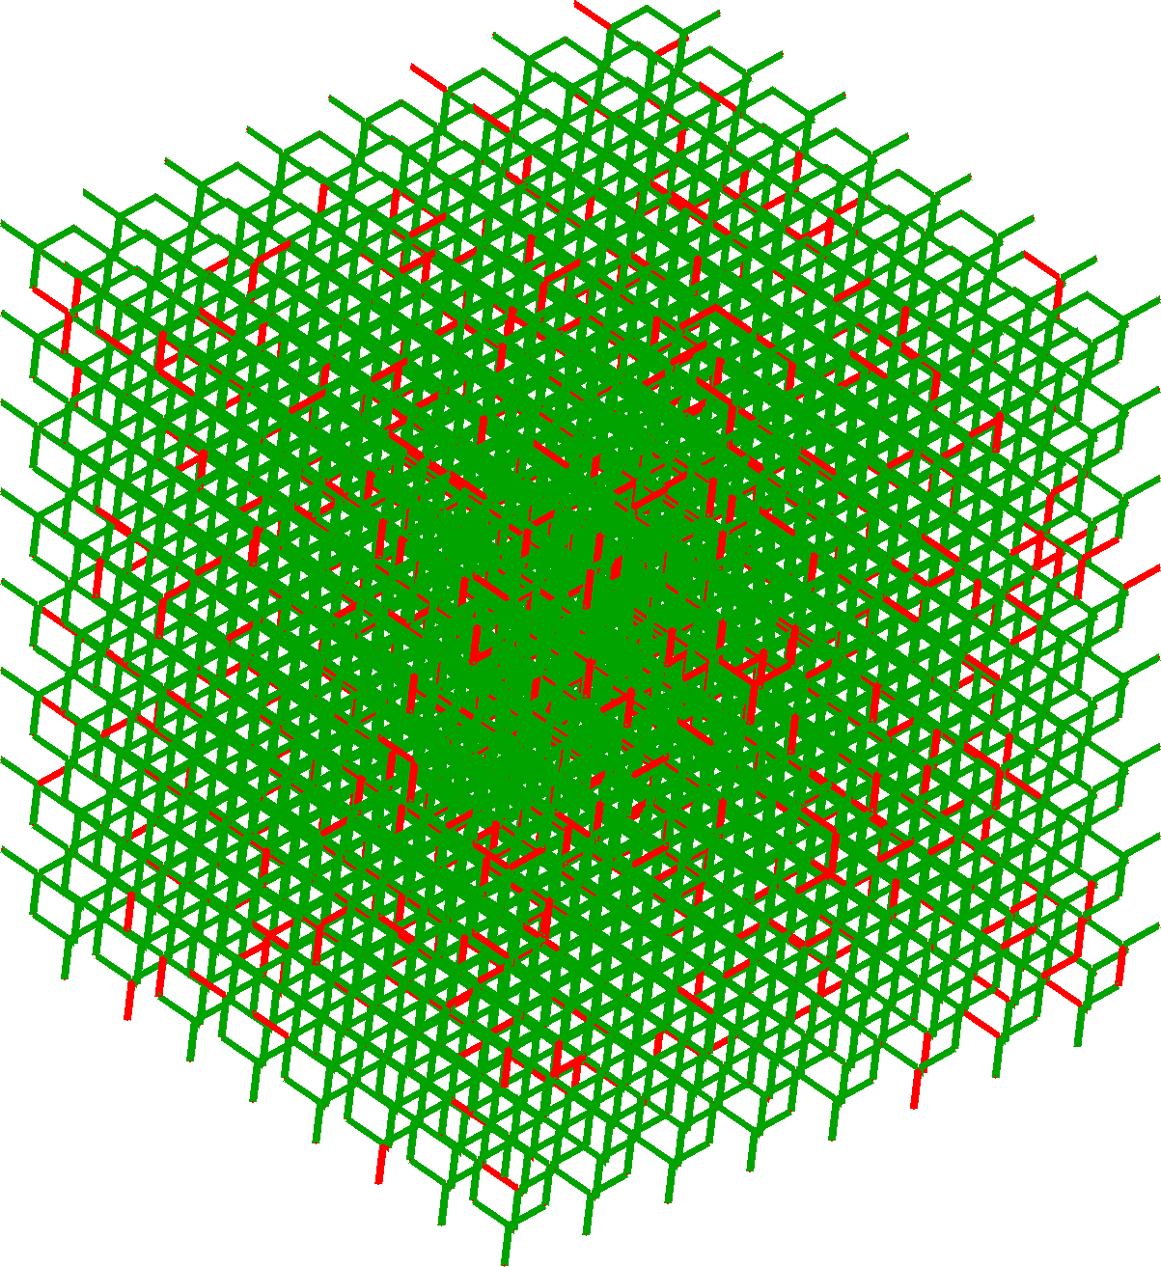
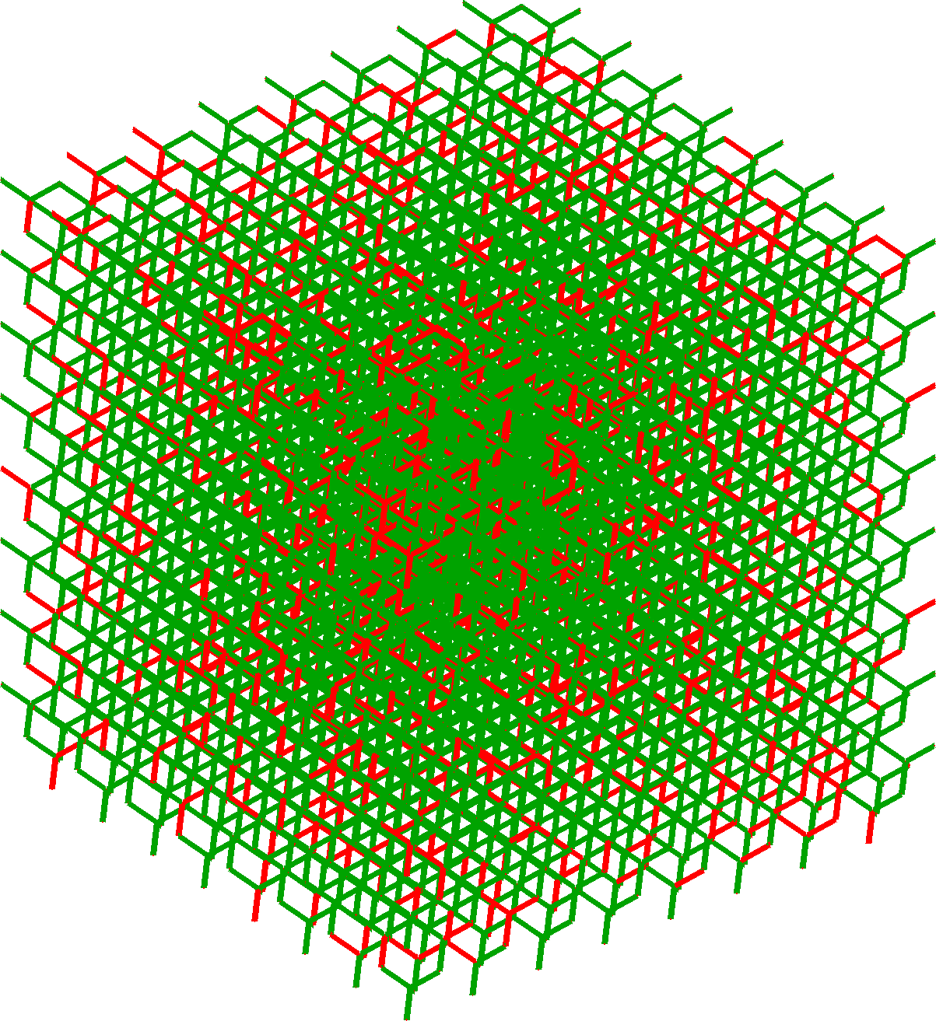
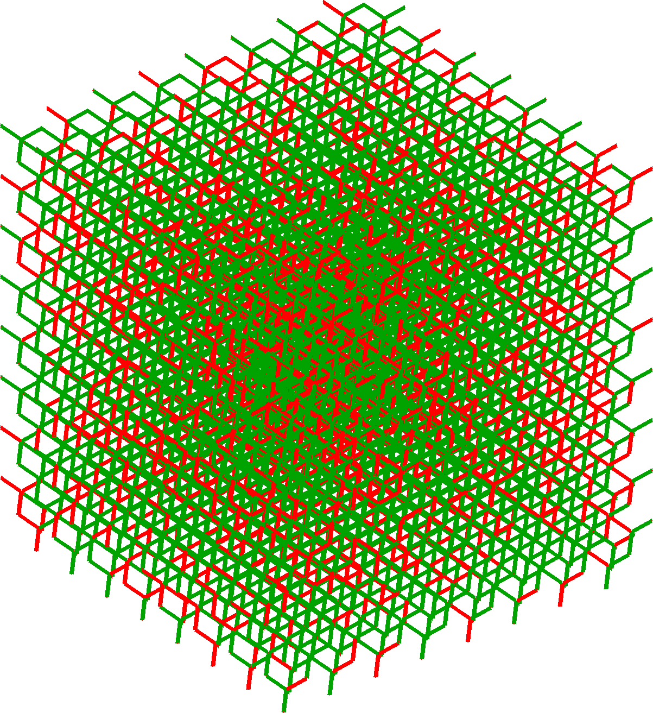



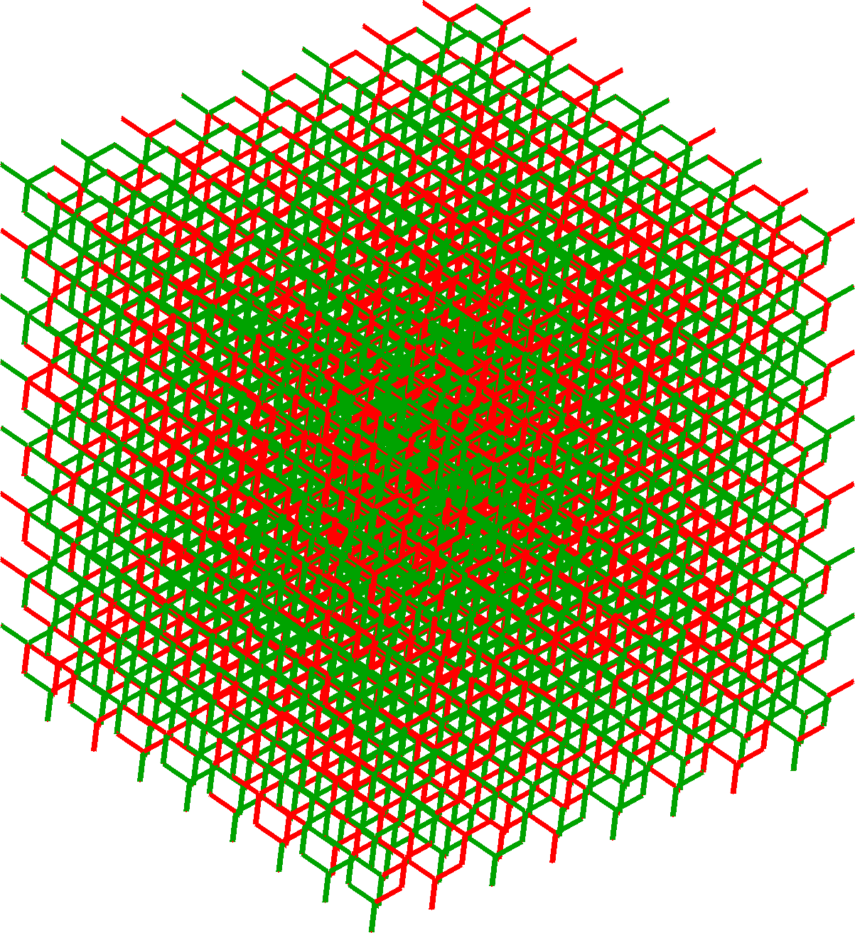
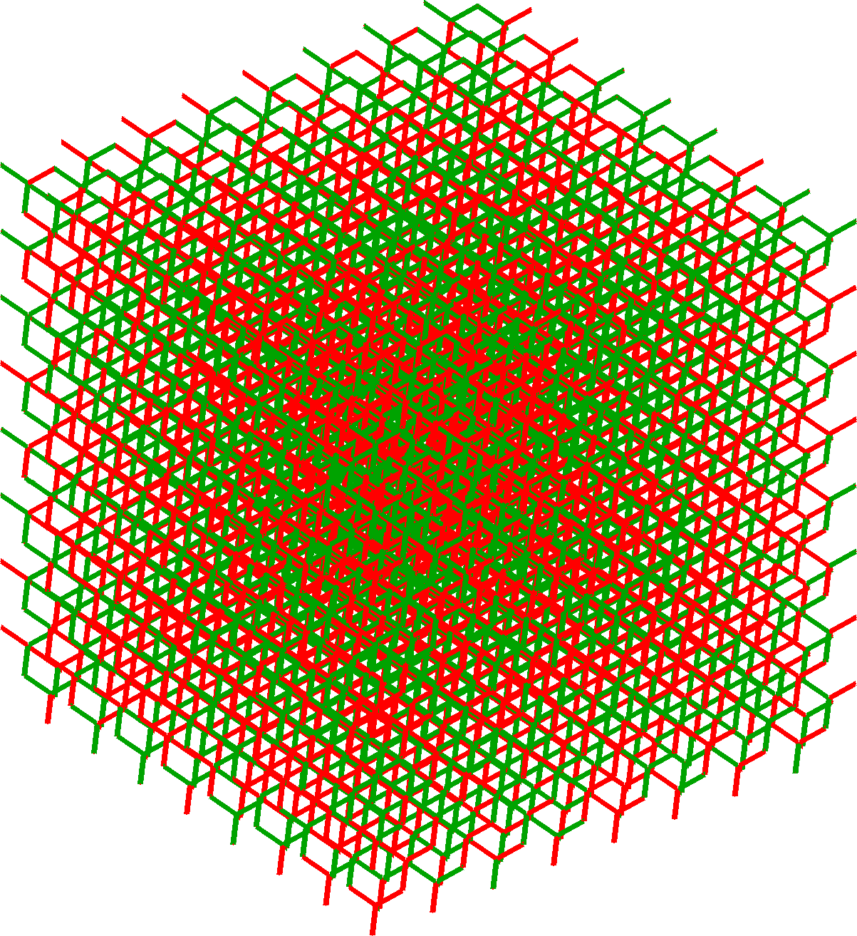
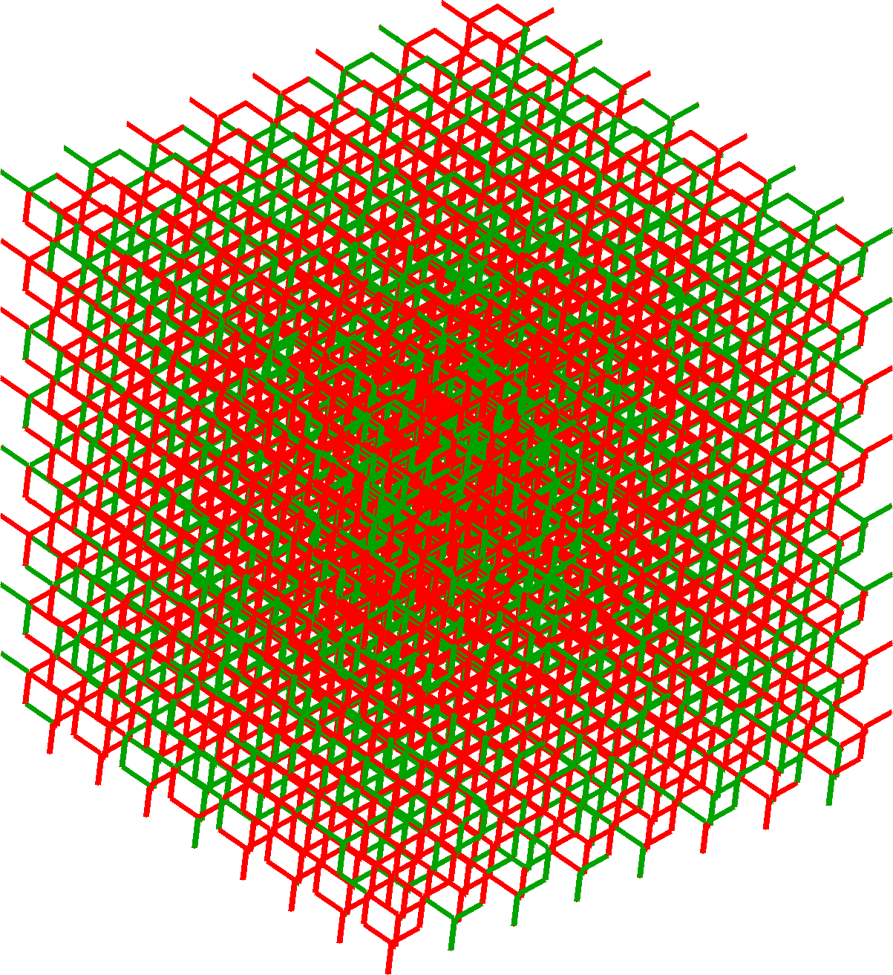



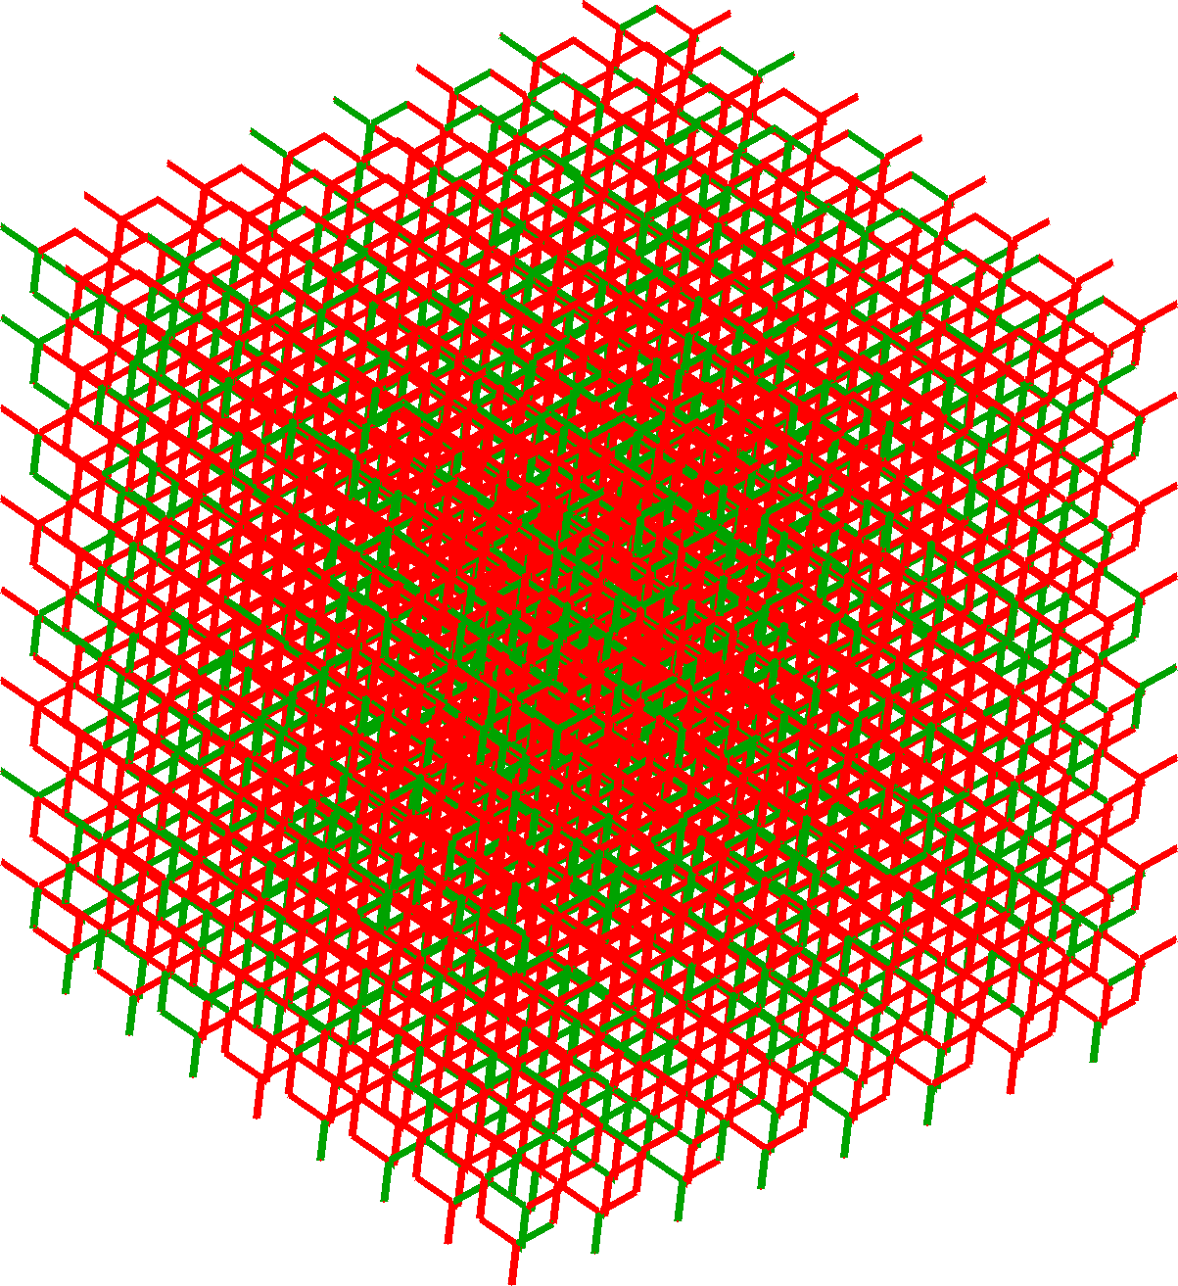
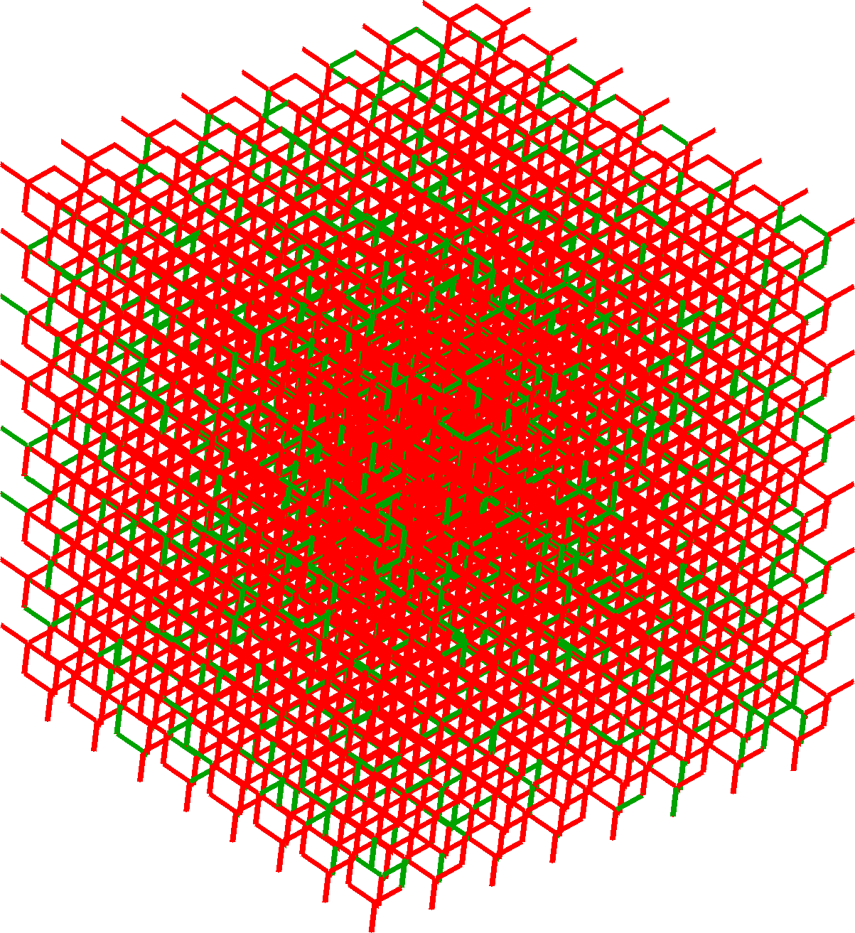
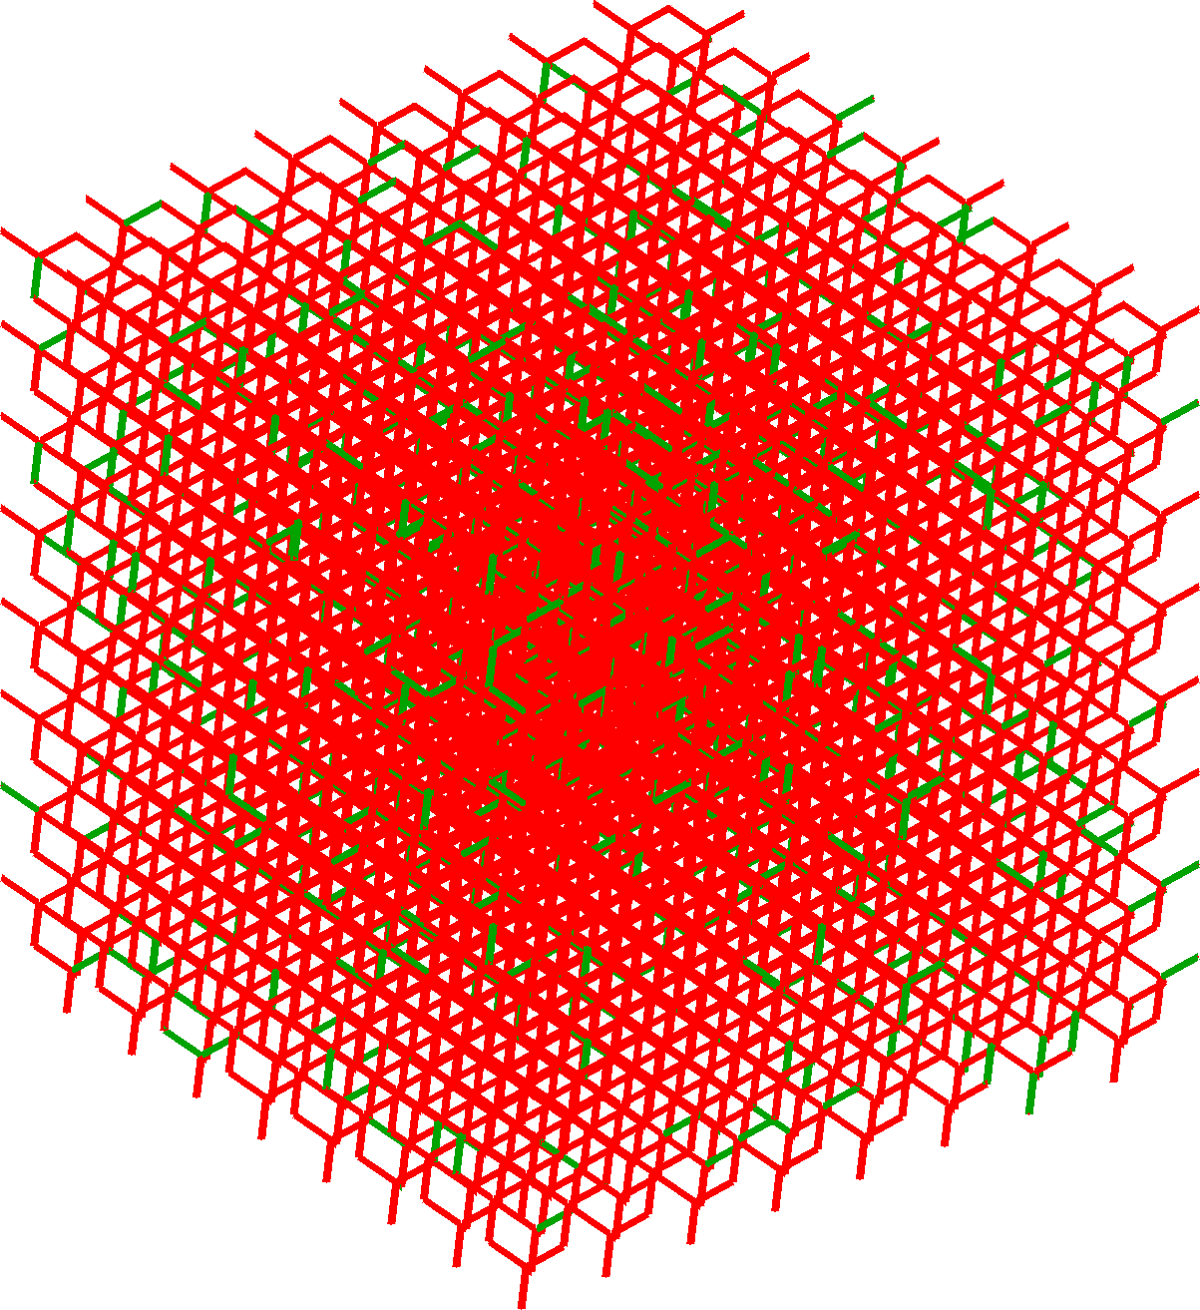


































Percolation of Multiple Phases
2D and 3D lattices occupied with:
Phase A
$f_{A}+f_{B}=1$
Phase B
2D: Hexagonal Lattice
$$f_{c}=0.6527$$
3D: Diamond Lattice
$$f_{c}=0.389$$
$$f_{A}=0.1$$
$$f_{B}=0.9$$
$$f_{A}=0.2$$
$$f_{B}=0.8$$
$$f_{A}=0.3$$
$$f_{B}=0.7$$
$$f_{A}=0.1$$
$$f_{A}=0.2$$
$$f_{A}=0.3$$
$$f_{B}=0.9$$
$$f_{B}=0.8$$
$$f_{B}=0.7$$
$$f_{A}=0.4$$
$$f_{B}=0.6$$
$$f_{A}=0.5$$
$$f_{B}=0.5$$
$$f_{A}=0.6$$
$$f_{B}=0.4$$
$$f_{A}=0.4$$
$$f_{A}=0.5$$
$$f_{A}=0.6$$
$$f_{B}=0.6$$
$$f_{B}=0.5$$
$$f_{B}=0.4$$
$$f_{A}=0.7$$
$$f_{B}=0.3$$
$$f_{A}=0.8$$
$$f_{B}=0.2$$
$$f_{A}=0.9$$
$$f_{B}=0.1$$
$$f_{A}=0.7$$
$$f_{A}=0.8$$
$$f_{A}=0.9$$
$$f_{B}=0.3$$
$$f_{B}=0.2$$
$$f_{B}=0.1$$

Slide 16
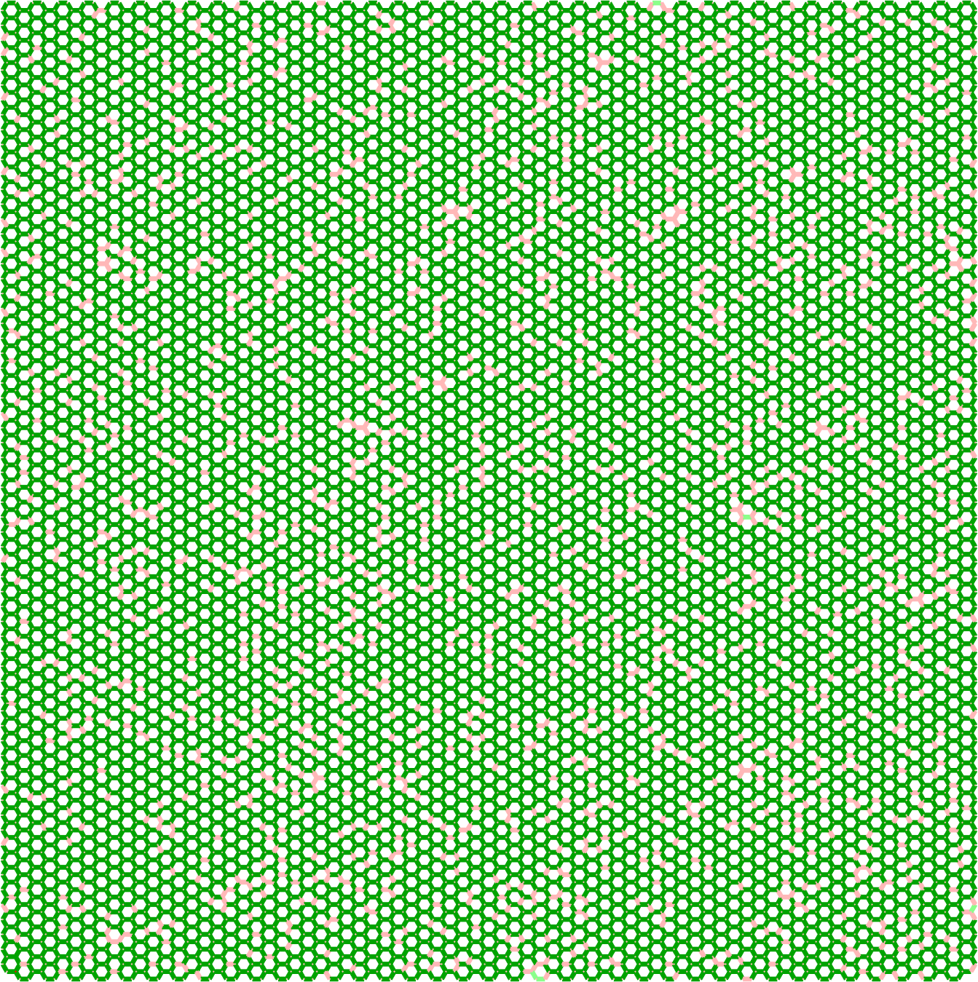
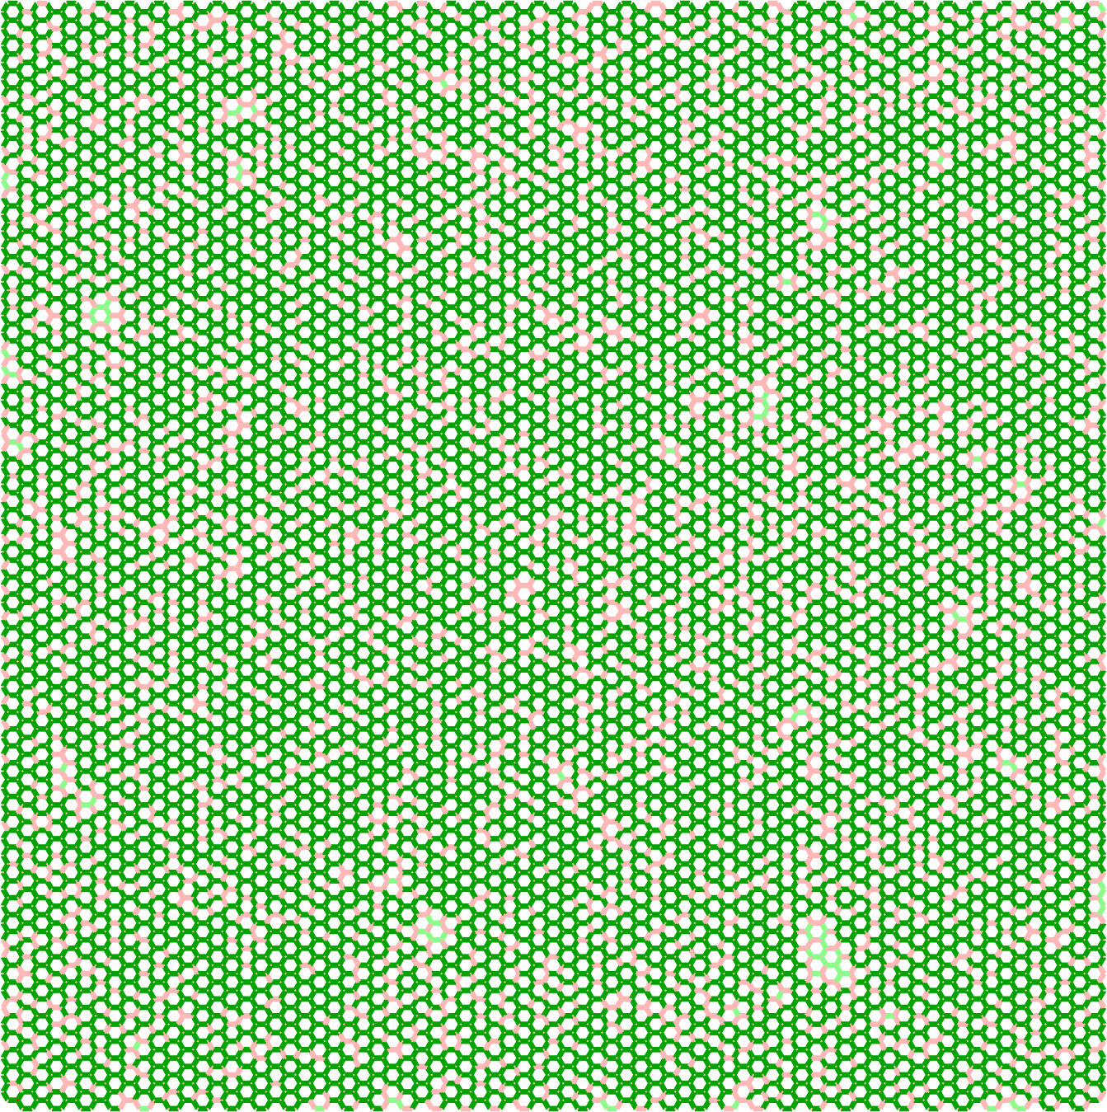
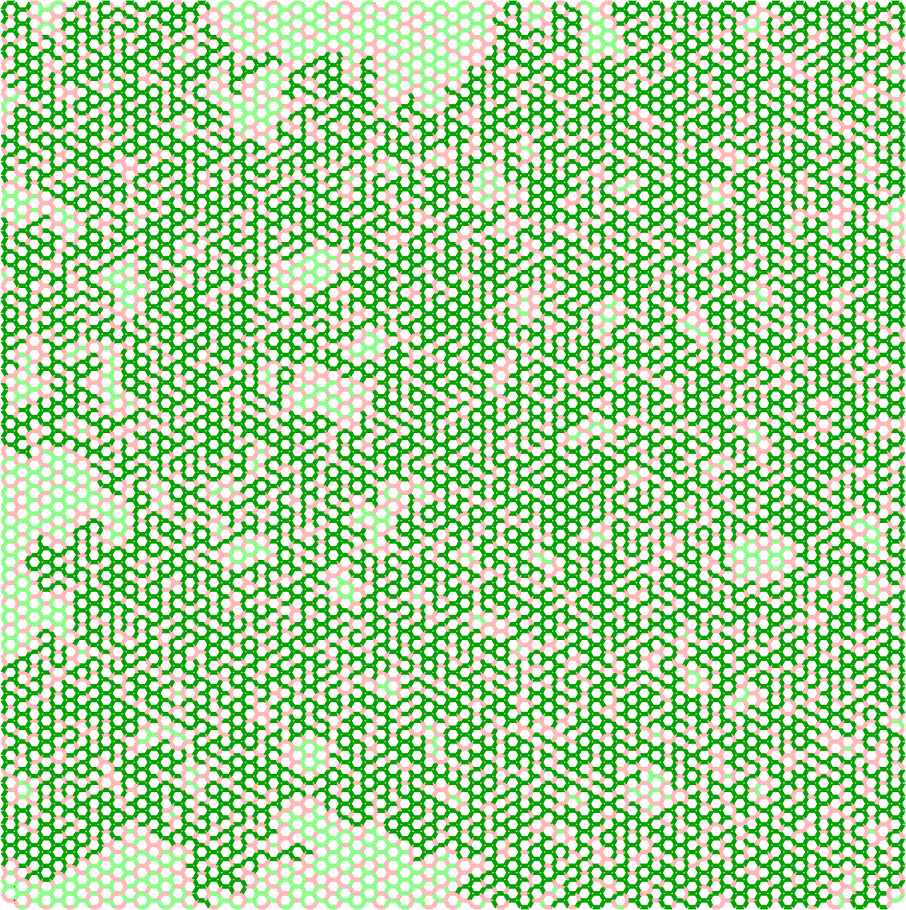
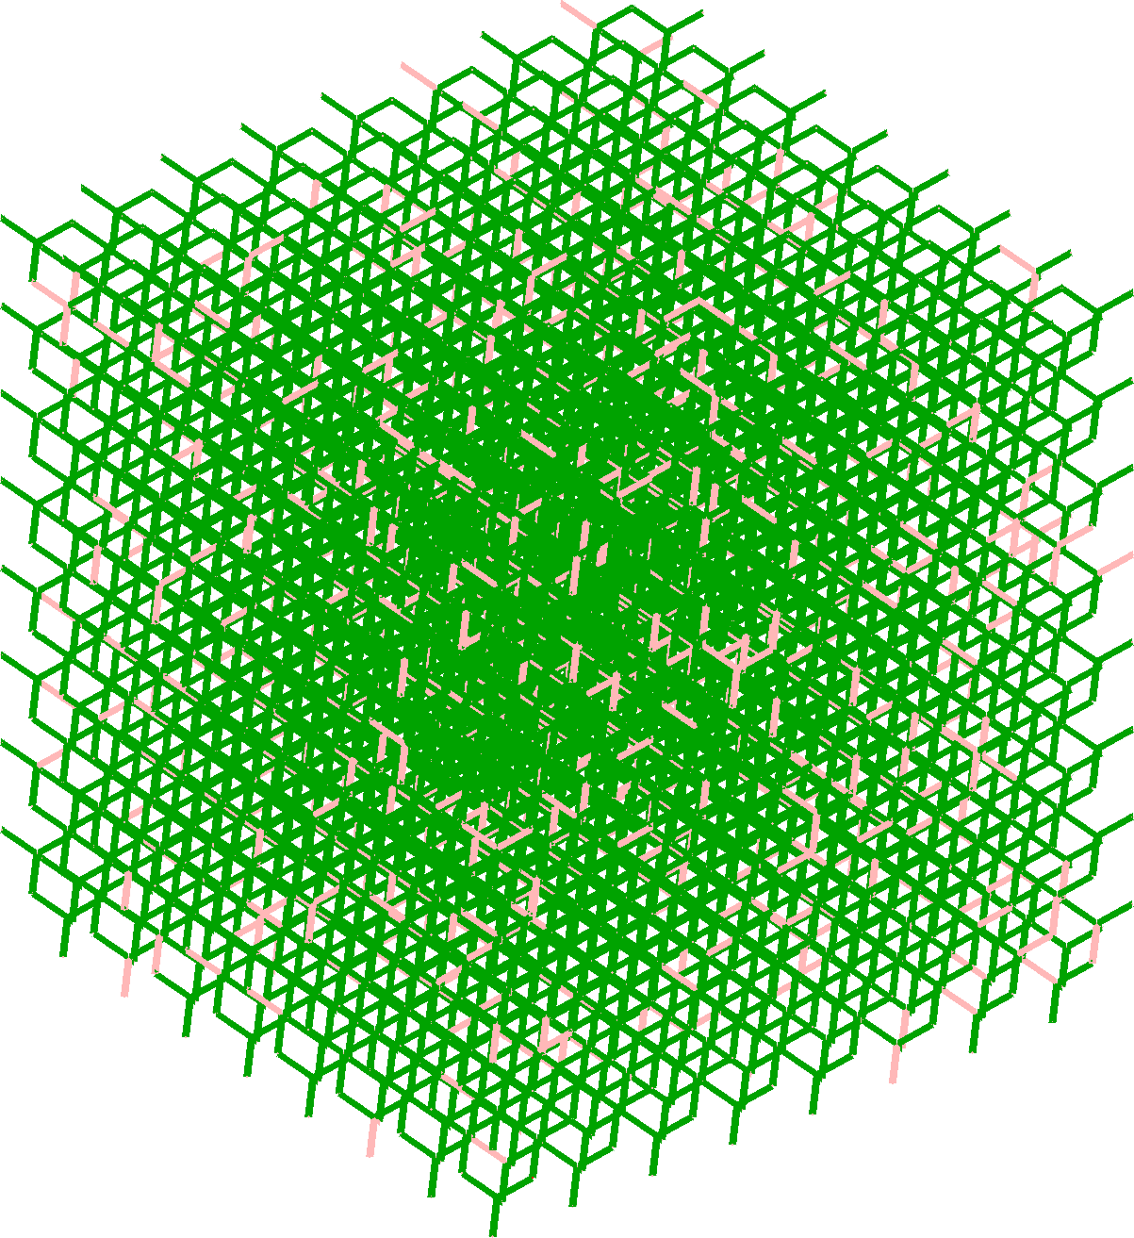
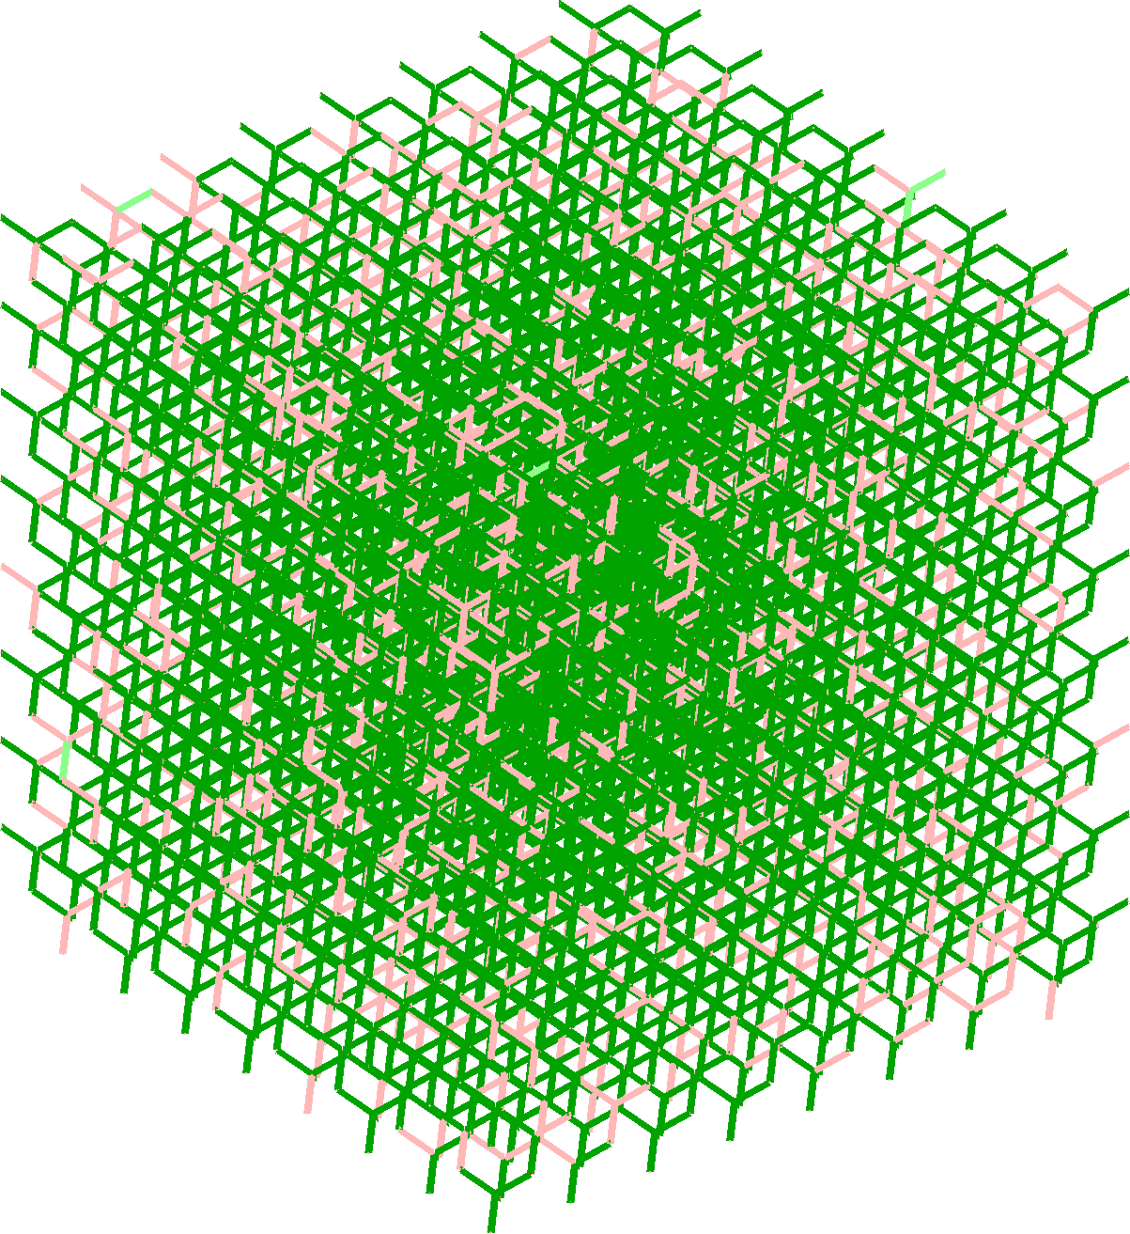
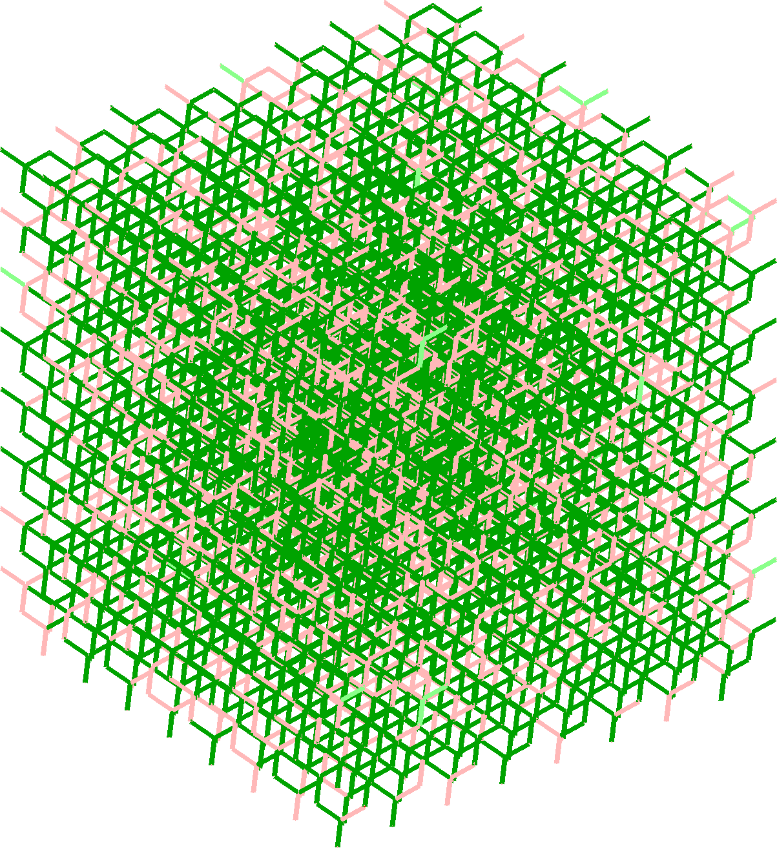



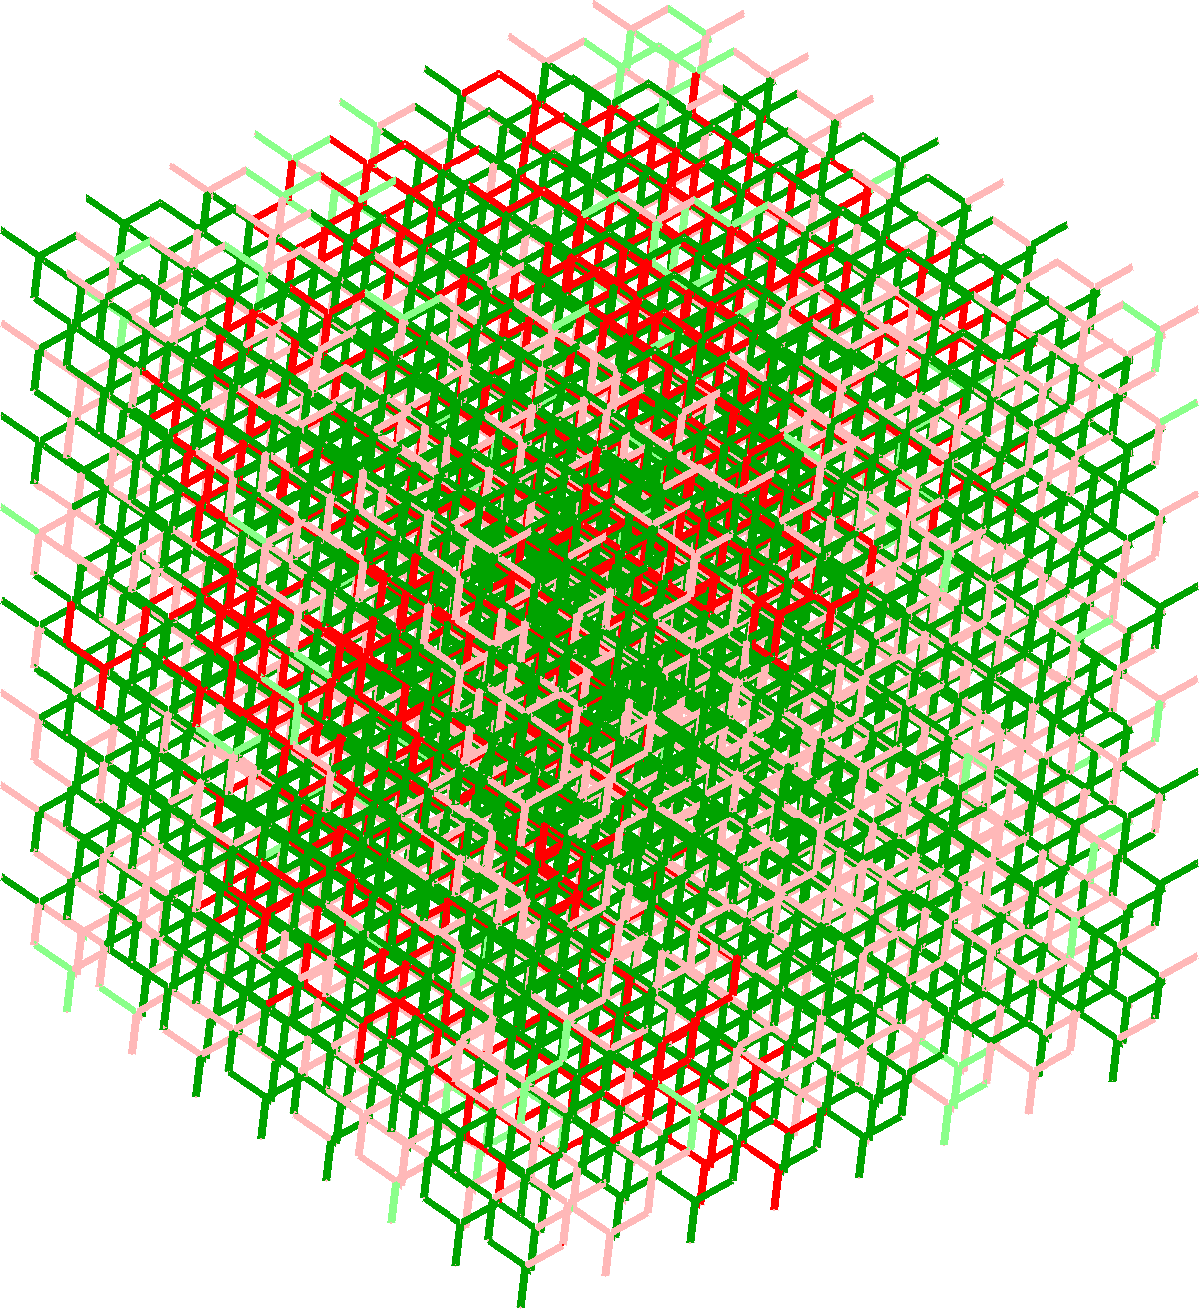
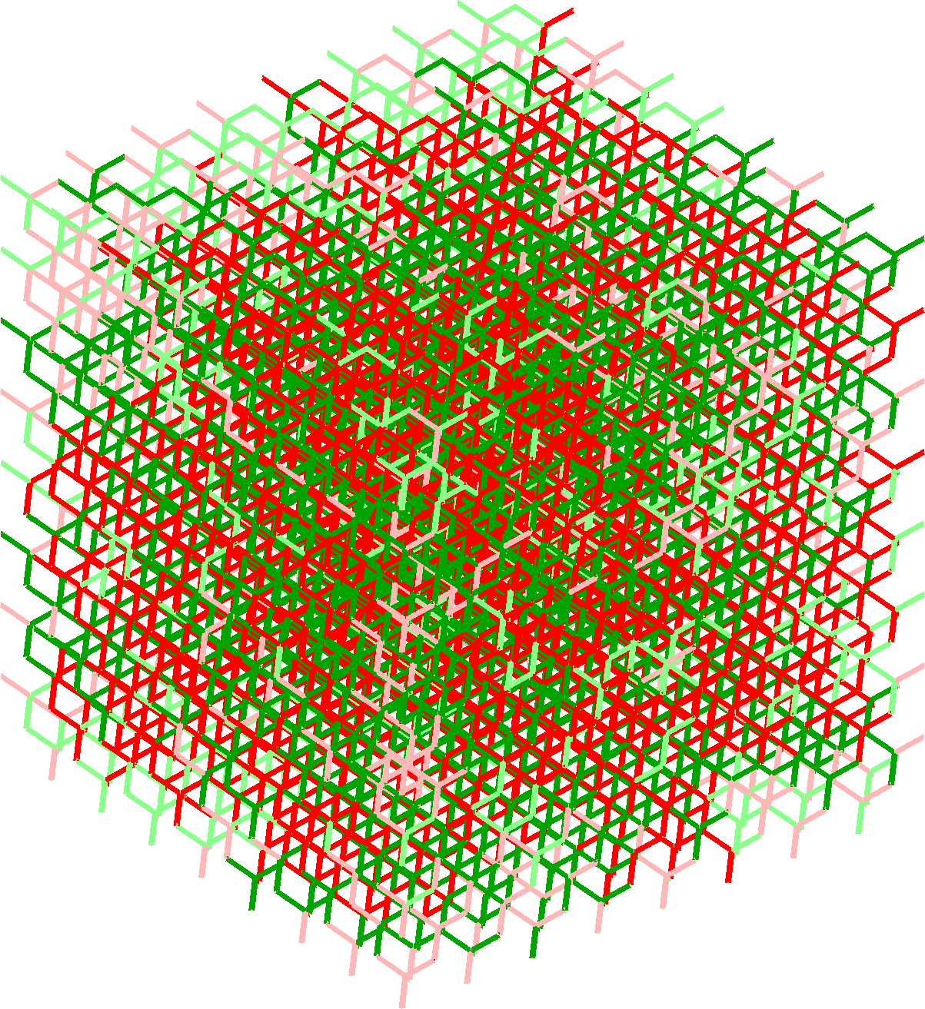









Percolation of Multiple Phases
Phase A: Percolating
Phase A: Not percolating
Phase B: Percolating
Phase B: Not percolating
2D: Hexagonal Lattice
$$f_{c}=0.6527$$
2D: $f_{c}>0.5$
3D: Diamond Lattice
$$f_{c}=0.389$$
3D: $f_{c}<0.5$
$$f_{A}=0.1$$
$$f_{B}=0.9$$
$$f_{A}=0.2$$
$$f_{B}=0.8$$
$$f_{A}=0.3$$
$$f_{B}=0.7$$
$$f_{A}=0.1$$
$$f_{A}=0.2$$
$$f_{A}=0.3$$
$$f_{B}=0.9$$
$$f_{B}=0.8$$
$$f_{B}=0.7$$
Only phase B percolates
$$f_{A}=0.4$$
$$f_{B}=0.6$$
$$f_{A}=0.5$$
$$f_{B}=0.5$$
$$f_{A}=0.6$$
$$f_{B}=0.4$$
$$f_{A}=0.4$$
$$f_{A}=0.5$$
$$f_{A}=0.6$$
3D:Both phases percolate
$$f_{B}=0.6$$
$$f_{B}=0.5$$
$$f_{B}=0.4$$
2D: No phase percolates
$$f_{A}=0.7$$
$$f_{B}=0.3$$
$$f_{A}=0.8$$
$$f_{B}=0.2$$
$$f_{A}=0.9$$
$$f_{B}=0.1$$
$$f_{A}=0.7$$
$$f_{A}=0.8$$
$$f_{A}=0.9$$
$$f_{B}=0.3$$
$$f_{B}=0.2$$
$$f_{B}=0.1$$
Only phase A percolates

Slide 17






Stable Drainage in 3D
$$\frac{η}{a}∝F^{−ν/{1+ν}}$$
$$F=N\left(P_{c}^{crit}\right)a∇P_{c}$$
Invasion-Percolation Model
Pore network : Diamond Lattice
$$f_{c}=0.389$$
Non-wetting phase near percolation
Wetting phase near percolation
Non-wetting phase: lighter
Drainage Front
Non-wetting phase: lighter
Drainage Front
0.389
$$P_{c}^{crit}$$
$$P_{c}^{max}$$
$$\vec{g}$$
0.389
$$\vec{g}$$
Wetting phase: heavier
Wetting phase: heavier
$$∇P_{c}≈2000 Pa/m$$
$$∇P_{c}≈700 Pa/m$$

Slide 18







Stable Drainage Front
$$\frac{η}{a}∝F^{−ν/{1+ν}}$$
$$F=N\left(P_{c}^{crit}\right)a∇P_{c}$$
3D
2D
The front is in a critical region where $P_{c}≈P_{c}^{crit}$
The front may extend over a large range of $P_{c}$,
containing:

Slide 19





Stable Drainage Front
$$\frac{η}{a}∝F^{−ν/{1+ν}}$$
$$F=N\left(P_{c}^{crit}\right)a∇P_{c}$$
3D
2D
$\frac{η_{t1}}{a}∝$ $F_{1}^{−ν/{1+ν}}$
$$F_{1}=N\left(P_{c}^{crit}\right)a∇P_{c}$$
The front is in a critical region where $P_{c}≈P_{c}^{crit}$
The front may extend over a large range of $P_{c}$,
containing:
critical region where $P_{c}≈P_{c}^{crit}$
Non-wetting phase near percolation

Slide 20




Stable Drainage Front
Wetting phase near percolation
critical region where $P_{c}≈P_{c}^{max}$
$$\frac{η}{a}∝F^{−ν/{1+ν}}$$
$$F=N\left(P_{c}^{crit}\right)a∇P_{c}$$
3D
2D
$\frac{η_{t2}}{a}∝$ $F_{2}^{−ν/{1+ν}}$
$$F_{2}=N\left(P_{c}^{max}\right)a∇P_{c}$$
$$\frac{η_{c}}{a}=\frac{P_{c}^{max}−P_{c}^{crit}}{∇P_{c}}$$
transition region from $P_{c}^{crit}$to${ P}_{c}^{max}$
Both phases percolate
$\frac{η_{t1}}{a}∝$ $F_{1}^{−ν/{1+ν}}$
$$F_{1}=N\left(P_{c}^{crit}\right)a∇P_{c}$$
The front is in a critical region where $P_{c}≈P_{c}^{crit}$
The front may extend over a large range of $P_{c}$,
containing:
critical region where $P_{c}≈P_{c}^{crit}$
Non-wetting phase near percolation

Slide 21






Conclusions and Outlook
Test the model validity with more realistic drainage simulations and experiments;
Expand the analyses to saturation and relative permeability scaling laws established for 2D porous media.
$$\frac{η_{3D}}{a}=\frac{P_{c}^{max}−P_{c}^{crit}}{a∇P_{c}}+C\left(F_{1}^{−ν/{1+ν}}+ F_{2}^{−ν/{1+ν}}\right)$$
$$\frac{η_{2D}}{a}∝F^{−ν/{1+ν}}$$
Can we theoretically predict this 3D front characteristics
similarly to what is done in 2D?

Slide 22

Motivation
Fundamental understanding of multiphase flows in porous media
Final saturations and trapped cluster structure
Evaporation rate
  Evaporation requires liquid connected to vapor pathways or sustained by capillary pumping through films. A narrow front reduces the hydraulically connected film region and shortens the constant‑rate drying period, so total drying time and flux decline when $w$is small. Characteristic lengths combining gravity and viscous dissipation set the maximum film‑sustaining width.
    Practical effect: narrower fronts → earlier transition from stage‑1 (fast) to stage‑2 (slow) evaporation → less total water removed during the high‑flux period.
Interfacial chemical reactions
  Reaction extent scales with interfacial area and contact time inside the front region. A wider front increases mixing volume and residence time, may promote more precipitation/dissolution.
Biofilm growth and biodegradation
  A broad connected front sustains habitable volumes and longer exposure to O₂ and substrates, enabling thicker biofilms and higher biodegradation rates; narrow/disconnected fronts limit biomass and local reaction intensity.

