Slide 1


Characterization and Modeling of Secondary Fe(OH)₃ Phases in Stimulated Shale (239)
Z. Kou, V. Alvarado*, S. Aryana, U. of Wyoming, Q. ,Li, Stony Brook, C. Ross, Stanford U.

Slide 2
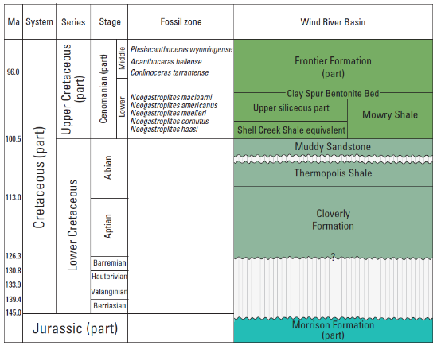
Introduction - Motivation
Notes:
MCS: Dakota Sandstone, the Muddy Sandstone, the Mowry Shale, and the Frontier Formation.
I want to highlight not the numbers per se, but that this is an important resource.

Slide 3
Mowry Shale - Characteristics
Notes:
MCS: Dakota Sandstone, the Muddy Sandstone, the Mowry Shale, and the Frontier Formation.
I want to highlight not the numbers per se, but that this is an important resource.

Slide 4
Mowry Shale – Mineralogic Characteristics*
Source | Quartz | Clay | Ankerite | K-feldspar | Plagioclase | Dolomite | Pyrite | TOC
SER | 40.6 | 31.4 | - | 14.7 | 12.1 | - | 1.3 | 2.6
USGS | 78.7 | 9.7 | 7.3 | - | - | 1.5 | 2.8 | 2.49
*Kou et al., URTEC 2025, DS031S064R005. A low-pH stimulation fluid was used to test the hypothesis that the choice of stimulation fluid could be responsible for harmful rock alterations
Notes:
MCS: Dakota Sandstone, the Muddy Sandstone, the Mowry Shale, and the Frontier Formation.
I want to highlight not the numbers per se, but that this is an important resource.

Slide 5
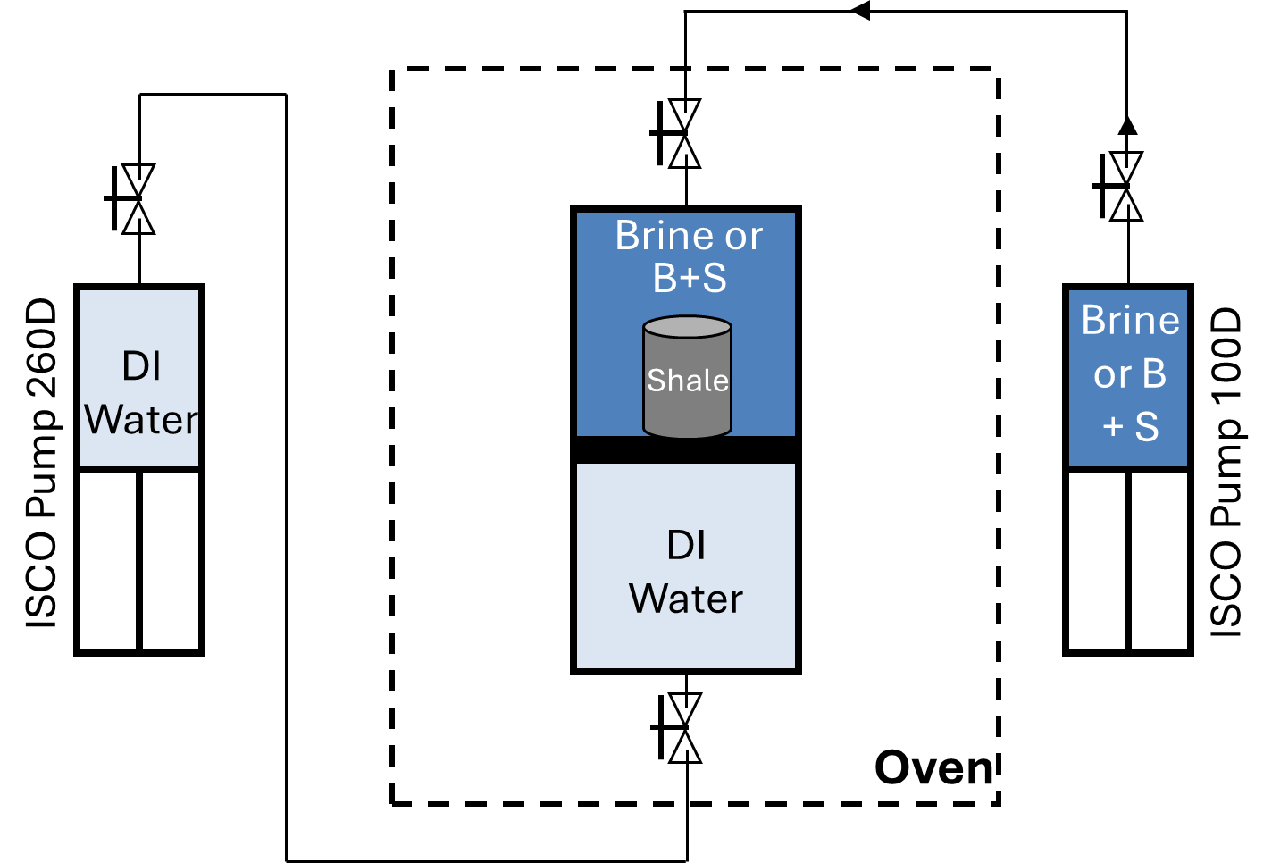
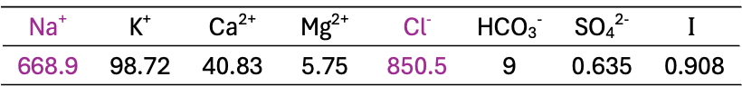
Methods (Li et al., Energy & Fuels, 2025)
Samples. USGS Well 11-1H @ 3228.54 m (10592.33 ft). XRD indicates 78.7% quartz, 9.7% chlorite, 7.3% ankerite, 1.5% dolomite and 2.8% pyrite
Aging process with Brine or Brine + Stimulation Fluid for 30 days
Scanning Electron Microscope- and Focused Ion Beam-Equipped SEM
Reactive Transport Modeling (CrunchFlow)
Formation water chemistry taken from the USGS.
Concentrations in mmol/L, Ionic strength in mol/L.
Na⁺ | K⁺ | Ca²⁺ | Mg²⁺ | Cl⁻ | HCO₃⁻ | SO₄²⁻ | $$I$$
668.9 | 98.72 | 40.83 | 5.75 | 850.5 | 9 | 0.635 | 0.908

Slide 6
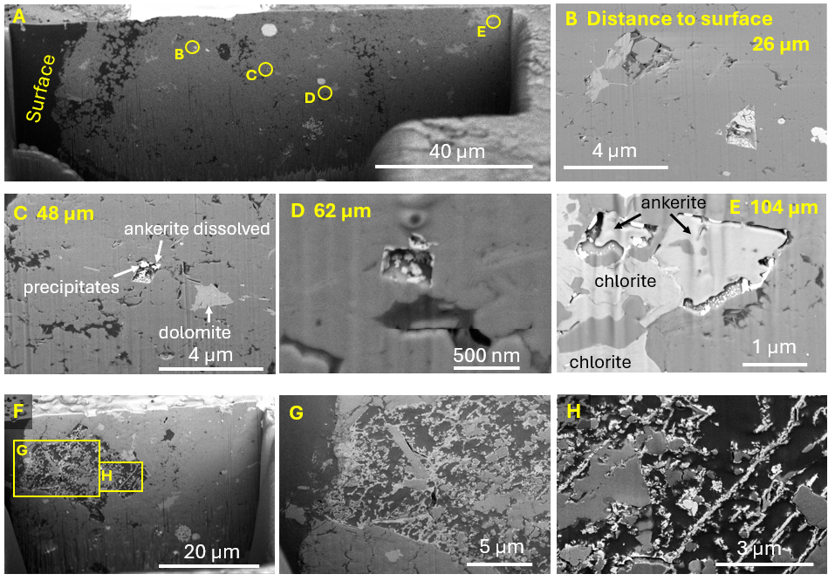

Slide 7
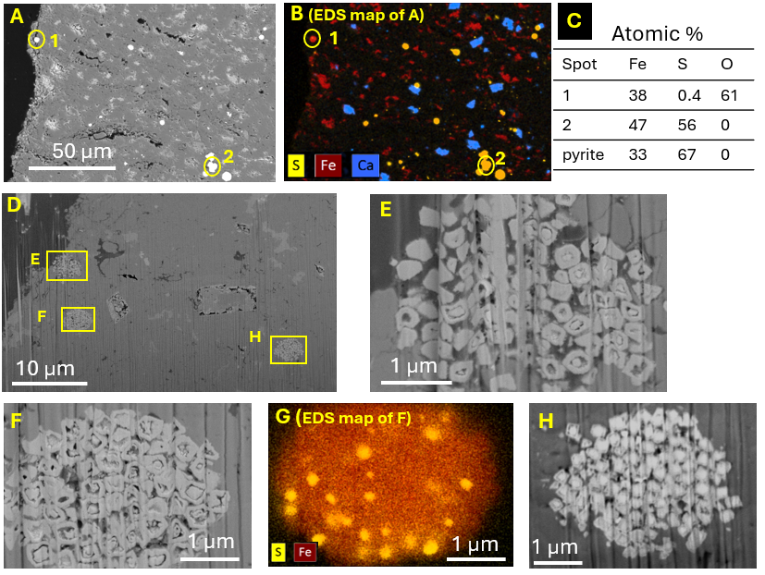
Pyrite replacement by secondary Fe(OH)₃

Slide 8
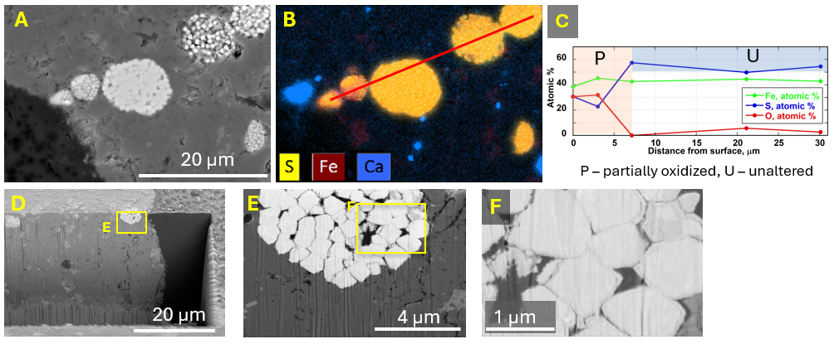
Brine-only case

Slide 9
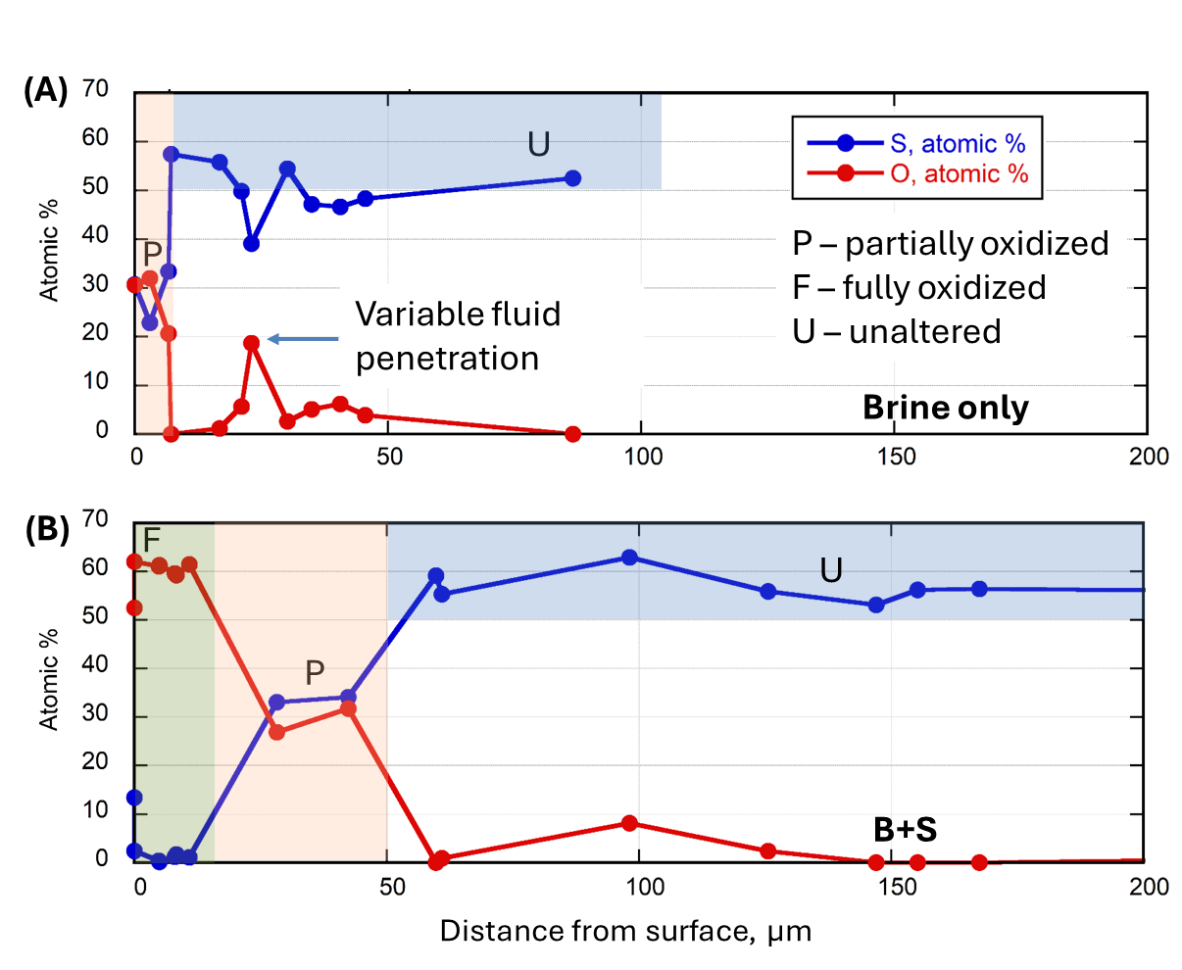
Pyrite oxidation

Slide 10
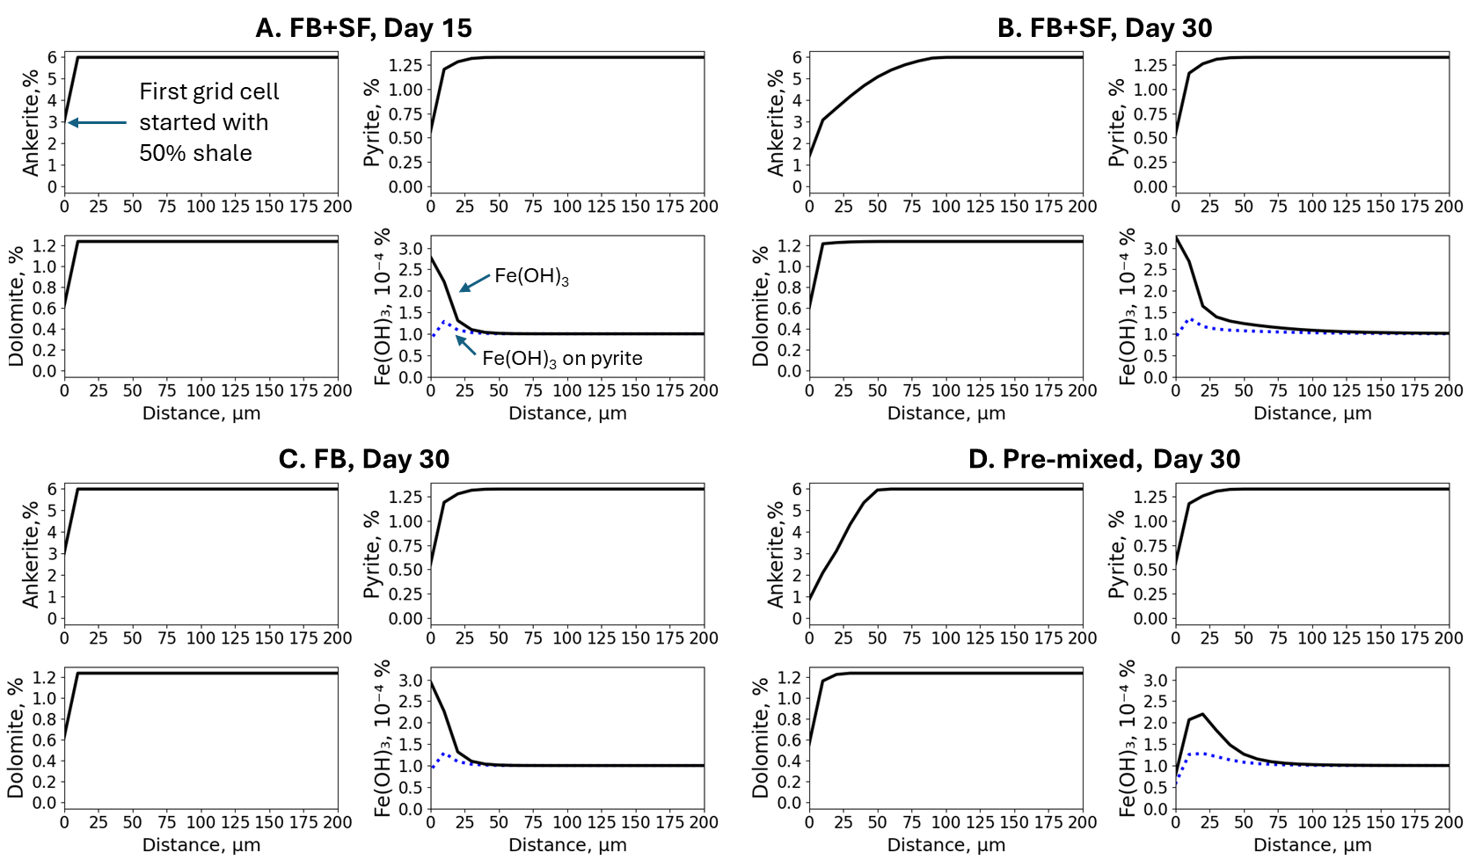
Reactive Transport Model Profiles

Slide 11
Summary
Two distinct morphologies of Fe(OH) were (1) loosely clustered, nanometer-sized precipitates with moldic pores from ankerite dissolution; (2) pyrite-replacing precipitates that preserved the framboidal structure
Reactive-transport model suggests that Fe in Fe(OH)₃ precipitates originated from ankerite dissolution by acid and from pyrite oxidation by dissolved oxygen
Findings provide the key factors influencing spatial distribution of secondary iron hydroxide with the rock matrix
Notes:
Organic-matter-hosted pores are also present but are generally >50 nm and developed inhomogeneously in various organic-matter components. (Milliken and Olsen, 2017)

Slide 12
Thank you

