Slide 1
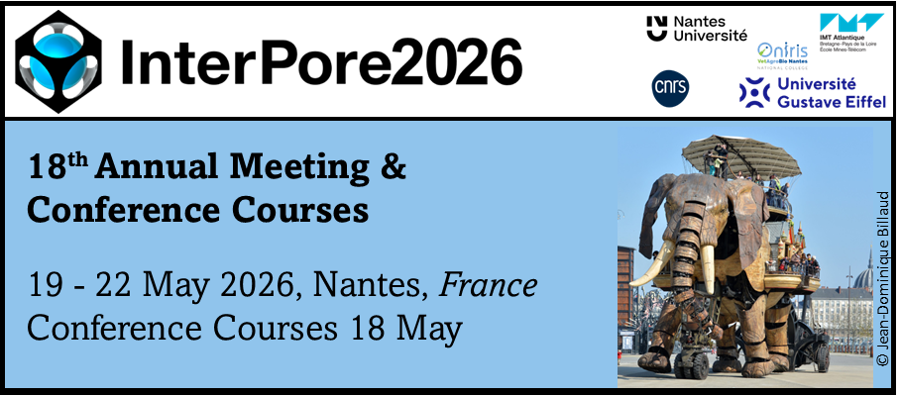


18th Annual Meeting & Conference Courses
19-22 May 2026, Nantes France
Effect of Temperature on Matrix Acidizing in Carbonate Formations Through 3D Computational Simulation Using OpenFOAM
Caio Cézar Goes Pereira, Nathalia Almeida Braga, Lorena Cardoso Batista Aum, Raphael Gachet, and Pedro Tupã Pandava Aum
pedroaum@ufpa.br
Federal University of Pará
Energy and Petroleum Science Laboratory
May 2026
www.lcpetro.ufpa.br

Slide 2
Outline
Carbonate Acidizing
Experiments at Laboratory Scale
Numerical Simulation Experiments
Objectives
Mathematical Model
Results
Conclusions
Outlooks

Slide 3
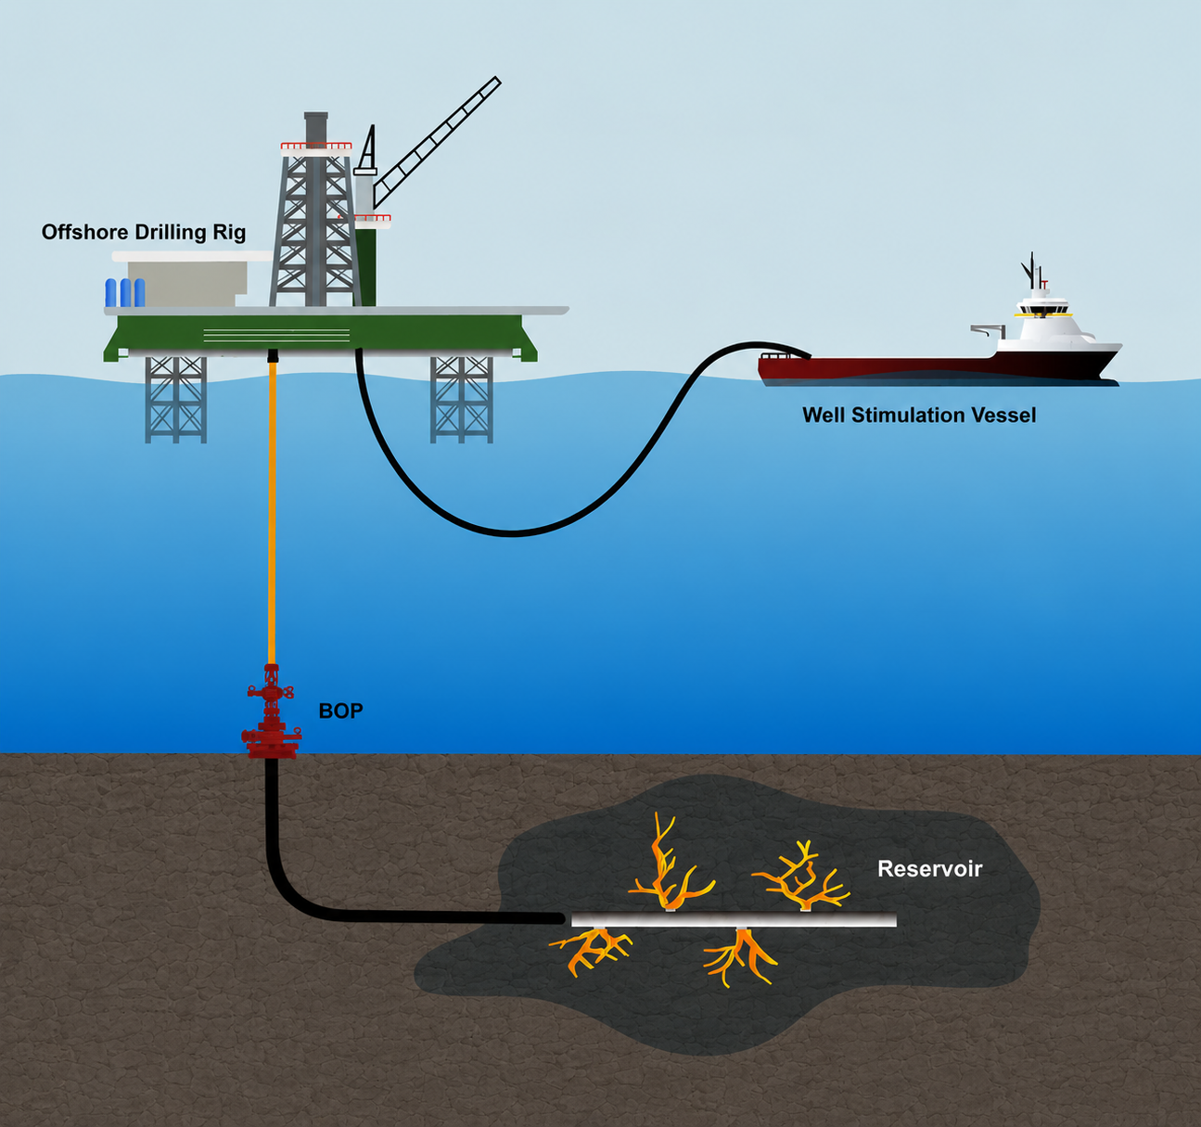
Carbonate Acidizing
Notes:
Em termos geoquímicos, um diabásio apresenta aproximadamente:
SiO₂: 45–52%
Al₂O₃: 13–17%
FeO + Fe₂O₃: 8–15%
MgO: 5–10%
CaO: 8–12%
Na₂O + K₂O: geralmente < 5%

Slide 4
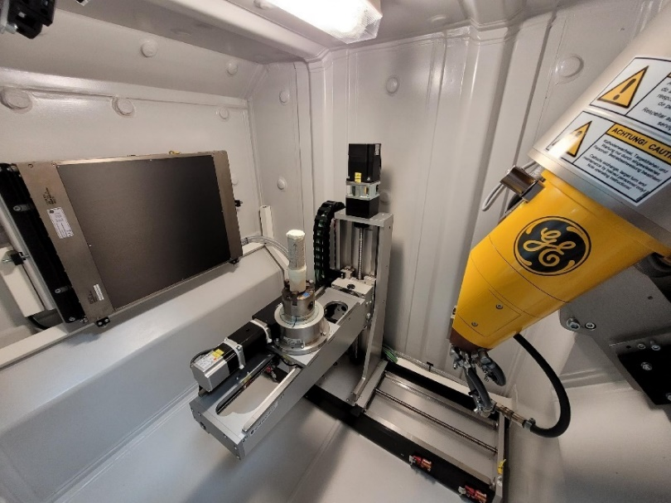
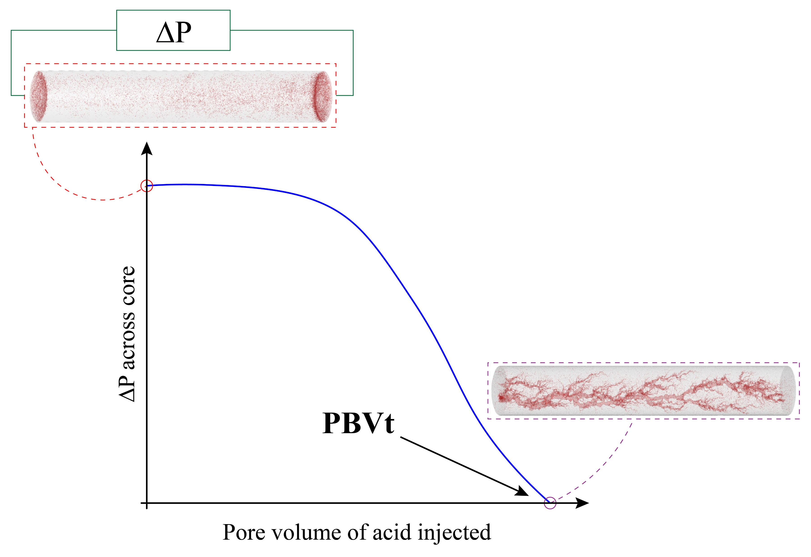
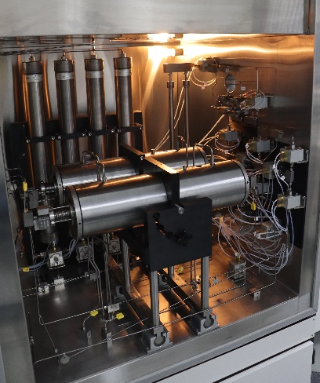
Carbonate Acidizing - Laboratory Experiments
Notes:
Em termos geoquímicos, um diabásio apresenta aproximadamente:
SiO₂: 45–52%
Al₂O₃: 13–17%
FeO + Fe₂O₃: 8–15%
MgO: 5–10%
CaO: 8–12%
Na₂O + K₂O: geralmente < 5%

Slide 5
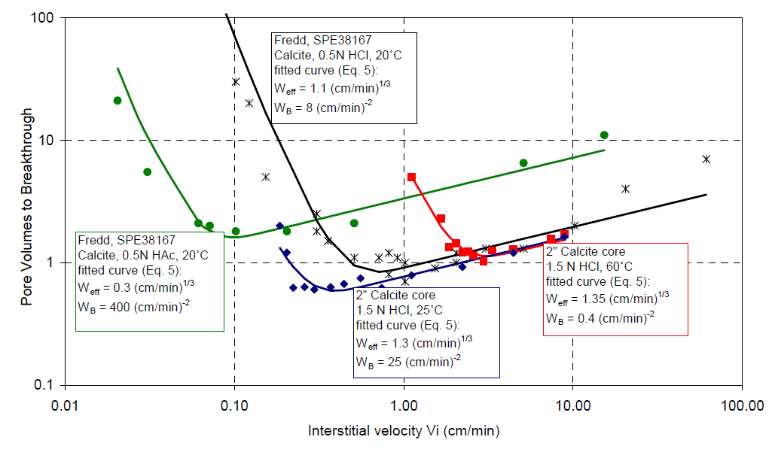
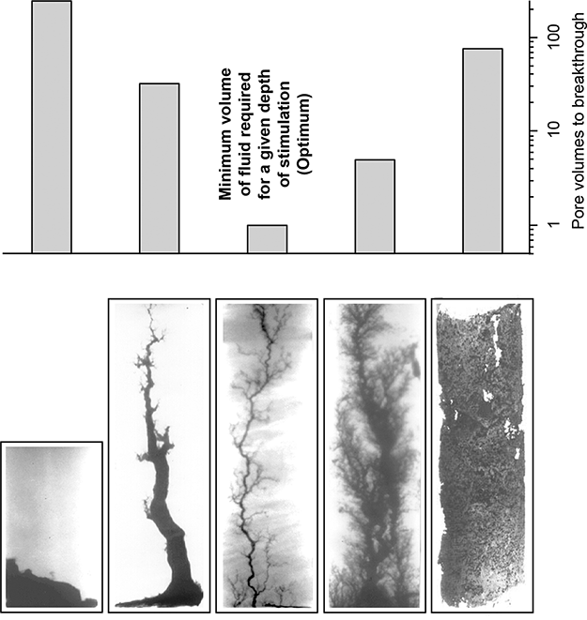
Carbonate Acidizing - Laboratory Experiments
Objective: optimum parameters for a dominant wormhole (lowest Pore Volumes to Breakthrough - PVBt)
Minimum volume of fluid required for a given depth of stimulation
Face
Dissolution
Conical
Wormhole
Dominant
Wormhole
Ramified
Wormhole
Uniform
Dissolution
[A Semiempirical Model To Calculate Wormhole Growth in Carbonate Acidizing - M. Buijse, Shell Intl. E&P B.V., and G. Glasbergen, Halliburton - SPE 96892]

Slide 6
Objective
3-D Reactive Flow Simulation, incorpotating the effects of temperature on reaction kinectics in carbonate acidizing simulations

Slide 7
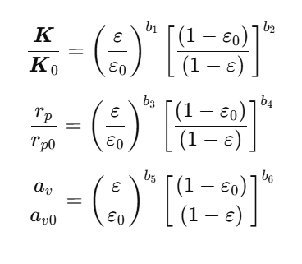
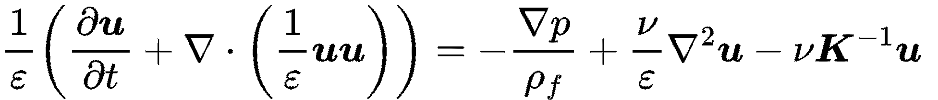
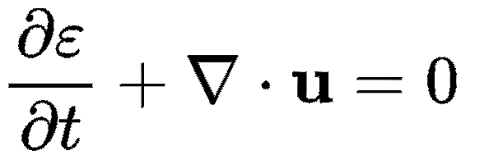
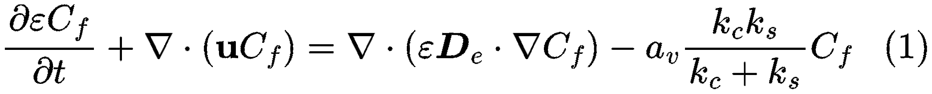
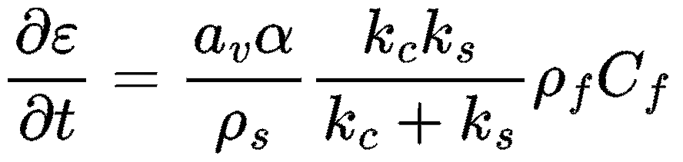
Mathematical Model
Momentum conservation
Porosity correlations
Mass conservation
Acid concentration
Porosity evolution
Panga et al. (2005), AIChE Journal Akanni et al. (2017), SPE J., SPE-187962-PA

Slide 8
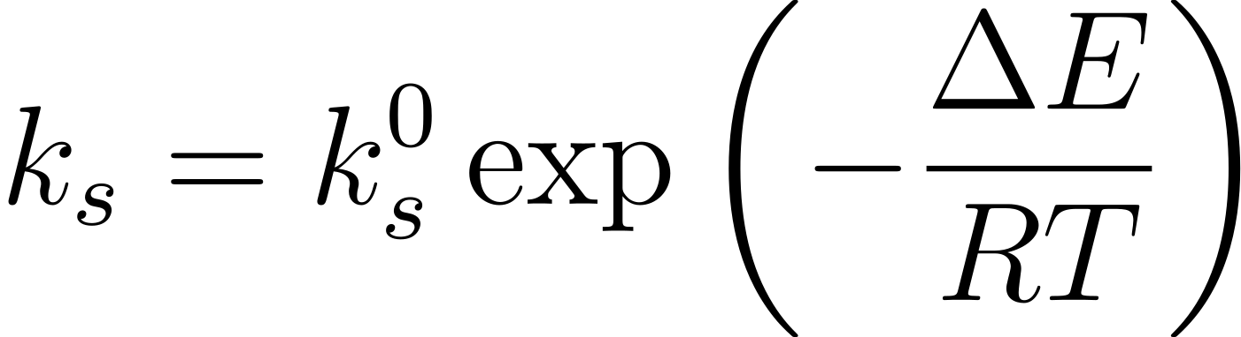
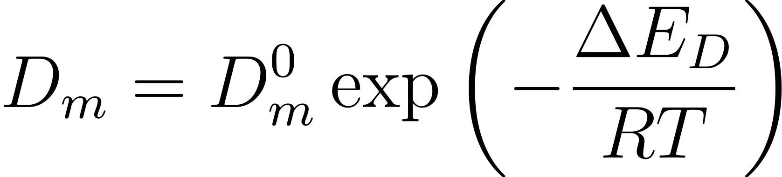
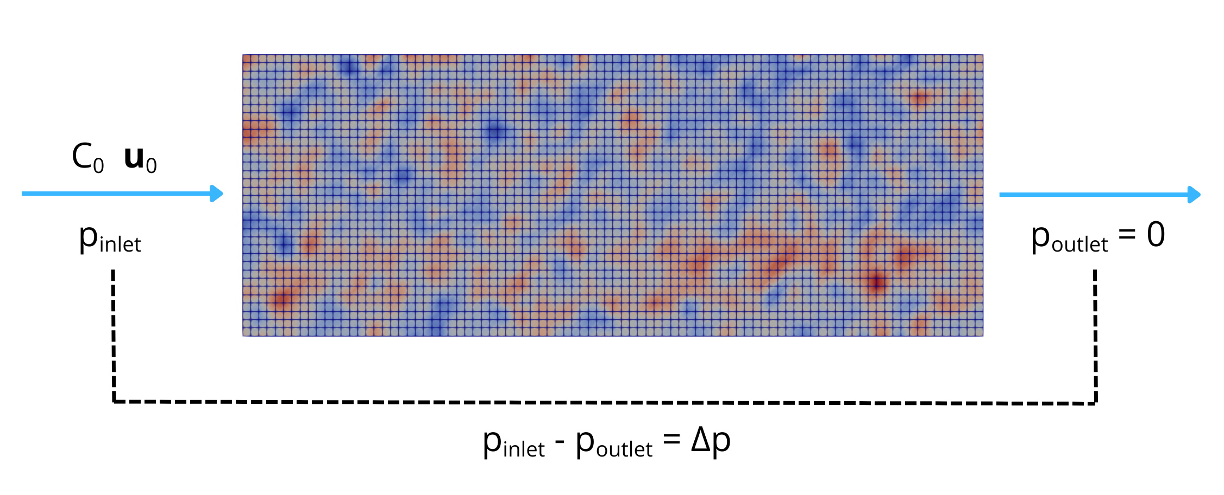

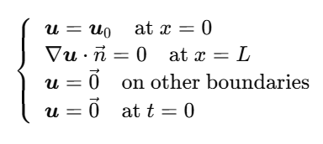
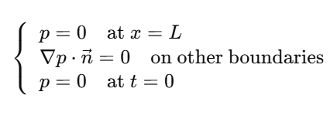
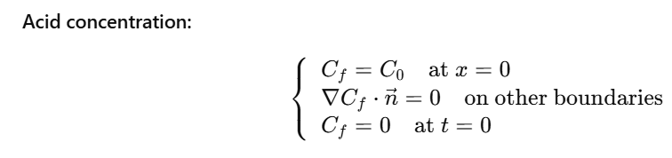
Mathematical Model
Reaction rate constant (ks):
Molecular diffusivity (Dm):

Slide 9
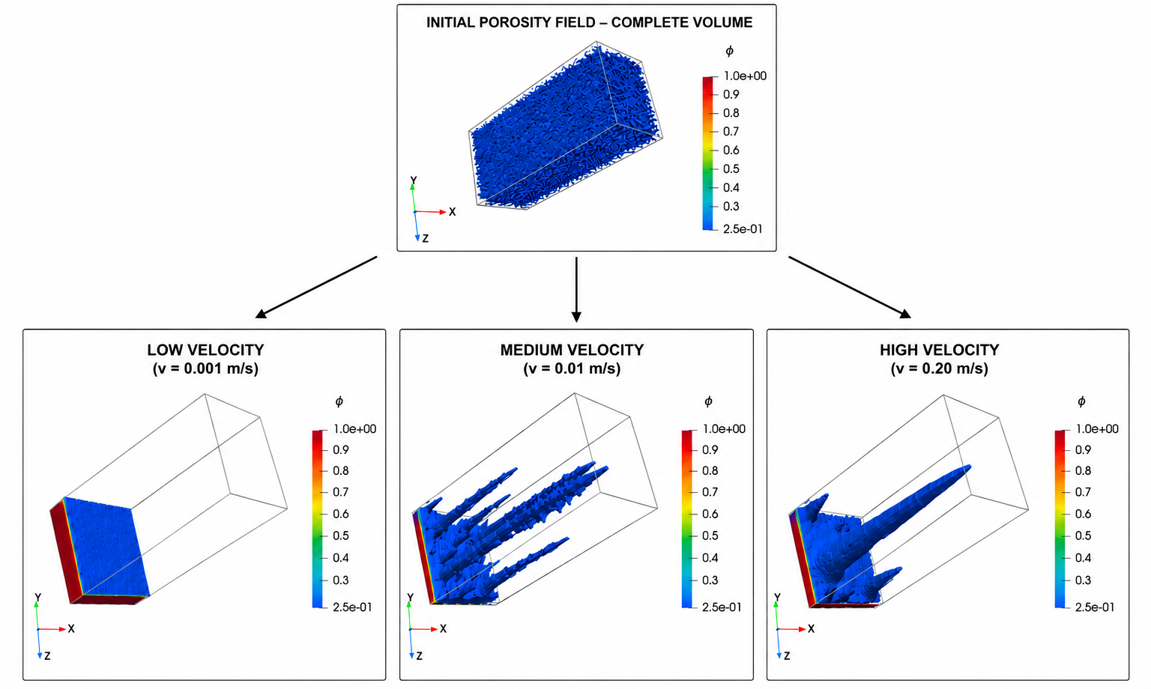
Results – Reactive Flow Simulation

Slide 10
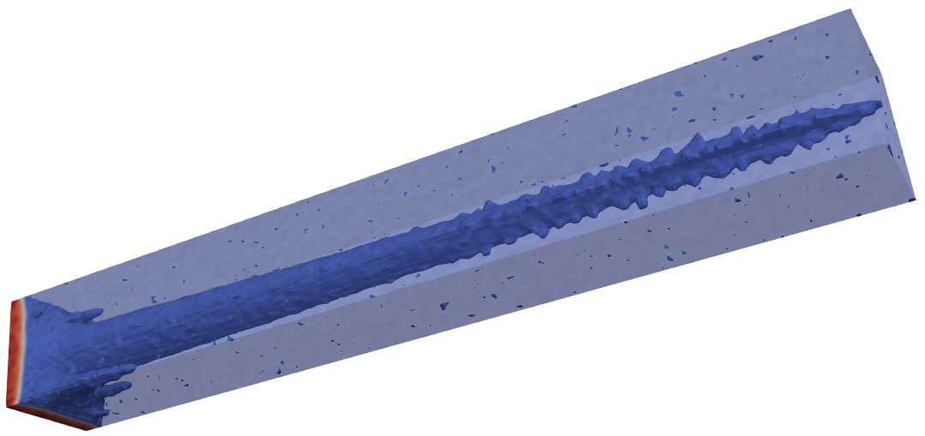
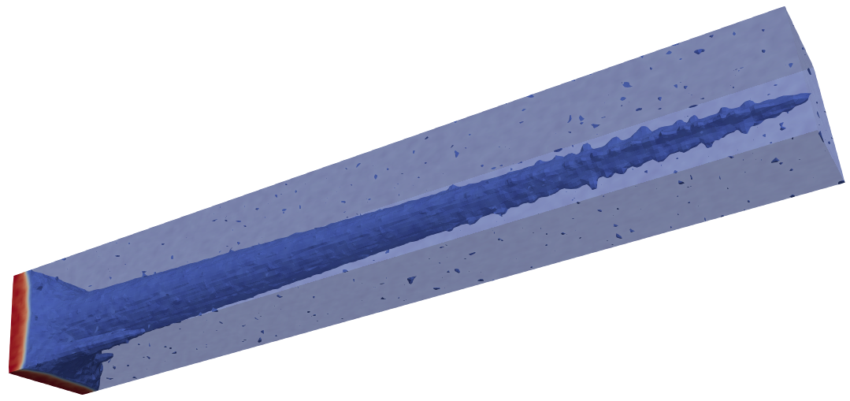
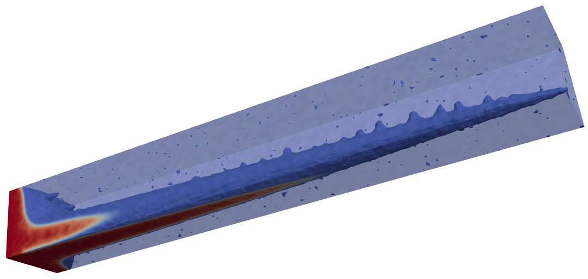
Results – low velocity (0.0001 m/s)
25 °C
50 °C
100 °C

Slide 11
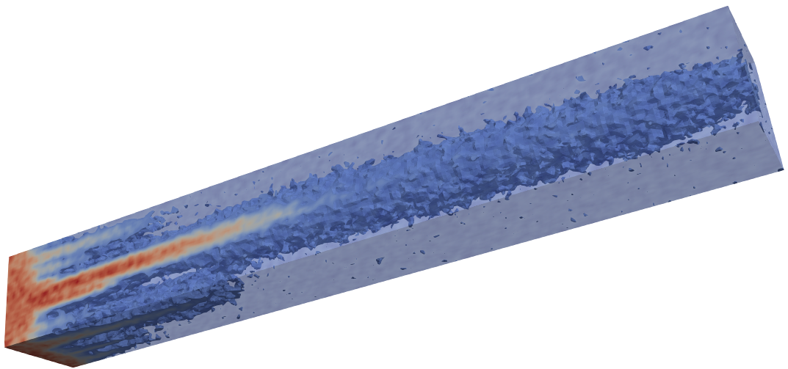
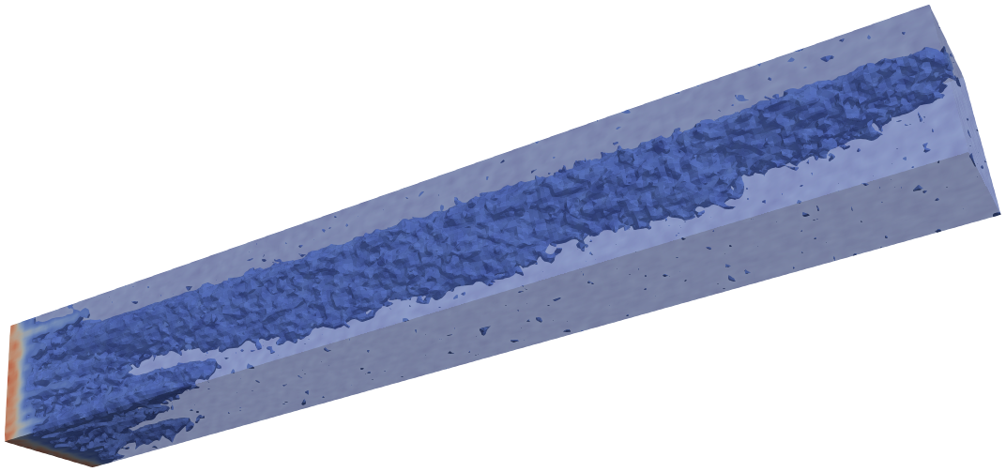
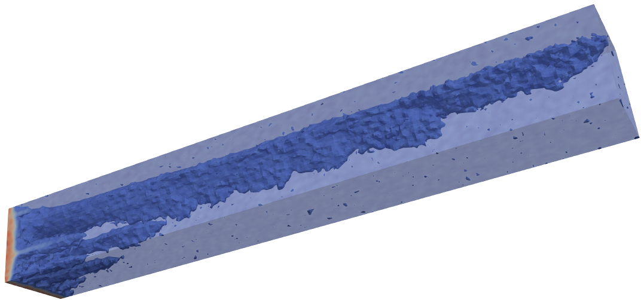
Results – Intermediate Velocity (0.01 m/s)
25 °C
50 °C
100 °C

Slide 12
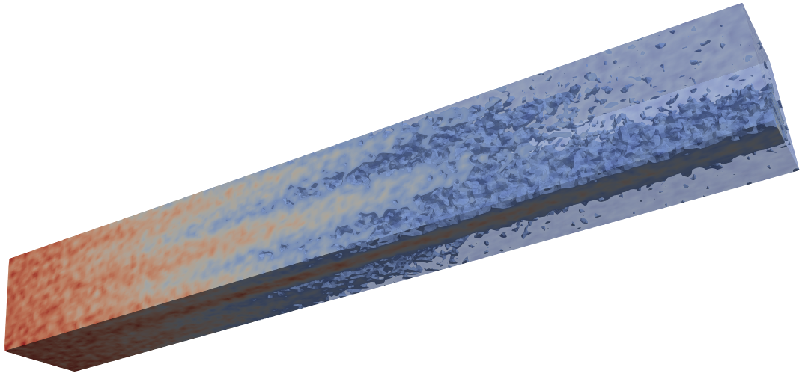
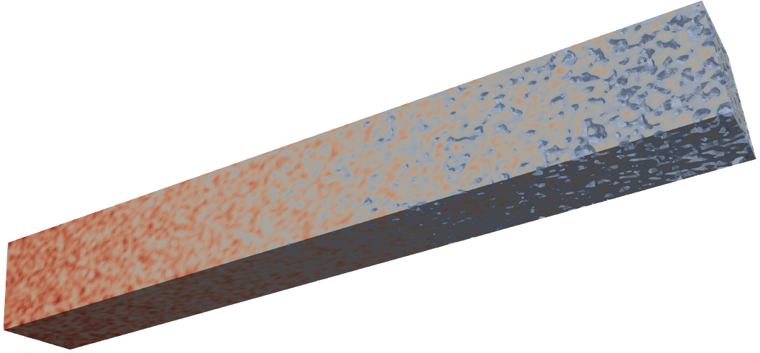
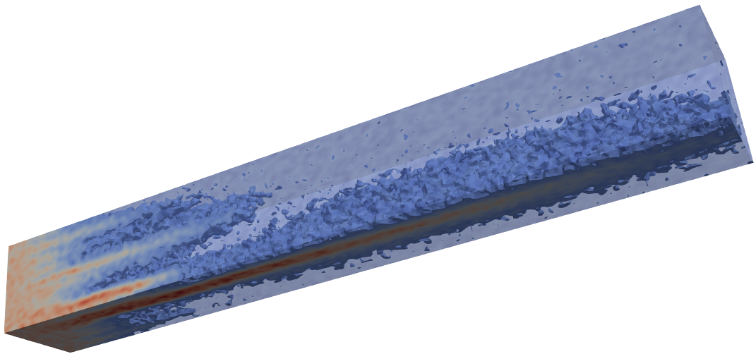
Results - high velocity (0.2 m/s)
50 °C
25 °C
100 °C

Slide 13
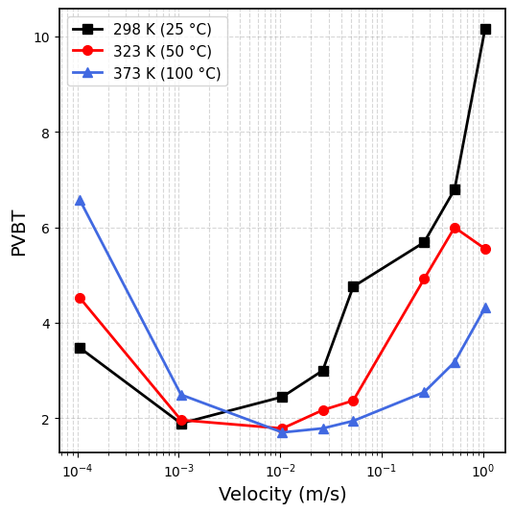
Results

Slide 14
Conclusions
Higher temperatures exhibit larger PVBT values before the optimal point is reached.
At high flow velocities, lower temperatures lead to higher PVBT values.
The optimal point shifts toward higher velocities as temperature increases.
The system exhibits distinct optimal operating conditions depending on the temperature level.

Slide 15
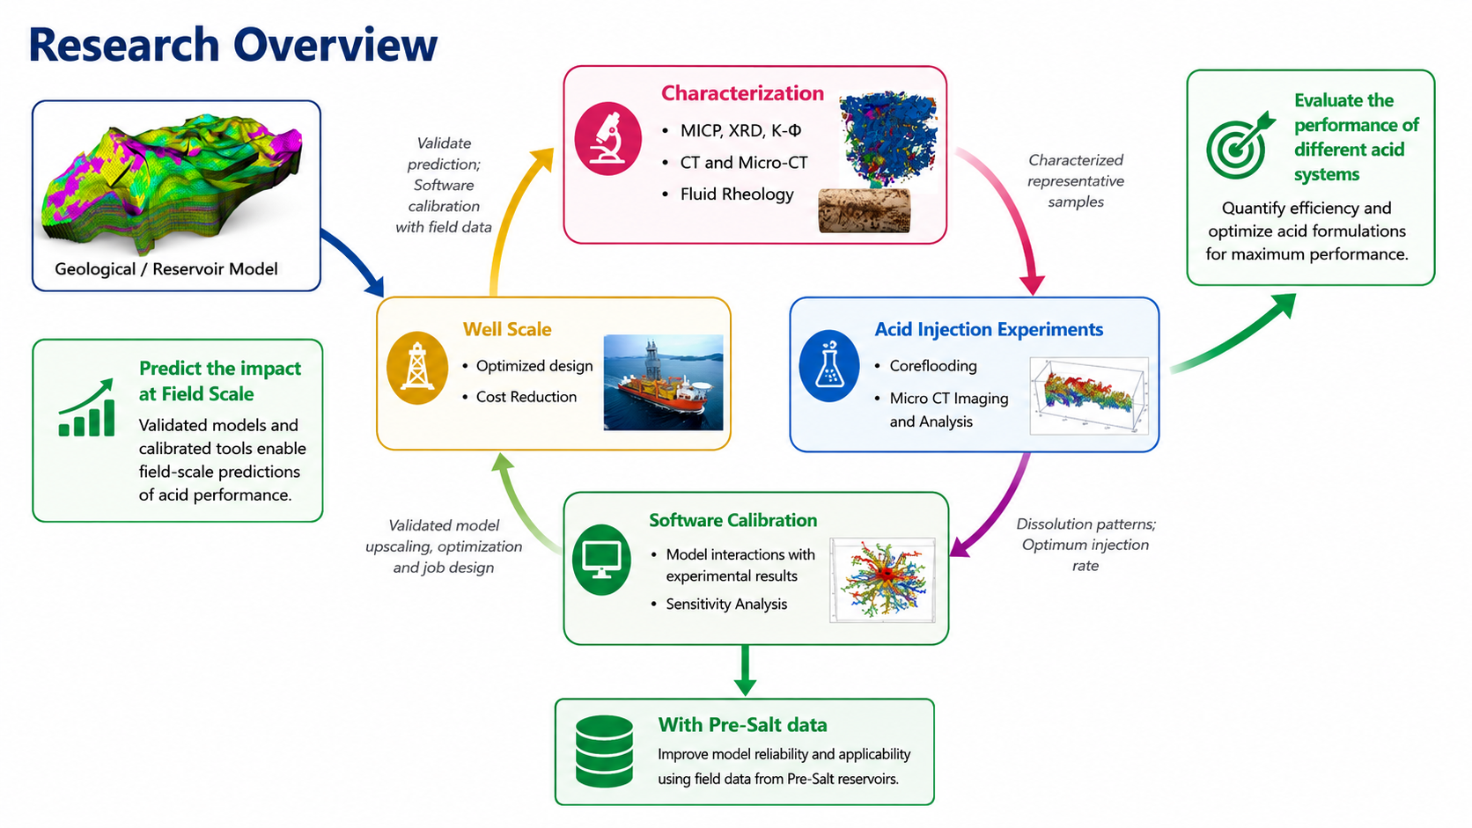


Research Outlook

Slide 16

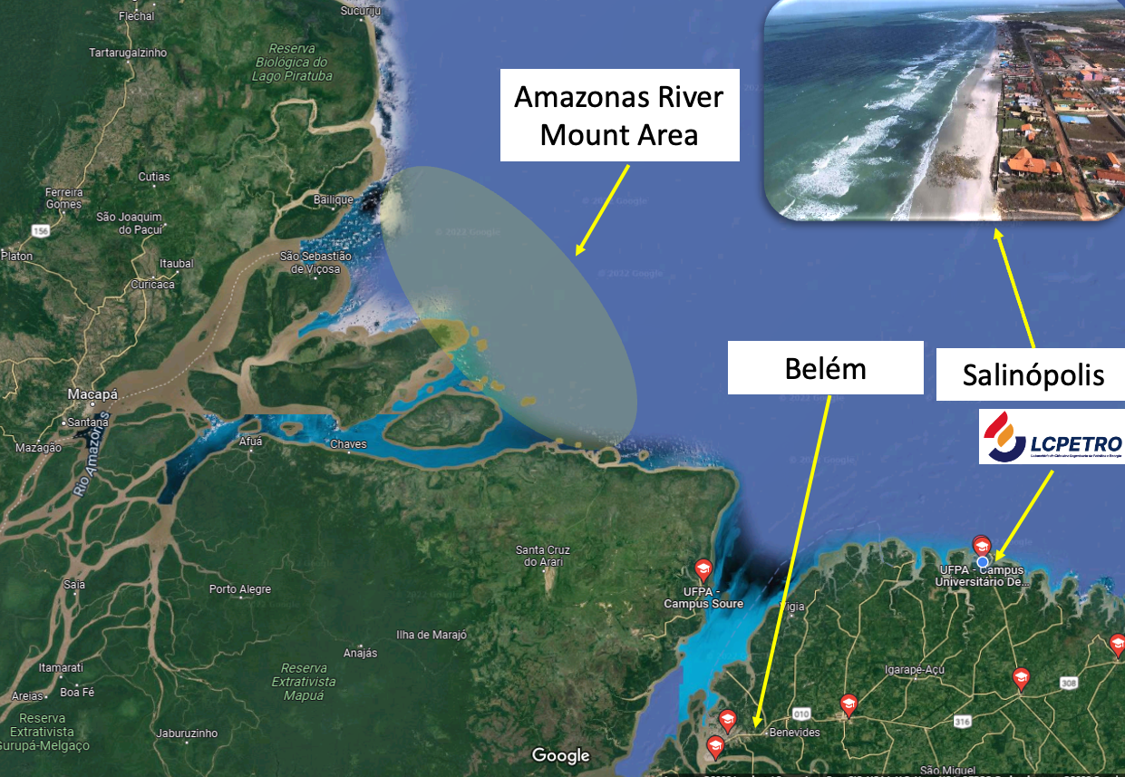
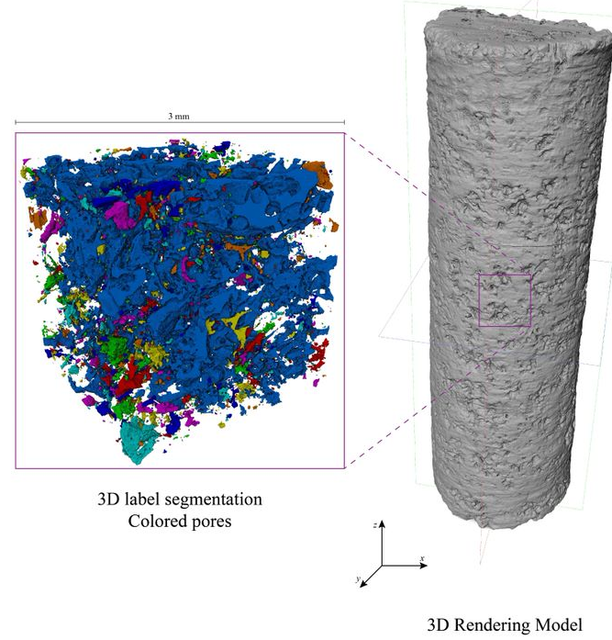
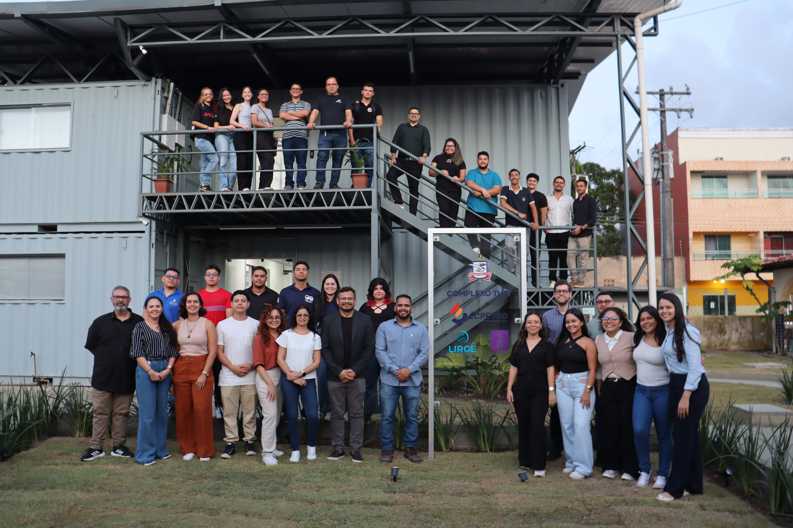
Research group focused on reactive and non reactive flow in porous media – experimental and numerical simulation
www.lcpetro.ufpa.br

Slide 17





Acknowledgments and Support

Slide 18
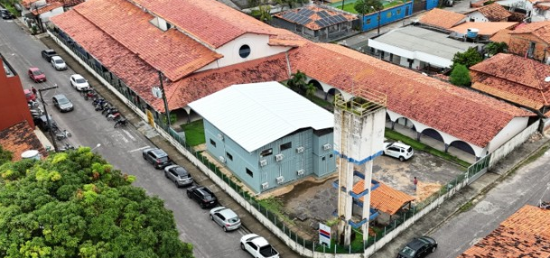


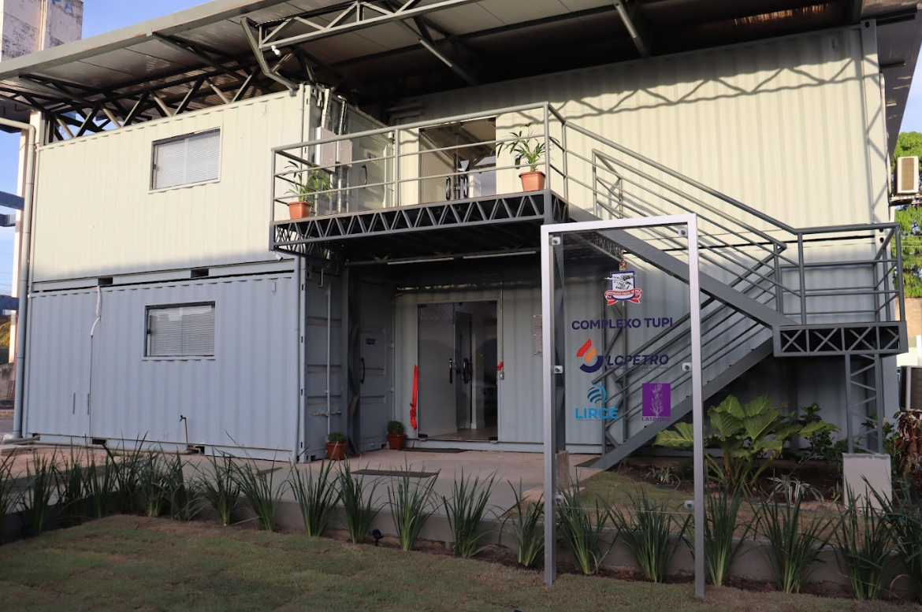

LCPETRO Facilities
LAB
ADM

Slide 19
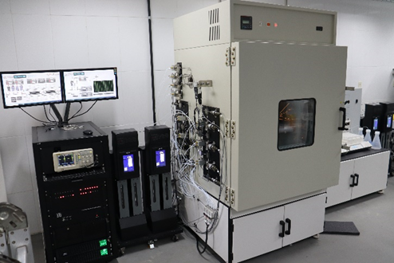
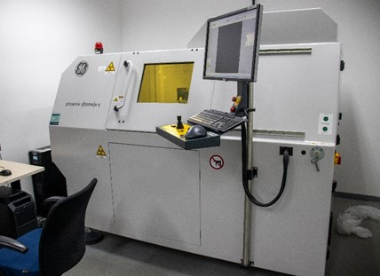
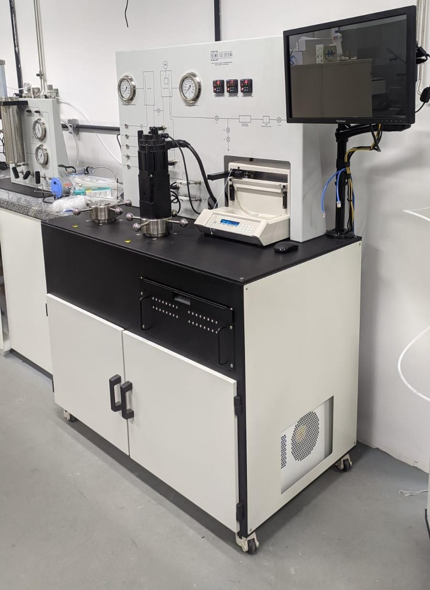
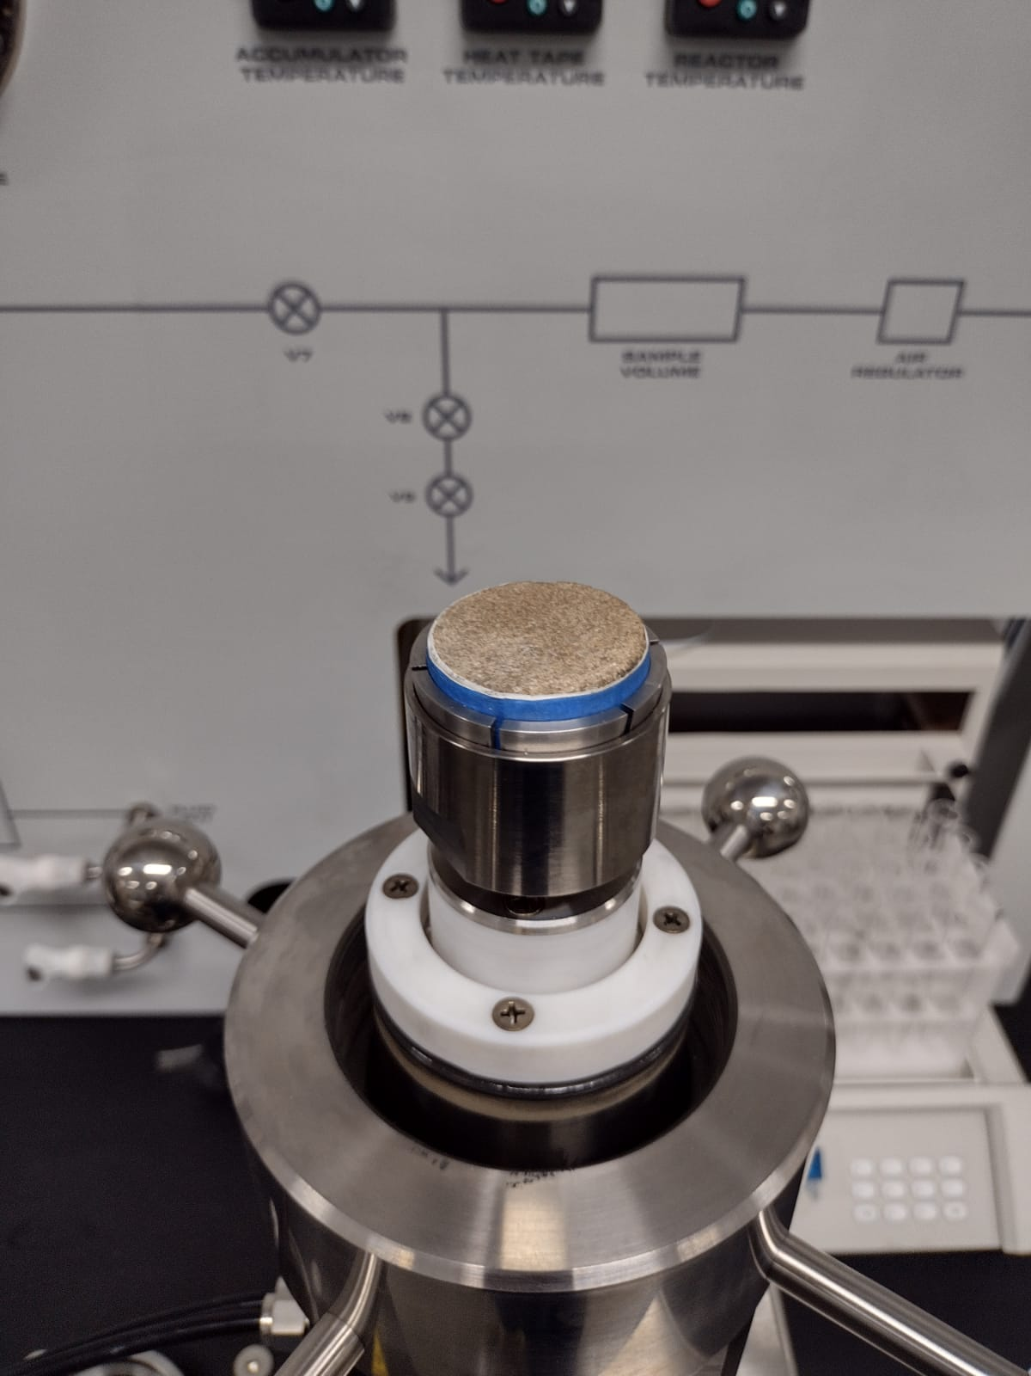
LCPETRO Equipment's
Available Equipment
2 Core Flooding System (wetted parts in Hastelloy C) both dual core
MicroCT V-Tomex-s/ GE
Rotating Disk Reactor (RDR) / DCI
Atomic Absorption Spectrophotometer / Thermo Sci. iCE 3500
Viscometer (with wetted parts in Hastelloy C) / Grace Instruments
Tensiometer
Automatic Rock Saturator
Permeameter, Porosimeter
3D Printer
Water Ultra-purifier
Fig. Coreflooding external (left) and internal (right) details
Fig. MicroCT external (left ), internal detail (right)
Fig. Rotating Disc Reactor external (left) and sampler (right) details
Notes:
Laboratory Visit (Movie): https://www.youtube.com/watch?v=Qy2p92HQDb0

