Slide 1
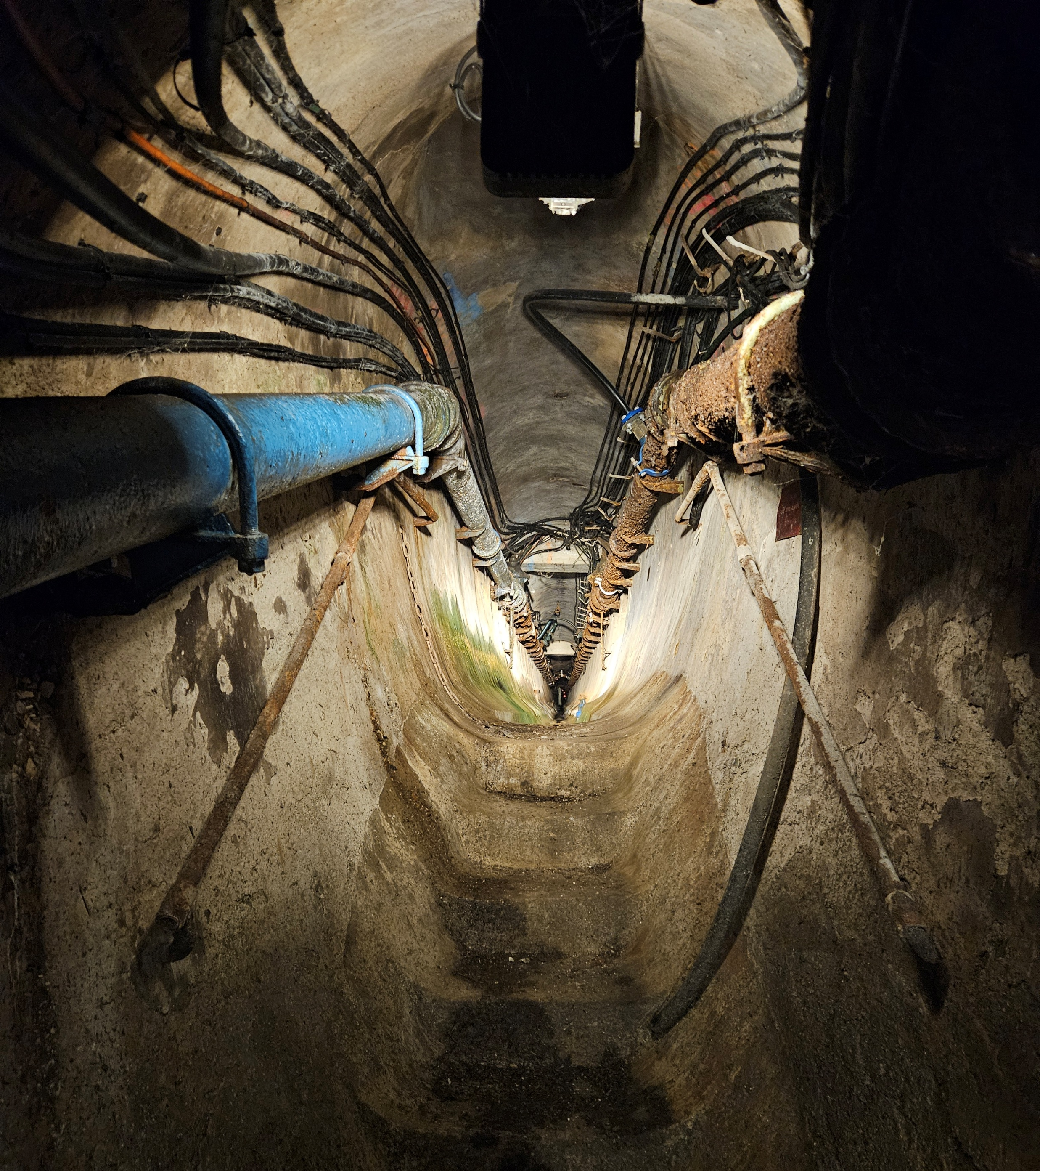
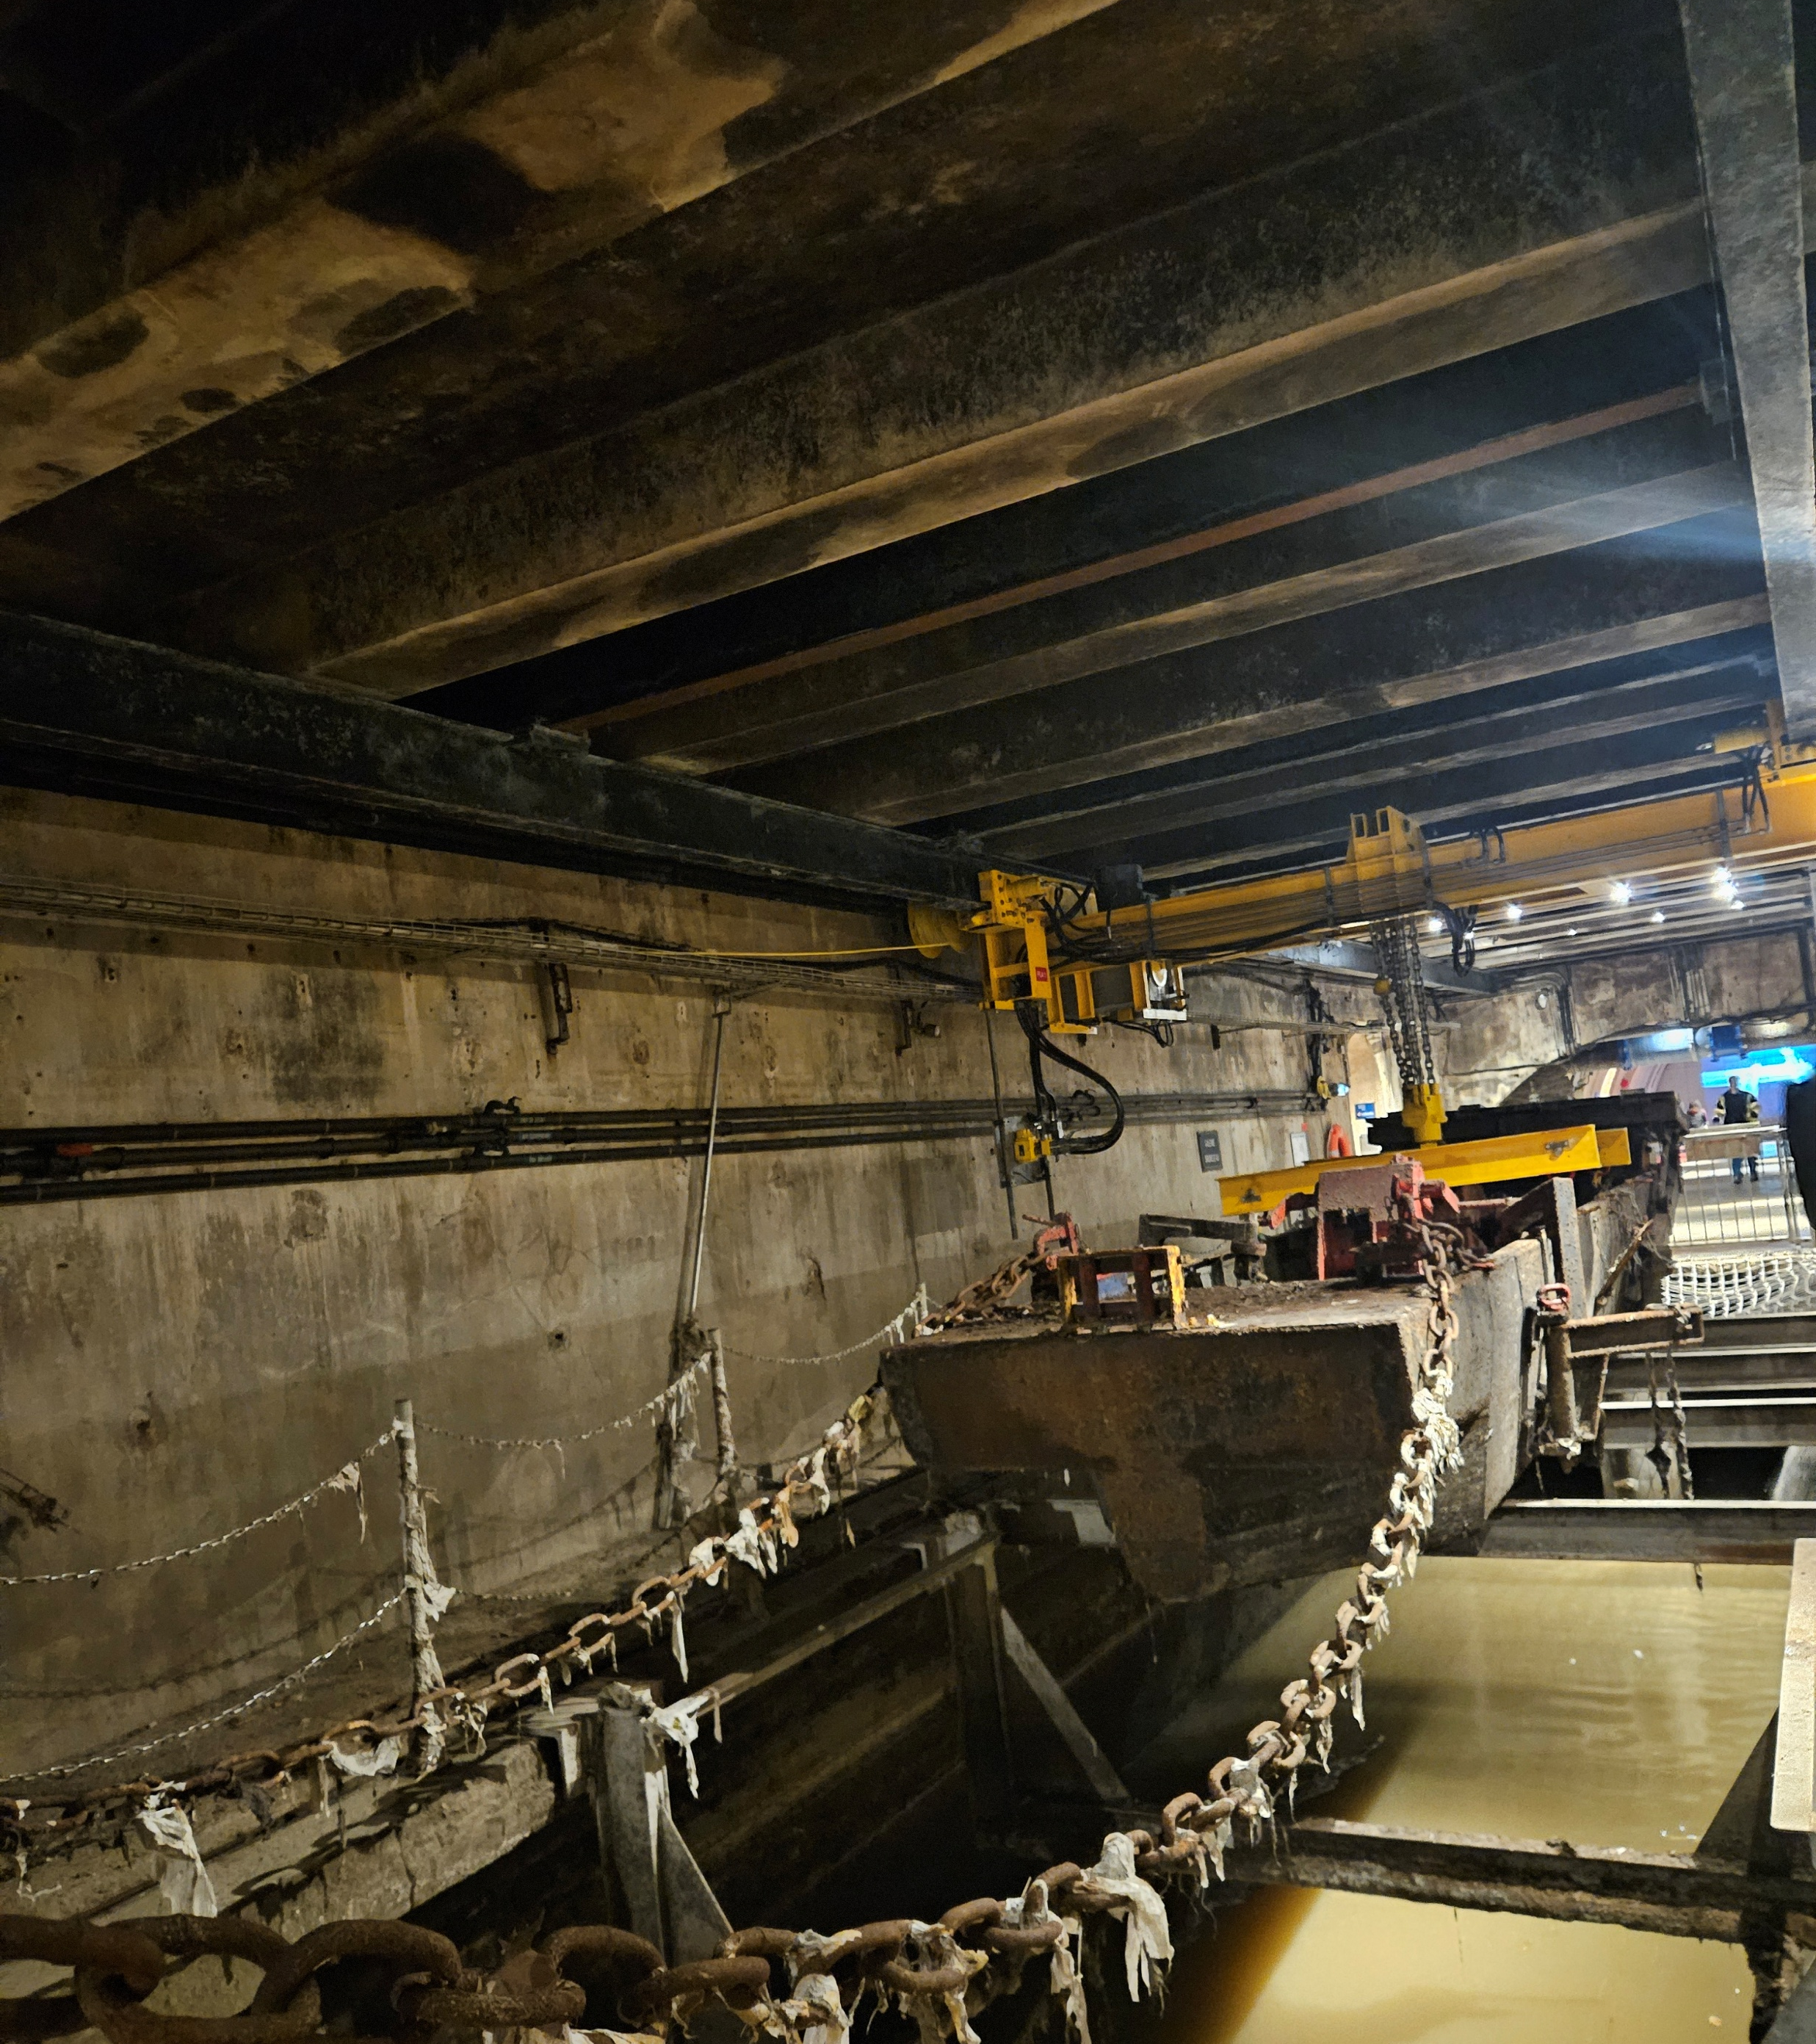

Slide 2
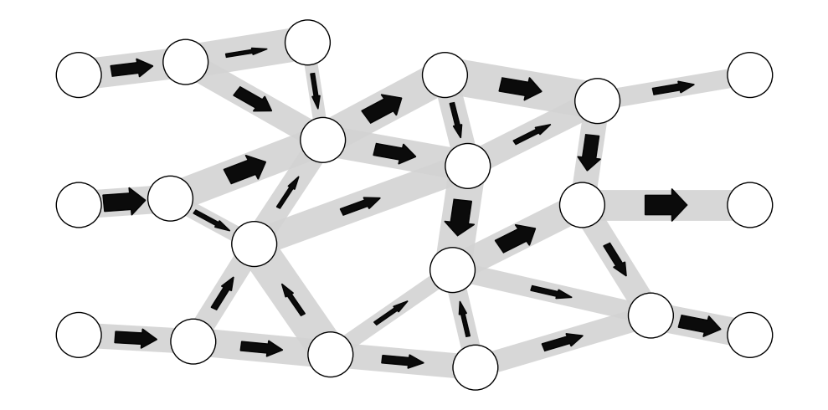
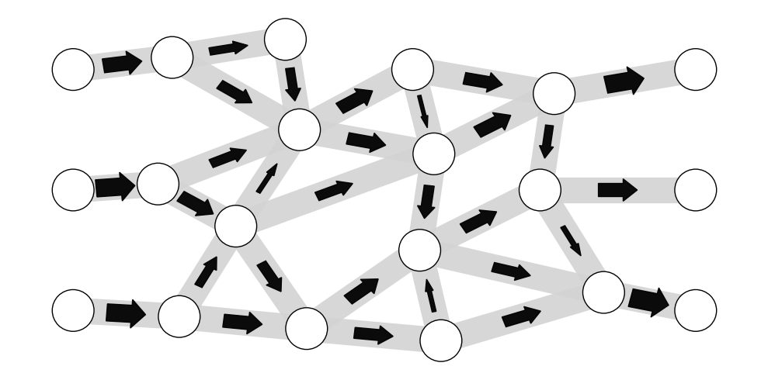
If all links had the same width, would the flow be uniform?
variance in width
uniform width
flow rate:
channel width:

Slide 3
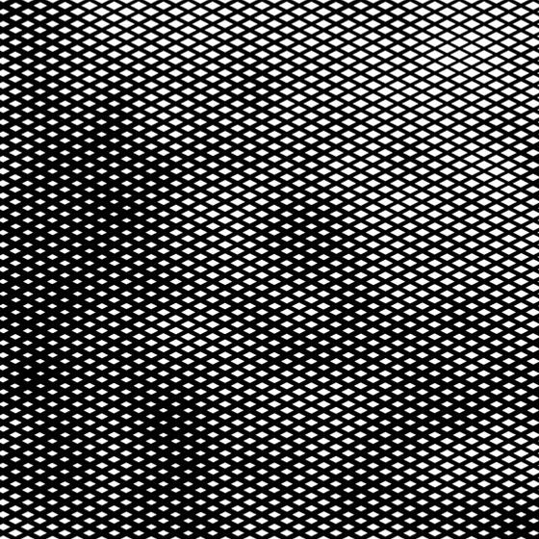
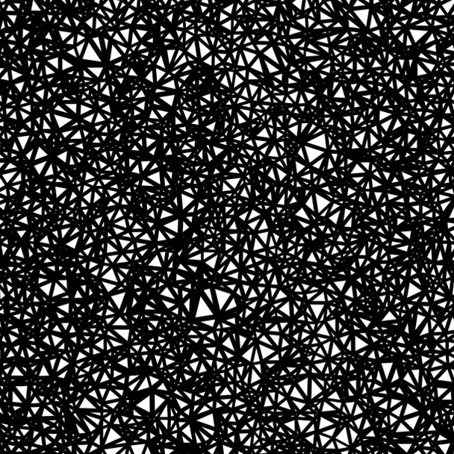
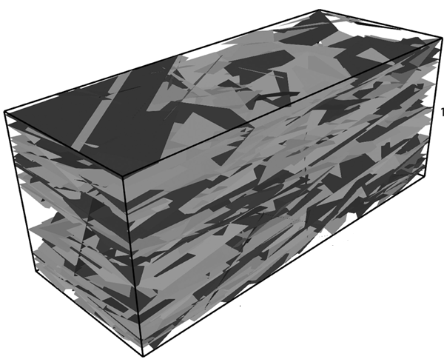
Structural barriers to complete homogenization and wormholing in dissolving porous and fractured rocks
Tomasz Szawełło¹, Jeffrey D. Hyman², Peter K. Kang³, & Piotr Szymczak¹
¹University of Warsaw ²Los Alamos National Laboratory ³University of Minnesota

Slide 4
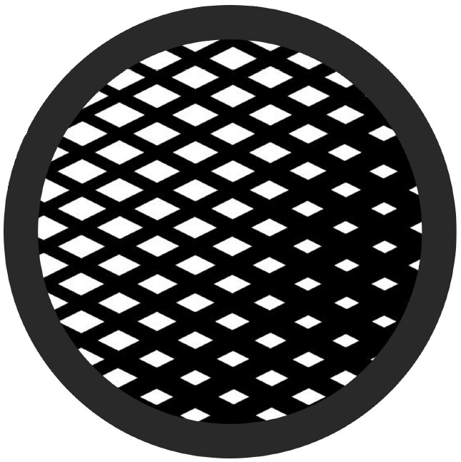
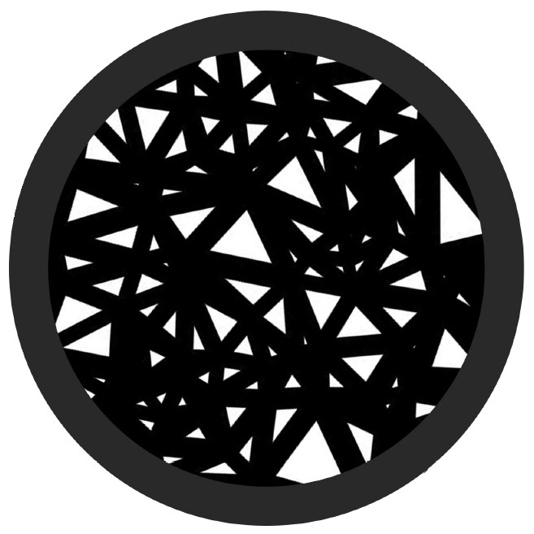
Heterogeneity
link-scale
(diameters/apertures)
segment-scale
(lengths)
network-scale
(connectivity)

Slide 5
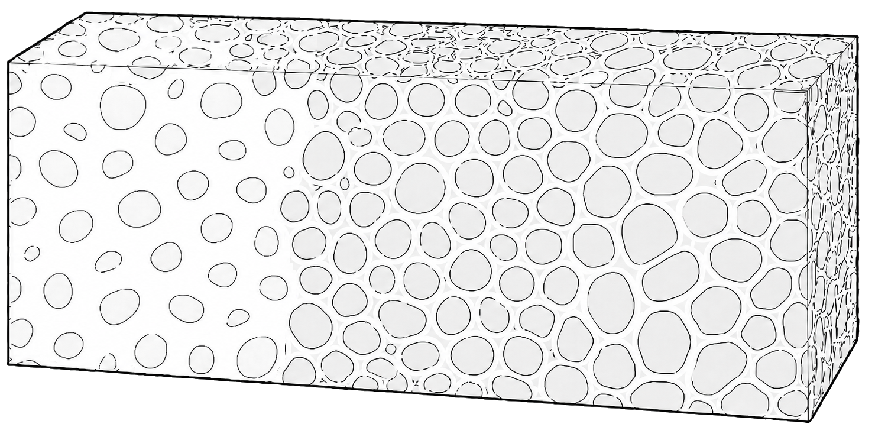
Dissolution in porous and fractured media
porous medium
reactive fluid
flow + reactant transport + chemical kinetics
evolving geometry
dissolution patterns
transformed region
e.g.
$$\text{CaC}{\text{O}}_{3}+2H^{+}→\text{C}{\text{O}}_{2}+H_{2}O+\text{C}{\text{a}}^{2+}$$

Slide 6
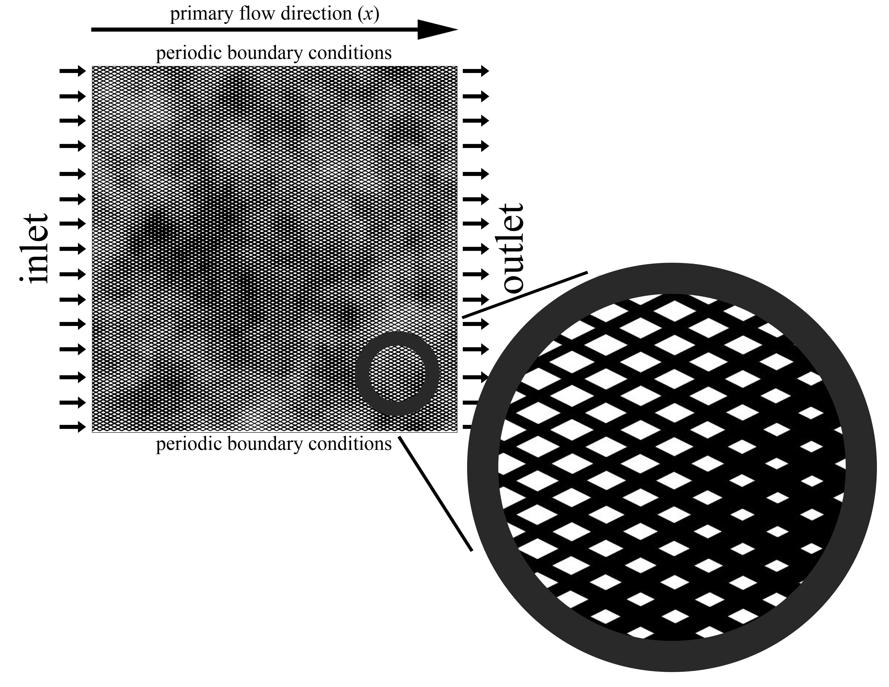
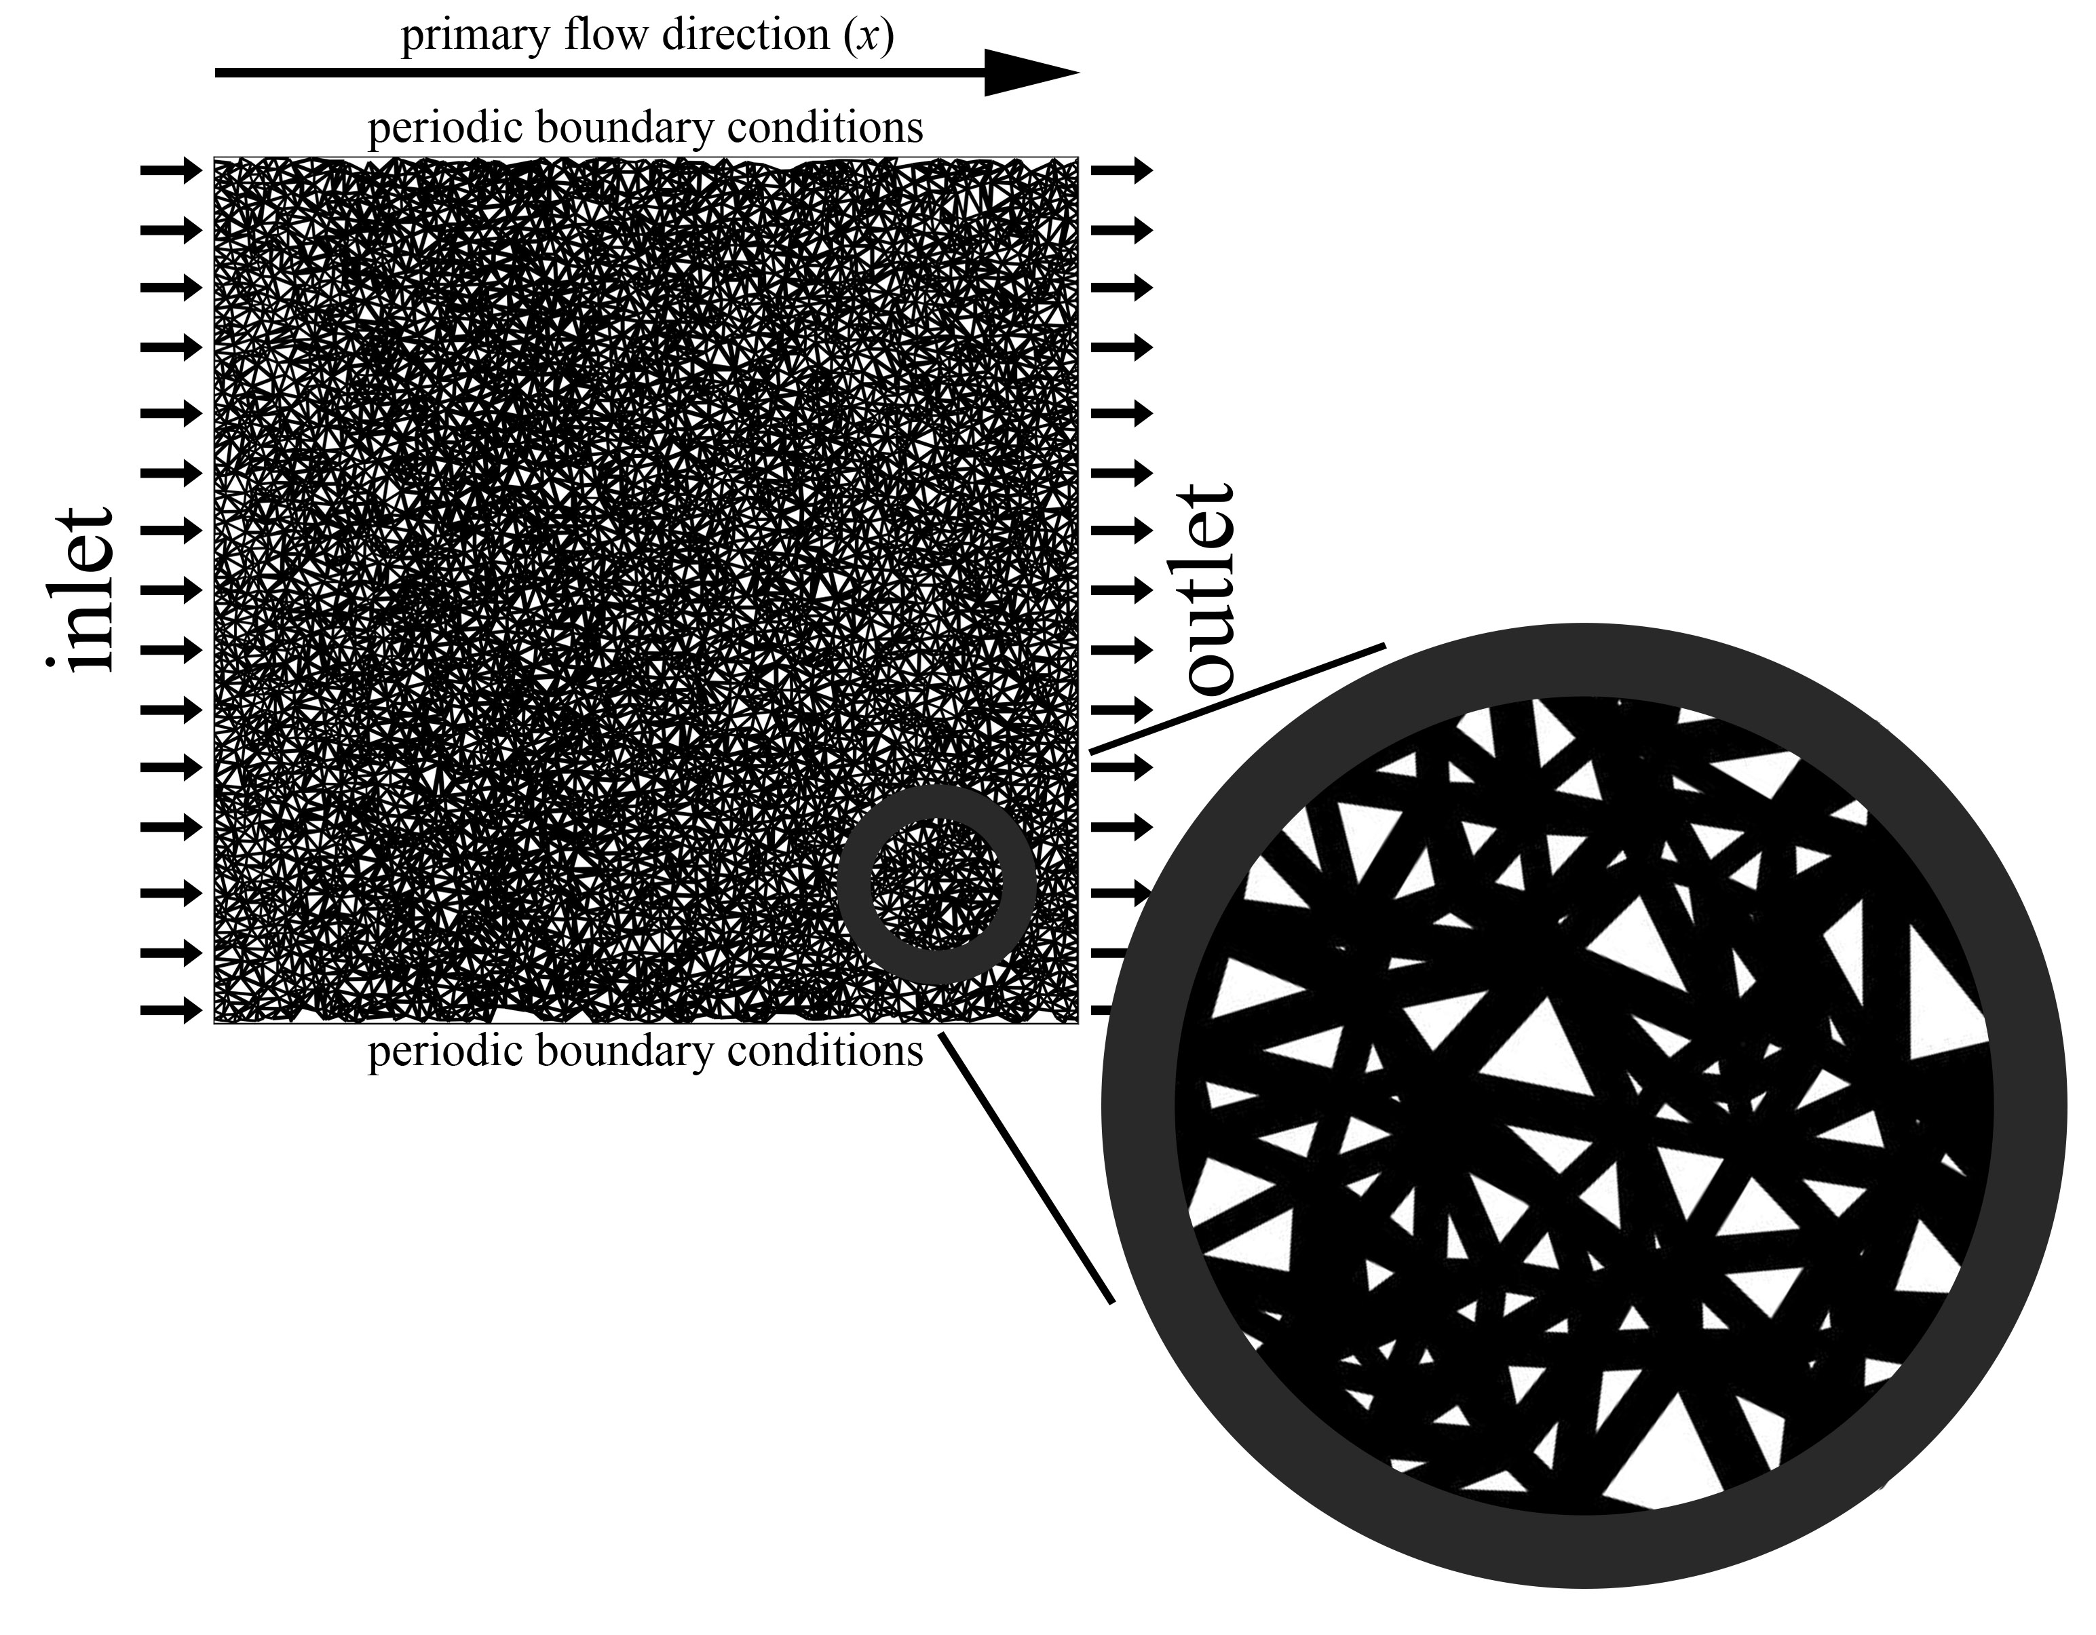
Pore network
regular
disordered
diameter map
diameter map
Hoefner & Fogler, AIChE J. (1988), Budek & Szymczak, Phys. Rev. E (2012)

Slide 7
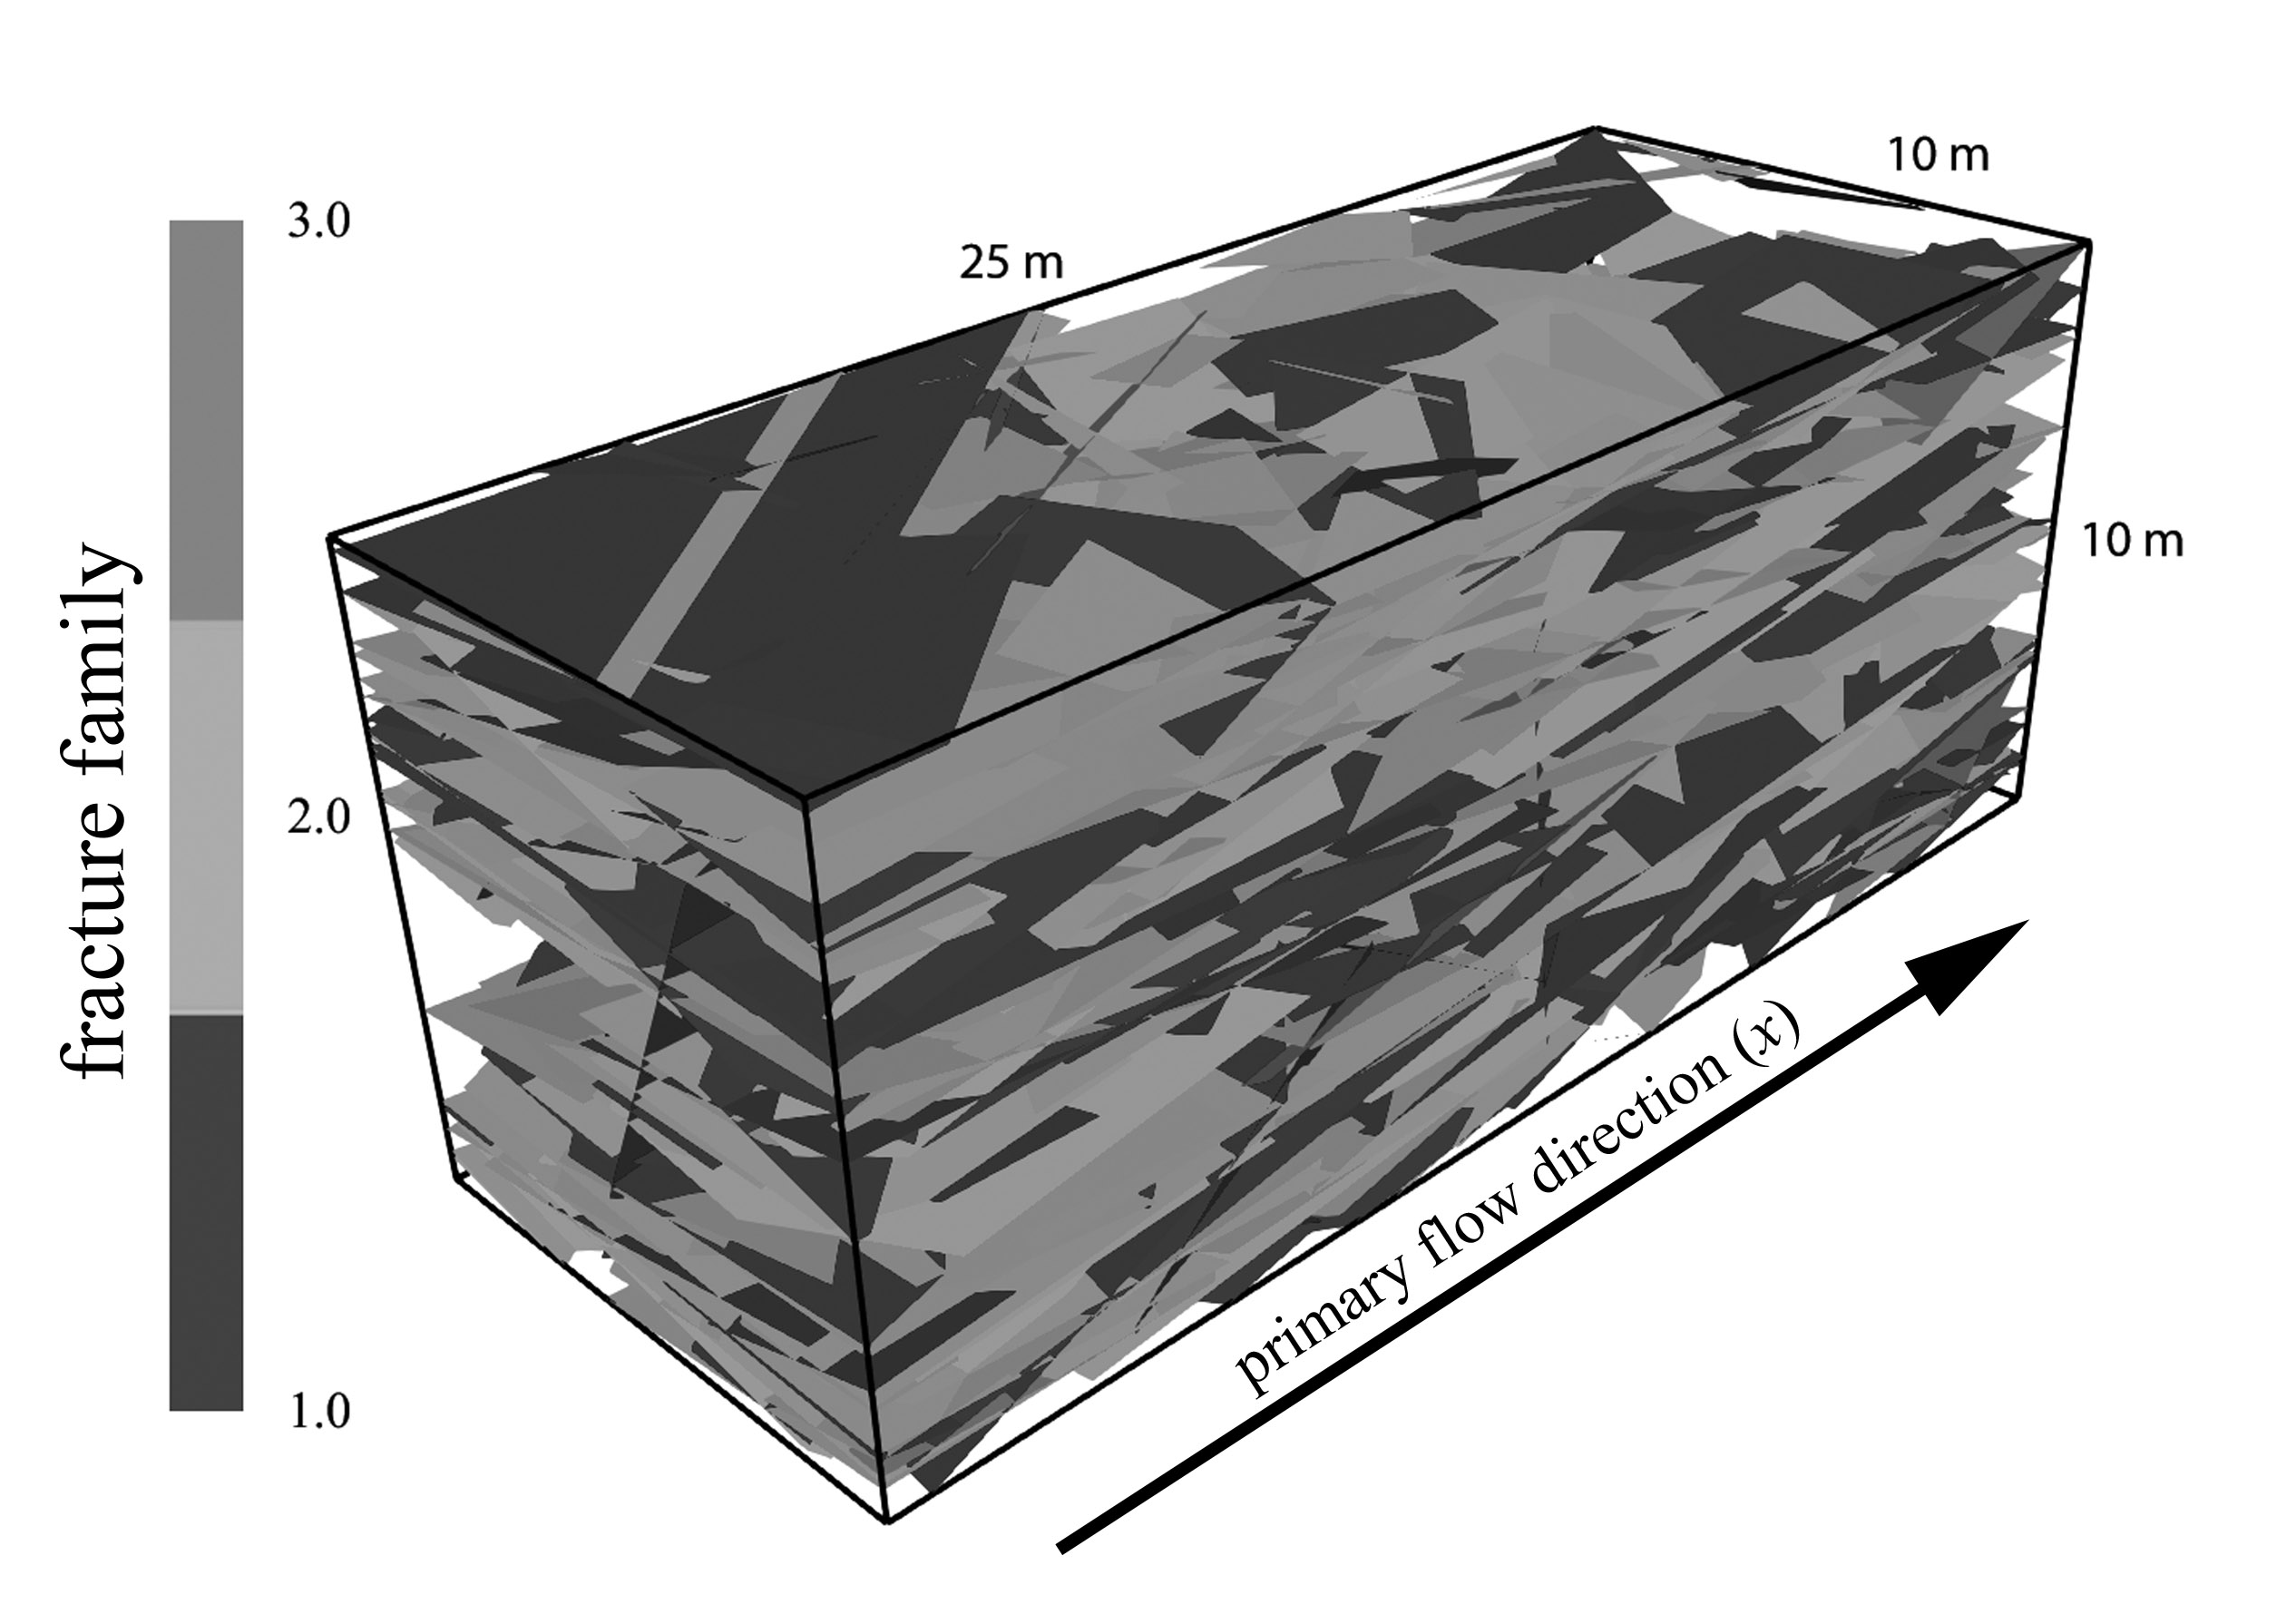
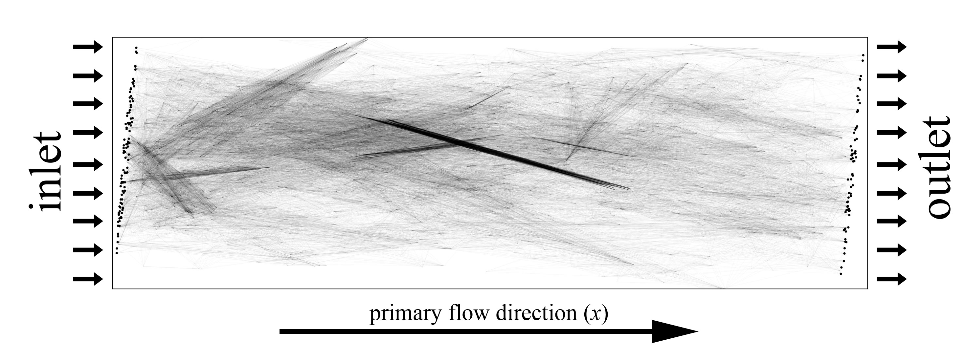
Discrete fracture network
Hyman et al., Comput. Geosci. (2015)
Hyman et al., Multiscale Model. Simul. (2018)
graph representation

Slide 8
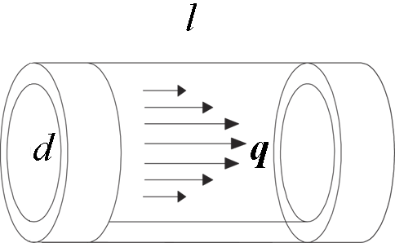
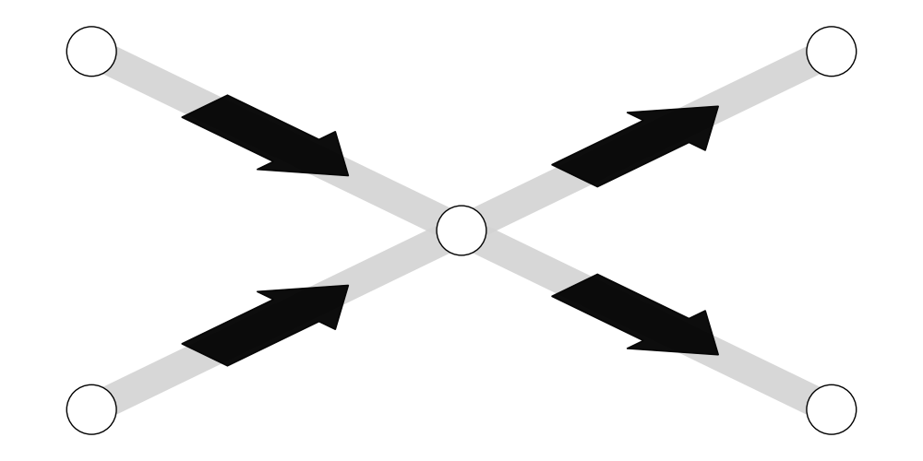
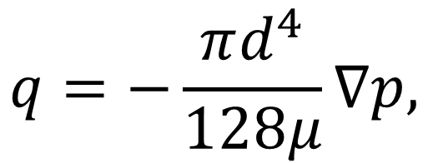
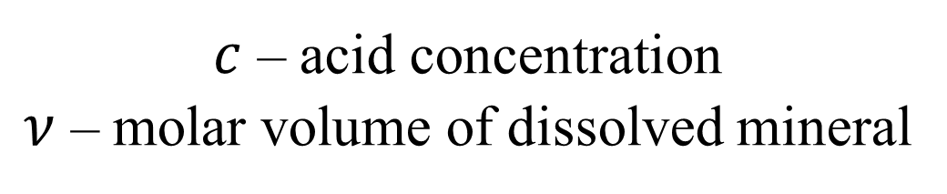
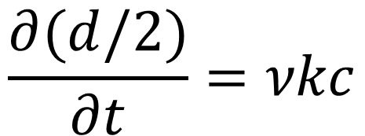
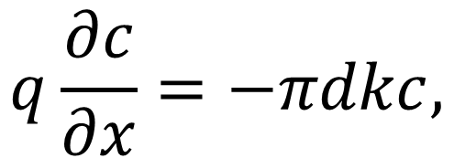
Flow, solute transport and erosion
$$q=−\frac{πd^{4}}{128μ}∇p,$$
$$q\frac{∂c}{∂x}=−πdkc,$$
$$\frac{∂(d/2)}{∂t}=νkc$$
$c$ – acid concentration
$ν$ – molar volume of dissolved mineral

Slide 9
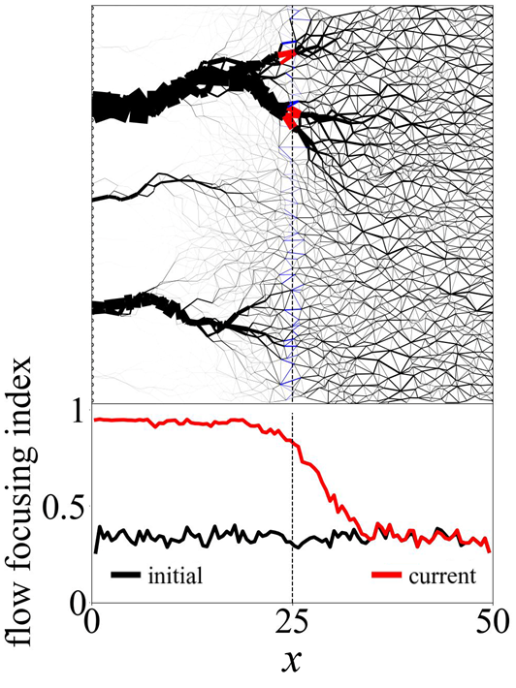
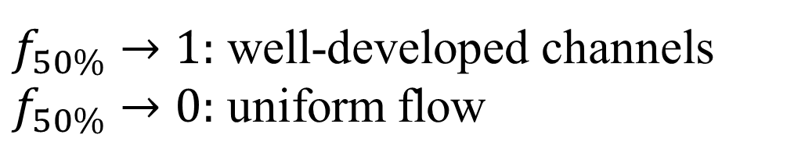
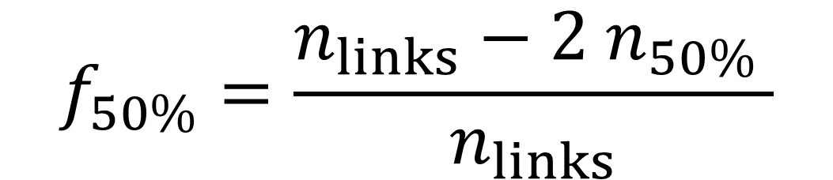
Flow focusing profile
At each cross-section, how many links are needed to carry half of the flow?
flow map
$$f_{50\%}=\frac{n_{links}−{2 n}_{50\%} }{n_{links}}$$
$f_{50\%}→1:$ well-developed channels
$f_{50\%}→0:$ uniform flow
Jang et al., Geophys. J. Int. (2011)
Szawełło et al., Geophys. Res. Lett. (2024)

Slide 10
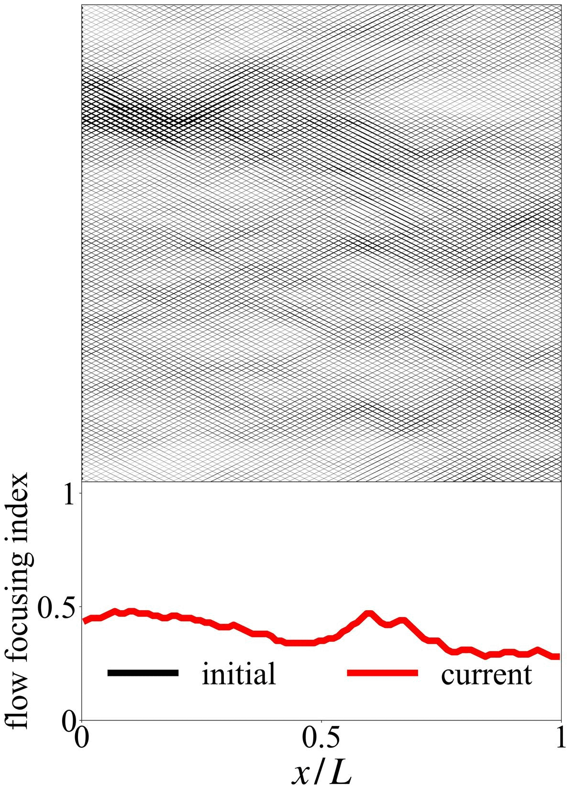

Uniform dissolution in a regular network
regular pore network
flow map
equal diameters
$→$ equal flow
flow focusing index drops almost to zero

Slide 11
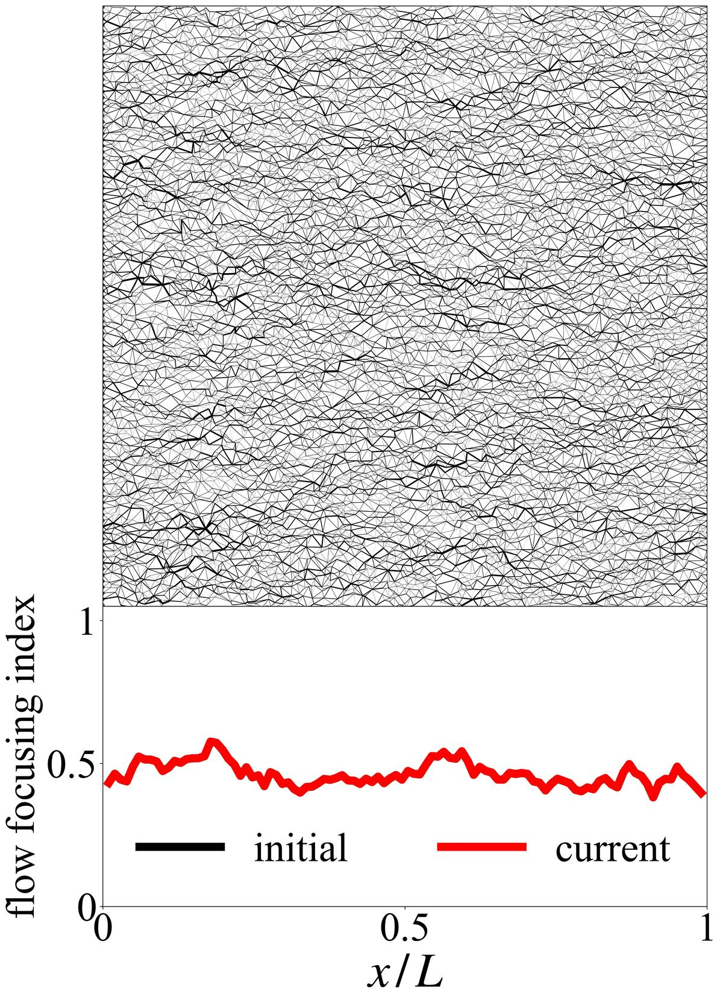
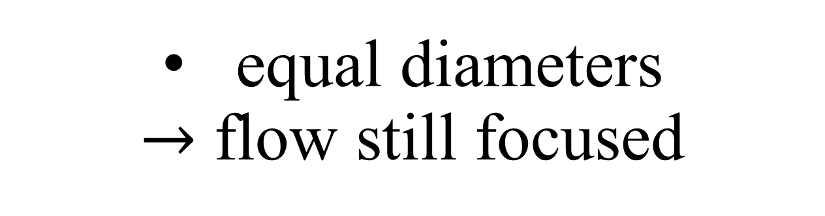
Uniform dissolution in a disordered network
disordered pore network
flow map
equal diameters
$→$ flow still focused
flow focusing index stabilizes at non-zero values

Slide 12
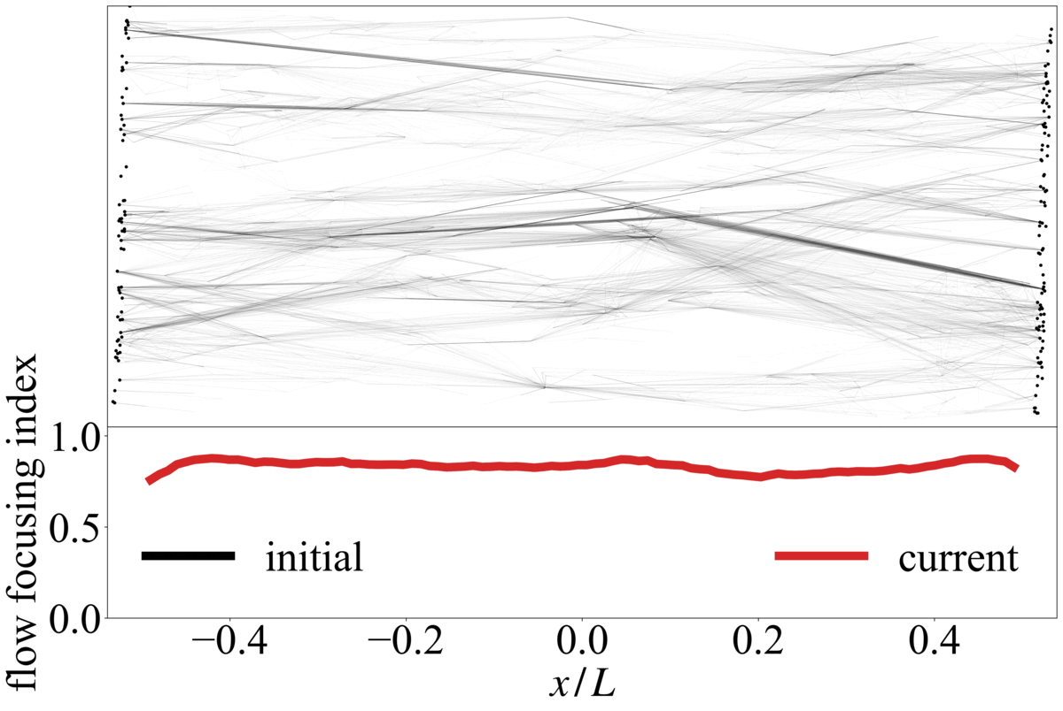
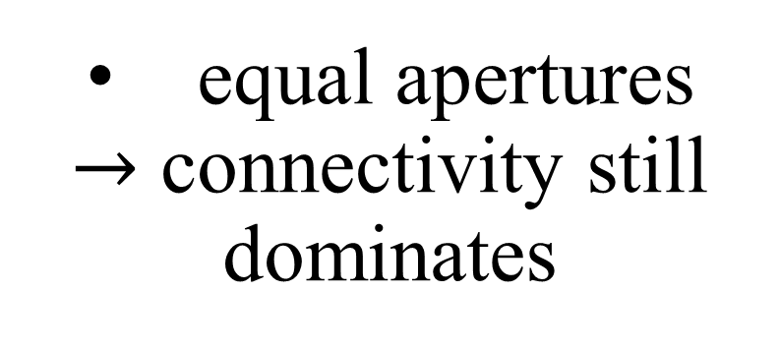
Uniform dissolution in a fracture network
discrete fracture network
equal apertures
$→$ connectivity still dominates
flow map
flow focusing index changes only minimally

Slide 13
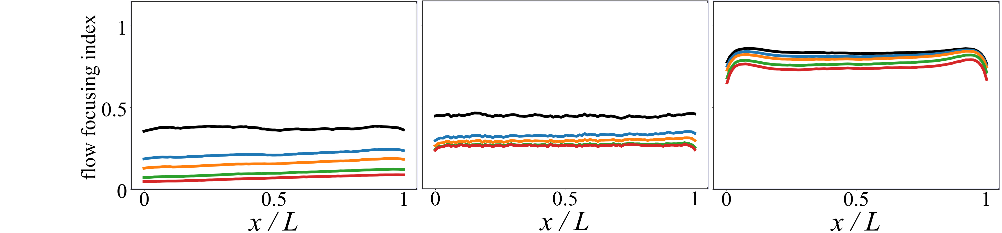
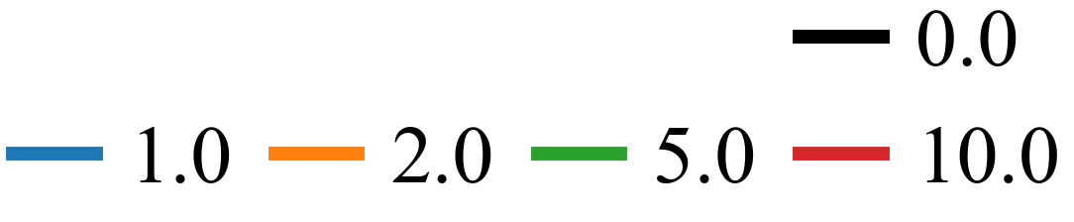
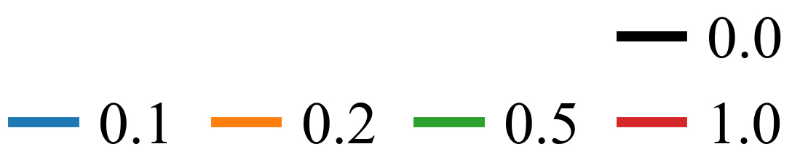



Dissolution cannot erase structural heterogeneity
regular pore network
disordered pore network
discrete fracture network
$$∞$$
$$∞$$
$$∞$$
Szawełło et al., Int. J. Rock Mech. Min. Sci. (2026)

Slide 14
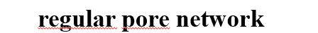
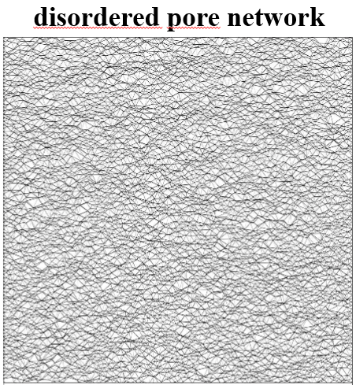
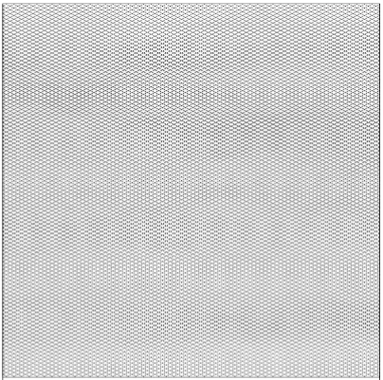

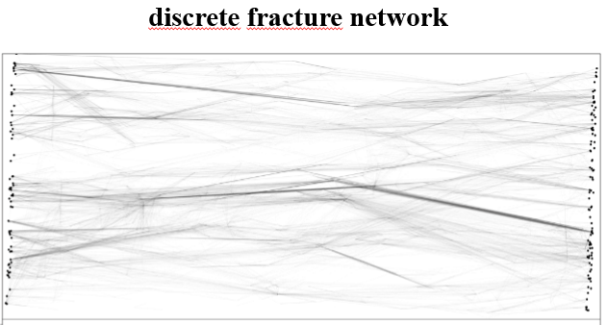
Dissolution can smooth link-scale heterogeneity.
Path lengths and connectivity can still focus flow.
After uniform dissolution:
Szawełło T., Hyman, J. D., Kang, P. K., & Szymczak, P. (2026). Structural barriers to complete homogenization and wormholing in dissolving porous and fractured rocks. Int. J. Rock Mech. Min. Sci., 200, 106431.
t.szawello@uw.edu.pl

Slide 16
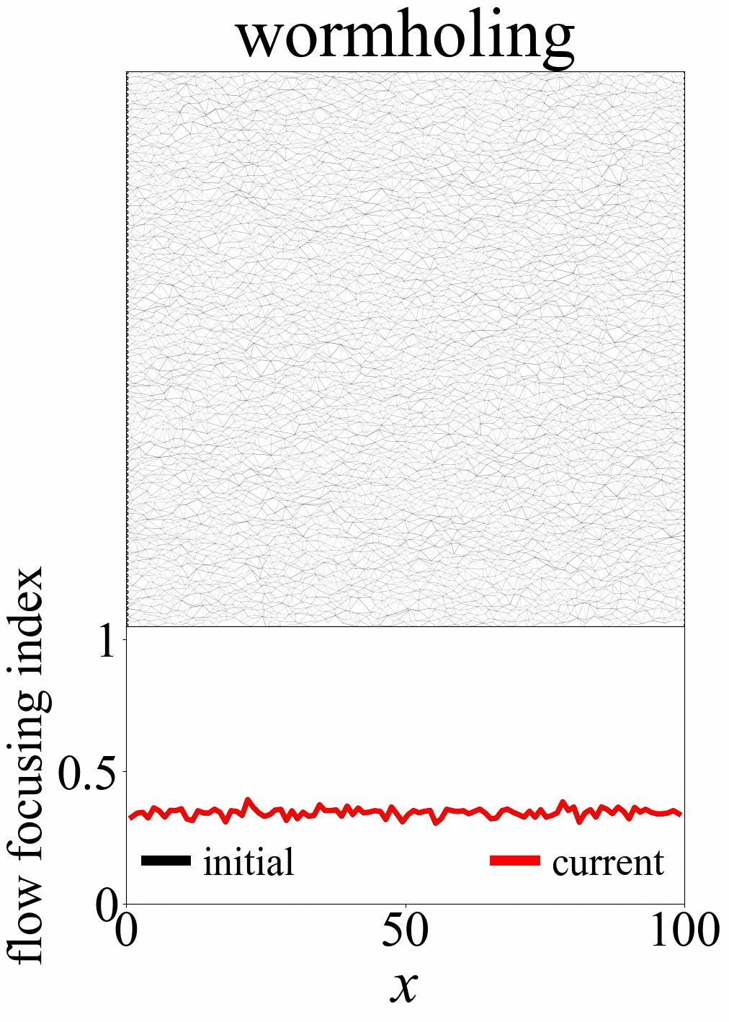
Flow focusing profile in porous media
flow map
a channel advancing from the inlet
a progressing front in the profile

Slide 17
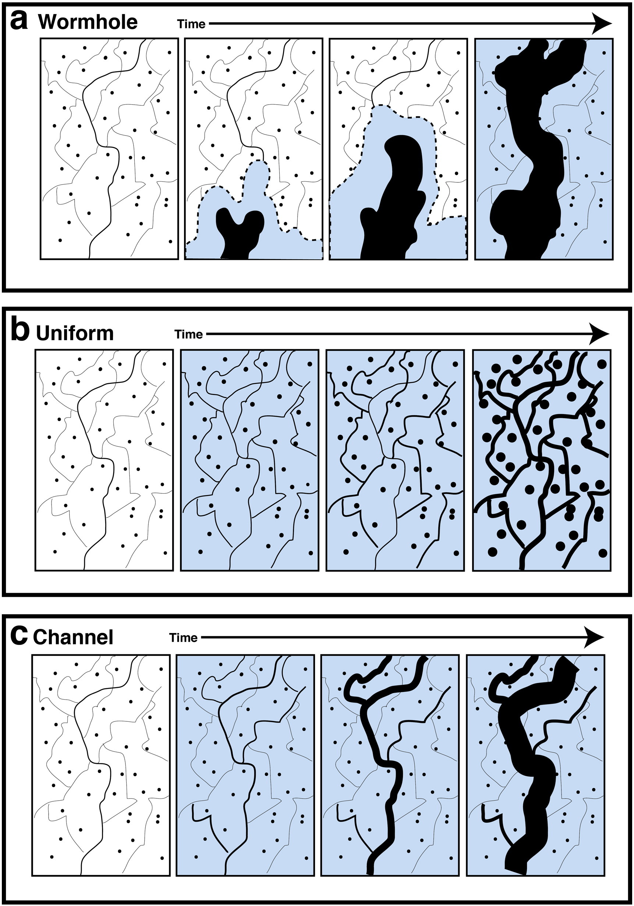
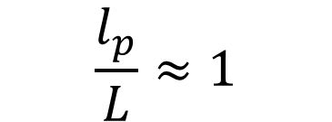
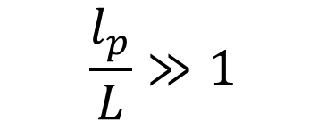
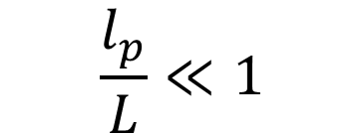
Dissolution regimes
wormholing
channels advance from the inlet into the medium
$$\frac{l_{p}}{L}≪1$$
channeling
initial flow pathway enlarging along its entire length
$$\frac{l_{p}}{L}≈1$$
uniform
$$\frac{l_{p}}{L}≫1$$
dissolution all across the system
Menke et al. Chem. Geol. (2016)

Slide 18
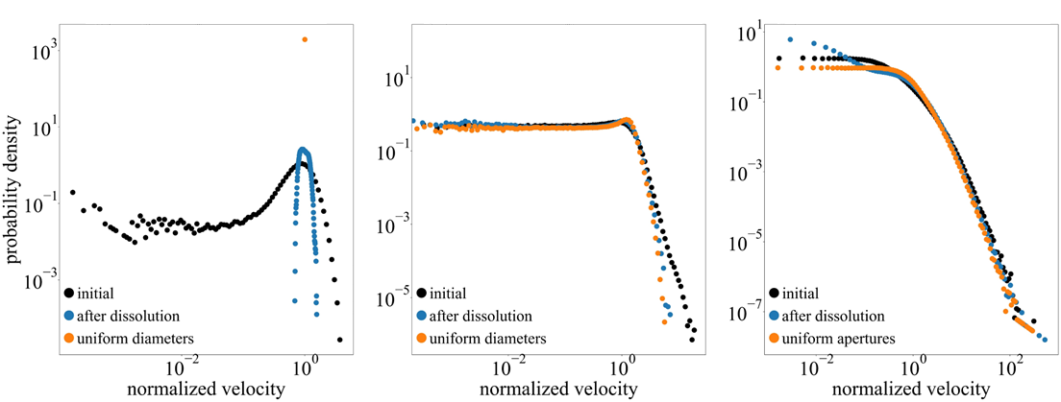
Velocity distribution
regular pore network
disordered pore network
discrete fracture network

Slide 19
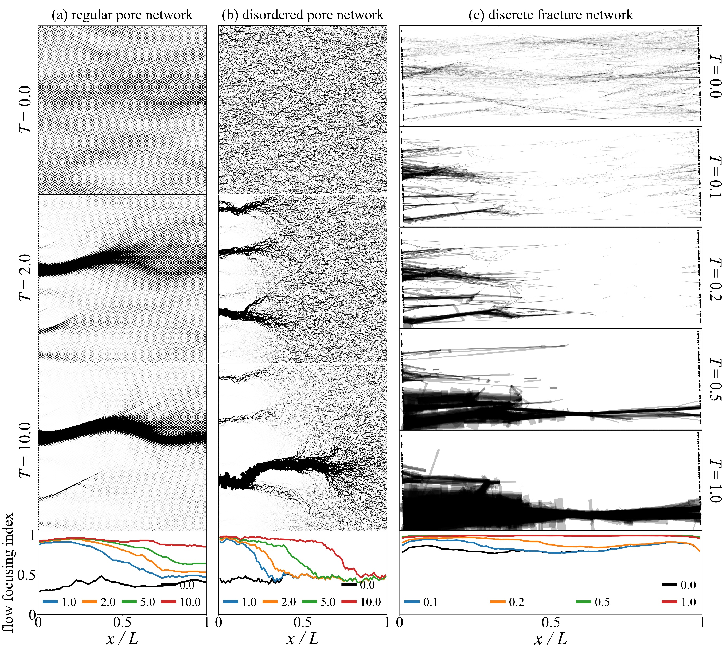
pore network
discrete fracture network
regular
disordered
Wormholing across various systems
flow maps

Slide 20
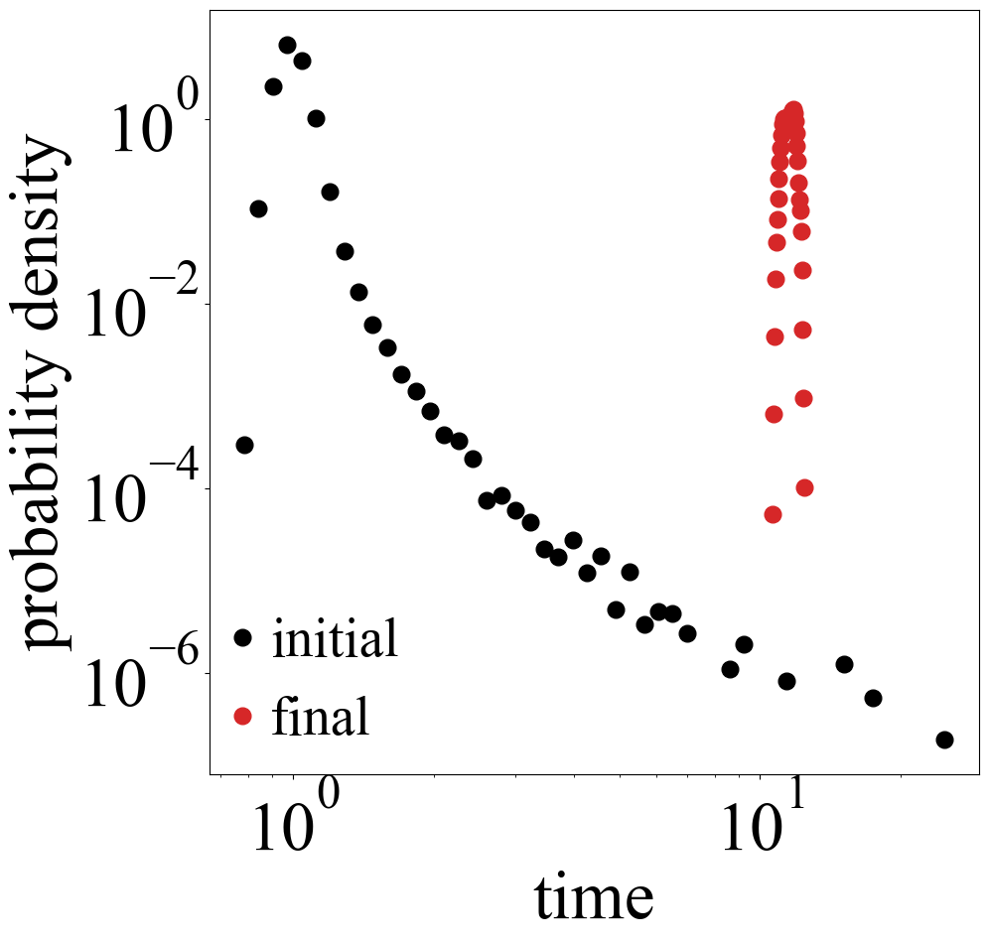
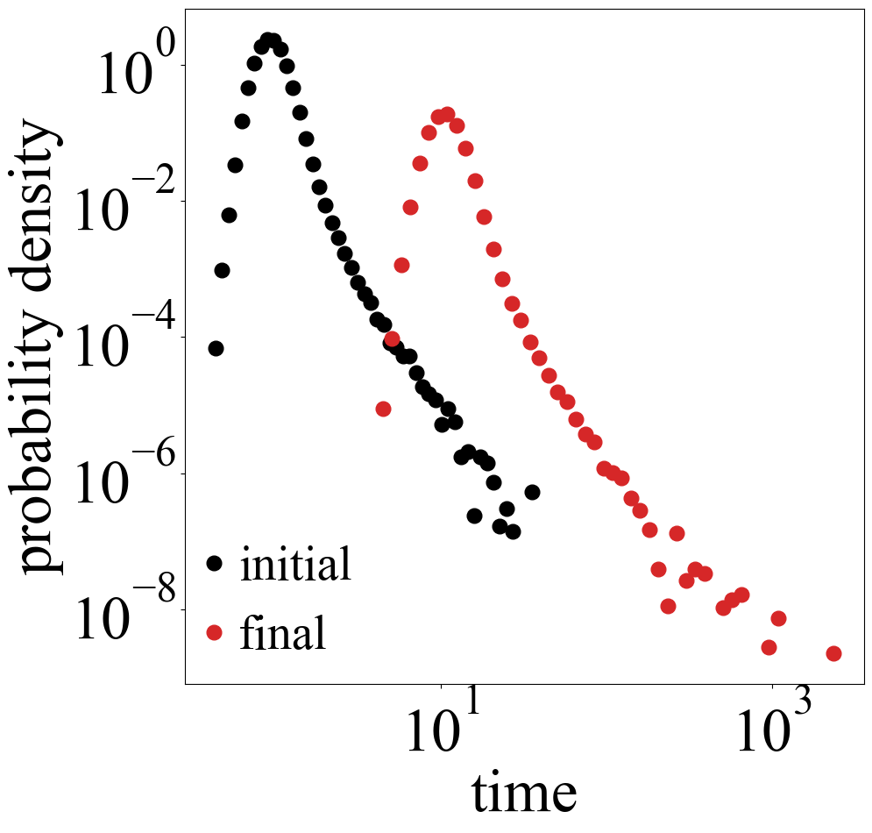
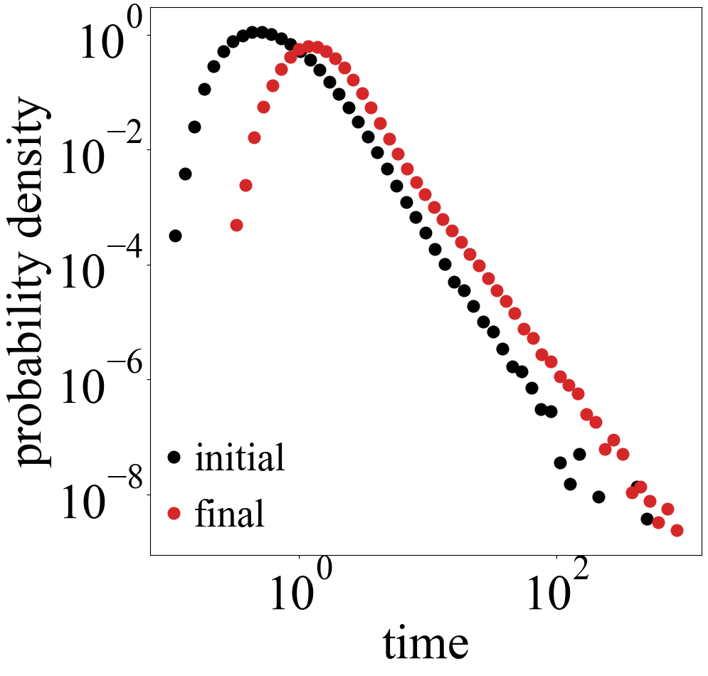
BTC for uniform dissolution
regular pore network
disordered pore network
discrete fracture network

Slide 21
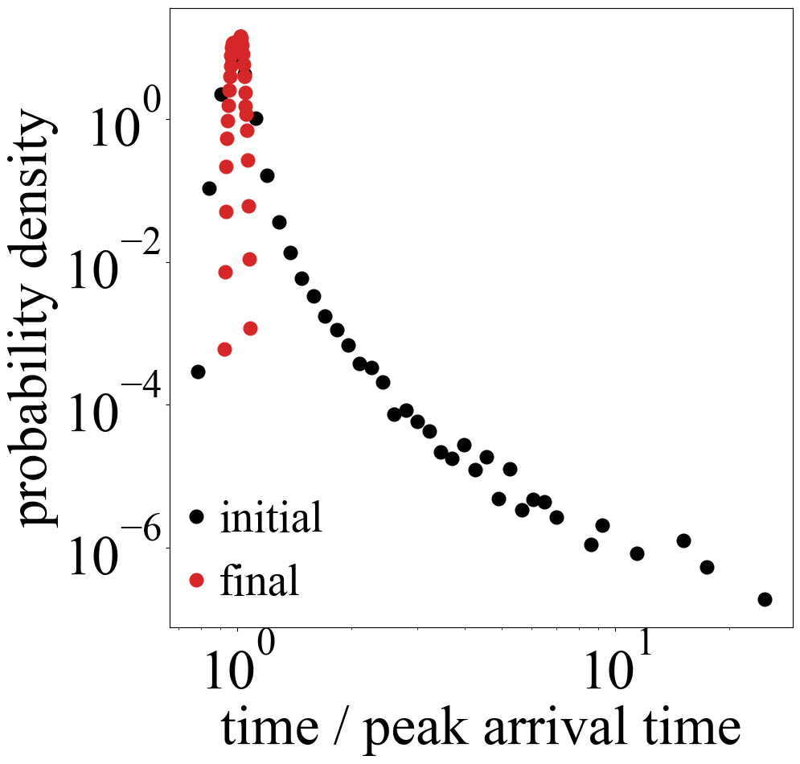
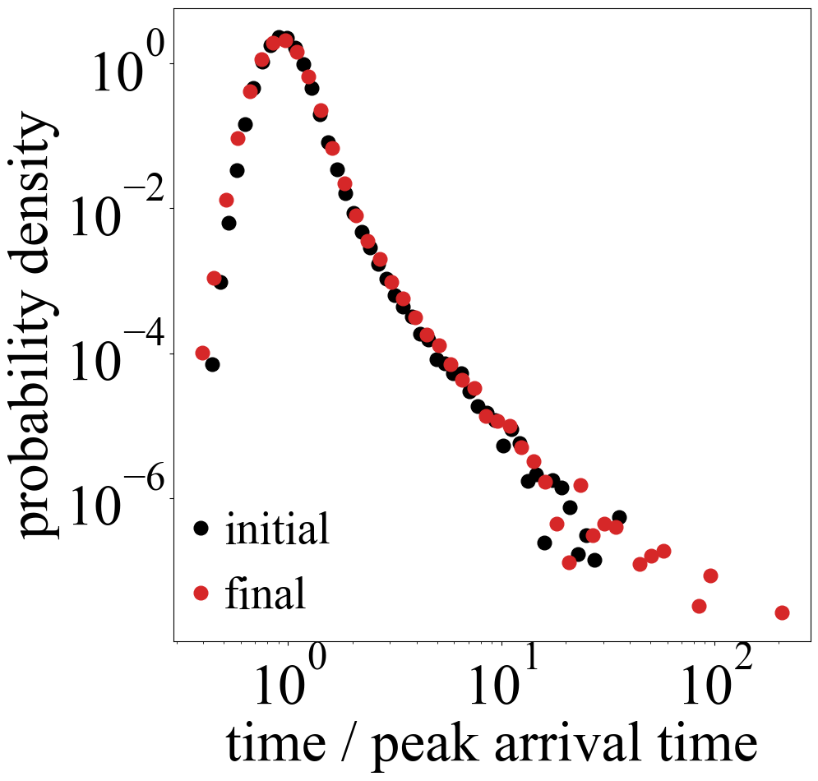
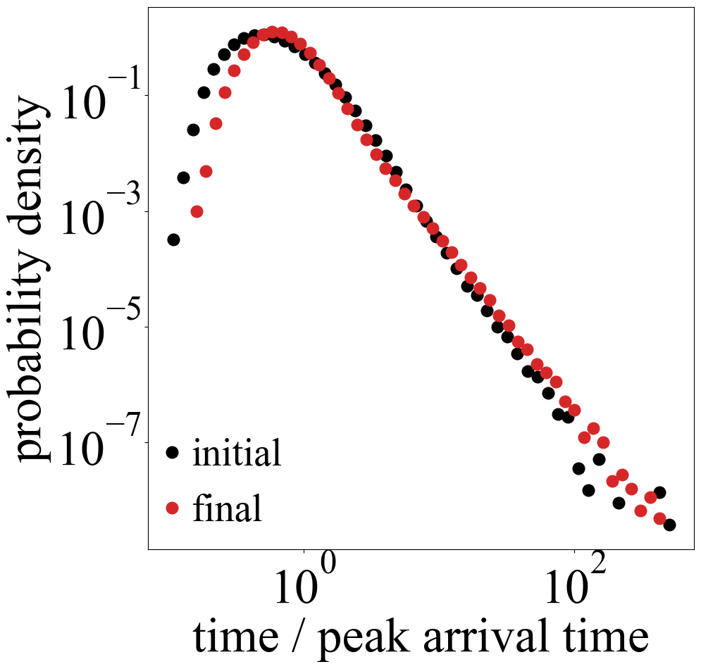
Normalized BTC for uniform dissolution
regular pore network
disordered pore network
discrete fracture network

Slide 22
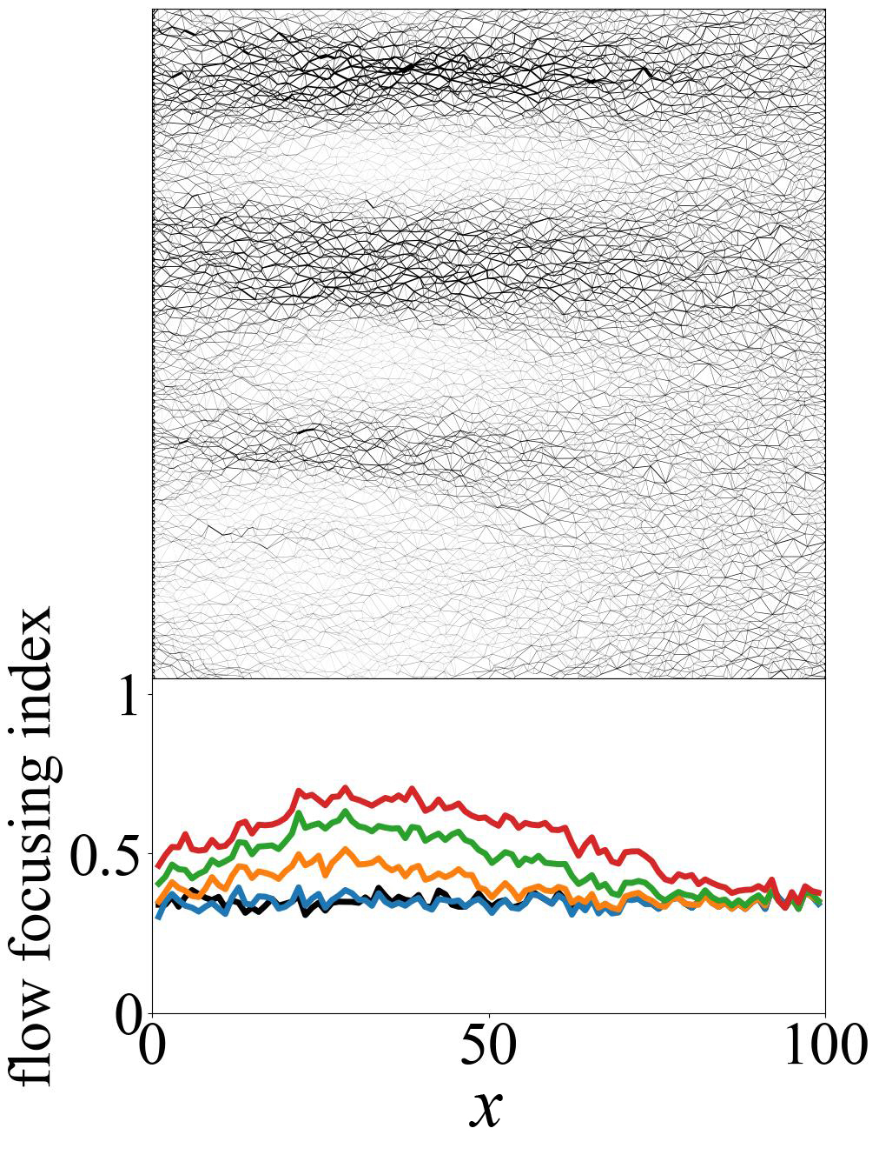
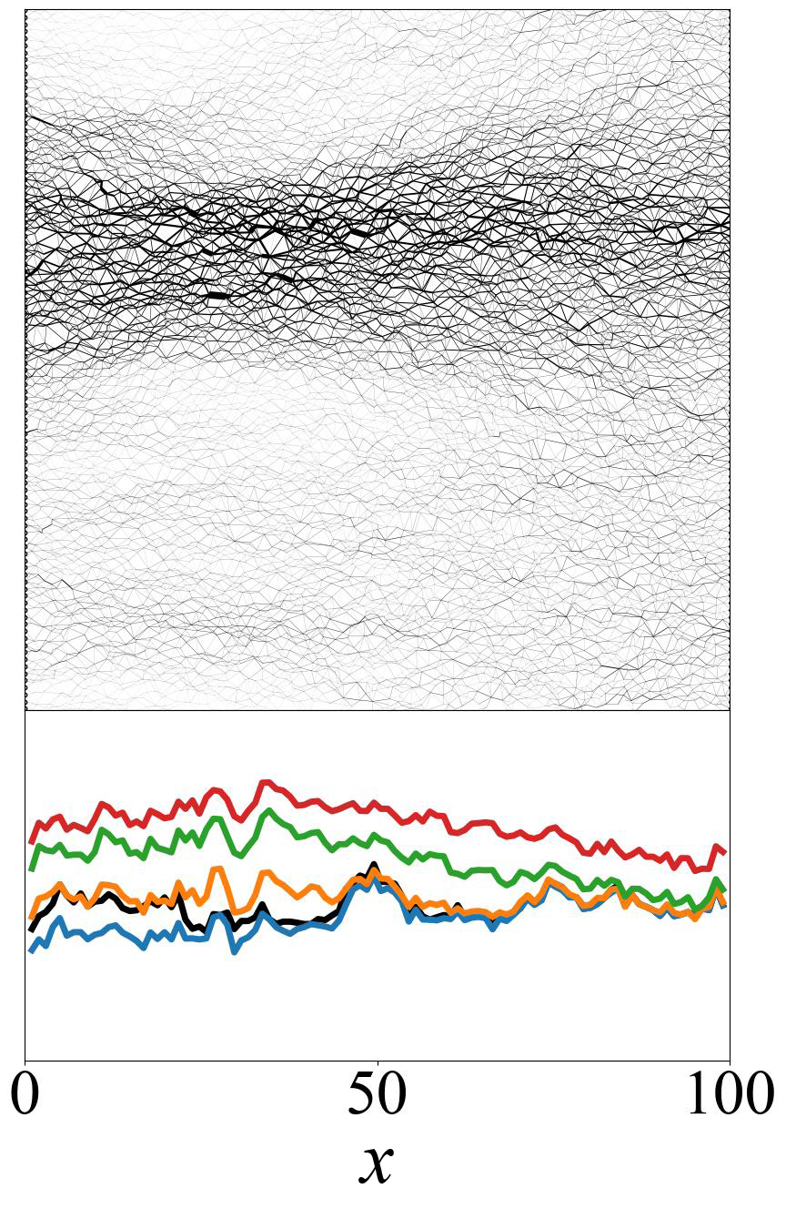




impact of heterogeneity
$$σ^{2}=0.01$$
$$σ^{2}=1$$
$$σ^{2}=5$$

Slide 23



uniform
flow focusing profile in fractured media
dissolution of 30 statistically identical discrete fracture networks
wormholing
channeling

Slide 24


Slide 25


Slide 26







pore surface
$$J_{diff}=\frac{D Sh}{d}(c−c_{w})$$
$$J_{r}={k c}_{w}$$
$$J_{r}$$
$$c_{w}$$
$$k_{eff}=\frac{k}{1+\frac{k d}{D Sh}}$$
$$J_{diff}$$
$$c$$
fluid bulk

Slide 27


Slide 28




Experimental pore network model
experiment by M. Dzikowski
laser-cut gypsum chip 3 cm x 3 cm after 35 h dissolution
simulation with a pore network model

