Slide 1
Solute Mixing Under Unstable Two-Phase Flow in Heterogeneous Porous Media Eugenio Pescimoro, Marco Dentz, Juan J. Hidalgo Institute of Environmental Assessment and Water Research IDAEA-CSIC

Slide 2





Introduction
What:
Passive tracer mixing and dispersion mechanisms in heterogeneous porous media saturated with two miscible fluids with different viscosities.
mixing
(dilution)
dispersion
(spreading)
Why:
Quantifying the impact of viscosity contrast on mixing is important in many natural and engineering processes such as groundwater flow, chemical reactors, microfluidic devices, wastewater treatment, ocean circulation and climate models.
How:
Numerical simulations where passive solute is transported by two miscible fluids with different viscosities through a heterogeneous porous media.

Slide 3
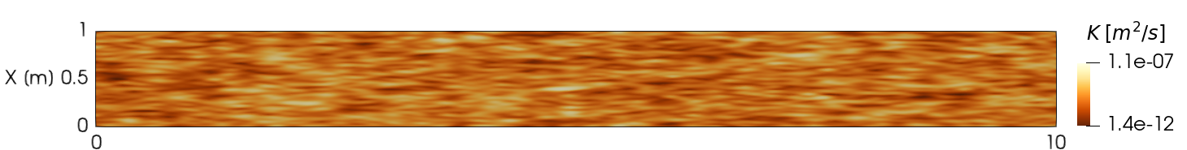
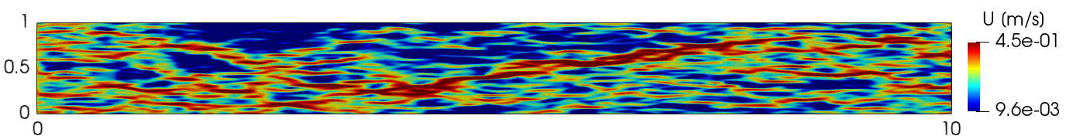
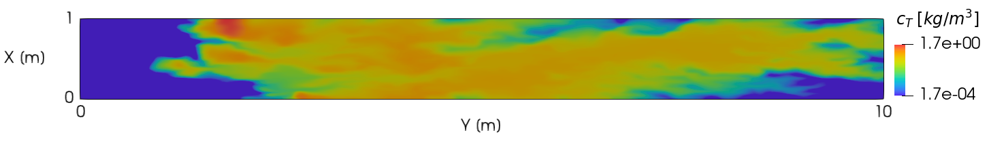





Setup
1) Permeability field: log-normal, ${\text{σ}}_{ln(k)}\text{=1.5}$, exponential, correlation length 1/10 of the domain
2) Screenshot of velocity field at fixed time for heterogeneous permeability and two phases
$${ c}_{F}$$
$$U_{y}=const$$
$$U∙n=0$$
$$p=0$$
3) Concentration field calculation: a passive tracer is introduced in the domain using a pulse injection through a section located at 1 meter from the inlet.
$${ c}_{T}$$

Slide 4
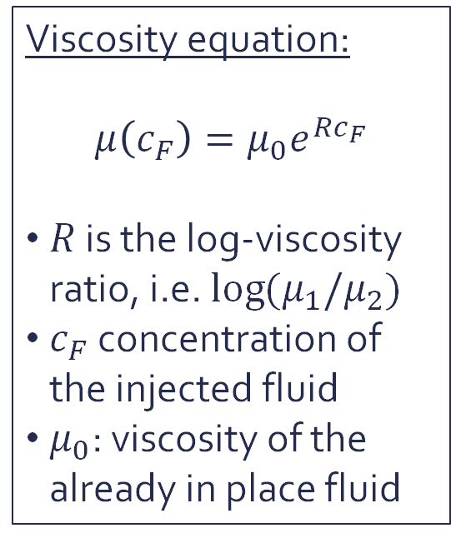
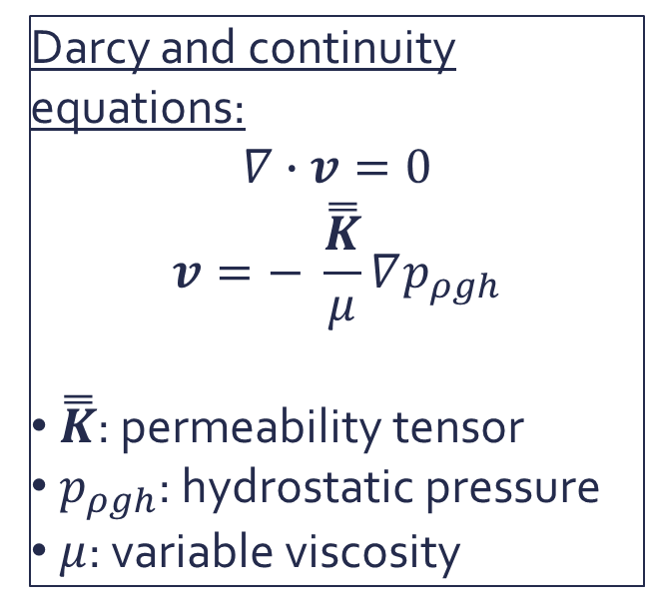
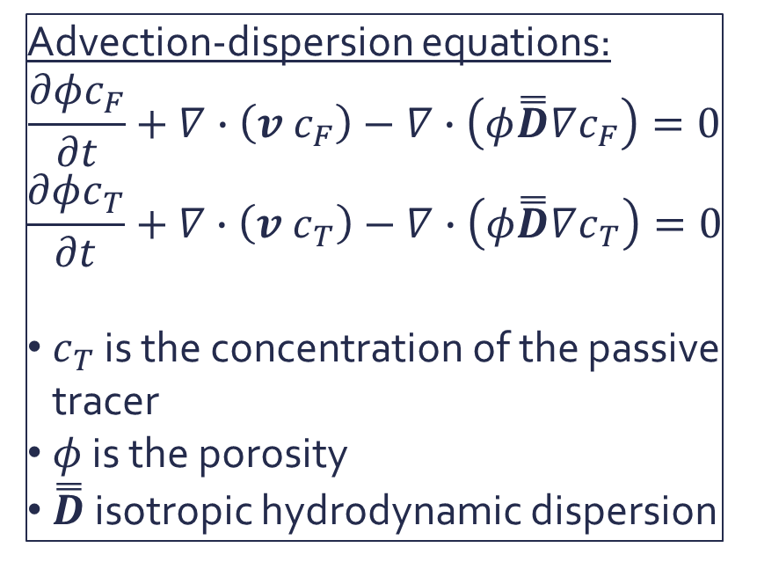
Equations
Darcy and continuity equations:
$$∇∙v=0$$
$$v=− \frac{\overset{̿}{K}}{μ}∇p_{ρgh}$$
$\overset{̿}{K}$: permeability tensor
$p_{ρgh}$: hydrostatic pressure
$μ$: variable viscosity
Viscosity equation:
$$μ\left(c_{F}\right)=μ_{0}e^{Rc_{F}}$$
$R$ is the log-viscosity ratio, i.e. $\log{(μ_{1}/μ_{2})}$
$c_{F}$ concentration of the injected fluid
$μ_{0}$: viscosity of the already in place fluid
Advection-dispersion equations:
$$\frac{∂φc_{F}}{∂t}+∇∙\left(v{ c}_{F}\right)−∇∙\left(φ\overset{̿}{D}∇c_{F}\right)=0$$
$$\frac{∂φc_{T}}{∂t}+∇∙\left(v{ c}_{T}\right)−∇∙\left(φ\overset{̿}{D}∇c_{T}\right)=0$$
$c_{T}$ is the concentration of the passive tracer
$φ$ is the porosity
$\overset{̿}{D}$ isotropic hydrodynamic dispersion

Slide 5
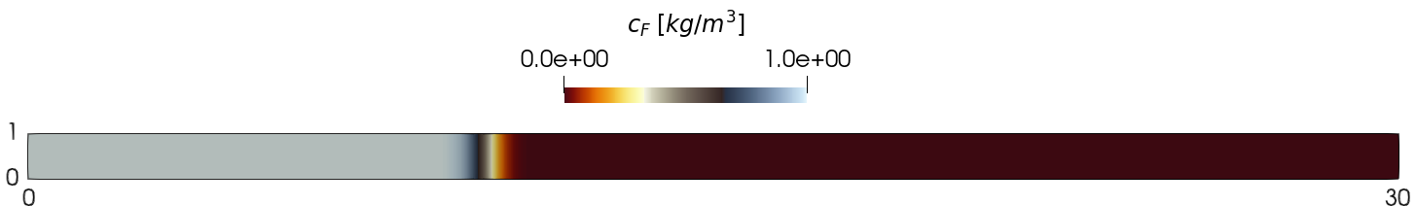
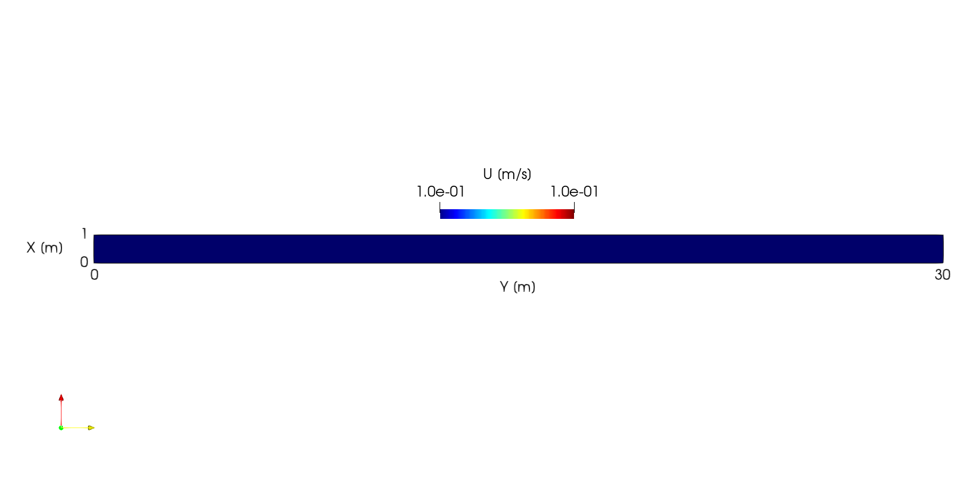
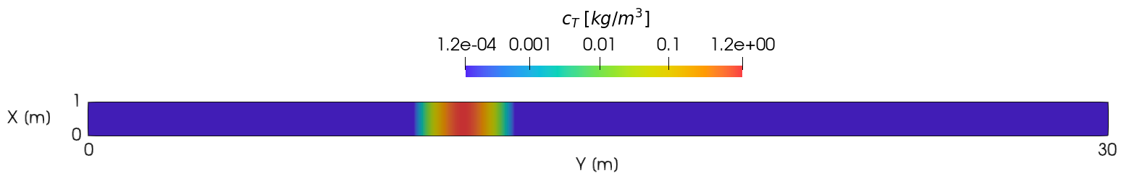

Hom. Perm. & No viscosity contrast (R=0)
$${ c}_{T}$$

Slide 6
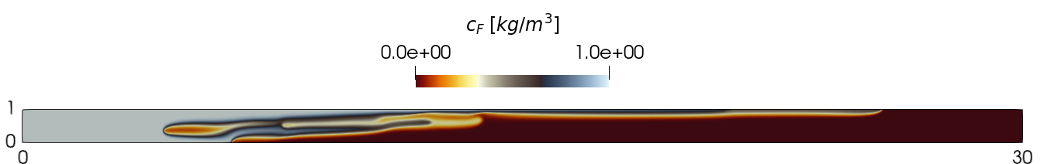
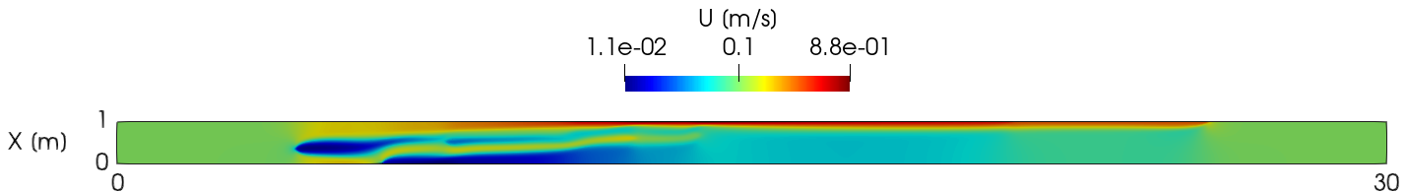
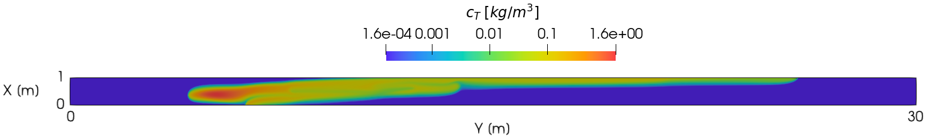


Hom. Perm. & Viscosity contrast (R=-3)
$${ c}_{F}$$
$${ c}_{T}$$

Slide 7
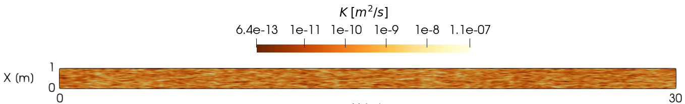
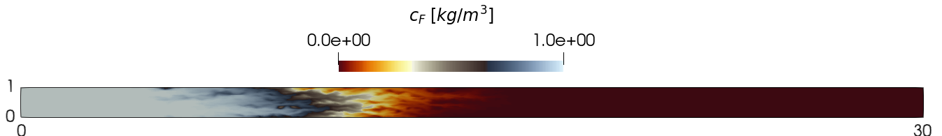
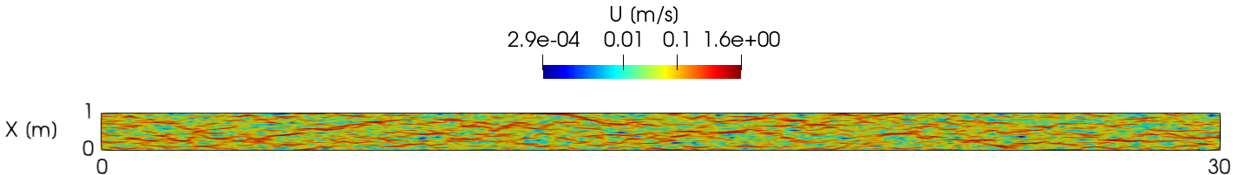
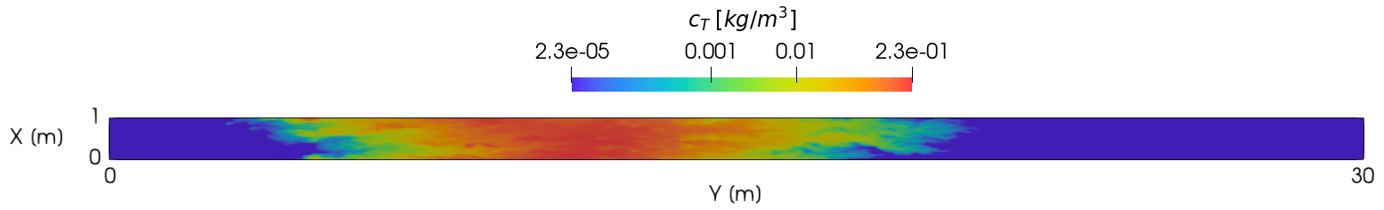


Het. Perm. & No viscosity contrast (R=0)
$${ c}_{F}$$
$${ c}_{T}$$

Slide 8
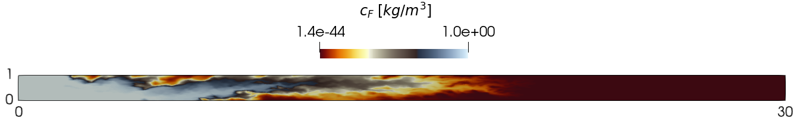
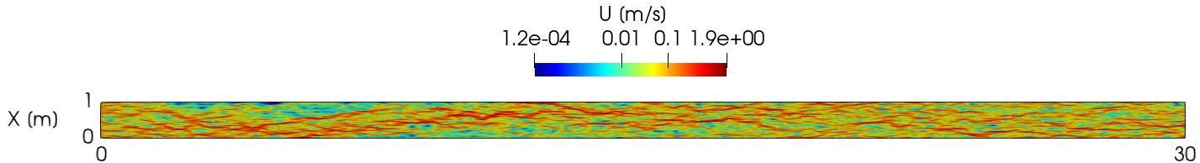
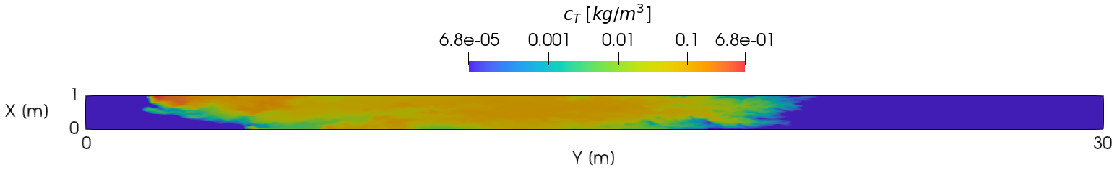

Het. Perm. & viscosity contrast (R=-3)
$${ c}_{F}$$
$${ c}_{T}$$

Slide 9
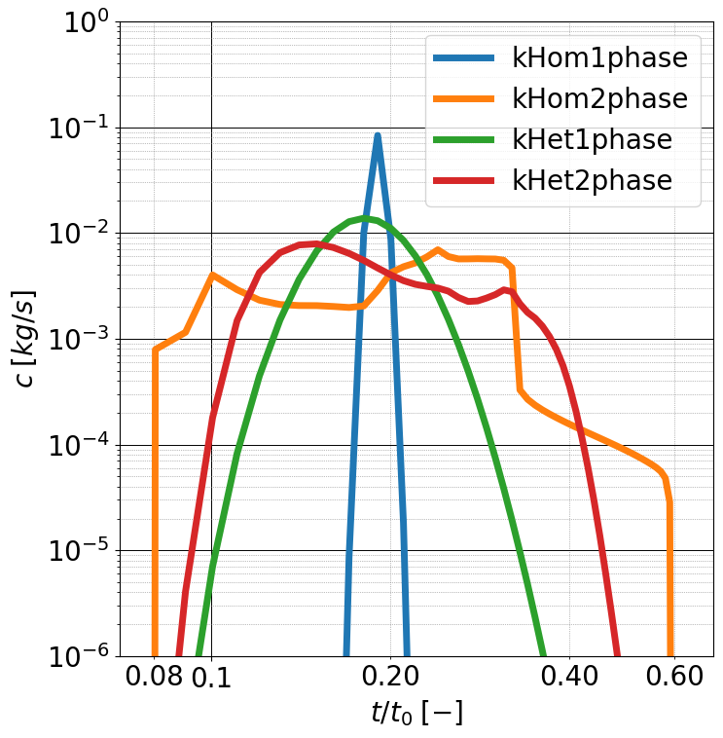
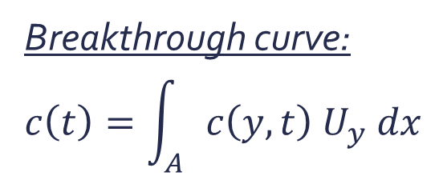

Breakthrough curve:
$$c\left(t\right)=\int_{A}{c\left(y,t\right) U_{y} dx}$$
$$t_{0}=L_{y}/U_{y}$$

Slide 10
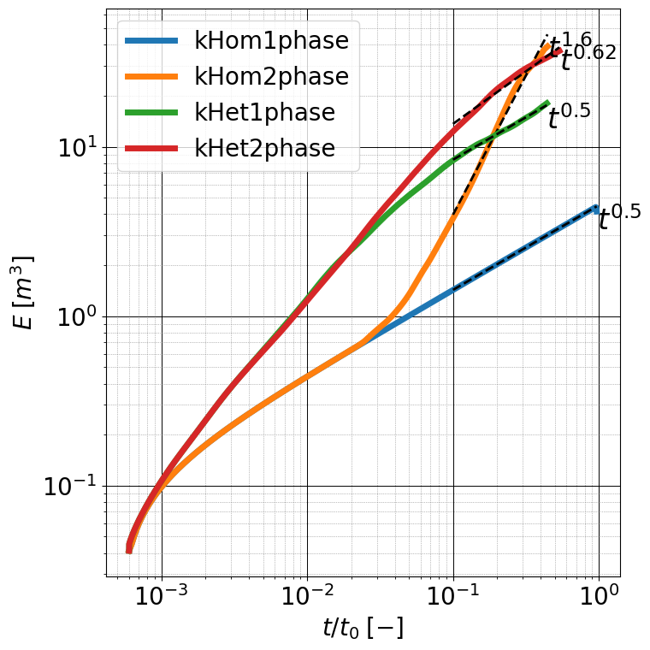
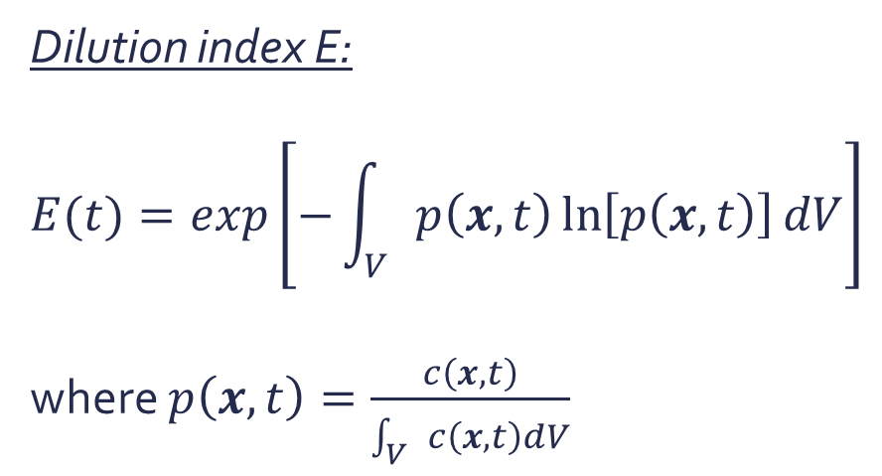
Dilution index E:
$$E(t)=exp\left[−\int_{V}{p\left(x, t\right)\ln\left[p\left(x, t\right)\right]dV}\right]$$
where $p\left(x, t\right)=\frac{c\left(x, t\right)}{\int_{V}{c\left(x, t\right)dV}}$

Slide 11
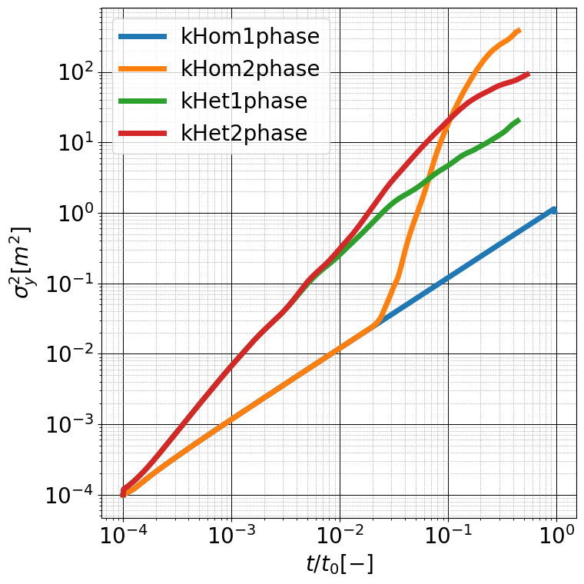
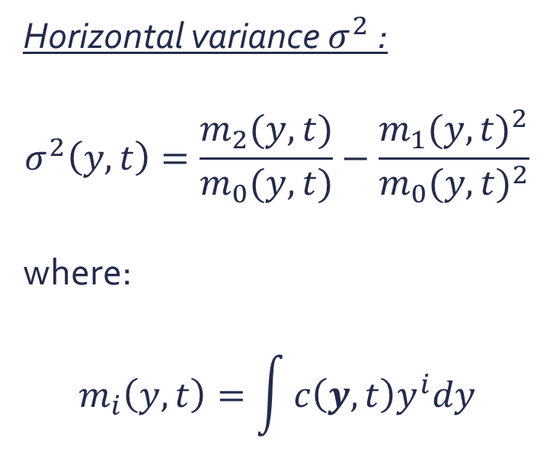
Horizontal variance $σ^{2}$:
$$σ^{2}\left(y, t\right)=\frac{m_{2}(y, t)}{m_{0}(y, t)}−\frac{{m_{1}(y, t)}^{2}}{{m_{0}(y, t)}^{2}}$$
where:
$$m_{i}\left(y, t\right)=\int{c\left(y, t\right)y^{i}dy}$$

Slide 12
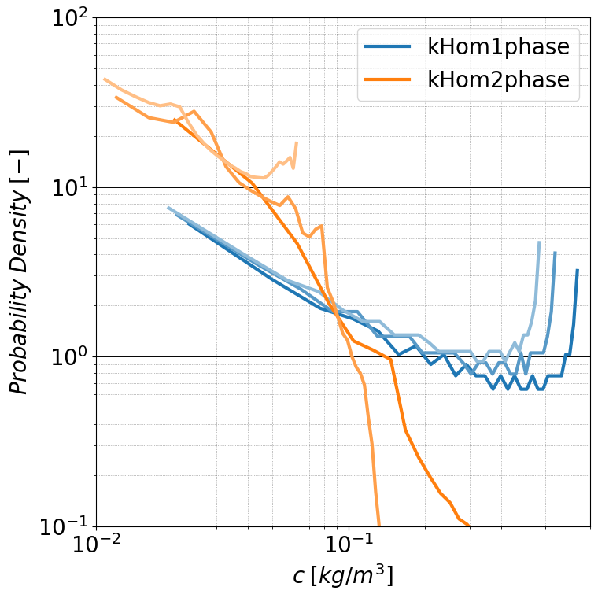
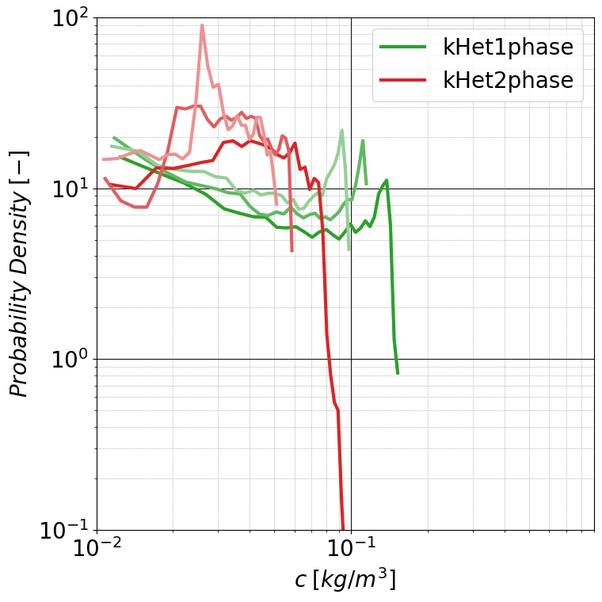
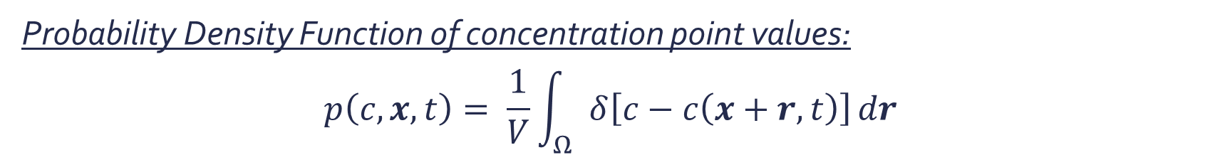
Probability Density Function of concentration point values:
$$p\left(c, x, t\right)= \frac{1}{V}\int_{Ω}{δ\left[c−c\left(x+r,t\right)\right]}dr$$
Time increases

Slide 13
Conclusions
Take home messages
the dilution index shows that the mixing of a solute develops faster in systems characterised by viscosity contrasts;
the horizontal variance highlights the contribution of the viscosity differences to enhancing dispersion mechanism through the stretching of the front;
overall, viscosity differences enhance the mixing and the spreading of passive solute similarly to what permeability contrast does.

Slide 14


Thank you for the attention! Contact: eugenio.pescimoro@idaea.csic.es
This project has received funding from the European Union’s Horizon 2020 research and innovation programme under the Marie Skłodowska- Curie grant agreement No 101202639.

Slide 15







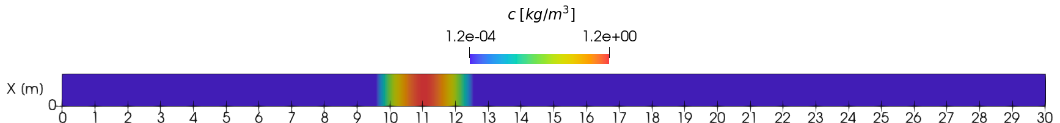
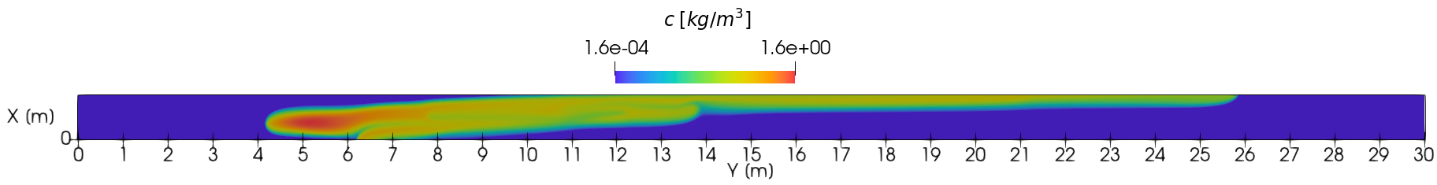
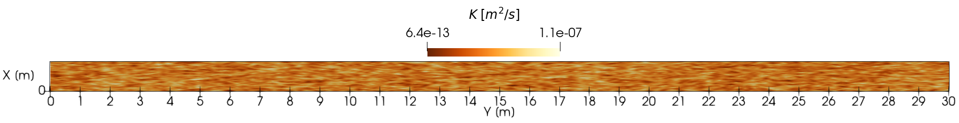
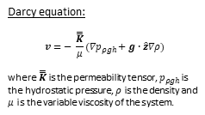
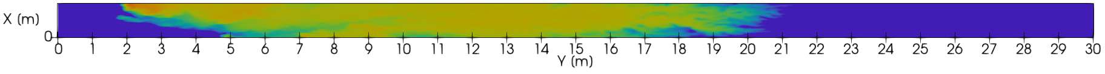
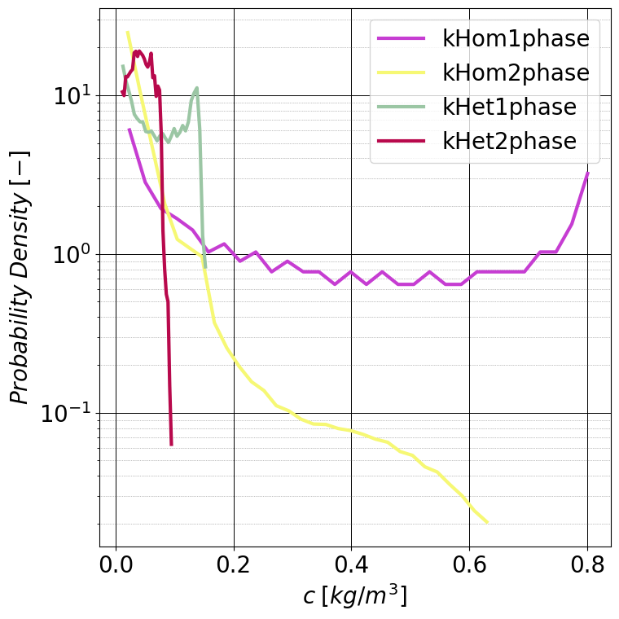
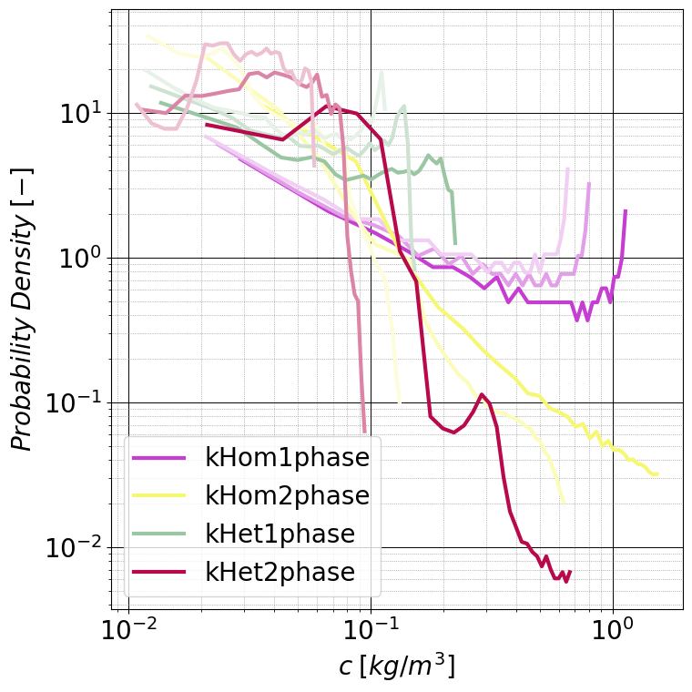
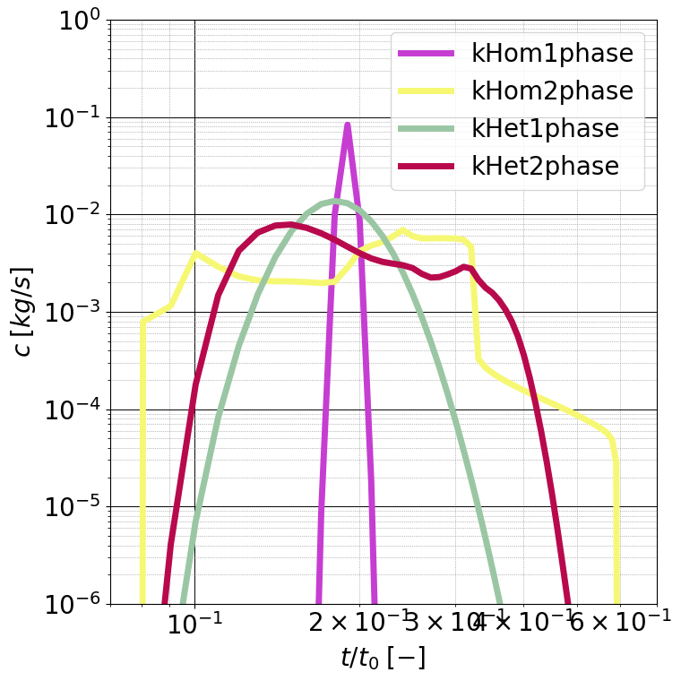
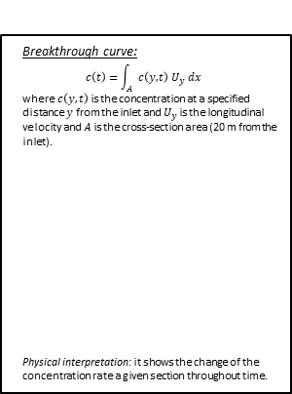
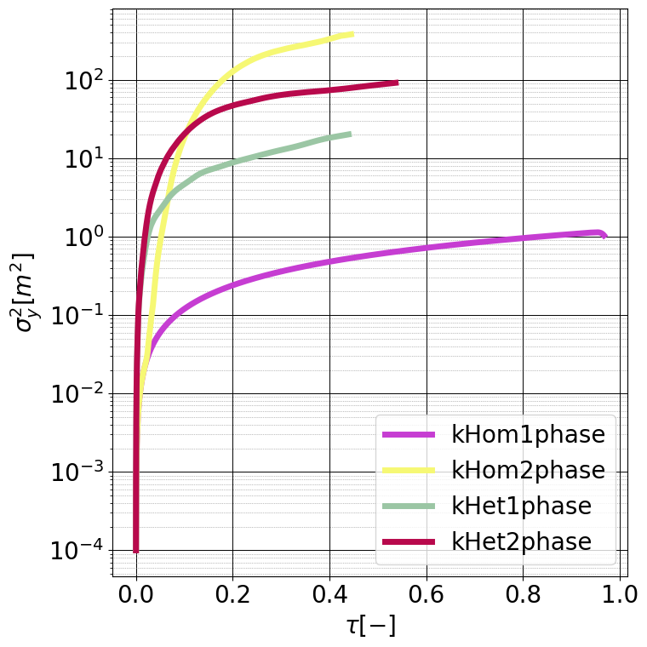

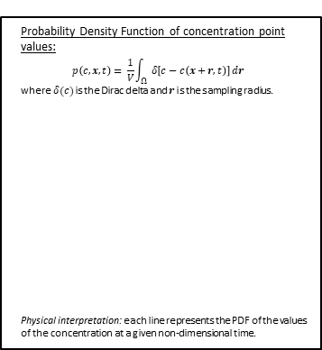
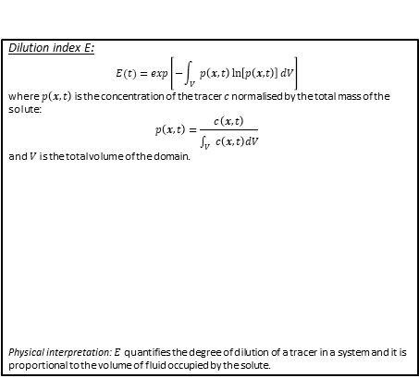
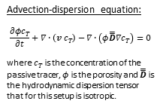
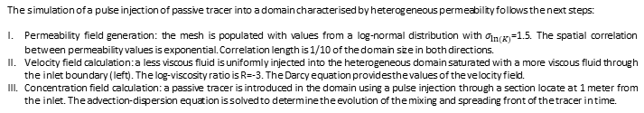

This project has received funding from the European Union’s Horizon 2020 research and innovation programme under the Marie Skłodowska- Curie grant agreement No 101202639.
Solute Mixing Under Unstable Miscible Two-Phase Flow in Heterogeneous Media
Authors: Eugenio Pescimoro, Marco Dentz, Juan J. Hidalgo, Federico Municchi
Institute of Environmental Assessment and Water Research (IDAEA-CSIC), Barcelona, Spain
Contact: eugenio.pescimoro@idaea.csic.es
What:
Passive tracer mixing and dispersion mechanisms in heterogeneous porous media saturated with two miscible fluids with different viscosities. Specifically, the effect of these mechanisms is quantified through the horizontal variance $σ^{2}$ and the dilution index $E .$
Why:
Quantifying how the presence of a second fluid enhances mixing is important in many natural and engineering processes. Some examples include: groundwater flow, chemical reactors, microfluidic devices, wastewater treatment, ocean circulation and climate models.
How:
Numerical simulations where passive solute is transported by two miscible fluids with different viscosities through a heterogeneous porous media. The whole simulation process (including postprocessing) is carried out using OpenFOAM libraries.
Simulation setup
The simulation of a pulse injection of passive tracer into a domain characterised by heterogeneous permeability follows the next steps:
Permeability field generation: the mesh is populated with values from a log-normal distribution with $σ_{ln⁡(K)}\text{=1.5}$. The spatial correlation between permeability values is exponential. Correlation length is 1/10 of the domain size in both directions.
Velocity field calculation: a less viscous fluid is uniformly injected into the heterogeneous domain saturated with a more viscous fluid through the inlet boundary (left). The log-viscosity ratio is R=-3. The Darcy equation provides the values of the velocity field.
Concentration field calculation: a passive tracer is introduced in the domain using a pulse injection through a section locate at 1 meter from the inlet. The advection-dispersion equation is solved to determine the evolution of the mixing and spreading front of the tracer in time.
A
B
passive tracer concentration in homogeneous permeability field saturated with one fluid;
passive tracer concentration in homogeneous permeability field saturated with two fluids;
Log-normal permeability field characterised by exponential distribution;
passive tracer concentration in heterogeneous permeability field saturated with one fluid;
passive tracer concentration in heterogeneous permeability field saturated with two fluids.
Darcy equation:
$$v=− \frac{\overset{̿}{K}}{μ}(∇p_{ρgh}+g∙\hat{z}∇ρ)$$
where $\overset{̿}{K}$ is the permeability tensor, $p_{ρgh}$ is the hydrostatic pressure, $ρ$ is the density and $μ$ is the variable viscosity of the system.
Viscosity equation:
$$μ\left(c_{F}\right)=μ_{0}e^{Rc_{F}}$$
where $R$ is the log-viscosity ratio and $c_{F}$ is the concentration of the injected fluid.
Advection-dispersion equation:
$$\frac{∂φc_{T}}{∂t}+∇∙\left(v{ c}_{T}\right)−∇∙\left(φ\overset{̿}{D}∇c_{T}\right)=0$$
where $c_{T}$ is the concentration of the passive tracer, $φ$ is the porosity and $\overset{̿}{D}$ is the hydrodynamic dispersion tensor that for this setup is isotropic.
C
D
E
Results and interpretation
Breakthrough curve:
$$c\left(t\right)=\int_{A}{c\left(y,t\right) U_{y} dx}$$
where $c\left(y,t\right)$ is the concentration at a specified distance $y$ from the inlet and $U_{y}$ is the longitudinal velocity and $A$ is the cross-section area (20 m from the inlet).
Physical interpretation: it shows the change of the concentration rate a given section throughout time.
Dilution index E:
$$E(t)=exp\left[−\int_{V}{p\left(x, t\right)\ln\left[p\left(x, t\right)\right]dV}\right]$$
where $p\left(x, t\right)$ is the concentration of the tracer $c$ normalised by the total mass of the solute:
$$p\left(x, t\right)=\frac{c\left(x, t\right)}{\int_{V}{c\left(x, t\right)dV}}$$
and $V$ is the total volume of the domain.
Physical interpretation: $E$ quantifies the degree of dilution of a tracer in a system and it is proportional to the volume of fluid occupied by the solute.
Horizontal variance $σ^{2}$:
$$σ^{2}\left(y, t\right)=\frac{m_{2}(y, t)}{m_{0}(y, t)}−\frac{{m_{1}(y, t)}^{2}}{{m_{0}(y, t)}^{2}}$$
where $m_{0}$, $m_{1}$and $m_{2}$ represent the raw horizontal moments of the concentration $c$:
$$m_{i}\left(y, t\right)=\int{c\left(y, t\right)y^{i}dy}$$
Physical interpretation: $σ^{2}$ measures the interface width and it is proportional to the spreading of the tracer.
Probability Density Function of concentration point values:
$$p\left(c, x, t\right)= \frac{1}{V}\int_{Ω}{δ\left[c−c\left(x+r,t\right)\right]}dr$$
where $δ(c)$ is the Dirac delta and $r$ is the sampling radius.
Physical interpretation: each line represents the PDF of the values of the concentration at a given non-dimensional time.
Take home messages
viscosity differences cause the stretching of the mixing front, as it is illustrated by the evolution of the horizontal variance;
the dilution index shows that the mixing of a solute develops faster in systems characterised by viscosity contrasts;
overall, viscosity differences enhance the mixing and the spreading of passive solute similarly to what permeability contrast does.
Future works
test the effect of density differences on mixing and spreading and compare it with the effect generated by viscous instabilities;
compare the effect of different types of heterogeneities on mixing dynamics such as continuous vs categorical permeability fields;
explore the effect of immiscible and reactive fluids on passive transport and mixing.

