Slide 1

Asymptotic homogenization of advection-diffusion-reaction model for packed bed reactors
Alessio Lombardo Pontillo
Diego Fida
Agnese Marcato
Daniele Marchisio
Gianluca Boccardo
Matteo Icardi
Ilenia Battiato
21/05/2026

Slide 2
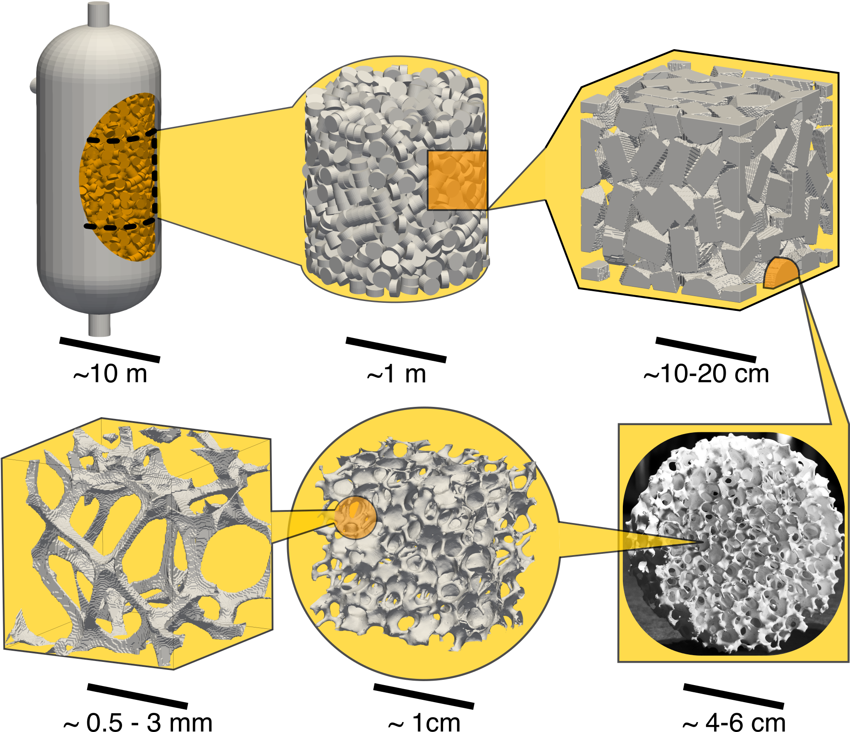
Homogenization via multiple scale expansion
In many chemical engineering applications, such as packed-bed reactors, macroscopic performance is strongly influenced by microscopic transport and reaction phenomena.
We need a tool to estimate reactor performance in real time and detect deviations from standard operating conditions, without oversimplifying the bed micromorphology.

Slide 3

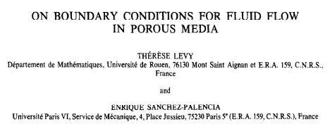
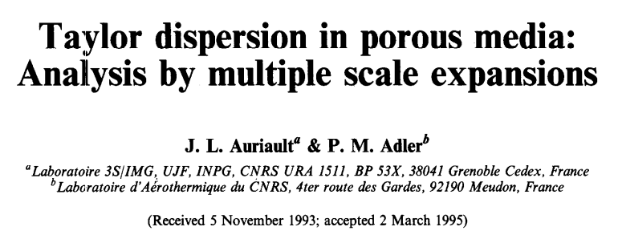

Homogenization via multiple scale expansion
Homogenization bridges scales, mapping pore-level geometry to predictive, stable, and fast macroscale models for design and control. It converts microstructural complexity into measurable effective properties.
One of the most famous application is the mathematical derivation of the Darcy’s law, starting from Stokes’ equation.
Homogenization
Homogenization is not only a theoretical framework, but a practical engineering tool for real-time performance monitoring and design.
High fidelity
High cost
Reduced cost
Retained accuracy

Slide 4
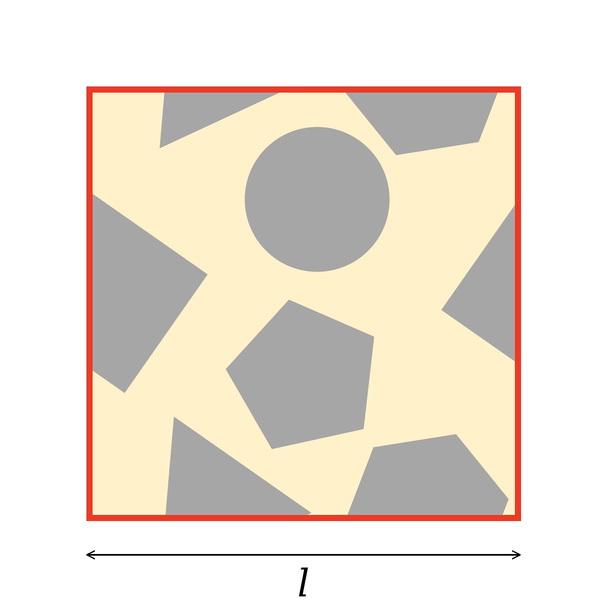



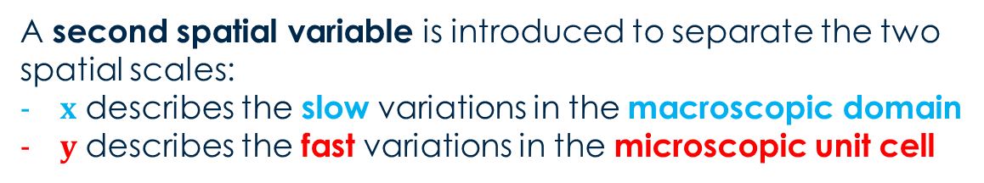





Hypothesis: Scale separation
Let us consider a microscopic unit cell (𝒍), periodically repeated to build the macroscopic domain (𝑳), such that the scale parameter is $ε=l/L≪1$.
$$𝒮$$
$$Γ$$
A second spatial variable is introduced to separate the two spatial scales:
$x$ describes the slow variations in the macroscopic domain
$y$ describes the fast variations in the microscopic unit cell
$$ℒ$$
$$y=x/ε$$
$ℒ$ = liquid phase
$𝒮$ = solid phase
$Γ$ = liquid-solid interface

Slide 5

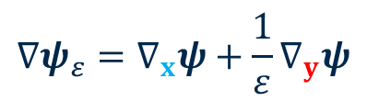



Two field variables
Because of scale separation, the generic field $ψ_{ε}\left(x,t\right)$ is described in terms of two independent spatial variables, and the differential operators split into two contributions:
$$ψ_{ε}\left(x,t\right)=ψ\left(x,x/ε,t\right)=ψ\left(x,y,t\right)$$
$$∇ψ_{ε}=∇_{x}ψ+\frac{1}{ε}∇_{y}ψ$$
Slow variations
Rapid oscillations
$$ψ_{ε}$$
$$ψ(x)$$
$$ψ(y)$$
We are interested only in the macroscopic behavior!
Same order of magnitude as the scale parameter $ε$

Slide 6
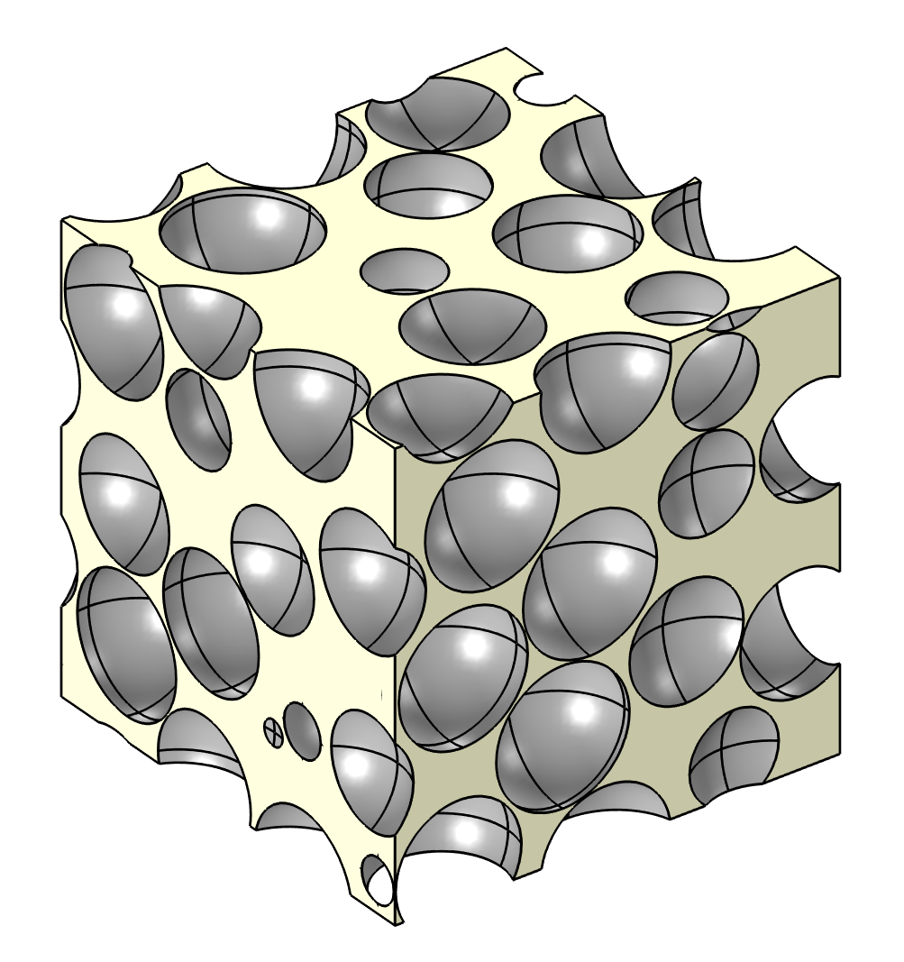
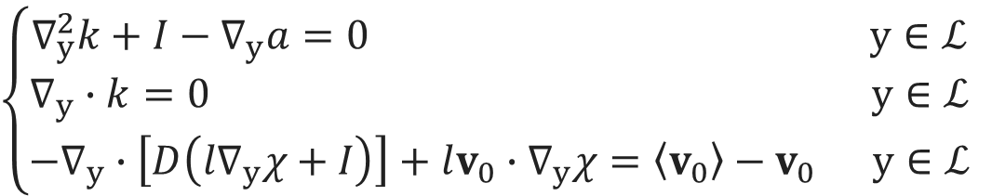
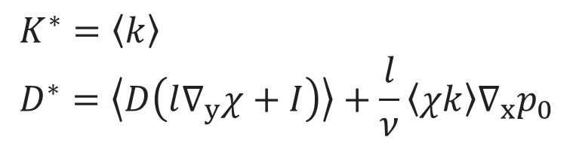
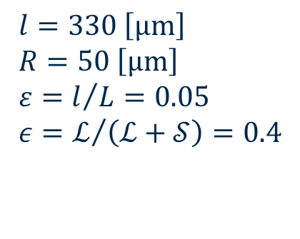
Closure Problem
Homogenization introduces a set of equation for considering the variation of effective coefficient due to the morphology.
$$\left\{\begin{aligned}∇_{y}^{2}k+I−∇_{y}a=0 y∈ℒ \\ ∇_{y}∙k=0 y∈ℒ \\ −∇_{y}∙\left[D\left(l∇_{y}χ+I\right)\right]+lv_{0}∙∇_{y}χ=\left\langle v_{0}\right\rangle −v_{0} y∈ℒ\end{aligned}\right.$$
$$l=330 \left[μm\right] \\ R=50 \left[μm\right] \\ ε=l/L=0.05 \\ ε=ℒ/{\left(ℒ+𝒮\right)}=0.4$$
Permeability
$$K^{∗}=\left\langle k\right\rangle \\ D^{∗}=\left\langle D\left(l∇_{y}χ+I\right)\right\rangle +\frac{l}{ν}\left\langle χk\right\rangle ∇_{x}p_{0}$$
Dispersion

Slide 7
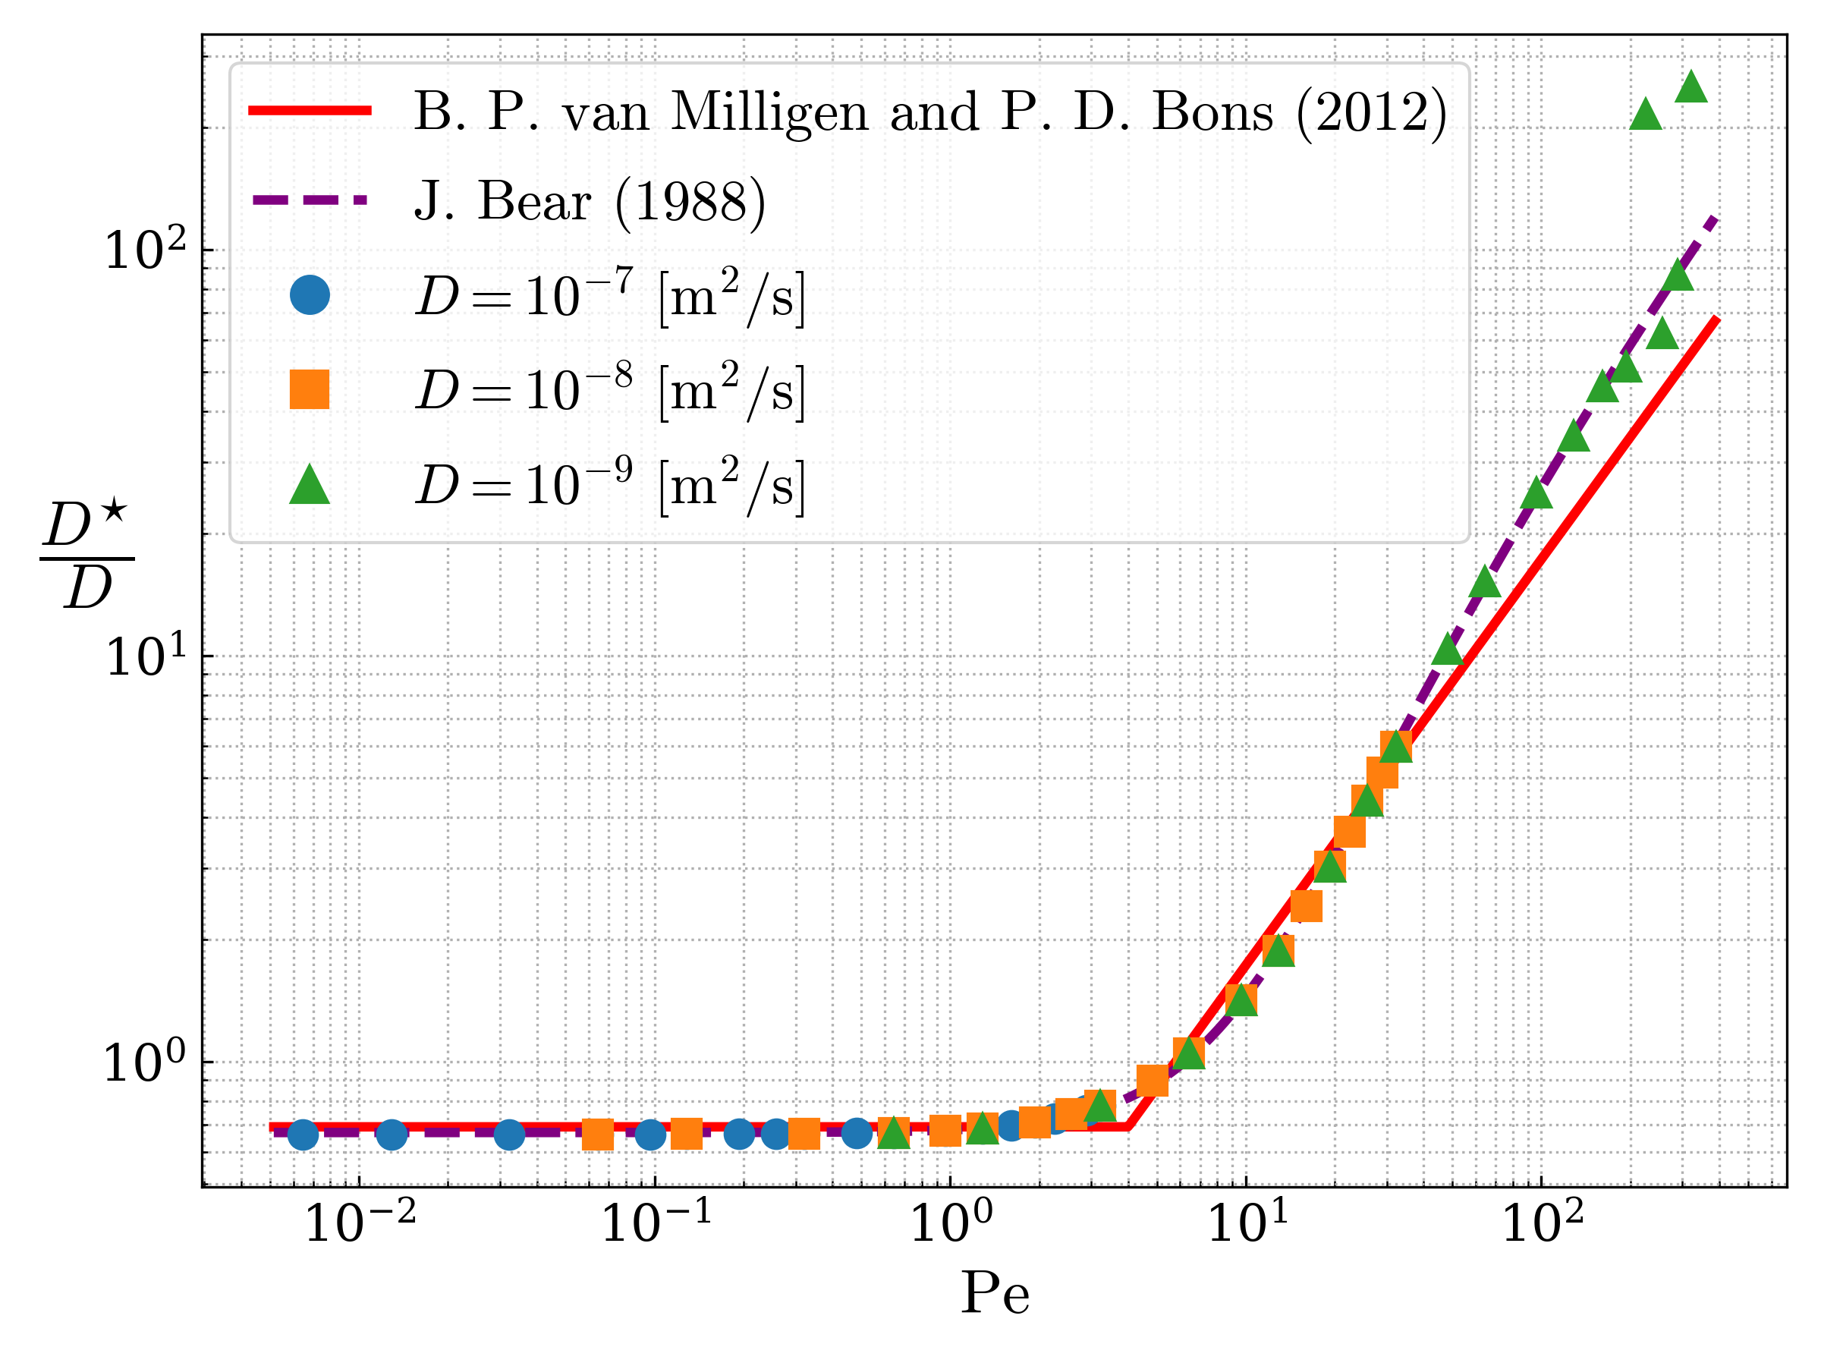
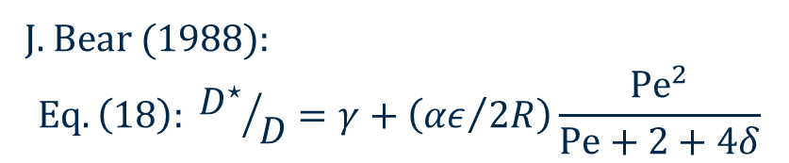
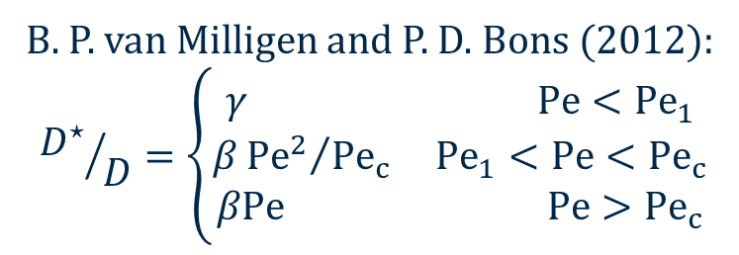
Dispersion and Pe
B. P. van Milligen and P. D. Bons (2012):
$${D^{⋆}}/D=\left\{\begin{aligned}γ Pe<{Pe}_{1} \\ β{{Pe}^{2}}/{{Pe}_{c}} {Pe}_{1}<Pe<{Pe}_{c} \\ βPe Pe>{Pe}_{c}\end{aligned}\right.$$
J. Bear (1988):
$$Eq. \left(18\right): {D^{⋆}}/D=γ+\left({αε}/{2R}\right)\frac{{Pe}^{2}}{Pe+2+4δ}$$

Slide 8
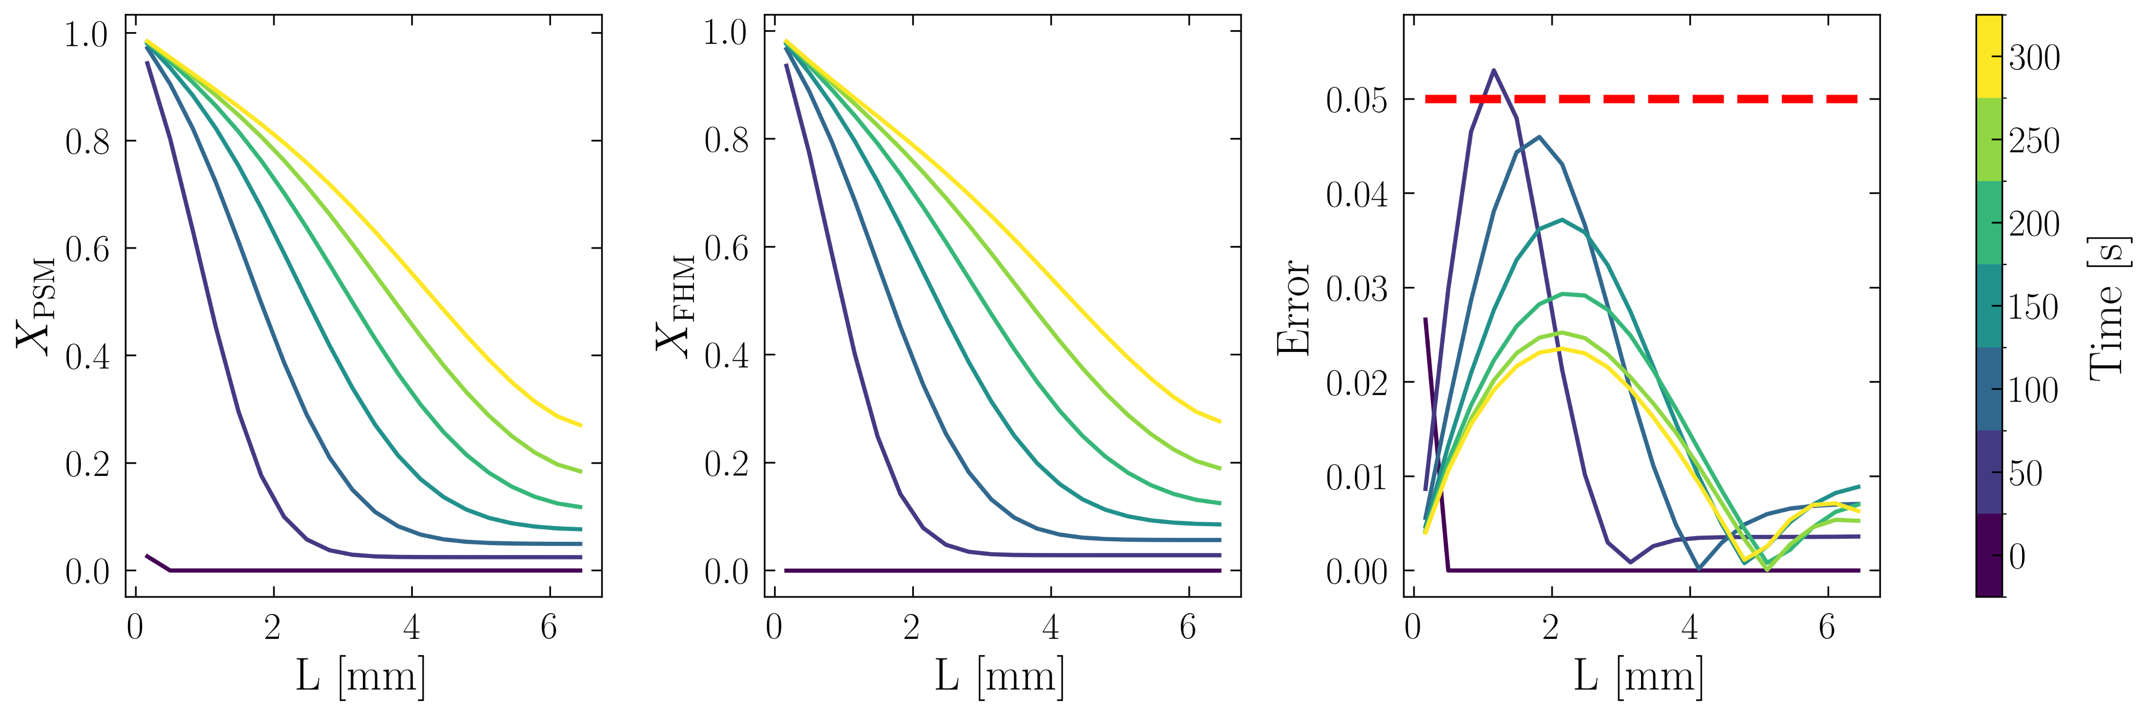

Application – Calcium Carbonate dissolution
$${Ca}^{2+}+{CO}_{3}^{2−}↔{CaCO}_{3}$$
A reactive packed bed where solute transport in the fluid is coupled with surface reactions occurring on the solid particles.
Battiato, I., & Tartakovsky, D. M. (2011). Applicability regimes for macroscopic models of reactive transport in porous media. Journal of contaminant hydrology, 120, 18-26.

Slide 9
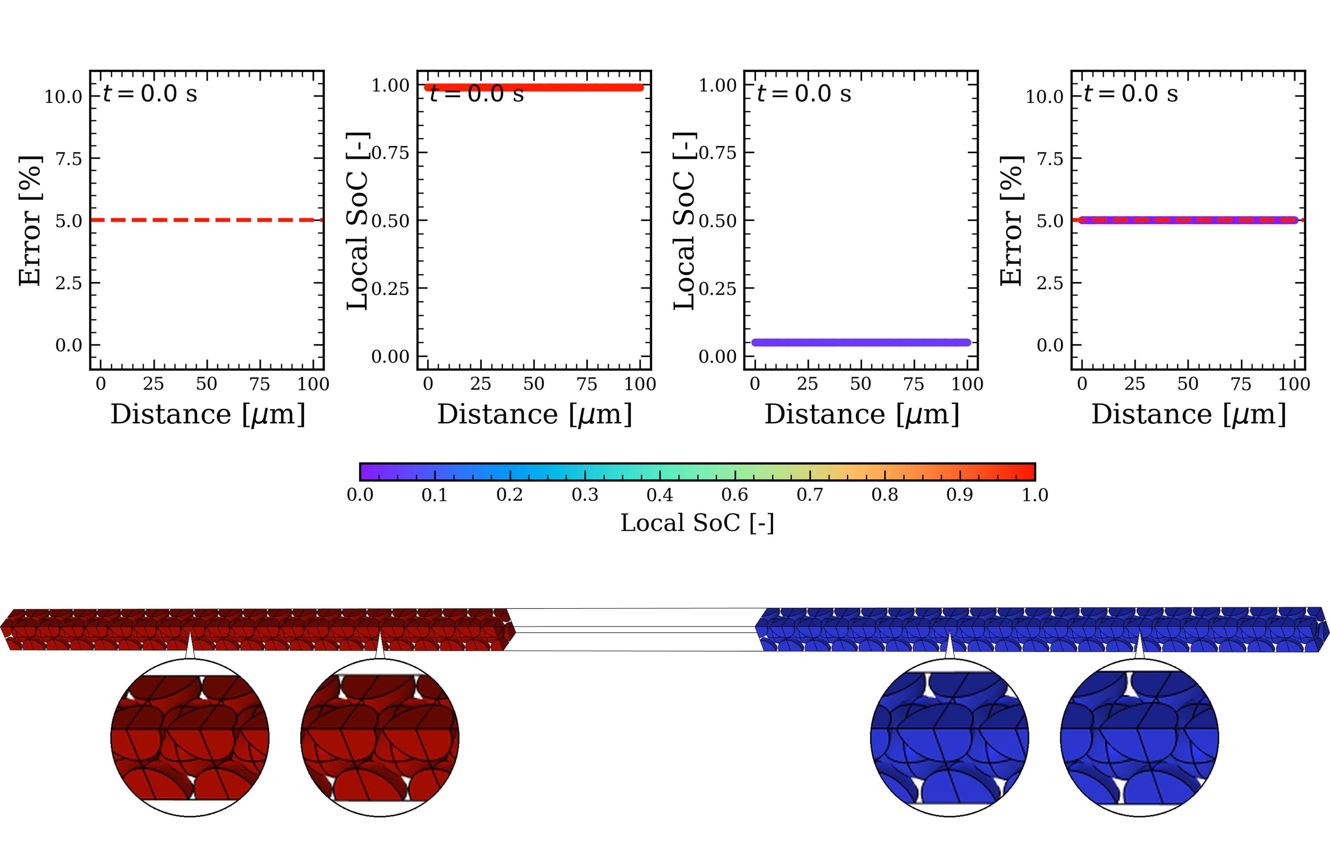

Application – Lithium-ion batteries
Li⁺ move between two solid electrode, anode and cathode, through a liquid electrolyte, converting chemical energy into electricity.
Cathode
$$Error=\left|ψ_{FHM}−ψ_{PSM}\right|=𝒪(ε)$$
Anode

Slide 10
Conclusions and Future Perspectives
The homogenized model is faster than a comparable pore scale one, with an estimable error of the same order of magnitude as the small scale parameter $ε$.
The homogenized model can be coupled with control algorithm, for in-line performance monitoring or it can support engineering design.
Future work will explore non-cubic unit cells and more realistic particle geometries to further improve the model’s representativeness and predictive capability.
Homogenization by multiscale asymptotic expansion is well suited to analyze transport and reaction in porous media with complex geometries and physics.

Slide 11


Thanks for your attention

Slide 12
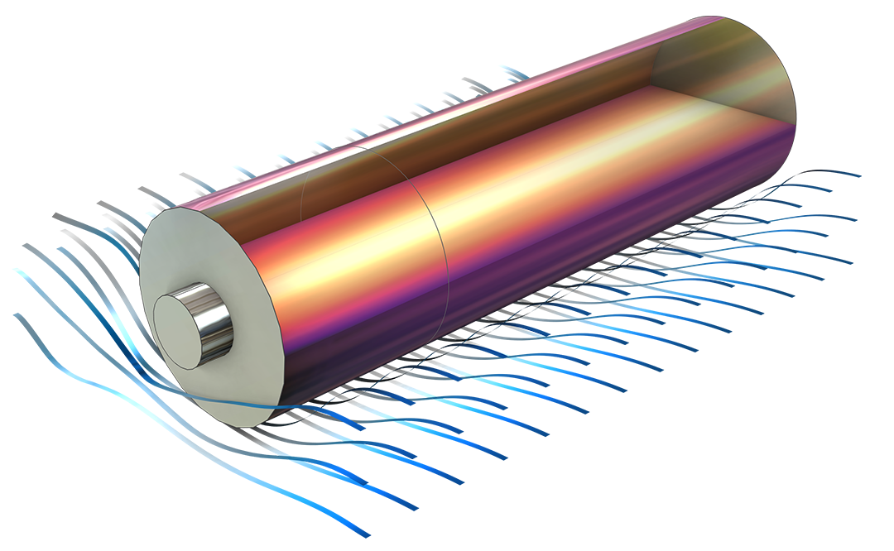
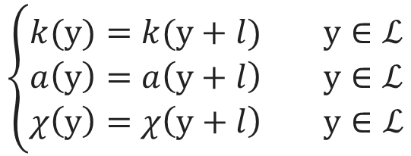
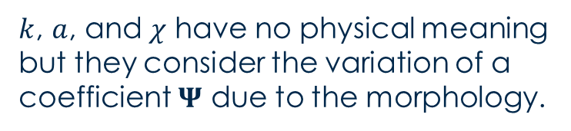
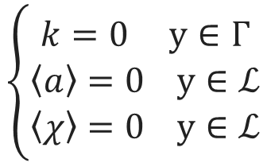
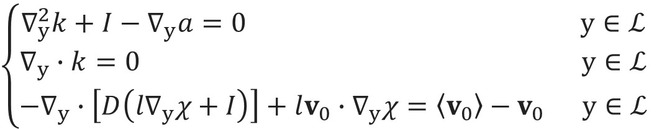
Closure Problem
$$\left\{\begin{aligned}∇_{y}^{2}k+I−∇_{y}a=0 y∈ℒ \\ ∇_{y}∙k=0 y∈ℒ \\ −∇_{y}∙\left[D\left(l∇_{y}χ+I\right)\right]+lv_{0}∙∇_{y}χ=\left\langle v_{0}\right\rangle −v_{0} y∈ℒ\end{aligned}\right.$$
$$\left\{\begin{aligned}k=0 y∈Γ \\ \left\langle a\right\rangle =0 y∈ℒ \\ \left\langle χ\right\rangle =0 y∈ℒ\end{aligned}\right.$$
$$\left\{\begin{aligned}k(y)=k(y+l) y∈ℒ \\ a\left(y\right)=a\left(y+l\right) y∈ℒ \\ χ\left(y\right)=χ\left(y+l\right) y∈ℒ\end{aligned}\right.$$
$k$, $a$, and $χ$ have no physical meaning but they consider the variation of a coefficient $Ψ$ due to the morphology.

Slide 13
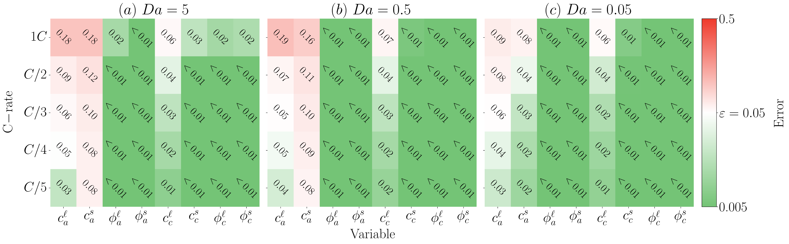



Results – Applicability regimes
Applicability conditions on the dimensionless numbers emerge during the mathematical derivation
$${Da}_{i}=\frac{Lk}{FD_{i}}<1$$
$${Pe}_{i}=\frac{RTK_{i}}{F^{2}D_{i}c_{i,ref}}<1$$
$$N_{ohm}=\frac{JLF}{RTK_{i}}<1$$
Applicability regimes are sufficient, but not necessary, conditions to ensure that: $error=\left|ψ_{FHM}−ψ_{PSM}\right|=𝒪(ε)$

Slide 14
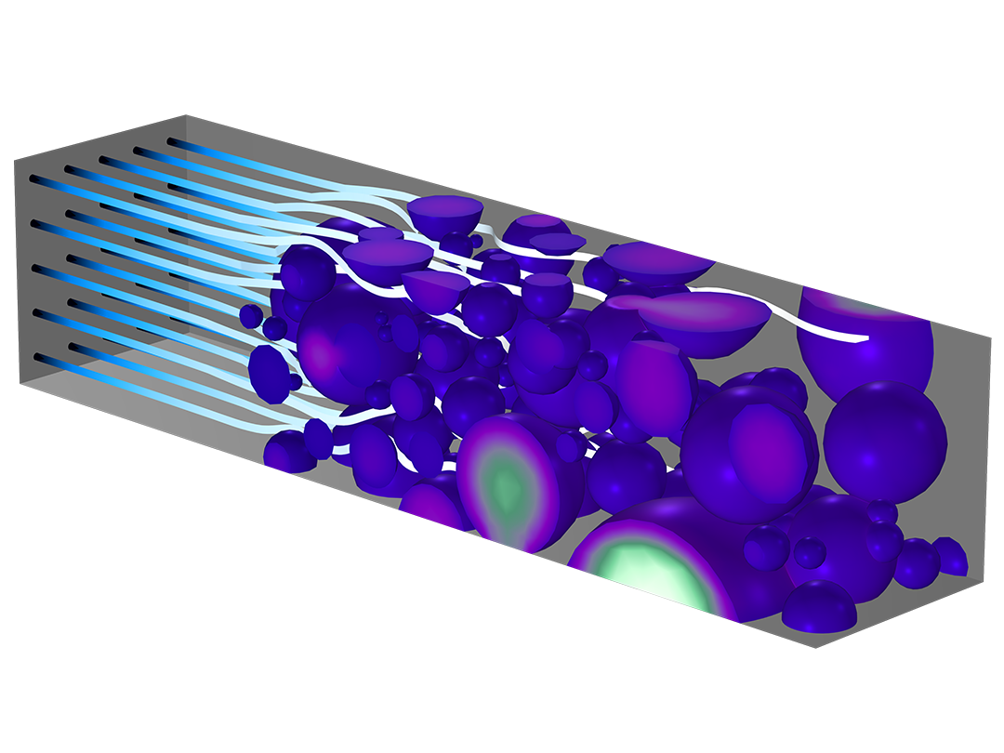
Conclusions
More realistic particles provide a more accurate graphite approximation than spheres, improving the prediction of electrode behavior, especially at high C-rates.
Automatic electrode generation enables faster first-cycle optimization by flexibly generating different materials and morphologies, reducing both experimental time and material consumption.
A reduced-order lithium-ion model, derived by homogenization via multiscale expansion, is fast and accurate for real-time in-line monitoring and State-of-Health (SoH) prediction.
The applicability regimes provide sufficient, but not necessary, conditions for accuracy. The homogenized model remains in good agreement with the pore-scale results even beyond these nominal boundaries.​

Slide 15









Acknowledgments
Silvia Bodoardo and Daniele Versaci
Ilenia Battiato
Andrea Querio and Elisa Buccafusco
Agnese, Andrea, Chiara, Defang, Diego, Edoardo, Eleonora, Elisa, Francesco, Gaia, Ghasem, Giacomo, Hosna, Jacopo, Kimiya, Lorena, Lorenzo, Marcello, Marco F., Marco M., Mario, Martina B., Martina G. B., Martina G., Mazhar, Michel, Michele, Nancy, Sandro, Sergio, Stefania, Vincenzo, Vittorio, Yi

Slide 16
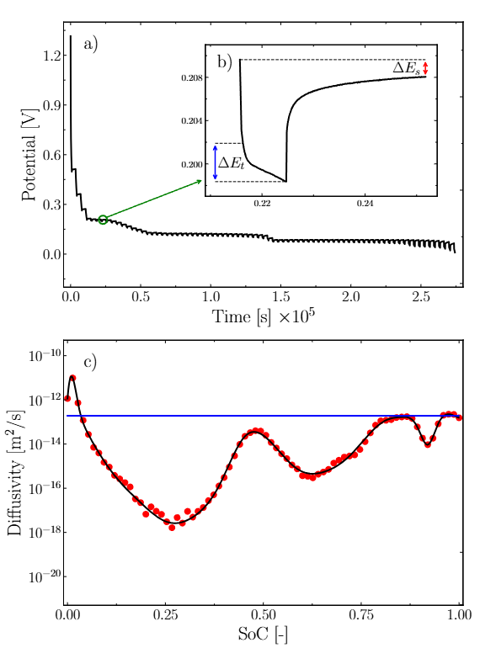
Galvanostatic Intermittent Titration Technique
23

Slide 17
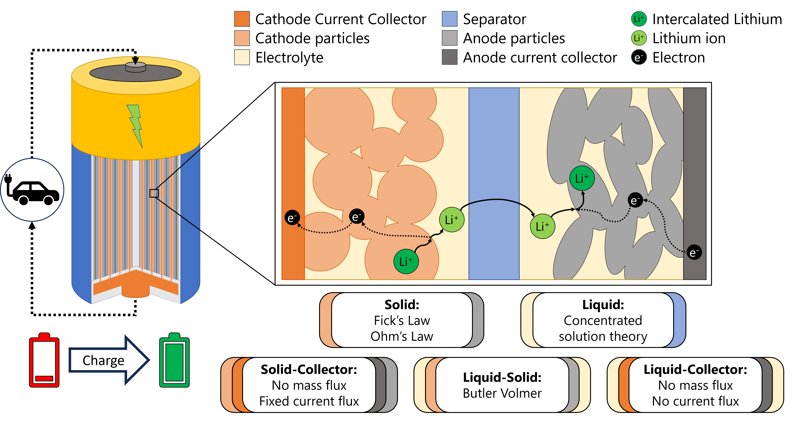
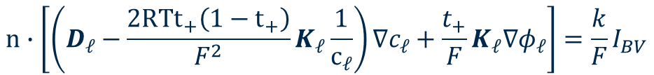
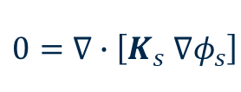
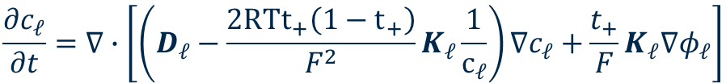

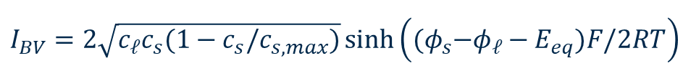
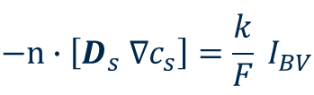
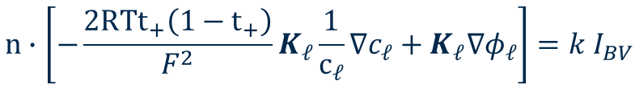
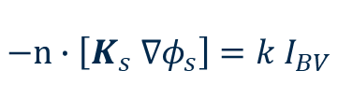
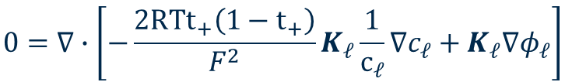
Microscale Equations
$$\frac{∂c_{ℓ}}{∂t}=∇∙\left[\left(D_{ℓ}−\frac{2RTt_{+}\left(1−t_{+}\right)}{F^{2}}K_{ℓ}\frac{1}{c_{ℓ}}\right)∇c_{ℓ}+\frac{t_{+}}{F}K_{ℓ}∇φ_{ℓ}\right]$$
$$n∙\left[\left(D_{ℓ}−\frac{2RTt_{+}\left(1−t_{+}\right)}{F^{2}}K_{ℓ}\frac{1}{c_{ℓ}}\right)∇c_{ℓ}+\frac{t_{+}}{F}K_{ℓ}∇φ_{ℓ}\right]=\frac{k}{F}I_{BV}$$
$$0=∇∙\left[−\frac{2RTt_{+}\left(1−t_{+}\right)}{F^{2}}K_{ℓ}\frac{1}{c_{ℓ}}∇c_{ℓ}+K_{ℓ}∇φ_{ℓ}\right]$$
$$n∙\left[−\frac{2RTt_{+}\left(1−t_{+}\right)}{F^{2}}K_{ℓ}\frac{1}{c_{ℓ}}∇c_{ℓ}+K_{ℓ}∇φ_{ℓ}\right]=k I_{BV}$$
$$\frac{∂c_{s}}{∂t}=∇∙\left[D_{s} ∇c_{s}\right]$$
$$−n∙\left[D_{s} ∇c_{s}\right]=\frac{k}{F} I_{BV}$$
$$0=∇∙\left[K_{s} ∇φ_{s}\right]$$
$$−n∙\left[K_{s} ∇φ_{s}\right]=k I_{BV}$$
$$I_{BV}=2\sqrt{c_{ℓ}c_{s}(1−c_{s}/c_{s,max})}\sinh\left({(φ}_{s}−φ_{ℓ}−E_{eq})F/2RT\right)$$

Slide 18
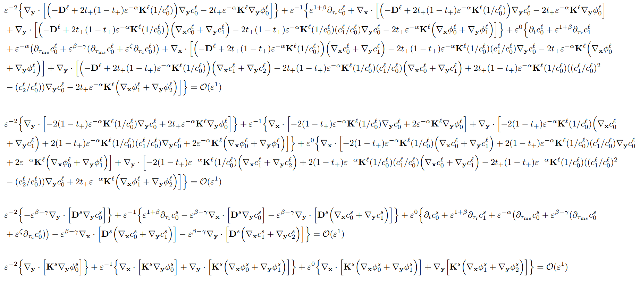
A lot of mathematical steps…
Concentration (Liquid)
Electric potential (Liquid)
Concentration (Solid)
Electric potential (Solid)

Slide 19
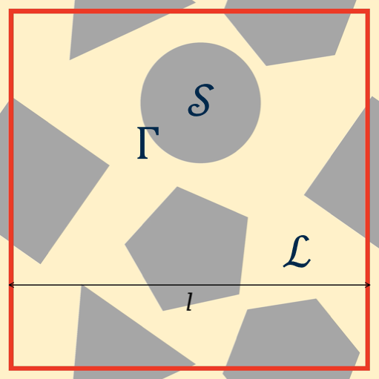



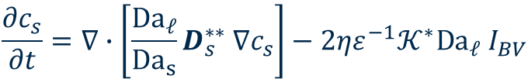

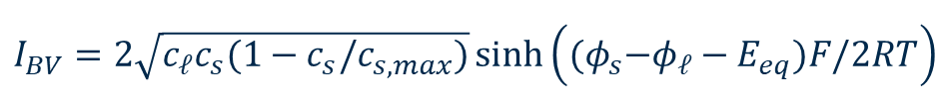

Macroscale Equations
Concentration
(Liquid)
$$\frac{∂c_{ℓ}}{∂t}=∇∙\left[\left(D_{ℓ}^{∗∗}−2t_{+}\left(1−t_{+}\right)Pe_{ℓ}K_{ℓ}^{∗∗}\frac{1}{c_{ℓ}}\right)∇c_{ℓ}+2t_{+}Pe_{ℓ}K_{ℓ}^{∗∗}∇φ_{ℓ}\right]+2ηε^{−1}𝒦^{∗}Da_{ℓ} I_{BV}$$
Electric potential
(Liquid)
$$0=∇∙\left[−2\left(1−t_{+}\right)Pe_{ℓ}K_{ℓ}^{∗∗}\frac{1}{c_{ℓ}}∇c_{ℓ}+2Pe_{ℓ}K_{ℓ}^{∗∗}∇φ_{ℓ}\right]+2ηε^{−1}𝒦^{∗}Da_{ℓ} I_{BV}$$
Concentration
(Solid)
$$\frac{∂c_{s}}{∂t}=∇∙\left[\frac{{Da}_{ℓ}}{{Da}_{s}}D_{s}^{∗∗} ∇c_{s}\right]−2ηε^{−1}𝒦^{∗}Da_{ℓ} I_{BV}$$
$$Ψ^{∗∗}=\left\langle Ψ\left(I+∇_{y}χ\right)\right\rangle$$
Electric potential
(Solid)
$$𝒦^{∗}=\frac{Γ}{ℒ}$$
$$η=\frac{ℒ}{ℒ+𝒮}$$
$$0=∇∙\left[2Pe_{s}K_{s}^{∗∗} ∇φ_{s}\right]−2ηε^{−1}𝒦^{∗}Da_{ℓ} I_{BV}$$
$${Da}_{i}=\frac{Lk}{FD_{i}}$$
$${Pe}_{i}=\frac{RTK_{i}}{F^{2}D_{i}c_{i,ref}}$$
Butler-Volmer
$$I_{BV}=2\sqrt{c_{ℓ}c_{s}(1−c_{s}/c_{s,max})}\sinh\left({(φ}_{s}−φ_{ℓ}−E_{eq})F/2RT\right)$$

Slide 20
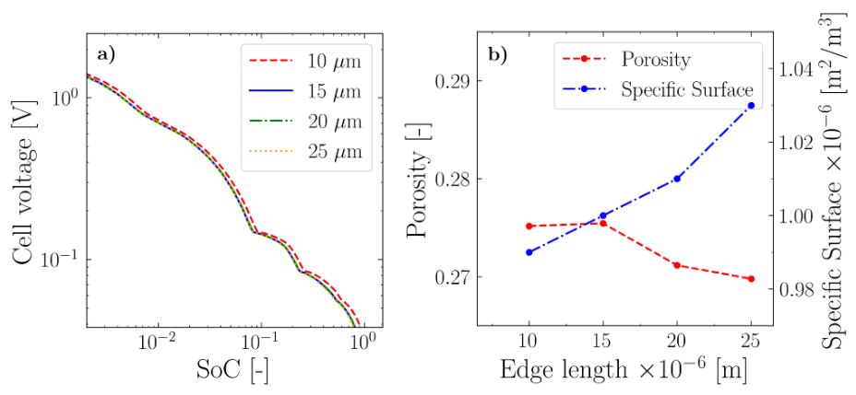
Representative Elementary Volume analysis
23

Slide 21
Solver setup
Study type | Time dependent with initialization
Time integration | Backward differentiation formula (stiff problem)
Time stepping | Adaptative
Non linear solver | Newton (Fully coupled)
Linear solver | Direct (MUMPS or PARDISO)
Solver tolerance | 0.001
Stored times | User defined (1001 points)
Stop criterion | End time or voltage
23

Slide 22
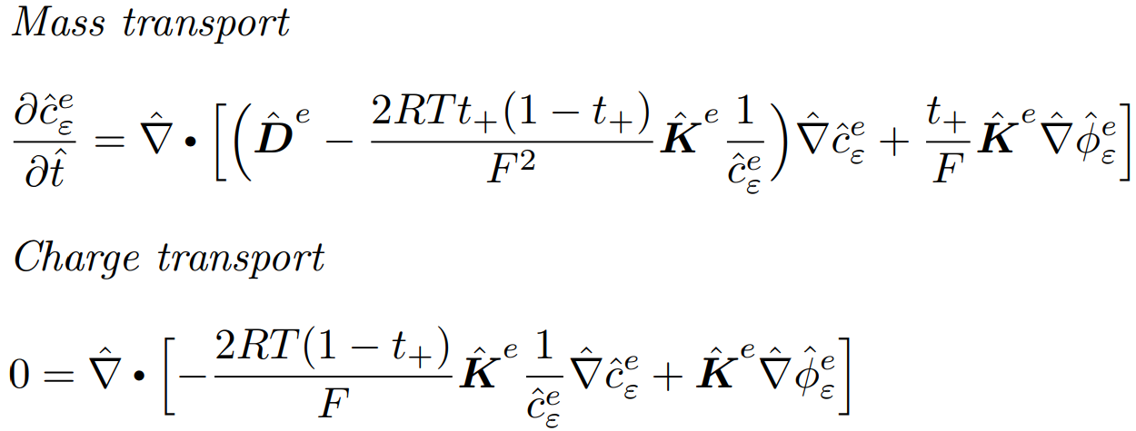
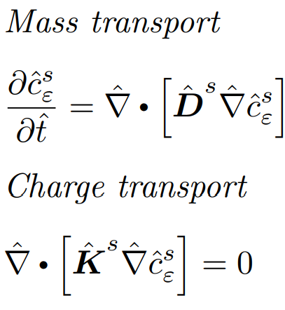
Homogenization of lithium-ions batteries equations
Mass Transport in the electrolyte
Charge Transport in the electrolyte
Mass Transport in the electrode
Charge Transport in the electrode
23

Slide 23
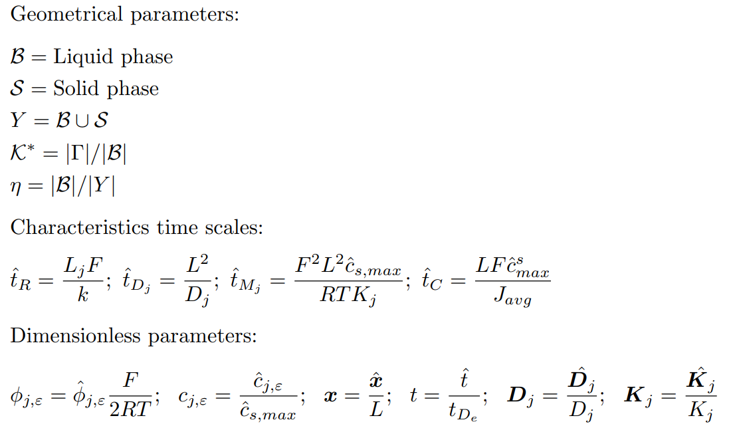
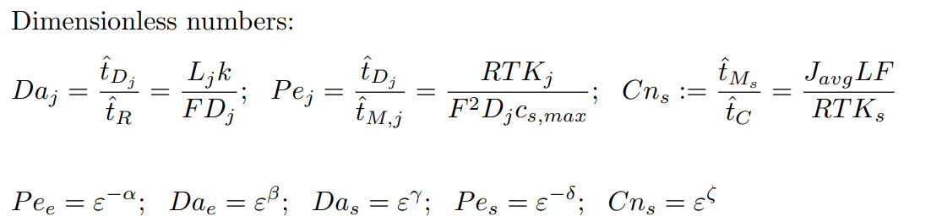
18

Slide 24
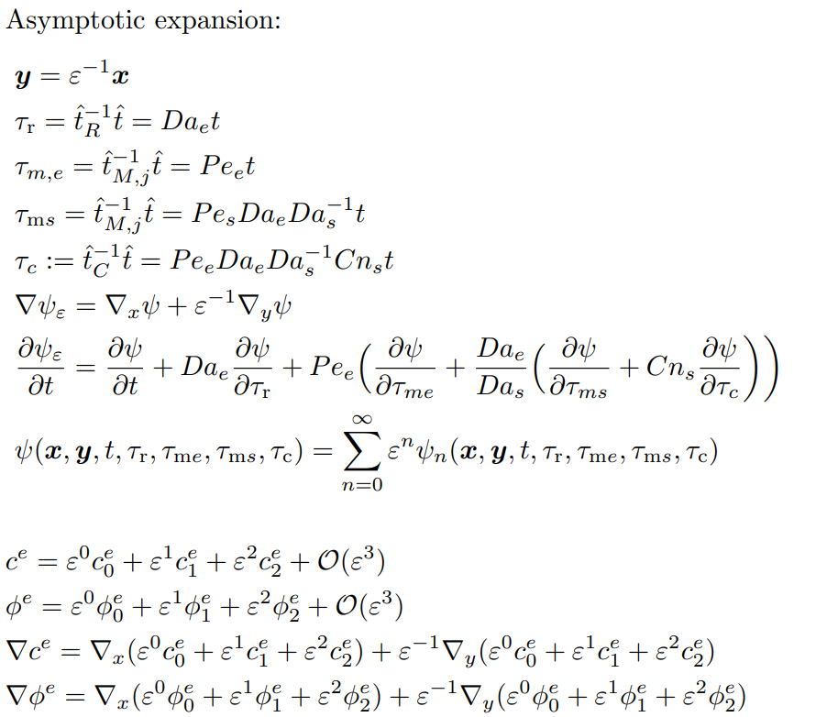
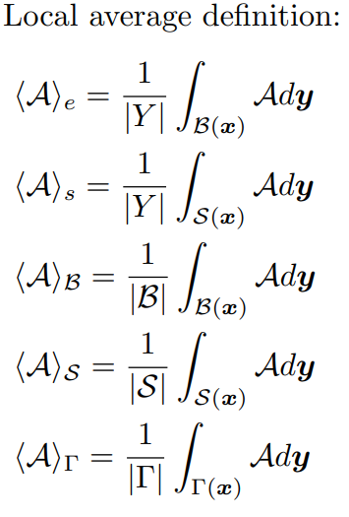
19

Slide 25
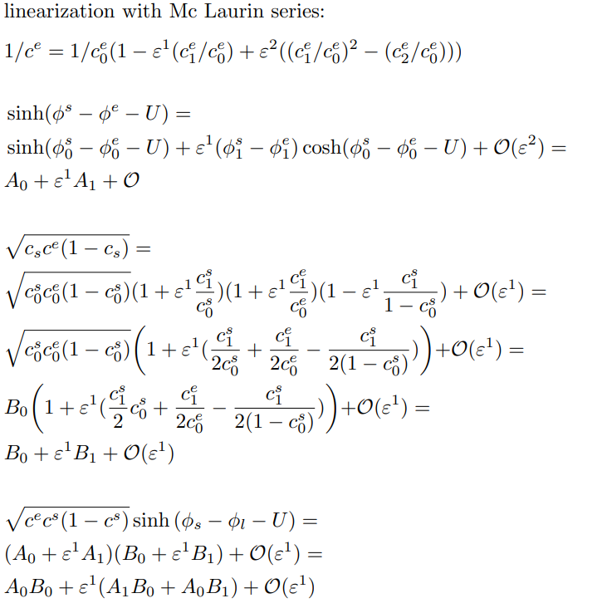
20

Slide 26
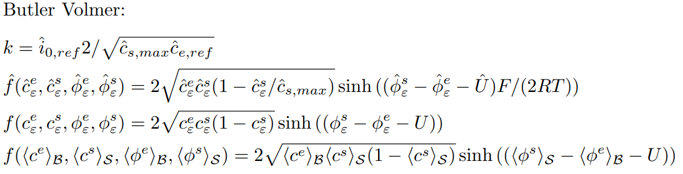
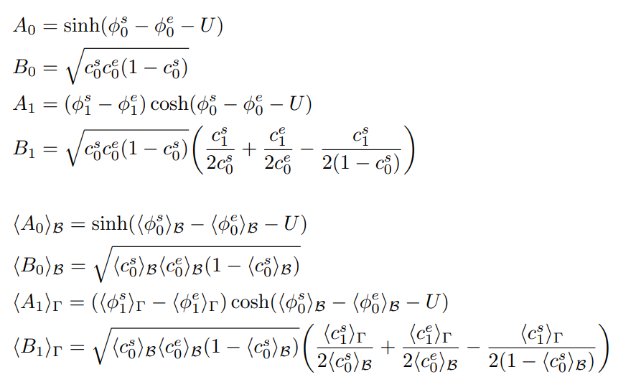
21

