Slide 1





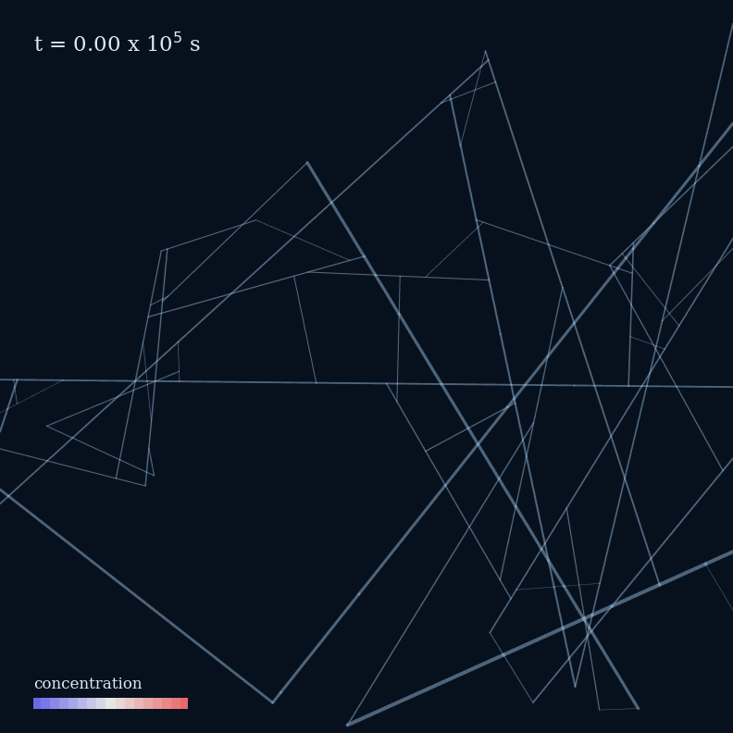
Fracture aperture evolution modeled by the Particle-Tracking method in discrete fracture network (DFN)
Wenyu Zhou,
Linda Luquot,
Delphine Roubinet
CNRS, Montpellier, France
Date: 19.05.2026
Interpore 2026
Notes:
Welcome and introduction
We develop a DFN PT reactive transport code. It represent the geochemical response to the fracture aperture evolution;
We will introduce our method, bechmark test restuls and model applicaity/sensitivity.

Slide 2
Why do we need an efficient reactive transport framework？
Reactive transport in fractured porous media
Includes advection in fracture, diffusion in the matrix and reactions
Controls permeability evolution, transport pathways and long-term behavior
Affects fracture alteration processes in active fault → our motivation
Full RTM are computationally expensive, especially in large fracture systems
FEM/ DFM require costly remeshing during dissolution/precipitation
Usually difficult in large evolving 3D networks
Current efficient DFN-RTM capabilities are still limited
We need a framework that is:
Efficient and scalable: suitable in different system scales
Interpretable: realistic chemistry-geometry couplling
Robust and modular: easy to couple with different chemistry inputs

Slide 3
Particle-Tracking method in DFN and our improvement
DFN-Particle tracking (DFN-PT) model from a previous study _{[1]}
Fractured rock: fracture segments + matrix blocks.
Solutes: particles → advection + stochastic matrix diffusion.
Hydraulic characteristics → particle pathways, velocity, residence time
Our improvement: particle residence time →
reaction progress → aperture feedback
Injection
Extraction
Fluid flow
Particle
Δb
Reaction progress
Application: efficient long-term prediction of reactive transport and permeability feedback in large DFNs.
[1] Roubinet, D (2013), Particle-tracking simulations of anomalous transport in hierarchically fractured rocks, Computers & Geosciences

Slide 4
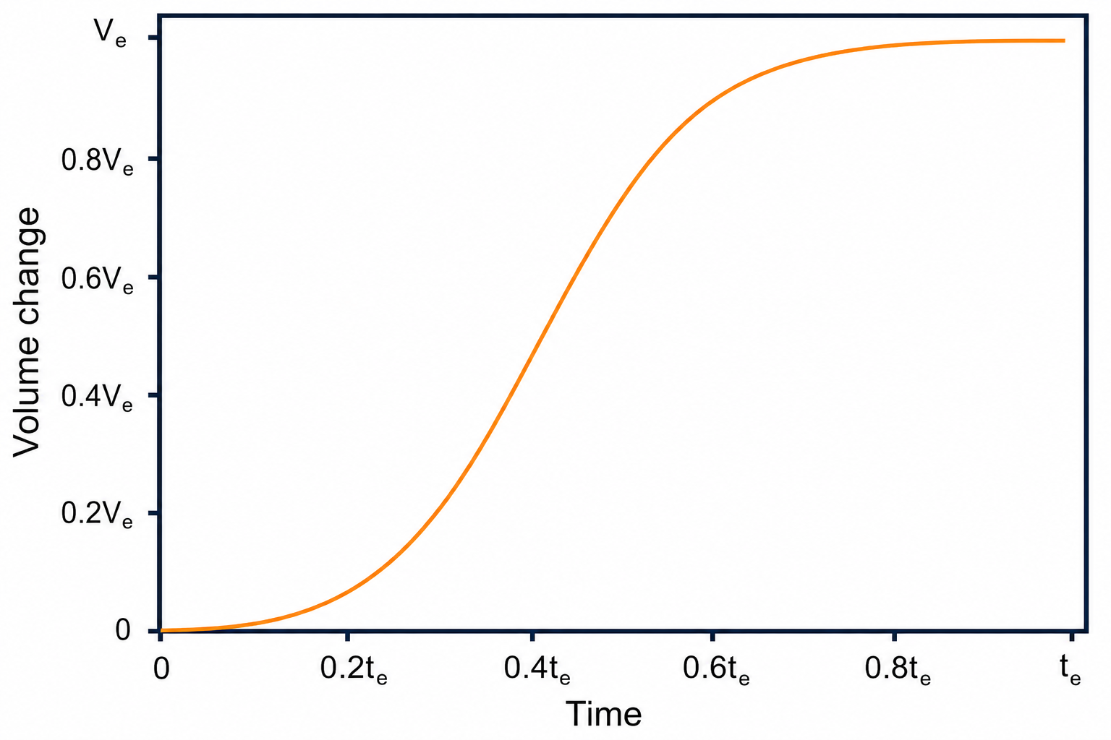




Chemistry coupling: from particle history to aperture evolution
F(t) is a PHREEQC calibrated surrogate function for cumulative mineral-volume change:
t₃,ΔV₃
t₄,ΔV₄
$$c_{i}, t_{r}, V_{f},A...→ F(t)$$
Mineral-volume increment introduced by one particle is represented as:
t₂,ΔV₂
$$∆V_{p}=\left[F(t_{p}+∆t)−F(t_{p})\right]⋅w_{p}$$
where $w_{p}$ is particle weight (volume or normalized weight)
t₁,ΔV₁
$$∆V_{seg}=\sum_{P}{∆V_{p}}$$
$$∆b=\frac{∆V_{seg}}{2L_{seg}h}$$
$∆V_{seg}$ is the sum of volume change by particles
Particle residence time is mapped to ΔV_{mineral}, then accumulated on each fracture segment
1
4
3
2
Assumptions:
stable mineral/fluid compositions; residence/concentration domain; controlled reaction rate; local chemistry state $→$ mineral change
Particle transport

Slide 5
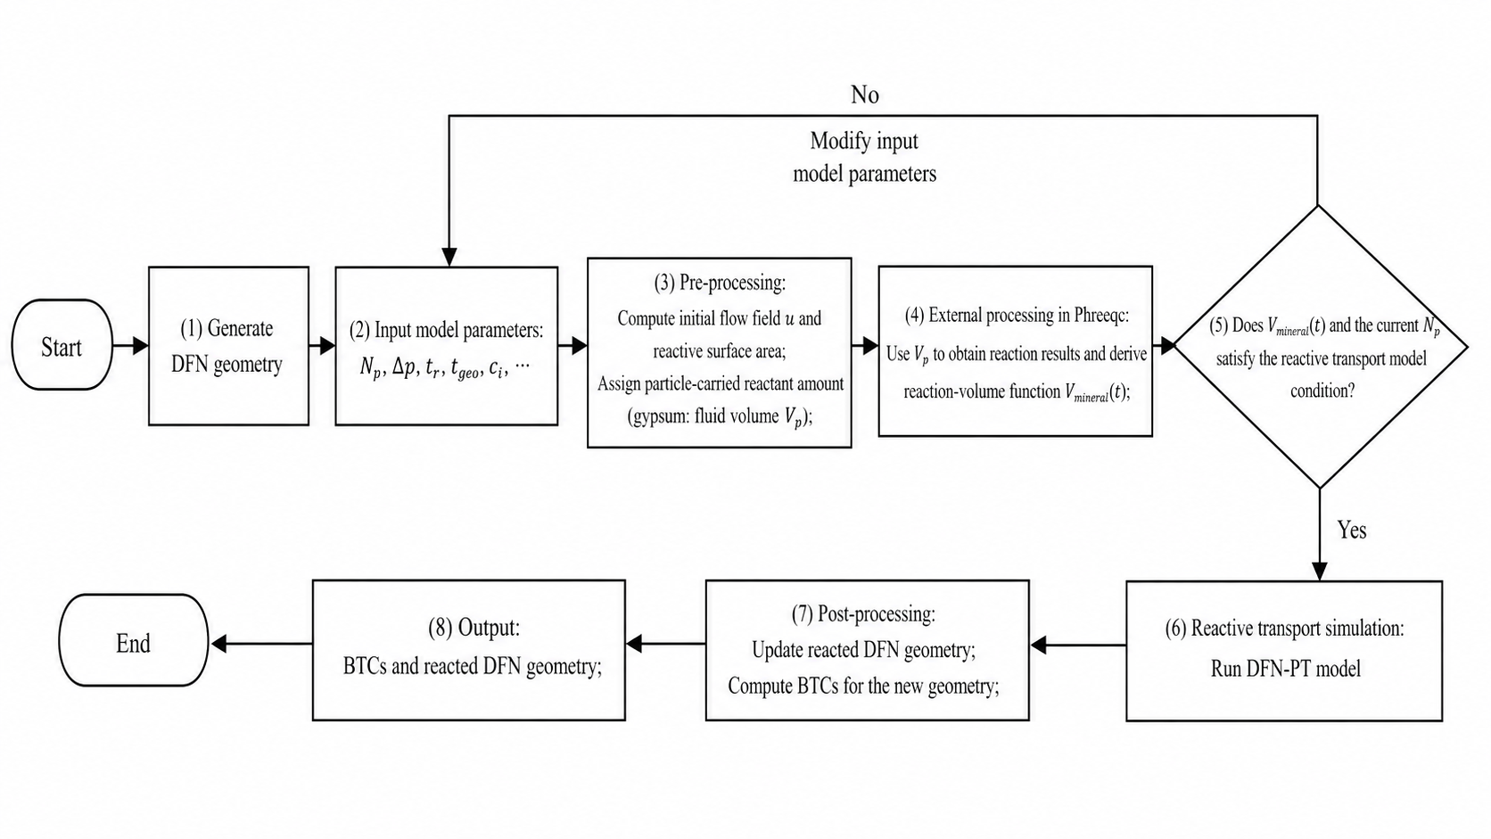
Particle-Tracking method in DFN and our improvement

Slide 6
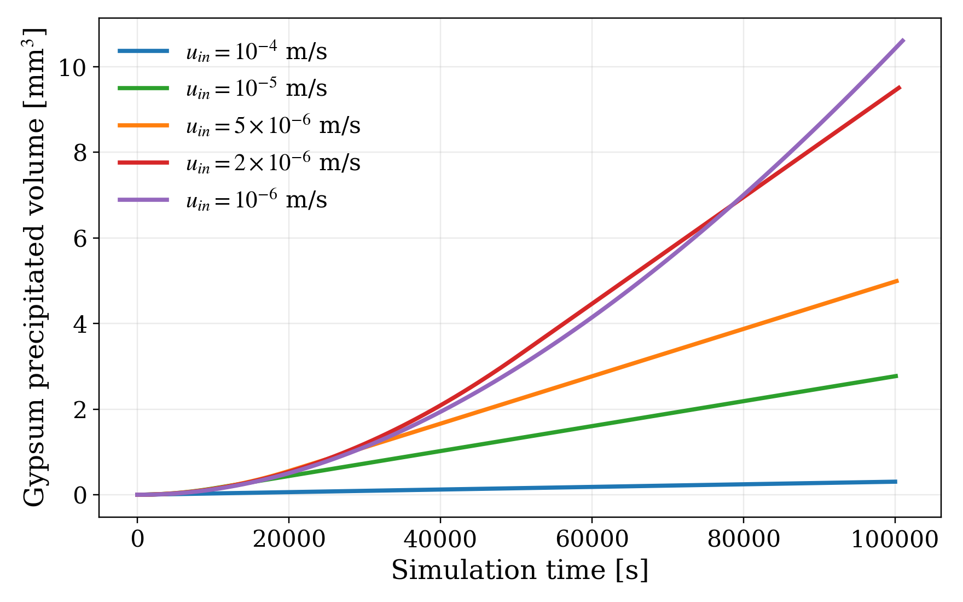
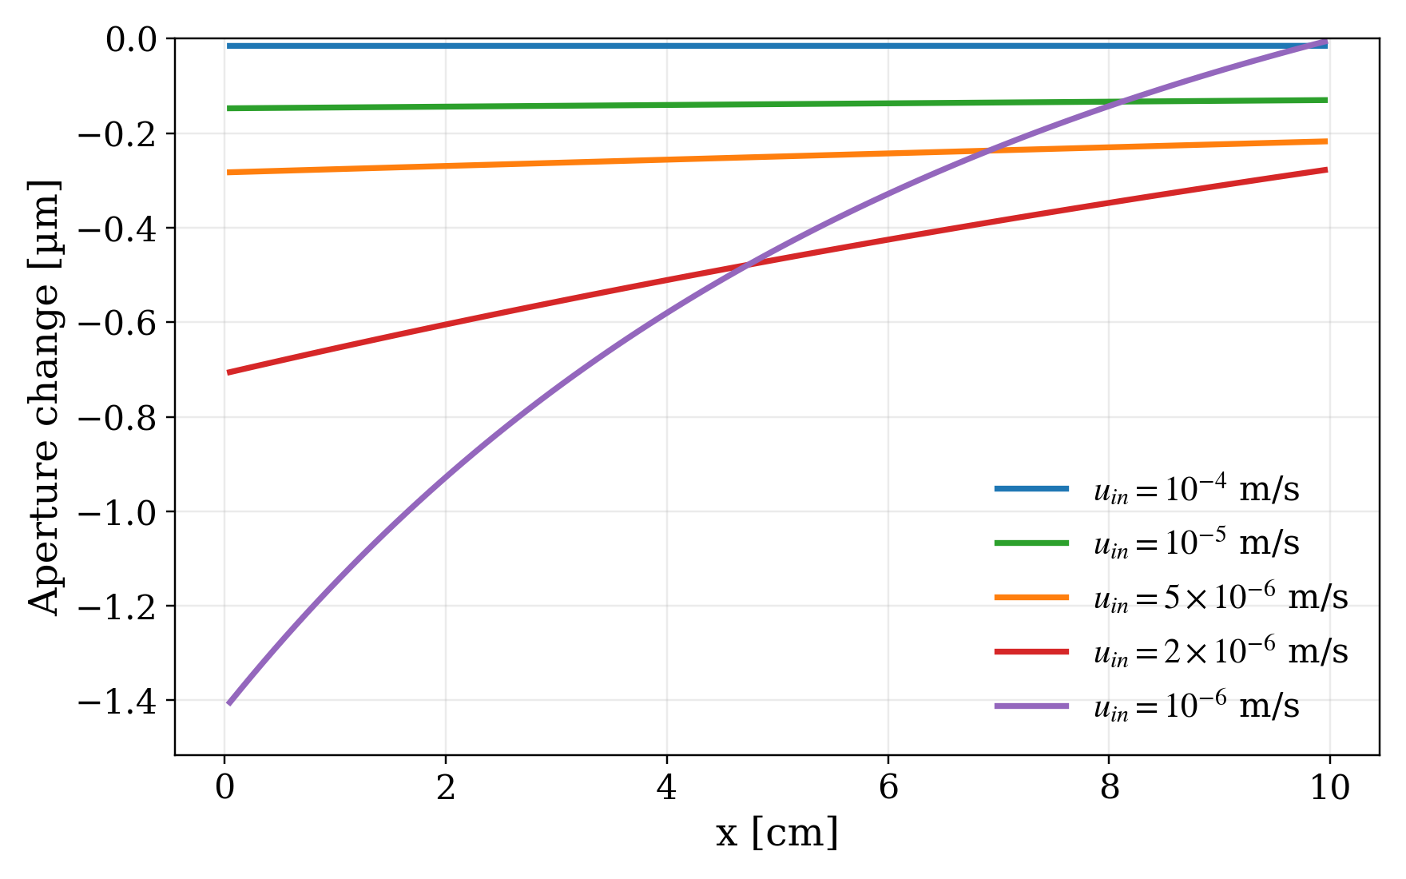
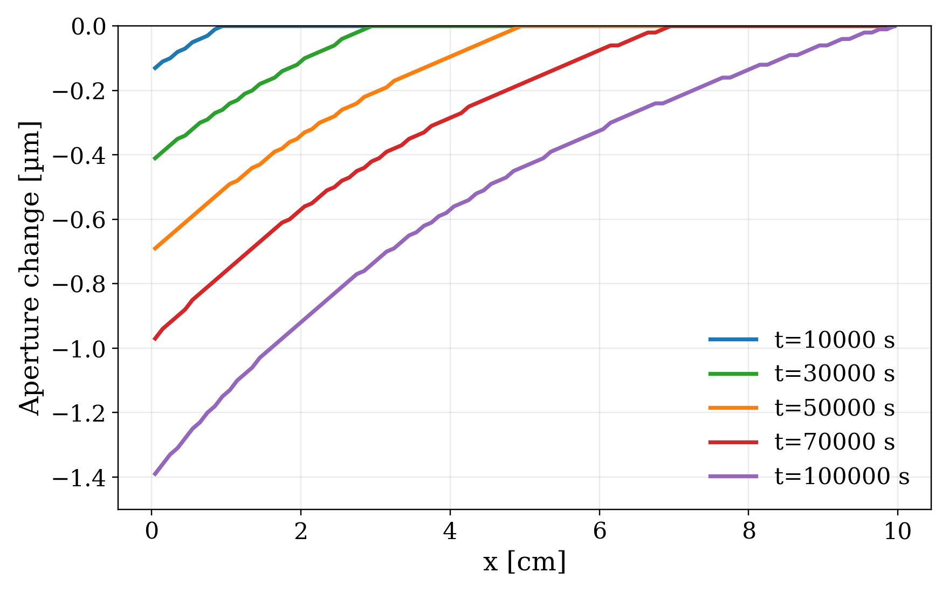
Gypsum precipitated volume in varied velocity with time
Benchmark test in single-fracture
Aperture evolution under different flow rate
Oversaturated water:
c_{₍Ca²⁺ / SO₄²⁻₎} = 30 mmol/kgw;
pH = 7; T = 25 °C; Ω_{gyp}≈ 2.2
Model setups:
t_{r} = 10⁵ s
N_{p} = 10000
...
b = 5 mm
segmentation number n = 100
L = 10 cm
Inject oversaturated water into a gypsum-based single fracture
Aperture distribution of varied inject velocity when t_{r} = 10⁵ s
Aperture evolution by the time with u_{in} = 10⁻⁶ m/s

Slide 7
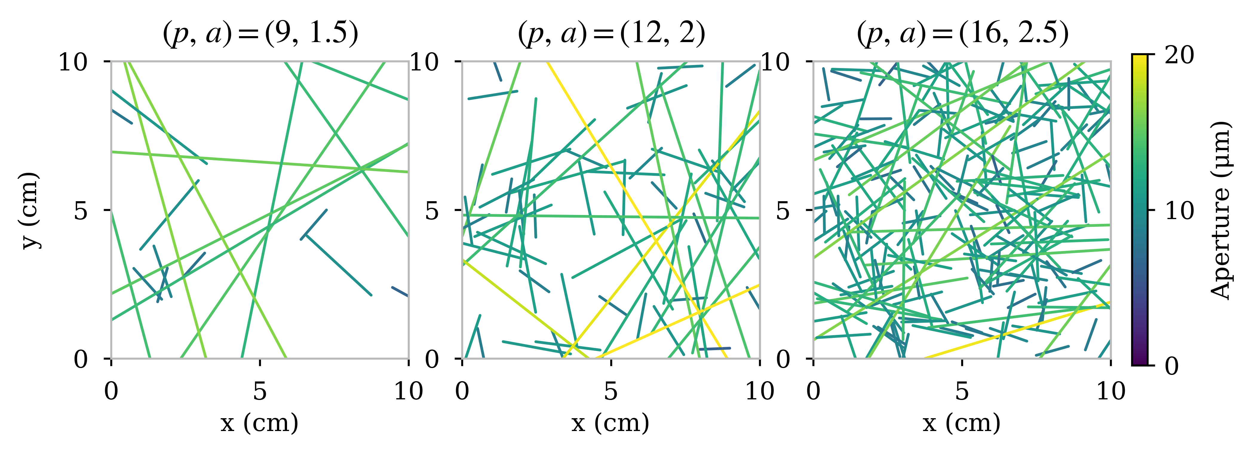
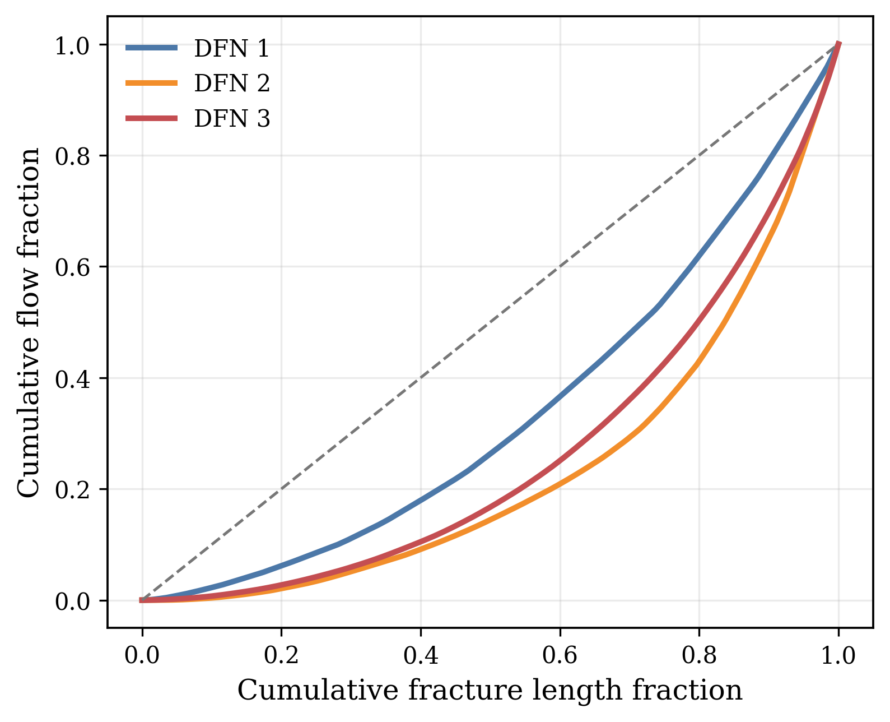
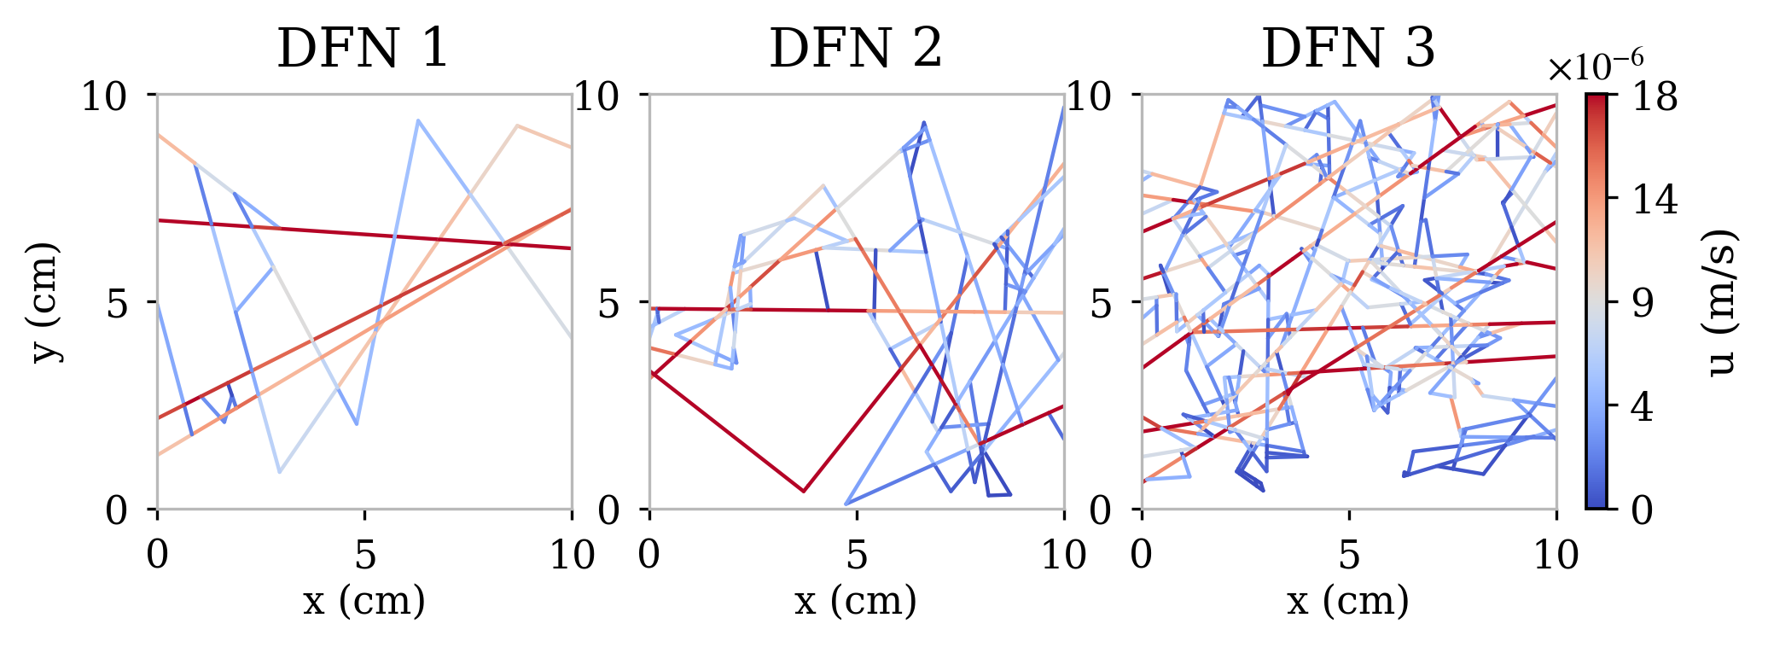
Sensitivity test setups with different synthetic DFN geometries
Two aspects are evaluated:
Physical: Flow rate and DFN structures
Numerical: N_{p}, Δt_{r}, and n
Baseline case is chosen to fit all cases
ΔP = 100 Pa, N_{p} = 10⁶, t_{r} = 10⁷ s, Δt_{r} = 1000 s
c_{₍Ca²⁺ / SO₄²⁻₎} = 150 mmol/kgw, n = 1
Sensitivity analysis setup:
ΔP = 10,100,1000 Pa ; 3 DFN structures
N_{p} = 10⁴, 10⁵, 10⁶, 10⁷
Δt_{r} = 10³, 10⁴, 10⁵ ,10⁶
n = 1, 2, 3, 4, 5, 6, 7
Different DFN geometries for testing (Power-law scaling, log-normal distribution)
DFN 1
DFN 2
DFN 3
Velocity fields for different DFN geometries

Slide 8
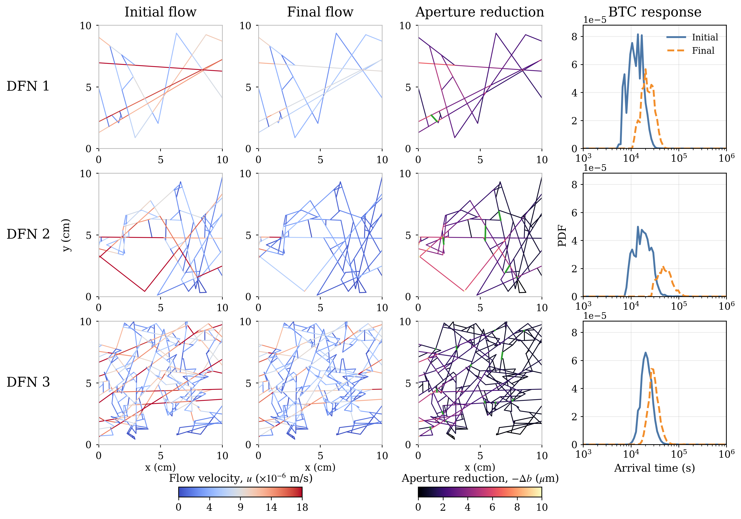
Sensitivity test results with different synthetic DFN geometries
Flow field updates
Skeleton reconstruction
Reduced BTCs response
*
Fracture segments disconnect

Slide 9
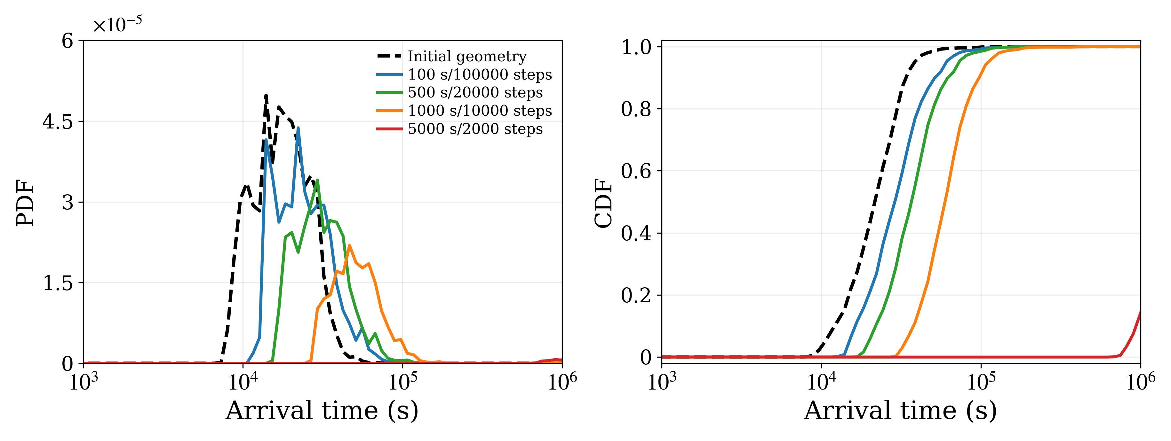
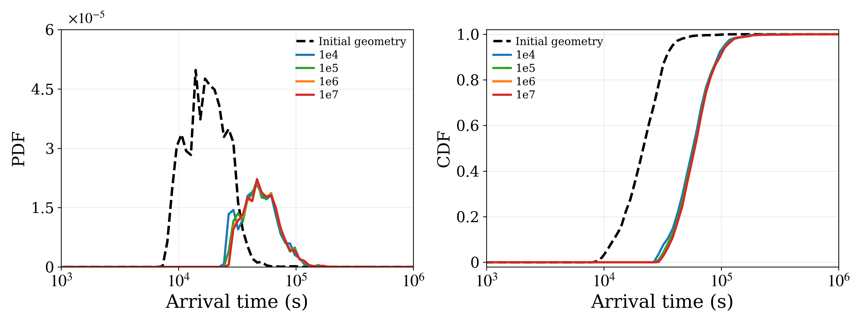
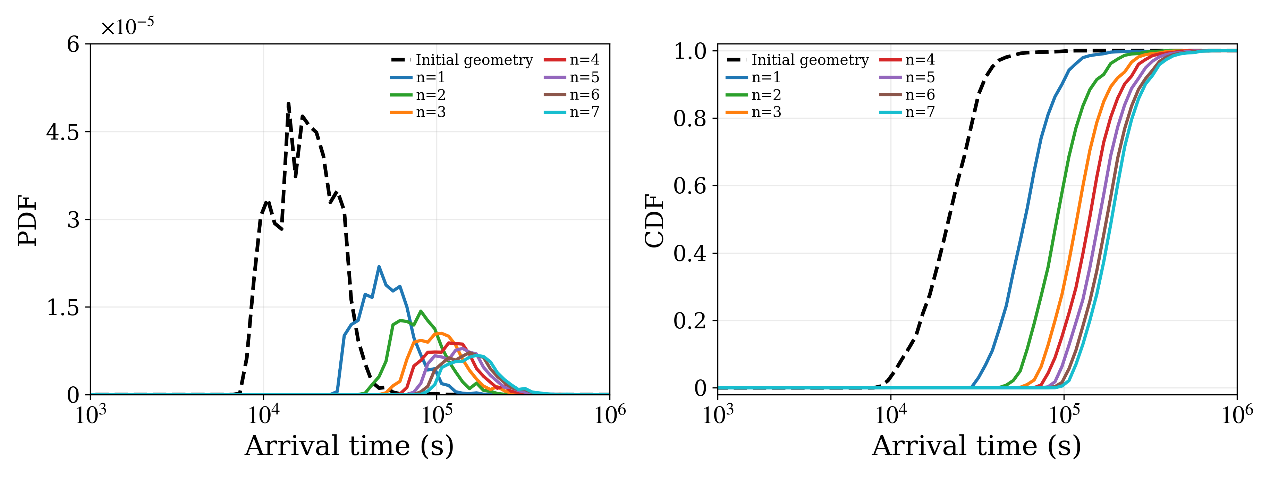
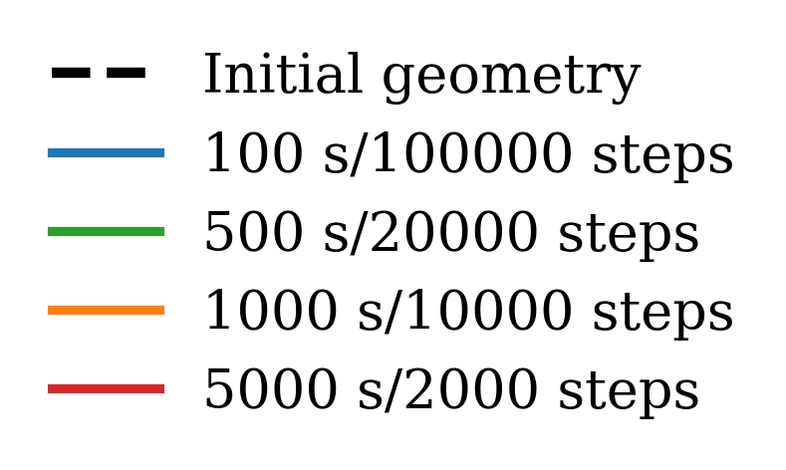
Effects of different numerical parameter settings
Reaction time step Δt_{r}
Particle number N_{p}
Segmentation number n
Both reaction time step and DFN segmentation number strongly affect RTM results

Slide 10
Take home messages
The DFN-PT model can simulate DFN aperture evolution
A bridge between particle-based transport and reaction-driven evolution in fracture systems
More efficient than conventional finite-element models
Localized fracture aperture changes (main flow paths)
Modeling parameters input matters → n and Δt_{r} are very sensitive, N_{p} depends
The current DFN-PT model needs further development (But promising!)
Chemistry is simplified as a surrogate function, not solved by full online RTM
Applicability depends on the reaction assumptions and parameter calibration
More validation is needed for multi-mineral systems
Future works:
Develop with specific questions → fracture segments?
Extend to multi-mineral systems through online coupling with reaction modules
This work is supported by Agence nationale de la recherche (ANR-23-CE05-0023, Alteraction)

Slide 11
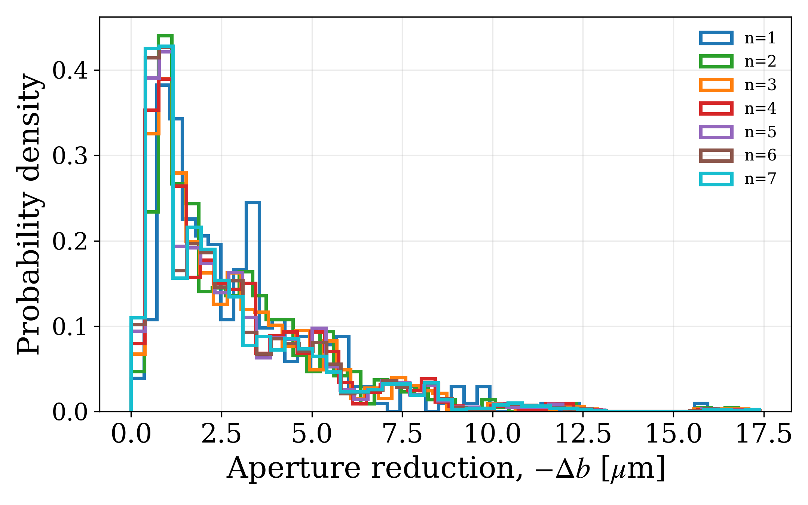
Sensitivity analysis

Slide 12
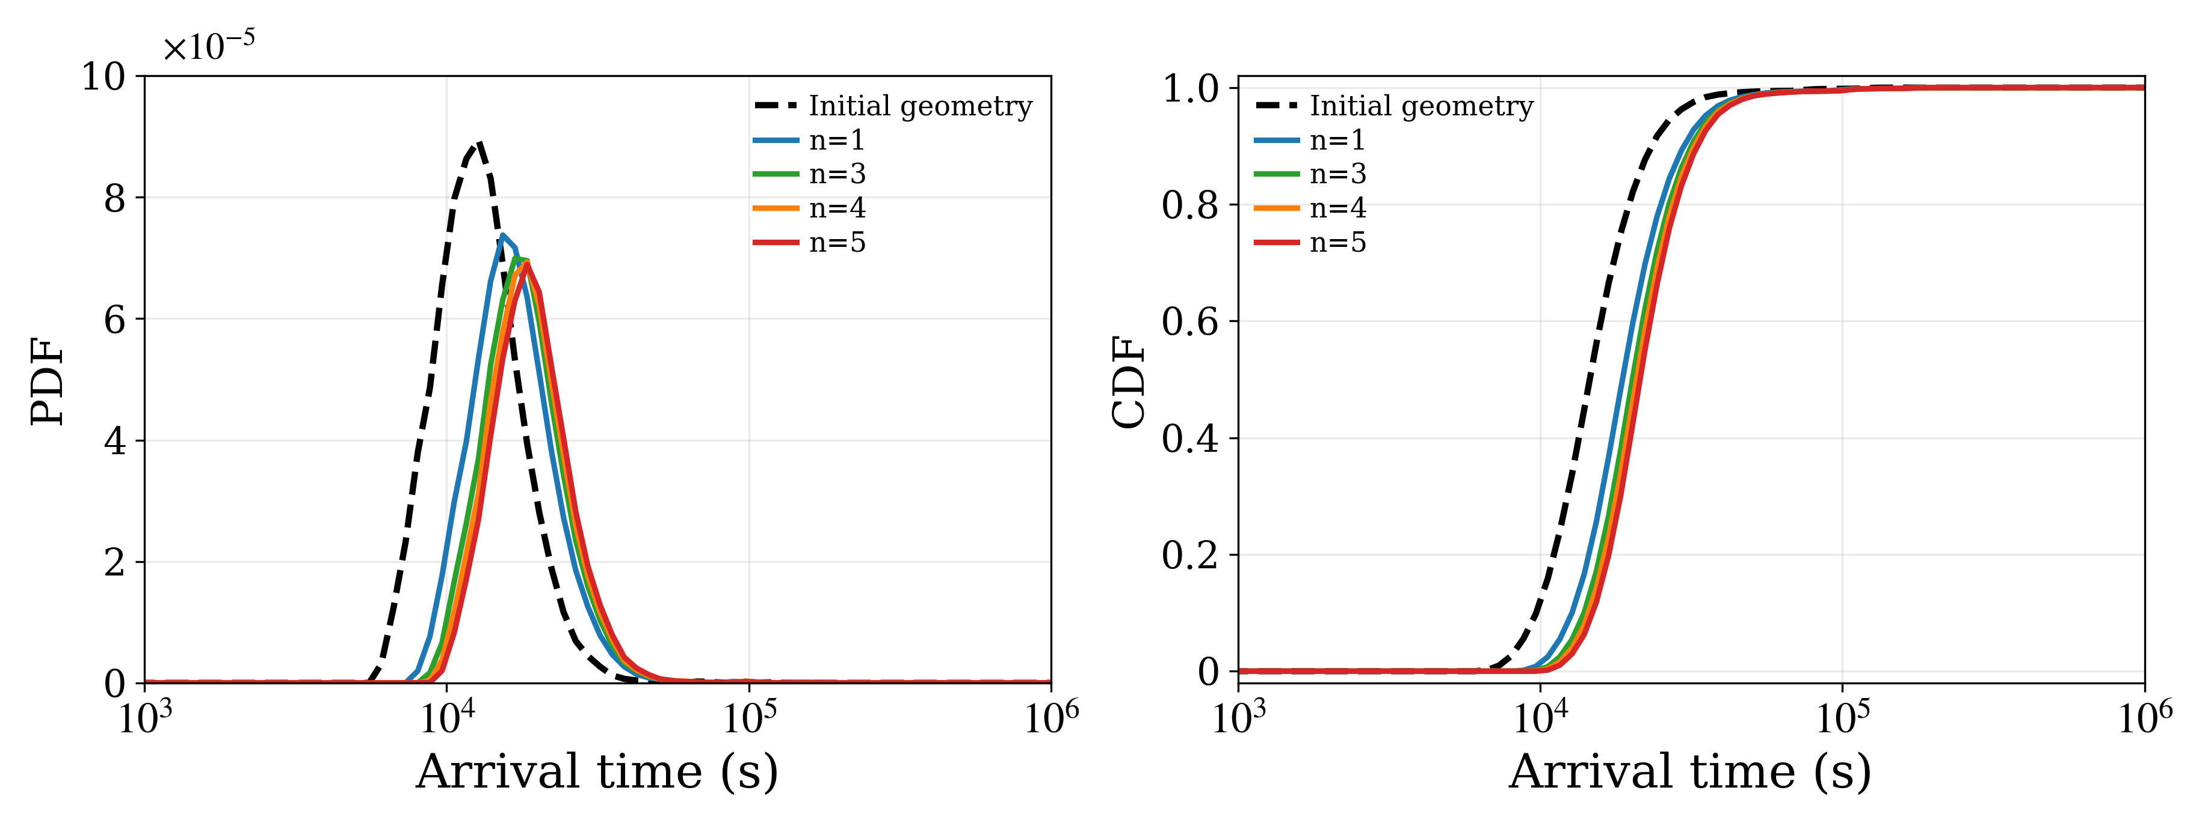
Sensitivity analysis
BTCs for DFN 3 with dt = 100s and different segmentation number

Slide 13
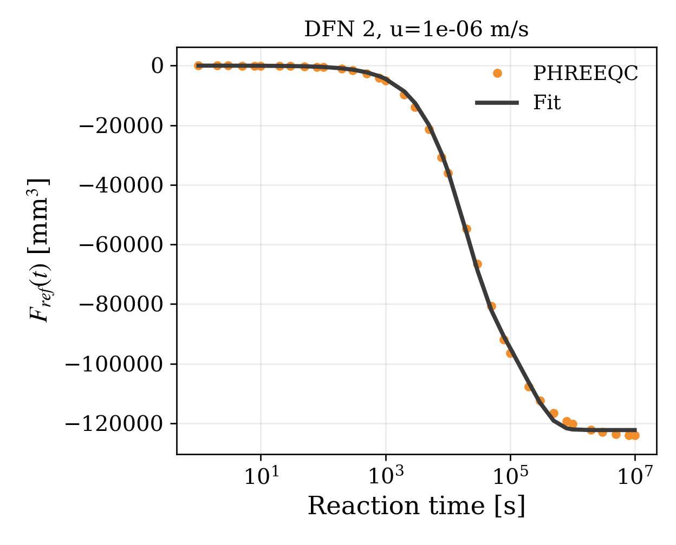
Sensitivity analysis

Slide 14
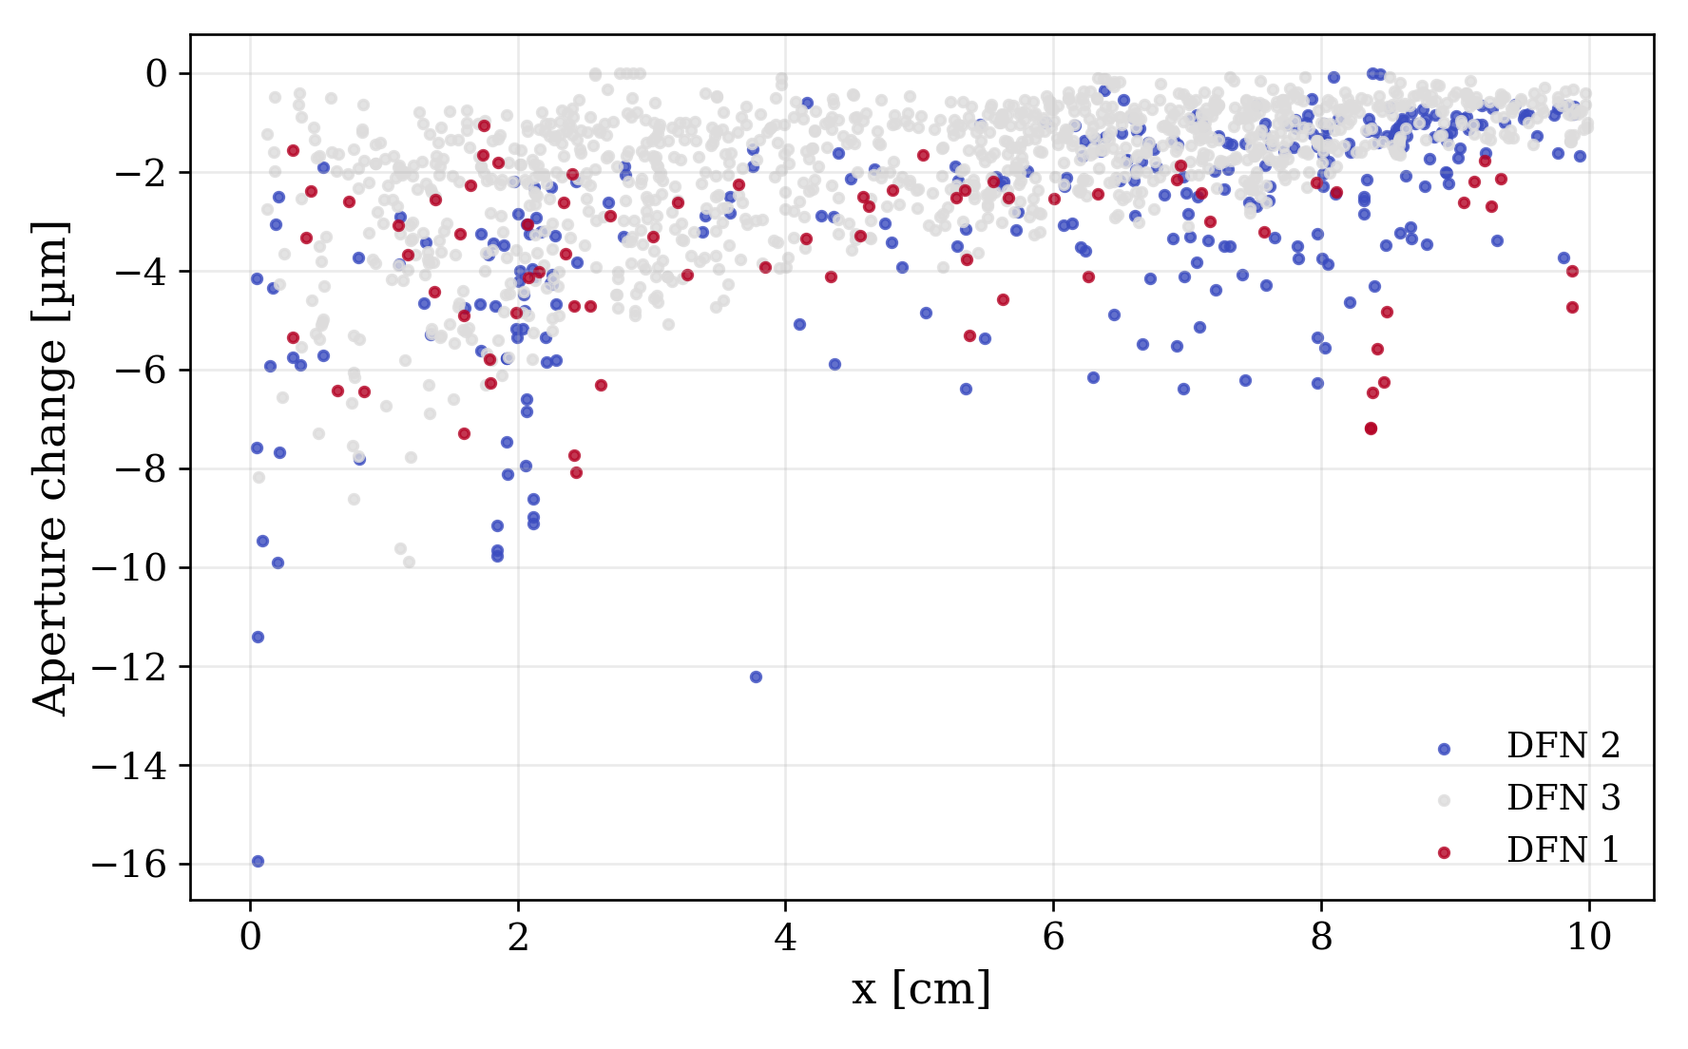
Sensitivity analysis

Slide 15
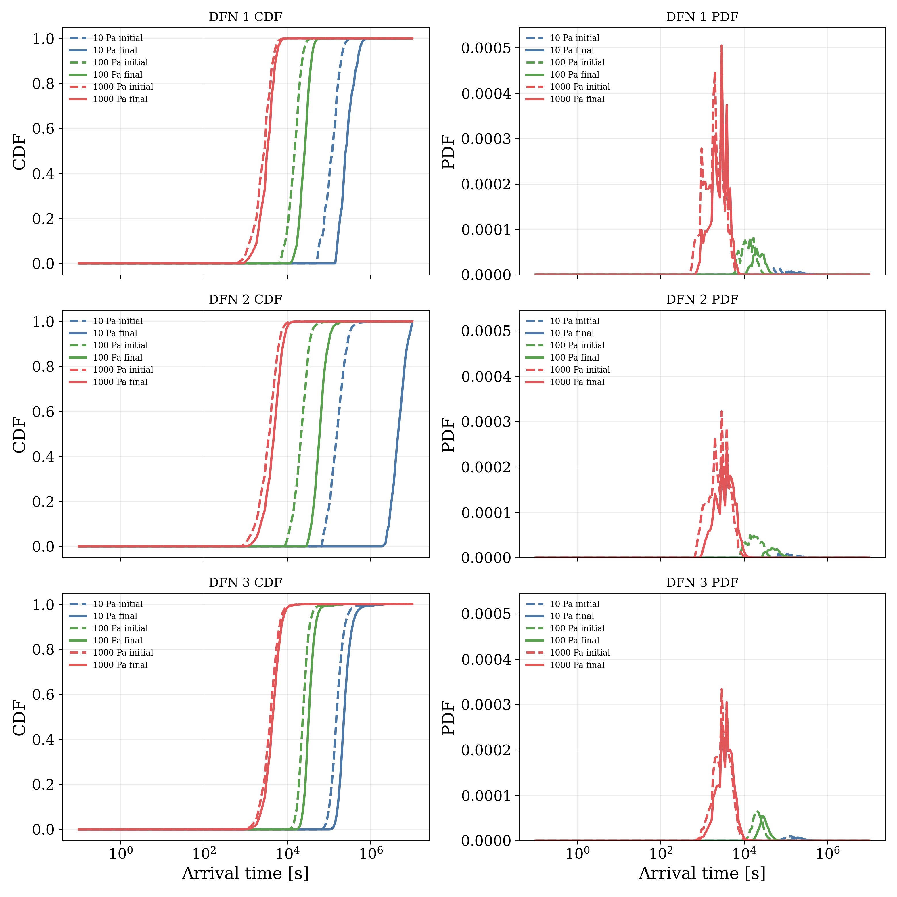
Sensitivity analysis

Slide 16
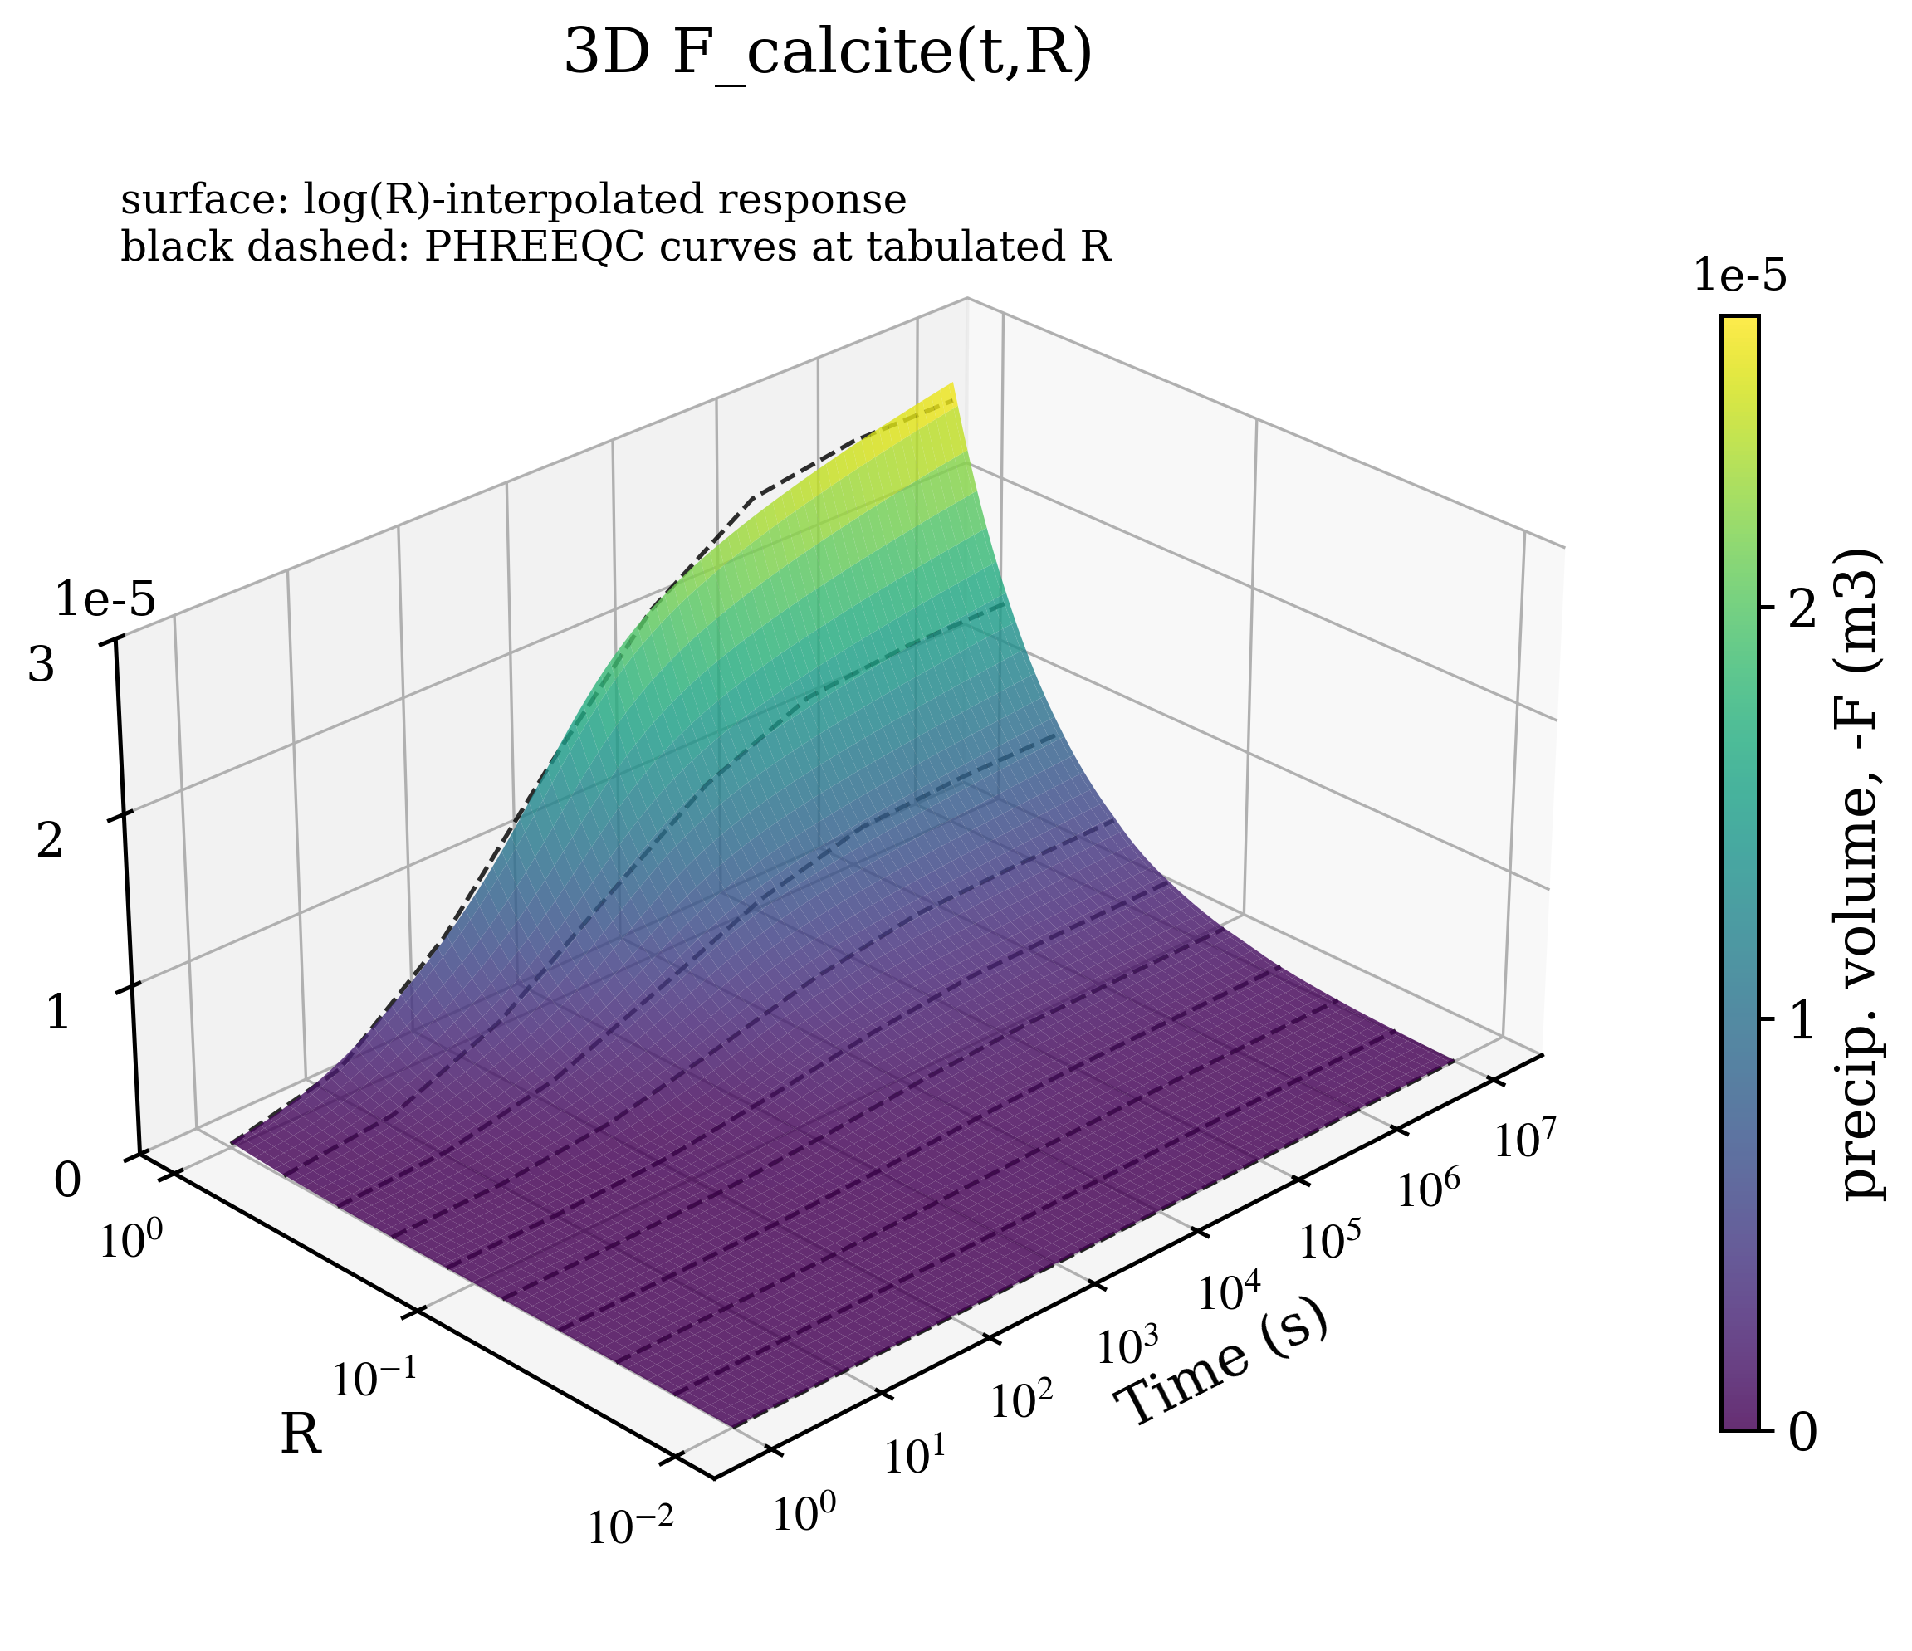
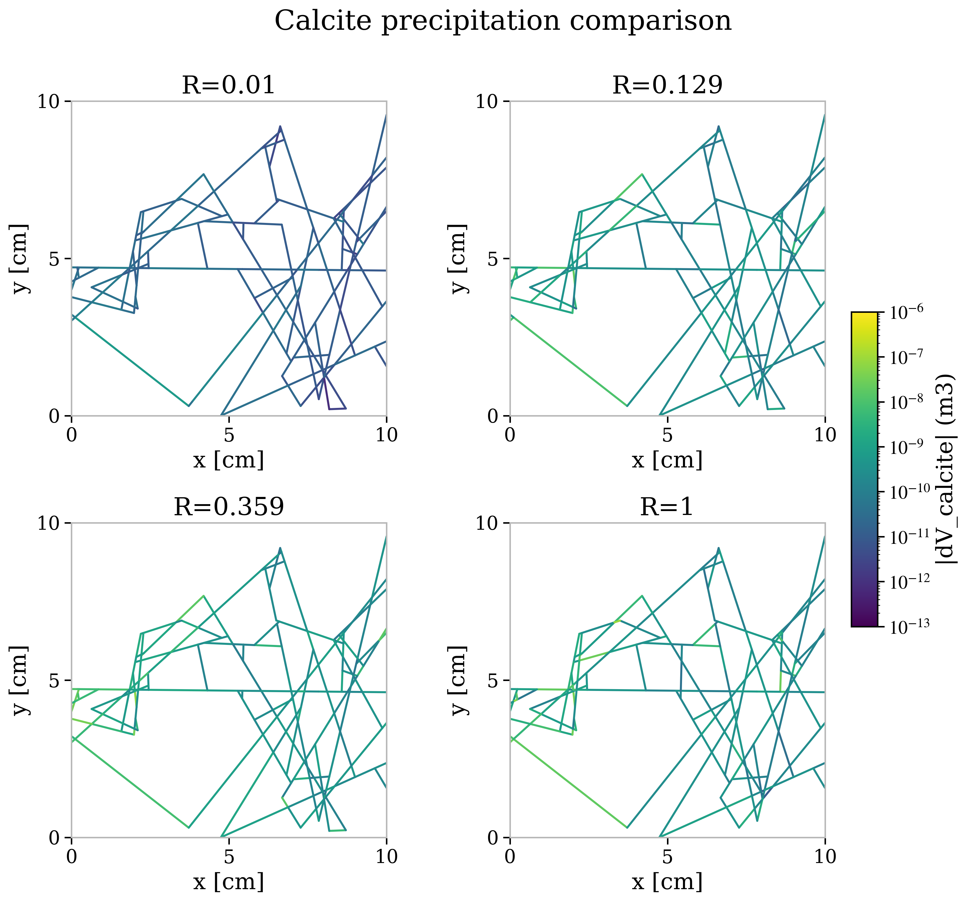
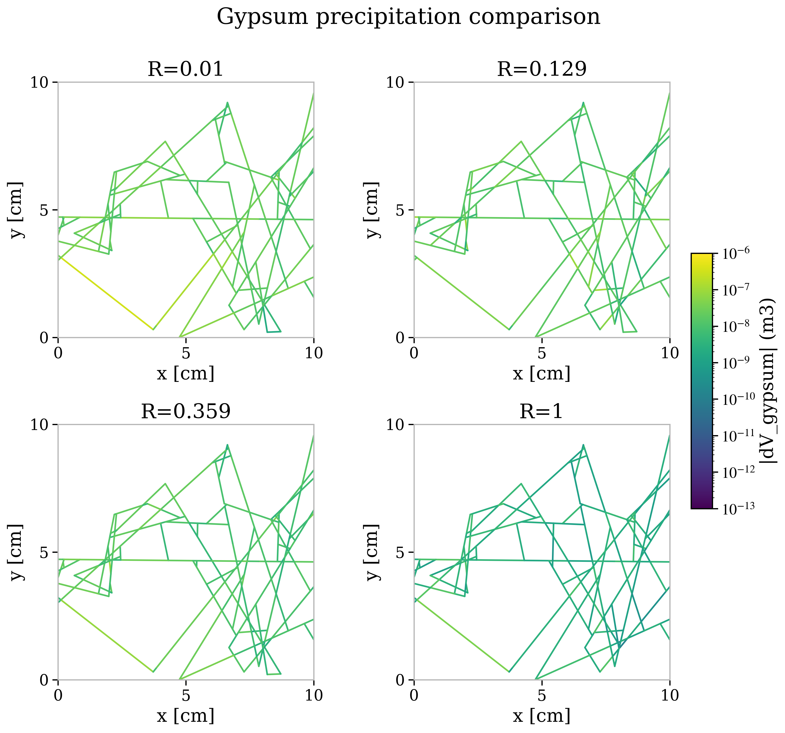
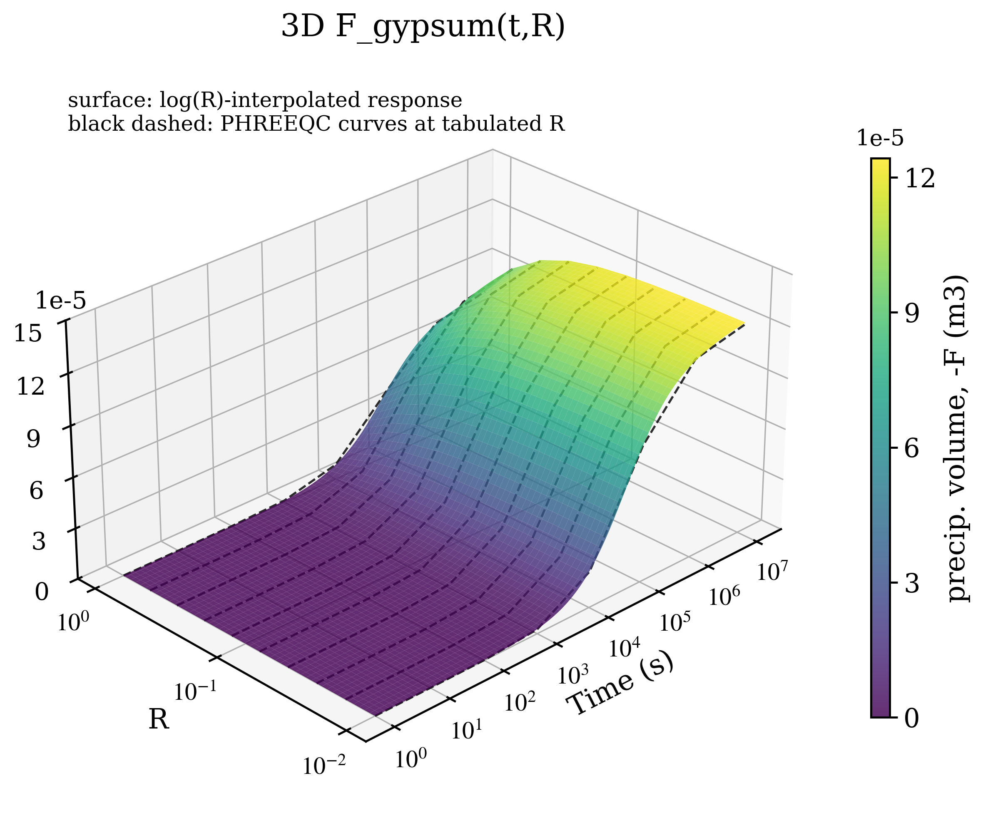
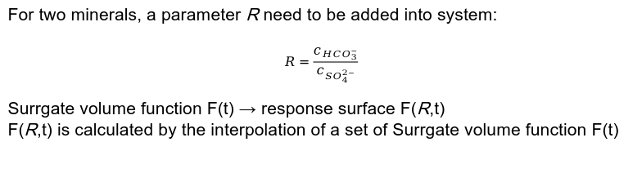
Extension: Calcite + Gypsum precipitation
For two minerals, a parameter R need to be added into system:
$$R=\frac{c_{{HCO}_{3}^{−}}}{c_{{SO}_{4}^{2−}}}$$
Surrgate volume function F(t) → response surface F(R,t)
F(R,t) is calculated by the interpolation of a set of Surrgate volume function F(t)

