Slide 1


Role of pore size distribution on velocity fields in 3D porous media
Mathieu Souzy, Fan Chen, Junfeng Sun, Antoine Wautier

Slide 2
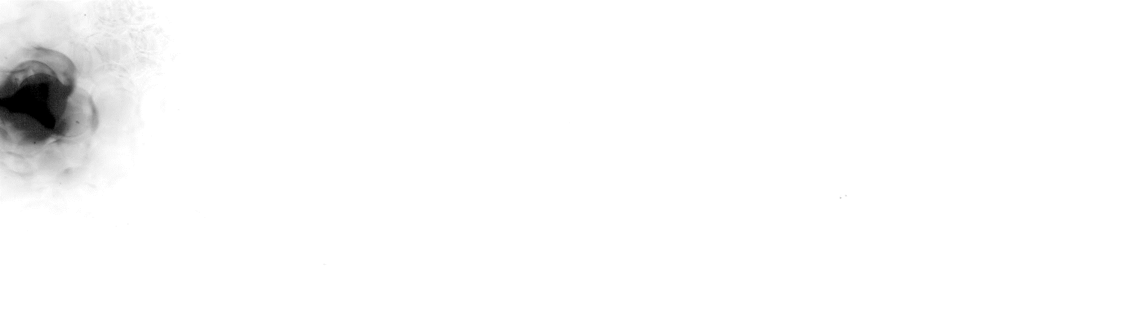
Flow in the bulk of a 3D porous media

Slide 3
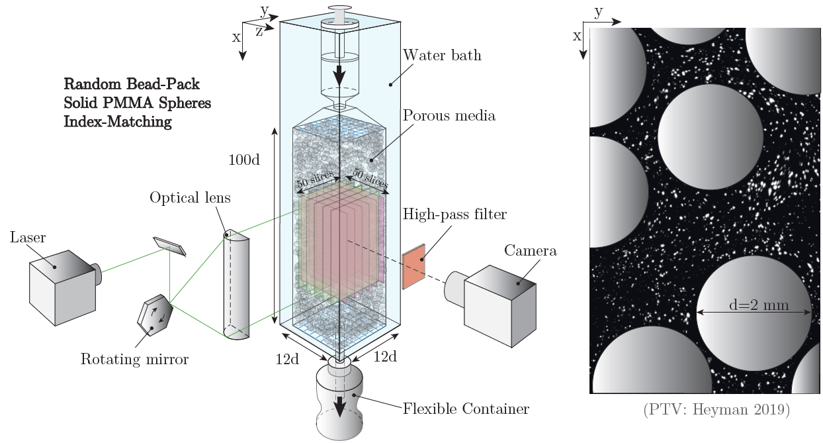
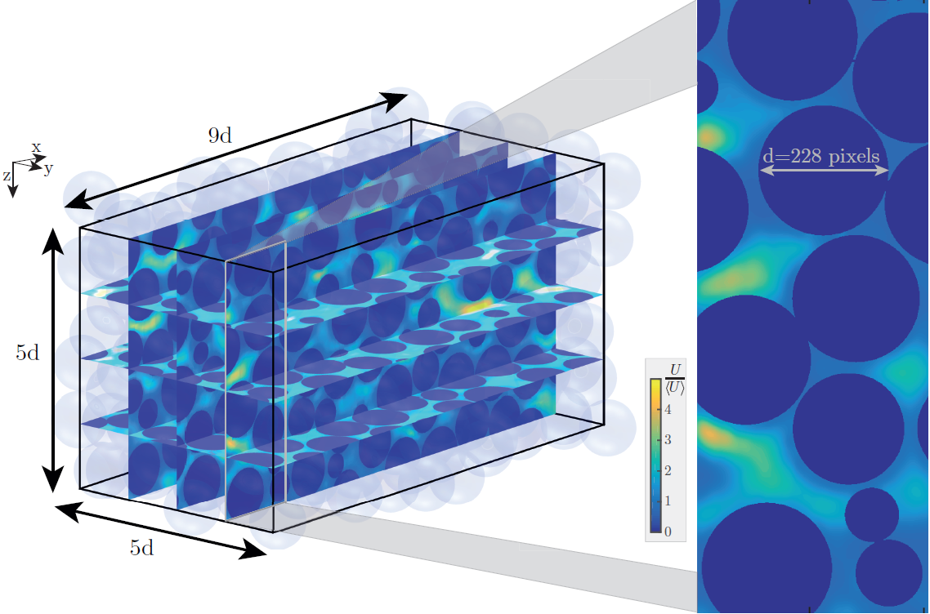
Experiments
Direct visualization of the flow
Refractive index matching of the solid & fluid
3D reconstruction of the velocity field
Grain-scale Lagrangian mesh-less

Slide 4
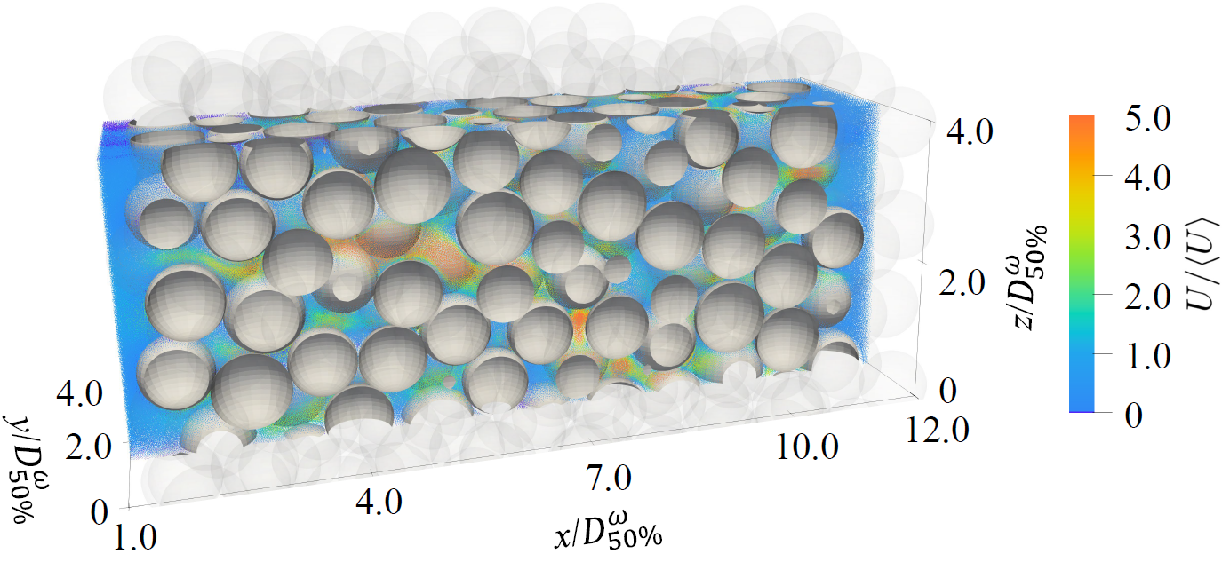
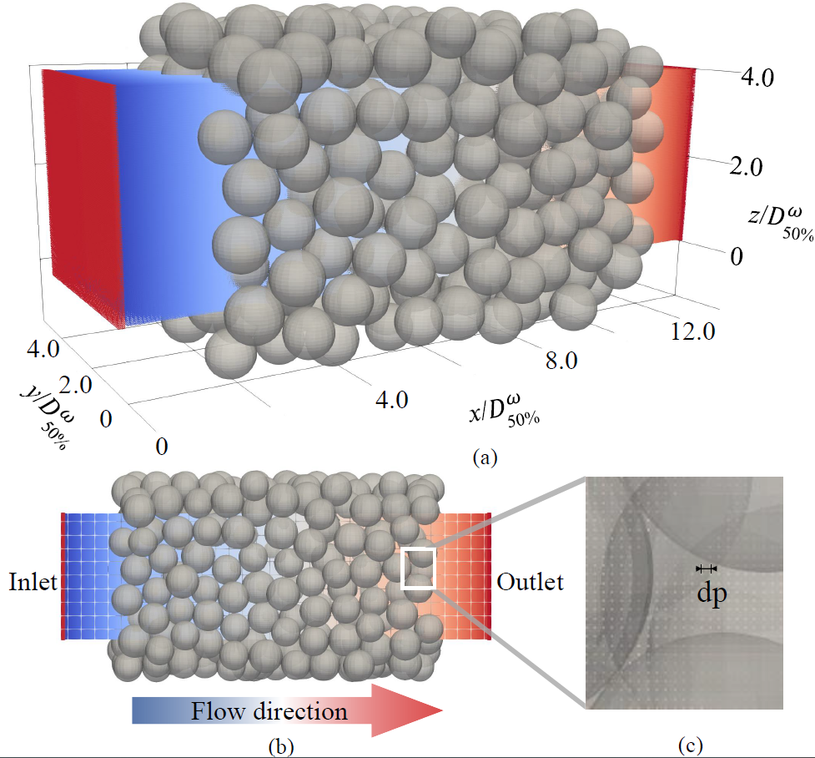
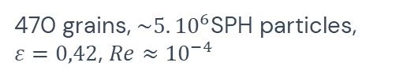
Numerical simulations
DEM for the microstructure
Inter‐grain contact turned‐off
SPH for the fluid phase
Grain-scale Lagrangian mesh-less
Parameters
470 grains, $\sim 5.{10}^{6}$SPH particles, $ε=0,42$, $Re≈{10}^{−4}$

Slide 5
Comparison for the monodisperse case
Validation of the numerical approach

Slide 6
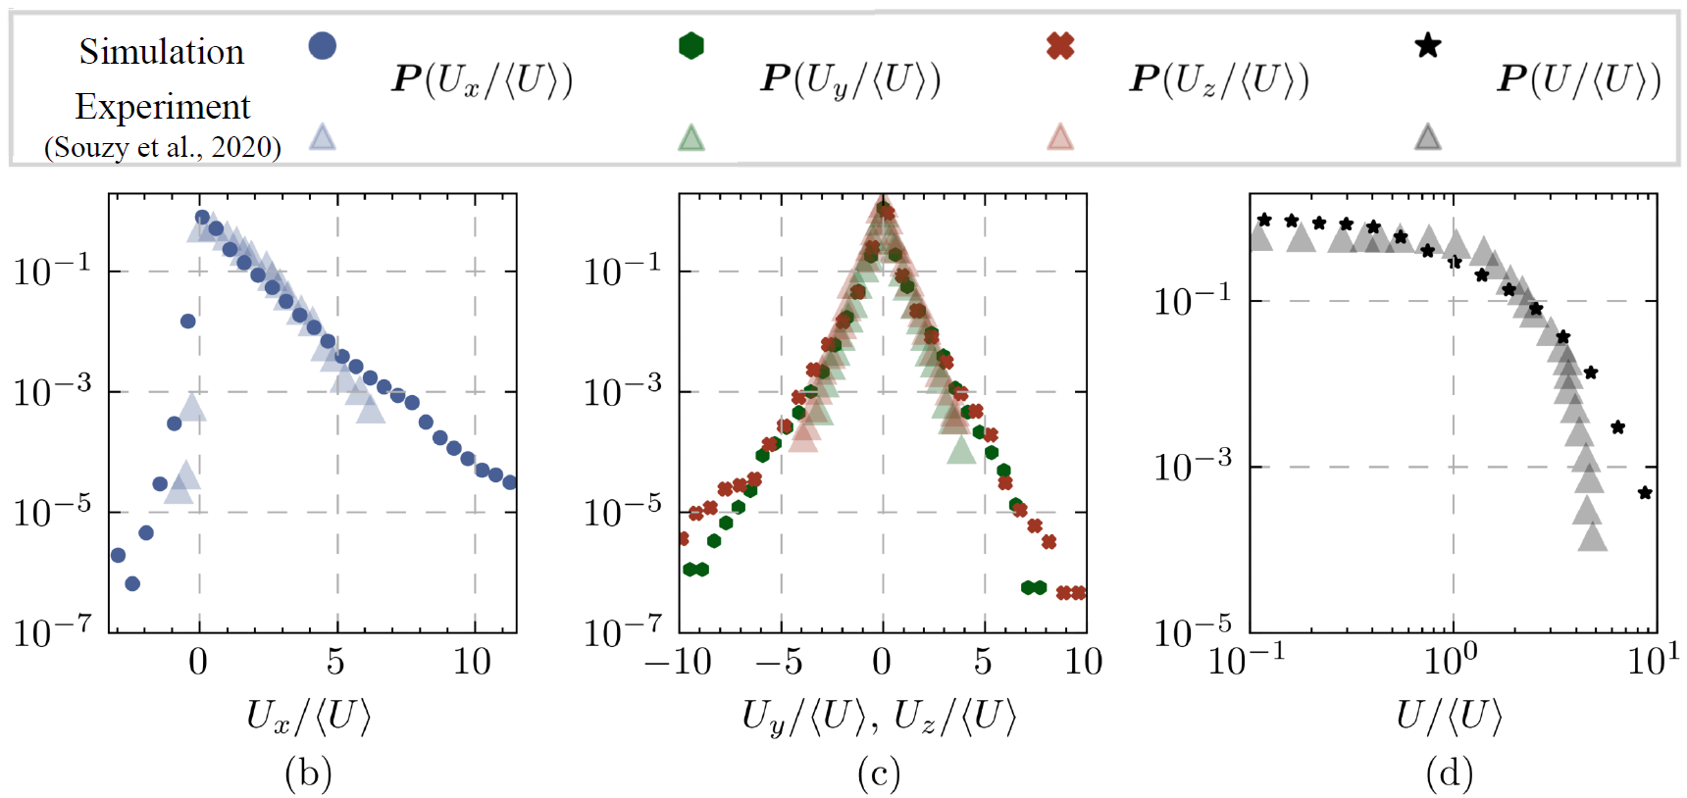
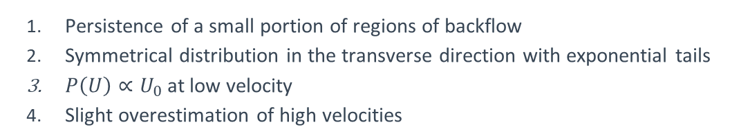
Velocity field statistics
Persistence of a small portion of regions of backflow
Symmetrical distribution in the transverse direction with exponential tails
$P\left(U\right)∝U_{0}$at low velocity
Slight overestimation of high velocities

Slide 7
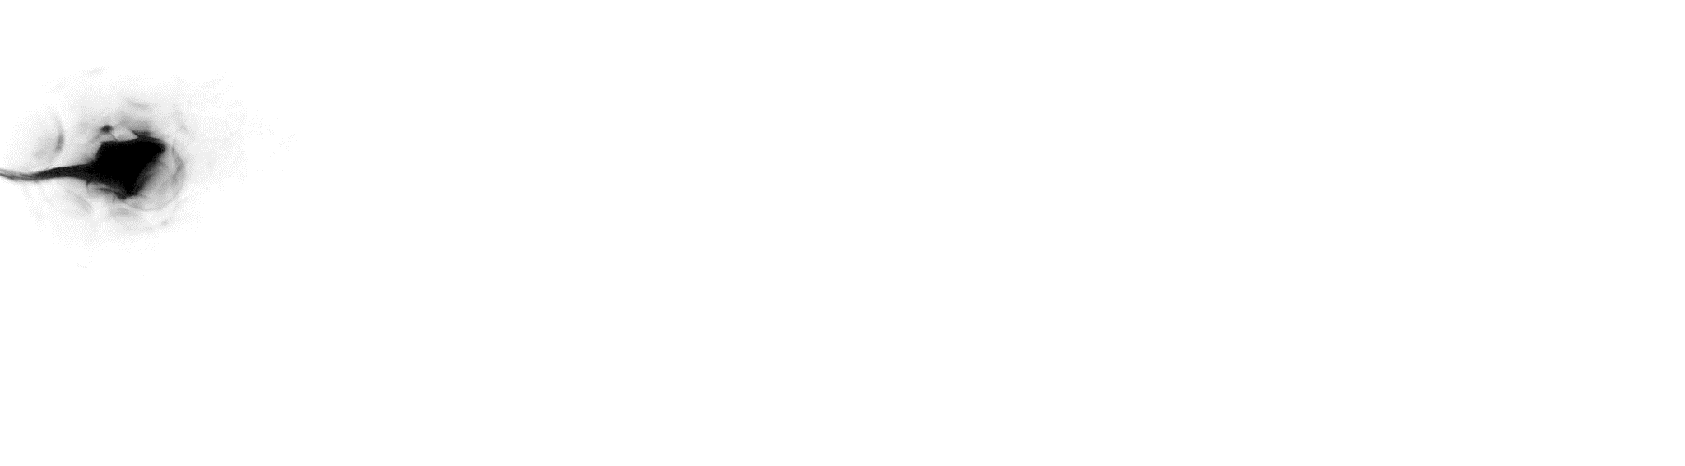
Dispersion process

Slide 8
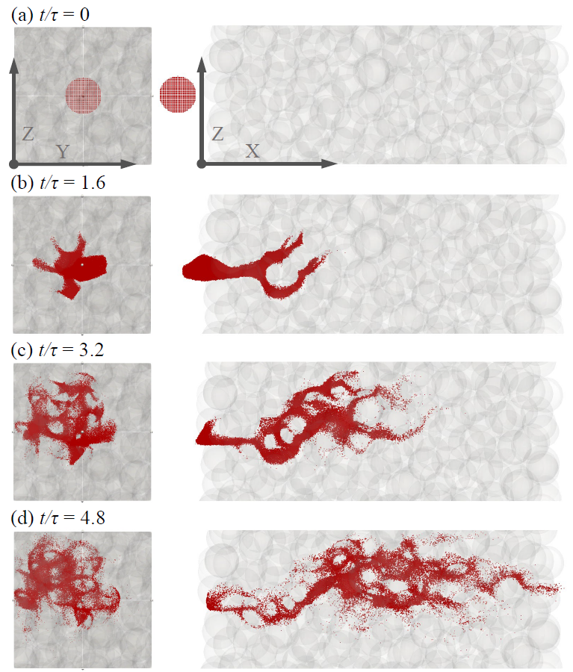
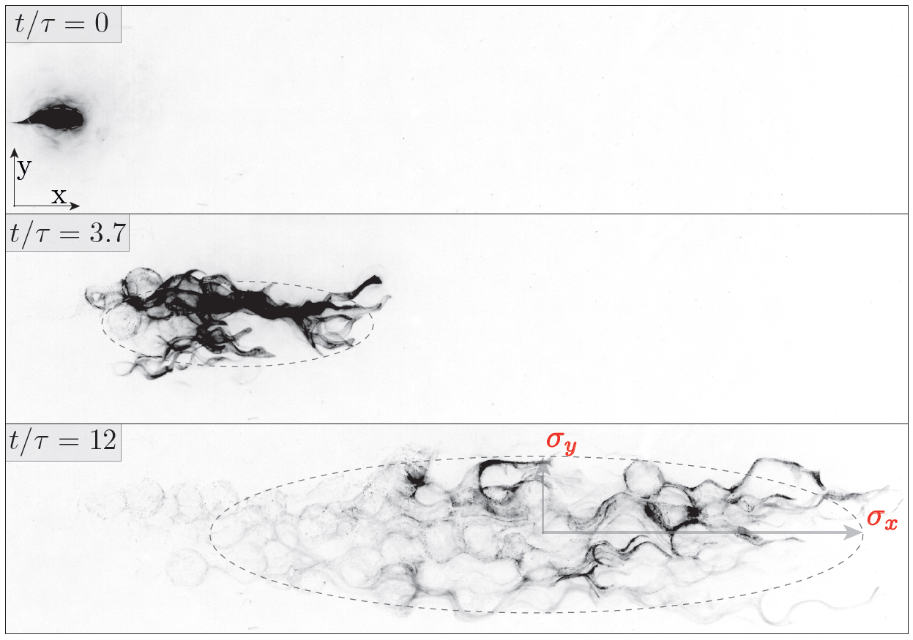

Dispersion process
$$τ=d/\left\langle U\right\rangle$$

Slide 9
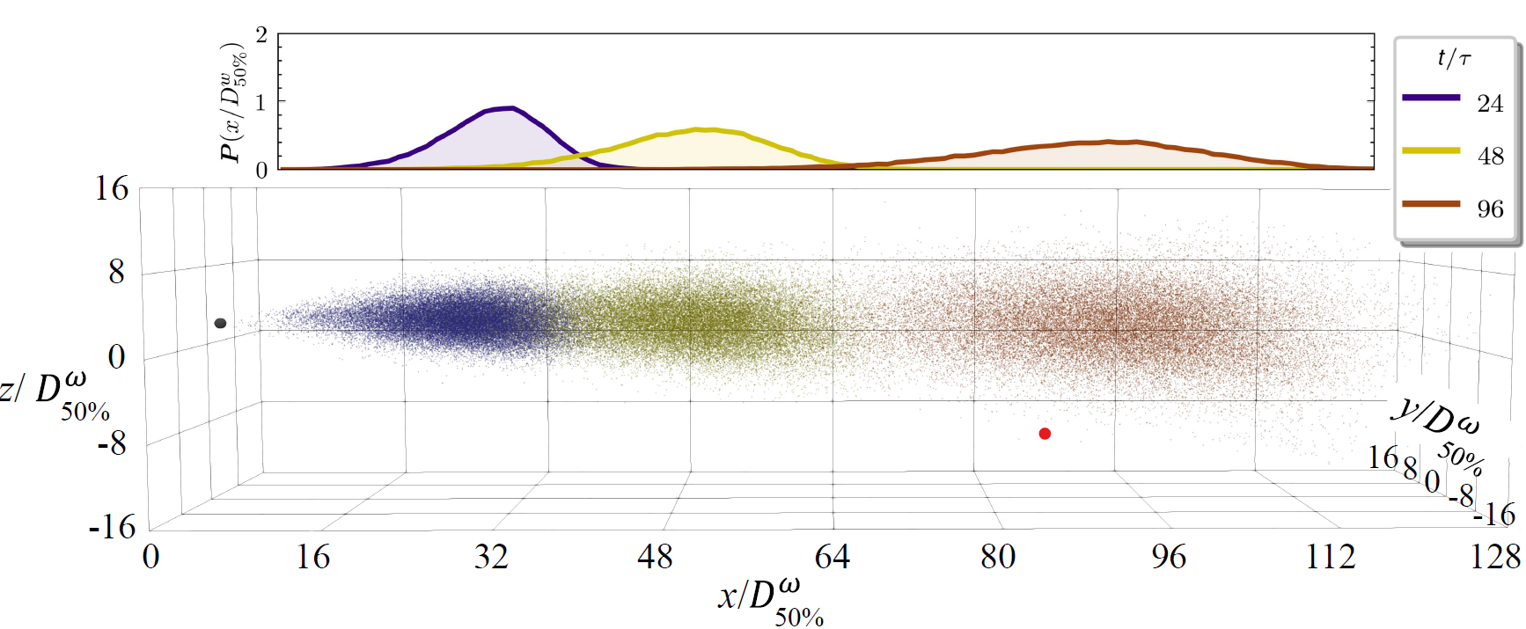
Dispersion process
$$τ=d/\left\langle U\right\rangle$$

Slide 10
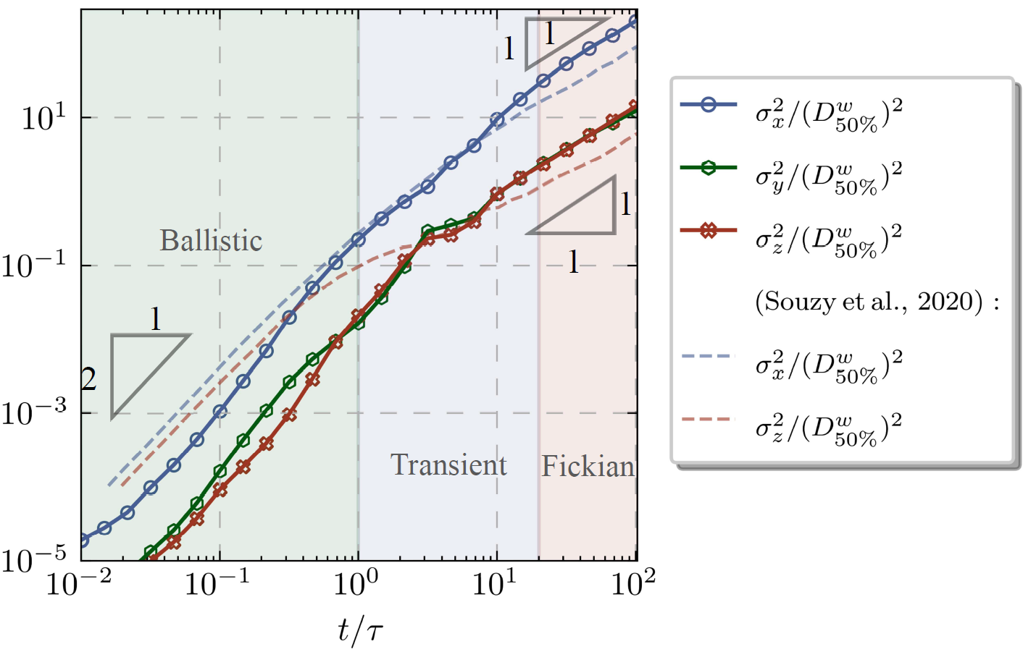
Variance of the tracers’ position
$$τ=d/\left\langle U\right\rangle$$

Slide 11
Varying the polydispersity
Effect of the pore size distribution over the flow kinematics

Slide 12
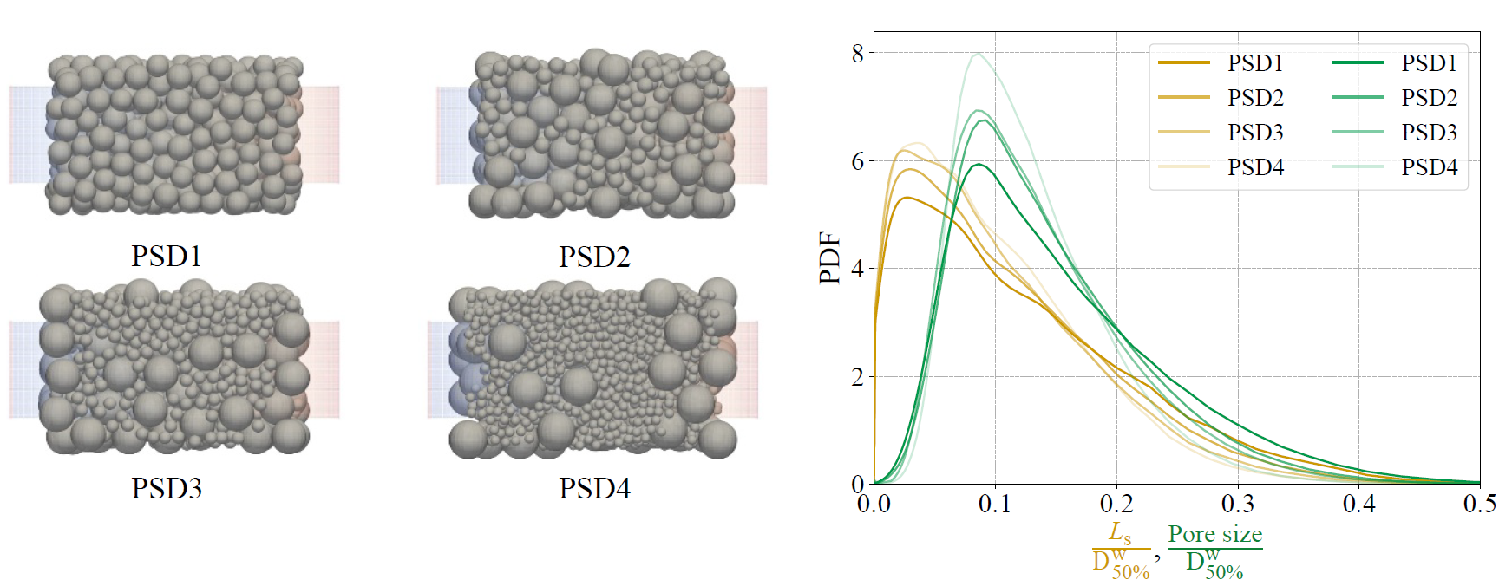
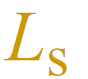

Varying pore size distribution
: Local distance to the nearest wall
: Radius of the inscribed sphere placed on the skeleton of the void space
Increased polydispersity Narrower pore size distribution

Slide 13
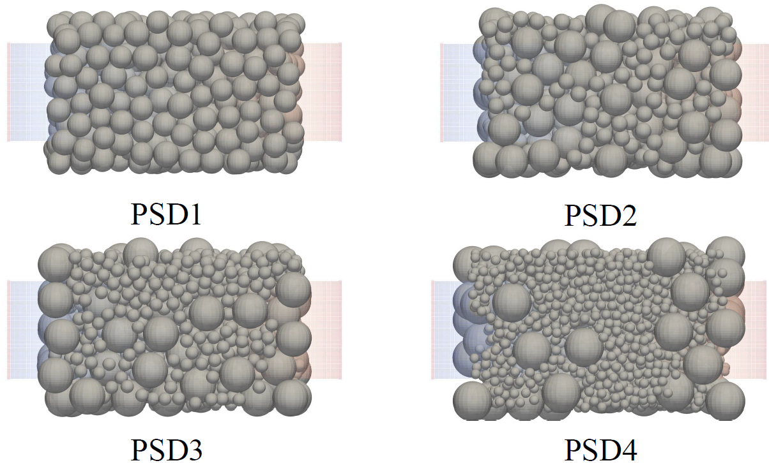
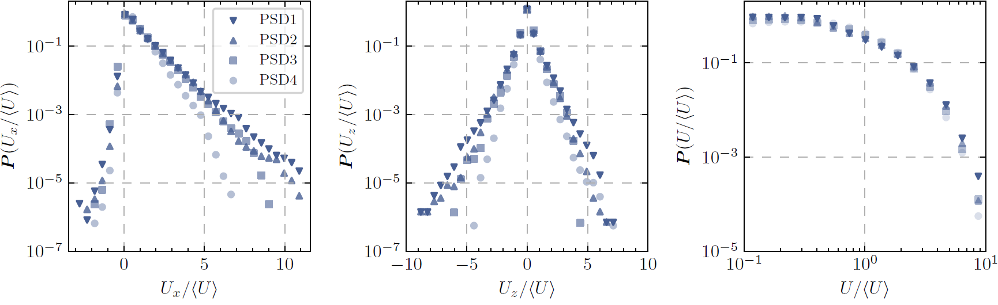
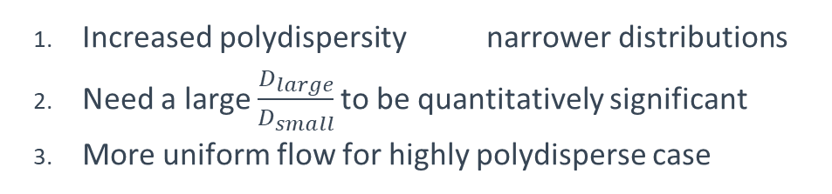
Narrower velocity distributions
Increased polydispersity narrower distributions
Need a large $\frac{D_{large}}{D_{small}}$ to be quantitatively significant
More uniform flow for highly polydisperse case

Slide 14
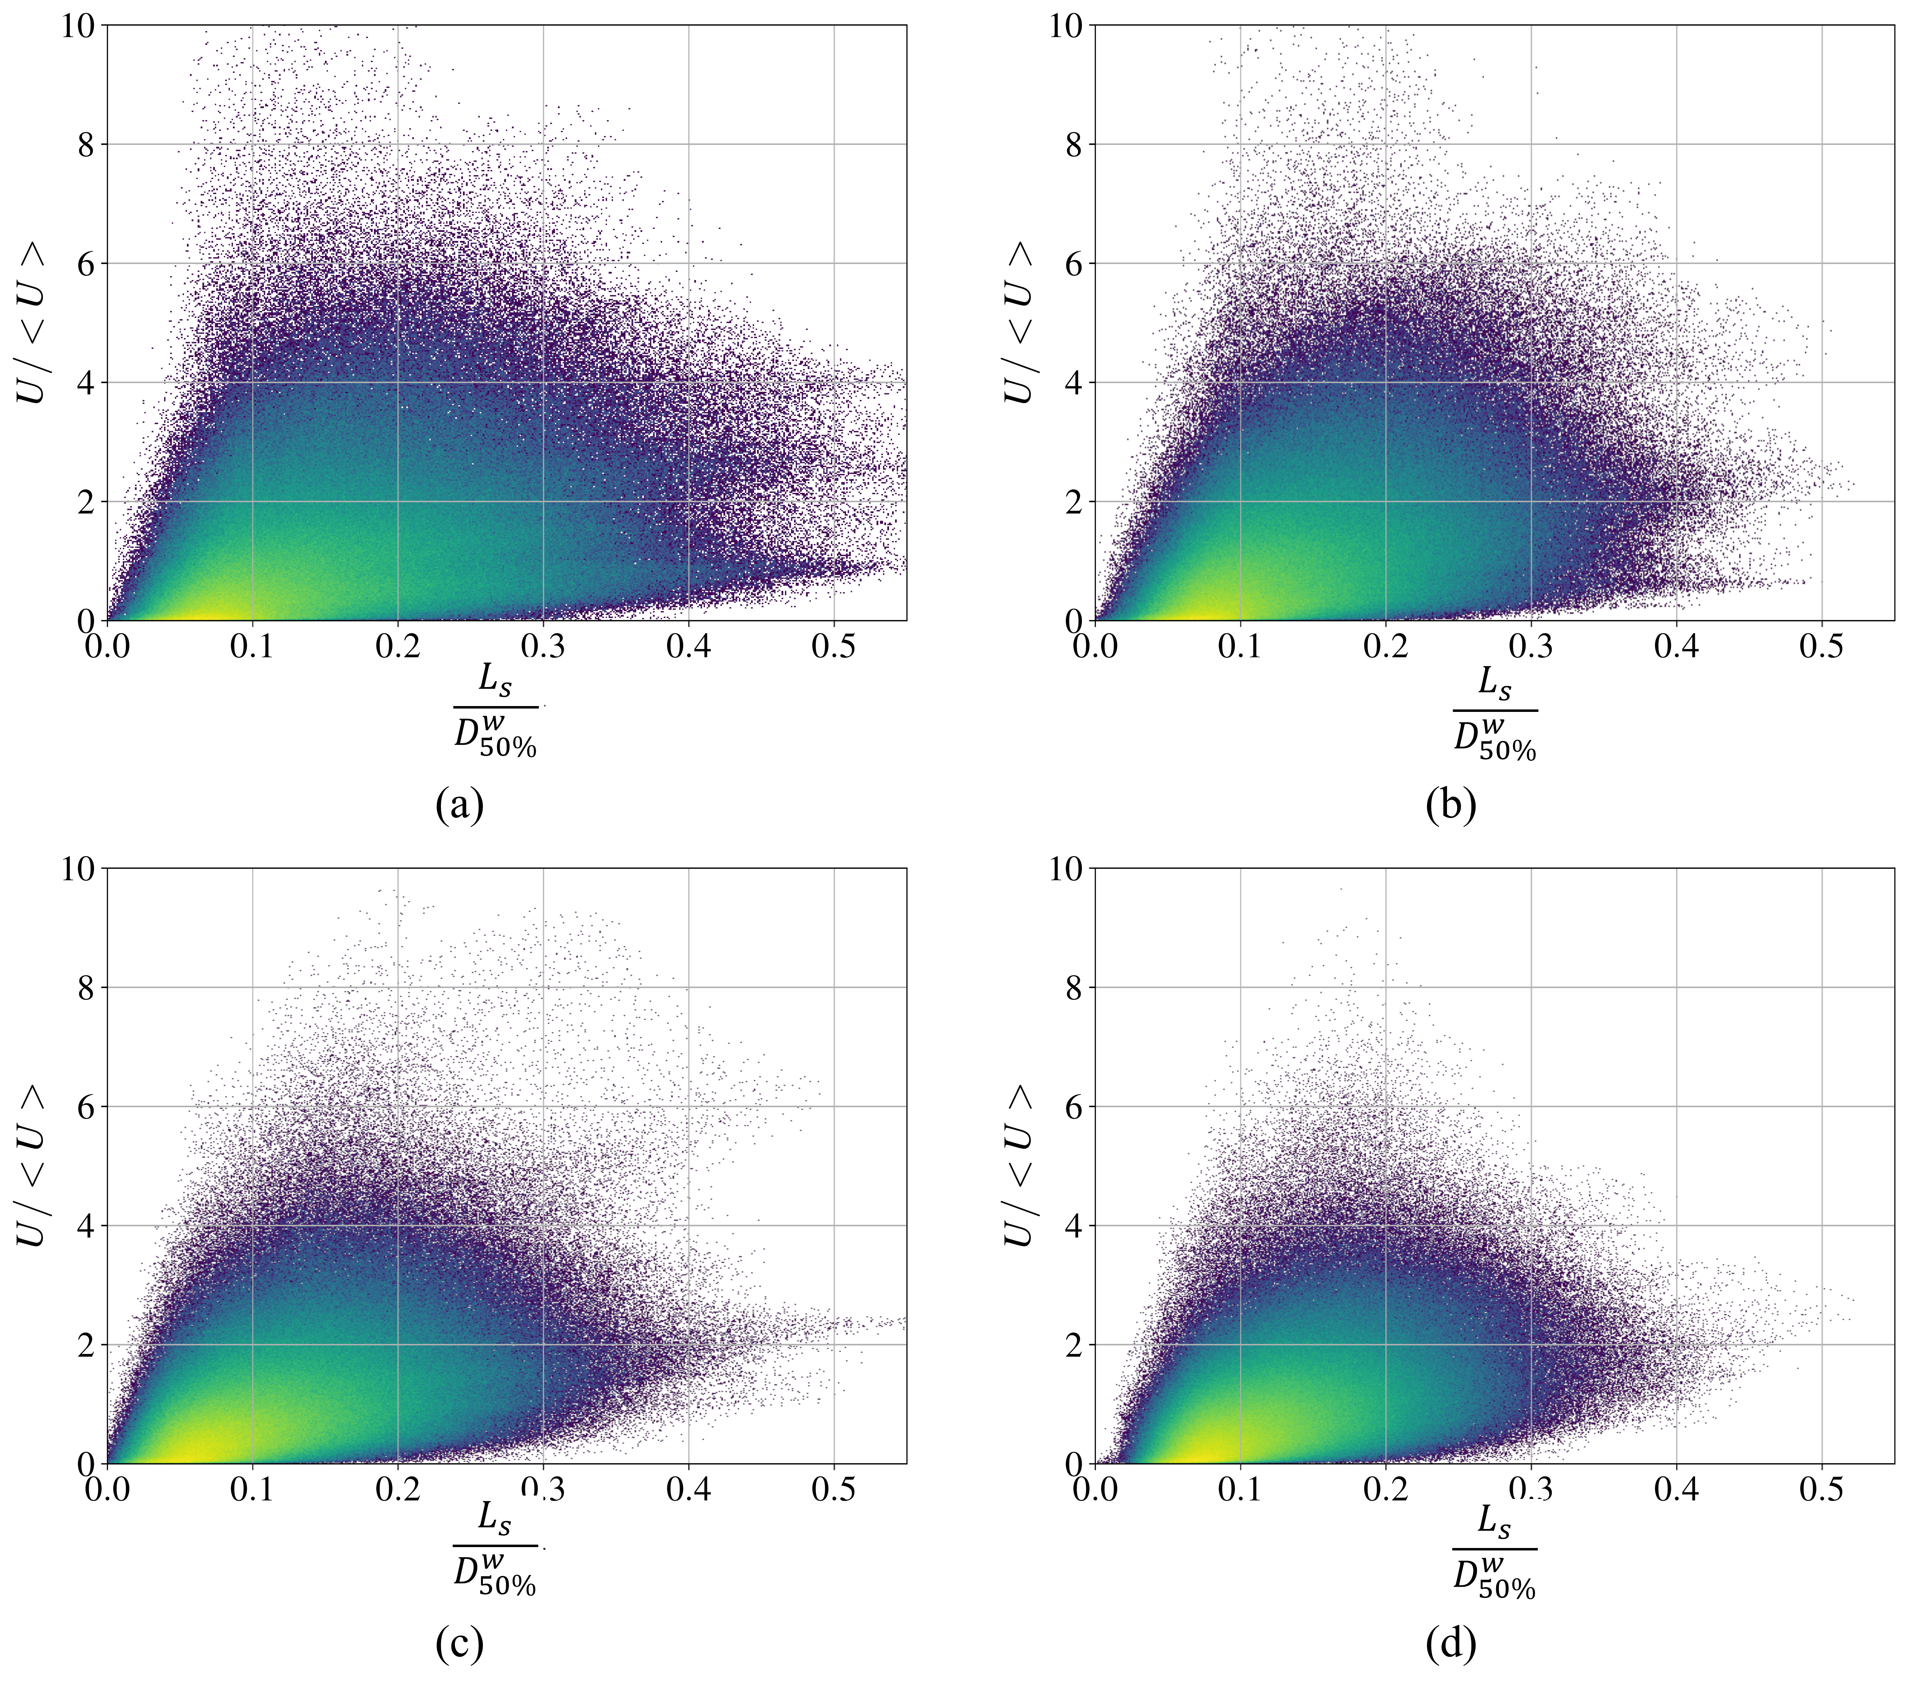
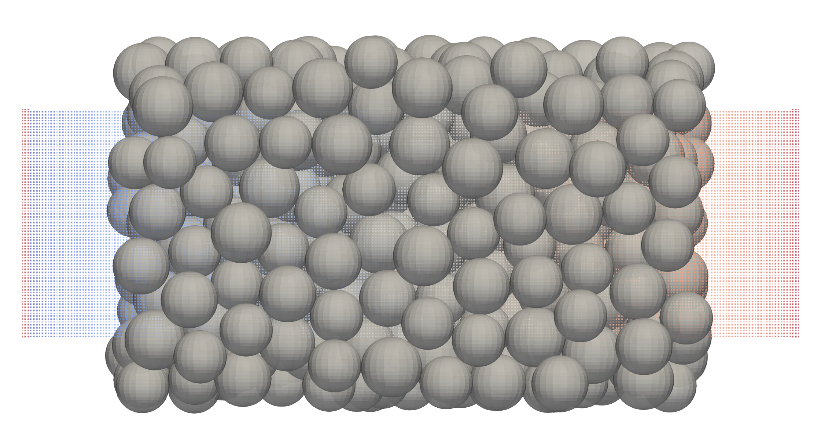
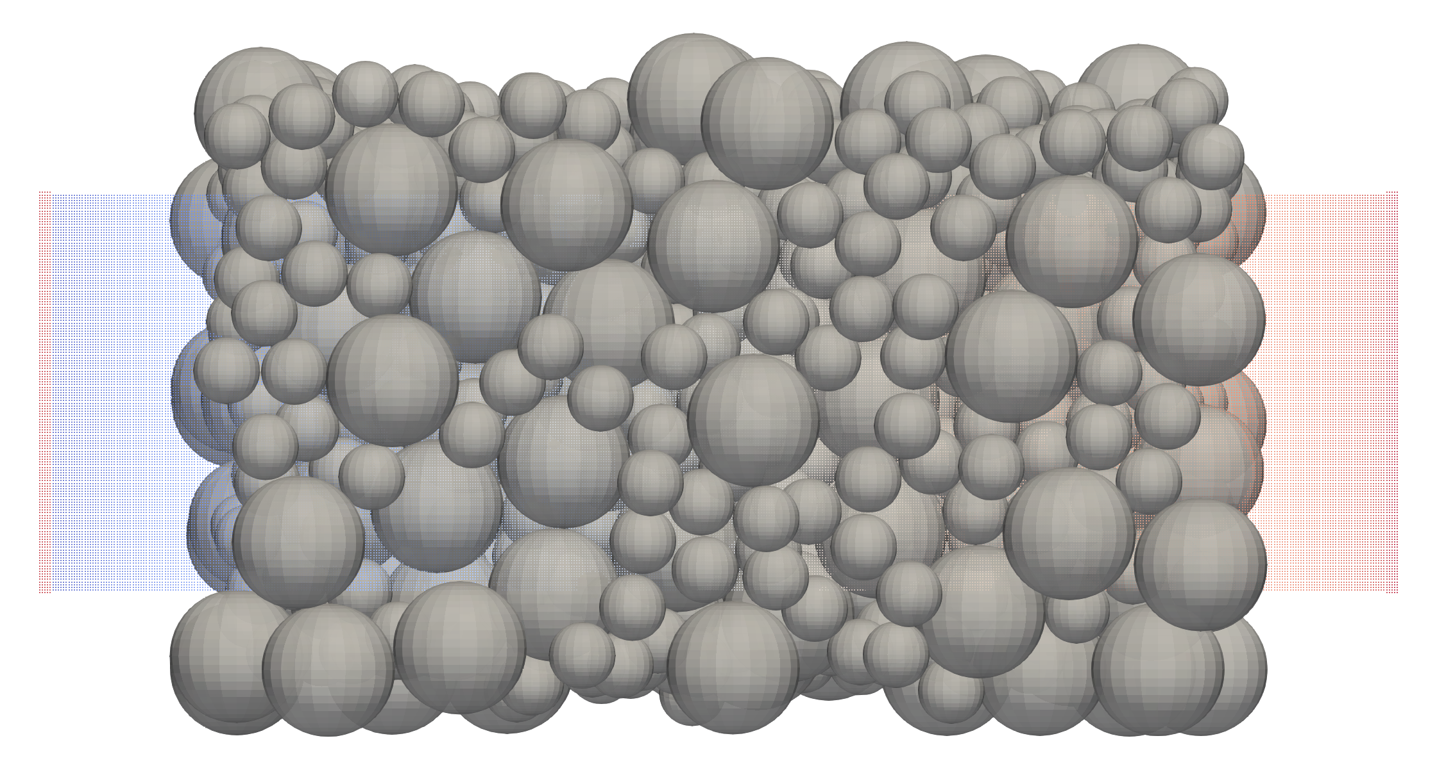
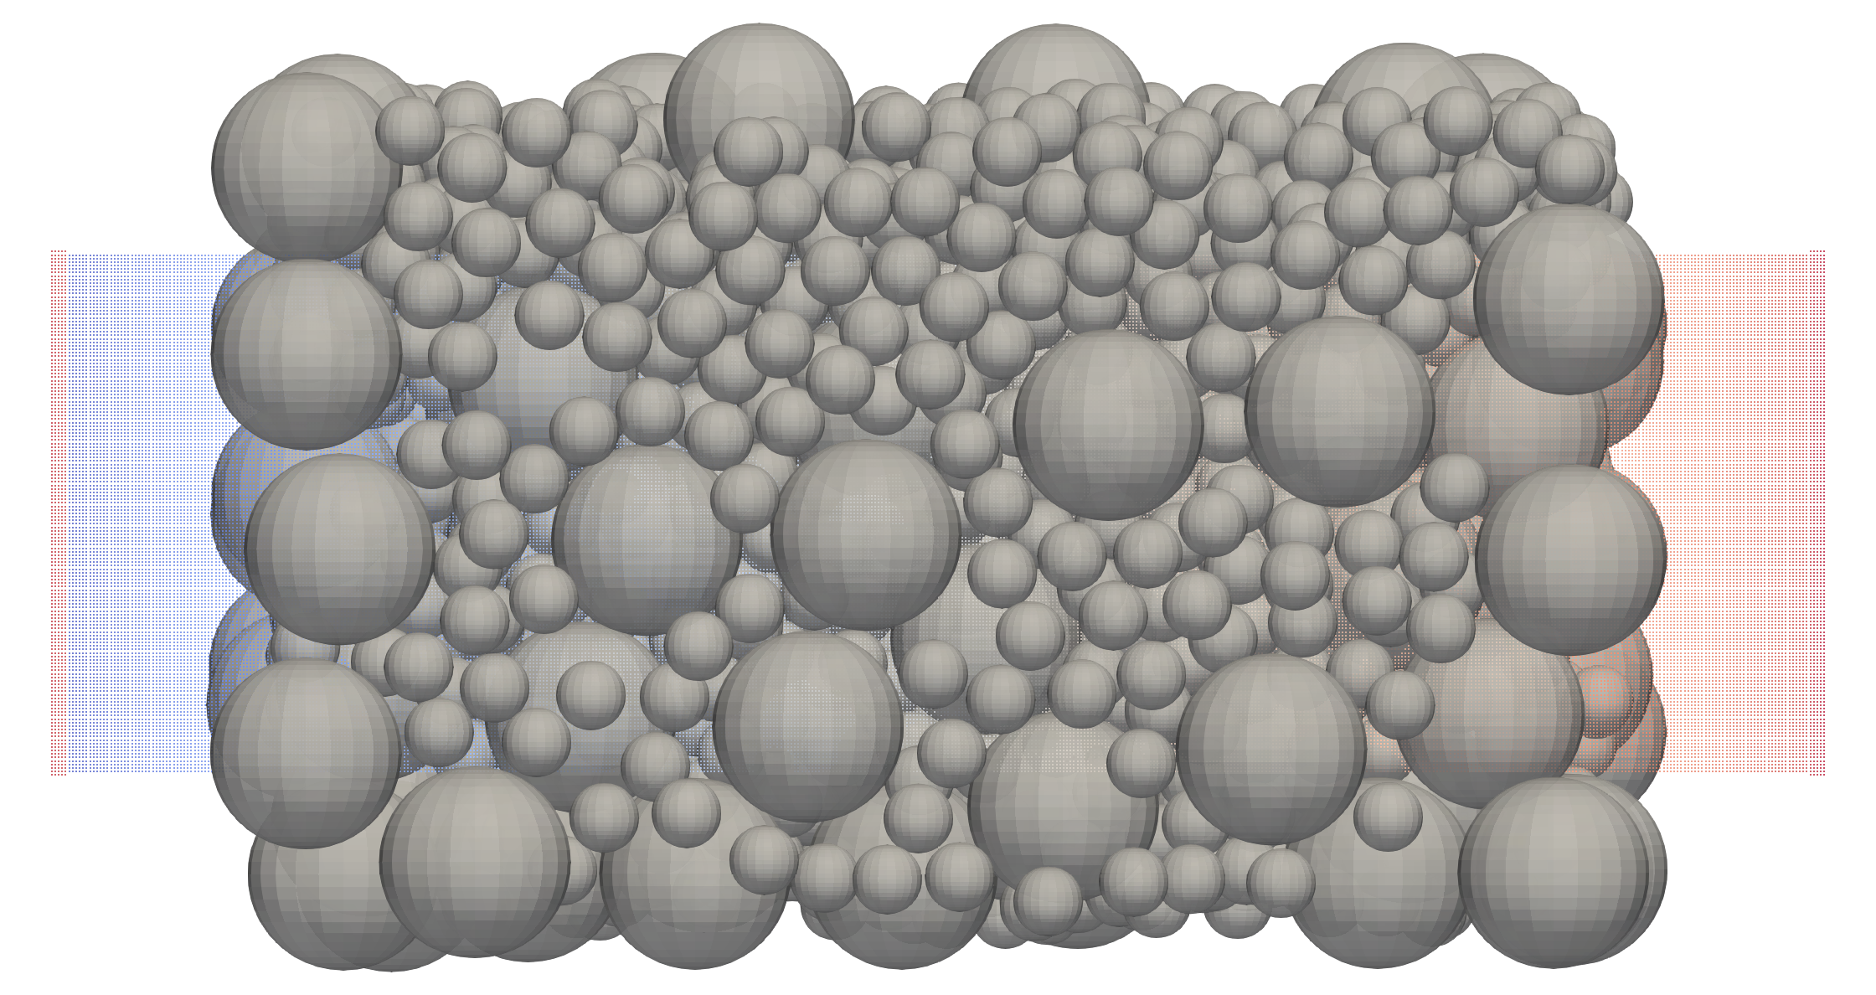
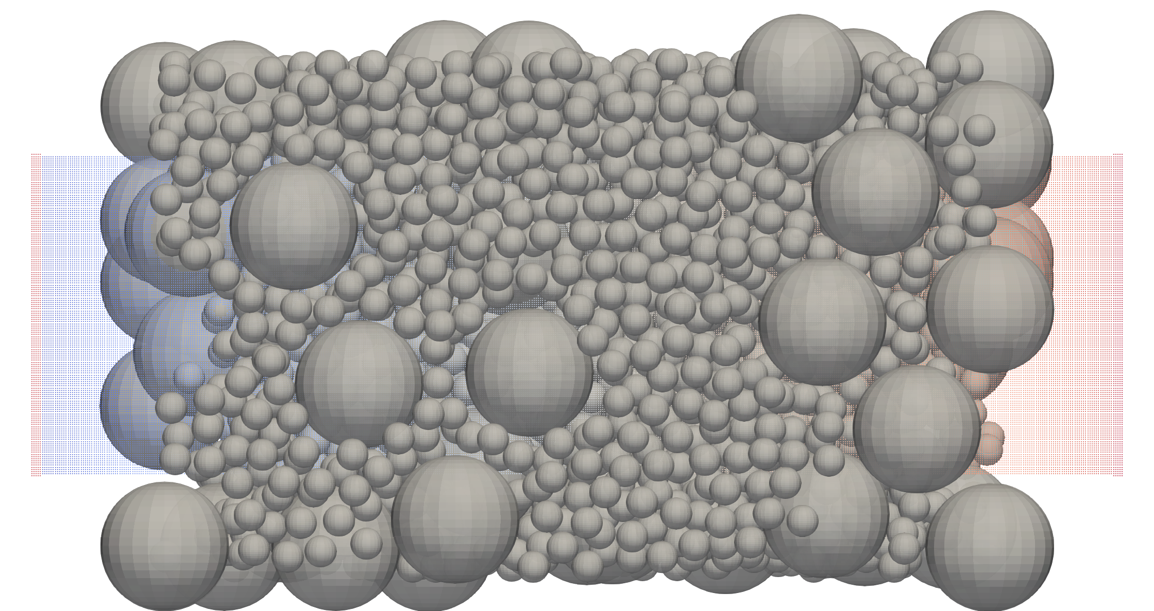
Velocity magnitude VS distance to a wall
Correlation between local distance to a solid interface and velocity magnitude
Shrinkage of the density map for increased polydispersity
: Local distance to the nearest wall

Slide 15
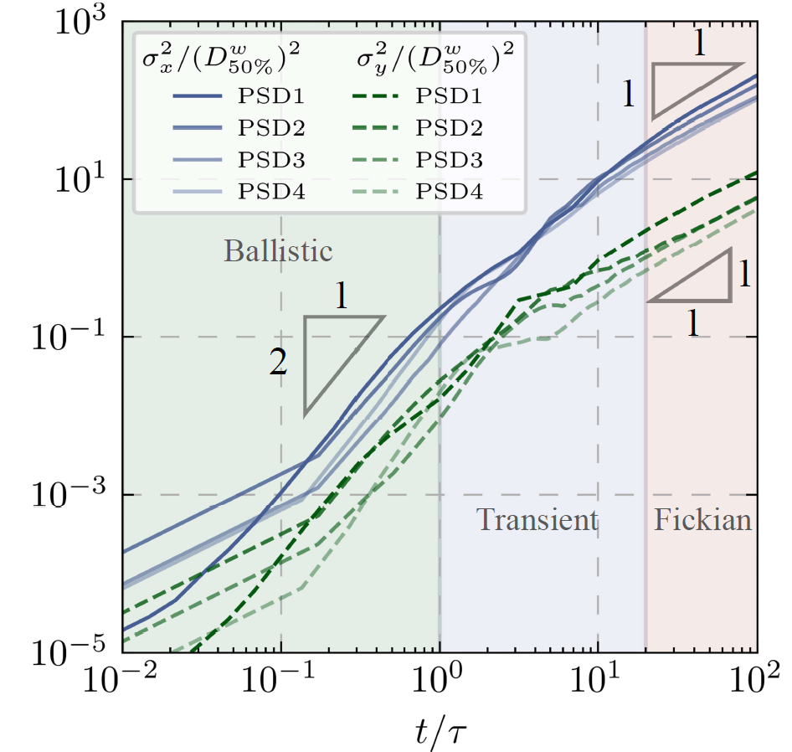
Dispersion process
Increased polydispersity decrease of the dispersion process, both in the longitudinal and the transverse directions

Slide 16
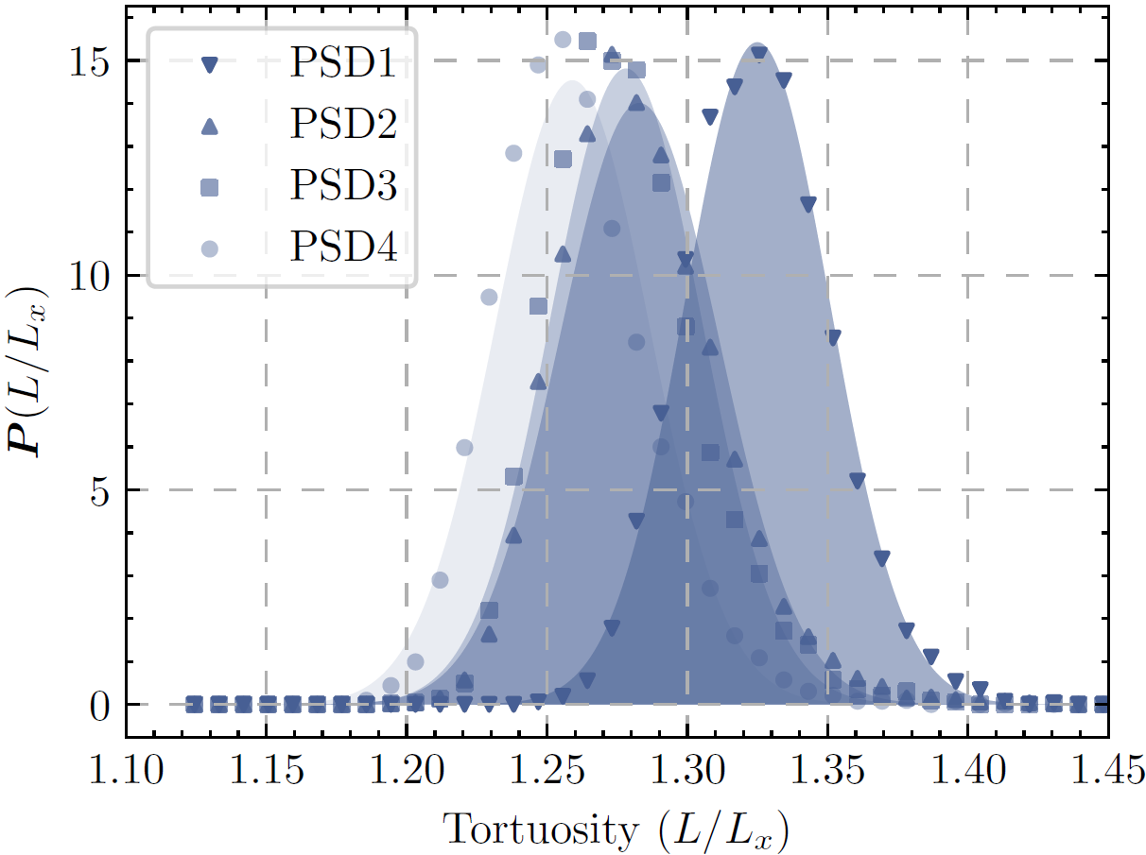
Streamline tortuosity
Normal distribution of tortuosity
Shift to lower values for higher polydispersity
Relative standard deviation increase with polydispersity
Stronger meandering but more alignment with longitudinal flow

Slide 17
Thanks for your attention
Any questions?
Flow kinematics in three‐dimensional porous media of varying pore size distribution using smoothed particle hydrodynamics, Fan Chen, Junfeng Sun, Antoine Wautier, and Mathieu Souzy, Water Resources Research, 2025, 10.1029/2025WR040413

