Slide 1


Physics-Preserving Enriched Galerkin Method for Fully-Coupled Thermo-Poroelasticity Model
Son-Young Yi
The University of Texas at El Paso
Collaborator: Sanghyun Lee (Florida State University)
InterPore 2026, May 21, 2026

Slide 2

Outline
01
Background and Motivation
02
Enriched Galerkin Method
03
Numerical Examples
04
Summary and outlook

Slide 3
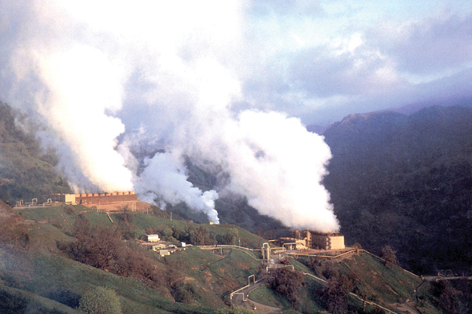
01
Background & Motivation

Slide 4
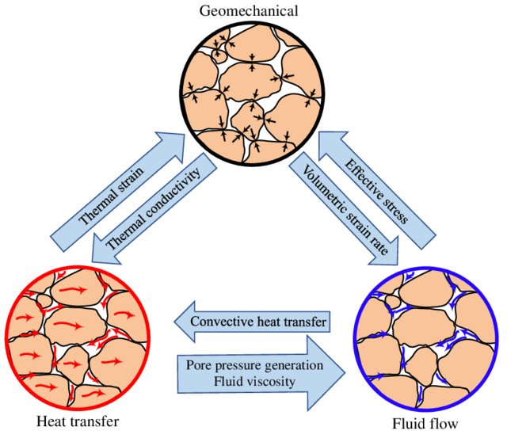
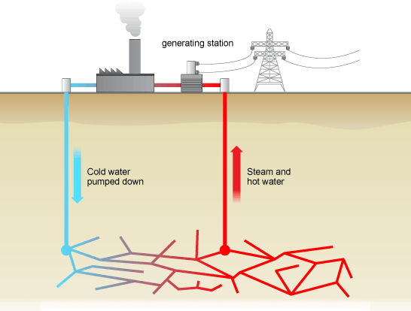
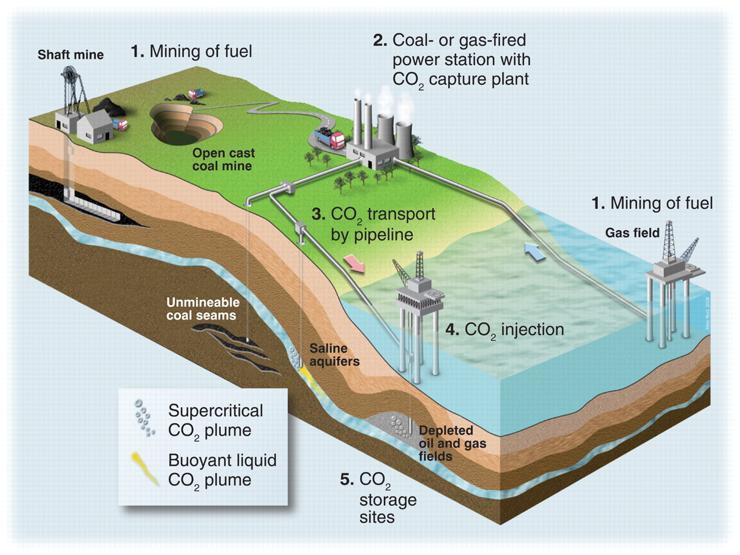
Thermo-Hydro-Mechanical (THM) Processes in Porous Media
THM processes refer to a complex interplay of heat transfer, fluid flow, and mechanical responses in natural and engineered porous media.
Applications:
Enhanced geothermal systems (EGS)
Carbon capture and storage (CCS)
Geological radioactive waste deposition
EGS
CCS

Slide 5
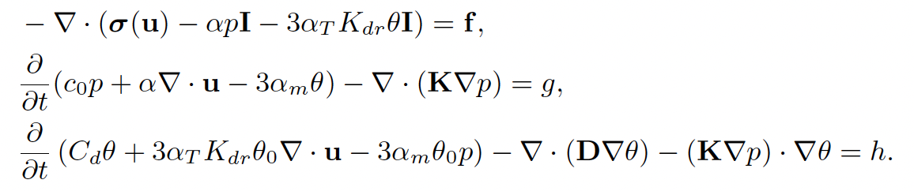
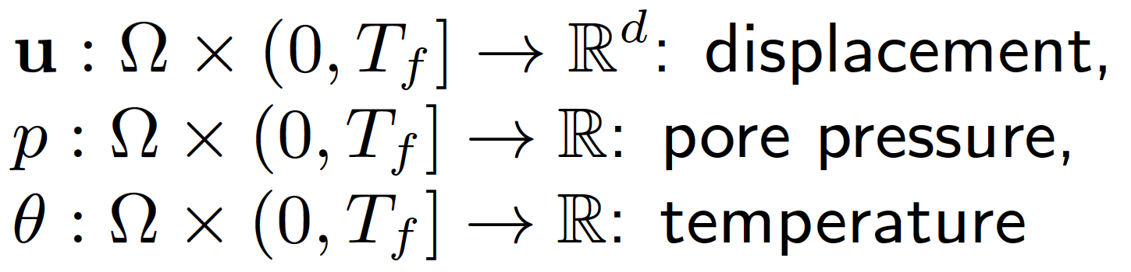
Mathematical Model: Three Balance Equations
Governing Equations (Biot’s Thermo-Poroelasticity Model)
Momentum balance (Mechanics)
Mass conservation (Flow)
Energy conservation (Heat)
Primary Variables:
Functions
Notes:
It is difficult to obtain analytical solutions for poroelasticity problems.
Therefore, solving poroelasticity problems relies mainly on numerical methods.

Slide 6
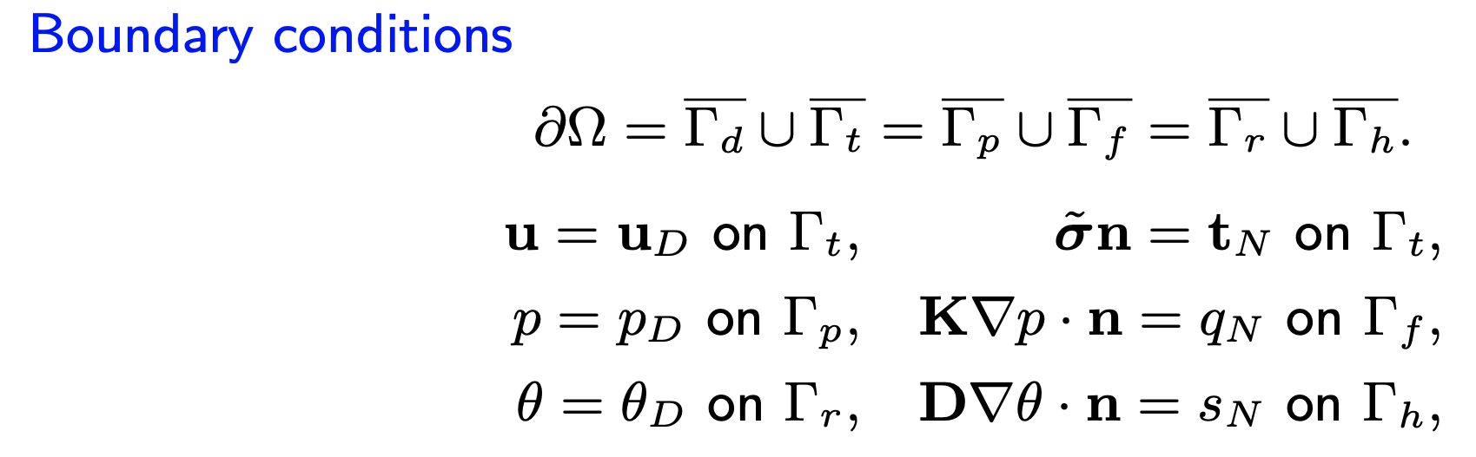
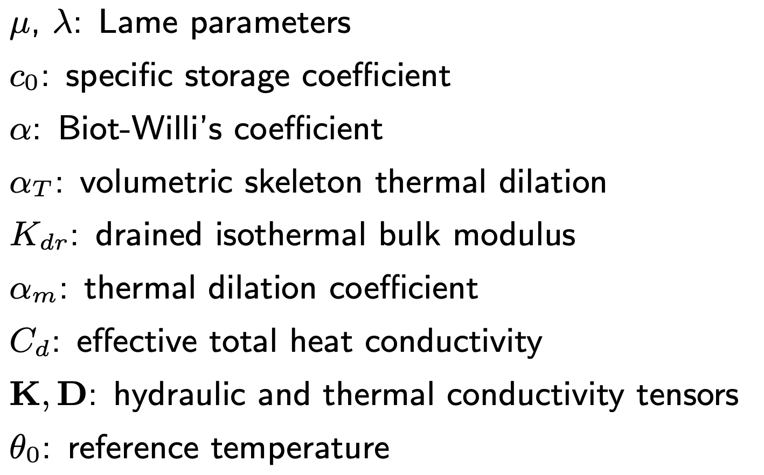
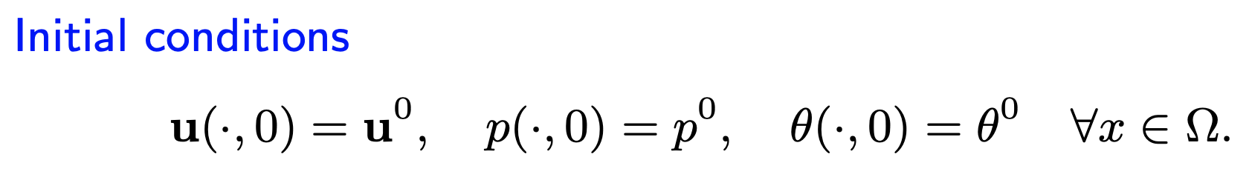
Mathematical Model: Three Balance Equations
Governing Equations (Biot’s Thermo-Poroelasticity Model)
Momentum balance (Mechanics)
Mass conservation (Flow)
Energy conservation (Heat)
Parameters
Notes:
It is difficult to obtain analytical solutions for poroelasticity problems.
Therefore, solving poroelasticity problems relies mainly on numerical methods.

Slide 7
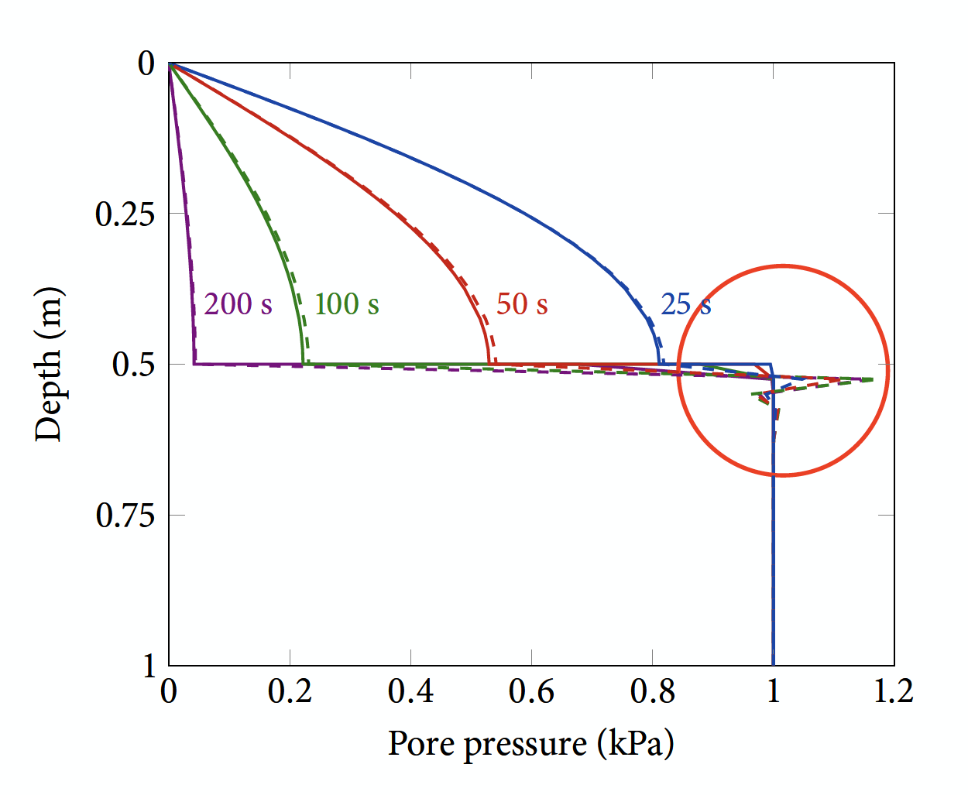
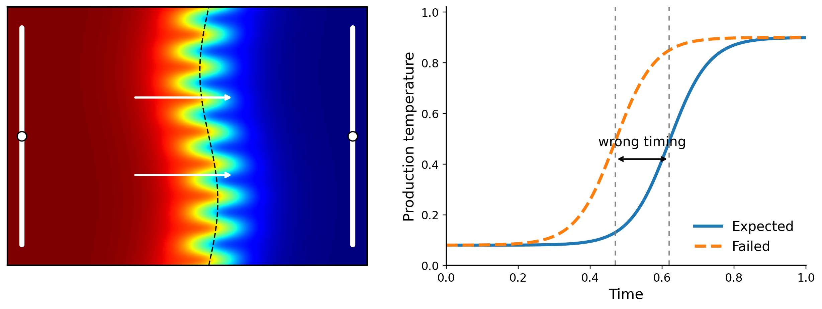
Numerical Trap for Each Subproblem
Near incompressibility can cause Poisson locking.
Engineering symptom:
Displacement becomes artificially stiff or inaccurate
Without local mass conservation, pressure and flux may be nonphysical near strong heterogeneity.
Engineering symptom:
Wrong injected/produced mass balance.
Without local energy conservation, non-physical temperature and heat flux may be produced
Engineering symptom:
Temperature overshoots/undershoots, wrong thermal breakthrough time.
Mechanics trap
Flow trap
Heat trap
High K
Low K
(10⁴ times lower)
Goal: one discretization strategy that respects all three physics.

Slide 8
Existing methods make trade-offs
Continuous Galerkin (standard FEM)
Physics-Preserving
Efficient and familiar, but local conservation and locking robustness are not automatic
Discontinuous Galerkin / Mixed FEM
Excellent conservation and robustness, but many more degrees of freedom
Mixed solvers
DG / MFEM
Mix-and-match solvers (CG, DG, FVM, FDM)
CG
Practical, but data transfer, coupling, implementation, and rigorous analysis become harder
Low Cost
Unified Analysis

Slide 9
Research Goals
We want to develop numerical methods with the following properties:
Computationally robust
Preserves underlying physical laws (e.g., mass conservation, energy conservation)
Free of numerical instabilities (Poisson locking, overshoots/undershoots)
Computationally efficient
Requires minimal number of degrees of freedom
Existing codes or software utilization
Unified numerical framework
Use the same type of method for the entire system for easier numerical analysis and implementation

Slide 10
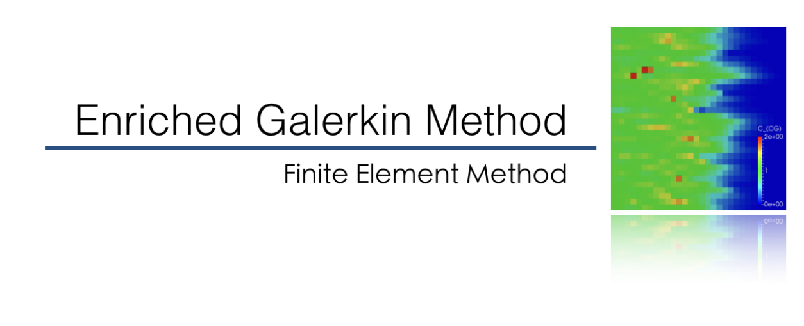
02

Slide 11
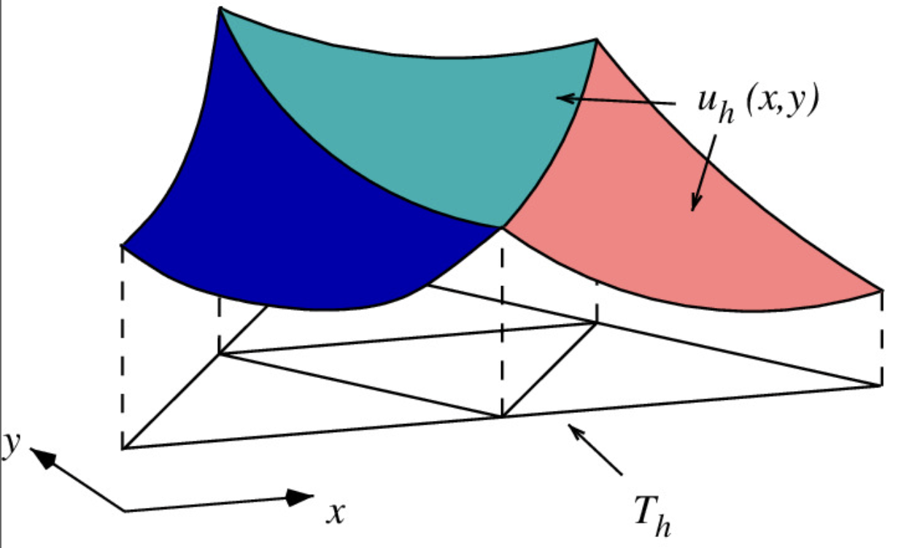
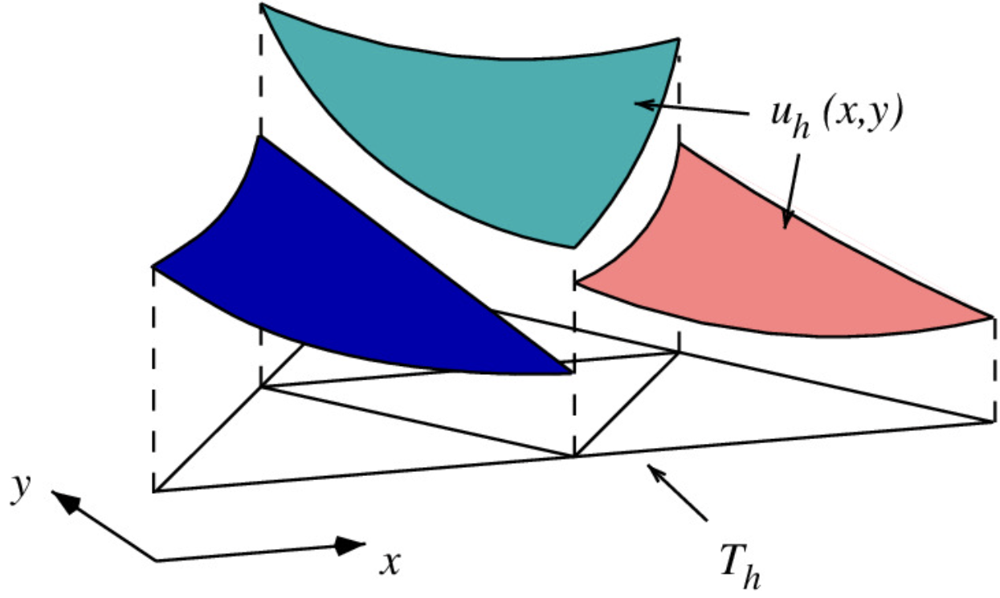


Continuous Galerkin (CG) vs. Discontinuous Galerkin (DG)
CG
DG
Discrete solution space
Discrete solution space
Advantages: | Small number of DoFs Simple variational form
Disadvantages: | Can present some numerical instability issues (e.g., overshoot/undershoot, locking) Doesn’t satisfy local mass/energy conservation
Advantages: | Many nice properties (e.g., local mass conservation, good representation of discontinuous solution)
Disadvantages: | Large number of DoFs
Enriched Galerkin method sits between these two!

Slide 12
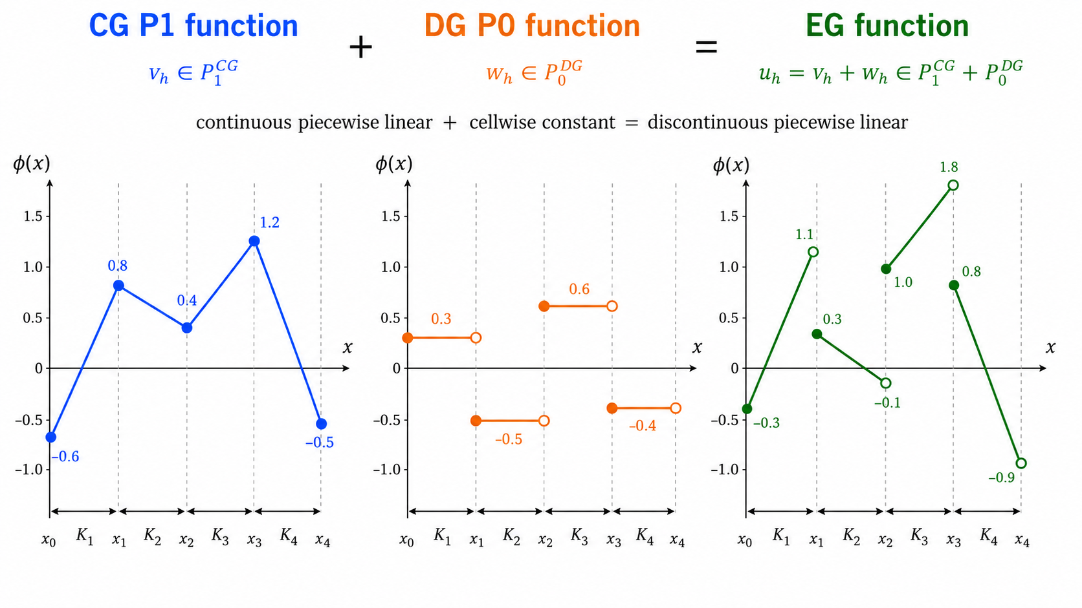
Enriched Galerkin (EG) Method: Idea
Idea: Enrich the CG function space with a minimal set of discontinuous functions!
Advantages:
Computational cost: CG < EG << DG
Inherit many desirable properties from DG (e.g., local mass conservation, locking-free, etc)
Can utilize existing FEM codes for the CG and DG methods

Slide 13
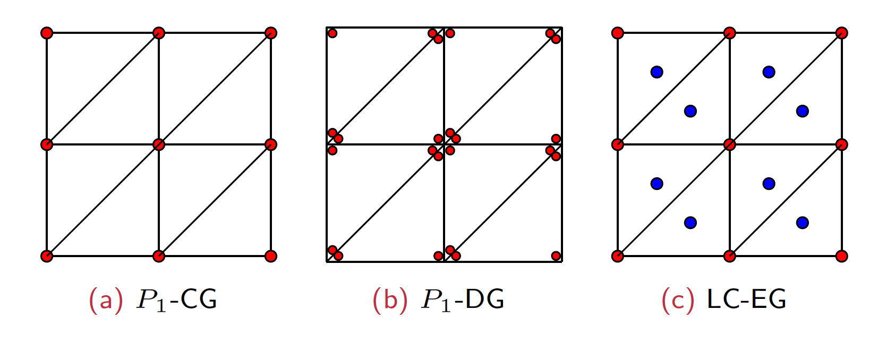
Locally-Conservative EG (LC-EG) Method
The LC-EG space: ℙ₁^{CG} + ℙ₀^{DG}
The discrete weak form is the same as the DG weak form.
Many nice properties from DG (e.g. local mass conservation) but with much lower computational costs.
Figure: Comparison of DOFs. A blue circle ( ) represents the enriched DOF.

Slide 14
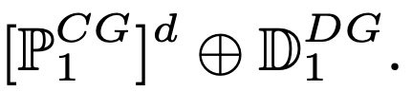
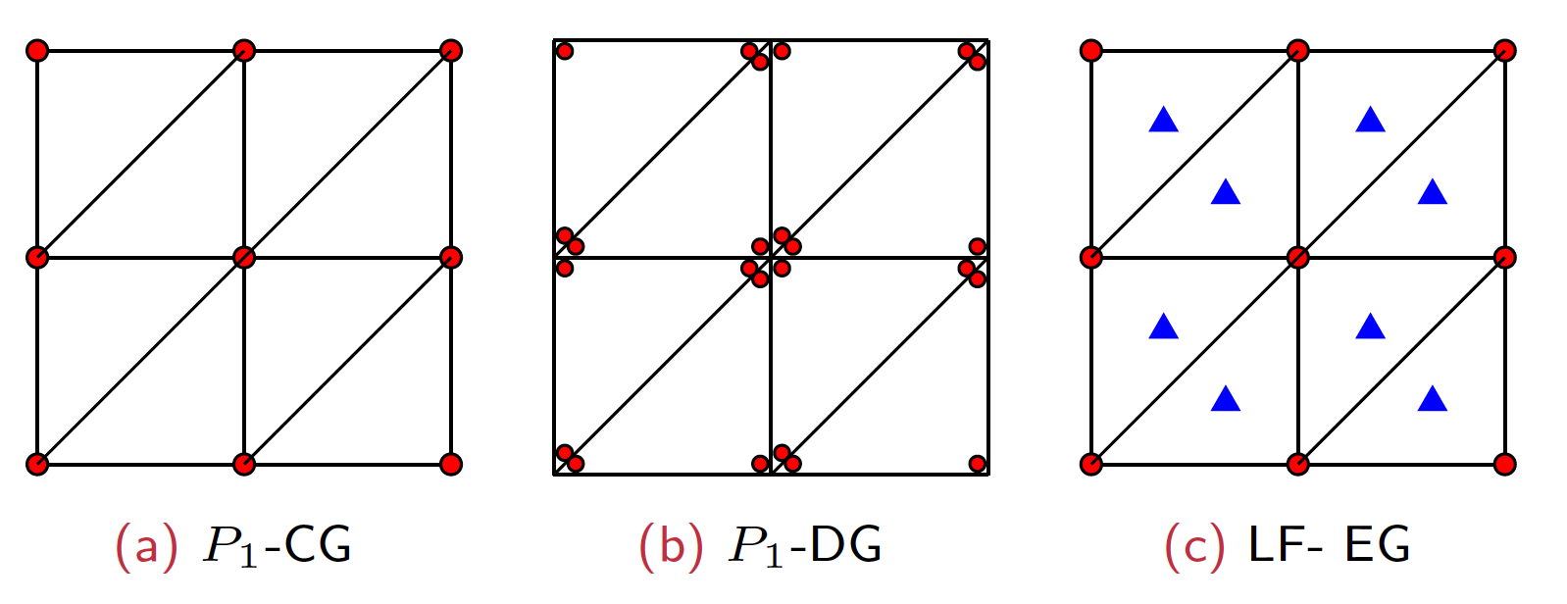
Locking-Free Enriched Galerkin (LF-EG) Method
The LF-EG space:
The LF-EG space contains non-trivial divergence-free vectors, allowing the EG method to be locking-free.
Figure: Comparison of DOFs. A red circle ( ) represents two DOFs and a blue triangle ( ) represents one DOF.
S.-Y. Yi, S. Lee, and L. Zikatanov, Locking-free enriched Galerkin method for linear elasticity, SIAM Journal on Numerical Analysis, vol. 60, no. 1, pp. 52--75, 2022.

Slide 15
Coupled EG Method for Thermo-Poroelasticity
Mechanics
Flow
Heat
LF-EG displacement space
locking-free behavior
LC-EG pressure space
local mass conservation
LC-EG temperature space
local energy conservation
Fully discrete scheme = backward Euler in time + coupled EG in space
At each time step solve simultaneously for (u, p, θ)
mechanics residual $\sim$ 0 · mass residual $\sim$ 0 · energy residual $\sim$ 0
Key point: the subproblems communicate in the same finite-element language.
Key point: the subproblems communicate in the same finite-element language.

Slide 16
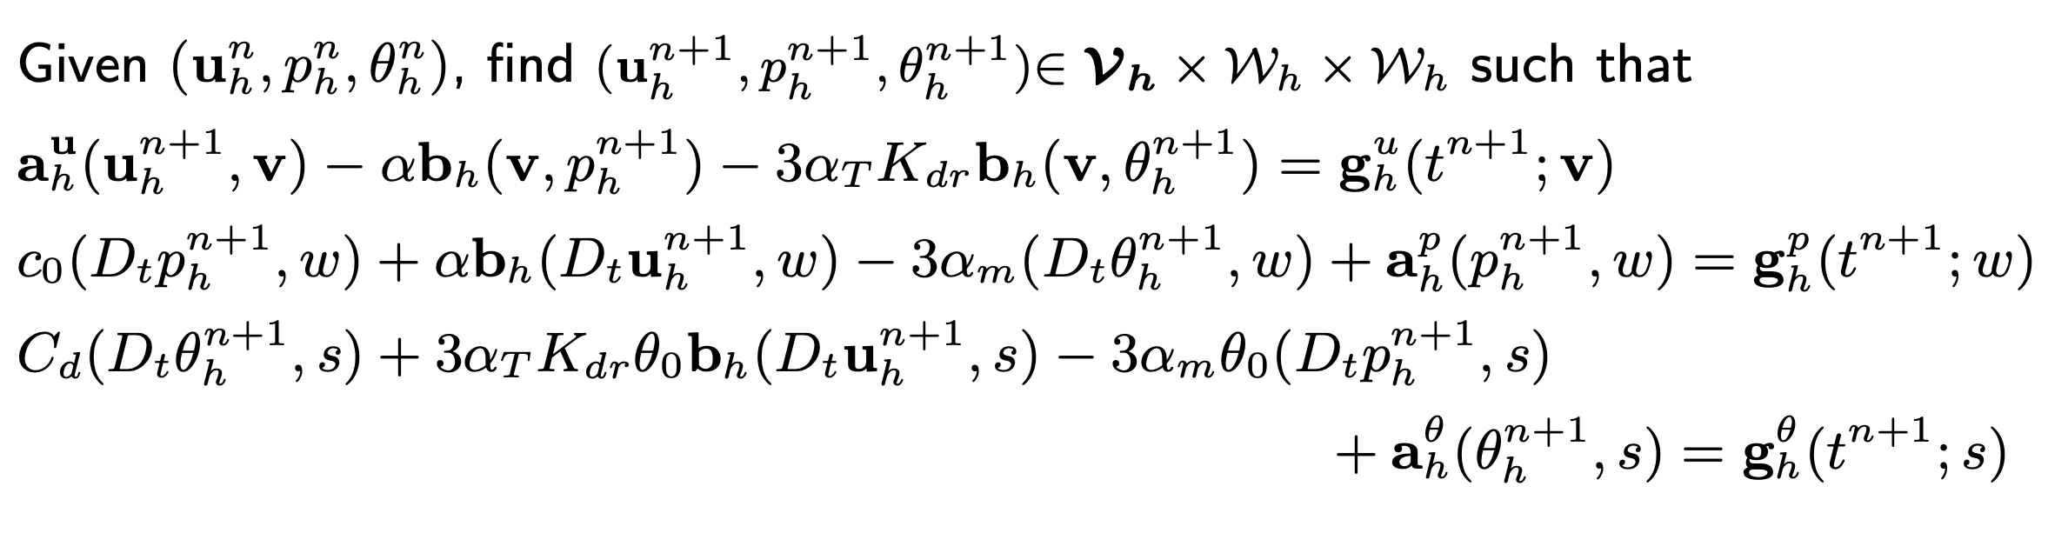
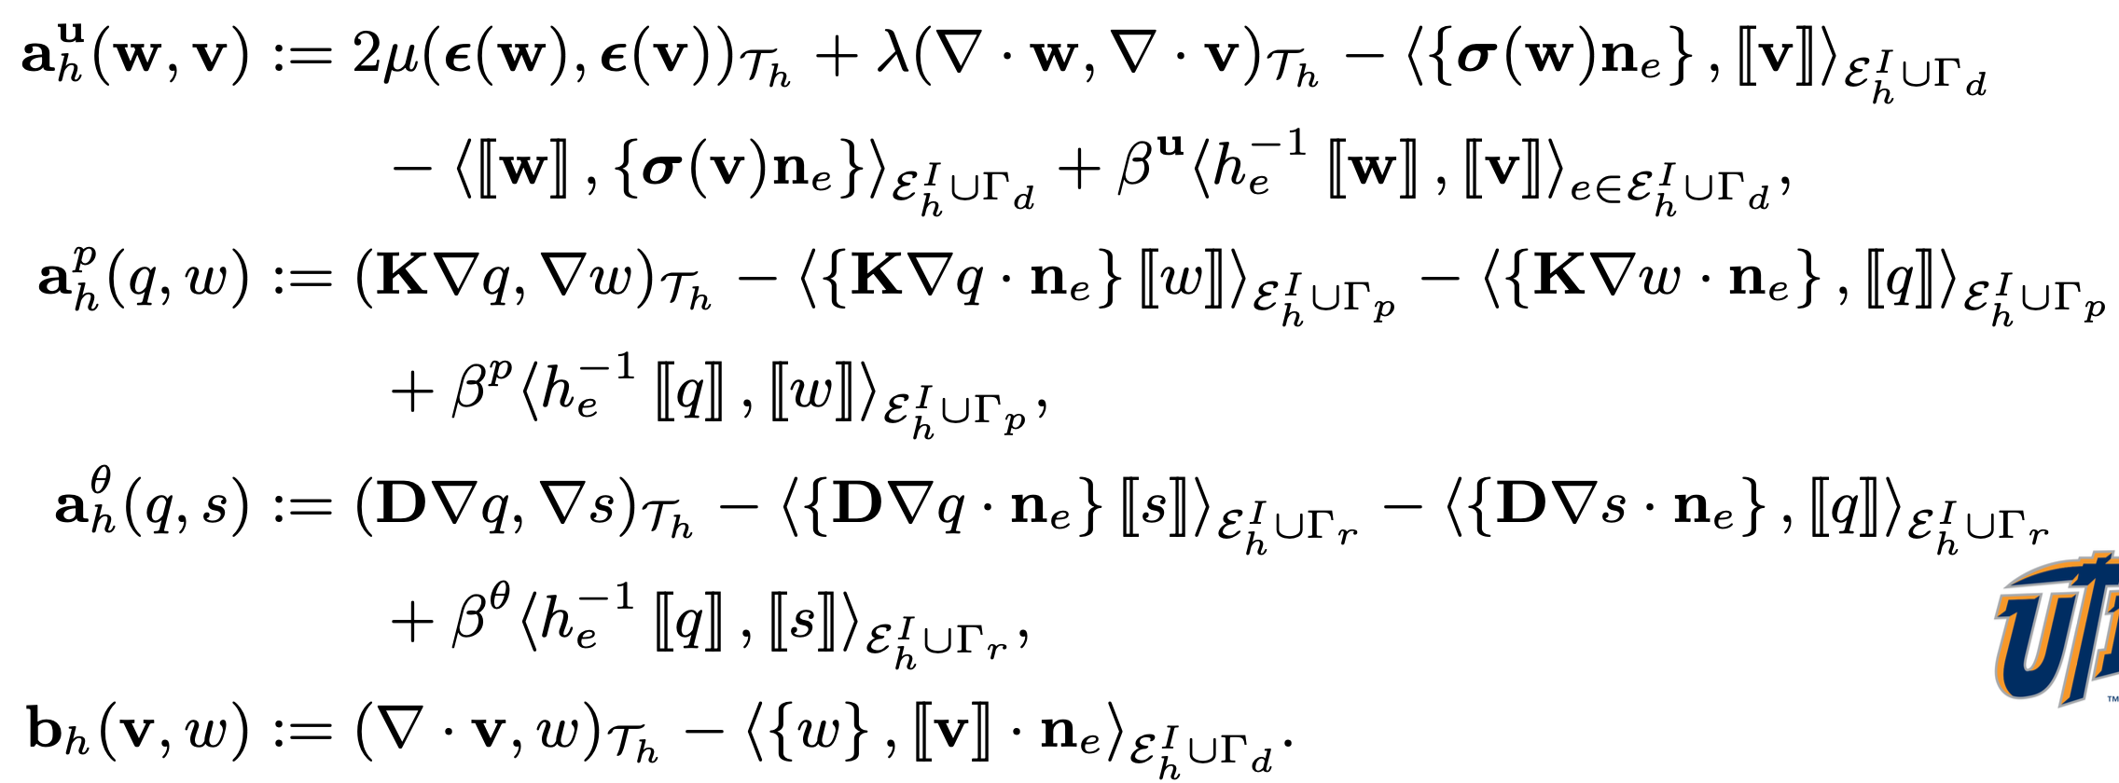
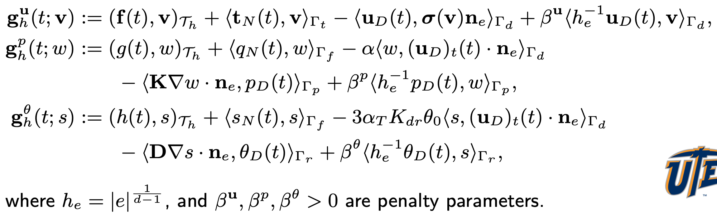
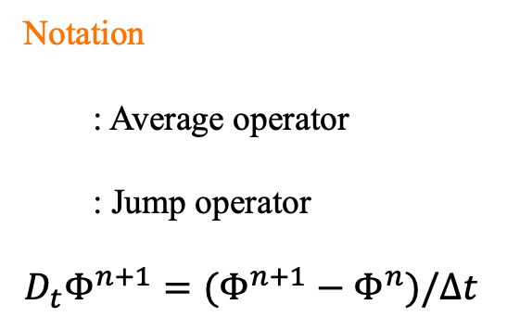
Fully-Discrete EG Method for Thermo-Poroelasticity
Notation
: Average operator
: Jump operator
$$D_{t}Φ^{n+1}=(Φ^{n+1}−Φ^{n})/Δt$$

Slide 17

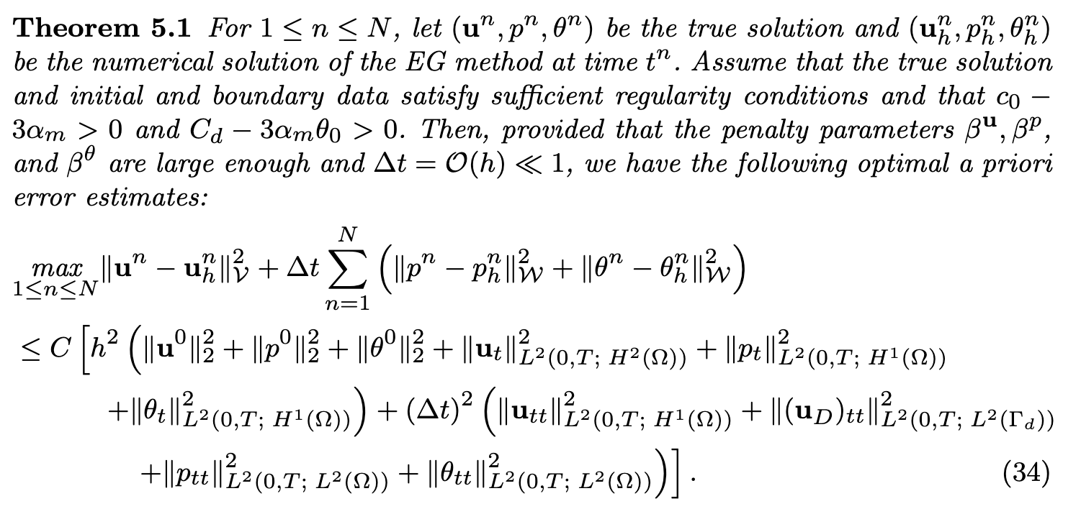
What Was Proved Theoretically?
Well-posedness:
Lemma
Assume that
Then, the fully-coupled and fully-discrete EG method for solving the thermo-poroelasticity
problem has a unique solution at each time step, provided that the penalty parameters
and are large enough.
Optimal convergence:
S.-Y. Yi and S. Lee, Physics-preserving enriched Galerkin method for a fully-coupled thermo-poroelasticity, Numerische Mathematik, vol. 156, pp. 949 -978, 2024.
Notes:
For this audience, the main takeaway is that the method is not only a practical discretization; it also has a rigorous stability and convergence foundation for the coupled THM system.

Slide 18
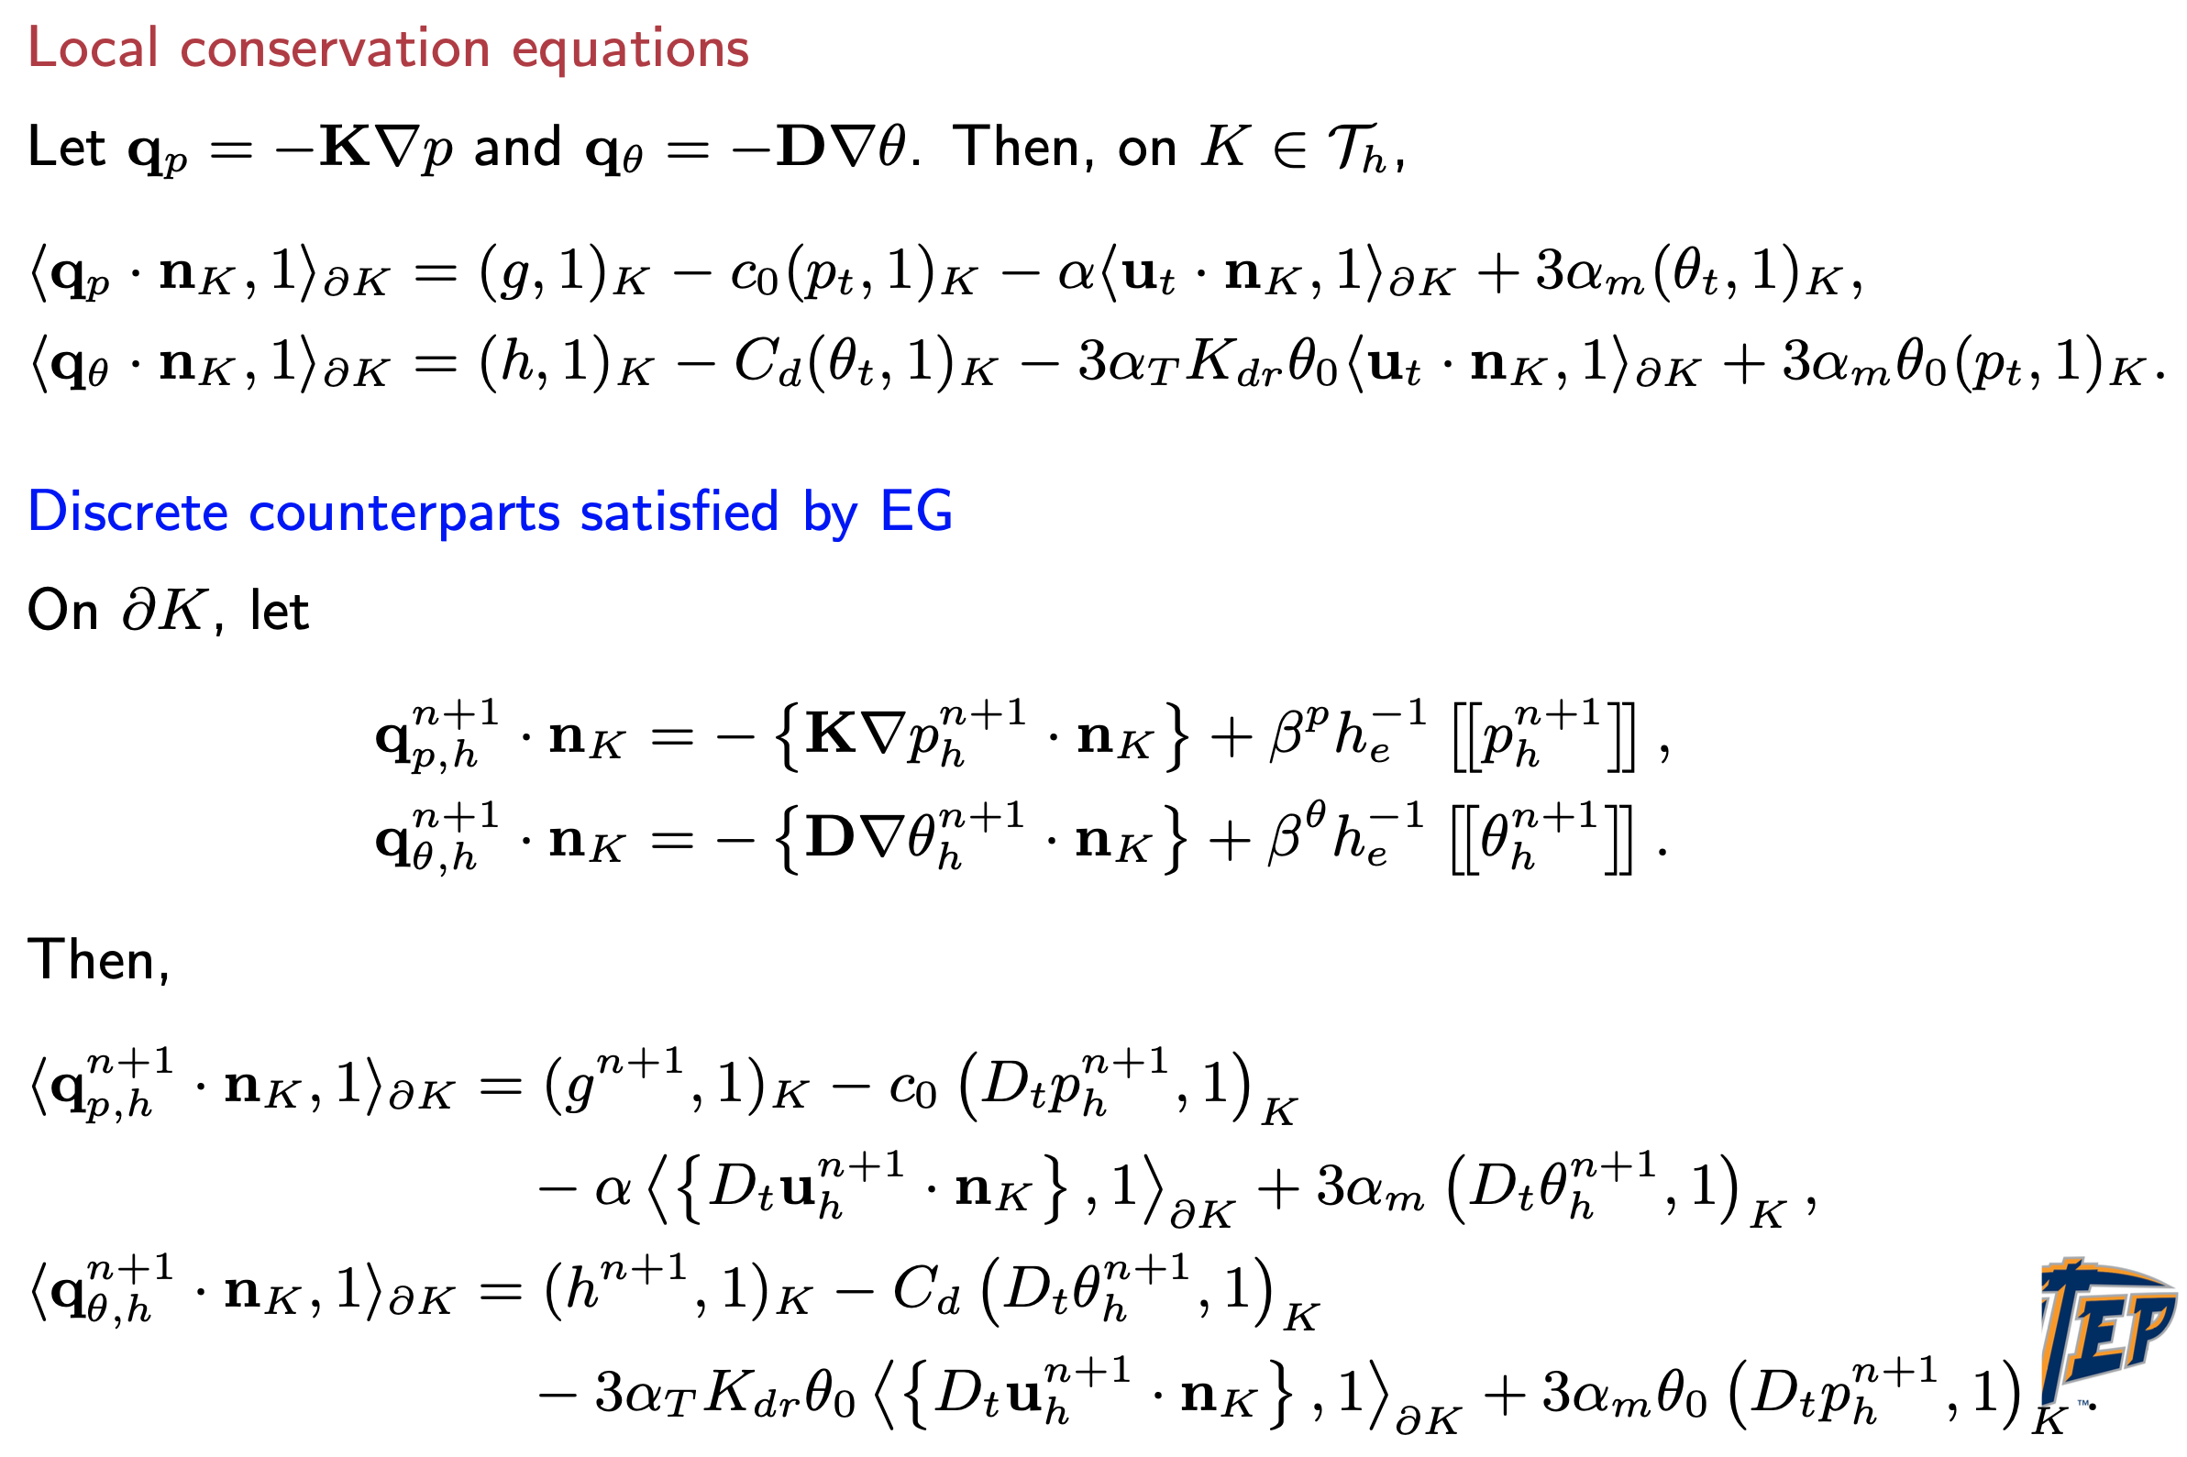
Mass & Energy Conservation Properties

Slide 19
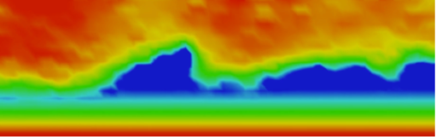
03
Numerical Examples

Slide 20
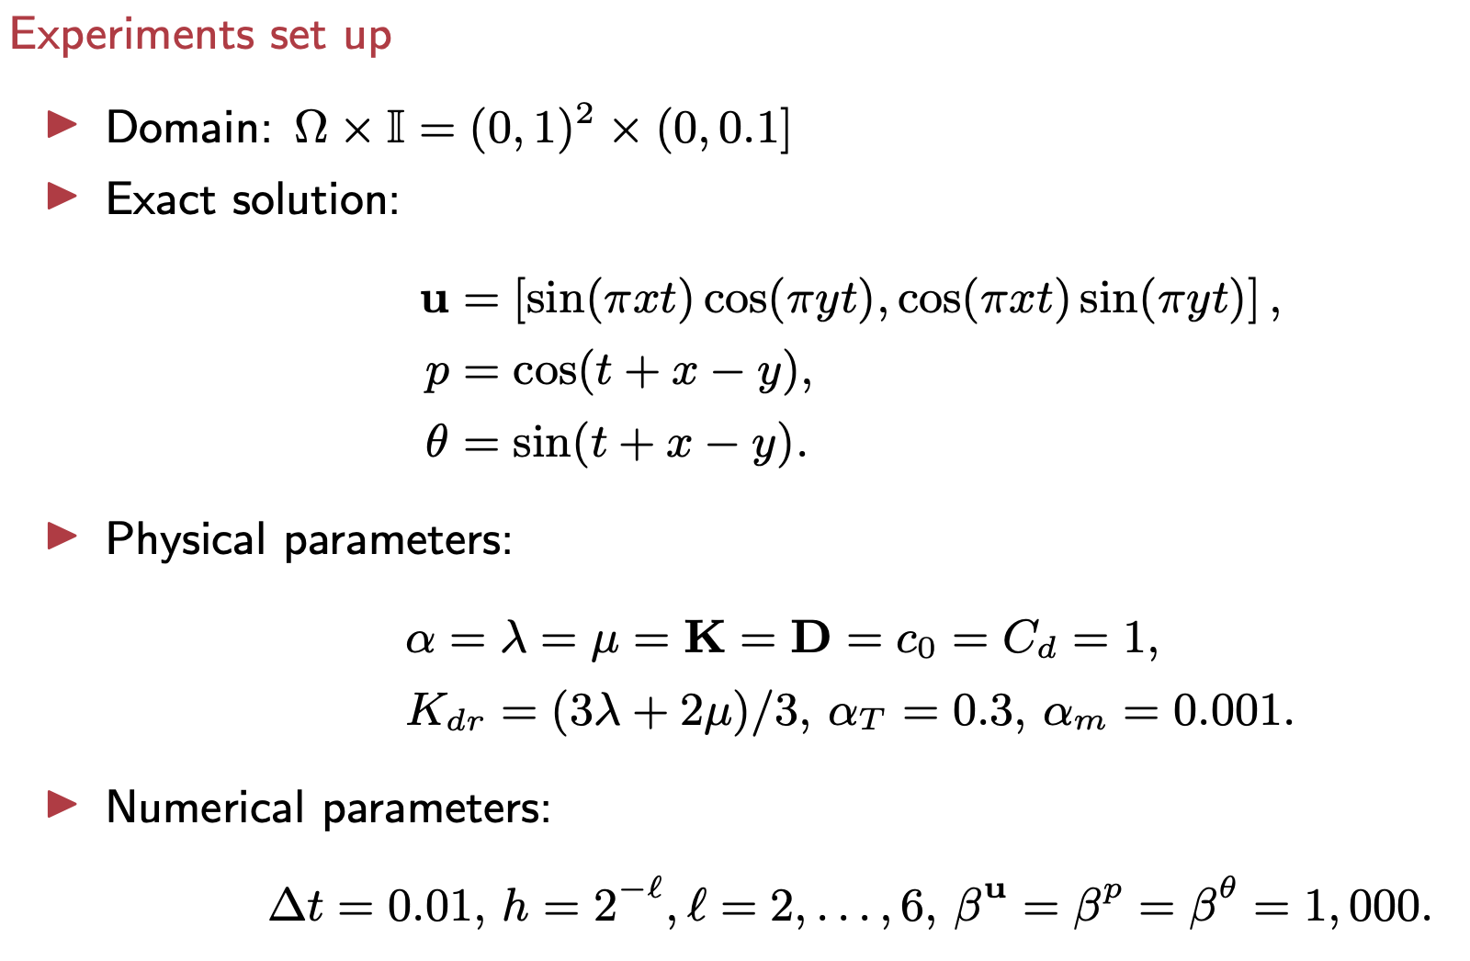
Ex.1: Convergence Tests with A Manufactured Solution

Slide 21
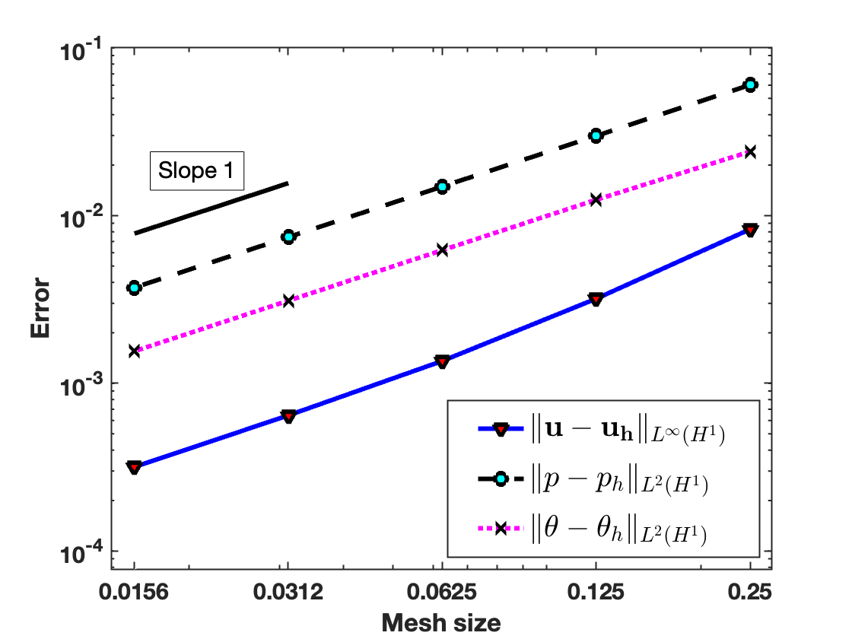
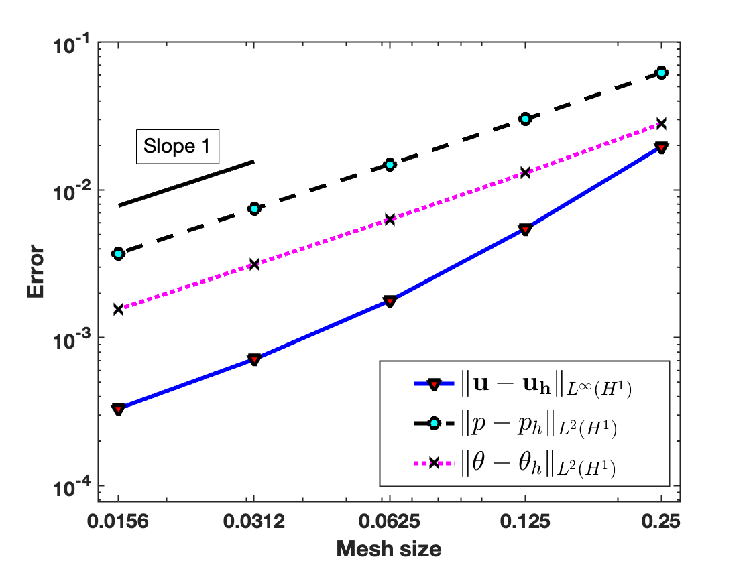
Ex.1: Convergence Matches the Theory
Test 1 with Dirichlet boundary condition
Test 2 with mixed boundary condition
Takeaway: the observed convergence rates agree with the optimal-order error estimates.

Slide 22
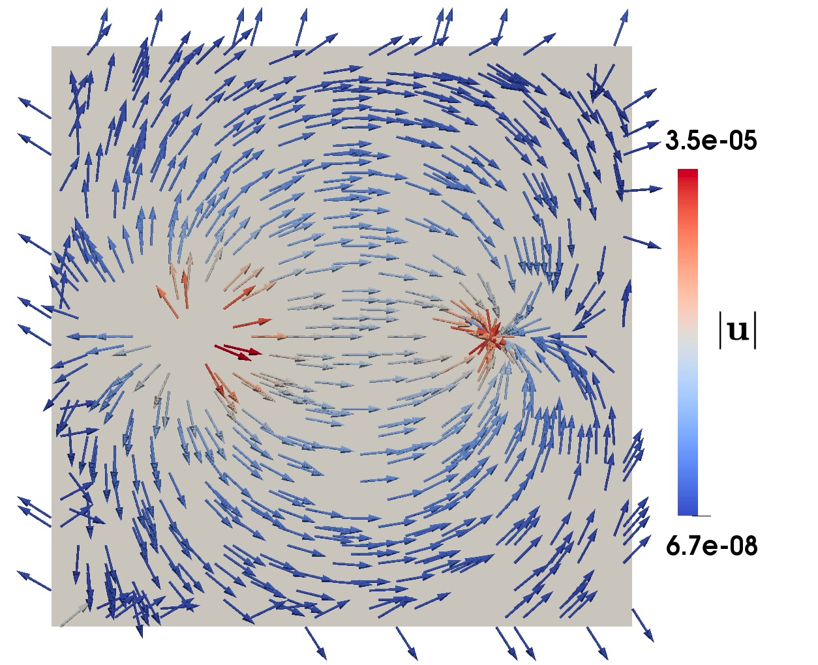
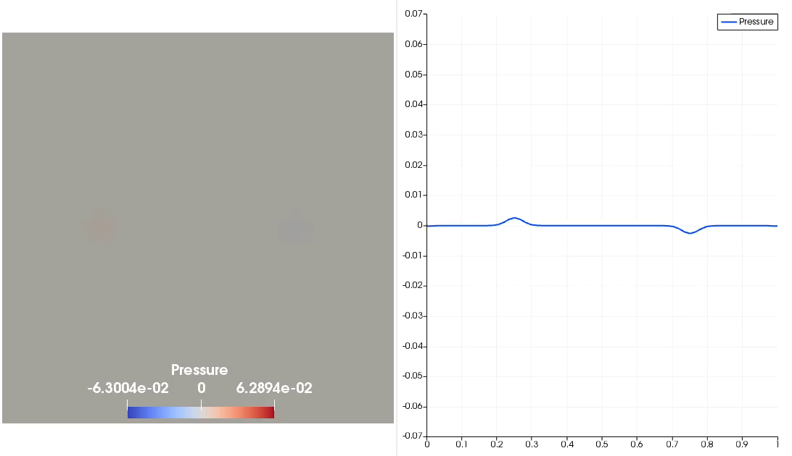
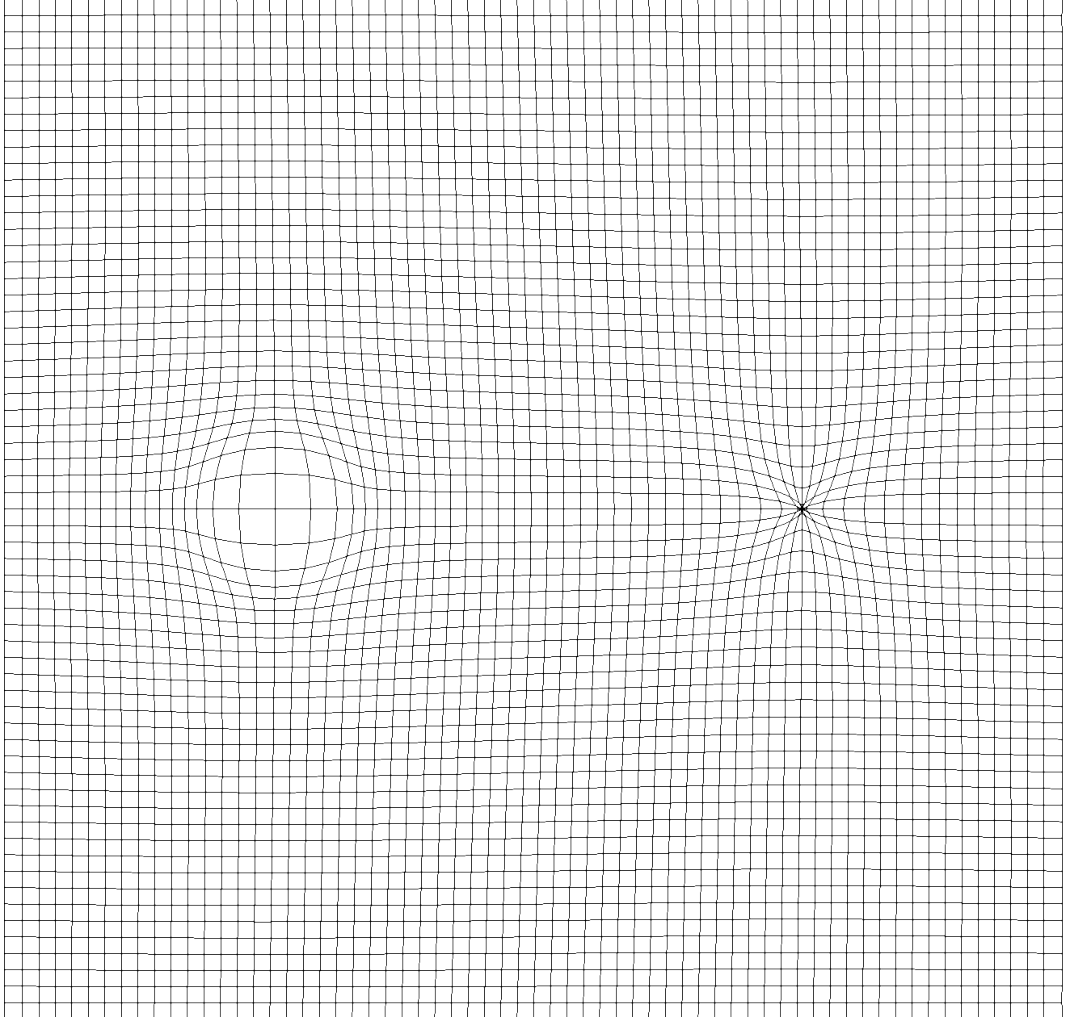
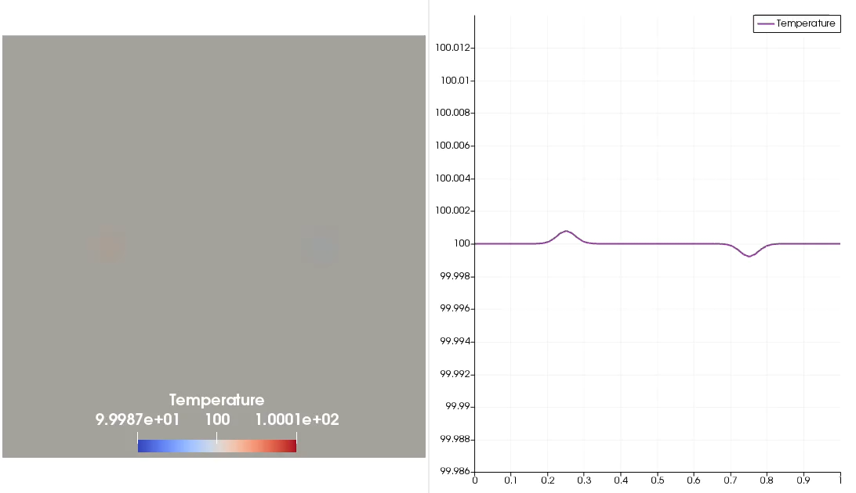
Ex 2. Coupled Response in Injection and Production
Setup
2D Homogeneous medium
Injection & production wells
Inj.
Prod.
Displacement field
Pressure (top) and temperature (bottom) & their cross-sections evolve consistently with sources/sinks

Slide 23
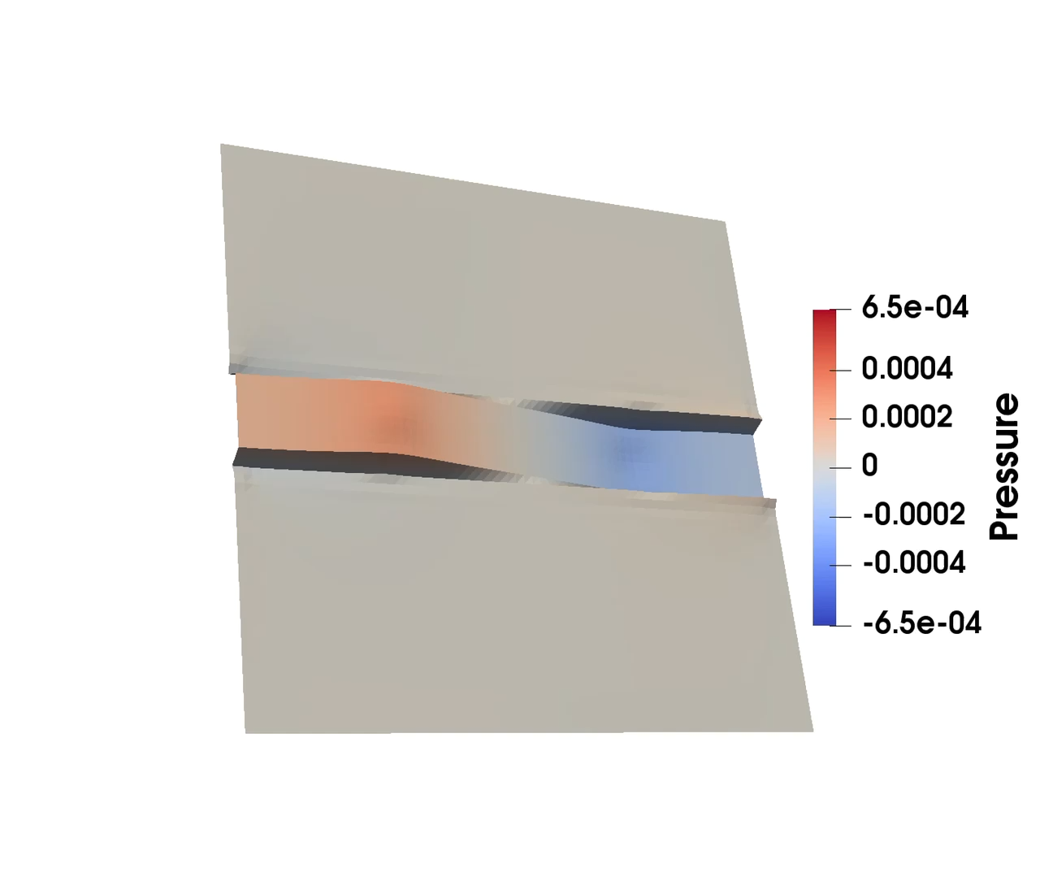
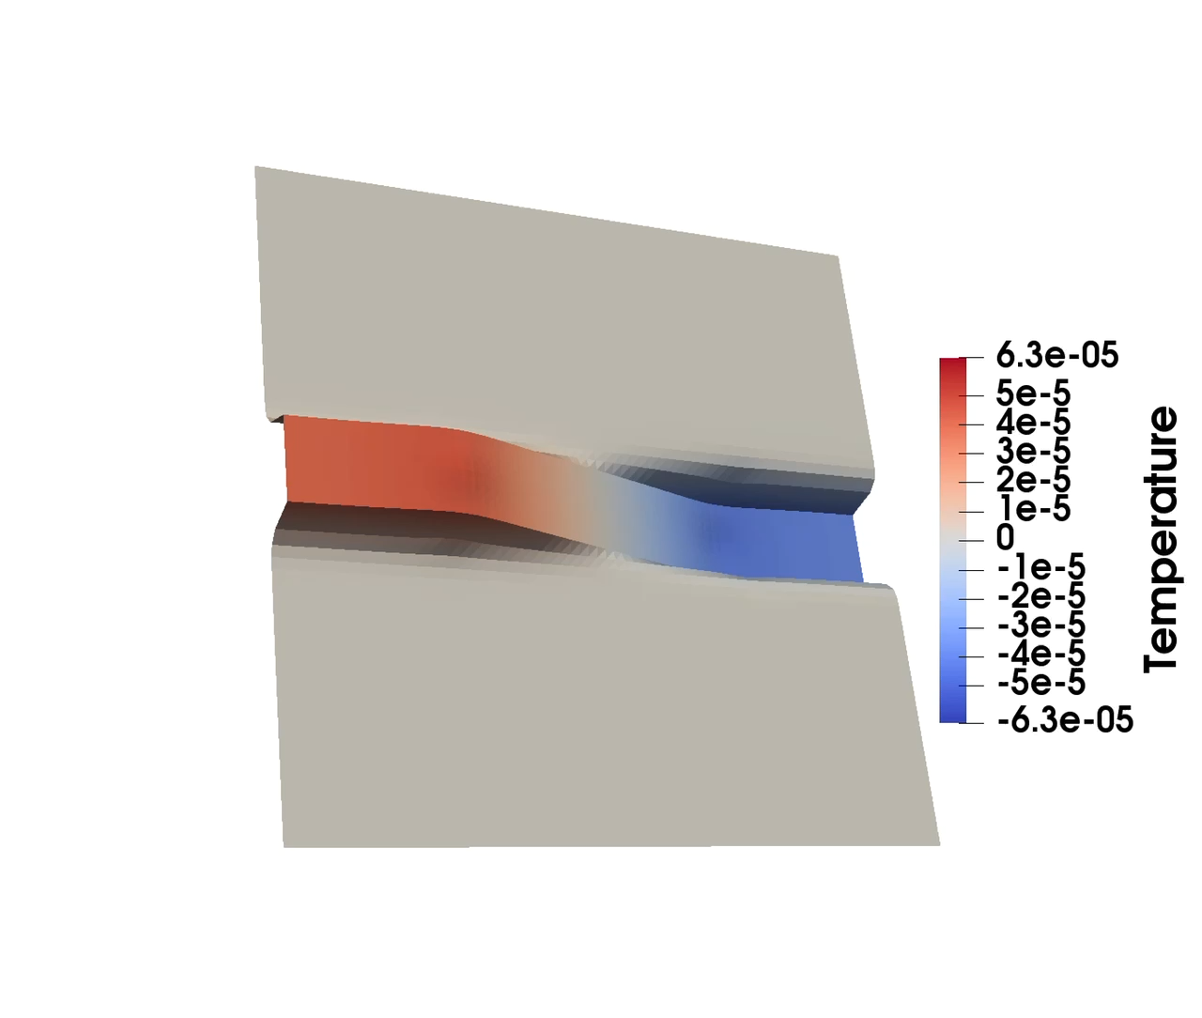
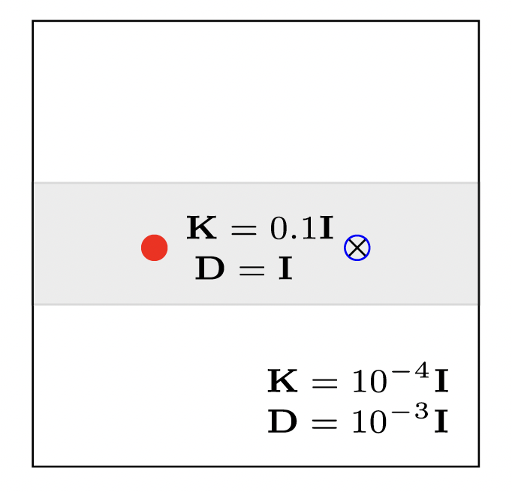
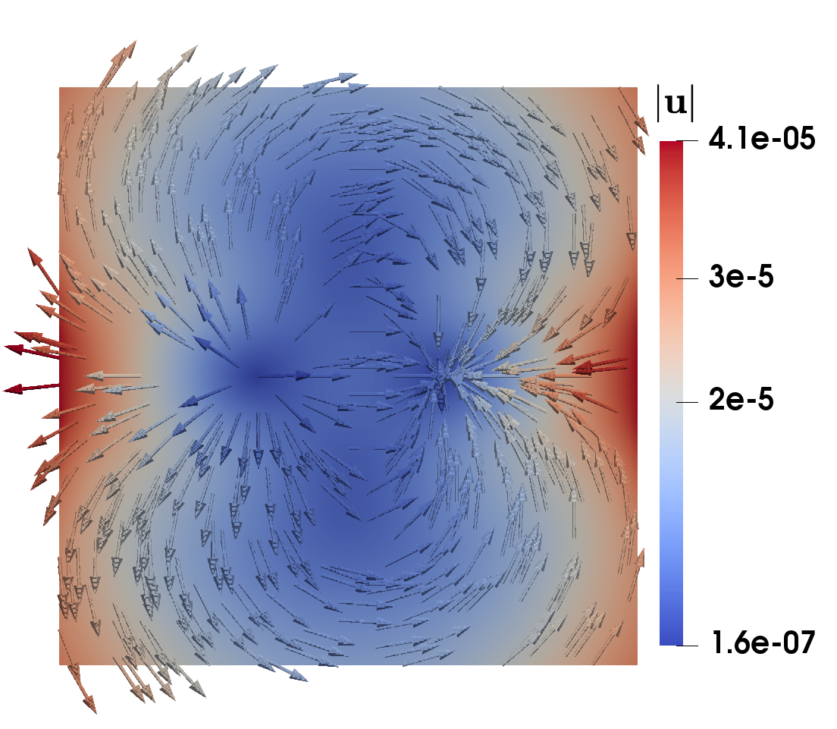
Ex.3: Simulations in a Layered Medium
Pressure
Temperature
Simulation Setup:
2D layered medium
Injection & production well
Displacement
What to notice
Layered/discontinuous coefficients are exactly where non-conservative methods can produce nonphysical behavior near interfaces.
Higher permeability
& heat conductivity

Slide 24
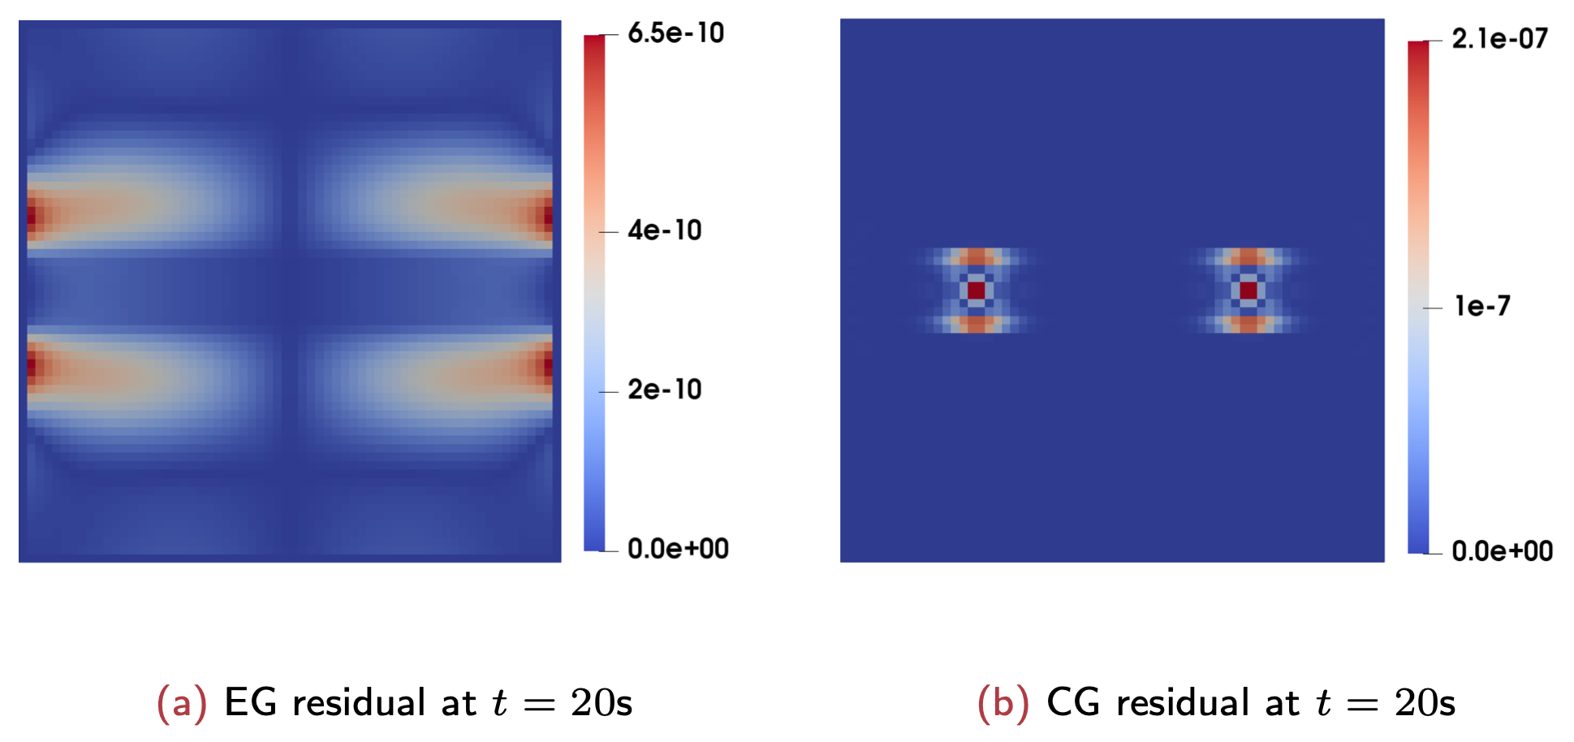
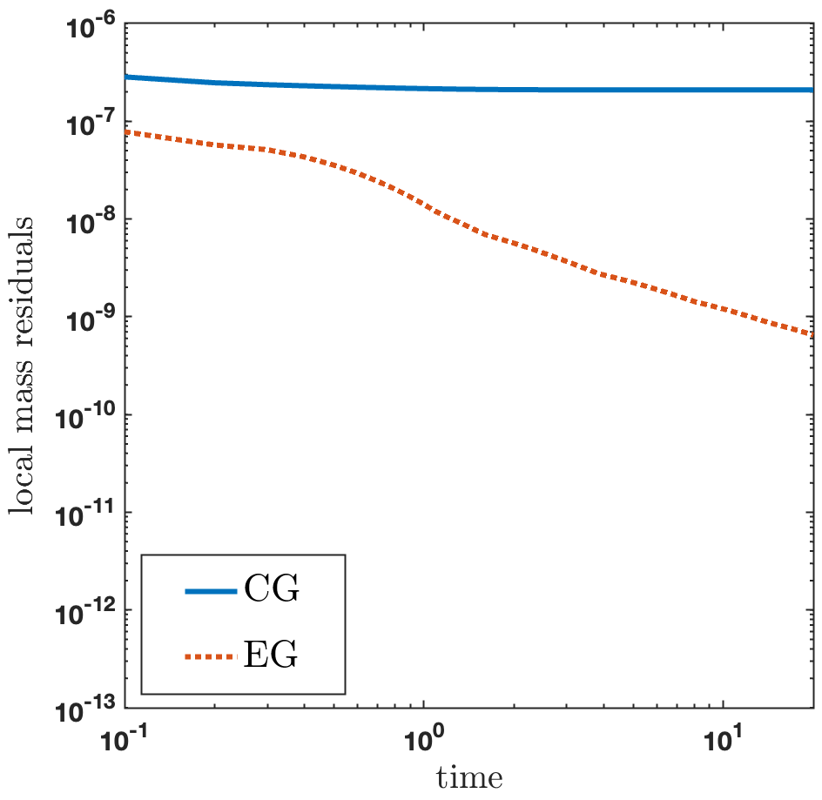
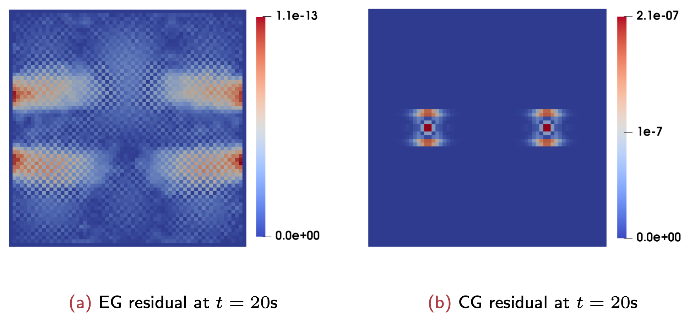
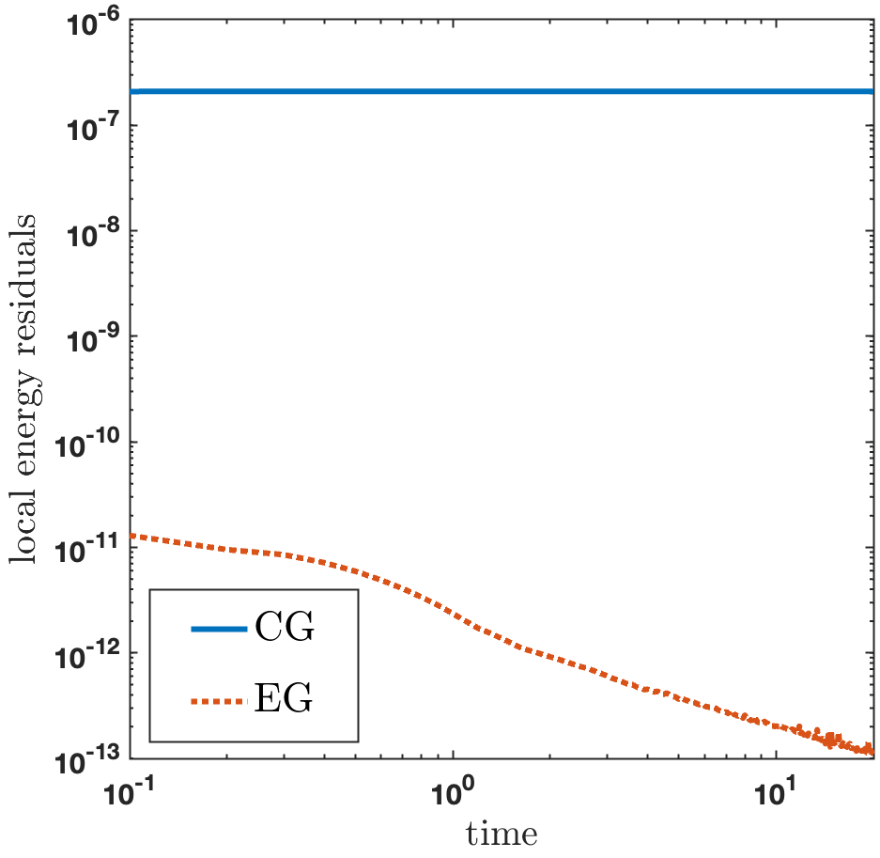
Ex.3: Local Conservation Residuals
Local mass conservation
residual:
Local energy conservation residual:
EG residual CG residual
Residual over time

Slide 25

04
Summary

Slide 26

Summary
Takeaways
THM simulations need robustness, conservation, and efficiency at the same time.
The coupled EG method uses LF-EG for mechanics and LC-EG for flow and heat.
The method is well-posed, optimally convergent, locally conservative, and computationally cheap (low DOF) for these properties.
Acknowledgements:
U.S. National Science Foundation (Grants DMS-2208402, DMS-2208426)
U.S. Department of Energy, Office of Science, Energy Earthshots Initiatives
(Award Number DE-SC-00240703)

