Slide 1



Algebraic dynamic multilevel method for CO₂ storage in deep saline aquifers
Mengjie Zhao
Ryan Haagenson
Marc Gerritsma
Cornelis Vuik
Hadi Hajibeygi
21, May, 2026
Notes:
Hello everyone. My name is Mengjie Zhao, I am from TU delft. Today I will present our recent work. The title is algebraic dynamic multilevel method for CO2 storage in deep saline aquifers, This work is in collobration with Dr. Marc Gerritsma, Prof. kees vuik and Prof. Hadi Hajibeygi.

Slide 2
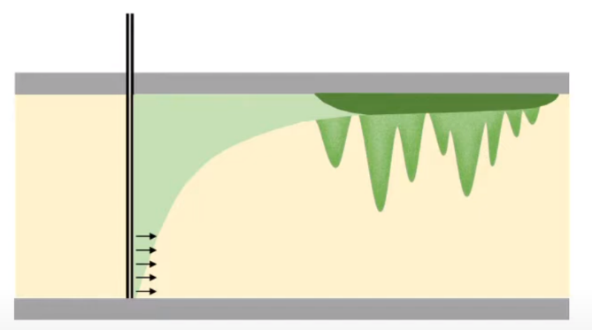
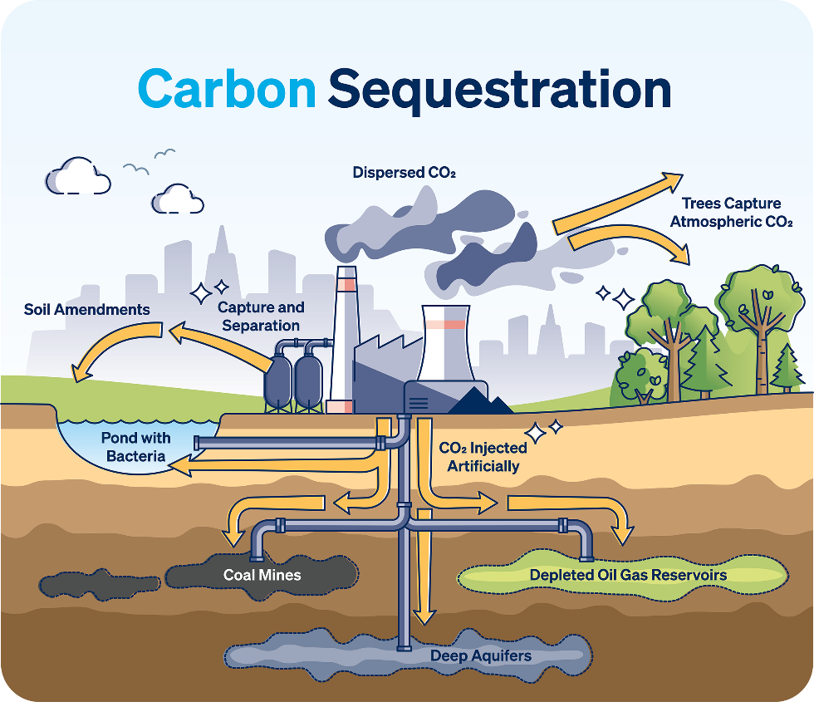

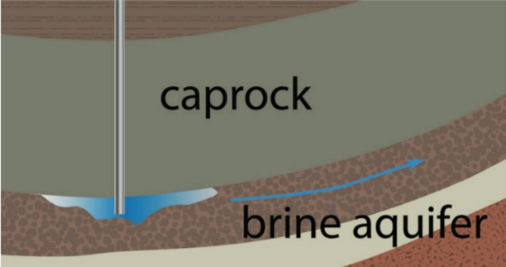
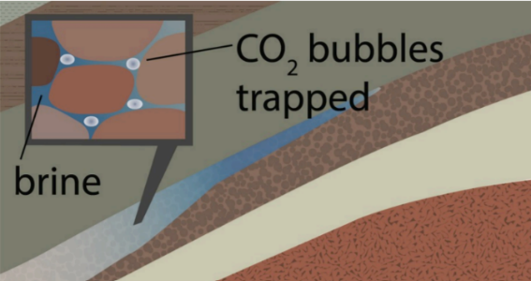
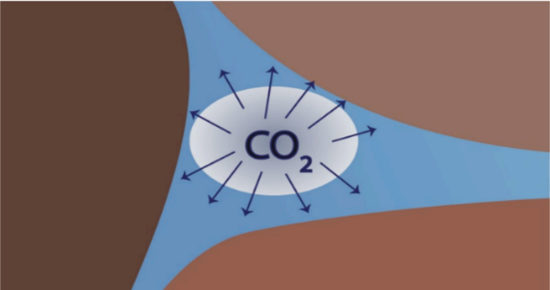

Background
Deep saline aquifer (Y. Wang, et al. 2021)
(a) Structural trapping
(b) Residual trapping
(c) Dissolution trapping
Carbon Capture and Storage (CCS)
(http://VectorMine/Shutterstock.com)
(d) Mineral trapping
Trapping mechanisms (B. Smit, et al. 2014)
Notes:
At first, I will briefly introduce the research background. As we know, because of the climate change and global warming, a potential strategy is CO2 storage in the subsurface systems. There are some safe underground formations. For example, the depleted reservoir. This method is straightforward, because the geological structures have retained hydrocarbons for quite a long time. The second choice is the deep saline aquifers, because it has vast capacity and widespread distribution. But various trapping mechanisms operating on different time scales add to the complexity in understanding such a dynamic process. In our work, we are mainly focused on the deep saline aquifers.

Slide 3

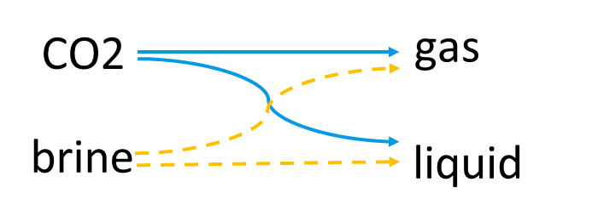
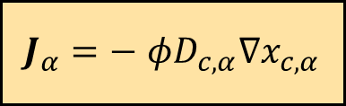
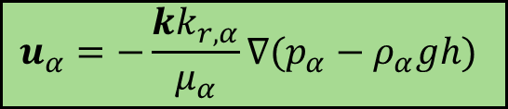
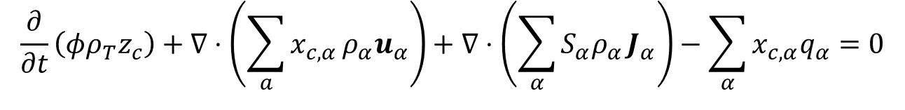
CCS Simulation: multi-physics formulation
Two-component, two-phase flow:
$$\frac{∂}{∂t}\left(φρ_{T}z_{c}\right)+∇⋅\left(\sum_{a}{x_{c,α}}ρ_{α}u_{α}\right)+∇⋅\left(\sum_{α}{S_{α}ρ_{α}}J_{α}\right)−\sum_{α}{x_{c,α}q_{α}}=0$$
$$u_{α}=−\frac{kk_{r,α}}{μ_{α}}∇(p_{α}−ρ_{α}gh)$$
$J_{α}=−$ $φ{D_{c,α}∇x}_{c,α}$
Convective flux: Darcy’s Law
Diffusive flux: Fick’s Law
Solution Strategy:
Overall-compositional formulation
Fully implicit system and Finite volume discretization in space
Notes:
Our approach uses the mass conservation law to model the two-component, two-phase flow of CO2 and brine, which can both exist in gas and liquid phases. We apply Darcy’s law for convective flux and Fick’s law for diffusive flux, using an overall compositional formulation and a fully implicit system to simulate these interactions.

Slide 4
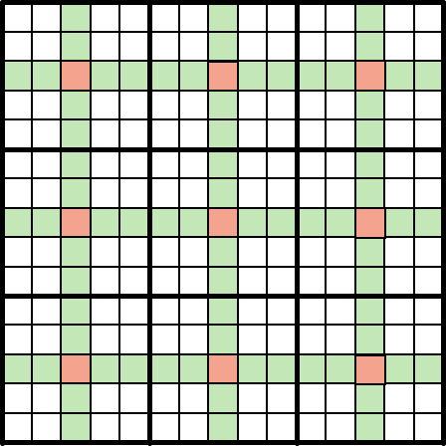
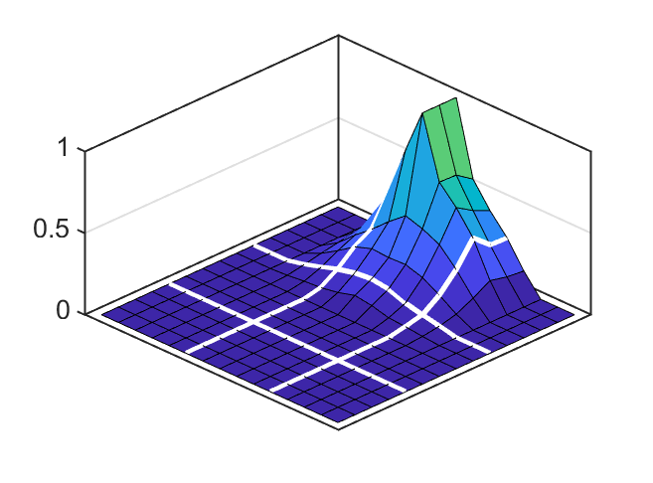
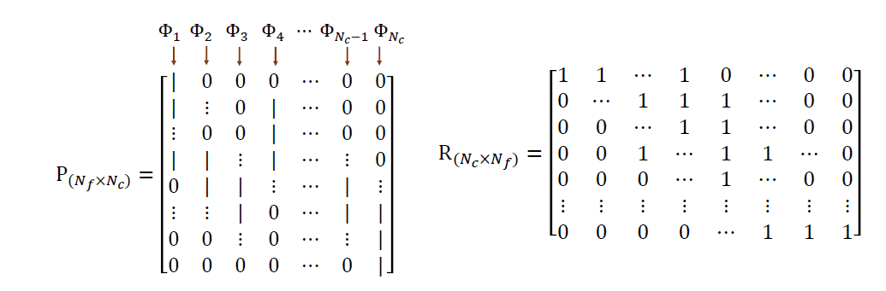
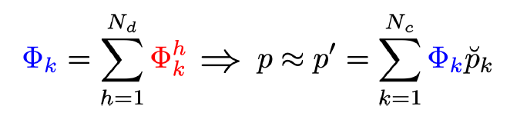
Multiscale Modeling
Dual coarse grid
0
0
0
1
Primary
coarse grid
0
0
Interior
Edge
Vertex
Notes:
However, dealing with high-dimensional problems without compromising grid resolution can be challenging. So we thought, why not solve the equations on a coarse scale and then interpolate them back to a fine scale? That's where our multiscale strategy comes in. This strategy approximates pressure at a fine scale using locally computed basis functions. For instance, if we set one coarse grid pressure to 1 and others to 0, we can solve this local problem to obtain the basis function, as you can see in the right figure. This method helps us build prolongation and restriction operators.

Slide 5
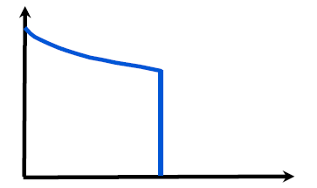
Algebraic Dynamic Multilevel (ADM) method
Fine Scale
Prod
Buckley-Leverett Function
Inj
2-level ADM grid
Prod
Coarsen when solution change is small,
refine when it changes rapidly
z_{max}
z_{min}
Inj
Notes:
Considering that CO2 storage is fundamentally a transport problem, we also need to monitor how the overall mass fraction of CO2 distributes. This means coarsening the solution when changes are minimal and refining it when changes are more drastic. Besides, Near the well areas, we refine more, as illustrated in the left figure. This method is called ADM.

Slide 6

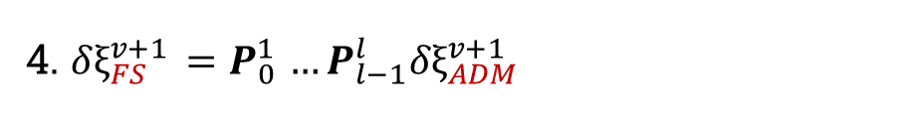
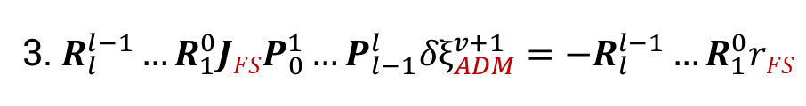


ADM Strategy
Offline stage
Start time step t
Construct the coarse grids
Select the ADM grid resolution
Compute the multiscale basis functions
Newton-Raphson Loop
Build the ADM operators( P and R )
1.Compute Residual (FS)
1. $r_{c}=RHS −LHS$
2. $r_{c}^{v+1}≈r_{c}^{ν}+\frac{∂r_{c}}{∂p_{w}}|^{ν}δp_{w}^{v+1}+\frac{∂r_{c}}{∂z_{CO2}}|^{ν}δz_{co2}^{v+1}$
2.Linearize the equations (FS)
3. $R_{l}^{l−1}…R_{1}^{0}JFSP_{0}^{1}…P_{l−1}^{l}{δξ}_{ADM}^{v+1}=−R_{l}^{l−1}…R_{1}^{0}rFS$
3. Solve the ADM system
4. Map the solution back to the fine-scale resolution
4. ${δξ}_{FS}^{v+1} {=P}_{0}^{1}…P_{l−1}^{l}{δξ}_{ADM}^{v+1}$
no
5. Flash and update fluid properties
5. $\sum_{c}{\frac{z_{C}\left(K_{C}−1\right)}{V\left(\left(K_{C}−1\right)\right)+1}}=0, { x}^{v+1}=x^{v}+δx^{v+1}$……
no
yes
yes
Converged?
t = t + Δ t
t==t_{final}
End
Notes:
When compared to the fine scale, the ADM strategy introduces an offline stage to compute the basis functions, and during the non-linear loop, it maps the solution back to fine-scale resolution.

Slide 7
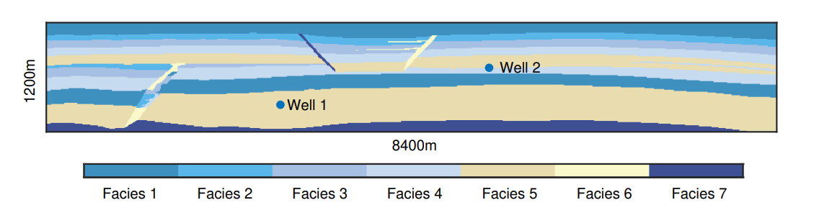
SPE 11B Benchmark Study
Initial condition: fully filled with water; Total Simulation Time: 1000 years
Reservoir temperature: 55℃
Seven facies: one seal (Facies 1), five permeable reservoir sands (Facies 2–6), and one impermeable (Facies 7).
Injection well 2 (after 25 years, then inject 25 years)
Injection well 1 (50 years)
SPE 11B benchmark geometry
Notes:
Finally, we applied the ADM method to the SPE11B benchmark. The initial condition is completely filled with water. The simulation runs for 1000 years with CO2 injected through two wells. The first well keeps injecting for 50 years and the second starts after 25 years and continues for another 25. The reservoir temperature is kept at 55 degrees Celsius. The bottom figure shows the seven facies in this geometry.

Slide 8
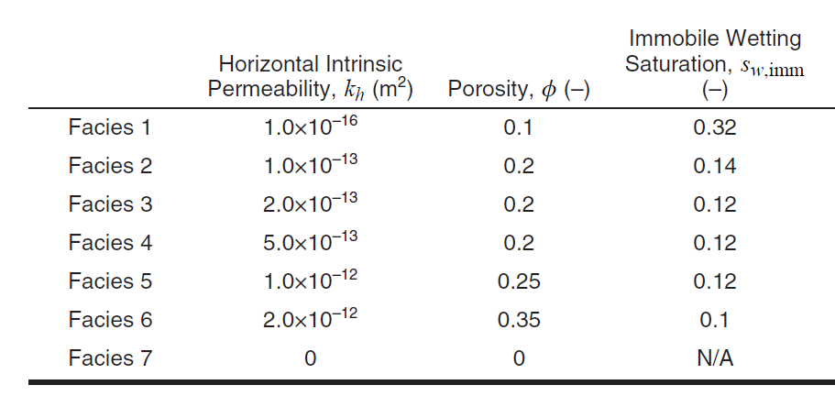
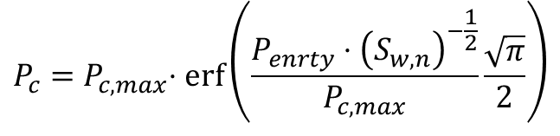
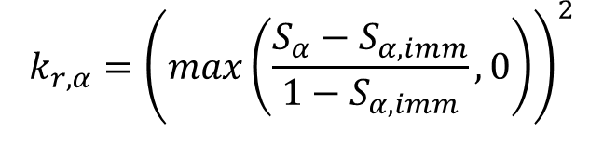
Physical Models
$$k_{r,α}={\left(max\left(\frac{S_{α}−S_{α,imm}}{1−S_{α,imm}},0\right)\right)}^{2}$$
Kr and Pc
Brooks-Corey function:
$$P_{c}=P_{c,max}{⋅\operatorname{erf}\left(\frac{P_{enrty}⋅{\left(S_{w,n}\right)}^{−\frac{1}{2}}}{P_{c,max}}\frac{\sqrt{π}}{2}\right)}$$
Facies Properties for 11B that vary between facies
Notes:
Now, let’s move on to the relative permeability and capillary pressure curves. The key point is that these are defined differently for each facies.

Slide 9


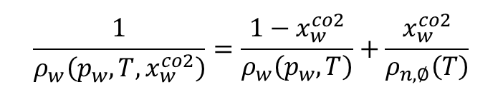
Thermodynamics
H2O mole fraction in CO2-rich phase
CO2 mole fraction in H2O-rich phase
Density of
CO2-rich phase
Density of
H2O-rich phase
$$x_{w}^{co2}=0.1$$
$$x_{w}^{co2}=0.05$$
Spycher et al. (2003)
Spycher et al. (2003)
NIST Database
NIST Database
$$\frac{1}{ρ_{w}\left(p_{w},T,x_{w}^{co2}\right)}=\frac{1−x_{w}^{co2}}{ρ_{w}\left(p_{w},T\right)}+\frac{x_{w}^{co2}}{ρ_{n,∅}\left(T\right)}$$
Notes:
On the thermodynamics side, we use the NIST database to figure out the density and rely on Spycher’s paper for calculating phase partitioning.

Slide 10
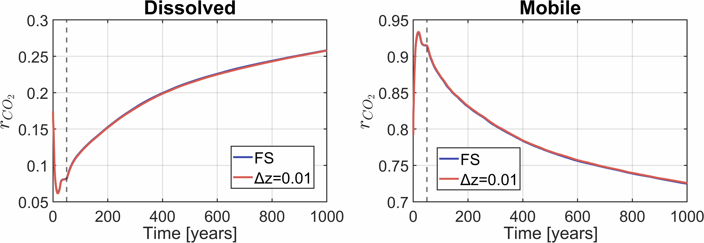

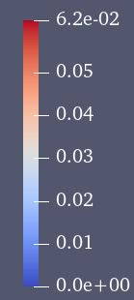
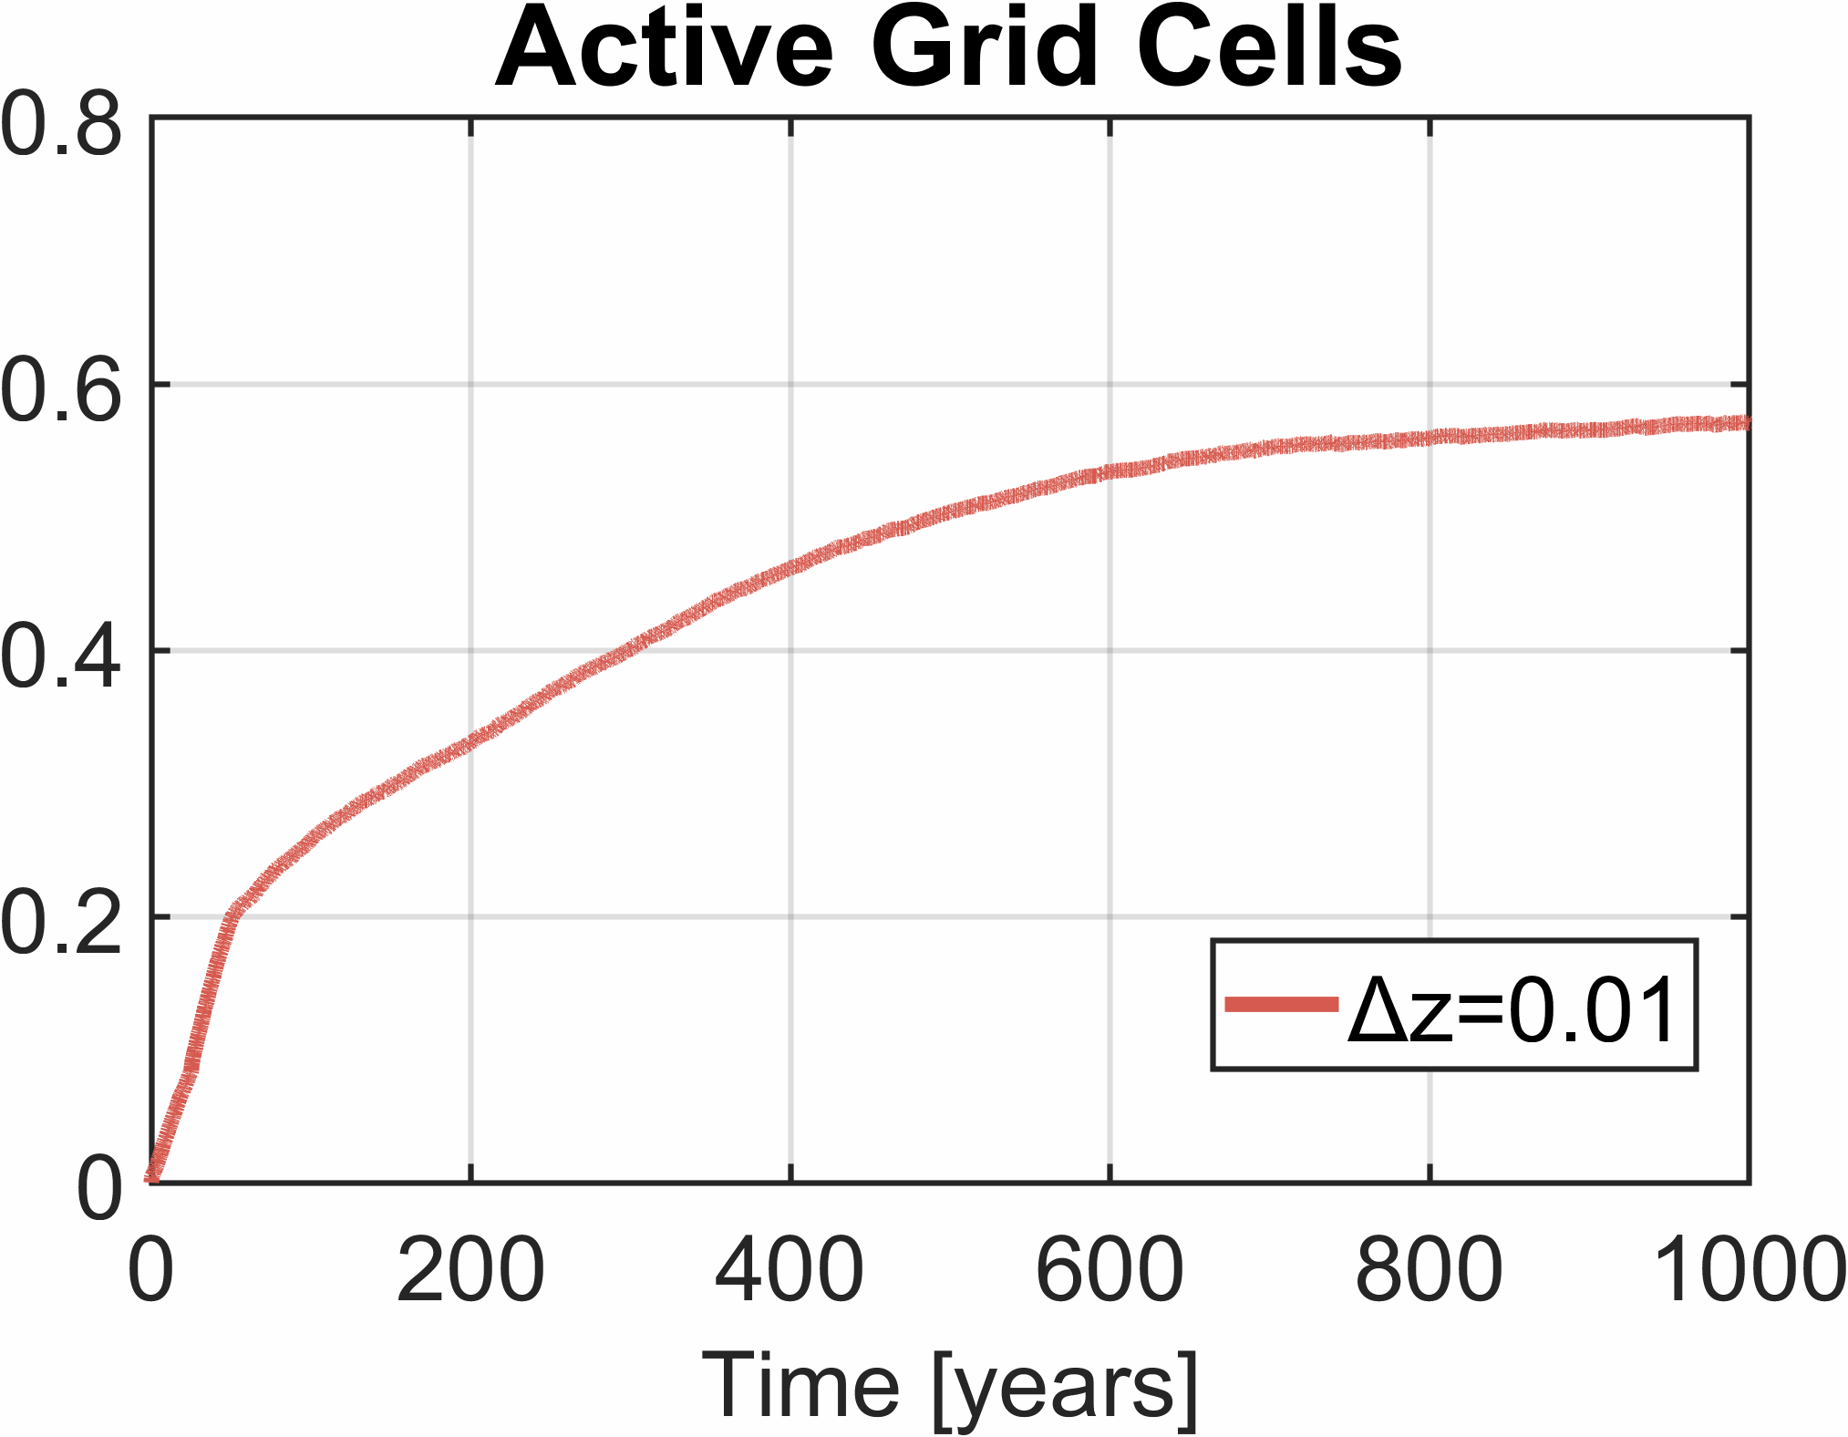
Simulation Results
CO2 mass fraction profile (Fine Scale)
CO2 mass fraction profile (ADM grid)^{[1]}
[1] Zhao, Mengjie, et al. "Algebraic dynamic multilevel (ADM) method for CO2 storage in heterogeneous saline aquifers." Journal of Computational Physics 539 (2025): 114202.
Notes:
Then, I am gonna show some results. On the left, the top panel is the fine scale reference. You can see the plume migrating upward, spreading laterally, and accumulating. The bottom panel shows the result using the ADM grid. We can observe that the plume shape and migration pathways are very similar to the fine-scale solution, but ADM achieves this by refining only where the dynamics are active. You can literally see that the grid is coarser elsewhere. On the right, I summarize the behaviour over time. ADM can also preserve the trapping trends while reducing computational cost compared with running the fine-scale model.

Slide 11

Trade-off Solutions
High resolution
Low resolution
Fine Scale
67.2% high resolution
Error = 0.089%
57% high resolution
Error = 0.096%
21.2% high resolution
Error = 0.33%
Temporal dynamics of CO₂ trapping in the SPE 11B model, illustrated as fractions of injected CO₂ in dissolved and mobile states
Notes:
ADM uses a user-defined threshold to decide where to refine. A smaller threshold triggers more refinement, gives a solution closer to fine scale. A larger threshold refines less, runs faster, but the error increases. At the top, you can see what happens as we vary this threshold. The bottom plots show the impact on storage-relevant metrics. Even at the lowest resolution, ADM still reproduces the key fine-scale trapping trends closely.

Slide 12
Same mass rate
Impact of problem size
Homogenous Field
Perm: 8.0e-14m²
Porosity: 0.2
Producer
Same per pore volume rate
3D size:
100 m * 28 m * 19m
199 m * 55 m * 19m
397 m * 109 m * 19m
Injector
Notes:
We also tried to show the effect of problem size. As the problem size increases, we can see that the percentage of active grid cells decreases. This suggests that ADM becomes more useful for large-scale problems.

Slide 13
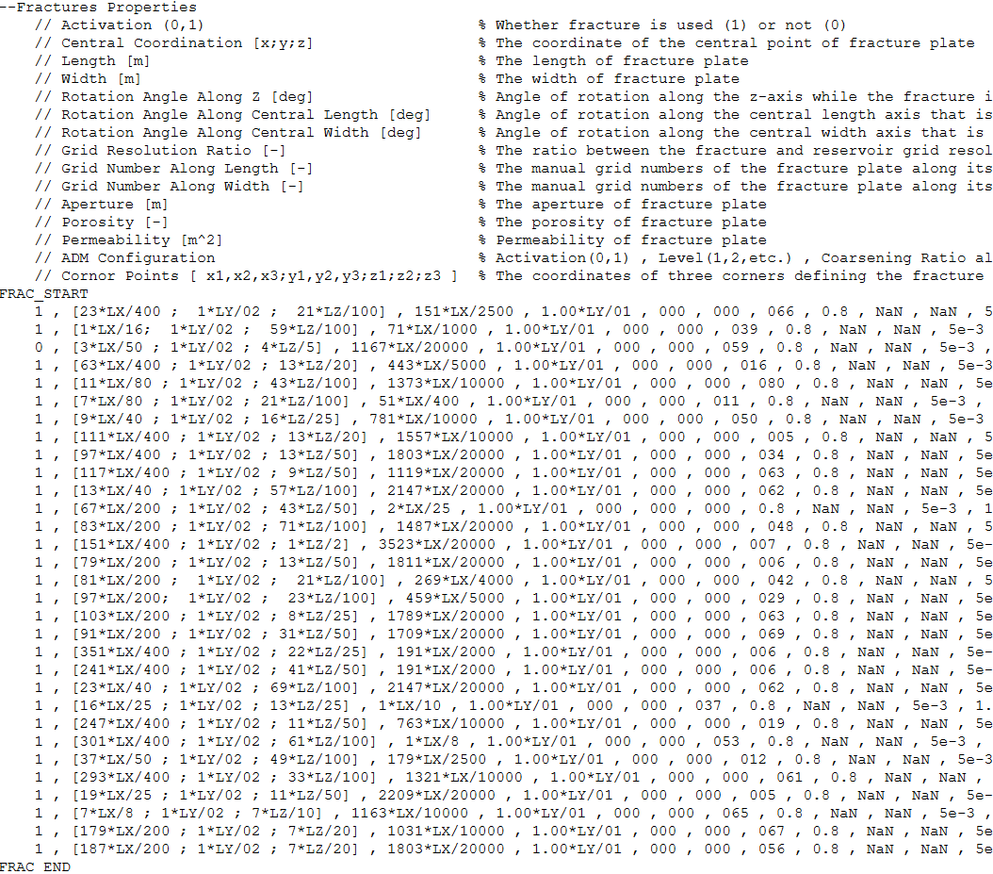
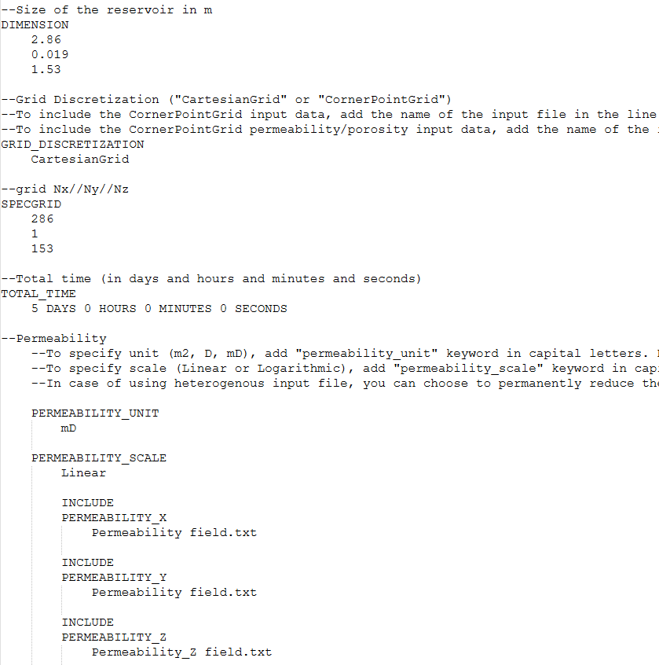
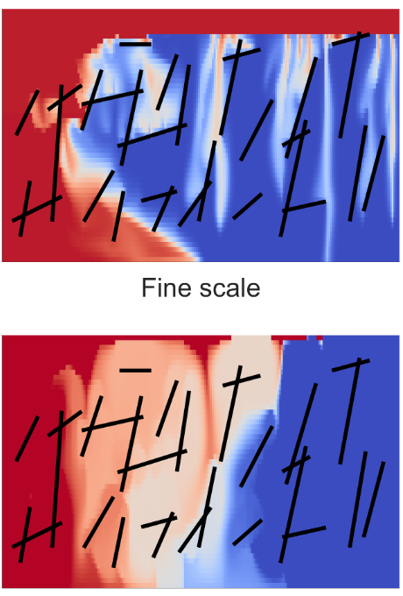
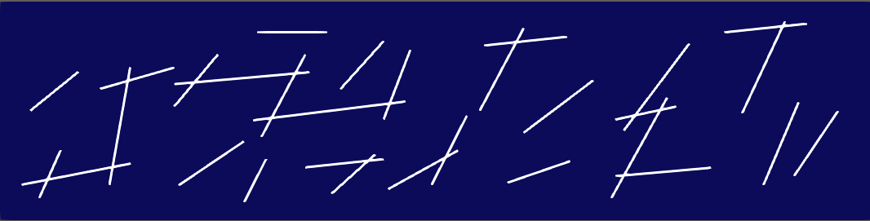
Impact of Fractures
High-Fidelity Simulation
DARSim-pEDFM package
Fractures Properties
Input Properties
Flow barriers
DARSim
Conductive fractures
Notes:
Then we study the impact of fractures within the DARSIM framework. we start from fracture information—geometry and properties such as orientation and permeability. We process these through the DARSIM–pEDFM package, After that, we assemble the input properties and run high-fidelity simulations in DARSIM. pEDFM method can deal with two types of fracture behaviour. In the top case, fractures act as flow barriers, they restrict cross-flow and can compartmentalize the domain. In the bottom case, fractures are conductive, they act as preferential pathways, allowing CO₂ to move faster and potentially reach farther, which can significantly change plume shape and risk-relevant outcomes.

Slide 14
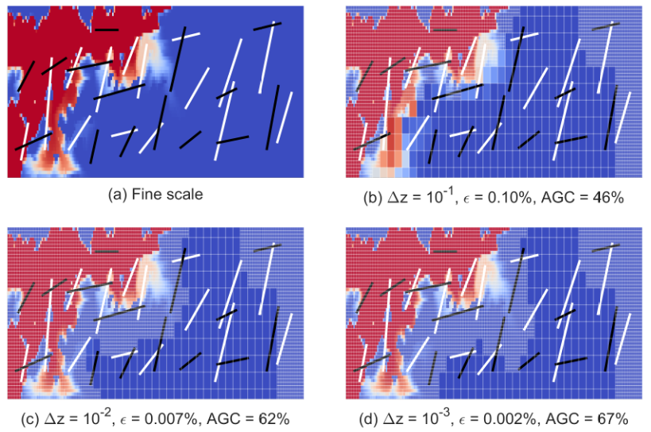
pEDFM-ADM Method
10,251 grid cells (201×51), with 30 fractures
Each coarse grid cell has 3×3 grid cells. We use 2 levels.
SPE10 Bottom
High resolution
Low resolution
Fine Scale
67% high resolution
Error = 0.002%
62% high resolution
Error = 0.007%
46% high resolution
Error = 0.10%
[1] Zhao, Mengjie, et al. "Multiscale projection-based embedded discrete fracture modeling approach for CO2 storage in deep saline aquifers." Advances in Water Resources (2025): 105200.
Notes:
we combine the fracture representation from pEDFM with the ADM. At the bottom, the first image is the fine-scale reference. The next three are pEDFM–ADM results with different refinement thresholds. Compared to the fine-scale reference, the pEDFM–ADM solutions remain visually consistent even at the lowest resolution, with very small errors, showing an efficient accuracy cost trade-off in fractured media

Slide 15
Conclusion
Multiphysics coupling, multiscale heterogeneity, and long-term trapping mechanisms add challenges for large-scale CCS simulations.
Algebraic dynamic multilevel method
Scalable framework for large-scale CCS simulations
Adjusts grid resolution based on a CO₂ front-tracking technique
Captures long-term trapping mechanisms
Notes:
To conclude, large-scale CO₂ storage simulations are challenging because they involve multiple coupled physical processes, strong heterogeneity across scales, and long-term trapping mechanisms that evolve over decades to centuries. the algebraic dynamic multilevel (ADM) method. This is a scalable, physics-based framework for large CCS simulations. It reduces computational cost by dynamically adjusting grid resolution, The results show that it can preserve storage-relevant trapping trends. Thank you for your attention.

Slide 16
Thanks for your attention
Mengjie Zhao
m.zhao-2@tudelft.nl

